Slide 1
Welcome to the
4th HIC for FAIR Detector Systems Networking Workshop
Speakers:
Please upload your talk previously to the session to the presentation laptop (operated by Semen Lebedev)
Talks will be made available on the Indico page later.

Slide 2
For a reduced conference fee for H4F members please contact Rainer Novotny:
Rainer.Novotny@exp2.physik.uni-giessen.de
(…. and also if you missed the abstract submission deadline and still would like to submit one.)

Slide 3
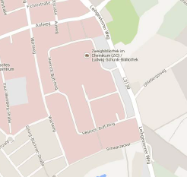
Lunch:
If you pre-ordered a lunch ticket (8 Euro), please visit me in the coffee break and pick it up
If not: sorry for you ;-) …. but there is a bakery close by in walking distance
Bäckerei Künkel
Fußweg
Hörsaalgebäude
Mensa im IFZ
Lunch ticket beinhaltet: eines der angebotenen Essen + Beilage, ein Softdrink

