Slide 1
Panda Field

Slide 2
Field Maps
Field maps are calculated and created in TOSCA (Jost Luehning)
Overlapping of different regions is calculated in TOSCA (Jost Luehning)
Panda Field package does not handle any overlapping maps

Slide 3
Field Maps: Simulation and reconstruction
The Framework uses a Factory Pattern for the fields:
Each experiment can implement its own Field by implementing the field creator class (PndFieldCreator)
Speeding up the field handling is crucial for simulation and reconstruction time
Runtime database can handle all fields in Panda transparently in files and data bases

Slide 4
Map Vs. Momentum in PANDA
(fBeamMom< 3) Suffix= ".0150”
(3.0 >=fBeamMom< 6.0) Suffix =".0406”
(6.0 >=fBeamMom< 10.0) Suffix=".0890”
(10.0 >= fBeamMom< 13.0) Suffix=".1191”
(fBeamMom>=13.0) Suffix=".1500”

Slide 5
Why different regions
Regions are defined along the z-Axis
Different grid size to optimize size in memory but keeping a valid linear interpolation
Some of the different maps have also different symmetry conditions
It can be used also on GPUs easily (Texture memory with hardware linear interpolation)

Slide 6
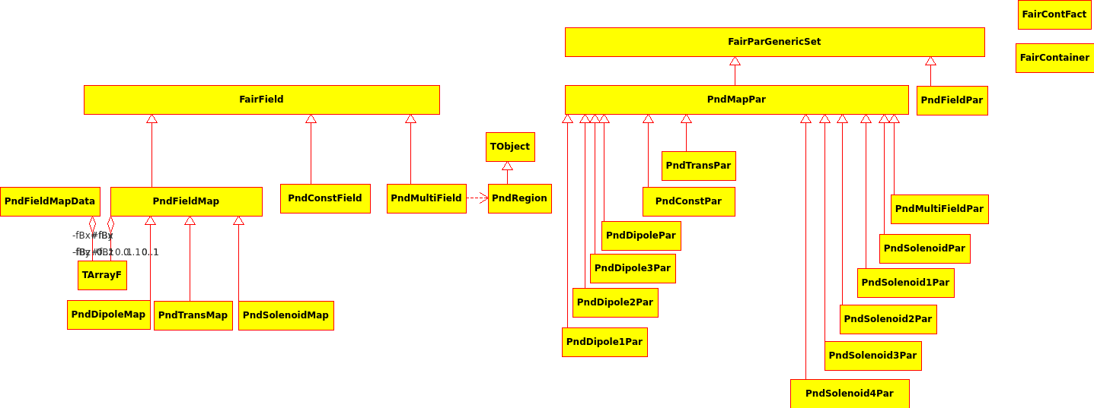
FairField is an implementation of TVirtualMagField that is used in simulation

Slide 7
Parameter classes

Slide 8
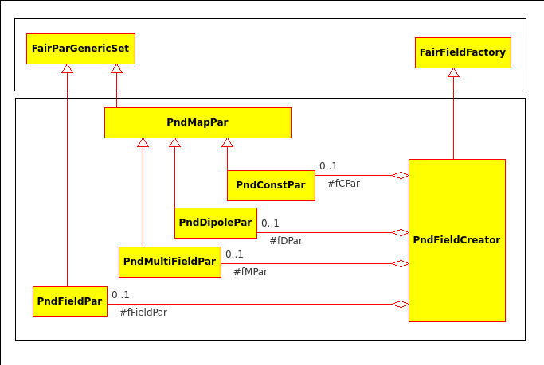
Field Factory pattern

Slide 9
FairMultiField Class
Make any combination of field classes according to regions along z-axis
Single field parameters are used to create the multi-field parameters
The Framework can reconstruct the field at any later stage from the parameters stored in the Run time data base for a certain run

