Slide 1
Shell model calculation on even-even Germanium isotopes
Presented by;
Amin Attarzaeh
PhD student of PNUM university
Mashhad, Iran.
August 2015
Groningen , Netherlands

Slide 2
Theory of applied nuclear model.
Calculation of energy levels.
Transition probability values, B(E2).
Quadrupole deformation parameter calculation.
Landscape

Slide 3
Theory of applied nuclear model
shell-model is one of the most prominent and successful nuclear model which can be compared with the electron shell model for atoms.
magic numbers 2,8,20,40,50,82 and 126 play important roles in determining nuclear properties.
Existence of spatial levels is determined by Pauli Exclusion Principle.
By knowing nuclear potentials for all nucleons in a nucleus one can calculate energy levels.

Slide 4
Calculation of energy levels
Energy levels of 70Ge, calculated by Oxbash and compared by experimental data.
# | J⁺ | # Energy | E_{OX} MeV | E_{exp} MeV
1 | 0 | 1 | 0.917 | 1.039
2 | 2 | 1 | 1.690 | 1.707
3 | 2 | 2 | 1.953 | 2.153
4 | 4 | 1 | 2.459 | 2.451
5 | 0 | 3 | 2.510 | 2.306
7 | 2 | 4 | 2.831 | 2.534
8 | 4 | 4 | 3.162 | 3.194
9 | 2 | 5 | 3.177 | 2.944

Slide 5
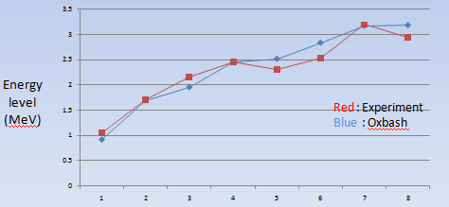
Calculation of energy levels
Comparison fitting curve of Oxbash result and Experimental data for 70Ge

Slide 6
Calculation of energy levels
Energy levels of 72Ge, calculated by Oxbash and compared by experimental data.
# | J⁺ | # Energy | E_{OX} MeV | E_{exp} MeV
1 | 0 | 1 | 0 | 0
2 | 2 | 1 | 0.875 | 0.834
3 | 4 | 1 | 2.227 | 2.049
4 | 0 | 2 | 2.348 | 2.029
5 | 2 | 2 | 3.070 | 3.034
7 | 4 | 2 | 3.443 | 3.378
8 | 4 | 3 | 3.841 | 3.840
9 | 2 | 3 | 3.886 | 3.872
10 | 4 | 4 | 4.656 | 4.705

Slide 7
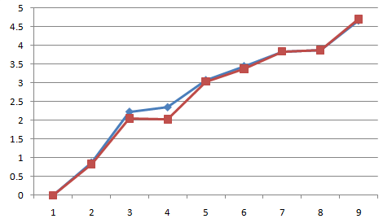
Calculation of energy levels
Comparison fitting curve of Oxbash result and Experimental data for 72 Ge
Energy level (Mev)
Red : Experiment
Blue : Oxbash

Slide 8
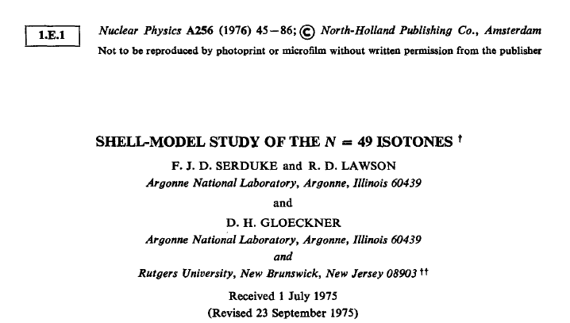
SLG model space and SLGM interaction resource

Slide 9
Calculation of energy levels
Energy levels of 74Ge, calculated by Oxbash and compared by experimental data.
# | J⁺ | # Energy | E_{OX} MeV | E_{exp} MeV
1 | 0 | 1 | 0 | 0
2 | 2 | 1 | 0.393 | 0.595
3 | 2 | 2 | 1.033 | 1.204
4 | 0 | 2 | 1.493 | 1.482
5 | 2 | 3 | 2.042 | 1.197
6 | 0 | 3 | 2.167 | 2.227
7 | 2 | 5 | 2.409 | 2.696

Slide 10
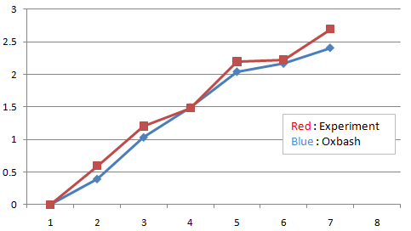
Calculation of energy levels
Comparison fitting curve of Oxbash result and Experimental data for 74 Ge
Energy level (Mev)

Slide 11
Calculation of energy levels
Energy levels of 76Ge, calculated by Oxbash and compared by experimental data.
# | J⁺ | # Energy | E_{OX} MeV | E_{exp} MeV
1 | 0 | 1 | 0 | 0
2 | 2 | 1 | 0.400 | 0.562
3 | 2 | 2 | 1.151 | 1.108
4 | 0 | 2 | 1.755 | 1.911
5 | 2 | 3 | 1.896 | 2.203
6 | 2 | 4 | 2.120 | 1.915
7 | 1 | 1 | 2.197 | 2.204
8 | 2 | 6 | 2.460 | 2.591
9 | 0 | 3 | 2.623 | 2.897

Slide 12
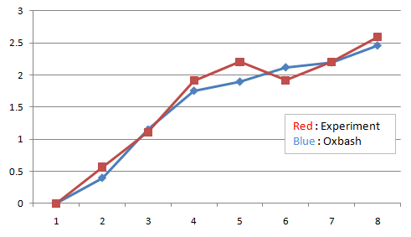
Calculation of energy levels
Comparison fitting curve of Oxbash result and Experimental data for 76 Ge
Energy level (Mev)

Slide 13
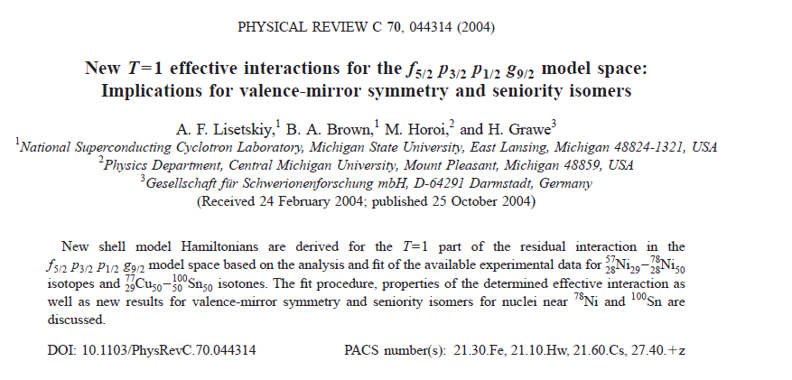
JJ44pn model space and JJ44bpn interaction resource

Slide 14
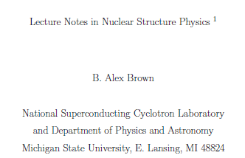
Transition probability values, B(E2)

Slide 15
Deformation parameter, β2

Slide 16
Transition probability and Deformation parameter of 70-76 Ge isotopes
 | B(E2); 0₁⁺ 2₁⁺ | β₂ Deformation Parameter | β₂ (EXP) | Model space | interaction
70Ge | 0.1702 E +3 | 0.22060 | 0.22640 | SLG (Oxbash) | SLGM
72Ge | 0.2307 E +3 | 0.25014 | 0.24020 | SLG (Oxbash) | SLGM
74Ge | 0.3020 E +3 | 0.28330 | 0.28570 | jj44pn ( Nushellx) | jj44bpn
76Ge | 0.2617 E +3 | 0.25910 | 0.26500 | jj44pn (Nushellx) | jj44bpn

Slide 17
First excited energy ,Transition probability and Deformation parameter of 70-76 Ge isotopes
 | First excited energy MeV | B(E2); 0₁⁺ 2₁⁺ | β₂ | β₂ (EXP)
70Ge | 1.039 | 0.1702 E +3 | 0.22060 | 0.22640
72Ge | 834.011 | 0.2307 E +3 | 0.25014 | 0.24020
74Ge | 0.595 | 0.3020 E +3 | 0.28330 | 0.28570
76Ge | 0.562 | 0.2617 E +3 | 0.25910 | 0.26500

Slide 18
Shell model levels

Slide 19
Results and Landscape
The out put of OXBASH calculation of energy levels for 70-72Ge isotopes has good agreement with empirical data with SLG model space and SLGM interaction.
To evaluate of B(E2), for 74Ge and 76Ge , jj44pn model space and jj44bpn interaction were used to earn the best fitting with experimental data.
The “magic numbers” and their values are not preserved; they evolve for unstable nuclei due to nuclear structure effects. Therefore, nuclear properties of the first excited 21+ states in even-even nuclei provide important information on evolution of nuclear properties and shell model studies.
Another important application of B(E2) evaluated data is for nuclear reaction model calculations. The precise values of quadrupole deformation parameters are absolutely essential for the Reference Input Parameter Library (RIPL) ,and nuclear reaction model codes such as EMPIRE and TALYS . These codes are extensively used for ENDF evaluations ,and the ENDF library provides evaluated neutron cross sections for frequently-used nuclear science and technology codes GEANT and MCNP.

Slide 20
We wish to thank Professor B. Alex Brown from the Department of Physics and Astronomy and National Superconducting Cyclotron Laboratory, Michigan State University for providing us the OXBASH code.

Slide 21
Thanks for your attention

