Slide 1
ISOVECTOR PROTON-NEUTRON PAIRING AND WIGNER ENERGY IN HARTREE-FOCK MEAN FIELD CALCULATIONS*
Daniel Negrea
National Institute of Physics and Nuclear Engineering
Bucharest, Romania
*D. Negrea, N. Sandulescu, Phys. Rev. C 90, 024322 (2014)

Slide 2


Wigner energy in empirical mass formula
Symmetry energy
Wigner energy
Taking out the Coulomb energy, one can write for an isobaric chain
^{Tz= |N − Z|/2}
(neglecting shell fluctuations, X≈1)
What is the origin of Wigner energy ?
Can proton-neutron pairing explain the Wigner energy ?

Slide 3



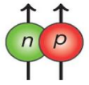

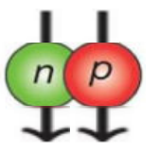
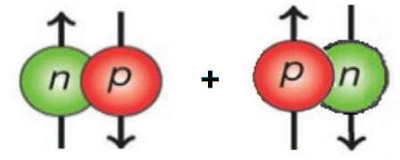
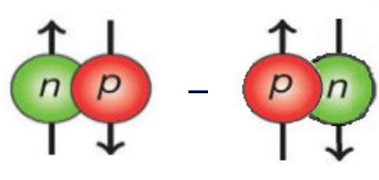


Proton-neutron pairing in N≈Z nuclei
isovector pairs
isoscalar pairs
Notes:
3
3
3
3
3

Slide 4

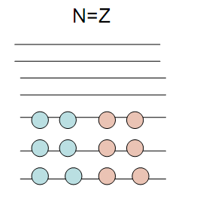

Treatment of isovector pairing
BCS-like treatments: - large errors (30-40%) for pairing energies
- breaks the particle number and the isospin
Alternative: Quartet Condensation Model (QCM)
- conserves exactly the particle number and isospin
- gives very accurate results (errors < 1%) for pairing energies
N. Sandulescu, D. N., J. Dukelsky, C. W. Johnson, Phys. Rev. C 85, 061303(R) (2012)
N. Sandulescu, D. N., C. W. Johnson, Phys. Rev. C 86, 041302(R) (2012)

Slide 5






Isospin restoration and quartet correlations: QCM model
Collective quartets with T=0:
(collective pair operators )
Condensate of quartets for N=Z nuclei is
a mixture of nn, pp and np condensates:
Quartet condensation in N>Z nuclei*
The neutrons in excess form a neutron pair condensate appended to the quartet condensate.
The neutron pairs in excess have different mixing amplitudes than the neutron pairs which are entering in the quartets.
*N. Sandulescu, D. N., C. W. Johnson, Phys. Rev. C 86, 041302(R) (2012)
Notes:
5
5
5
5
5

Slide 6
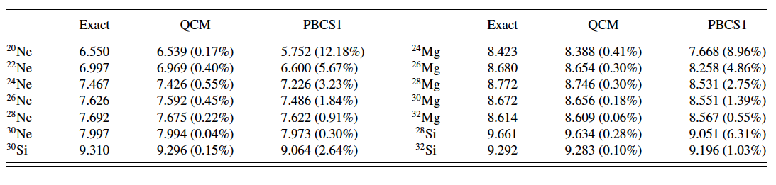
Isovector pairing and quartet condensation for N≥Z nuclei

Slide 7
Isovector pairing in QCM+Skyrme-HF
pairing is acting outside a closed core
single-particle energies: from Skyrme-HF
densities
HF
The HF and QCM calculations are iterated together until the convergence.
The pairing energy is added to the mean-field energy.

Slide 8
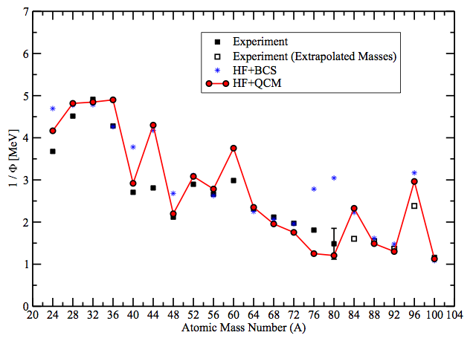
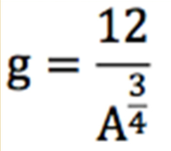
The influence of isovector pn pairing on the symmetry energy
T=0,2,4
D. N. , N. Sandulescu, Phys. Rev. C 90, 024322 (2014)
HF+QCM calculations describe very well the standard symmetry energy.
HF+BCS and HF+QCM give quite similar results for 1/Φ.
the isovector proton-neutron pairing does not play a major role for the standard symmetry energy.

Slide 9
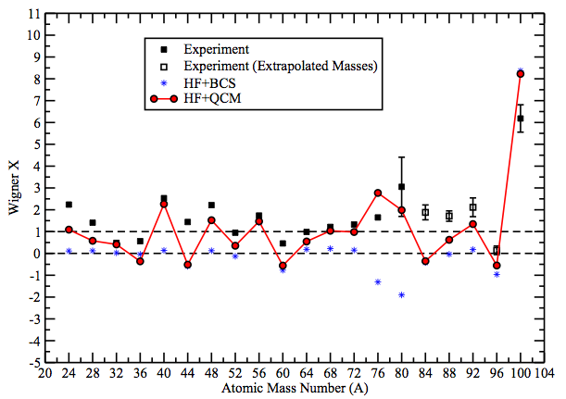
The influence of isovector pn pairing on the Wigner energy
T=0,2,4
Sk-HF+QCM with selfconsistent calculation of deformation
D. N. , N. Sandulescu, Phys. Rev. C 90, 024322 (2014)
HF+BCS fails to describe the Wigner energy (X close to zero for many isobaric chains).
HF+QCM results are following well the large fluctuations of X with the mass number.
Conclusion: isovector pn pairing is describing well the Wigner energy
when described accurately by QCM.

Slide 10
Summary and conclusions
isovector pairing is accurately described by alpha-like quartets, not by Cooper pairs
treated in Quartet Condensate Model, isovector pairing describes well the Wigner energy
BCS fails to describe the Wigner energy
Open question: what is the contribution of the isoscalar proton-neutron pairing?
QCM was already generalized for T=1 and T=0 pairing.
(N. Sandulescu, D.N., D. Gambacurta, arXiv:1507.04144)

Slide 11
Thank you for your attention

Slide 12

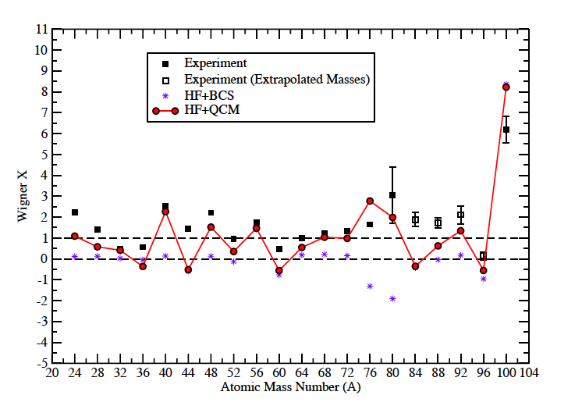
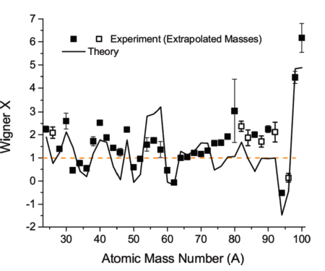
Wigner energy: comparison with earlier calculations
Bentley & Frauendorf PRC(2013)
Negrea & Sandulescu PRC(2014)

Slide 13
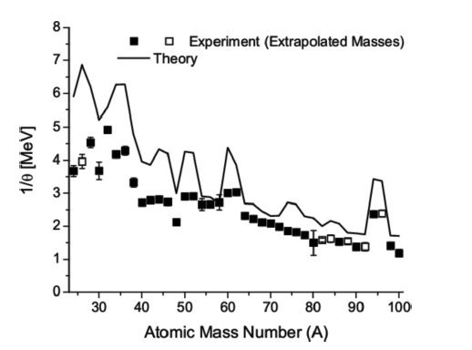
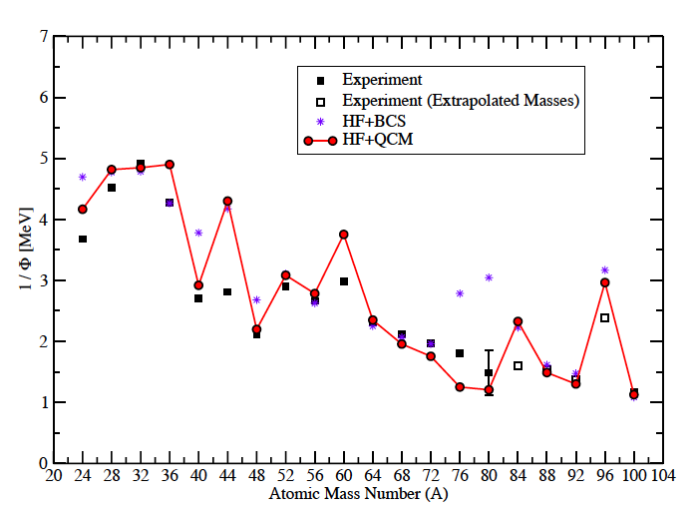
Symmetry energy: comparison with earlier calculations
Bentley & Frauendorf PRC(2013)
Negrea & Sandulescu PRC(2014)

Slide 14
Isoscalar and isovector proton-neutron pairing in time-reversed states
isovector
isoscalar
ansatz for ground state
superposition of quartet condensates and pair condensates

Slide 15
Competition between isovector and isoscalar pairing
pairing on top of deformed Skyrme-HF
isovector and isoscalar pairing always coexist
(N. Sandulescu, D.N., D. Gambacurta, arXiv:1507.04144)

Slide 16
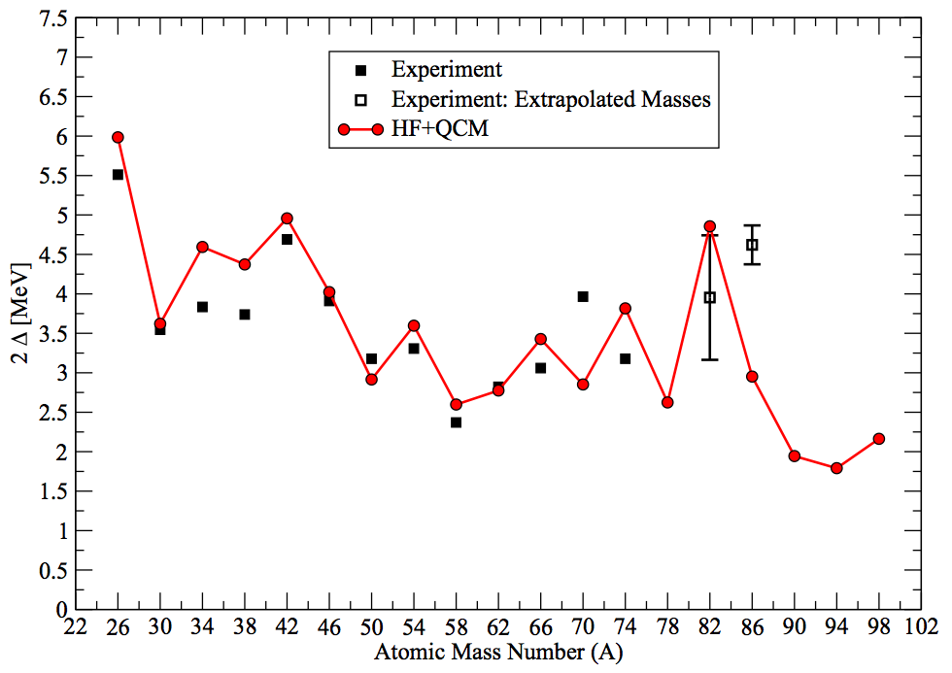
Even-even to odd-odd mass difference along the N = Z line

