Slide 1

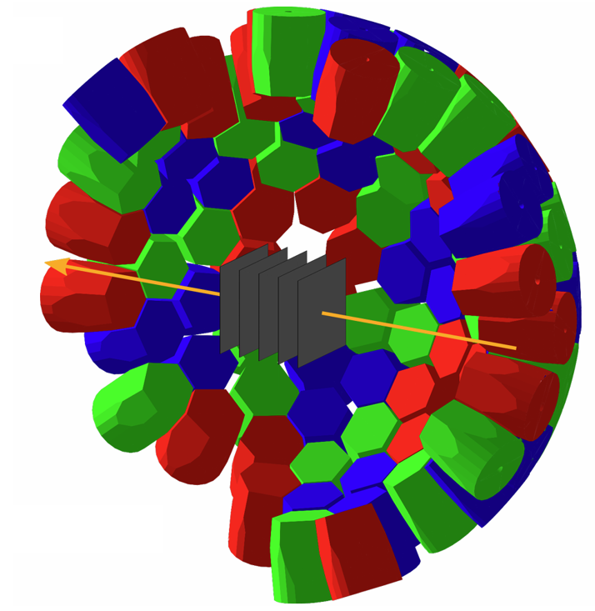
Development of a Machine Learning Pipeline for Reaction Position Reconstruction in LISA
16/09/2026 Kentaro MORIGUCHI
Supervisor: Dr. Fillipo Angelini
Notes:
Hello everyone.Thank you for being here. My name is Kentaro Moriguchi. And my supervisor is Fillipo Angelini.
Today, I’m going to talk about the "Development of a Machine Learning Pipeline for Reaction Position Reconstruction in LISA."

Slide 2
Introduction
Notes:
First, I would like to discuss the background of developing a machine learning pipeline for this study.

Slide 3
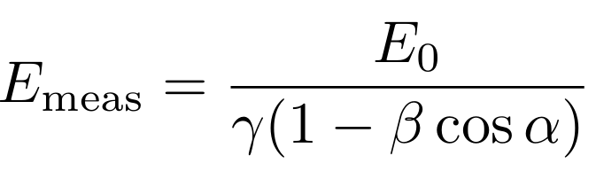
Intro: In-beam γ-ray spectroscopy
γ-rays
・Measure γ-rays emitted from short-lived, fast-moving nuclei
・These nuclei travel at high speeds (β=v/c~0.6)
・Focus on excited nuclei generated after proton knockout (pKO) reaction
z
α
z-1
Beam:
β~0.6
・γ-rays are emitted in-flight and Doppler shifted
・To accurately correct this Doppler shift,
Target
Reaction products
⇒We need exact values of γ-ray emission angle and the velocity at the time of emission
Notes:
This research focuses on measuring γ-rays from short-lived nuclei.
These nuclei travel at extremely high speeds, with β around 0.6
Specifically, we are looking at excited nuclei generated after proton knockout (pKO) reactions.
γ-rays emitted from such high-speed particles experience a significant Doppler shift.
To correct this Doppler shift, we need to know two exact values: the γ-ray emission angle, and the velocity at the time of emission."

Slide 4
Intro: In-beam γ-ray spectroscopy
Requires good angular and velocity resolution
・Thick targets must be used to ensure sufficient yield
・When using a thick target, we can’t find where γ-ray come from
→assuming γ-ray coming form the center of the target
(dash line)
⇒large angular resolution
HPGe
γ-rays
Beam:
β~0.6
α
α’
α
Reaction products
Target
Thickness: few mm
Notes:
However, to ensure sufficient yield in in-beam γ-ray spectroscopy, thick targets must be used.
When using a thick target, the exact depth the reaction occurs is unknown.
For convenience, calculations are typically made assuming the γ-ray was emitted from the center of the target.
Consequently, angular uncertainty increases.

Slide 5





Intro: In-beam γ-ray spectroscopy
Requires good angular and velocity resolution
・Solution: using layered diamond detectors as targets
(active target; LISA)
・LISA (LIfetime Measurements with Solid Active targets)
・ Measuring particle energy loss in each layer
HPGe
γ-rays
Target
(Diamond Detector)
Beam:
β~0.6
α
Reaction products
Active targets = targets + detectors
$${dE}_{1}$$
$${dE}_{2}$$
$${dE}_{3}$$
$${dE}_{4}$$
$${dE}_{5}$$
Notes:
To solve this problem, we use an active target consisting of layered diamond detectors, called LISA.(LIfetime Measurements with Solid Active targets)
An active target is a device that functions as both target and a detector
There are five layers.
These detectors can measure the energy lost by particles in each layer.

Slide 6
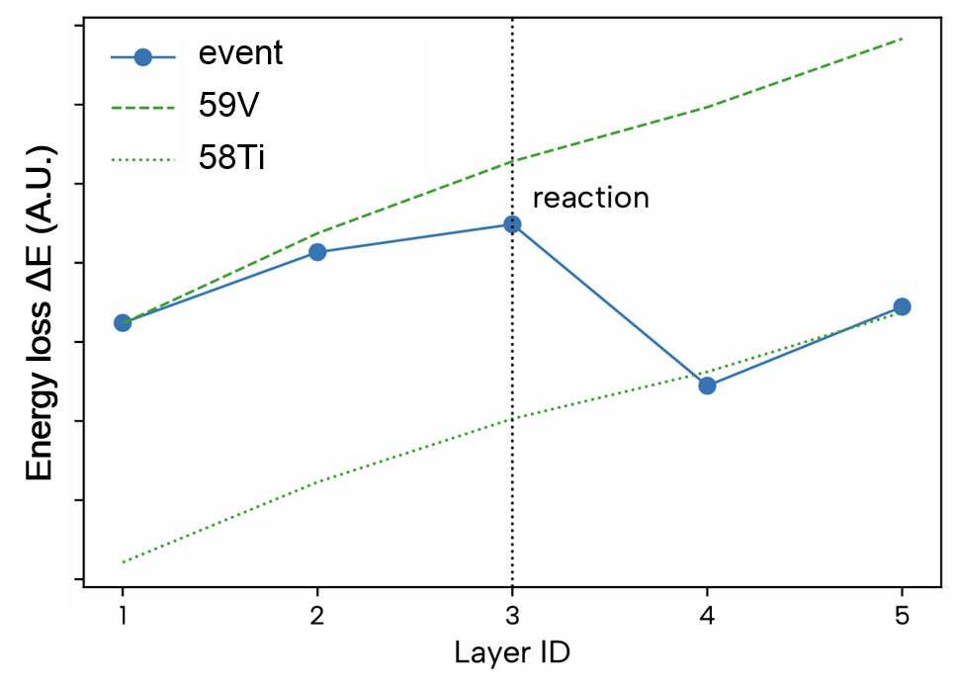
Intro: In-beam γ-ray spectroscopy
Requires good angular and velocity resolution
・Solution: using layered diamond detector as targets
(active target; LISA)
・LISA (LIfetime Measurements with Solid Active targets)
・ Measuring particle energy loss in each layer
HPGe
γ-rays
Target
(Diamond Detector)
Beam:
β~0.6
α
Reaction products
Active targets = targets + detectors
$${dE}_{1}$$
$${dE}_{2}$$
$${dE}_{3}$$
$${dE}_{4}$$
$${dE}_{5}$$
Notes:
When a particle’s charge changes, the energy loss in each layer jumps before and after the reaction.

Slide 7
Intro: In-beam γ-ray spectroscopy
Requires good angular and velocity resolution
・Solution: using layered diamond detector as targets
(active target; LISA)
・LISA (LIfetime Measurements with Solid Active targets)
・ Measuring particle energy loss in each layer
HPGe
γ-rays
Target
(Diamond Detector)
Beam:
β~0.6
α
Reaction products
・When charge-changing reaction occurs, energy loss in each layer changes abruptly before and after
reaction. (Bethe formula)
⇒we can identify the layer where reaction occurred
$${dE}_{1}$$
$${dE}_{2}$$
$${dE}_{3}$$
$${dE}_{4}$$
$${dE}_{5}$$
Notes:
By detecting this change, we can identify the specific layer where the reaction occurred.

Slide 8
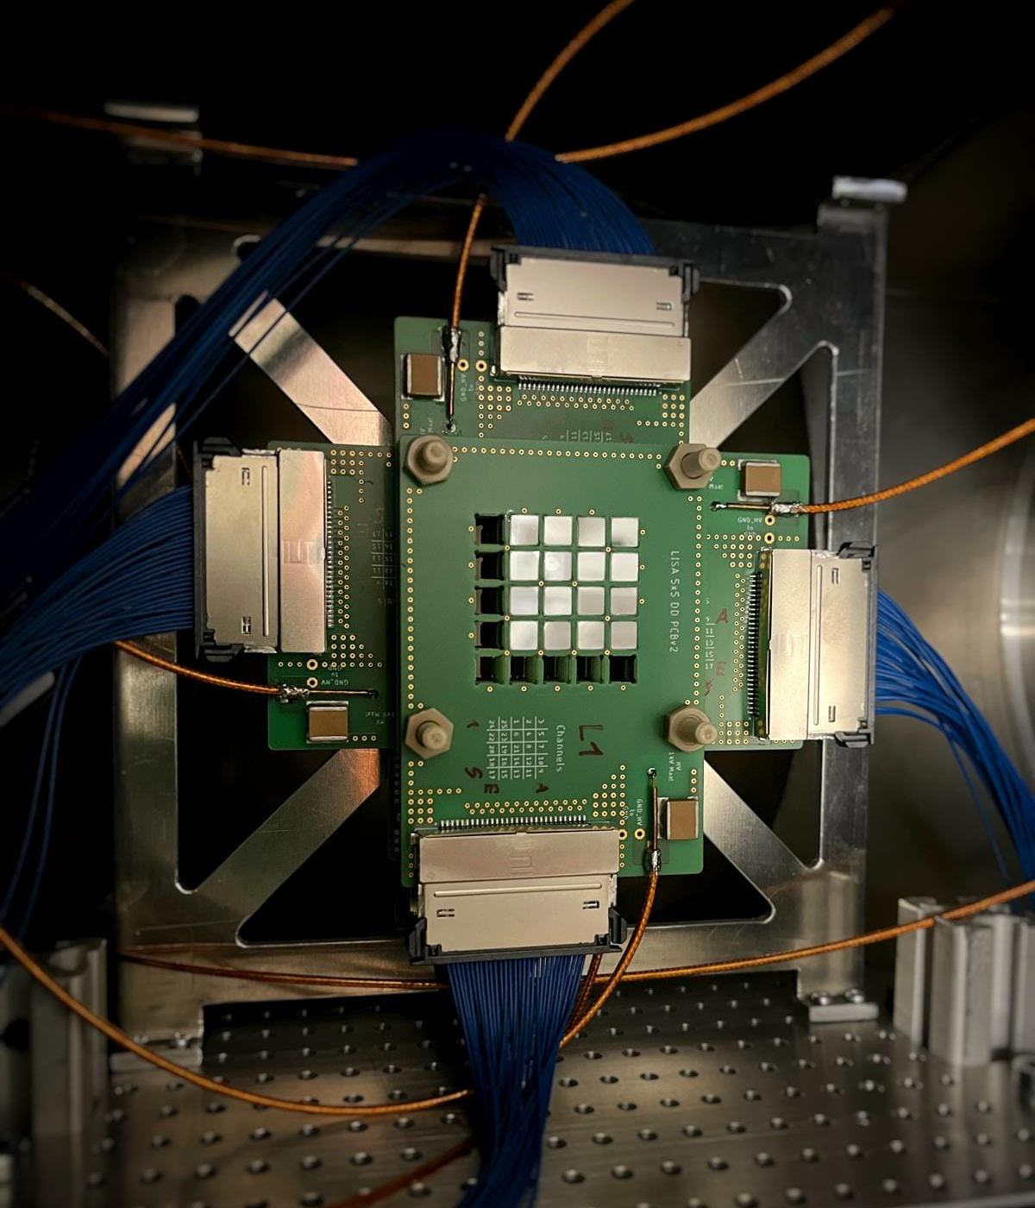
Intro: Details of Setup ~ AGATA and LISA ~
AGATA
What is specific setup?
・Combines layered active targets (LISA)
with 4π γ-ray spectrometer (AGATA)
・AGATA: Advanced GAmma Tracking Array
・AGATA is a highly position-sensitive Ge detector
LISA
Notes:
Specifically, the setup combines LISA with a 4π γ-ray spectrometer, like AGATA.
AGATA is functioning as a highly position-sensitive Ge detector.
The figure on the right shows this setup.

Slide 9
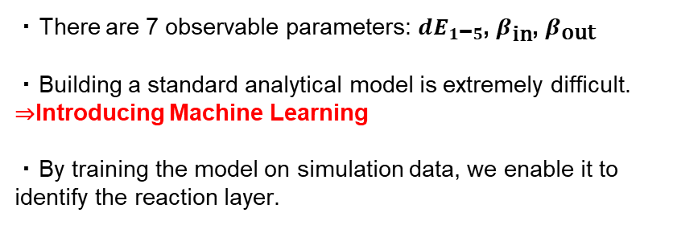

Intro: Why ML is needed and previous achievements
・There are 7 observable parameters: $dE_{1\text{−}5}$, $β_{\text{in}}$, $β_{\text{out}}$
・Building a standard analytical model is extremely difficult.
⇒Introducing Machine Learning
・By training the model on simulation data, we enable it to identify the reaction layer.
+ $β_{\text{in}}$, ${ β}_{\text{out}}$
Notes:
We use these 7 parameters. energy loss in each layer, plus incoming and outgoing velocities.
Building a standard analytical model from scratch is extremely difficult.
Because there are too many variables, and the system is too complex.
Therefore, we introduced machine learning.
We trained the model on simulation data that closely matches the experiment.
This allows it to identify the reaction layer.

Slide 10
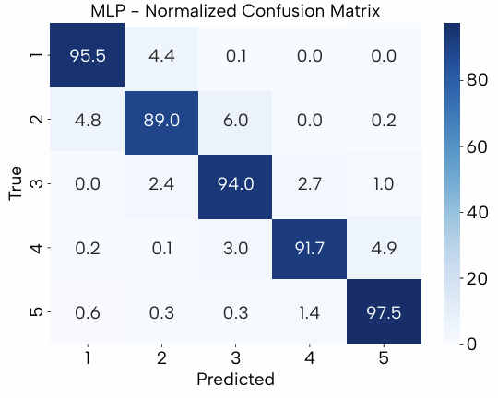
Intro: Why ML is needed and previous achievements
・There are 7 observable parameters: $dE_{1\text{−}5}$, $β_{\text{in}}$, $β_{\text{out}}$
・Building a standard analytical model is extremely difficult.
⇒Introducing Machine Learning
・By training the model on simulation data, we enable it to identify the reaction layer.
+ $β_{\text{in}}$, ${ β}_{\text{out}}$
ML Classifier
<Previous Achievements>
・By using ML model, we achieved to classify reaction layers with high accuracy (~ 93%).
⇒We overcame the angular resolution issue.
Next: high velocity resolution
Classification accuracy
Accuracy: 93%
Notes:
By using these 7 features, our model identified the reaction layer with over 93% accuracy.
This solved the angular resolution issue.
But what about velocity resolution?

Slide 11
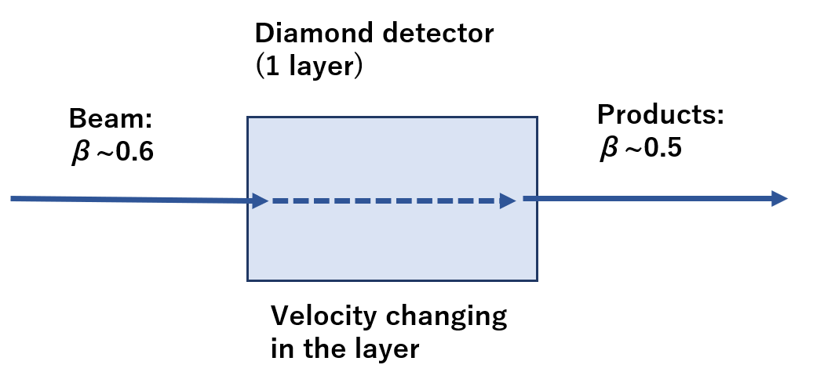
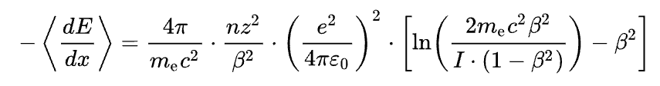
Intro: Why high spatial resolution is needed
・Thick targets ⇒velocity changes in the targets
⇒impacts Doppler correction
・How measure (calculate) velocity with high accuracy?
⇒Using reaciton position
・Determining the exact reaction position
⇒allows us to calculate the particle velocity at the reaction point using the Bethe formula:
500㎛
⇒ Using 5 layers is not enough
Notes:
When using a thick target like this, especially with highly charged particles, the velocity changes while passing through the layers.
This velocity change significantly impacts the Doppler correction.
If we can accurately determine not just the reaction layer but the exact "depth of the reaction point,"
we can back-calculate the instantaneous velocity at the reaction point by using Bethe's formula.
Of course, using five layers improves the position resolution, but this alone is not enough.

Slide 12
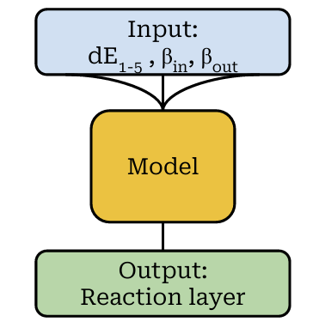
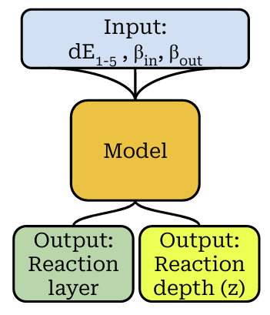
Intro: What ML model we developed
What we want to do is updating previous ML pipeline.
・Simple “layer classification” is insufficient
・we need higher position resolution
Develop another ML model which can reconstruct Reaction position
update
Notes:
Therefore, in this study, we expanded our current model into a full machine learning pipeline.
This ML pipeline handles both layer classification and continuous position reconstruction.

Slide 13
Methodology
Notes:
Next, I will explain the specific methods we used.
7mins

Slide 14
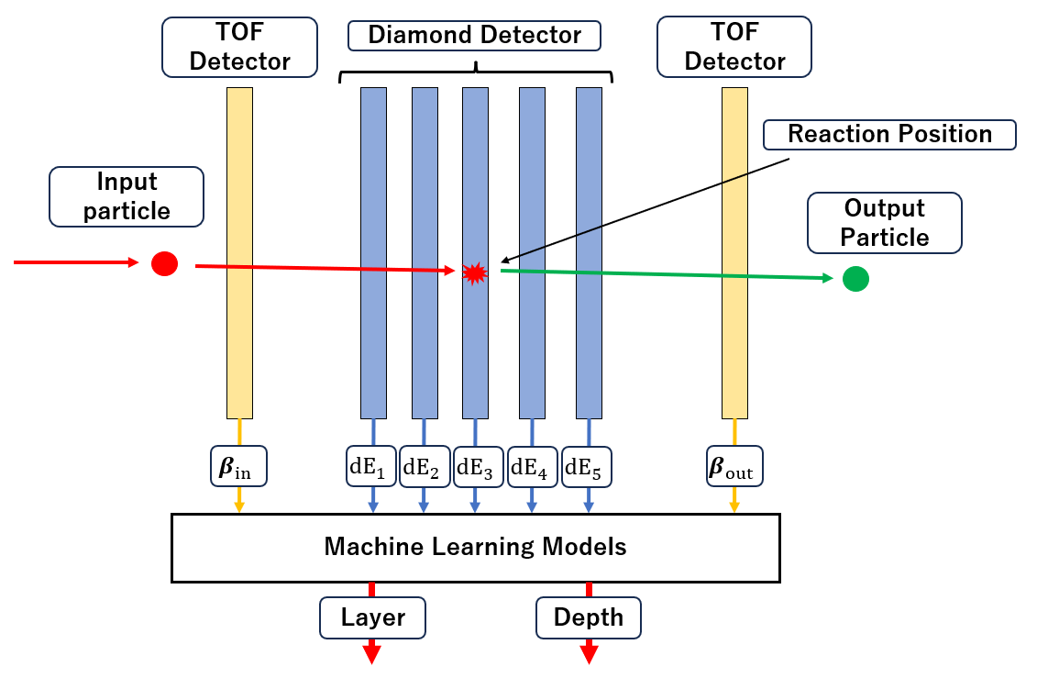
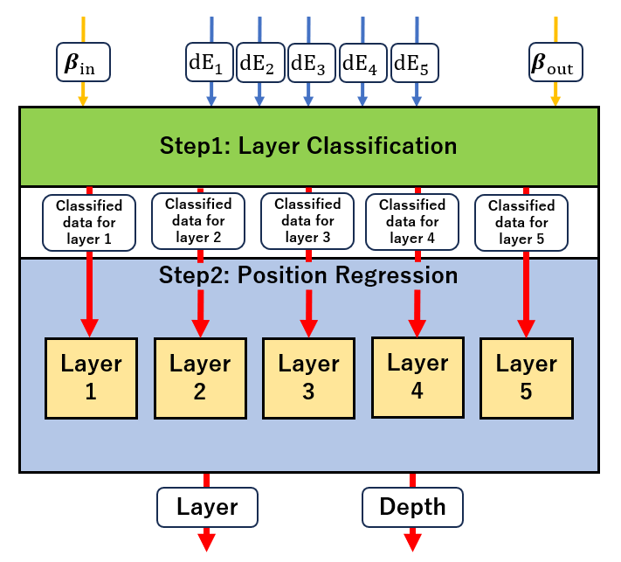
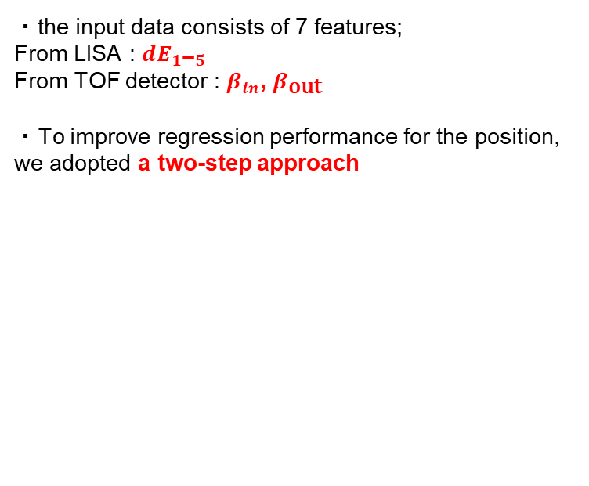
Method: the ML Architecture we used
・the input data consists of 7 features;
From LISA : $dE_{1\text{−}5}$
From TOF detector : $β_{in}$, $β_{\text{out}}$
・To improve regression performance for the position, we adopted a two-step approach
TOF: Time Of Flight
Notes:
First, regarding this model: the input data consists of 7 features—the energy loss from LISA, and the incoming and outgoing velocities of the particle from TOF detector.
To improve regression performance for the position, we adopted a two-step approach, as shown in the figure.

Slide 15
Method: the ML Architecture we used
・We adopted a two-step approach.
◆Step1：Reaction Layer Classification
Identifying the specific reaction layer where the event occurred by using classifiers.
◆Step2：Reaction Position Regression per Layer
We apply a dedicated position reconstruction model for each classified layer.
⇒achieves high position resolution
Notes:
The Step1 is Reaction layer Classification.
In Step 1, we Identify the specific reaction layer as before.
The Step2 is Reaction Position Regression in each layer
In Step 2, we apply a dedicated position reconstruction model for each classified layer in order to calculate the precise reaction position within these layers.
This pipeline achieves high position resolution.

Slide 16
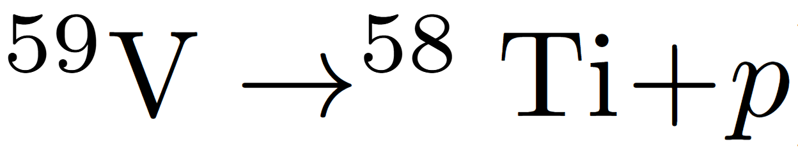
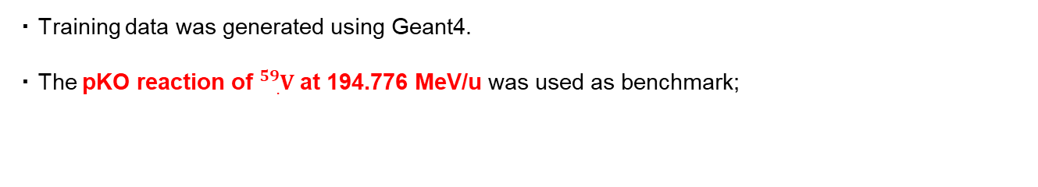
Method: What reaction we used and how data we generated
・Training data was generated using Geant4.
・The pKO reaction of ${}_{.}^{59}V$ at 194.776 MeV/u was used as benchmark;
・Evaluated model robustness:
1.Varying particle types and energies
2.Testing with a cocktail beam
・For the target, we used five 500㎛ thick targets, 2500㎛ in total.
Target
(Diamond Detector)
500㎛
2500㎛ in total
Notes:
Training data was generated using Geant4.
As a benchmark, we used the pKO reaction of 59V at this energy.
Based on this, we evaluated how the pipeline's behavior changes when the energy or type of incident particle is varied.
We also tested the pipeline by using a cocktail beam.
For the target, we used five 500 μm thick diamond detectors, totaling 2500 μm in thickness.

Slide 17
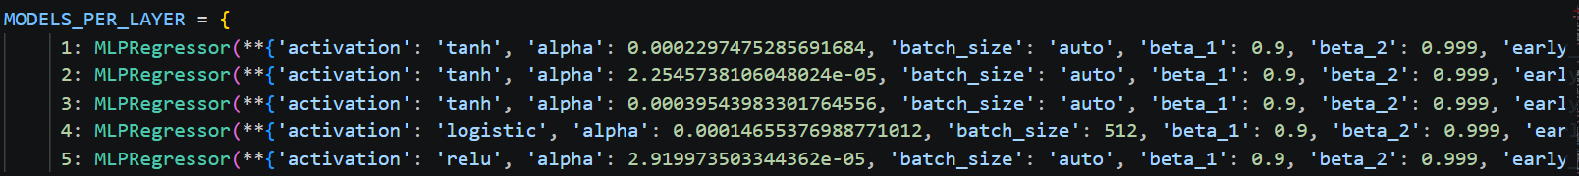
Method: How ML are optimized and selected
・We optimized the ML models and their hyperparameters by using Optuna framework.
・ determined the final model by balancing performance with computational cost.
・MLPClassifier was adopted as Step1, MLPRegressor as Step2.
※MLP = Multi-Layer Perceptron,
a type of neural network
Notes:
We used the Optuna framework to optimize the model.
Then, we chose the final version by balancing performance and computational cost.
We adopted MLPClassifier as Step1 and MLPRegressor as Step2.
MLP stands for Multi Layer Perceptron, it is a type of neural network.

Slide 18
Method: How ML are optimized and selected
・We optimized the ML models and their hyperparameters by using Optuna framework.
・ determined the final model by balancing performance with computational cost.
・MLPClassifier was adopted as Step1, MLPRegressor as Step2.
※MLP = Multi-Layer Perceptron,
a type of neural network
Multilayer Perceptron Learning, geeksforgeeks, accessed 15/09/2026
Notes:
We used the Optuna framework to optimize the model.
Then, we chose the final version by balancing performance and computational cost.
We adopted MLPClassifier as Step1 and MLPRegressor as Step2.
MLP stands for Multi Layer Perceptron, it is a type of neural network.

Slide 19
Method: Which metric we used
・We used two metrics as criteria for optimization and evaluation
○Accuracy
○R² (Coefficient Determination)
・We used Accuracy as evaluation metric for Step1, R² for Step2.
・Accuracy: the % of events assigned to the correct layer
○Accuracy
○R² (Coefficient Determination)
Notes:
We used 2 metrics as criteria for optimization and evaluation.
For performance metrics, we used Accuracy for Step 1, and the coefficient determination (R^2) for Step 2.
Here, Accuracy in Step 1 refers to the percentage of events assigned to the correct layer.

Slide 20
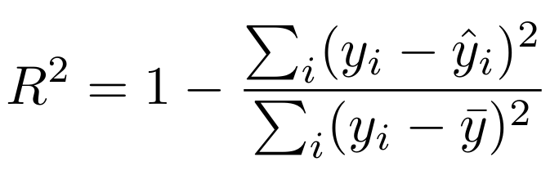
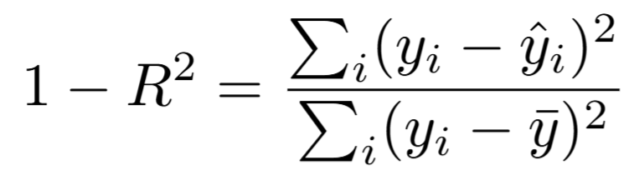
〇What is R² (Coefficient Determination)
Method: Which metric we used
←the numerator:
the error the model makes
←the dominator:
the natural variance of data
・The larger R² = the better regression
・ 1 - R² is also used.
← when R²=0.9, 1 - R² = 0.1,
⇒the error the model makes is 1/10 of
the natural variance of data.
Notes:
Next, here is the definition of the coefficient determination.
The larger R2 means the better regression.
We also used 1-R2, which represents the ratio of the error the model makes to the natural variance of the data.
so, when R²=0.9, 1 - R² = 0.1, it means the error the model makes is 10 times smaller than the natural variance of data.

Slide 21
Results and Discussion
Notes:
Moving on to the results.
11mins

Slide 22
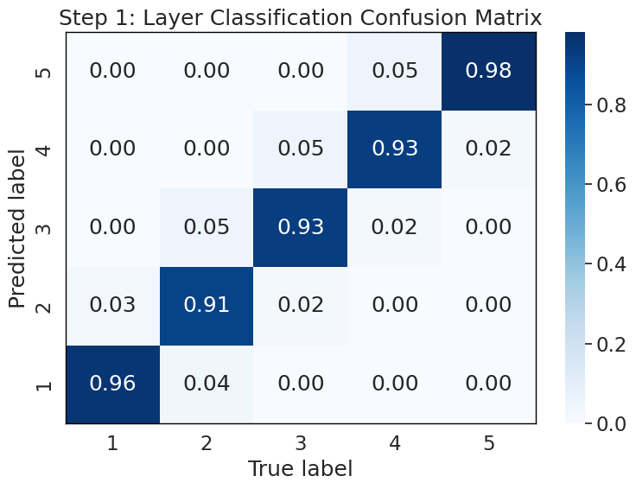
Results : Model performance ~ Case of the 59V pKO reaction ~
・ the performance for the benchmark:
59V at 194.776 MeV/u.
・Classification accuracy in Step1 reached 94.25%
< Classification in Step1>
Classification accuracy in each layer
Predicted reaction layer
Actual reaction layer
Accuracy: 94.25%
Notes:
First, this is the performance for the benchmark: 59V at this energy.
Under these conditions, the classification accuracy in Step 1 reached 94.25%.
This figure shows the classification accuracy in Step 1.
The vertical axis shows the predicted reaction layer, and the horizontal axis shows the actual reaction layer.

Slide 23
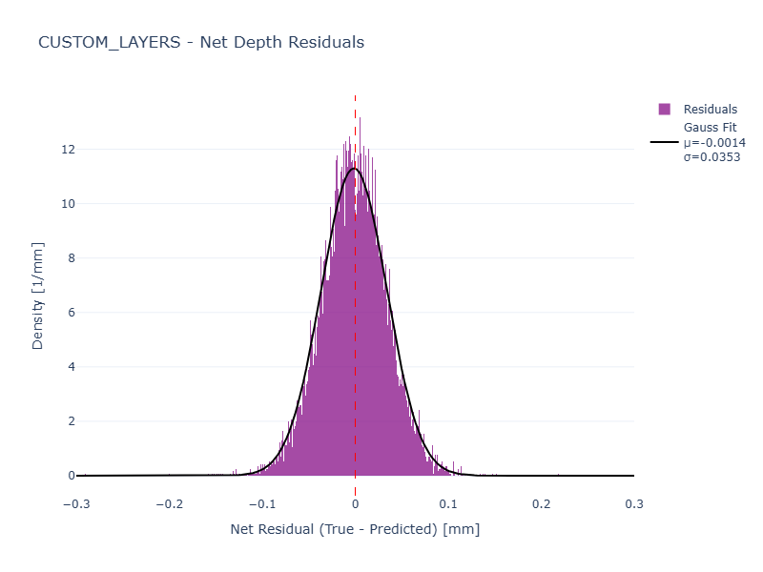
Results : Model performance ~ Case of the 59V pKO reaction ~
・ the performance for the benchmark:
59V at 194.776 MeV/u.
・Classification accuracy in Step1 reached 94.25%
< Regression in Step2>
・R² in Step 2 was 0.9435.
・This means the variance of the reconstructed position was reduced to about 1/18.
※1 – R² = 1 – 0.9435 ~ 1/18
・Gaussian fitting ⇒ σ = 35.3 µm
Density [1/mm]
Net Residual (True - Predicted) [mm]
R²: 0.9435
Notes:
For Step 2, the R^2 value was 0.9435.
This means the variance of the reconstructed position was reduced to about 1/18
compared to the variance before position regression .
We applied a Gaussian fit to the histogram, and the resulting sigma was 35.3 micrometers.
This figure shows the Step 2 regression results.
It compares the actual reaction points with the model's predictions.

Slide 24
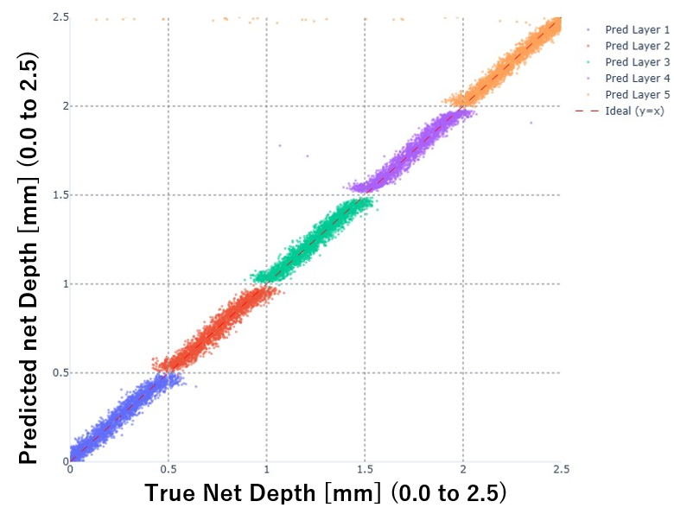
Results : Model performance ~ Case of the 59V pKO reaction ~
・The reaction points are predicted with high accuracy.
・Misclassified events are concentrated around the layer boundaries.
・These predictions match the actual reaction depths well even for misclassified events.
Notes:
Next, this scatter plot shows the relationship between the true net reaction depth and the net depth predicted by the machine learning model.
As you can see, the reaction points are predicted with very high accuracy.

Slide 25
Results : Model performance ~ Case of the 59V pKO reaction ~
・The reaction points are predicted with high accuracy.
・Misclassified events are concentrated around the layer boundaries.
・These predictions match the actual reaction depths well even for misclassified events.
Notes:
Now, let's zoom in on this specific area.
We can see that the misclassified events are concentrated around the layer boundaries.
However, even for these data points, you can see that the predicted depth match the actual reaction depths quite well.

Slide 26
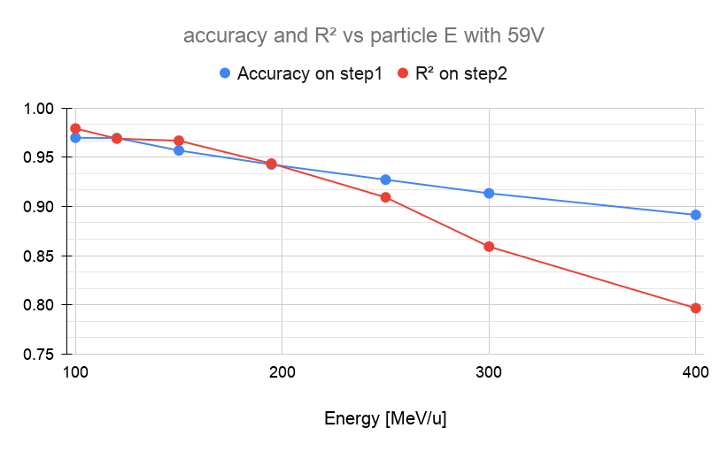
Results : Dependence on Incident particle Energy
・Reaction:
・Both accuracy in Step1 and R² in step2 slightly degrade as incident energy increases.
・However, high performances are still maintained even at 400MeV/u.
at 400 MeV/u,
※ 1 – R² = 1 – 0.8 ~ 1/5
Notes:
Next, we looked at the results when changing the incident particle conditions.
This figure shows the results of varying the incident energy from 100 MeV/u to 400 MeV/u for the 59V pKO reaction.
As the energy increases, both the classification performance in Step 1 and the regression performance in Step 2 show a slight downward trend.
However, high classification and regression performances are still maintained even at 400 MeV/u.

Slide 27
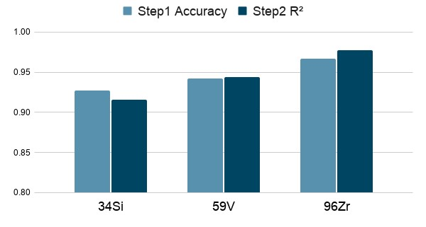
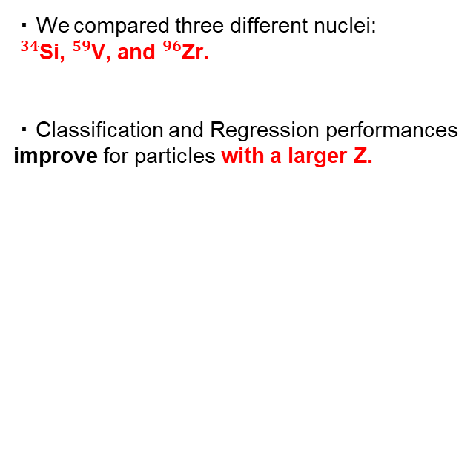
Results : Dependence on Particle type
・We compared three different nuclei:
${}_{​}^{34}{\text{Si}}$, ${}_{​}^{59}{\text{V}}$, and ${}_{​}^{96}{\text{Zr}}$.
・Classification and Regression performances improve for particles with a larger Z.
Energy fixed: 194.776MeV/u
Notes:
We also fixed the energy and changed the particle types to 34Si and 96Zr.
This comparison shows that classification performance improves for particles with a larger atomic number Z.

Slide 28

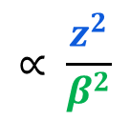
〇Bethe-Bloch Formula
Results : Why ML prediction performance changed
approximately
$$∝ \frac{z^{2}}{β^{2}}$$
・ Particle Dependence :
・ Energy Dependence :
$$z^{2} −{(z−1)}^{2}= 2z − 1$$
Larger Z
significant change in dE/dx before and after the pKO reaction
ML predictions easier
Notes:
These behaviors can be explained using Bethe's formula.
Regarding the particle type: a larger Z results in a more significant change in dE/dx before and after the pKO reaction.
This clarifies the signal differences, making it easier for the model to predict the position.

Slide 29
〇Bethe-Bloch Formula
Results : Why ML prediction performance changed
approximately
$$∝ \frac{z^{2}}{β^{2}}$$
・ Particle Dependence :
・ Energy Dependence :
$$z^{2} −{(z−1)}^{2}= 2z − 1$$
Larger Z
significant change in dE/dx before and after the pKO reaction
ML predictions easier
Higher Energy
Larger β
Smaller dE/dx
ML predictions slightly harder
Notes:
On the other hand, regarding energy dependence: when the particle energy is high (it means velocity is fast), it makes dE/dx smaller according to Bethe's formula.
As a result, the change in energy loss before and after the reaction becomes less distinct, making classification more difficult.

Slide 30
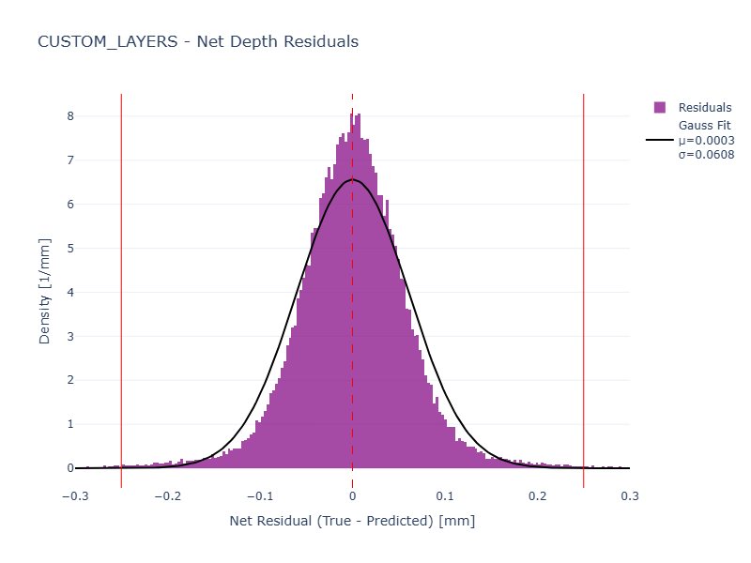
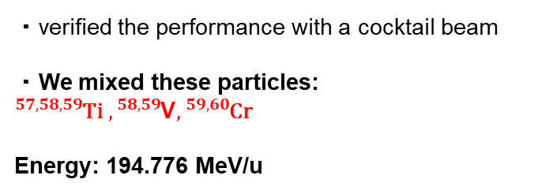
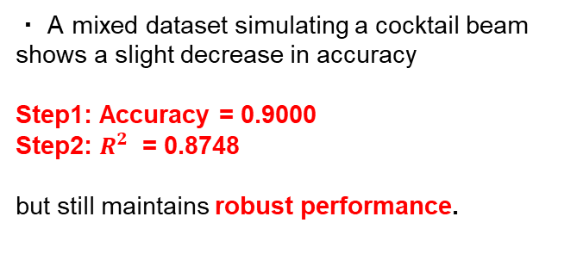
Results : Performance on Datasets with a Mix of Different Nuclei (cocktail beam)
・verified the performance with a cocktail beam
・We mixed these particles:
$${}_{​}^{57,58,59}{\text{Ti}} ,{}_{​}^{58,59}{\text{V}},{}_{​}^{59,60}{\text{Cr}}$$
Energy: 194.776 MeV/u
<Cocktail beam>
Density [1/mm]
・ A mixed dataset simulating a cocktail beam shows a slight decrease in accuracy
Step1: Accuracy = 0.9000
Step2: $R^{2}$ = 0.8748
but still maintains robust performance.
Net Residual (True - Predicted) [mm]
R²: 0.8748
Notes:
Furthermore, we verified the performance assuming a cocktail beam with multiple mixed particles.
We used the data containing these particles.
Although performance dropped slightly compared to a single particle beam, it maintained robust predictive capabilities.

Slide 31
Results : Performance on Datasets with a Mix of Different Nuclei (cocktail beam)
<Single-particle (59V)>
<Cocktail beam>
Density [1/mm]
Density [1/mm]
Net Residual (True - Predicted) [mm]
Net Residual (True - Predicted) [mm]
R²: 0.9435
R²: 0.8748
Notes:
As you can see, the model maintains a high level of accuracy even when compared to the single-particle case.

Slide 32
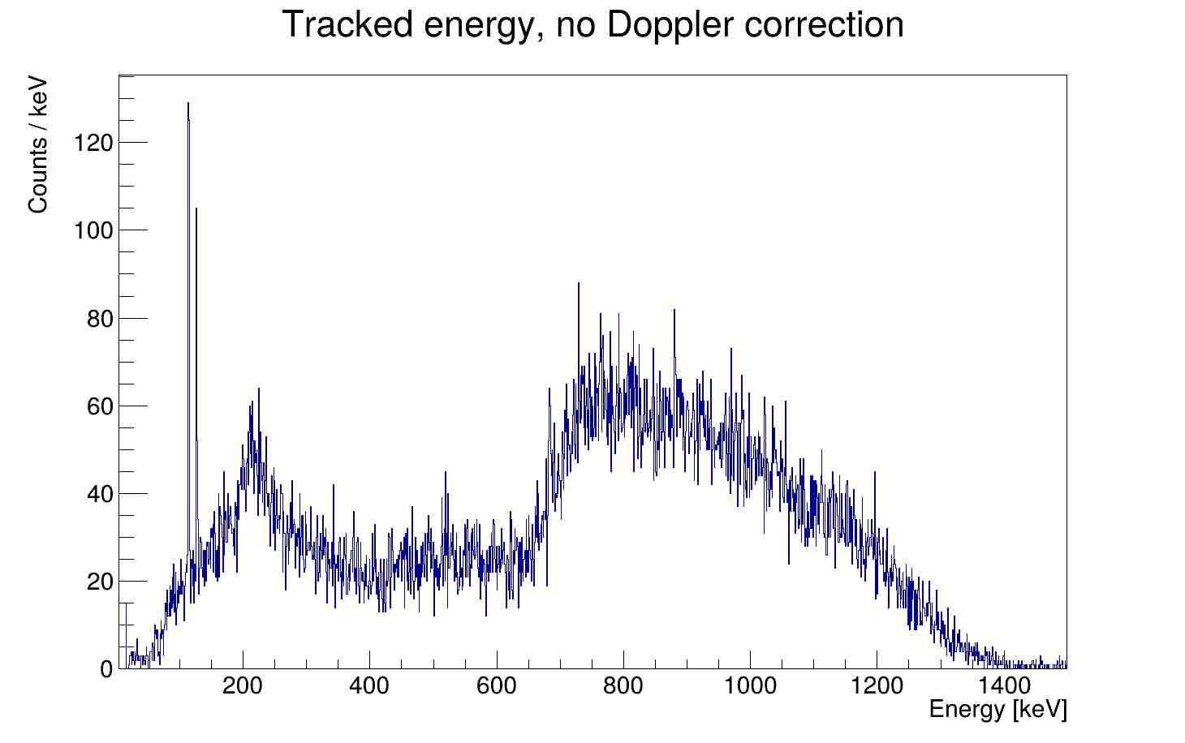
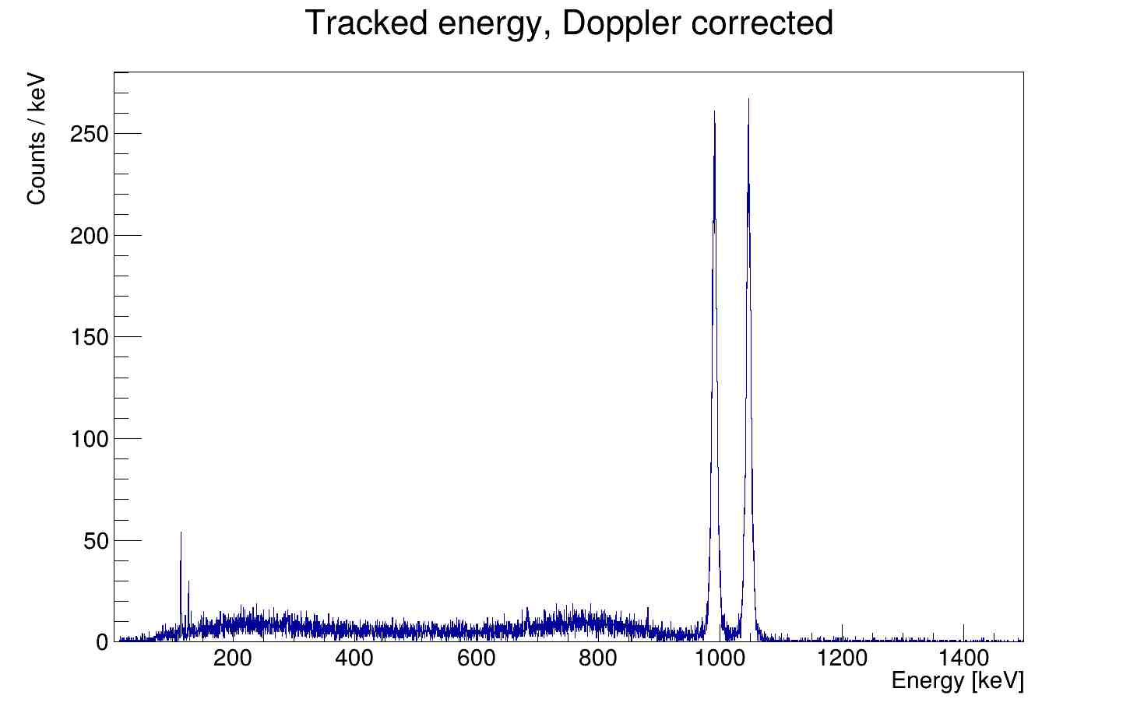
Results : Contribution to γ-ray Energy Resolution
・Finally, we evaluated how much the γ-ray energy resolution improves using this position prediction model.
・The observed γ-ray energies were Doppler-corrected based on Doppler formula.
Doppler corrected
Notes:
Finally, and this is the most important part, we evaluated how much the γ-ray energy resolution improves using this position prediction model.
The observed γ-ray energies were Doppler-corrected based on the Doppler effect formula.
The uncorrected spectrum is shown on the left, while the corrected spectrum is shown on the right.

Slide 33
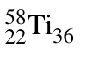

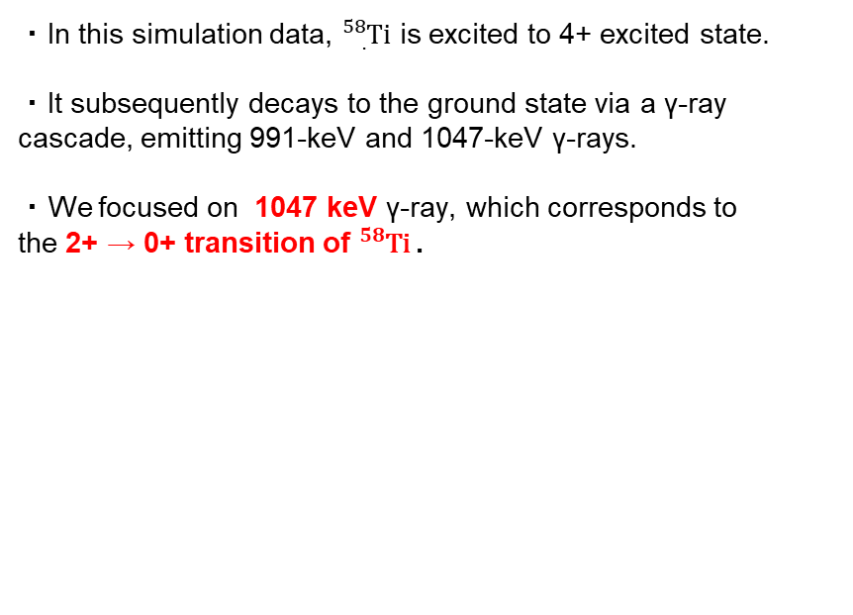


Results : Contribution to γ-ray Energy Resolution
991 keV
$$4^{+}$$
2038 keV
・In this simulation data, ${}_{.}^{58}{Ti}$ is excited to 4+ excited state.
・It subsequently decays to the ground state via a γ-ray cascade, emitting 991-keV and 1047-keV γ-rays.
・We focused on 1047 keV γ-ray, which corresponds to
the 2+ → 0+ transition of ${}_{​}^{58}{\text{Ti}}$.
1047 keV
$$2^{+}$$
1047 keV
$$0^{+}$$
0.0
Notes:
In this simulation, 58Ti is excited to 4+ excited state and it decays to ground state via γ-ray cascade, emitting these γ-rays.
Here, we focused specifically on the 1047 keV γ-ray, which corresponds to the 2+ -> 0+ transition of 58Ti.

Slide 34
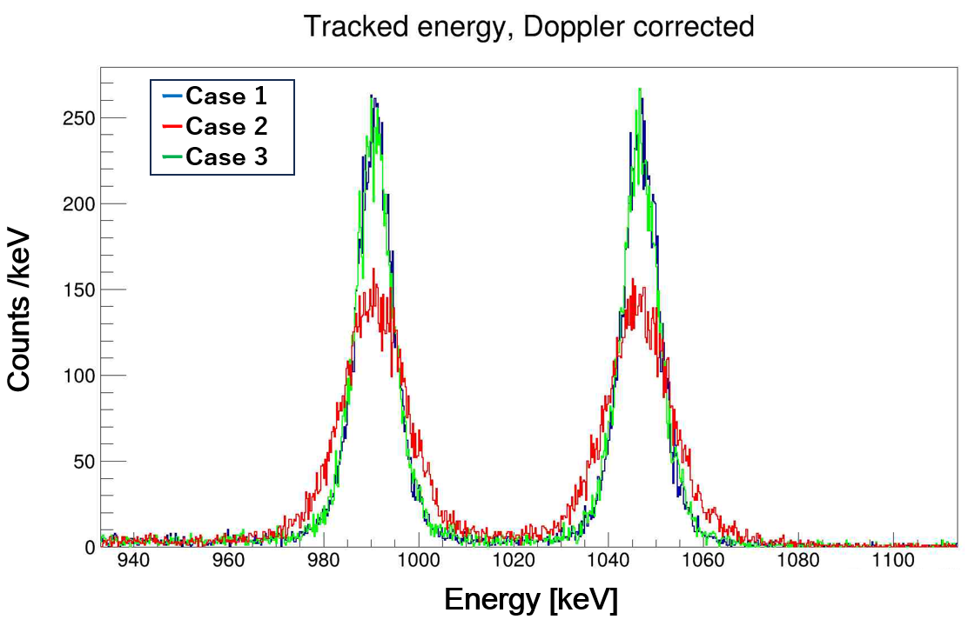
Results : Contribution to γ-ray Energy Resolution
991 keV
1047 keV
We compared 3 cases as follows:
・Case 1 : true reaction vertex
⇒theoretical limit
・Case 2 : predicted layer
・Case 3 : predicted layer + predicted reaction vertex
Incident Energy : 100 MeV/u
Our main focus
Notes:
We compared the following three conditions:
* Case 1: Doppler correction using the true reaction vertex (this represents the theoretical limit).
* Case 2: Doppler correction using the center position of the layer predicted by the model.
* Case 3: Doppler correction using the reaction position reconstructed by the model.
First, this figure compares the results at 100 MeV/u. Case 3 exhibits a very sharp peak, indicating excellent resolution.

Slide 35
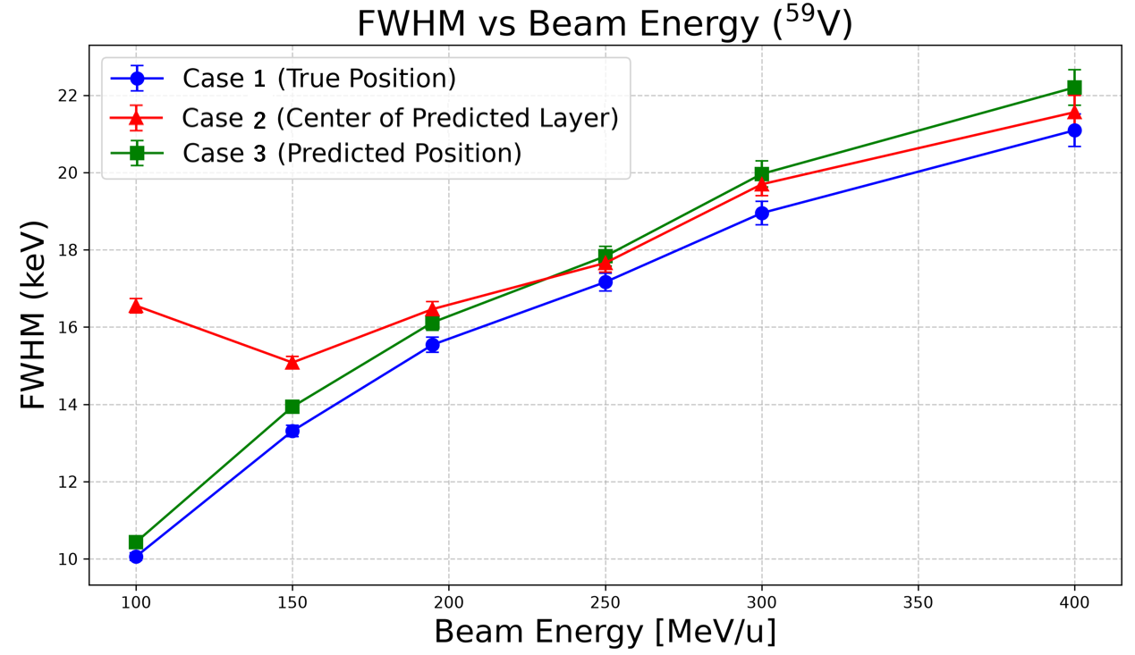
Results : Contribution to γ-ray Energy Resolution
・This is the FWHM of peaks when varying the incident particle energy (100-400 MeV/u).
・ Below 200 MeV/u, the performance of Case 3 closely approaches the theoretical limit (Case 1), proving to be highly effective.
・ Particularly at 100 MeV/u, the FWHM was reduced and improved to 63% of Case 2.
※Smaller FWHM = Better resolution
FWHM reduced to 63%!!
reduced to 63%
γ-ray Energy : 1047 keV
Notes:
Next are the results when varying the incident particle energy.
Below 200 MeV/u, Case 3 almost reaches the theoretical limit; Case 1. This shows it is highly effective.
Particularly at 100 MeV/u, the FWHM was reduced and improved to 63% of the conventional method (Case 2).

Slide 36
Conclusion
Notes:
Finally, the summary:

Slide 37
Conclusion
・Developed an ML pipeline to reconstruct reaction position using particle energy loss and velocity.
・This allowed us to improve position resolution to σ=35.3 µm within a 2500 µm thick target.
・The model maintained high prediction accuracy and demonstrated robustness even when the particle conditions were changed.
・ML-based Doppler correction showed excellent results, especially in the low-energy regime.
⇒FWHM reduced to 63%
・Future goal: Apply the developed ML pipeline to actual experimental data.
Notes:
We developed a ML pipeline that reconstructs the reaction position using energy loss in each layer and particle velocity.
This allowed us to improve the position resolution to σ = 35.3 μm within a 2500 μm thick target.
The model maintained high prediction accuracy and demonstrated practical robustness even when the particle conditions were changed.
With our predicted positions, the Doppler correction significantly improved in the low-energy regime, and the FWHM was reduced to 63% of the conventional value.
As a future goal, we plan to apply this newly developed ML pipeline to the analysis of actual experimental data.

Slide 38
Thank you for listening!
Notes:
Thank you for your attention.
20mins

Slide 39
Backup

Slide 40
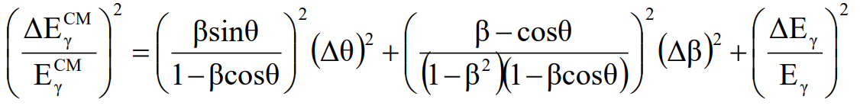
Backup: Propagation of error

Slide 41
Backup: What is AGATA
・Highly segmented HPGe Detectors
This allow the array to identify the specific segment where
a γ-ray interacted.
・Gamma-Ray Tracking Algorithms
It uses advanced software algorithms based on the Compton scattering formula to trace the complete path of the γ-ray as it scatters from crystal to crystal, summing the deposited energy to recover the full original energy.

