Slide 1

Magnetic field fluctuations at HITRAP in GSI
Pieter Deceuninck
Supervisor: Dr. Rima Schüßler

Slide 2
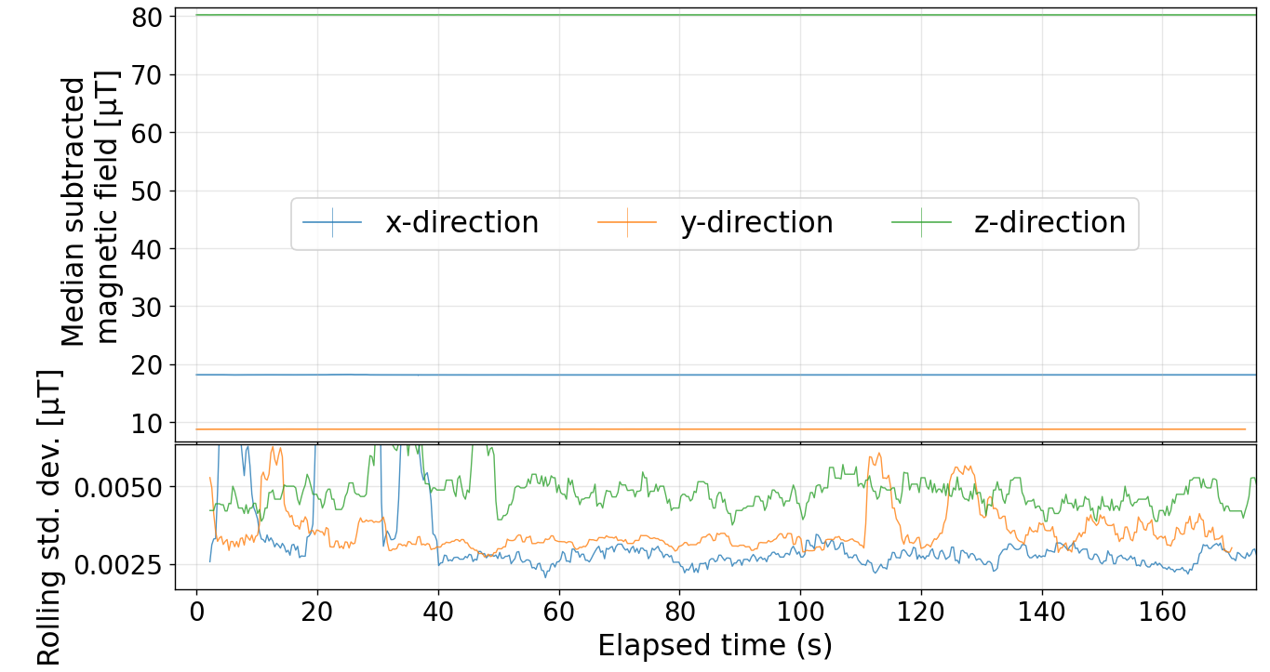
Overview
Magnetic field fluctuations
Why are we interested?
  Penning trap
Setup
  Fluxgate
  Holder
  Electronics
Results
  Day / night
  Weekend / workday
  Special events
Outlook
Plot of magnetic field in 3 dimensions

Slide 3
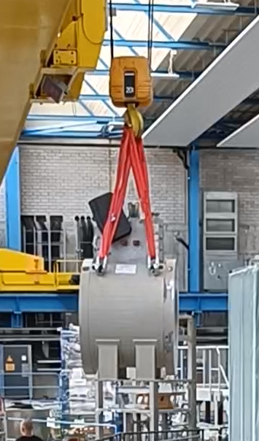
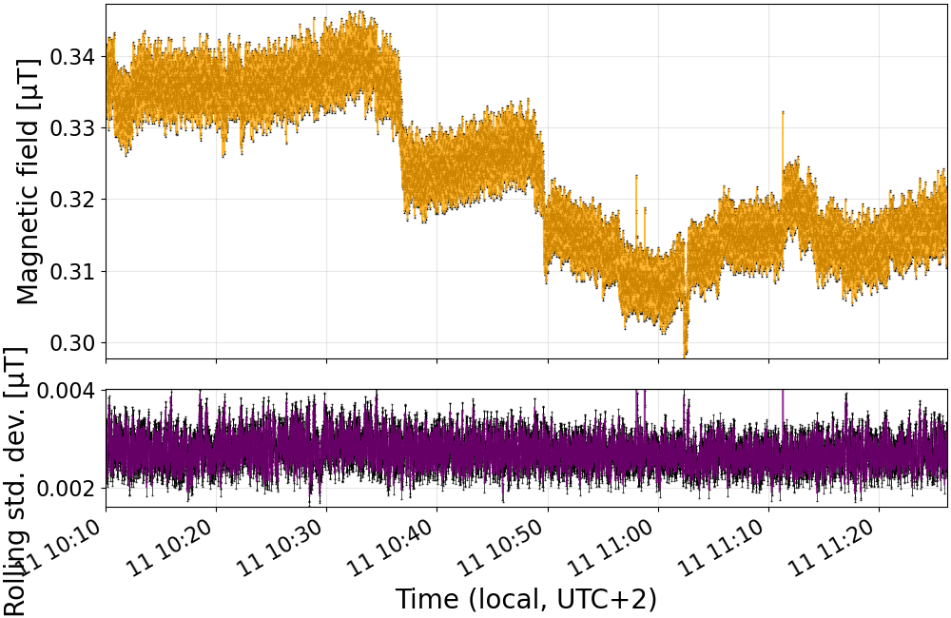
Magnetic field oscillations

Slide 4
Why are we interested?
E = mc²
g-factors
Fine structure constant
Q-values
  Neutrino mass
  Neutrino-less double beta decay
QED tests in highly charged ions
…

Slide 5
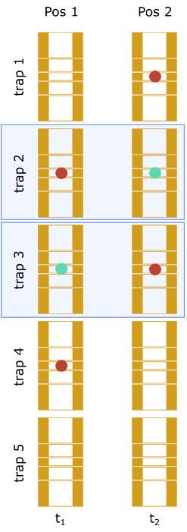
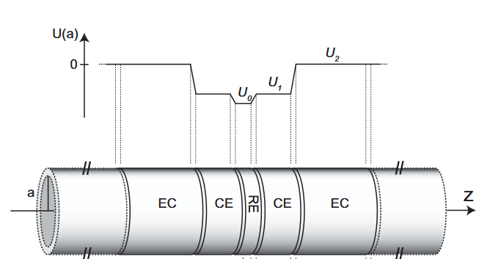
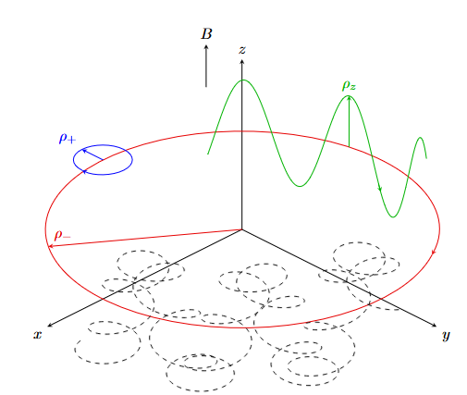
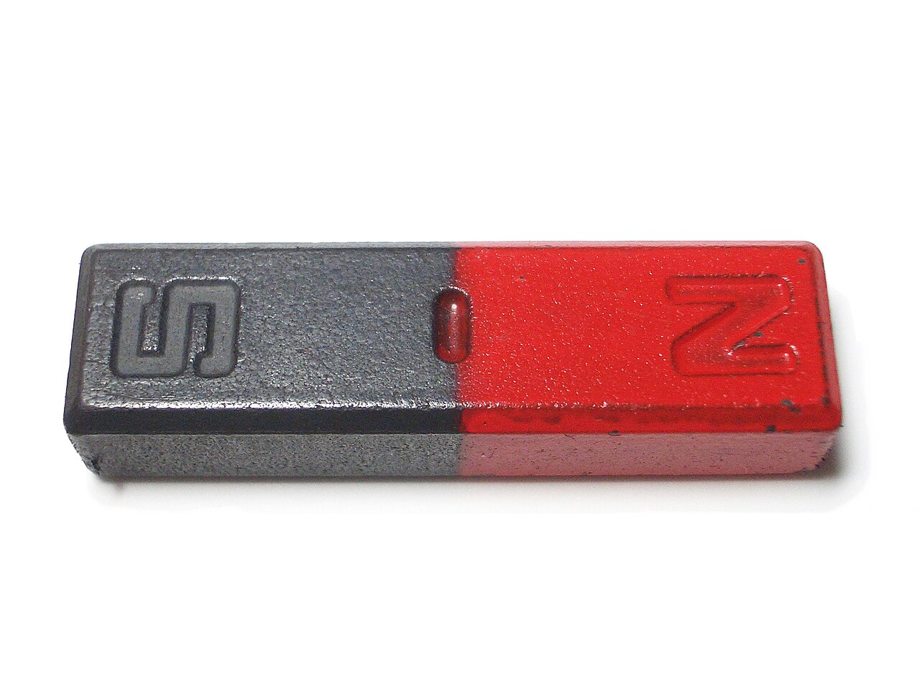

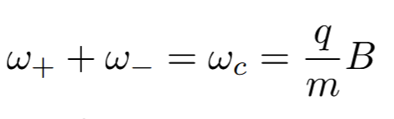






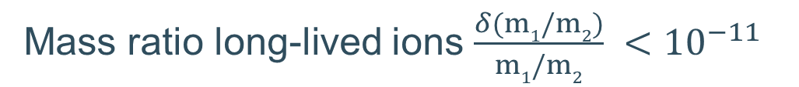

Penning trap
modified cyclotron motion
magnetron motion
axial motion
[2]
[1]
$$\vec{B}$$
[3]
RE = ring electrode
CE = correction electrode
EC = end cap
Mass ratio long-lived ions $\frac{δ(m1/m2)}{m1/m2} <{10}^{−11}$
[1] Roux, C., “The trap design of PENTATRAP”, <i>Applied Physics B: Lasers and Optics</i>, vol. 107, no. 4, Springer, pp. 997–1005, 2012. doi:10.1007/s00340-011-4825-4.
[2] K. Kromer, Environmentally-induced systematic effects at the high-precision mass spectrometer PENTATRAP, Master’s thesis, Max Planck Institute for Nuclear Physics in Heidelberg (2019).
[3] https://leadlifewell.com/blog/7-tips-to-help-you-juggle-like-a-pro/
Notes:
modified cyclotron motion with frequency ω+ (which is the free-space
cyclotron frequency with a correction from the electrostatic field

Slide 6
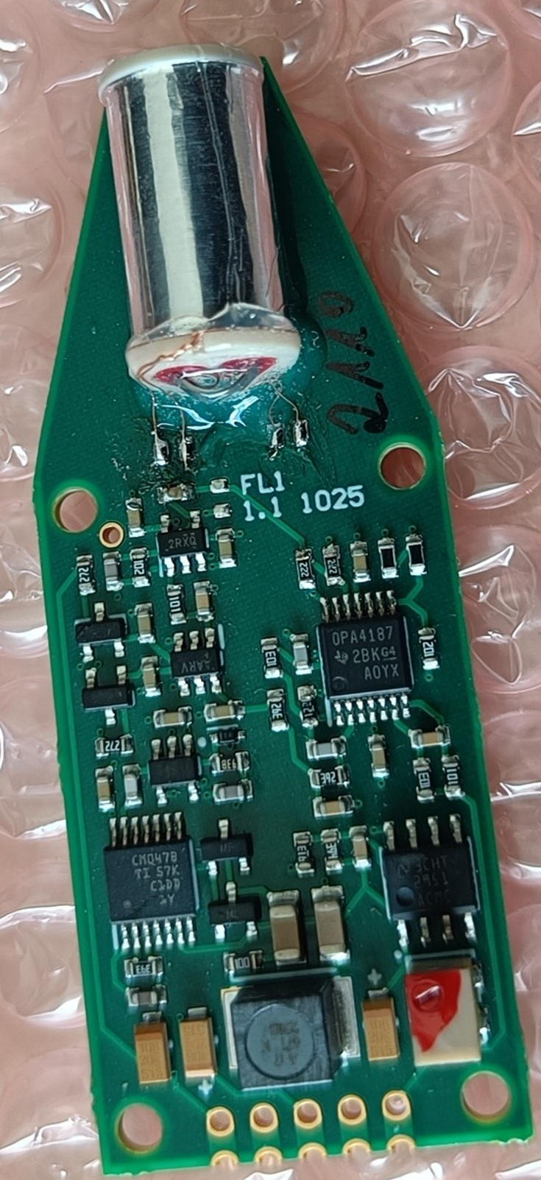
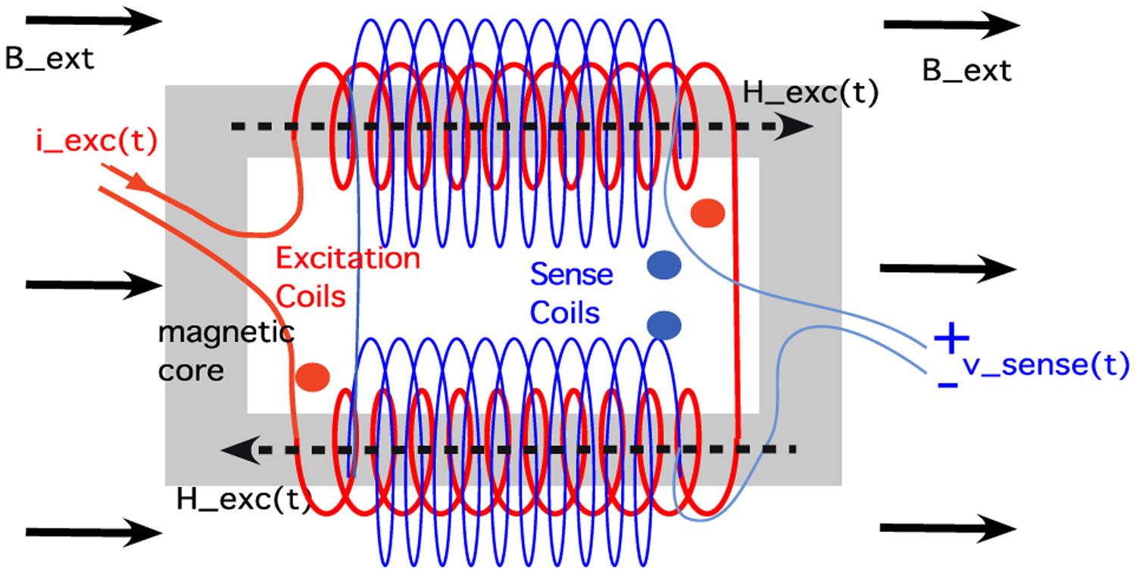
Setup: fluxgate

Slide 7
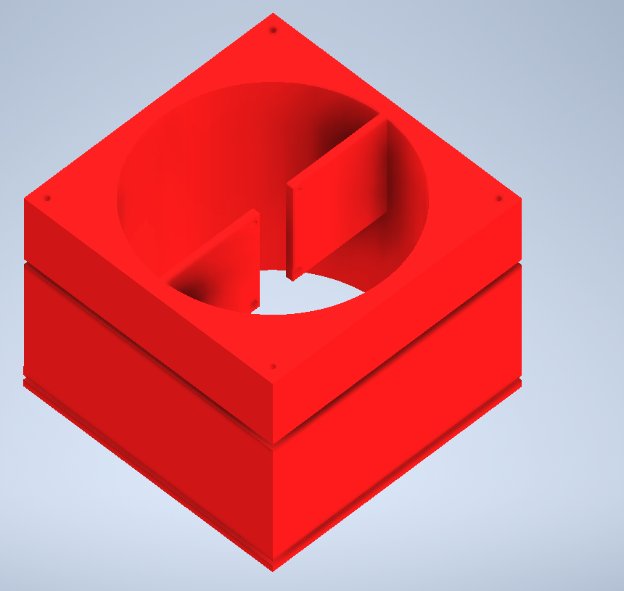
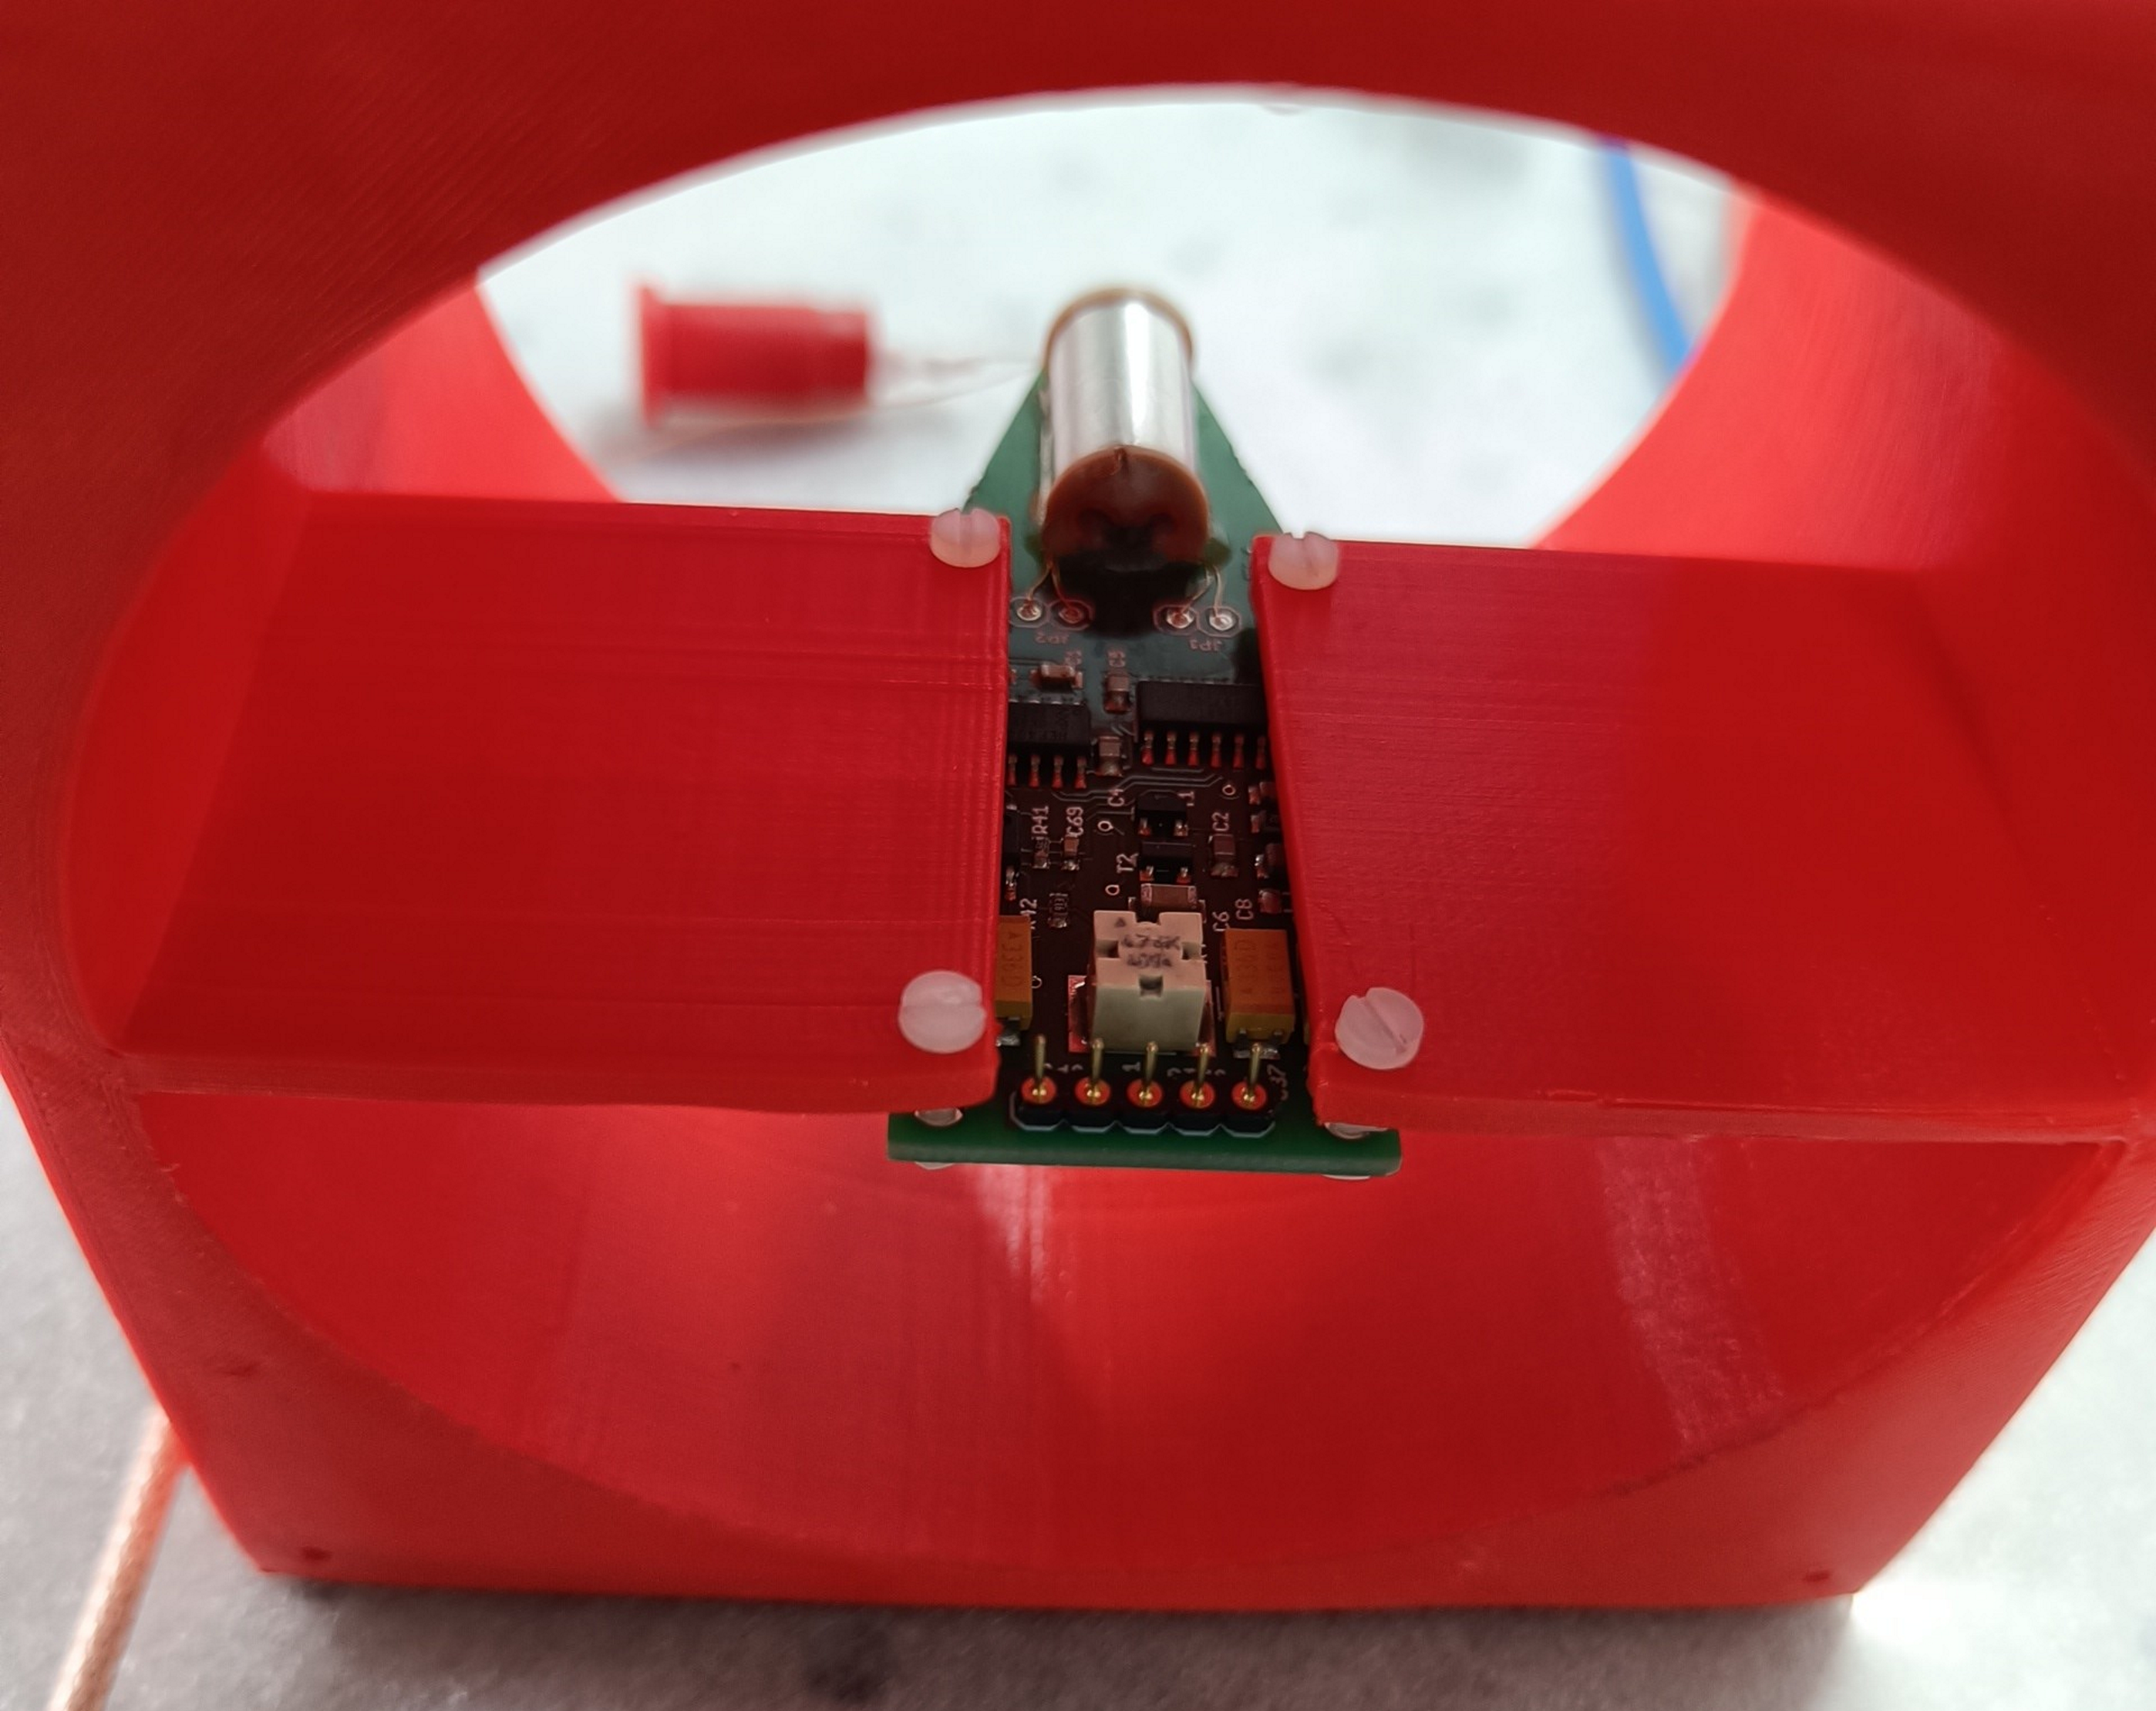
Setup: holder

Slide 8

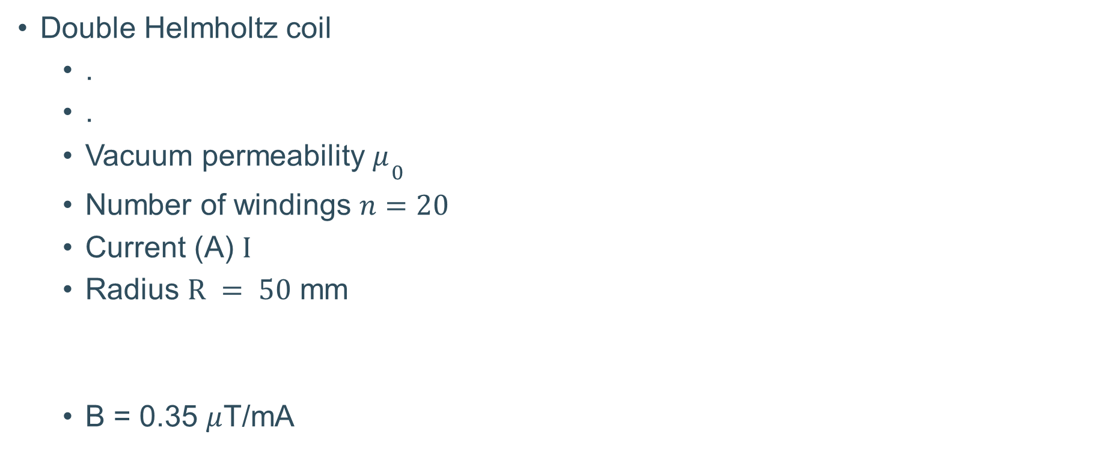
Why the funny shape?
Double Helmholtz coil
  .
  .
  Vacuum permeability $μ{}_{0}^{​}{\begin{aligned} \\ ​\end{aligned}}$
  Number of windings $n=20$
  Current (A) $I$
  Radius $R = 50$ mm
  B = 0.35 $μ$T/mA

Slide 9
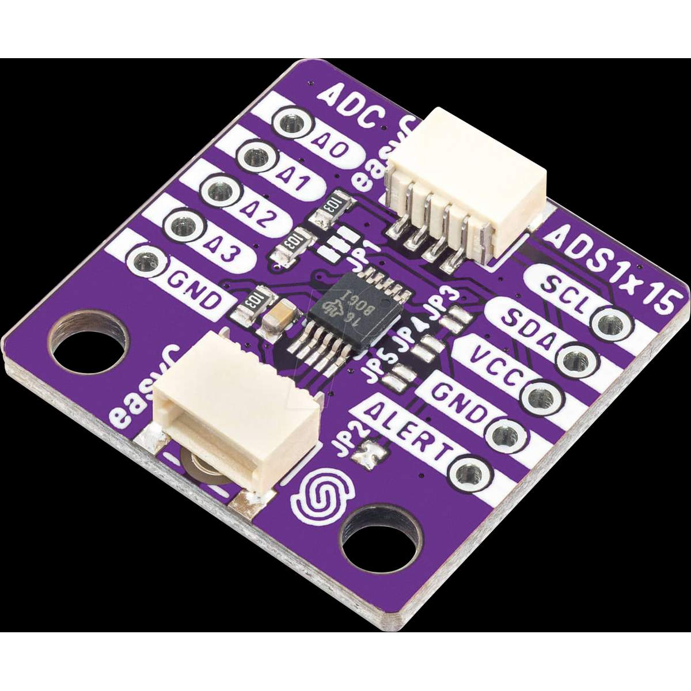
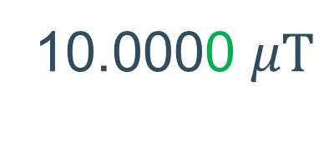
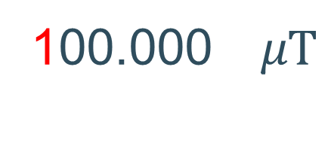
Analog to Digital Converter (ADC) resolution
Fluxgate resolution: < 0.02 nT / Hz^{1/2}
ADC resolution: 16 BIT
  Full range → 1.5 nT resolution
  Counteract Earth magnetic field → 0.2 nT resolution
fluctuations
100.000 $μT$
10.0000 $μT$
https://ladendirekt.de/elektronik/produkte/debo-adc-16bit-entwicklerboards-adc-kanal-16-bit-bbba6f61
Notes:
And I hear you all thinking: this is like a day and night difference. But actually… no. This is like a day and night difference.

Slide 10
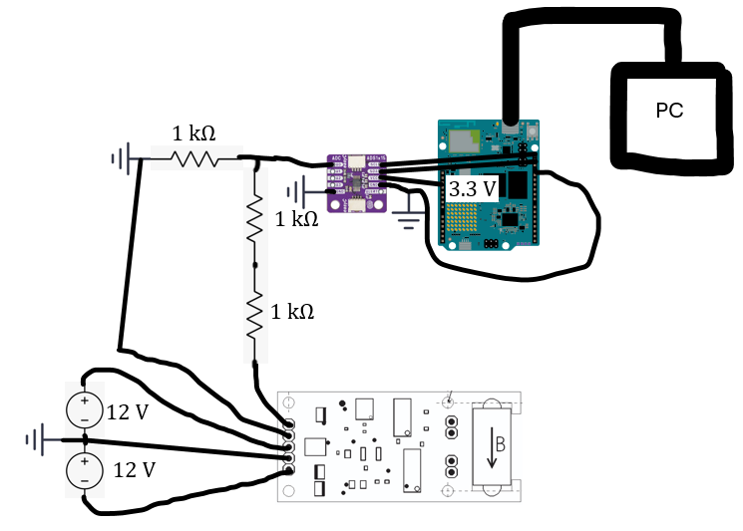
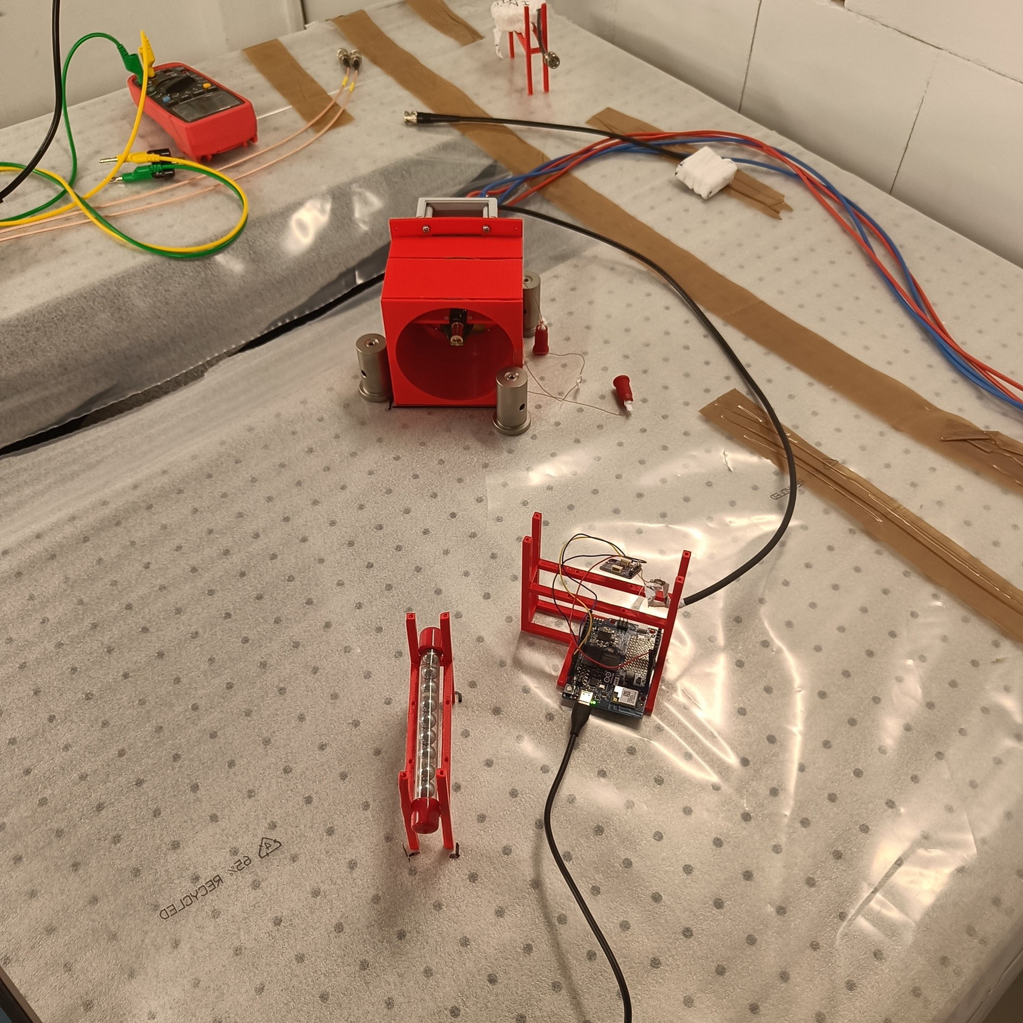
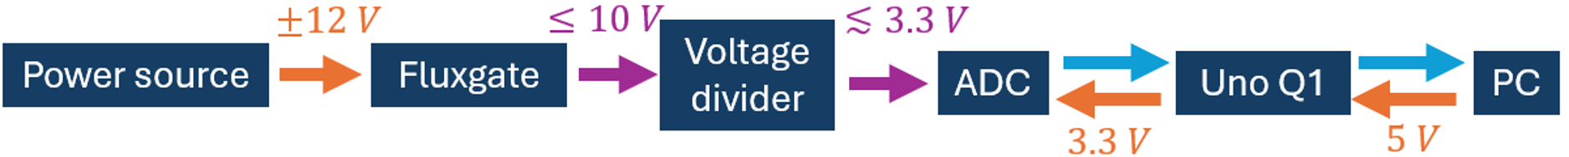
Setup: electronics
Weights
Magnet

Slide 11
Possible questions at this point
Did something brake?
Why is there a magnet?
Magnet

Slide 12
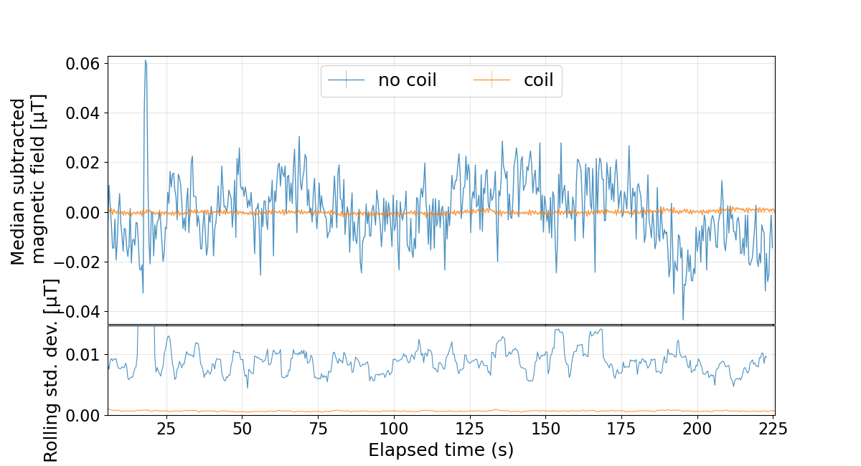

Results: coil
Notes:
And I hear you all thinking: this is like a day and night difference. But actually… no. This is like a day and night difference.

Slide 13
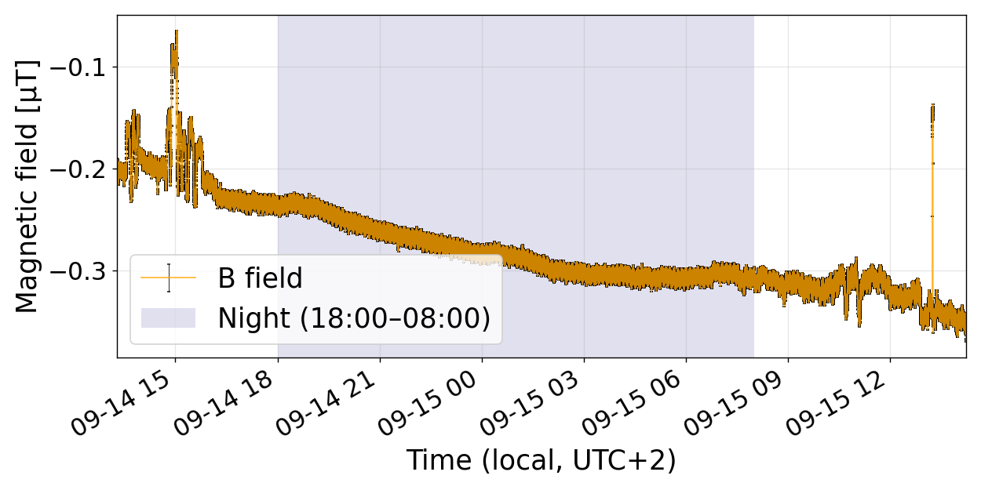
Results: day / night
Data

Slide 14
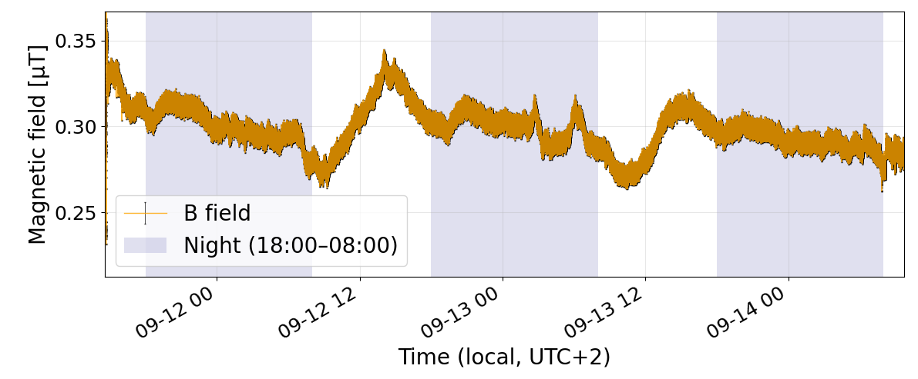
Results: weekend
Saturday
Sunday
Data
Friday
Monday

Slide 15
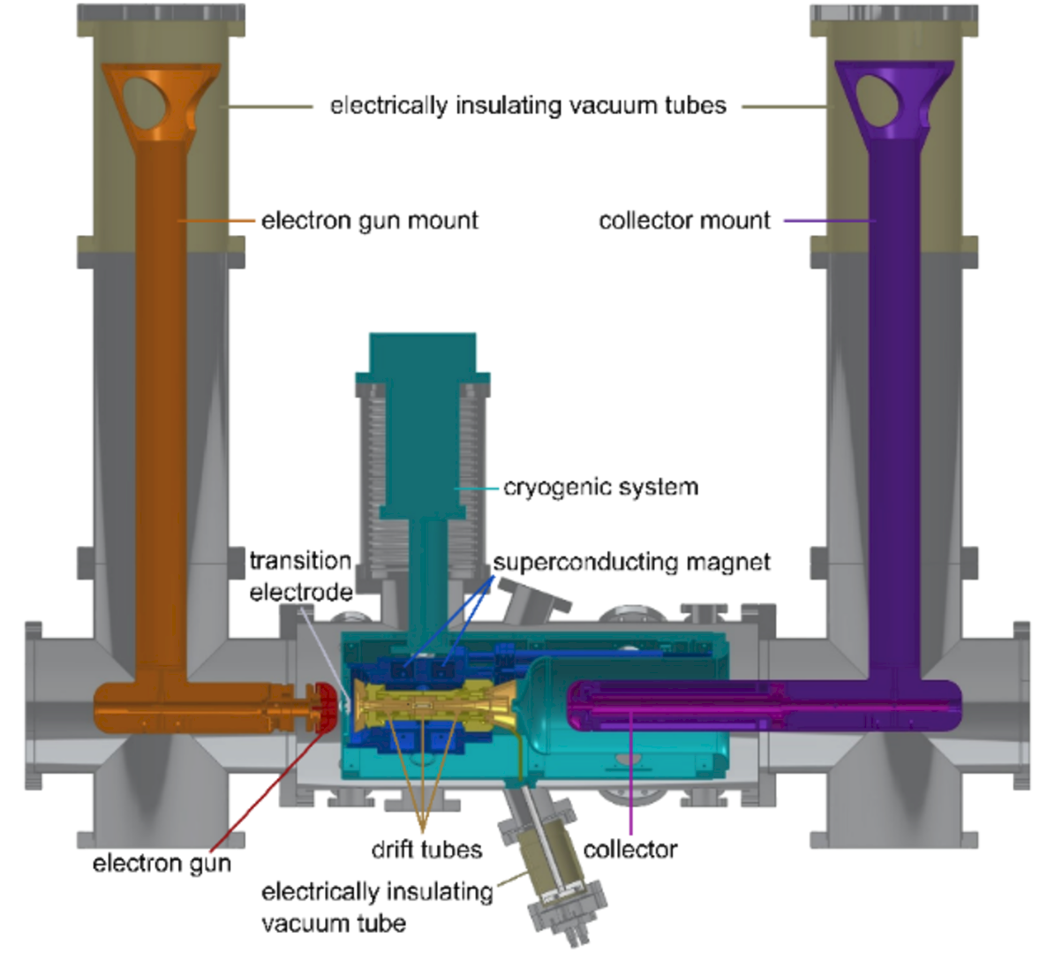
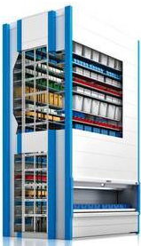
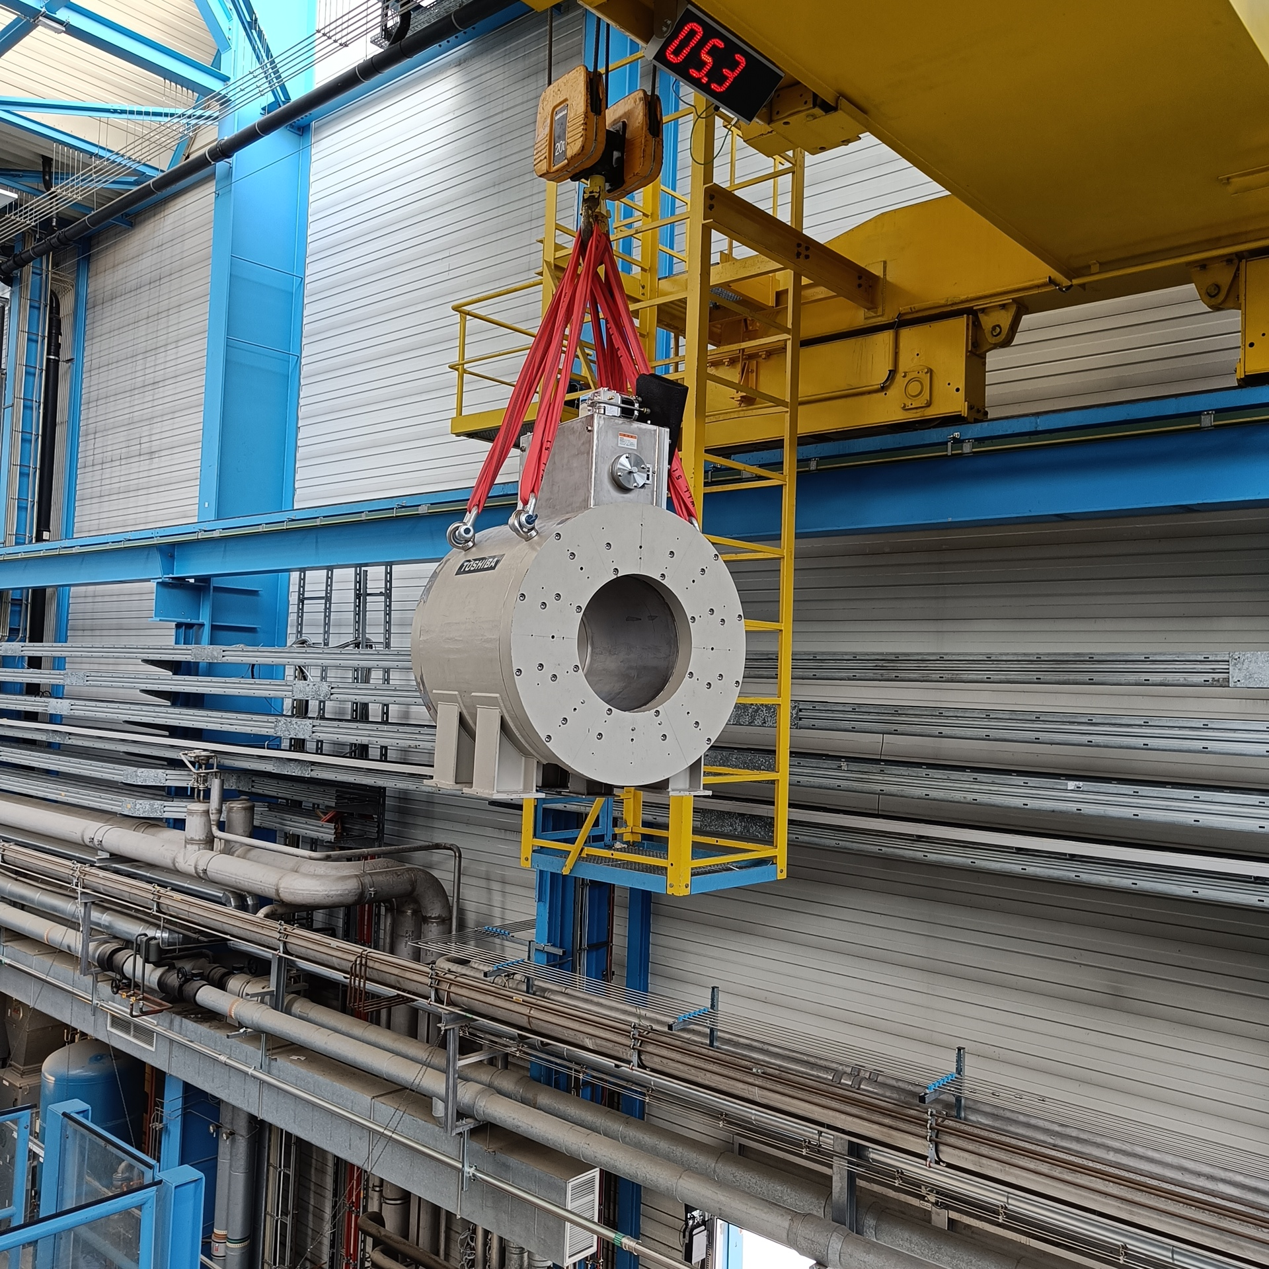
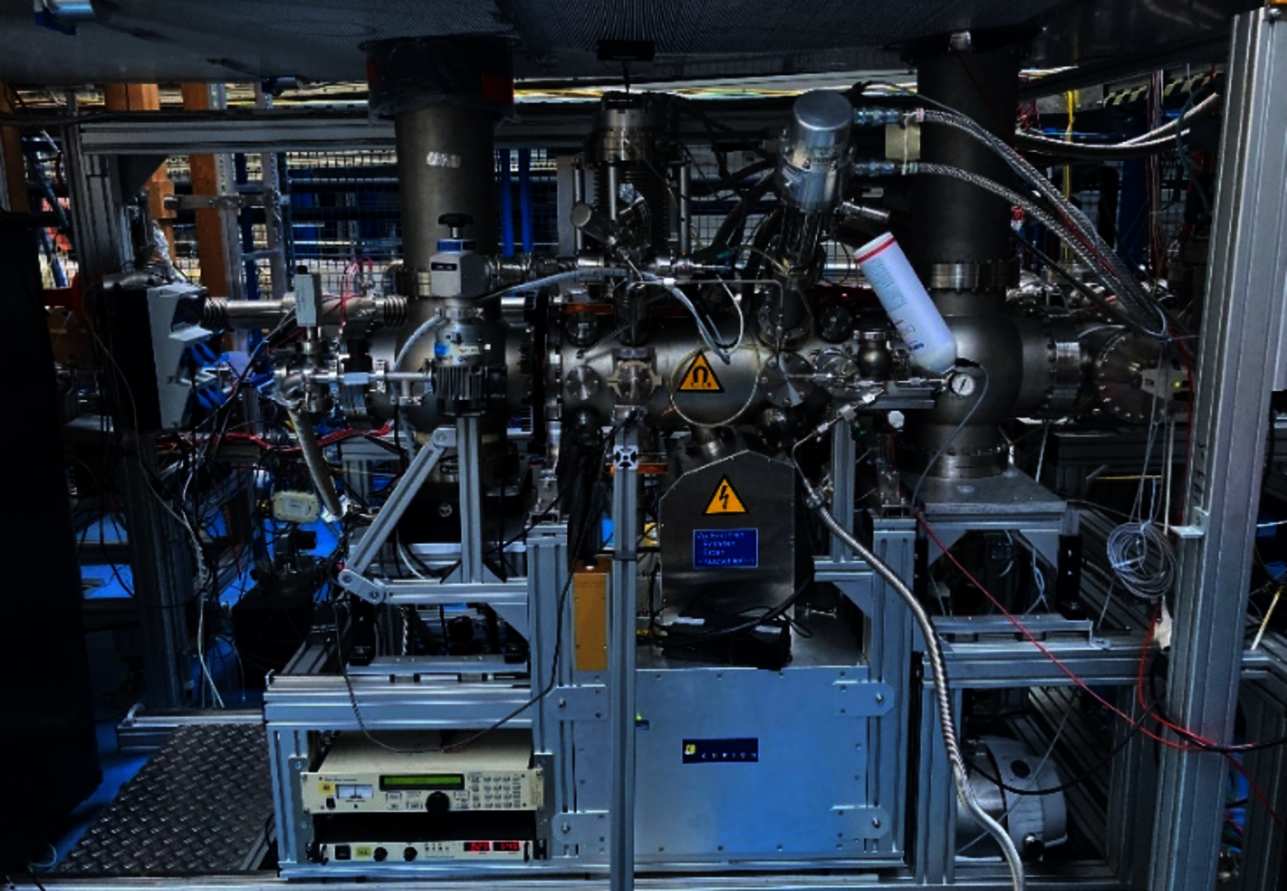
Special events
Pater noster
(Kardex remstar
Shuttle xp 500)
S-EBIT II
Heavy bridge crane
https://www.gsi.de/work/forschung/appamml/atom-quanten-fundamentalphysik/instrumentierung/ion-sources
https://www.archiexpo.de/prod/kardex/product-9012-762015.html
Notes:
4T

Slide 16
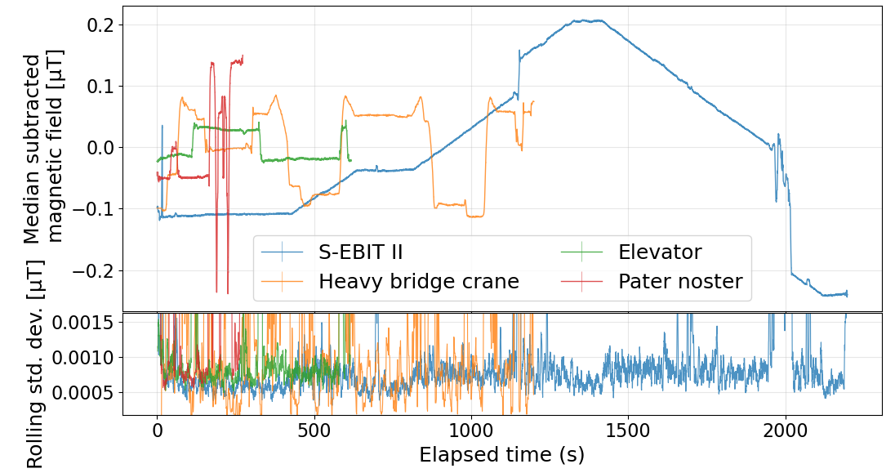
Results: special events
Notes:
3,5s

Slide 17
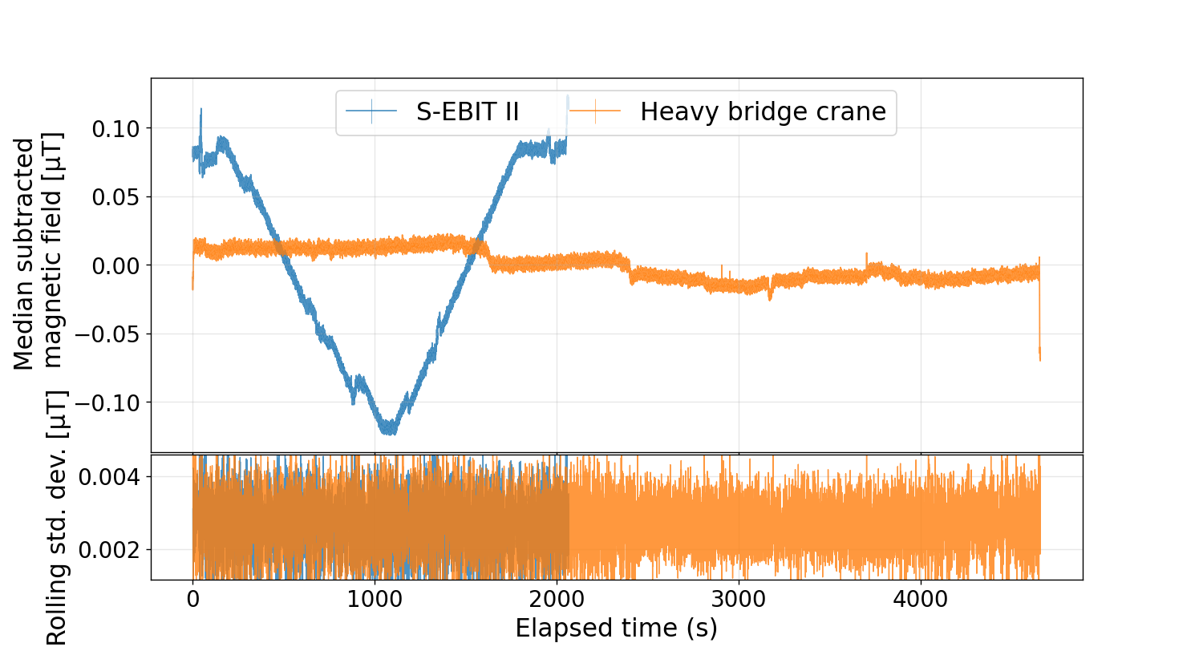
Results: special events, other lab

Slide 18
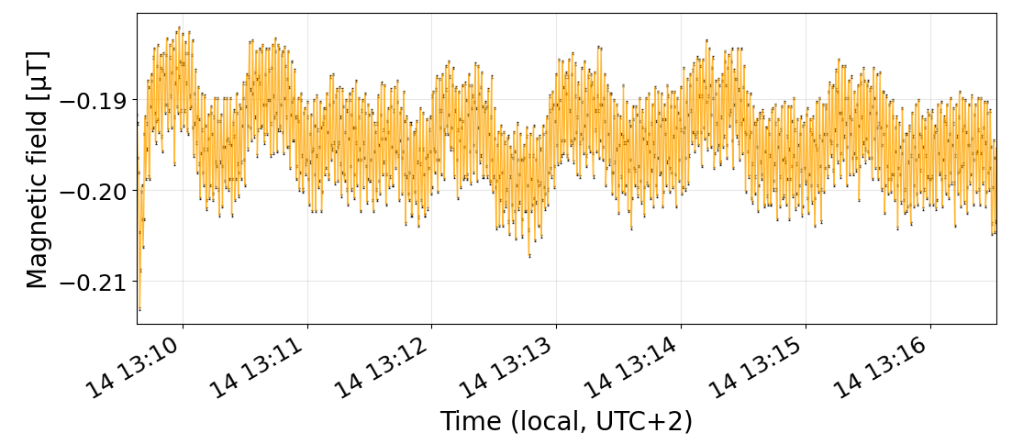
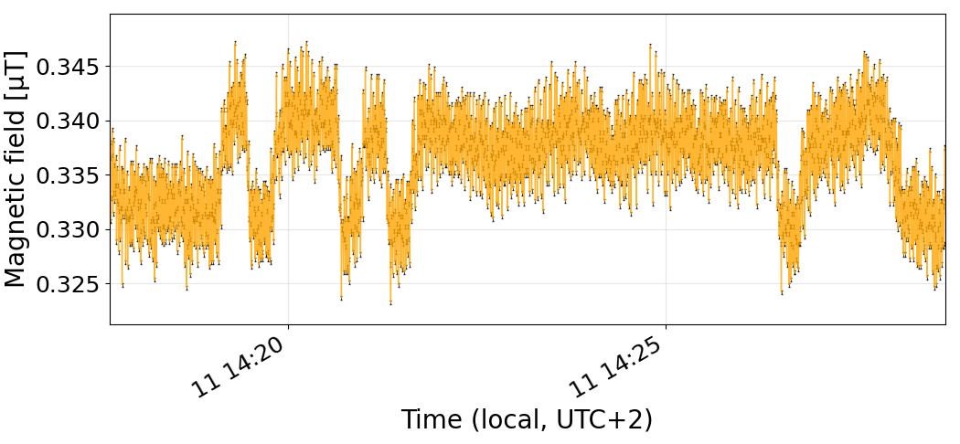
Results: special events, other lab
Pater noster
Put back
get
up
elevator
down

Slide 19
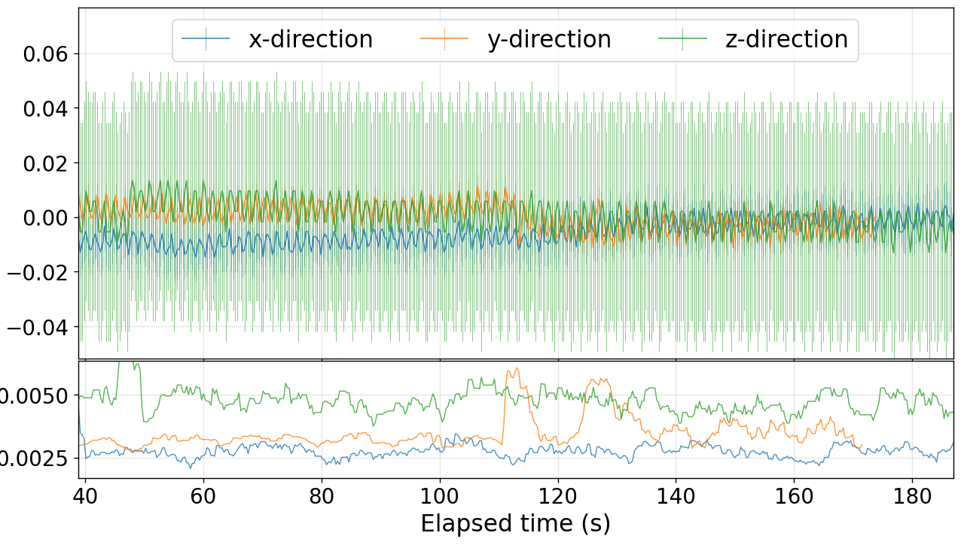
Results: direction

Slide 20
Outlook
Veto system
  3 fluxgates
24-bit ADC
Fluxgate calibration

Slide 21
Acknowledgements
Dr. Rima Schüßler
Atomic, Plasma Physics and Application (APPA) group

Slide 22
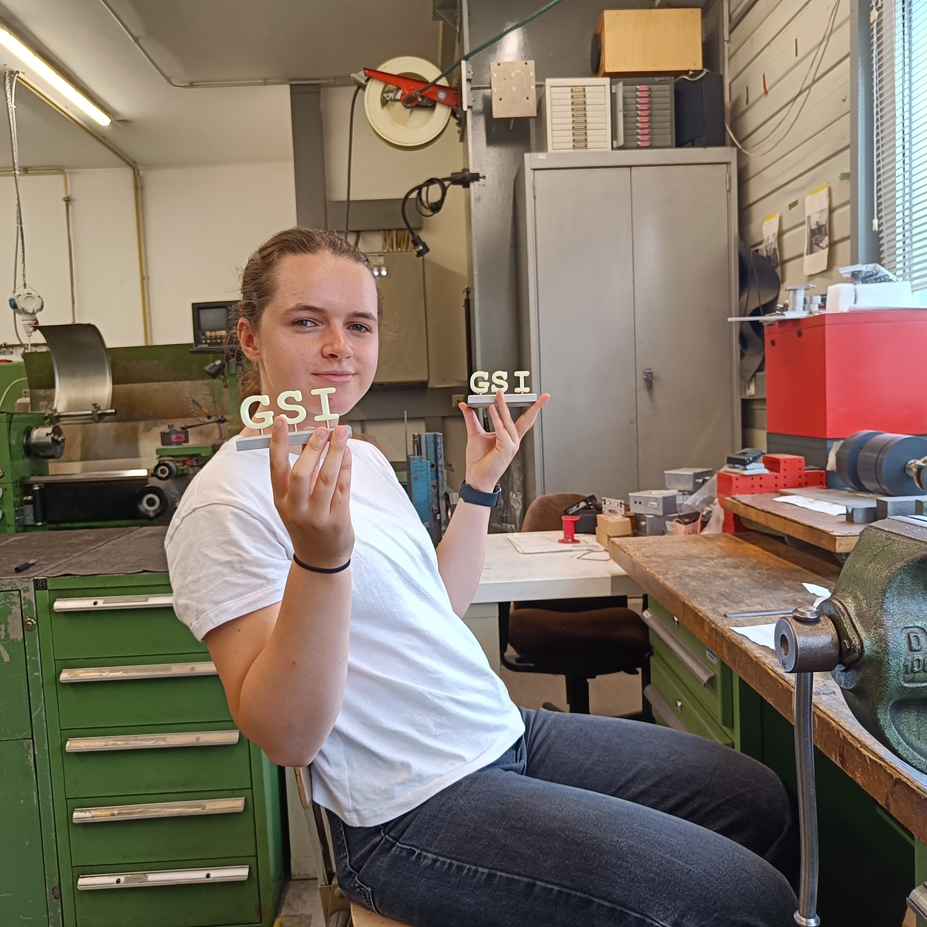
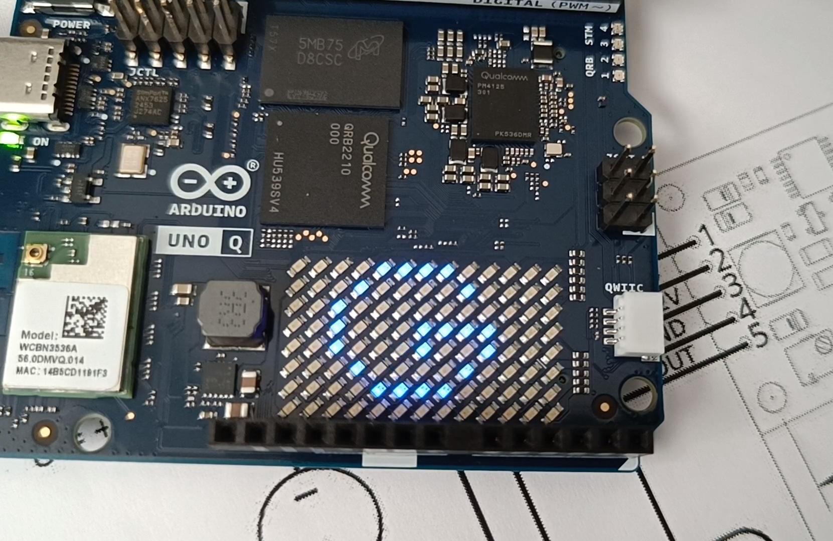
Questions?

Slide 23
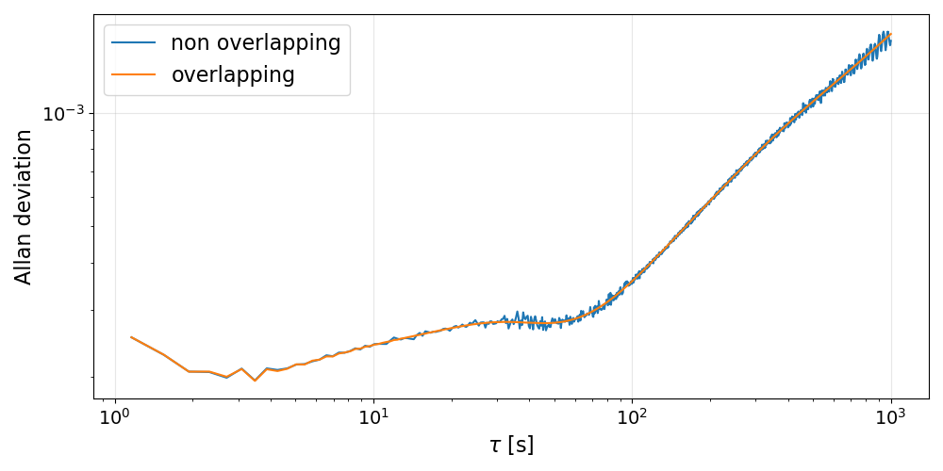
Extra slide: Allan noise

