Slide 1
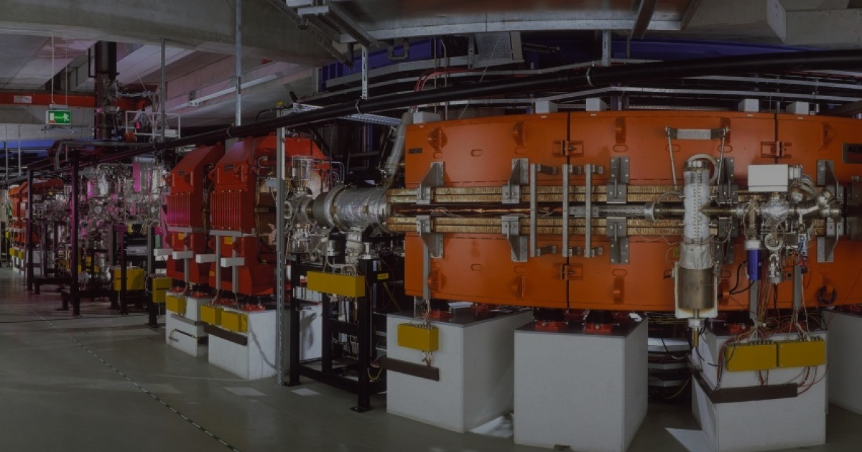
Simulation of
Electron cooling at
ESR and CRYING
2026
GSI Summer School Project
Present by Ployphimon Jongtarkarnsombut

Slide 2
Can current simulations model actually produce results that accurately match the experimental results ?

Slide 3
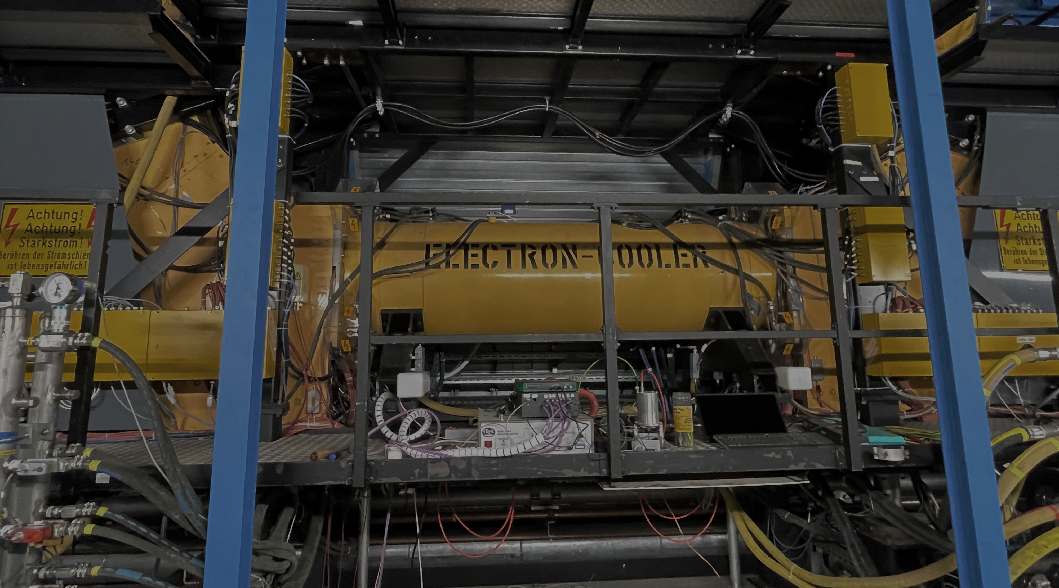
01
What is
Electron Cooling ?

Slide 4
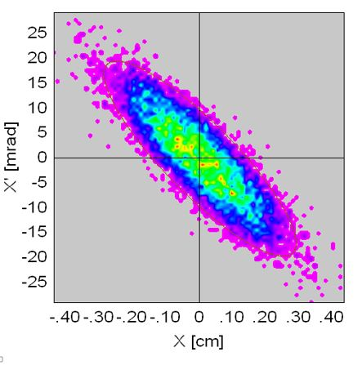
The ions don’t have the same energy !
Some variation:
Velocity
Momentum
Which will cause the beam spread out of the phase space
How to reduce beam spread?
https://www.ntg.de/

Slide 5
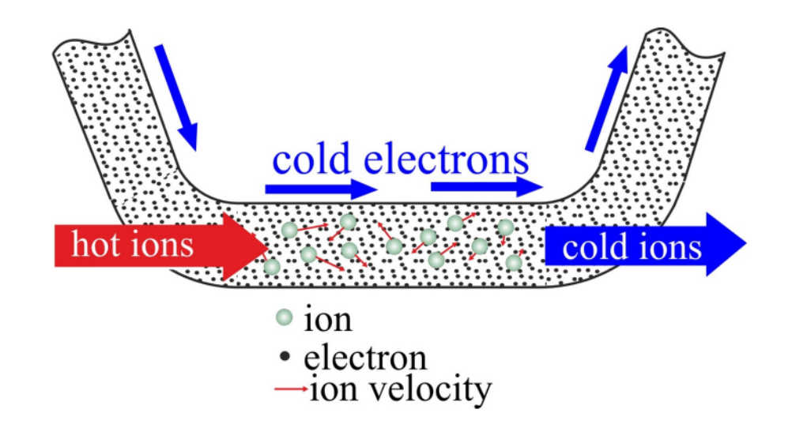
Electron Cooling Principle
Reduce velocity and momentum spread of ions
Obtain low emittance beams
Achieve higher precision in collision experiments.

Slide 6
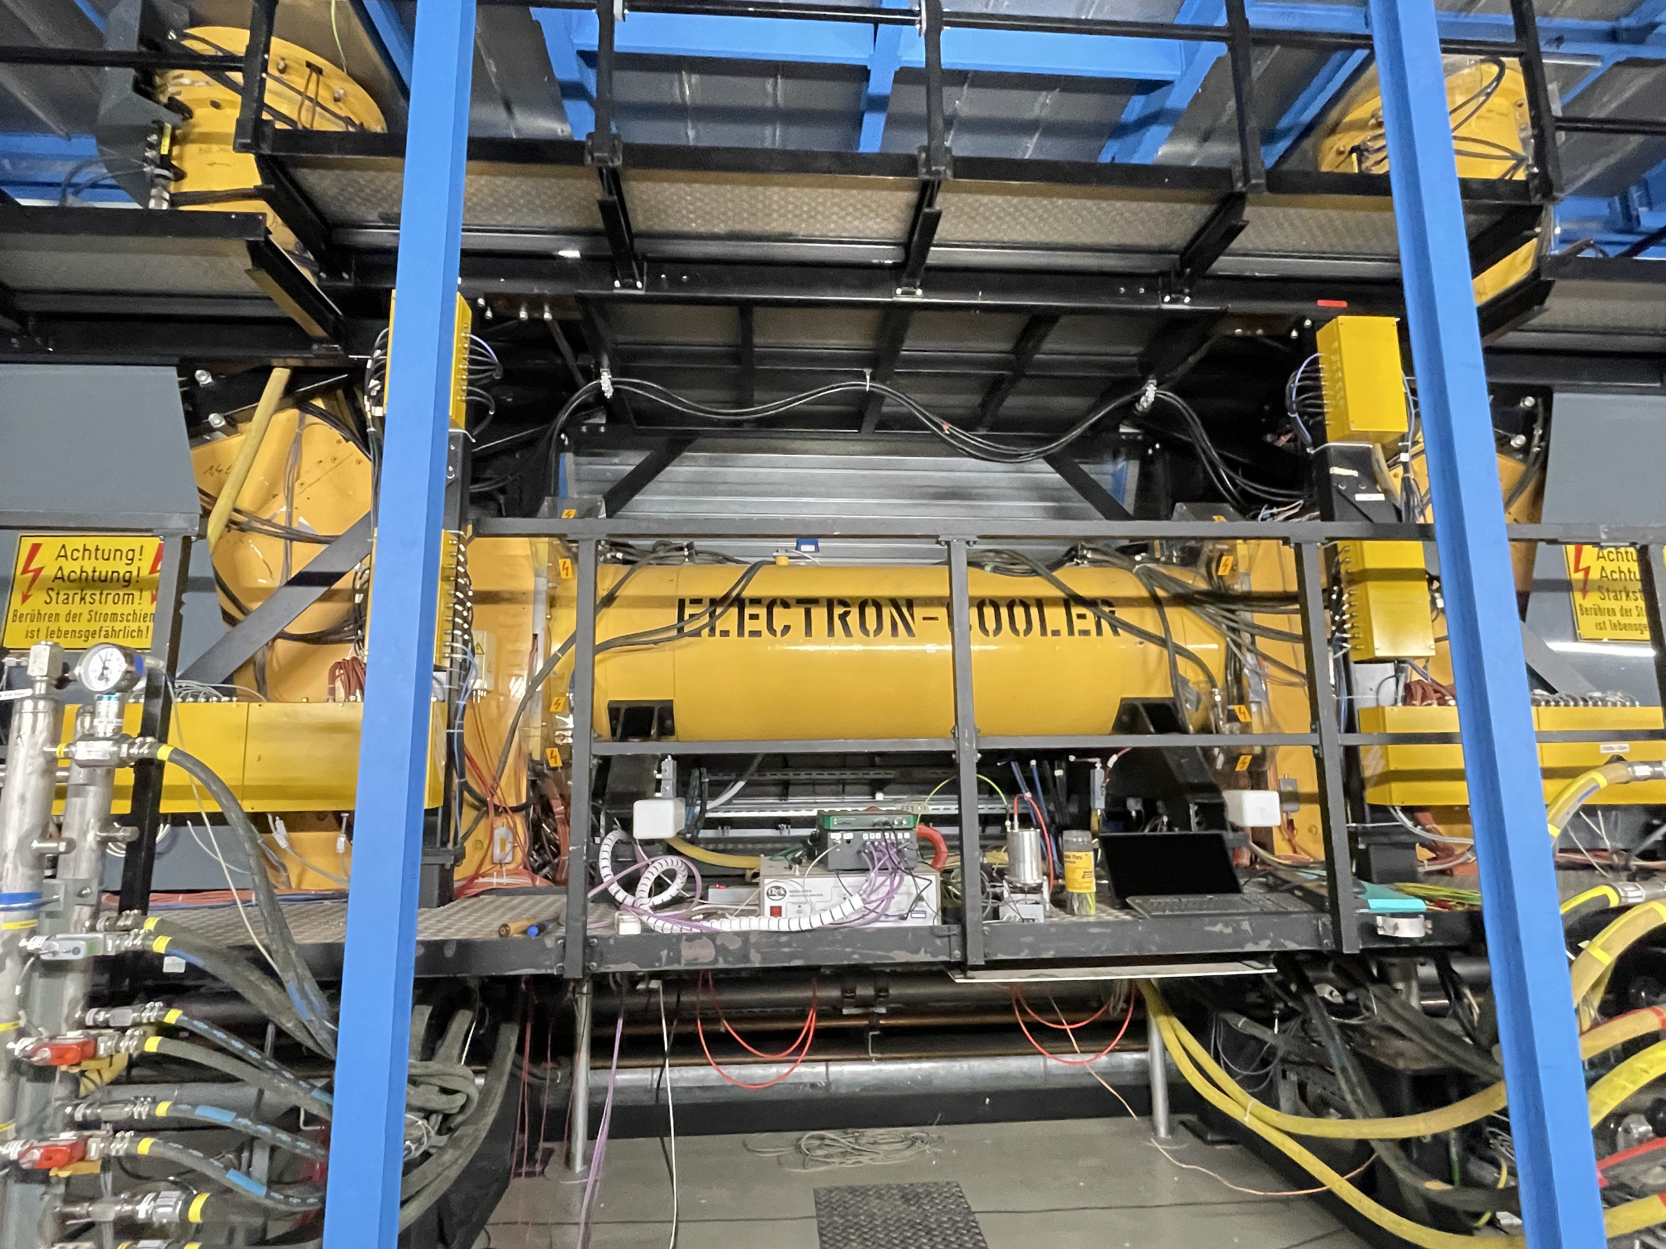
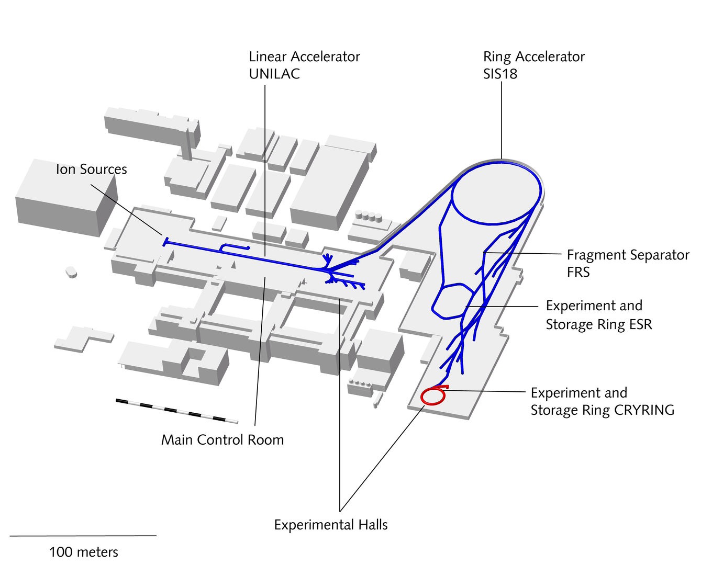
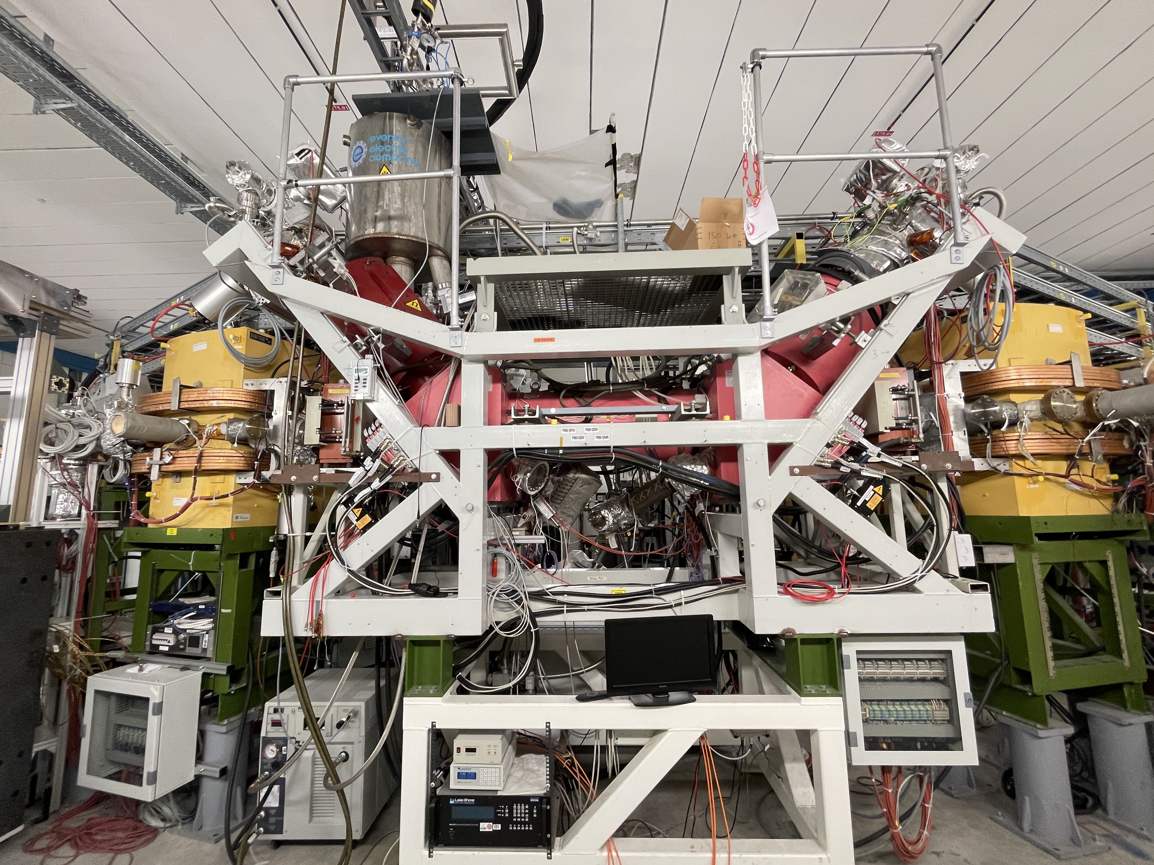
GSI Storage Rings
ESR
100 MeV/u
01
CRYRING
1-10 MeV/u
02
https://www.gsi.de/

Slide 7
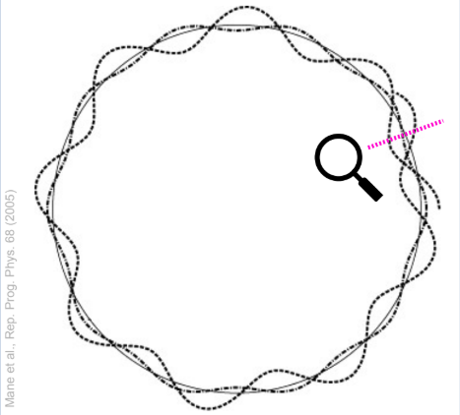
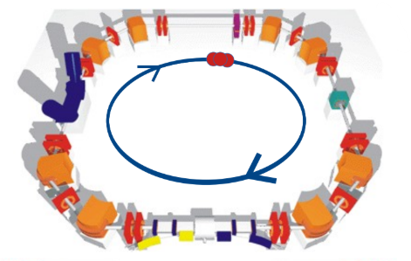

JSPEC
Particle tacking code developed at Jefferson Lab
Calculates two effects :
Mane et al., Rep. Prog. Phys. 68 (2005)
Electron Cooling
Intrabeam scatterimg
And see how beam change over time
Complete model describes the cooling force :
$$F_{cool}\left(v\right)=−4π{\left(\frac{Ze^{2}}{4πε_{0}}\right)}^{2}\frac{n_{e}L_{c}}{m_{e}}∭f_{e}(u)\frac{v−u}{{|v−u|}^{3}}{du}_{x}{du}_{y}{du}_{z}$$

Slide 8
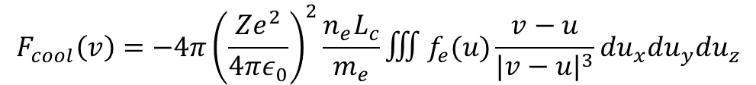
Complete model describes the cooling force :
Electron Longaritum
Electron
Density
Ion Velocity
Electron Velocity
$$F_{cool}\left(v\right)=−4π{\left(\frac{Ze^{2}}{4πε_{0}}\right)}^{2}\frac{n_{e}L_{c}}{m_{e}}∭f_{e}(u)\frac{v−u}{{|v−u|}^{3}}{du}_{x}{du}_{y}{du}_{z}$$
Cooling Force
Strength of Coulomb interaction
Consider the whole electron velocity distribution
Strength of Cooling Force

Slide 9
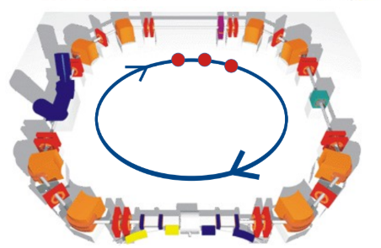
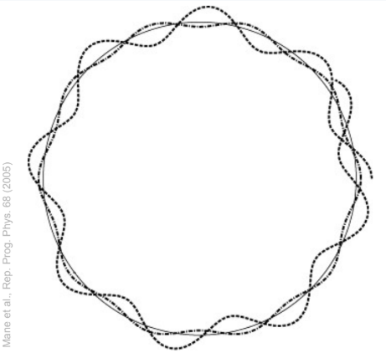
Longitudinal Motion
Transverse Motion
Ion Oscillation between horizontal and vertical
Focus on the direction along the beam
Compare with the reference particle

Slide 10
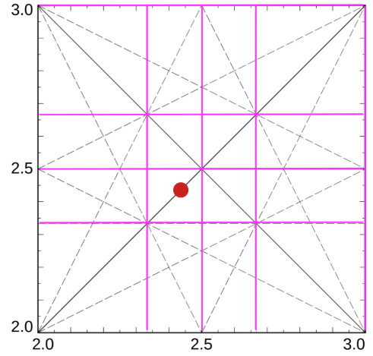


$$Q_{x,y}=\frac{1}{2π}∮dφ_{x,y}$$
RF Cavity :
Aware of Resonance if
$$(Q_{x},Q_{y})$$

Slide 11
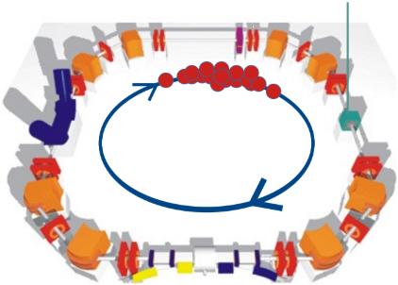
Coasting Beam
Bunched Beam

Slide 12
01
01
02
02
Magnetize
Non-Magnetize
Numerical 1 Dimensional
DSM
Magnetize
Magnetize
Meshkov
Meshkov
Magnetize
Magnetize
03
Derbenev-Skrinky
Magnetize

Slide 13
Cooling Force Fromulations
01
01
02
02
Magnetize
Non-Magnetize
Numerical 1 Dimensional
DSM
Meshkov
Meshkov
03
Derbenev-Skrinky

Slide 14
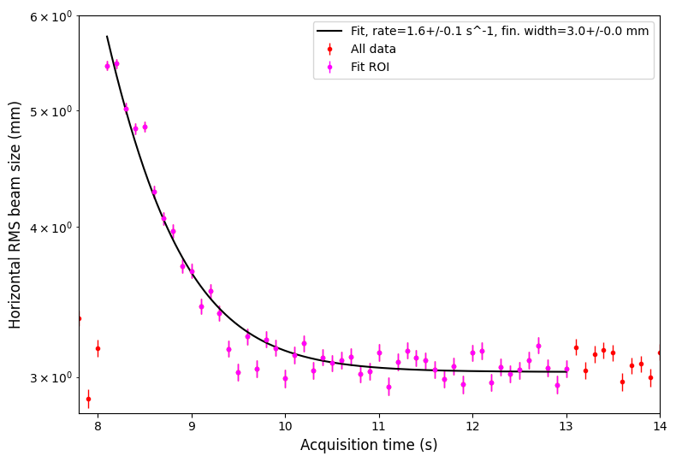
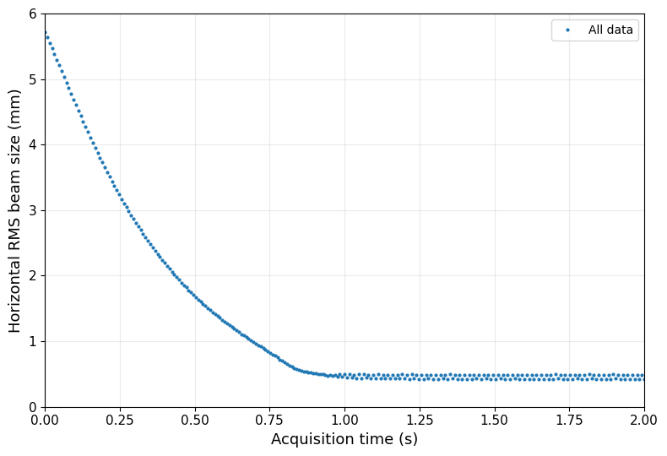
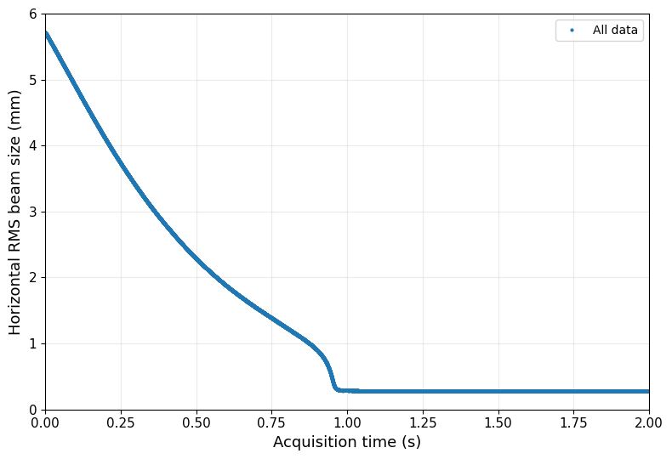
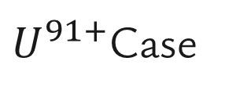
$U^{91+}$Case
Magnetic DSM model
Experimental Data
From CRYRING
Non-Magnetic Numerical 3D model
Cooling Rate is match to the experimental result
Equilibrium beam size is smaller than experiment

Slide 15
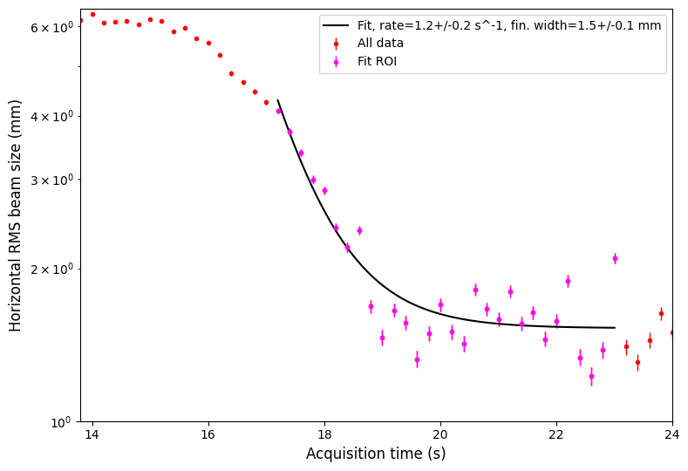
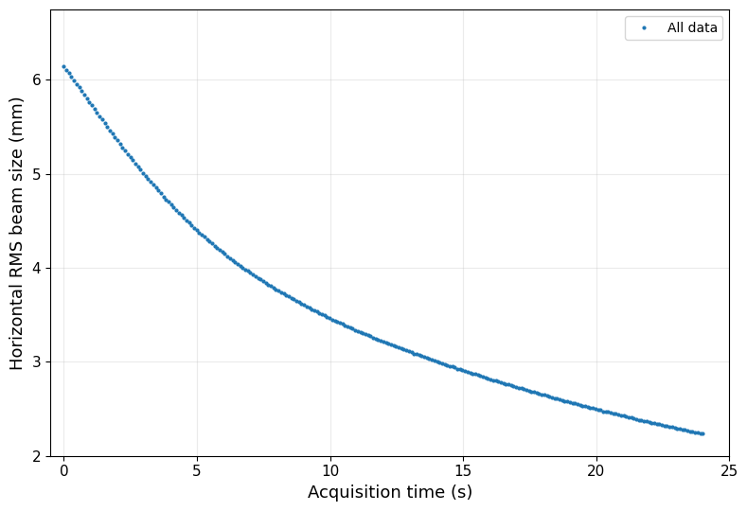
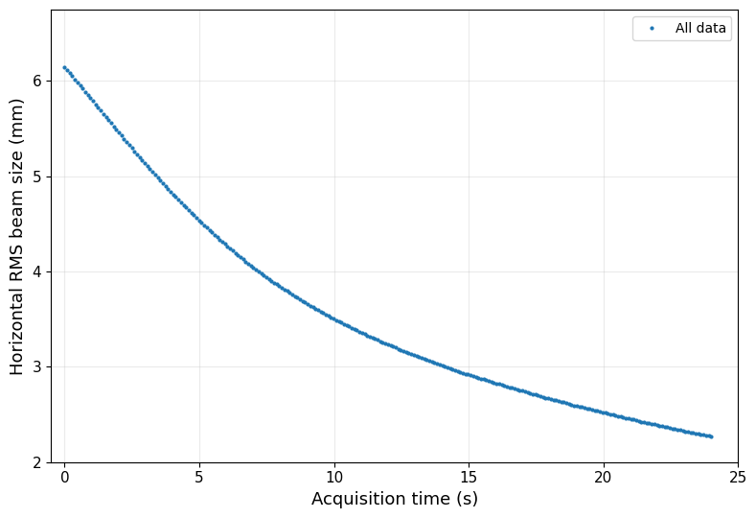
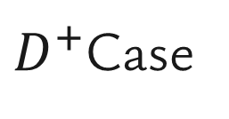
$D^{+}$Case
Experimental Data
From CRYRING
Non-Magnetic Numerical 1D model
Magnetic Meshkov model

Slide 16
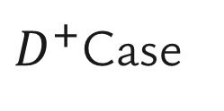



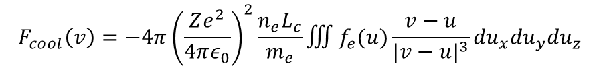
$D^{+}$Case
$$U^{91+}$$
$$D^{+}$$
$$F_{cool}\left(v\right)=−4π{\left(\frac{Ze^{2}}{4πε_{0}}\right)}^{2}\frac{n_{e}L_{c}}{m_{e}}∭f_{e}(u)\frac{v−u}{{|v−u|}^{3}}{du}_{x}{du}_{y}{du}_{z}$$
$$F_{cool}∝ n_{e}Z^{2}$$

Slide 17
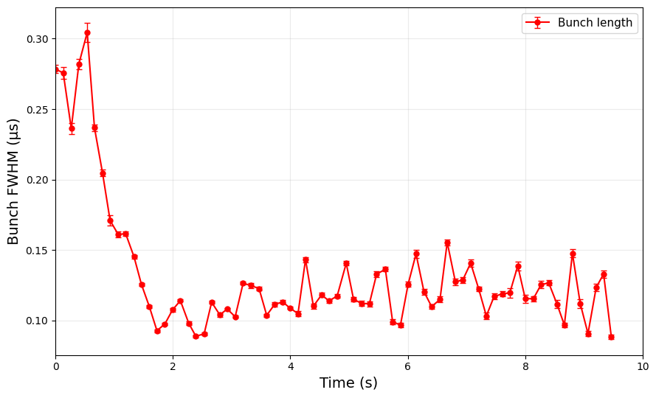
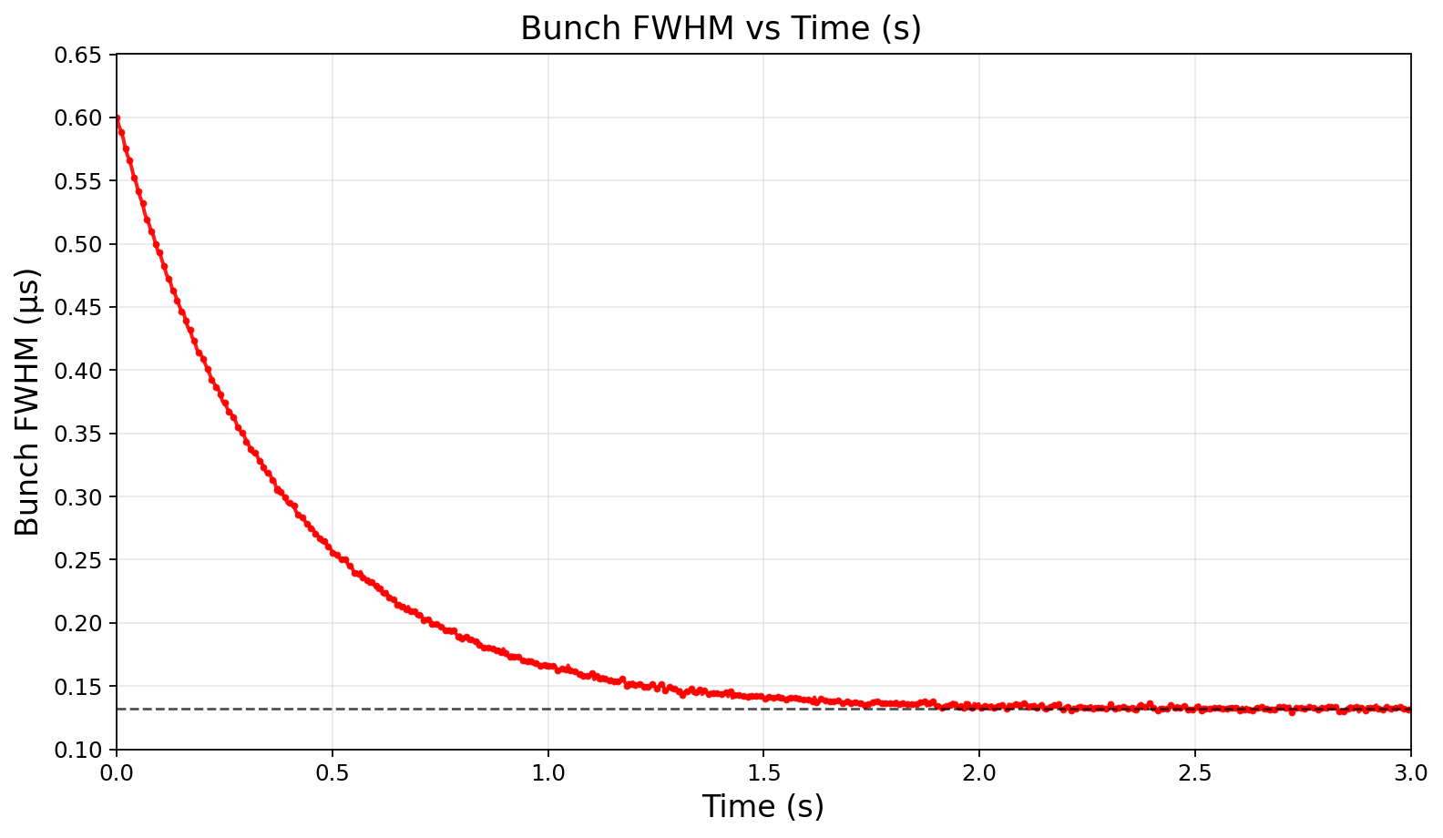
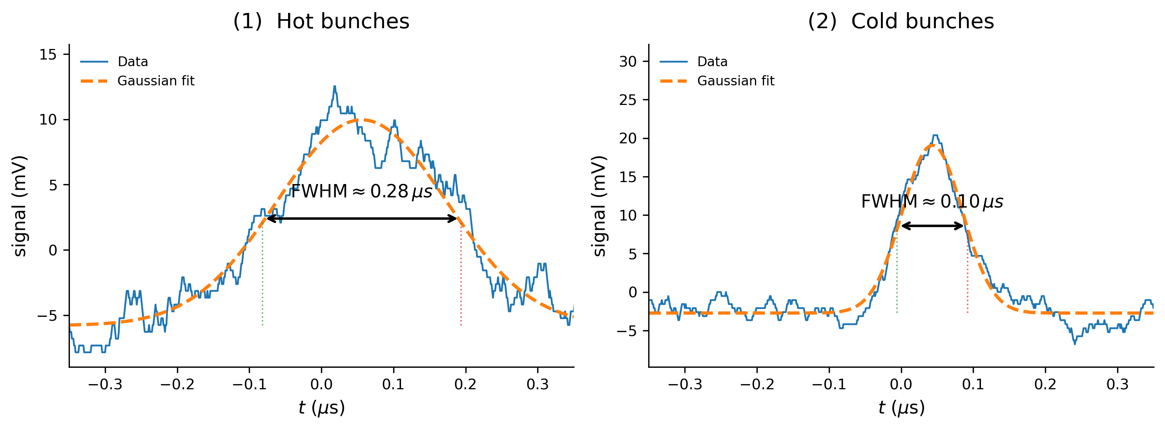
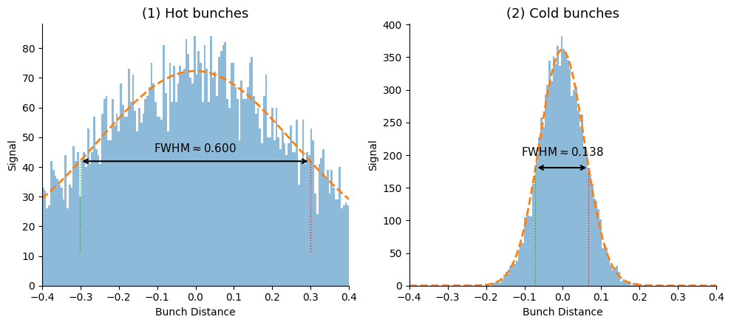
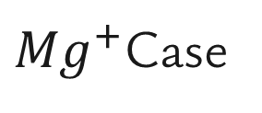
${Mg}^{+}$Case

Slide 18
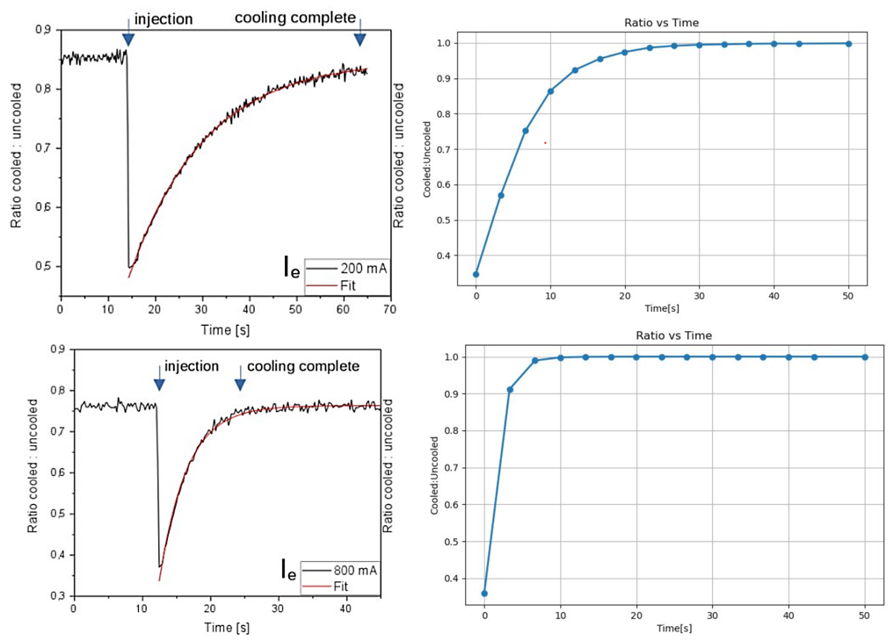



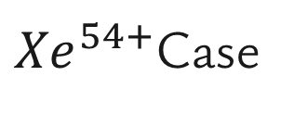
${Xe}^{54+}$Case
From the equation:
$$F_{cool} ∝ n_{e}$$
200 mA
We know that:
$$n_{e} ∝ I_{e}$$
Therefore:
$$F_{cool} ∝ I_{e}$$
800 mA

Slide 19
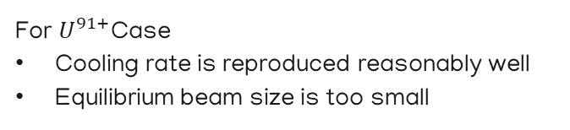
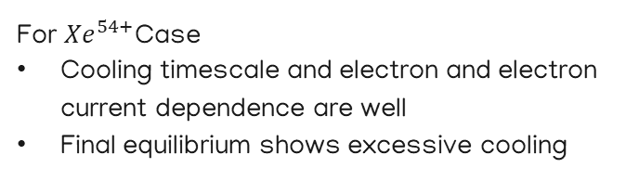
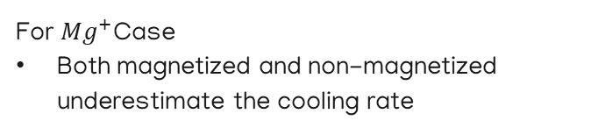
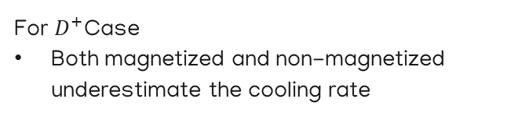
Summarize Overall Results
For $U^{91+}$Case
Cooling rate is reproduced reasonably well
Equilibrium beam size is too small
For ${Mg}^{+}$Case
Both magnetized and non-magnetized underestimate the cooling rate
For $D^{+}$Case
Both magnetized and non-magnetized underestimate the cooling rate
For ${Xe}^{54+}$Case
Cooling timescale and electron and electron current dependence are well
Final equilibrium shows excessive cooling
No single cooling-force model can produce both the cooling dynamics and the final equilibrium beam properties to explain all conditions

Slide 20
Limitations of Electron cooling simulation program
Space Charge
Particles push each other away
Not included in the current JSPEC2 simulation
Heating mechanisms and non-Gaussian beam halo
The experimental beam is not a simple Gaussian Distribution as it in simulated
Halos are not fully reproduced by IBS model in the program

Slide 21
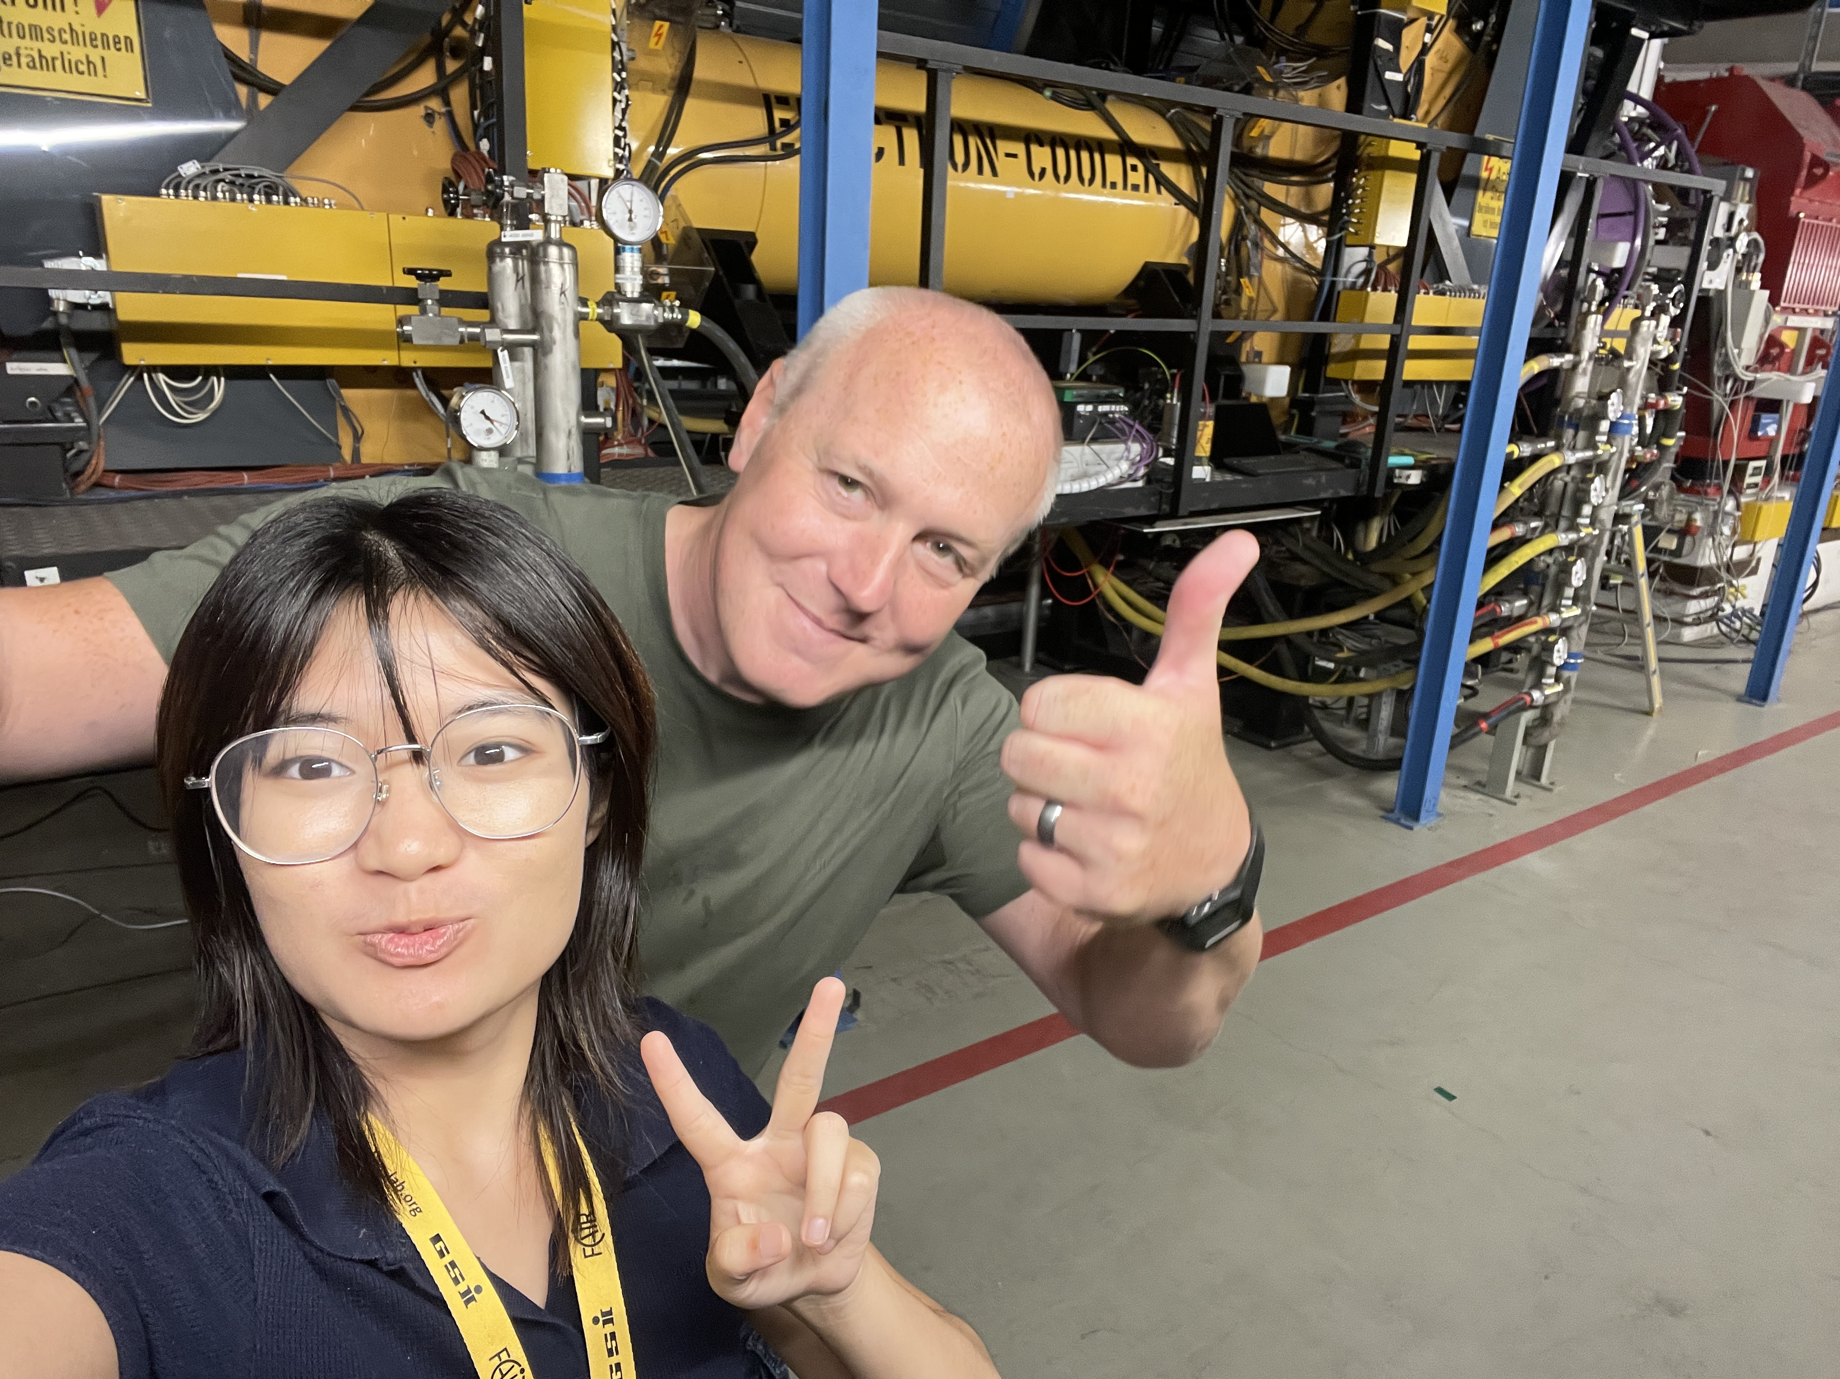
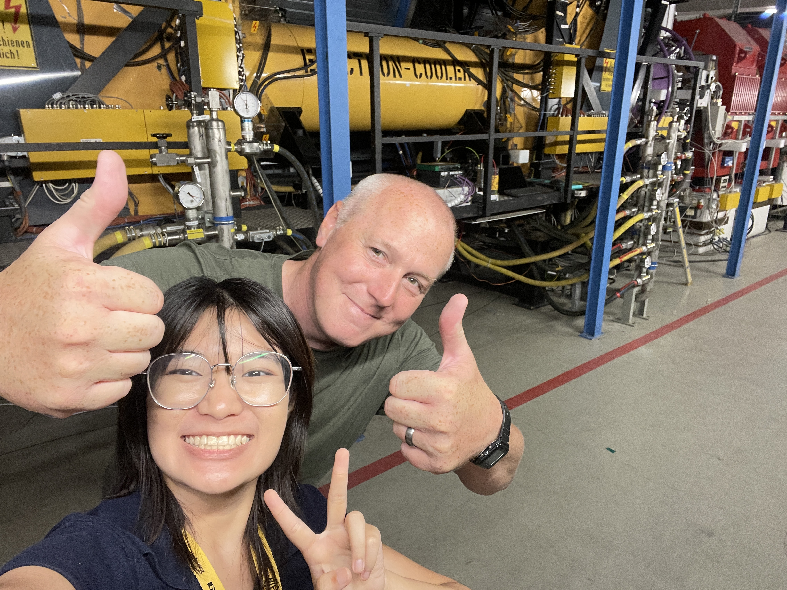

Slide 22
Thank you
Do you have any questions?

