Slide 1
Longitudinal Phase-Space Reconstruction
from Rebuncher Voltage Scans
Beam diagnostics at the GSI High Charge State Injector (HLI)

Slide 2
Introduction & setup
The HLI delivers a 1.4 MeV/u heavy-ion beam to the UNILAC. Clean injection requires knowing the beam parameters delivered from the HLI.
d₁ = 0.6m
d₂=11.4m
beam
BSM1
Rebuncher
BSM2
entrance plane
exit plane
Goal: reconstruct the beam's second moments at BSM1 from a BSM2 rebuncher-voltage scan and use the direct BSM1 measurement to reduce their uncertainty.
Longitudinal phase-space reconstruction
2

Slide 3


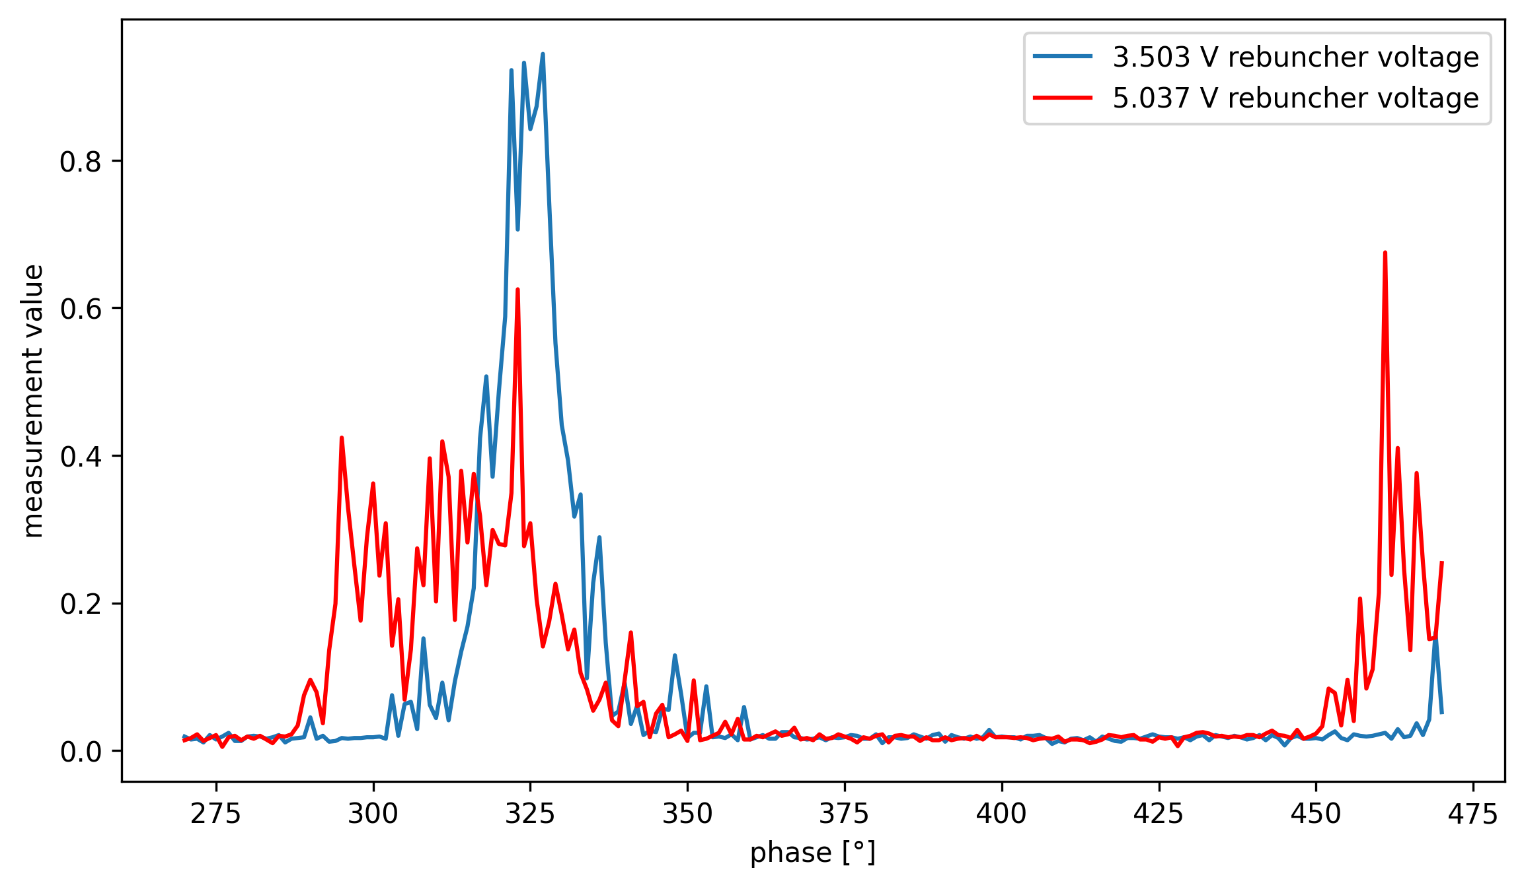

BSM2 data
=1.9m$≈$4500°
Longitudinal phase-space reconstruction
3

Slide 4
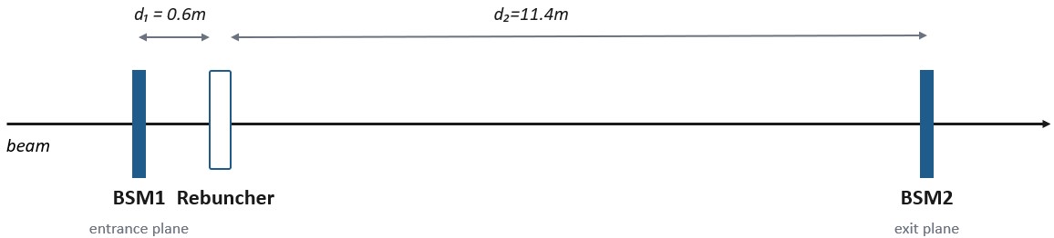
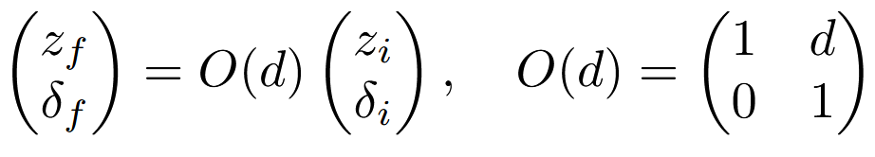
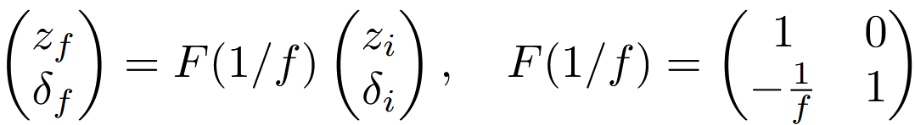
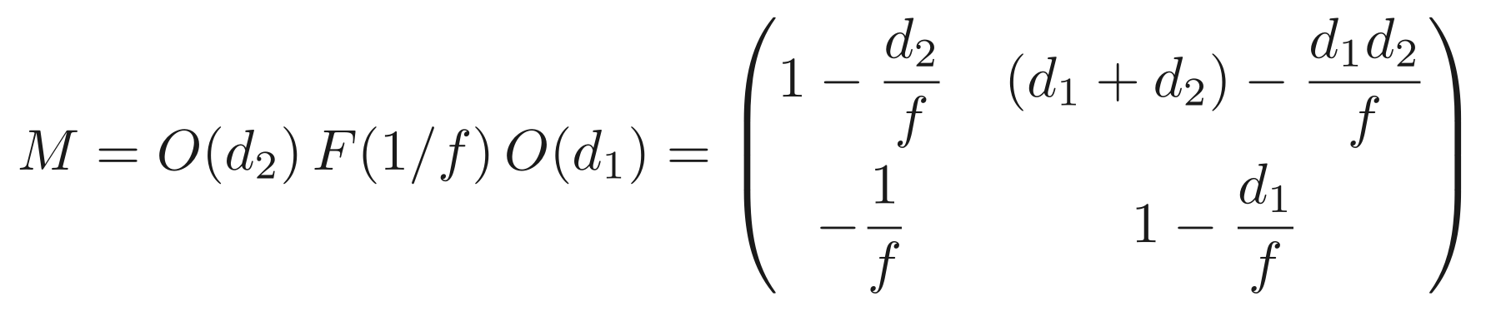
Longitudinal beam dynamics
Coordinates: longitudinal offset z and relative momentum deviation δ.
Drift and thin rebuncher act as linear maps on (z, δ):
drift, length d
thin rebuncher, strength 1/f
Combined transfer matrix (BSM1 → BSM2):
Longitudinal phase-space reconstruction
4

Slide 5
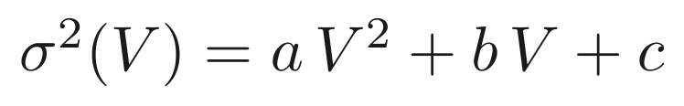
The voltage parabola
Propagating the beam through M and averaging over the distribution gives
Voltage enters through 1/f = κV, with κ = (π/180) · q s /(β p₀).
M₁₁ and M₁₂ are linear in V, so the bunch length squared is quadratic in V:
The coefficients a, b, c are linear combinations of the three moments; inverting recovers the moments.
Longitudinal phase-space reconstruction
5

Slide 6
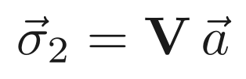
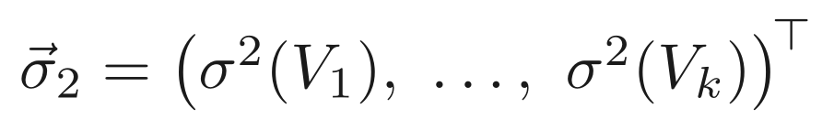
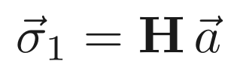
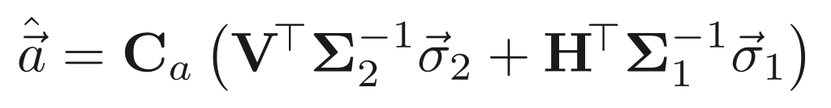
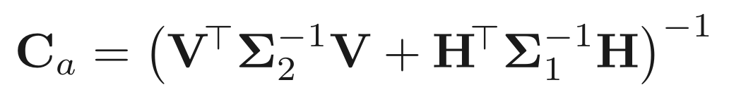
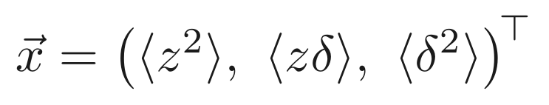
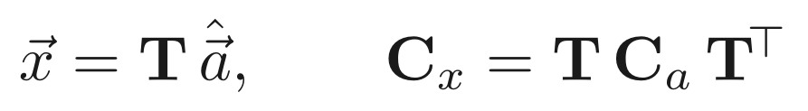
Reconstruction: weighted least squares
Each scanned voltage gives one linear equation for the coefficients a = (a, b, c). Stack BSM2 with the optional BSM1 constraint and weight by the inverse covariance.
BSM2 scan, rows (V², V, 1)
BSM1, direct entrance width
Weighted least-squares solution of the stacked system:
Σ₂ and Σ₁ are the measurement covariances of the two data vectors.
coefficients → moments, with propagated covariance
With no BSM1 this is the plain BSM2 fit; adding BSM1 adds information about the initial bunch length
Longitudinal phase-space reconstruction
6

Slide 7
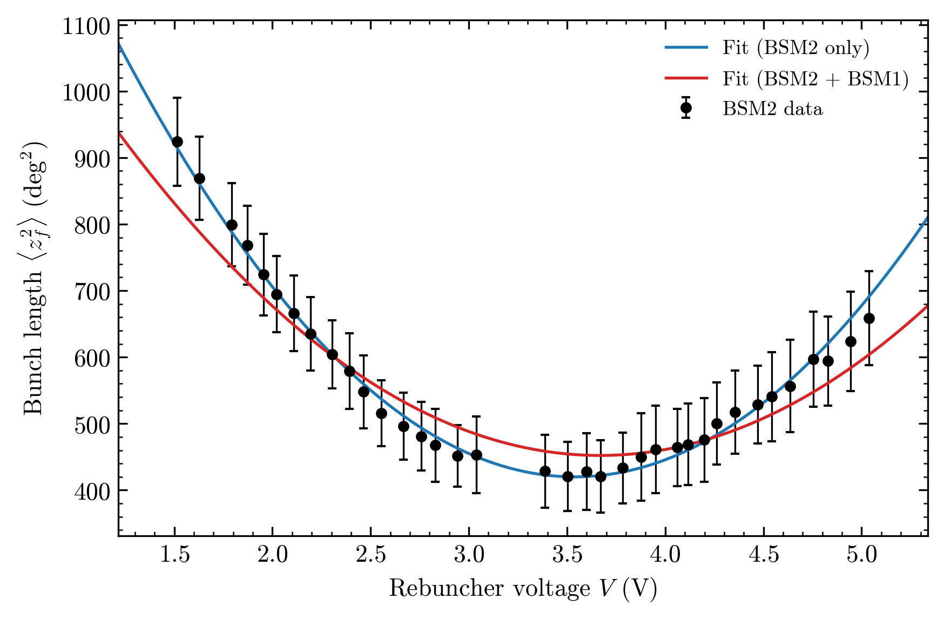
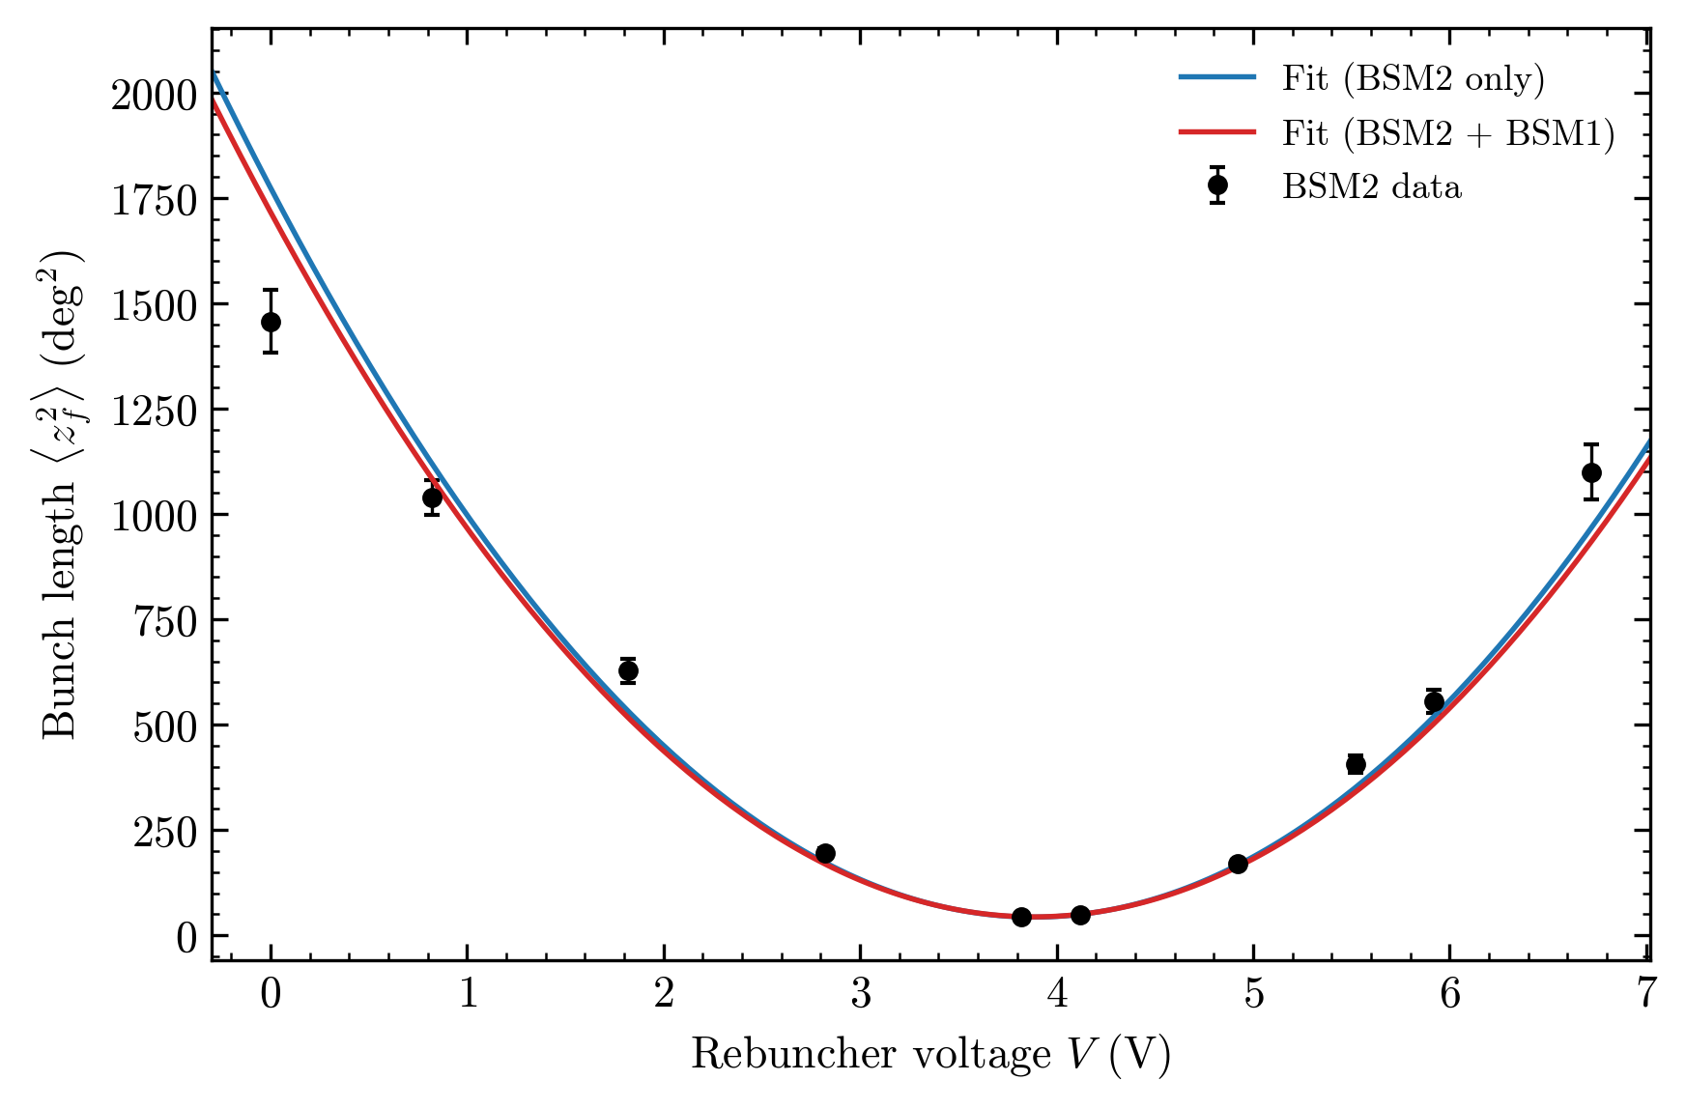
Parabola results
Two campaigns: Ar⁸⁺ (36 voltage points, July 2025) and He¹⁺ (10 points, May 2025).
Argon: large per-point uncertainty
Helium: parabola tightly constrained
Points follow a parabola, BSM2 doesn’t constrain the fit as much for argon as for helium.
Longitudinal phase-space reconstruction
7

Slide 8
Reconstructed moments
Argon (Ar⁸⁺)
Quantity | BSM2 only | BSM2 + BSM1 | BSM1 direct
σ_z (deg) | 17.8 ± 0.7 | 14.6 ± 0.2 | 14.4 ± 0.2
⟨zδ⟩ (deg)*10³ | −36 ± 3 | −25 ± 1 | —
σ_δ*10⁴ | 21.2 ± 0.7 | 18.4 ± 0.2 | —
Helium (He¹⁺)
Quantity | BSM2 only | BSM2 + BSM1 | BSM1 direct
σ_z (deg) | 14.5 ± 0.2 | 14.2 ± 0.1 | 13.6 ± 0.2
⟨zδ⟩ (deg)*10³ | −28.4 ± 0.6 | −27.4 ± 0.5 | —
σ_δ*10⁴ | 19.8 ± 0.2 | 19.4 ± 0.2 | —
Combining the monitors always tightens the reconstruction; the effect is largest for the imprecise argon scan.
Longitudinal phase-space reconstruction
8

Slide 9
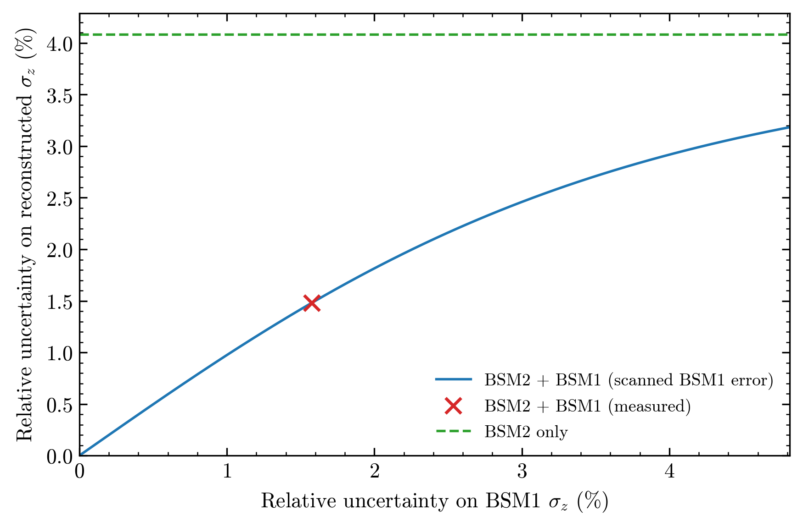
Two monitors
x-axis: assumed relative uncertainty on the BSM1 width.
y-axis: resulting uncertainty on the reconstructed σ_{z}.
Blue: combined fit. Red ×: measured BSM1. Green dashed: BSM2 only.
Left → BSM1 dominates; right → BSM1 ignored, back to BSM2-only.
For argon the reconstructed bunch length uncertainty improves.
Longitudinal phase-space reconstruction
9

Slide 10
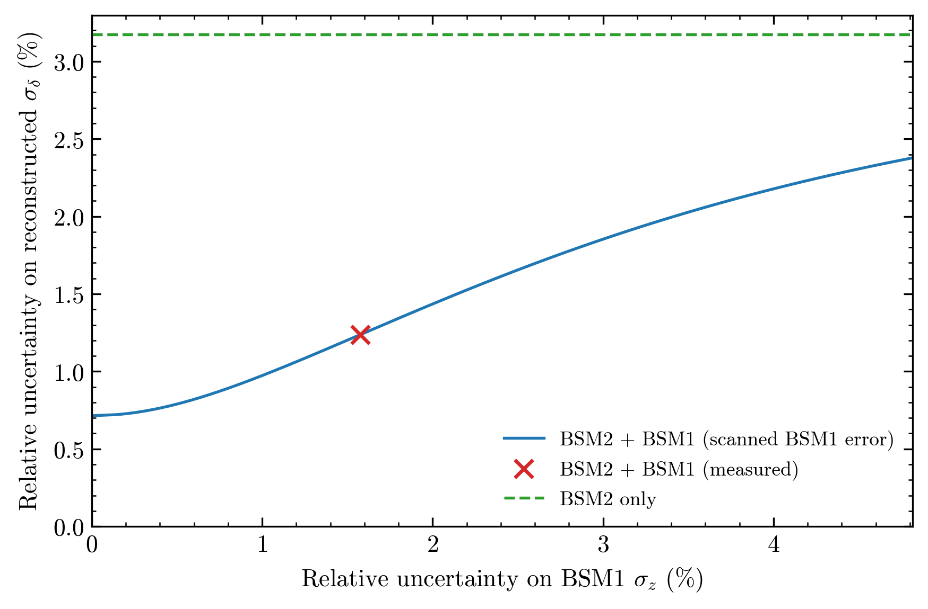
Argon momentum spread
Same construction for the momentum spread.
BSM1 improves it as well, but the curve never reaches zero.
BSM1 measures only the bunch length, not the momentum spread. Even a perfect BSM1 leaves it limited by the BSM2 scan, so a nonzero floor remains.
Longitudinal phase-space reconstruction
10

Slide 11
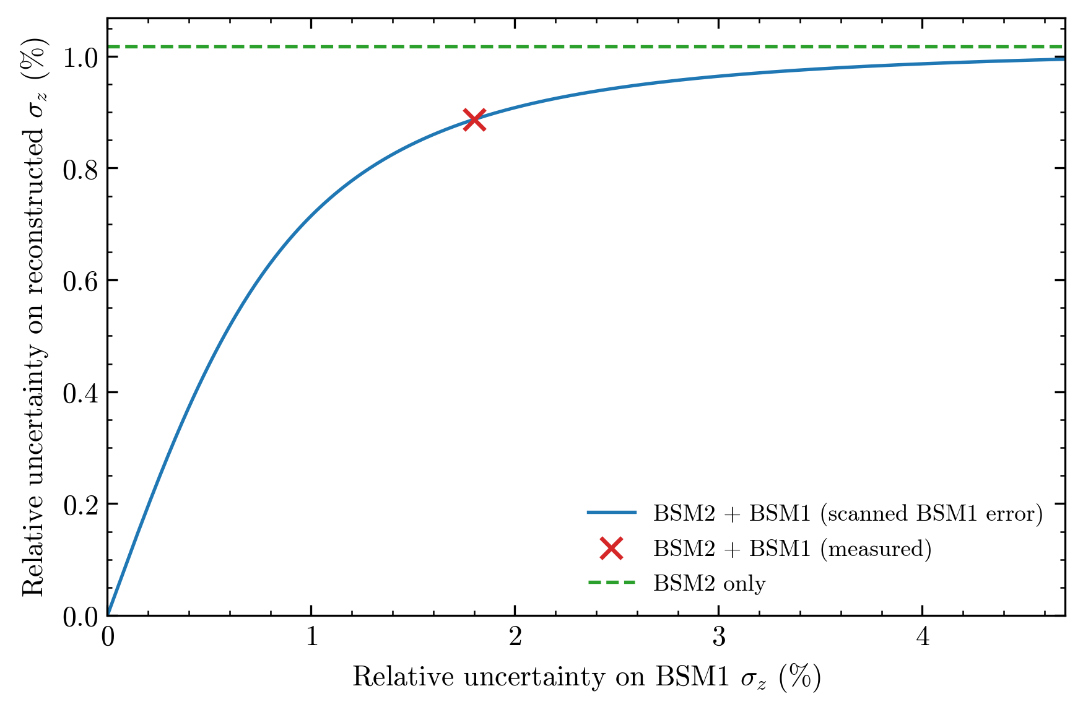
Helium: the reversed case
Here the BSM2 scan is already precise (green line).
The measured BSM1 uncertainty is larger, so BSM1 adds little.
The combined result beats the direct BSM1 measurement in uncertainty, so here BSM1 benefits from BSM2.
Longitudinal phase-space reconstruction
11

Slide 12
Conclusion
We have determined longitudinal second moments from beam profiles obtained in a voltage scan at BSM2 through a weighted least squares fit.
Adding the direct BSM1 measurement as a weighted constraint reduces the reconstructed uncertainties.

Slide 13
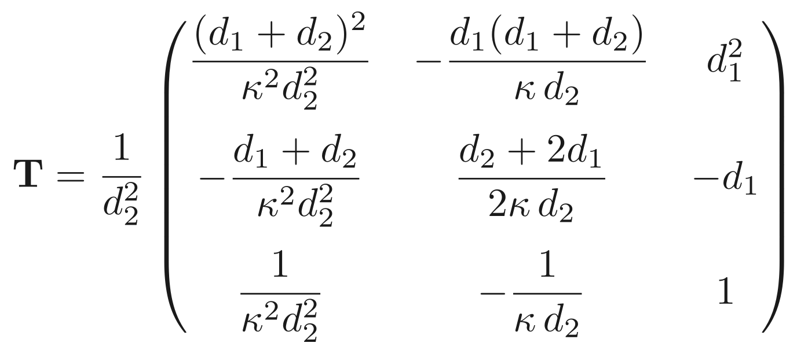
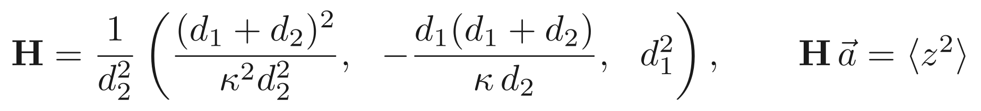
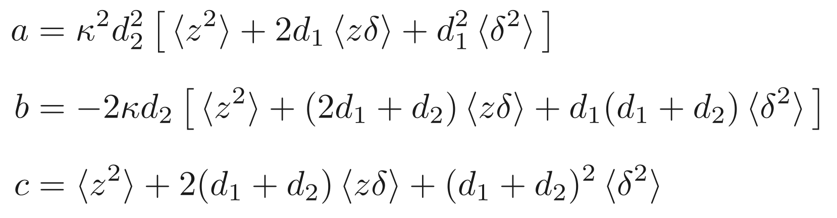
Backup slide: Matrices
i

Slide 14
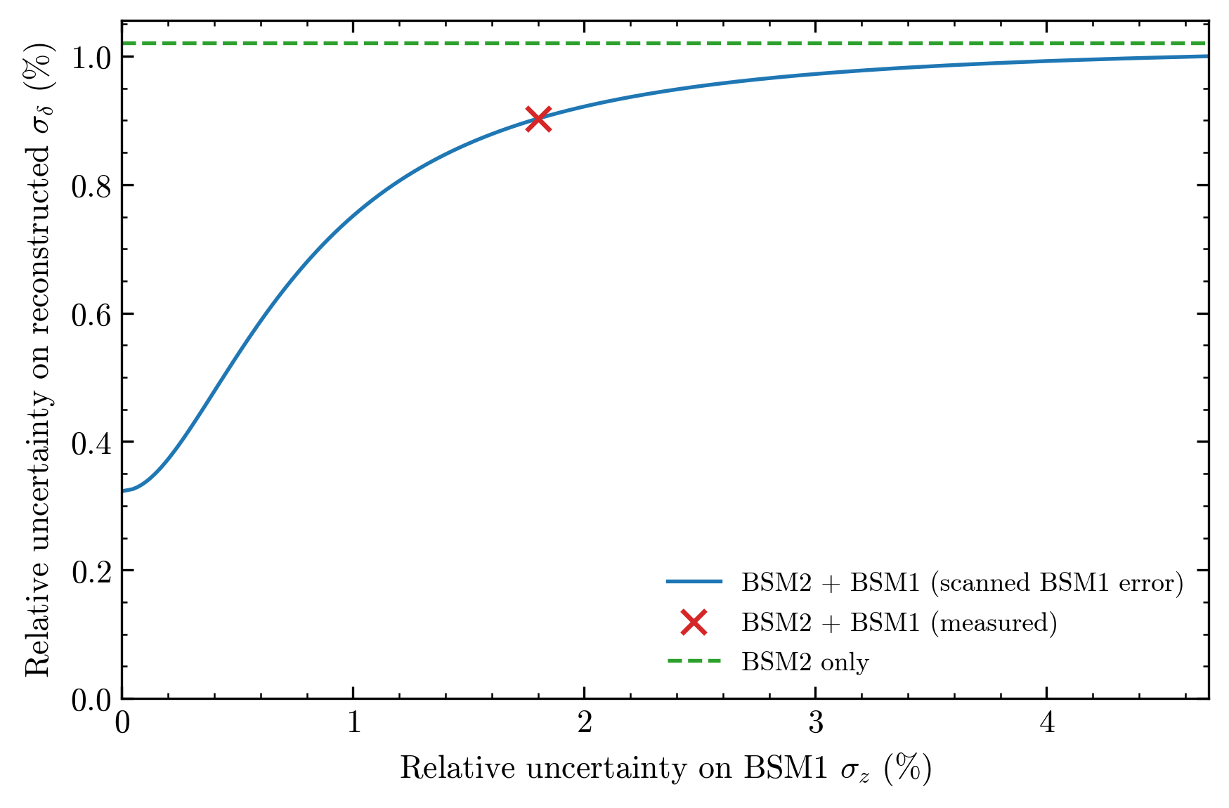
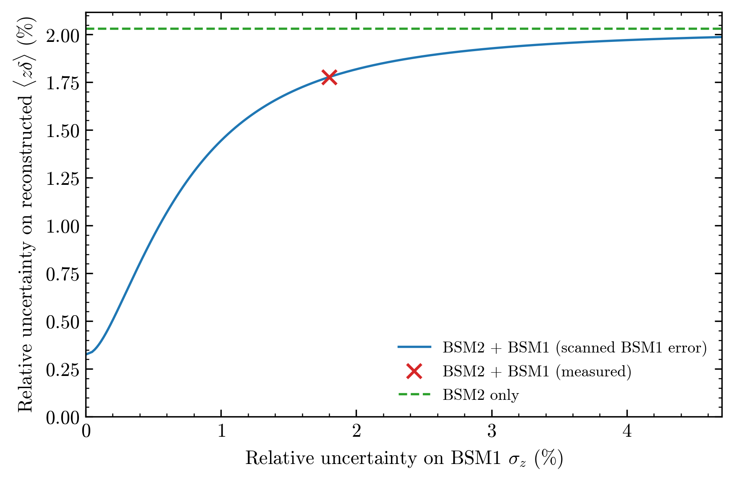
Backup slide: He uncertainties

Slide 15
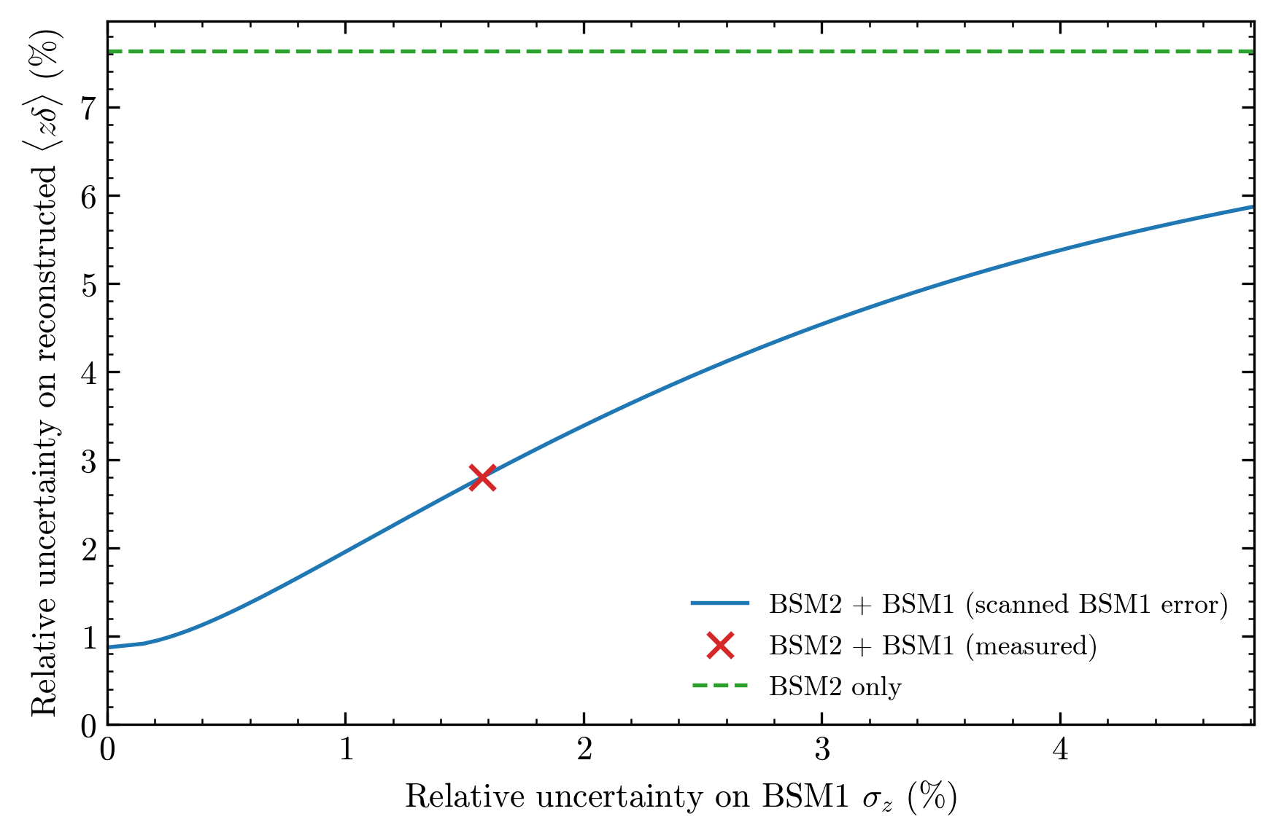
Backup slide: Ar uncertainties

Slide 16
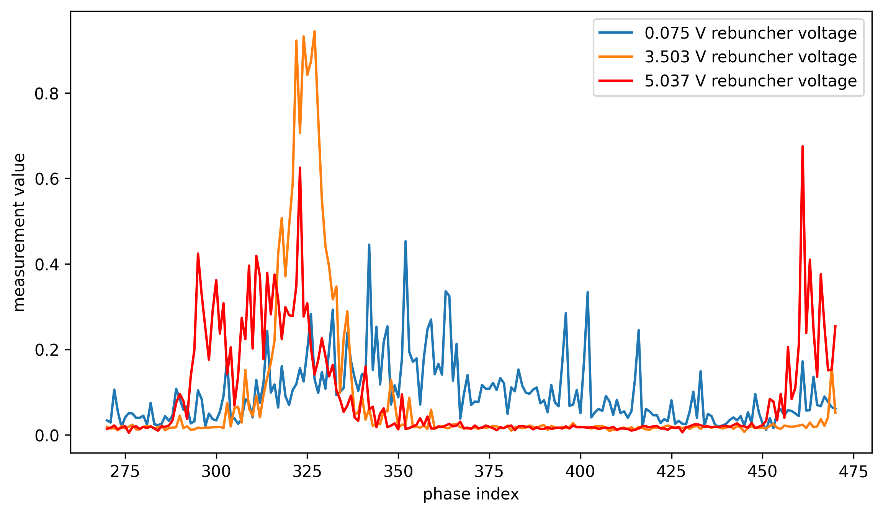
Backup slide: 0 voltage profile

Slide 17
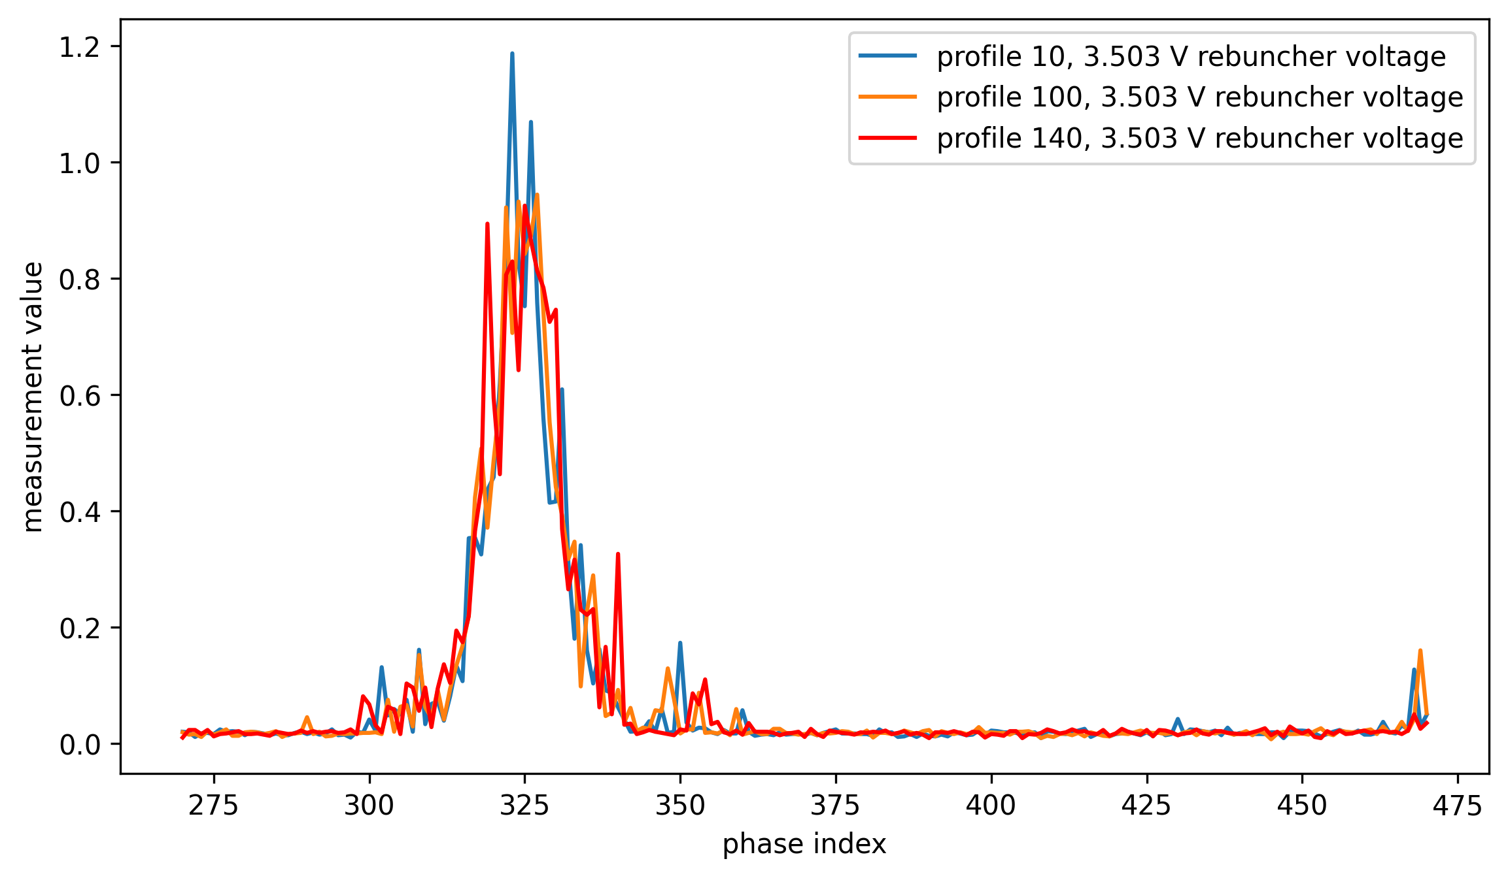
Backup slide: different profiles, same voltage

Slide 18
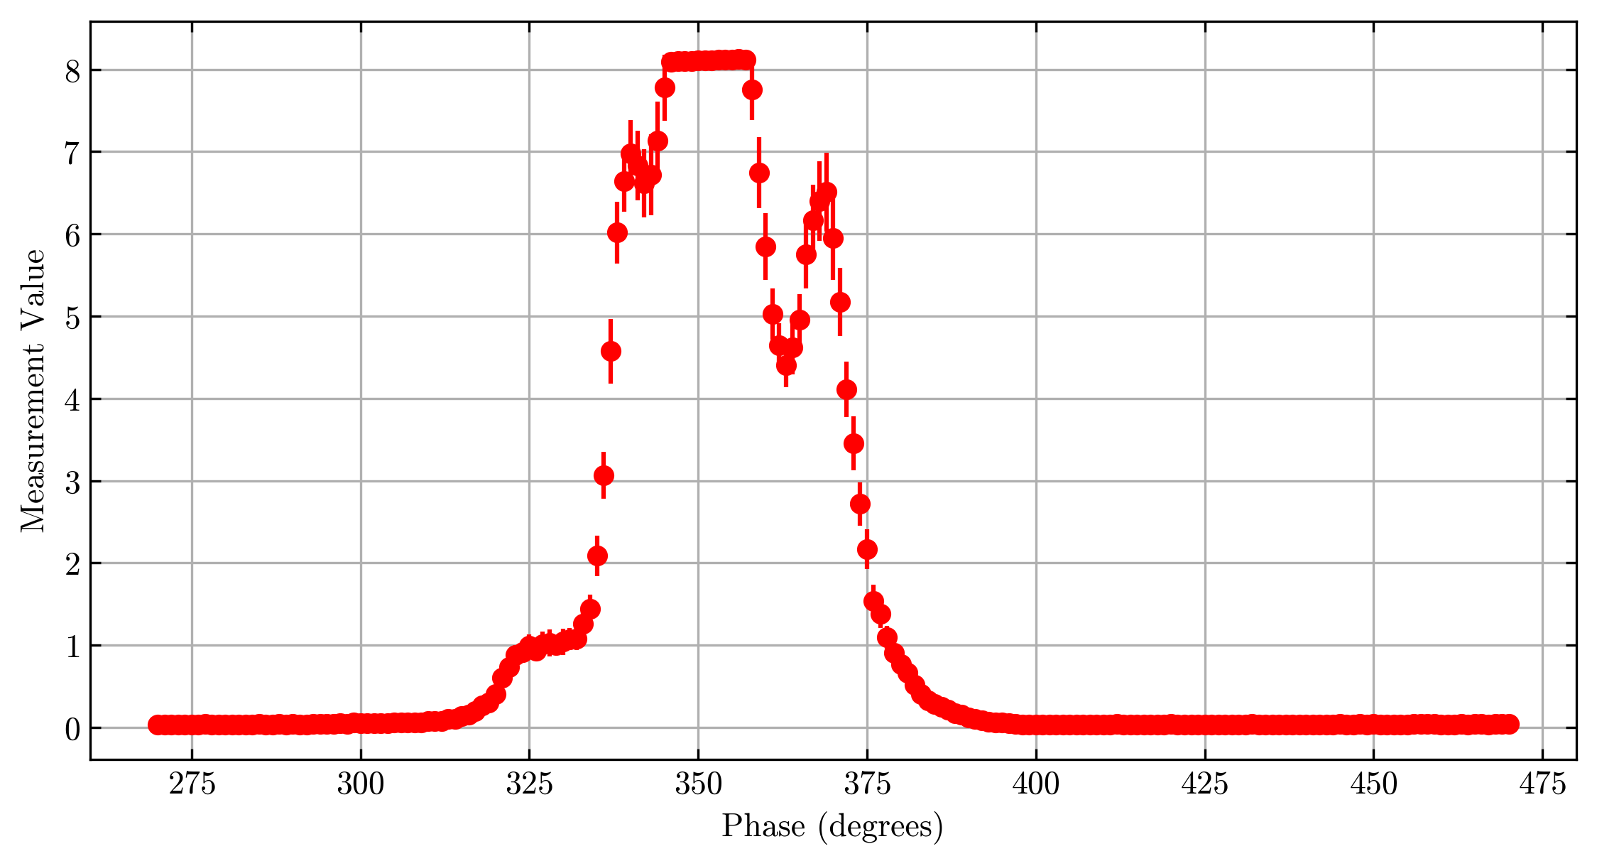
Backup slide: BSM1 average profile

