Slide 1



Data analysis of ACTAF
Patrik Doležal
239444@vutbr.cz
Supervisor: Oleg Kiselev
International Summer Student Program at GSI-FAIR
16 September 2026

Slide 2
Contents
AMBER
ACTAF
DAQ
Signal processing
Alpha-Source vs HV
FFT
Conclusion

Slide 3
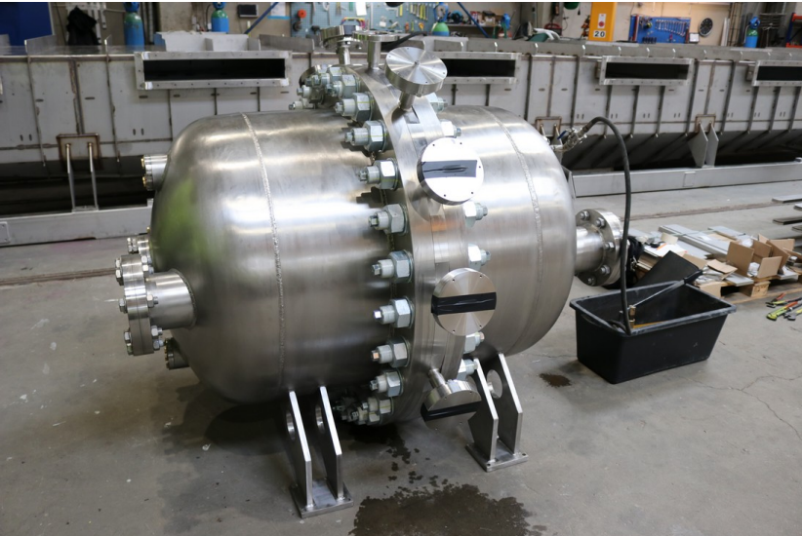
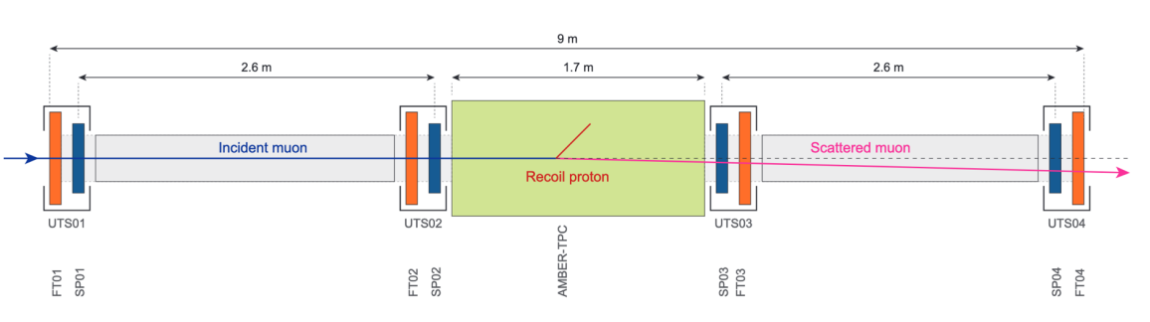
AMBER
AMBER (Apparatus for Meson and Baryon Experimental Research) experiment at CERN, M2 beam line
Main focus: Proton charge radius measurement
  via elastic muon-proton scattering
  Addresses the “proton radius puzzle“
Other phase-1 goals: hadron spectroscopy, Drell-Yan process

Slide 4
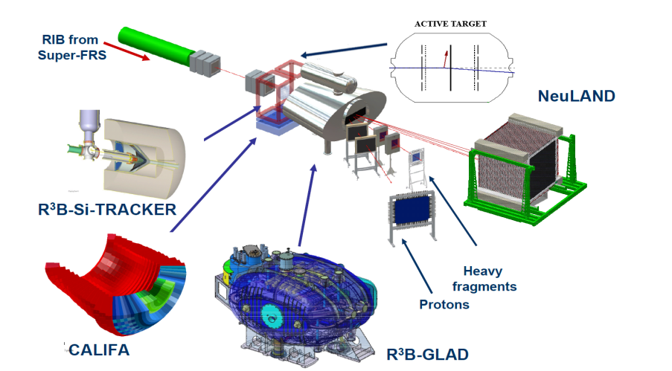
ACTAF in FAIR
ACTAF (ACtive TArget for FAIR) = a TPC (time-projection chamber) built for R³B (NUSTAR), using rare beams from the Super-FRS
Gas itself is both the reaction target and the detection medium
The TPC used in AMBER‘s proton-radius measurement is ACTAF – the same detector
Low momentum transfer
2030?

Slide 5
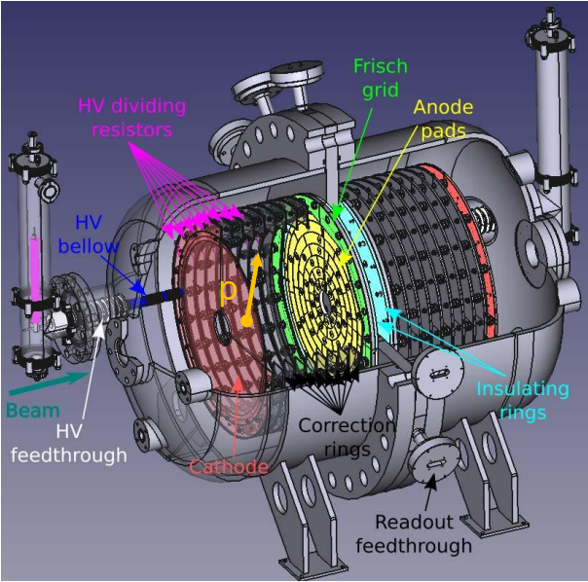
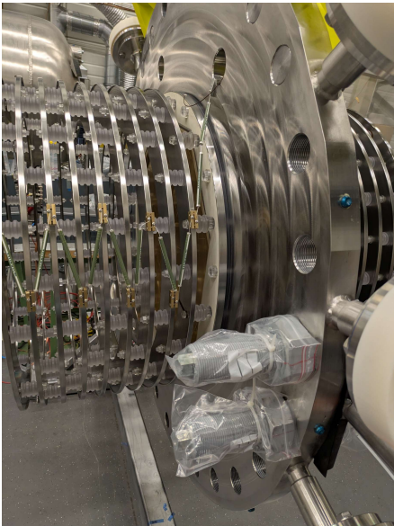
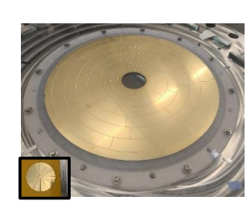
Detector geometry
Two anodes planes: uptream and downstream
2 × 64 pads total (128 channels)
Each pad corresponds to a defined detector position
²⁴¹Am sources inside

Slide 6
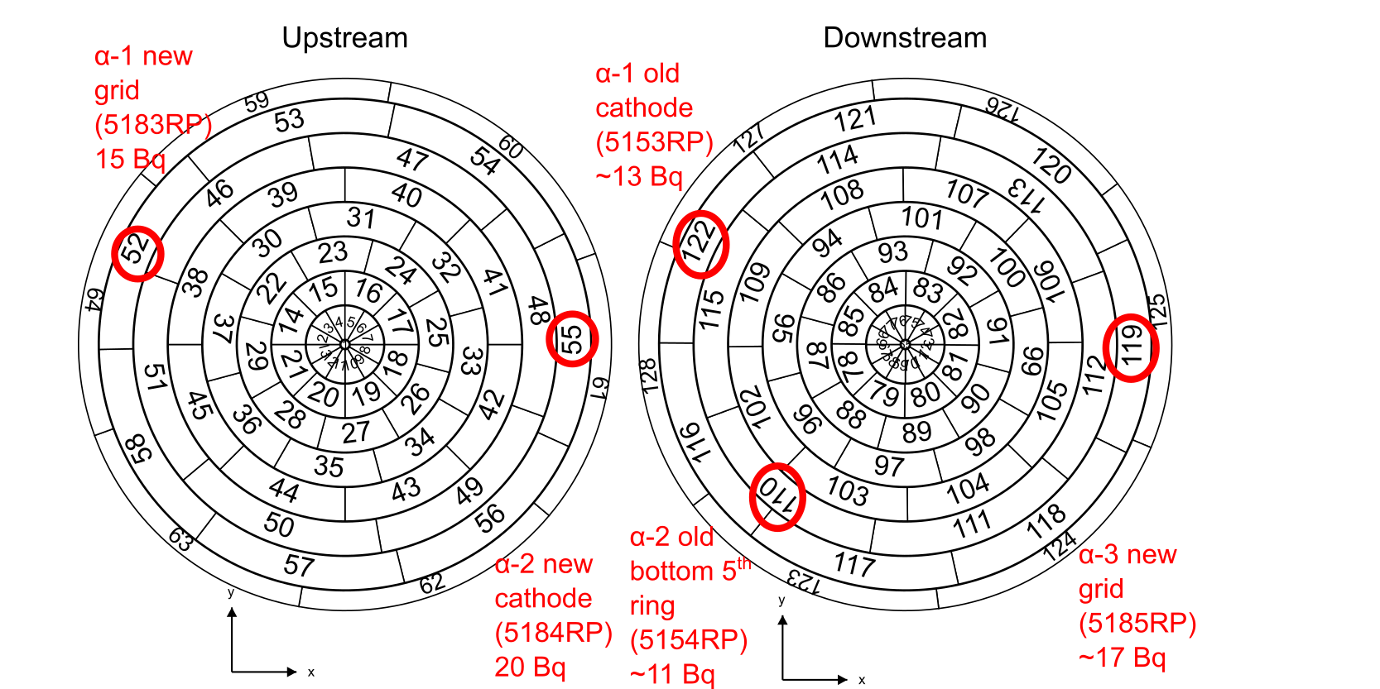
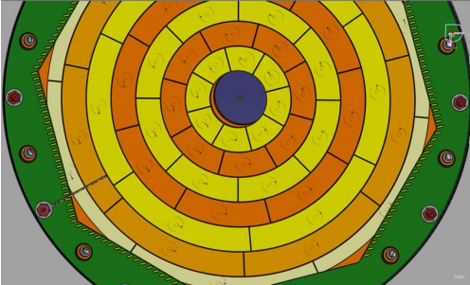

²⁴¹Am alpha sources
Five ²⁴¹Am sources installed in the detector
Alpha-peak position reflects changes in gas quality

Slide 7
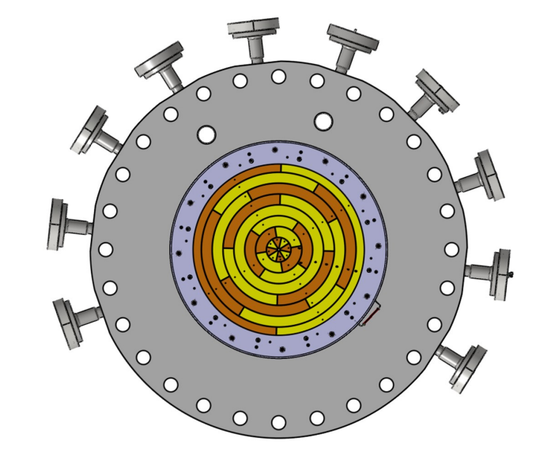
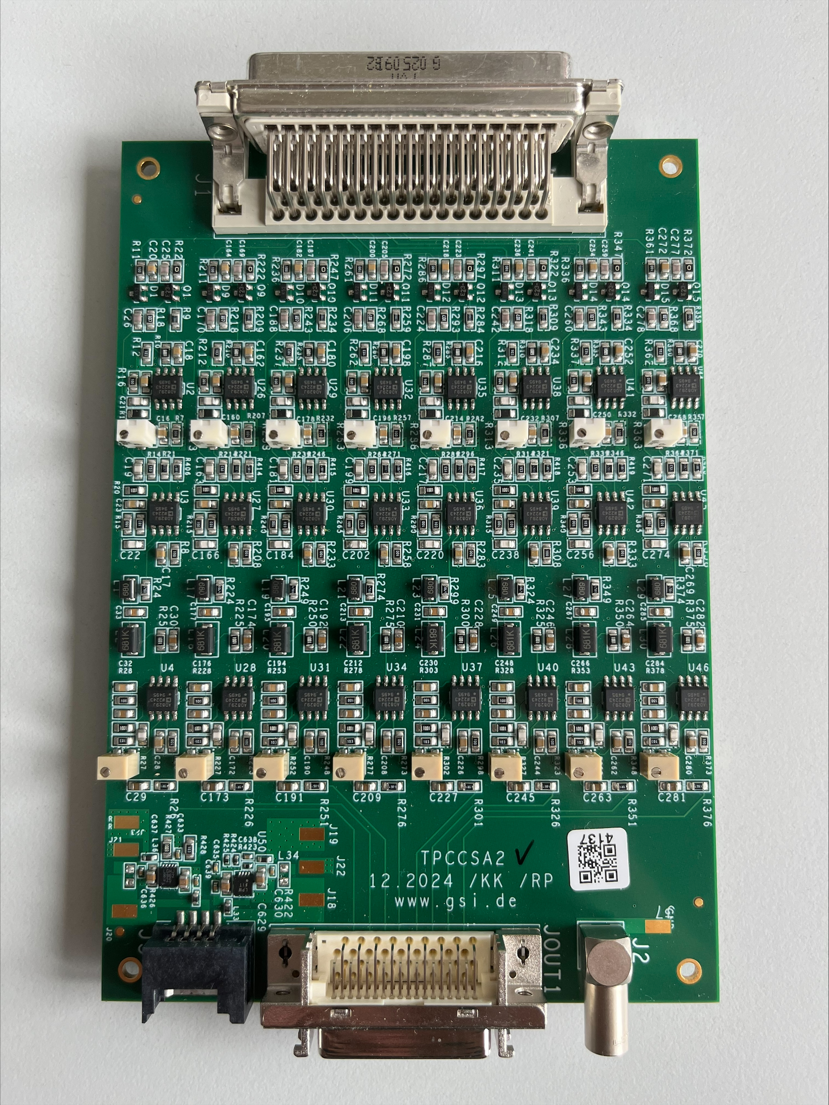
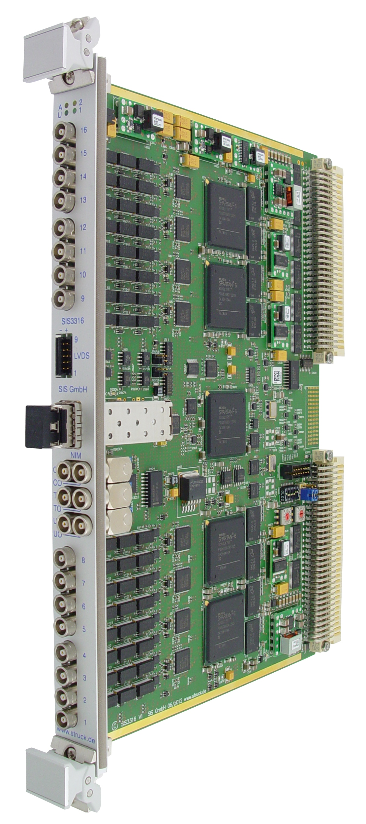
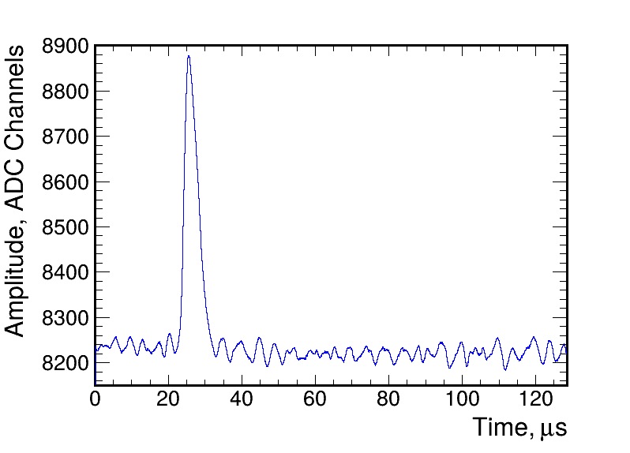
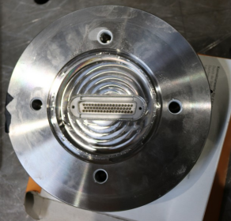
Data acquisition
ACTAF pads
Pre-amplifiers
SIS3316 FADC modules
Recorded waveforms
14-bit ADC
2500 samples/ channel
4-sample averaging
19.44 MHz effective sampling rate

Slide 8
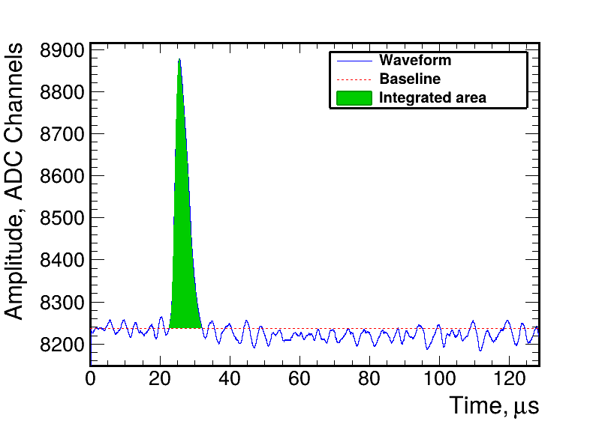
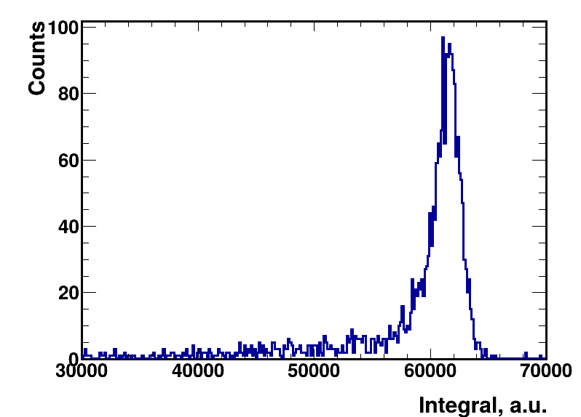
Signal-processing chain
SIGNAL PROCESSING
SG filter
baseline
Integration
calibration+cut
POSITION RECONSTRUCTION
(x,y) ←pad, geom.
z, energy ← from cal
MAPPED DATA
waveform
pad ID
CAL DATA
Energy
pad ID
HIT DATA
x,y,z
energy
Data analysis in this work

Slide 9
Data analysis
Long shutdown at CERN, no beam available
Used this time to go through existing data and check the detector performance
July 2026: dedicated runs without beam
During these runs High Voltage was decresed from 100% to 10%

Slide 10
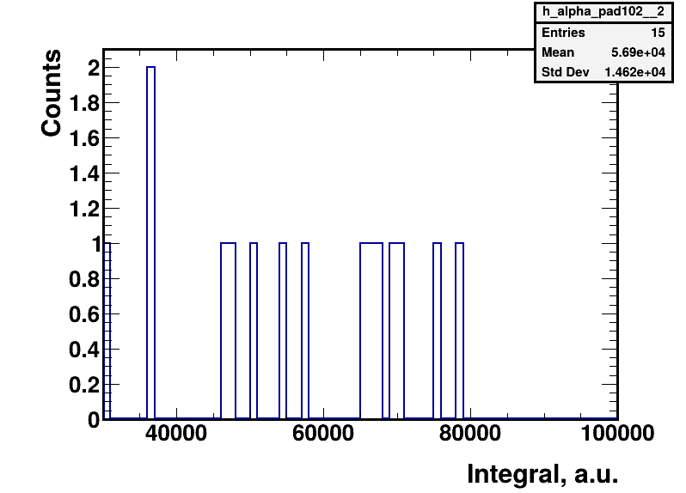
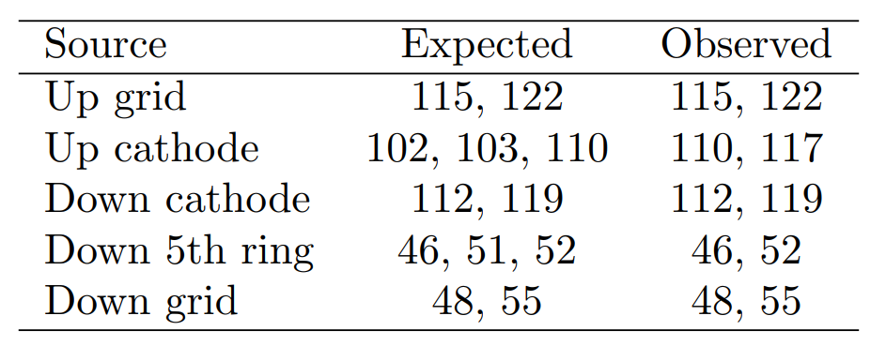
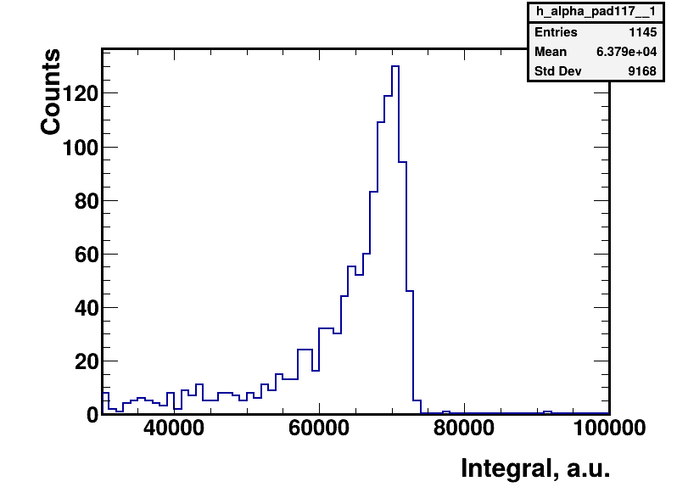
Identification of alpha-source pads
Expected pad positions determined from detector geometry
Alpha peaks identified in the pulse-integral spectra
Measured positions with expected mapping
Some signals observed on neighbouring pads
Low source activity can make some peaks difficult to identify

Slide 11
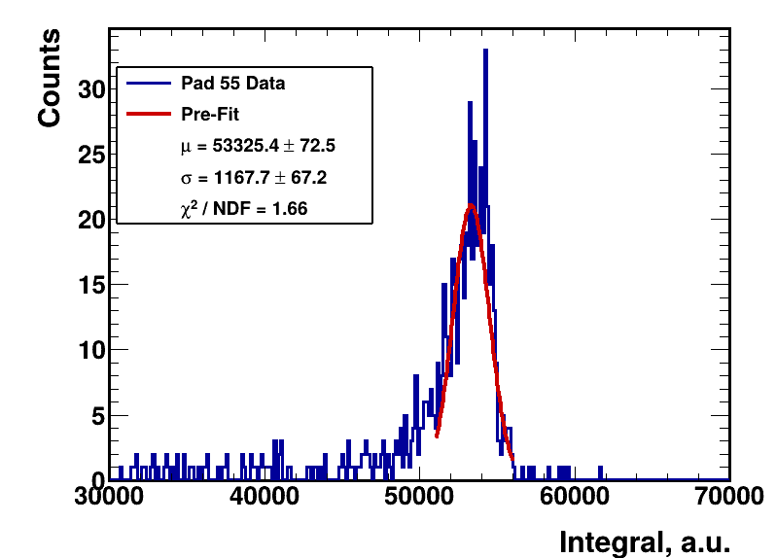
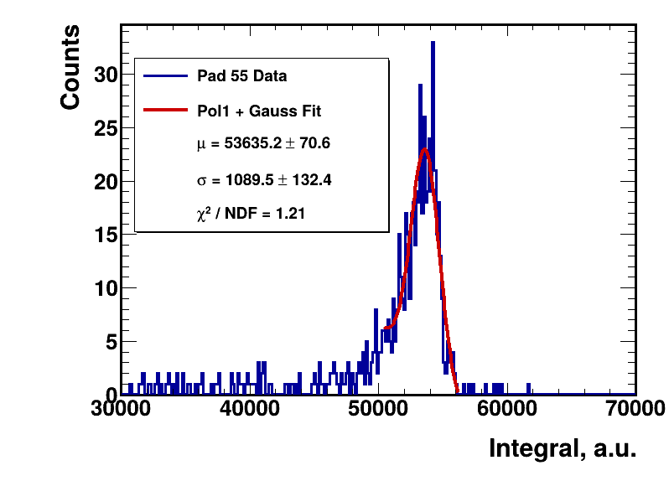
Alpha-peak fitting
Peak Search
Peak identification: ROOT TSpectrum
Initial Gaussian fit → μ, σ
Final fit performed around the identified peak
Output: peak position + uncertainty
Gauss fit
μ, σ
Gauss + pol1
Mean + uncertainty

Slide 12
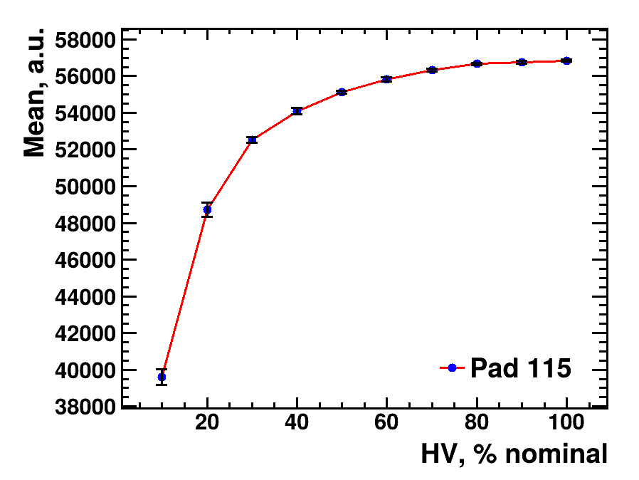
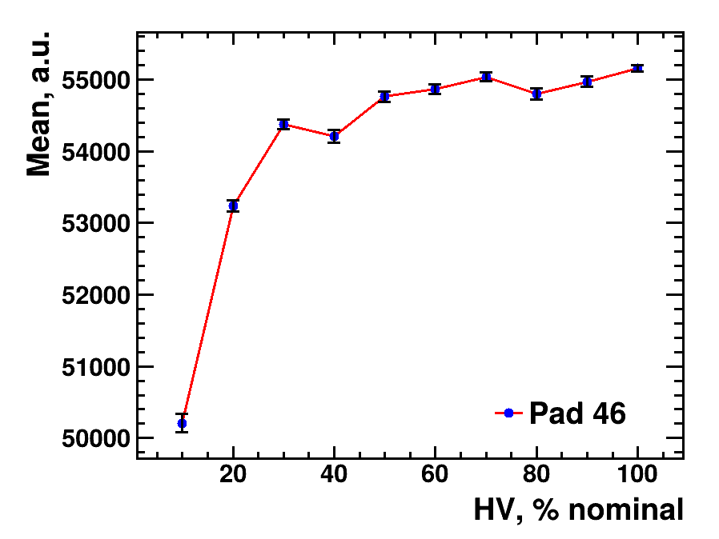
Alpha peak vs. HV
Mean alpha-peak positon determined for each HV setting
Peak position decreses with decreasing HV
Behaviour observed consistently across the investigated pads
Used to study the anode response as a fuction of HV
July 2026 → ²⁴¹Am runs →HV: 100% to 10% →visible α-peaks→Peak fitting →Mean vs HV

Slide 13
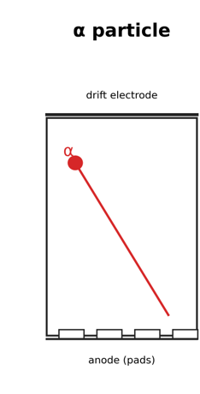
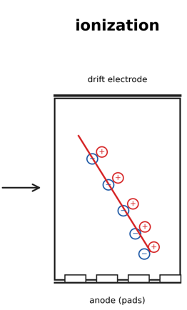
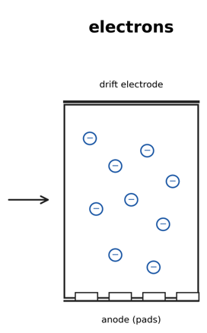
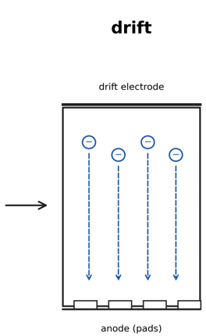
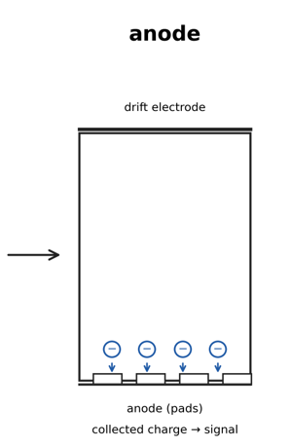
Interpretation of HV dependence
High drift-field HV
Faster electron drift
Shorter drift time
Less electron attachment
Larger collected charge
Low drift-field HV
Slower electron drift
Higher probability of electron attachment
Smaller collected charge
Observed: approximately exponential decrese of the mean pulse integral with decreasing HV

Slide 14
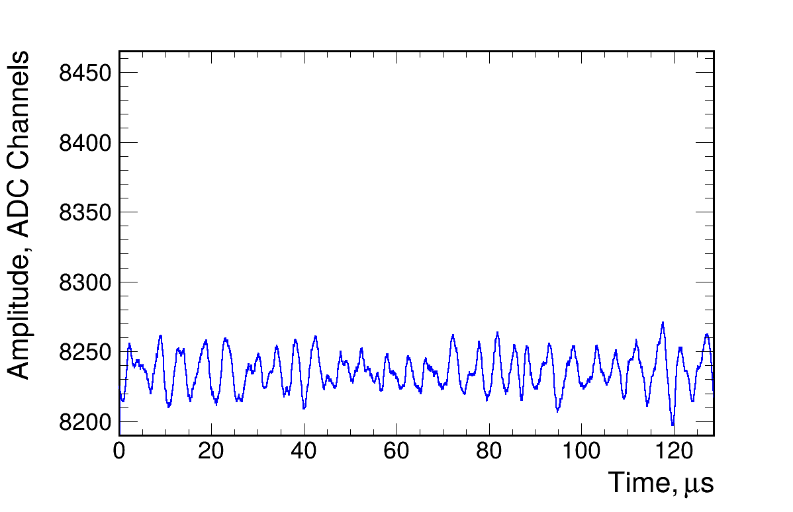
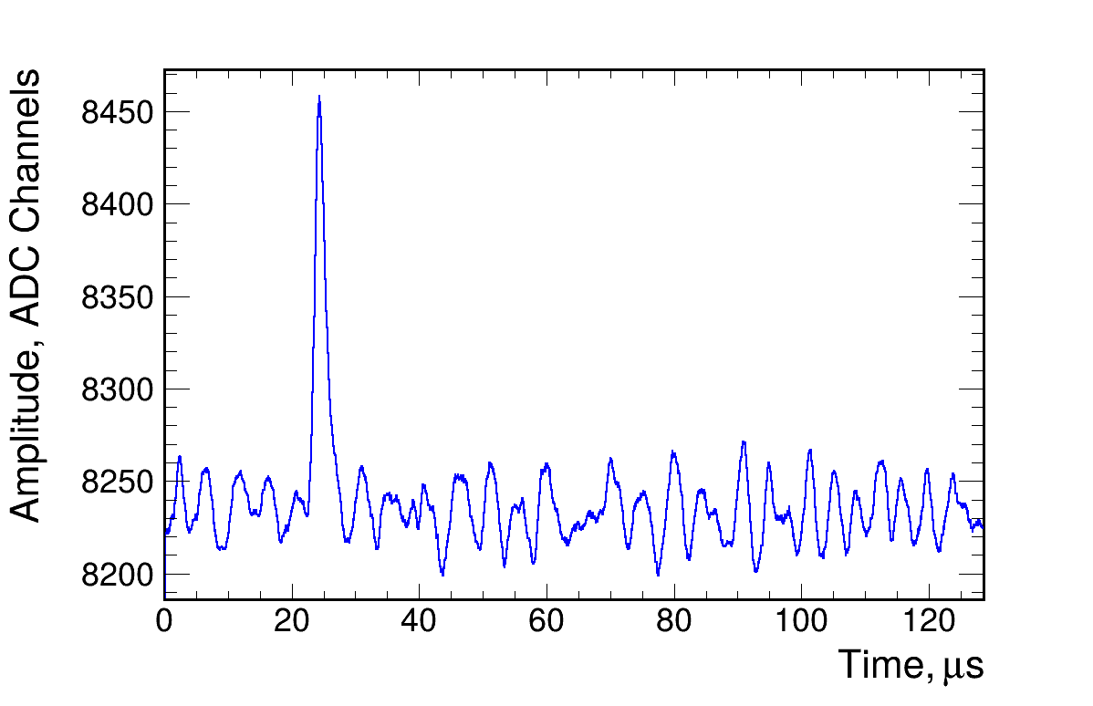
Electronic noise
Signal
Noise
Noise observed in the recorded waveforms
Selected pads showed a pronounced noise component
Noise investigated in the frequency domain using FFT
Several distinct frequency components were observed
Observed fluctuations

Slide 15
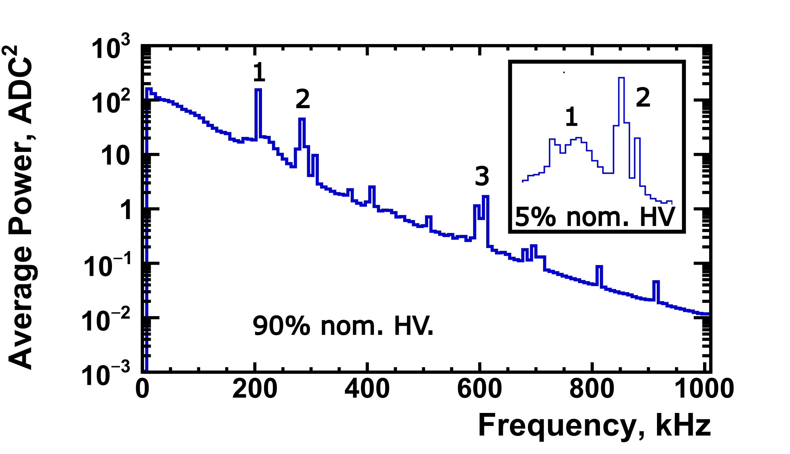
Fourier analysis
Raw(Mapped) waveforms transformed into frequency domain
FFT performed using Root TVirtualFFT
Spectra averaged over all events in the run
Several distinct frequency components were observed
Waveform →FFT →frequency spectrum →noise peaks
Pad 122

Slide 16
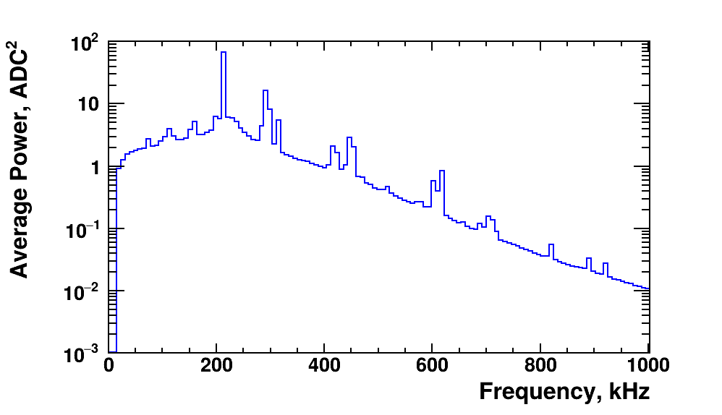
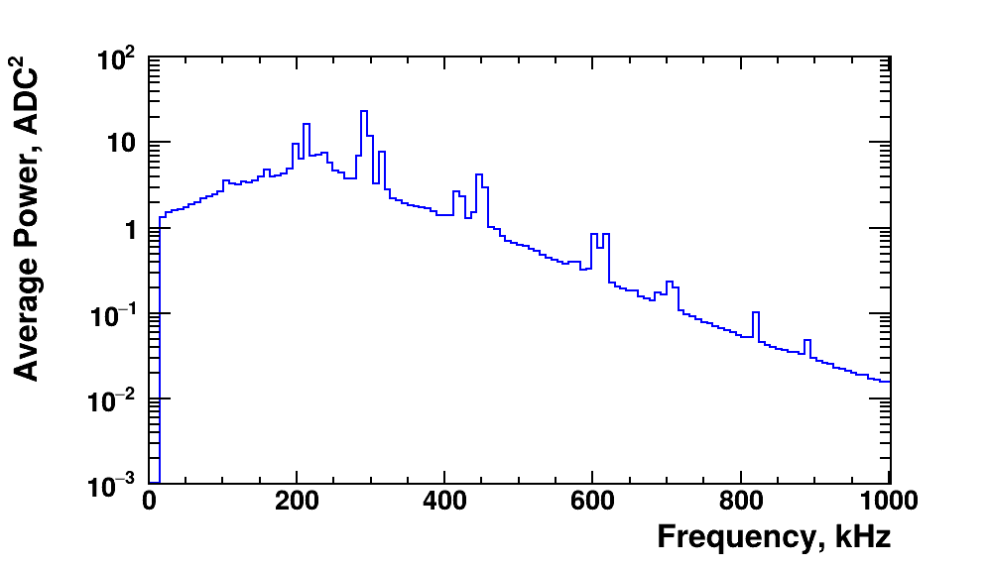
Noise and HV dependence
Pad 107 – 80 % HV
Pad 107 – 20 % HV
Three prominent peaks: ~206, 280, 610 kHz, visible on every inspected pad.
~206 kHz peak amplitude decreases with lower HV.

Slide 17
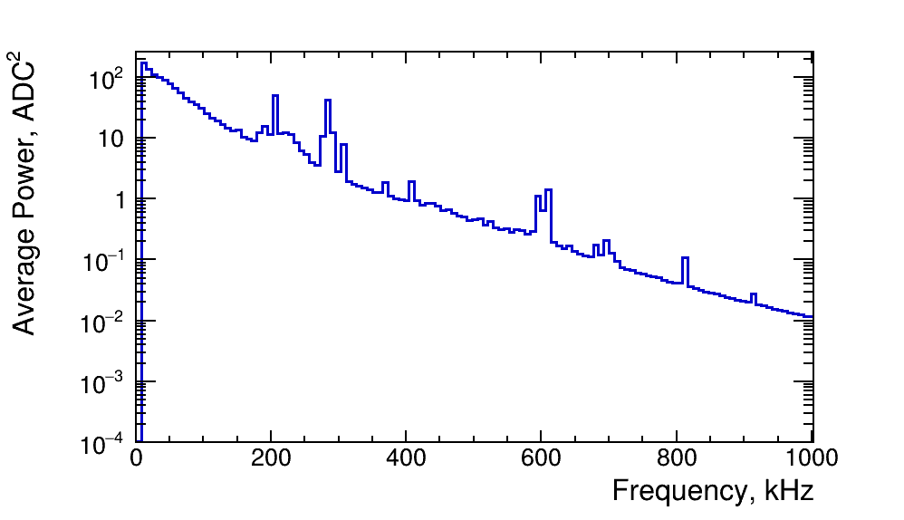
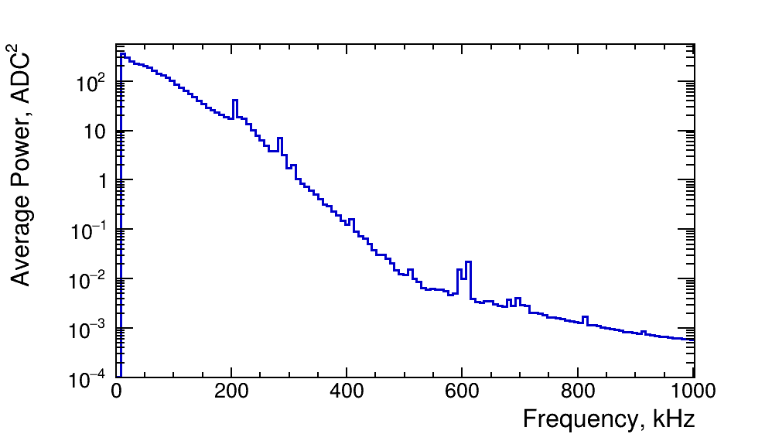
FFT Map vs Cal data
The same frequency components are present in both Mapped (Raw) and Cal data.
The Savitzky-Golay filter does not fully reduce the noise.
Mapped waveform→FFT→frequency peaks
Mapped waveform →signal processing (SG filer + other steps) →Cal data →FFT →same peaks

Slide 18
Conclusions
²⁴¹Am alpha sources provide clear signals for detector monitoring and calibration
Alpha-peak position shows a clear dependence on the applied HV
Electronic noise contains several distinct frequency components
The amplitude of the ~206 kHz component decreases with decresing HV
Further investigation of the noise sources is needed and digital filtering should be concidered

Slide 19

Thank you!
Member of AMBER (Another Minute Before Early Rising) in free time:
Member of ACTAF (Another Coffee To Avoid Fatique) in free time:

