Slide 1


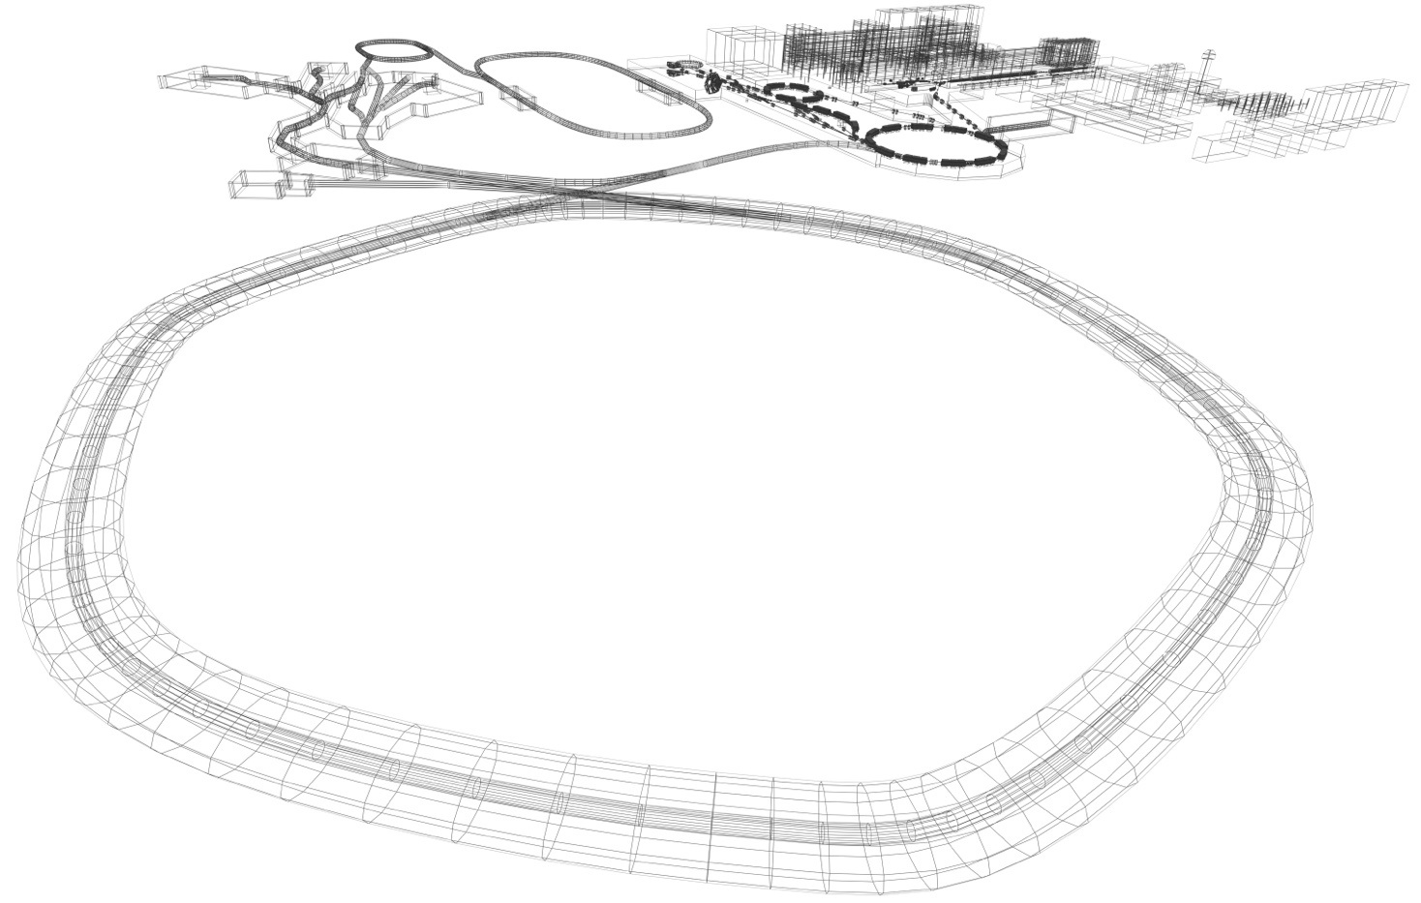
Microdosimetry of complex radiation fields
Federica Anastasia Diana
University of Naples ”Federico II”
Tutor: Enrico Pierobon
1

Slide 2
Index
  Space radiation environment
  Microdosimetry
  Radiation Field and Source Geometry
  Spectrum Conversion
  Geant4 Simulations with the Diamond Detector
  Results
2

Slide 3
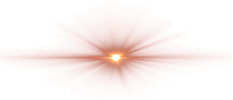
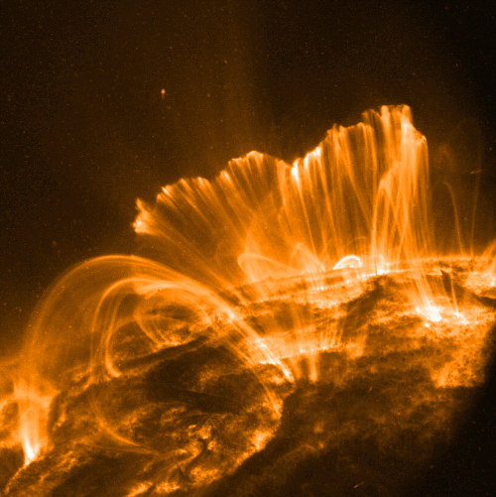

Introduction, a general view of the problem
Space radiation is one of the main risks for astronauts during long-duration space missions.
The radiation environment in space is mainly composed of galactic cosmic rays (GCRs) and solar particle events (SPEs).
Possibility of important health risks
Need for radition field characterization
3

Slide 4
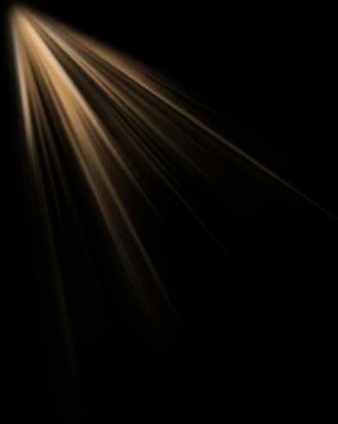
Galactic Cosmic Rays (GCRs)
Chronic exposure during long-duration missions
Result
GCRs provide a continuous background of
highly energetic particles
(protons, heavy ions...)
long-term health risks
Dense ionization
tracks in biological tissue
4

Slide 5
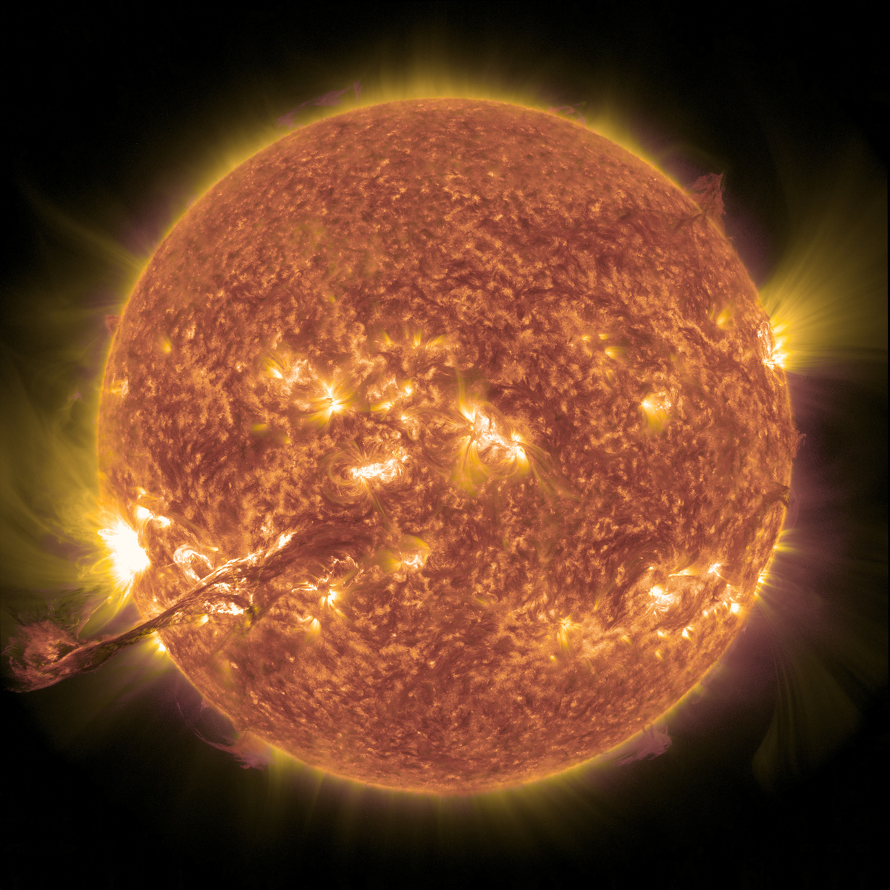
Solar Particle Events (SPEs)
SPEs are temporary increases in the flux of energetic
particles produced by solar activity.
Complex radiation field
Ions and protons with broad kinetic energies
Particle flux and dose rate can increase significantly over a
short period
ACUTE RADIATION EFFECTS
We will focus on Solar Particle Events
5

Slide 6
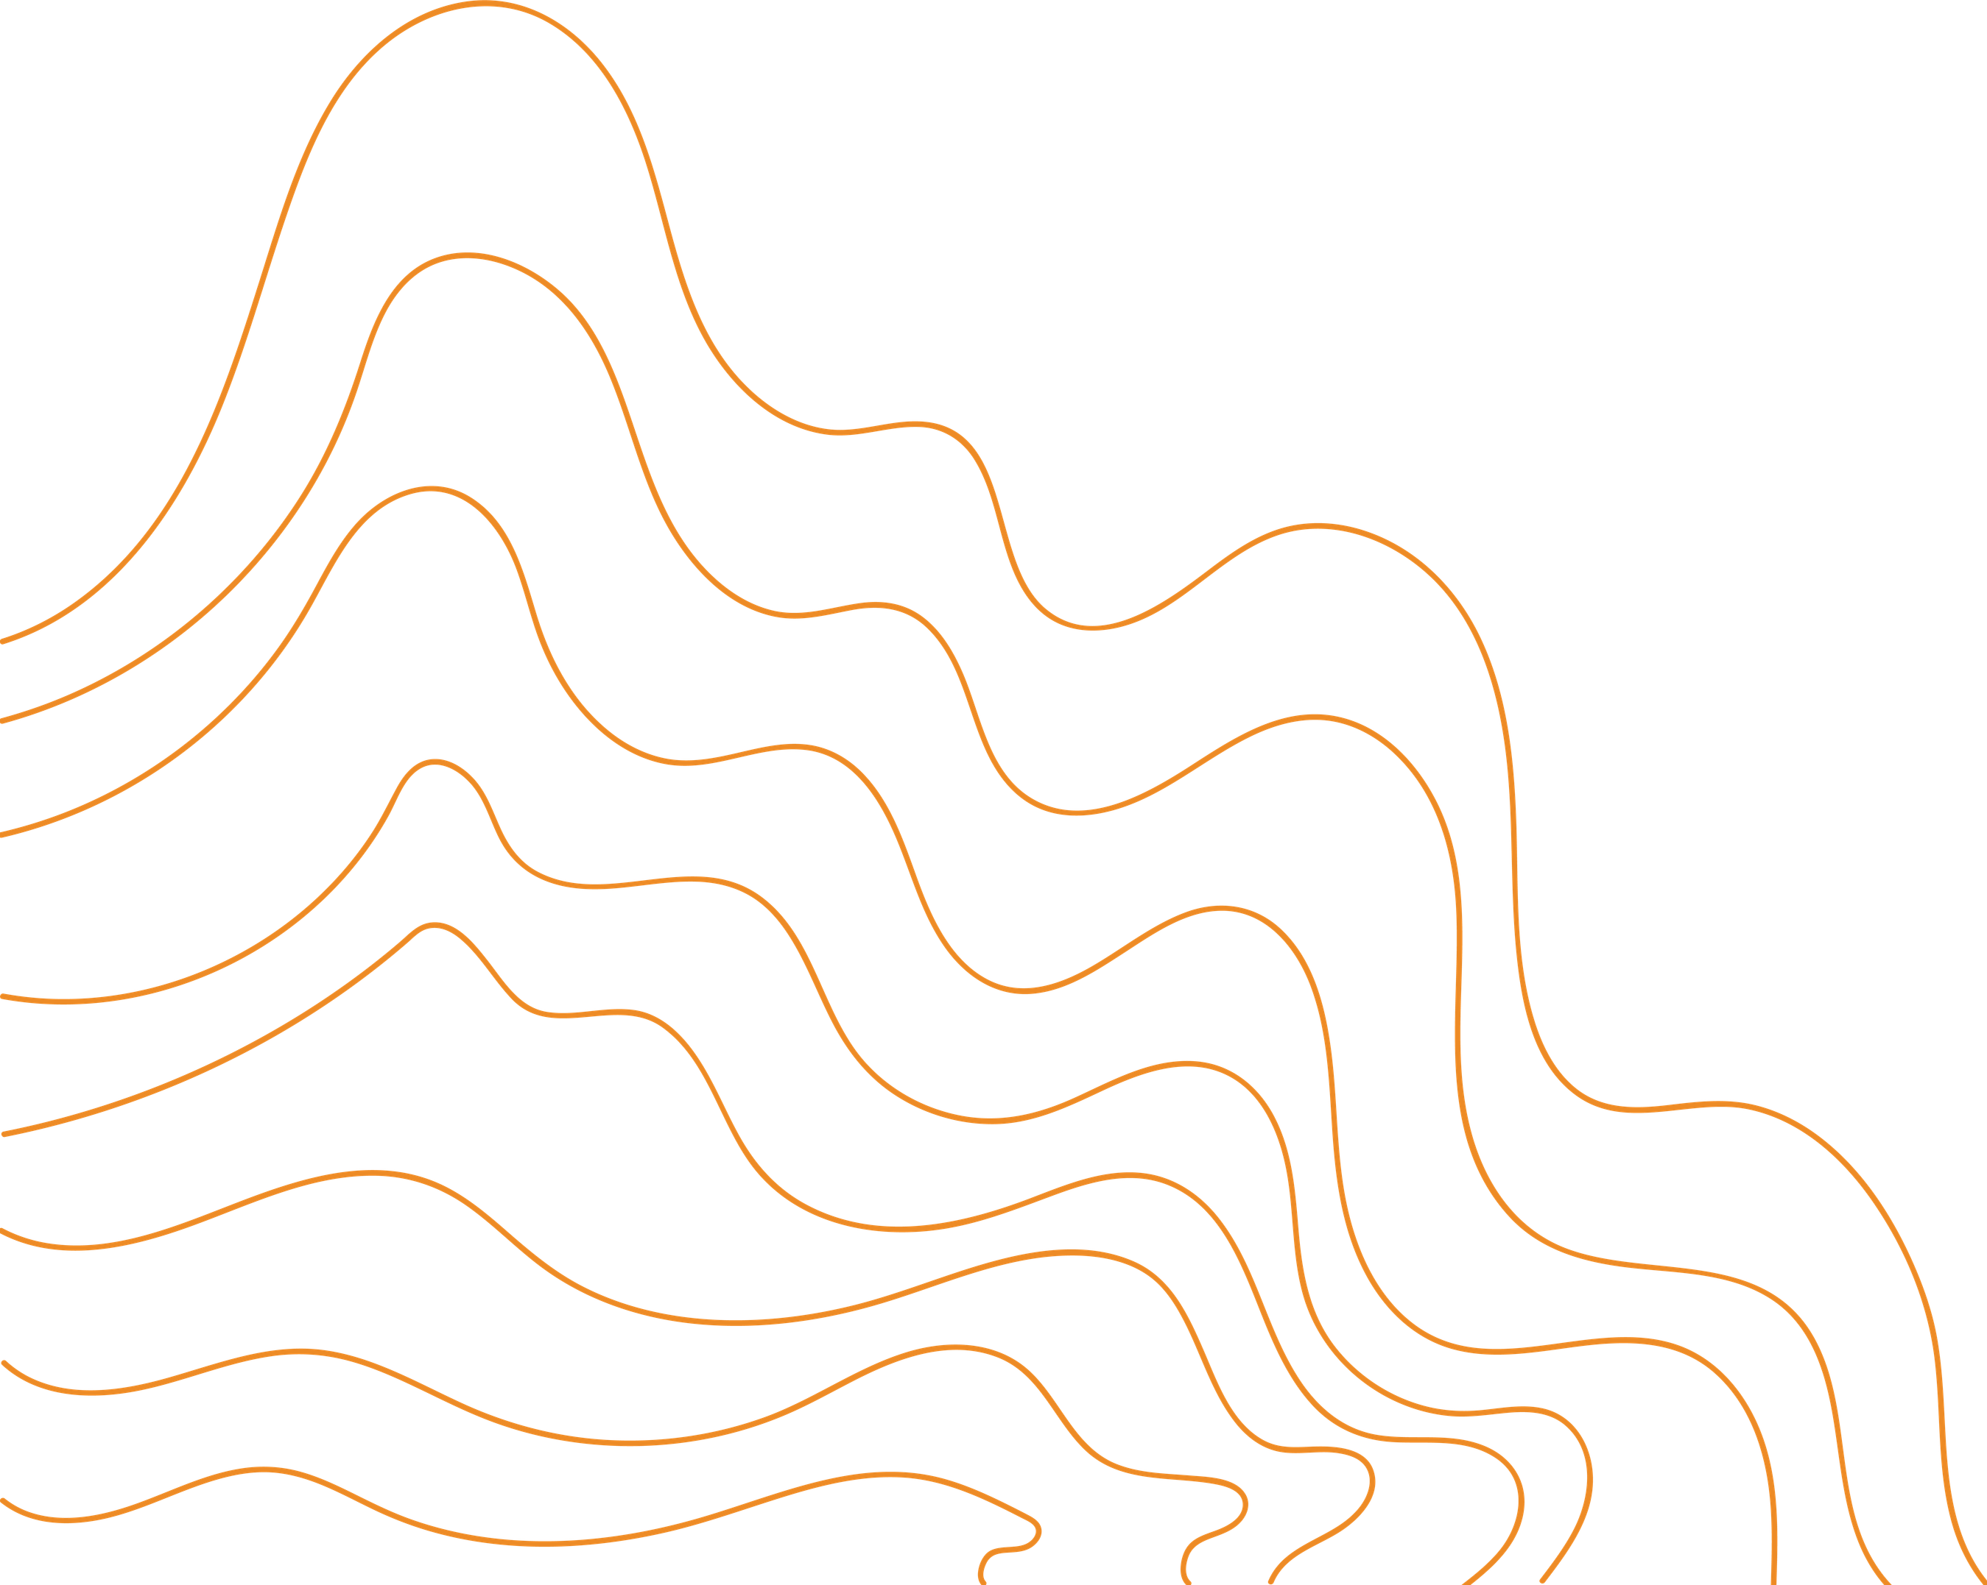
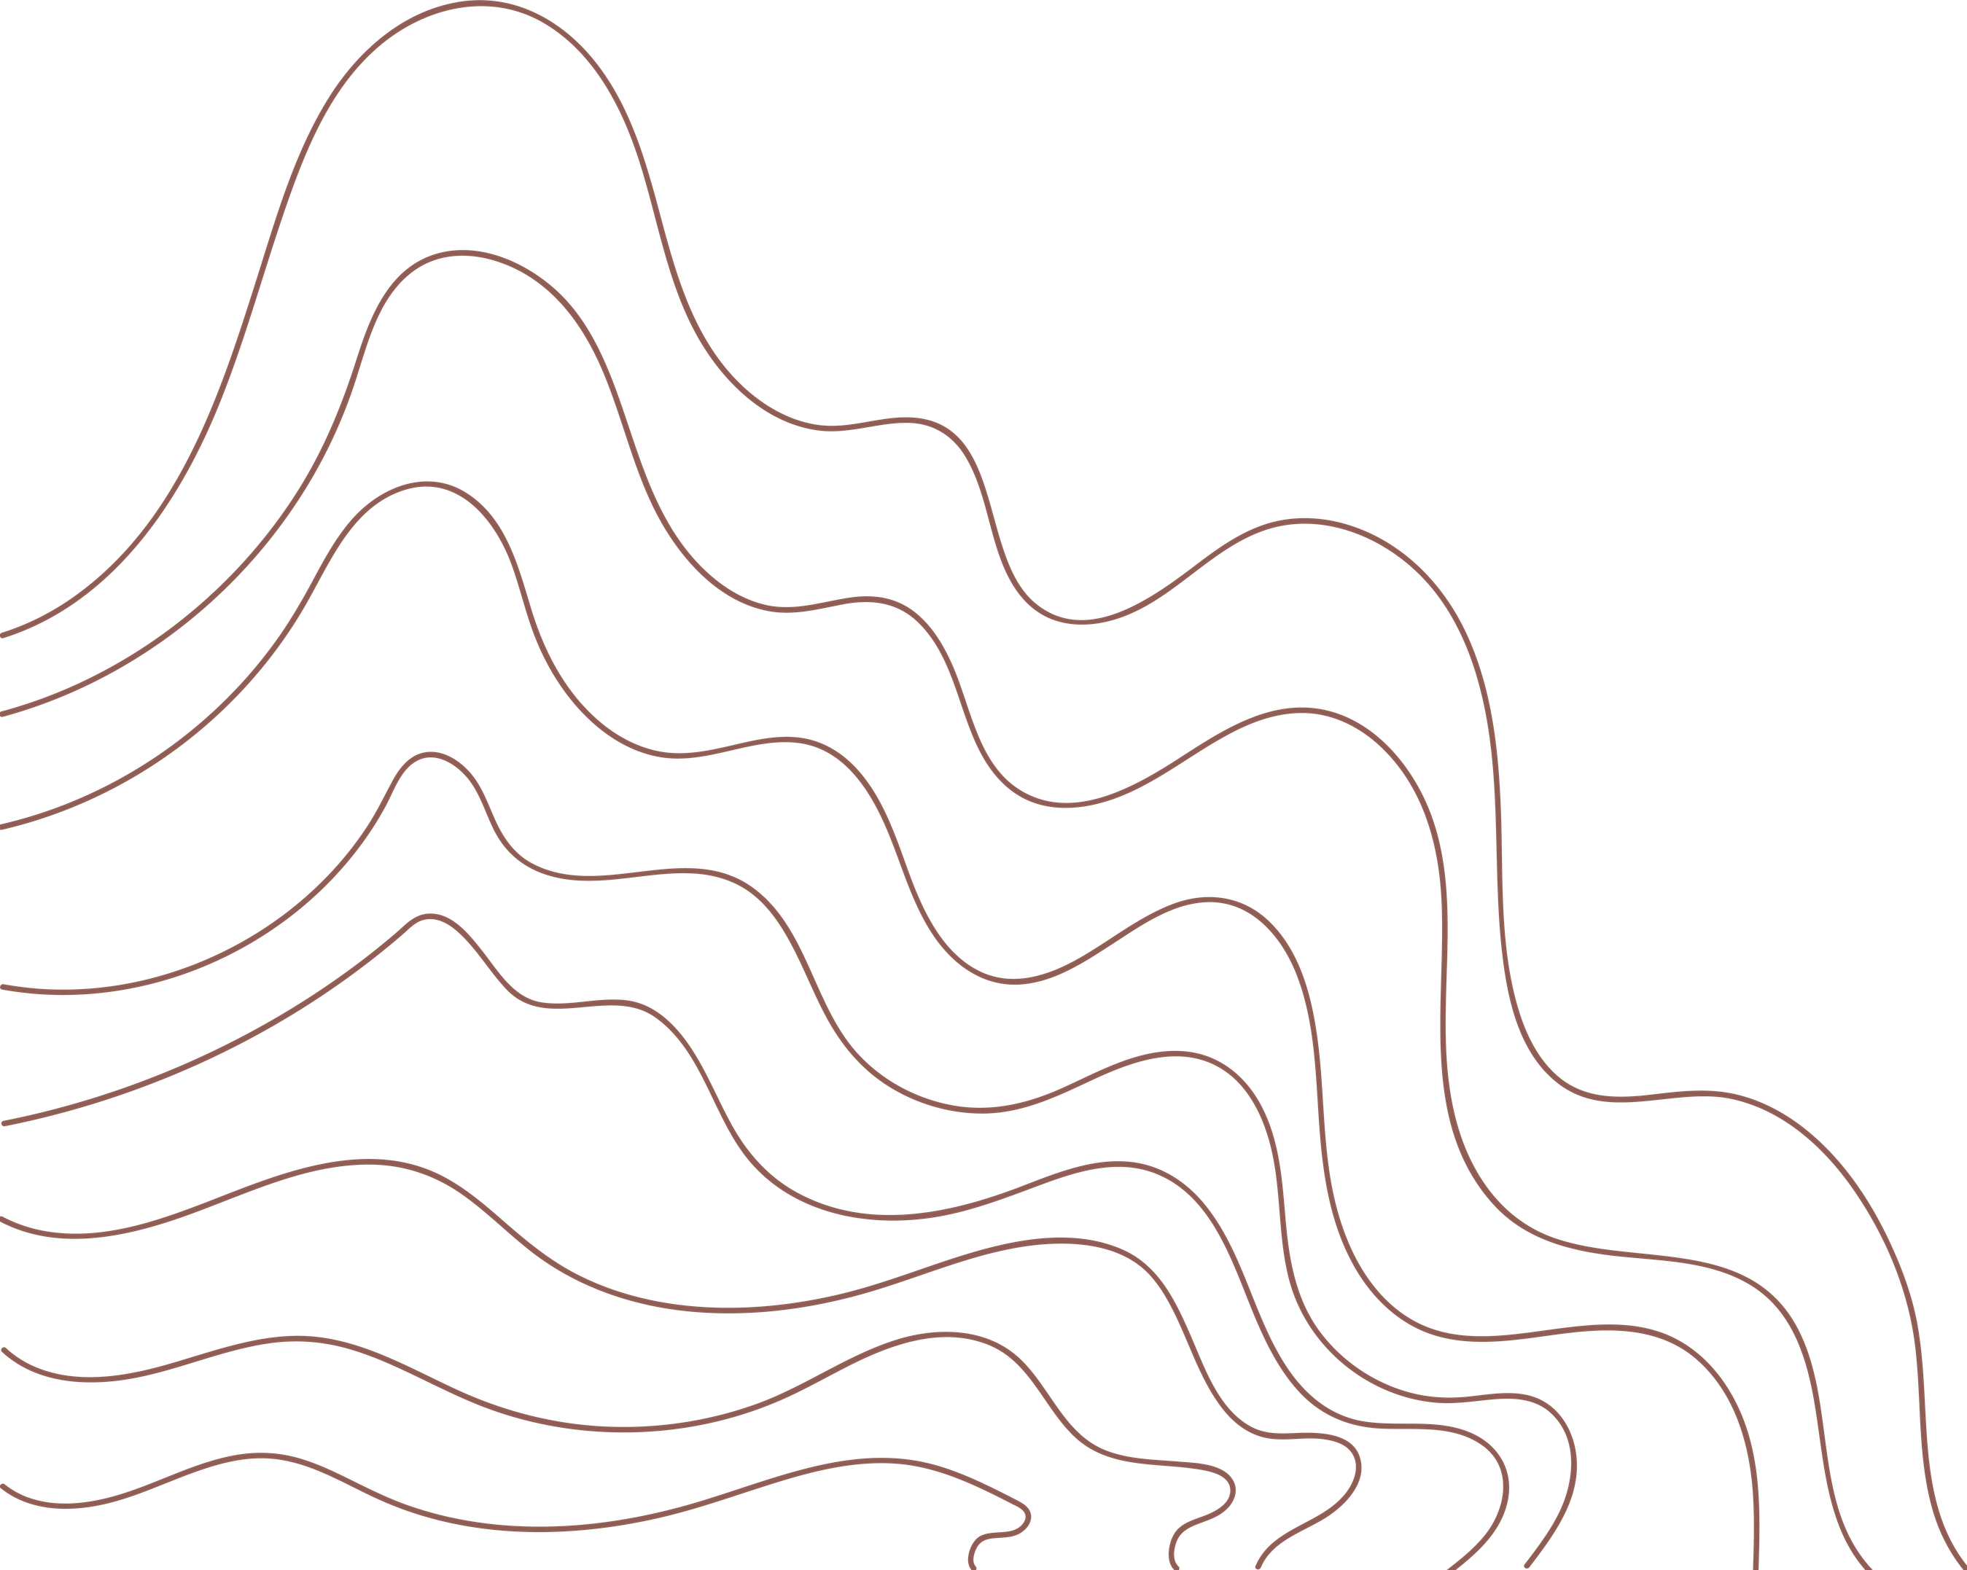
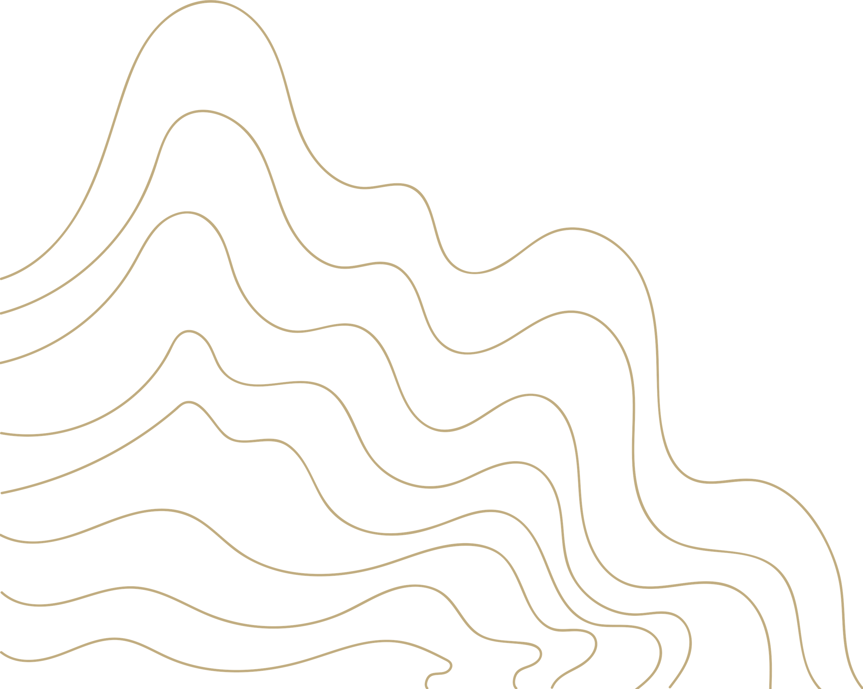
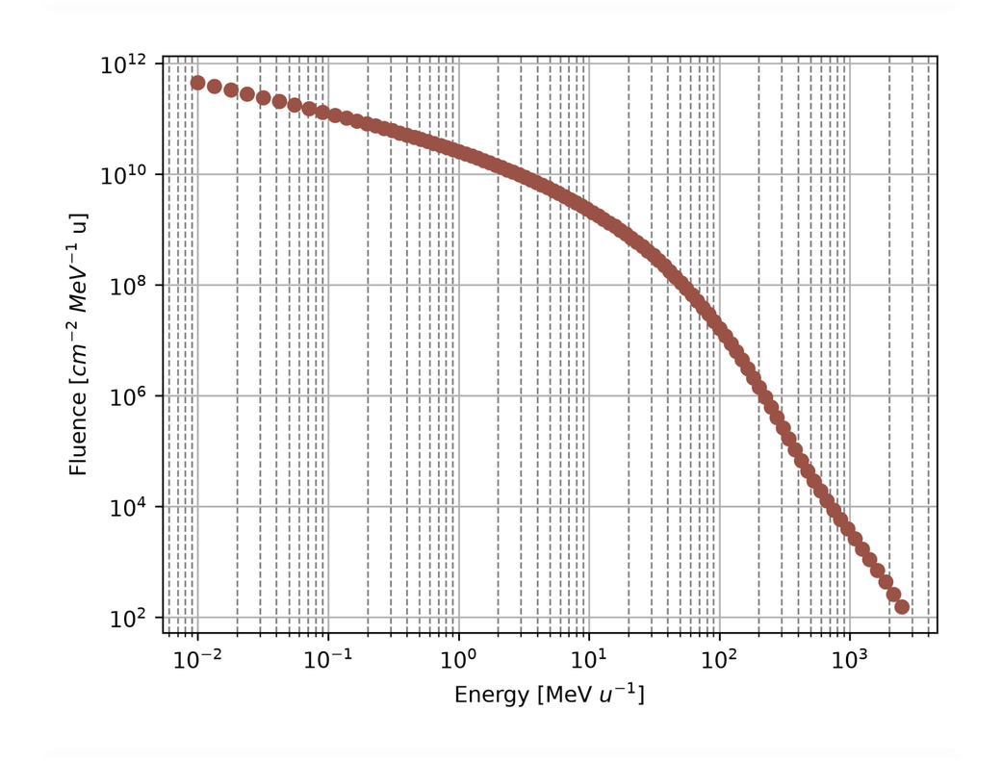

1989 Solar Particle Event
  Between August and October 1989;
  most of the protons are concentrated at relatively low energies;
  approximately exponential behaviour;
  the spectrum extends well into the high-energy region, with protons reaching energies above 500 MeV (Range in water greater than 1 m).
6

Slide 7
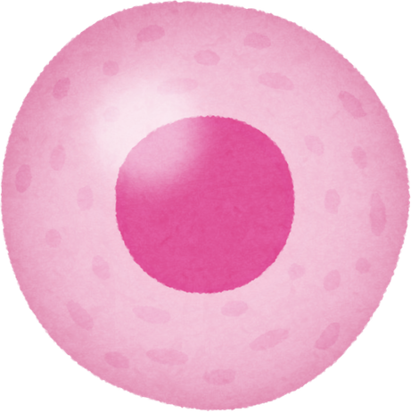
Microdosimery
Microdosimetry characterizes radiation by studying the variation of energy deposition in microscopic volumes.
mm
mu
This approach provides information about the radiation field
Macroscopy Dosimetry
Microdosimetry
deterministic value
stochastic energy deposition
7

Slide 8
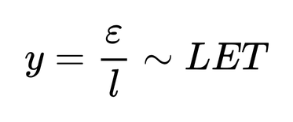
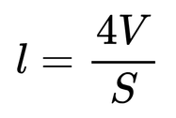
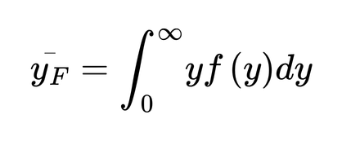
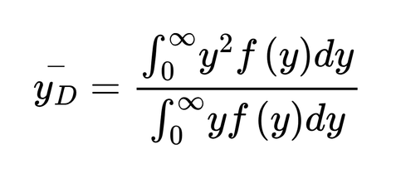
Microdosimery
Given ε, the energy imparted to the diamond sensitive volume, the corresponding lineal energy, , was then calculated as
where is the mean chord length of the sensitive volume and was calculated as
sensitive volume
surface area of the sensitive volume
The resulting lineal-energy distribution was then used to construct the frequency- and dose- weighted distributions, yf(y) and yd(y), respectively.
The frequency-mean lineal energy:
f(y) represents the normalized frequency distribution of lineal energy.
The dose-mean lineal energy:
8

Slide 9
Monte Carlo simulation and Geant4
What is Monte Carlo?
A computational method based on repeated random sampling
Simulate physical systems and probabilistic processes
At microscopic scales, energy deposition varies from event to event, yielding a distribution of imparted energies
Why Monte Carlo?
What is Geant4?
An open-source toolkit developed to model the transport and interaction of particles through matter.
9

Slide 10
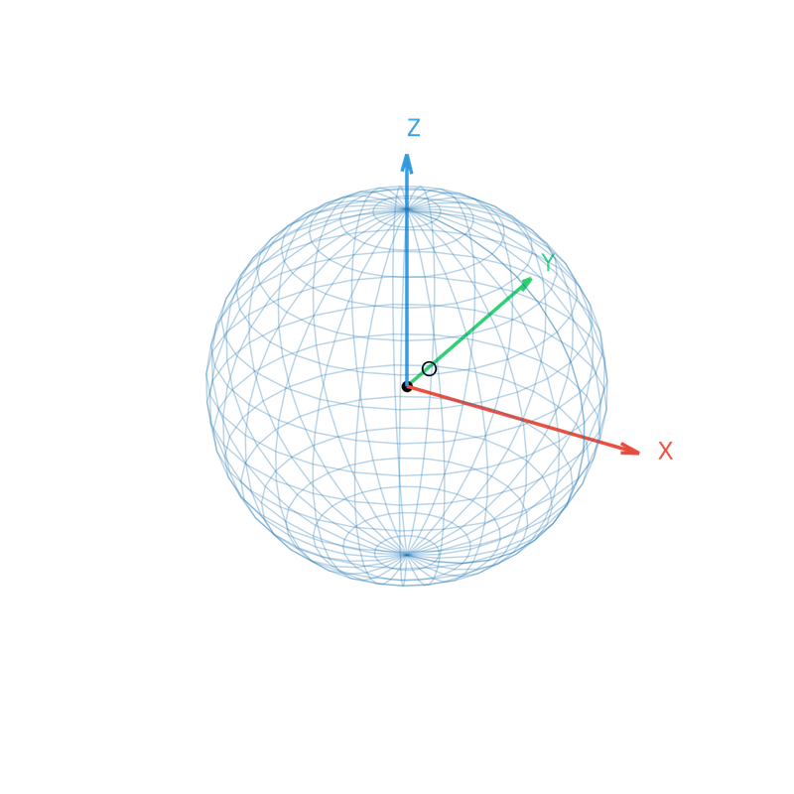
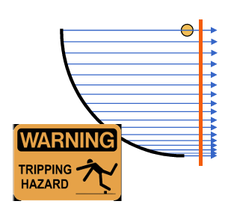
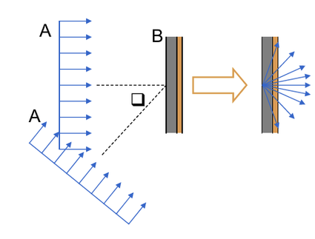
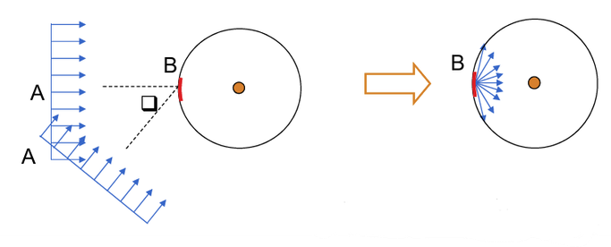
Radiation Field and Source Geometry
Aim: Reproducing an isotropic radiation field at the detector location
source geometry: spherical surface
Iso vs Cosine-law angular distribution
Full flux
Reduced by a factor cos
  Isotropic angular emission from the surface leads to non isotropic fluence in the volume
*Giovanni Santin ESA / ESTEC and RheaTechLtd
Cosine-law angular emission
10

Slide 11

Spectrum Conversion
OLTARIS SPE Spectrum
multi particles spectra
Python Parser
  source geometry
  angular distribution
Developed with BLABLADOR + OpenCode
Geant4 Macro Generation
Geant4 GPS-compatible energy distribution
Monte Carlo Simulation
single
particle spectra
VALIDATION
11

Slide 12
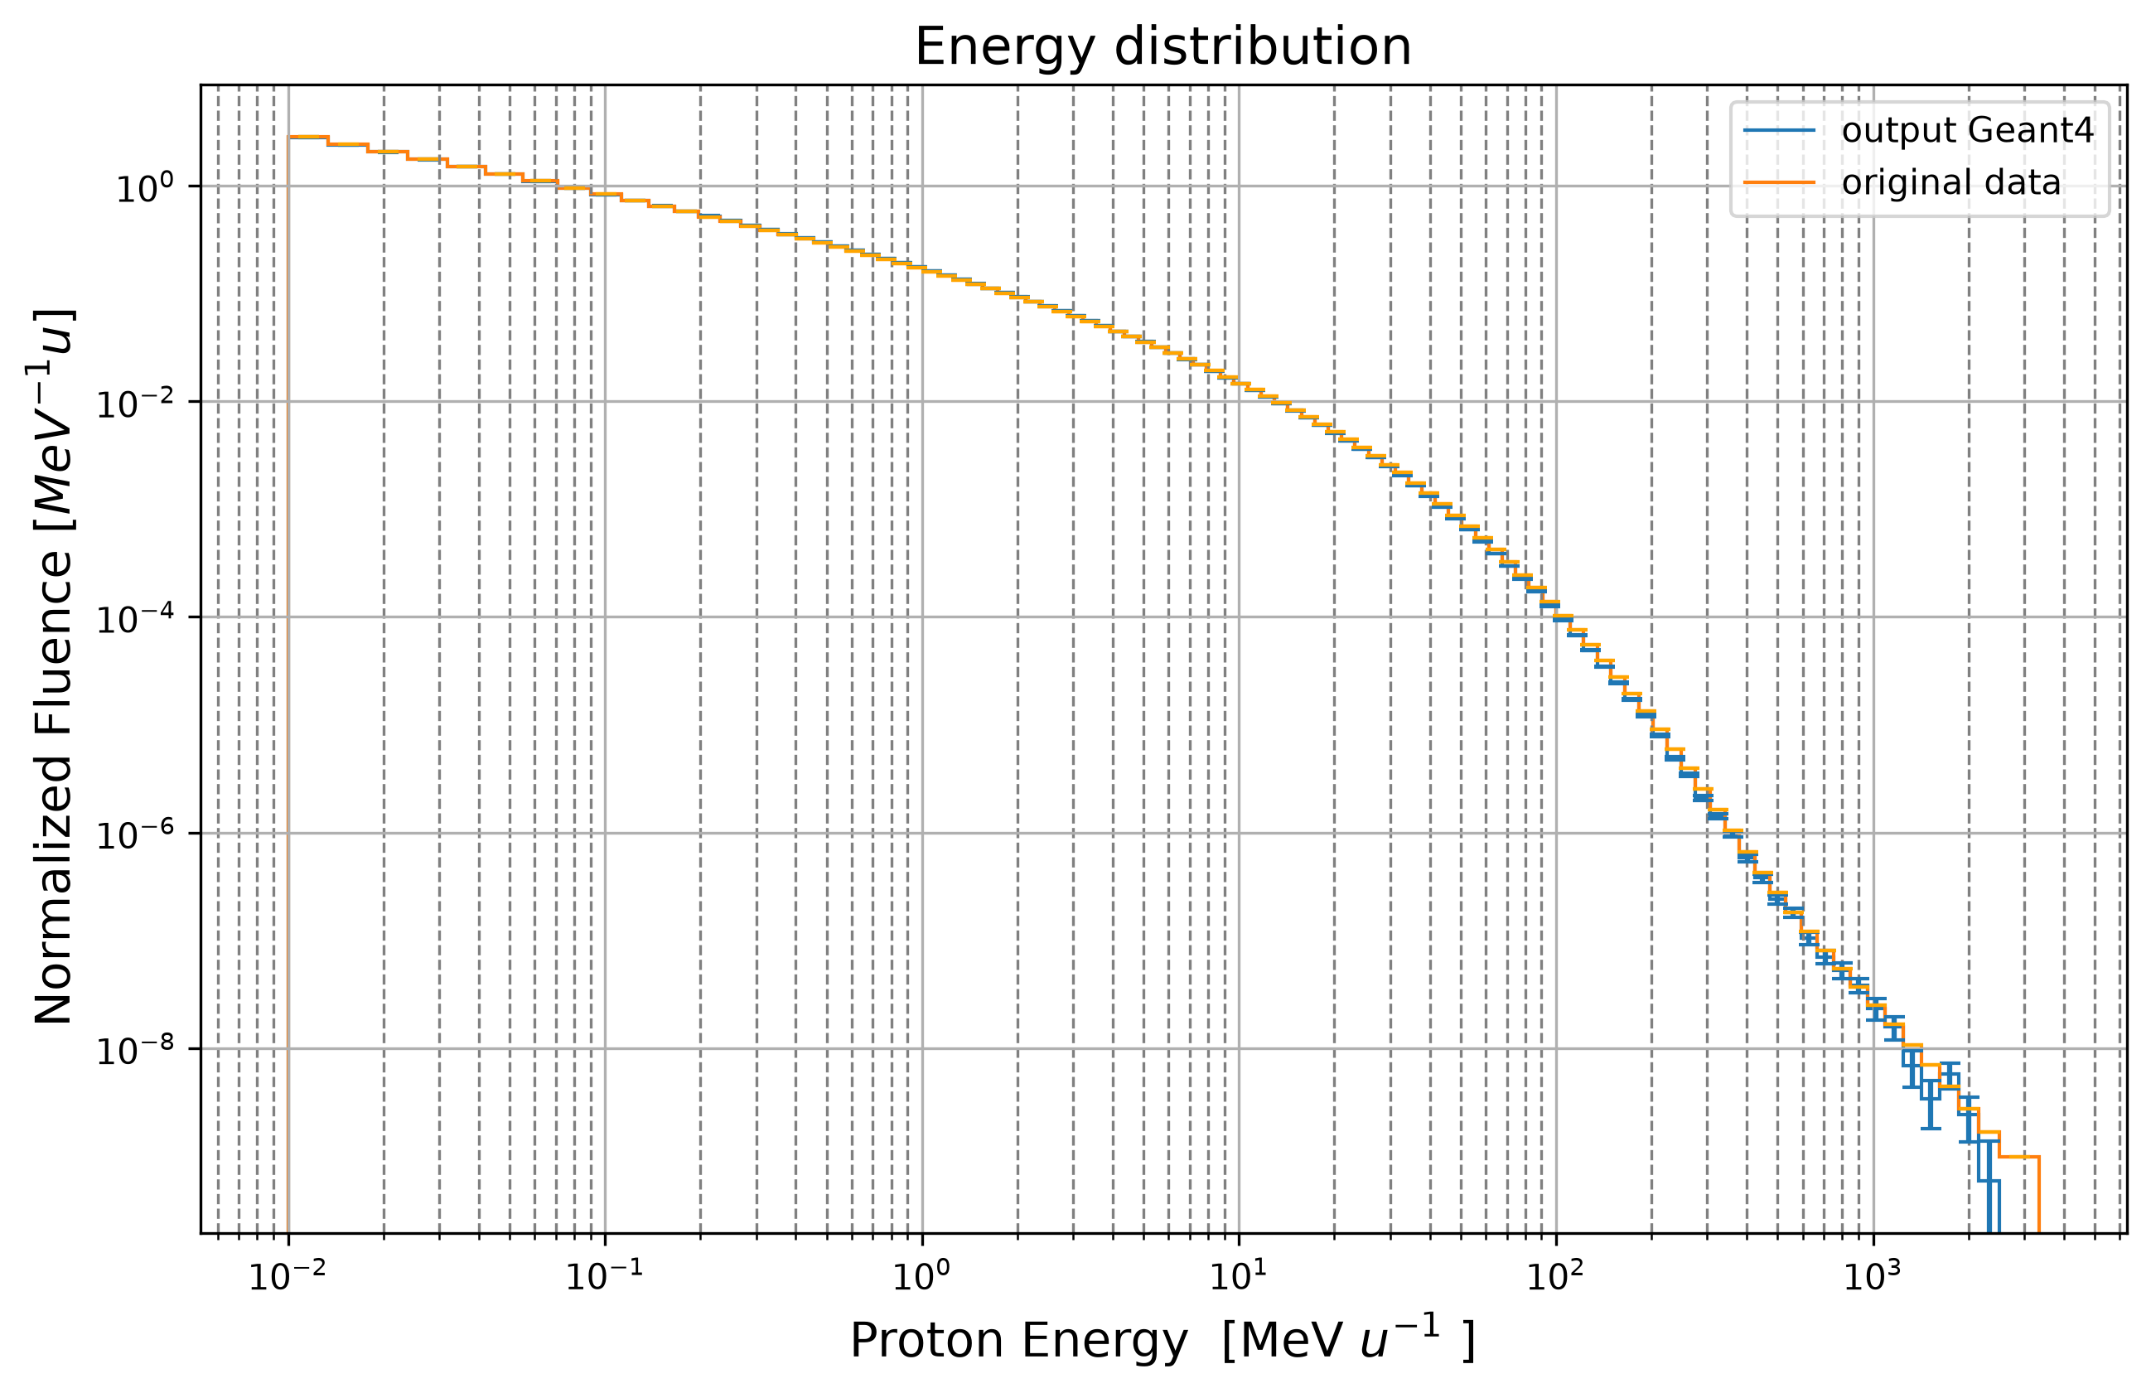

Results
Comparison of Energy Spectra
Both distributions were normalized to their respective integrals, allowing their spectral shapes to be compared.
12

Slide 13
Geant4 Simulations with the Diamond Detector
13

Slide 14
Detectors Simulated
Tissue-Equivalent Proportional Counter (TEPC)
Diamond Detector
large gas cavity + low density
→ microscopic tissue-equivalent volume
small physical volume → microscopic energy deposition
  gas-filled detector
  simulates microscopic volumes of biological tissue
  measures the energy deposited by radiation
  solid-state detector
  uses diamond as a tissue-equivalent sensitive material
  measures the energy deposited by radiation at microscopic scales
Reference
14

Slide 15
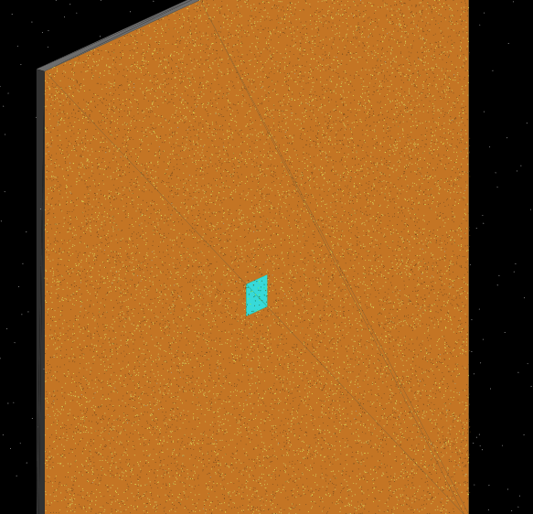
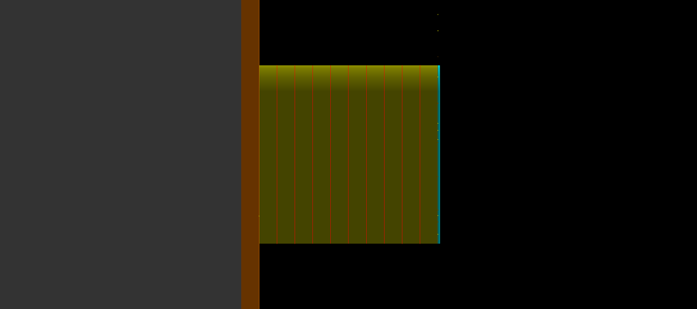
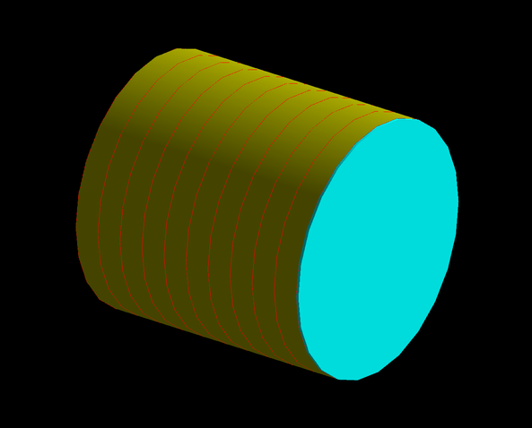
Geant4 Simulations with the Diamond Detector
Diamond detector geometry
It consists of a 100 × 100 array of diamond microdosimeters arranged on a rectangular carbon substrate.
1 mu
1 mu
5 mu
15

Slide 16
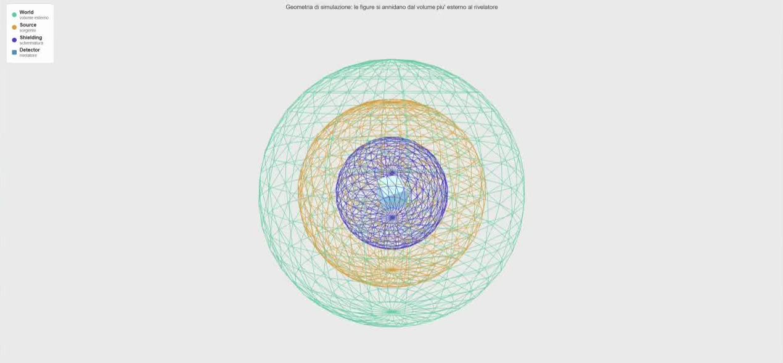
Geant4 Simulations with the Diamond Detector
The diamond microdosimeter was placed inside a spherical aluminum shielding with an areal density of 10 g cm−2
light shielding
detector
World
Source
shielding
16

Slide 17
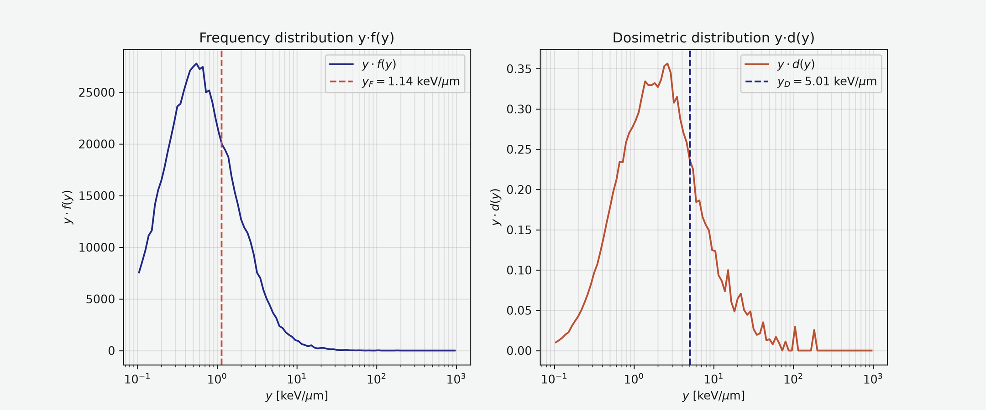
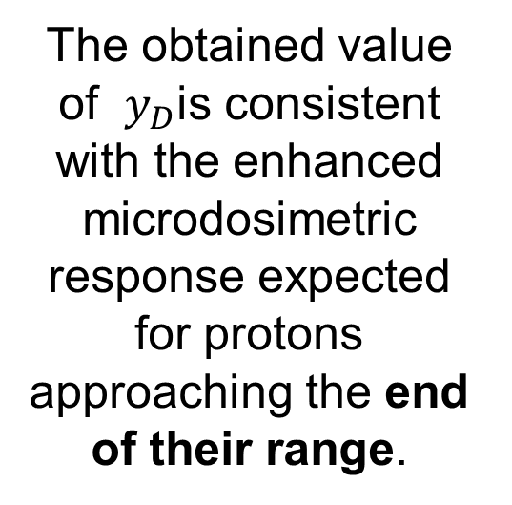
Results
Microdosimetric Spectrum
The obtained value of $y_{D}$is consistent with the enhanced microdosimetric
response expected for protons approaching the end of their range.
17

Slide 18
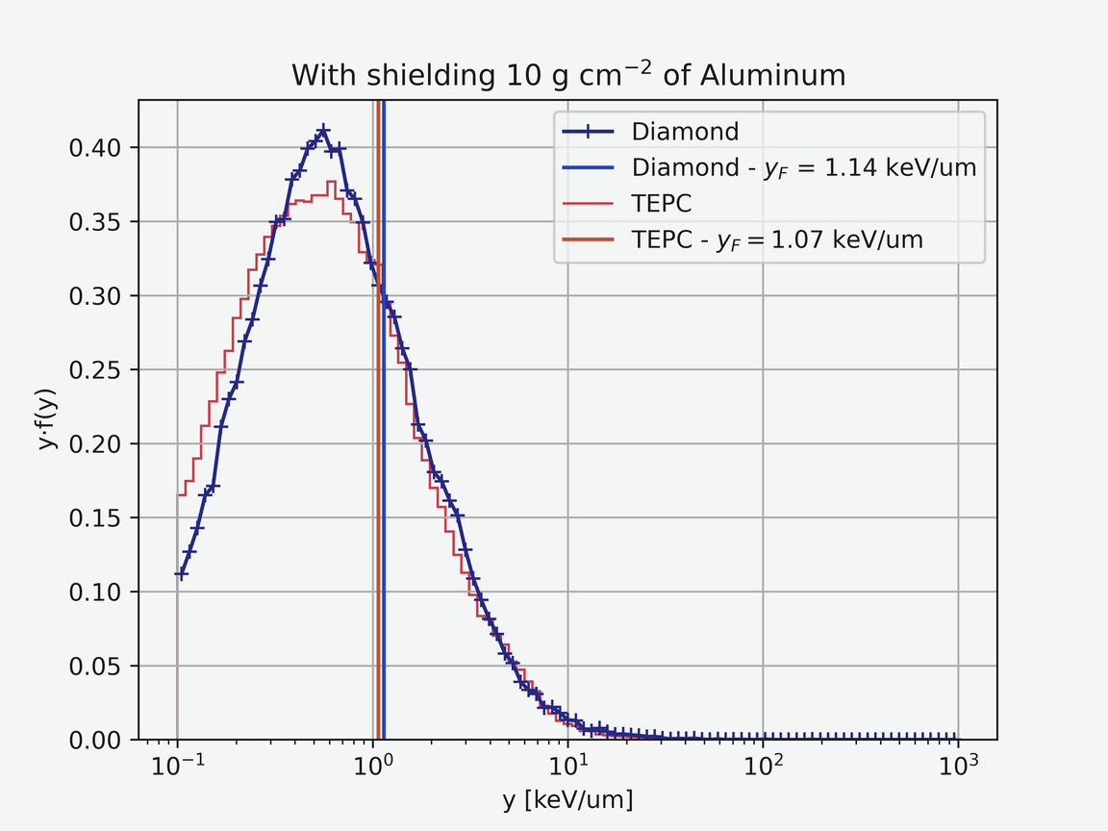
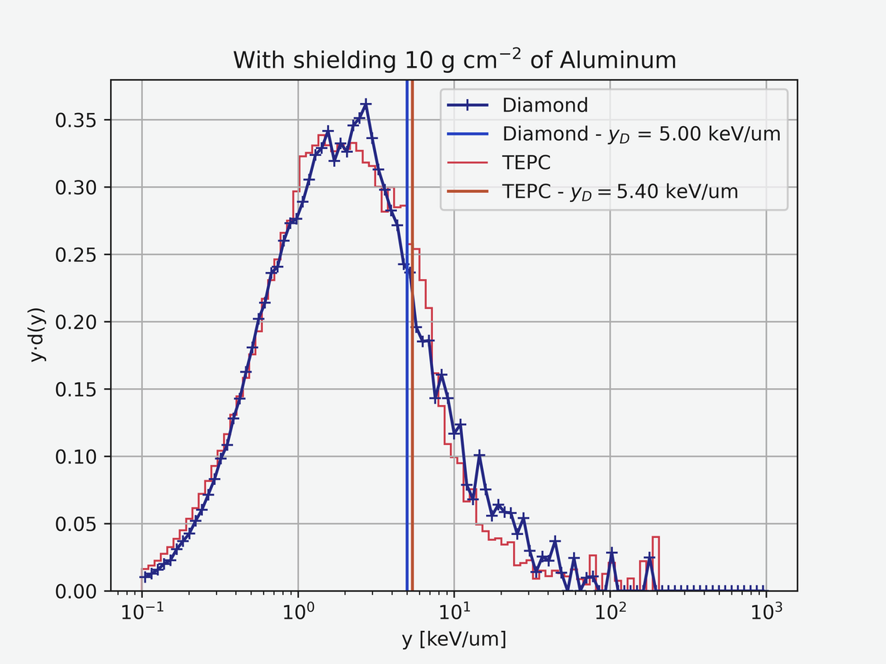
Results
Microdosimetric Spectrum, validation with TEPC
18

Slide 19
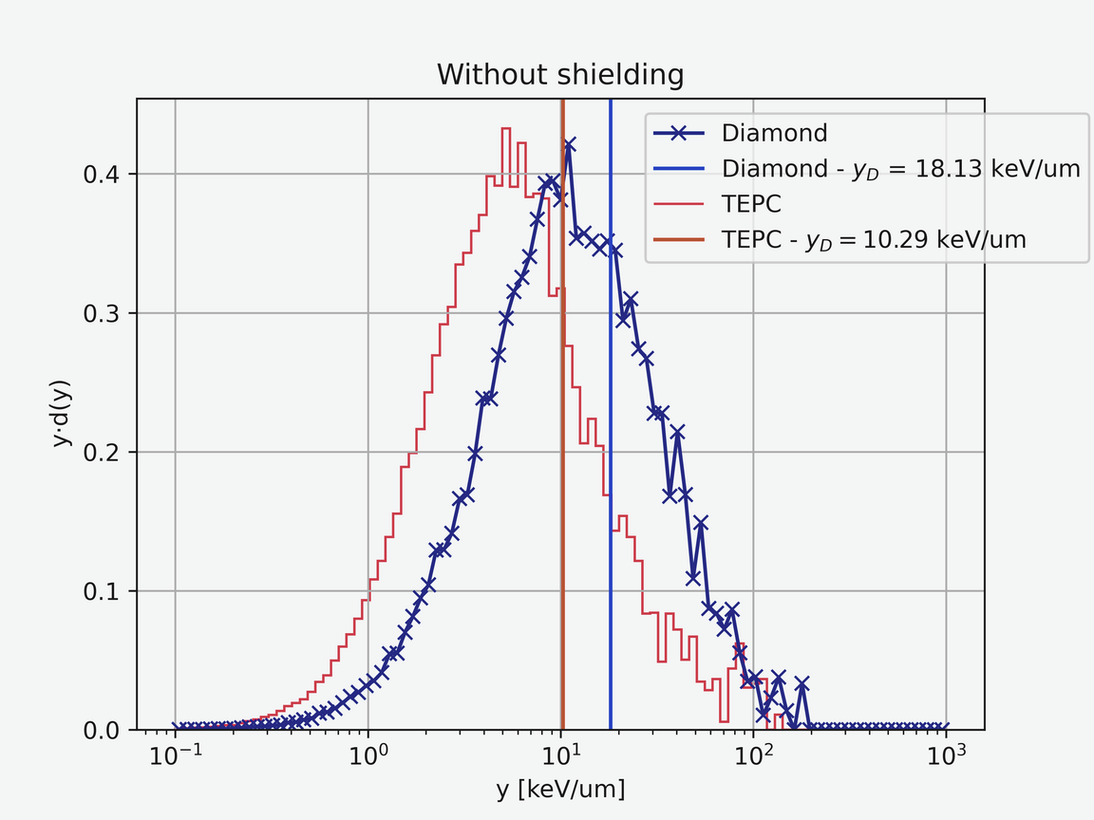
Results
Shielding and without shileding comparison
19

Slide 20
Conclusion
THE RESULTS SHOW THAT:
  The developed codes were able to effectively convert historical SPE data into Geant4 macro files
  This approach can be generalized to different SPEs
  The response of the diamond microdosimeter to the simulated SPE can be characterized through the resulting microdosimetric distributions and lineal-energy quantities, in agreement with the established literature and the TEPC approach.
20

Slide 21
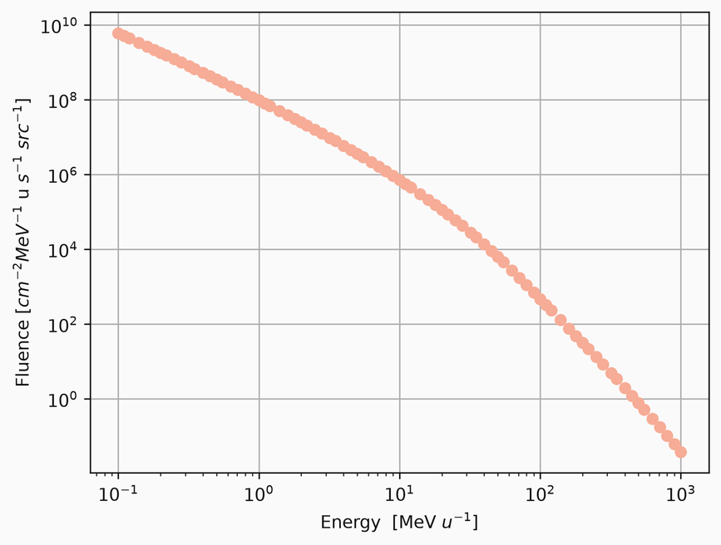
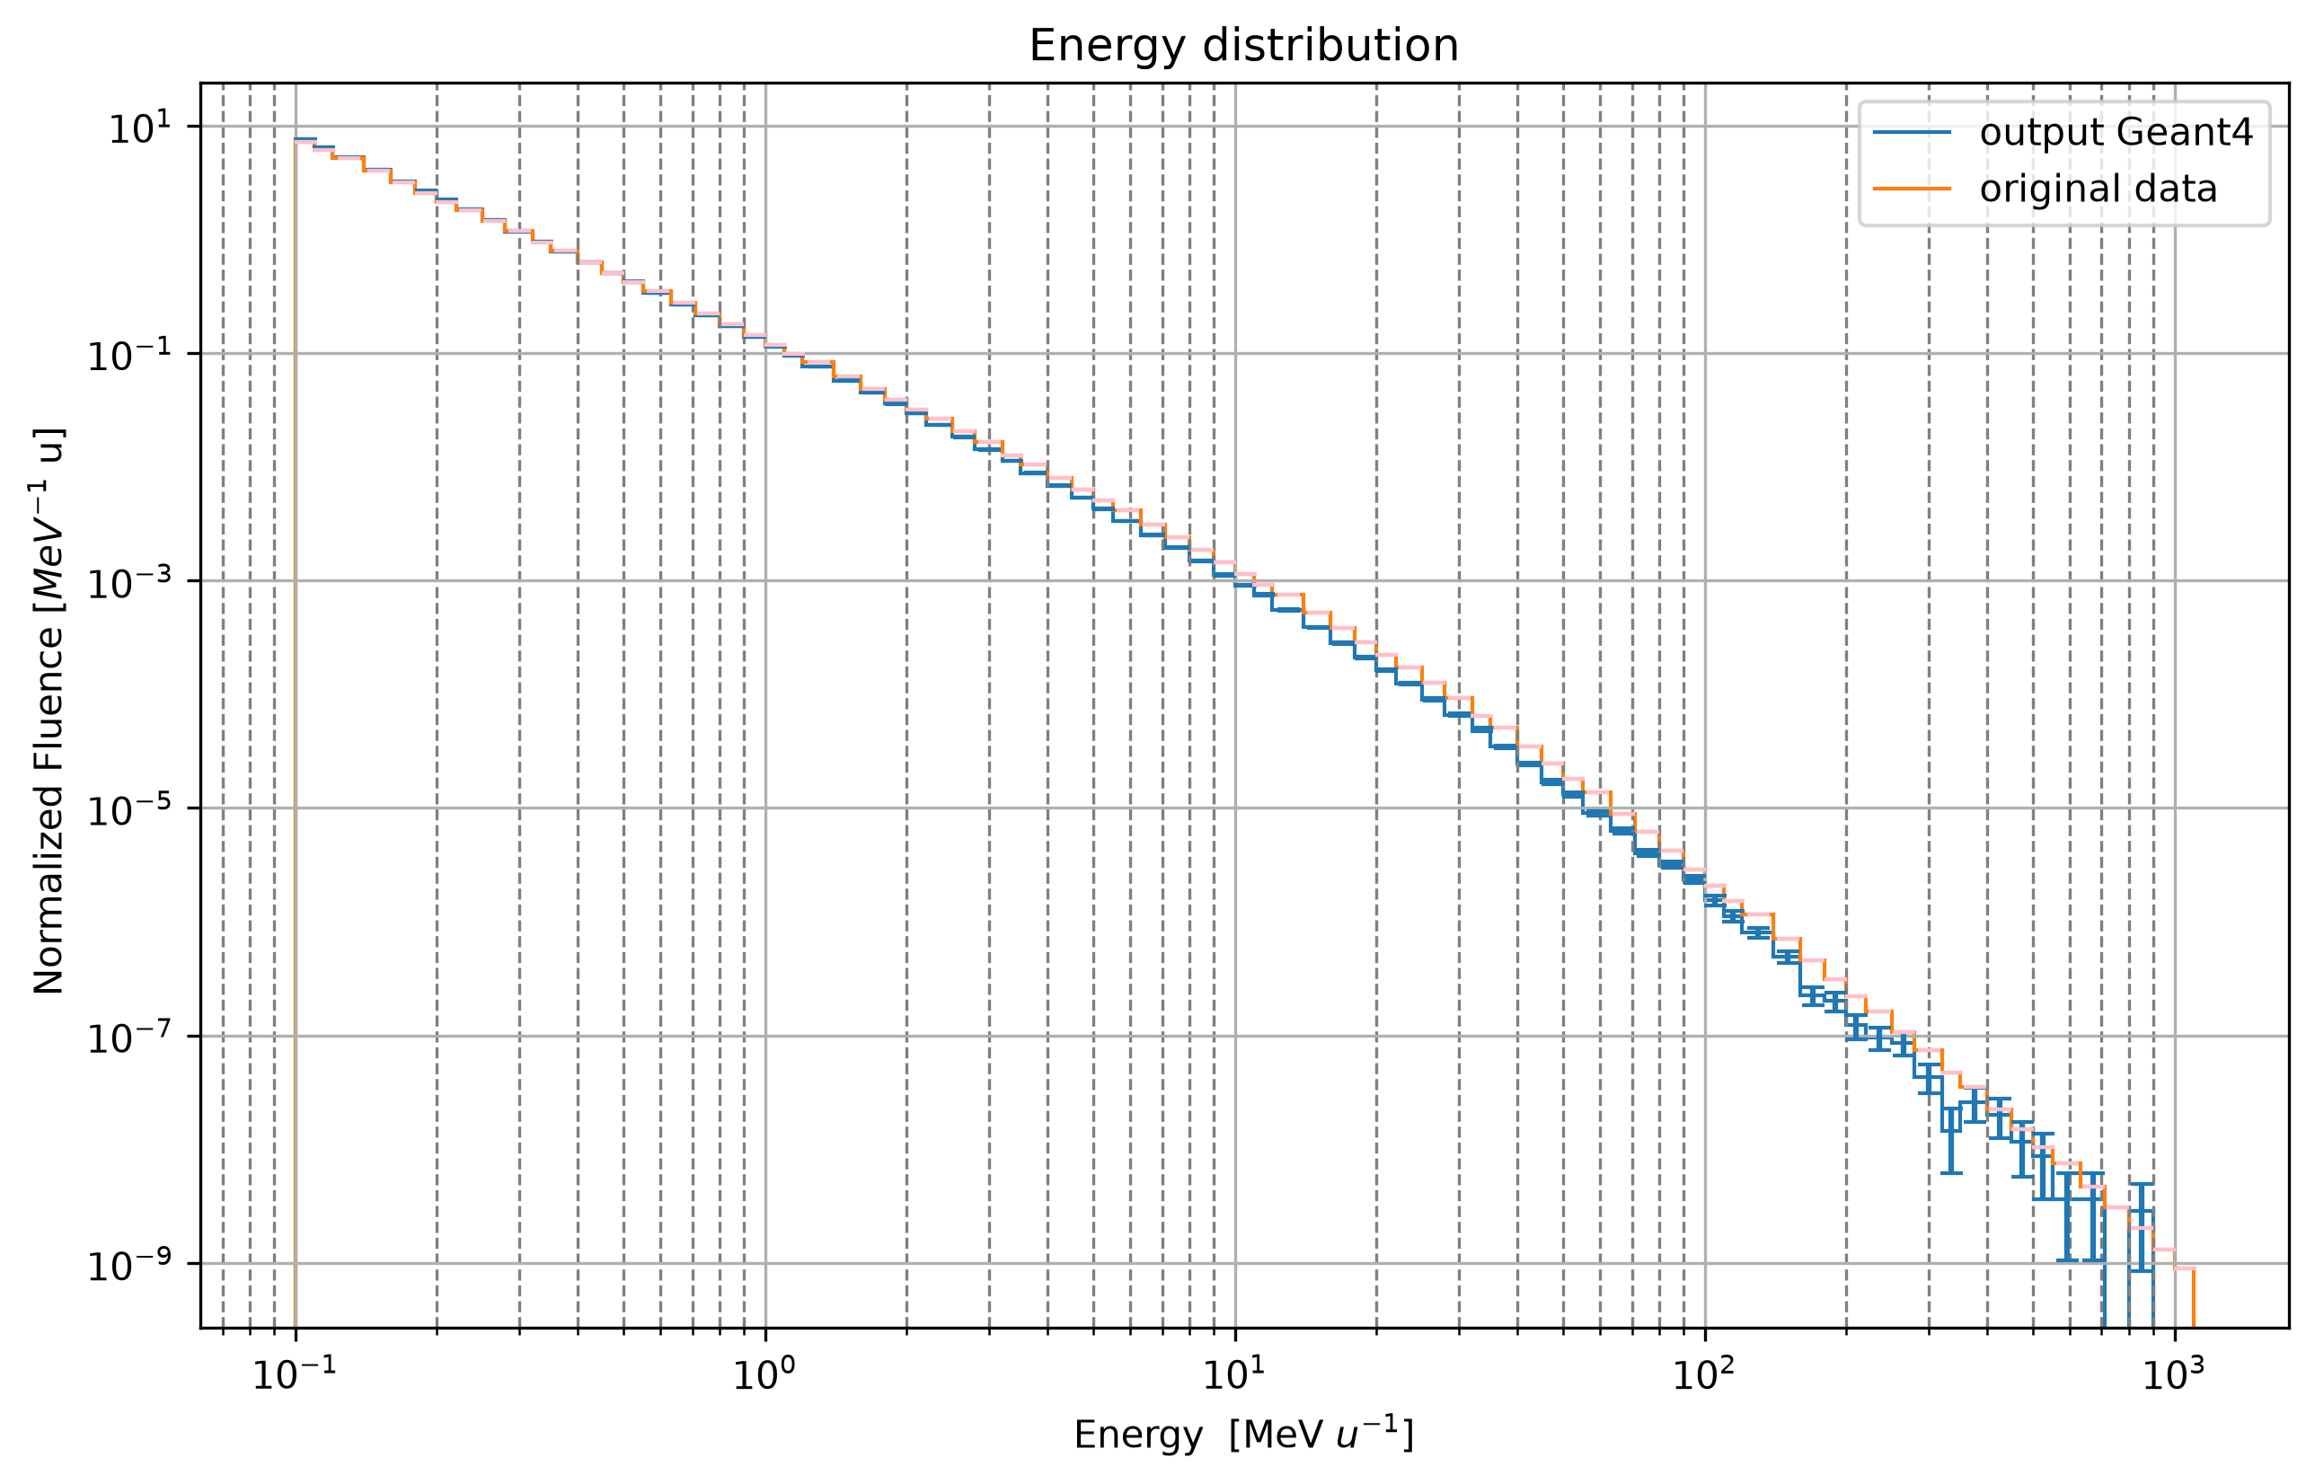
Conclusion
  4. The method can be generalized
Data from: Spenvis
Particles: Proton and Helium
21

Slide 22
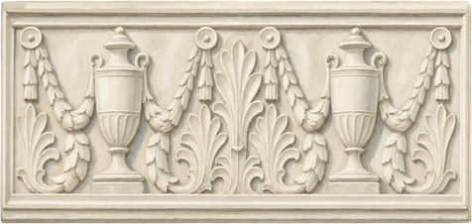

THANK YOU FOR YOUR ATTENTION
23

Slide 23
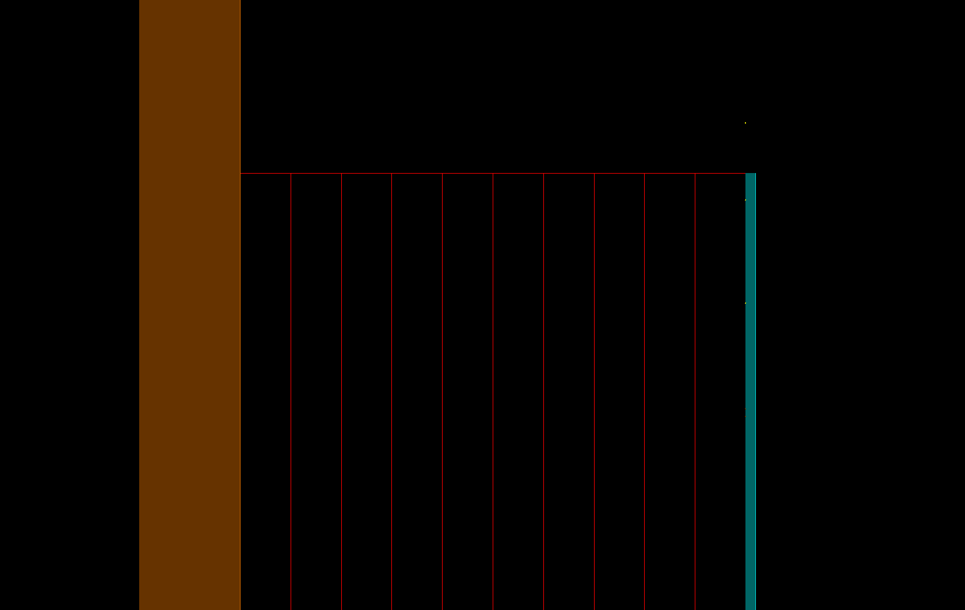
Geant4 Simulations with the Diamond Detector
Diamond detector geometry
It consists of a 100 × 100 array of diamond microdosimeters arranged on a rectangular carbon substrate.
Intrinsic diamond
electrode
0.10 um
p-diamond
Sensitives volume segmentation
1 um
substrate
Epoxy
50 um
0.5 um
15

Slide 24
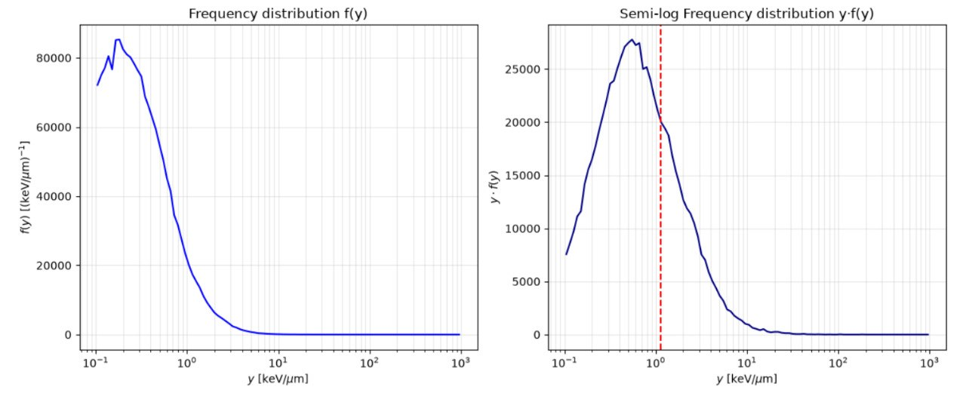
Results
15

