Slide 1
PASTA Readout Electronics
&
MUST Digitization
Sofian Sakr
GSI/FAIR International Summer School Program

Slide 2
Outline
Motivation
Straw Tube Detectors – Mechanism
PASTA at mCBM
Results 1
MUST Simulation Workflow
Digitization
MUST geometries comparison (v26e vs. v26m)
Results 2
Conclusion & Outlook
Acknowledgement

Slide 3
Motivation
LHCb OT Straw-Tube Modules
  OT usage at GSI/FAIR
    PANDA (PASTA)
    CBM (MUST)
Testing PANDA readout electronics – TRBnet
MUST Digitization: comparison between two MUST geometries (v26e, v26m)

Slide 4
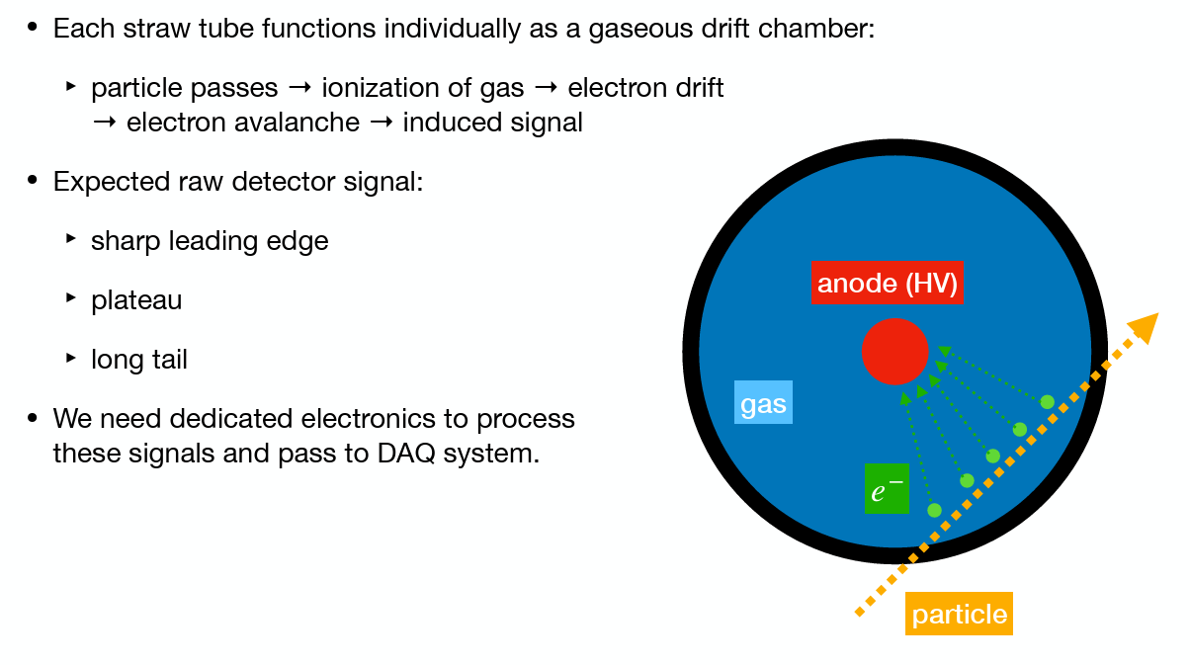
Straw Tube Detectors – Mechanism
© Darwin Alexander

Slide 5
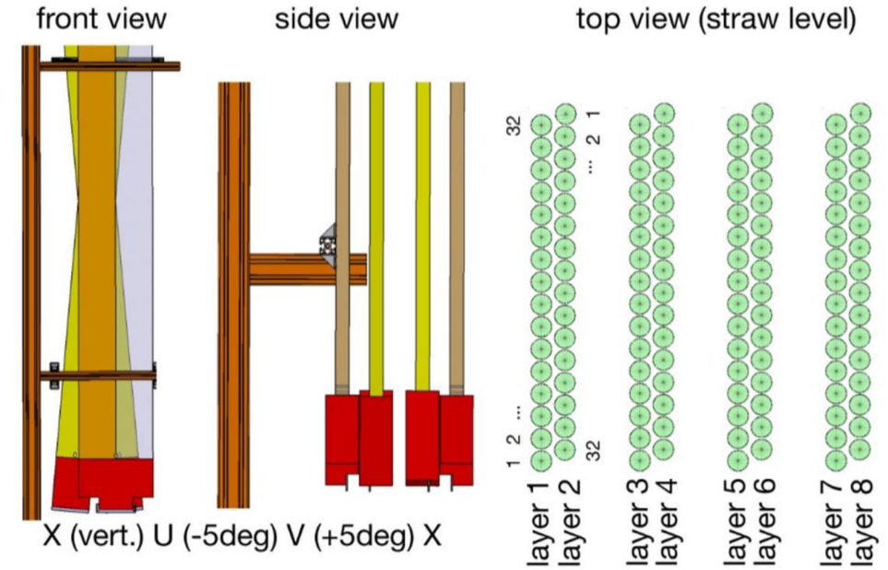
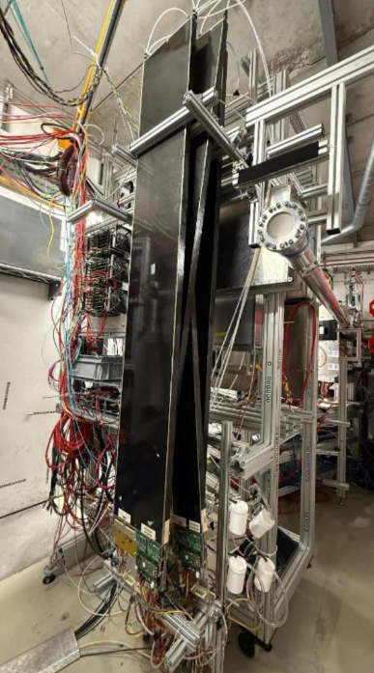
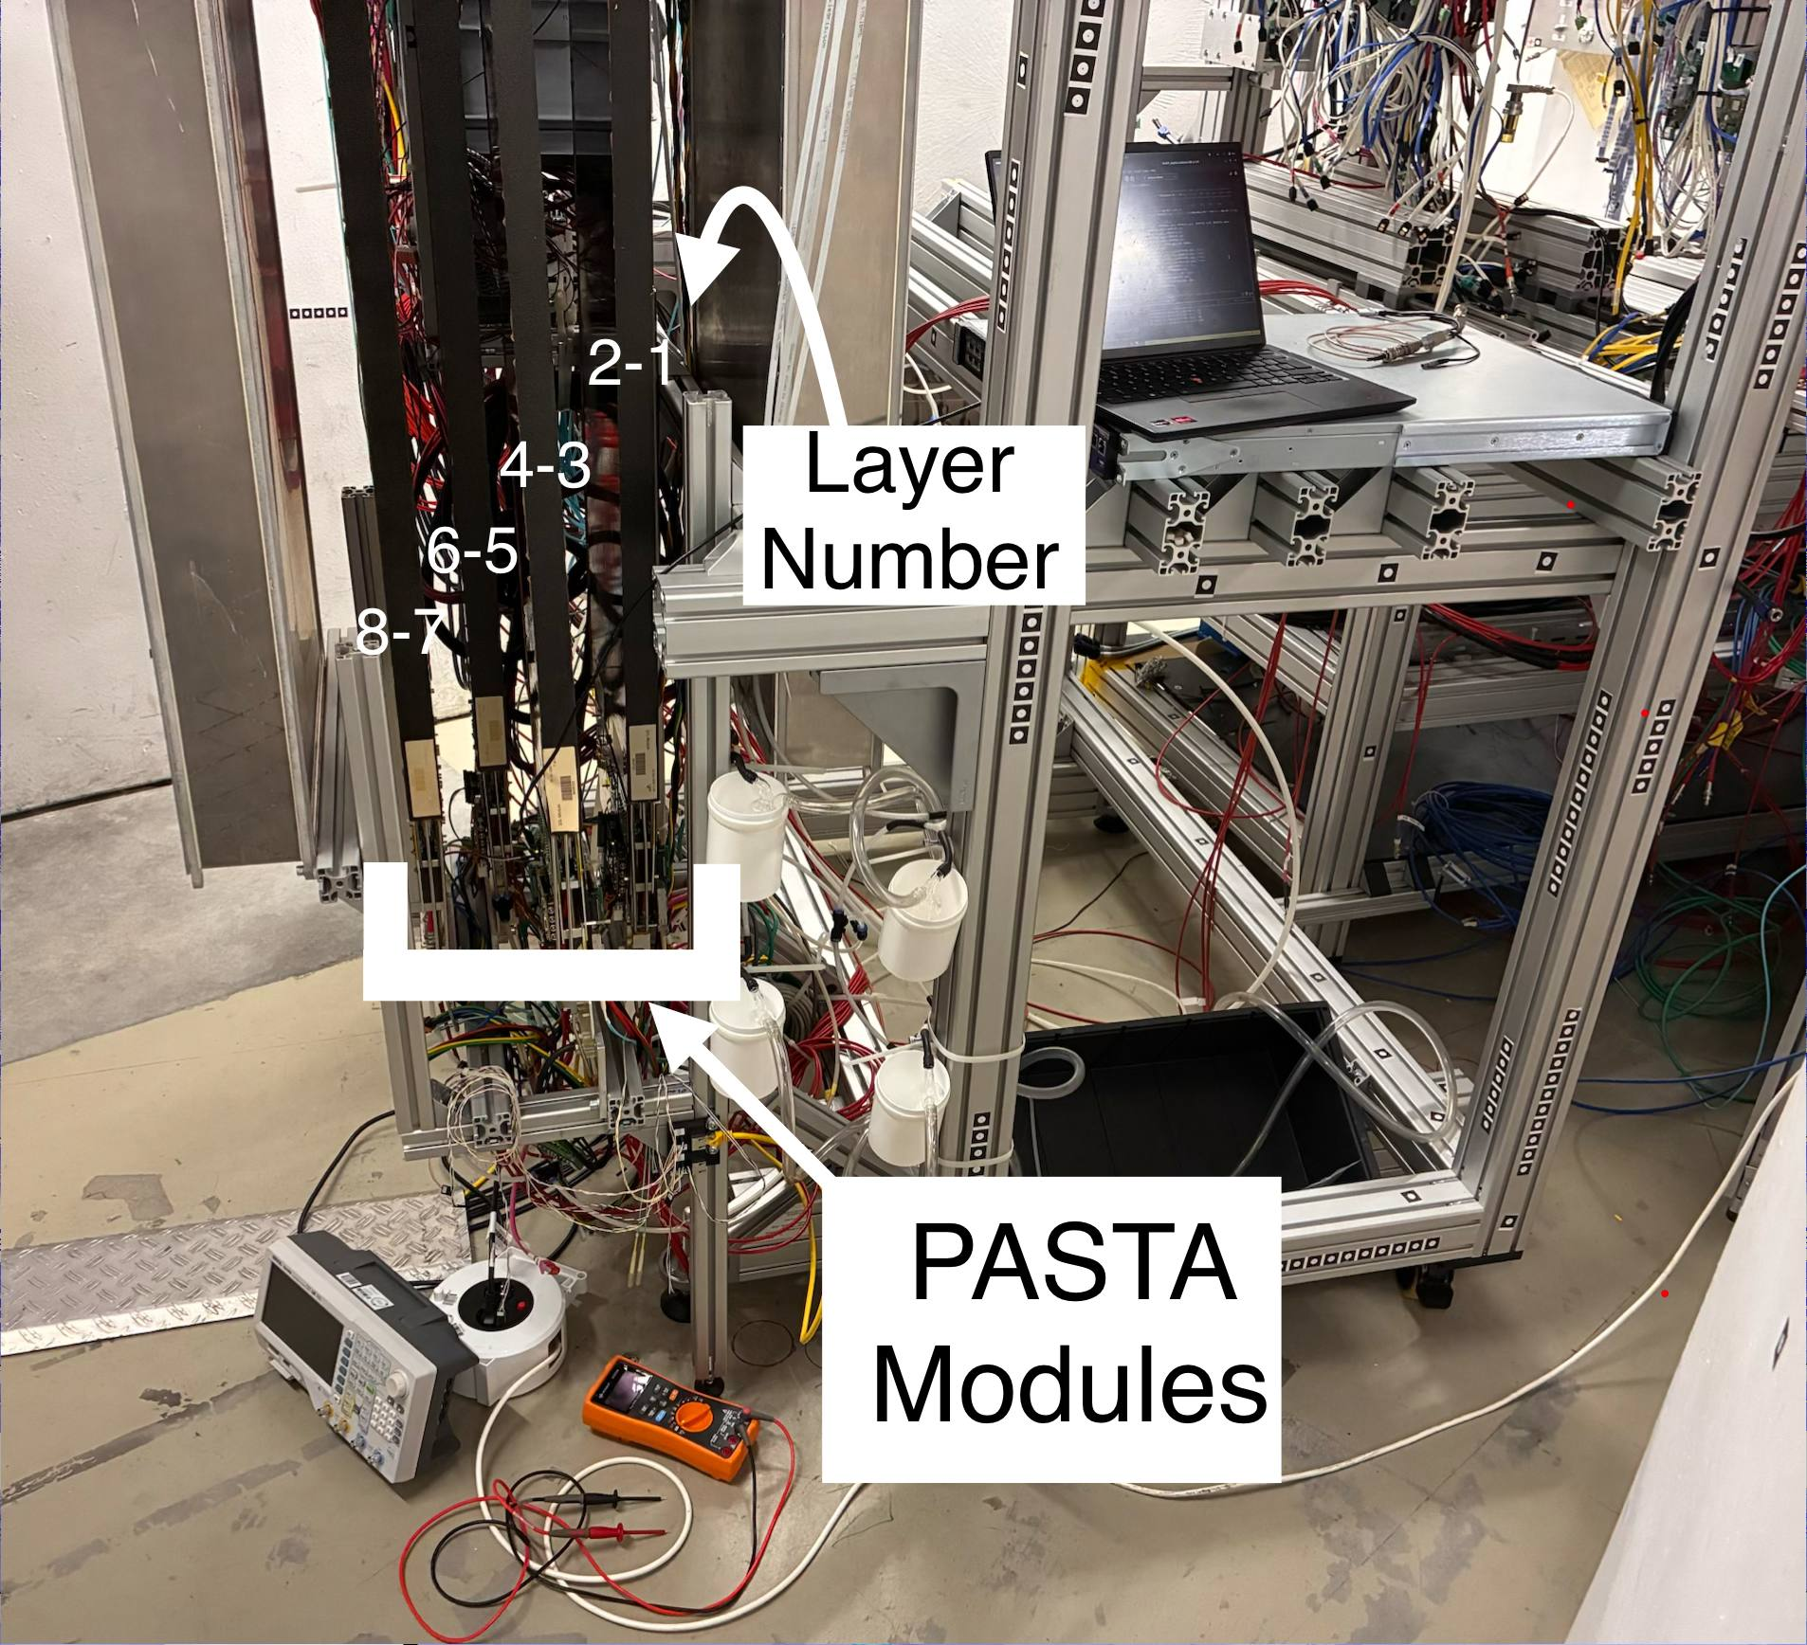
PASTA at mCBM Cave
© S. Koch (GSI) and
R. Karabowicz (GSI)

Slide 6
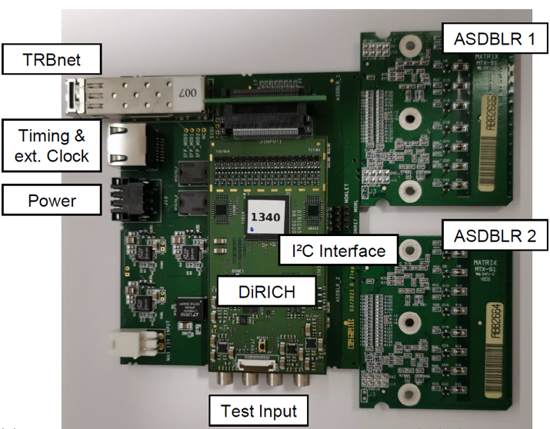
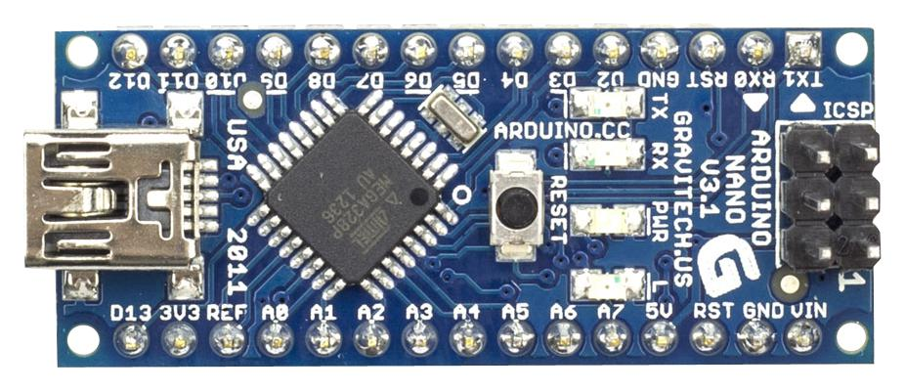
PASTA at mCBM Cave
Reuse ASDBLR ASICs and HV boards
Laptop
© Tassos & Luca

Slide 7
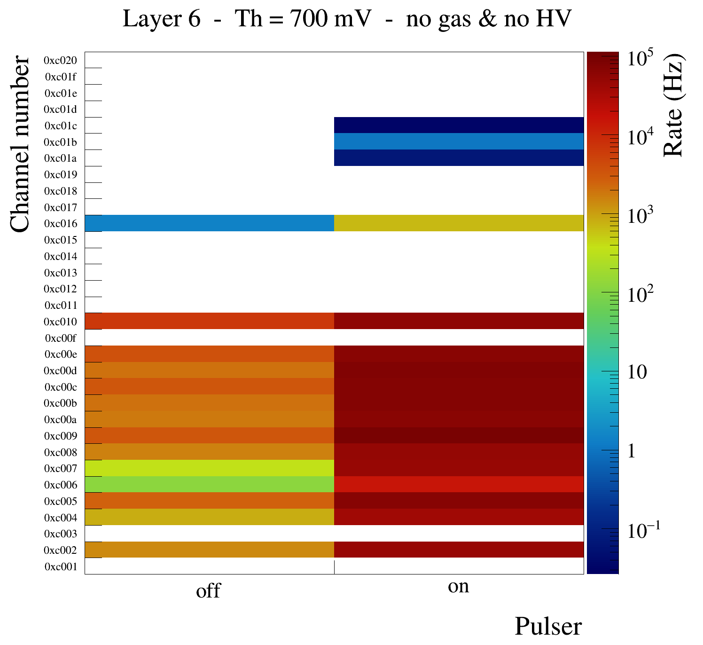

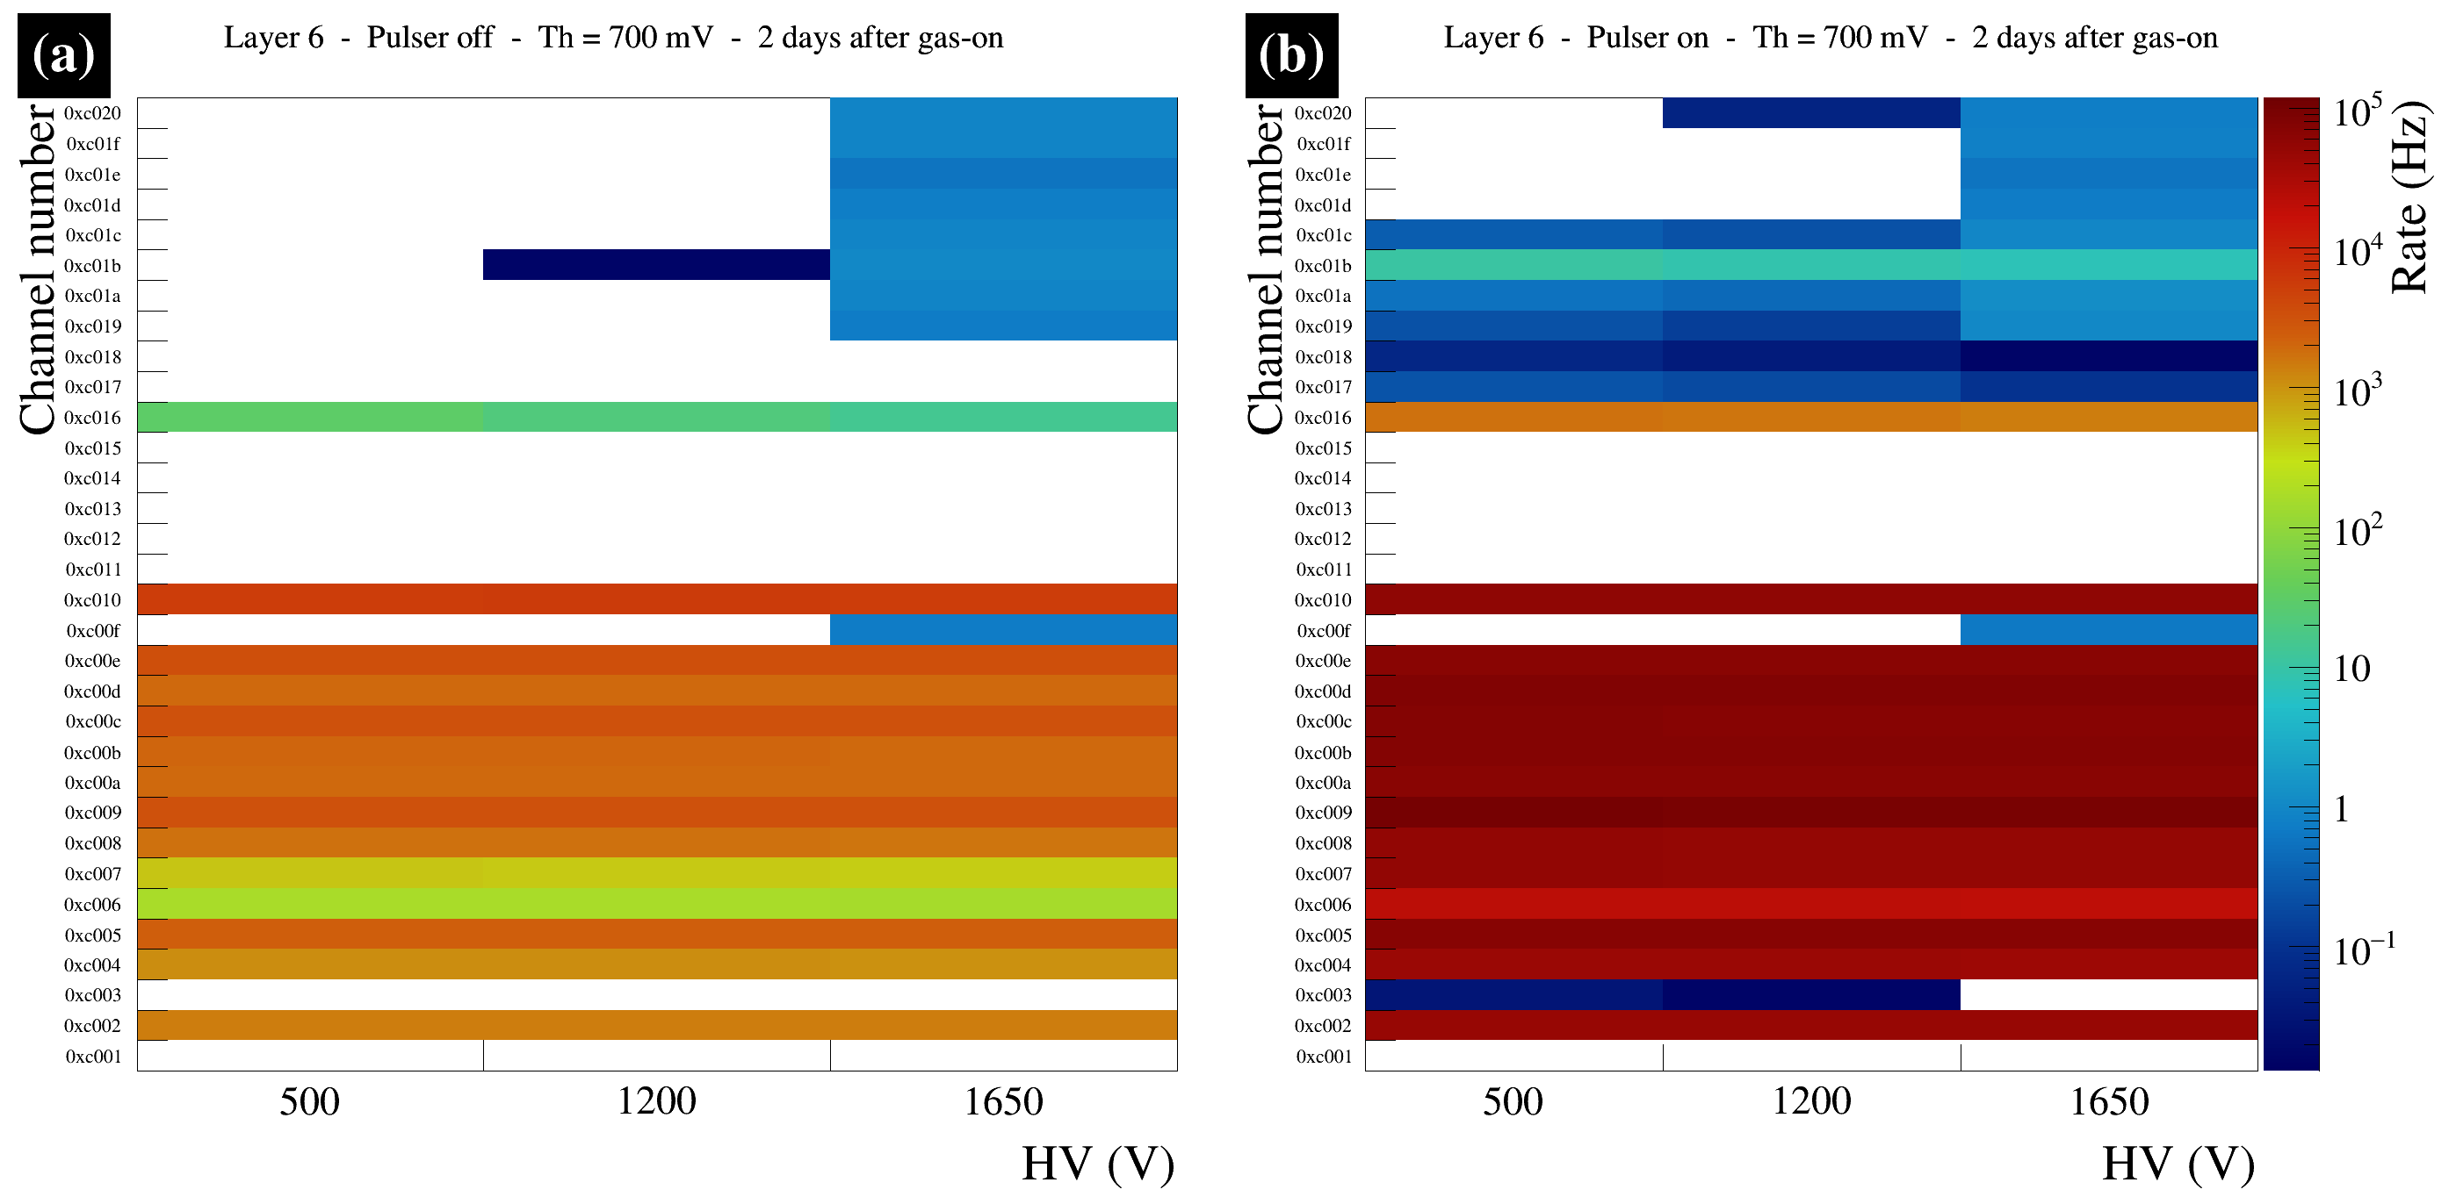
PASTA at mCBM: Readout

Slide 8
PASTA at mCBM: Readout
Turning-on high voltage & gas seem to not affect the electronics noise
Remarks:
  We also carried out the analysis for few hours after the gas on

Slide 9
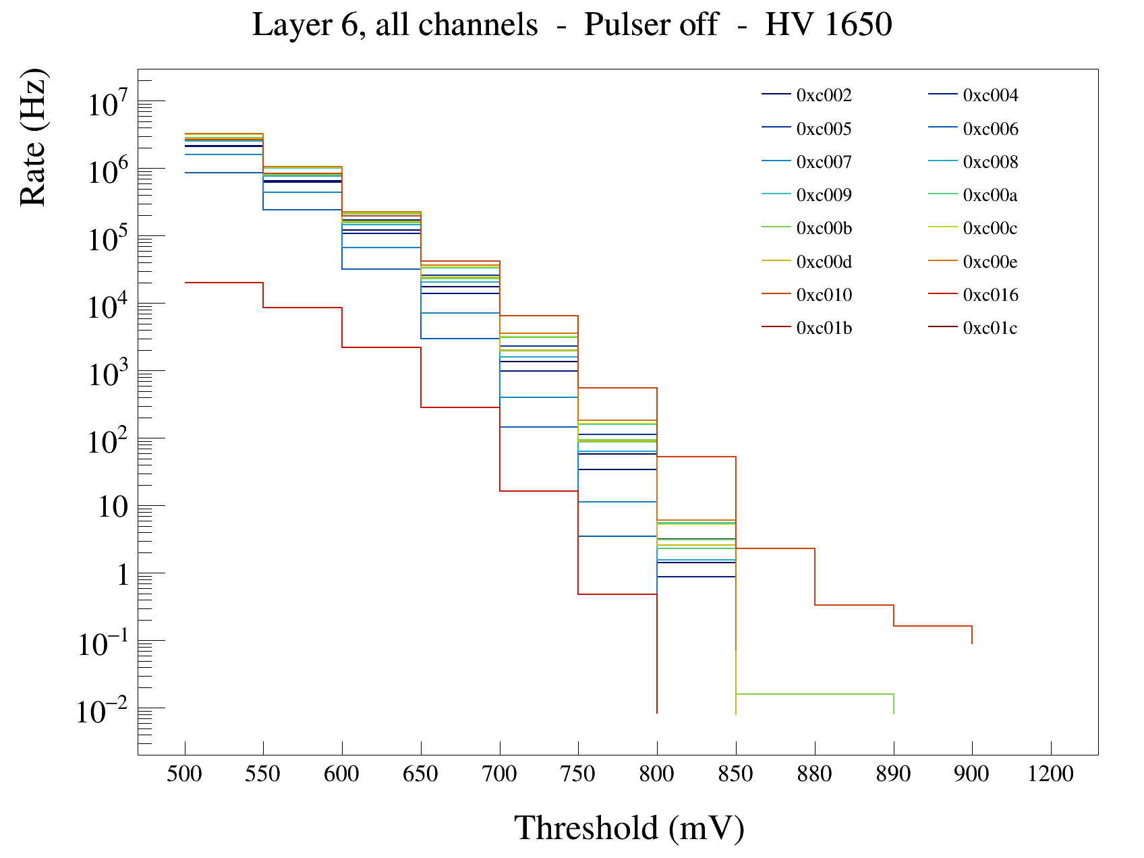
PASTA at mCBM: Readout
Threshold between 850–900mV, suppresses the electronics noise

Slide 10
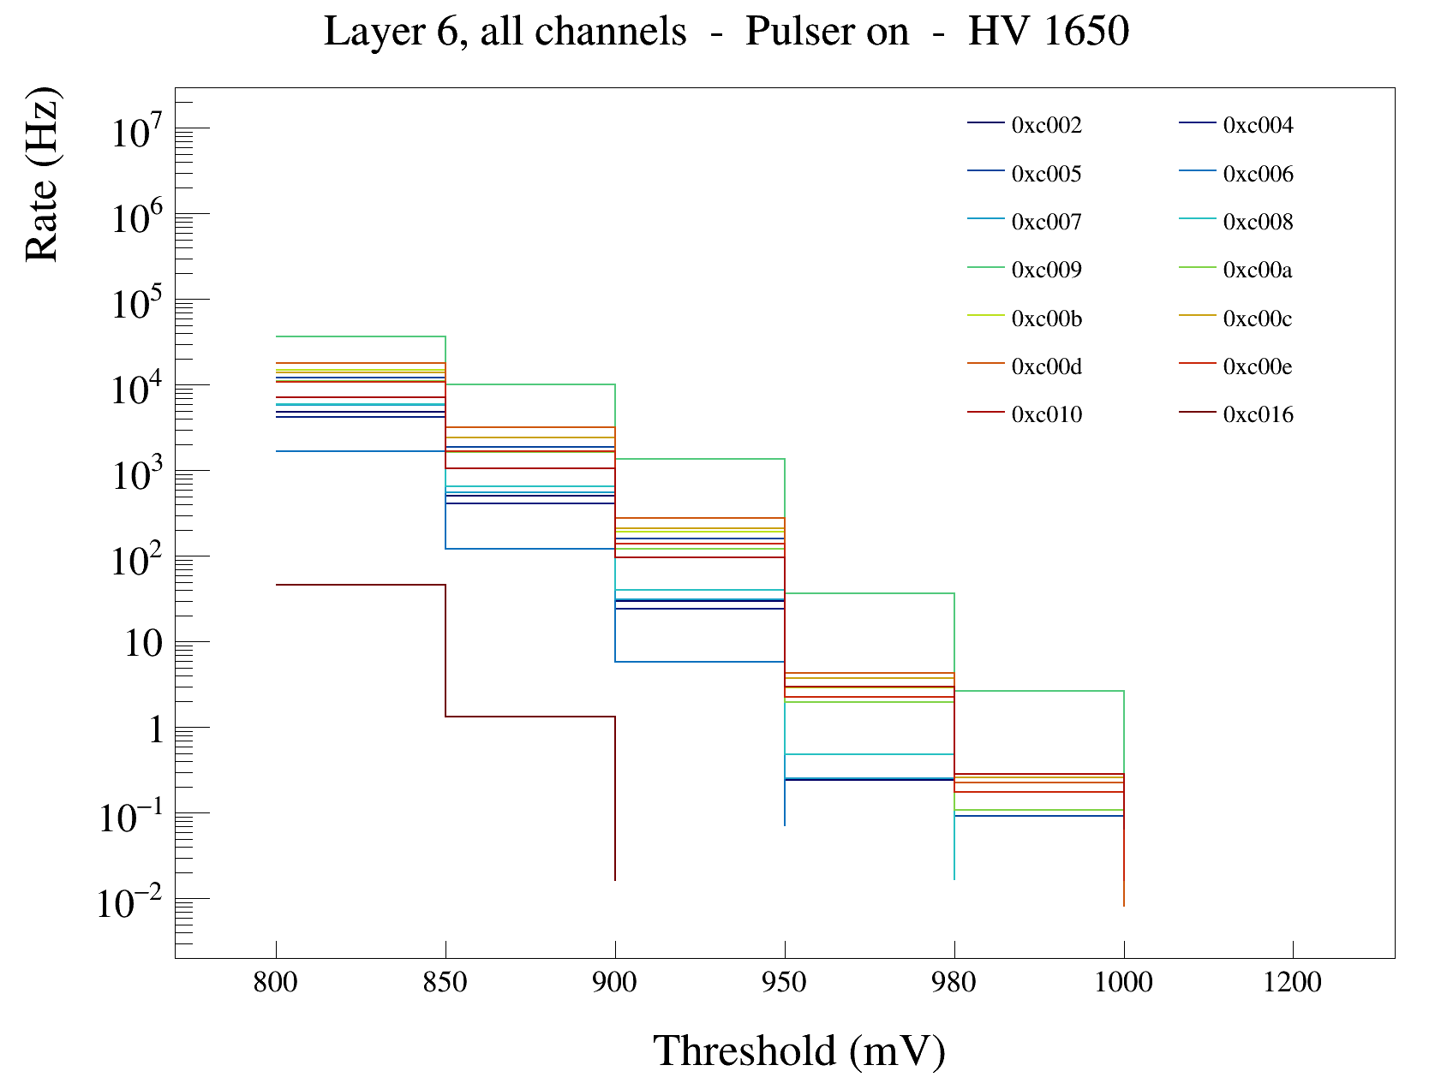
PASTA at mCBM: Readout
Threshold between 850–900mV, suppresses the electronics noise

Slide 11
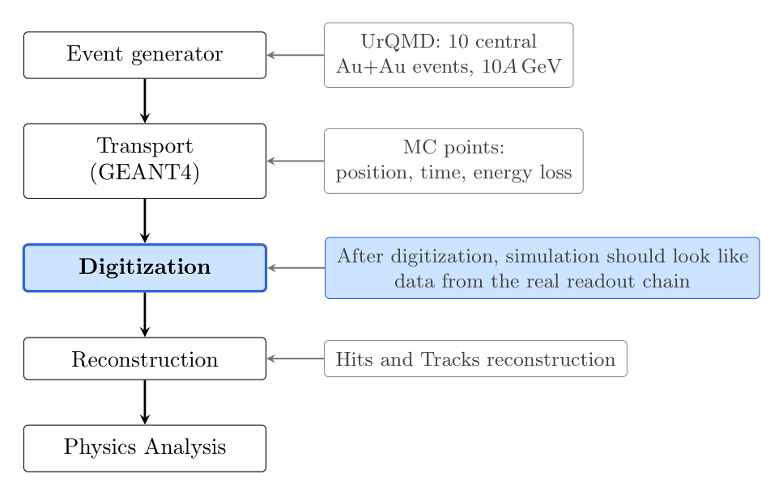

MUST Simulation Workflow

Slide 12
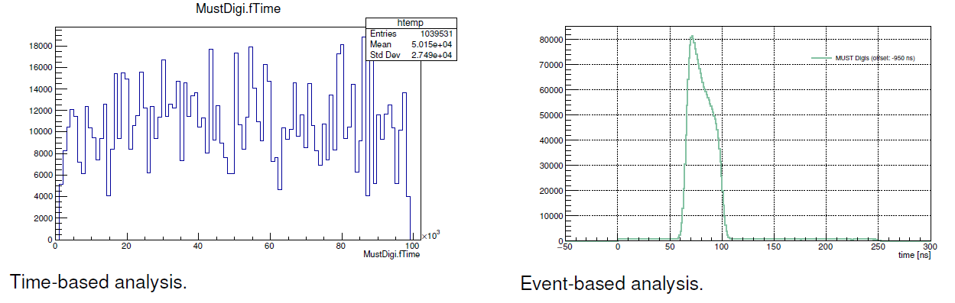


Digitization – Modes
© Rafal Lalik
Time-based: what will the detector actually deliver?
Event-based: how does the detector respond to one collision?

Slide 13
Digitization – Modes
© Rafal Lalik
Time-based: what will the detector actually deliver?
Event-based: how does the detector respond to one collision?

Slide 14





Digitization
Total Measured Time:
  fixed T₀, event-by-event mode,
  time of flight of particle from the target to the straw,
  drift time of the charge carriers in the straw tube,
  signal propagation in the straw,
  other delays in cables and electronics.
Random noise generation
  every straw, every event: fires with fixed probability (≈ 15 kHz/straw), uniform in a ±200 ns window around
simulations
using radius formula
hit position along v-axis to readout
zero, Gaussian 2.5 ns time resolution is added on top

Slide 15
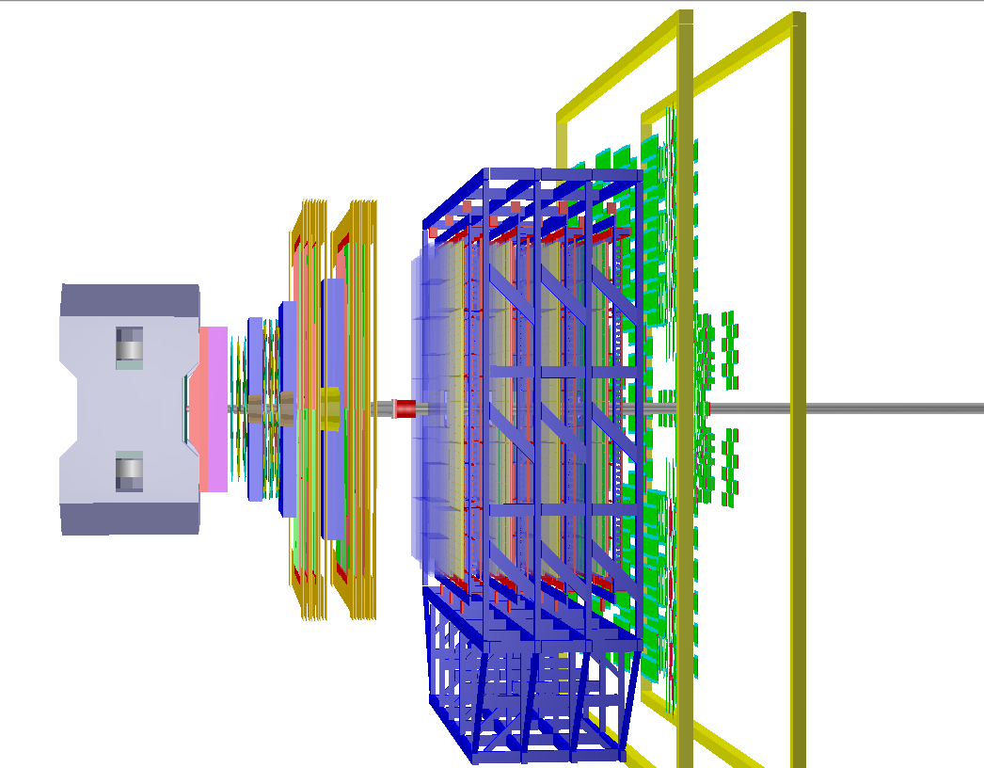

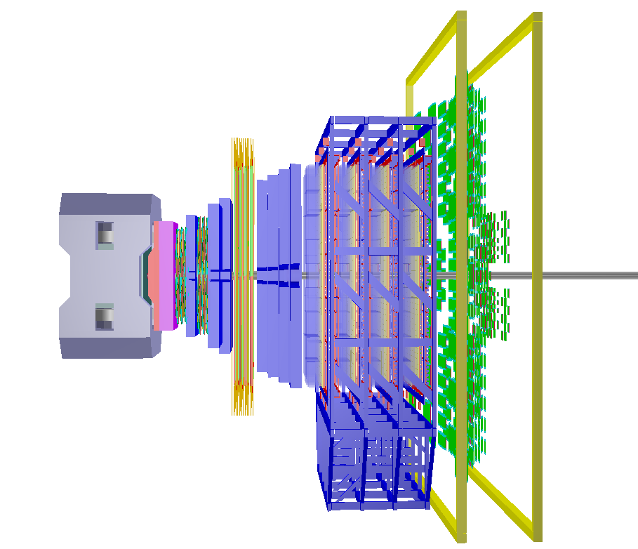
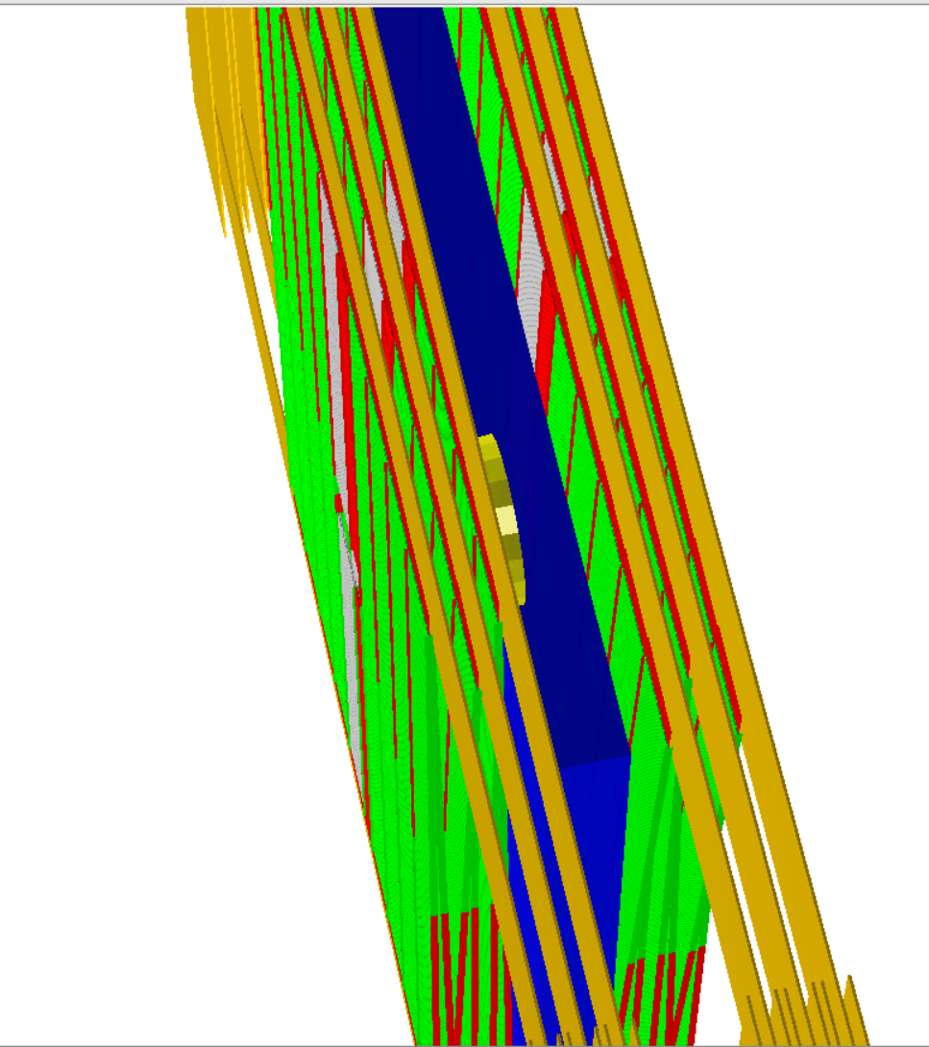
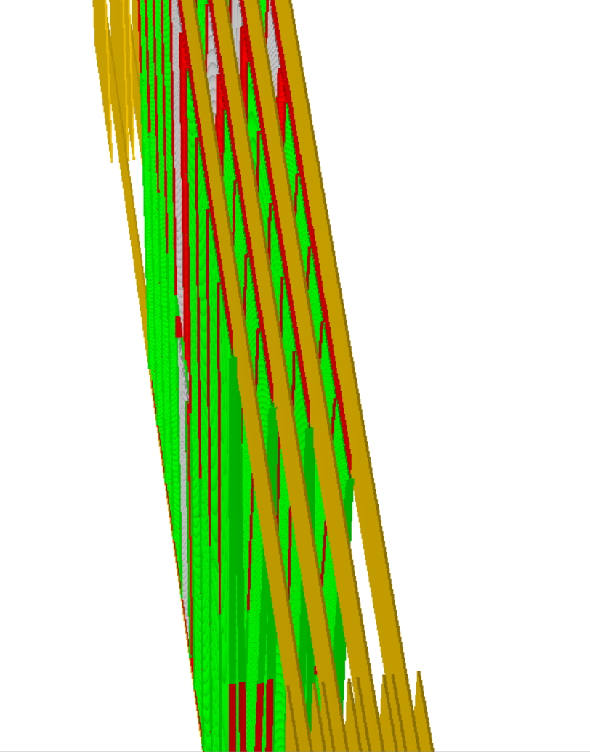
MUST geometries comparison
MUST v26e
MUST v26m
Station
0
Station
1
Station
1
Station
0

Slide 16
MUST geometries comparison
MUST v26e
MUST v26m
Station
0
Station
1
Station
1
Station
0

Slide 17

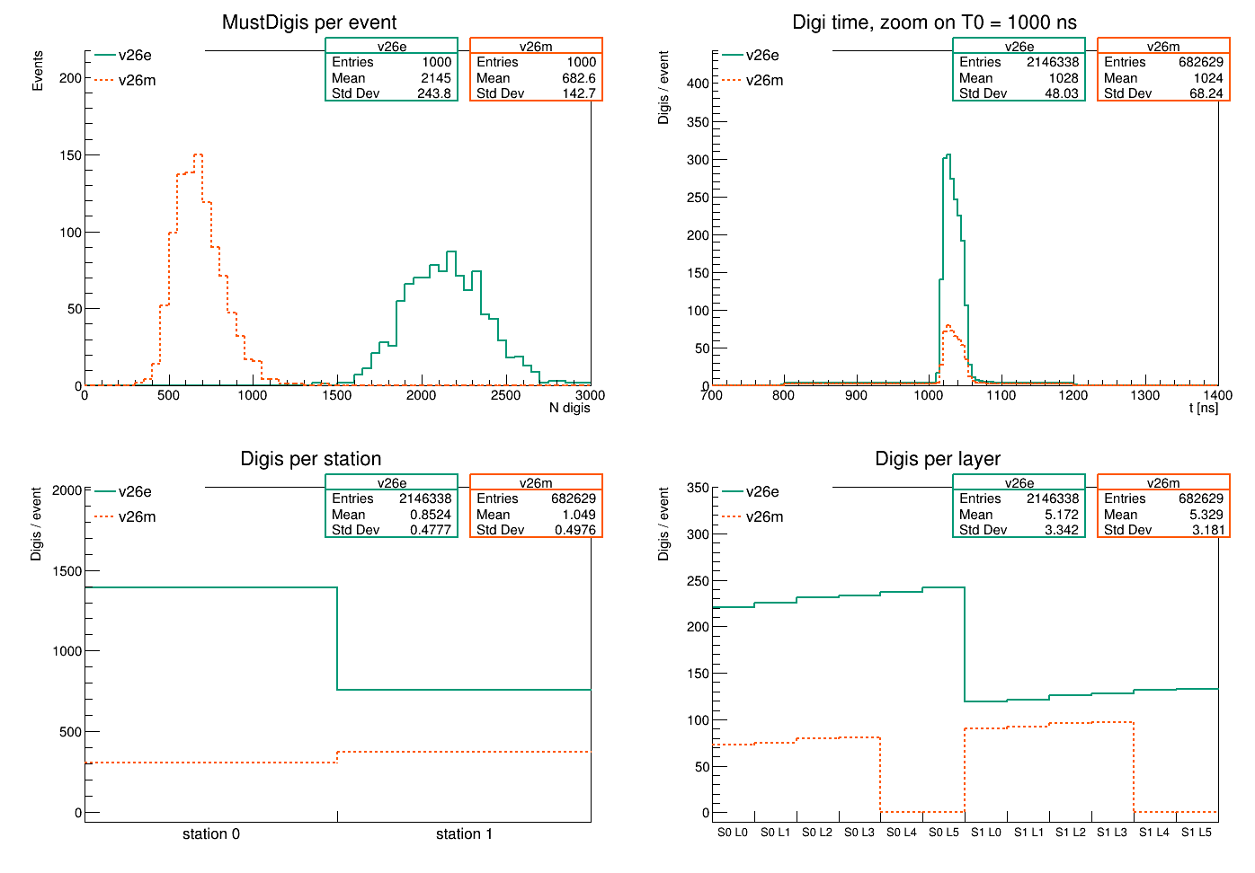
Results: Digitizer Output
MUST: Event-based Digitization
Different digis per station; because the absorber effect: back-scattering

Slide 18
Results: Digitizer Output
MUST: Event-based Digitization
Different digis per station; because the absorber effect: back-scattering

Slide 19
Results: Digitizer Output
MUST: Event-based Digitization
Different digis per station; mostly because of the absorber effect: back-scattering

Slide 20
Results: Digitizer Output
MUST: Event-based Digitization
Different digis per station; mostly because of the absorber effect: back-scattering

Slide 21
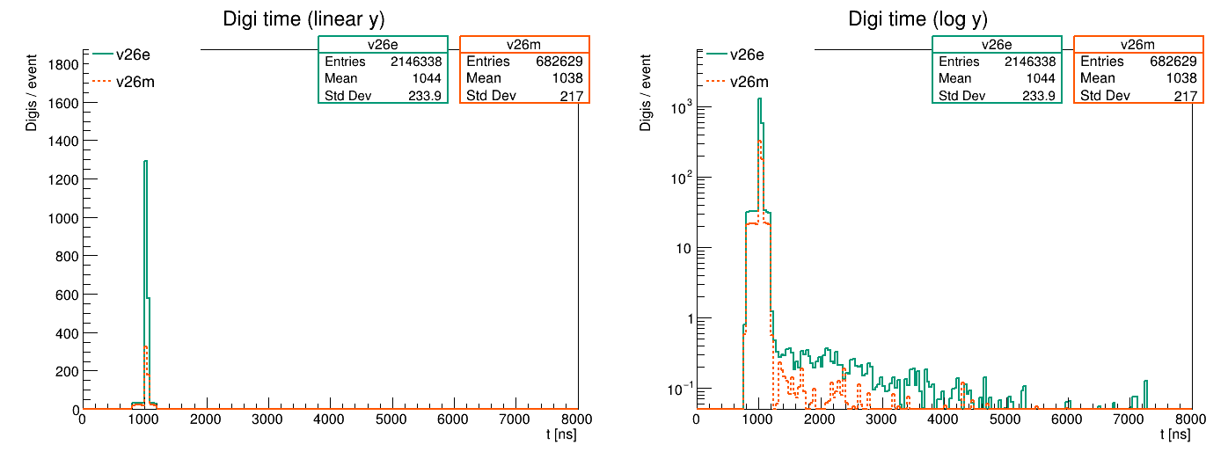
Results: Digis/event in log scale
MUST: Event-based Digitization
Several peaks after T0 for both designs?

Slide 22
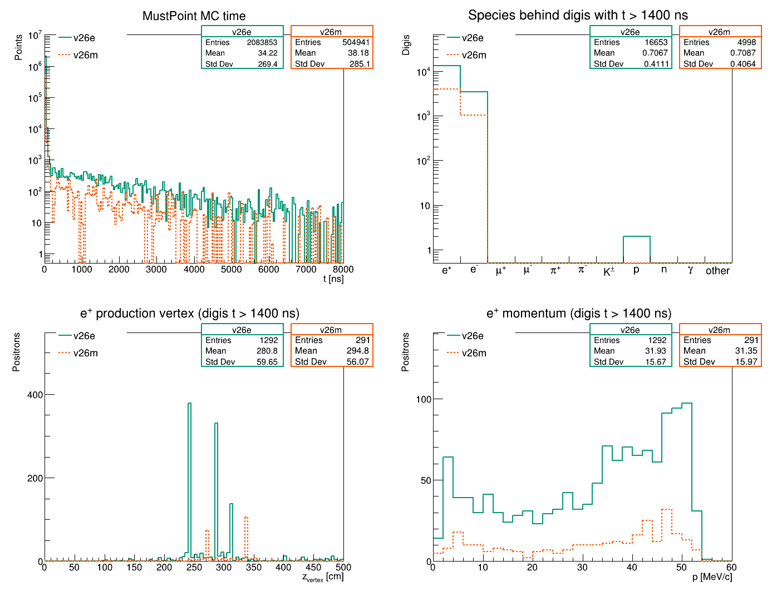

Results: Late-Peaks characterization
MUST: Event-based Digitization
All observed-late peaks are from Positrons

Slide 23
Results: Late-Peaks characterization
MUST: Event-based Digitization
The observed-late peaks are from positrons, electrons, and protons

Slide 24
Results: Late-Peaks characterization
MUST: Event-based Digitization
The observed-late peaks are from positrons, electrons, and protons

Slide 25
Results: Late-Peaks characterization
MUST: Event-based Digitization
The observed-late peaks are from positrons, electrons, and protons

Slide 26
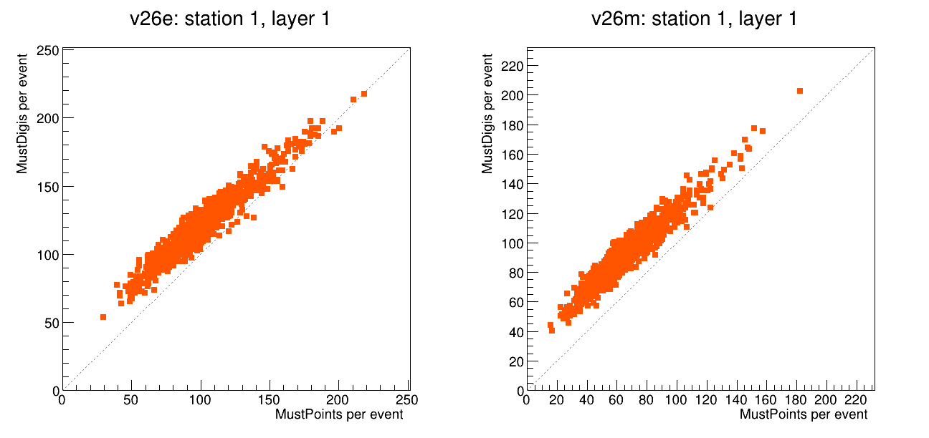
Results: Digis vs. Points – per event
MUST: Event-based Digitization
Why not 1:1?
  Because the noise adds digis that have no points at all
  The inefficiency, two particles received at the same time & position

Slide 27
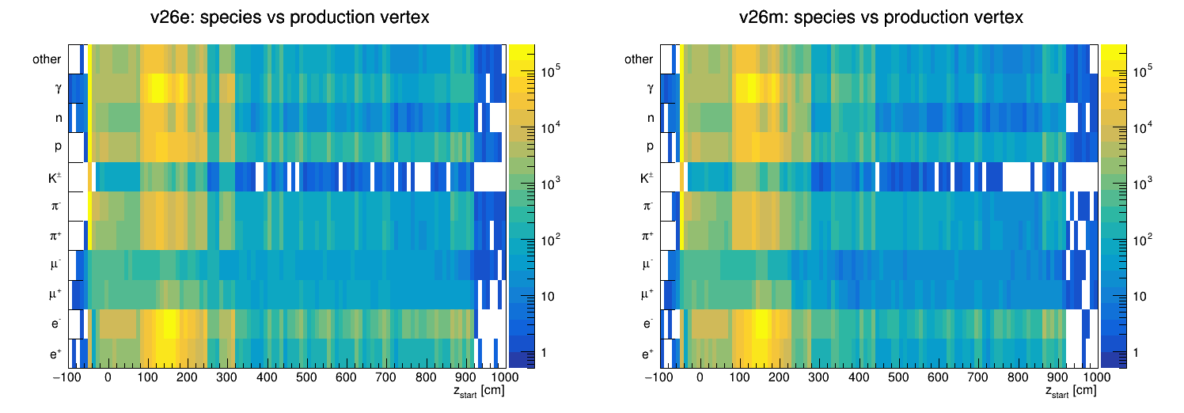
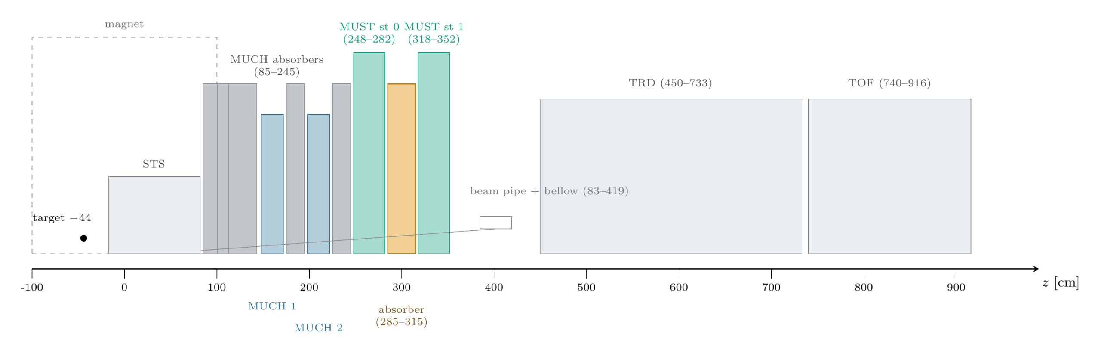
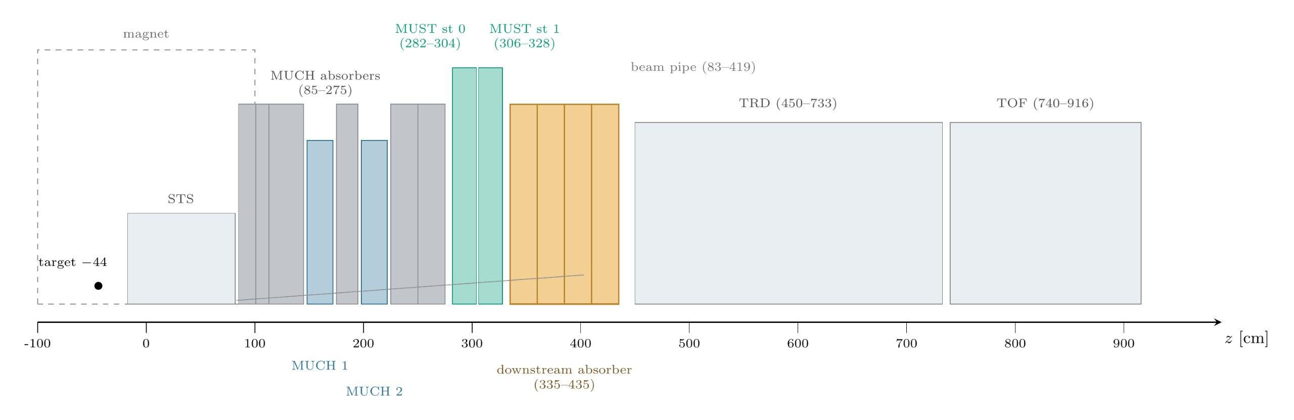
Results: Particle & Production Vertex
MUST: Event-based Digitization
MUST v26e
MUST v26m

Slide 28
Conclusion & Outlook
High voltage & Gas don’t affect the electronics noise
Threshold between 850–900mV, suppresses the electronics noise
MUST Digitizer event-based mode is revealing late peaks by positrons, electrons, and protons
Possible Future Work:
  Comparing the different readout (DOGMA vs. TRBnet)
  The digitizer:
    Employing real electronics noise values
    Adding threshold variable for energy deposition

Slide 29
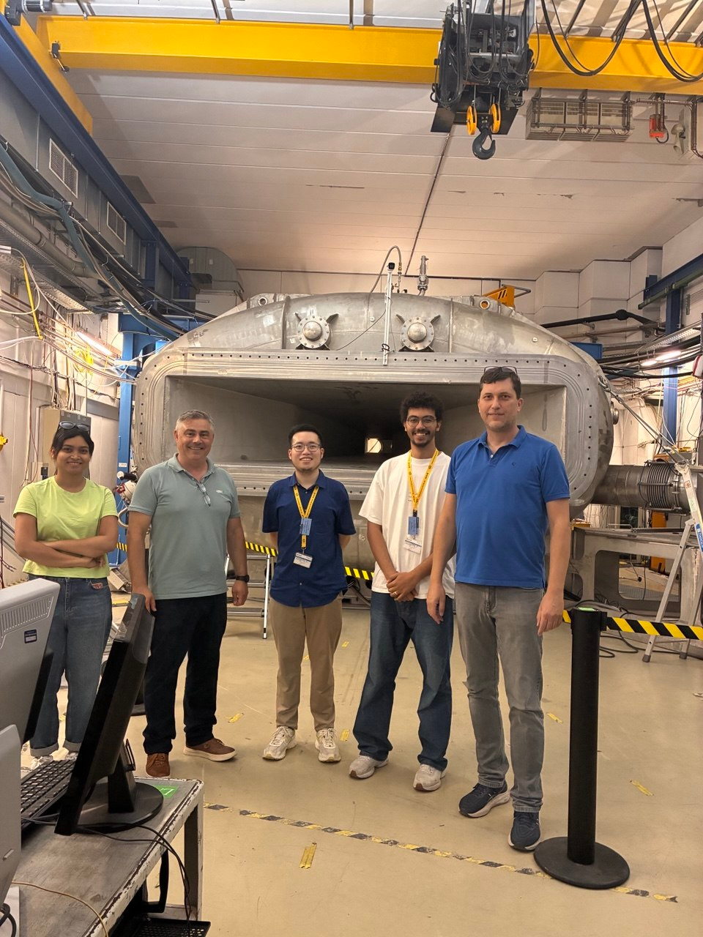

Acknowledgement
Dr. Anastasios Belias
Dr. Shreya Roy
Luca Schramm
Darwin Alexander
Rafal Lalik
Dr. David Emschermann

Slide 30
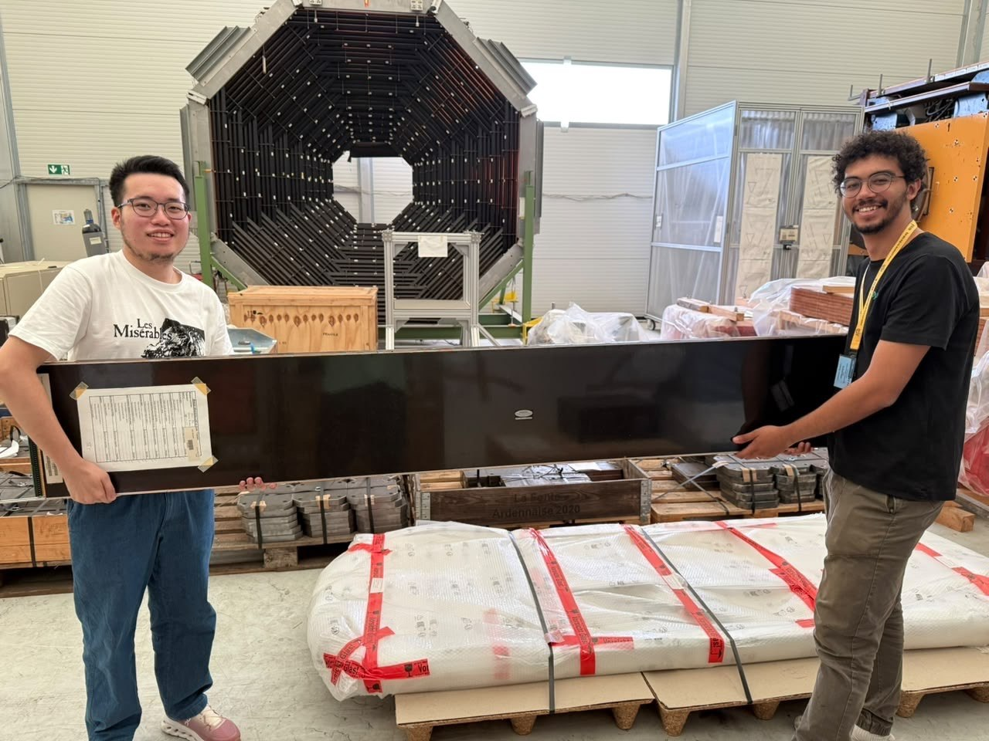
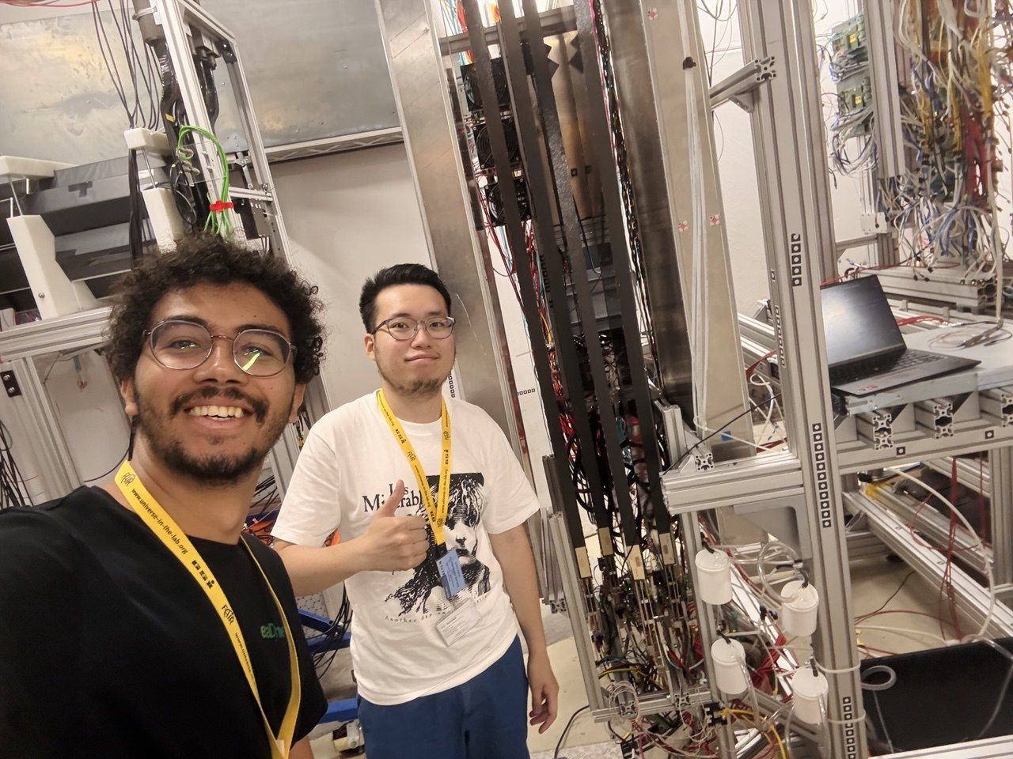

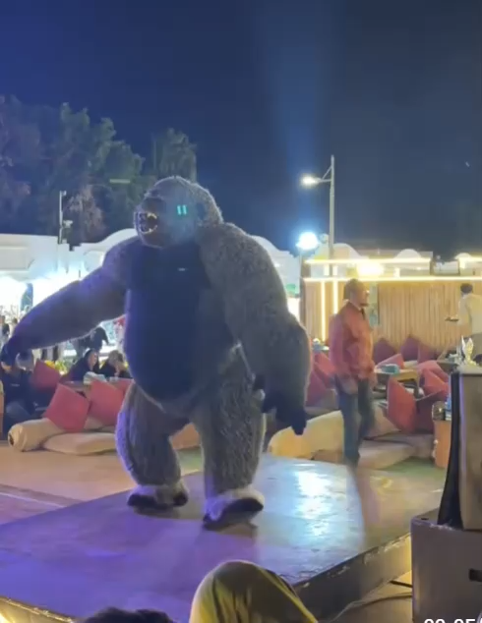
Thank You!
Q&A
شكرا
Shockran
GSI/FAIR International Summer School Program

Slide 31
Backup Slides
GSI/FAIR International Summer School Program

Slide 32
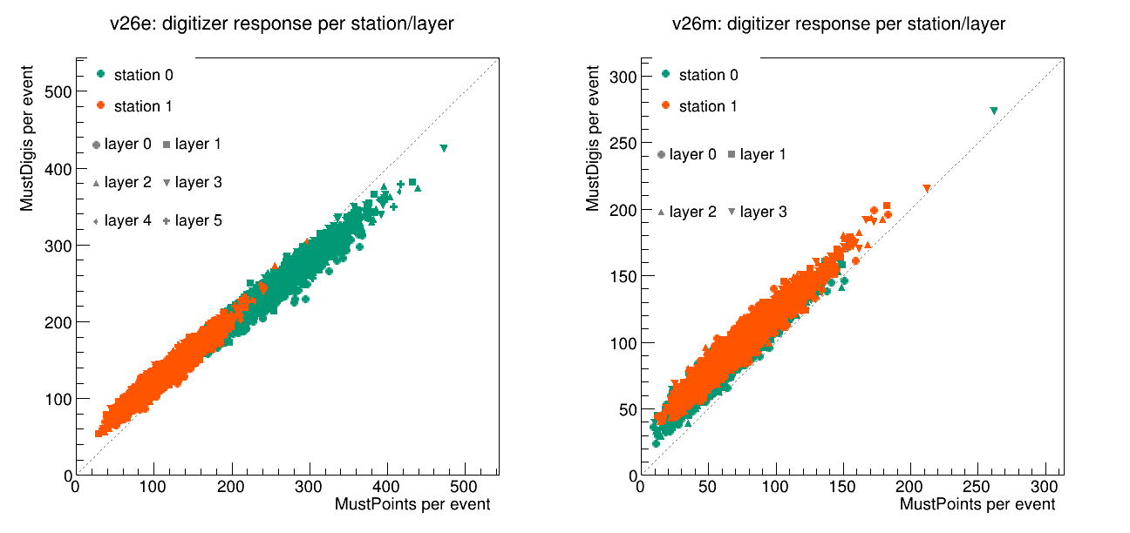

Slide 33
MUST Simulation Workflow

Slide 34
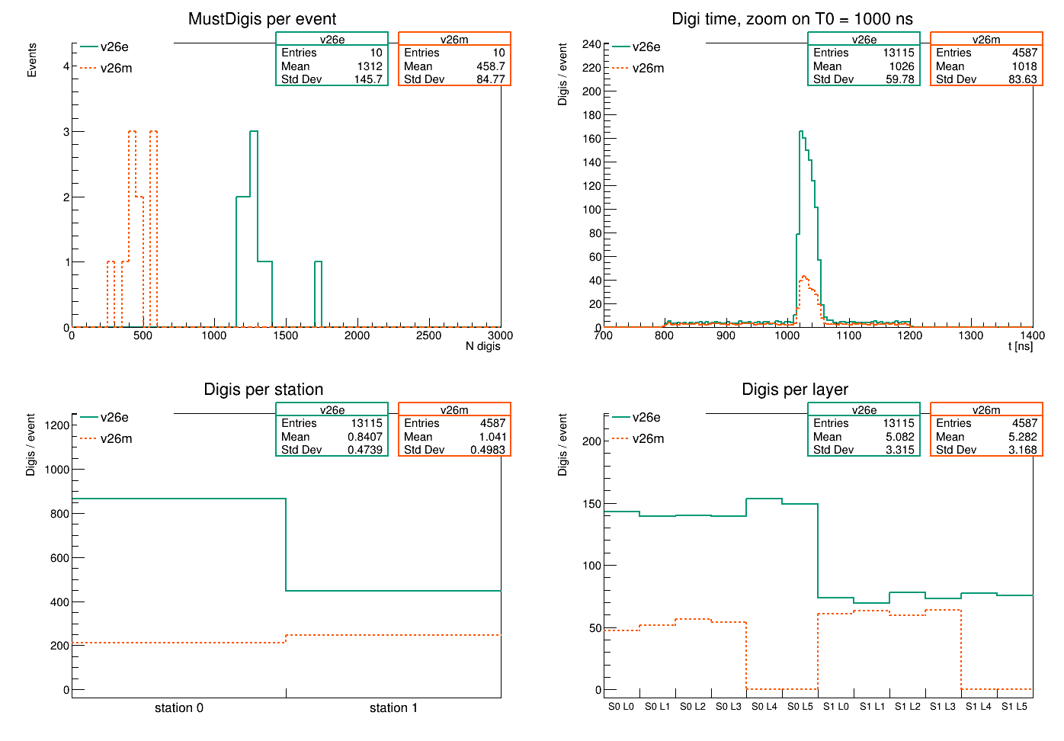
Results: Digitizer Output
MUST: Event-based Digitization
Different digis per station; because the absorber effect: back-scattering

Slide 35
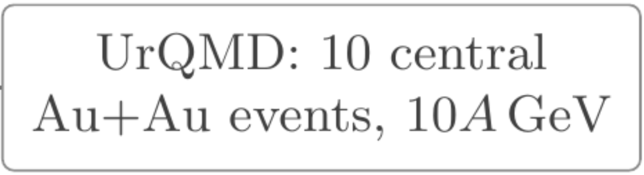
Results: Digitizer Output
MUST: Event-based Digitization
Different digis per station; because the absorber effect: back-scattering

Slide 36
Results: Digitizer Output
MUST: Event-based Digitization
Different digis per station; because the absorber effect: back-scattering

Slide 37
Results: Digitizer Output
MUST: Event-based Digitization
Different digis per station; because the absorber effect: back-scattering

Slide 38
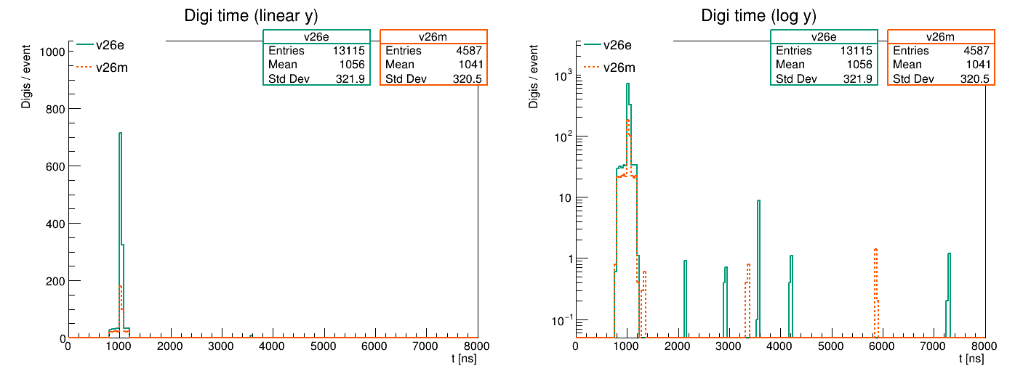
Results: Digis/event in log scale
MUST: Event-based Digitization
Several peaks after T0 for both designs?

Slide 39
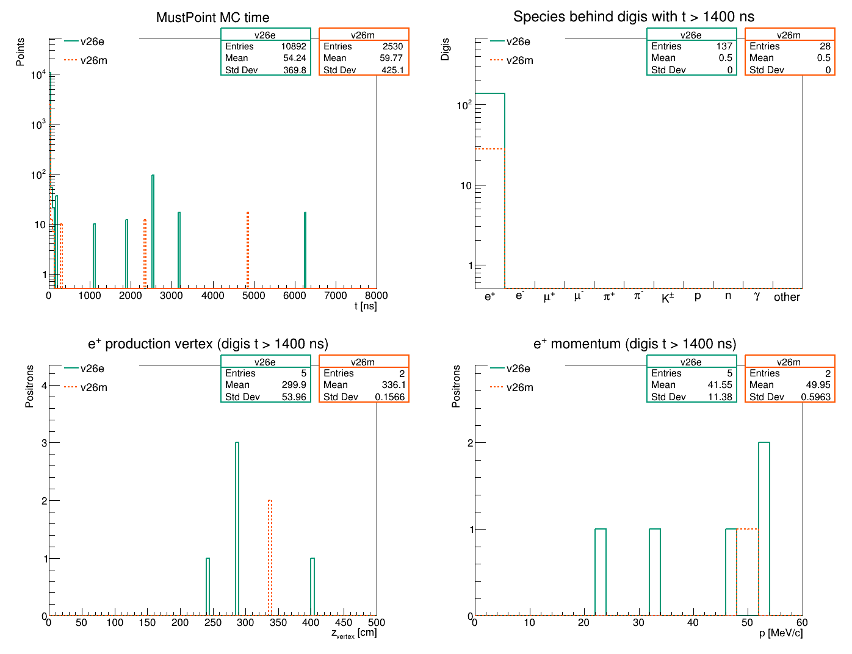
Results: Late-Peaks characterization
MUST: Event-based Digitization
All observed-late peaks are from Positrons

Slide 40
Results: Late-Peaks characterization
MUST: Event-based Digitization
All observed-late peaks are from Positrons

Slide 41
Results: Late-Peaks characterization
MUST: Event-based Digitization
All observed-late peaks are from Positrons

Slide 42
Results: Late-Peaks characterization
MUST: Event-based Digitization
All observed-late peaks are from Positrons

Slide 43
Results: Late Positrons — K⁺ & p
primary (direct)
created in material
created in weak decay
v26e — absorber inside the tracker — 5 e⁺ — 137 late digis
z [cm] vertex below each particle · target at z = −44
Event 2
K⁺
K⁺
π⁺
µ⁺
e⁺
52.3 MeV/c
t = 1.11 µs
−44
94
244
241
241
Event 6
p
π⁺
µ⁺
e⁺
23.8 MeV/c
t = 3.19 µs
−44
402
402
402
Event 8
K⁺
µ⁺
e⁺
52.1 MeV/c
t = 1.91 µs
−44
243
286
32.7 MeV/c
t = 2.55 µs
Event 9
K⁺
µ⁺
e⁺
−44
124
285
Event 9
p
n
n
π⁺
µ⁺
e⁺
46.9 MeV/c
t = 6.27 µs
−44
130
190
192
285
285
v26m — absorber downstream — 2 e⁺ — 28 late digis
Event 1
K⁺
K⁰
K⁰
K⁺
K⁺
µ⁺
e⁺
50.5 MeV/c
t = 2.35 µs
−44
249
266
272
273
274
336
Event 3
K⁺
µ⁺
e⁺
49.4 MeV/c
t = 4.84 µs
−44
188
336

Slide 44
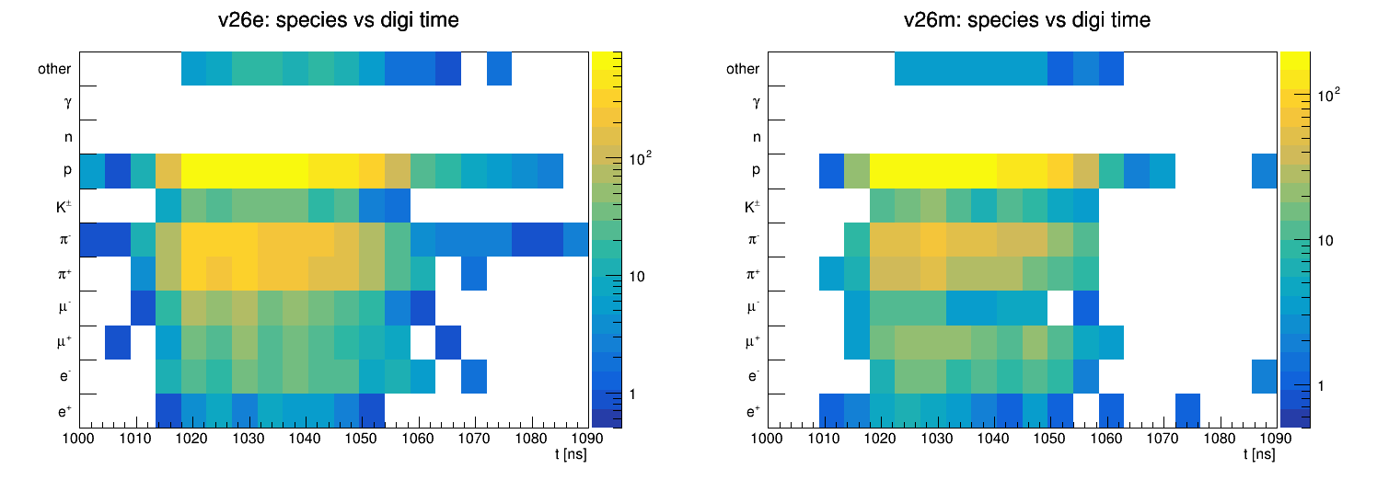
Results: Particle at digi-time

Slide 45
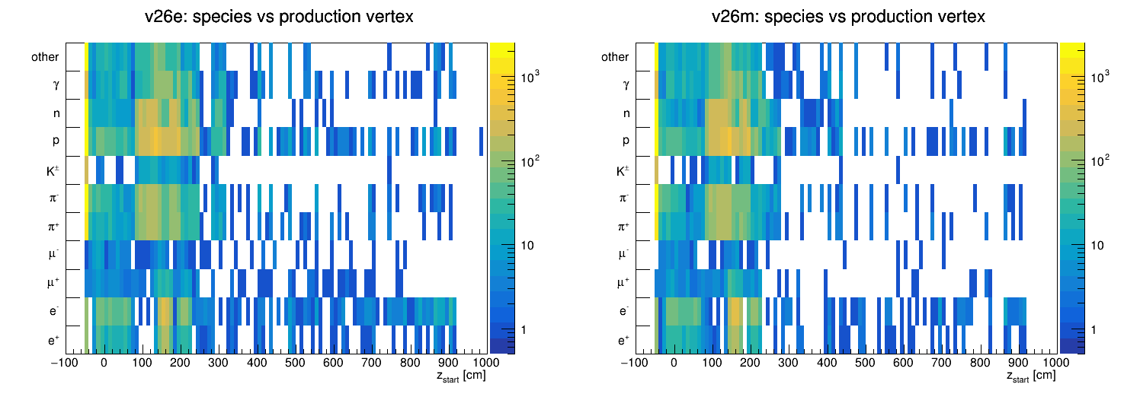
Results: Particle & Production Vertex
MUST v26e
MUST v26m

Slide 46
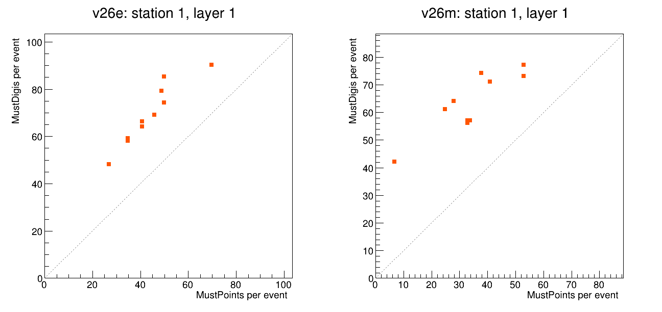
Why not 1:1? Because the noise adds digis that have no point at all.

Slide 47
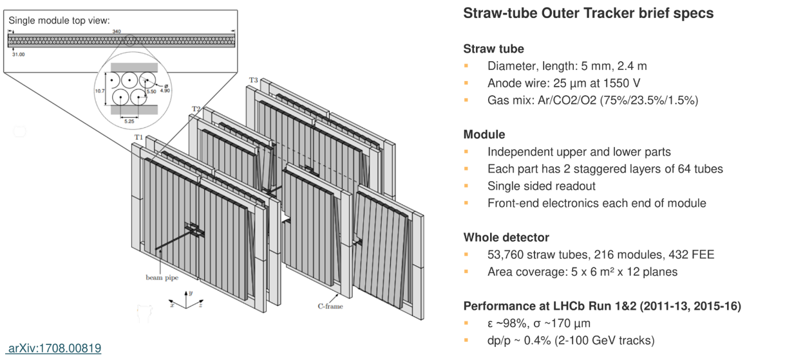
The straw-tube Outer Tracker

Slide 48
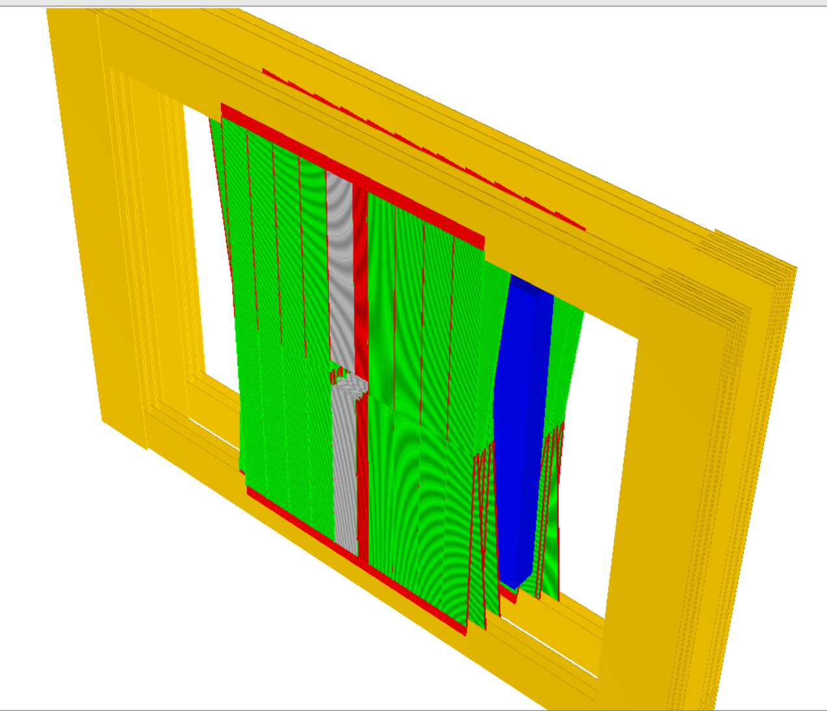
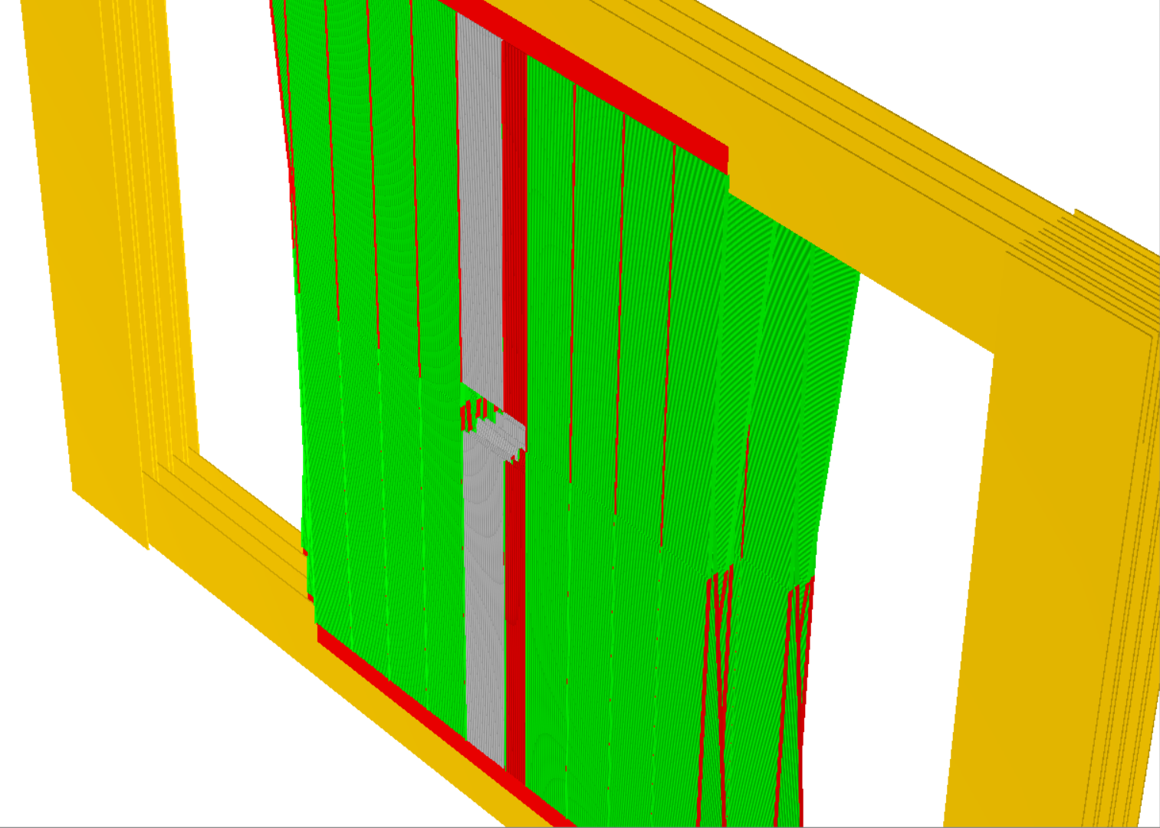
v26e
v26m

Slide 49
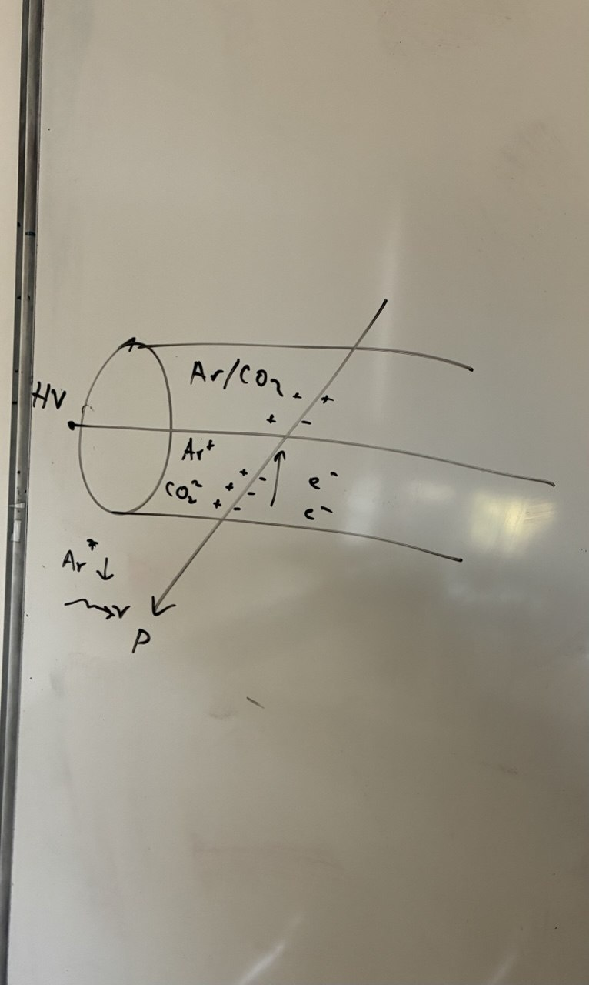
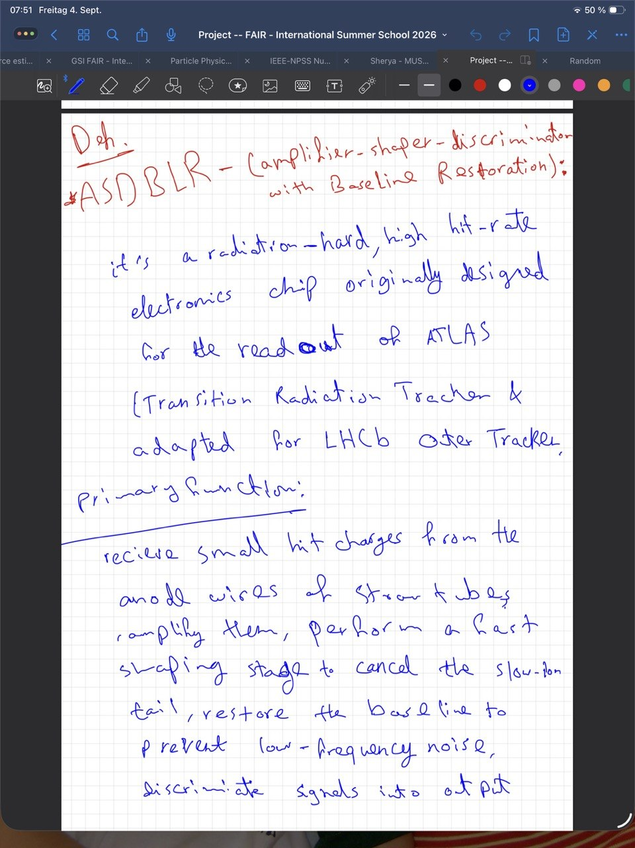
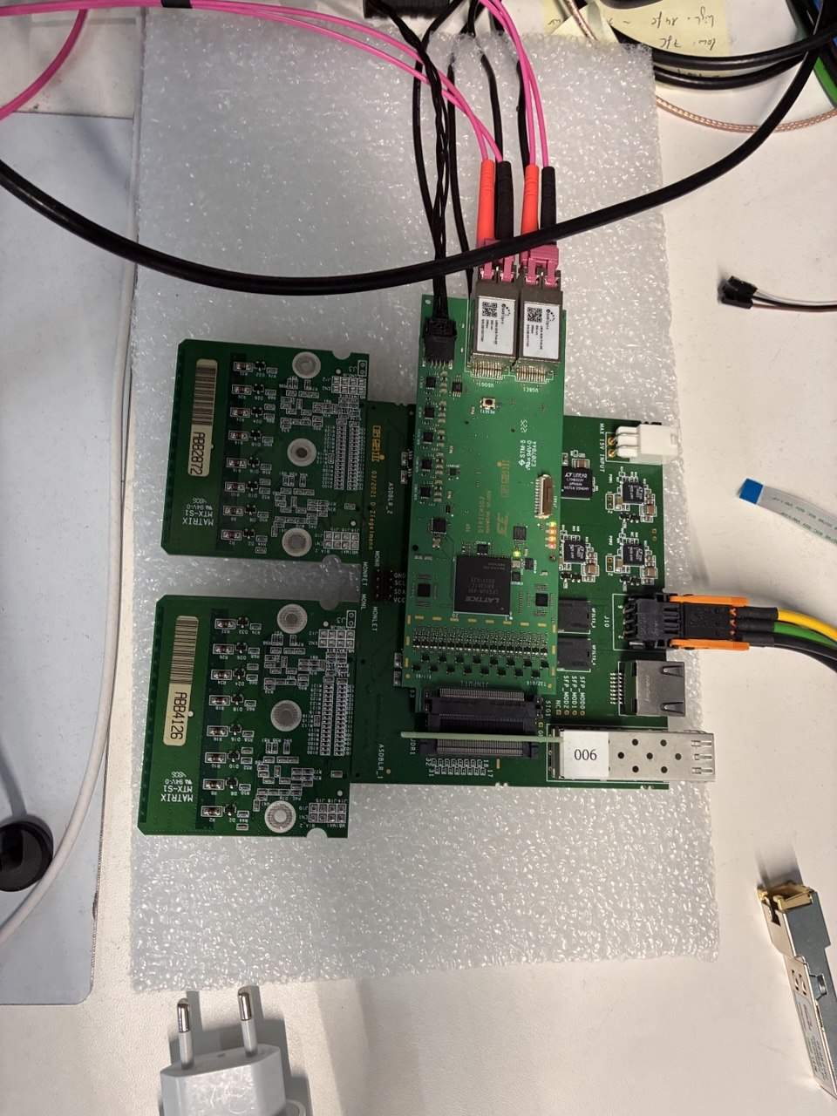
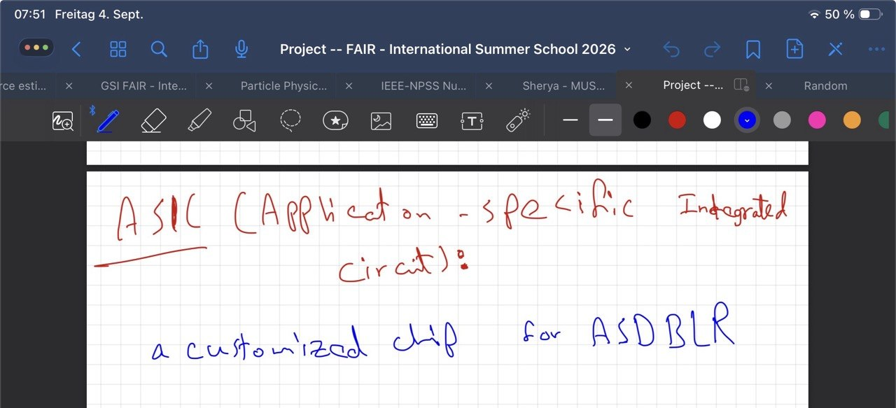
Notes

Slide 50
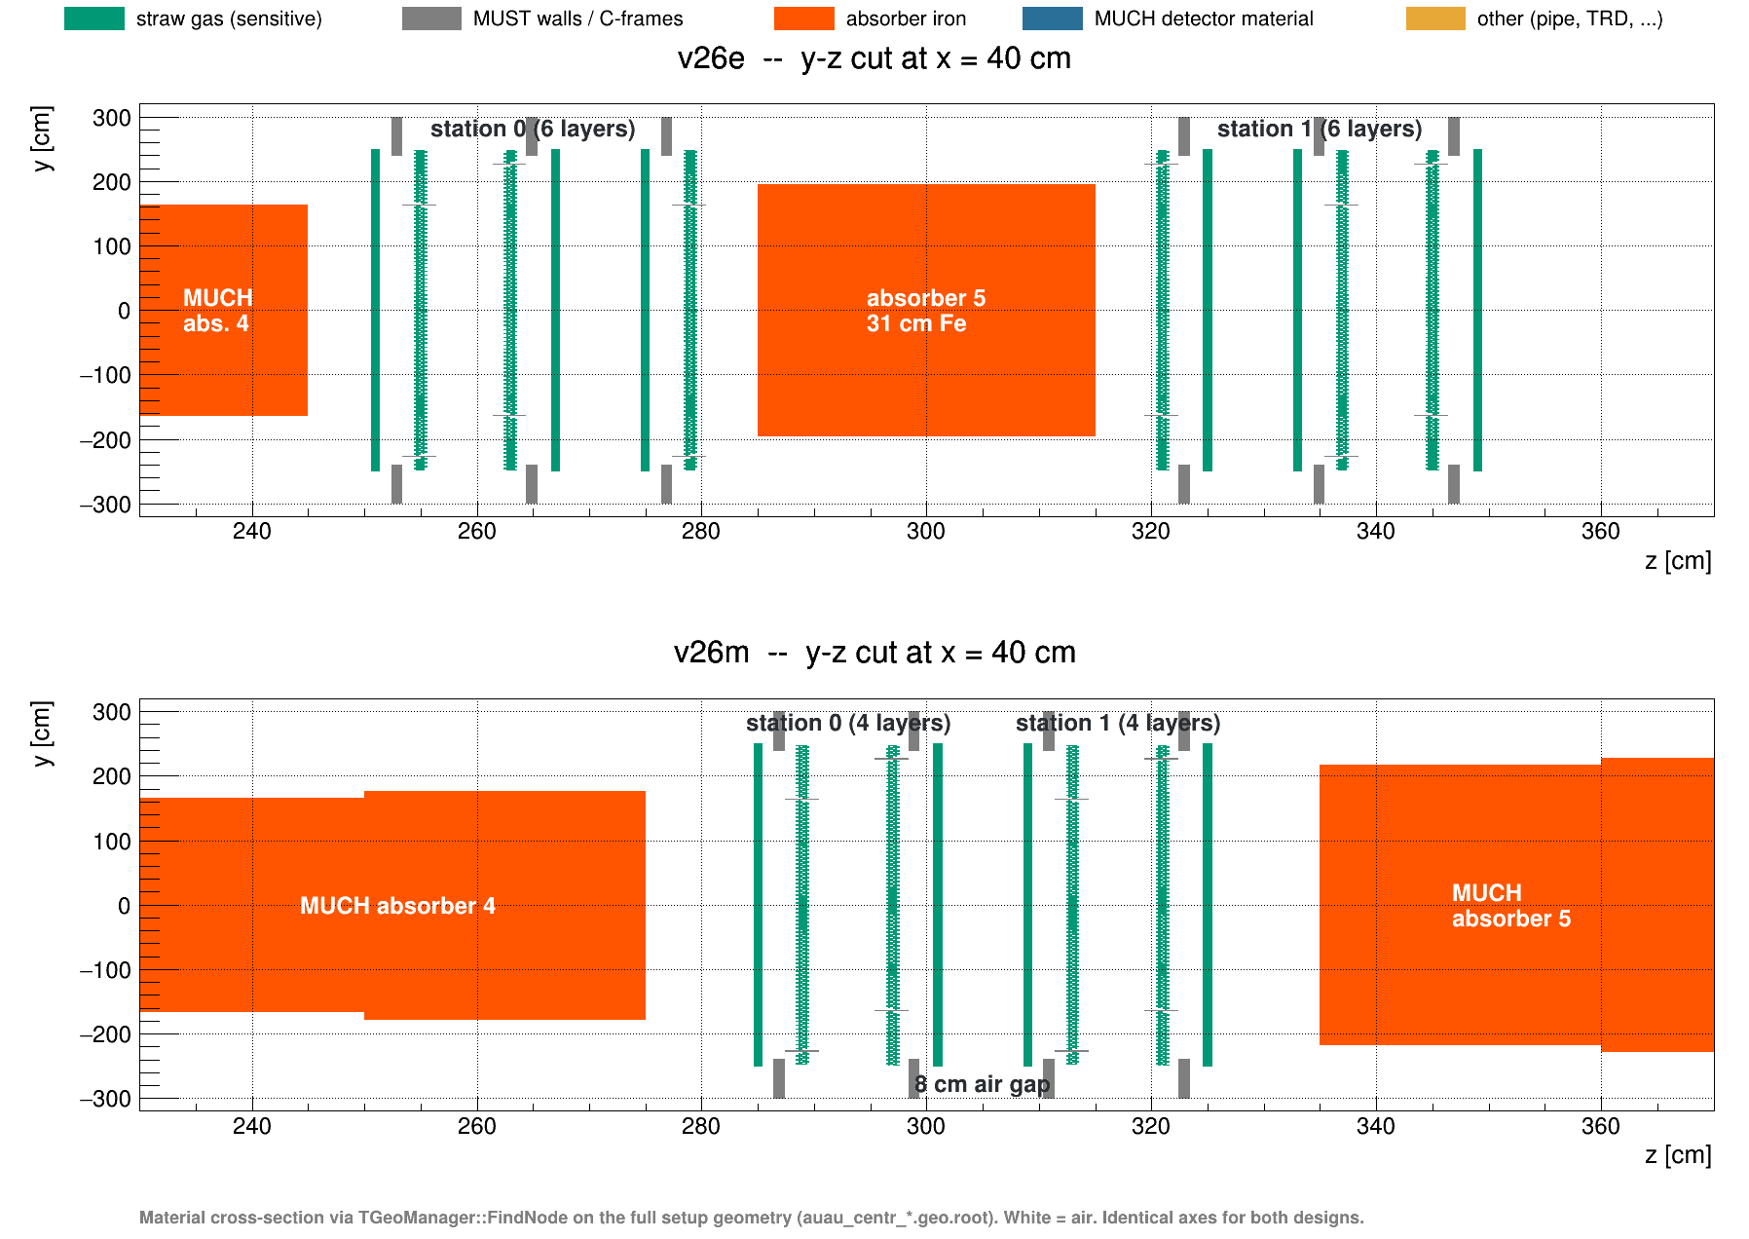
0

