Slide 1
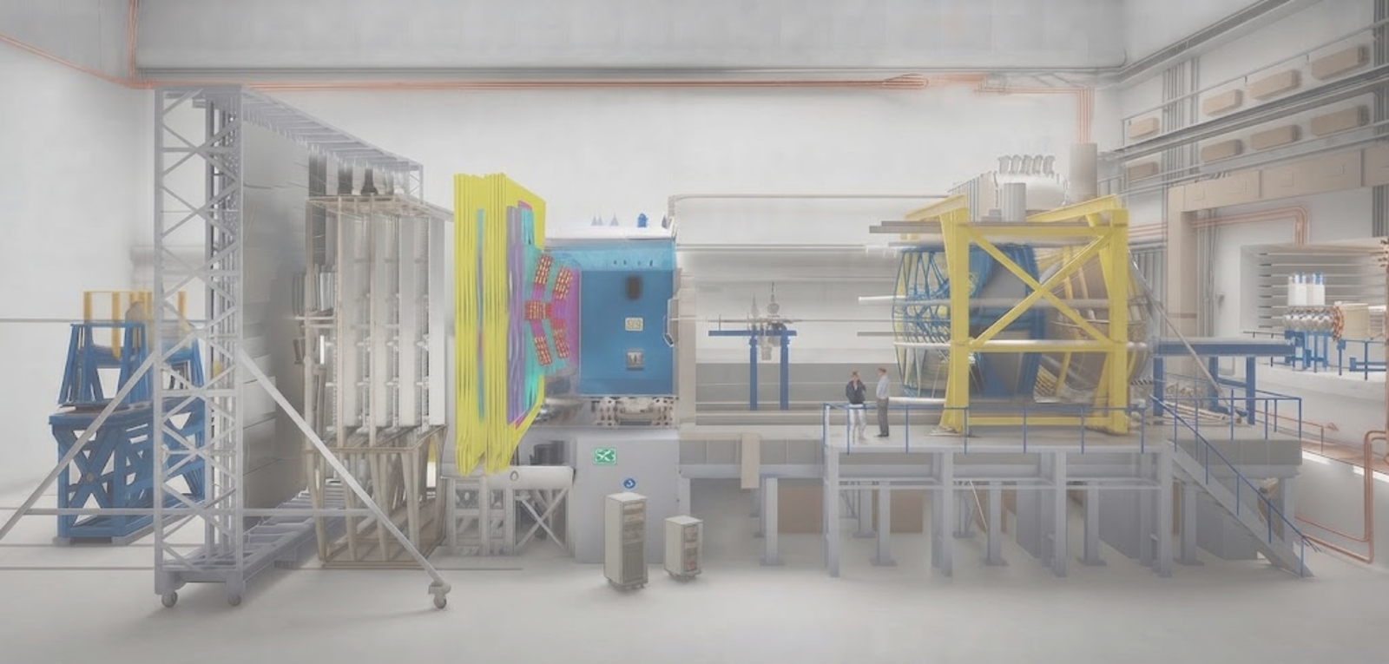

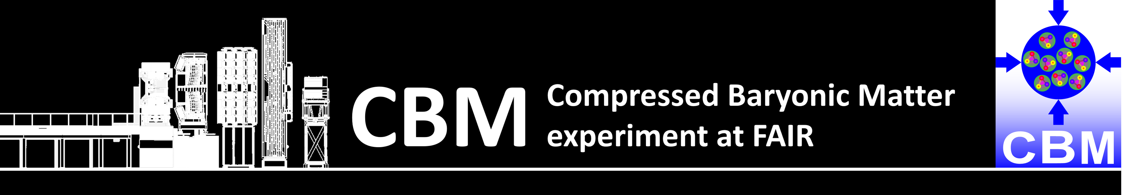


Feasibility studies for MUST in CBM
Software work in CBM MUST (Muon Straws) LHCb OT
04/09/2026 Sofia Lopes | NOVA School of Science and Technology | sofia.alonso.lopes@gmail.com 1

Slide 2
Contents
Motivation
The CBM MUST
v26e vs v26m Geometries
Background Study (URQMD generator)
Efficiency Study (BOX generator)
Conclusion and Outlook
Additional documentation
04/09/2026 Sofia Lopes | NOVA School of Science and Technology | sofia.alonso.lopes@gmail.com 2

Slide 3
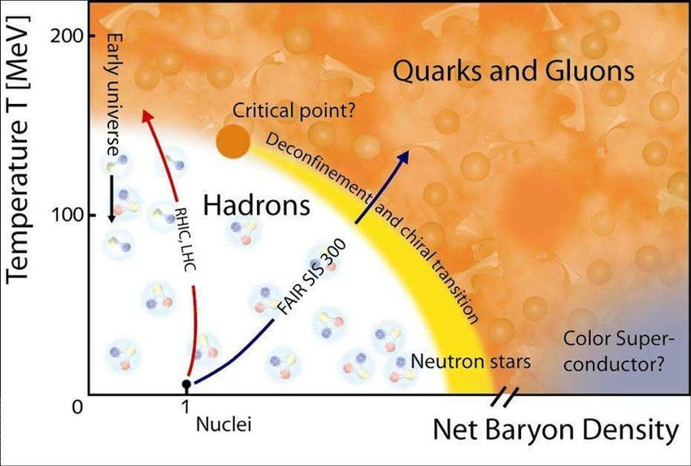
Motivation
Main Goals
Map the QCD phase diagram;
Search for the QCD Critical Point, with high-precision measurements.
Verify whether, in this regime, the transition is smooth or a sharp first-order phase transition.
High precision Measurements
Acessing rare probes
Clear Signal
High interaction Rates: ~10 MHz
Muons
Great understanding of the collision
Di-Muon from J/ψ decay
04/09/2026 Sofia Lopes | NOVA School of Science and Technology | sofia.alonso.lopes@gmail.com 3

Slide 4

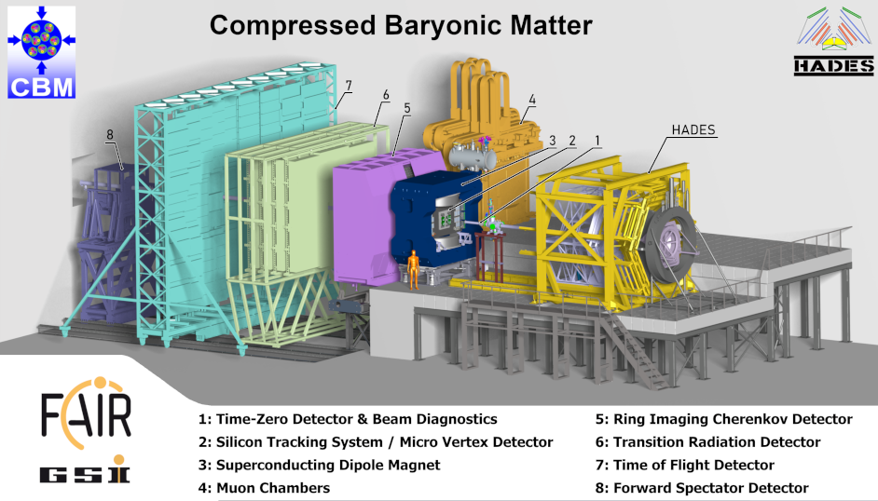
Muon Straws from
LHC Outer Tracker
PANDA → CBM
04/09/2026 Sofia Lopes | NOVA School of Science and Technology | sofia.Alonso.lopes@gmail.com 4

Slide 5
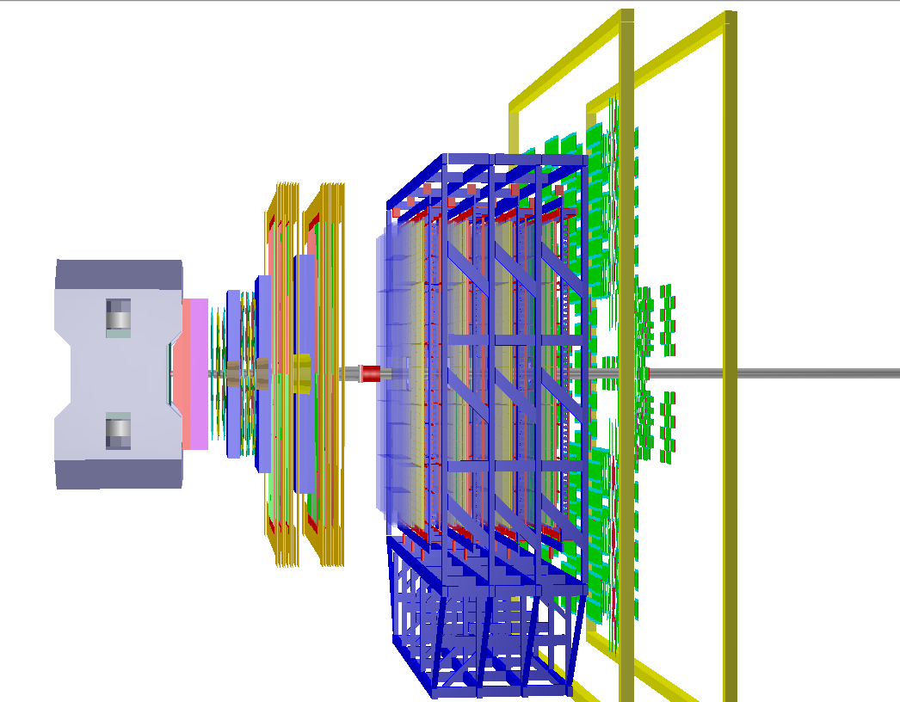
v26e MUST geometry
Modules
Type | F | S1 | S2 | S3
Staggered Monolayers | 64 |  |  | 32
Straws | 128 |  |  | 64
MUCH
z = 125 cm
GEM
2 Stations – 3 Layers Each – GEMs (Gas Electron Multiplier) 4 Hadron Absorbers Shields (Al + Pb)
MUST v26e
2 Stations – 6 Layers each – Organized into Modules: Used Modules: 132 | Unused: 84 Stations separated by a 30 cm Fe absorber Stereo Angles Station 0: XU VX XU: 0º, -5º , +5º, 0º, 0º, -5º Station 1: VX XU VX: +5º, 0º, 0º, -5º, +5º, 0º 32256 active straws
GEM
MUST
04/09/2026 Sofia Lopes | NOVA School of Science and Technology | sofia.Alonso.lopes@gmail.com 5

Slide 6
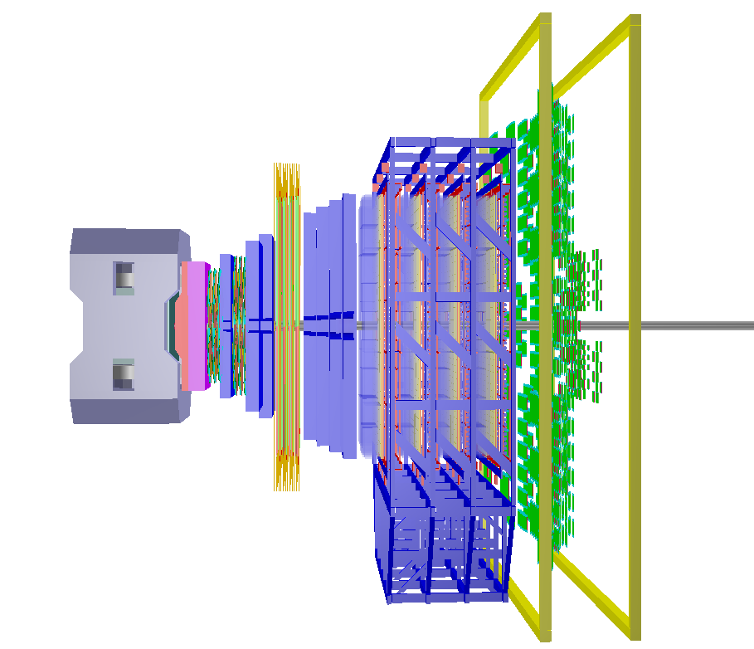
v26m MUST geometry
MUCH
Modules
Type | F | S1 | S2 | S3
Staggered Monolayers | 64 |  |  | 32
Straws | 128 |  |  | 64
z = 125 cm
MUCH
2 Stations – 3 Layers each - GEMs (Gas Electron Multipliers) 5 Hadron Absorbers Shields (Al + Pb)
MUST v26m
2 Stations – 4 Layers each – Organized into Modules: Used Modules: 88 | Unused: 128 Stations separated by a 2 cm gap like all the other layers. Stereo Angles Station 0: XUVX: 0º, -5º , +5º, 0º Station 1: XUVX: 0º, -5º, +5º, 0º 21504 active straws
GEM MUST
04/09/2026 Sofia Lopes | NOVA School of Science and Technology | sofia.Alonso.lopes@gmail.com 6

Slide 7
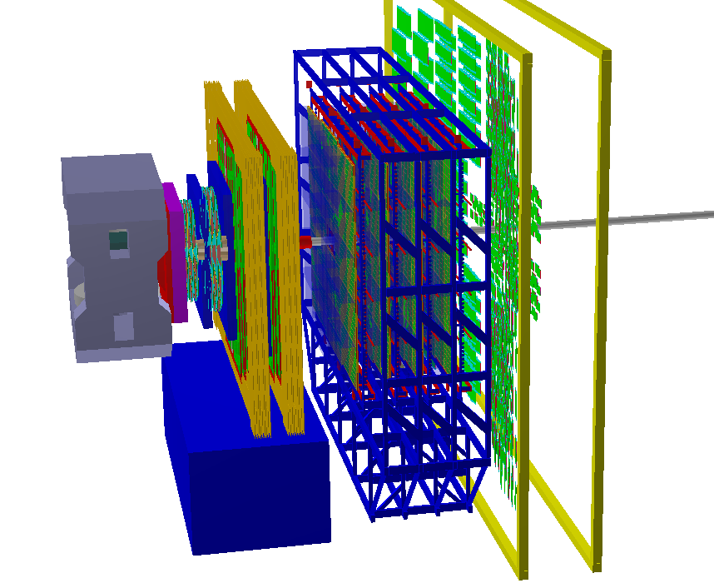
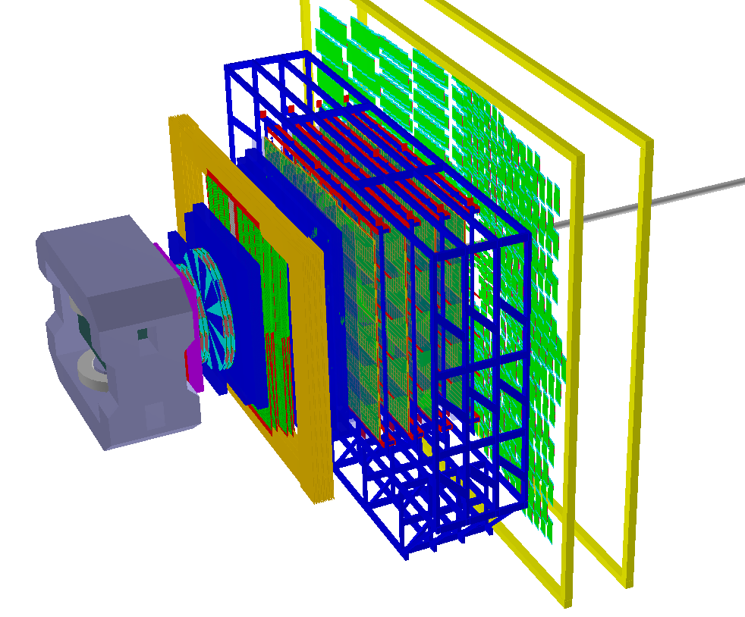
MUST geometries
v26e v26m
04/09/2026 Sofia Lopes | NOVA School of Science and Technology | sofia.Alonso.lopes@gmail.com 7

Slide 8
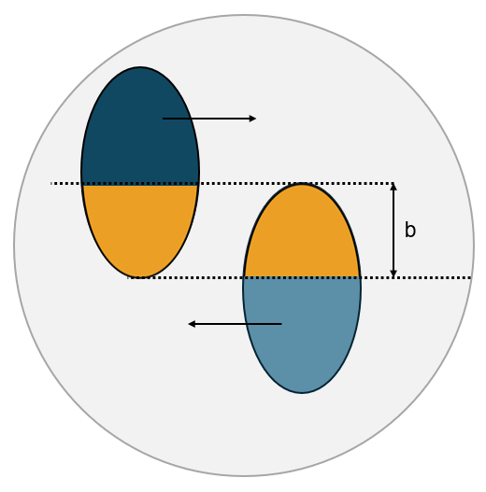
Two different studies
BACKGROUND STUDY
URQMD
Au + Au
12 AGeV
1000 events
Central Collision
Minimum Bias Collision
mbias
EFFICIENCY STUDY
Theta
BOX
2000 particles
100 events
Muons
2.5º – 40º
2.5º – 25º
Pions
Momentum
Protons
0.5 – 4.0 GeV/c
0.5 – 15 GeV/c
04/09/2026 Sofia Lopes | NOVA School of Science and Technology | sofia.Alonso.lopes@gmail.com 8

Slide 9
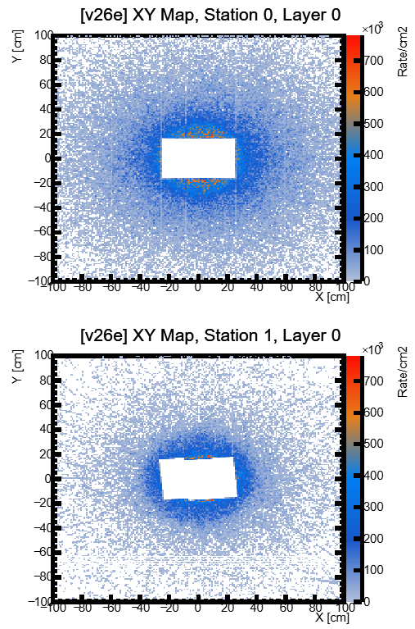
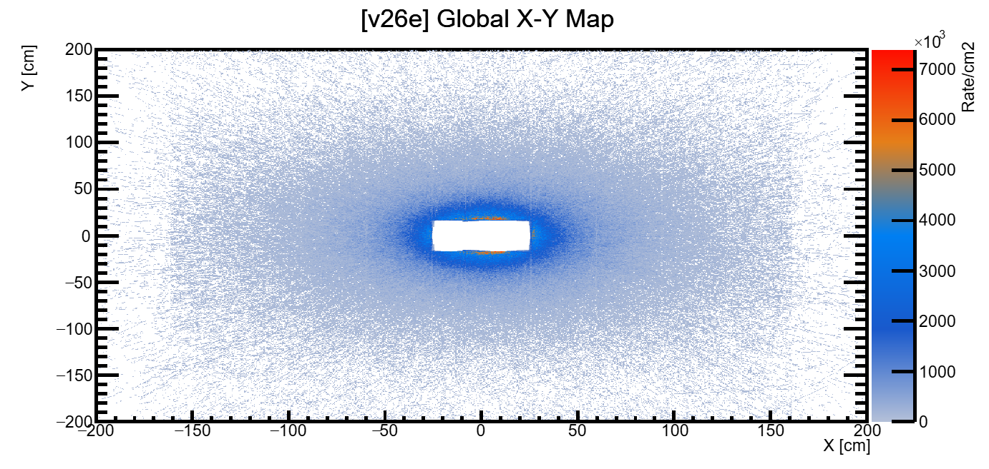
URQMD Generator MCTracks
URQMD AuAu 12AGeV centr
1000 Events Geant4
Hits/s/cm² along XY v26e
233473 entries
Great reduction: Absorber
44% reduction in entries
Maximum Rate/cm² S0 L0 and S1 L1
~780kHz @10MHz
102447 entries
04/09/2026 Sofia Lopes | NOVA School of Science and Technology | sofia.Alonso.lopes@gmail.com 9

Slide 10
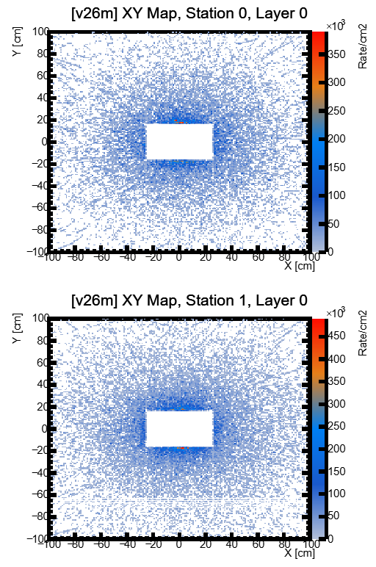
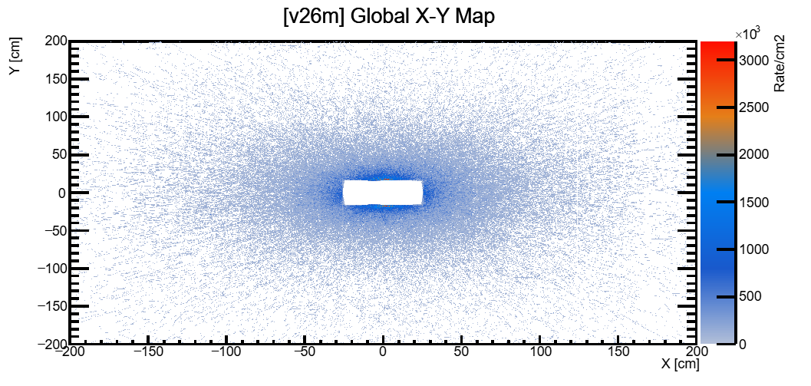
URQMD Generator MCTracks
URQMD AuAu 12AGeV centr
1000 Events Geant4
Hits/s/cm² along XY v26m
53687 entries
Maximum Rate/cm² S0 L0
~390kHz @10MHz
Maximum Rate/cm² S1 L0
~490kHz @10MHz
67708 entries
04/09/2026 Sofia Lopes | NOVA School of Science and Technology | sofia.Alonso.lopes@gmail.com 10

Slide 11
URQMD Generator MCTracks
URQMD AuAu 12AGeV centr
1000 Events Geant4
MCTracks per Event
~6715 Tracks/event
~5x more secondary particle entries than primary.
Low momentum for secondary particles: Mean 0.48 GeV/c.
Will they be stopped before reaching the end of the MUST?
04/09/2026 Sofia Lopes | NOVA School of Science and Technology | sofia.Alonso.lopes@gmail.com 11

Slide 12
Background study
URQMD AuAu 12AGeV centr
1000 Events Geant4
Number of MUST Points per N(MCTrack) for particles that survived the MUCH
Just Muons
Anything but Muons
Just Muons
Anything but Muons
~1.3 μ/event
~1.4 part/event
~1.7 μ/event
~0.9 part/event
MUST end
MUST end
MUST end
MUST end
04/09/2026 Sofia Lopes | NOVA School of Science and Technology | sofia.Alonso.lopes@gmail.com 12

Slide 13
Background study
URQMD AuAu 12AGeV mbias
1000 Events Geant4
Multiple hit and station occupancy mbias collision
V26m shows a greater reduction rate of frequency for each hit increase.
Both geometries show sharper occupancy peaks (~0.3–0.4 hits/straw) concentrated around modules 8–9.
v26m occupancy stays ~5x lower than v26e.
04/09/2026 Sofia Lopes | NOVA School of Science and Technology | sofia.Alonso.lopes@gmail.com 13

Slide 14
Background study
URQMD AuAu 12AGeV mbias
1000 Events Geant4
Straw occupancy mbias collision
Greater reduction in straw occupancy between stations for v26e → Absorber.
V26m presents a straw occupancy 3x smaller then v26e for the first station.
V26m presents a straw occupancy 1.5x smaller then v26e for the second station.
v26e Particle Rate = 1200kHz/straw
v26m Particle Rate = 400kHz/straw
For 10MHz Interaction Rate.
04/09/2026 Sofia Lopes | NOVA School of Science and Technology | sofia.Alonso.lopes@gmail.com 14

Slide 15
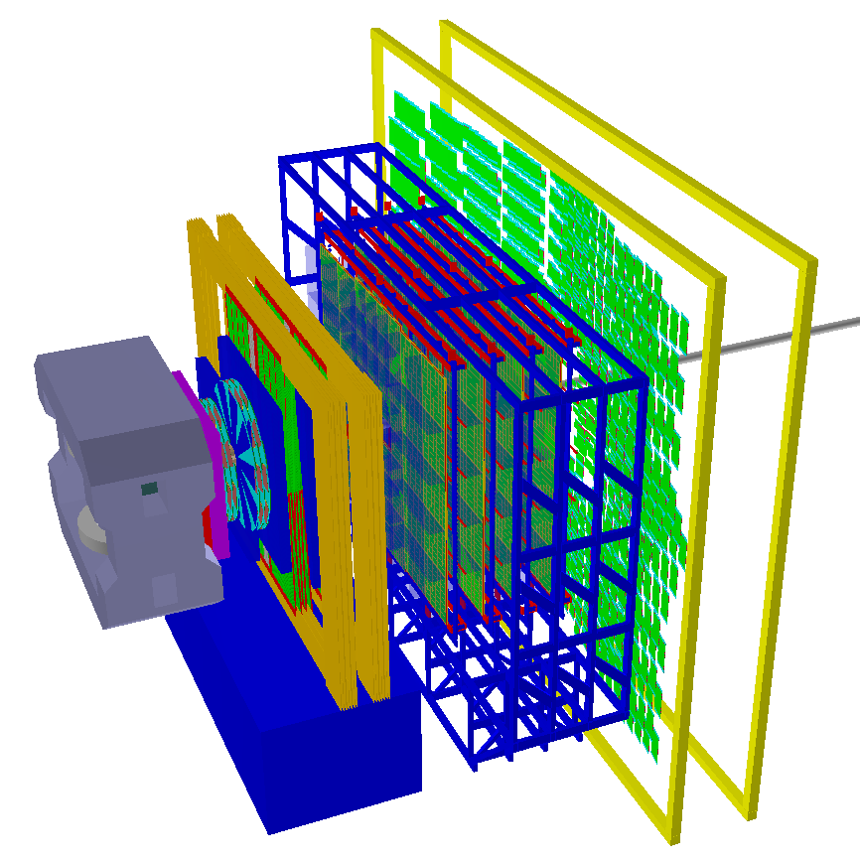
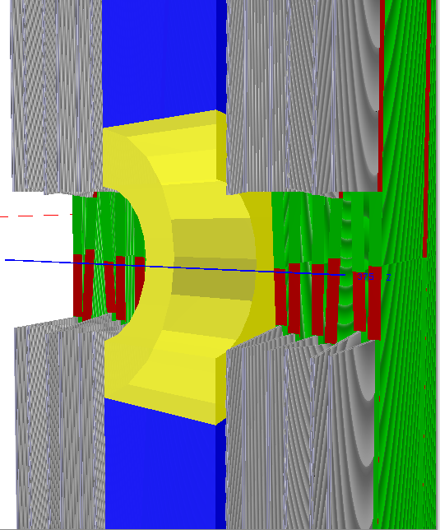
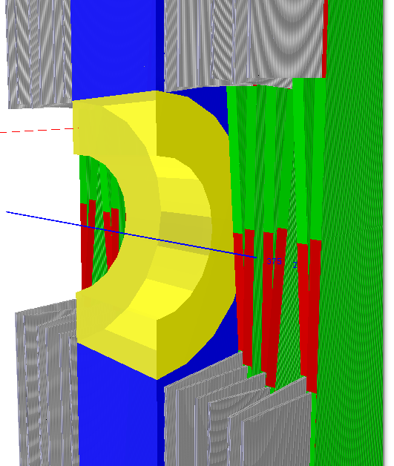
Two new geometries
V26c and v26d
From the outside they look similar…
v26c
v26d
Mid-Station
Absorber
Al Shield Cone
2 Inner modules present themselves intruding into the shield area
2 Inner modules present Shortened straws
04/09/2026 Sofia Lopes | NOVA School of Science and Technology | sofia.Alonso.lopes@gmail.com 15

Slide 16
Two new geometries
URQMD AuAu 12AGeV centr
1000 Events Geant4
Occupancies V26c and v26d
04/09/2026 Sofia Lopes | NOVA School of Science and Technology | sofia.Alonso.lopes@gmail.com 16

Slide 17
Background study
URQMD AuAu 12AGeV centr
1000 Events Geant4
Particles that survive MUCH and MUST
Only particles that transversed all MUCH and MUST stations are included!
No noise from secondary muons for both geometries.
Fewer MUST points for protons for v26m → Fewer Layers in v26m, no direct conclusion.
Overall, few MUST points per event → Good background suppression
04/09/2026 Sofia Lopes | NOVA School of Science and Technology | sofia.Alonso.lopes@gmail.com 17

Slide 18
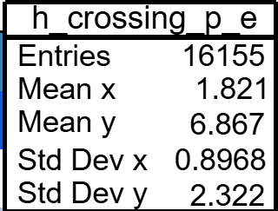
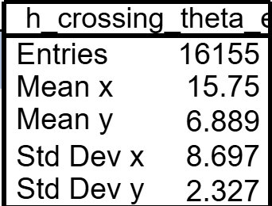
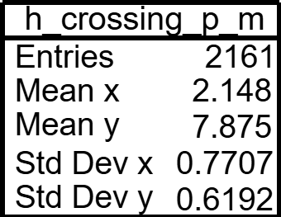
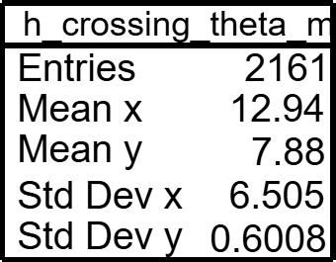
Background study
URQMD AuAu 12AGeV centr
1000 Events Geant4
Transverse of particles that survived MUCH along MUST
TOTAL MCTracks
v26e
6717644
v26m
5985563
Background reduction
10⁻³
Background reduction
10⁻⁴
04/09/2026 Sofia Lopes | NOVA School of Science and Technology | sofia.Alonso.lopes@gmail.com 18

Slide 19
Efficiency study
BOX muons
2000 particles / Event
100 Events Geant4
Transverse of Muons along MUST
>90%
v26m v26e
04/09/2026 Sofia Lopes | NOVA School of Science and Technology | sofia.Alonso.lopes@gmail.com 19

Slide 20
Efficiency study
BOX pions
2000 particles / Event
100 Events Geant4
Transverse of Pions along MUST
1%
v26m v26e
04/09/2026 Sofia Lopes | NOVA School of Science and Technology | sofia.Alonso.lopes@gmail.com 20

Slide 21
Efficiency study
BOX protons
2000 particles / Event
100 Events Geant4
Transverse of Protons along MUST
0.4%
v26m v26e
04/09/2026 Sofia Lopes | NOVA School of Science and Technology | sofia.Alonso.lopes@gmail.com 21

Slide 22
Take home message
      Detector health: v26m's lower straw/station occupancy and multi-hit frequency support less charge accumulation
      Background & rates: v26m gives ~2x lower peak hit rate while using 2 fewer layers per station → lower costs
      Muon detection efficiency: no significant difference between geometries.
04/09/2026 Sofia Lopes | NOVA School of Science and Technology | sofia.Alonso.lopes@gmail.com 22

Slide 23
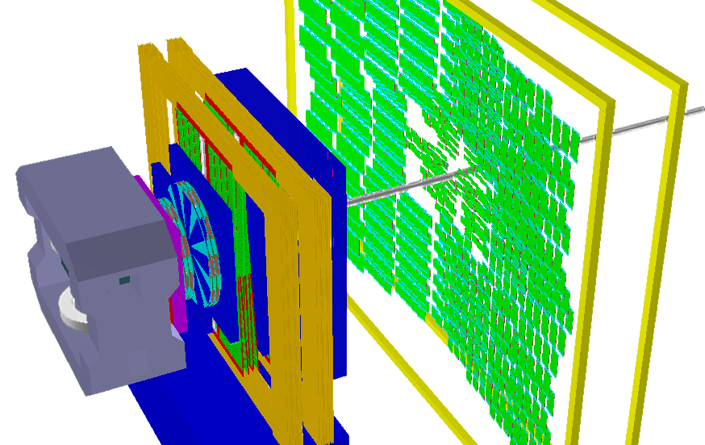
Outlook
Study of TRD and TOF points with the new v26f geometry…
v26e with a back-absorber
Study of TRD and TOF points with the v26e and v26m geometry
04/09/2026 Sofia Lopes | NOVA School of Science and Technology | sofia.Alonso.lopes@gmail.com 23

Slide 24
Thank you for you attention!
Software work in CBM MUST (Muon Straws) LHCb OT
04/09/2026 Sofia Lopes | NOVA School of Science and Technology | sofia.Alonso.lopes@gmail.com 24

Slide 25
Backup Slides
Software work in CBM MUST (Muon Straws) LHCb OT
04/09/2026 Sofia Lopes | NOVA School of Science and Technology | sofia.Alonso.lopes@gmail.com 25

Slide 26
Additional Slides
URQMD AuAu 12AGeV centr
1000 Events Geant4
Total Data – What particles do we get from the Au+Au collision?
04/09/2026 Sofia Lopes | NOVA School of Science and Technology | sofia.Alonso.lopes@gmail.com 26

Slide 27
Additional Slides
URQMD AuAu 12AGeV centr
1000 Events Geant4
Total Data – Distribution of MCTracks starting coordinates
04/09/2026 Sofia Lopes | NOVA School of Science and Technology | sofia.Alonso.lopes@gmail.com 27

Slide 28
Additional Slides
URQMD AuAu 12AGeV centr
1000 Events Geant4
Muon Data – Distribution of MCTracks starting coordinates
04/09/2026 Sofia Lopes | NOVA School of Science and Technology | sofia.Alonso.lopes@gmail.com 28

Slide 29
Additional Slides
URQMD AuAu 12AGeV centr
1000 Events Geant4
Muon Data – Start Z and mother particles
04/09/2026 Sofia Lopes | NOVA School of Science and Technology | sofia.Alonso.lopes@gmail.com 29

Slide 30
Additional Slides
URQMD AuAu 12AGeV centr
1000 Events Geant4
Muon Data – Momentum for v26e
04/09/2026 Sofia Lopes | NOVA School of Science and Technology | sofia.Alonso.lopes@gmail.com 30

Slide 31
Additional Slides
URQMD AuAu 12AGeV centr
1000 Events Geant4
Muon Data – Momentum for v26m
04/09/2026 Sofia Lopes | NOVA School of Science and Technology | sofia.Alonso.lopes@gmail.com 31

Slide 32
Additional Slides
URQMD AuAu 12AGeV centr
1000 Events Geant4
Muon Data – pX, pY and Transverse momentum
04/09/2026 Sofia Lopes | NOVA School of Science and Technology | sofia.Alonso.lopes@gmail.com 32

Slide 33
Additional Slides
URQMD AuAu 12AGeV centr
1000 Events Geant4
Muon Data – pz vs pT 2D Histogram
04/09/2026 Sofia Lopes | NOVA School of Science and Technology | sofia.Alonso.lopes@gmail.com 33

Slide 34
Additional Slides
URQMD AuAu 12AGeV centr
1000 Events Geant4
Muon Data – Theta, Eta, Phi
04/09/2026 Sofia Lopes | NOVA School of Science and Technology | sofia.Alonso.lopes@gmail.com 34

Slide 35
Additional Slides
URQMD AuAu 12AGeV centr
1000 Events Geant4
Muon Data – Pz for Muons from different decays
04/09/2026 Sofia Lopes | NOVA School of Science and Technology | sofia.Alonso.lopes@gmail.com 35

Slide 36
Additional Slides
URQMD AuAu 12AGeV centr
1000 Events Geant4
Muon, Pion and Kaons pz
04/09/2026 Sofia Lopes | NOVA School of Science and Technology | sofia.Alonso.lopes@gmail.com 36

Slide 37
Additional Slides
URQMD AuAu 12AGeV centr
1000 Events Geant4
Muon Data – MUST and MUCH points vs momentum
04/09/2026 Sofia Lopes | NOVA School of Science and Technology | sofia.Alonso.lopes@gmail.com 37

Slide 38
Additional Slides
URQMD AuAu 12AGeV centr
1000 Events Geant4
Muon Data – Start z reaching the MUST
[v26e]
[v26m]
04/09/2026 Sofia Lopes | NOVA School of Science and Technology | sofia.Alonso.lopes@gmail.com 38

Slide 39
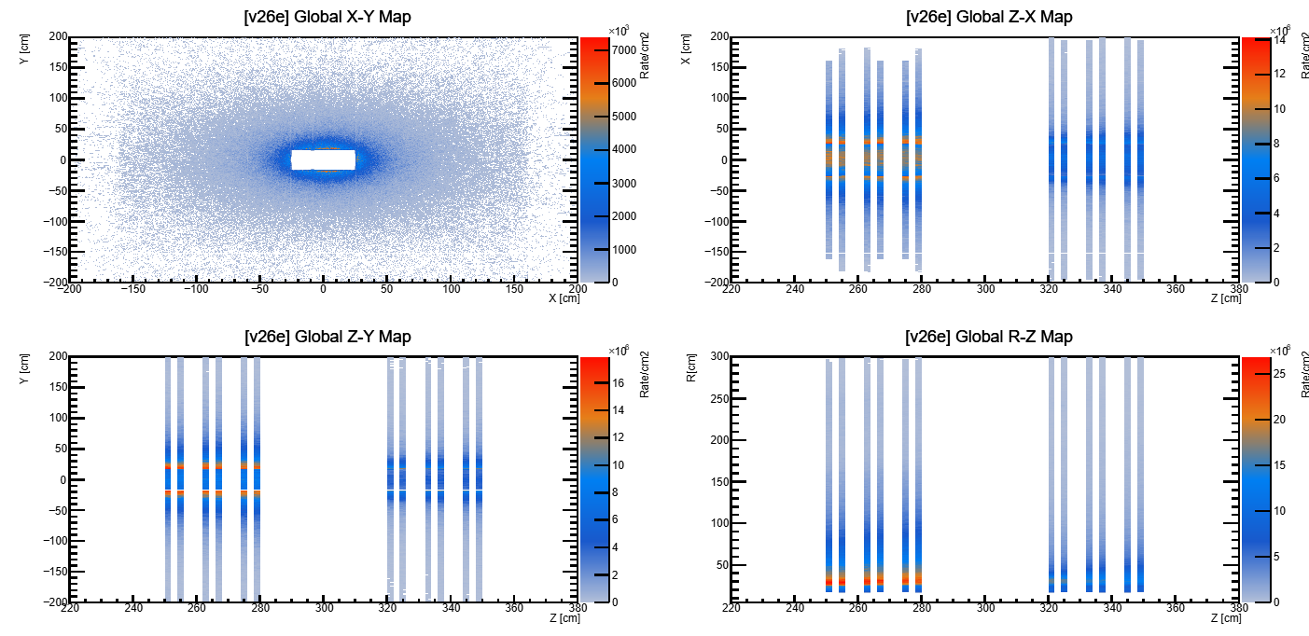
Additional Slides
URQMD AuAu 12AGeV centr
1000 Events Geant4
Distribution of Hits/Event/s for v26e
04/09/2026 Sofia Lopes | NOVA School of Science and Technology | sofia.Alonso.lopes@gmail.com 39

Slide 40
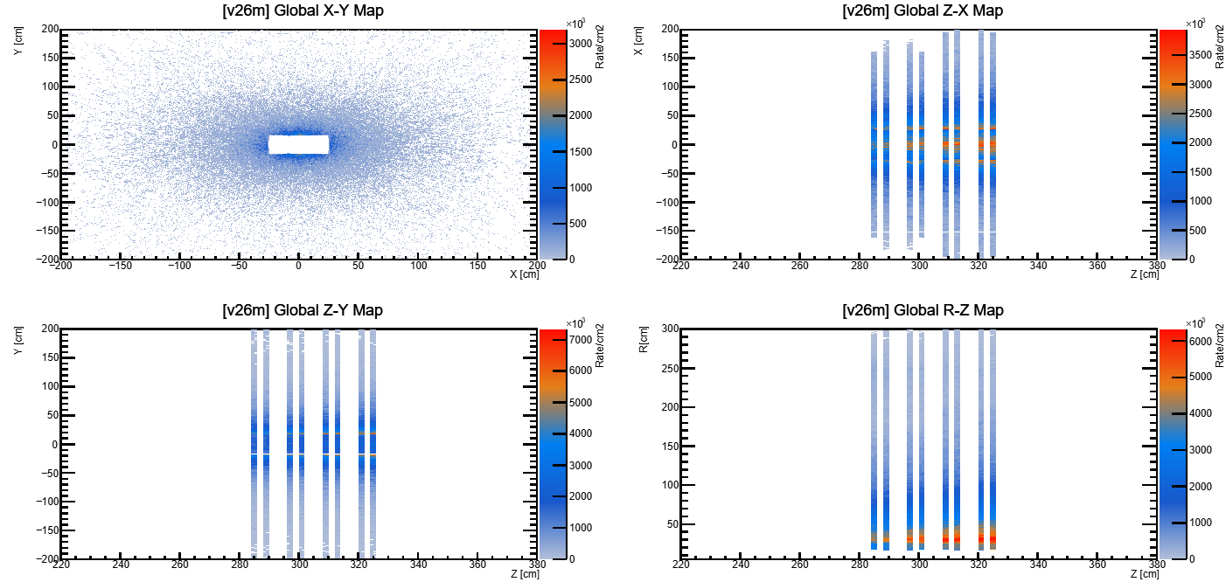
Additional Slides
URQMD AuAu 12AGeV centr
1000 Events Geant4
Distribution of Hits/Event/s for v26m
04/09/2026 Sofia Lopes | NOVA School of Science and Technology | sofia.Alonso.lopes@gmail.com 40

Slide 41
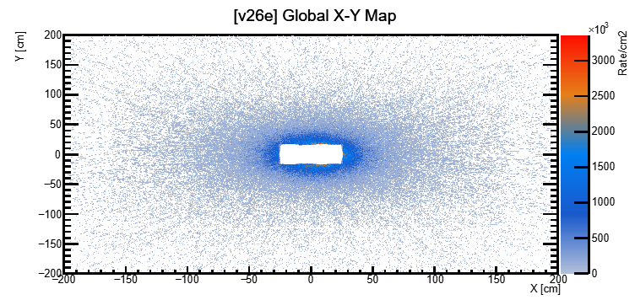
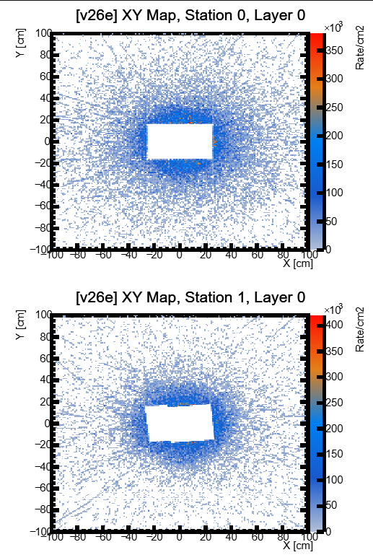
Additional Slides
URQMD AuAu 12AGeV mbias
1000 Events Geant4
Hits/s//Event/cm2 along XY v26e MBIAS
Maximum Rate/cm2 S1 L0
~420Hz @10MHz
04/09/2026 Sofia Lopes | NOVA School of Science and Technology | sofia.Alonso.lopes@gmail.com 41

Slide 42
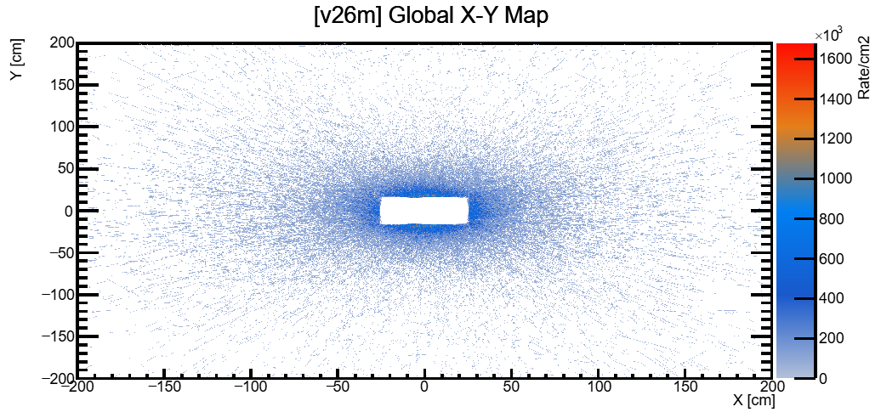
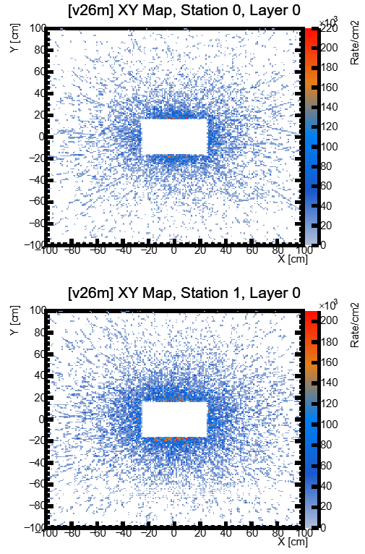
Additional Slides
URQMD AuAu 12AGeV mbias
1000 Events Geant4
Hits/s//Event/cm2 along XY v26m MBIAS
Maximum Rate/cm2 S0 L0
~220Hz @10MHz
04/09/2026 Sofia Lopes | NOVA School of Science and Technology | sofia.Alonso.lopes@gmail.com 42

Slide 43
Additional Slides
URQMD AuAu 12AGeV centr
1000 Events Geant4
Particles that produce MUST points
Here we have secondary particles created in the MUCH and MUST
More counts for v26e → More tracks.
04/09/2026 Sofia Lopes | NOVA School of Science and Technology | sofia.Alonso.lopes@gmail.com 43

Slide 44
Additional Slides
URQMD AuAu 12AGeV
1000 Events Geant4
Hits rate per event
CENTER
MINIMUM BIAS
04/09/2026 Sofia Lopes | NOVA School of Science and Technology | sofia.Alonso.lopes@gmail.com 44

Slide 45
Additional Slides
URQMD AuAu 12AGeV Centr
1000 Events Geant4
Multiple hit, station, and straw occupancy centre collision
04/09/2026 Sofia Lopes | NOVA School of Science and Technology | sofia.Alonso.lopes@gmail.com 45

Slide 46
Efficiency study
BOX muons
2000 particles / Event
100 Events Geant4
Transverse of Muons that survived GEM section along MUST
04/09/2026 Sofia Lopes | NOVA School of Science and Technology | sofia.Alonso.lopes@gmail.com 46

Slide 47
Efficiency study
BOX pions
2000 particles / Event
100 Events Geant4
Transverse of Pions that survived GEM section along MUST
04/09/2026 Sofia Lopes | NOVA School of Science and Technology | sofia.Alonso.lopes@gmail.com 47

Slide 48
Efficiency study
BOX protons
2000 particles / Event
100 Events Geant4
Transverse of Protons that survived GEM section along MUST
04/09/2026 Sofia Lopes | NOVA School of Science and Technology | sofia.Alonso.lopes@gmail.com 48

Slide 49
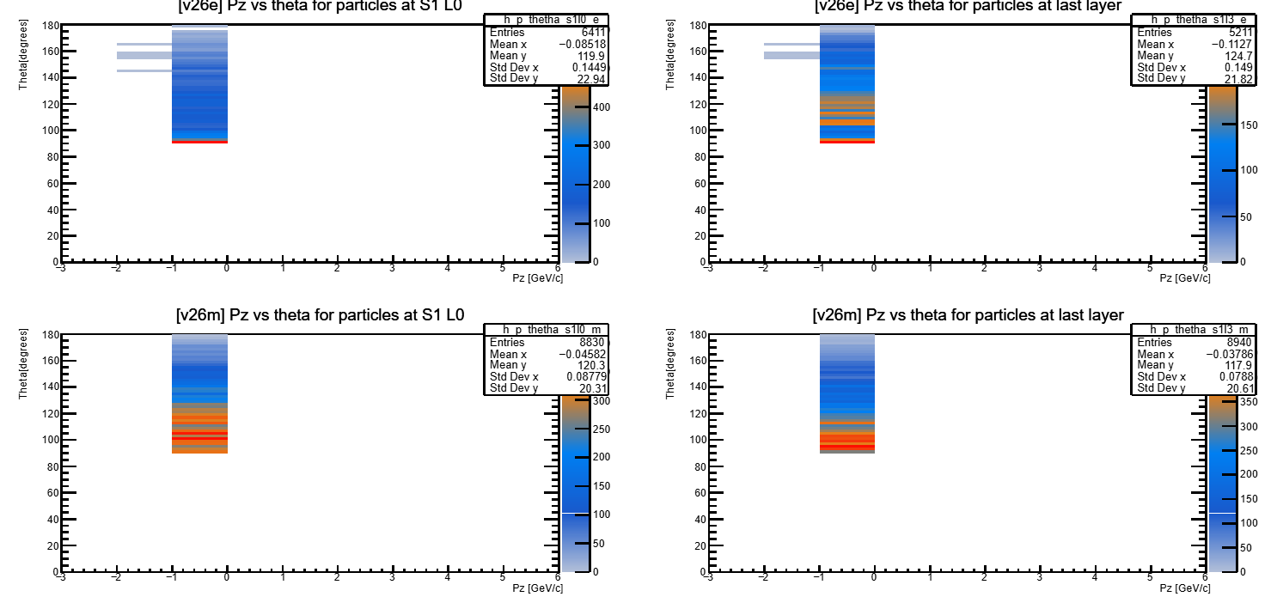
Additional Slides
URQMD AuAu 12AGeV Centr
1000 Events Geant4
Backscattering Verification
04/09/2026 Sofia Lopes | NOVA School of Science and Technology | sofia.Alonso.lopes@gmail.com 49

Slide 50
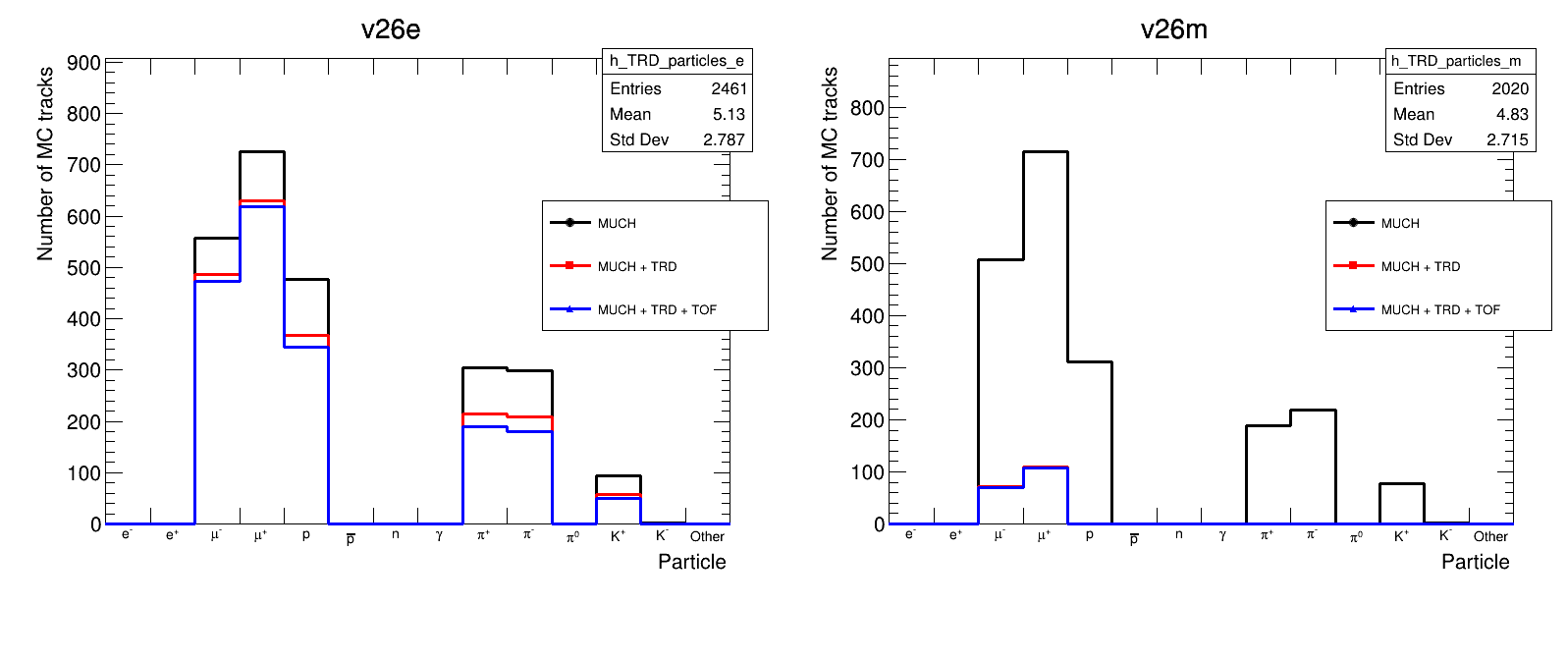
TRD and TOF STUDY
BOX protons
2000 particles / Event
100 Events Geant4
Transverse of all particles that survived MUCH + TRD + TOF
04/09/2026 Sofia Lopes | NOVA School of Science and Technology | sofia.Alonso.lopes@gmail.com 50

Slide 51
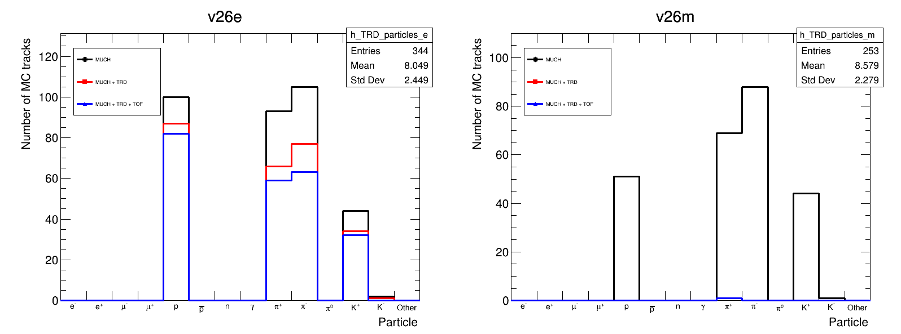
TRD and TOF STUDY
BOX protons
2000 particles / Event
100 Events Geant4
Transverse of primary particles that survived MUCH + TRD + TOF
04/09/2026 Sofia Lopes | NOVA School of Science and Technology | sofia.Alonso.lopes@gmail.com 51

