Slide 1



Optimization of the cooling concept for the upgrade of the Silicon Tracking System at the CBM experiment
Valentin BUGAESCU
Tutor: Maksym Teklishyn
Horia Hulubei National Institute for R&D in Physics and Nuclear Engineering
Faculty of Physics, University of Bucharest, Romania
11 September 2026

Slide 2

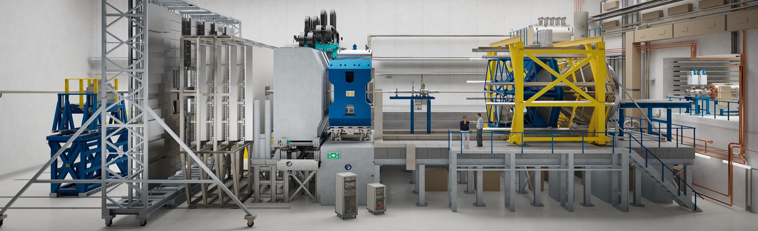
Compressed Baryonic Matter (CBM)
Image:https://www.cbm.gsi.de/

Slide 3
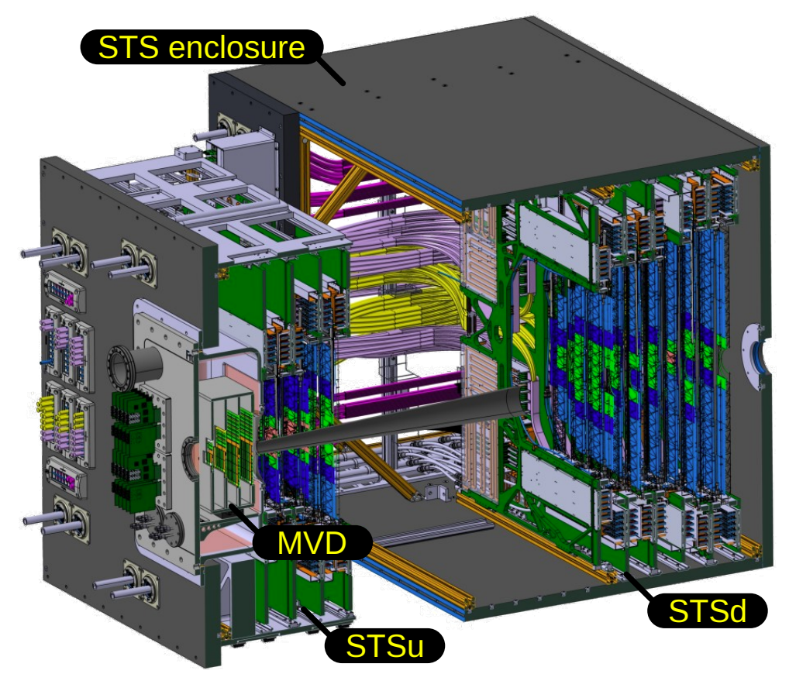
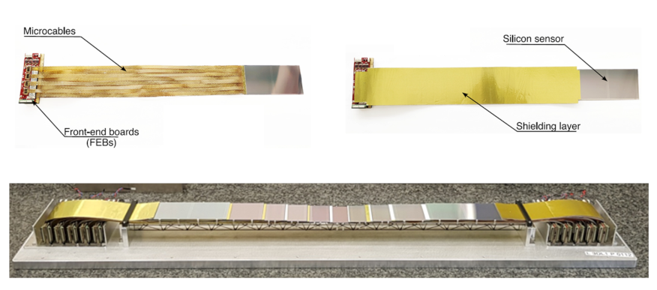
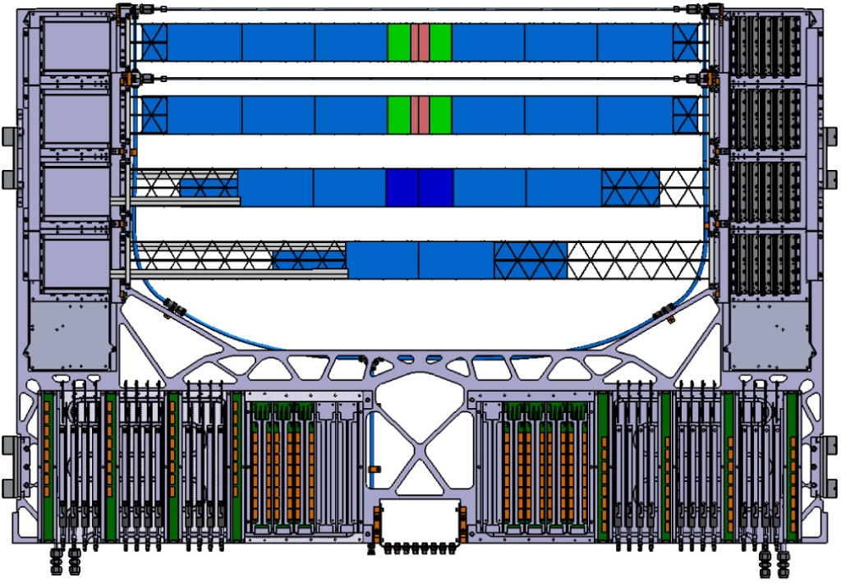
Silicon Tracking System (STS)
Images: https://indico.kit.edu/event/5139/contributions/20573/attachments/9510/16079/cbm_tk_upgrade_drd7_kit_teklishyn.pdf

Slide 4
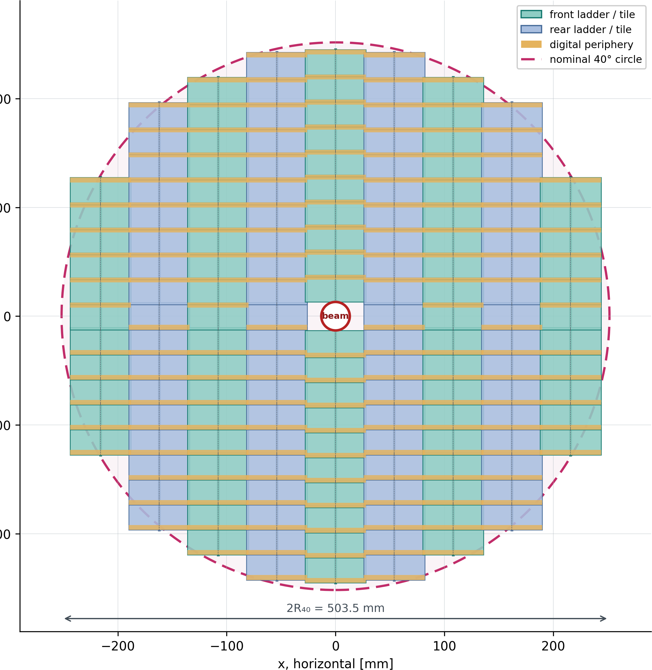
CBM Tracker Upgrade
Considerations for upgrade:
Better momentum resolution
Finer granularity
Smaller dead time
Wider acceptance
Better timing resolution

Slide 5
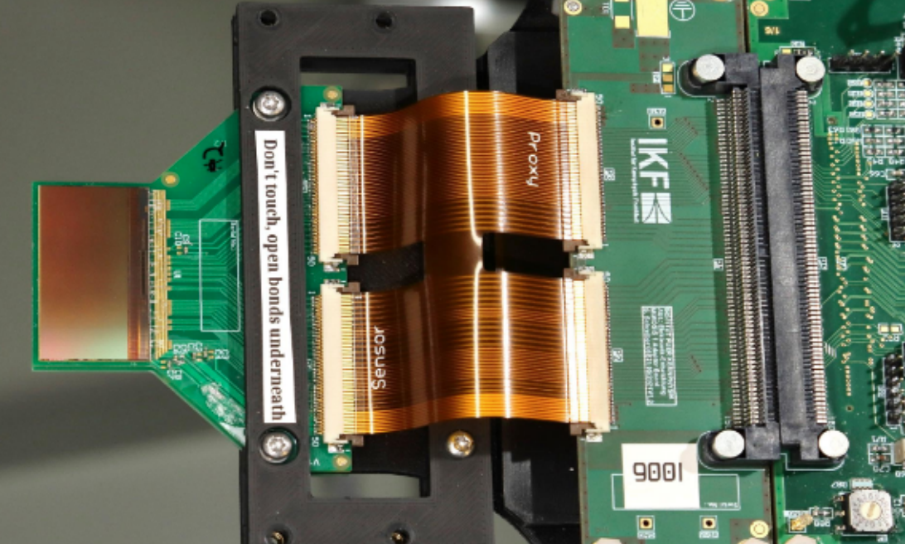
MAPS (Monolithic Active Pixel Sensors)
Differences from the present STS:
Control and data acquisition is done by short digital flex cables.
Power distribution is done by low-mass aluminium conductors directly to MAPS clips.
Electronics (including in-pixel amplification, digitization and readout) are attached to the back of the sensor.
Space used before for FEB’s, cables and cooling will be used for a wider pixel acceptance.
Test setup with two MIMOSIS-2.1 chips and the corresponding readout electronics mounted at mCBM setup.
Source:10.48550/arXiv.2506.20545

Slide 6

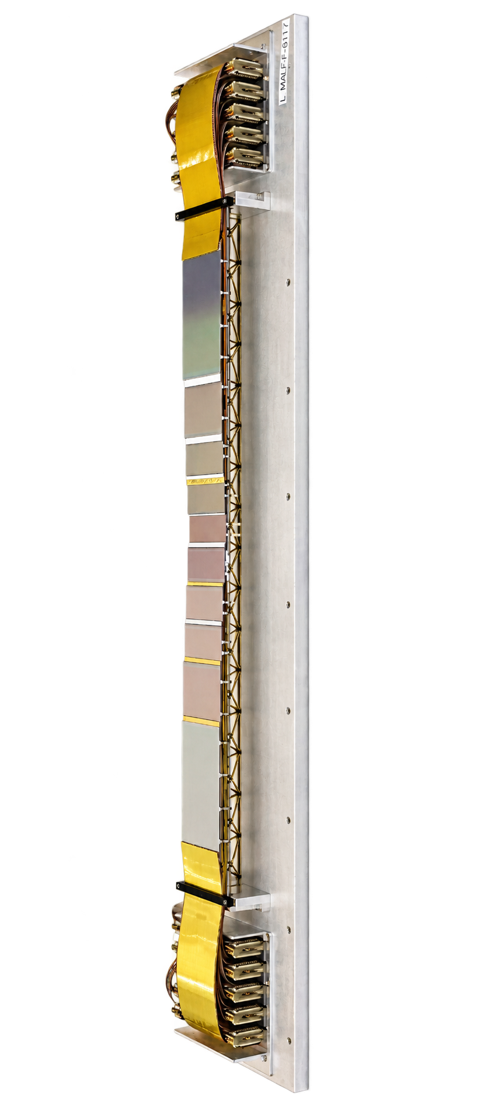
Cooling problem
The direct surface integration of the novel electronics onto the detector substrate necessitates robust thermal management to reduce thermal loads and prevent sensor overheating.
The projected thermal flux density is estimated to range between 50 and 200 mW/cm².
The new setup should follow the requirements:
Low material budget
Sensor temperatures of maximum 33°C
Low thermal gradient of sensors
Small induced vibrations
Cheap materials

Slide 7
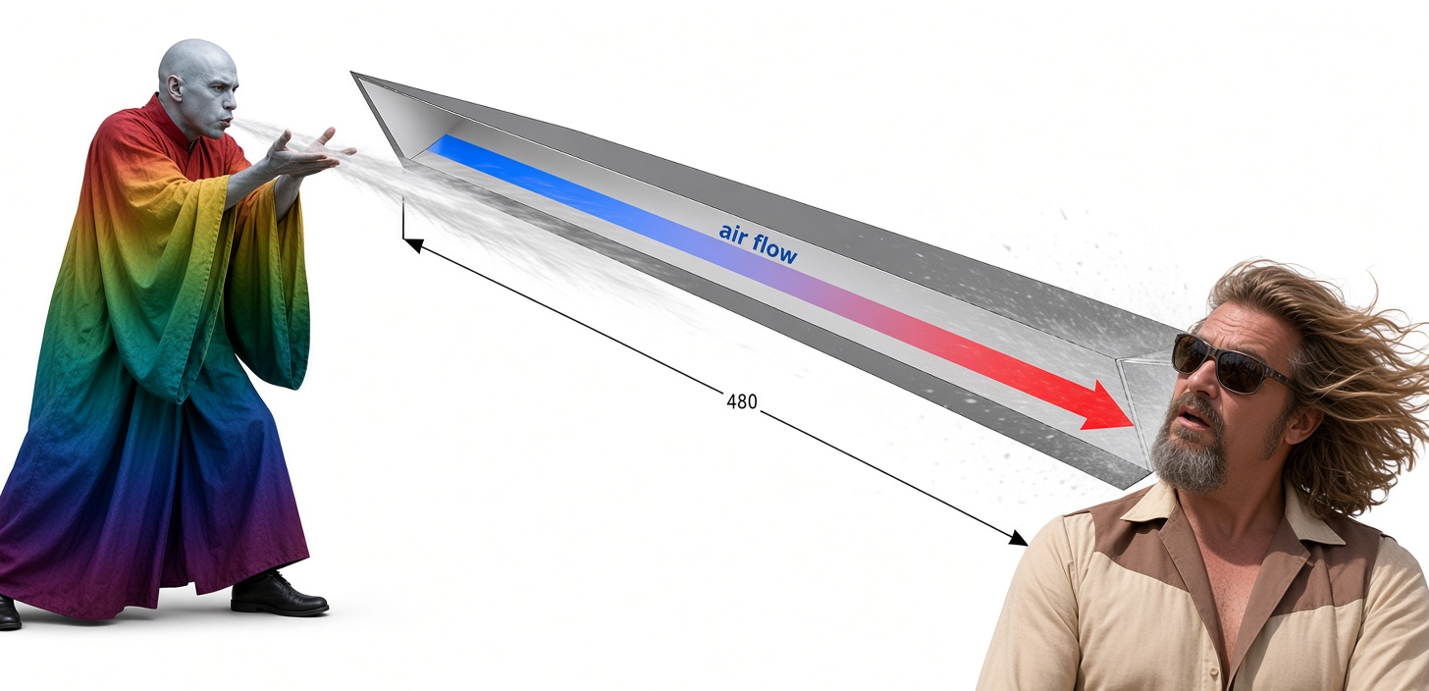
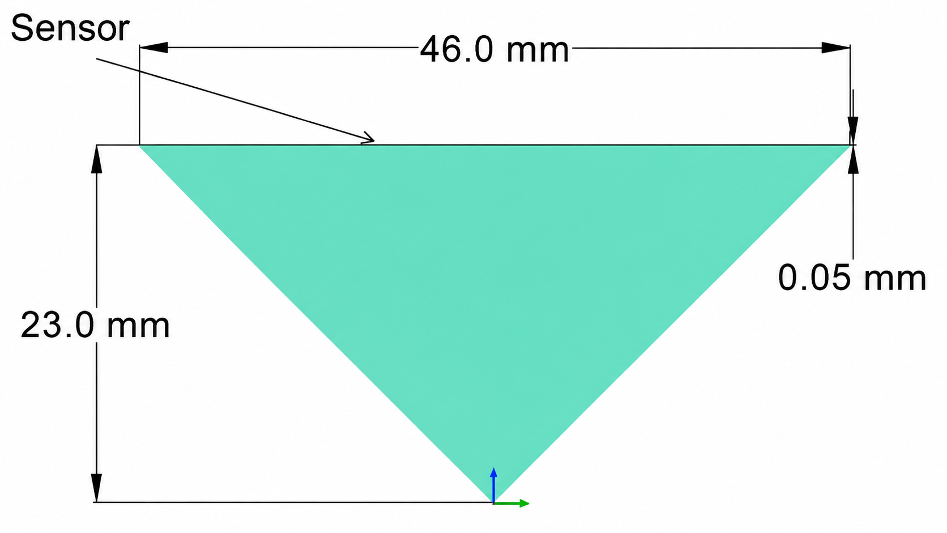
Ladder model
Simulated heat power | Maximum allowed temperature | Temperature gradient per sensor | Sensor heat draw | Sensor thickness
100 mW/cm2 | 33°C | <5°C | 22.08 W | 0.05 mm

Slide 8

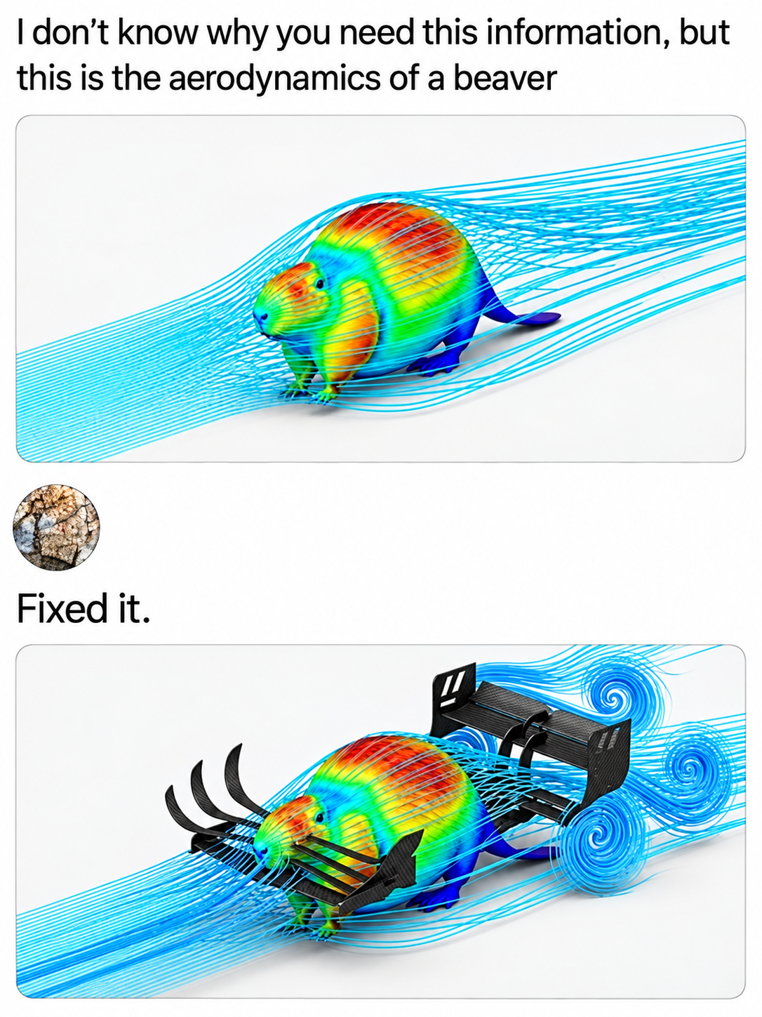
OpenFOAM is the free, open source CFD software developed primarily by OpenCFD Ltd since 2004. OpenFOAM has an extensive range of features to solve anything from complex fluid flows involving chemical reactions, turbulence and heat transfer, to acoustics, solid mechanics and electromagnetics .
Image: https://www.youtube.com/watch?v=BbPIDMkY5gQ

Slide 9
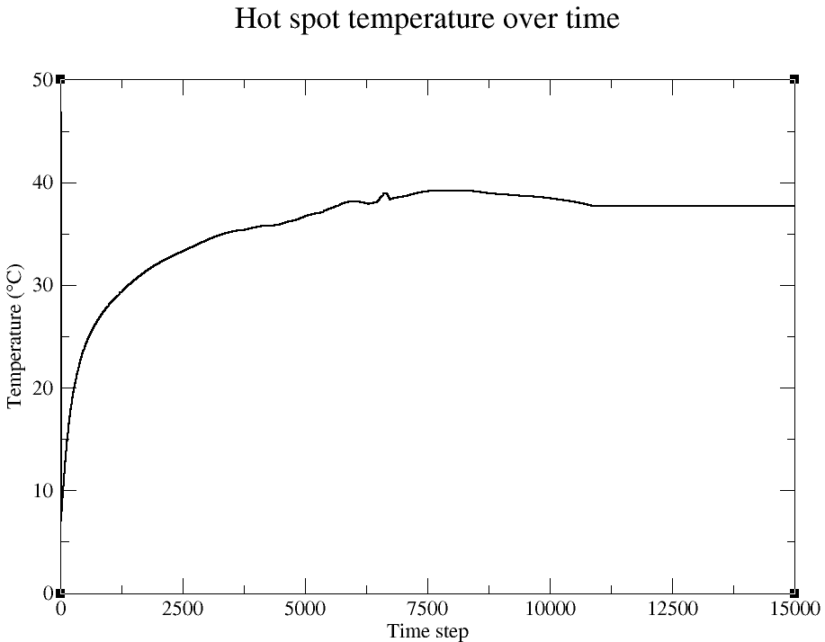
Optimal run parameters
Air speed | 3 m/s
Air temperature | 0 °C
Sensor initial temperature | 46.8°C
Gas type | Air
Air model | RAS (Reynolds-Averaged Simulation)
Air flow | 1.58 l/s
Mass flow | 2.02 g/s
Air density | 1.27 kg/m³

Slide 10
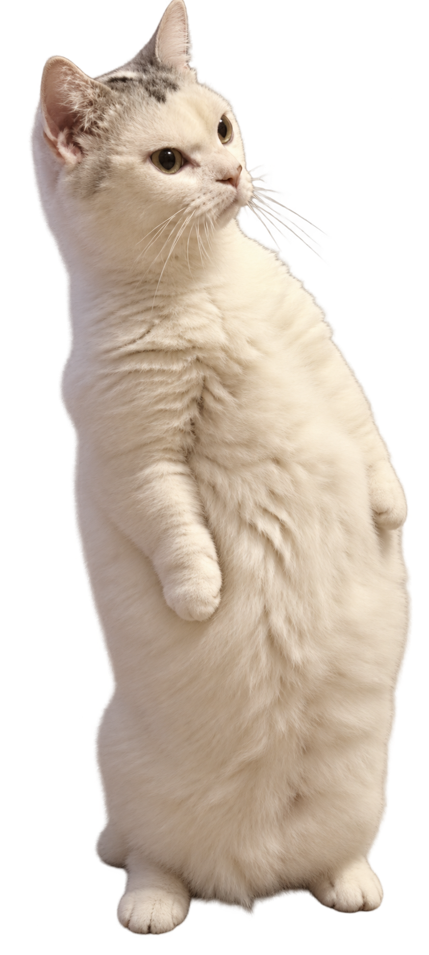

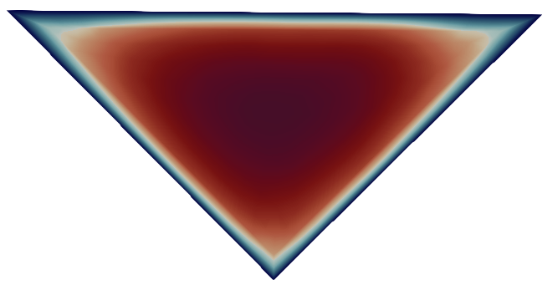

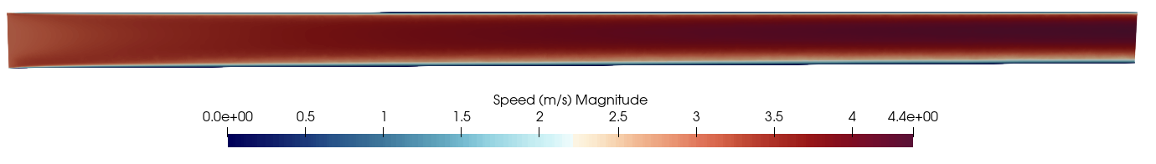
Hollow Sensor Ladder (Geometry No.1)
Air inlet speed magnitude distribution
Air outlet speed magnitude distribution
Ladder cross-sections
Air flow
Vertical cut

Slide 11

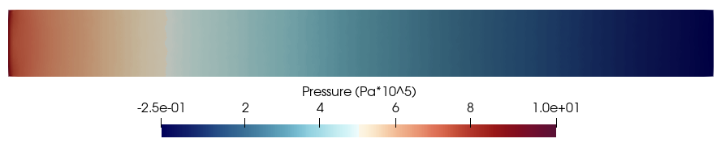
Hollow Sensor Ladder (Geometry No.1)
Horizontal slices at sensor surface
Air flow

Slide 12
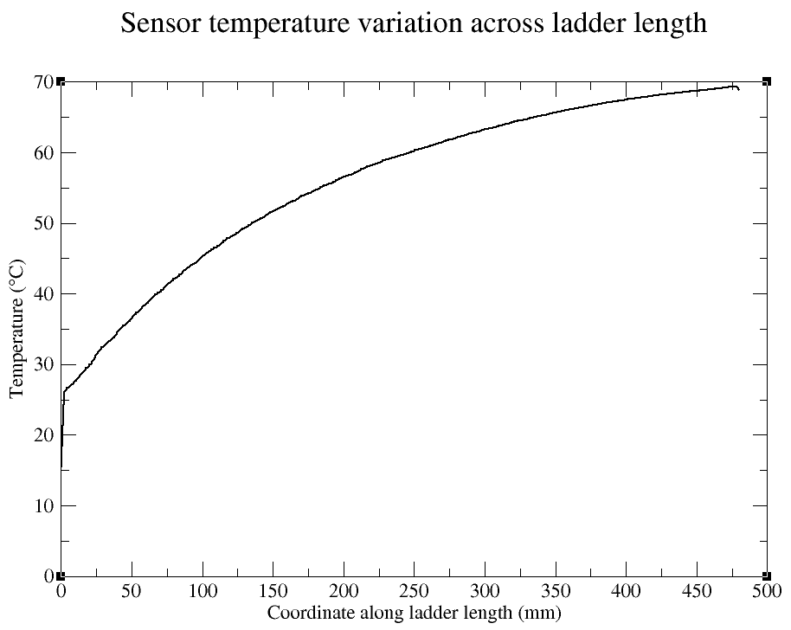
Hollow Sensor Ladder (Geometry No.1)
Parameter | Simulation result
Hot spot temperature | 70.2°C
Time steps | 5000
Pressure variation | 10.25 Pa
Maximum air speed | 4.4 m/s
Temperature gradient across ladder length | 54.7°C

Slide 13
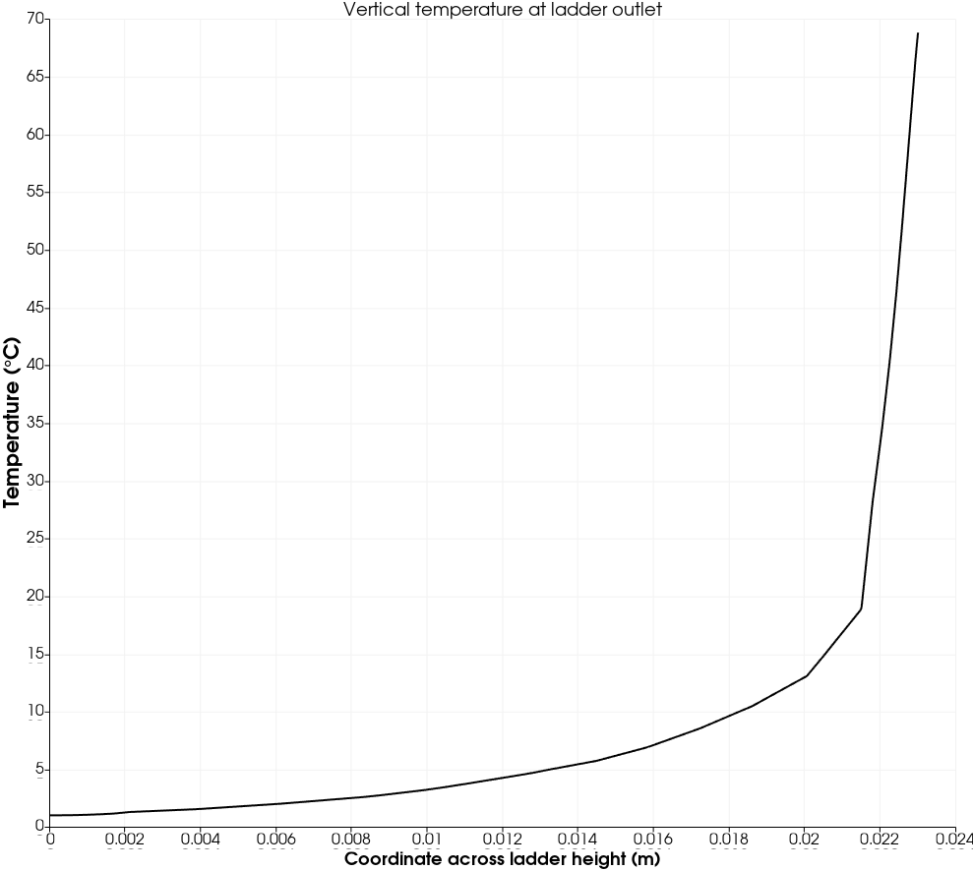
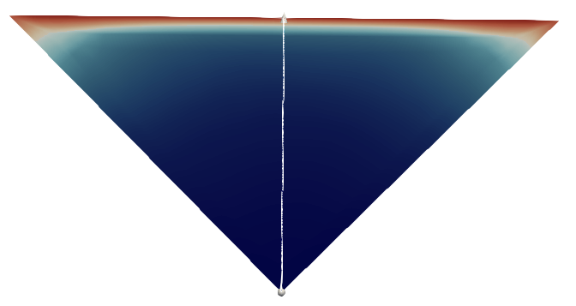
Vertical air mixing
Maximum temperature gradient | 40.8 (°C/mm)
Coordinate on height of maximum gradient | 22.7 mm (0.3 mm from sensor)
Sensor
Outlet cross-section

Slide 14
Conclusions (Geometry No.1)
Advantages | Disadvantages
Low speed magnitude (4.4 m/s) | Very high temperatures (70.2°C)
Simple geometry | High sensor temperature gradient
Low material budget | Low cooling efficiency
Low pressure variations (<11.5 Pa)

Slide 15
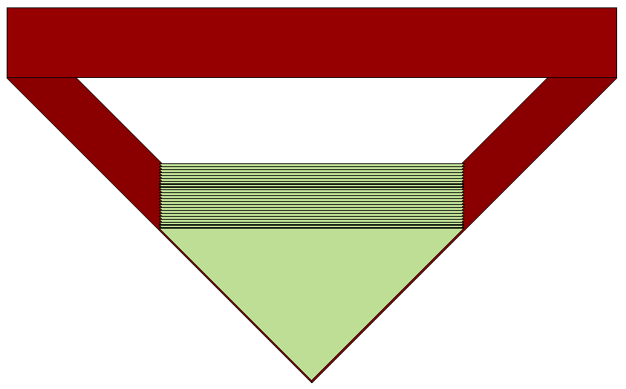
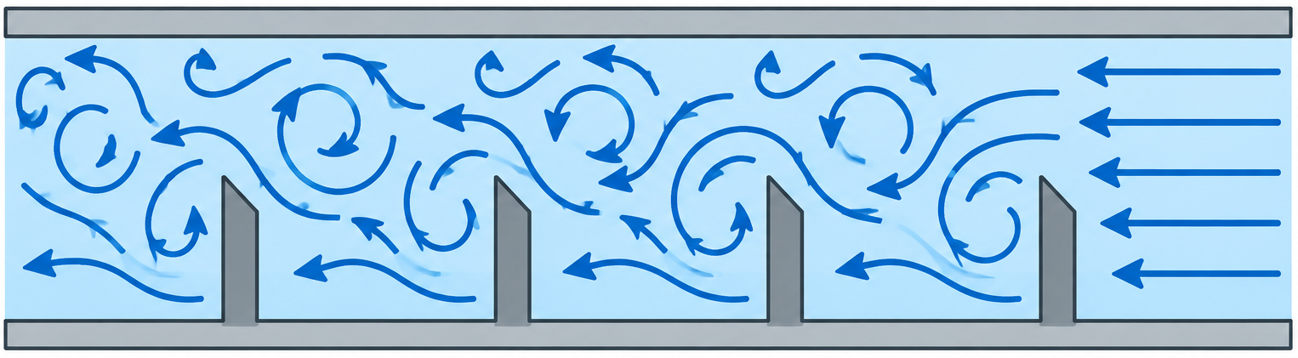
Uniform distributed fins on sensor ladder Geometry No.2)
Number of fins | 23
Spacing | 20 mm
Fins height | 11.5 mm
Internal configuration

Slide 16
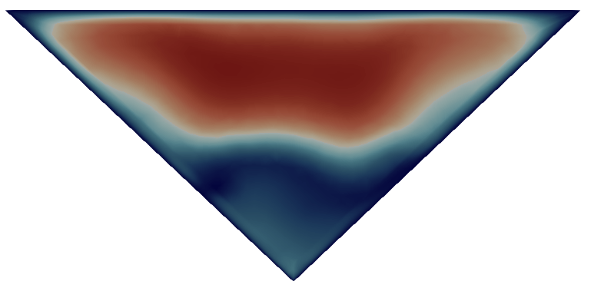
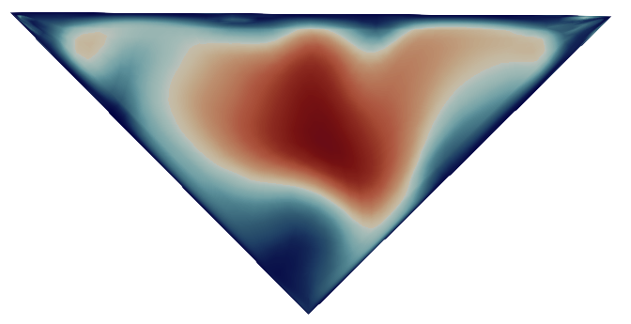
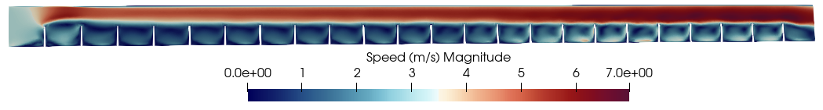
Ladder with fins (Geometry No.2)
Middle cross-section
Outlet cross-section
Vertical longitudinal section
Air flow

Slide 17


Ladder with fins (Geometry No.2)
Horizontal slices at sensor surface
Air flow

Slide 18

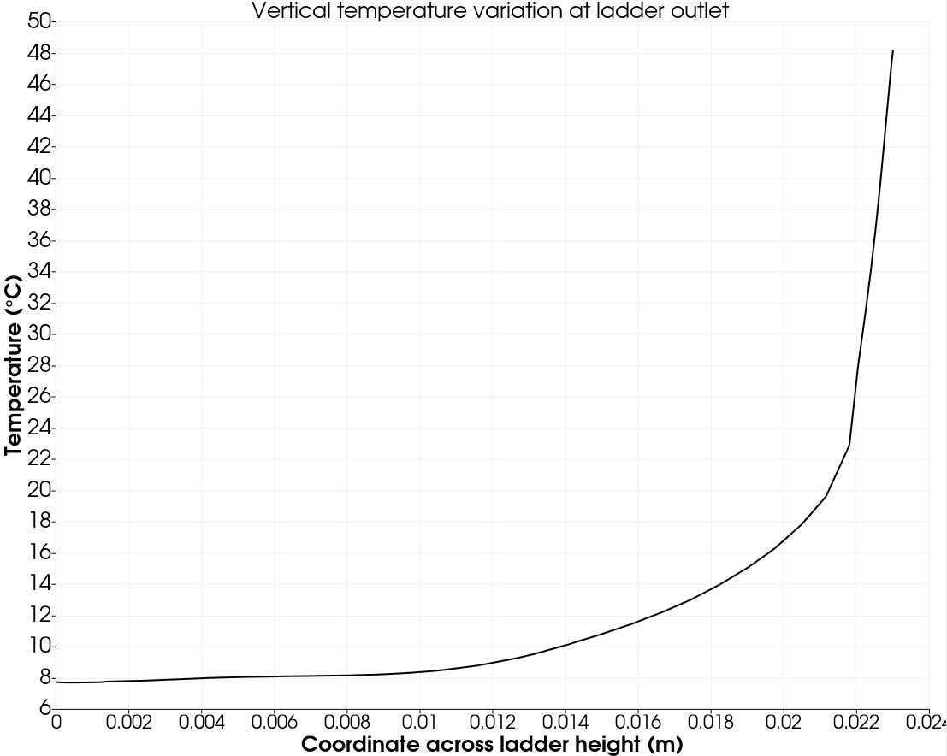

Ladder with fins (Geometry No.2)
Vertical longitudinal section
Air flow

Slide 19
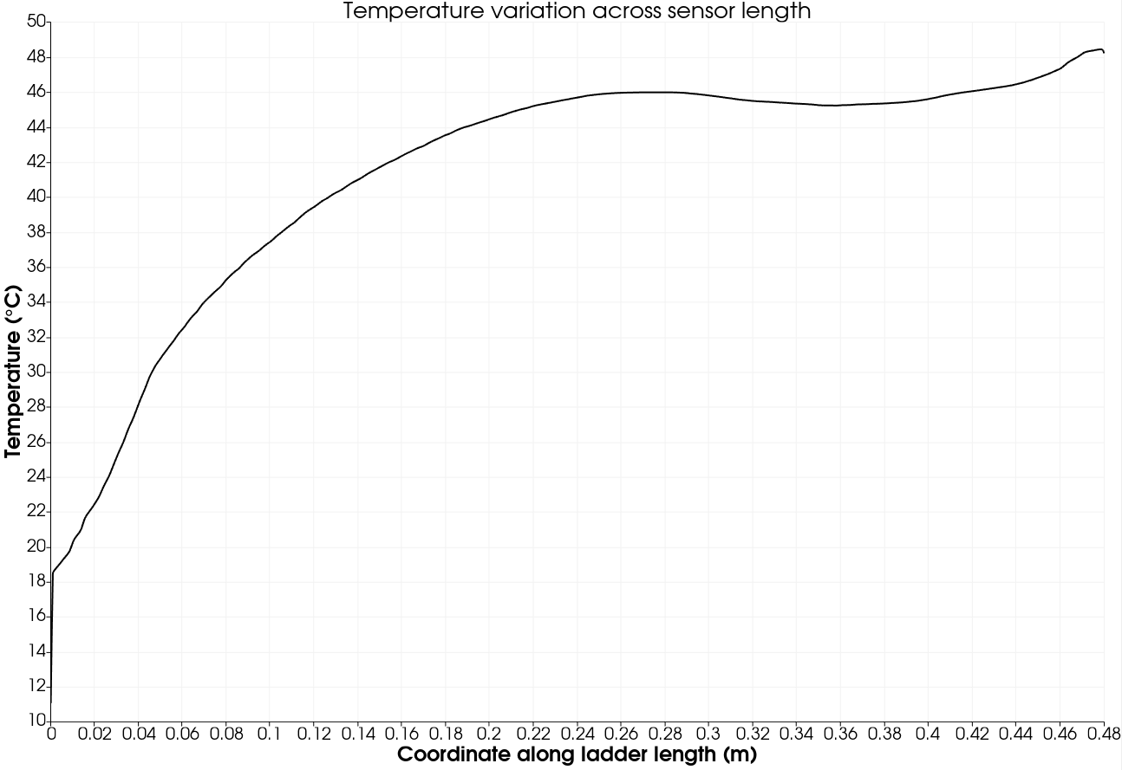
Ladder with fins (Geometry No.2)
Parameter | Simulation result
Hot spot temperature | 49.0°C
Time steps | 14000
Pressure variation | 49.3 Pa
Maximum air speed | 7.0 m/s
Temperature gradient across ladder length | 25.2°C

Slide 20
Conclusions (Geometry No.2)
Advantages | Disadvantages
Higher cooling efficiency | High temperatures (49.0°C)
Better overall vertical mixing of air | High sensor temperature gradient
Lower vertical temperature gradient near sensor (25.2 °C/mm at 22.8 mm height) | Higher air speed (7 m/s)
 | Higher pressure range (49.3 Pa)
 | Higher material budget

Slide 21
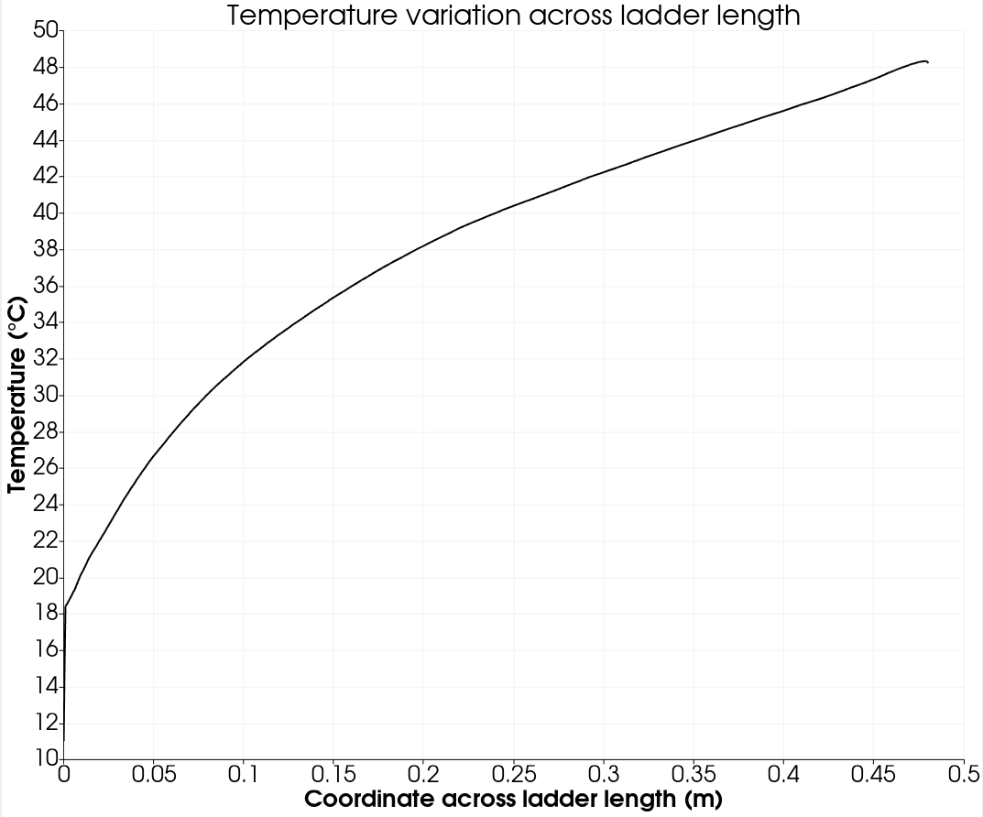
Ladder with fins (Geometry No.3)
Number of fins | 23
Spacing | 20 mm
Fins height | 8 mm
Hot spot temperature | 50.1 °C
Maximum air speed | 5.2 m/s
Pressure variation | 24 Pa
Temperature gradient across ladder height | 90.5 °C/mm

Slide 22
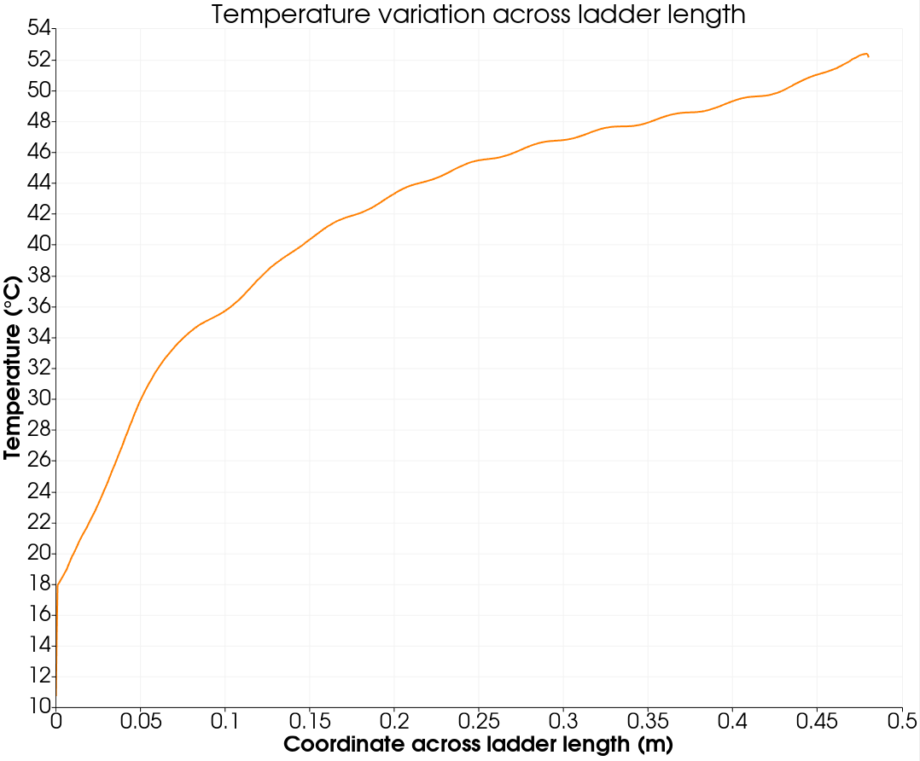
Ladder with fins (Geometry No.4)
Number of fins | 11
Spacing | 40 mm
Fins height | 11.5 mm
Hot spot temperature | 53.5 °C
Maximum air speed | 6 m/s
Pressure variation | 42 Pa
Temperature gradient across ladder height | 27.8 °C/mm

Slide 23
Conclusions (Geometry No.2, 3 and 4)
Different input parameters for simulation
Geometry No. | Air input speed (m/s) | Air input temperature (°C) | Hot spot temperature (°C)
2 | 3.0 | 0 | 49.0
2 | 3.0 | -15 | 31.52
2 (with Helium) | 3.0 | 0 | 35.71
3 | 3.0 | 0 | 50.15
4 | 3.0 | -15 | 37.08
4 | 3.0 | 0 | 53.48
Hot spot temperature is strongly correlated with maximum air speed
Vertical air mixing is not significant
The geometry implies adding additional material
High speed created by fins increase the risk of significant vibrations

Slide 24
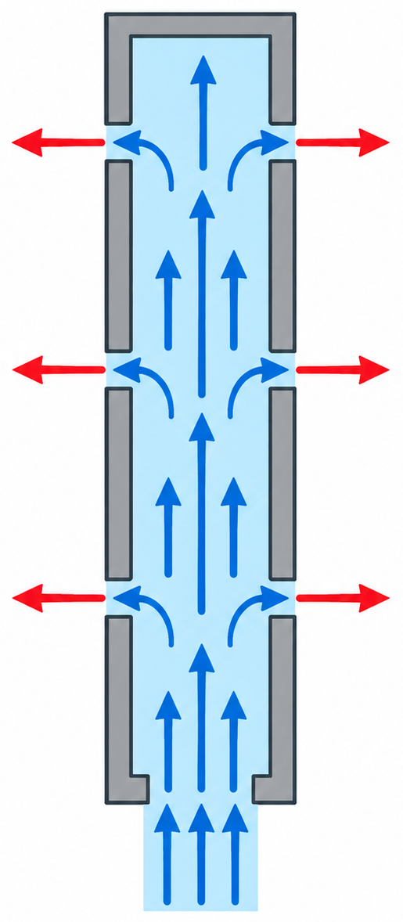
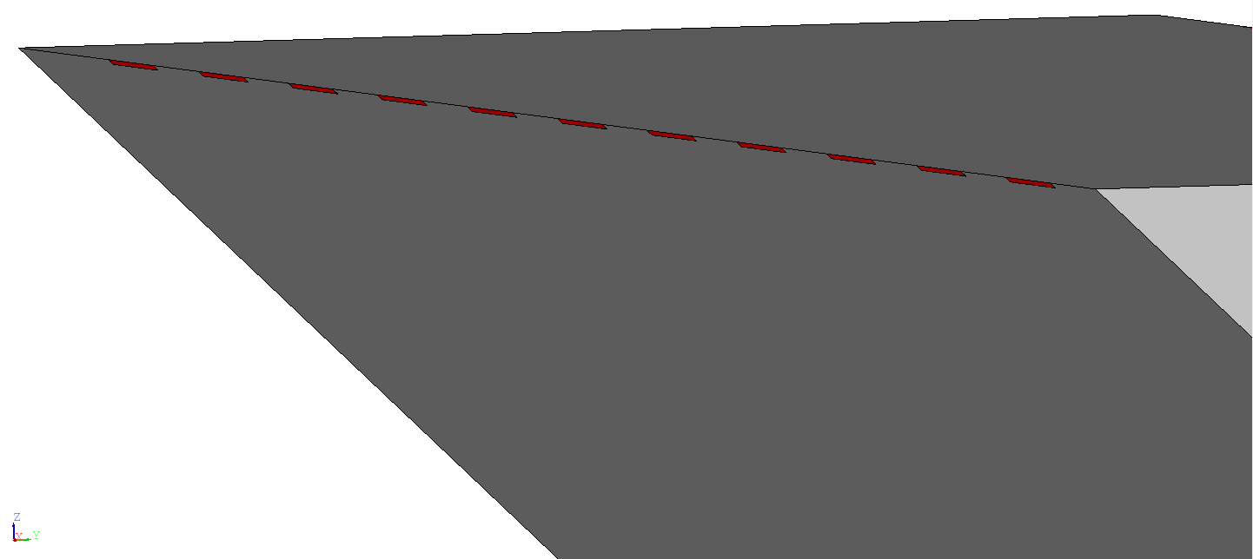
Ladder with additional exhaust openings near sensor (Geometry No.5)
Number of openings | 22 (11 on each side)
Spacing | 20 mm
Openings height | 0.28 mm

Slide 25
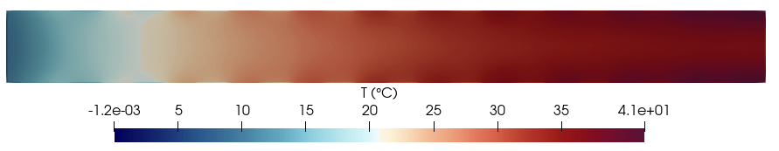
Ladder with additional exhaust openings near sensor (Geometry No.5)
Horizontal slice at sensor surface
Geometry No. | Air input speed (m/s) | Air input temperature (°C) | Hot spot temperature (°C)
5 | 3.0 | 0 | 46.07
5 | 3.0 | -10 | 34.91
Hot spot temperature | 41.4 °C
Maximum air speed | 4.1 m/s
Pressure variation | 15 Pa

Slide 26
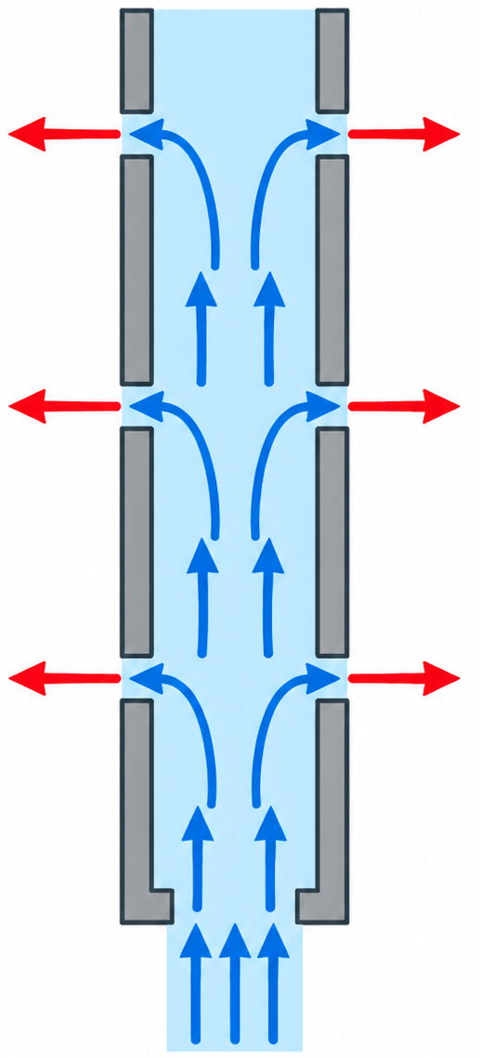
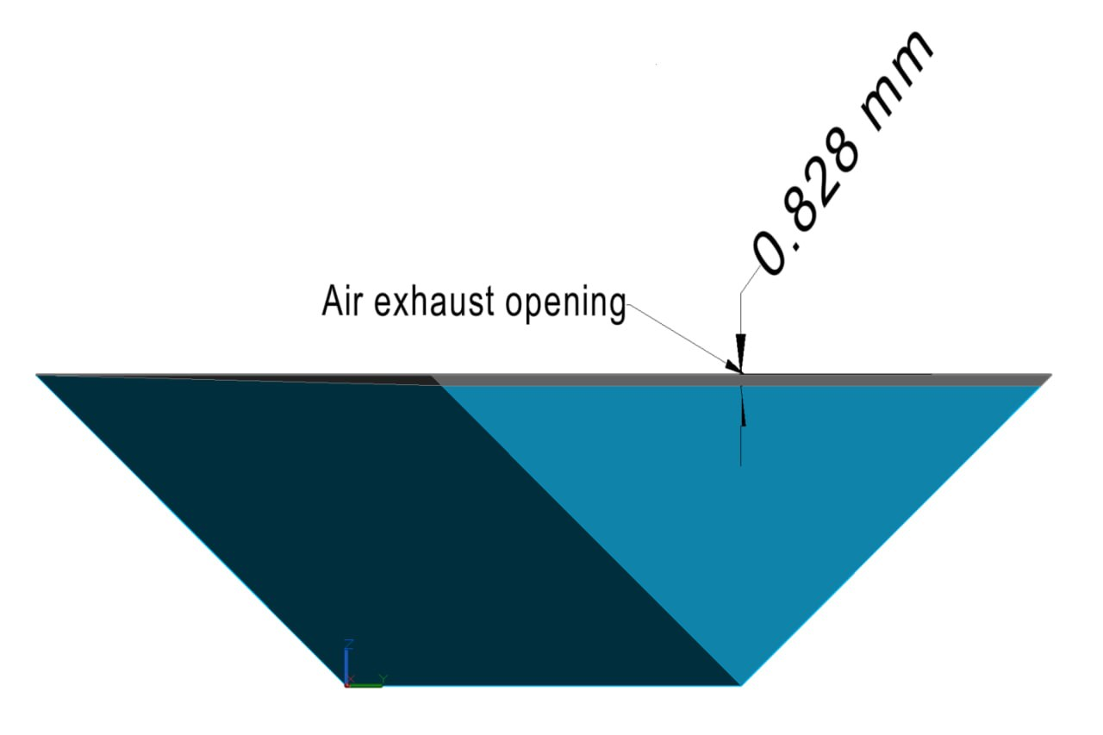
Ladder with longitudinal exhaust openings and closed end (Geometry No.6)

Slide 27
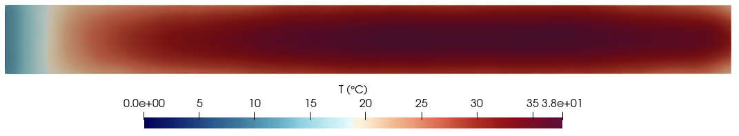

Ladder with longitudinal exhaust openings and closed end (Geometry No.6)
Horizontal slices at sensor surface

Slide 28
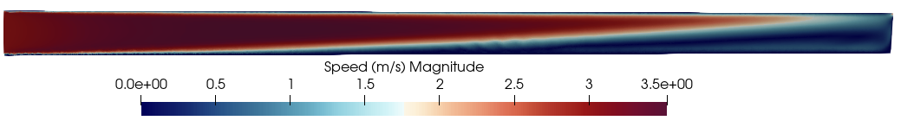
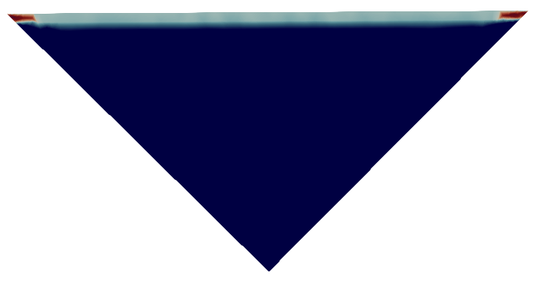
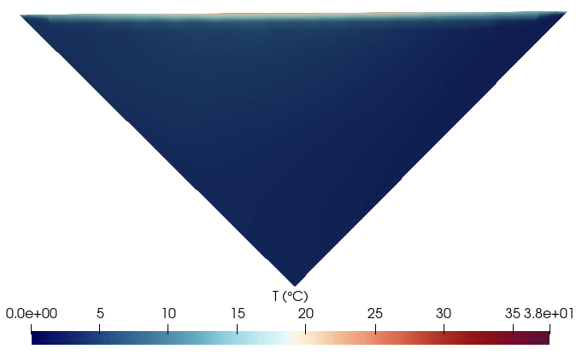
Ladder with longitudinal exhaust openings and closed end (Geometry No.6)
Vertical longitudinal section
Outlet cross-section velocity distribution
Outlet cross-section temperature distribution

Slide 29
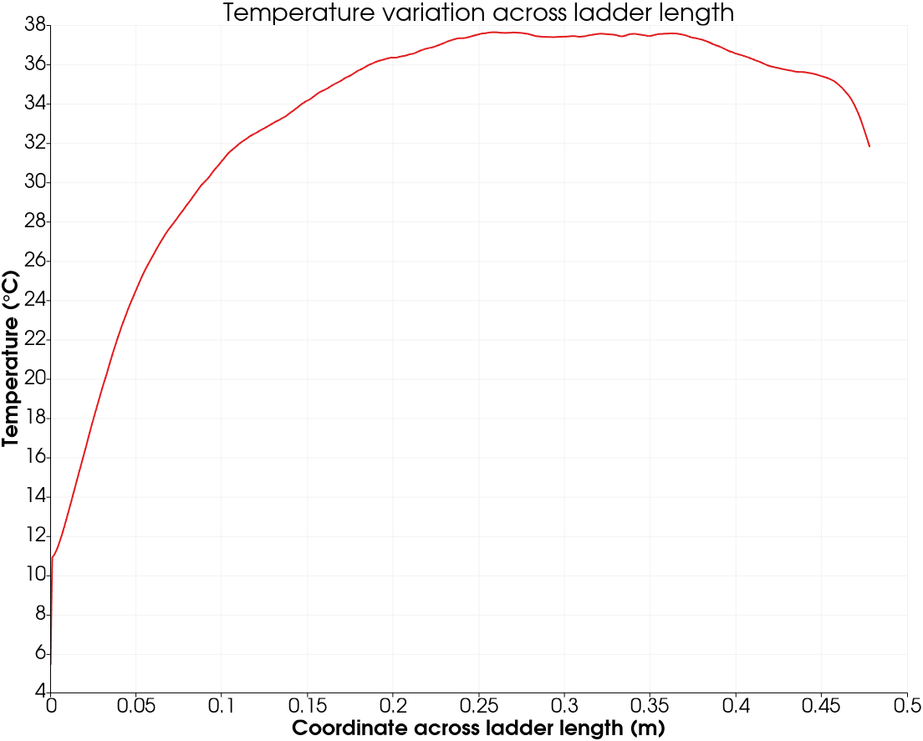
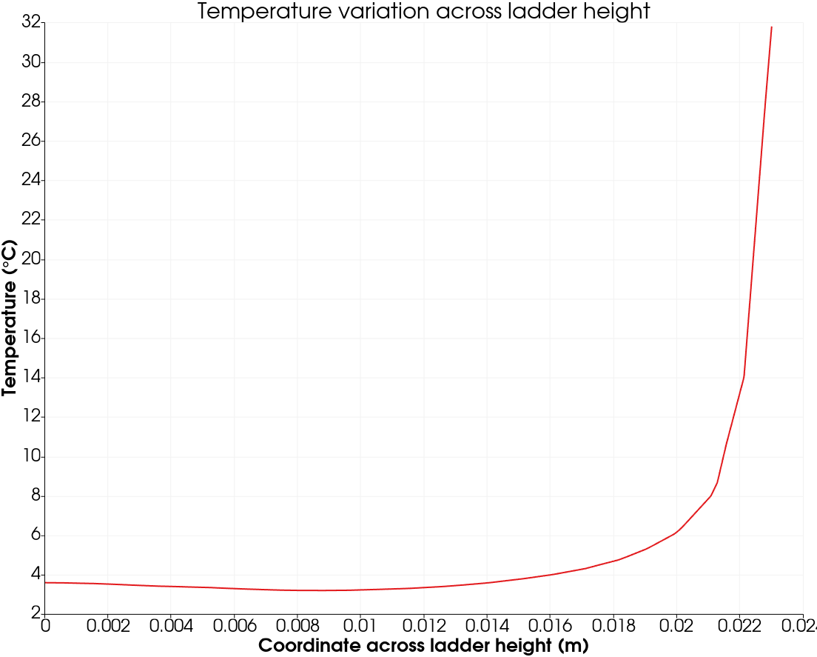
Ladder with longitudinal exhaust openings and closed end (Geometry No.6)

Slide 30
Ladder with longitudinal exhaust openings and closed end (Geometry No.6)
Parameter | Simulation result
Hot spot temperature | 37.7°C
Time steps | 15000
Pressure variation | 21 Pa
Maximum air speed | 5.7 m/s
Geometry No. | Air input speed (m/s) | Air input temperature (°C) | Hot spot temperature (°C)
6 | 3.0 | 0 | 37.7
6 | 3.5 | 0 | 34.8
6 | 4.0 | 0 | 32.2
6 | 3.0 | -5 | 32.4

Slide 31
Conclusions (Geometry No.6)
Advantages | Disadvantages
Highest cooling efficiency | Lateral thermal gradient
No need for vertical mixing
Lowest longitudinal gradient
High speed zones are distributed only locally
Low pressure variation
Low material budget

Slide 32
Conclusions
The necessity of vertical mixing is not proven as a good option
A efficient method of cooling is pushing the air right to the sensor for avoiding air overheating
Temperature of inlet air may have a near linear dependence on hot spot temperature
Air inlet speed decreases the temperature gradient and hot spot temperature but increases the risk of vibrations
The final setup will require a very fine tuning of inlet speed and temperature of air
Exhaust openings dimensions has to be chosen by the inlet speed

Slide 33
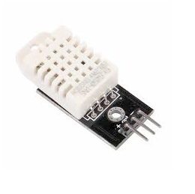
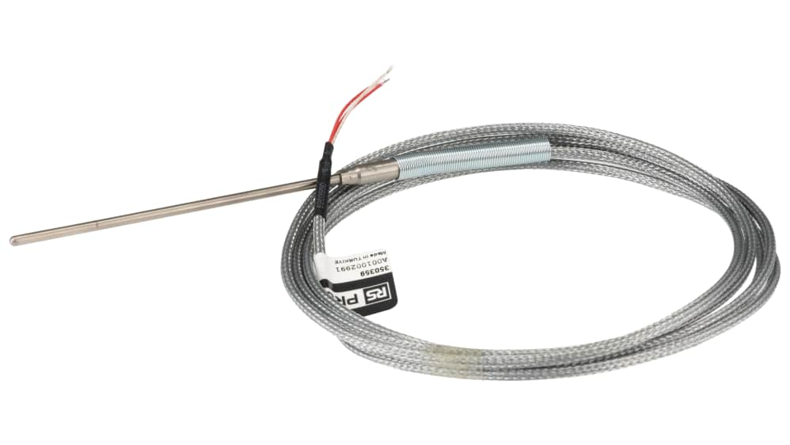

Backup plan
Raspberry Pi model: Raspberry Pi 3 Model B
OS: Raspberry Pi OS Lite (32-bit)
Base: Debian 13 “Trixie”
AQ: Influxdb
Sensors installed:
DHT22 (x3) – temperature and humidity sensor
PT1000 (RSPRO)

Slide 34
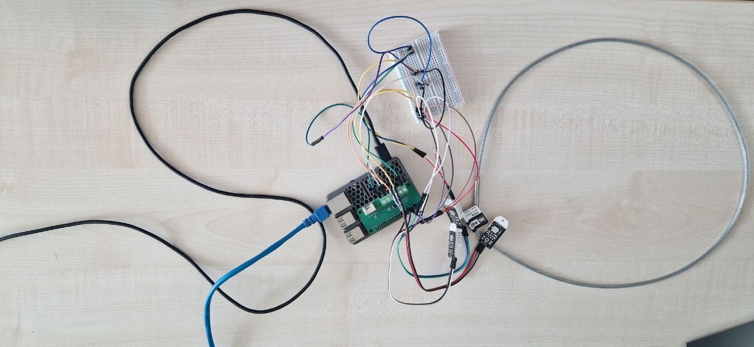
This is it
Something
something....

Slide 35


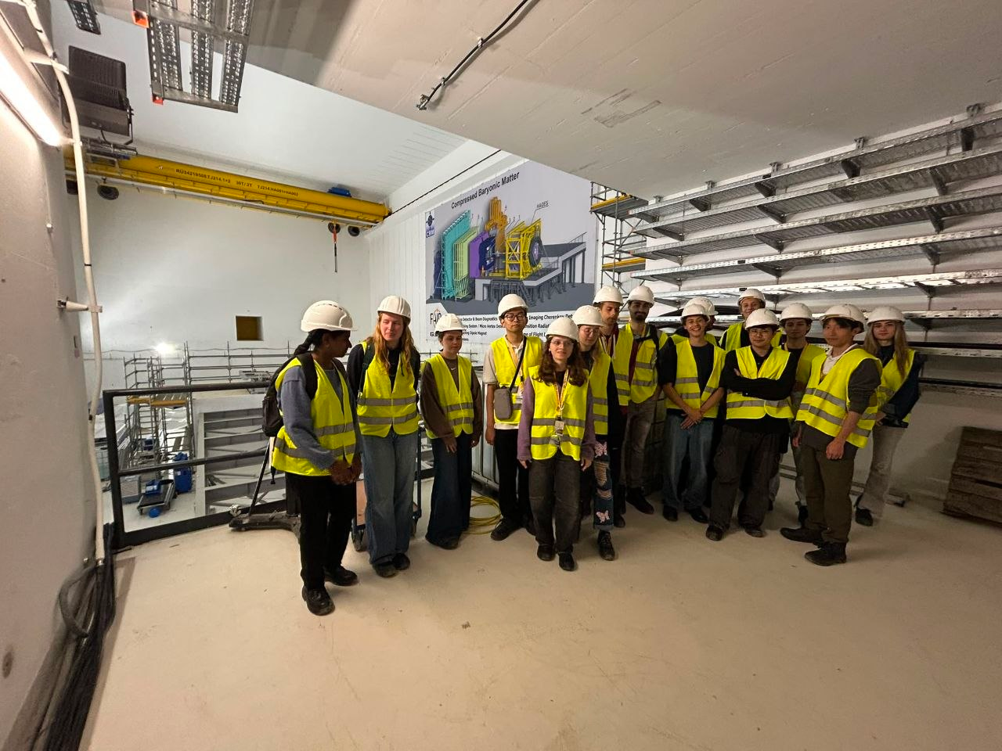
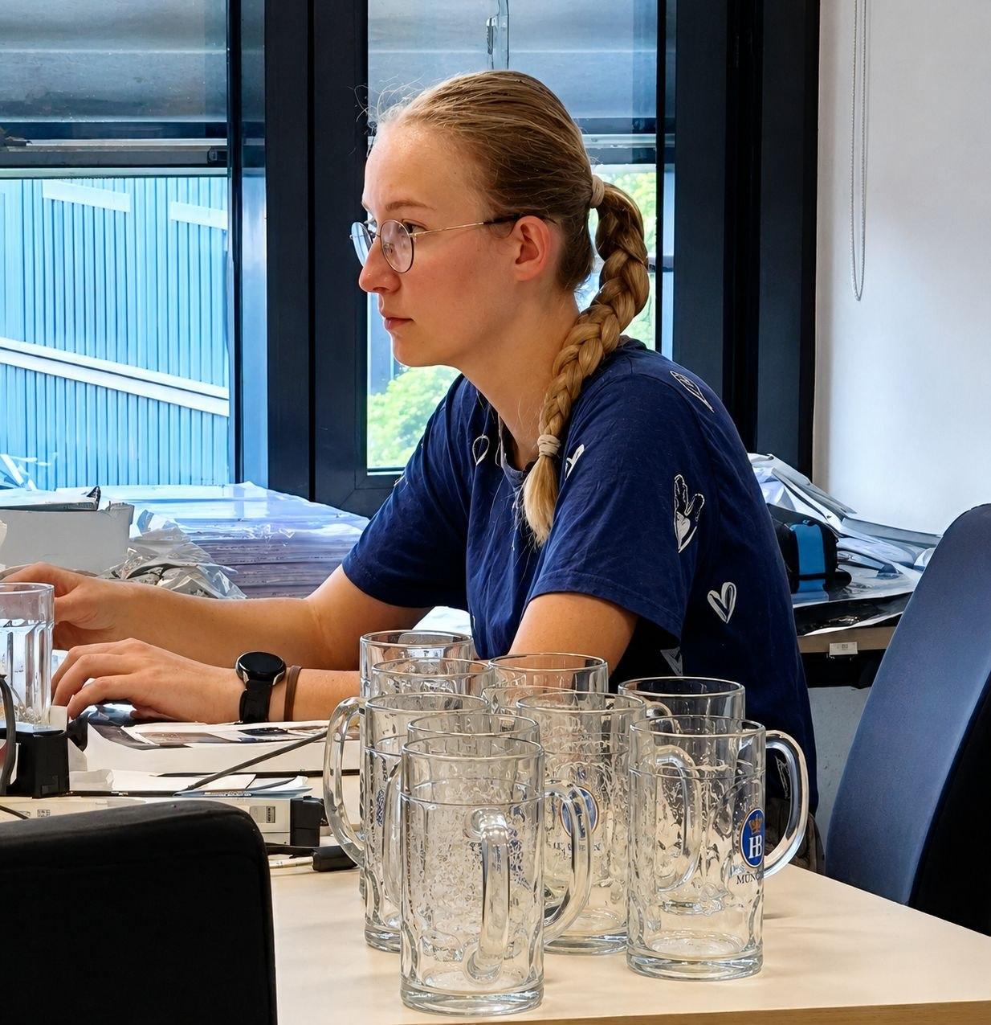
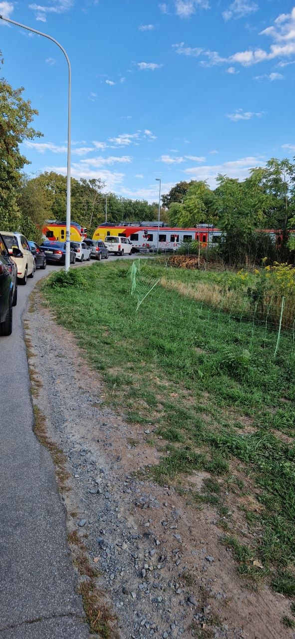


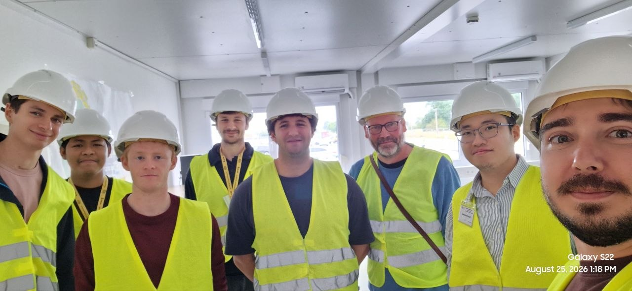


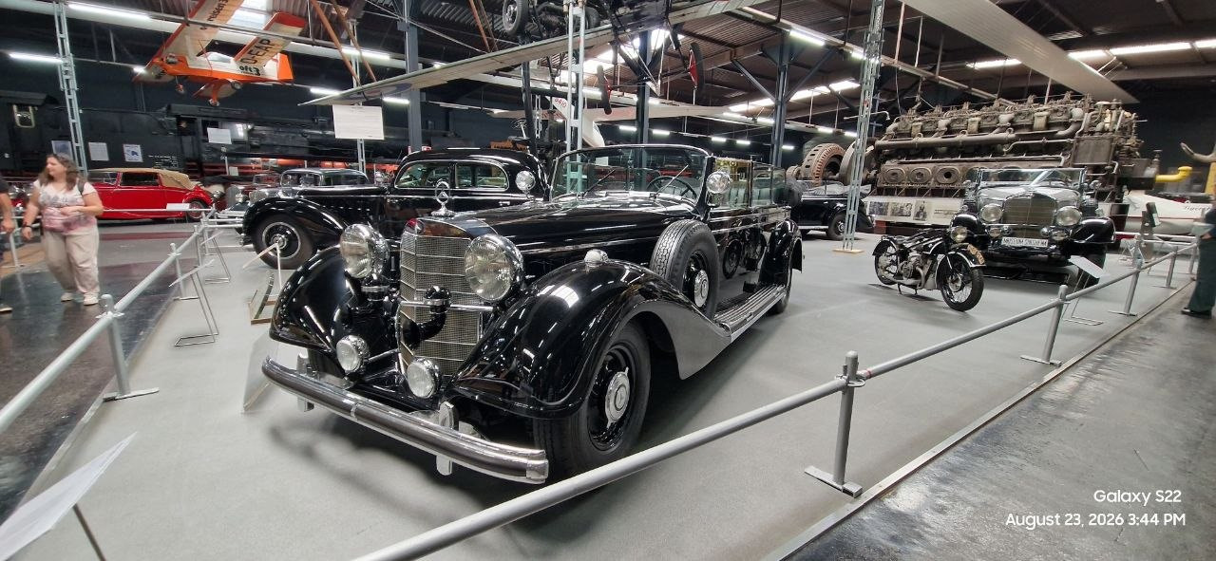

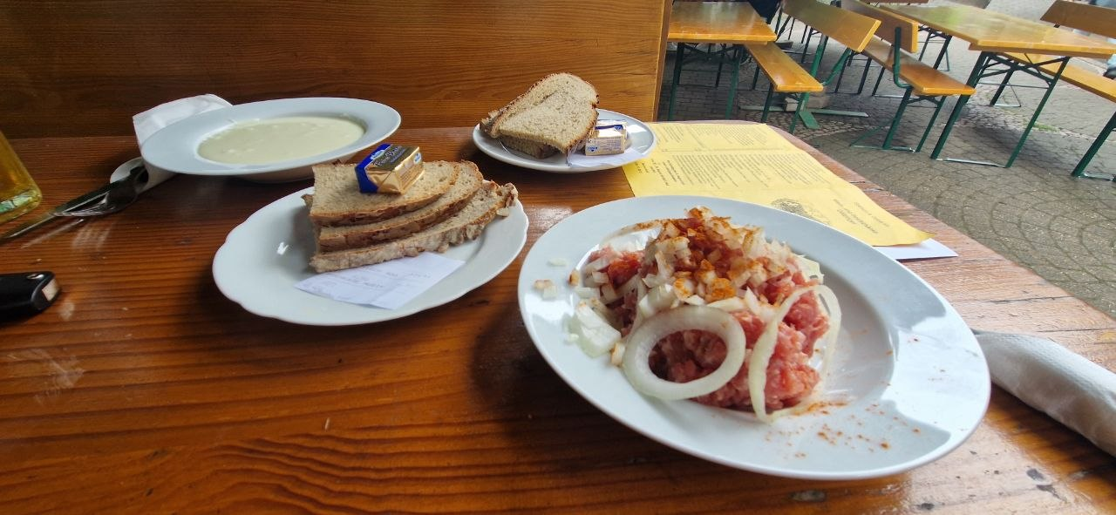


Thank you!

Slide 36
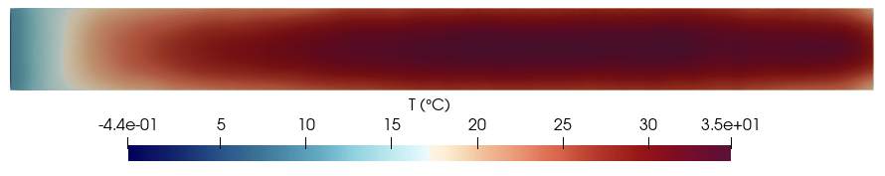
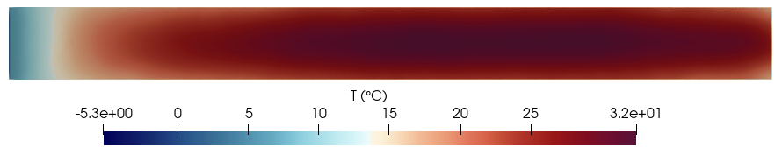
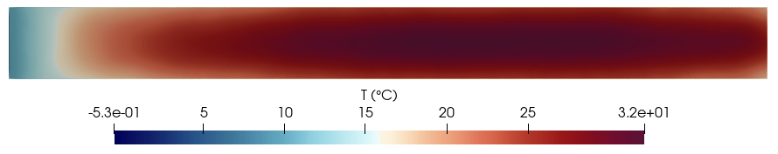
Extra slides
3 m/s
3.5 m/s
-5 °C
4 m/s

