Slide 1
Integration studies for the CBM Tracker Upgrade
Leonardo Zibetti – University of Manchester
ISSP
Supervisor: Maksym Teklishyn

Slide 2
Contents
CBM Experiment
STS Detector & MAPS
Angular Distribution of Collision Products
Angle-dependent Uncertainty Formula
Outlook and Conclusion

Slide 3
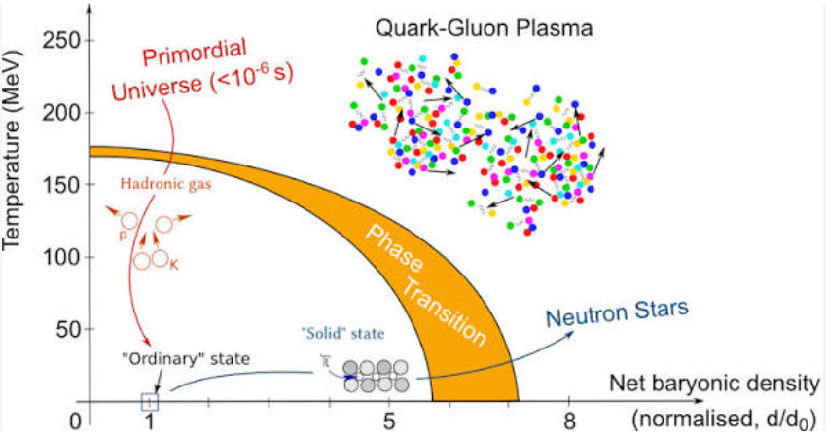
CBM Experiment
Explore QCD phase diagram
  High net-baryon density
  Moderate Temperature
Observables:
  Equation of State
  Critical point
  Chiral symmetry
  Chemical freeze-out line

Slide 4
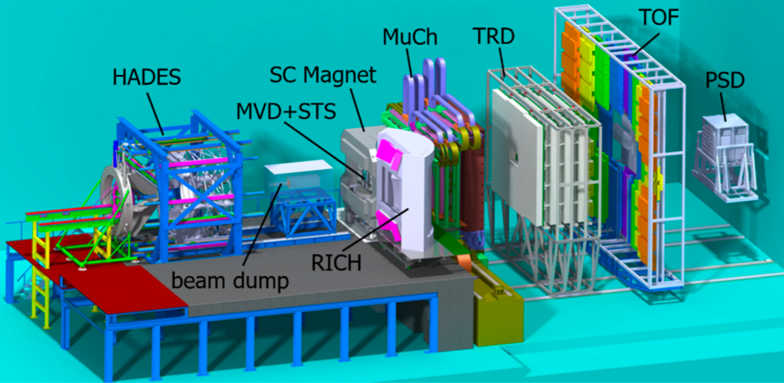

CBM Experiment
Fixed target heavy ion experiment
High interaction rate - 10 MHz
Centre of mass energy range

Slide 5
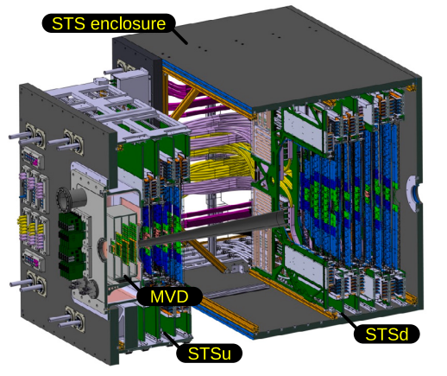
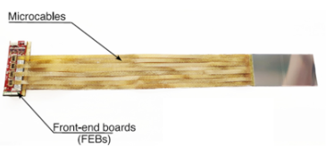
STS Detector
876 double-sided silicon microstrip modules across 8 stations
Material budget: 0.3%–1.4% X₀ per station (via ultra-thin microcable readout)
Self-triggered, free-streaming readout with real-time reconstruction
~17 μm spatial resolution, 5 ns timing
CBM Collaboration, Silicon Tracking System (STS), GSI/FAIR, https://www.cbm.gsi.de/node/19
Notes:
Tracking detector
Microstrip silicon sensors
R&D finished
Detector parameters
Read out very unique to reduce material budget

Slide 6
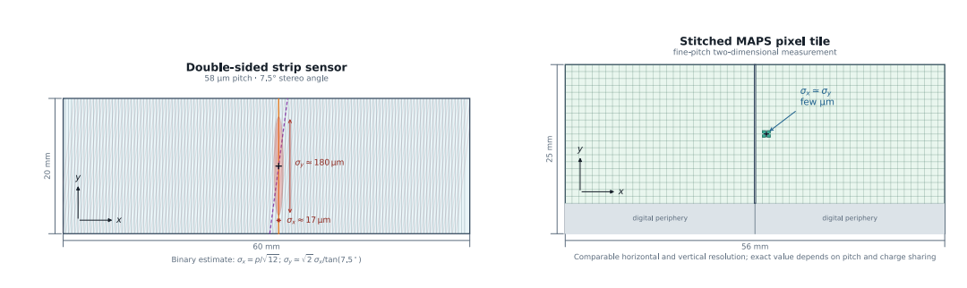
Monolithic Active Pixel Sensors (MAPS)
Strip vertical resolution is limited
Strip measures two 1D coordinates independently
Pixels both coordinates are measured locally ~few μm resolution
Pixel 2D segmentation avoids the combinatorial ghost-hit problem

Slide 7
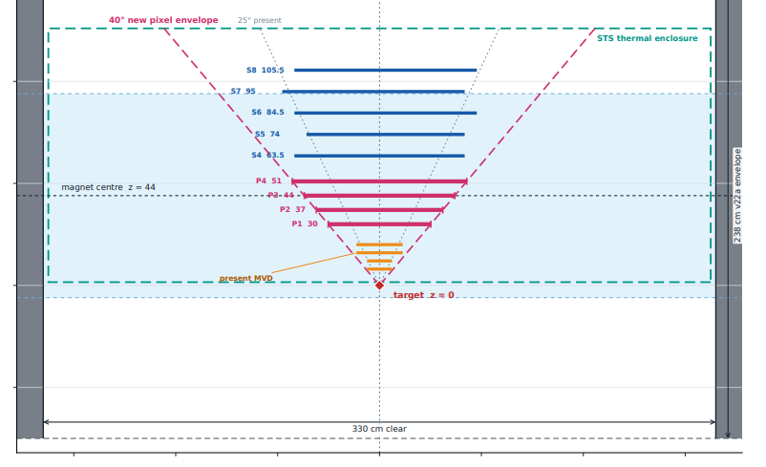
Monolithic Active Pixel Sensors (MAPS)
Proposed tracker upgrade aperture:

Slide 8

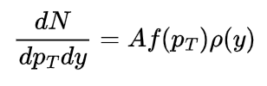
Angular Distribution of Collision Products
Know: Collision energy and produced particles mass
Expand momentum spectrum in terms of: rapidity, transverse momentum and azimuthal angle
Assume:
Central collision (Azimuthal independence) + factorisation of spectrum:
Notes:
Expand momentum spectrum in terms of: rapidity, transverse momentum and azimuthal angle

Slide 9


Transverse Momentum Spectrum
Local thermodynamic equilibrium
Maxwell-Boltzmann statistics
Free-streaming emission at species independent kinetic freeze-out temperature
Notes:
single thermalised fireball that expands and cools before freezing out into free-streaming hadrons

Slide 10


Kinetic Freeze-out Temperature
Ultra-relativistic ideal gas
Isentropic expansion + fixed baryon number
Stefan-Boltzmann law for ultra-relativistic gas
Symmetric, comparable-mass collision
Full-stopping, instant thermalisation
Notes:
g -> effective dof
ϵ -> energy density
n′0 -> initial baryon density of the Lorentz contracted system

Slide 11
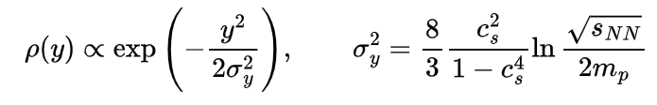

Rapidity Spectrum
Gaussian approximation of Landau model:
Same assumptions as before:
  Fixed Equation of State
  Full Nuclear Stopping
  Instant thermalisation
  Ultra relativistic ideal gas
Notes:
single thermalised fireball that expands and cools before freezing out into free-streaming hadrons

Slide 12
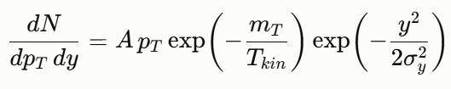



Angular Distribution of Collision Products
CoM frame momentum spectrum:
Rapidity boost (along beam axis) from CoM frame to Lab frame
Change variables to
The freeze-out baryon density:
g = 13 (hadronic phase)
Notes:
though CBM probes the mixed-phase region, this has negligible impact since g determines T_0 only via a fourth-root dependence.

Slide 13
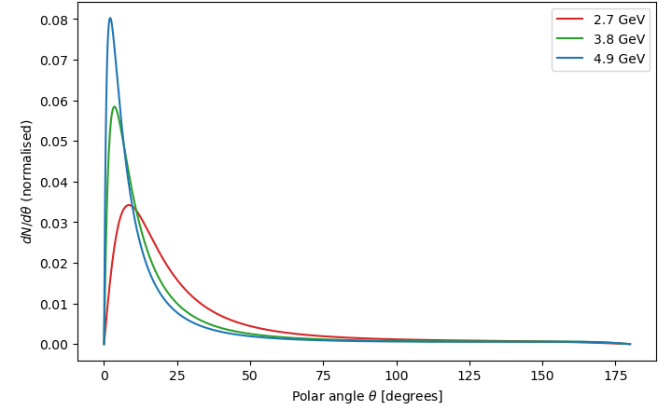
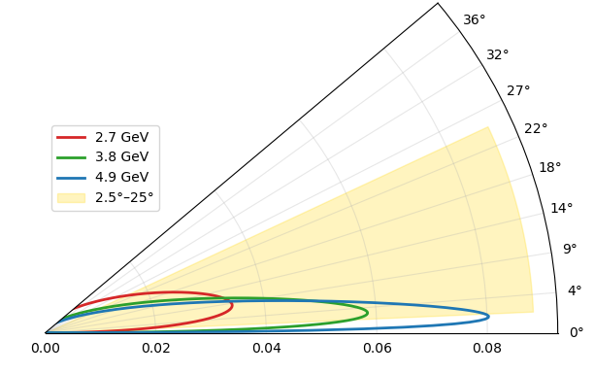
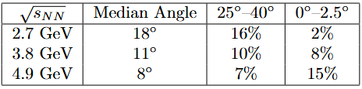
Protons
Polar axis:

Slide 14
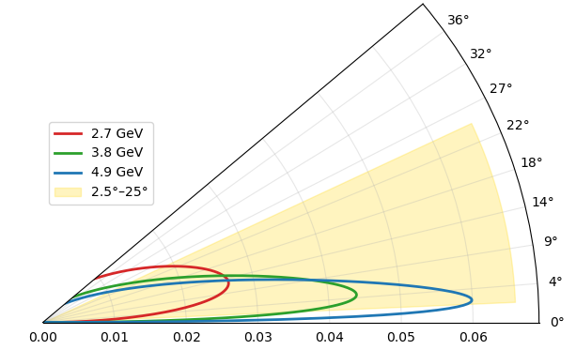
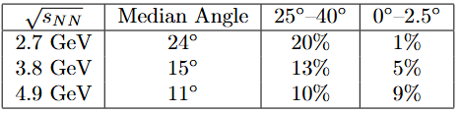
Kaons

Slide 15
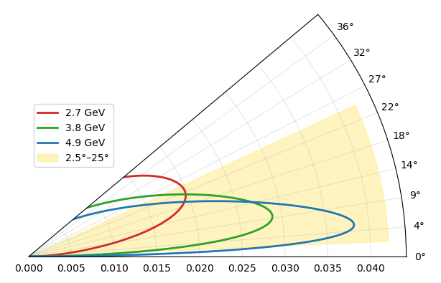
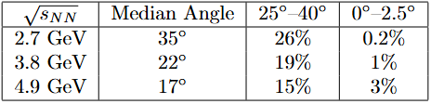
Pions
Notes:
Limitation: factorisation assumption starts to break down for lighter particles

Slide 16
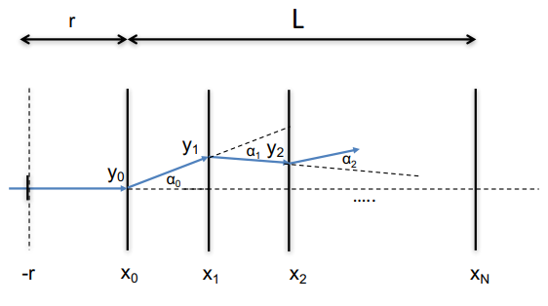

Angle-dependent Uncertainty Formula
Uncertainty due to:
  Resolution error
  Multiple Scattering error: small-angle deflection of charged particle

Slide 17
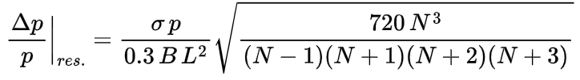
Angle-dependent Uncertainty Formula
Analytical expression for momentum uncertainty:
Assume:
  Parabolic trajectory
  Layer uncorrelated small scattering
  Equidistant stations of identical resolution and thickness
  Magnetic field covers detector uniformly

Slide 18
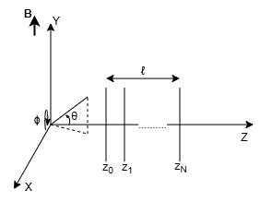




Angle-dependent Uncertainty Formula
Modify to STS geometry
Track length, L, and material traversed, d, scale with
Transverse dipole field, momentum in the bending plane:
scales with where,
Notes:
(angle in the x-z plane)

Slide 19
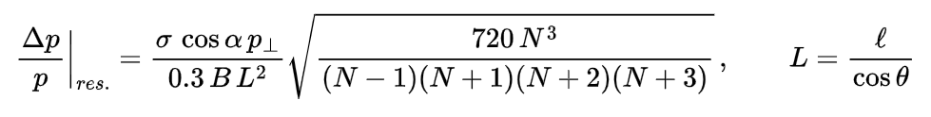


Angle-dependent Uncertainty Formula
Phi-dependence cancels:
Multiple-scattering contributions in the bending and non-bending planes treated independently, valid for small, Gaussian, isotropic scattering
Invalid as
Notes:
valid for small-angle, Gaussian, isotropic scattering.

Slide 20
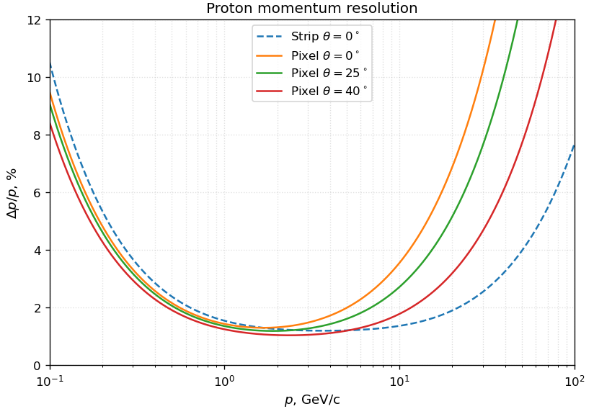
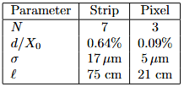
Strip Vs Pixel
B = 1 T for both

Slide 21


Outlook
Equations are complementary
  Uncertainty Formula measured precision at given
  Angular distribution how many particles at given
Combine them into a single figure of merit for a candidate detector geometry:
optimal layout:
  Maximises acceptance
  Minimises average uncertainty

Slide 22
Conclusion
Developed two complementary analytical tools to estimate detector acceptance and precision
Current STS layout covers the region where most particles are expected
Estimated how many more particles captured from extended aperture
Compared current STS detector uncertainty to potential upgrade
Next: Combine both tools to give a first-order picture of the optimal detector layout

Slide 23
Thank you for your attention!

Slide 24
Backup Slides

Slide 25

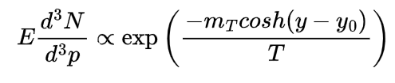


Factorisation Assumption
Fluid element at rapidity , temperature T emits a boosted Boltzmann spectrum
Full fluid spectrum is convolution of the single-element spectrum with the fluid's rapidity profile
Expand near gives a Boltzmann-suppressed Gaussian, width
Ref: E. Schnedermann, J. Sollfrank, U. Heinz, Phys. Rev. C 48, 2462 (1993), arXiv:nucl-th/9307020

Slide 26

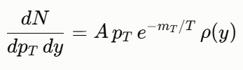



Factorisation Assumption
so thermal gaussian is flat over window that contributes, the convolution integral reduces to a constant
Approximation relies on
  holds well for heavier particles, weakens for lighter ones, where is smaller and ​ grows

