Slide 1


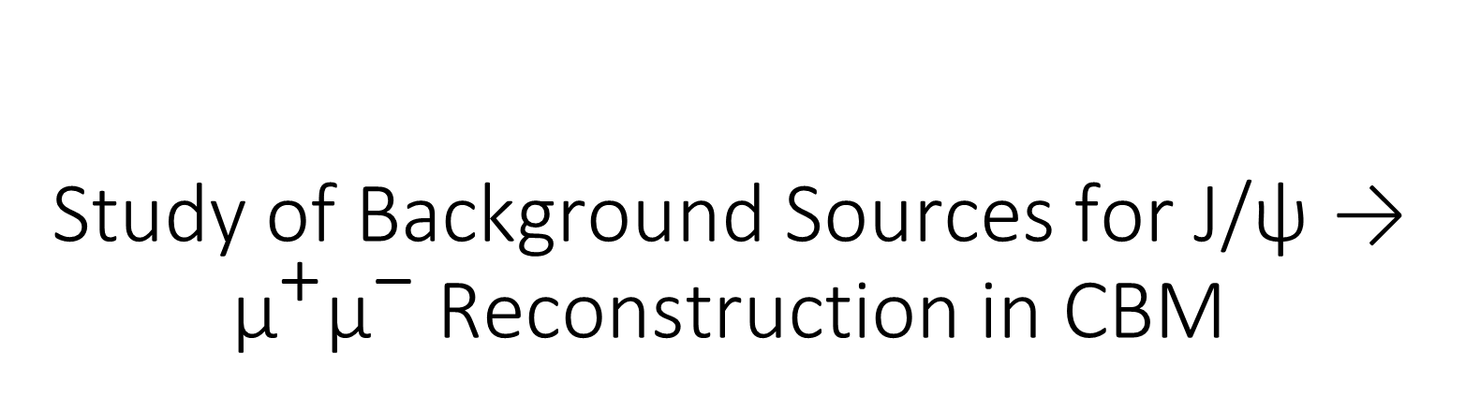
Study of Background Sources for J/ψ → ${\text{μ}}^{\text{+}}{\text{μ}}^{\text{−}}$ Reconstruction in CBM
HARSHINI MAILAINATHAN
TUTORS: Dr. Anna Senger, PD DR. Manuel Lorenz

Slide 2
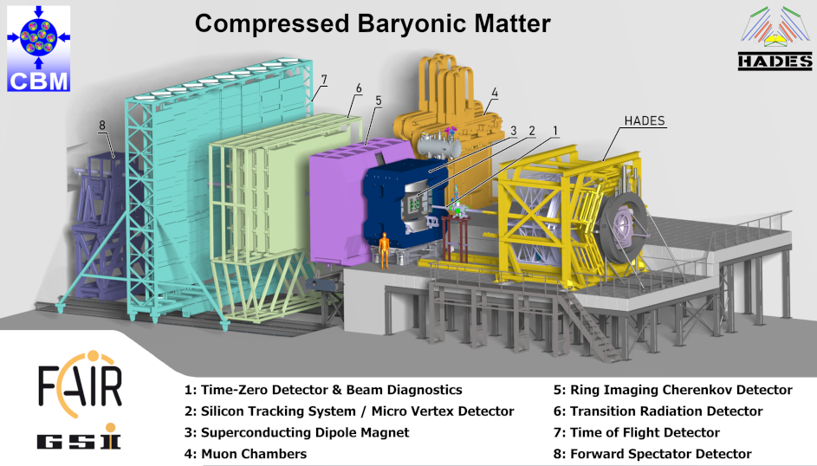
The Compressed Baryonic Matter (CBM) Experiment
The Compressed Baryonic Matter experiment is one
the four pillars of FAIR. CBM is a fixed target experiment.
The primary aim of CBM is to study strongly interacting
matter at high net baryon densities.
The experimental goal is to measure rare probes like
particles containing charm quarks, vector mesons, etc.,
These rare observables require efficient background
suppression and high interaction rates.

Slide 3
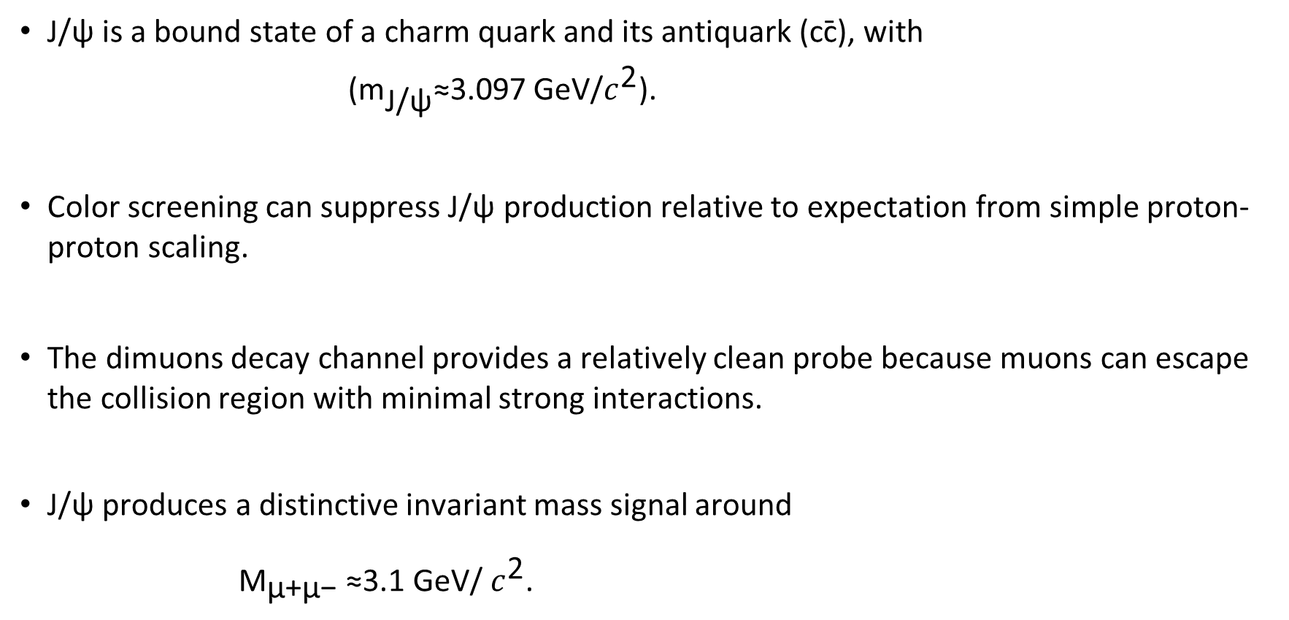
Physics Motivation
J/ψ is a bound state of a charm quark and its antiquark (cc̄), with
(${\text{m}}_{\text{J/ψ}}$​≈3.097 GeV/$c^{\text{2}}$).
Color screening can suppress J/ψ production relative to expectation from simple proton-proton scaling.
The dimuons decay channel provides a relatively clean probe because muons can escape the collision region with minimal strong interactions.
J/ψ produces a distinctive invariant mass signal around
${\text{M}}_{\text{μ+μ−}}$ ​≈3.1 GeV/ $c^{\text{2}}$.

Slide 4
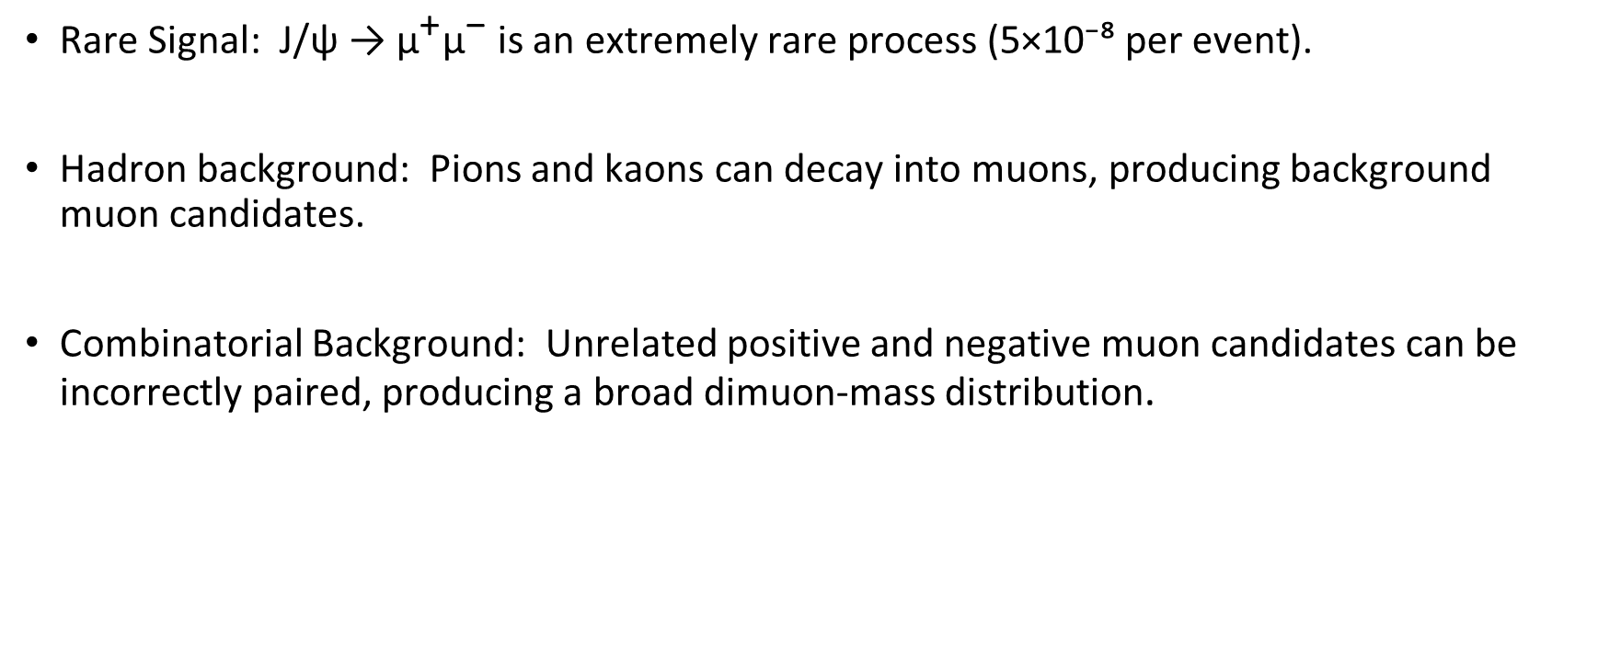
Challenges
Rare Signal: J/ψ → ${\text{μ}}^{\text{+}}{\text{μ}}^{\text{−}}$is an extremely rare process (5×10⁻⁸ per event).
Hadron background: Pions and kaons can decay into muons, producing background muon candidates.
Combinatorial Background: Unrelated positive and negative muon candidates can be incorrectly paired, producing a broad dimuon-mass distribution.

Slide 5
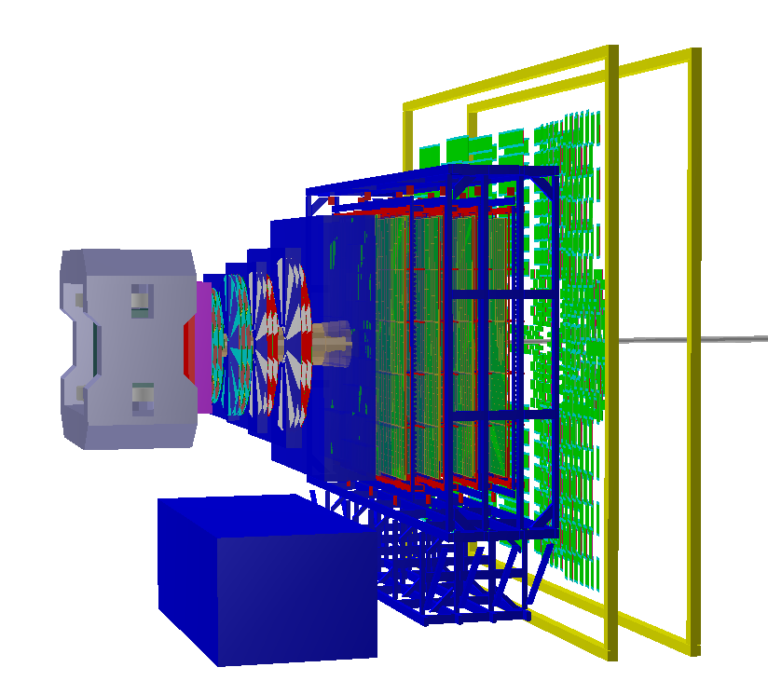
CBM Muon setup
Silicon Tracking System (STS) :
Reconstruct charged – particle trajectories and vertex.
Provides momentum information.
Muon Chamber System (MUCH) :
Absorbers suppress hadrons.
Tracking stations identify penetrating tracks.
Transition Radiation Detector (TRD) :
Provides additional track information.
Mainly designed for electron identification.
Time-Of-Flight (TOF) detector :
Measures particle arrival time.
Provides additional particle identification information.
TOF
TRD
STS
MuCh
Beam pipe

Slide 6
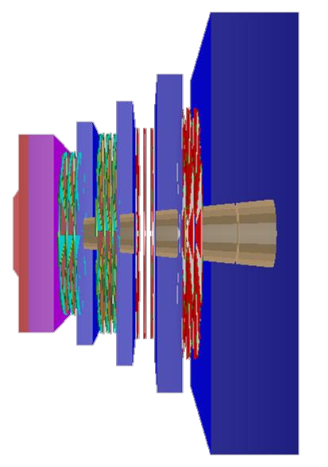
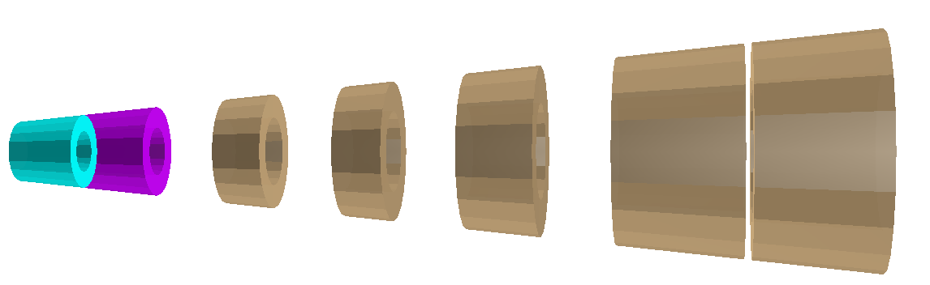
MuCh Geometry
Fe
Fe
Fe
Key idea : Muon identification from penetration + track
information
Absorbers : Supress pions, kaons and other hadrons.
60 cm C
(20+20+30+100) cm Fe
Detectors : Measure particles that penetrate the
Absorber.
2 GEM + 2 RPC stations
Shields inside absorbers :
30 cm Al + 30 cm Pb – first absorber
(20+20+30+100) cm Fe – other absorbers
Fe
C
Fe
Fe
Fe
Al
Pb
Fe

Slide 7
Collision System and Simulations
Input:
UrQMD p+Au collisions at 28.3 GeV (15 million minimum-bias events).
PLUTO J/ψ→μ⁺μ⁻ (5 Million signals):
    theoretical prediction for multiplicity 5×10⁻⁸
    branching ratio 6%
Detector simulation:
GEANT4 – Particle transport through CBM detector.
Reconstruction:
Event-by-event reconstruction of hits, tracks and vertices.
Analysis:
Track-quality selection and dimuon analysis – this project starts here.

Slide 8
Reconstruction
First step
Second step
extrapolation
of the STS tracks
STS
MUCH
TRD
TOF
track reconstruction
primary vertex
momentum
mass² of particles from time measurements

Slide 9
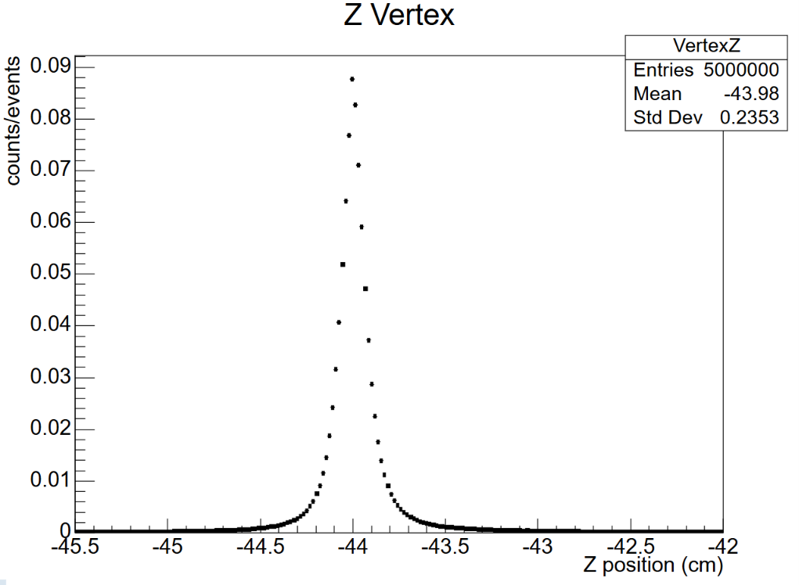
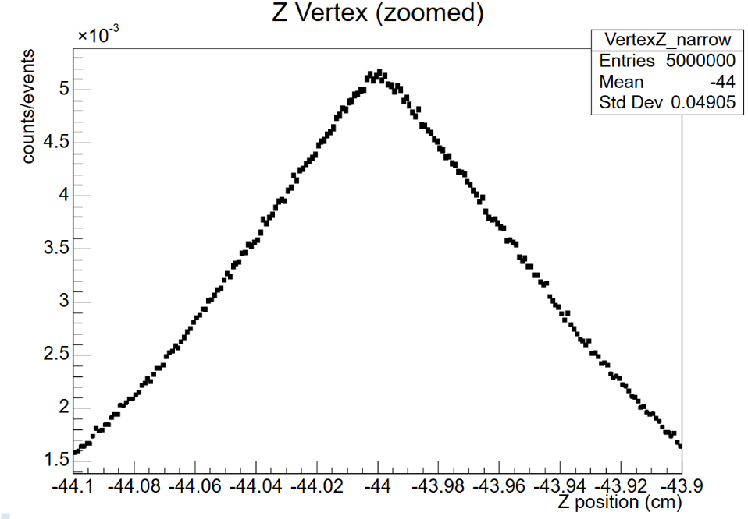
Vertex reconstruction
Reconstructed primary vertex : Z ≈ -44 cm
Consistent with the target position.

Slide 10
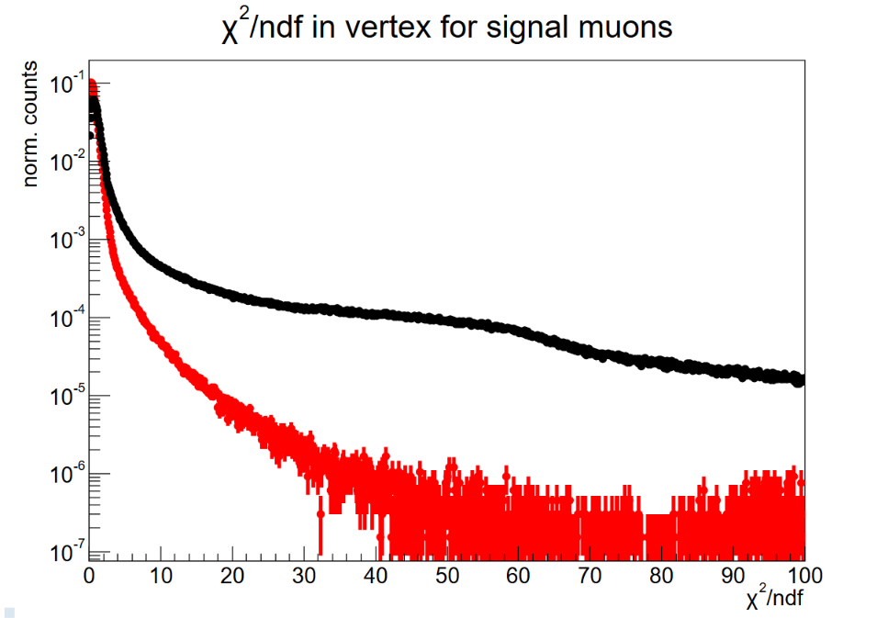
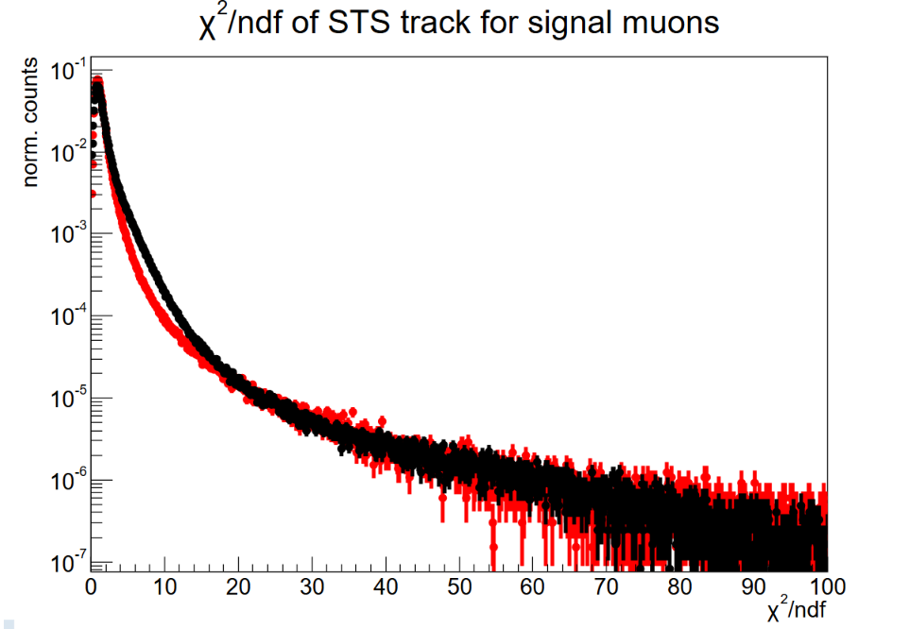
$χ^{2}$ - Reconstructed track parameters
Signal
Background

Slide 11
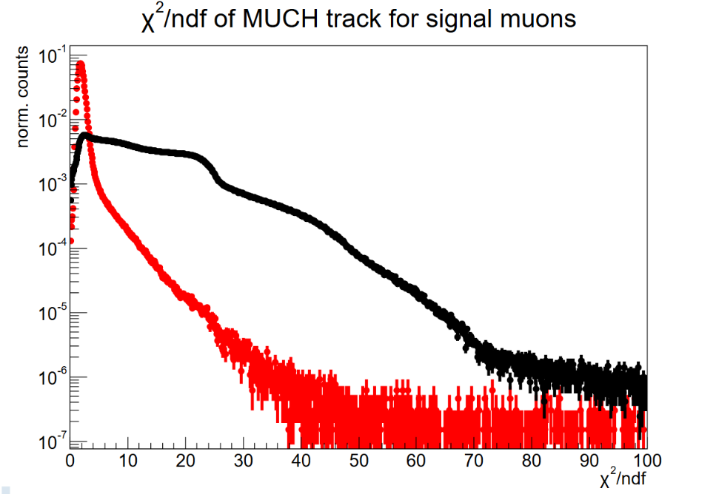
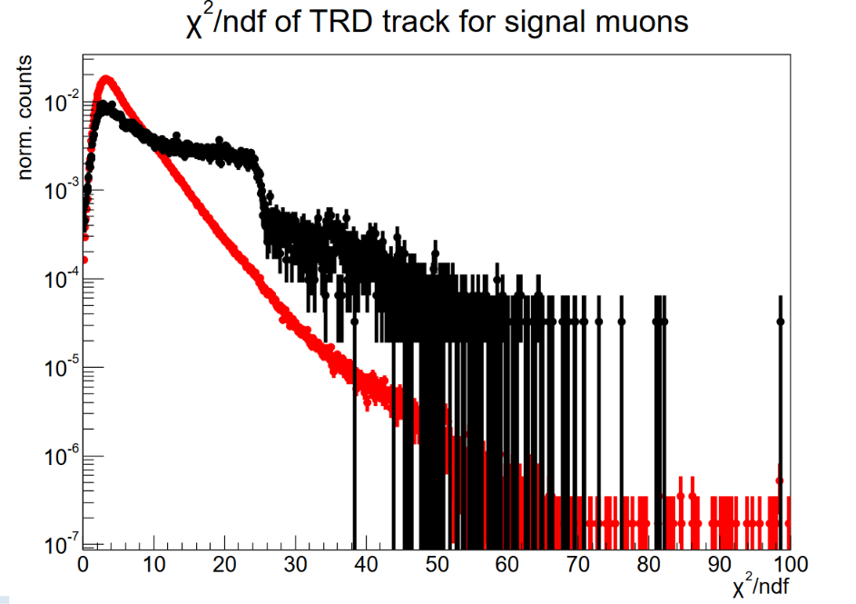


Slide 12
Cuts to select muon track candidates
χ²/ndf vertex | χ²/ndf STS | χ²/ndf MUCH | STS hits | MUCH hits | TRD hits | σ TOF | TOF distance
< 3 | < 2 | < 2.5 | ≥ 8 | ≥ 11 | > 3 | 3σ | < 10 cm

Slide 13
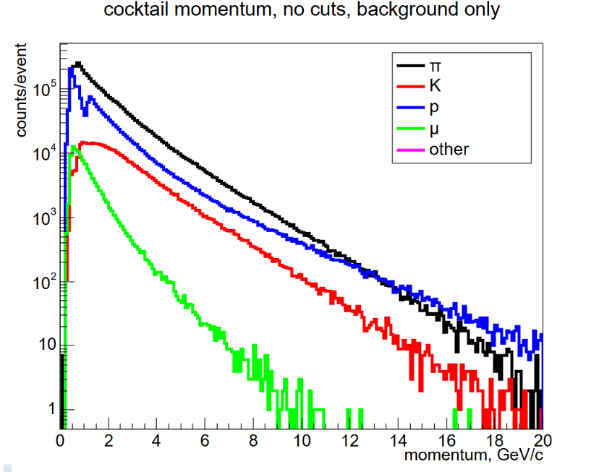
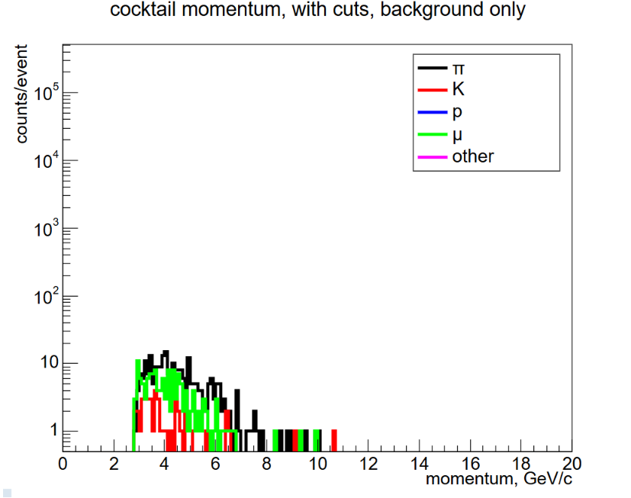
After Selection:
All background species are strongly suppressed.
Only a small residual population remains.
Muons survive preferentially in the ~2.5–10 GeV/c range.
Before Selection:
Protons dominate below ~1 GeV/c.
Pions dominate at higher momentum.
Muon component is small and concentrated at low momentum.

Slide 14
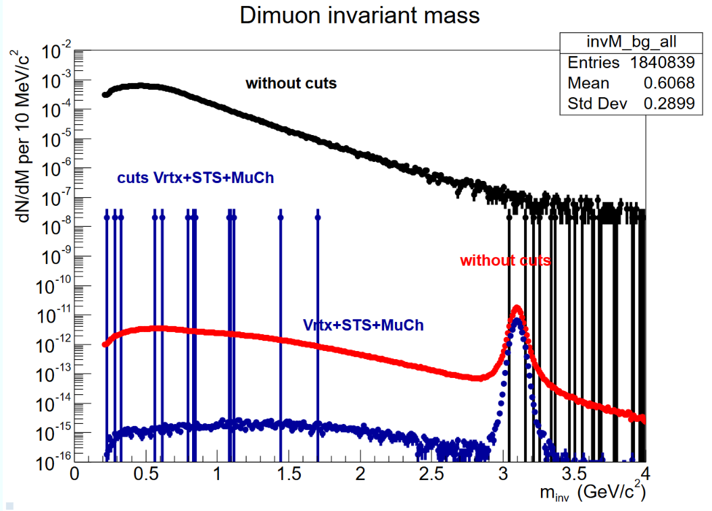
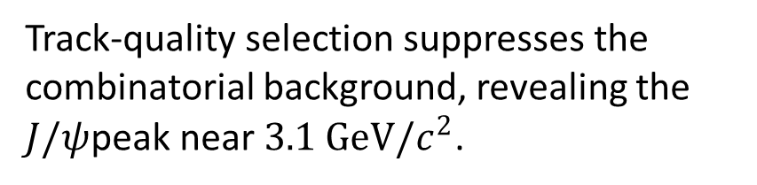
Dimuon Invariant Mass
Track-quality selection suppresses the combinatorial background, revealing the $J/ψ$peak near $3.1 GeV/c^{2}$.

Slide 15
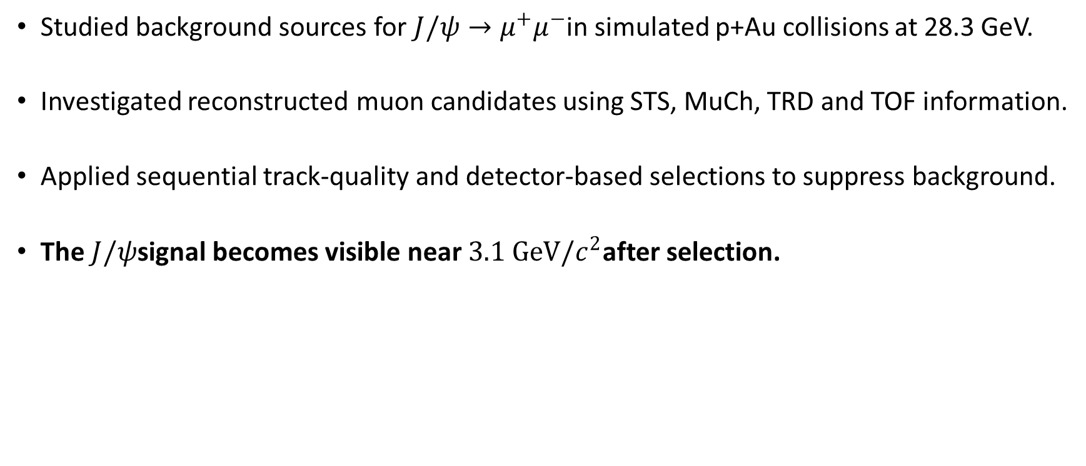
Summary
Studied background sources for $J/ψ→μ^{+}μ^{−}$in simulated p+Au collisions at 28.3 GeV.
Investigated reconstructed muon candidates using STS, MuCh, TRD and TOF information.
Applied sequential track-quality and detector-based selections to suppress background.
The $J/ψ$signal becomes visible near $3.1 GeV/c^{2}$after selection.

Slide 16
THANK YOU
Acknowledgement:
I would like to thank my tutors Dr. Anna Senger and PD Dr. Manuel Lorenz for their help and guidance in this project.
Thank you Prof. Dr. Ralf Averbeck and Dr. Gabriela Menge for this wonderful opportunity.
Thank you my dear fellow Summer Students.

Slide 18
Backup slides

Slide 19
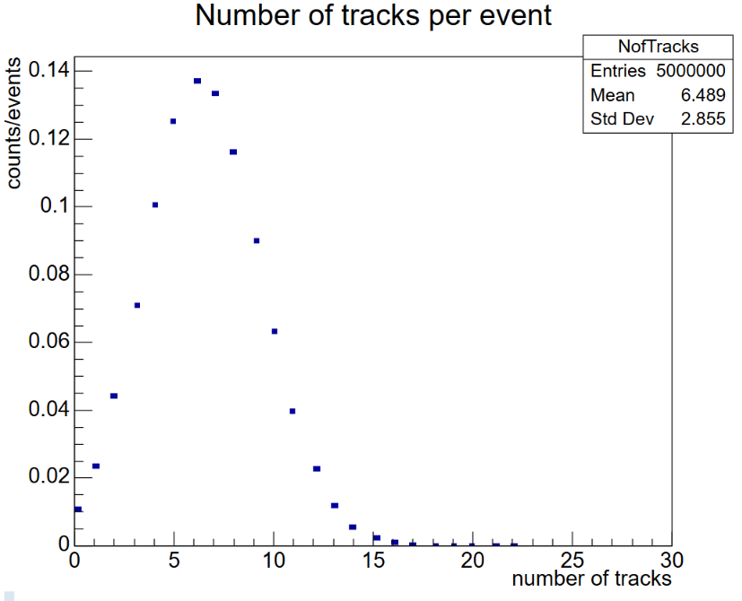
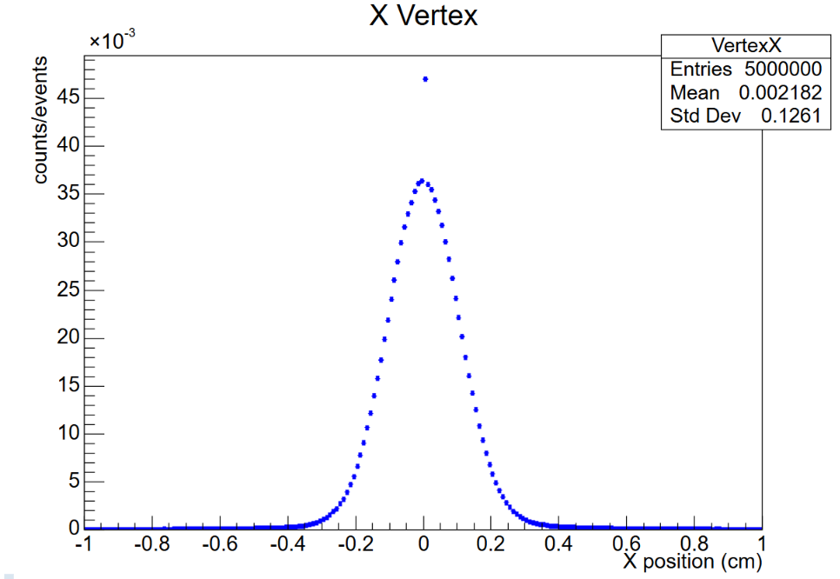
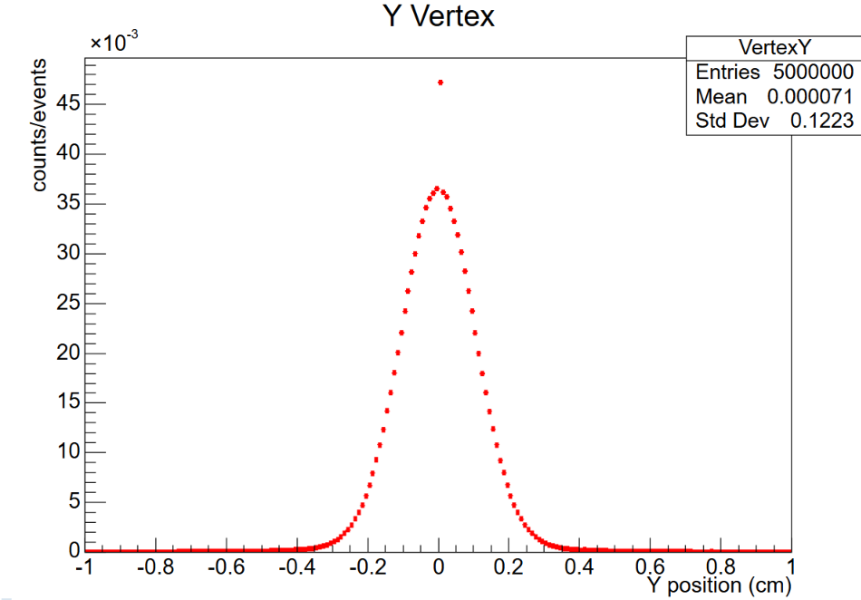

Slide 20
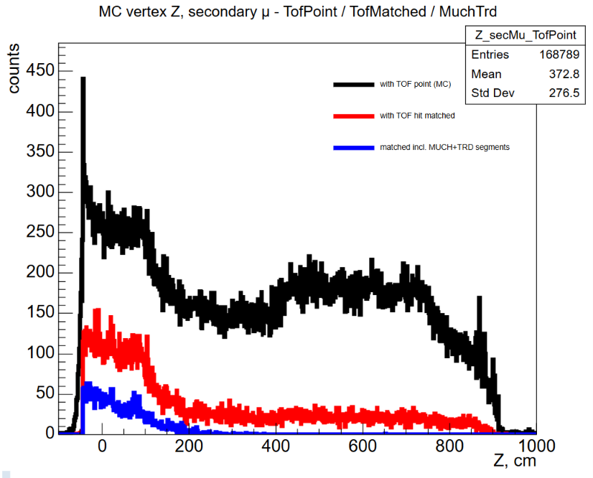

Slide 21
