Slide 1
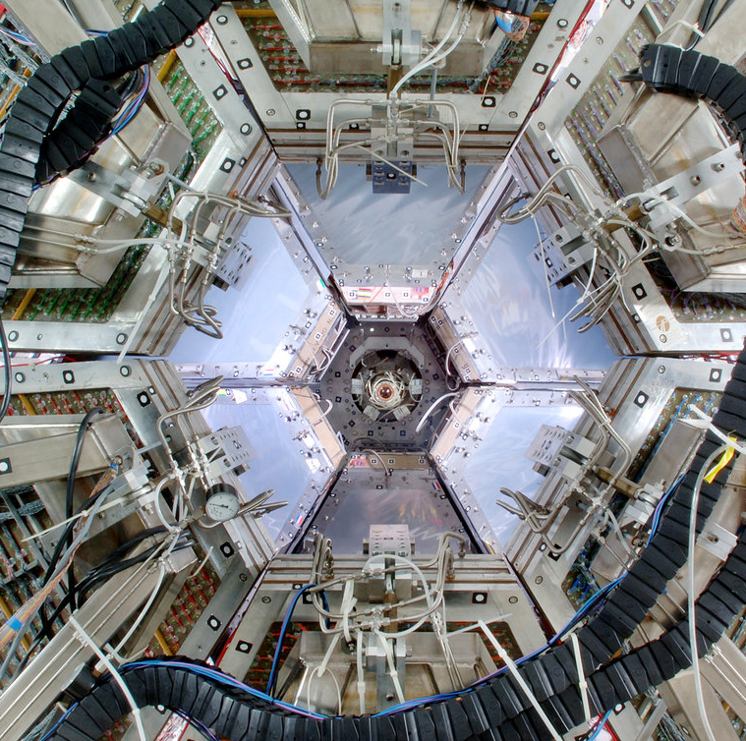


Summer Student Program 2026
.
Calibrating Beam Momentum at HADES
Wiktoria Handzlik
Supervisor : Dr. Marvin Kohls

Slide 2
Project Aim:
Secondary beam experiments need to calibrate nominal momentum - how can we do this?
OVERVIEW
Two methods:
Manual PID cut application
Neural Network assisted candidate selection
01.

Slide 3
Motivation
Pion-nucleon interactions are of interest to probing QCD dynamics
At GSI ^{[1]}:
Baryon resonance formation
Dense, hot hadronic matter
Photo production experiments
MOTIVATION
Problem
Beams at HADES are secondary
Need to calibrate nominal beam momentum
01.
^{[1]} The HADES Collaboration, ‘Proposal for Experiments at the GSI Pion Beam Facility’, (2024)

Slide 4
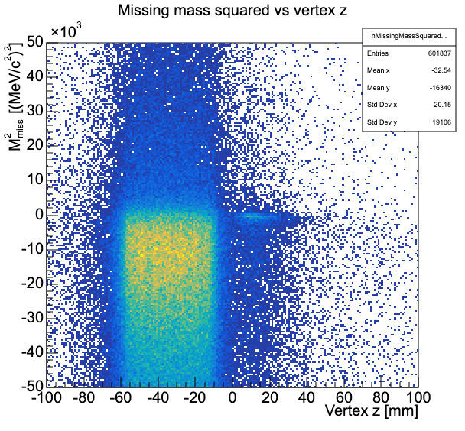
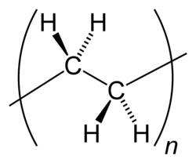


Motivation
In the Aug 2014 $π^{−}C$ beamtime, can see elastic scattering artifact
More on where this graph came from later
Carbon target
Polyethylene target holder
MOTIVATION
Polyethylene structure
Quasi-free protons
Elastic $π^{−}p$ scattering
01.

Slide 5







Why elastic $π^{−}p$ scattering?
Conservation of momentum - know exact kinematics
Expect 2 clean product tracks
$$P_{\text{π},final}$$
Four momentum conservation:
$$P_{\text{beam}}+P_{\text{target}}=P_{π,\text{final}}+P_{\text{p,final}}$$
Missing mass squared:
$$ℳ_{\text{miss}}^{2}={\left(P_{\text{beam}}+P_{\text{target}}−P_{π,\text{final}}−P_{\text{p,final}}\right)}^{2}$$
Elastic condition:
$$ℳ_{\text{miss}}^{2}\overset{ \text{elastic}}{=}0$$
BACKGROUND
$$P_{\text{beam}}$$
$P_{\text{target}}$ = 0
$$P_{\text{p},final}$$
01.

Slide 6
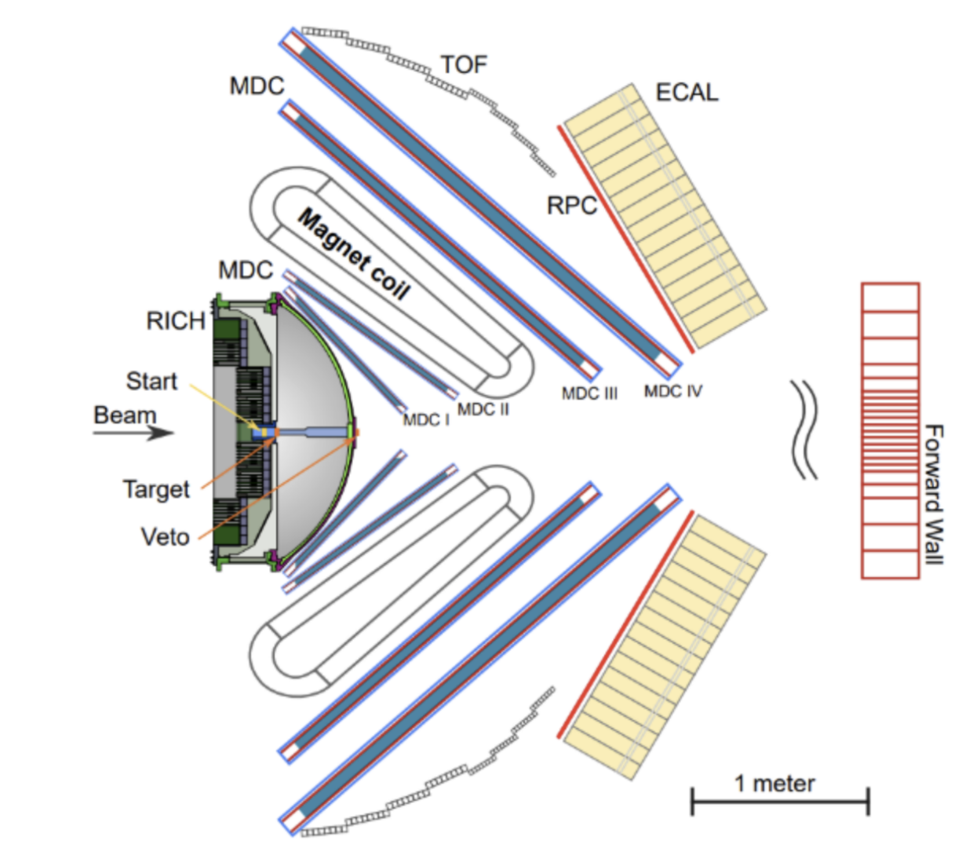

Setup
MDCs – track reconstruction (Runge Kutta) and specific energy loss
TOF & RPC – particle arrival timing
HADES SETUP
Together, reconstruct $β$ and four-momentum for each track, so can PID
A. Shabanov et al., ‘Calibration of the electromagnetic calorimeter ECal of the HADES experiment.’, Journal of Physics: Conference Series, 1667, 012039 (2020)
01.

Slide 7

Two approaches to isolate elastic $π^{−}p$ candidates:
Manual PID cut application
Selecting events based on physical restrictions
(QA cuts, PID band fitting, vertex refitting)
METHODS
Neural Network candidate selection
Binary classifier trained on simulation, compared directly via missing mass squared distributions
01.

Slide 8
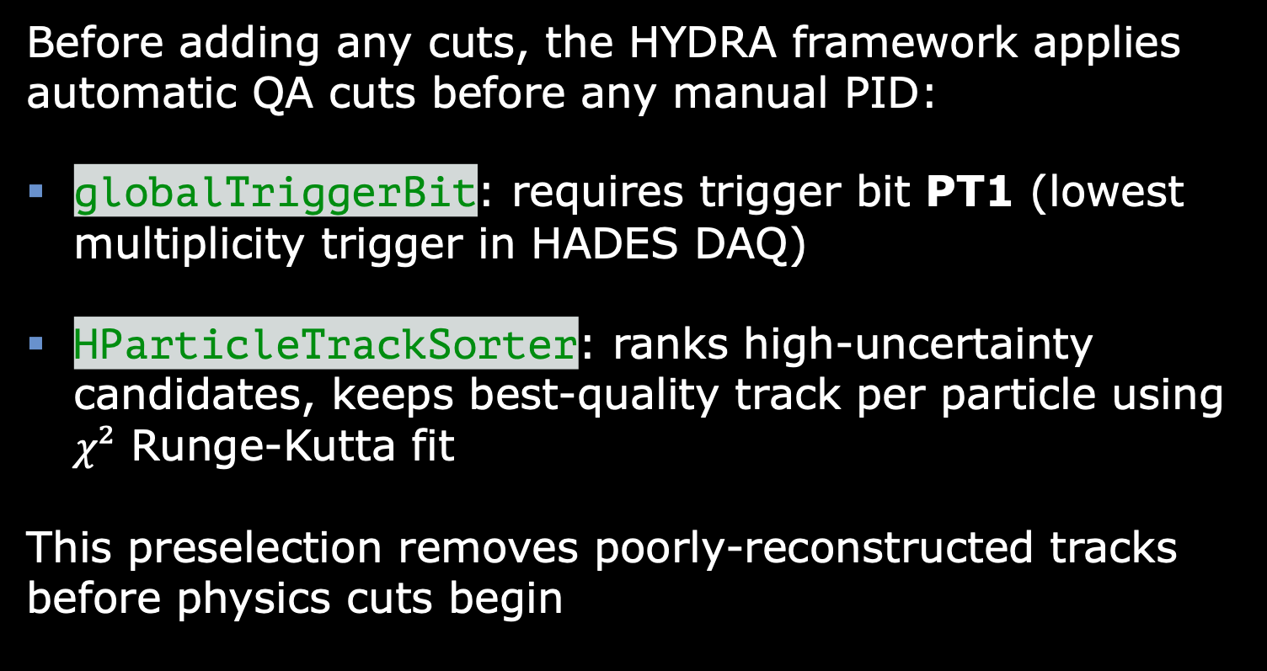
QA Cuts (Preselection)
Before adding any cuts, the HYDRA framework applies automatic QA cuts before any manual PID:
globalTriggerBit: requires trigger bit PT1 (lowest multiplicity trigger in HADES DAQ)
HParticleTrackSorter: ranks high-uncertainty candidates, keeps best-quality track per particle using $χ²$ Runge-Kutta fit
This preselection removes poorly-reconstructed tracks before physics cuts begin
CLASSICAL – QA CUTS
01.

Slide 9
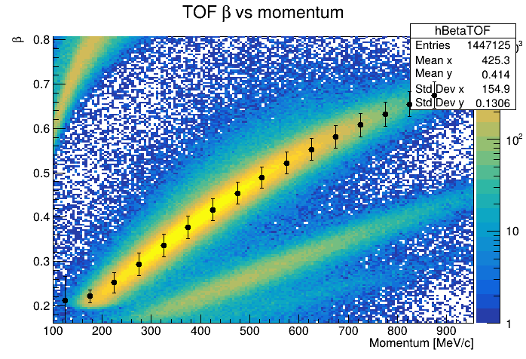

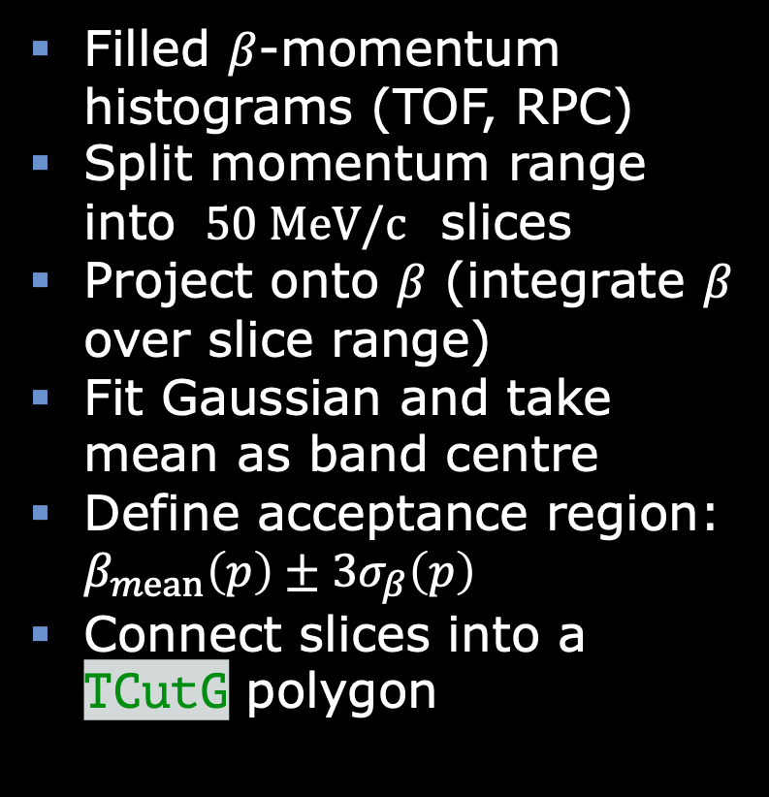
PID Band Fitting
Filled $β$-momentum histograms (TOF, RPC)
Split momentum range into $50 MeV/c$ slices
Project onto $β$ (integrate $β$ over slice range)
Fit Gaussian and take mean as band centre
Define acceptance region: $β_{mean}\left(p\right)±3σ_{β}\left(p\right)$
Connect slices into a TCutG polygon
CLASSICAL – PID BANDS
This gives momentum dependent $β$ resolution, so better than fixed cuts!
01.

Slide 10
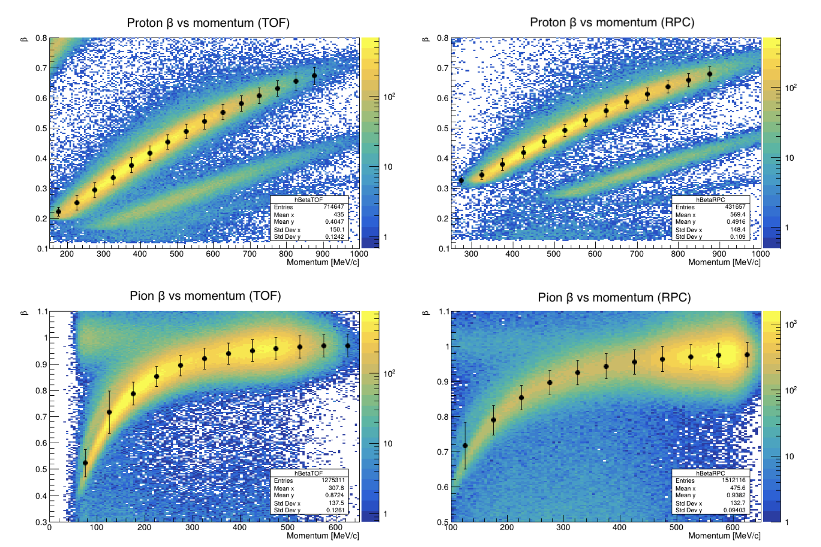

CLASSICAL – PID BANDS
01.

Slide 11
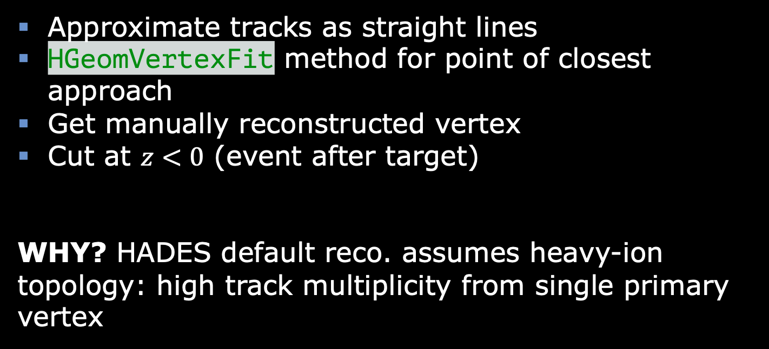
Vertex Refitting
Approximate tracks as straight lines
HGeomVertexFit method for point of closest approach
Get manually reconstructed vertex
Cut at $z<0$ (event after target)
WHY? HADES default reco. assumes heavy-ion topology: high track multiplicity from single primary vertex
CLASSICAL - VERTEX REFITTING
01.

Slide 12
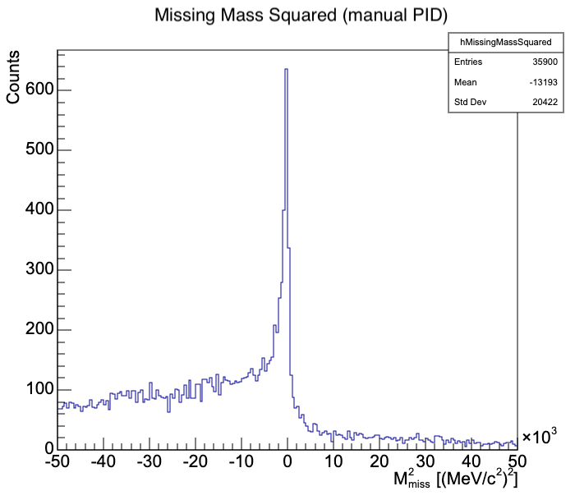

Classical PID Results
$35,900$ candidate events
$p_{beam}=651±20 MeV/c$
$∼39 MeV/c$ correction to nominal
CLASSICAL RESULT
01.

Slide 13
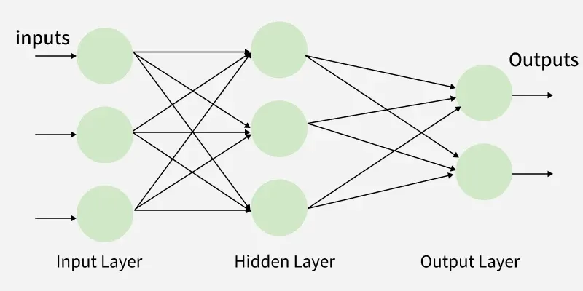

NN Architecture
Small binary MLP (PyTorch) - inputs are kinematic/PID quantities, no spatial or sequential structure
Training data: GEANT-simulated $π⁻C$ at $690 MeV/c$, including generator-truth labels
No manual PID cuts applied before training, only track sorting to positive/negative branches
NEURAL NETWORK
01.
Multilayer Perceptron Learning, geeksforgeeks, accessed 09/09/2026

Slide 14

NN Features
Inputs: each track's momentum, angle, β, reco. mass, and energy-loss signature $dE/dx$
Considers four physics-derived quantities: missing mass squared, opening angle, coplanarity, vertex position
Built the same way for simulation and real data, so there's no mismatch in how features are calculated
Output is a single score between 0 and 1 ("how signal-like is this event")
NEURAL NETWORK
01.

Slide 15
NN Training
60/20/20 train/validation/test split, stratified by label (preserves signal/background ratio)
Trained to separate true elastic events from background, using GEANT truth labels
Standardisation (mean/std) computed from training split only
NN TRAINING
01.

Slide 16
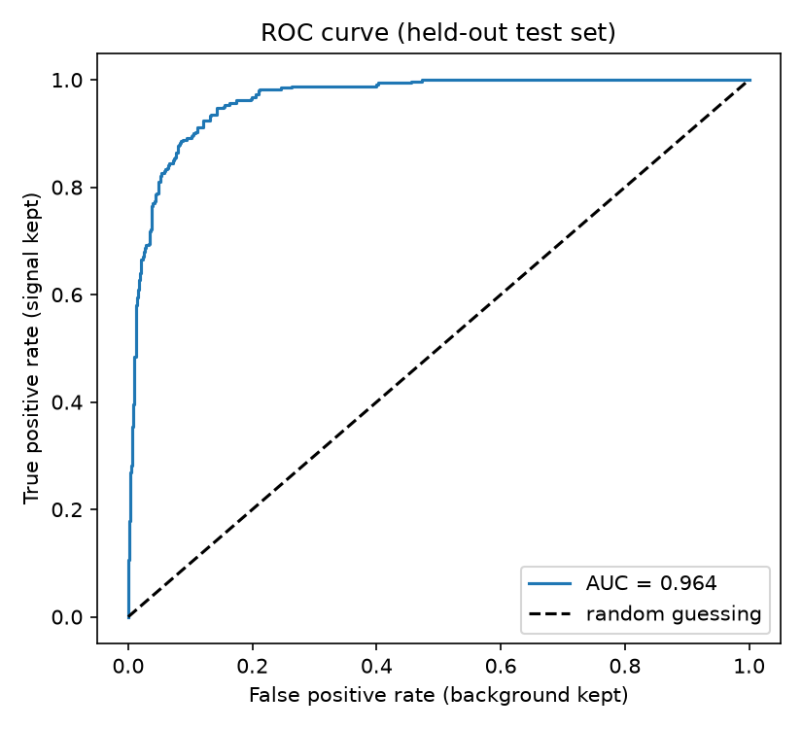
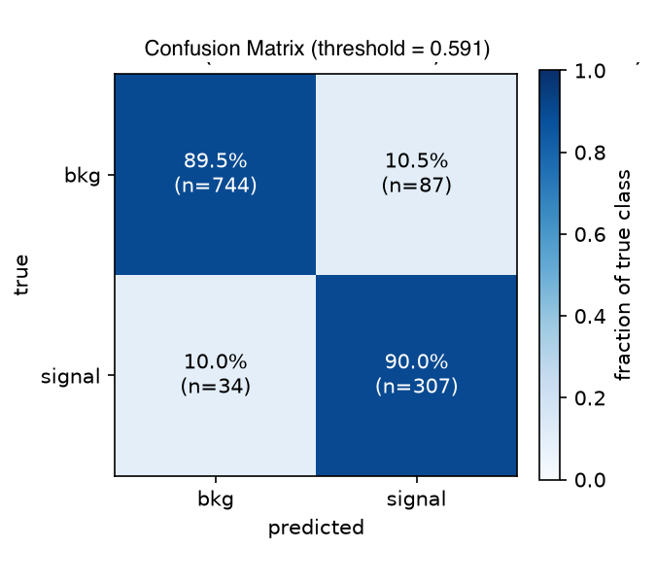
NN Evaluation
NN EVALUATION
AUC = 0.964, 90% signal efficiency at threshold 0.591
01.

Slide 17
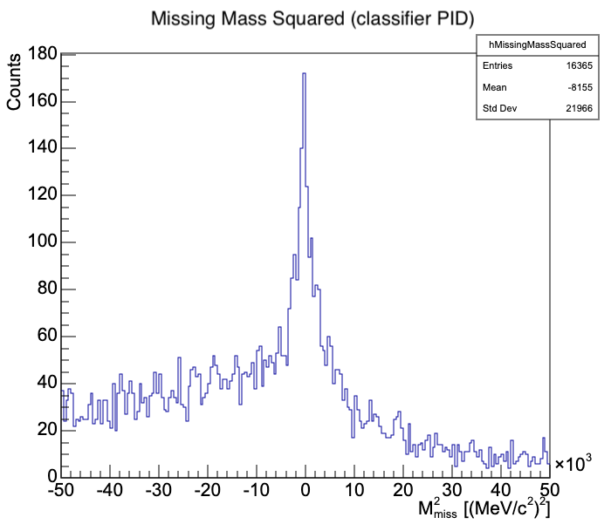


NN Results on Real Data
$16,365$ candidate events ($2.2×$ less)
$p_{beam}=764±127 MeV/c$
$∼113 MeV/c$ correction to nominal
NN APPLICATION
01.

Slide 18

NN Results on Real Data and Limitations
Simulation modelled $π⁻C$ scattering only
Real elastic signal is predominantly π⁻p from the target holder
NN learned simulation-specific topology, not the true signal topology
Need for Monte Carlo simulation
NN APPLICATION
01.

Slide 19
Conclusion and Outlook
Classical cuts gave best calibration at 651 ± 20 MeV/c
Next steps:
  Retrain on simulation matching real target composition
  Domain adversarial NNs (DANNs) — learn signal/background independent of sim-vs-real domain
DANN approach already motivated within HADES collaboration^{[2]}
CONCLUSION
01.
^{[2]} M. Kohls, ‘Particle Identification with MLPs and PINNs Using HADES Data’, SciPost, e-print:2509.17685, (2025).

Slide 20





Thank you for your attention!
01.

