Slide 1



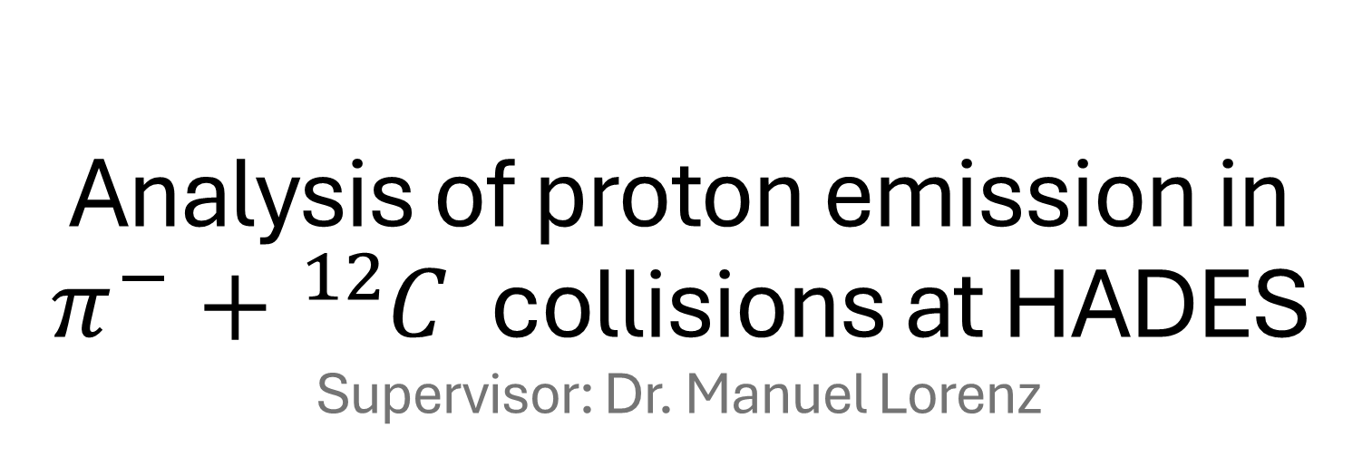
Analysis of proton emission in $π^{−}+{}_{​}^{12}​C$ collisions at HADES
Supervisor: Dr. Manuel Lorenz
Vera Schuhmann
Summer Student Report
15.09.2026

Slide 2
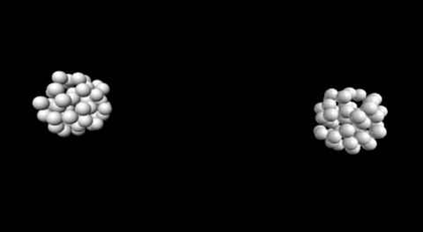
Particle collision

Slide 3
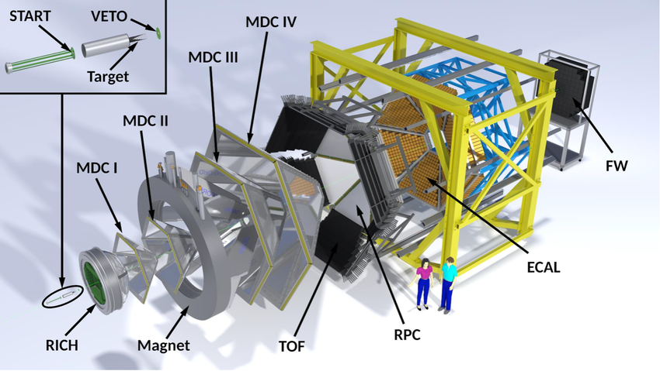
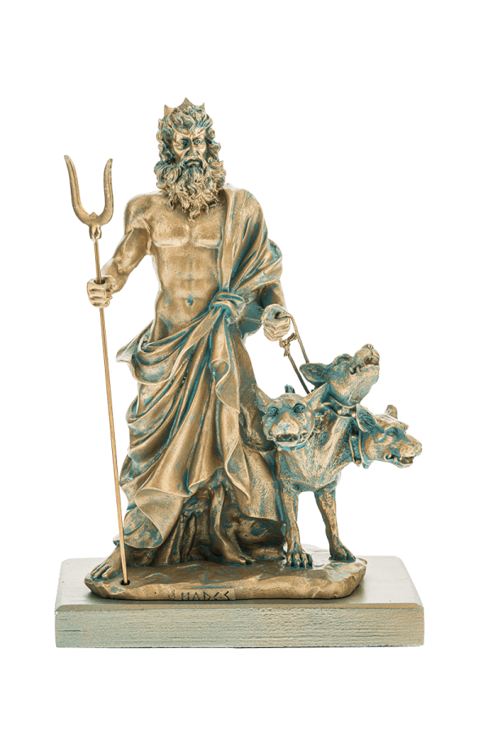
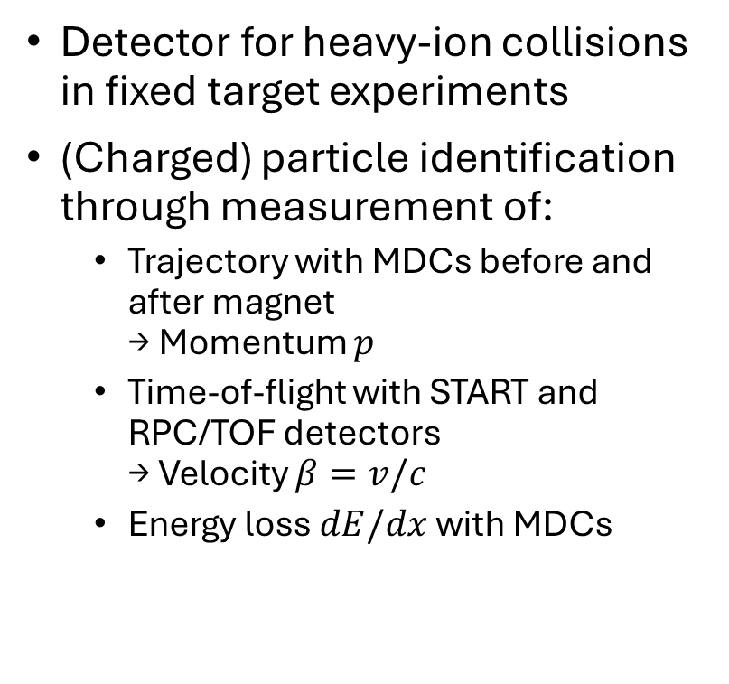
HADES detector
Detector for heavy-ion collisions in fixed target experiments
(Charged) particle identification through measurement of:
  Trajectory with MDCs before and after magnet
  → Momentum $p$
  Time-of-flight with START and RPC/TOF detectors
  → Velocity $β=v/c$
  Energy loss $dE/dx$ with MDCs
Notes:
Show RPC and TOF!
Also MDCs and Magnet
RPC = Resistive Plate Chamber
TOF = Time Of Flight
MDC = Magnetic Drift Chamber

Slide 4
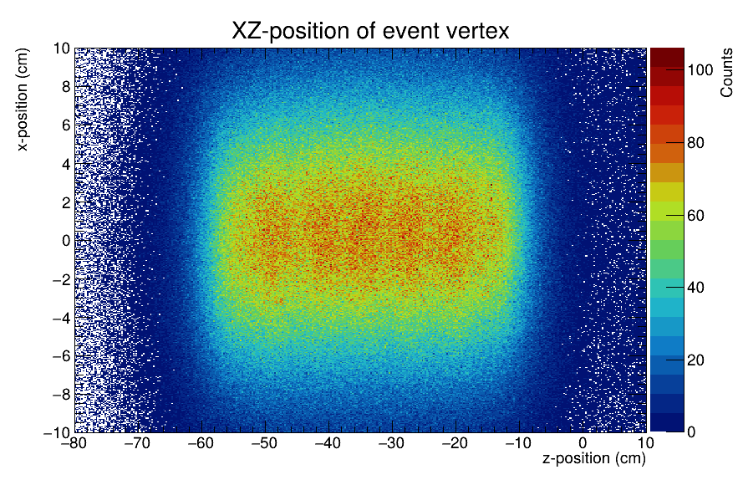
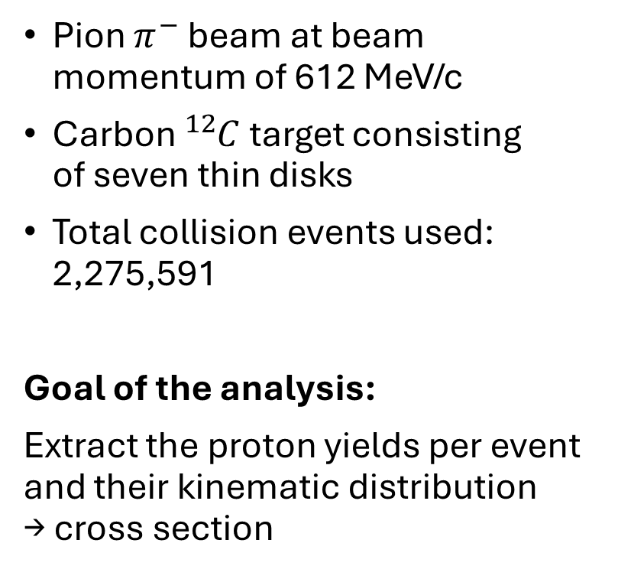
Experimental setup
Pion $π^{−}$ beam at beam momentum of 612 MeV/c
Carbon ${}_{​}^{12}C$ target consisting
of seven thin disks
Total collision events used: 2,275,591
Goal of the analysis:
Extract the proton yields per event and their kinematic distribution
→ cross section

Slide 5
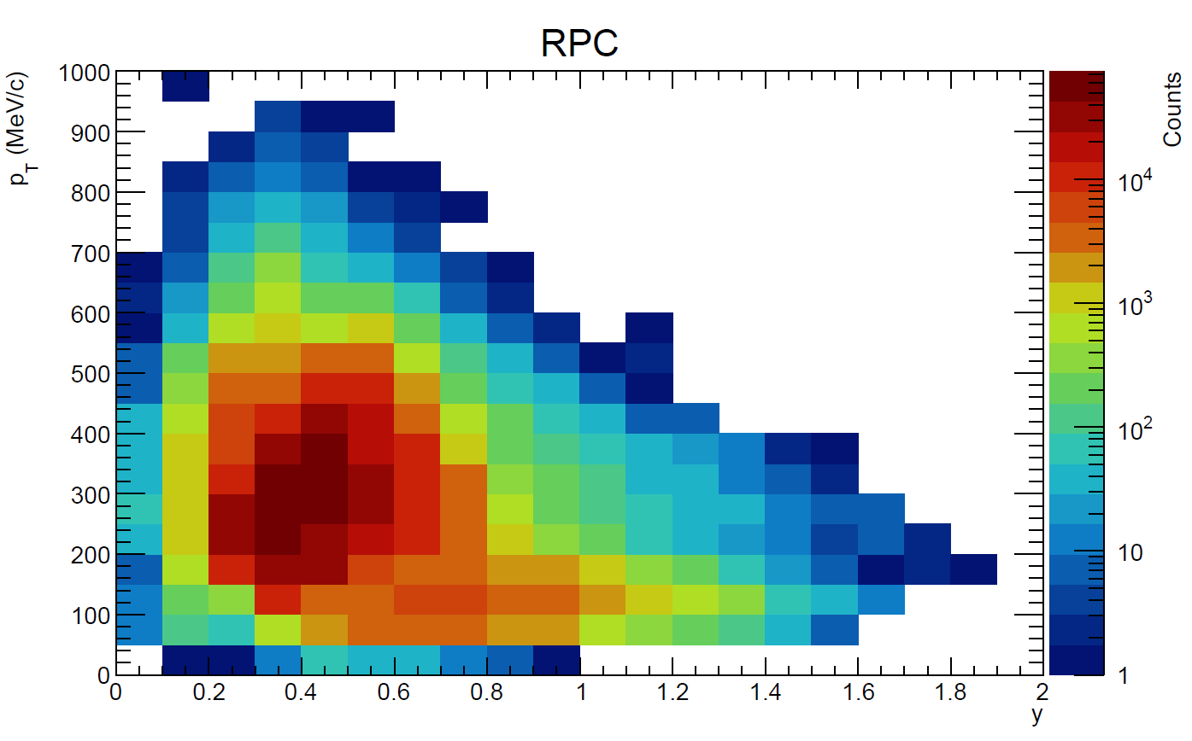

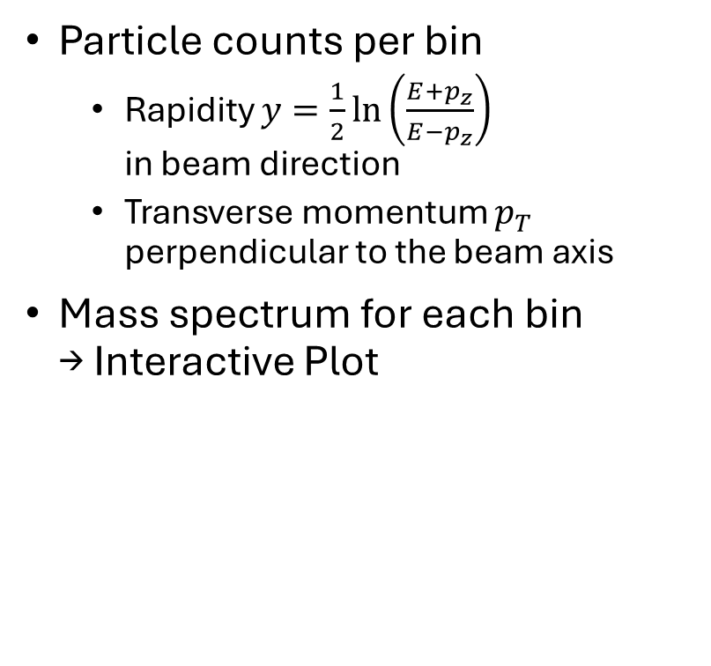
Kinematic distribution: $p_{T}−y$
Particle counts per bin
  Rapidity $y=\frac{1}{2}\ln\left(\frac{E+p_{z}}{E−p_{z}}\right)$
  in beam direction
  Transverse momentum $p_{T}$ perpendicular to the beam axis
Mass spectrum for each bin
→ Interactive Plot
Notes:
Hopefully works SMOOTH LIKE BUTTER
Bins to show:
Positrons + pions: pt50, y1.0
Pions: pt100, y0.7
Protons: pt250, y0.4
Deuterons: pt500, y0.3
Deuterons + Tritium: pt500, y0.2

Slide 6
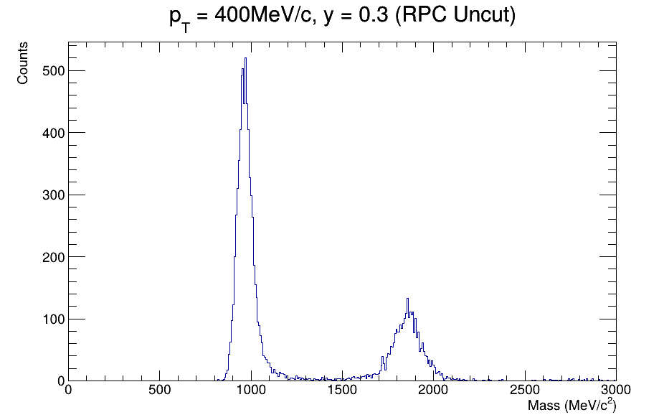
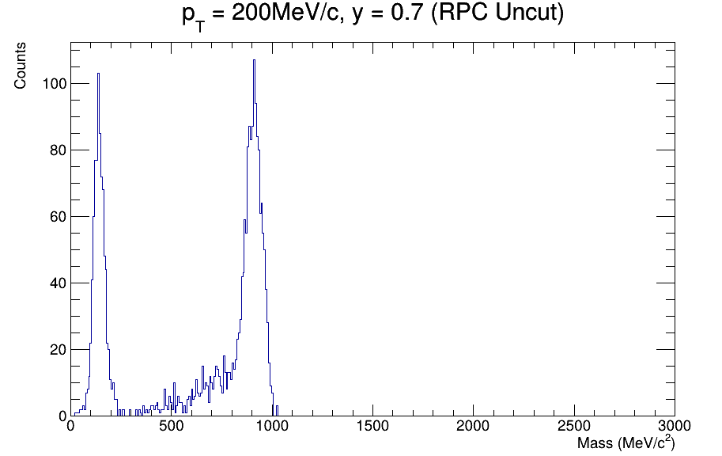
Kinematic distribution: $p_{T}−y$
Particle counts per bin
  Rapidity $y=\frac{1}{2}\ln\left(\frac{E+p_{z}}{E−p_{z}}\right)$
  in beam direction
  Transverse momentum $p_{T}$ perpendicular to the beam axis
Mass spectrum for each bin
→ Interactive Plot
Notes:
Bins to show:
Positrons + pions: pt50, y1.0
Pions: pt100, y0.7
Protons: pt250, y0.4
Deuterons: pt500, y0.3
Deuterons + Tritium: pt500, y0.2

Slide 7
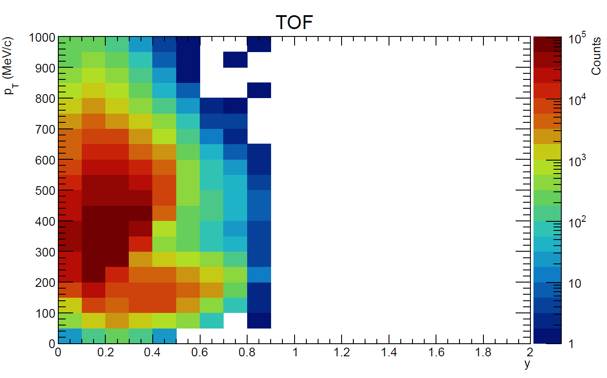
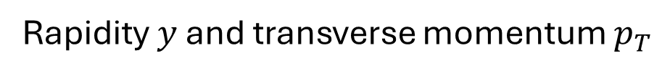
Kinematic distribution: $p_{T}−y$
Rapidity $y$ and transverse momentum $p_{T}$
Notes:
Point out: TOF at lower rapidity and higher transv. momentum than RPC, else just squished together

Slide 8
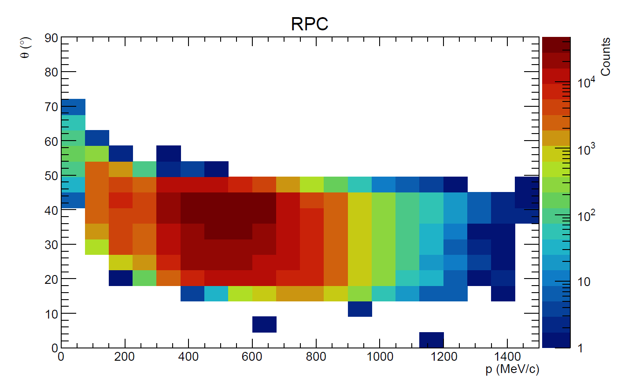
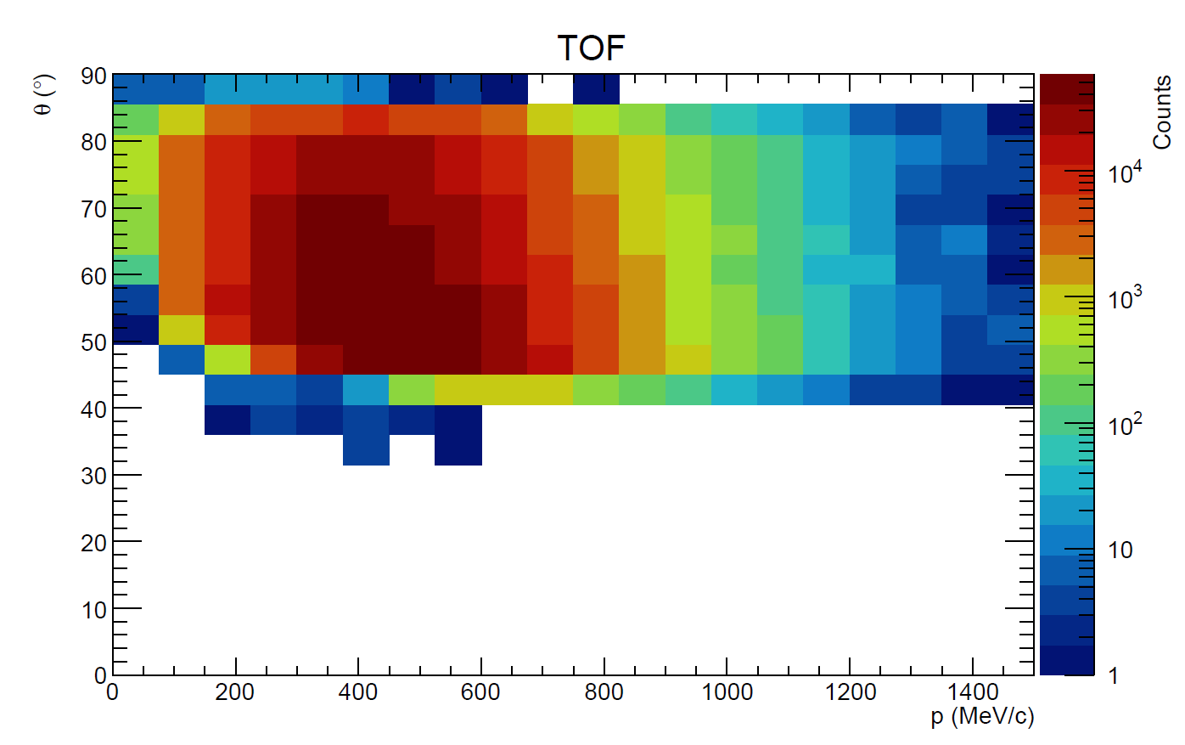

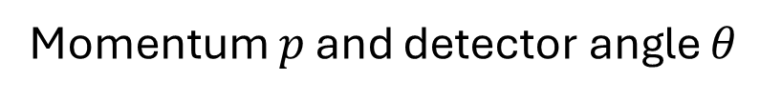
Kinematic distribution: $p−θ$
Momentum $p$ and detector angle $θ$
Notes:
Point out: TOF at larger polar angles than RPC -> detector geometry
Transition to next slide: how to extract only the protons

Slide 9
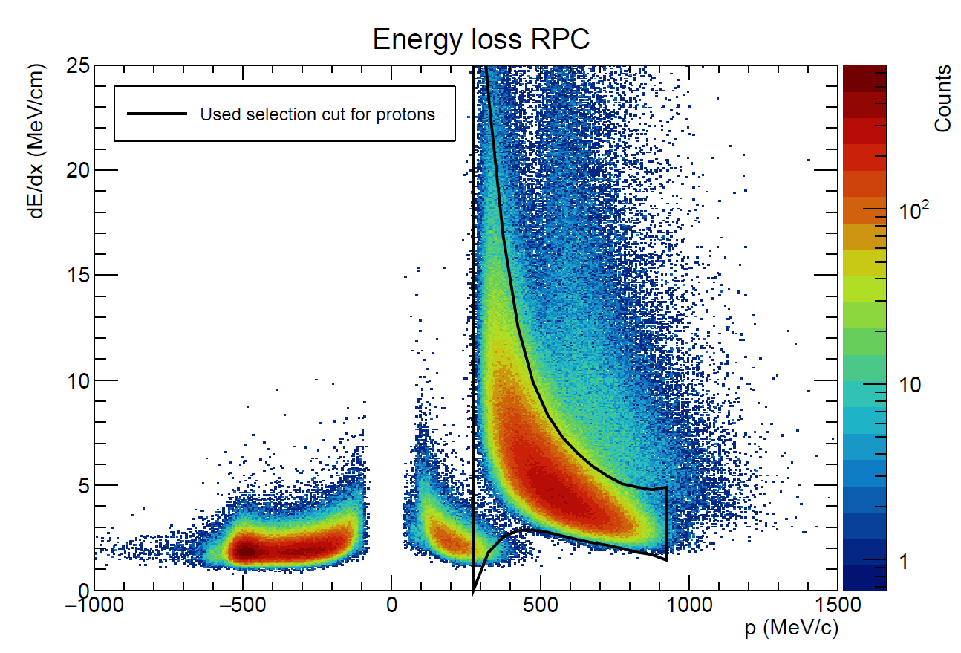
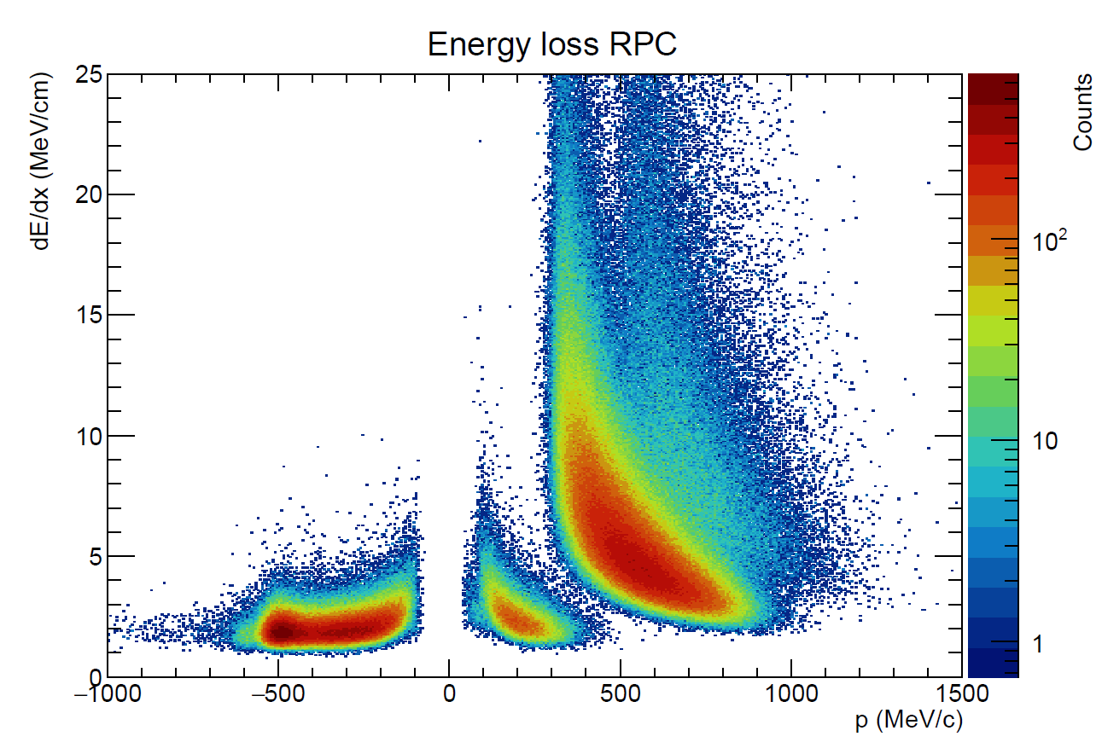
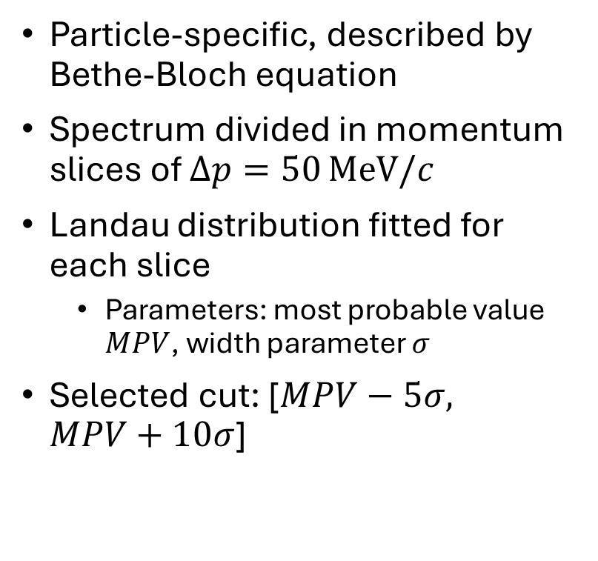
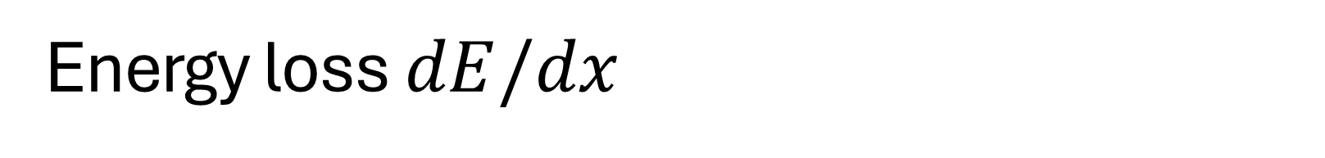
Energy loss $dE/dx$
Particle-specific, described by Bethe-Bloch equation
Spectrum divided in momentum slices of $Δp=50 MeV/c$
Landau distribution fitted for each slice
  Parameters: most probable value $MPV$, width parameter $σ$
Selected cut: [$MPV−5σ,$
$MPV+10σ$]

Slide 10
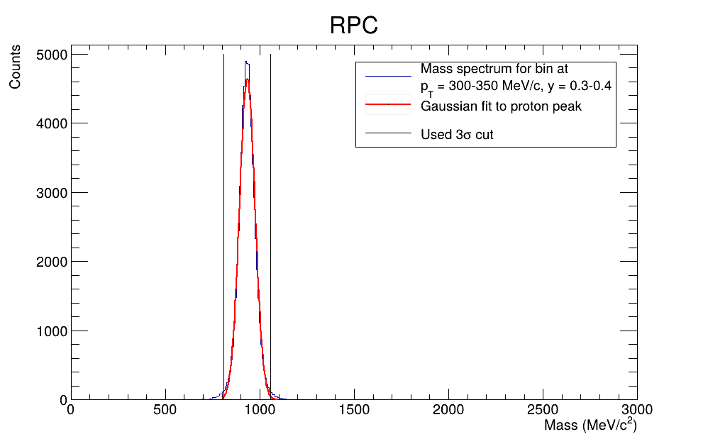
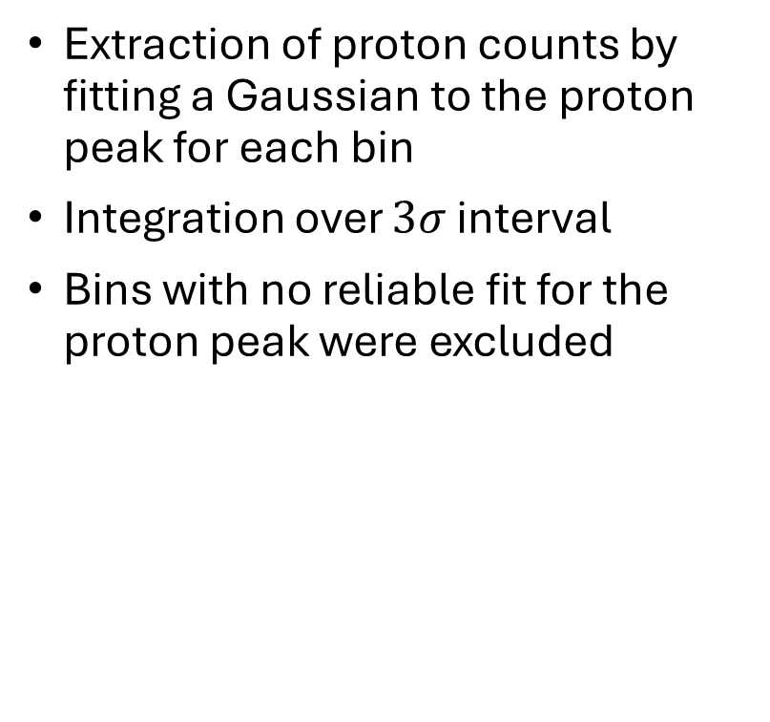
Proton counts
Extraction of proton counts by fitting a Gaussian to the proton peak for each bin
Integration over $3σ$ interval
Bins with no reliable fit for the proton peak were excluded

Slide 11
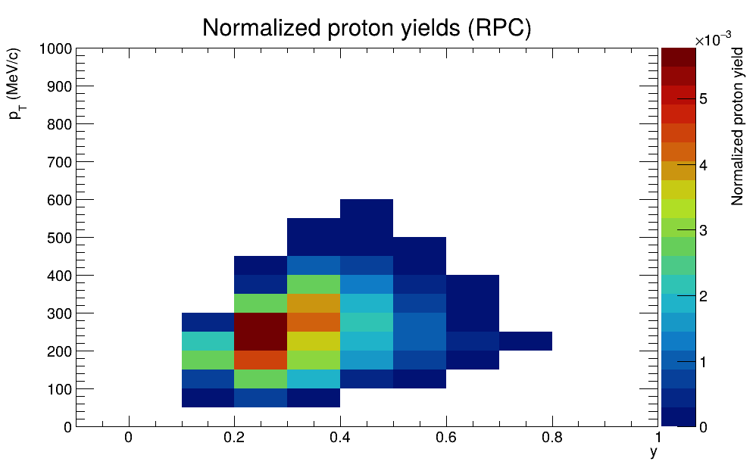
Normalized proton yields
Integrated proton counts
Normalized by bin size and number of analysed events
=> Proton yield per event and bin
Notes:
Note: rapidity range only 0-1

Slide 12
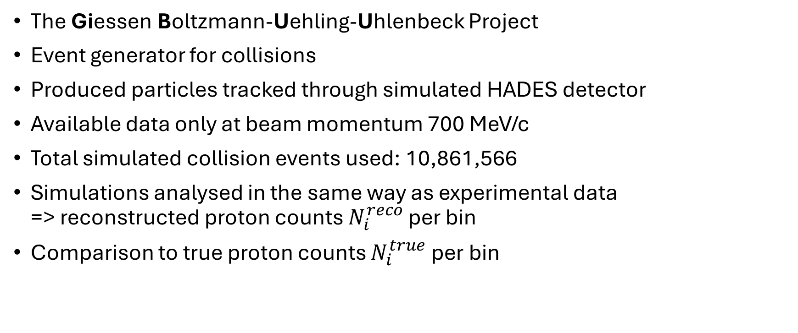
GiBUU simulations
The Giessen Boltzmann-Uehling-Uhlenbeck Project
Event generator for collisions
Produced particles tracked through simulated HADES detector
Available data only at beam momentum 700 MeV/c
Total simulated collision events used: 10,861,566
Simulations analysed in the same way as experimental data
=> reconstructed proton counts $N_{i}^{reco}$ per bin
Comparison to true proton counts $N_{i}^{true}$ per bin

Slide 13
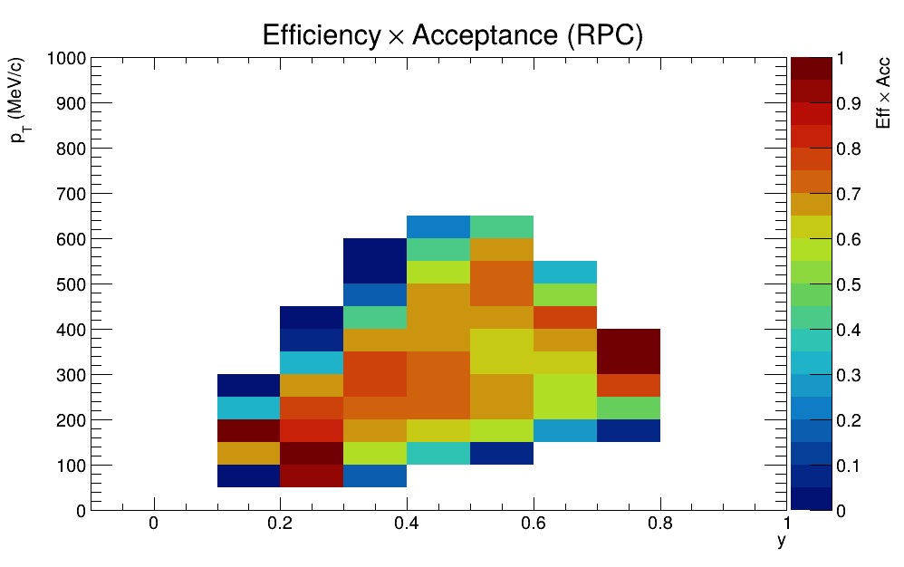
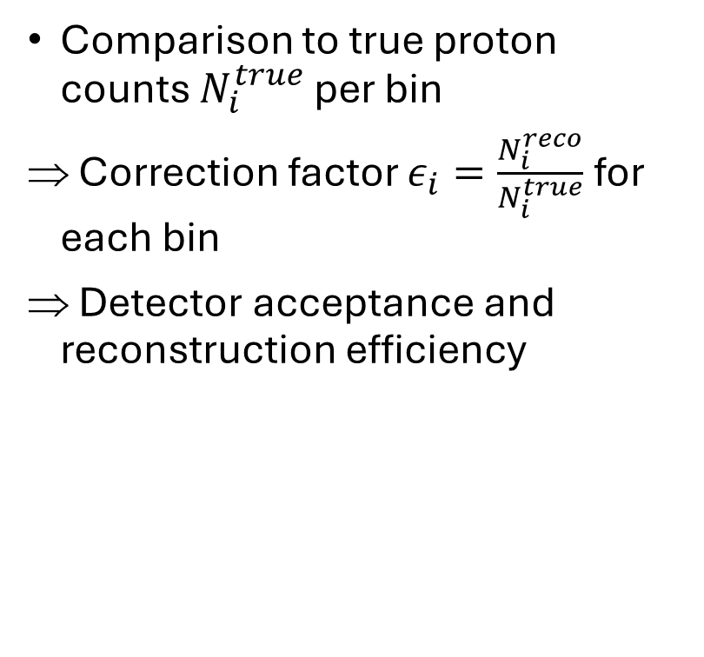
Efficiency & acceptance correction
Comparison to true proton counts $N_{i}^{true}$ per bin
Correction factor $ε_{i}=\frac{N_{i}^{reco}}{N_{i}^{true}}$ for each bin
Detector acceptance and reconstruction efficiency

Slide 14
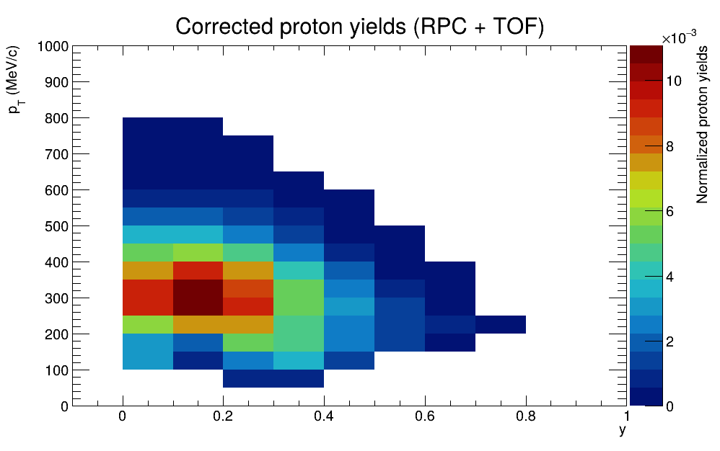
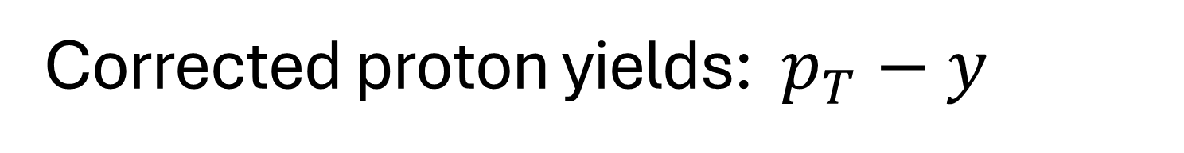
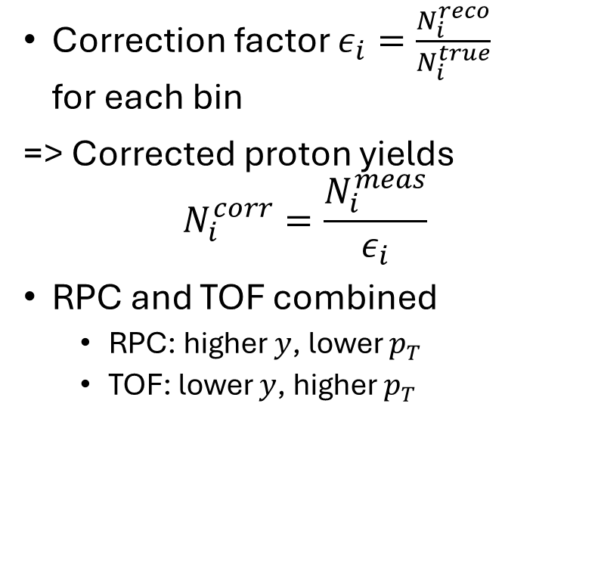
Corrected proton yields: $p_{T}−y$
Correction factor $ε_{i}=\frac{N_{i}^{reco}}{N_{i}^{true}}$
for each bin
=> Corrected proton yields
$$N_{i}^{corr}=\frac{N_{i}^{meas}}{ε_{i}}$$
RPC and TOF combined
  RPC: higher $y$, lower $p_{T}$
  TOF: lower $y$, higher $p_{T}$

Slide 15
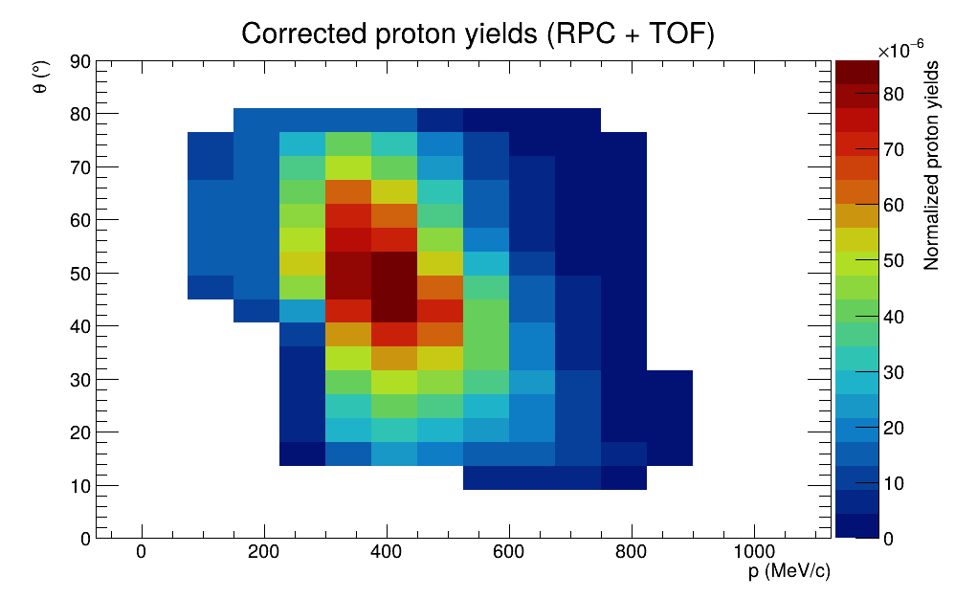
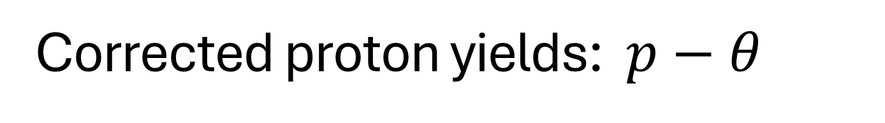
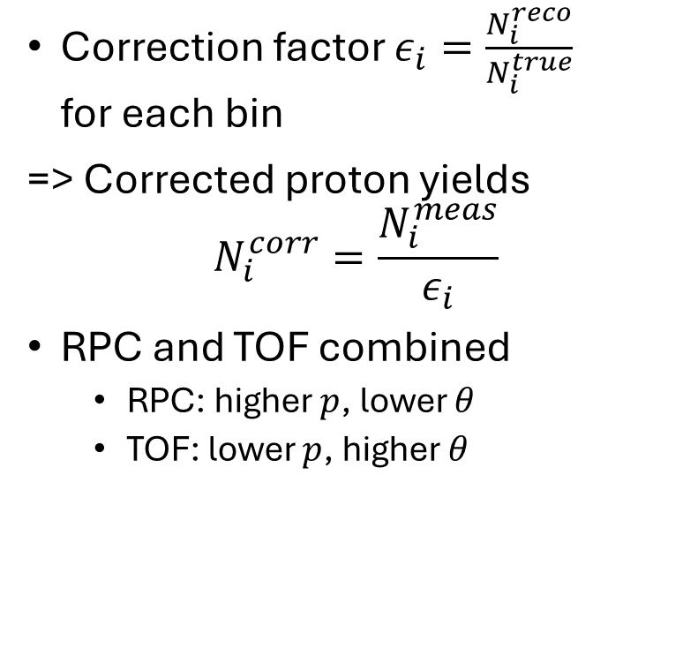
Corrected proton yields: $p−θ$
Correction factor $ε_{i}=\frac{N_{i}^{reco}}{N_{i}^{true}}$
for each bin
=> Corrected proton yields
$$N_{i}^{corr}=\frac{N_{i}^{meas}}{ε_{i}}$$
RPC and TOF combined
  RPC: higher $p$, lower $θ$
  TOF: lower $p$, higher $θ$
Notes:
SMOOTH LIKE BUTTER!!!

Slide 16
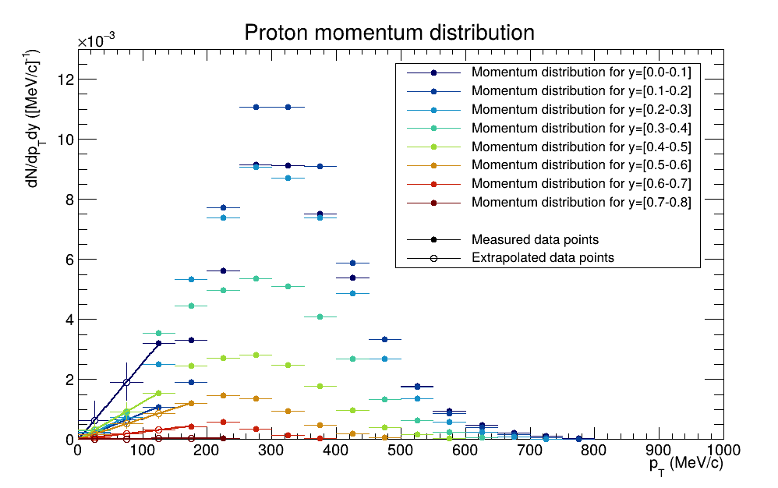
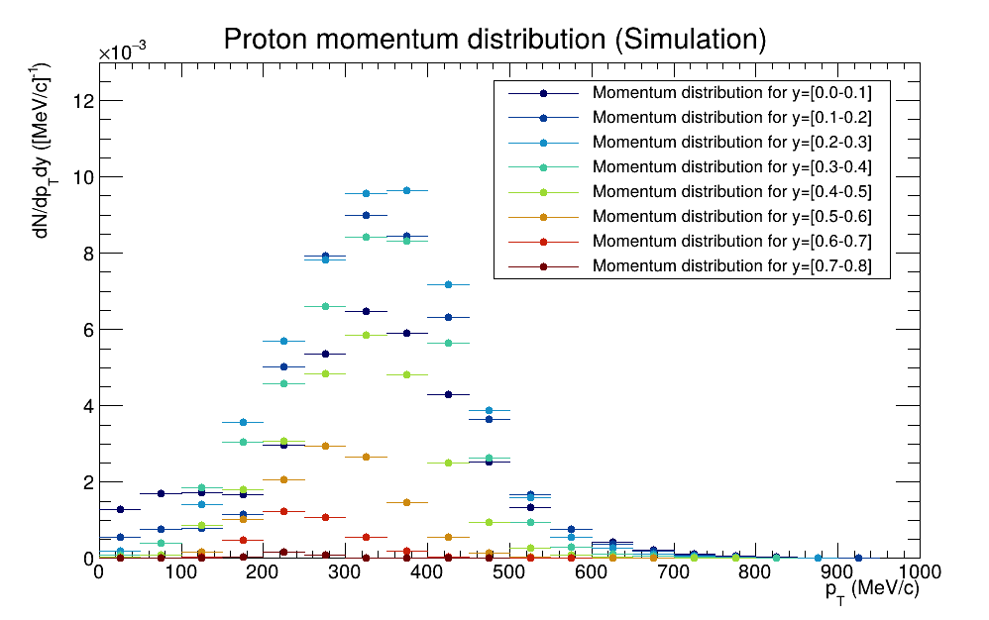
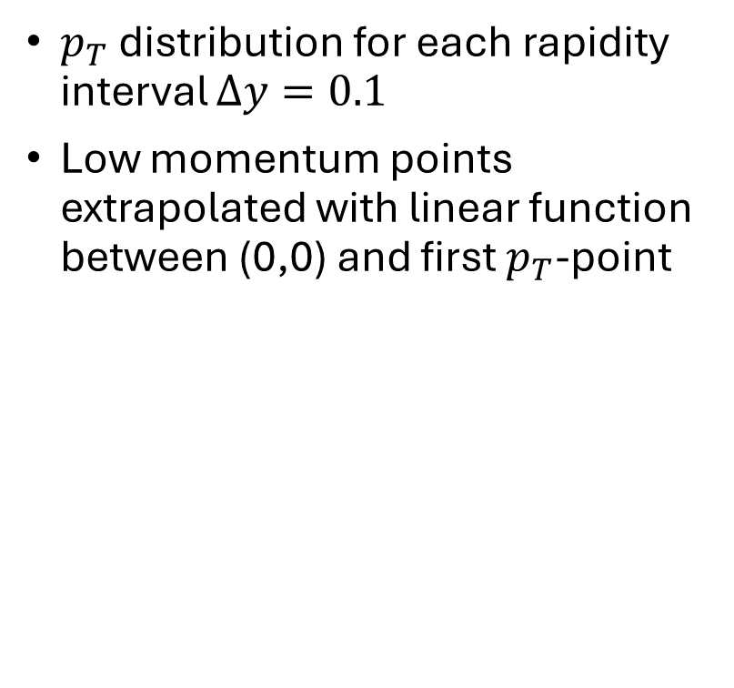
Differential proton yields
$p_{T}$ distribution for each rapidity interval $Δy=0.1$
Low momentum points extrapolated with linear function between (0,0) and first $p_{T}$-point
Notes:
No low p_T points because of detector geometry -> small polar angle, no detection
Looks like Boltzmann, but doesn’t work

Slide 17
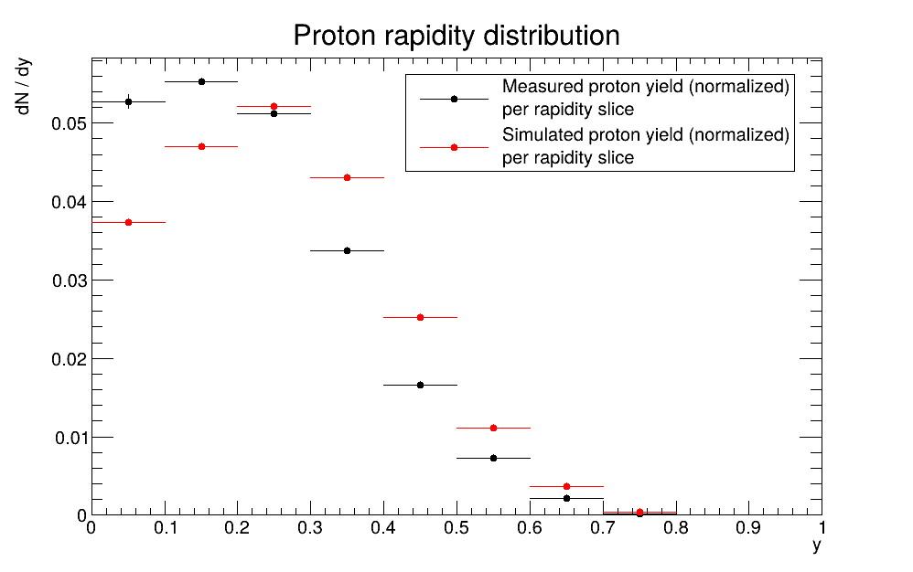
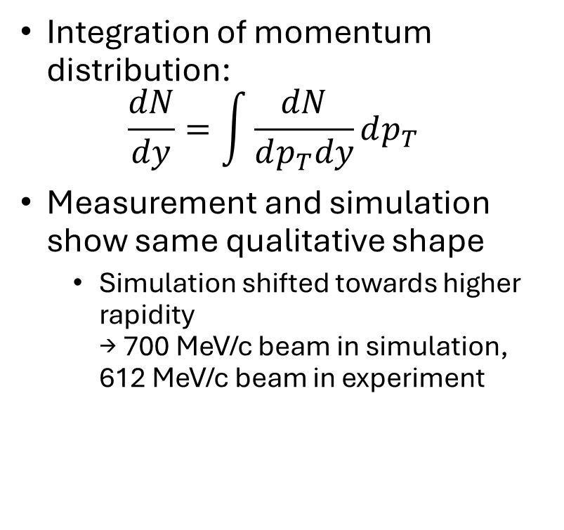
Proton rapidity distribution
Integration of momentum distribution:
$\frac{dN}{dy}=\int{\frac{dN}{dp_{T}dy}}dp_{T}$
Measurement and simulation show same qualitative shape
  Simulation shifted towards higher rapidity
  → 700 MeV/c beam in simulation, 612 MeV/c beam in experiment

Slide 18
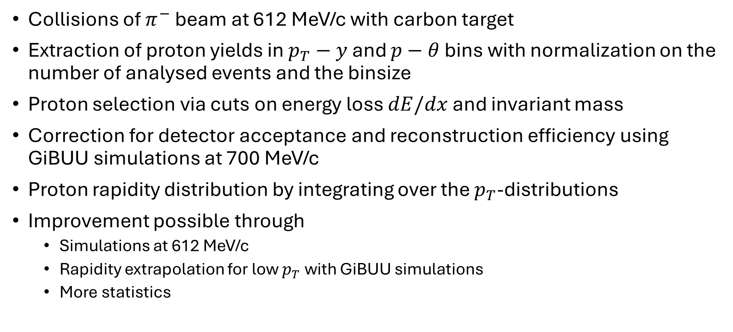
Summary & Outlook
Collisions of $π^{−}$ beam at 612 MeV/c with carbon target
Extraction of proton yields in $p_{T}−y$ and $p−θ$ bins with normalization on the number of analysed events and the binsize
Proton selection via cuts on energy loss $dE/dx$ and invariant mass
Correction for detector acceptance and reconstruction efficiency using GiBUU simulations at 700 MeV/c
Proton rapidity distribution by integrating over the $p_{T}$-distributions
Improvement possible through
  Simulations at 612 MeV/c
  Rapidity extrapolation for low $p_{T}$ with GiBUU simulations
  More statistics
Notes:
After my analysis: calculate cross section out of differential proton yields (consider trigger efficiency)

Slide 19
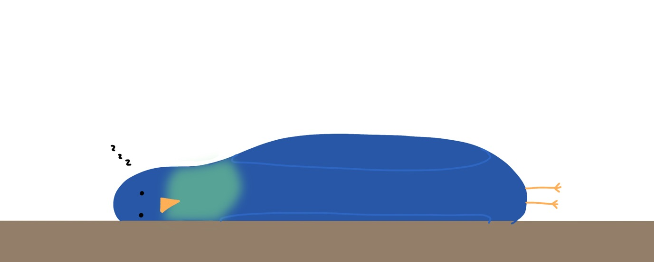
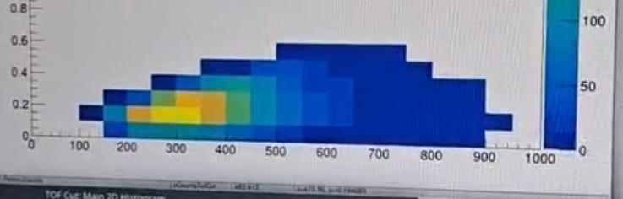
Thank you for your attention!

Slide 20
Interactive pt-y Plot for RPC
scp –r hadgst03@lxi001.gsi.de:/u/hadgst03/vschuhmann .
Bins to show:
  Positrons + pions: pt50, y1.0
  Pions: pt100, y0.7
  Protons: pt250, y0.4
  Deuterons: pt500, y0.3
  Deuterons + Tritium: pt500, y0.2

Slide 21
Introduction
Collision in general (picture/animation)
Then mass spectrum with all particles
But no info on kinematic distribution, # per event, detector effects
Goal: extract proton yields (counts per #events) and their distribution, independent of detector

Slide 22
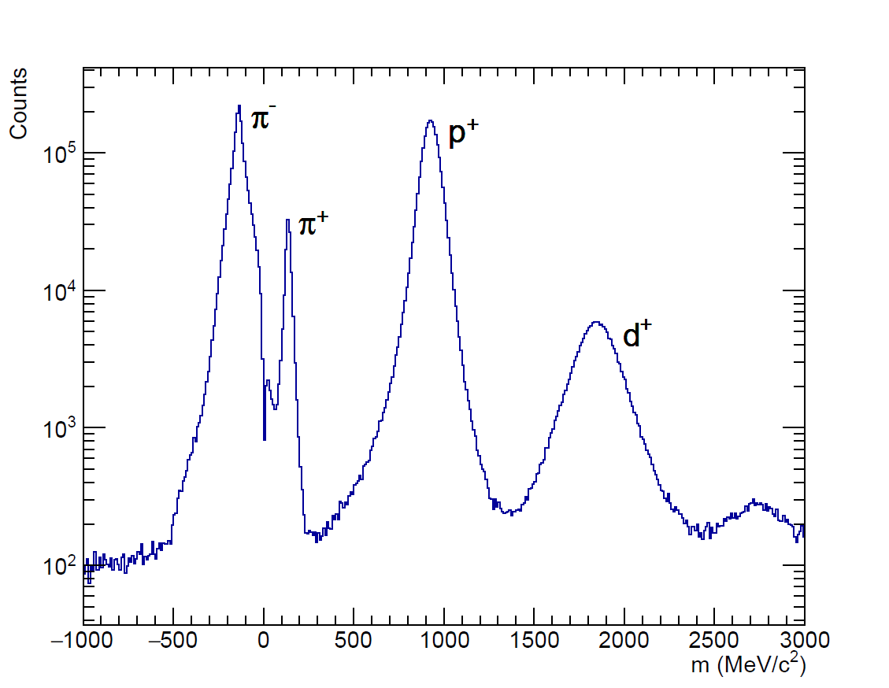
Mass Spectrum

