Slide 1



Neutral pion reconstruction using electromagnetic calorimeter
Summer Student Program 2026
Nikola Winklerová
Palacký University Olomouc
Tutor: Malgorzata Gumberidze

Slide 2
Outline
GSI: The Venice of particle physics
HADES Experiment
Hands-on detector work
Neutral Pion (π⁰)
Identification of photons
Reconstruction of neutral pions
Summary & Outlook
Notes:
Thank you for the introduction, Darwin. My name is Nikola, for those who don't know me yet, and I am currently studying for my Bachelor's degree at Palacký University in Olomouc. During the Summer Student Program, I worked on neutral pion reconstruction using the electromagnetic calorimeter, as part of the HADES group under the supervision of Gosia.
Let’s first look at where HADES is located within GSI. There are quite a few beamlines here, so navigating GSI can sometimes feel a little bit like navigating Venice.
Then I will talk about the ECAL and the detector work I participated in, followed by the neutral pion reconstruction and the main results.

Slide 3
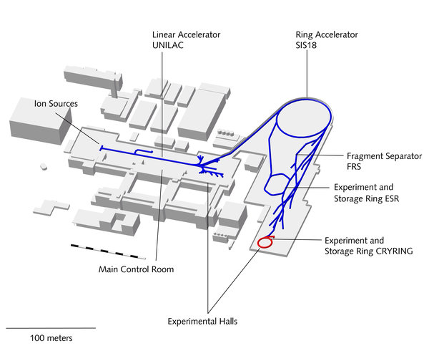
How the beam gets to HADES cave?
Ion source: production of the required ion beam
UNILAC: pre-acceleration of the ions
SIS18: acceleration to the required beam energy
Beam extraction: ions are extracted from SIS18
Beam transport: beam is guided to the experimental halls → e.g. HADES
HADES measures A+A, p+A, p+p, π+A collisions with energy of 0.2 – 4.5 GeV per nucleon
Notes:
The ions are first produced in the ion source. They are then injected into the UNILAC, where they are pre-accelerated.
From there, the beam is transferred to the SIS18 synchrotron, where the ions are accelerated to the required beam energy.
The beam is then extracted and transported through the accelerator facility to the experimental area, including HADES.

Slide 4

The HADES experiment

Slide 5
The HADES experiment
Neutral pion reconstruction using ECAL

Slide 6
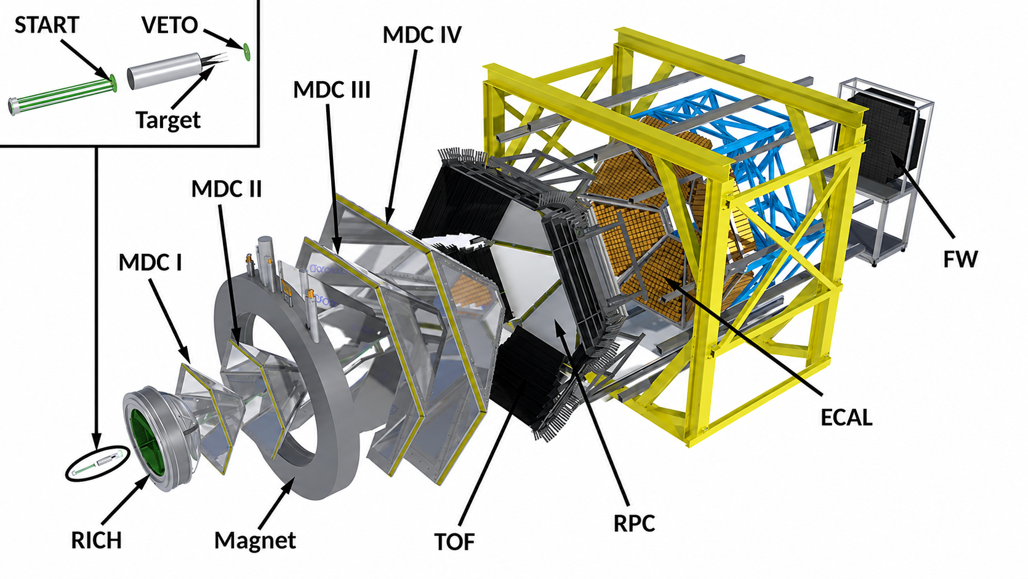
The HADES experiment
High Acceptance Di-Electron Spectrometer
Fixed-target experiment at SIS18 (GSI, Germany)
Acceptance
Nearly full azimuthal coverage
Polar angle between 18° – 85°
0.5° - 7° with forward wall
Charged particle identification
Time-of-Flight walls (TOF and RPC)
Energy loss (MDC and TOF)
e⁺/e⁻ identification (RICH and ECAL)
Neutral particle identification → ECAL
Notes:
The name HADES stands for …
HADES is a fixed-target experiment designed mainly for the identification of charged particles. The different detector systems provide information about the particles produced in the collision.
HADES is build from 6 identifical sectors with nearly full azimuthal coverage and polar angles between 18 to 85.
The beam reaches to HADES cave and first interacts with the target, where the collision takes place and new particles are produced.
The different detector systems then provide information about these particles. The RICH is used for electron and positron identification, while the MDCs reconstruct the trajectories of charged particles. The magnetic field bends the trajectories, which allows us to determine the particle momentum.
Further downstream, the TOF and RPC detectors provide timing and velocity information, which helps with particle identification.
It was mainly designed to identify only charged particles but in 2017 the ECAL was added, which also allows us to detect neutral particles through their electromagnetic energy deposits.
And this is the part of HADES that my work was focused on.

Slide 7
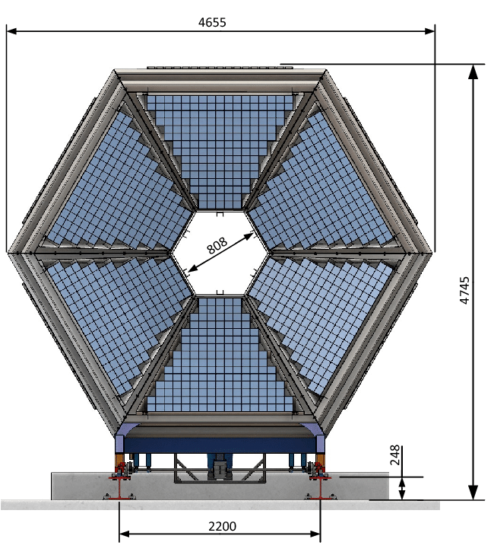
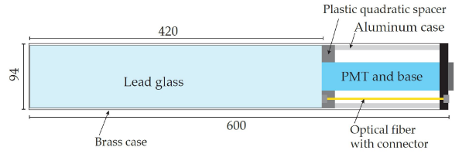
ECAL (Electromagnetic Calorimeter)
978 lead-glass modules arranged in 6 sectors
In the forward region of HADES, behind the RPC
Covers 12° < θ < 45°
Cherenkov light → PMT → electrical signal
Measuring particle energy and arrival time
Notes:
The electromagnetic calorimeter was added to HADES to improve photon detection.
It consists of 978 lead-glass modules arranged in six sectors and is located in the forward region of HADES, behind the RPC.
When a high-energy photon enters the lead glass, it produces an electromagnetic shower and Cherenkov light. The light is collected by a photomultiplier tube and converted into an electrical signal.
From this signal, we can determine the energy and arrival time of the particle.

Slide 8
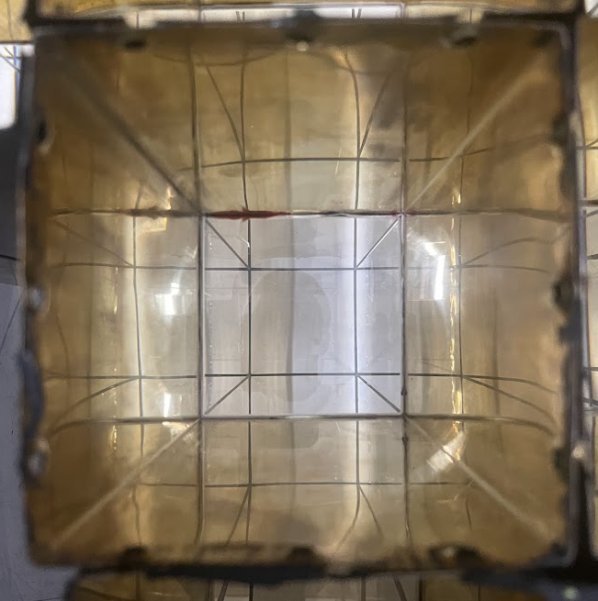
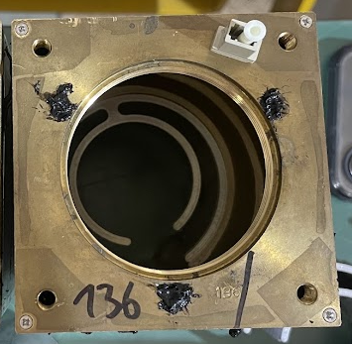
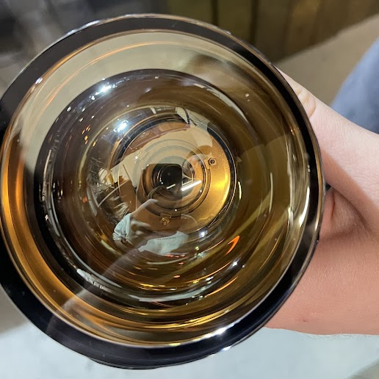
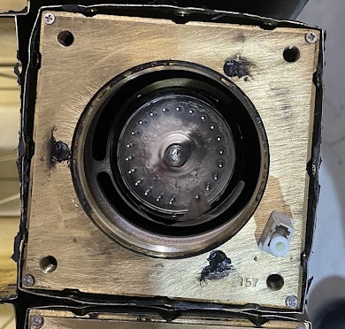
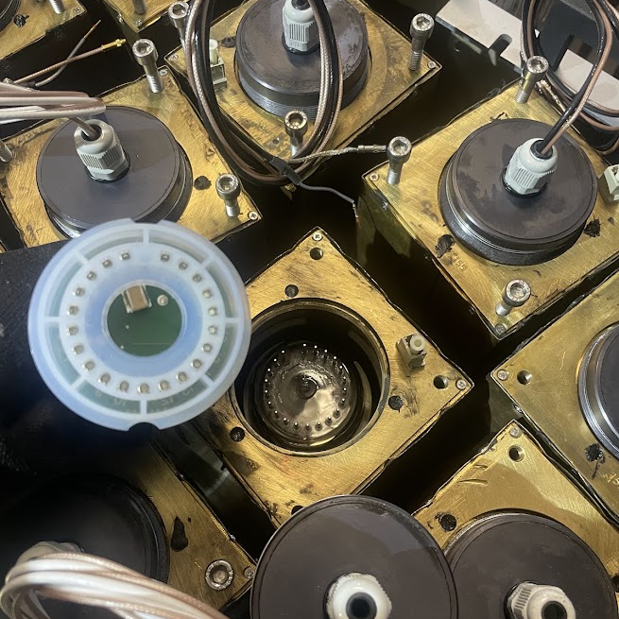
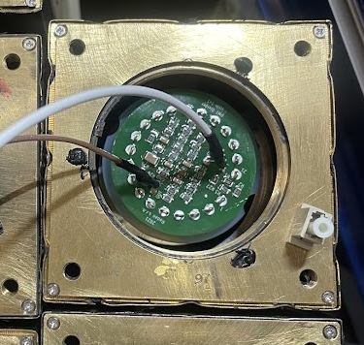
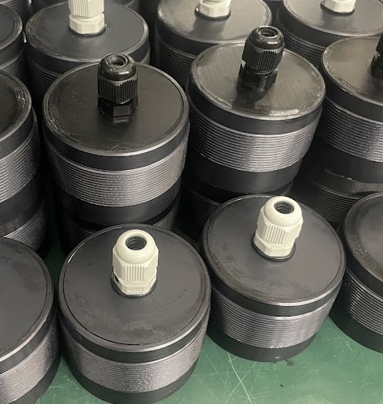
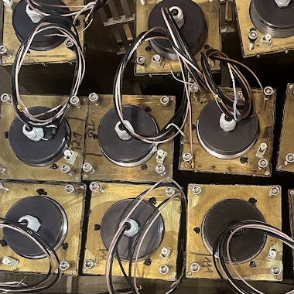
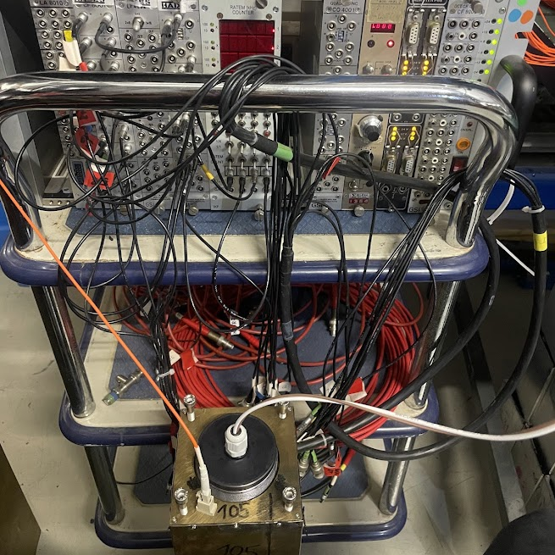
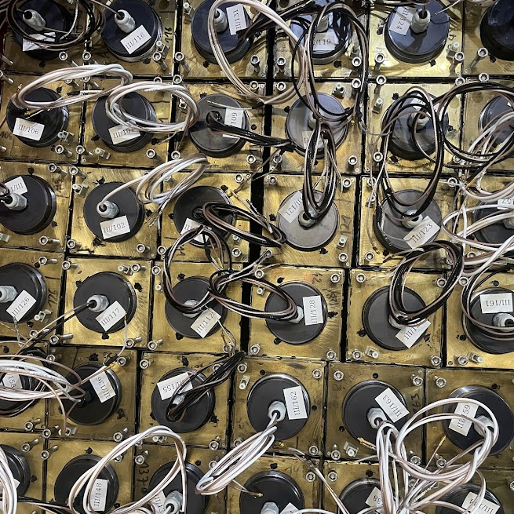
Electromagnetic calorimeter module
Notes:
Why are we working on these modules?
The ECAL is still a relatively young part of HADES, with the first sectors installed in 2017. However, some of the PMTs have already been in operation for several years, and maintaining a stable and well-performing detector is important for the quality of the data.
We therefore replace PMTs, because the performance of the photomultiplier directly affects the quality of the measured signal, and consequently the energy and time resolution of the calorimeter.
Here we can see the individual stages of assembling a module.
First, the lead-glass block is placed inside a brass case, which provides the mechanical support and protects the module.
At the back of the lead-glass block, we attach the photomultiplier tube, or PMT. The PMT needs to be in good optical contact with the lead glass, so we use a conductive paste between the two parts.
Then we attach the divider, or voltage divider, to the PMT.
After that, we close the module with the cover and connect it to the readout electronics.
Finally, we test the PMT using a laser. The laser sends light into the lead glass, and we check whether the PMT responds correctly and produces the expected signal.

Slide 9
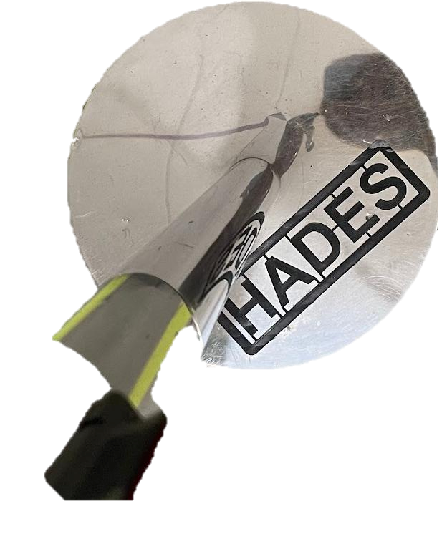
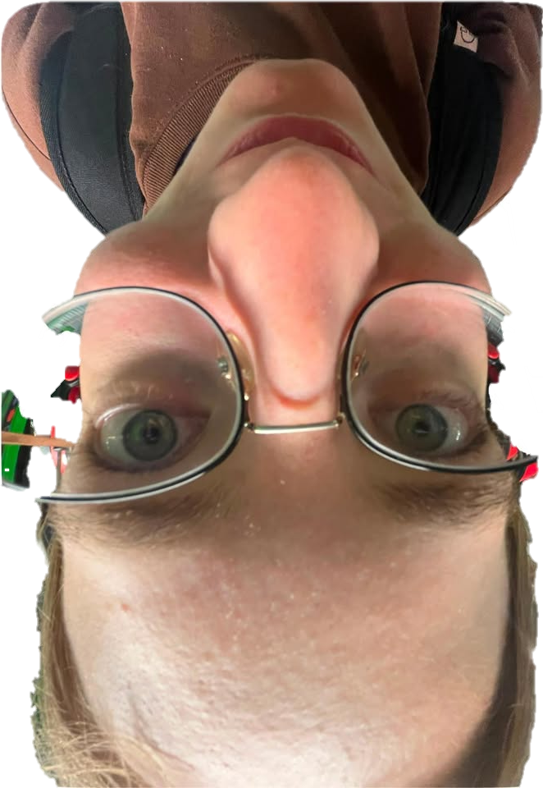

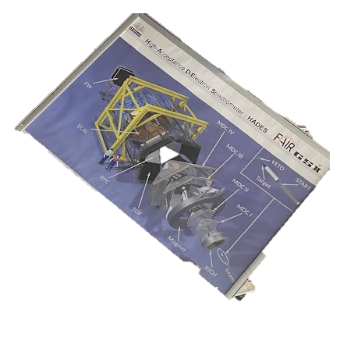
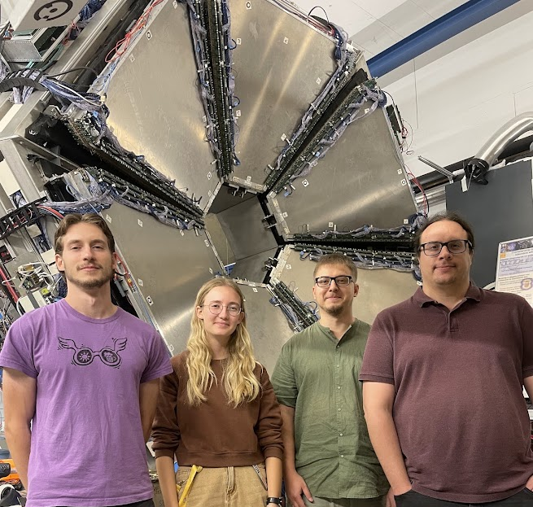
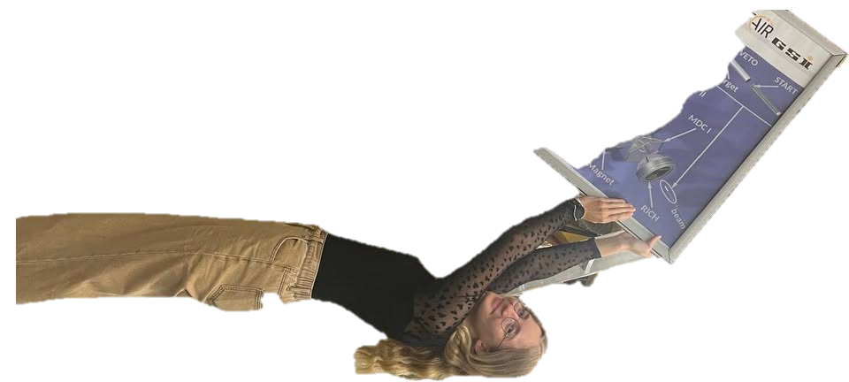
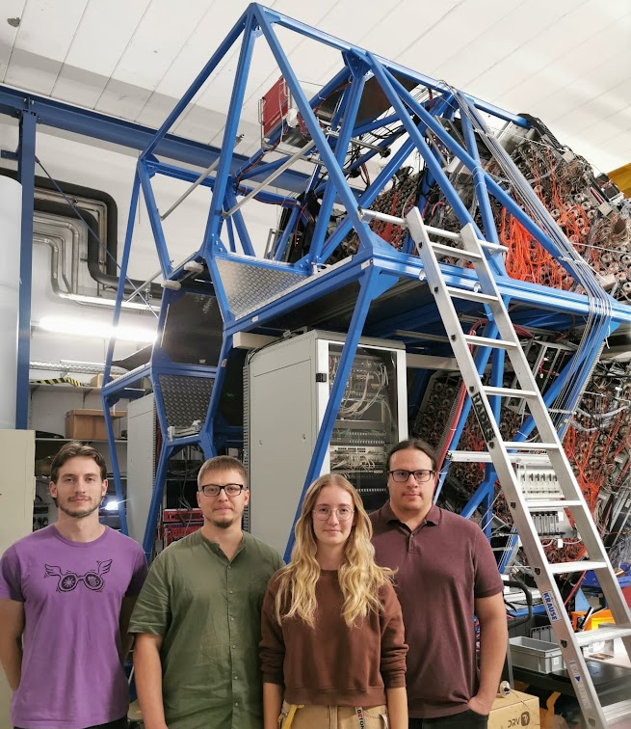

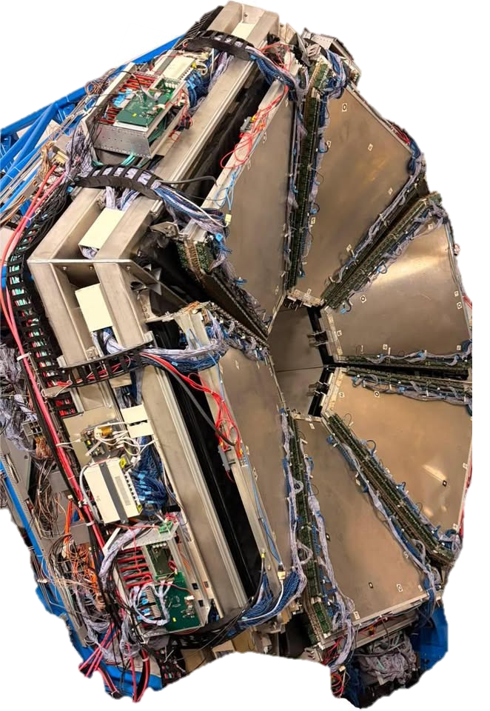
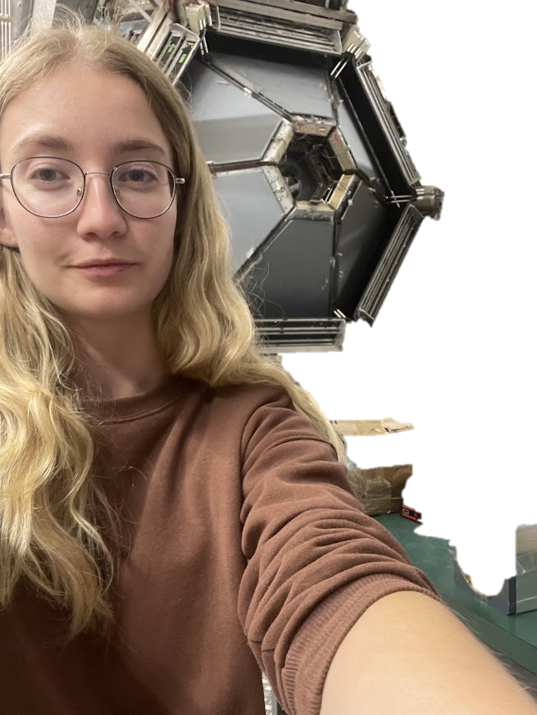

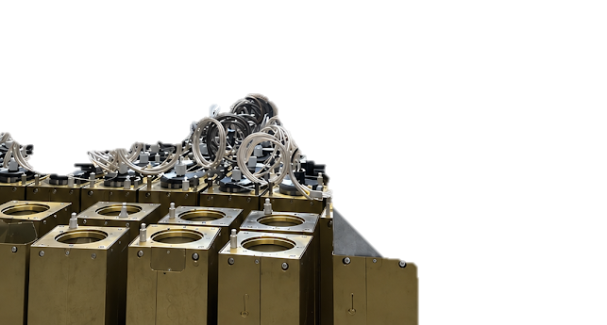
Our l vely team
Notes:
And of course, I was not doing all of this alone. I was part of a great team, and I really want to thank everyone here.
Without these people, I literally wouldn't have done anything — mainly because I wouldn't have been able to lift even one of these modules by myself.

Slide 10
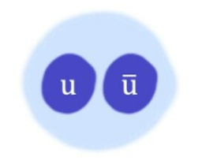

Neutral Pion (π⁰)
neutral meson made of up and down quarks
very short lifetime and decays mainly into two photons
BR(π⁰ → γγ) ≈ 98.8%
produced in large numbers in heavy-ion collisions
not affected by Coulomb repulsion
study of particle production and isospin symmetry
used to validate the detector performance
photon reconstruction using ECAL
π⁰
γγ
ECAL
π⁰ reconstruction
Notes:
Before moving to the analysis, I would like to briefly introduce the neutral pion.
The π⁰ is a neutral meson made of up and down quarks. It has a very short lifetime and decays mainly into two photons, with a branching ratio of about 98.8 percent.
Neutral pions are produced in large numbers in heavy-ion collisions, so they can provide useful information about particle production.
Because they are electrically neutral, they are not affected by Coulomb repulsion.
Measuring $π^{+}$, $π^{−}$, and $π^{0}$allows us to study particle production and isospin symmetry.
Reconstructing the diphoton invariant mass peak of the π0 validates the detector performance, calibration, and photon identification necessary for studying electromagnetic probes in high-density nuclear matter.
For my work, the most important point is the decay into two photons. These photons can be detected in the ECAL, which allows us to reconstruct the π⁰.

Slide 11
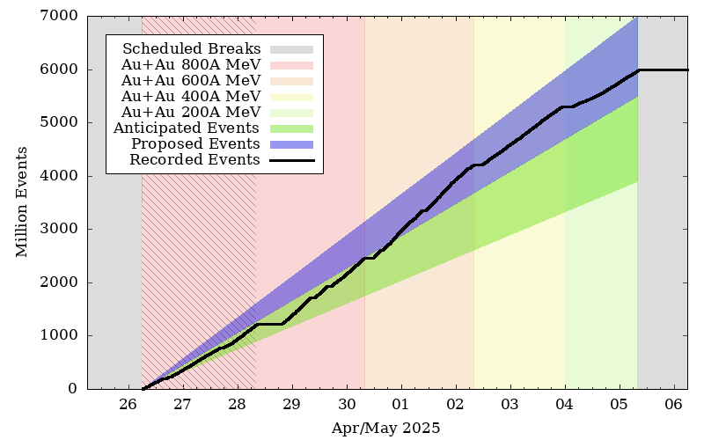
From detector to data: analyses steps
DATA
event selection
photon identification
π⁰ reconstruction
experiment
Au+Au beam energy scan 200 – 800 AMeV
February 2024 (5 days) and April 2025 (9 days)
Analysis based on one day statistics
Notes:
Explain the picture with the energies and recorded data (the black line).
For the data analysis, I worked with two data sets, from February 2024 and April 2025.
I used the same analysis procedure for both data sets.
First, I applied the event and photon selection. Then I studied different energy thresholds and the beta distribution. After selecting the photon candidates, I reconstructed the diphoton invariant mass and fitted the π⁰ peak.
Once the experiment took place and the DATA are collected, each detector needs to be calibrated. To get the data useful for physics analysis we produced DST (Data Summary Tape) files, which contains physical quantity characterizing reconstructed particle. On top of this file every user can perform his own analyses.
We started with the event selection in order to get the high purity (quality) data sample. Overlaping and pile-up events were removed.

Slide 12
Photon identification

Slide 13
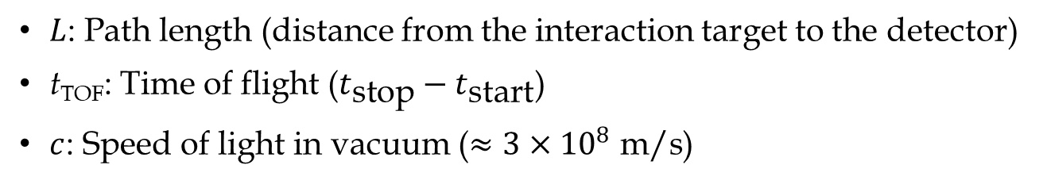

β distribution
→ comparison of the particle candidates
→ effect of energy cuts
→ selection applied consistently to both data sets
$$β=\frac{v}{c}=\frac{L}{c⋅t_{TOF}}$$
$L$: Path length (distance from the interaction target to the detector)
t_{TOF}: Time of flight ($t_{\text{stop}}−t_{\text{start}}$)
$c$: Speed of light in vacuum ($≈3×{10}^{8} \text{m}\text{/}\text{s}$)
Notes:
I looked at the reconstructed particle velocity, expressed as beta, where beta is the particle velocity divided by the speed of light.
The beta distribution helps us distinguish different types of particle candidates. The low-beta region is dominated by slower hadrons, while photons are expected around beta equal to one.

Slide 14
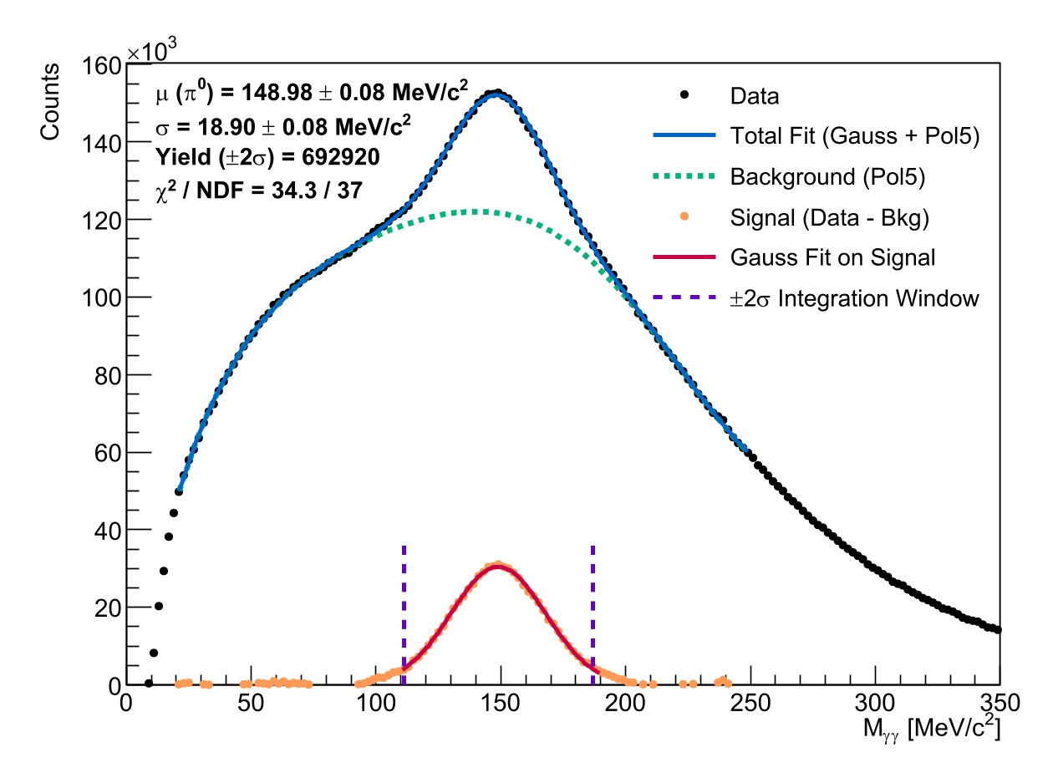
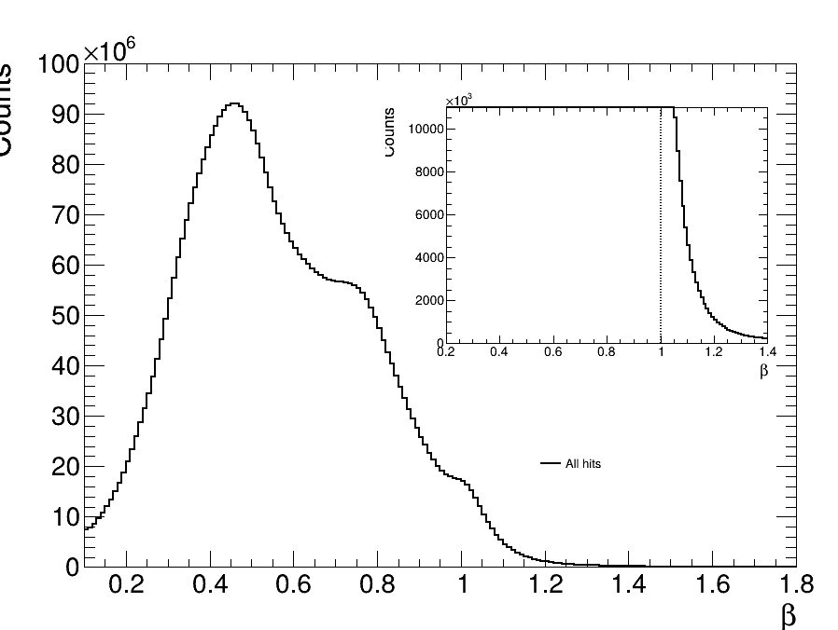
February 2024
Default selection criteria:
Only clusters with one ECAL cell
Removing 10 inner cells
Notes:
I used some basic selection criteria for the ECAL clusters.
I selected clusters containing only one ECAL cell. This gives us a cleaner and simpler photon sample and avoids more complicated shower or cluster topologies at this stage of the analysis.
I also removed the ten inner cells, because these cells have a higher background contribution.
These criteria were then kept consistent during the following steps of the analysis.

Slide 15
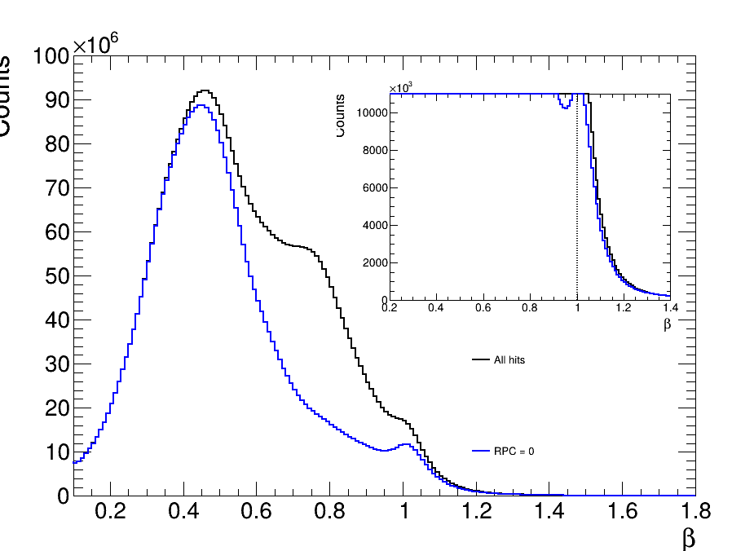
February 2024
Default selection criteria:
Only clusters with one ECAL cell
Removing 10 inner cells
Removal of the charged particles:
RPC veto: NO clusters matched to RPC hit
Notes:
The next step was to remove charged particles from the photon sample.
The first criterion was the RPC veto.
If an ECAL cluster was matched to a hit in the RPC, I rejected it.
This helps remove charged particles that reach the ECAL and produce a signal there.

Slide 16
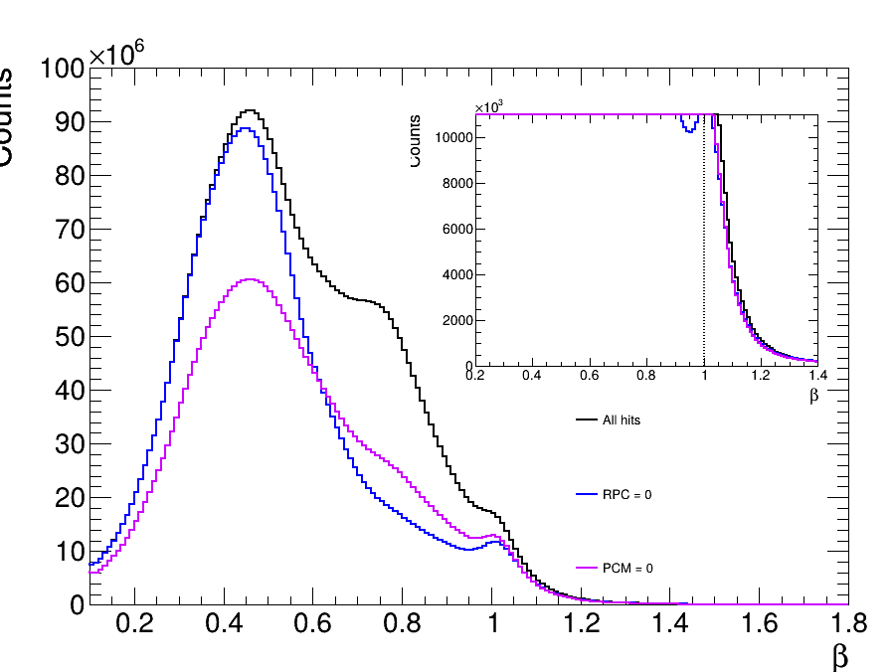
February 2024
Default selection criteria:
Only clusters with one ECAL cell
Removing 10 inner cells
Removal of the charged particles:
RPC veto: NO clusters matched to RPC hit
PCM veto: NO clusters matched to MDC
Notes:
I then added another charged-particle veto, based on the MDC tracking information.
If an ECAL cluster was matched to an extrapolated charged-particle track, it was rejected.

Slide 17
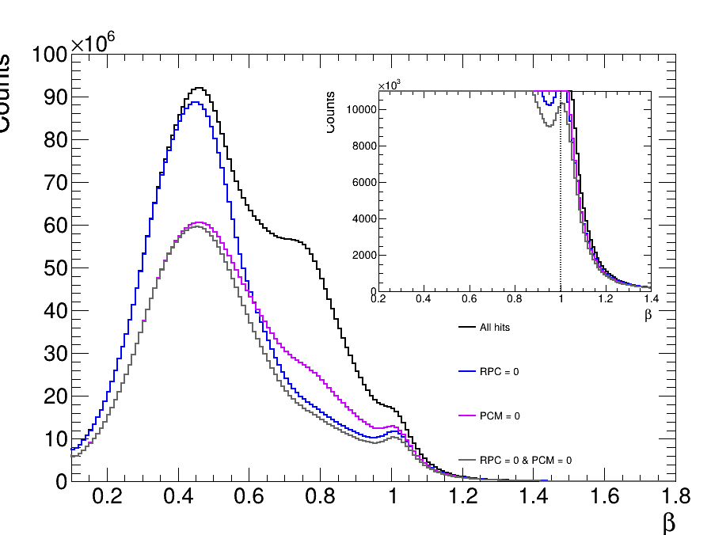
February 2024
Default selection criteria:
Only clusters with one ECAL cell
Removing 10 inner cells
Removal of the charged particles:
RPC veto: NO clusters matched to RPC hit
PCM veto: NO clusters matched to MDC
Notes:
Together, the RPC and PCM vetoes help reduce the contribution from charged particles.

Slide 18
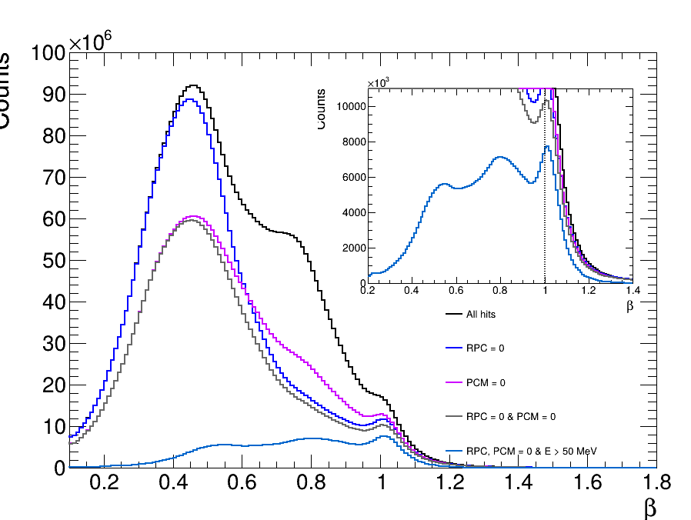
February 2024
Default selection criteria:
Only clusters with one ECAL cell
Removing 10 inner cells
Removal of the charged particles:
RPC veto: NO clusters matched to RPC hit
PCM veto: NO clusters matched to MDC
Energy threshold: suppresses low-velocity background → highlights the photon peak
  Eγ > 50 MeV
Notes:
After applying the charged-particle vetoes, I started testing different energy thresholds.
Here the threshold is 50 MeV.
The idea is to gradually increase the energy requirement and see how the beta distribution changes.

Slide 19
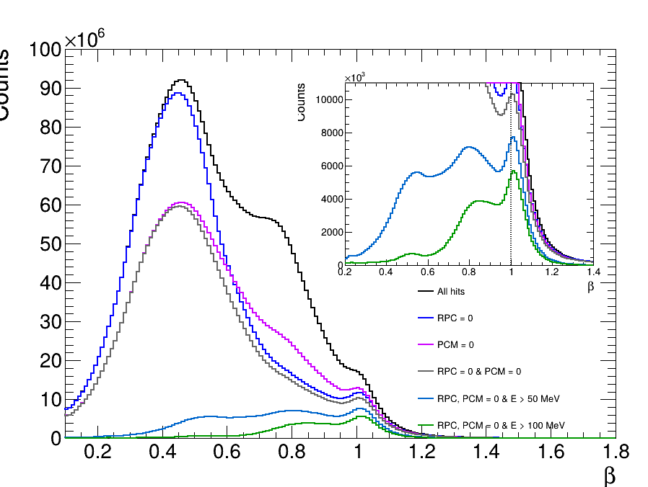
February 2024
Default selection criteria:
Only clusters with one ECAL cell
Removing 10 inner cells
Removal of the charged particles:
RPC veto: NO clusters matched to RPC hit
PCM veto: NO clusters matched to MDC
Energy threshold: suppresses low-velocity background → highlights the photon peak
  Eγ > 50 MeV
  Eγ > 100 MeV
Notes:
Here I increased the energy threshold to 100 MeV.
We can see that increasing the threshold starts to suppress more of the low-velocity background.
At the same time, we lose some statistics, so we have to find a reasonable compromise.

Slide 20
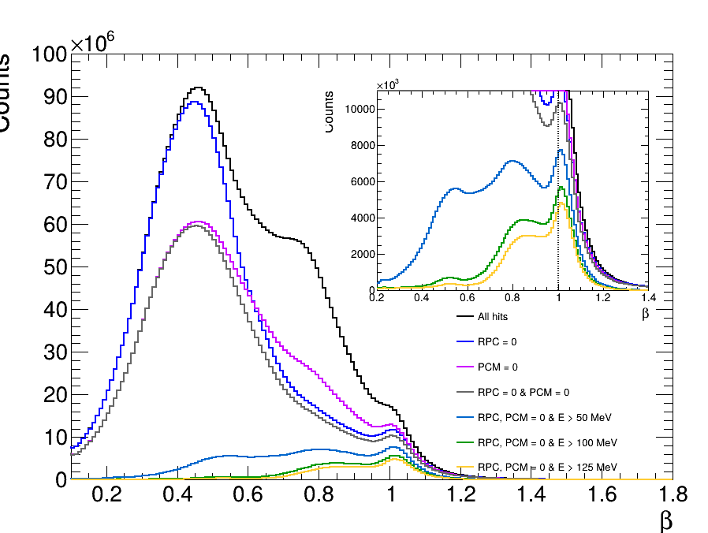
February 2024
Default selection criteria:
Only clusters with one ECAL cell
Removing 10 inner cells
Removal of the charged particles:
RPC veto: NO clusters matched to RPC hit
PCM veto: NO clusters matched to MDC
Energy threshold: suppresses low-velocity background → highlights the photon peak
  Eγ > 50 MeV
  Eγ > 100 MeV
  Eγ > 125 MeV
Notes:
The next threshold is 125 MeV.
With this selection, the photon-like peak around beta equal to one becomes more visible, while a significant part of the low-beta background is suppressed.
This threshold was therefore used in the final photon selection.

Slide 21
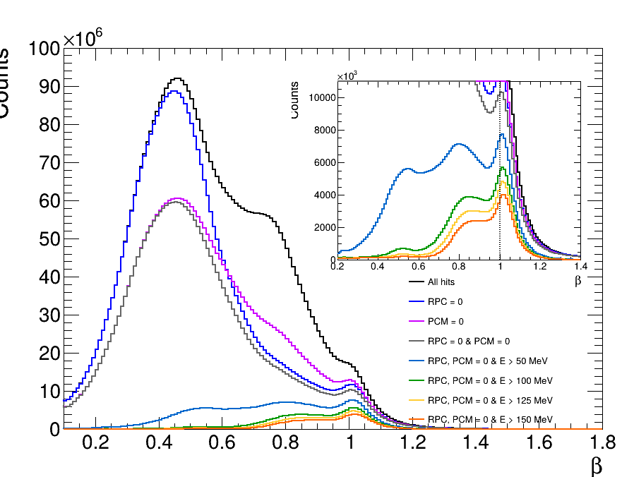
February 2024
Default selection criteria:
Only clusters with one ECAL cell
Removing 10 inner cells
Removal of the charged particles:
RPC veto: NO clusters matched to RPC hit
PCM veto: NO clusters matched to MDC
Energy threshold: suppresses low-velocity background → highlights the photon peak
  Eγ > 50 MeV
  Eγ > 100 MeV
  Eγ > 125 MeV
  Eγ > 150 MeV
Notes:
Here the threshold is increased further to 150 MeV.
This removes even more low-energy background, but it also reduces the number of photon candidates.
So, increasing the threshold is not automatically better, because we also lose statistics.

Slide 22
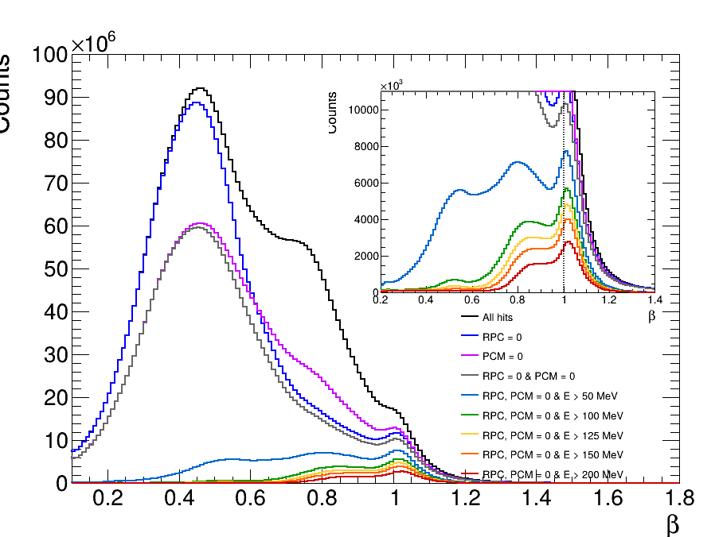
February 2024
Default selection criteria:
Only clusters with one ECAL cell
Removing 10 inner cells
Removal of the charged particles:
RPC veto: NO clusters matched to RPC hit
PCM veto: NO clusters matched to MDC
Energy threshold: suppresses low-velocity background → highlights the photon peak
  Eγ > 50 MeV
  Eγ > 100 MeV
  Eγ > 125 MeV
  Eγ > 150 MeV
  Eγ > 200 MeV
Notes:
Finally, I tested a threshold of 200 MeV.
At this point, the background is strongly reduced, but the number of remaining candidates is also much smaller.
Based on this study, I chose 125 MeV as the energy threshold for the final photon selection.

Slide 23
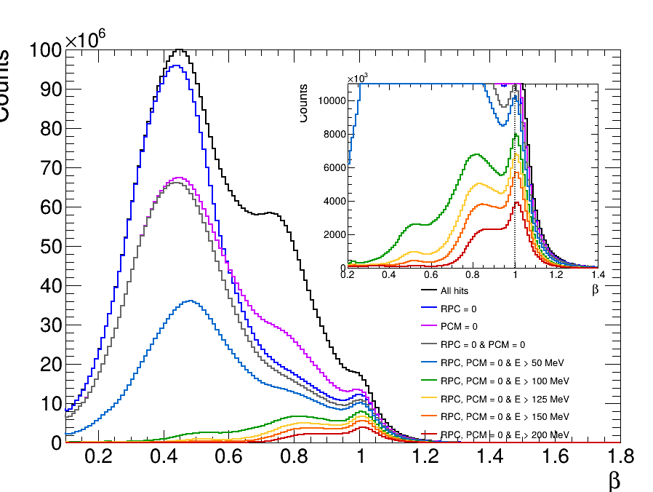
February 2024
April 2025
Notes:
Up to this point, I have shown the selection using the February 2024 data.
I then applied the same procedure to the April 2025 data set.
Using the same selection criteria is important because it allows us to compare the two data sets in a consistent way.

Slide 24
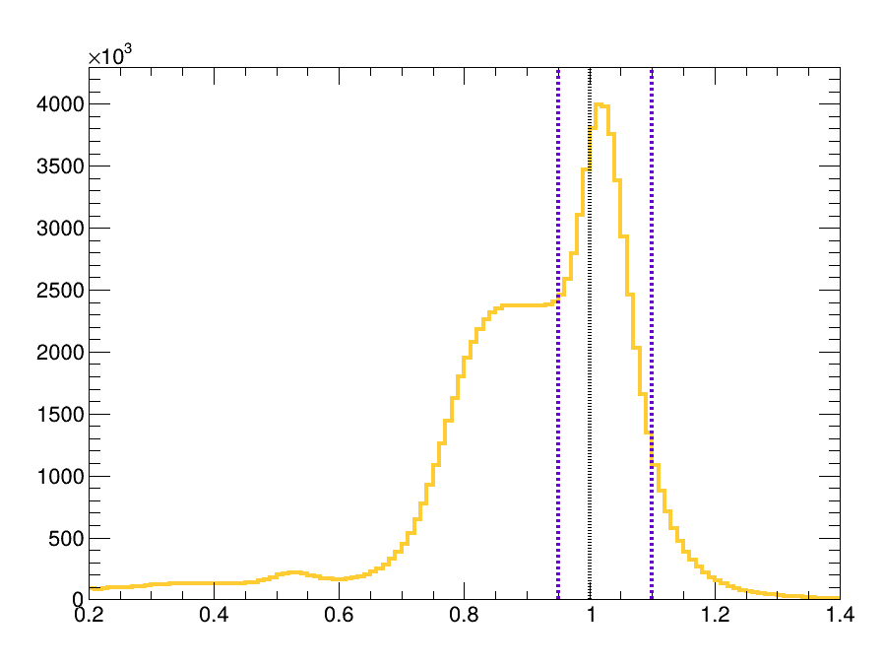
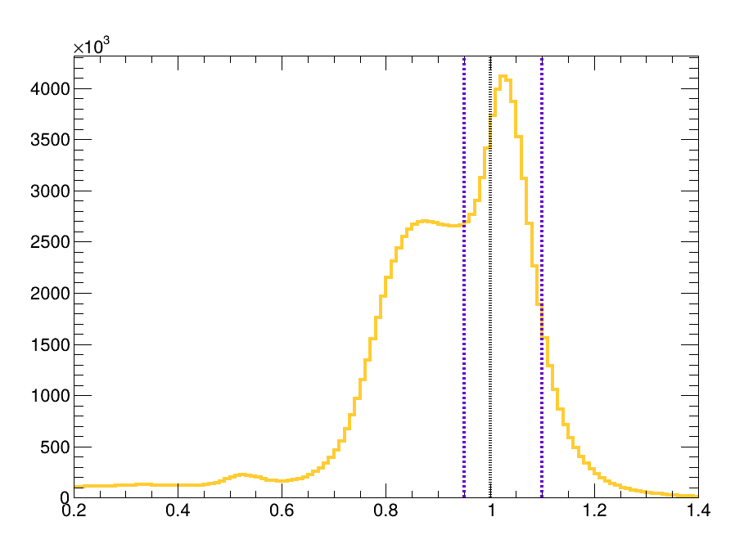
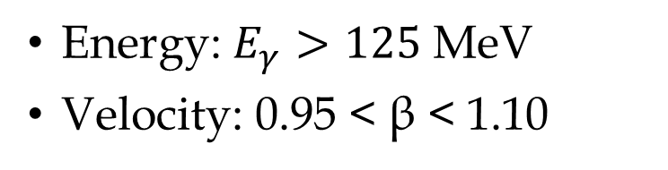
Photon selection
February 2024
April 2025
RPC veto: RPC = 0
Track-match veto: PCM = 0
Energy: $E_{γ}>125$ MeV
Velocity: 0.95 < β < 1.10
Notes:
So, after all these steps, we arrive at the final photon selection.
First, there must be no matching RPC hit, so RPC has to be zero.
Second, there must be no matching charged-particle track, so PCM has to be zero.
The photon energy has to be above 125 MeV.
And finally, we require the velocity to be between 0.95 and 1.10 in beta.
These criteria give us our final sample of photon candidates.
You can see the peak is slighly shifted to the right. We are investigating on ECAL calibration.

Slide 25

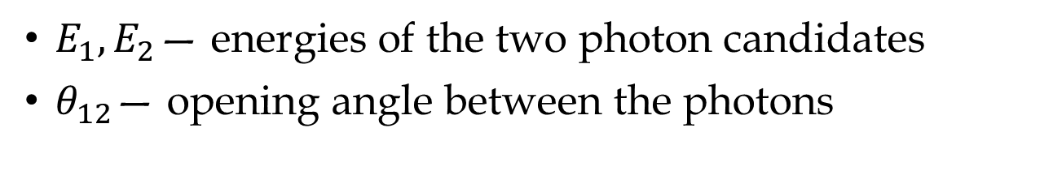
Invariant mass
$$M_{γγ}=\sqrt{2∙E_{1}∙E_{2}∙\left(1−\cos{θ_{12}}\right)}$$
$E_{1},E_{2}$— energies of the two photon candidates
$θ_{12}$— opening angle between the photons
Notes:
After selecting the photon candidates, we can use them to reconstruct neutral pions.
The basic idea is to take two photons and calculate their invariant mass.
The invariant mass depends on the energies of the two photons and on the opening angle between them.

Slide 26
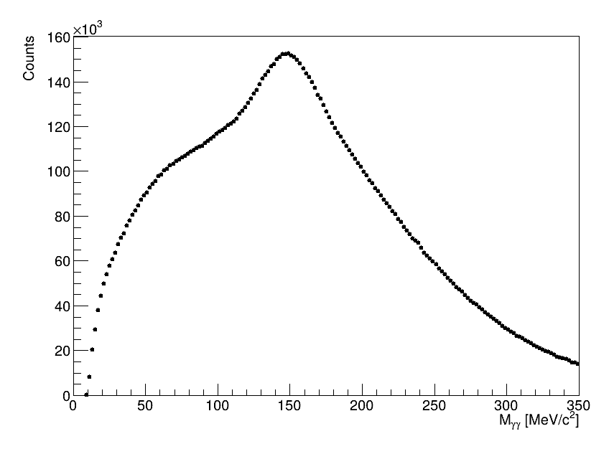
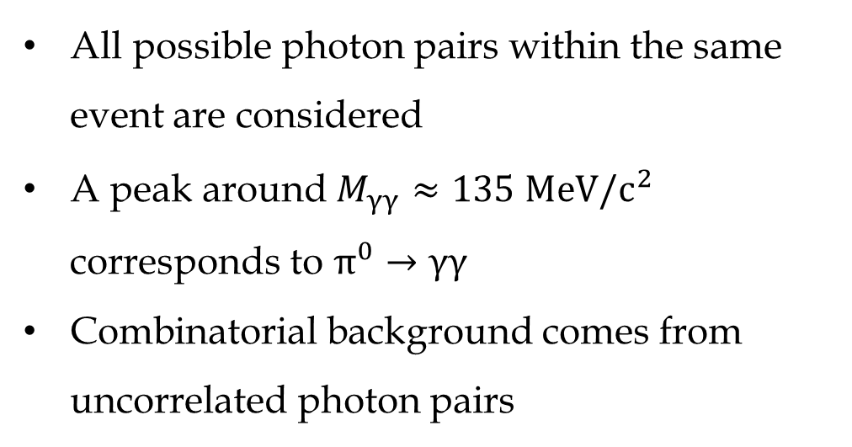
February 2024
All possible photon pairs within the same event are considered
A peak around $M_{γγ}≈135 MeV/c^{2}$ corresponds to $π^{0}→γγ$
Combinatorial background comes from uncorrelated photon pairs
Notes:
For each event, I consider all possible photon pairs, because we do not know in advance which two photons came from the same π⁰ decay.
The correct photon pairs produce a peak around the π⁰ mass.
However, there are also many combinations where the photons are not related to the same pion.
These uncorrelated combinations form the combinatorial background.

Slide 27
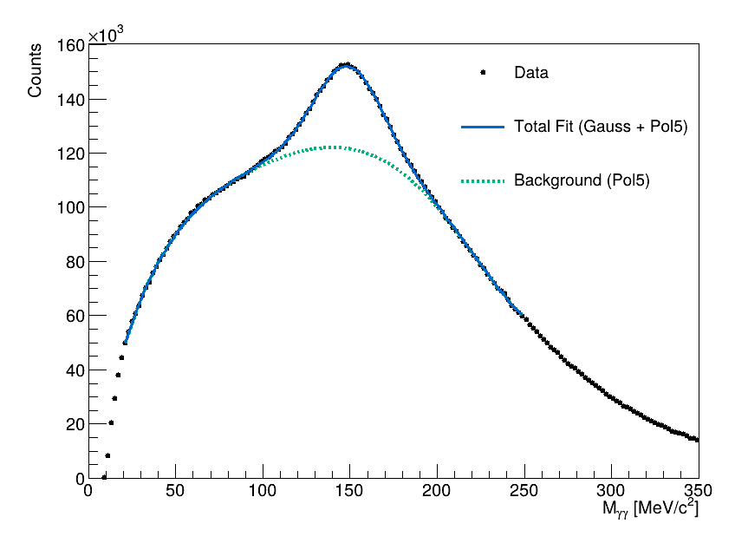
February 2024
Total fit = Gaussian + 5th-order polynomial fit
  range: 20–250 MeV/c²
Combinatorial background
  polynomial function
  mixed-event method
Notes:
The experimental data are shown as the black points. I fit the distribution with two components: a Gaussian function describing the π⁰ signal, and a fifth-order polynomial describing the smooth combinatorial background.
The blue curve is therefore the total fit, which is the sum of the Gaussian signal and the polynomial background.
The green curve shows only the polynomial component of this fit, so it represents our estimate of the combinatorial background.
Another possible improvement would be to use the event-mixing method for a better estimation of the combinatorial background. Instead of combining photon candidates from the same event, we would combine photons from different, but similar, events. Since photons from different events cannot originate from the same π⁰, this gives us an estimate of the combinatorial background without the real π⁰ signal. We could then use this mixed-event distribution to subtract the background from the experimental invariant-mass spectrum.

Slide 28
February 2024
  Reconstructed mass peak is shifted
  Necessity of applying energy loss/ECAL calibration corrections
  Signal extraction
Notes:
“So now I subtract the estimated background bin by bin from the experimental distribution.”
“This leaves us with a distribution that is much closer to the actual π⁰ signal.”
“The remaining peak can then be fitted with a Gaussian, from which we can determine its position and width.”
However, we can already see that the reconstructed mass is shifted.

Slide 29
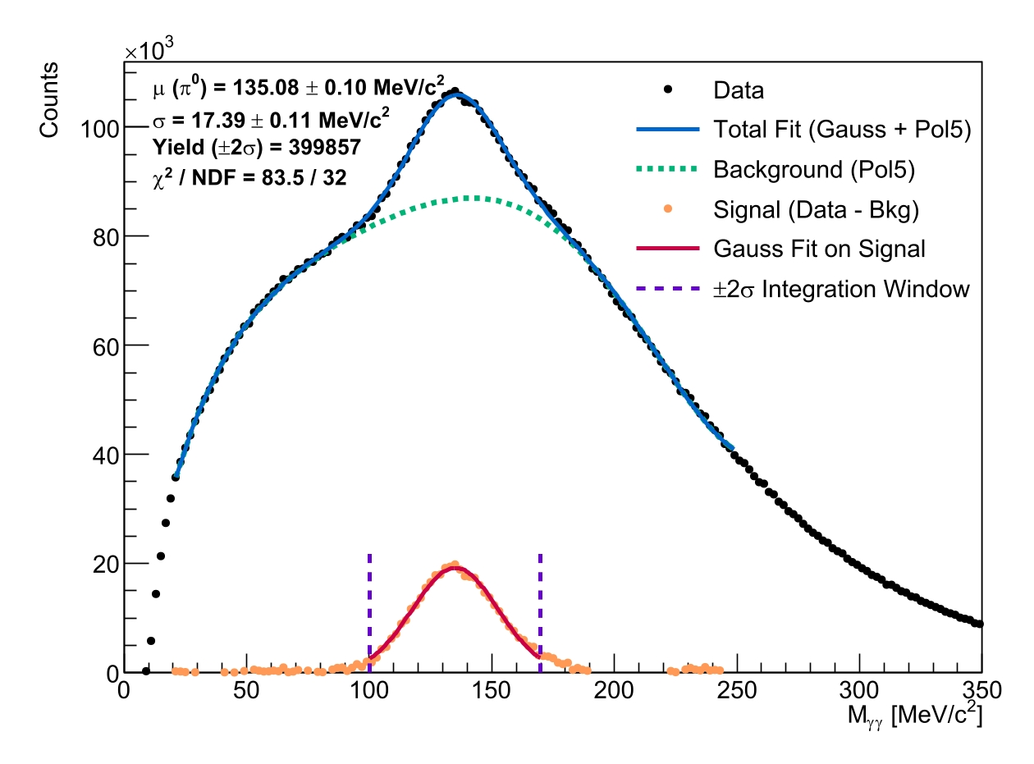
February 2024
no energy loss correction
with energy loss correction
Notes:
Now I can show the final results for the February 2024 data.
The left plot shows the result without the energy-loss correction, where the reconstructed pion mass is shifted away from the expected value.
After applying the energy correction, shown on the right, the reconstructed mass moves much closer to the expected neutral pion mass of about 135 MeV per c squared.
The fitted mass after the correction is 135.08 plus or minus 0.10 MeV per c squared.
The ECAL calibration is based on fast leptons, where the momentum is related to the measured energy. However, these particles lose some energy before reaching the ECAL, for example in the RPC material. This energy loss therefore needs to be corrected, based on simulations.

Slide 30
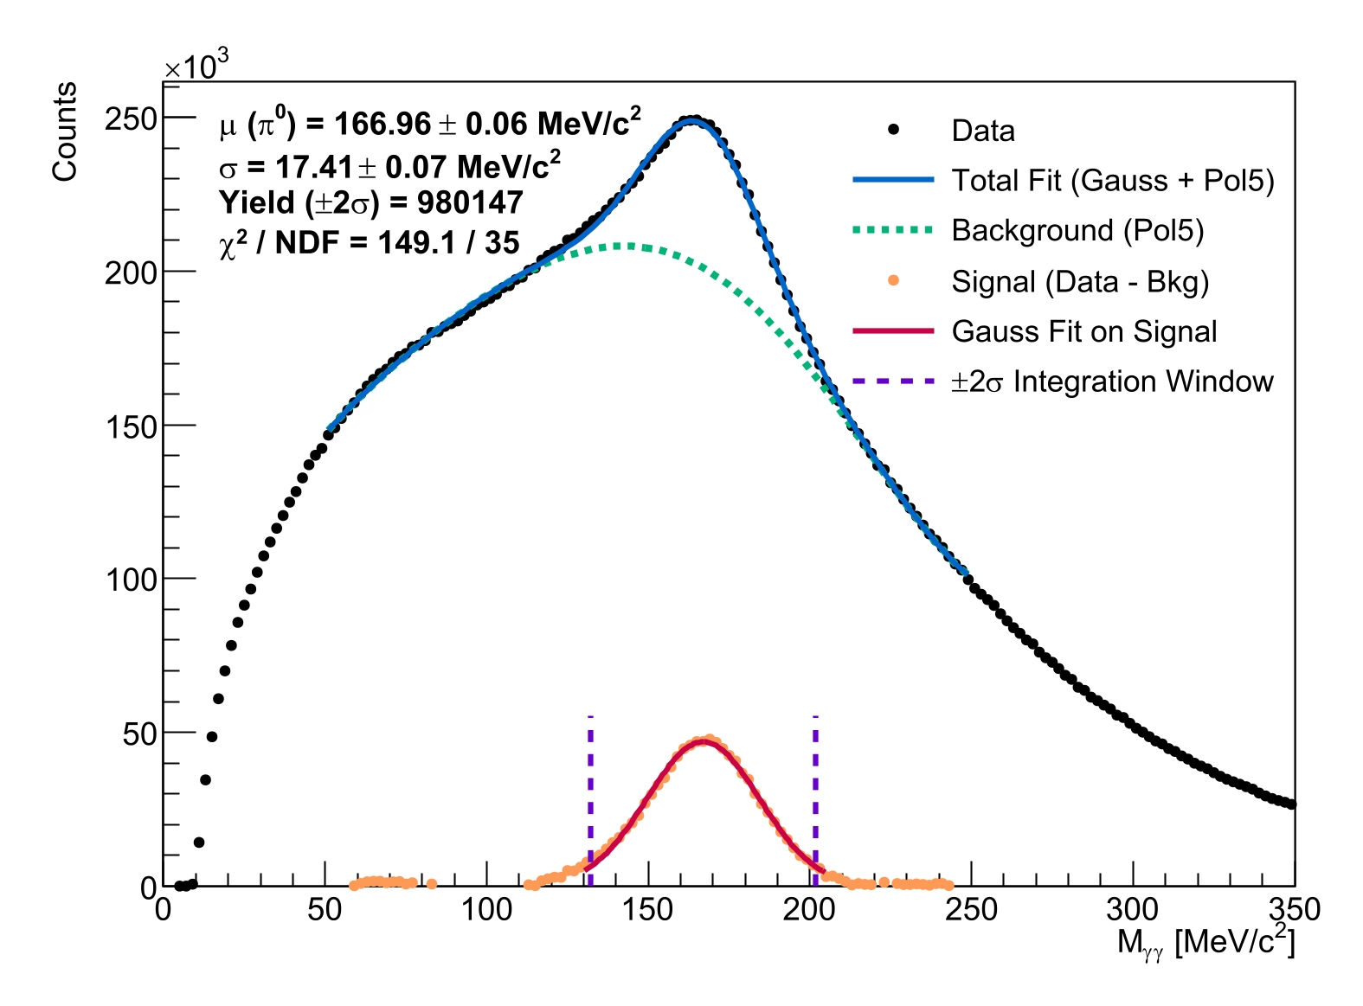
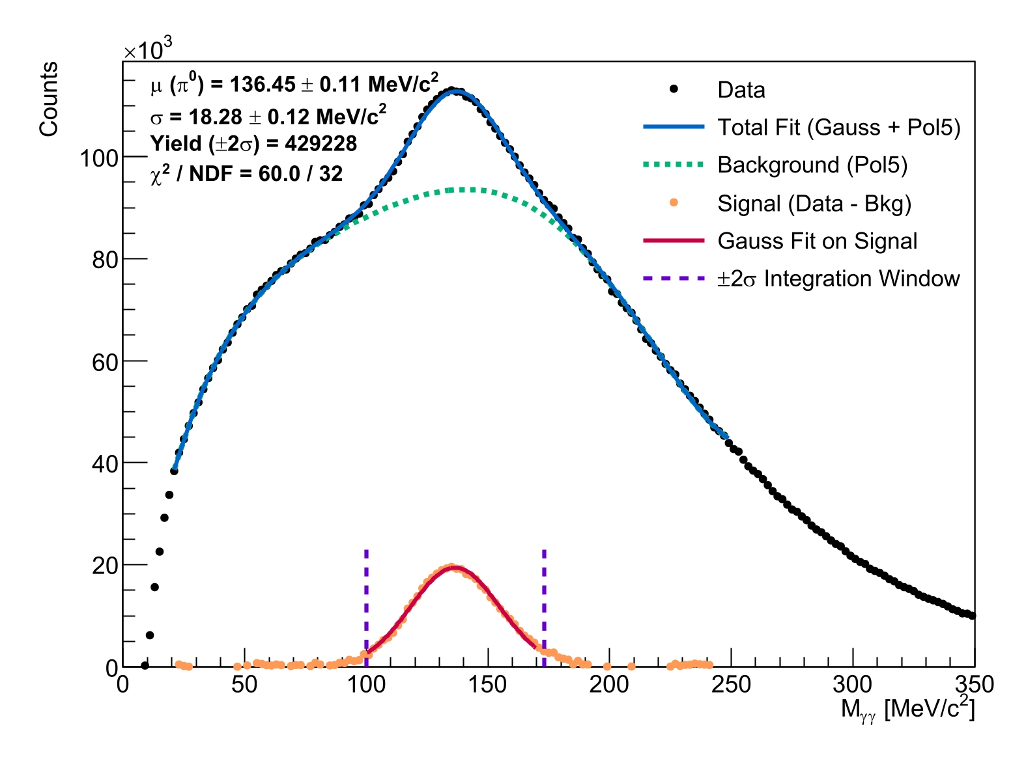
April 2025
no energy loss correction
with energy loss correction
Notes:
Here we have the corresponding results for the April 2025 data.
Again, without the energy correction, the reconstructed mass is shifted.
After applying the correction, the peak moves close to the expected pion mass.
For this data set, the reconstructed mass is 136.45 plus or minus 0.11 MeV per c squared.
So, both data sets give a reconstructed mass close to the expected value after the correction.

Slide 31
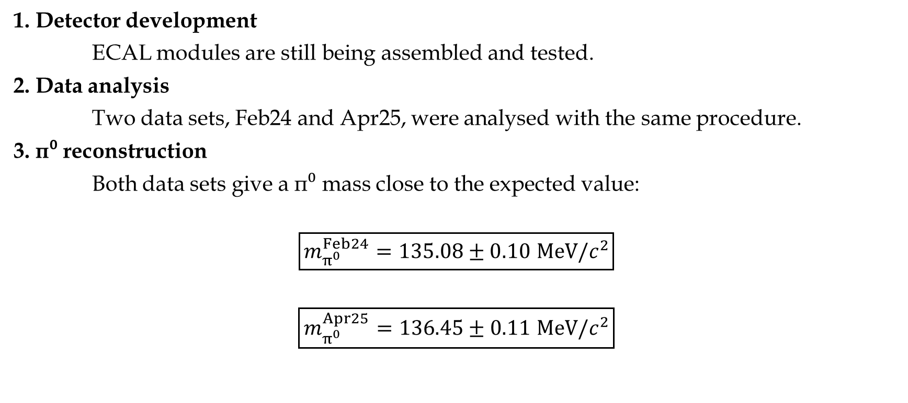
Summary
1. Detector development
ECAL modules are still being assembled and tested.
2. Data analysis
Two data sets, Feb24 and Apr25, were analysed with the same procedure.
3. π⁰ reconstruction
Both data sets give a π⁰ mass close to the expected value:
$$\boxed{m_{π^{0}}^{Feb24}=135.08±0.10 MeV/c^{2}}$$
$$\boxed{m_{π^{0}}^{Apr25}=136.45±0.1\text{1} MeV/c^{2}}$$
Notes:
So, to summarize my work, there were three main parts.
First, I participated in the development of the ECAL by assembling and testing individual modules.
Second, I analysed two data sets from February 2024 and April 2025 using the same reconstruction procedure.
And finally, I reconstructed the neutral pion from its decay into two photons.
After applying the energy correction, both data sets give a pion mass close to the expected value of about 135 MeV per c squared.

Slide 32
My future
Ongoing optimization of the ECAL energy calibration
ECAL assembly, detector testing, and PMT readout integration — in progress
Extension of the neutral-pion analysis for an upcoming Bachelor's thesis
  Better background estimation using the event-mixing method
  Multidimensional analysis of π⁰
Notes:
“There are still several things that could be improved in the future.”
“The first one is the ECAL energy calibration, which is still ongoing.”
“The detector work will also continue with ECAL assembly, testing, and PMT readout integration.”
“I would also like to continue this neutral-pion analysis as part of my Bachelor's thesis.”
“One possible improvement would be to use the event-mixing method for a better estimation of the combinatorial background.”
“And finally, I would like to extend the π⁰ analysis to a multidimensional study.”
“Instead of looking only at the inclusive π⁰ invariant-mass spectrum, we could study the pion production as a function of several kinematic variables.”
“This would give us more detailed information about the π⁰ production and the detector performance.”

Slide 33
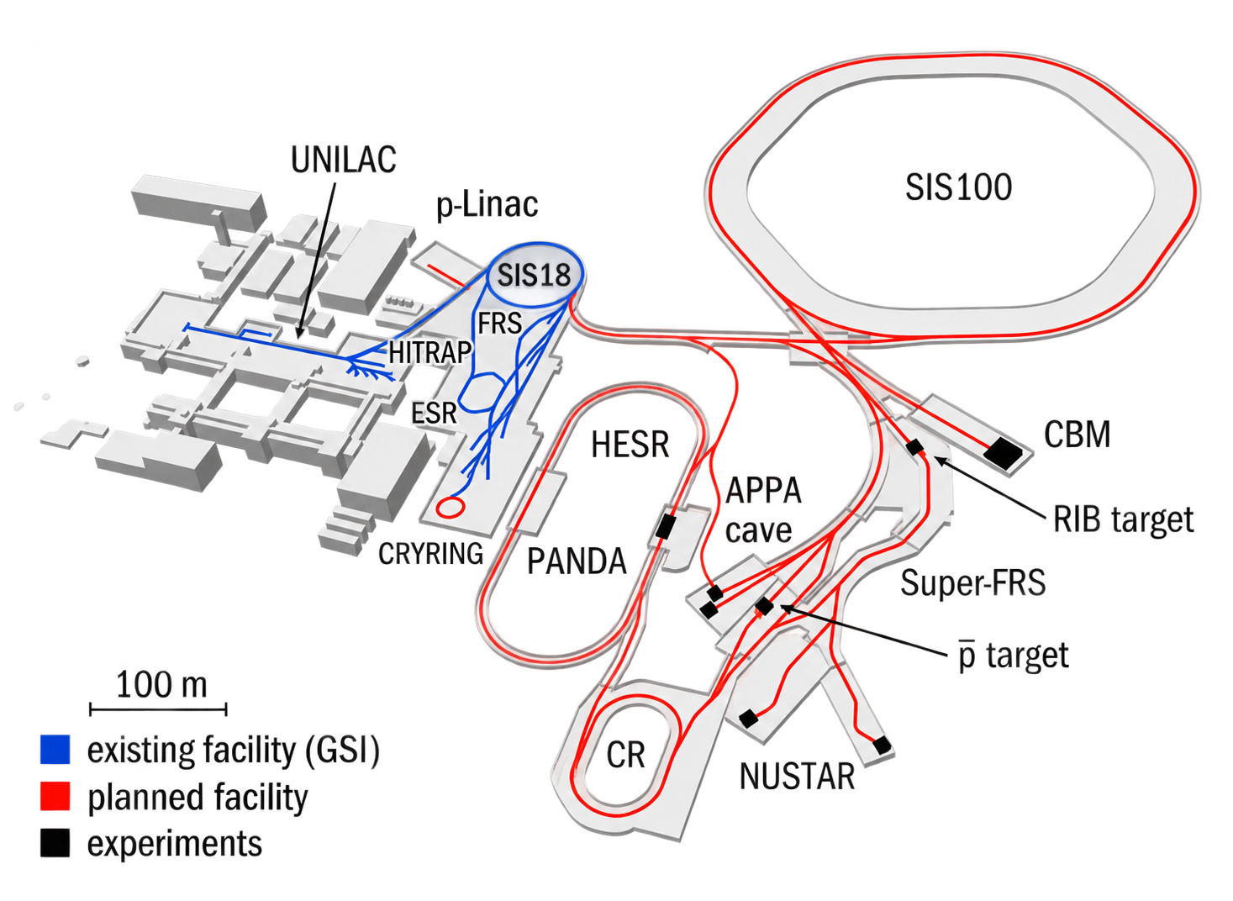

HADES future
/HADES
from GSI to FAIR
(luckily, not to Venice)
Notes:
“HADES will move from GSI to FAIR, to the new CBM experimental hall.”
“So, at the beginning I said that navigating GSI can sometimes feel a little bit like navigating Venice.”
“Now HADES is moving — but luckily, not to Venice, only to FAIR.”

Slide 34
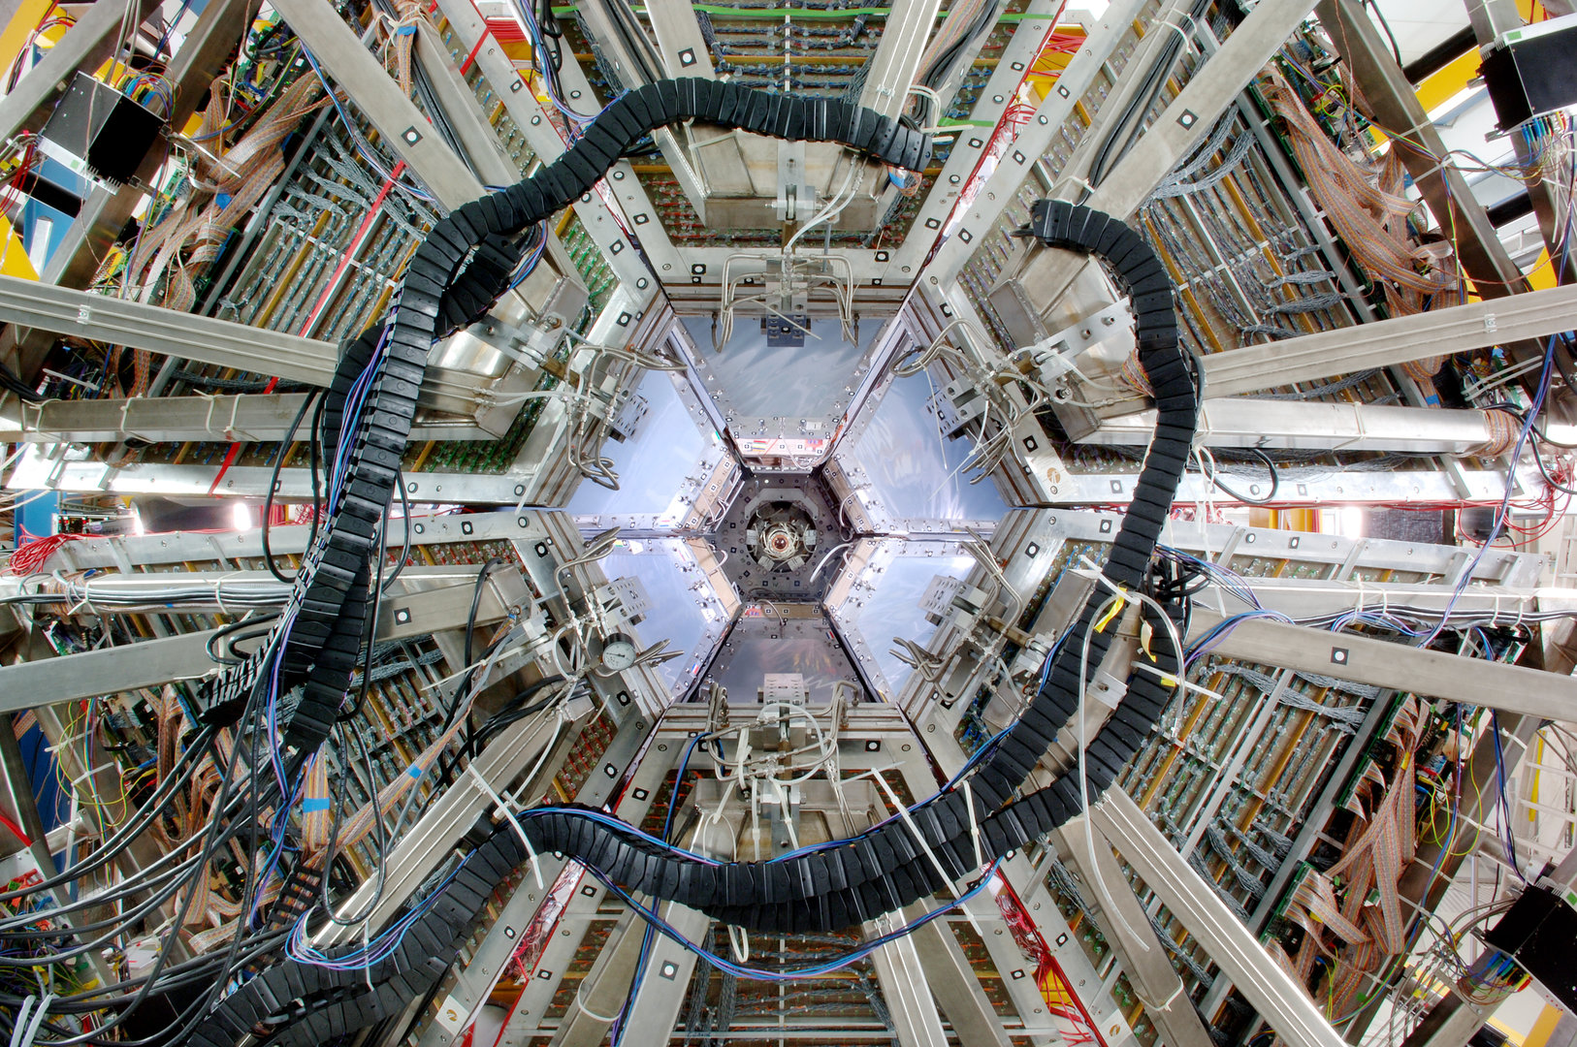
Thank you for your attention!

