Slide 1
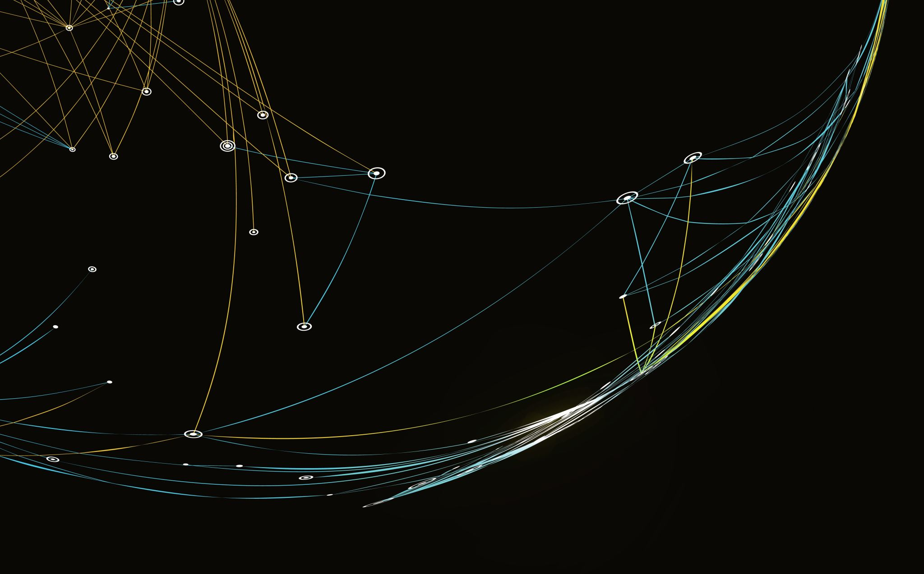

Charm predictions for p+Au (at) CBM
By Harit Tunkim
Tutor: Jan Steinheimer-Froschauer
Department of physics and material, Faculty of science, Chiang Mai University

Slide 2



1
Introduction
$$1.27 GeV/c^{2}$$
Charm quark mass ~ 1.4 Proton mass
Need high energies and momenta density
Created early in the collision event
Interact with nuclear matters
Used for studying very hot & dense matter
$$2/3$$
C
$$1/3$$
Charm
Au
Au
Dense matter
C
Collision
beam
target
Notes:
I will begin by introducing you to a charm quark. Charm quark is one of the elementary particles in the standard model. It interacts with other quarks via strong interaction.

Slide 3
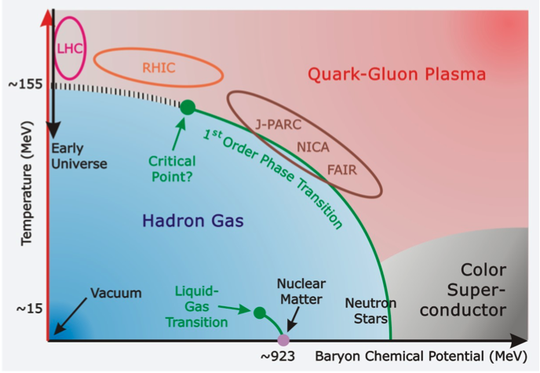
2
Previous Studies
Charm production at LHC & RHIC
Ultrarelativistic energy
Very hot temperature
Model early universe
Lower Energies (Still High)
Very high net baryon densities
Strongly interacting system
Good for studying QCD interaction
Figure 1: QCD phase diagram
Ref: A. Steidl, CRC-TR-211
Notes:
In previous studies, charm production is typically done at the ultrarelativistic energy, where its model the very early universe.

Slide 4
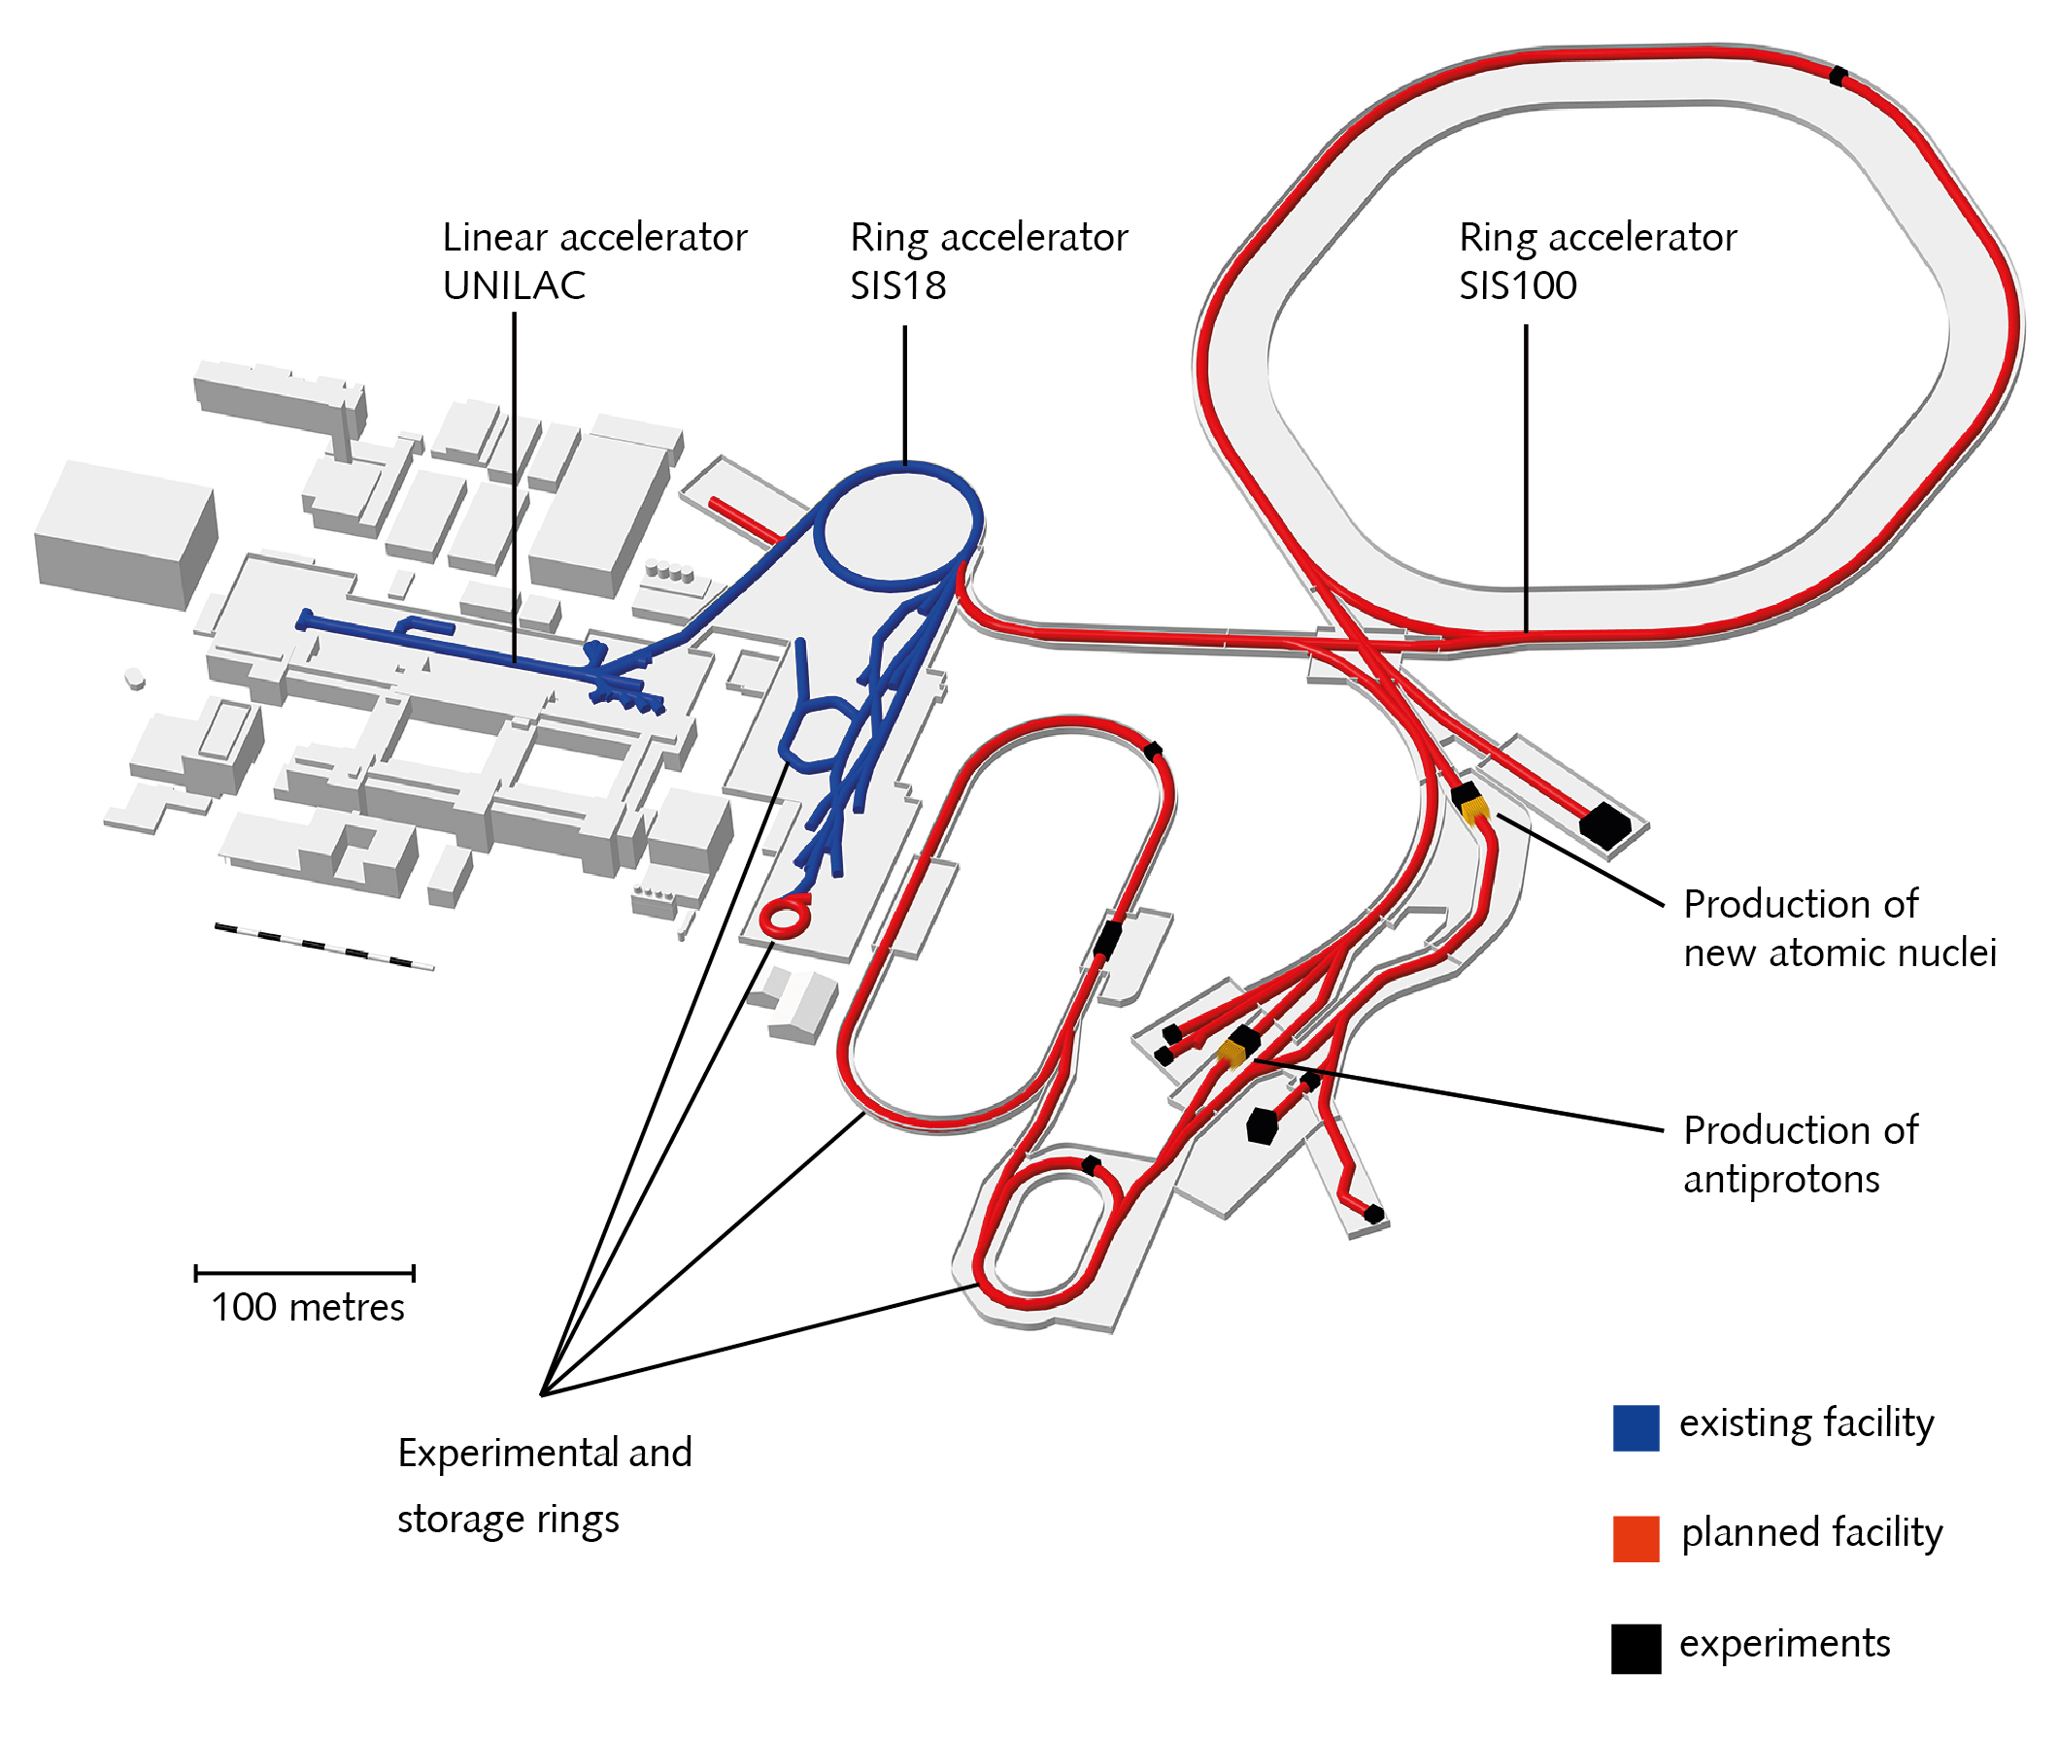
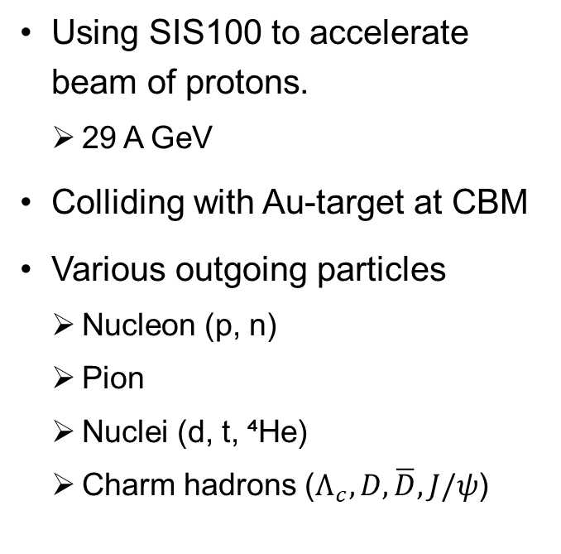
3
CBM Experiment
Using SIS100 to accelerate beam of protons.
  29 A GeV
Colliding with Au-target at CBM
Various outgoing particles
  Nucleon (p, n)
  Pion
  Nuclei (d, t, ⁴He)
  Charm hadrons ($Λ_{c},D,\overline{D},J/ψ$)
CBM
Figure 2: GSI/FAIR facility
Source: GSI/FAIR, 2026
Notes:
To study at this energy scale, The experiment is proposed to be done in the CBM experiment at FAIR facility.

Slide 5
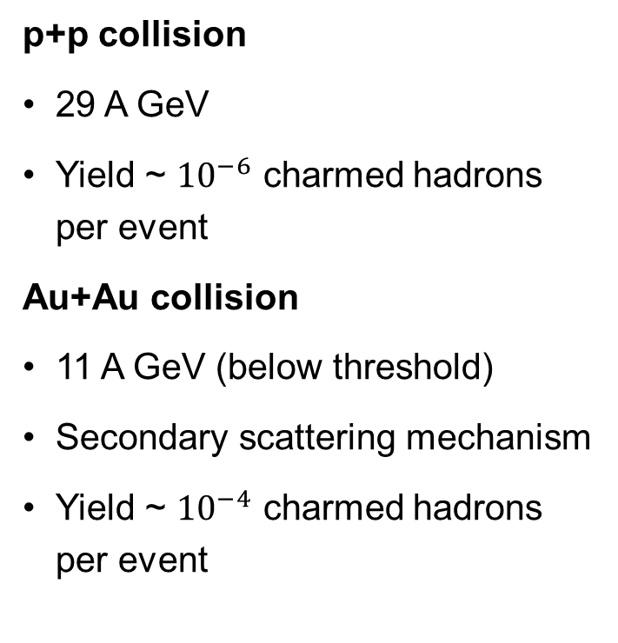
4
Previous Simulations
p+p collision
29 A GeV
Yield ~ ${10}^{−6}$ charmed hadrons per event
Au+Au collision
11 A GeV (below threshold)
Secondary scattering mechanism
Yield ~ ${10}^{−4}$ charmed hadrons per event
29 A GeV
target
p
p
Au
Au
target
11 A GeV
Au
target
29 A GeV
p
p+Au?
Ref: J. Steinheimer, A. Botvina, and M. Bleicher, 2017
Notes:
There are previous predictions on p+p and gold+gold collision.

Slide 6
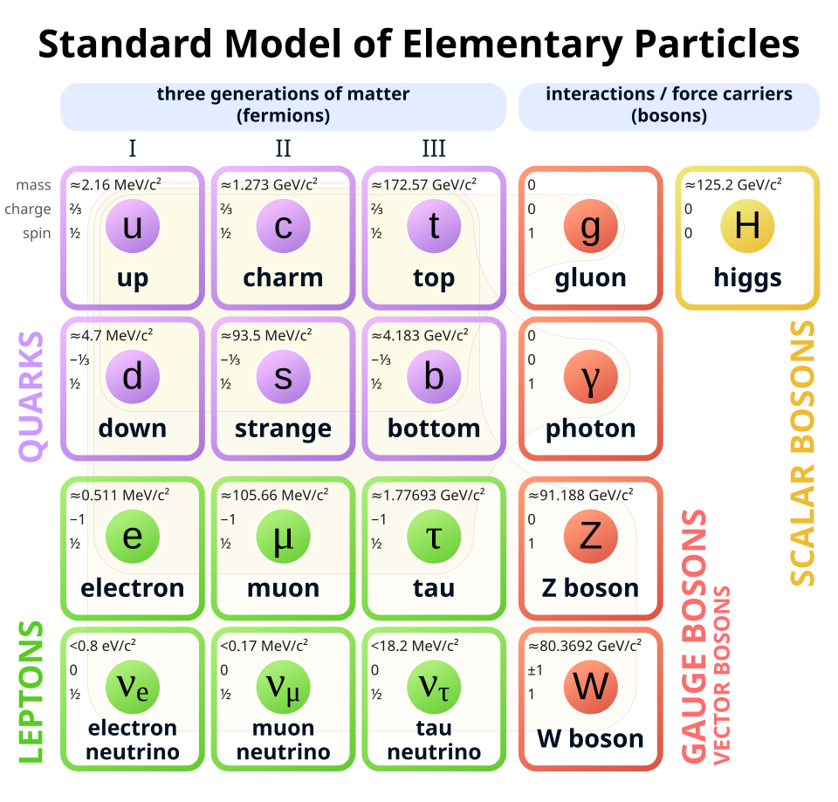
5
Theory
Quantum Chromodynamics (QCD)
Studying the strong interaction between quarks
Mediating by gluons
Gluon self-interaction
Ultra high energy
  Perturbative QCD
Lower energy
  Perturbative method breakdown
Figure 3: A table of standard model
Source: Wikipedia, 2024
Notes:
Moving on to the theory behind it, physics behind this is governed by quantum chromodynamics (QCD). It is the study of the strong interactions between quarks.

Slide 7
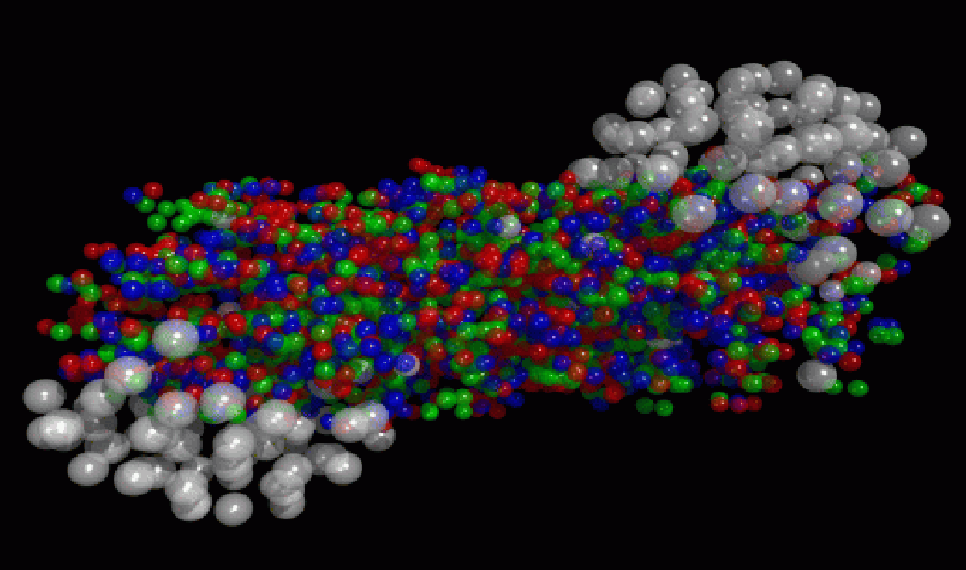
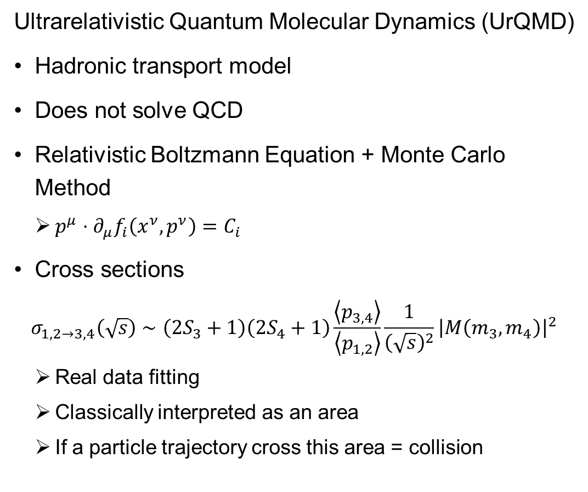
6
UrQMD
Ultrarelativistic Quantum Molecular Dynamics (UrQMD)
Hadronic transport model
Does not solve QCD
Relativistic Boltzmann Equation + Monte Carlo Method
  $p^{μ}⋅∂_{μ}f_{i}\left(x^{ν},p^{ν}\right)=C_{i}$
Cross sections
$$σ_{1,2→3,4}\left(\sqrt{s}\right)∼\left(2S_{3}+1\right)\left(2S_{4}+1\right)\frac{\left\langle p_{3,4}\right\rangle }{\left\langle p_{1,2}\right\rangle }\frac{1}{{\left(\sqrt{s}\right)}^{2}}{\left|M\left(m_{3}, m_{4}\right)\right|}^{2}$$
  Real data fitting
  Classically interpreted as an area
  If a particle trajectory cross this area = collision
Figure 4: UrQMD simulation
Source: urqmd.org
Notes:
Because of that, we chose to simulate the charm production using Ultrarelativistic Quantum Molecular Dynamics (UrQMD) model.
Base on Relativistic Boltzmann Equation with the utilization of Monte Carlo

Slide 8

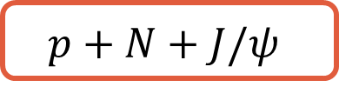


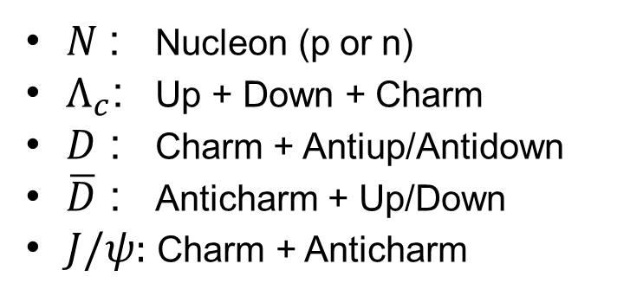

7
Charm Production Processes
$$p+N$$
Excited
$$p+N+Λ_{c}+\overline{D}$$
$$p+N+D+\overline{D}$$
$$p+N+J/ψ$$
$N$ : Nucleon (p or n)
$Λ_{c}$: Up + Down + Charm
$D$ : Charm + Antiup/Antidown
$\overline{D}$ : Anticharm + Up/Down
$J/ψ:$ Charm + Anticharm
Notes:
In the charm production, there are 3 processes we considered which provide us with light and long live charmed hadrons.

Slide 9
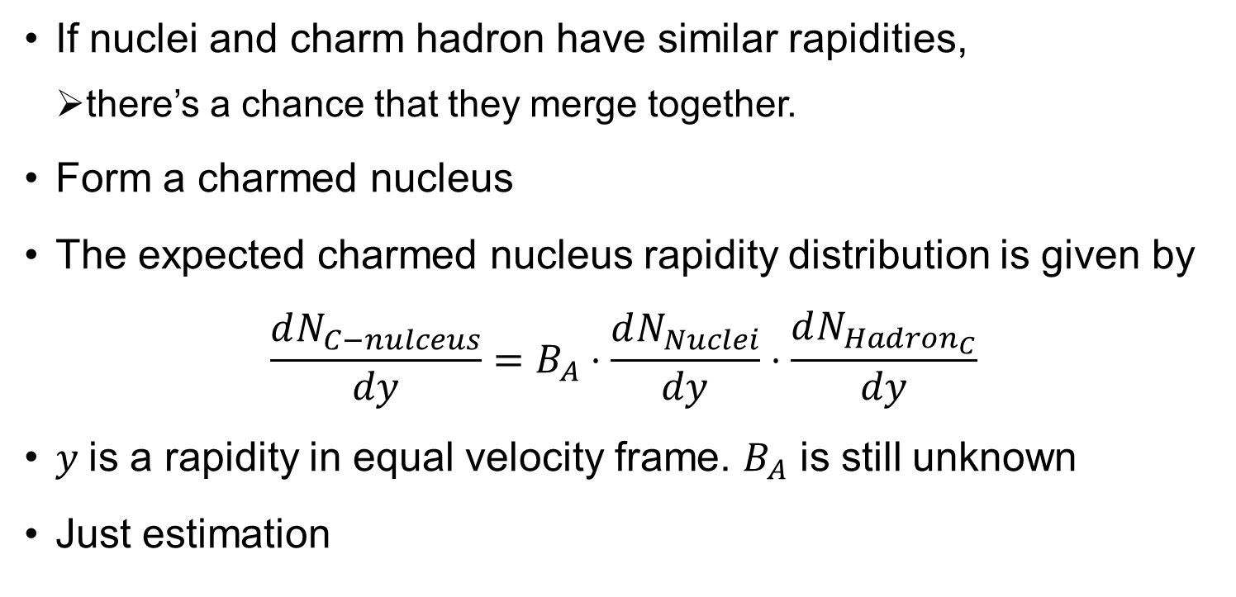
8
Coalescence Algorithm
If nuclei and charm hadron have similar rapidities,
  there’s a chance that they merge together.
Form a charmed nucleus
The expected charmed nucleus rapidity distribution is given by
$$\frac{dN_{C−nulceus}}{dy}=B_{A}⋅\frac{dN_{Nuclei}}{dy}⋅\frac{dN_{Hadron_{C}}}{dy}$$
$y$is a rapidity in equal velocity frame. $B_{A}$ is still unknown
Just estimation
Notes:
Additionally, in this project, the production probability of charmed nucleus is estimated by coalescence algorithm.

Slide 10
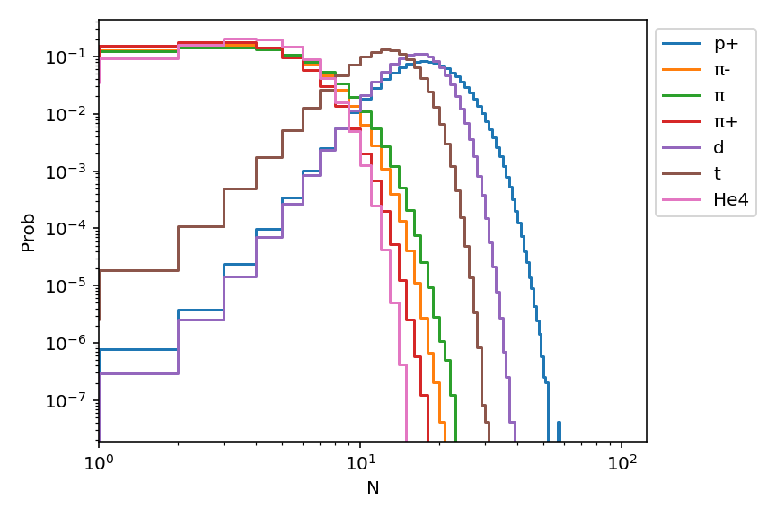
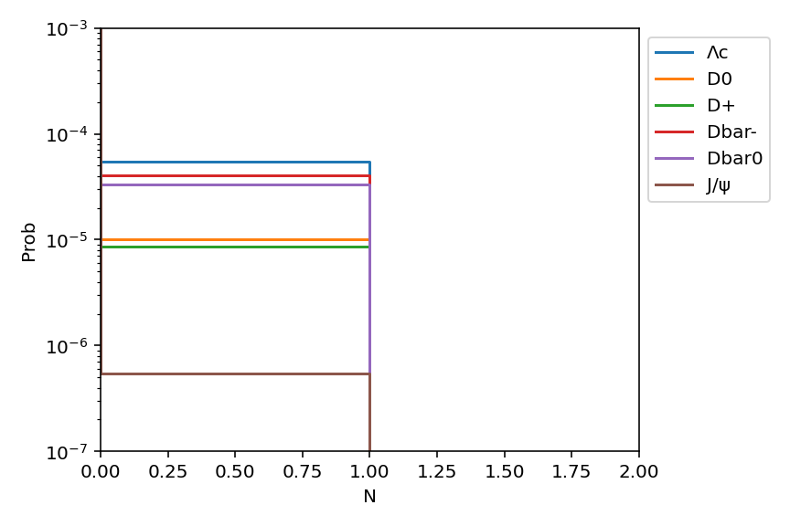
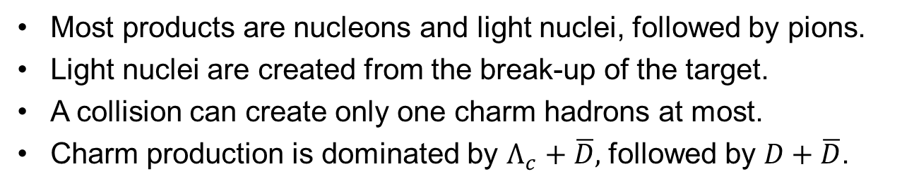
9
Multiplicities Results
Figure 5: Multiplicities distributions (nuclei & pion)
Figure 6: Multiplicities distributions (charmed hadrons)
Most products are nucleons and light nuclei, followed by pions.
Light nuclei are created from the break-up of the target.
A collision can create only one charm hadrons at most.
Charm production is dominated by $Λ_{c}+\overline{D},$ followed by $D+\overline{D}$.
Notes:
Now, I move to the results.

Slide 11
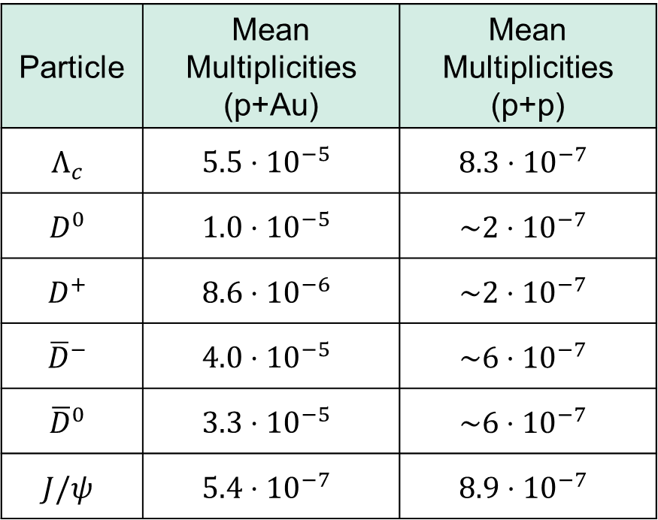
10
Mean Multiplicities
Particle | Mean Multiplicities (p+Au) | Mean Multiplicities (p+p)
$$Λ_{c}$$ | $$5.5⋅{10}^{−5}$$ | $$8.3⋅{10}^{−7}$$
$$D^{0}$$ | $$1.0⋅{10}^{−5}$$ | $$\sim 2⋅{10}^{−7}$$
$$D^{+}$$ | $$8.6⋅{10}^{−6}$$ | $$\sim 2⋅{10}^{−7}$$
$${\overline{D}}^{−}$$ | $$4.0⋅{10}^{−5}$$ | $$\sim 6⋅{10}^{−7}$$
$${\overline{D}}^{0}$$ | $$3.3⋅{10}^{−5}$$ | $$\sim 6⋅{10}^{−7}$$
$$J/ψ$$ | $$5.4⋅{10}^{−7}$$ | $$8.9⋅{10}^{−7}$$
Compare with p+p collision
p+Au > p+p
About 50 to 60 times
Can be used for future study
  Charm being reabsorbed into the nucleus
Table 1: Mean multiplicities from p+Au vs p+p colision
Ref: J. Steinheimer1 , A. Botvina and M. Bleicher, 2017
Notes:
This is the table comparing the multiplicities from proton+gold and proton+proton collision.

Slide 12
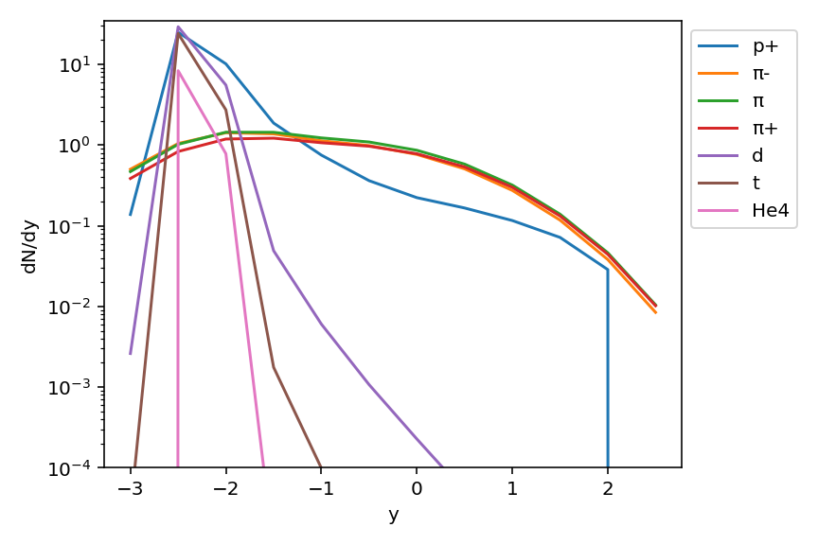
11
Rapidity Results
Use equal velocity frame
Protons move from –z to +z direction.
Peaks about -2.5 → A target move from +z to -z.
A broader width of the distribution for pion
From lighter mass
Figure 7: Rapidity distributions (nuclei & pion)
Notes:
The next result is the rapidity distribution of light nuclei and pion.

Slide 13
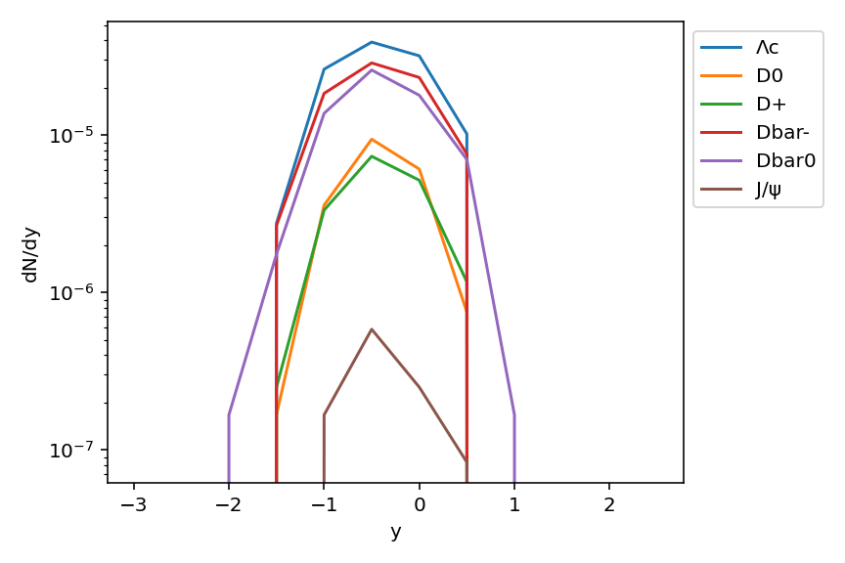
12
Rapidity Results
Peaks about -0.5
Produced more towards the direction of the projectile than the light nuclei.
If move with the target nucleus
  High chance of rescatter and be lost in the target nucleus.
Figure 8: Rapidity distributions (charmed hadrons)
Notes:
The next graph shows the rapidity distribution of charm hadrons.

Slide 14
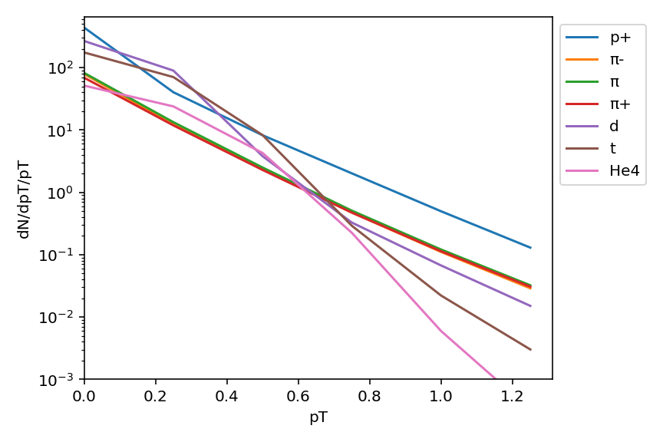
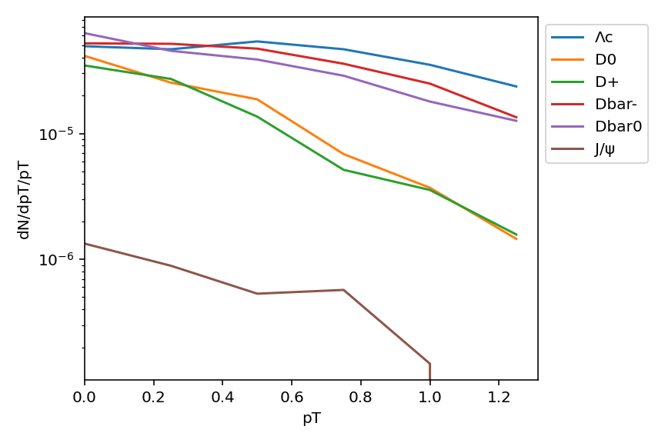
13
Transverse Momentum (pT) Results
Figure 9: pT distributions (nuclei & pion)
Figure 10: pT distributions (charmed hadrons)
Most particles follow an approximately exponential shape expected from thermal spectra.
Results provide guidance for experimental studies.
Notes:
Next graphs that I want to show you are the transverse momentum distribution.

Slide 15
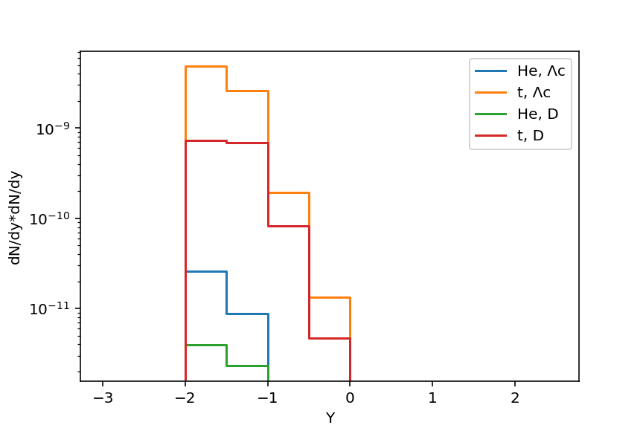
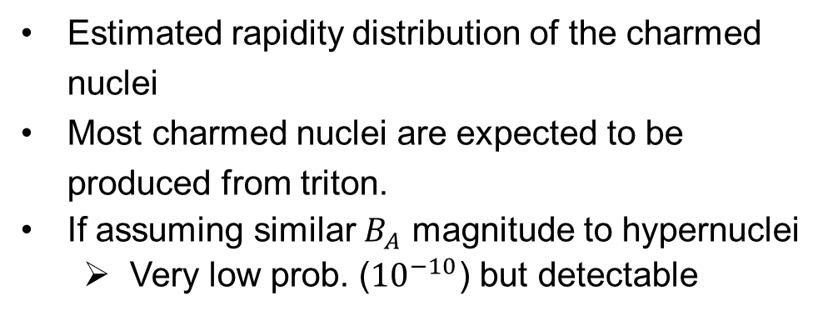
14
Charmed Nuclei Estimation
Estimated rapidity distribution of the charmed nuclei
Most charmed nuclei are expected to be produced from triton.
If assuming similar $B_{A}$ magnitude to hypernuclei
  Very low prob. (${10}^{−10}$) but detectable
Notes:
The last result here is, as we discussed before, the estimated rapidity distribution of the charmed nuclei.

Slide 16
15
Summary
Prediction of p+Au charm production in the CBM experiment
Significant yield of charmed hadrons than p+p collision
Rapidity distribution → Charmed hadrons move in the projectile direction.
Thermal spectra shape transverse momentum distribution
Estimating the charmed nuclei production probability
An Important input for the charm program at the upcoming CBM experiment

Slide 17
Thank you!

