Slide 1

EXTRACTION DYNAMICS OF β-DECAY PRODUCTS IN A PAUL TRAP:
A SIMULATION STUDY OF ¹⁴⁰Cs
Candidate: Matteo Pocobelli Ragosta (University of Naples “Federico II”)
Supervisor: Dr. Timo Dickel (GSI Helmholtzzentrum fur Schwerionenforschung)

Slide 2
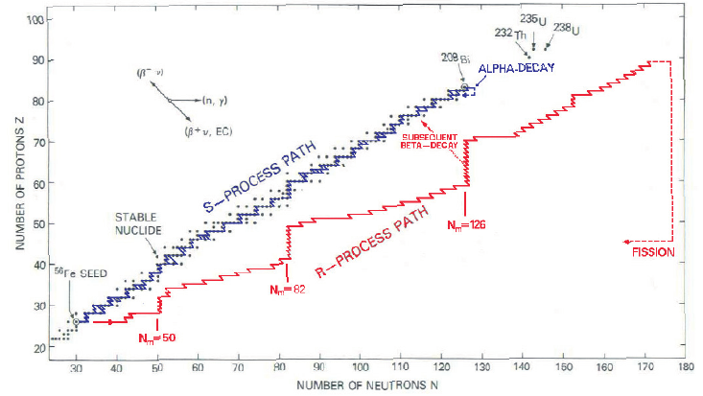
FROM THE r-PROCESS
TO RADIOACTIVE ION TRAPPING
Goal: Trap radioactive ions to study r-process neutron captures.
Issue: Continuous β-decay alters kinematics and charge states.
Solution: 3D SIMION tracking to optimize extraction and maintain target purity.

Slide 3
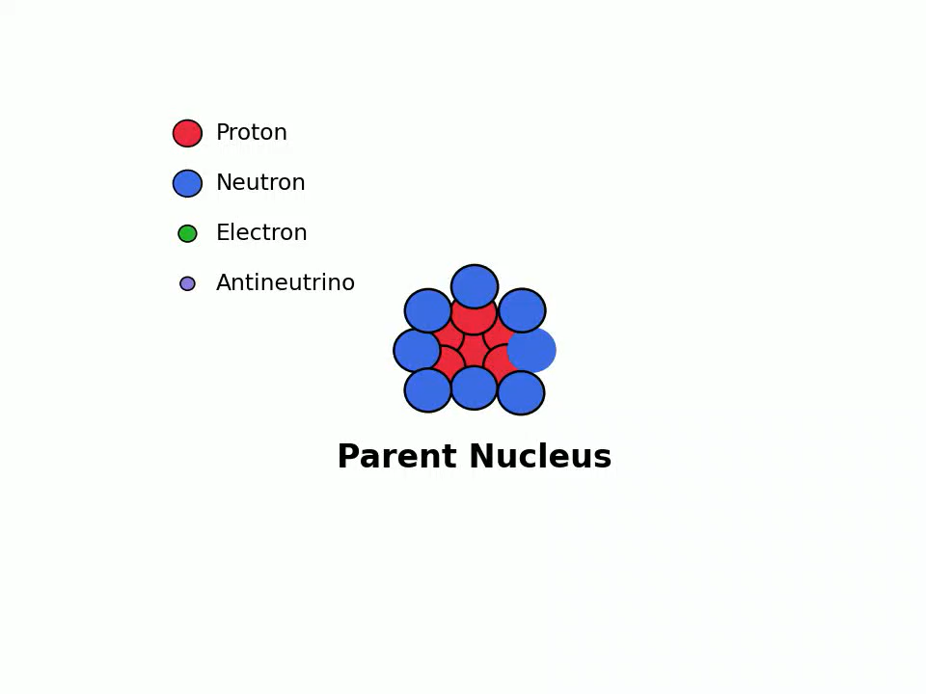
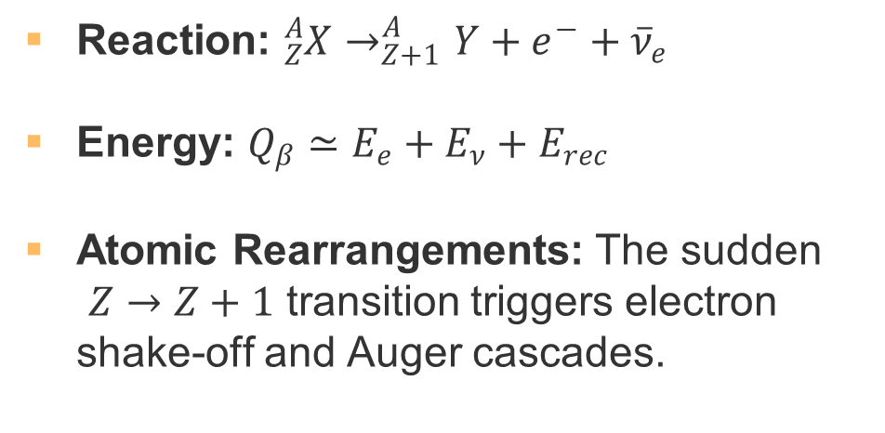
β-DECAY:
FROM PARENT TO DAUGHTER IONS
Reaction: ${}_{Z}^{A}X→_{Z+1}^{A}Y+e^{−}+{\overline{ν}}_{e}$
Energy: $Q_{β}≃E_{e}+E_{ν}+E_{rec}$
Atomic Rearrangements: The sudden
$Z→Z+1$ transition triggers electron shake-off and Auger cascades.

Slide 4
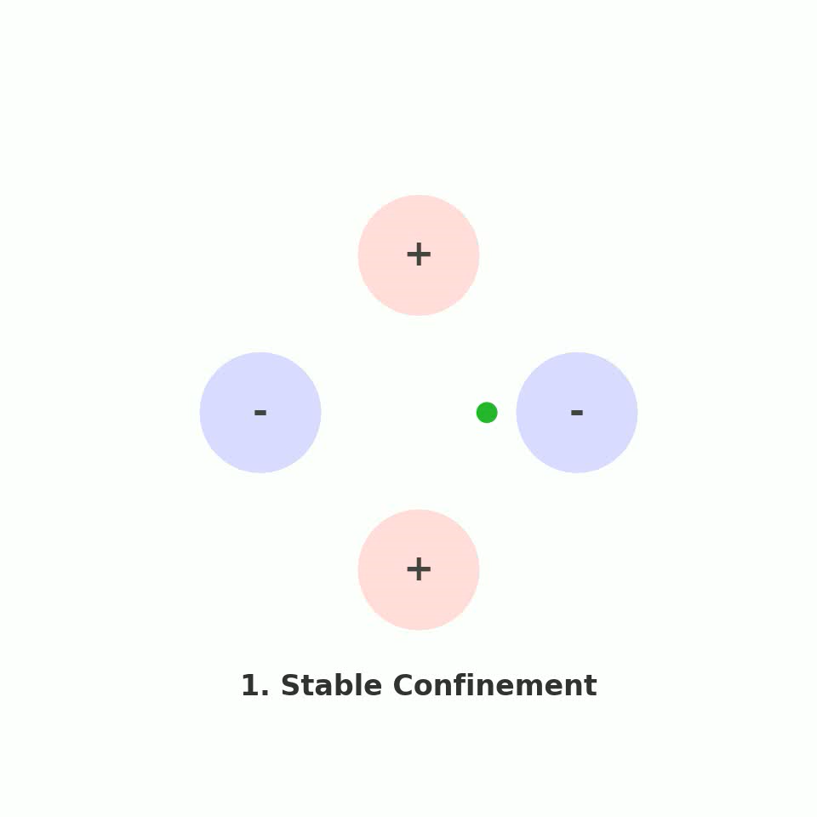
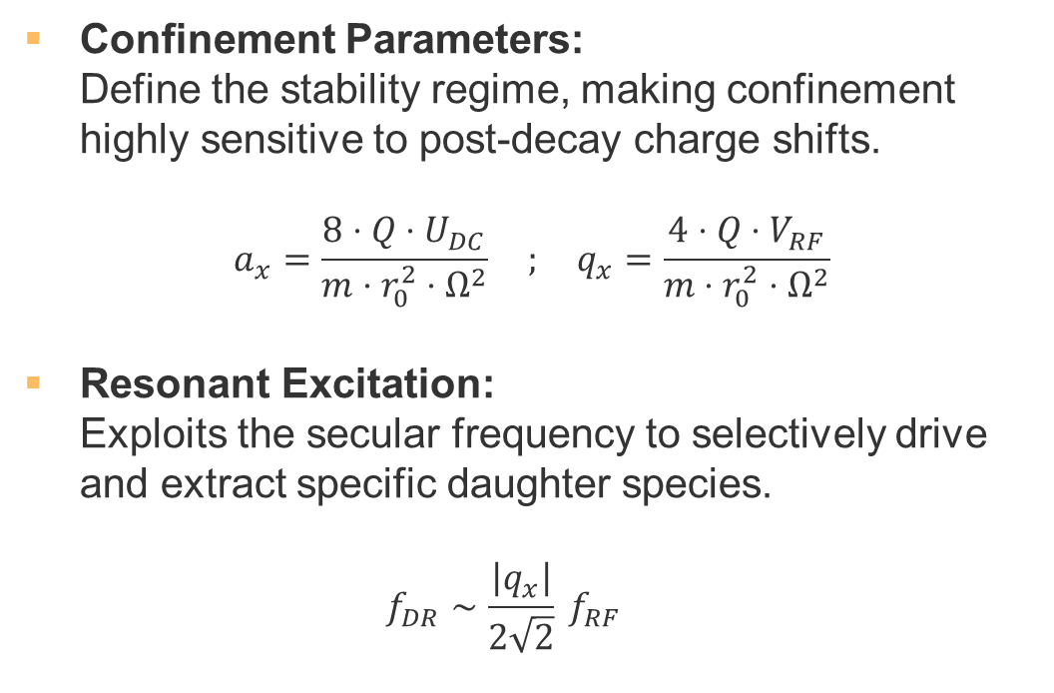
PAUL TRAP AND RESONANT
DIPOLAR EXCITATION
Confinement Parameters:
Define the stability regime, making confinement highly sensitive to post-decay charge shifts.
$$a_{x}=\frac{8⋅Q⋅U_{DC}}{m⋅r_{0}^{2}⋅Ω^{2}} ; q_{x}=\frac{4⋅Q⋅V_{RF}}{m⋅r_{0}^{2}⋅Ω^{2}}$$
Resonant Excitation:
Exploits the secular frequency to selectively drive and extract specific daughter species.
$f_{DR}∼\frac{\left|q_{x}\right|}{2\sqrt{2}} f_{RF}$

Slide 5
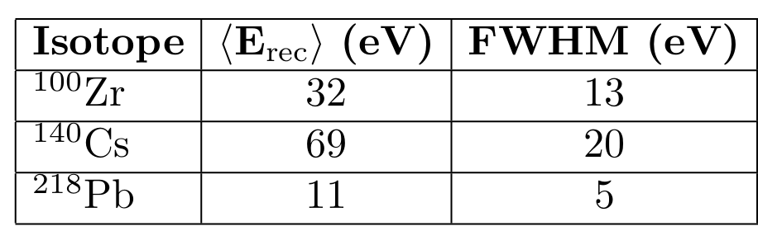
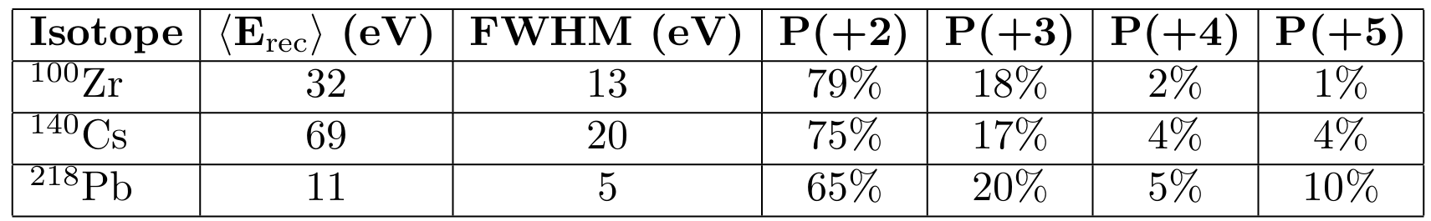
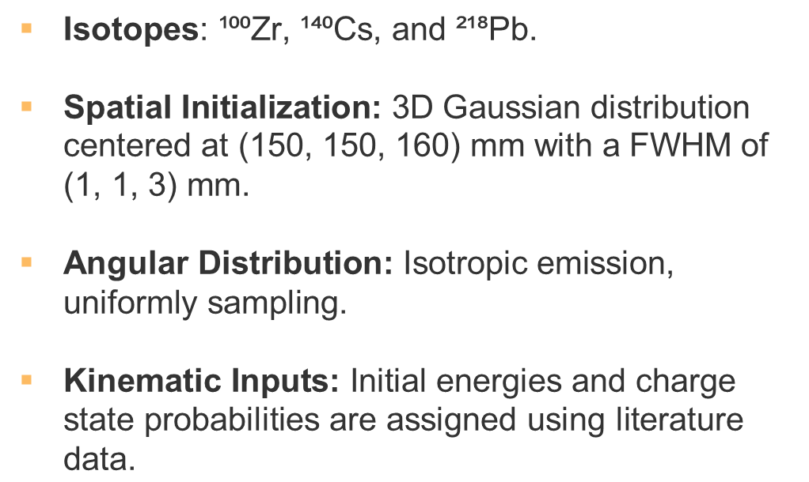
ENERGY SCALES OF β-DECAY DAUGHTER IONS
$\text{Isotopes}\text{:}\text{ ¹⁰⁰Zr, ¹⁴⁰Cs, and ²¹⁸Pb.}$
$\text{Spatial Initialization:}\text{ 3D Gaussian distribution centered at (150, 150, 160) mm with a FWHM of (1, 1, 3) mm.}$
$\text{Angular Distribution:}\text{ Isotropic emission, uniformly sampling}\text{.}$
$\text{Kinematic Inputs:}\text{ Initial energies and charge state probabilities are assigned using literature data.}$

Slide 6
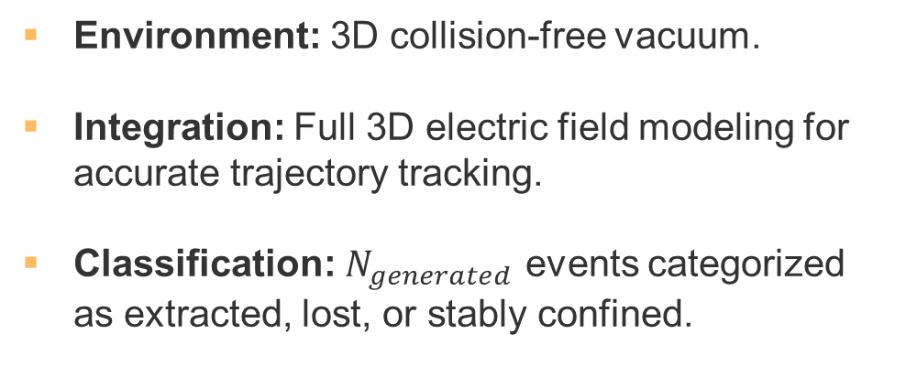
TRAP GEOMETRY AND
ELECTRODE CONFIGURATION
Environment: 3D collision-free vacuum.
Integration: Full 3D electric field modeling for accurate trajectory tracking.
Classification: $N_{generated}$ events categorized as extracted, lost, or stably confined.

Slide 7
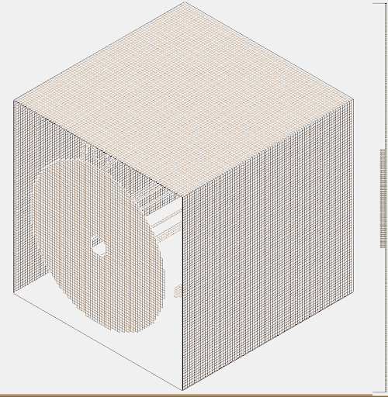
TRAP GEOMETRY AND
ELECTRODE CONFIGURATION
Environment: 3D collision-free vacuum.
Integration: Full 3D electric field modeling for accurate trajectory tracking.
Classification: $N_{generated}$ events categorized as extracted, lost, or stably confined.
Chamber X-walls: 850 V
Chamber Y-walls: 1000 V
Chamber Z-walls: 0 V

Slide 8
TRAP GEOMETRY AND
ELECTRODE CONFIGURATION
Environment: 3D collision-free vacuum.
Integration: Full 3D electric field modeling for accurate trajectory tracking.
Classification: $N_{generated}$ events categorized as extracted, lost, or stably confined.
Chamber X-walls: 850 V
Chamber Y-walls: 1000 V
Chamber Z-walls: 0 V
200 V

Slide 9

TRAP POTENTIALS AND
EXCITATION PARAMETERS

Slide 10
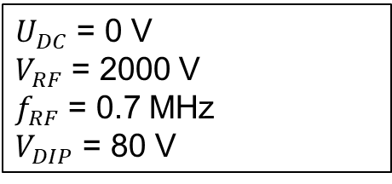
TRAP POTENTIALS AND
EXCITATION PARAMETERS
$U_{DC}$ = 0 V
$V_{RF}$ = 2000 V
$f_{RF}$ = 0.7 MHz
$V_{DIP}$ = 80 V
$$V_{trap}\left(t\right)=U_{DC}+V_{RF}\cos\left(2π f_{RF}t\right)+V_{DIP}\cos{(2π f_{DR}t)}$$

Slide 11
TRAP POTENTIALS AND
EXCITATION PARAMETERS
$U_{DC}$ = 0 V
$V_{RF}$ = 2000 V
$f_{RF}$ = 0.7 MHz
$V_{DIP}$ = 80 V
30 kV
$$V_{trap}\left(t\right)=U_{DC}+V_{RF}\cos\left(2π f_{RF}t\right)+V_{DIP}\cos{(2π f_{DR}t)}$$

Slide 12
TRAP POTENTIALS AND
EXCITATION PARAMETERS
$U_{DC}$ = 0 V
$V_{RF}$ = 2000 V
$f_{RF}$ = 0.7 MHz
$V_{DIP}$ = 80 V
30 kV
-42 kV
$$V_{trap}\left(t\right)=U_{DC}+V_{RF}\cos\left(2π f_{RF}t\right)+V_{DIP}\cos{(2π f_{DR}t)}$$

Slide 13
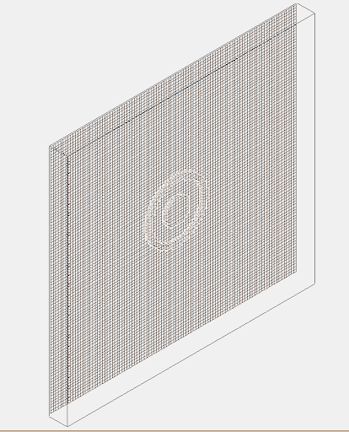
TRAP POTENTIALS AND
EXCITATION PARAMETERS
$U_{DC}$ = 0 V
$V_{RF}$ = 2000 V
$f_{RF}$ = 0.7 MHz
$V_{DIP}$ = 80 V
30 kV
-42 kV
-18 kV
$$V_{trap}\left(t\right)=U_{DC}+V_{RF}\cos\left(2π f_{RF}t\right)+V_{DIP}\cos{(2π f_{DR}t)}$$

Slide 14
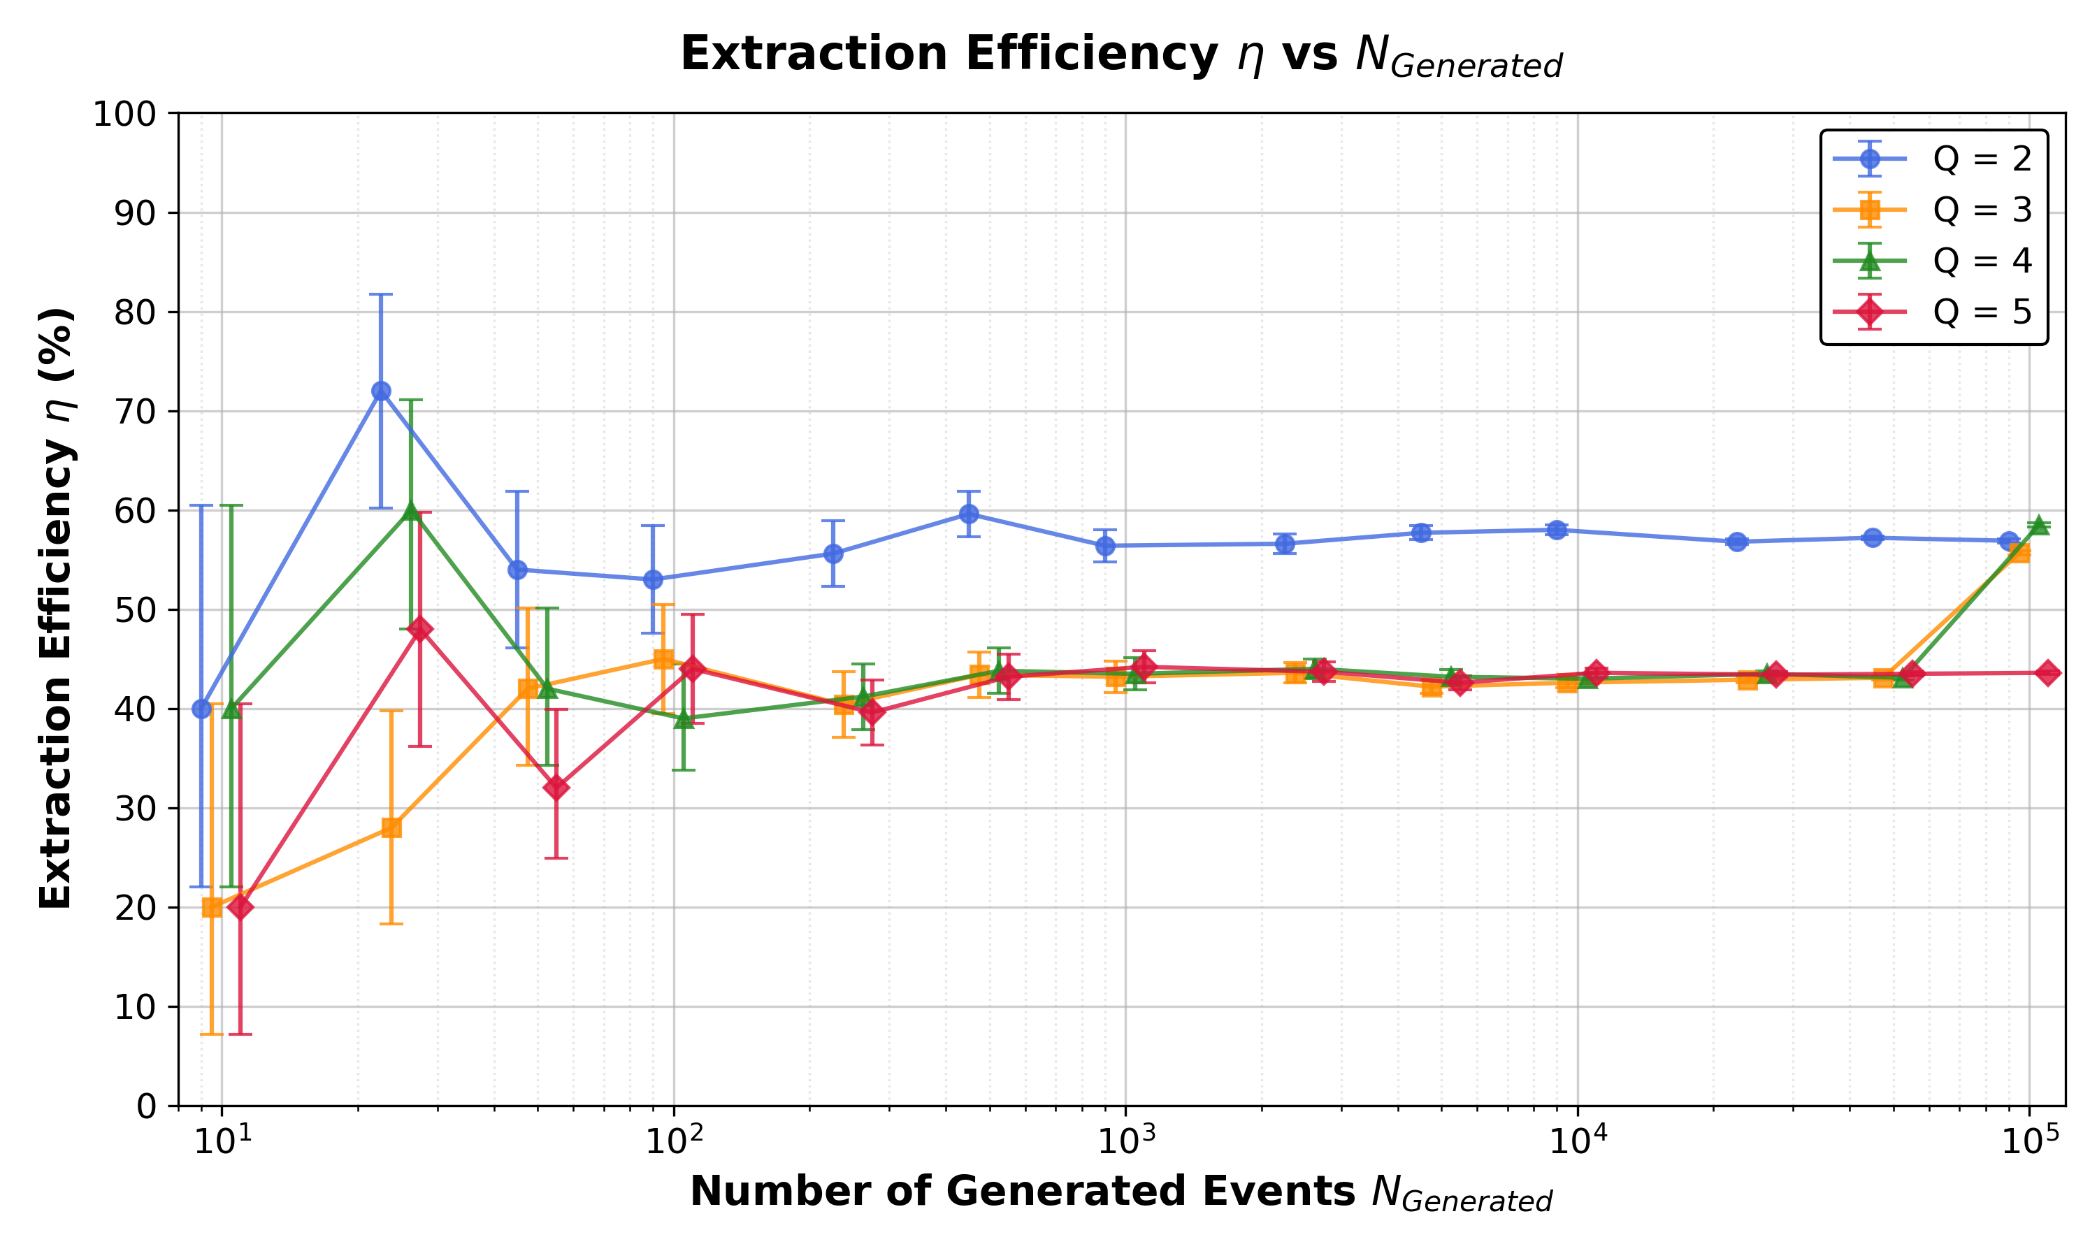
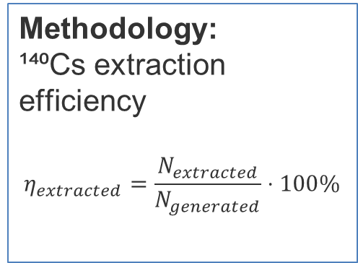
EXTRACTION EFFICIENCY
Methodology:
¹⁴⁰Cs extraction efficiency
$$η_{extracted}=\frac{N_{extracted}}{N_{generated}}⋅100\%$$

Slide 15
EXTRACTION EFFICIENCY
Methodology:
¹⁴⁰Cs extraction efficiency
$$η_{extracted}=\frac{N_{extracted}}{N_{generated}}⋅100\%$$
Convergence: plateau after 5000 events, showing ~57% efficiency for Q = 2 and ~44% for the others.

Slide 16
EXTRACTION EFFICIENCY
Methodology:
¹⁴⁰Cs extraction efficiency
$$η_{extracted}=\frac{N_{extracted}}{N_{generated}}⋅100\%$$
The 100k Anomaly: for Q = 3 and Q = 4 at the highest statistical limit.
Convergence: plateau after 5000 events, showing ~57% efficiency for Q = 2 and ~44% for the others.

Slide 17
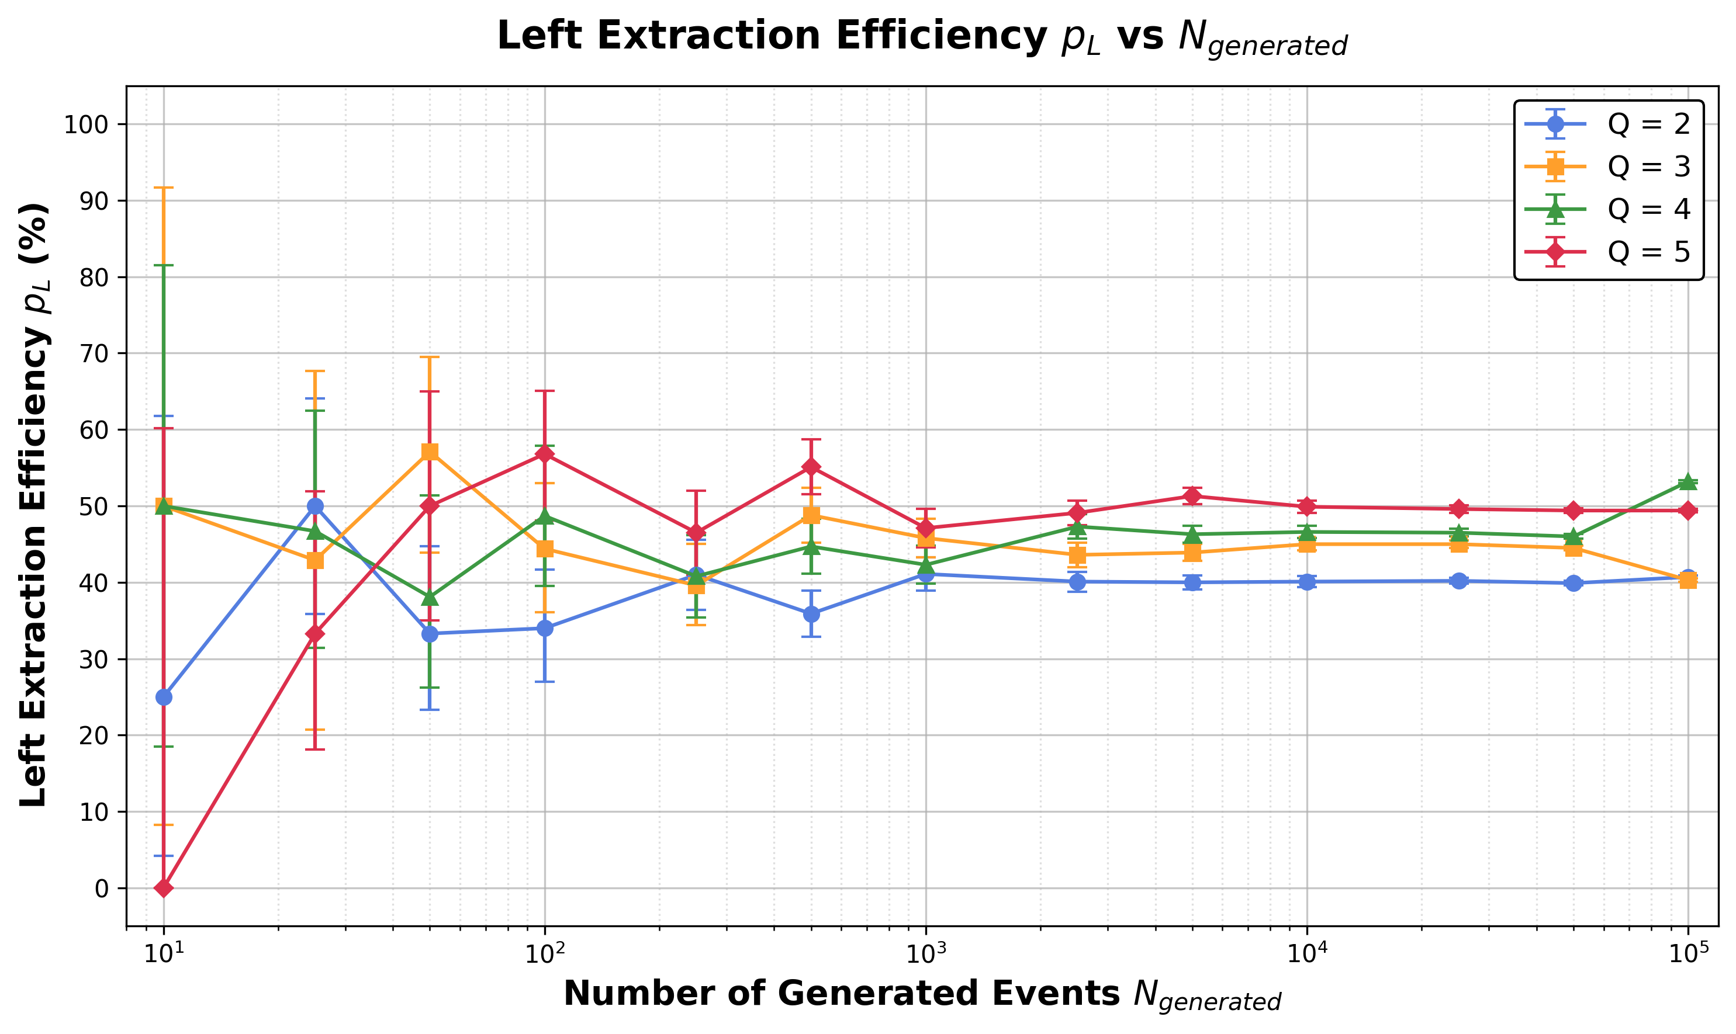
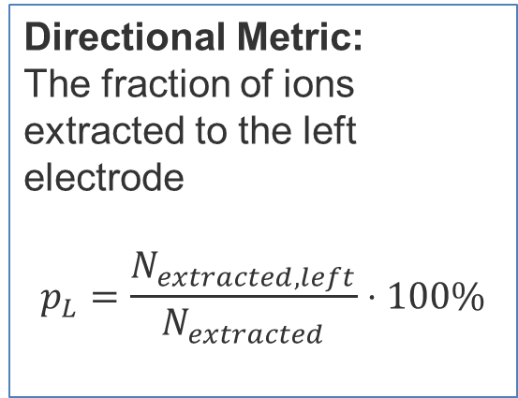
LEFT-RIGHT EXTRACTION ASYMMETRY
Directional Metric:
The fraction of ions extracted to the left electrode
$$p_{L}=\frac{N_{extracted,left}}{N_{extracted}}⋅100\%$$

Slide 18
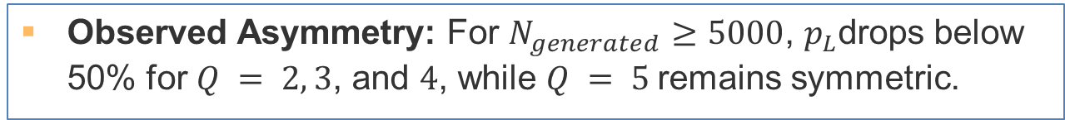
LEFT-RIGHT EXTRACTION ASYMMETRY
Directional Metric:
The fraction of ions extracted to the left electrode
$$p_{L}=\frac{N_{extracted,left}}{N_{extracted}}⋅100\%$$
Observed Asymmetry: For $N_{generated}≥5000$, $p_{L}$drops below 50% for $Q = 2, 3$, and $4$, while $Q = 5$remains symmetric.

Slide 19
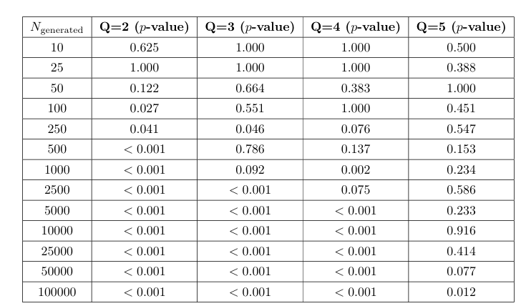
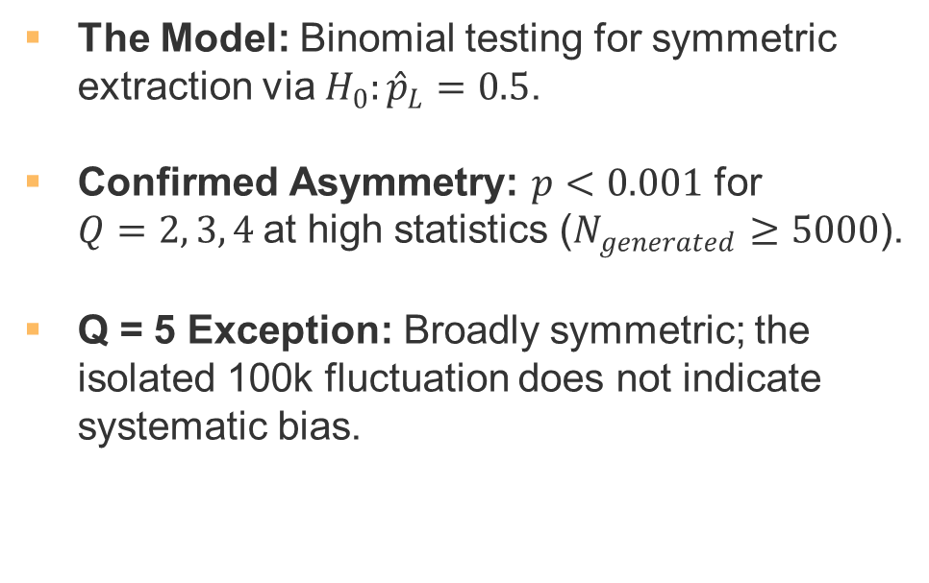
STATISTICAL TEST
FOR EXTRACTION ASYMMETRY
The Model: Binomial testing for symmetric extraction via $H_{0}:{\overset{ˆ}{p}}_{L}=0.5$.
Confirmed Asymmetry: $p<0.001$ for
$Q=2, 3, 4$at high statistics ($N_{generated}≥5000$).
Q = 5 Exception: Broadly symmetric; the isolated 100k fluctuation does not indicate systematic bias.

Slide 20
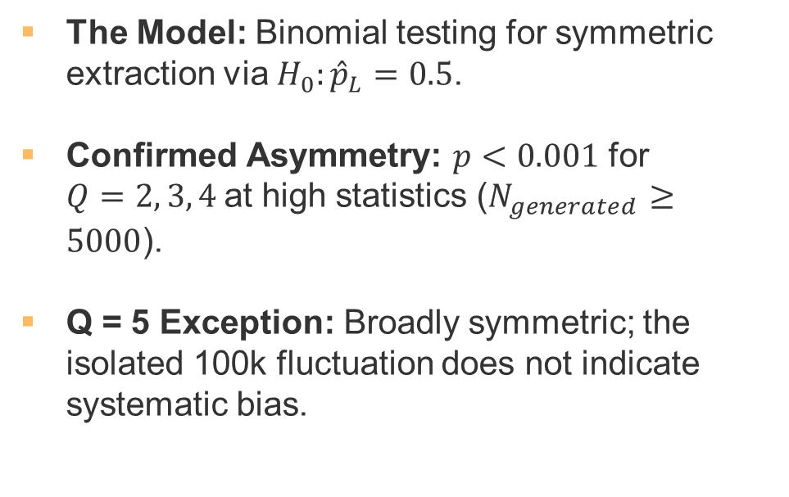
STATISTICAL TEST
FOR EXTRACTION ASYMMETRY
The Model: Binomial testing for symmetric extraction via $H_{0}:{\overset{ˆ}{p}}_{L}=0.5$.
Confirmed Asymmetry: $p<0.001$ for
$Q=2, 3, 4$at high statistics ($N_{generated}≥5000$).
Q = 5 Exception: Broadly symmetric; the isolated 100k fluctuation does not indicate systematic bias.

Slide 21
STATISTICAL TEST
FOR EXTRACTION ASYMMETRY
The Model: Binomial testing for symmetric extraction via $H_{0}:{\overset{ˆ}{p}}_{L}=0.5$.
Confirmed Asymmetry: $p<0.001$ for
$Q=2, 3, 4$at high statistics ($N_{generated}≥5000$).
Q = 5 Exception: Broadly symmetric; the isolated 100k fluctuation does not indicate systematic bias.

Slide 22
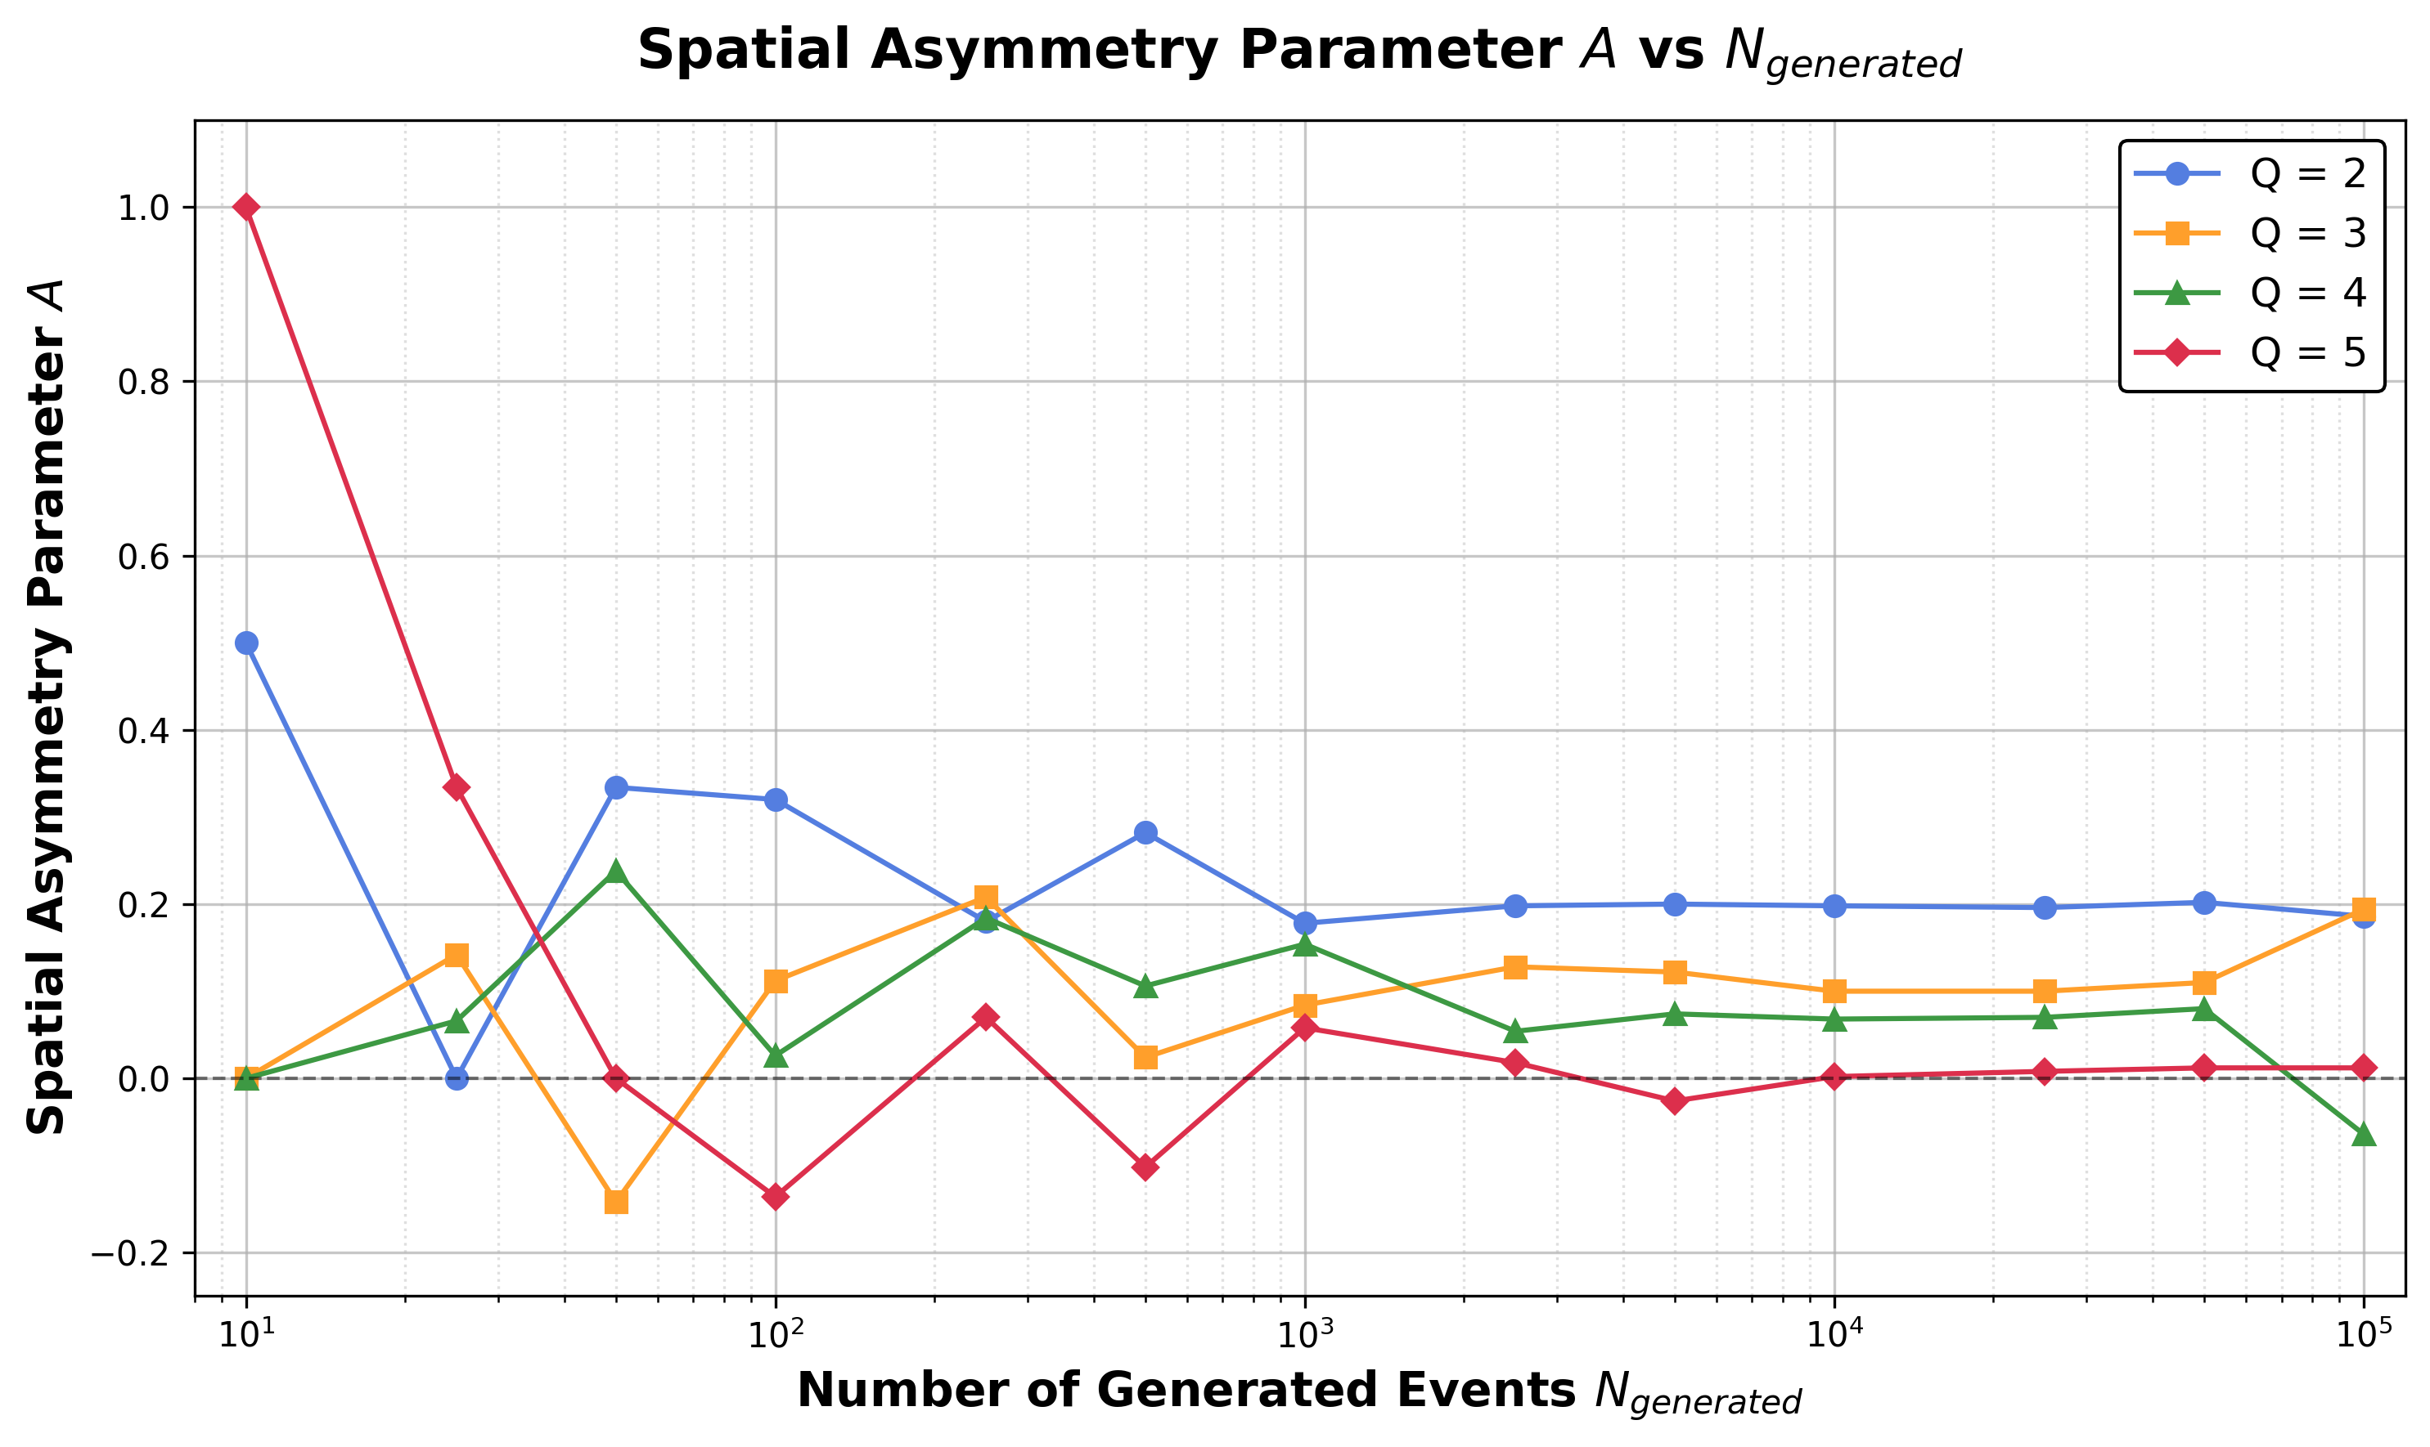
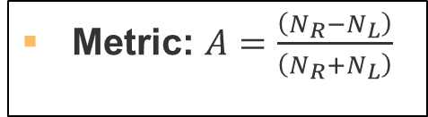
ASYMMETRY PARAMETER
Metric: $A=\frac{\left(N_{R}−N_{L}\right)}{\left(N_{R}+N_{L}\right)}$

Slide 23
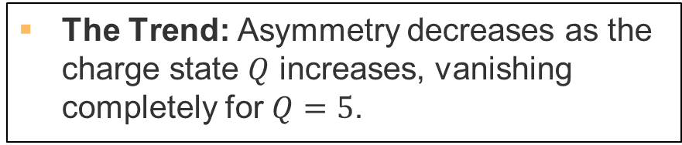
ASYMMETRY PARAMETER
Metric: $A=\frac{\left(N_{R}−N_{L}\right)}{\left(N_{R}+N_{L}\right)}$
The Trend: Asymmetry decreases as the charge state $Q$ increases, vanishing completely for $Q=5$.

Slide 24
CONCLUSIONS:
Successful Setup: Identified geometric and potential parameters that yield high extraction efficiency.
Q-Dependence: Efficiency peaks at ~57% for Q = 2, compared to ~44% for Q = 3, 4, and 5.
Asymmetry: Extraction shows a clear rightward directionality for Q = 2, 3, and 4.
Anomalies: Unexplained efficiency deviations at 100,000 runs highlight the need for further study.

Slide 25
FUTURE PRESPECTIVES:
Verify the high-statistics anomalies and spatial/angular distributions.
Test symmetric geometries and new trap-potential scans.
Extend the analysis to ¹⁰⁰Zr and ²¹⁸Pb to compare different mass and decay kinematics.

Slide 26
THANKS FOR
YOUR ATTENTION

