Slide 1
SARRP characterisation for small animal irradiation dosimetry and imaging
Dario Langellotti (University of Naples)

Slide 2
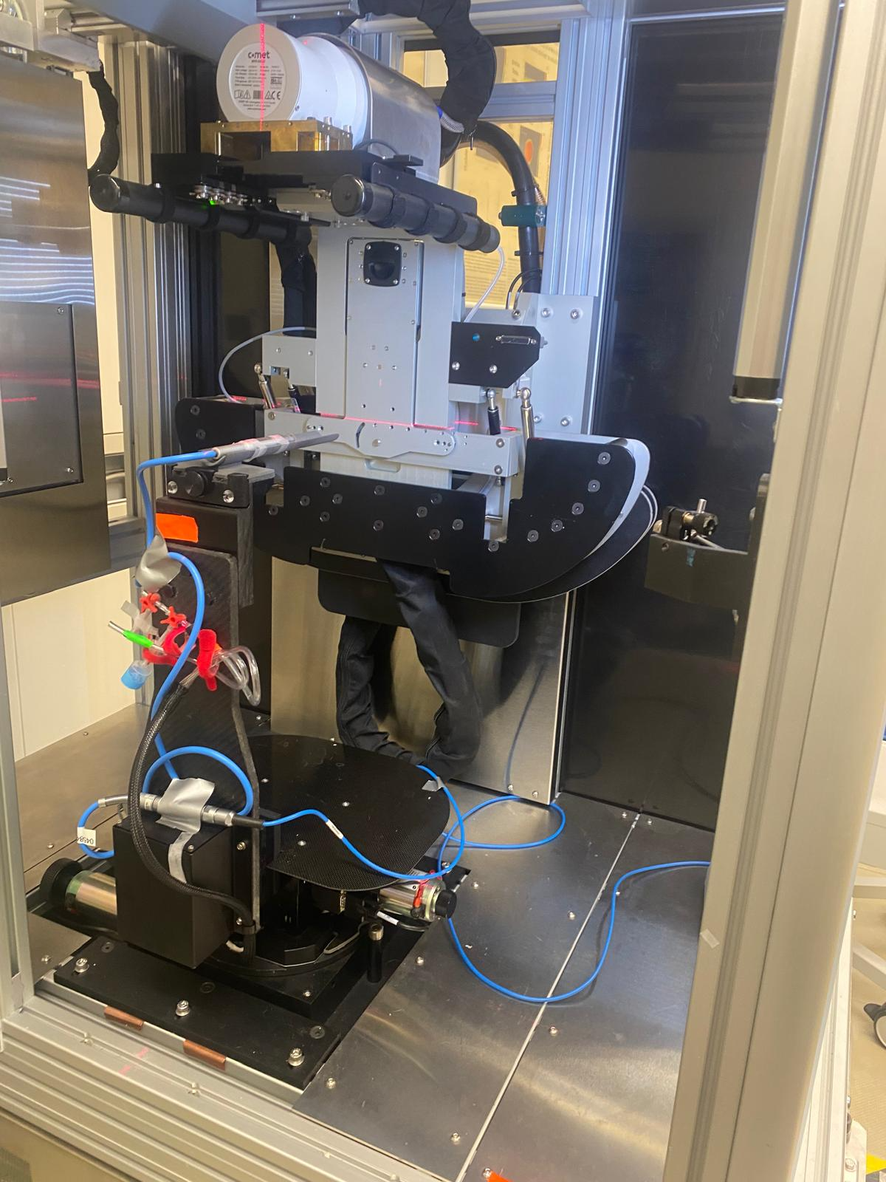
SARRP
Where? Cave M
Small Animal Radiation Research Platform
  In Vivo and in vitro irradiation and imaging
CT
How it works?

Slide 3
Table of content
Materials & methods:
1
1
SARRP
Ionization chambers & GafChromic film EBT3
2
Results:
2
Conclusions
3
Dose study and characterization
Instrumentation calibration and repeatability
Field uniformity for both collimated and open fields

Slide 4
Motivation
Main Goals
accuracy and reproducibility of experimental irradiations.
Characterization of the Collimated Field (10 mm × 10 mm) and the Open Field
Challenges of the open field
Why is accurate dose characterization important?

Slide 5
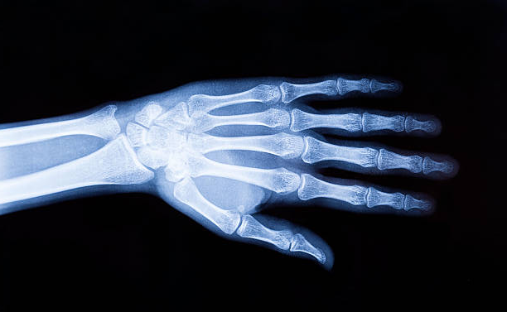
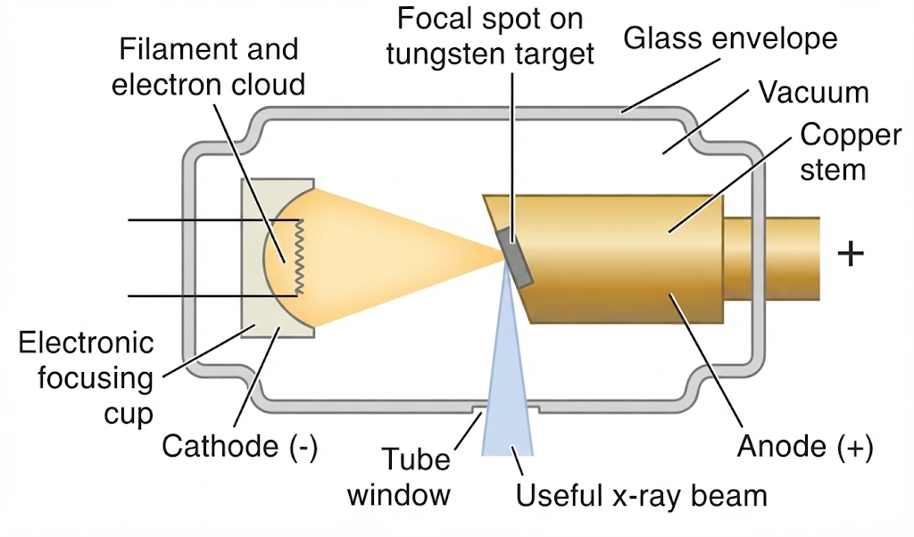
Materials & methods(1) – SARRP
Have you ever had an X-ray?
but do you know how it works?
Electrons emitted from the cathode
Accelerated toward a metal target
e⁻
X-rays production
Main charateristics:
Tube voltage
Tube current
Filter
0 to 30 mA
5 to 225kV
0.15mm Cu
/ 1 mm Al

Slide 6
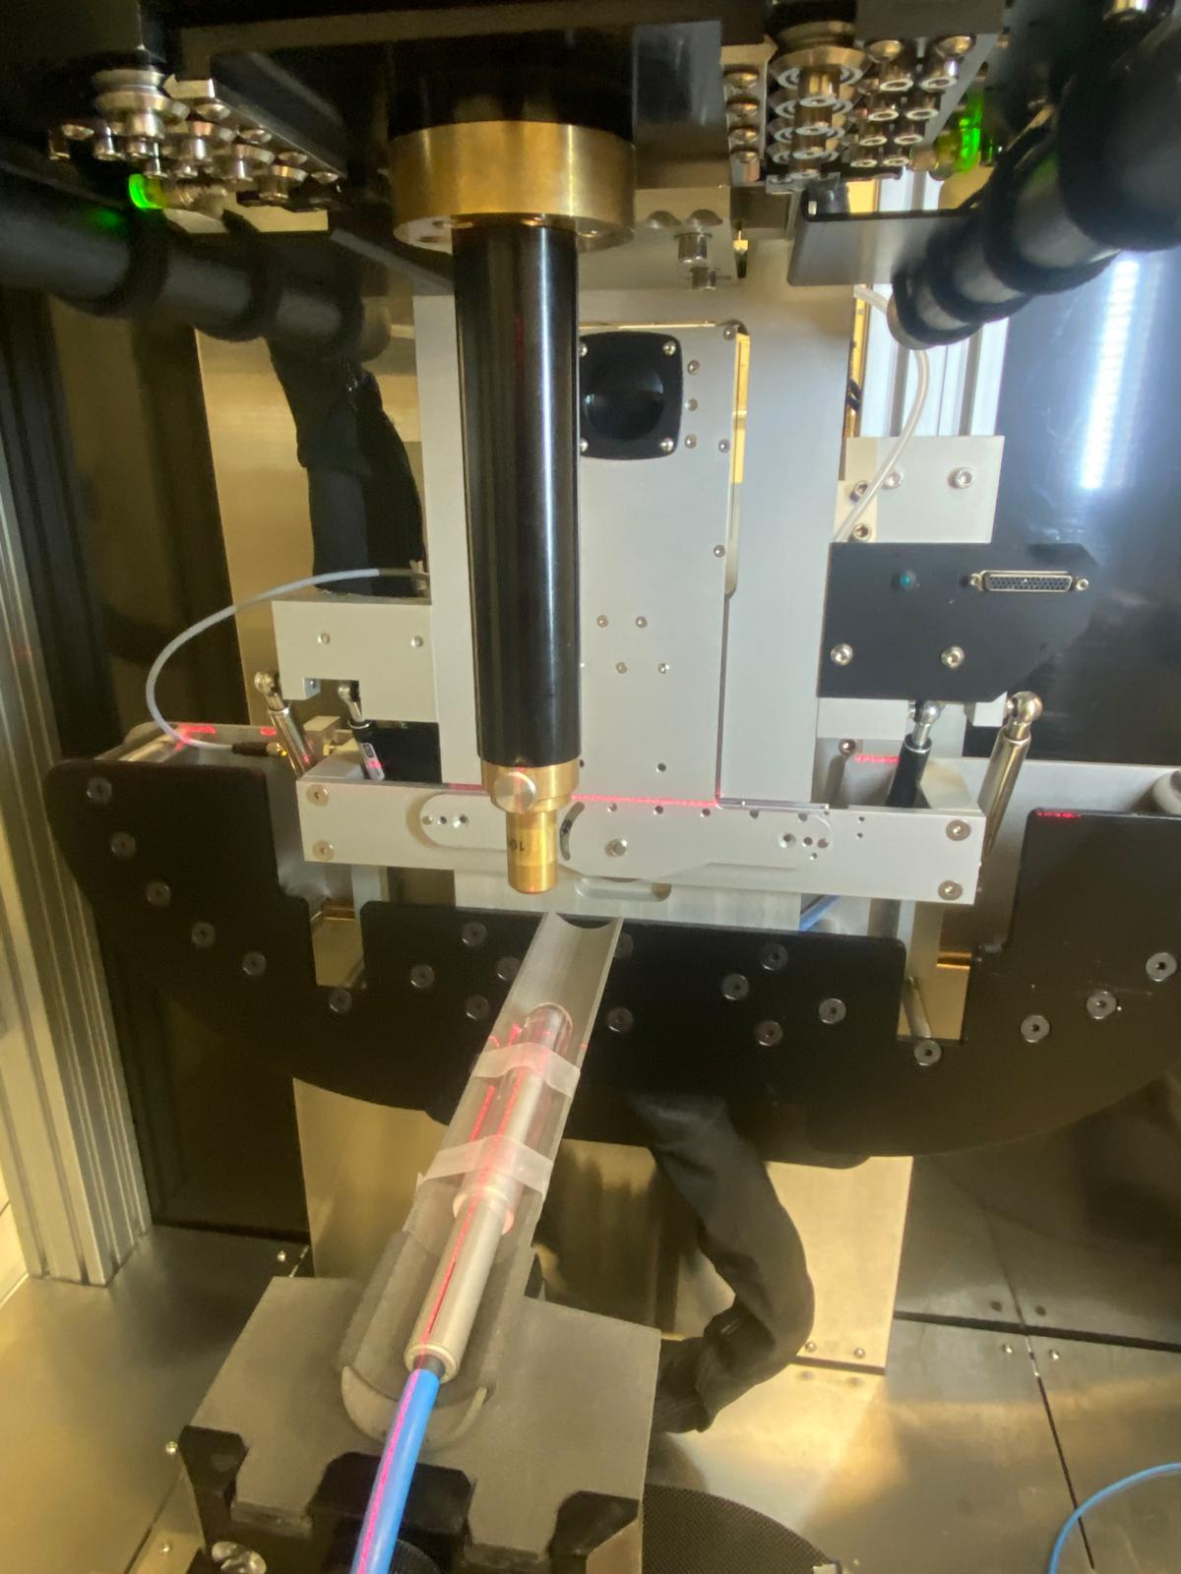
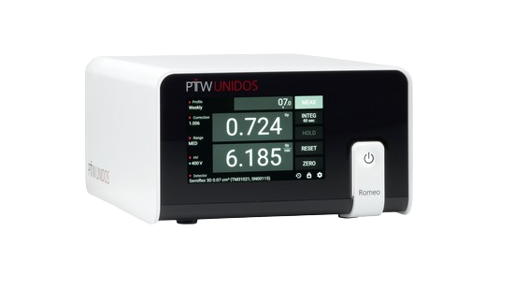
Material & methods (2) - SARRP
Collimator
5.25 cm
Ionization
chamber
Romeo elettrometer

Slide 7
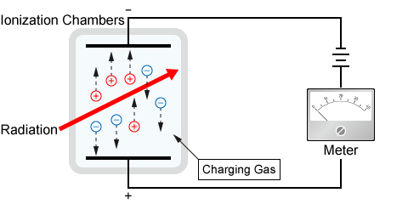
Material & methods (3) – Ionization chambers
Ionization
Production of secondary electrons
Electric potential is applied
Ion collection

Slide 8
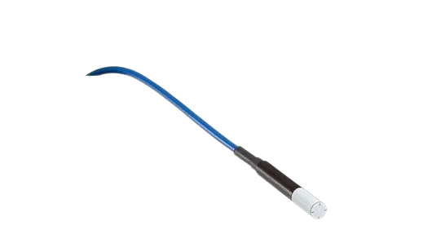
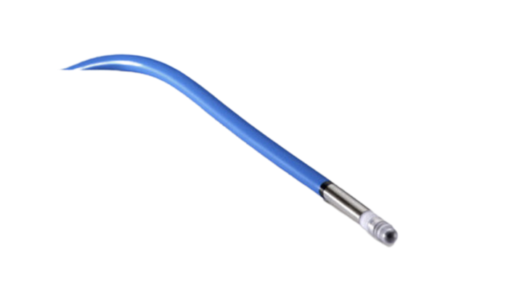
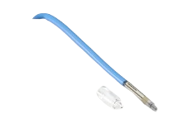
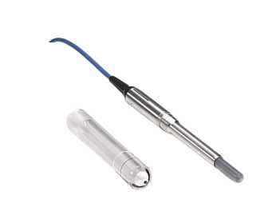
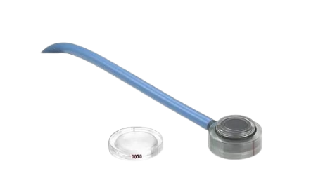
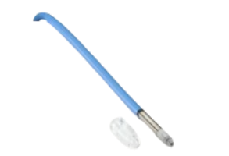
Material & methods (4) – Ionization chambers
Ionization chambers
Flash Diamond
1.1 mm radius x 1 μm thickness
Semiflex
2.75 mm radius x 16.25 mm lenght
PinPoint
1 mm radius × 5 mm length
Advanced Markus
2.5 mm radius × 1 mm depth
Farmer Chamber
3.05 mm radius × 23.0 mm length
Mini PinPoint
1.45 mm radius × 5 mm length

Slide 9
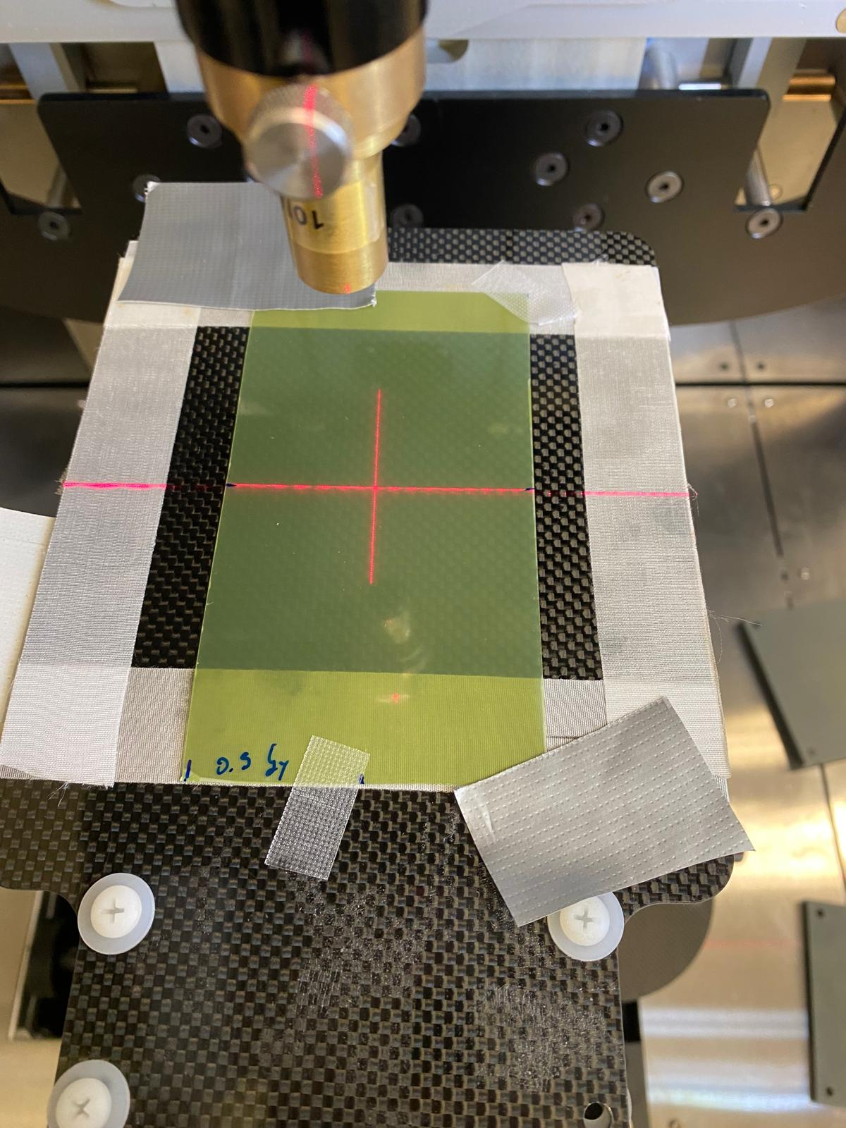
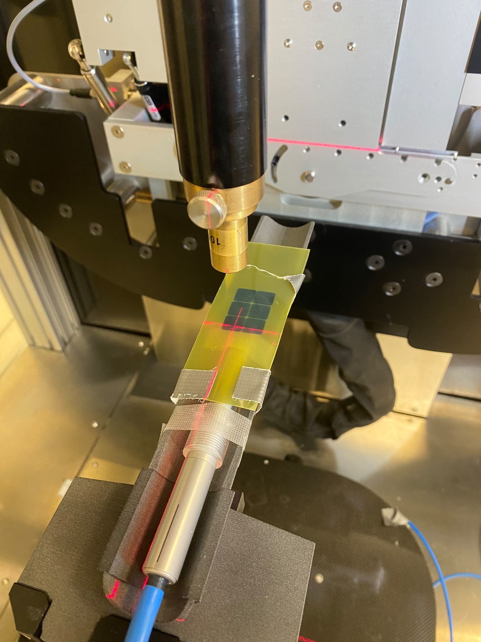
Material & methods (5) –GafChromic films
Gafchromic EBT-3 [0.2 – 10] Gy
Polyester (125 μm )
Active layer (28 μm )
Polyester (125 μm )
Ionization induces polymerization
Changing the optical properties of the film
Before irradiation
After irradiation
High spatial resolution
lower accuracy

Slide 10
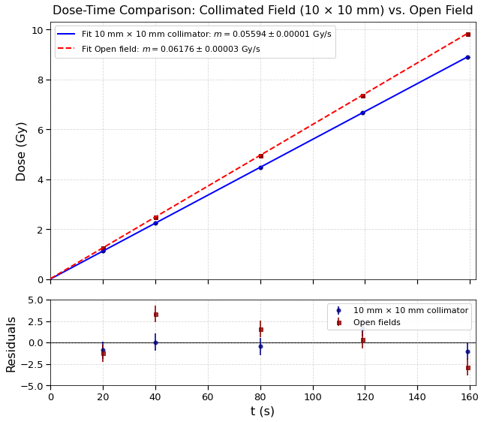
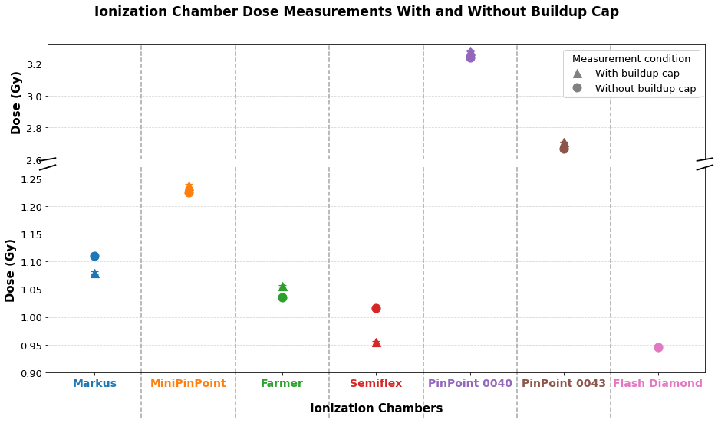
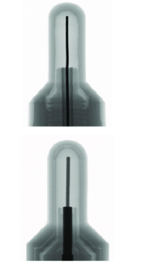
Results (1)
6 fields were used and 3 repetitions were performed
Linear distribution as expected (MiniPinPoint was used)
old PinPoint
FUN FACT
Differences in dose measurement between 10mm x 10mm collimator and open field
  Transient effects and beam switching delays
Flash diamond
0.94 % deviation to Semiflex
modern PinPoint
Other chambers
The photoelectric effect is emphasized.
Good agreement and low relative error
Experimental Repeatability

Slide 11
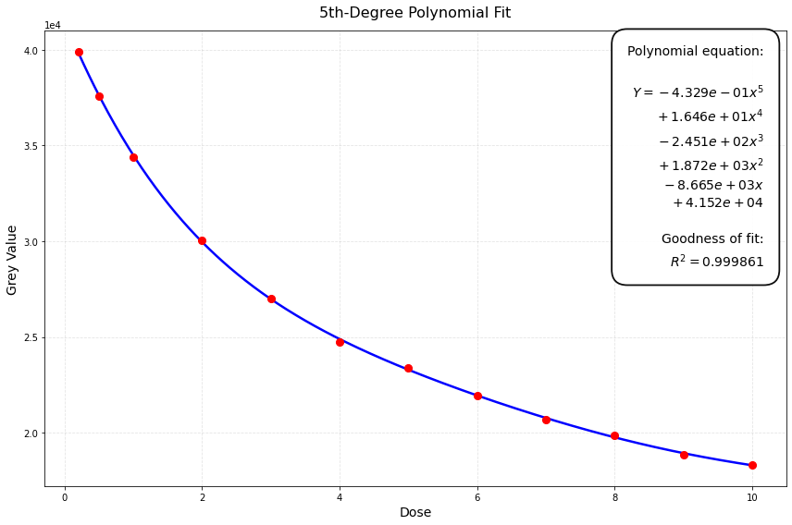
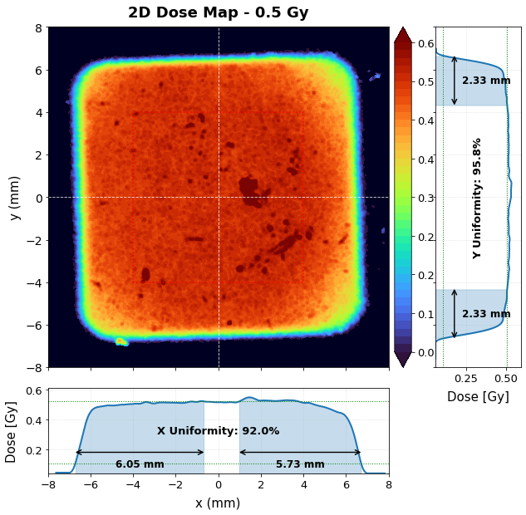
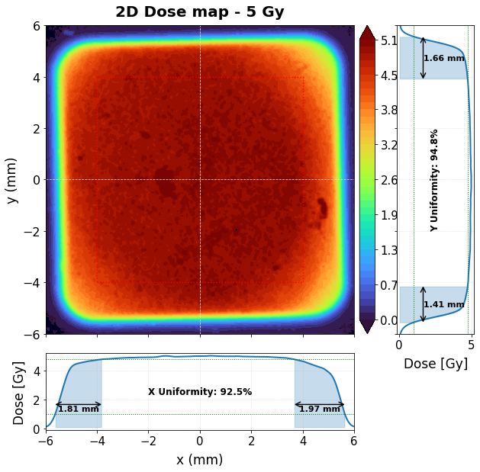
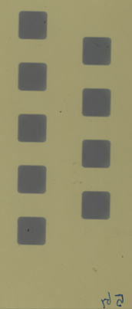
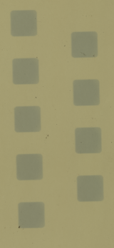
Results (2)
5 Gy
1 Gy
Fifth-polynomial fit
  Used for the calibration of the flm
  Correspondence between grayscale value and dose for each pixel
Deviation to deliver dose less than 2%
A copper filter provided differences in homogeneity along the two axes.

Slide 12
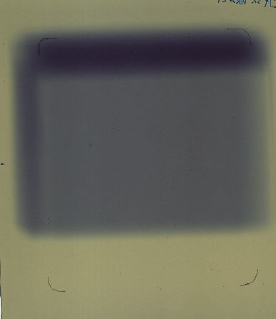
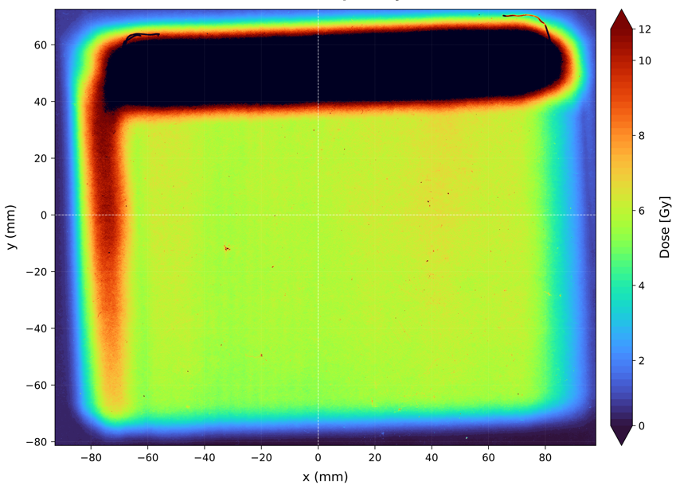
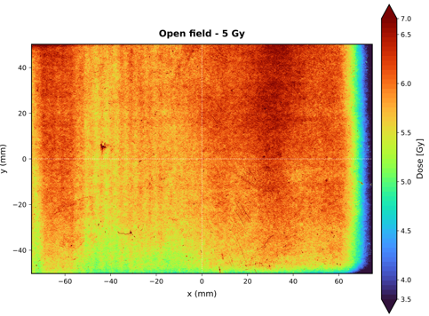

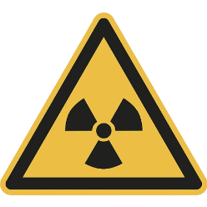
Results (3)
20.3 cm
More than 12 Gy!!
25.4 cm
17% overdose relative to the prescribed dose (5 Gy)
WHY IS IT A PROBLEM?

Slide 13
Conclusions (1)
Good overall agreement between delivered and prescribed dose
FlashDiamond showed the best agreement, with a deviation of only 0.94% compared with the reference dosimeter, even when 9 fields were used.
A suggestion:
Please don’t use old PinPoint chamber!!

Slide 14
Conclusions (2)
The open-field configuration exhibited significant spatial inhomogeneities, with an approximately 17% overdose in the central region and local doses exceeding 10 Gy.
The 10 mm × 10 mm collimator provided the most suitable conditions for reproducible preclinical irradiation
Be careful when you use open field!

Slide 15

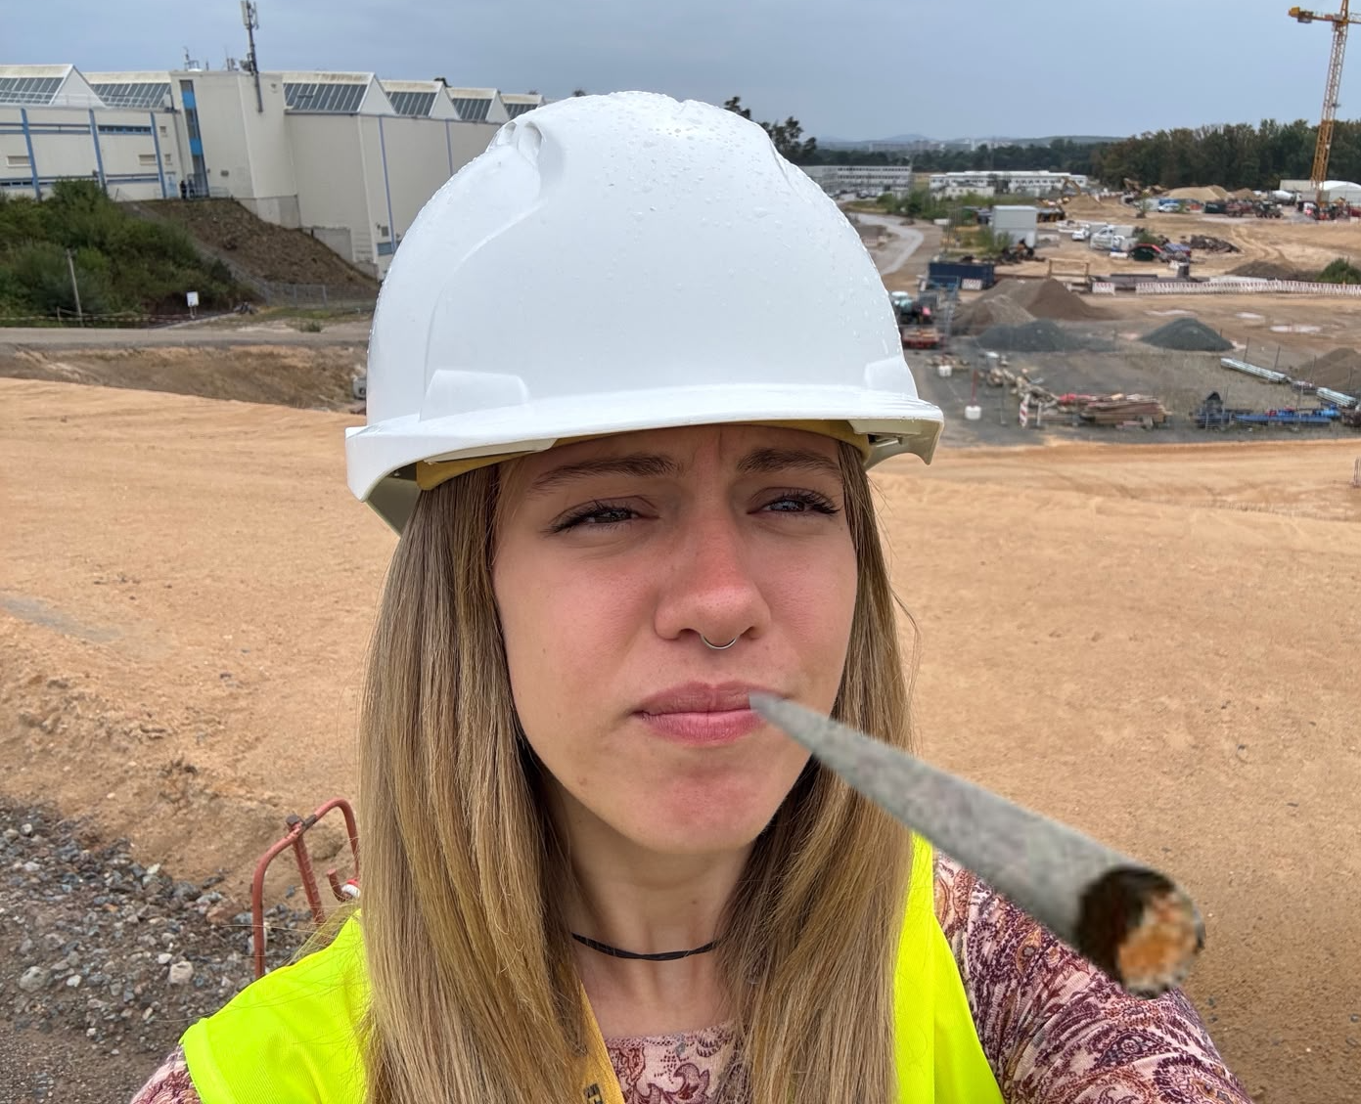




Acknoledgment
… e grazie per l’attenzione!!!

