Slide 1
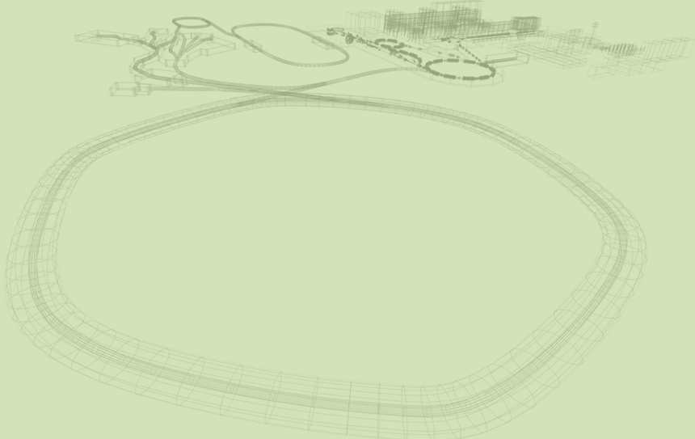
FLUKA Simulations and Physical Characterization of Proton Beams Base Data
for TRiP98 Treatment Planning
Desiree Furfaro
Università degli Studi di Napoli Federico II
Tutor: Martina Moglioni

Slide 2
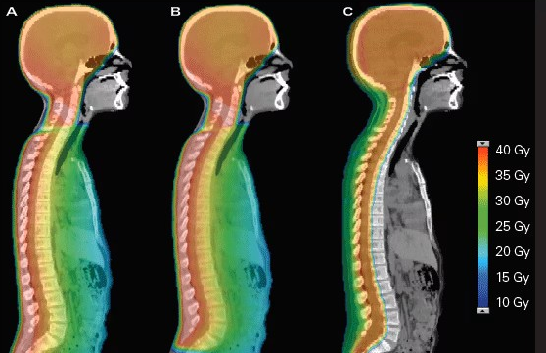
Proton Therapy
Dose:
Amount of energy deposited by ionizing radiation per unit mass of matter, measured in Gray (Gy).
Bragg peak:
Sharp maximum of energy deposition occurring near the end of a proton's path, allowing the dose to be concentrated at a specific depth.
Localized dose deposition:
High dose delivery concentrated within the target volume.

Slide 3
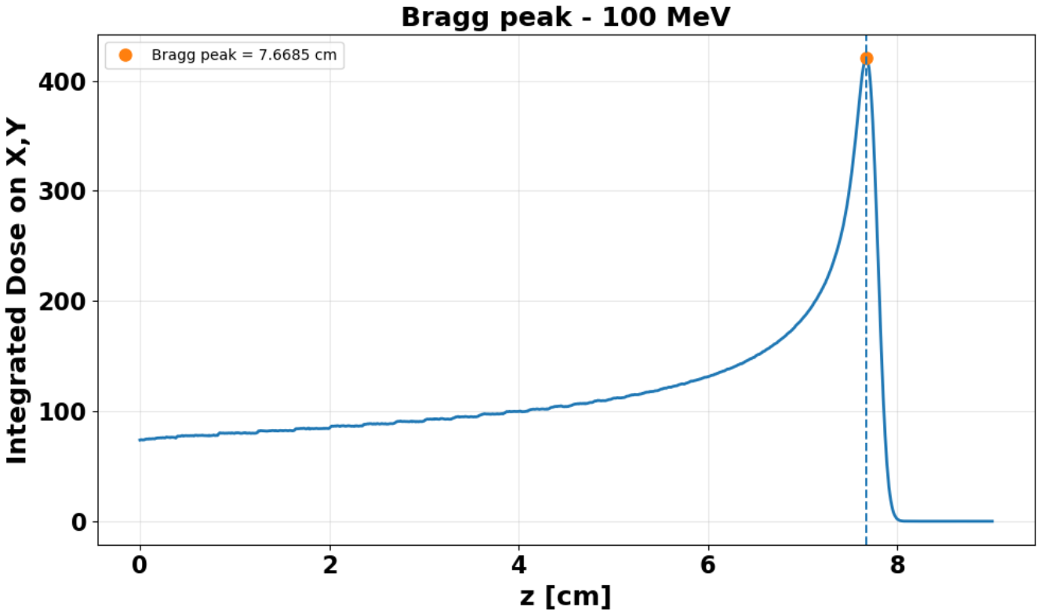
Reduced distal dose:
Minimal dose beyond the Bragg peak, sparing healthy tissues and critical organs.
Advantage for tumor treatment:
Improved dose conformity and reduced irradiation of surrounding healthy tissues.
Spread-Out Bragg peak (SOBP):
Combination of Bragg peaks at different depths to create a uniform high-dose region covering the entire tumor volume.
Example of Bragg peak for an energy of 100 MeV for protons:

Slide 4

Beam Characterization
Accurate proton beam characterization is essential for treatment planning,
as it allows the dose distribution to be reliably described within the patient.
In particular, the depth-dose distribution determines how the dose varies with penetration depth,
while the lateral beam spread describes the transverse distribution and broadening of the beam.
FLUKA simulations:
A Monte Carlo simulation code used to model particle interactions and radiation transport in matter, providing detailed dose and beam characterization.
TRiP98 treatment planning:
A treatment planning system, developed here at the GSI, for ion-beam therapy, used to calculate and optimize the dose distribution delivered
to the tumor.

Slide 5
Protons Interactions with Matter
Energy Loss
Electromagnetic interactions:
Protons continuously lose energy mainly through interactions with atomic electrons.
Energy deposition:
The lost energy is transferred to the medium, producing ionization and excitation.
Depth-dose distribution:
Energy deposition increases toward the end of the proton range, leading to the Bragg peak.
Multiple Coulomb Scattering (MCS)
Coulomb interactions:
Protons undergo repeated small-angle deflections due to interactions with atomic nuclei.
Angular deflections:
Multiple scattering progressively changes the proton trajectories.
Lateral beam broadening:
The accumulated deflections increase the transverse spread of the beam with depth.

Slide 6
Objectives
The main goal of this project is to generate proton beam base data for TRiP98
Simulate proton beams at different energies
Determine the Bragg peak and proton range for every energy
Characterize transverse beam broadening
Fit transverse profiles with a Double-Gaussian model
Compare MCS with the Highland model
Analyze primary and secondary particle spectra

Slide 7
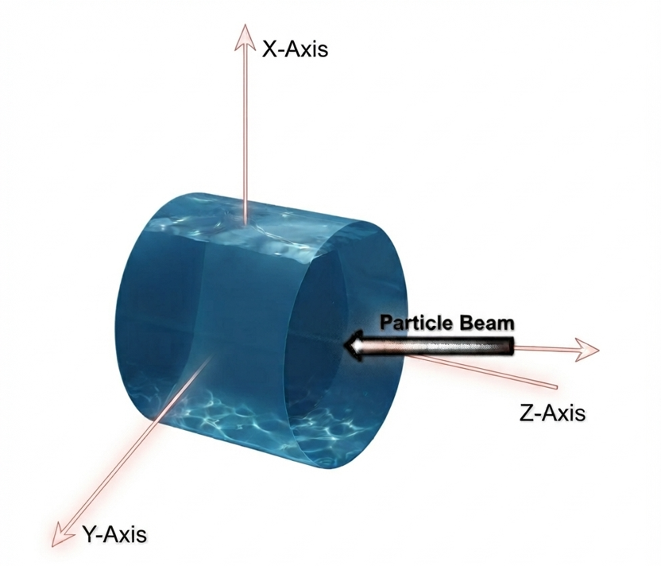
FLUKA Simulation Setup
A simplified water phantom was used to characterize the dose distribution of proton beams at different energies.
Geometry:
Cylindrical water target (WATER78)
Radius: 15 cm
Length: 50 cm
Vacuum environment
Proton beam:
Energies: 50, 100, 150, 200 MeV
Needle-like proton beam
Dose scoring:
3D dose distribution: scored using USRBIN
Spatial resolution: 0.1 × 0.1 × 0.1 mm³

Slide 8
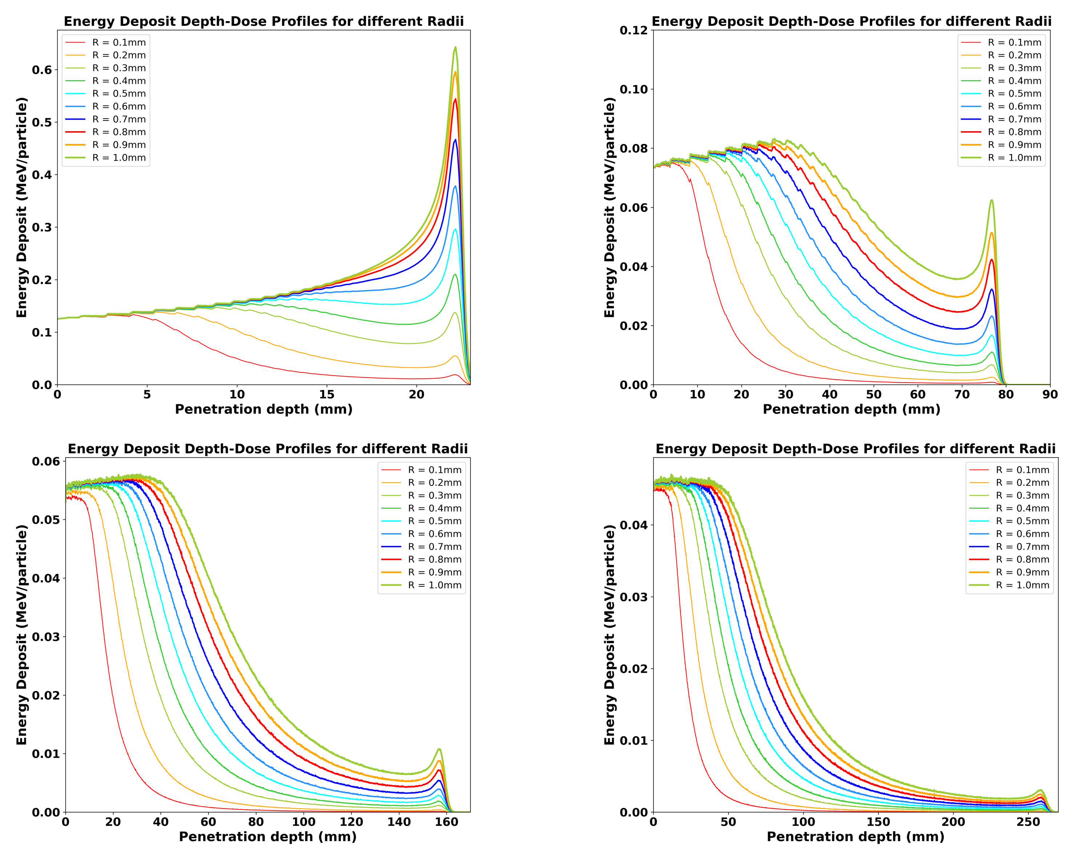
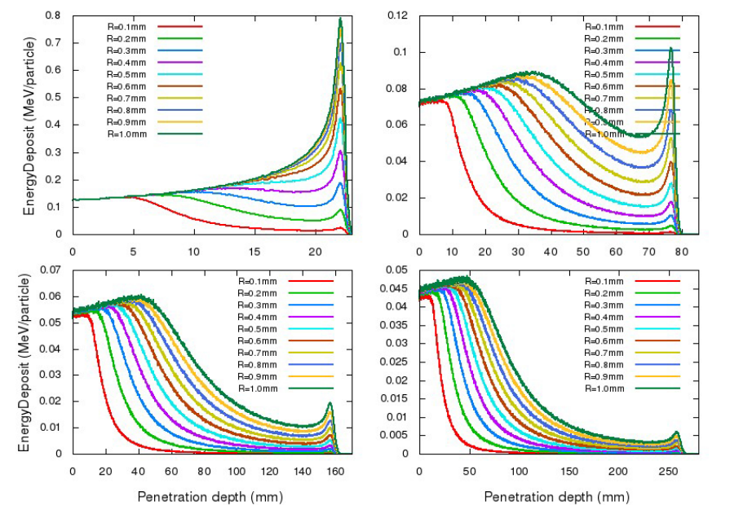
Results of the Depth-Dose Distributions for Protons
Good agreement with the previous Monte Carlo results (using GEANT4), despite small deviations due to different implementations and statistical fluctuations
Simulations on FLUKA: 50, 100, 150 and 200 MeV for protons
Simulations on GEANT4: 50, 100, 150 and 200 MeV for protons

Slide 9
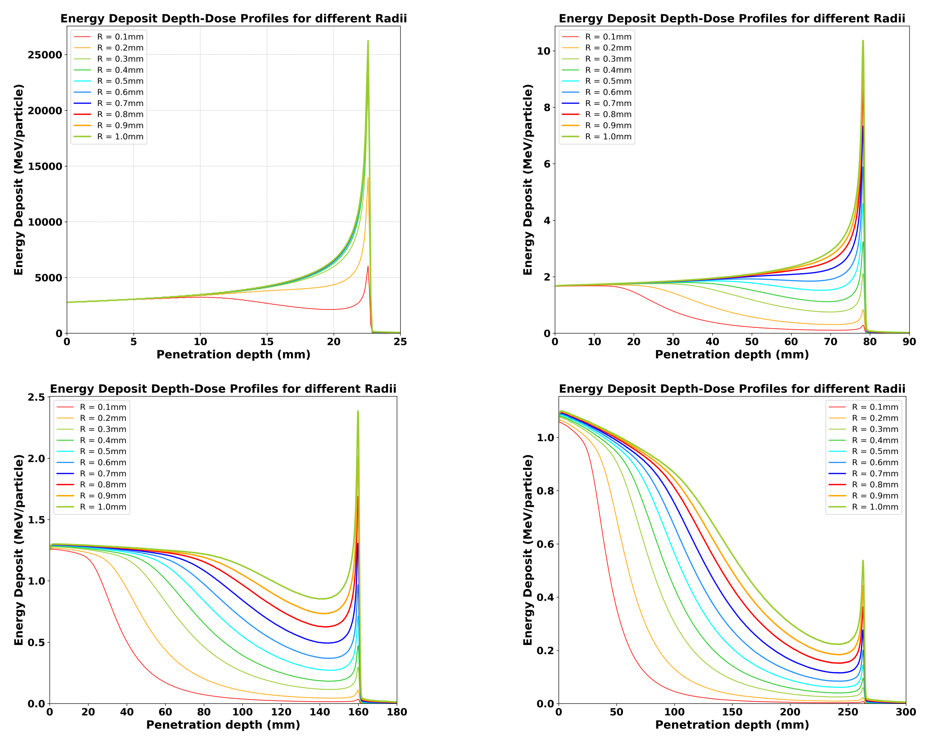
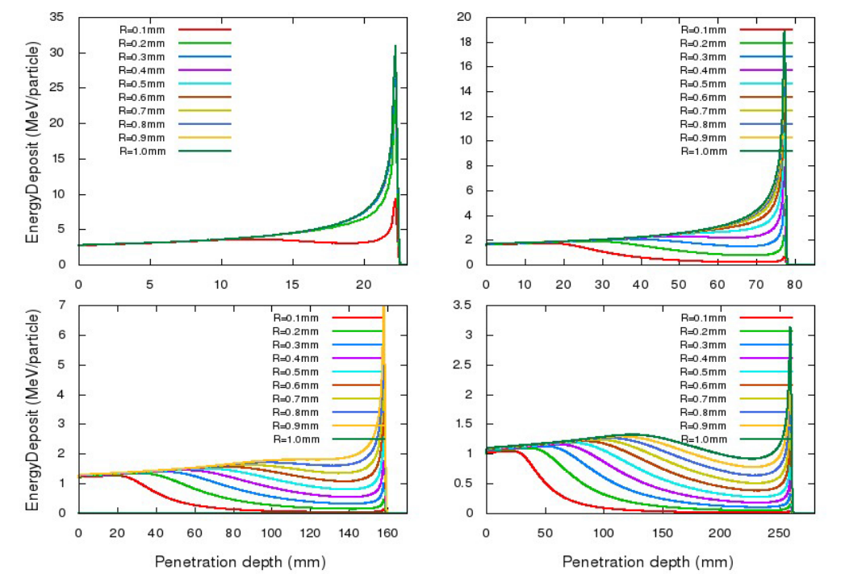
Results of the Depth-Dose
Distributions for Carbon Ions
The carbon energy was determined by using the same range and identifying the corresponding energy value through LISECUTE++.

Slide 10
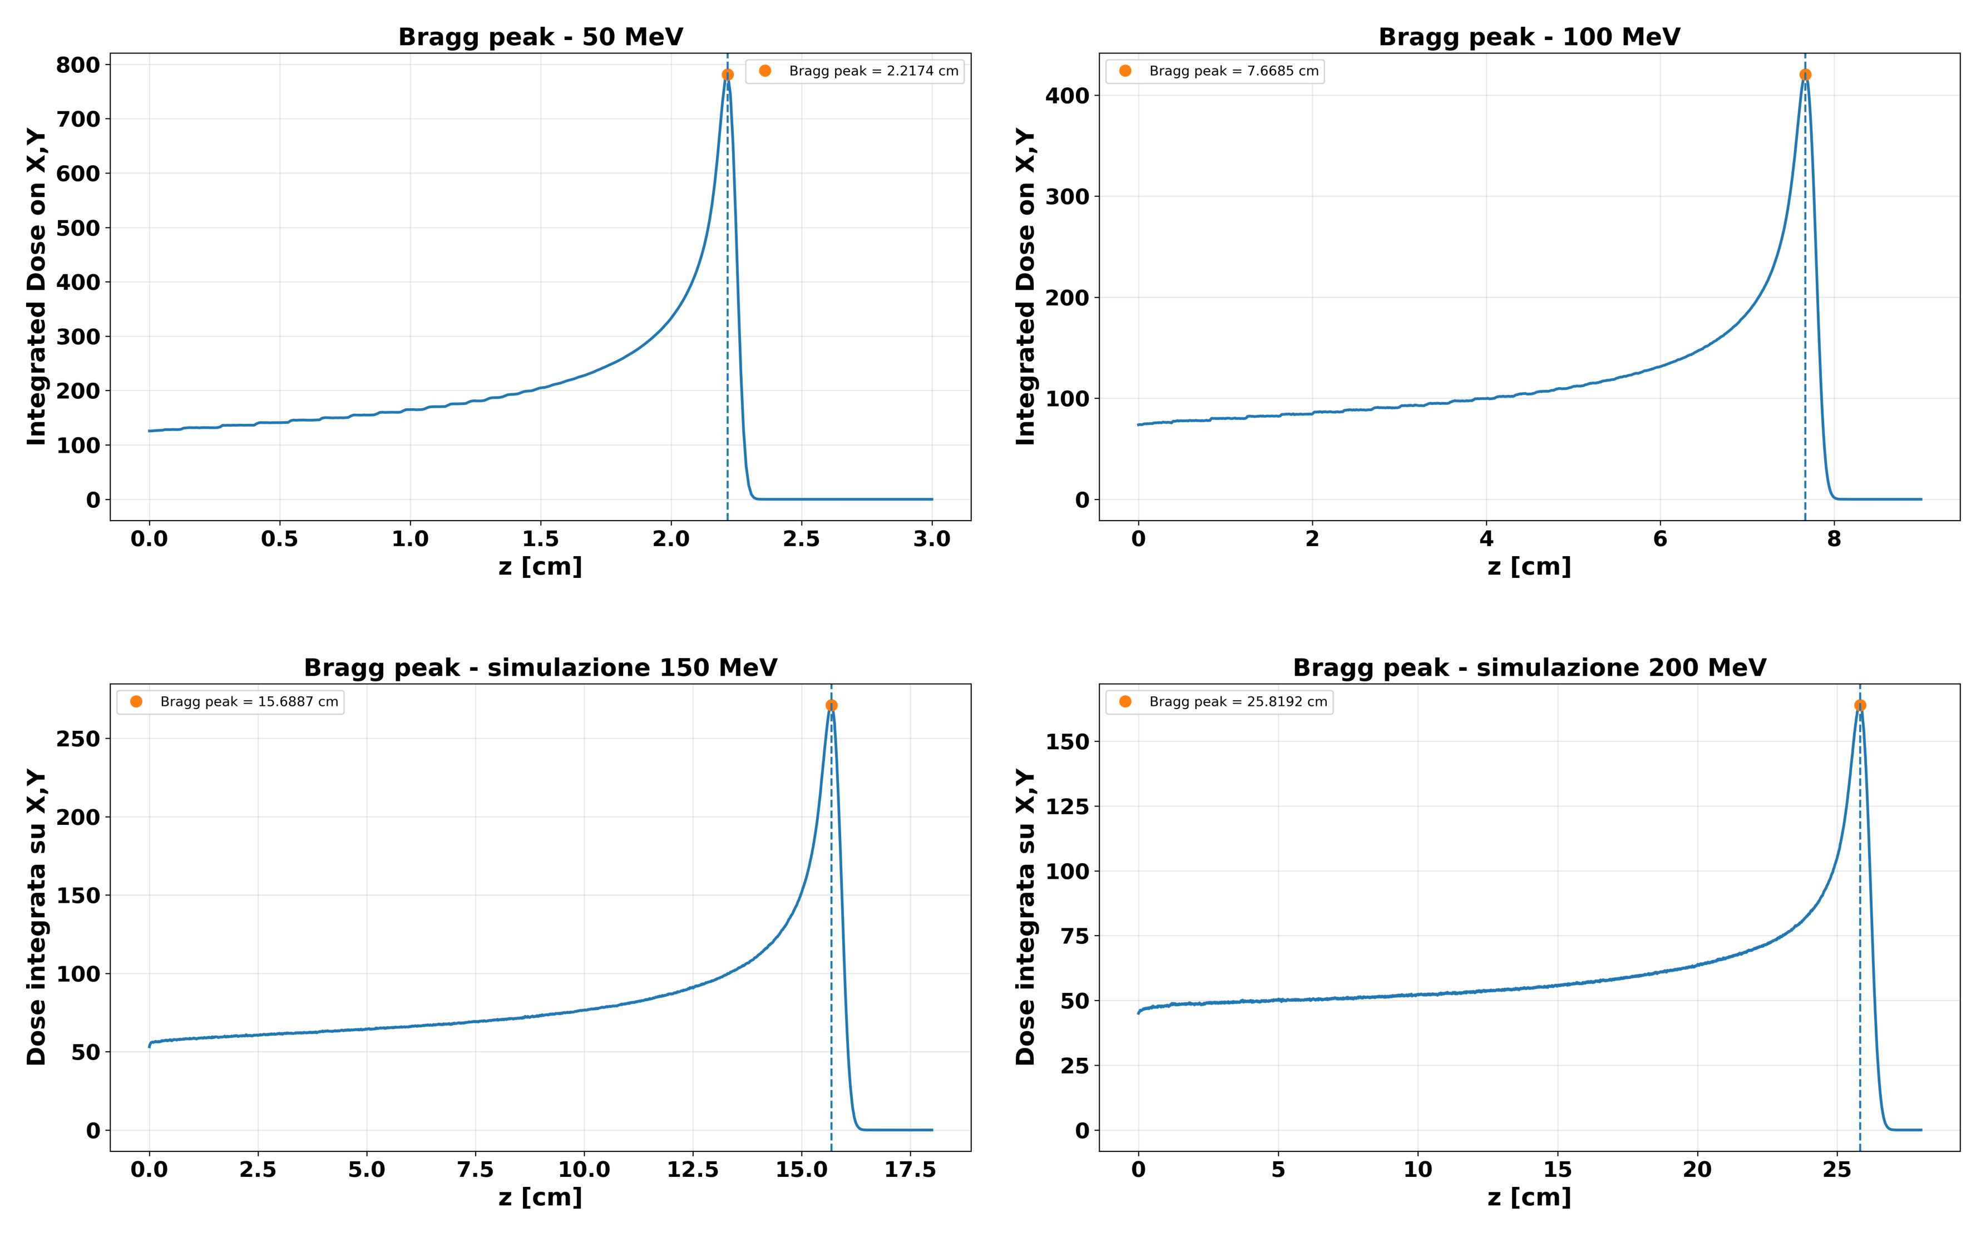
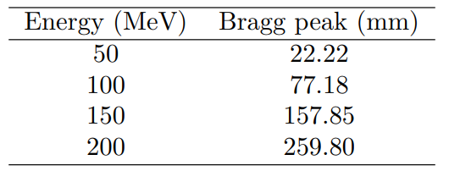
Bragg Peak Position
The depth-dose distribution shows a characteristic Bragg peak, with the peak position increasing with proton energy.
These are the results from the FLUKA simulations.

Slide 11
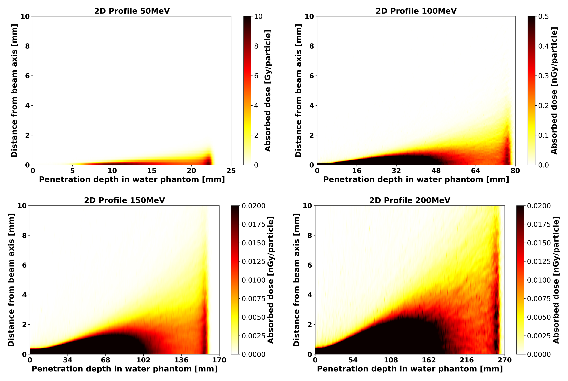
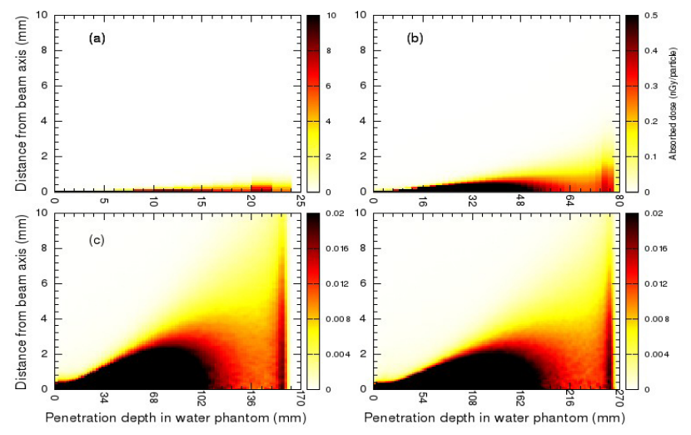
2D Profiles for Protons
The 2D lateral dose profiles show good agreement with previous Monte Carlo results, confirming the consistency of the FLUKA beam characterization, with only minor deviations and statistical fluctuations.
Simulations on FLUKA:
Simulations on GEANT4:

Slide 12
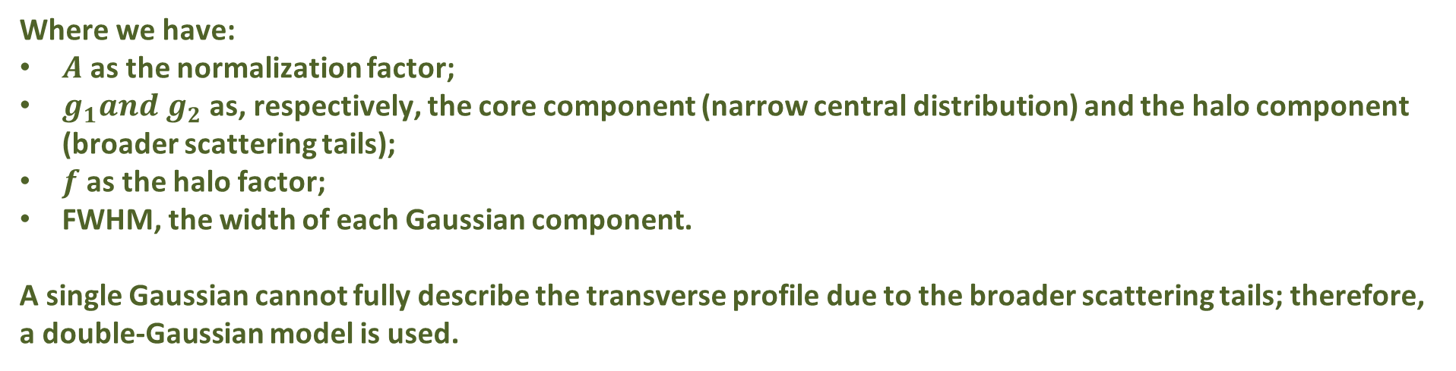
Double-Gaussian Model
$$D\left(x\right)=A[\left(1−f\right)g_{1}+f∗g_{2}]$$
Where we have:
$A$ as the normalization factor;
$g_{1}and g_{2}$ as, respectively, the core component (narrow central distribution) and the halo component (broader scattering tails);
$f$ as the halo factor;
FWHM, the width of each Gaussian component.
A single Gaussian cannot fully describe the transverse profile due to the broader scattering tails; therefore, a double-Gaussian model is used.

Slide 13
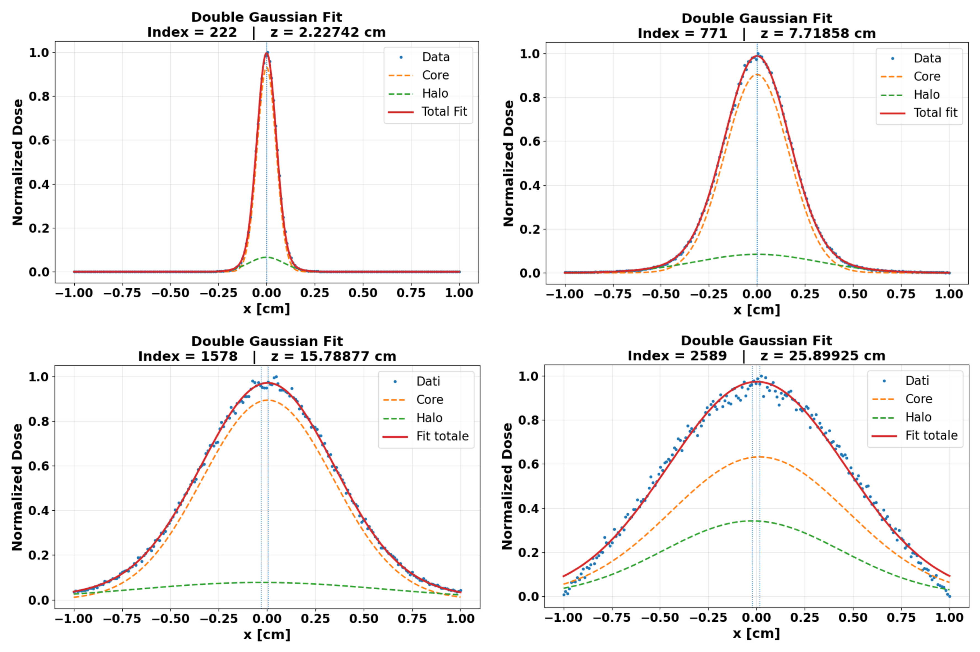
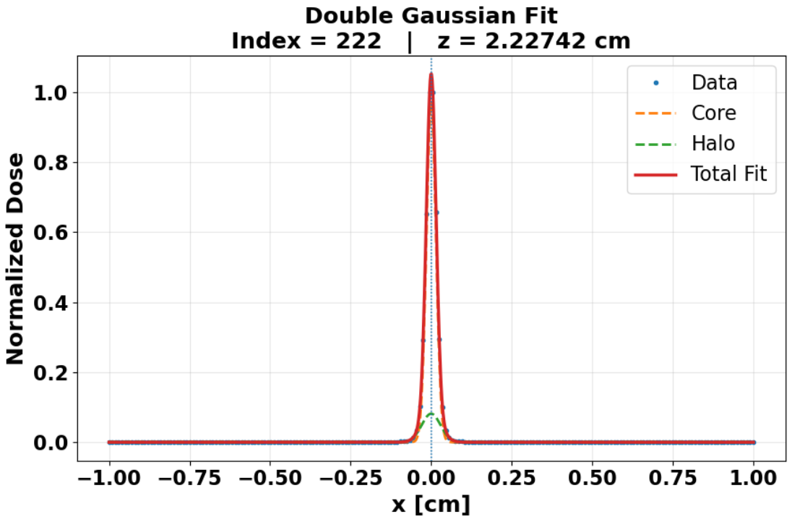
Double Gaussian model applied on the four different proton energies:
Double Gaussian fit for proton energies: (FLUKA simulations)
Double Gaussian fit for carbon-ions for 92.49MeV:
(FLUKA simulations)

Slide 14
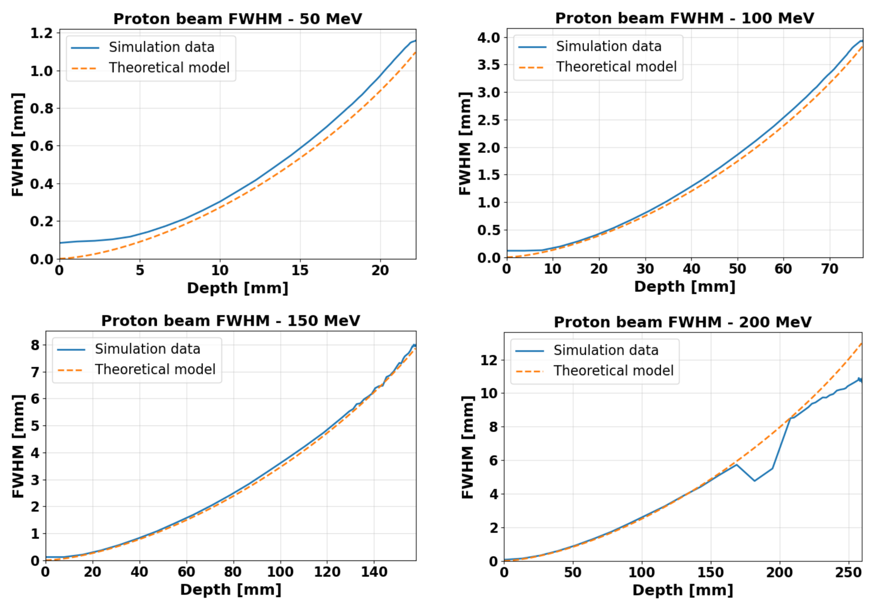
FLUKA vs Highland:
FWHM [mm] vs Depth [mm]
The FLUKA results reproduce the expected increase in lateral beam broadening with depth. The comparison with the Highland prediction shows overall consistency, with deviations reflecting the limitations of the analytical model compared with the full Monte Carlo description.
The reason the two trends do not match is that the theoretical model's data account only for kinetic energy loss, rather than all the scattering processes that FLUKA takes into account.

Slide 15
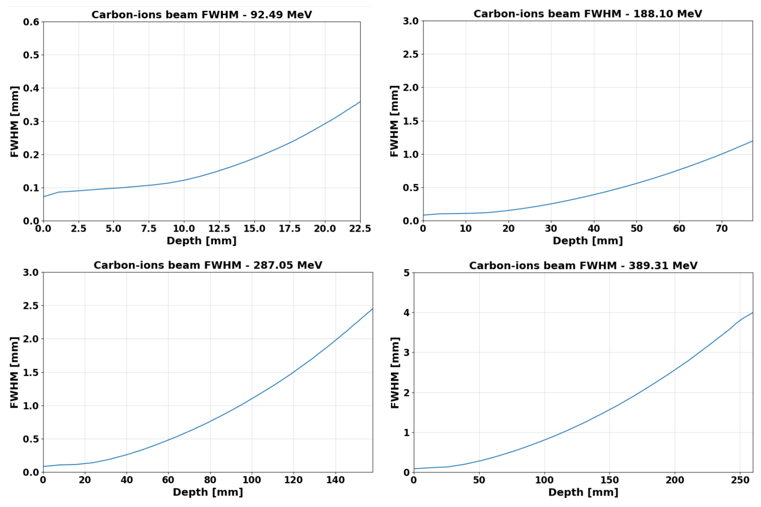
FWHM[mm] vs Depth[mm] for Carbon Ions

Slide 16
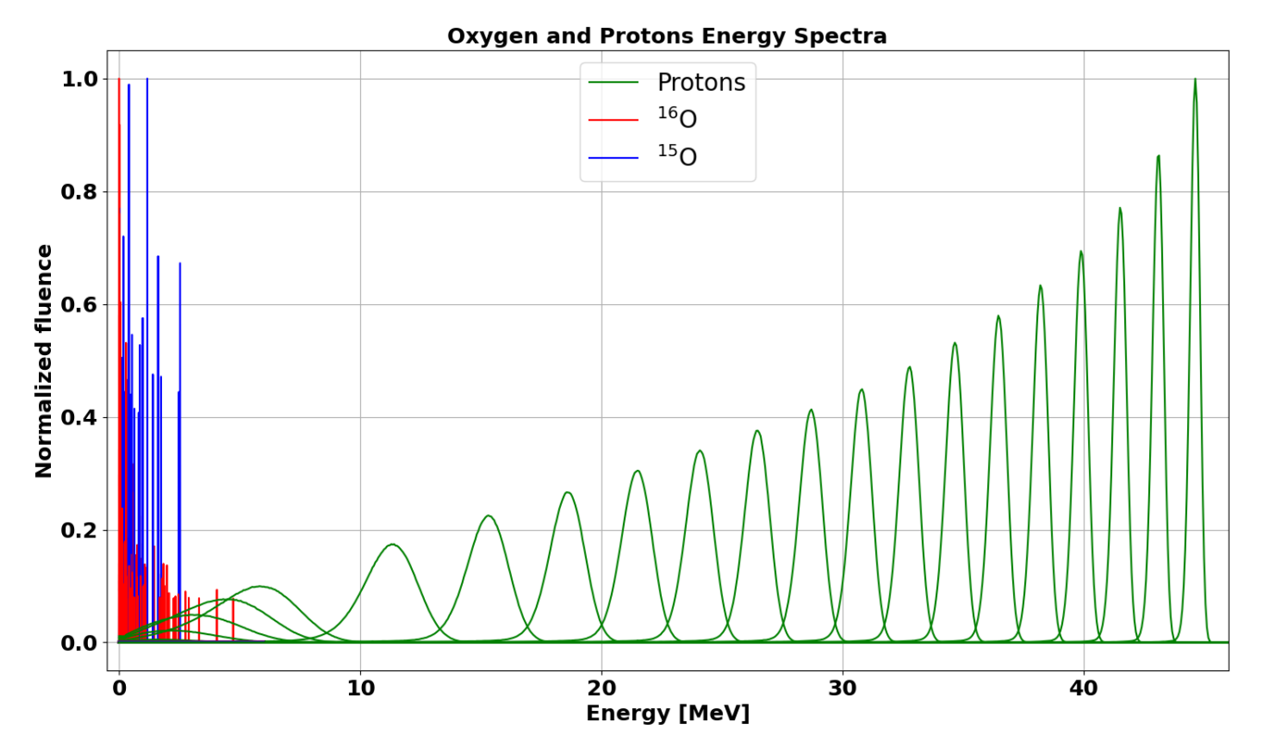
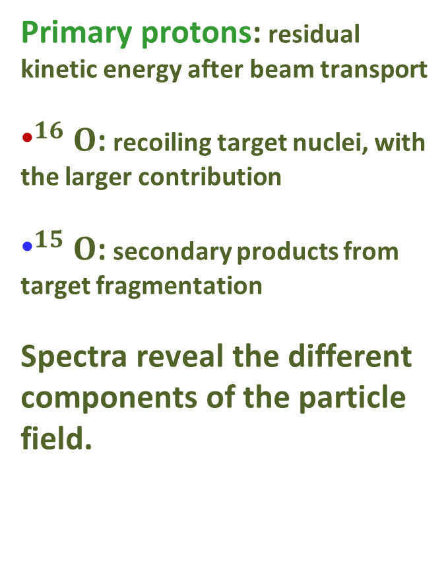
Particle Spectra
Primary protons: residual kinetic energy after beam transport
${\text{•}}^{16}O$: recoiling target nuclei, with the larger contribution
${\text{•}}^{15}O$: secondary products from target fragmentation
Spectra reveal the different components of the particle field.

Slide 17
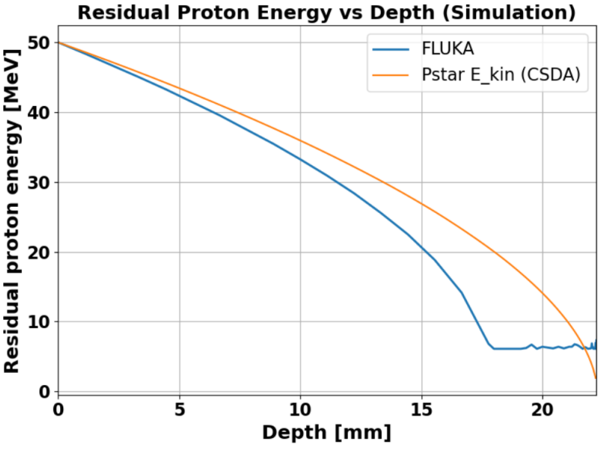
FLUKA vs Pstar:
Residual Proton Energy
In this analysis, it’s investigated how the residual kinetic energy of the primary protons changes with depth.
As expected, the proton energy progressively decreases as the particles travel through the water target.
The FLUKA results take into account not only electromagnetic energy losses, but also nuclear interactions and MCS, which contribute to broadening the energy distribution.

Slide 18
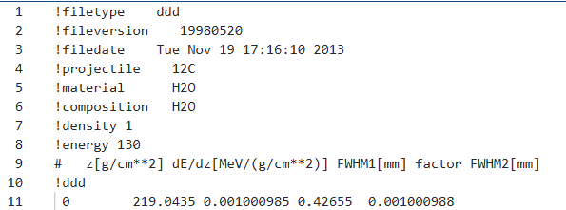
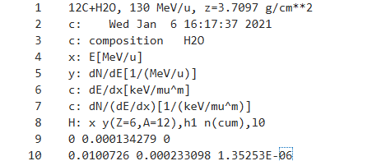
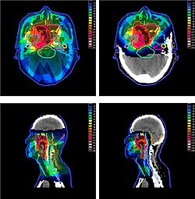


TRiP98
The parameters will be converted in TRiP98 format:
.ddd files (Depth-Dose Distribution) and .spc files (Spectra)
This base data is used for RiP98 for treatment planning, to calculate optimal target coverage.

Slide 19
Conclusions
To conclude, this work allows to generate and characterize the base data
required for the description of therapeutic proton beams.
The depth-dose distributions and Bragg peak positions were investigated for different beam energies, while the lateral profiles were characterized using double-Gaussian fits.
Also, the particle energy spectra was studied to obtain information about the different components of the radiation field and the nuclear interactions occurring in the target.
Overall, the results provide a basis for the characterization of therapeutic proton beams and represent a first step towards the future implementation of these base data in TRiP98 for treatment planning.

Slide 20
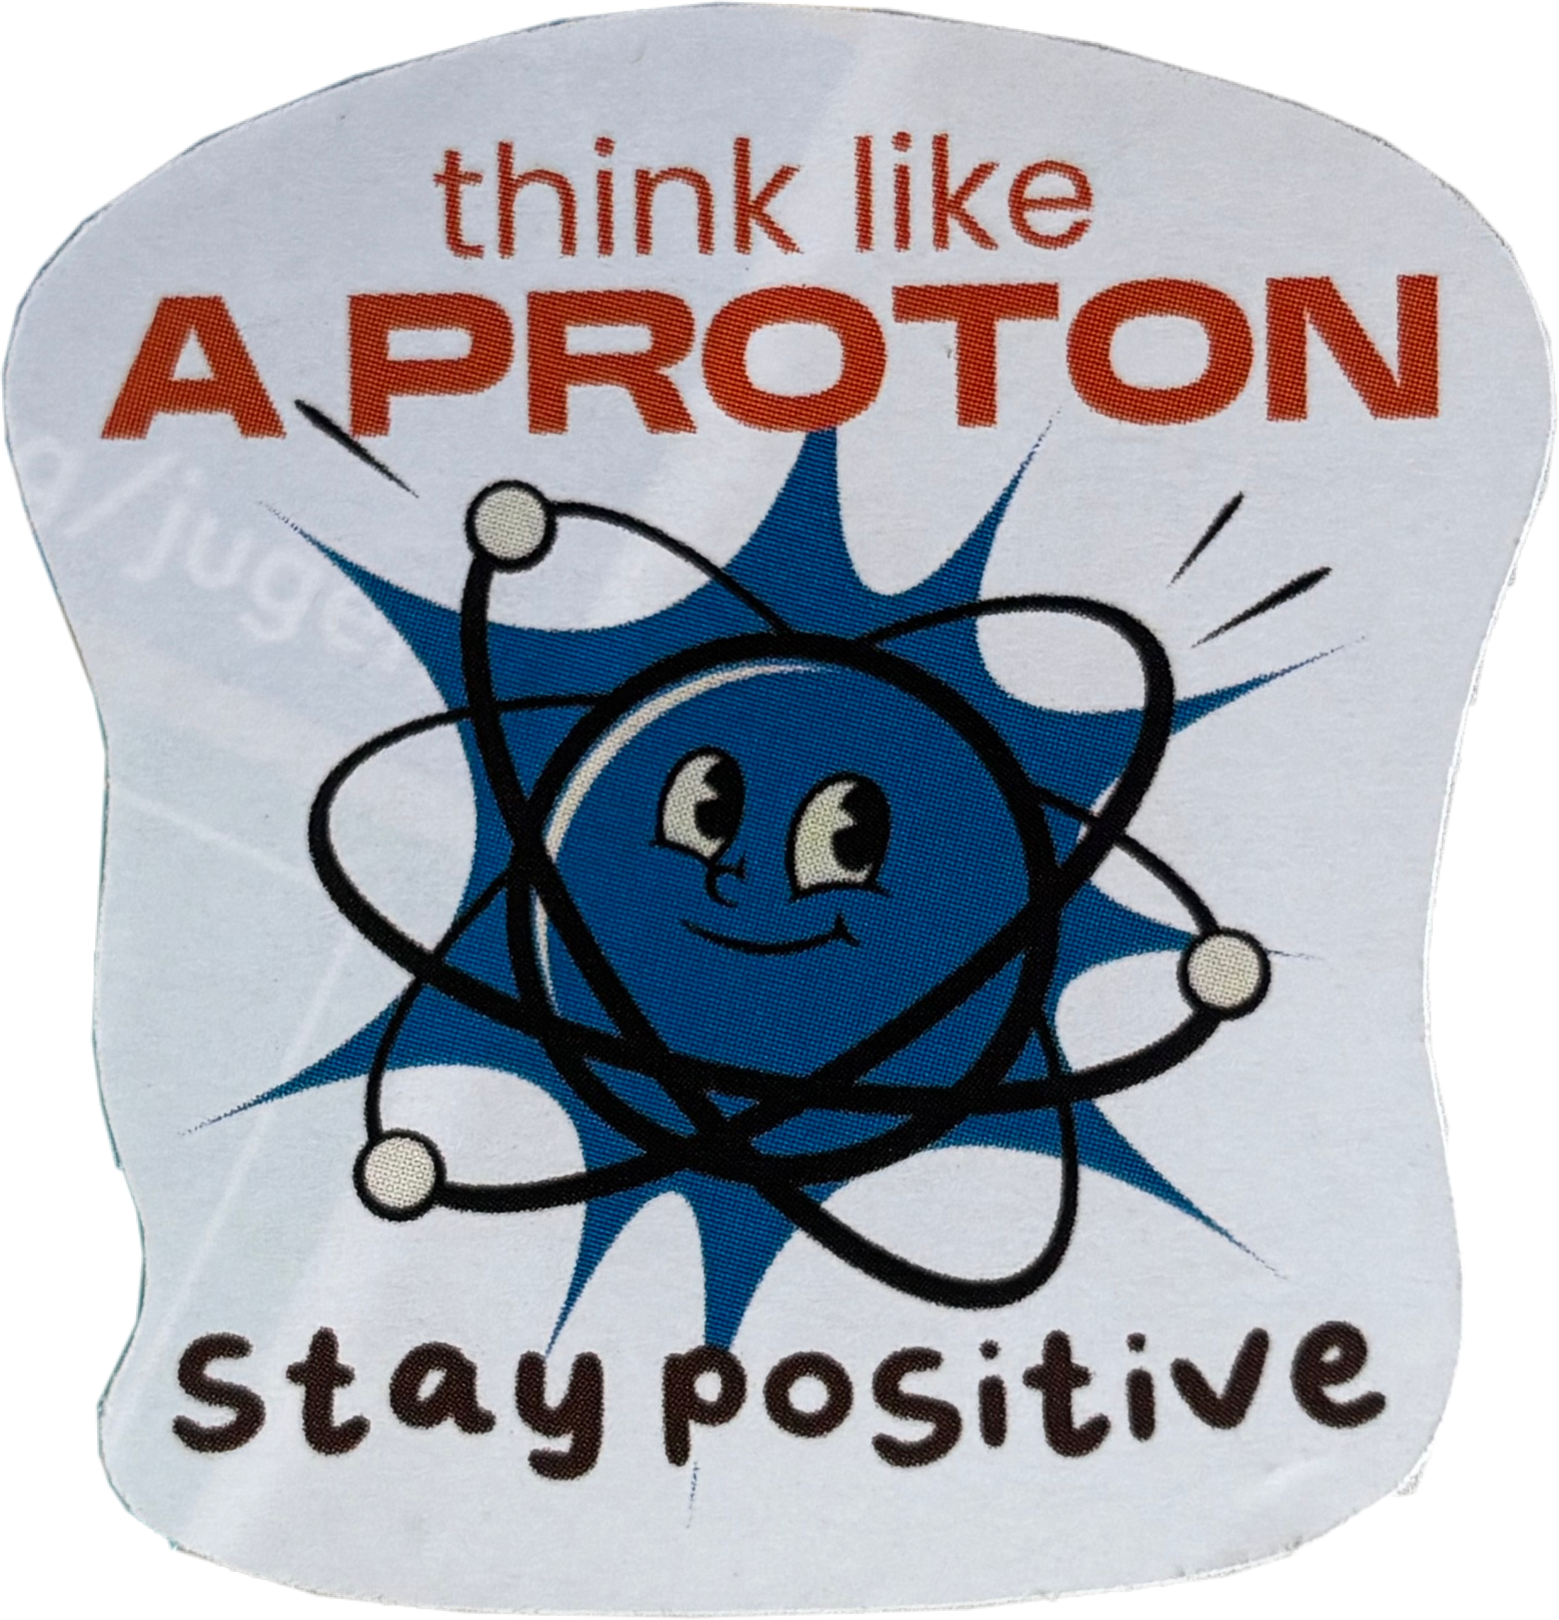
Thank you for your attention!

