Slide 1
AI-accelerated robust optimisation in particle therapy
Carmen-Andreea Maxim
“Babeș-Bolyai” University | GSI International Summer Student Program
Scientific Coordinator
Prof. Dr. Christian Graeff
14th September 2026

Slide 2
Table of contents
Introduction
b. AI MODEL
Conclusion
a. Proof of concept
Motivation

Slide 3
Introduction
Cancer therapies:
- Radiotherapy
- Particle therapy
Update 7th September 2026

Slide 4
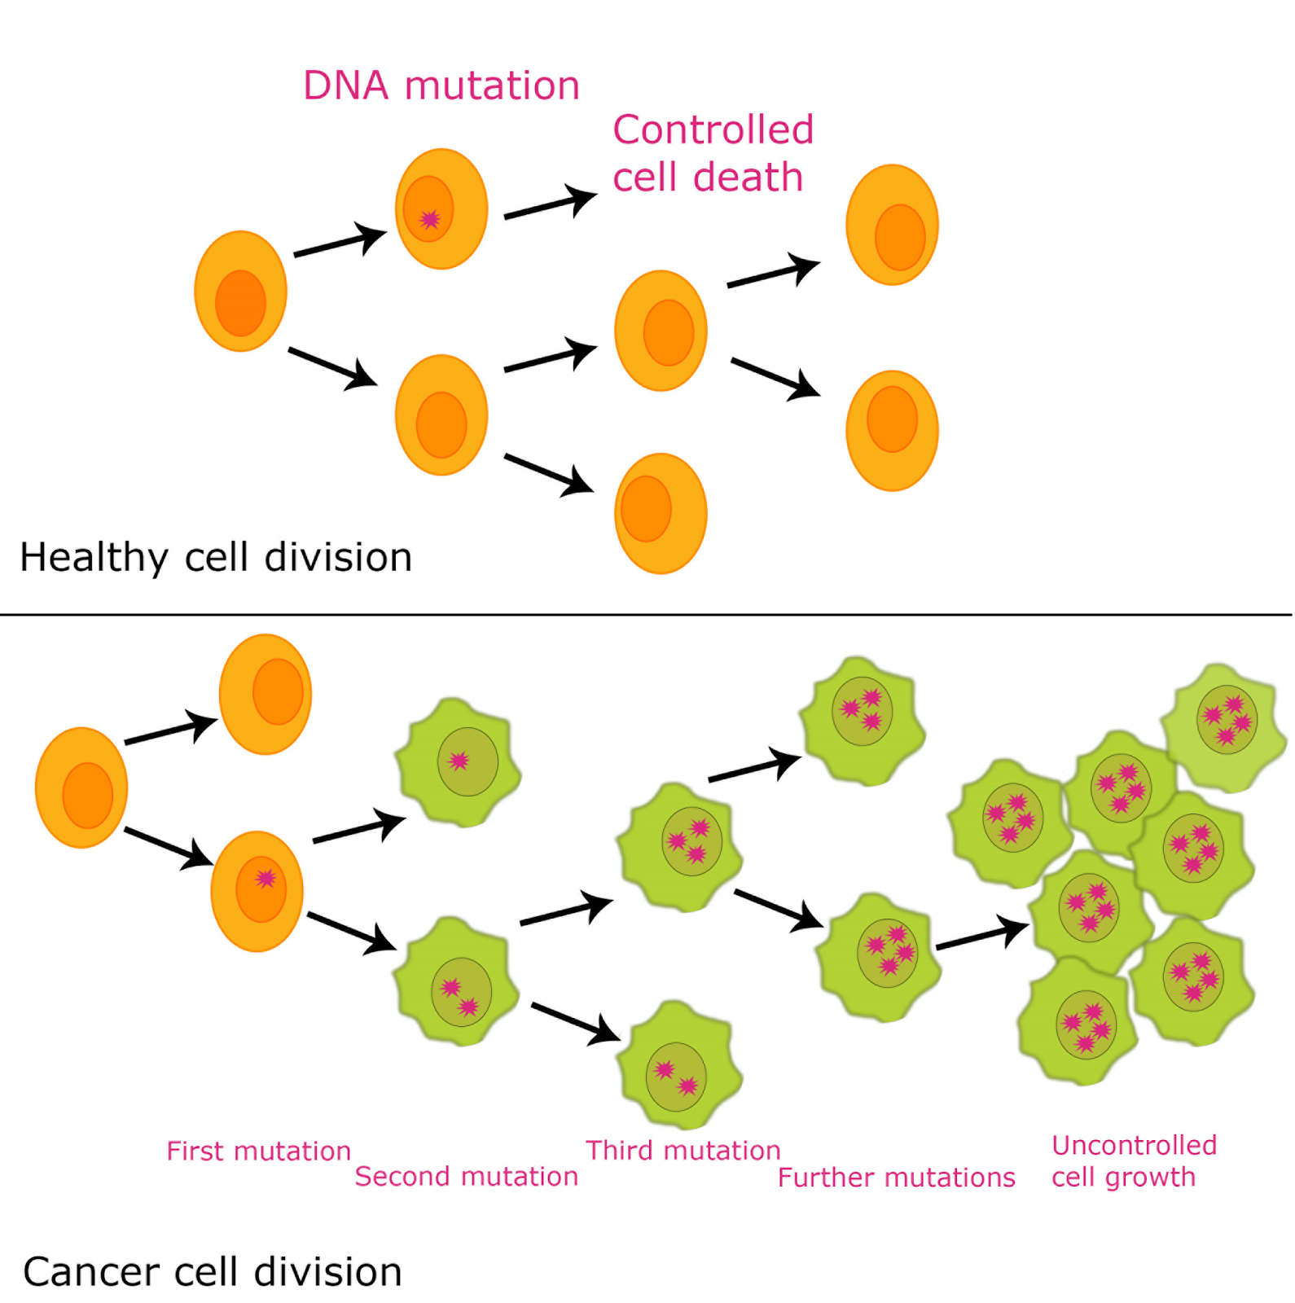
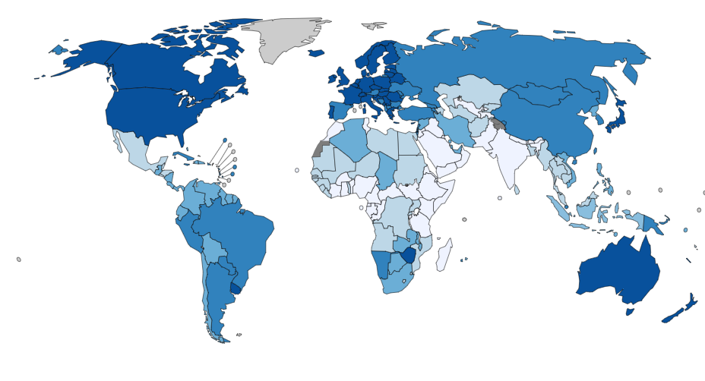
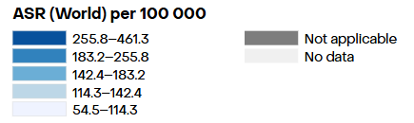
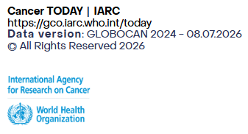
Cancer
Medical challenge of the century
Driven by uncontrolled genetic mutations
~1 in 5 people will develop cancer in their lifetime¹
Mortality rate:1 in 9 (men) and 1 in 13 (women)
¹: GLOBOCAN 2022
Notes:
Cancer remains one of the great medical challenges of our century. At its core, it's a genetic disease: cells accumulate mutations that let them escape normal control, divide uncontrollably, and invade healthy tissue. Statistically, almost one in five people will be diagnosed with some form of cancer during their lifetime. And the longer a tumor grows, the more new mutations it picks up — making it progressively harder to treat.

Slide 5
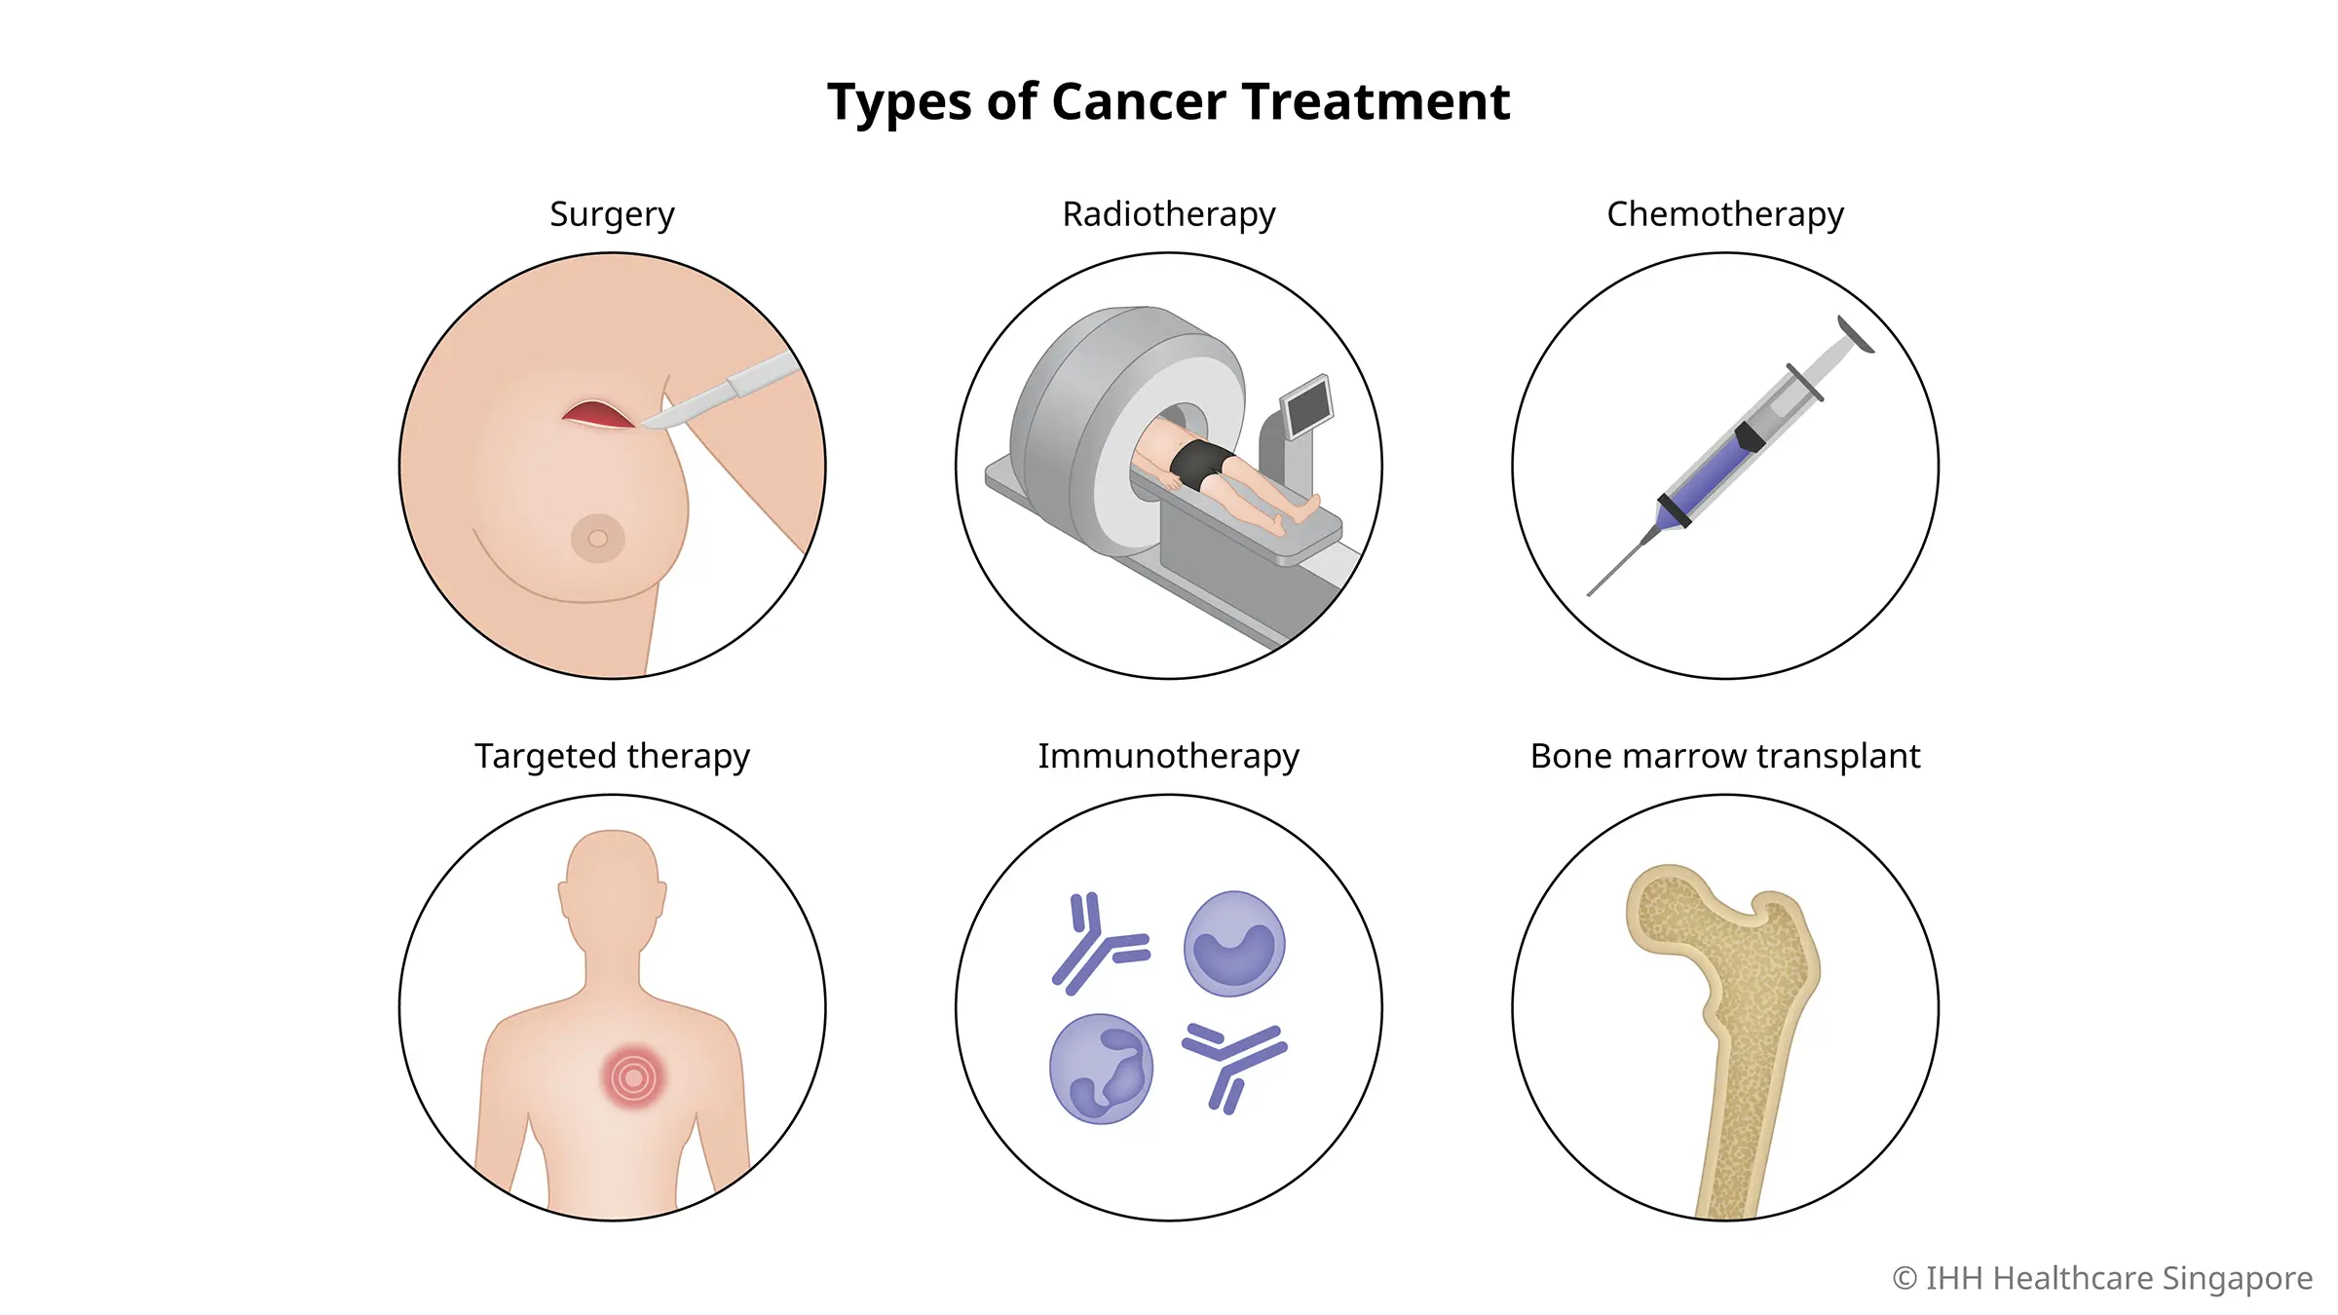
Cancer
Main current treatments
Trains the immune system to recognise and attack cancer cells
Used in ~50% of patients, local
Solid, localised, accessible tumours
Systemic action
Whole-body toxicity
Notes:
Surgery physically removes the tumor, but only works if it's localized and reachable. Chemotherapy attacks fast-dividing cells anywhere in the body, but it also damages healthy ones. Immunotherapy is newer — it trains the immune system to recognize and attack cancer cells. And radiotherapy, used in roughly half of all cancer patients, destroys the tumor locally with radiation — which is where our topic begins."

Slide 6
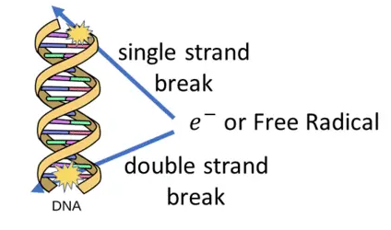

Radiotherapy
How radiation destroys cancer cells
DNA damage
Electrons
directly break chemical bonds
Ionise water molecules
Create free radicals
https://cdn.shortpixel.ai/spai/w_966+q_lossy+ret_img+to_webp/howradiologyworks.com/wp-content/uploads/2019/06/Slide4-1.gif
Notes:
Conventional radiotherapy uses high-energy X-ray photons. When a photon hits tissue, the Compton effect occurs: the photon transfers energy to an electron, which is ejected and travels through the cell. This electron ionizes surrounding molecules — including water, the most abundant molecule in cells — generating highly reactive free radicals. These radicals attack DNA, causing breaks. The worst-case scenario is a break in both strands of the DNA double helix at the same location — damage the cell usually can't repair correctly, leading to cell death.

Slide 7
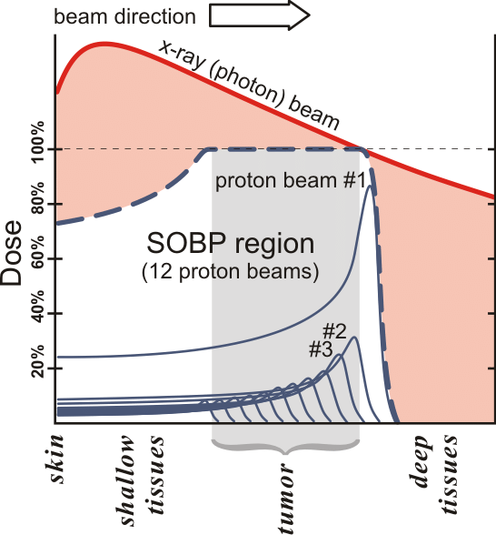

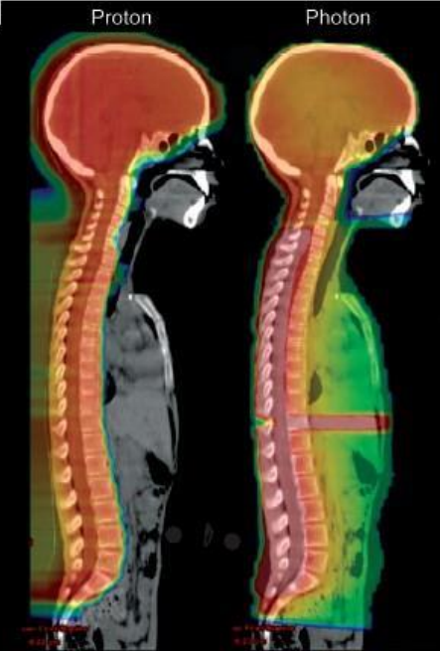
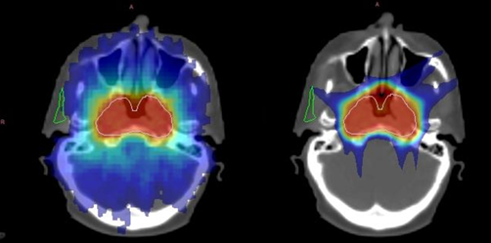
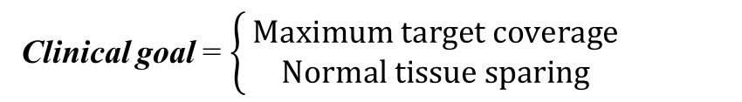
Radiotherapy
X-ray problem
→ Particle Therapy
Clinical goal = $\left\{\begin{matrix} Maximum target coverage & \\ Normal tissue sparing & \end{matrix}\right.$
Medulloblastoma – pediatric cancer
→ Photon’s depth-dose profile:
  Energy deposition peaks near the skin surface;
  Exponential decrease with depth.
  Organs at Risk (OARs) exposure.
→ Charged particles’ depth-dose profile:
  Energy deposition at a precise depth.
  = the Bragg peak
  Beyond the peak: dose drops to nearly zero
  Precise dose delivery (energy modulation).
  Multiple beams + varying energies
    → SOBP (Spread-Out Bragg Peak)
    Entire tumour coverage
  High dose in the tumour, OAR sparing
Photon
Proton
https://www.researchgate.net/publication/325426270/figure/fig3/AS:631654955634730@1527609685667/The-different-depth-dose-distributions-from-photons-and-protons-as-a-function-of-depth.png
Notes:
The fundamental problem with X-rays is the shape of their depth-dose profile: energy deposition peaks near the skin surface and then decreases roughly exponentially with depth. In practice, the beam keeps traveling through the body after reaching the tumor, depositing unnecessary — sometimes dangerous — dose in healthy organs nearby, called organs at risk, or OARs.

Slide 8
Motivation
Treatment Uncertainties
Full Robust Optimisation
Update 7th September 2026

Slide 9
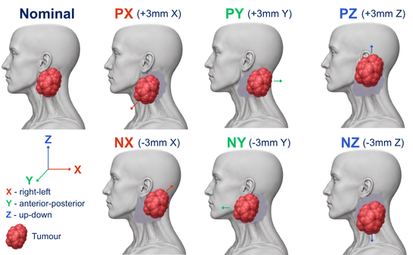
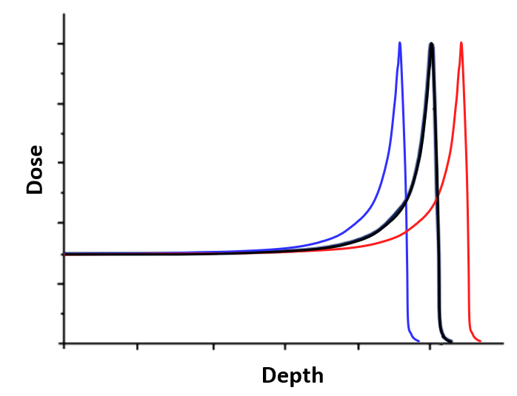
Treatment Uncertainties
Shift in the field’s range
-3%
+3%
Patient positioning → 6 error scenarios
Range uncertainty → 2 error scenarios
Daily setup variations | Internal organ motion | Anatomical changes
Notes:
The precision of the Bragg peak is, paradoxically, also its weak point. Because the high dose is concentrated at one exact depth, even a small change matters enormously: the patient isn't positioned identically at every session, organs shift with breathing, and anatomy can change day to day — bladder filling, weight loss, swelling. These positioning and range variations can shift the Bragg peak exactly where it shouldn't be — outside the tumor, or straight into a healthy organ.

Slide 10
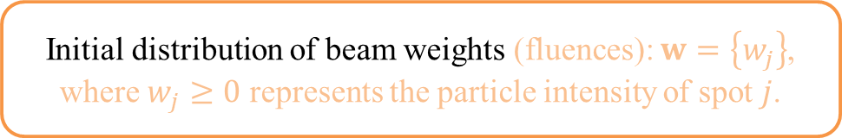
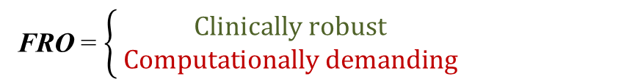
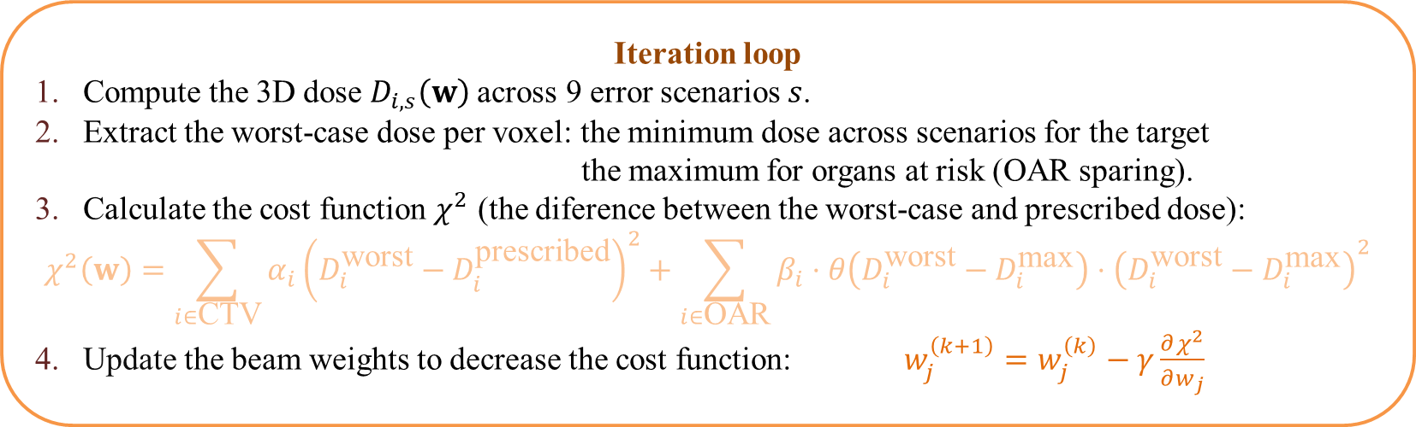
Full Worst-Case Robust Optimisation (FRO)
- Mitigates treatment uncertainties
Initial distribution of beam weights (fluences): $w=\left\{w_{j}\right\}$, where $w_{j}≥0$ represents the particle intensity of spot $j$.
voxel = the 3D equivalent of a pixel
Iteration loop
Compute the 3D dose $D_{i,s}\left(w\right)$across 9 error scenarios $s$.
Extract the worst-case dose per voxel: the minimum dose across scenarios for the target the maximum for organs at risk (OAR sparing).
Calculate the cost function $χ^{2}$ (the diference between the worst-case and prescribed dose):
$$χ^{2}\left(w\right)=\sum_{i∈\text{CTV}}{α_{i}}{\left(D_{i}^{\text{worst}}−D_{i}^{\text{prescribed}}\right)}^{2}+\sum_{i∈\text{OAR}}{β_{i}}⋅θ\left(D_{i}^{\text{worst}}−D_{i}^{\text{max}}\right)⋅{\left(D_{i}^{\text{worst}}−D_{i}^{\text{max}}\right)}^{2}$$
4. Update the beam weights to decrease the cost function: $w_{j}^{\left(k+1\right)}=w_{j}^{\left(k\right)}−γ\frac{∂χ^{2}}{∂w_{j}}$
Need for AI-acceleration
FRO = $\left\{\begin{matrix} Clinically robust & \\ Computationally demanding & \end{matrix}\right.$
→
Notes:
Unlike conventional photon radiotherapy, carbon ion therapy exploits the Bragg peak to deposit maximum energy precisely inside the tumor while sparing healthy tissues. However, this sharp physical fall-off makes treatment plans extremely vulnerable to setup errors and range uncertainties, which can shift high doses into critical organs at risk. To ensure safety, clinical routines rely on Full-Robust Optimization, evaluating 9 distinct uncertainty scenarios for every voxel. While effective, calculating these 3D dose matrices at every single optimization iteration creates a severe computational bottleneck.

Slide 11
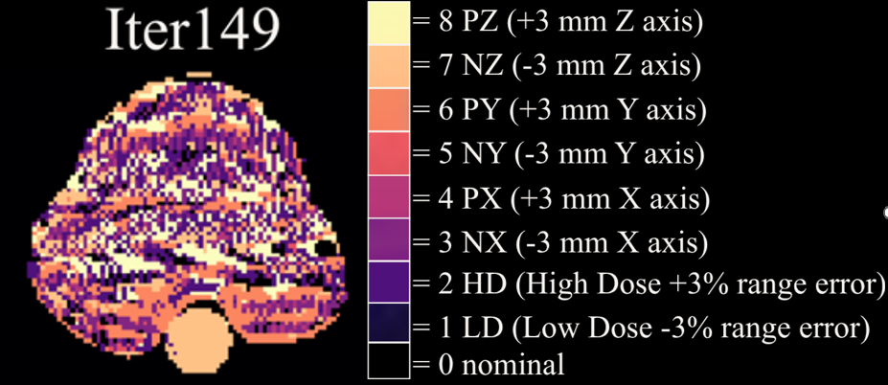
Predicted Worst-Case Robust Optimisation (PRO)
Employes an AI Model to predict the Worst-Case Scenario Map (WCM) = 3D map of the worst scenario per voxel.
The Goal
The predicted WCM + nominal scenario are supplied to the treatment planning system
Clinically acceptable plan, avoiding the computational demand.

Slide 12
A. Proof of Concept Study
Update 7th September 2026

Slide 13
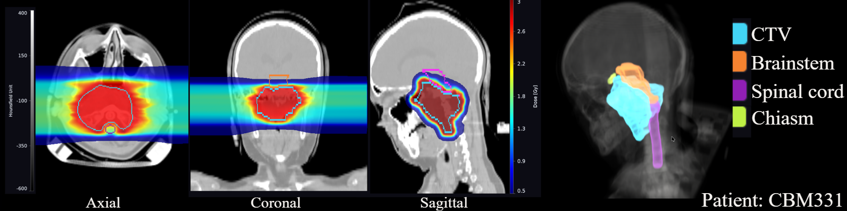
Materials & Methods
Cohort = 49 head-and-neck cancer patients (GSI-HN database).
TRiP98 treatment planning system:
1. Plan optimisation → 2. Robustness evaluation
Find the optimised spot intensities Calculate the optimised spot intensities across 9 error scenarios
Treatment plans
2 opposing fields, optimisation parameters that prioritise:
target coverage + OARs sparing: brainstem, spinal cord, and optic chiasm
Notes:
Unlike conventional photon radiotherapy, carbon ion therapy exploits the Bragg peak to deposit maximum energy precisely inside the tumor while sparing healthy tissues. However, this sharp physical fall-off makes treatment plans extremely vulnerable to setup errors and range uncertainties, which can shift high doses into critical organs at risk. To ensure safety, clinical routines rely on Full-Robust Optimization, evaluating 9 distinct uncertainty scenarios for every voxel. While effective, calculating these 3D dose matrices at every single optimization iteration creates a severe computational bottleneck.

Slide 14
Materials & Methods
FRO (Full Robust Optimisation across all 9 uncertainty scenarios)
At each iteration step, the WCM was calculated and stored.
SSRO (Selected-Scenario Robust Optimisation)
– dose calculations only against the nominal scenario and the last iteration of WCM (FRO).
NRO (Non-Robust Optimisation)
– without taking into account uncertainties, to quantify the necessity of robust planning.

Slide 15
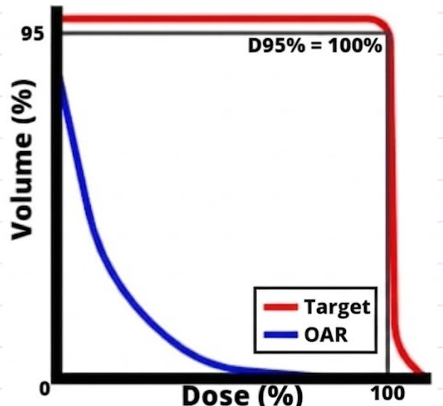
Materials & Methods
Evaluation Metrics
Dose-Volume Histogram (DVH)
D95 (the dose received by 95% of the volume) – characterises target coverage;
D50 – evaluates median target dose;

Slide 16
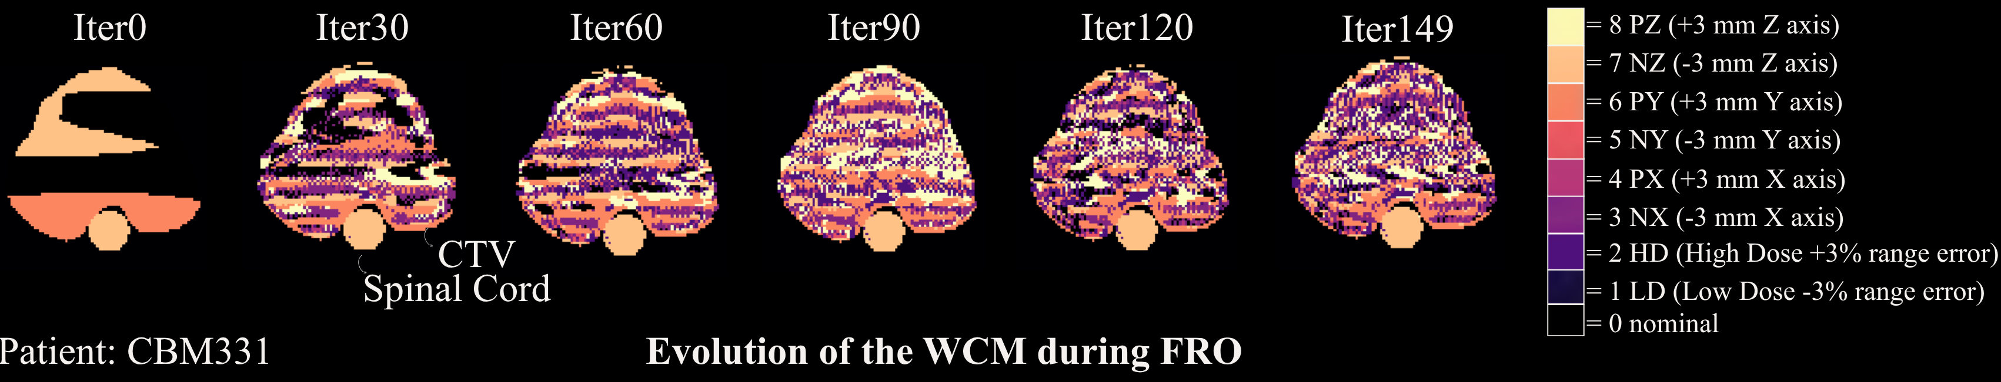
Results – 1 patient analysis
FRO (Full-Robust Optimisation across all 9 discrete uncertainty scenarios):
At each iteration step, the voxel-wise worst-case scenario (WCM) was identified and stored.
First iterations – homogeneity, few dominant scenarios
Progressively more heterogeneous CTV, with few stable regions
Stable pattern for OAR (spinal cord)
Behaviour observed across entire patient cohort
Initial indication that the final WCM is
AI-predictable.
Notes:
Unlike conventional photon radiotherapy, carbon ion therapy exploits the Bragg peak to deposit maximum energy precisely inside the tumor while sparing healthy tissues. However, this sharp physical fall-off makes treatment plans extremely vulnerable to setup errors and range uncertainties, which can shift high doses into critical organs at risk. To ensure safety, clinical routines rely on Full-Robust Optimization, evaluating 9 distinct uncertainty scenarios for every voxel. While effective, calculating these 3D dose matrices at every single optimization iteration creates a severe computational bottleneck.

Slide 17
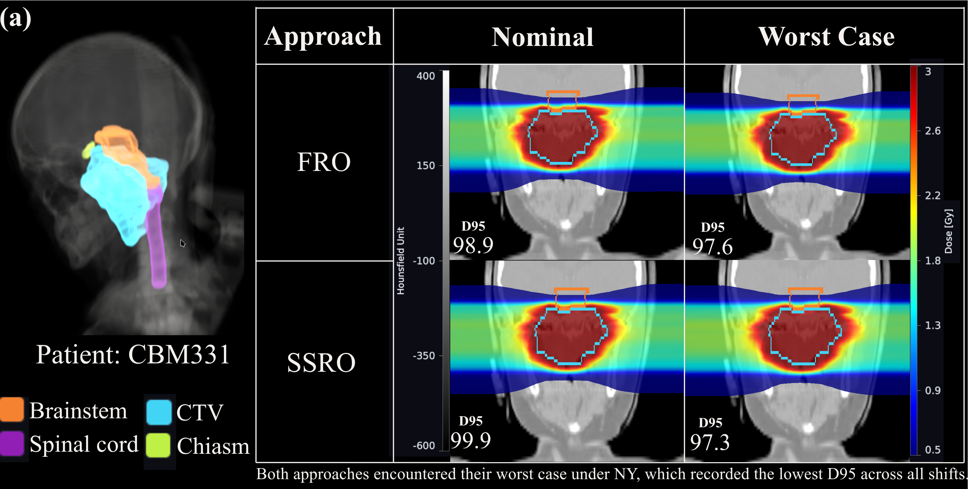
Results – 1 patient analysis
3D anatomy, coronal dose distributions, and D95 coverage for both robust strategies under nominal and worst-case scenarios
Notes:
Unlike conventional photon radiotherapy, carbon ion therapy exploits the Bragg peak to deposit maximum energy precisely inside the tumor while sparing healthy tissues. However, this sharp physical fall-off makes treatment plans extremely vulnerable to setup errors and range uncertainties, which can shift high doses into critical organs at risk. To ensure safety, clinical routines rely on Full-Robust Optimization, evaluating 9 distinct uncertainty scenarios for every voxel. While effective, calculating these 3D dose matrices at every single optimization iteration creates a severe computational bottleneck.

Slide 18
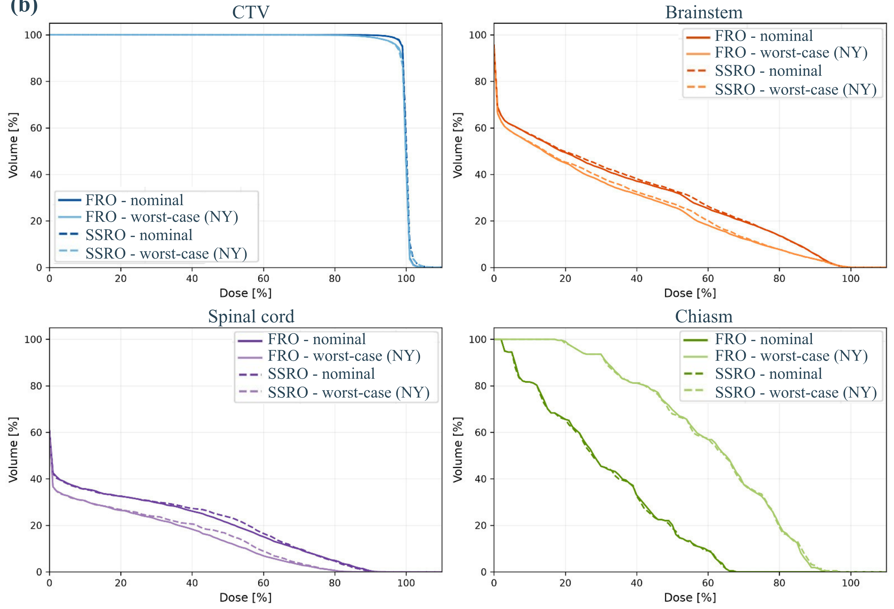
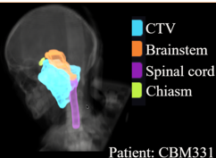
Results – 1 patient analysis
CTV:
FRO and SSRO overlap
Nominal case = steeper DVH slope than worse case (NY)
OARs
NY scenario shifts dose forward:
spares posterior OARs (brainstem, spinal cord)
increases exposure to chiasm
Notes:
Unlike conventional photon radiotherapy, carbon ion therapy exploits the Bragg peak to deposit maximum energy precisely inside the tumor while sparing healthy tissues. However, this sharp physical fall-off makes treatment plans extremely vulnerable to setup errors and range uncertainties, which can shift high doses into critical organs at risk. To ensure safety, clinical routines rely on Full-Robust Optimization, evaluating 9 distinct uncertainty scenarios for every voxel. While effective, calculating these 3D dose matrices at every single optimization iteration creates a severe computational bottleneck.

Slide 19
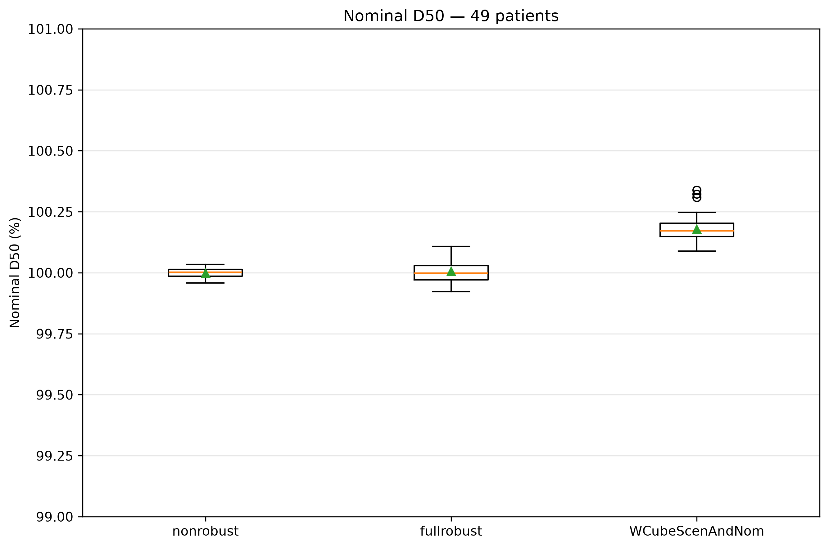
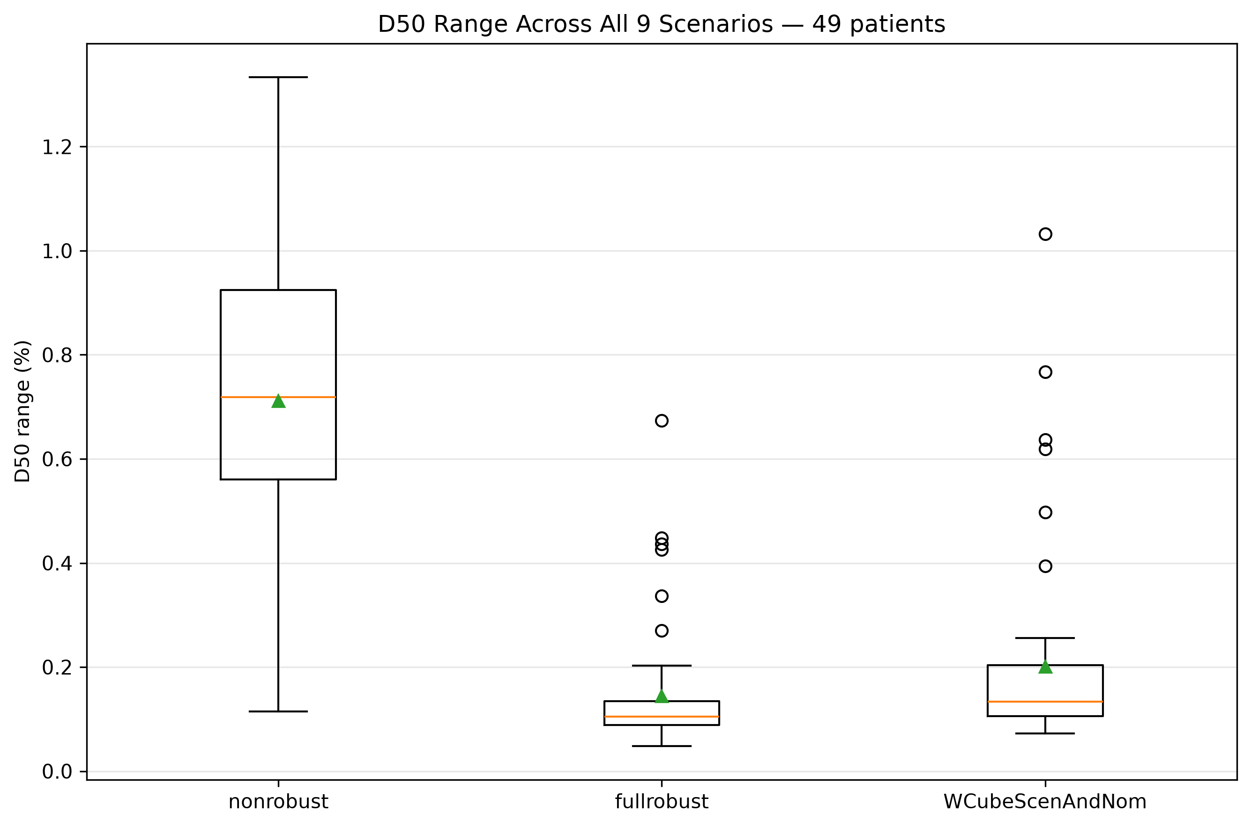
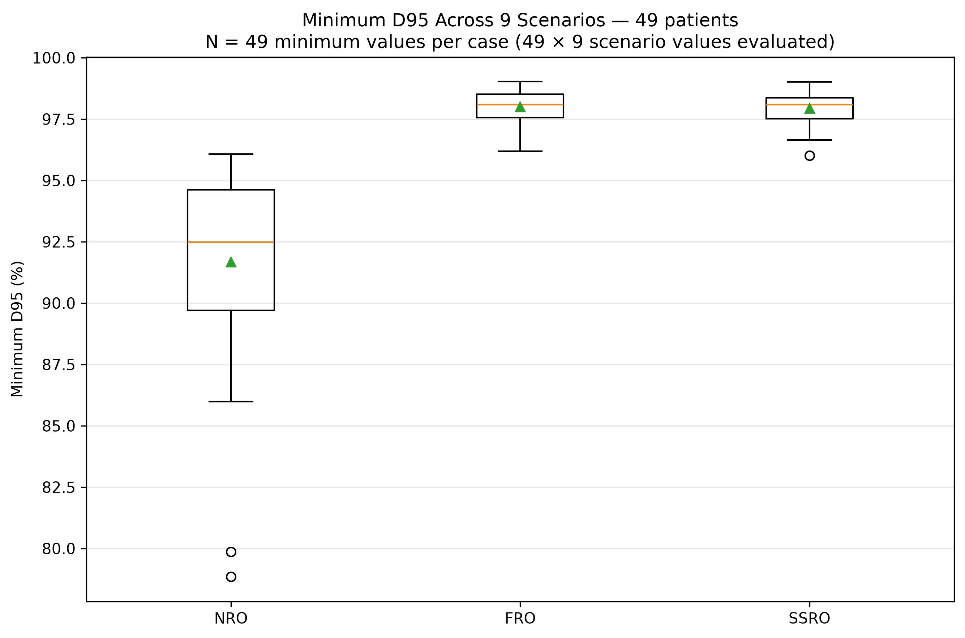
Results – Global Analysis
Global analysis
All strategies achieve a nominal D50 near 100%
SSRO – acceptable shift
SSRO, FRO = stable D50:
NRO = variable D50
NRO fails under worst-case shifts, while SSRO matches FRO
Notes:
Unlike conventional photon radiotherapy, carbon ion therapy exploits the Bragg peak to deposit maximum energy precisely inside the tumor while sparing healthy tissues. However, this sharp physical fall-off makes treatment plans extremely vulnerable to setup errors and range uncertainties, which can shift high doses into critical organs at risk. To ensure safety, clinical routines rely on Full-Robust Optimization, evaluating 9 distinct uncertainty scenarios for every voxel. While effective, calculating these 3D dose matrices at every single optimization iteration creates a severe computational bottleneck.

Slide 20
B. AI model
Update 7th September 2026

Slide 21
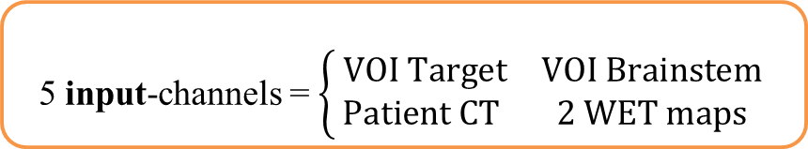
Materials & Methods
Aim: Predict the WCM directly from patient anatomy
  3D SegResNet architecture
  Implemented in MONAI (Medical Open Network for AI)
  Encoder-decoder structure with residual connections for volumetric spatial prediction.
5 input-channels = $\left\{\begin{matrix}\text{ V}OI Target & \text{VOI Brainstem } \\ Patient CT & \text{2 WET maps }\end{matrix}\right.$
Ground Truth = 9-channel probability distribution.
A voxel’s label is determined by counting how frequently each of the 9 scenarios occurs across the last 20 iterations of the WCM (FRO)
  9 output-channels = 9 logits per voxel
  – predicted probability distribution across the 9 uncertainty scenarios.
  The highest logit = the predicted worst-case scenario per voxel
WET map = Water Equivalent Thickness Map, encoding ranges of the beam
Notes:
Unlike conventional photon radiotherapy, carbon ion therapy exploits the Bragg peak to deposit maximum energy precisely inside the tumor while sparing healthy tissues. However, this sharp physical fall-off makes treatment plans extremely vulnerable to setup errors and range uncertainties, which can shift high doses into critical organs at risk. To ensure safety, clinical routines rely on Full-Robust Optimization, evaluating 9 distinct uncertainty scenarios for every voxel. While effective, calculating these 3D dose matrices at every single optimization iteration creates a severe computational bottleneck.

Slide 22
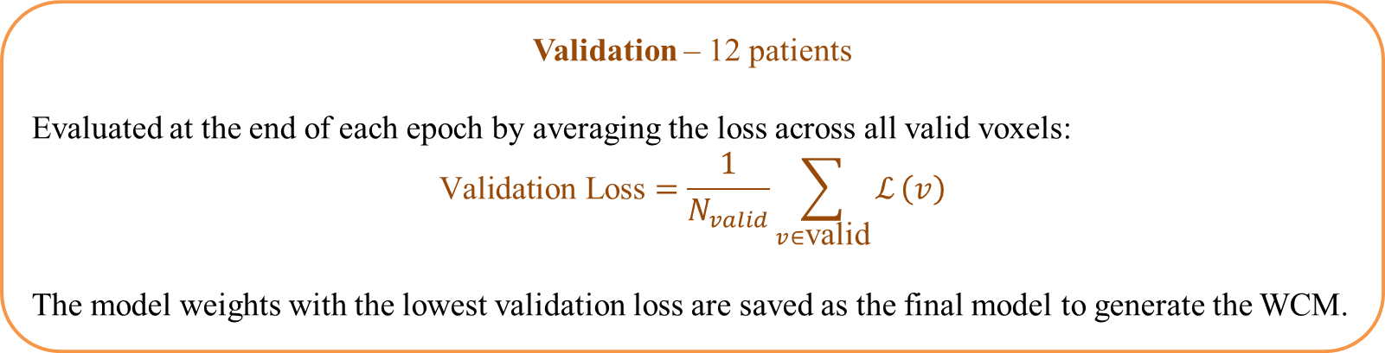
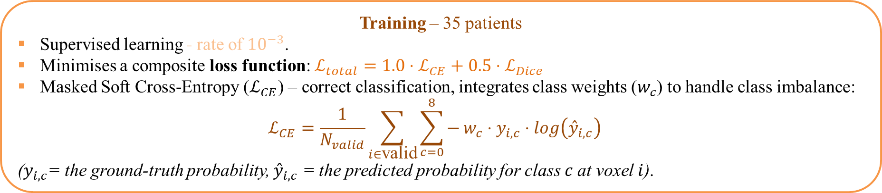
Materials & Methods
Training – 35 patients
Supervised learning - rate of ${10}^{−3}$.
Minimises a composite loss function: $ℒ_{total}=1.0⋅ℒ_{CE}+0.5⋅ℒ_{Dice}$
Masked Soft Cross-Entropy ($ℒ_{CE}$) – correct classification, integrates class weights ($w_{c}$) to handle class imbalance:
$$ℒ_{CE}=\frac{1}{N_{valid}}\sum_{i∈\text{valid}}{\sum_{c=0}^{8}{−}}w_{c}⋅y_{i,c}⋅{\log\left({\overset{ˆ}{y}}_{i,c}\right)}_{}$$
($y_{i,c}$= the ground-truth probability, ${\overset{ˆ}{y}}_{i,c}$ = the predicted probability for class $c$at voxel $i$).
Validation – 12 patients
Evaluated at the end of each epoch by averaging the loss across all valid voxels:
$$\text{Validation Loss}=\frac{1}{N_{valid}}\sum_{v∈\text{valid}}{ℒ}\left(v\right)$$
The model weights with the lowest validation loss are saved as the final model to generate the WCM.
${\text{Dice Loss Component} ℒ}_{Dice} e$ncourages spatial overlap between predictions and ground-truth distributions.
Notes:
Unlike conventional photon radiotherapy, carbon ion therapy exploits the Bragg peak to deposit maximum energy precisely inside the tumor while sparing healthy tissues. However, this sharp physical fall-off makes treatment plans extremely vulnerable to setup errors and range uncertainties, which can shift high doses into critical organs at risk. To ensure safety, clinical routines rely on Full-Robust Optimization, evaluating 9 distinct uncertainty scenarios for every voxel. While effective, calculating these 3D dose matrices at every single optimization iteration creates a severe computational bottleneck.

Slide 23
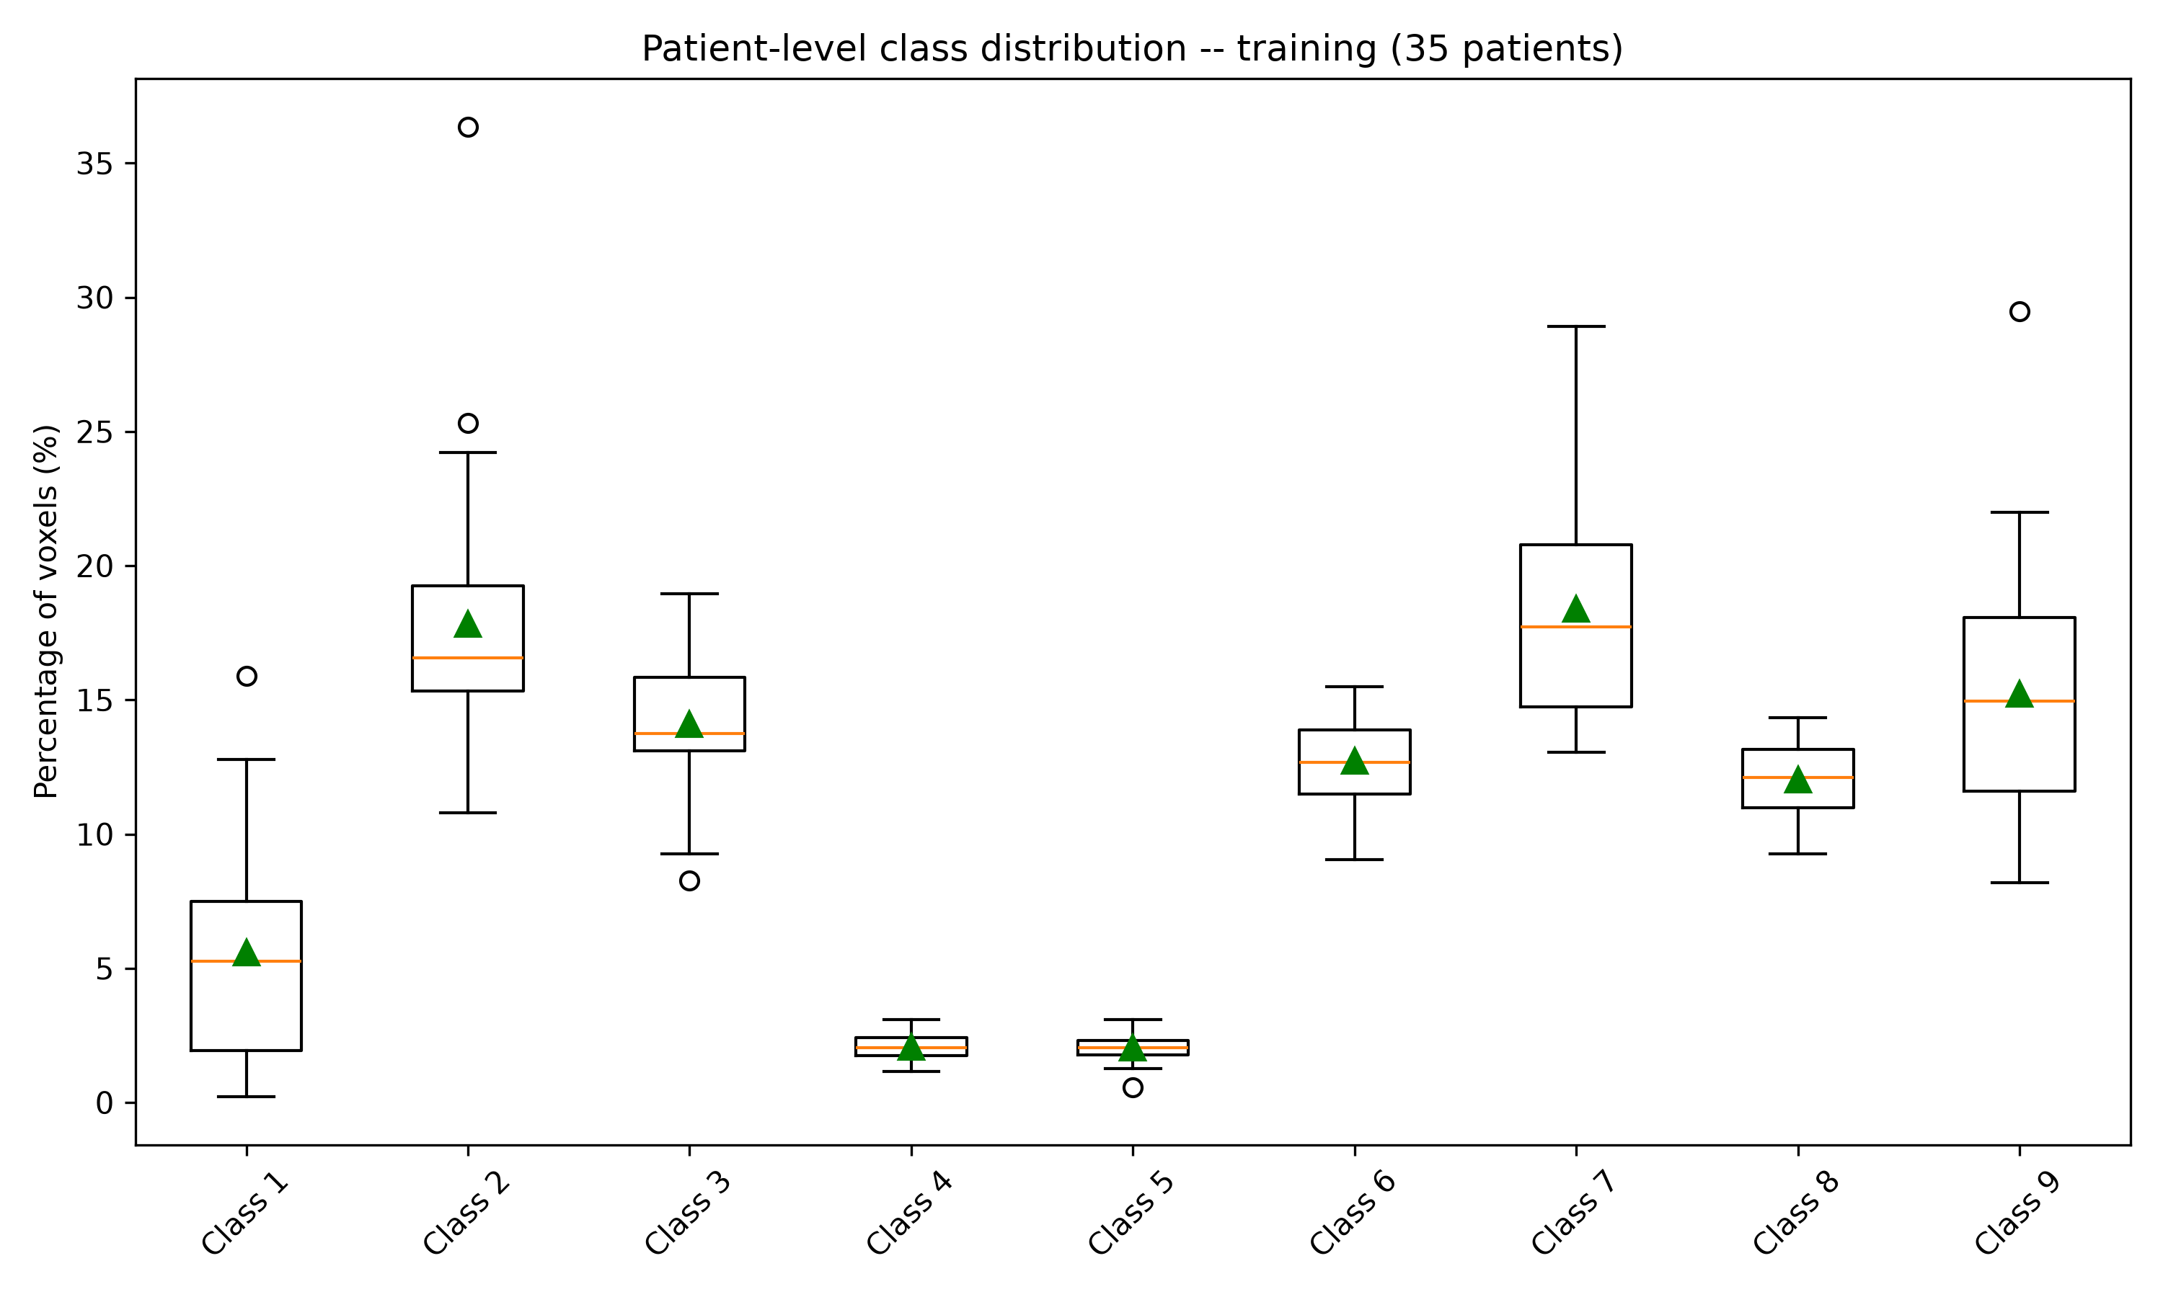
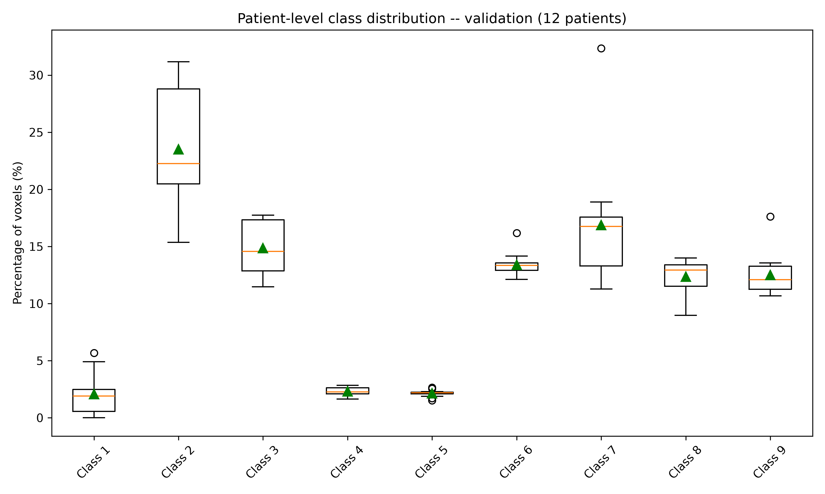

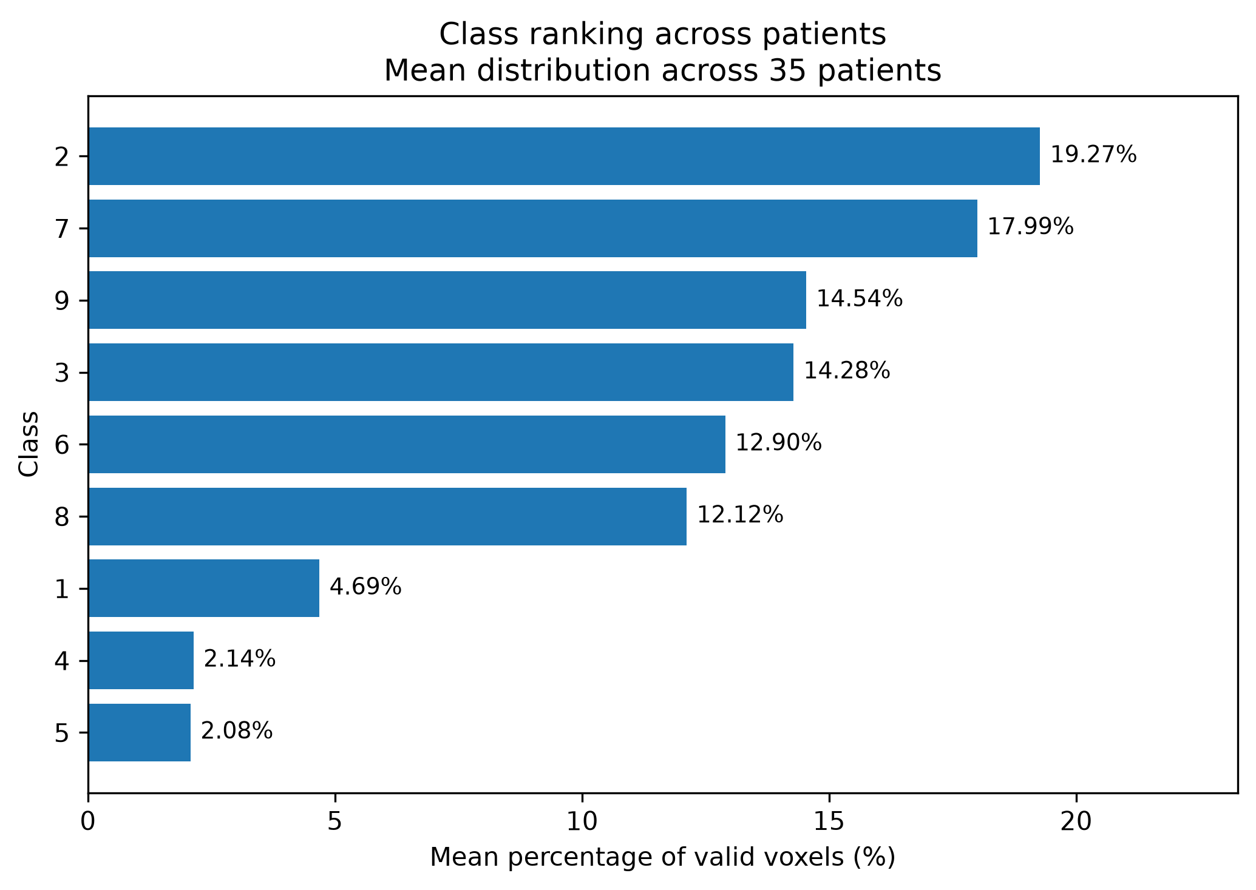
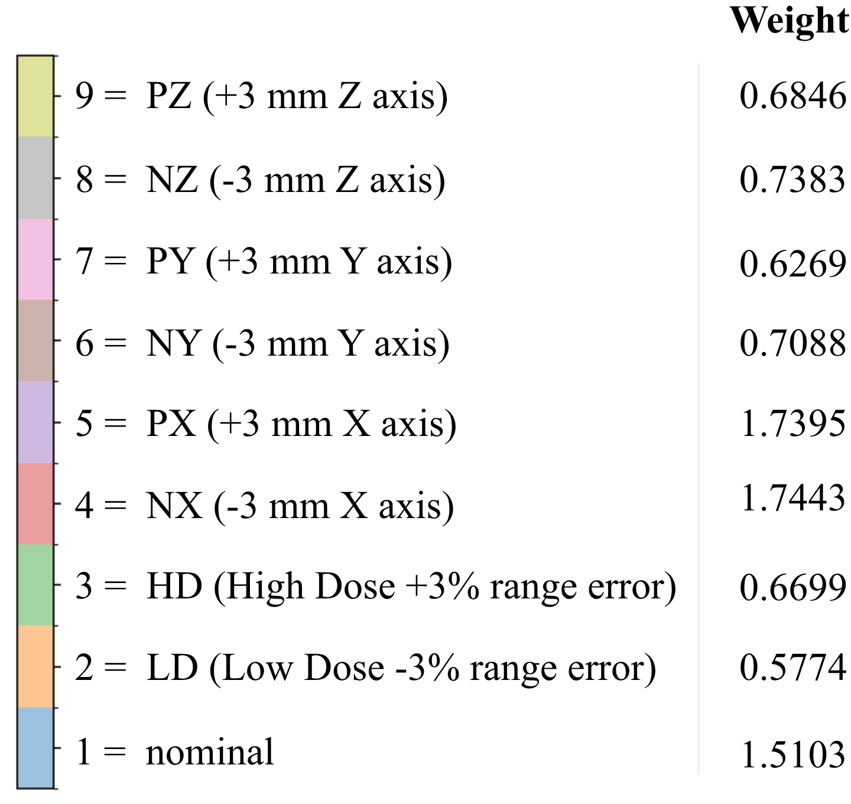
Results – Class Distribution Analysis
Voxel Count by Class (Ground Truth)
Weighted CE
The training and validation datasets share similar class distributions.
Class 4,5 = beam direction shifts
Notes:
Unlike conventional photon radiotherapy, carbon ion therapy exploits the Bragg peak to deposit maximum energy precisely inside the tumor while sparing healthy tissues. However, this sharp physical fall-off makes treatment plans extremely vulnerable to setup errors and range uncertainties, which can shift high doses into critical organs at risk. To ensure safety, clinical routines rely on Full-Robust Optimization, evaluating 9 distinct uncertainty scenarios for every voxel. While effective, calculating these 3D dose matrices at every single optimization iteration creates a severe computational bottleneck.

Slide 24
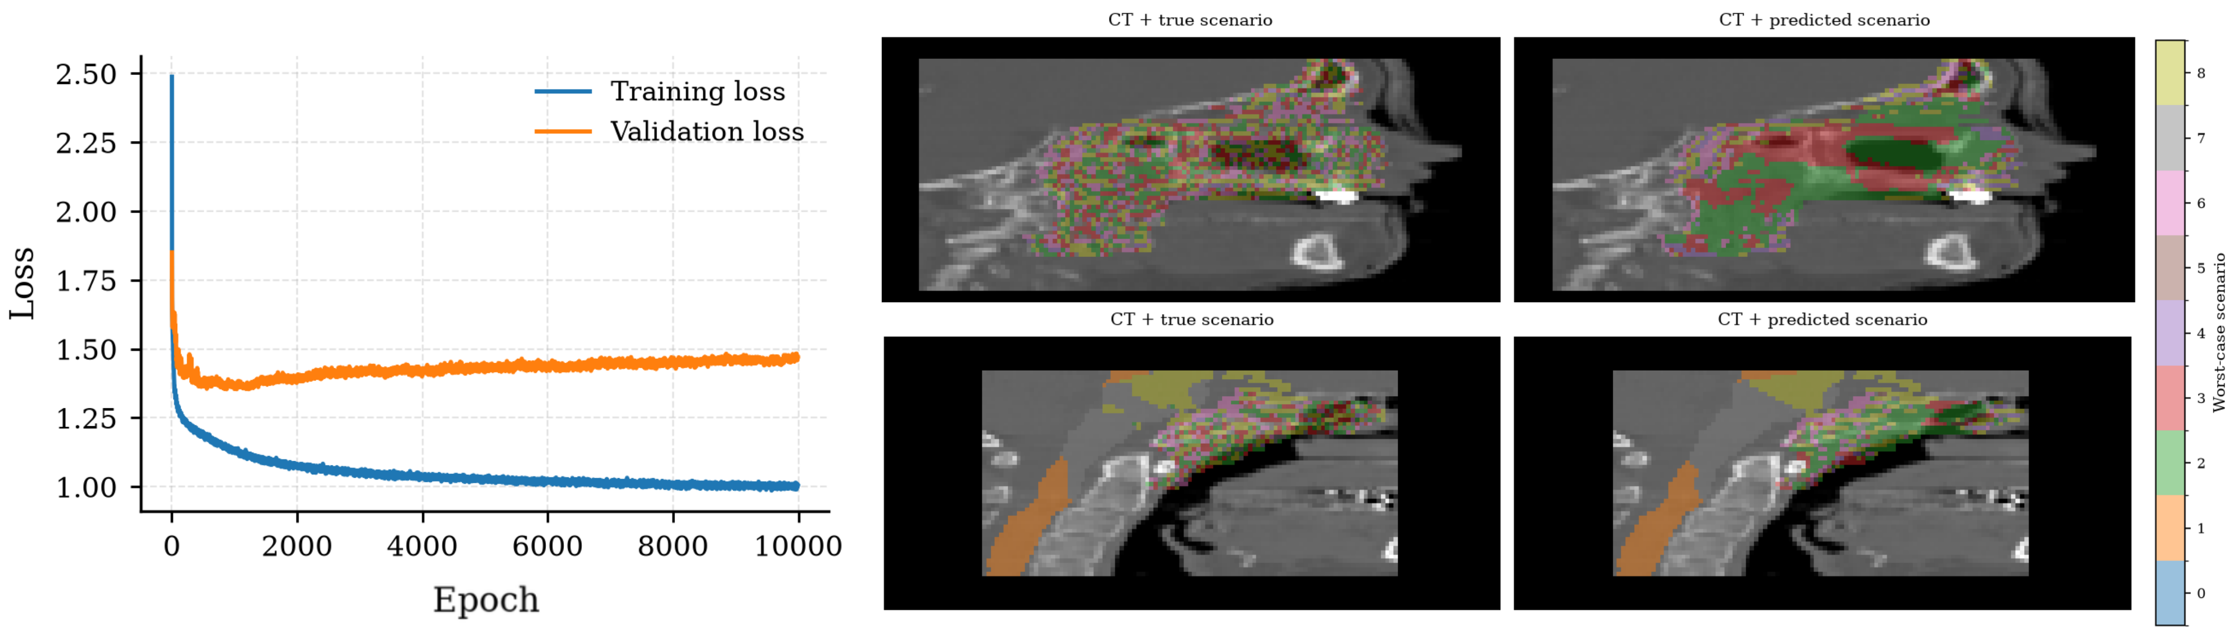
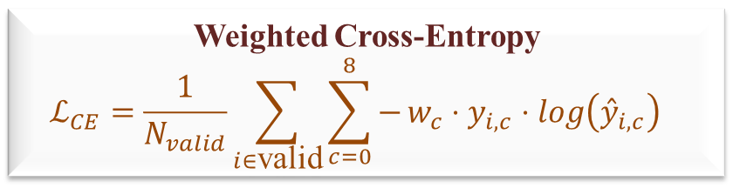

Results – AI Model Performance
$$\text{Composite Loss Function }$$
$$ℒ_{total}=1.0⋅ℒ_{CE}+0.5⋅ℒ_{Dice}$$
Weighted Cross-Entropy
$$ℒ_{CE}=\frac{1}{N_{valid}}\sum_{i∈\text{valid}}{\sum_{c=0}^{8}{−}}w_{c}⋅y_{i,c}⋅{\log\left({\overset{ˆ}{y}}_{i,c}\right)}_{}$$
Batch size = 1
Dropout 0.2
The visualisation of the prediction corresponds to the last epoch.
Dropout = disable of neurons during training - reduces overfitting
${\text{Dice Loss Component} ℒ}_{Dice} e$ncourages spatial overlap between predictions and ground-truth distributions.
Notes:
Unlike conventional photon radiotherapy, carbon ion therapy exploits the Bragg peak to deposit maximum energy precisely inside the tumor while sparing healthy tissues. However, this sharp physical fall-off makes treatment plans extremely vulnerable to setup errors and range uncertainties, which can shift high doses into critical organs at risk. To ensure safety, clinical routines rely on Full-Robust Optimization, evaluating 9 distinct uncertainty scenarios for every voxel. While effective, calculating these 3D dose matrices at every single optimization iteration creates a severe computational bottleneck.

Slide 25
Conclusions
The target coverage metrics analysing the FRO, SSRO and NRO provide strong proof of concept for the Predicted Scenario Robust Optimisation approach.
A single worst-case map (WCM) along with the nominal scenario encapsulate sufficient information to drive robust optimisation, eliminating the need to compute all 9 scenario dose distributions during optimisation.
AI model predicting the WCM, with weighted CE according to the dataset → prevent class imbalance.
Further work: Improve the AI prediction | Validate the Predicted Scenario Robust Optimisation.
Notes:
Unlike conventional photon radiotherapy, carbon ion therapy exploits the Bragg peak to deposit maximum energy precisely inside the tumor while sparing healthy tissues. However, this sharp physical fall-off makes treatment plans extremely vulnerable to setup errors and range uncertainties, which can shift high doses into critical organs at risk. To ensure safety, clinical routines rely on Full-Robust Optimization, evaluating 9 distinct uncertainty scenarios for every voxel. While effective, calculating these 3D dose matrices at every single optimization iteration creates a severe computational bottleneck.

Slide 26
THANK YOU!
Carmen-Andreea Maxim
“Babeș-Bolyai” University | GSI International Summer Student Program
Update Presesntation 7th September 2026

Slide 27
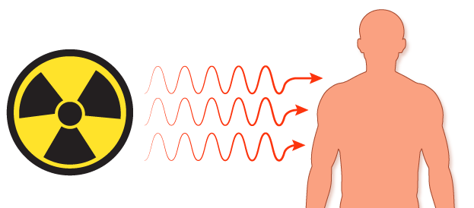
Radiotherapy
Dose and effects
High, localised dose
Deterministic effects
= lethal DNA damage
Dose
= energy absorbed / mass of tissue (Gray, J/kg)
Low, diffused dose
Stochastic effects
= sub-lethal damage
https://bit.ly/3SRVsjS
Notes:
Radiation dose measures how much energy is absorbed per unit mass of tissue, measured in Gray. The key distinction is between deterministic effects — which appear quickly at high doses, with severity scaling with dose, like direct tumor destruction — and stochastic effects, which occur randomly even at low doses, where the probability increases with dose but not the severity — for example, the risk of a secondary cancer induced by scattered radiation in healthy tissue.

