Slide 1
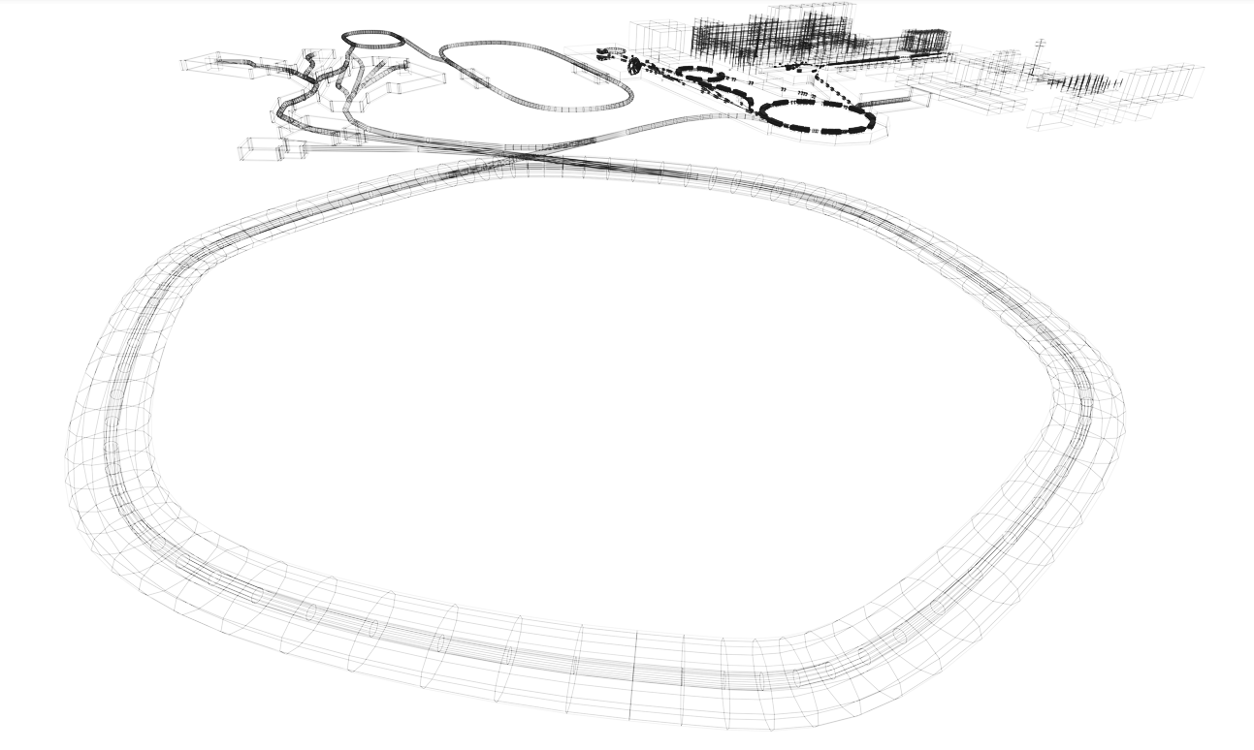
Investigation of Elastic Proton Scattering on
Neutron-Rich Nuclei with the R³B Setup
Anna Husztek · GSI/FAIR Summer Student Program 2026
Supervisor: Valerii Panin · R³B Collaboration · GSI, Darmstadt

Slide 2
Outline
1
Motivation
Importance of exotic nuclei
2
R³B setup
G-24-00249 experiment
3
Elastic proton scattering
4
Data analysis
Results for ²⁵F, ²⁴F and ²²O
5
Conclusion & outlook
Notes:
Introduce R3B
Specific campaign behinf the data
Properties of exotic nuclei
Extracted clean elastic signal

Slide 3
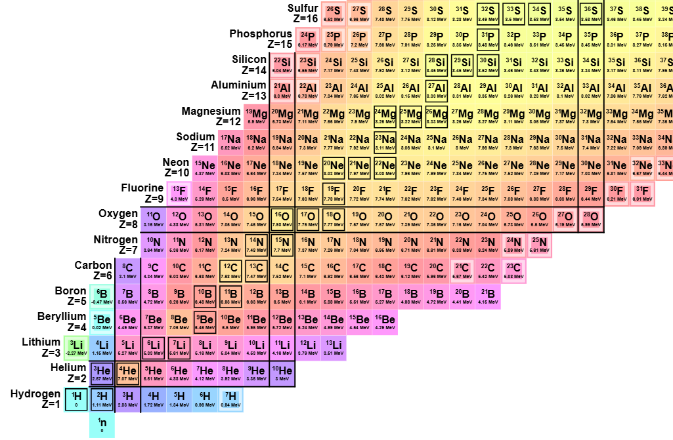
Motivation
Neutron-rich isotopes near the drip line → a sensitive testing ground for nuclear models
Proton-induced reactions with Radioactive-Ion beams to probe the structure of exotic nuclei with the R3B setup
Developing analysis tools and data mining of G-24-00249 experiment
Goal: obtain reaction cross sections for the elastic proton scattering to probe the nuclear matter-density distribution ρ(r)
https://people.physics.anu.edu.au/~ecs103/chart/
Notes:
Neuronrich isotopes-sensitive testing ground where our models are most likely to break
specifically atomic number
One way to probe them->through proton-induced…->let us get at their sturcture directly with the r3b setup
My part: build analysis tools, do data mining

Slide 4
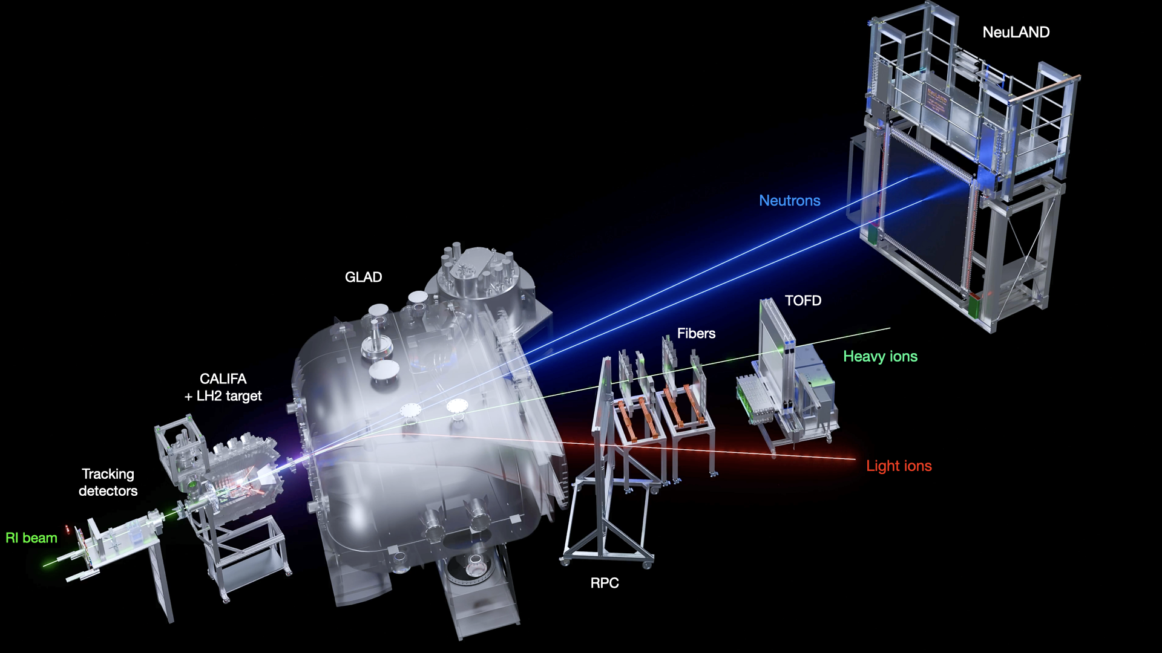
The R³B setup
▪ Reactions with Relativistic Radioactive Beams – inverse & complete kinematics
▪ Secondary beams from the FRS, identified & tracked upstream
▪ CALIFA calorimeter around the target: γ-rays + light charged particles
▪ GLAD magnet downstream: separates heavy fragments, light particles & neutrons
Notes:
versatile and modular setup for studying exotic nuclei via reactions in inverse and complete kinematic
Around the target area, the reactions are measured in the CALIFA calorimeter
Downstream, the superconducting GLAD bends the trajectories-> enabling particle identification and total momentum reconstruction

Slide 5
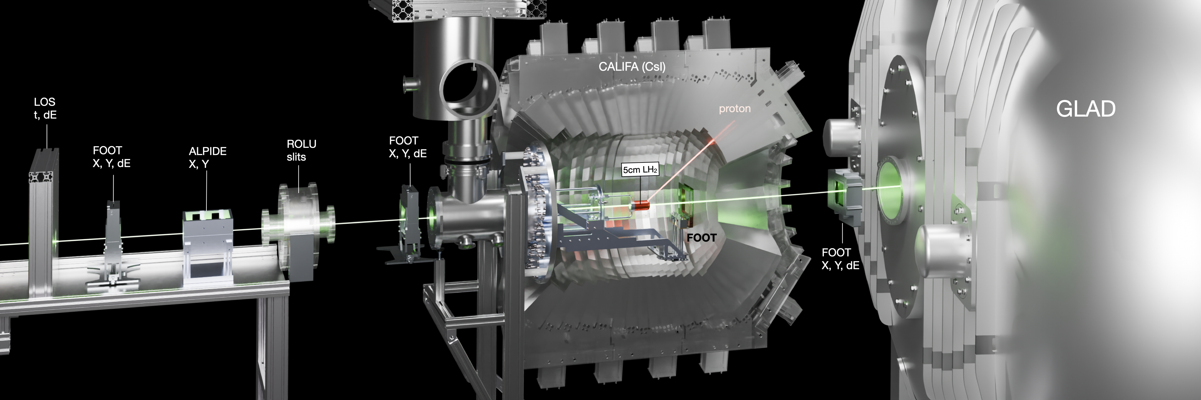
The G-24-00249 experiment
Aim
  Study of the structure of neutron rich isotopes
Detectors
  FOOT & ALPIDE: incoming/outgoing heavy-ion tracking
  CALIFA: recoil protons + γ-rays
  GLAD magnet + fiber trackers + ToF wall: charge, mass & momentum of fragments
Beam & target
  Secondary cocktail beams at ≈640 MeV/u
  50 mm thick liquid-hydrogen (LH₂) target
Notes:
Let me quickly walk you through the detectors the beam actually passes through
Several det: energy loss, angle and tof
gets tracked through the GLAD dipole magnet, and is measured by

Slide 6
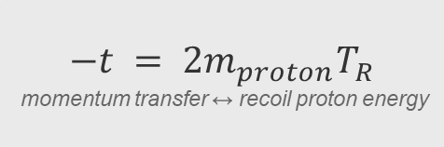
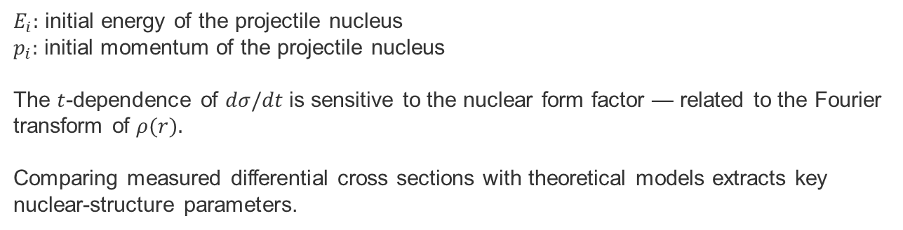
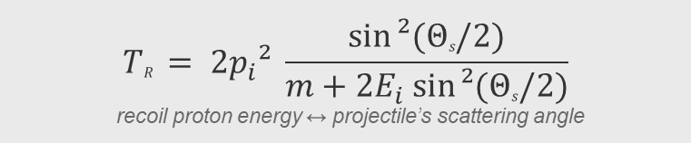
Elastic proton scattering
Direct probe of the nuclear matter-density distribution ρ(r); studied here in inverse kinematics with radioactive beams.
$$−t = 2m_{proton}T_{R}$$
momentum transfer ↔ recoil proton energy
$$TR = 2p_{i}² \frac{sin⁡²(Θs/2)}{m+2E_{i} sin⁡²(Θs/2)}$$
recoil proton energy ↔ projectile’s scattering angle
$E_{i}:$ initial energy of the projectile nucleus
$p_{i}:$ initial momentum of the projectile nucleus
The $t$-dependence of $dσ/dt$is sensitive to the nuclear form factor — related to the Fourier transform of $ρ(r).$
Comparing measured differential cross sections with theoretical models extracts key nuclear-structure parameters.
Notes:
). We describe the reaction with the momentum transfer t,
Recoil protons kinetic energy
Tᵣ completely independently->useful for cross-checking on our analysis

Slide 7
Data-Analysis Strategy
Data reduction
1
Raw data
Binary LMD files
2
Unpacking
UCESB/UPEXPS
3
R³B ROOT
Calibration & reconstruction
4
Event filter
Selection of the incoming isotopes, minimum conditions for the reactions
5
Single ROOT file with filtered data
Physics analysis
1
PID & tracking
Identifying incoming / outgoing isotopes
2
Vertex reconstruction
Interaction point & scattering angle
3
CALIFA analysis
Identify recoil proton
4
Kinematic cuts
Coplanarity & energy → clean elastic sample
5
Cross section
Reconstruction of the differential cross section
Notes:
here's how we actually get from raw data to results
the interaction vertex, to know exactly where inside the target the reaction happened.
Move on to

Slide 8
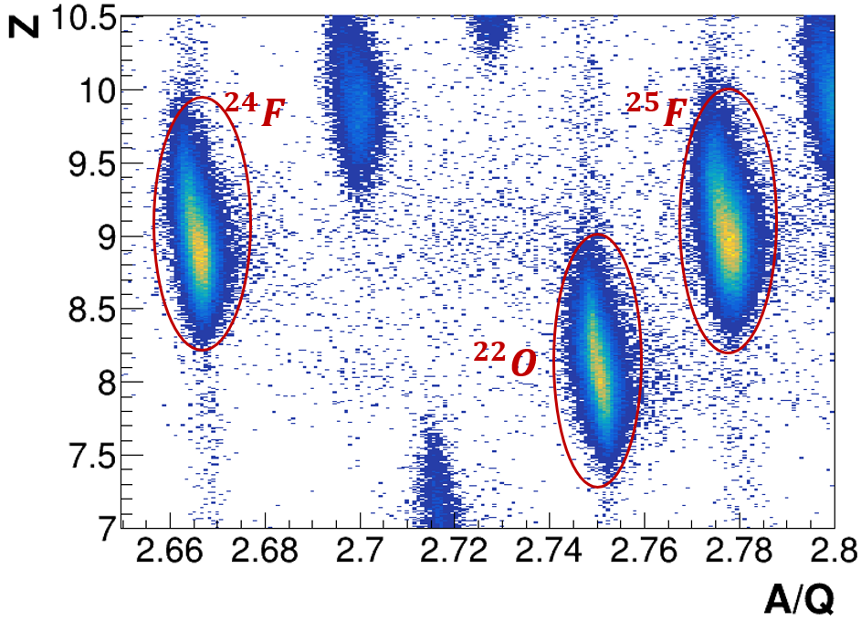
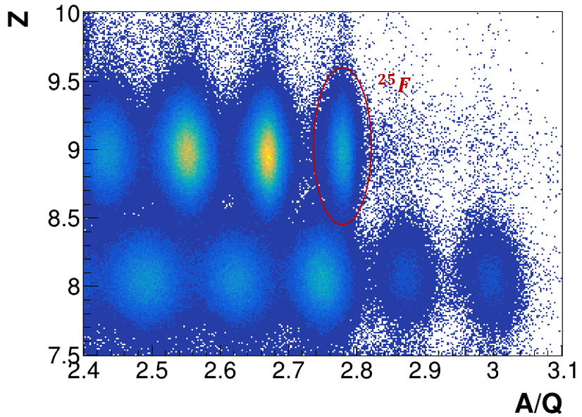
Particle identification & isotope selection
PID in FRS (incoming)
PID through GLAD (outgoing)
Identical incoming/outgoing isotope + single high-energy CALIFA hit → isolates the elastic channel.
Notes:
incoming beam as seen in the FRS
atomic number against mass-to-charge ratio->24, 25, 22 stand out clearly
The condition that /requirement

Slide 9
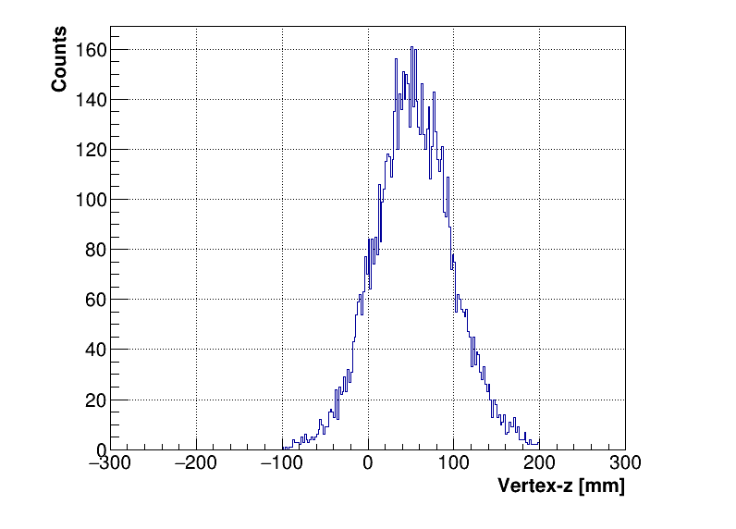
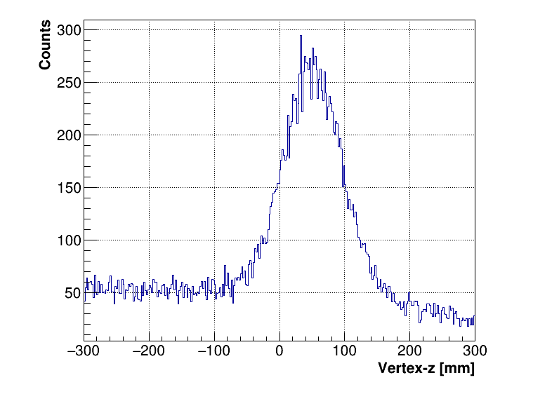
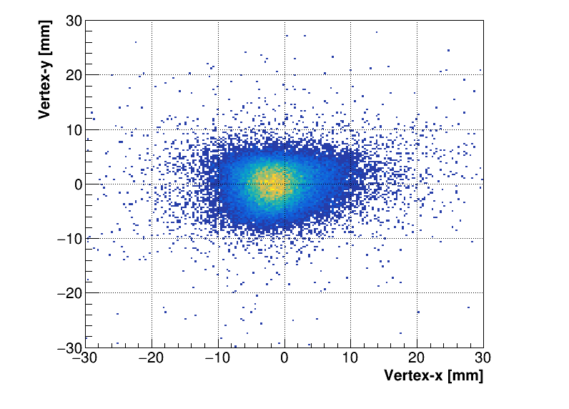
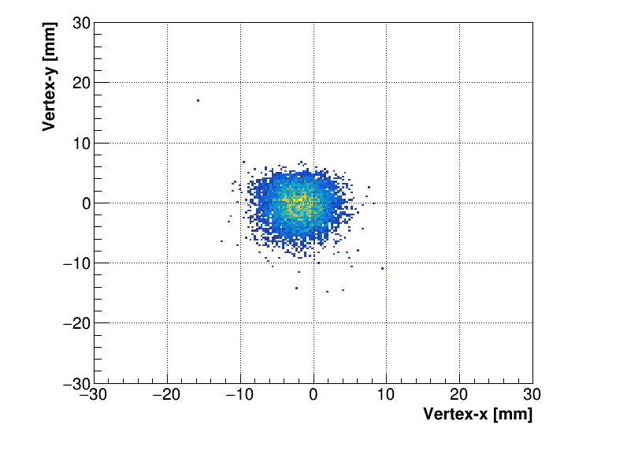


Vertex reconstruction
▪ In-beam Si FOOT trackers reconstruct the vertex in LH₂ and the scattering angle
$$^{25}F$$
$$^{25}F$$
Mean = 53.2 ± 0.5 mm
Sigma = 45.1 ± 0.4 mm
Notes:
. By taking the tracks reconstructed from the in-beam silicon trackers upstream and downstream, and extrapolating them, we can reconstruct exactly where inside the liquid-hydrogen target the reaction happened-> tell us the scattering angle
how much of the spread gets cleaned up after

Slide 10
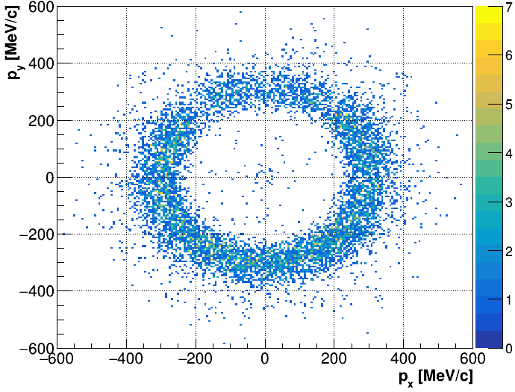
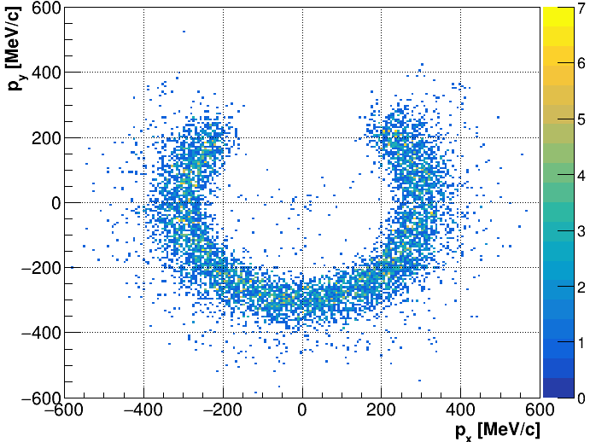
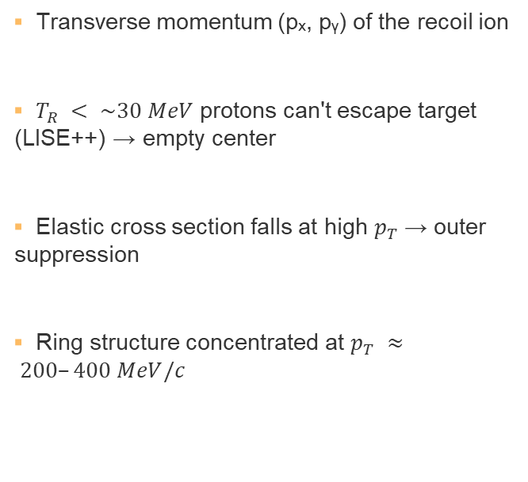

Reconstructing the recoil kinematics
▪ Transverse momentum (pₓ, pᵧ) of the recoil ion
▪ $T_{R} < \sim 30 MeV$ protons can't escape target (LISE++) → empty center
▪ Elastic cross section falls at high $p_{T}$→ outer suppression
▪ Ring structure concentrated at $p_{T} ≈ 200–400 MeV/c$
$$^{25}F$$
Acceptance cut
Notes:
empties out the centre of the ring
itself falls steeply at larger momentum transfer, which suppresses the outer edge.
out two faint lines cutting across the ring ->support bars , remove what most likely goes through them

Slide 11
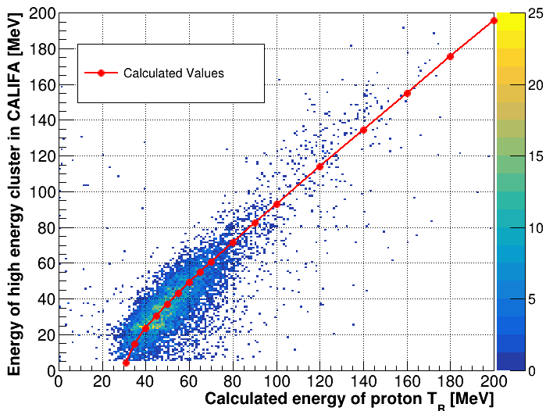
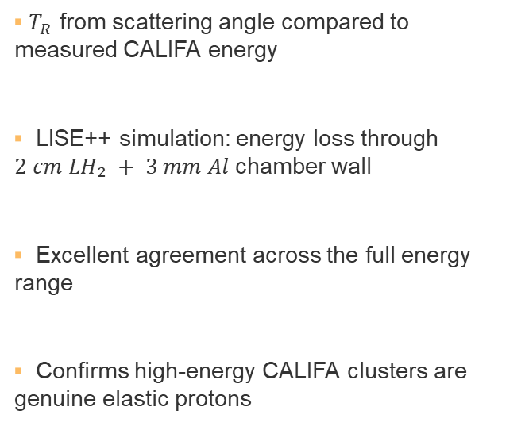

CALIFA analysis
▪ $T_{R}$ from scattering angle compared to measured CALIFA energy
▪ LISE++ simulation: energy loss through $2 cm LH₂ + 3 mm Al$chamber wall
▪ Excellent agreement across the full energy range
▪ Confirms high-energy CALIFA clusters are genuine elastic protons
$$^{25}F$$
Notes:
make sure we’re actually looking at elastic proton scattering events, we compared
Matche with lise++

Slide 12
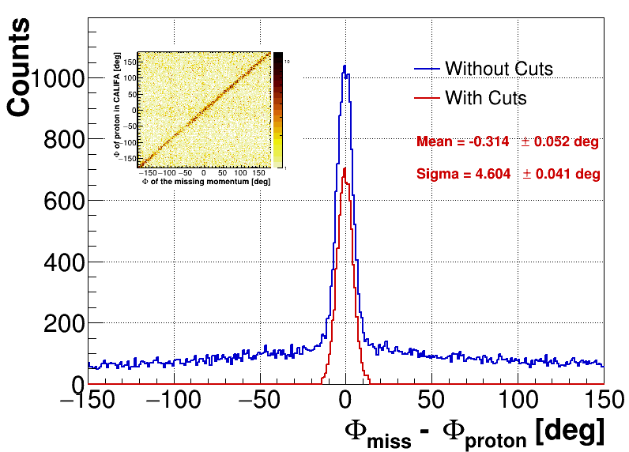

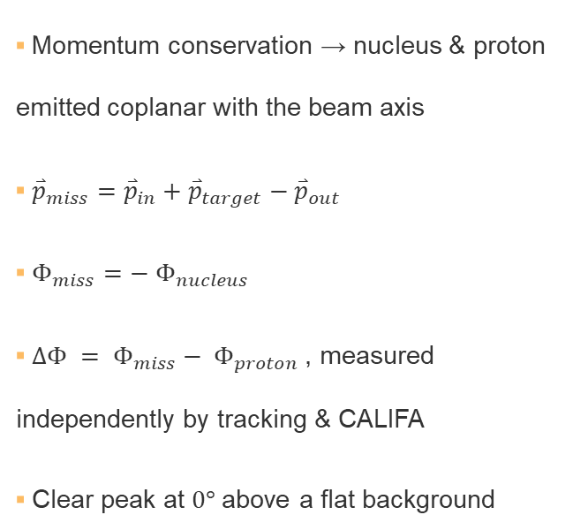
Coplanarity check
▪ Momentum conservation → nucleus & proton emitted coplanar with the beam axis
▪ ${\overset{⃑}{p}}_{miss}={\overset{⃑}{p}}_{in}+{\overset{⃑}{p}}_{target}−{\overset{⃑}{p}}_{out}$
▪ $Φ_{miss}=− Φ_{nucleus}$
▪ $ΔΦ = Φ_{miss}− Φ_{proton}$, measured independently by tracking & CALIFA
▪ Clear peak at $0°$above a flat background
$$^{25}F$$
Notes:
One more consistency check, this time using momentum
scattered nucleus and the recoil proton

Slide 13

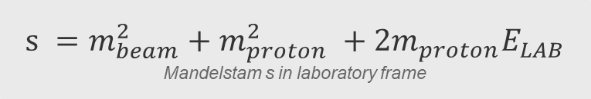
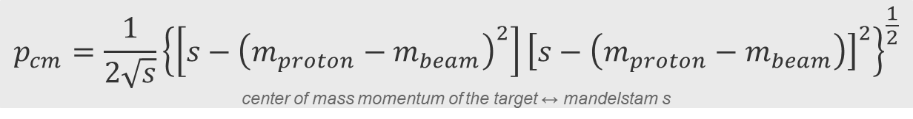
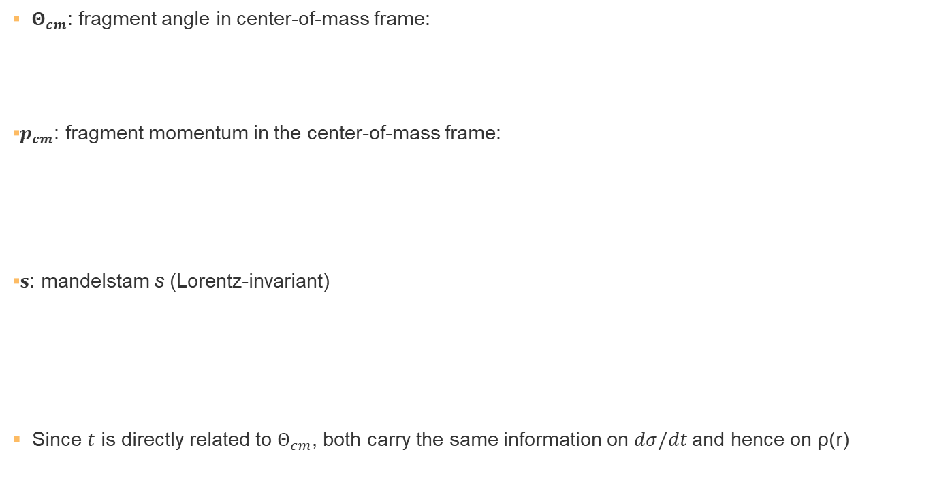
Center of mass angle
▪ $Θ_{cm}$: fragment angle in center-of-mass frame:
▪$p_{cm}$: fragment momentum in the center-of-mass frame:
▪$s$: mandelstam s (Lorentz-invariant)
▪ Since $t$ is directly related to $Θ_{cm}$, both carry the same information on $dσ/dt$and hence on ρ(r)
$$cosΘcm = 1 + \frac{t}{2p_{cm}²}$$
center of mass angle of the target ↔ momentum transfer
$$p_{cm}=\frac{1}{2\sqrt{s}}{\left\{\left[s−{\left(m_{proton}−m_{beam}\right)}^{2}\right]{\left[s−\left(m_{proton}−m_{beam}\right)\right]}^{2}\right\}}^{\frac{1}{2}}$$
center of mass momentum of the target ↔ mandelstam s
$$s =m_{beam}^{2}+m_{proton}^{2} +2m_{proton}E_{LAB}$$
Mandelstam s in laboratory frame
Notes:
Mandelstam variable s — the Lorentz-invariant total energy squared of the system
worth looking at both distributions and make interpretations for the density distribution from both of them

Slide 14
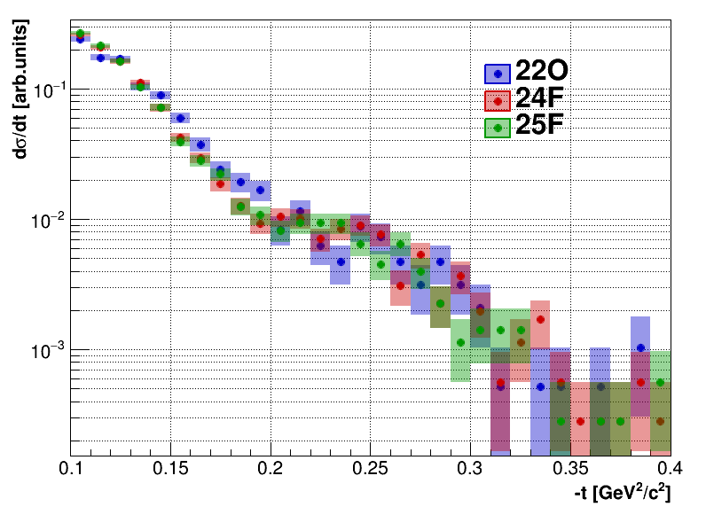
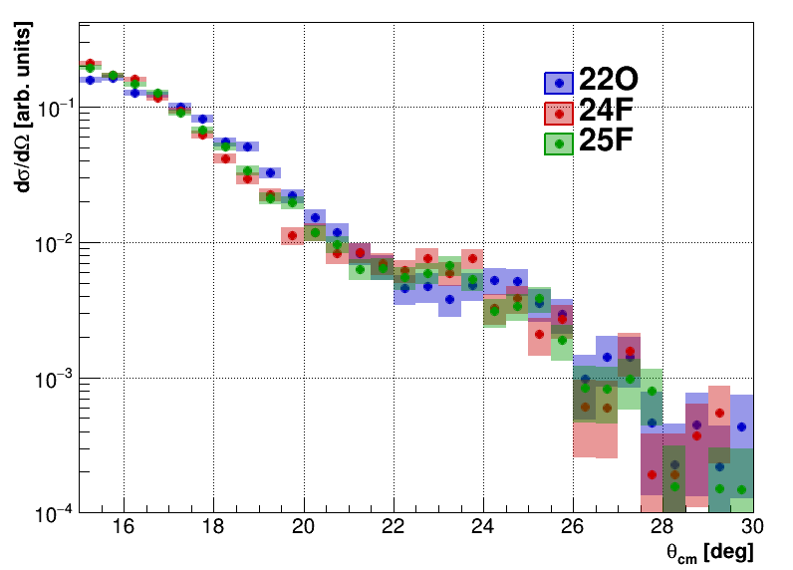

Results: t and $Θ_{cm}$ distributions
Similar pattern for $^{24}F$ and $^{25}F$, while the distribution for $^{22}O$differs from both.
Notes:
²²O clearly stands out->interpretation in terms of single particle levels
While the neutron 2s½ orbital is empty in ²²O, it holds one neutron in ²⁴F, and is completely filled in ²⁵F.

Slide 15
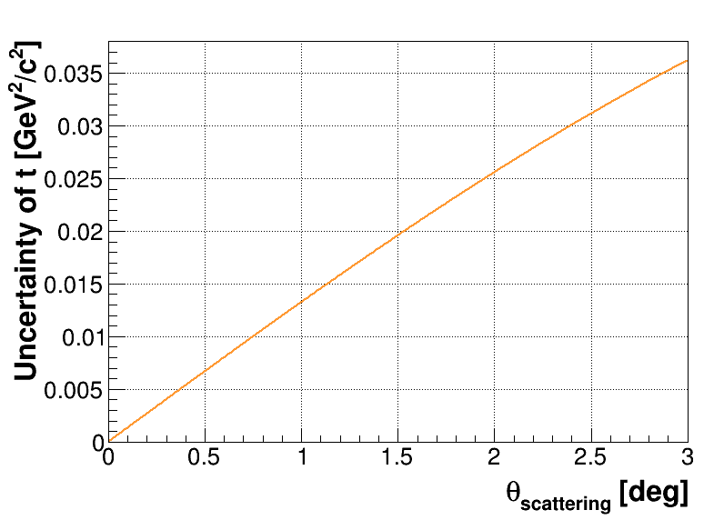
Error of mandelstam t
Experimental range
Notes:
next to a plot of the uncertainty of t
uncertainty grows with angle
dashed lines mark the actual range we measure and the point of this slide is simply that our resolution stays well under control across that whole range.

Slide 16
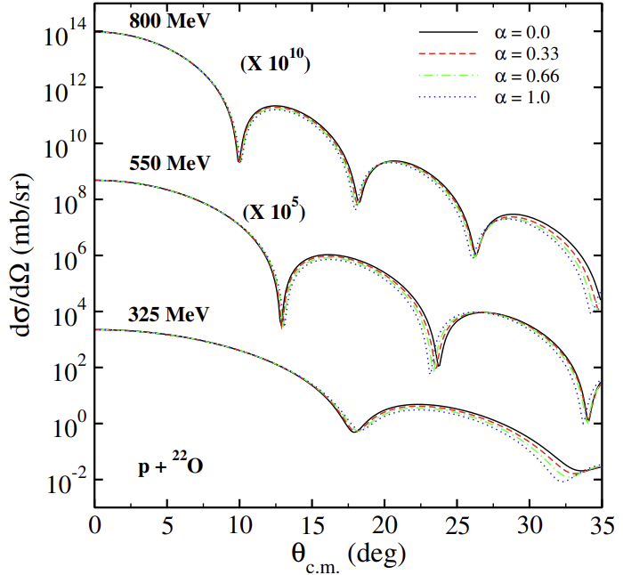
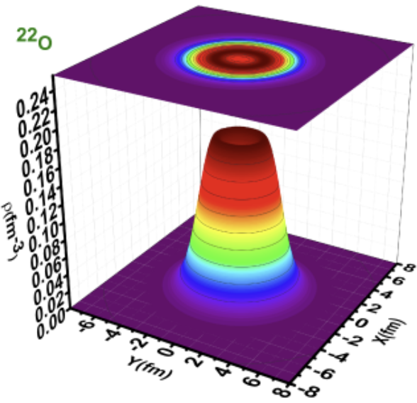

Bubble nature of $^{22}O$
V. Kumar et al., Phys. Scr. 101, 085301 (2026).
V. Choudhary et al., Proc. DAE Symp. Nucl. Phys. 65, 313 (2021).
Notes:
roughly flat density in the core that only drops off near the surface
that central density is itself depleted

Slide 17
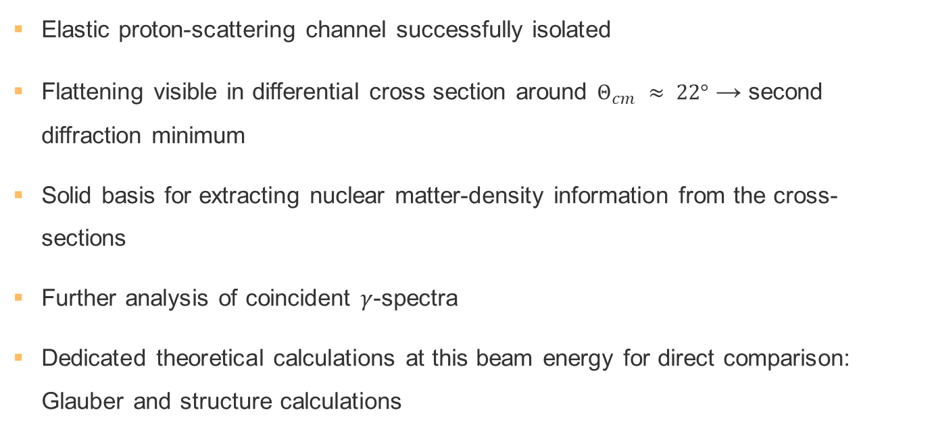
Conclusion & outlook
Elastic proton-scattering channel successfully isolated
Flattening visible in differential cross section around $Θ_{cm} ≈ 22°$ → second diffraction minimum
Solid basis for extracting nuclear matter-density information from the cross-sections
Further analysis of coincident $γ$-spectra
Dedicated theoretical calculations at this beam energy for direct comparison: Glauber and structure calculations
Notes:
Isolated..for all 3 isotopes
start interpreting the differences between isotopes in terms of single-particle levels.
That said, we can only be fully confident in the elastic-channel
calculations at this exact beam energy, ->directly confirm that what we are seeing is…

Slide 18
Thank you for your attention

