Slide 1
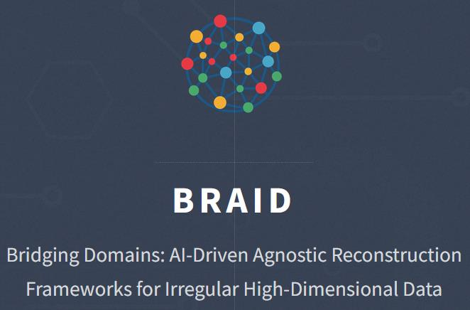
BRAID at GSI/FAIR
irregular hits
Smiriti Sharma · PhD Student
GS I/ Goethe University Frankfurt
AI Workshop · 31 August 2026
Notes:
Opening: introduce the BRAID framework, then immediately state the GSI/FAIR focus: muon identification and reconstruction in hadron-physics beam lines.

Slide 2
What is BRAID?
BRAID is a collaborative research initiative focused on developing AI-driven frameworks for the reconstruction of physics signals in irregular high-dimensional data, bridging high-energy physics, nuclear/hadron physics, astrophysics, and industry applications such as medical monitoring
Introduce consortium
partners
domain expertise
Mention funding by BMFTR (Logo and GRANT number)

Slide 3
Why BRAID?
The consortium aims at:
Single common framework for detector-agnostic reconstruction across large energy range, hihghest to lowest.
The common denominator is not the physics channel but it is the data.
Computer science
High-energy physics
Graph learning
Adaptive reduction
Locality
Dense, high-rate
collider events
Detector-agnostic
reconstruction
Astroparticle
Hadron & nuclear
Sparse sensors
Irregular geometry
Changing beams
and detector conditions
BRAID · GSI/FAIR · AI/ML for hadron physics
2
Notes:
Do not present BRAID as four separate projects. The point is that computer-science methods are developed centrally and then challenged by different domains.

Slide 4
What BRAID is building
A common ML language for irregular detector data.
01
02
03
04
Irregular inputs
Learn locality
Reduce early
Reconstruct
Sparse detector hits
+ timing / signals
Dynamic graph
construction
Adaptive, local
dimensionality reduction
Particles / objects
with physics constraints
3
Notes:
Use this slide to explain the technical idea without diving into architecture details. The important distinction is adaptive reduction while preserving locality and physics constraints. The proposal explicitly focuses first on offline reconstruction, with later potential for online use.

Slide 5
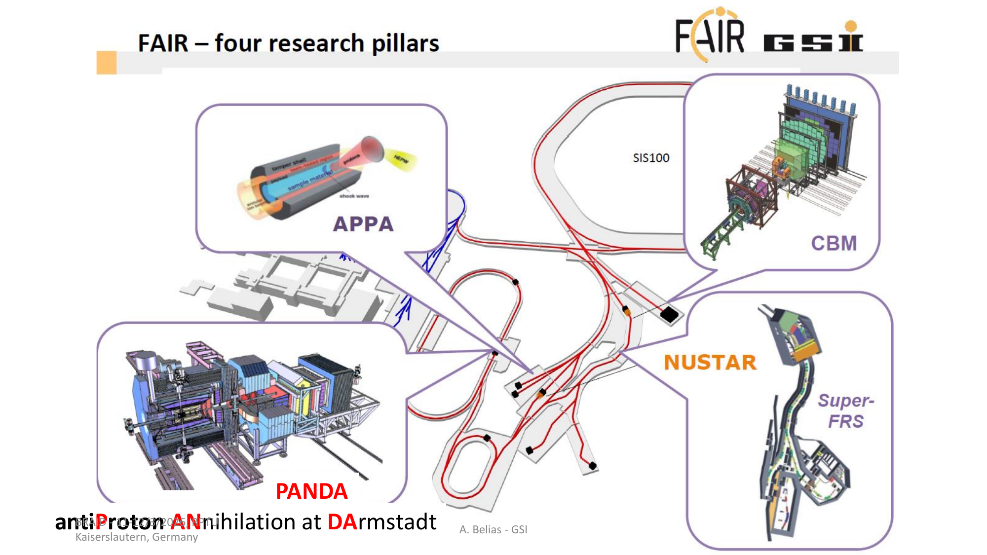
BRAID Project at GSI/FAIR
Focus of this talk
CBM
Fixed-target heavy-ion / proton collisions
→ dense nuclear matter
PANDA
Antiproton annihilation
→ hadron structure & spectroscopy
Shared challenge
Complex detector signals must be turned into reliable particle information.
4
Notes:
FAIR has several research pillars; this presentation narrows to CBM and PANDA because they are the WP4 application domains at GSI.

Slide 6
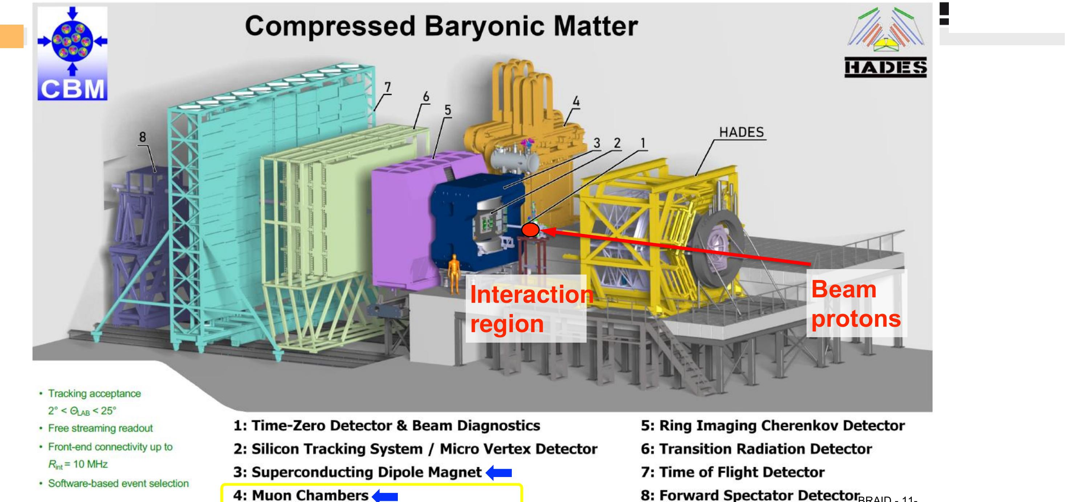
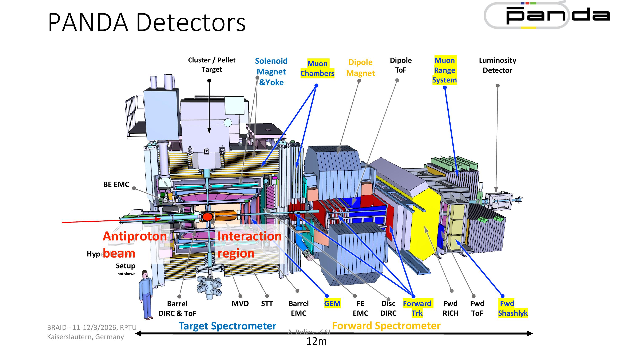
FAIR use cases of various muon detectors at different beams: CBM / PANDA
CBM
PANDA
SIS100 fixed-target collisions · high baryon density · high event rates
Antiproton beam · hadron spectroscopy · tracking + PID in a large detector
5
Notes:
Use the detector images as visual anchors. The point is not to explain every subsystem, but to show that the data structures and operating conditions differ substantially.

Slide 7
Why muon identification?
The physics need
Forward-scattering example
• Muons are very good signatures in many hadron-physics measurements and carries a large amount of physics.
• The main task is to separate muons from other particles and background.
• Forward beam-line setups can combine gaseous detectors, straw tubes and absorbers.
• The detector arrangement changes with beam, target and experimental goal.
beam
target
absorber
straw / gas
detector
absorber
muon
signal
reconstructed
muon
BRAID question
Can one reconstruction strategy remain reliable when the beam line and detector configuration change?
Common task → adaptable reconstruction
6
Notes:
This is the conceptual bridge from BRAID to your own topic. The expose document explicitly frames muon identification as a common task across versatile hadron-physics beam lines and mentions large-area gaseous detectors, straw tubes and absorbers.

Slide 8
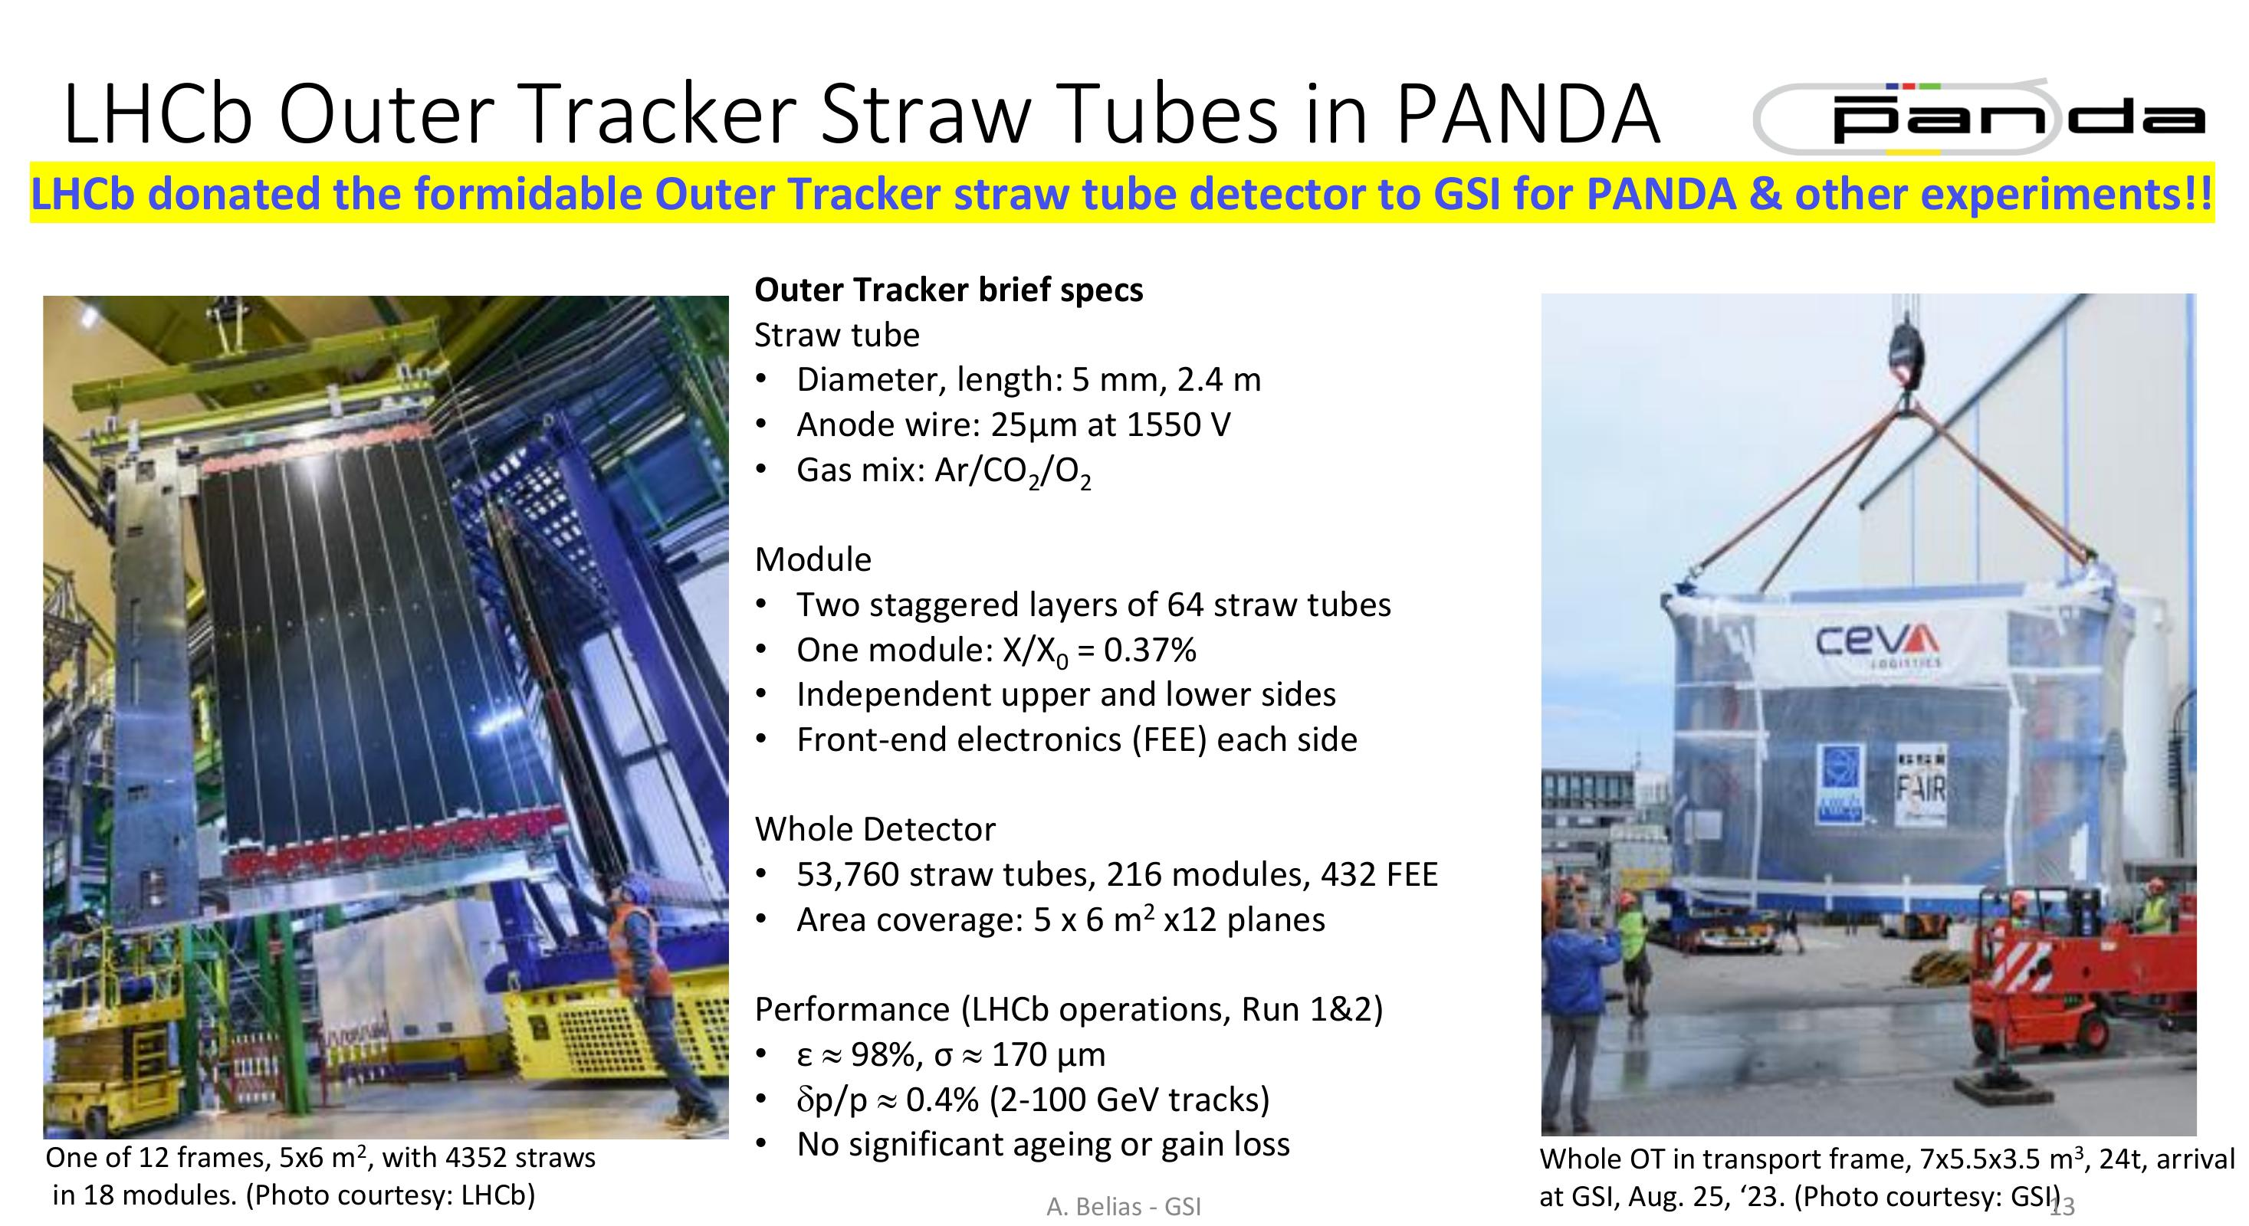
The detector at GSI
LHCb Outer Tracker → GSI
• 53,760 straw tubes in 216 modules
• 12 planes covering about 5 × 6 m² each
• Measured efficiency ≈ 98% and spatial resolution ≈ 170 μm in LHCb operation
• Repurposing provides a real detector platform for adaptive reconstruction studies.
MUST: Muon Straws
7
Notes:
Important wording: do not imply that the LHCb OT is already a finished CBM/PANDA muon detector. The GSI presentation describes the MUST use case and a task force examining feasibility, while the OT is being integrated for PANDA and potentially other experiments.

Slide 9
From simulation to reconstruction
Physics event
Generate beam / collision events
Transport
Propagate particles through the detector geometry
Detector response
Collect hit-level information from straw / gaseous detectors
Reconstruction
Group hits → tracks / particle candidates → muon ID
Validation
Compare against truth and, where possible, beam-time data
8
Notes:
The example campaign shown here follows the simulation work discussed in the project: 1000 central Au+Au events at 8 AGeV, with UrQMD and GEANT4. Replace or expand the example once the final simulation configuration is frozen.

Slide 10
The use of ML
WP1 · ML concepts
WP4 · hadron & nuclear physics
• Graph / message-passing architectures that build topology dynamically.
• Adaptive point-cloud reduction that preserves locality.
• Learned treatment of non-differentiable operations such as thresholds and clustering.
• Physics constraints and efficiency considerations are built into the methods.
• Define physics goals and reconstruction metrics.
• Build public simulated datasets for SIS100 and HESR conditions.
• Test robustness against changing beam and detector conditions.
• Use ML for detector-geometry comparisons and optimisation.
feedback: physics ↔ ML
9
Notes:
This is a key slide. WP1 is the central hub of BRAID, while WPs 2–4 apply, validate and refine the methods. WP4 should not be presented as a standalone ML application.

Slide 11
Goal: identify muons reliably without redesigning the reconstruction for every detector configuration.
01
Simulation
02
Reconstruction
03
Validation & adaptation
Build detector-level MC samples for representative beam lines and geometries.
Study hit patterns, track building and muon/background discrimination.
Test robustness across beam conditions, geometry changes and eventually real data.
Expected outputs
benchmark datasets
reconstruction metrics
robust ML models
geometry studies
10
Notes:
Keep this slide personal and concrete: this is the part of BRAID that your PhD work connects to. Avoid claiming results that do not exist yet.

Slide 12
BRAID
Develops reconstruction methods for irregular, high-dimensional data.
FAIR / GSI
Provides a demanding environment where beam, target and detector conditions vary.
My work
Uses muon identification as a concrete test of how adaptable these methods can be.
11
Notes:
Close by returning to the central idea: detector-agnostic reconstruction is useful only if it remains physically meaningful and robust when the detector and operating conditions change.

Slide 13
THANK YOU

