Slide 1
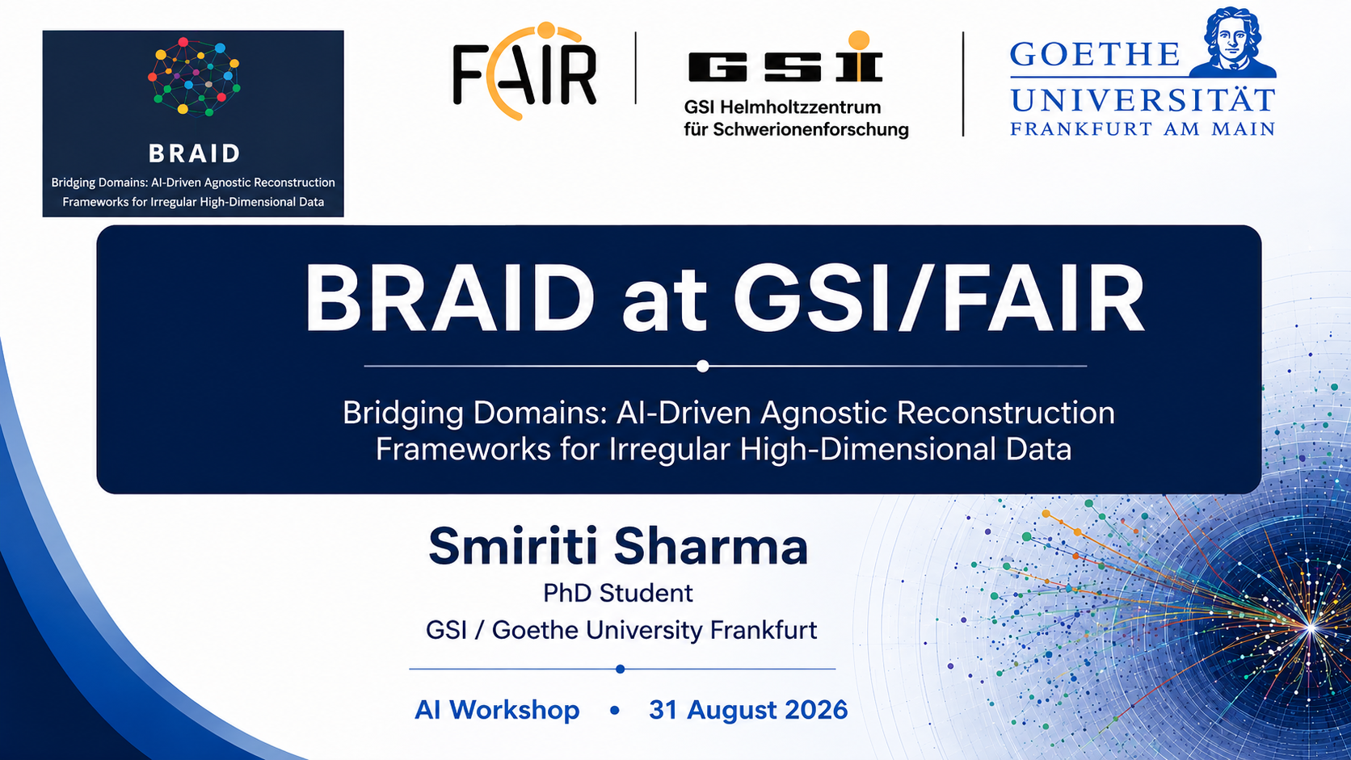
Notes:
Opening: introduce the BRAID framework, then immediately state the GSI/FAIR focus: muon identification and reconstruction in hadron-physics beam lines.

Slide 2

What is BRAID?
BRAID develops detector-agnostic ML methods for low-level reconstruction of irregular, high-dimensional detector data.
The objective is to learn useful representations of detector signals without relying on a fixed detector geometry.
CONSORTIUM PARTNERS
KIT
Karlsruhe Institute of Technology
RPTU
RPTU Kaiserslautern-Landau
TU
TU Dortmund
HEP / ML
Scientific computing / ML
Astroparticle physics
UPPSALA
Uppsala University
GSI
GSI / FAIR
inomed
inomed
Associated · neutrino physics
Hadron & nuclear physics
Industry · medical monitoring
FUNDING
ErUM-Data · funding period 2025–2028
BRAID is funded under the ErUM-Data programme and develops AI/ML methods for detector-agnostic reconstruction of irregular, high-dimensional data.
The consortium connects computer science with HEP, astroparticle physics, hadron & nuclear physics, and industry applications such as medical monitoring developing common methods that are challenged and refined by the application domains.
Source: BRAID proposal

Slide 3
3
3
Why BRAID?
A common ML language for irregular detector data
BRAID CORE · COMPUTER SCIENCE
PHYSICS DOMAINS · APPLICATION
DETECTOR-AGNOSTIC RECONSTRUCTION
Physics-informed ML
From detector signals to physics objects
High-Energy Physics
Graph & message-passing methods
Represent detector hits as a relational structure rather than a fixed image-like grid.
Physics constraints
Encode locality, symmetries and domain knowledge as inductive bias.
Adaptive dimensionality reduction
Reduce the number of relevant inputs while retaining information needed for reconstruction.
Attention & information propagation
Propagate information between related detector responses before object reconstruction.
Dense, high-rate events
and highly complex topologies
01
Irregular inputs
Sparse detector hits,
timing and signals
Dynamic graph construction
and information propagation
Astroparticle Physics
02
Learn structure
Sparse sensors
and irregular geometry
03
Reduce intelligently
Adaptive local dimensionality
reduction
Hadron & Nuclear Physics
Changing beams, targets
and detector conditions
04
Reconstruct
Particles / objects
with physics constraints
Scientific objective: develop reconstruction methods that are sufficiently generic to transfer across detector configurations while retaining physics-relevant information and robustness to changing conditions.
Notes:
Do not present BRAID as four separate projects. The point is that computer-science methods are developed centrally and then challenged by different domains.

Slide 4
What BRAID is building
A common ML approach for irregular, high-dimensional detector data.
FROM RAW DETECTOR INFORMATION TO RECONSTRUCTED PHYSICS OBJECTS
03
Reduce early
Irregular inputs
Learn locality
Reduce early
Reconstruct
Sparse hits + timing / signals
Dynamic graph construction
Adaptive, local dimensionality reduction
Particles / objects with physics constraints
No fixed grid: sparse detector responses are represented directly.
Learn relations between nearby detector responses using graph connectivity.
Adaptively reduce the representation while preserving reconstruction-relevant information.
Use the reduced representation to identify and reconstruct physics objects.
The key technical idea
Preserve spatial / temporal locality in the learned representation.
Make thresholds, clustering and combinatorial decisions ML-optimisable.
Reduce early so later reconstruction stages process fewer inputs.
Source: BRAID proposal
Notes:
Use this slide to explain the technical idea without diving into architecture details. The important distinction is adaptive reduction while preserving locality and physics constraints. The proposal explicitly focuses first on offline reconstruction, with later potential for online use.

Slide 5
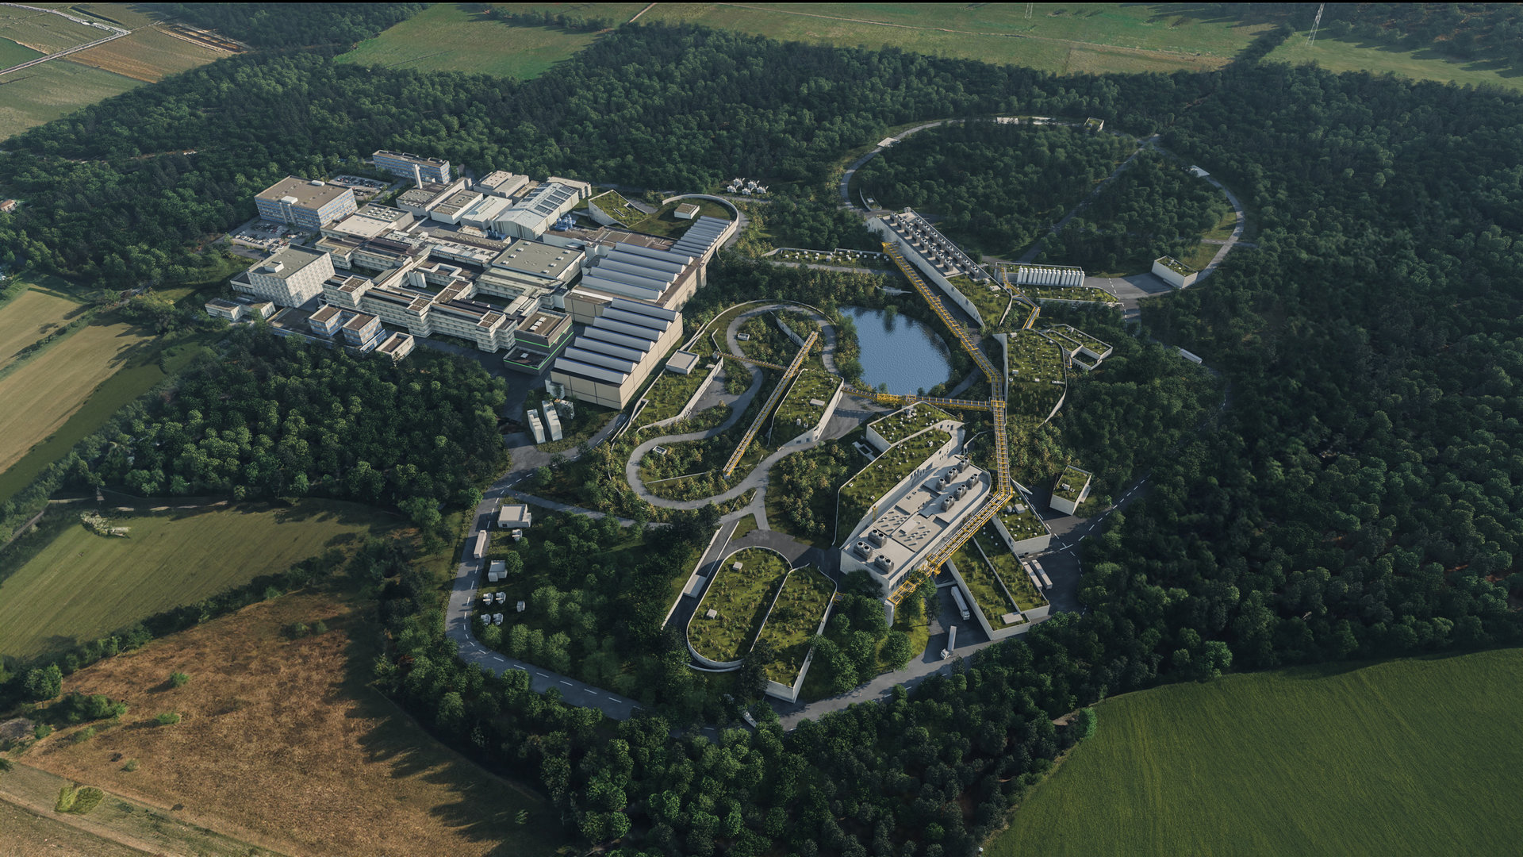
BRAID at GSI/FAIR
FAIR provides a common experimental environment with very different beam lines, targets and detector systems.
SHARED CHALLENGES
Different beams
Proton, heavy-ion and antiproton beams produce different event topologies and multiplicities.
Different detector layouts
Tracking and muon systems differ in geometry, granularity and absorber configuration.
Changing conditions
Reconstruction must tolerate operational and detector-configuration changes.
Common reconstruction goal
Infer particle-level information from sparse detector responses with robust performance.
5
Source: BRAID proposal
Notes:
FAIR has several research pillars; this presentation narrows to CBM and PANDA because they are the WP4 application domains at GSI.

Slide 6
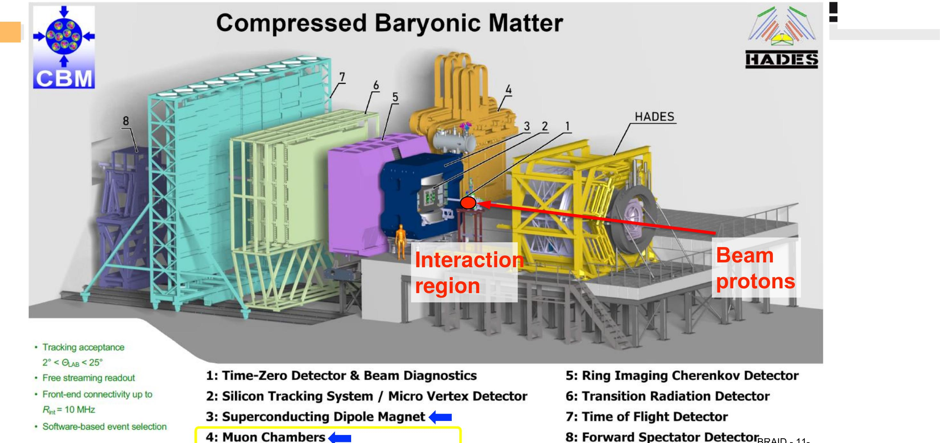
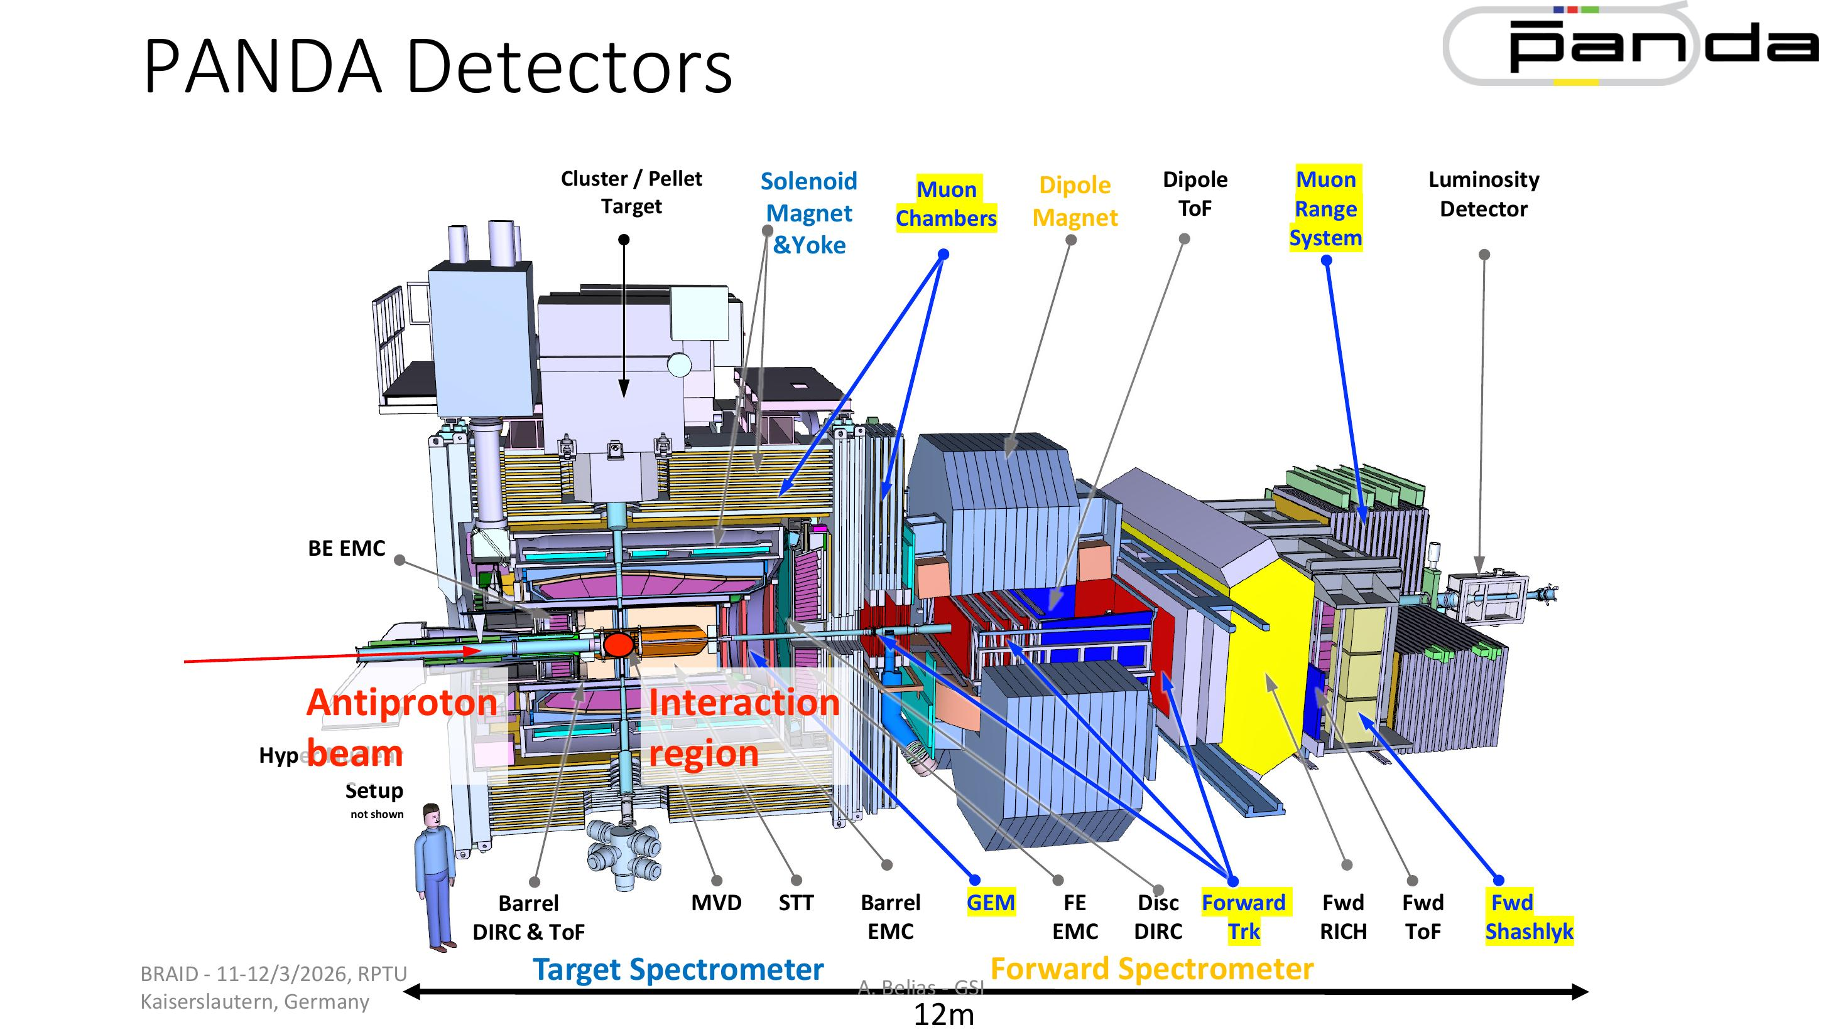
FAIR use cases: muon detectors across different beams
CBM
PANDA
SIS100 fixed-target heavy-ion collisions
• High rates and complex backgrounds
• Muon identification with MuCh / MuSt
Antiproton collisions for hadron spectroscopy
• Tracking + particle identification
• Complementary muon-system environment
Can muon reconstruction remain robust when conditions change?
6
Source: BRAID proposal
Notes:
Use the detector images as visual anchors. The point is not to explain every subsystem, but to show that the data structures and operating conditions differ substantially.

Slide 7
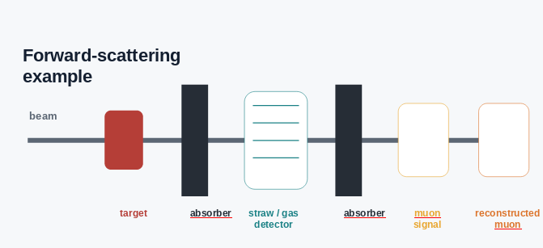
INSTRUMENTATION FOR FORWARD DETECTOR
CHALLENGE
The reconstruction problem is to infer the muon hypothesis from correlated detector responses in the presence of background.
• Muons can traverse absorber material and leave signals in downstream layers.
• Hadronic interactions and secondaries can create background hits and false candidates.
• Forward systems can combine gaseous detectors, straw tubes and absorbers.
• The ML representation must exploit hit correlations while remaining robust to geometry changes.
Particle propagation → detector response → correlated hits → track / candidate → muon identification
7
Source: BRAID proposal
Notes:
This is the conceptual bridge from BRAID to your own topic. The expose document explicitly frames muon identification as a common task across versatile hadron-physics beam lines and mentions large-area gaseous detectors, straw tubes and absorbers.

Slide 8
From simulation to reconstruction
WP4 uses controlled detector simulations to develop and test reconstruction methods for FAIR conditions.
1
PHYSICS EVENT
2
TRANSPORT
3
DETECTOR RESPONSE
4
RECONSTRUCTION
5
VALIDATION
Generate the collision according to the chosen physics scenario and event class.
Example: central Au+Au events at 8 AGeV.
Transport particles through the detector/material geometry with GEANT4.
Obtain detector-level hits together with Monte-Carlo truth.
Build tracks / particle candidates and study muon-background separation.
Evaluate efficiency, purity and resolution against Monte-Carlo truth.
EXAMPLE DATASET
WHAT WE GET FROM THE SIMULATION
1000 central Au+Au events at 8 AGeV
Detector-level hits + Monte-Carlo truth provide a controlled benchmark for development and validation.
UrQMD event generation → GEANT4 transport
Source: BRAID proposal
8
Notes:
The example campaign shown here follows the simulation work discussed in the project: 1000 central Au+Au events at 8 AGeV, with UrQMD and GEANT4. Replace or expand the example once the final simulation configuration is frozen.

Slide 9
The Use of ML- WP1: ML Concepts
WP1 develops the machine-learning concepts for irregular, high-dimensional data.
WP1a — Physics-informed ML architectures
WP1b — Adaptive reduction & discrete optimisation
KIT
RPTU
• Construct graph topologies for sparse detector responses.
• Develop message-passing architectures for information propagation.
• Incorporate physics constraints and locality as inductive bias.
• Investigate attention / information propagation.
• Develop architectures transferable across detector configurations.
• Develop adaptive dimensionality reduction with minimal information loss.
• Combine classical algorithms with ML where useful.
• Address thresholding, clustering and other non-differentiable operations.
• Learn discrete / combinatorial decisions.
• Provide reduction mechanisms for adaptive reconstruction.
Jan Kieseler — PI, KIT
Alessandro Brusamolino — PhD student, KIT
Nicolas R. Gauger — PI, RPTU
Long Chen — PostDoc, RPTU
WP1a ↔ WP1b
BRAID · WP1 — ML Concepts
Source: BRAID proposal
9
Notes:
This is a key slide. WP1 is the central hub of BRAID, while WPs 2–4 apply, validate and refine the methods. WP4 should not be presented as a standalone ML application.

Slide 10
Where does GSI stand in BRAID?
WP4 — Hadron & Nuclear Physics
GSI is the participating institute in WP4
PI: Anastasios Belias
Applies the ML methods from WP1 to FAIR physics, mainly CBM and also PANDA
Works on fast and adaptive reconstruction, simulation datasets, and physics-performance studies
Also looks at how different detector geometries affect the reconstruction
FAIR provides the physics cases where the ML methods can be tested and improved under different experimental conditions
EXTRA SLIDE JUST FOR V2 (not sure to add this or not)

Slide 11
BRAID
Develops detector-agnostic ML methods for irregular, high-dimensional detector data.
FAIR / GSI
Provides a demanding hadron/nuclear-physics environment with different beams, detector configurations and operating conditions.
My work
Uses muon reconstruction as a concrete test of transferability, robustness and physics performance.
11
Source: BRAID proposal
Notes:
Close by returning to the central idea: detector-agnostic reconstruction is useful only if it remains physically meaningful and robust when the detector and operating conditions change.

Slide 12
THANK YOU

