Slide 1
Development of novel detector concepts for nuclear physics with rare isotope beams at FRIB
Marco Cortesi
Detector Systems Group Leader
cortesi@frib.msu.edu
7 September 2026

Slide 2
Outline
FRIB Overview
Detector Systems Supporting ARIS
  DL-PPAC tracking/ToF, diagnostics suite, beam performance stats
  Discharge Mitigation: Anti-Discharge Unit (ADU)
Focal-Plane Tracking & PID (S800 / Sweeper / HRS)
MPGD R&D Program
  Multi-Layer THGEM (M-THGEM): position sensitive readout for TPC in active-target (AT) mode
  Multi-Mesh THGEM (MM-THGEM): Fission-Fragment Imaging and implementation on the GIRAFFE detector system
Summary & Outlook

Slide 3

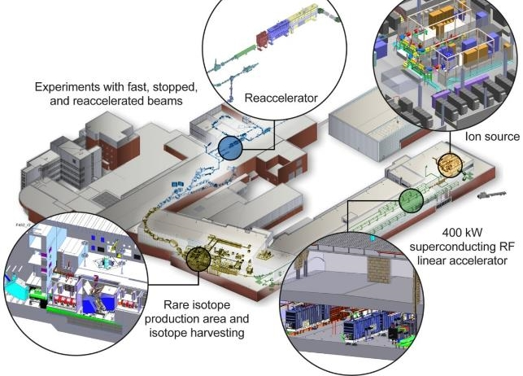

Fantastic Nuclei and Where to Find Them
FRIB is a U.S. DOE Office of Science scientific user facility, one of 28, providing beams of rare isotopes for nuclear science research
Key capability: up to 400 kW beam power at design capacity (currently operating at ~20 kW, 30 kW demonstrated)
Enables experiments with fast beams (~200 MeV/u), stopped (trapped) beams, and reaccelerated beams (0.6–10 MeV/u)
In-flight isotope separation provides access to more than 80% of the isotopes predicted to exist in nature
Facility for Rare Isotope Beams (FRIB)
FRIB Science Drivers
• Nuclear Structure and Reactions
• Nuclear Astrophysics
• Fundamental Symmetries
• Societal Benefits and Applications

Slide 4
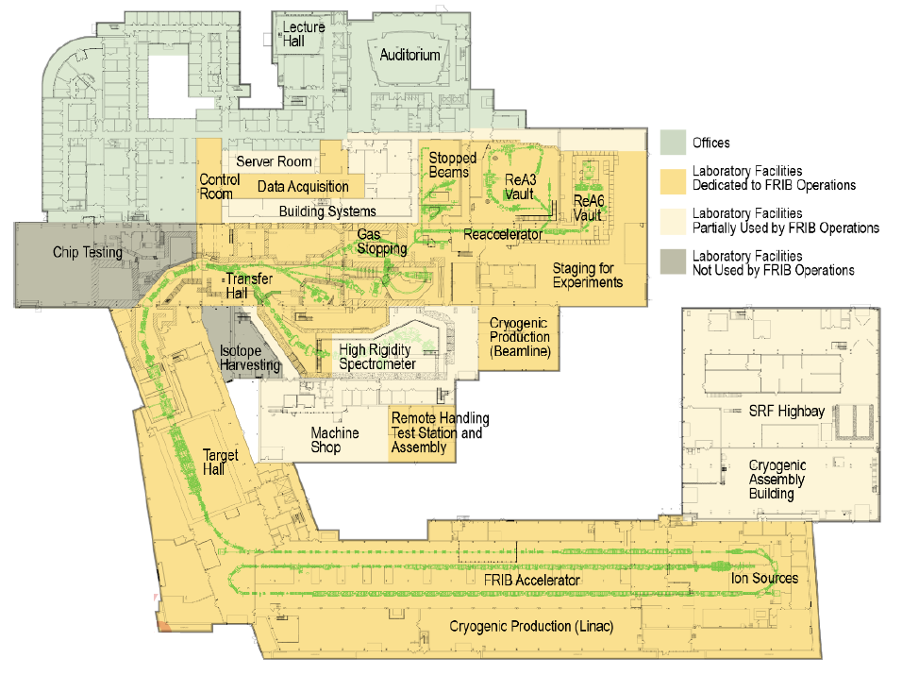
FRIB Laboratory Layout
LINAC
Superconducting linear accelerator that boosts heavy-ion beams to energies above 200 MeV/u.
Production Target System
Converts the primary beam into a wide range of rare isotopes via fragmentation or fission.
ARIS
Advanced Rare Isotope Separator — selects and purifies the isotopes of interest for delivery to experiments.
Experimental Areas
BECOLA, N4, ReA, S2, and S3/S800 host precision, reaccelerated-beam, and fast-beam experiments.
Experimental Areas
BECOLA
ReA
N4
S2
S3/S800
ARIS
Production Target Area
LINAC

Slide 5
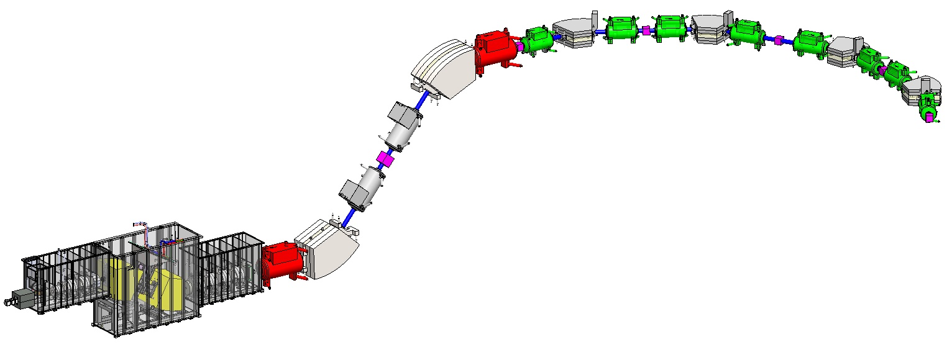
Bird’s Eye View of ARIS: Detectors
Multi-stage (two- or three-stage) separation using “wedges”
Selectable optics
  Momentum compression
  High resolution CB1
  Large acceptance CB2
Features
  Particle identification (PID)
  of individual isotopes
  Production of ions via projectile
  fragmentation and/or abrasion-fission
DB1
(Pre-Separator Focal Plane)
DB2
DB3
DB4
DB5
(Final
Focal Plane)
A/Q
Z
Diamond
PPAC pair
Thin Sci
PPAC pair
PIN
PPAC
Thick Sci
Thin Sci
Target
Event-by-Event Identification based on Bρ-ΔE-ToF
Pre-Separator Wedge
Critical for momentum compression and transmission
PPAC pair
PIN Stack
Thin
Sci
PPAC pair
HPGe
Notes:
Ok, now back to ARIS, detectors. Salvatore just shared a lot about the ARIS detectors, so I will tell you how we use them.

Slide 6
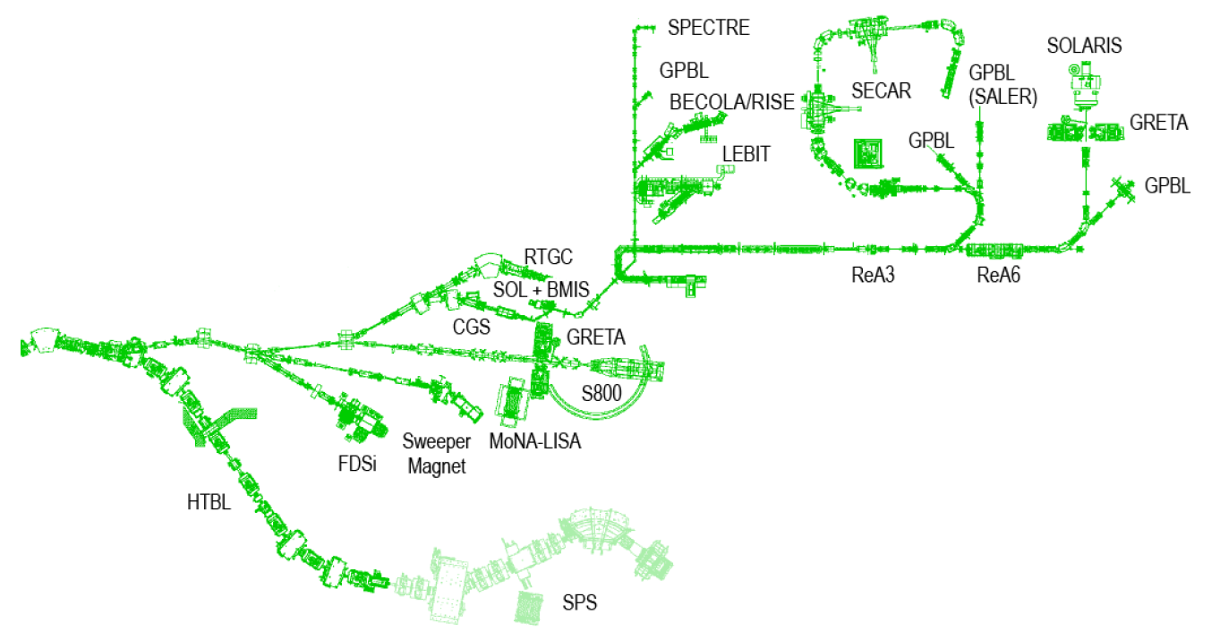
Science Opportunities at FRIB
with Fast, Stopped, Reaccelerated Beams
FRIB hosts a suite of scientific instruments and general-purpose beamlines in support of the user program
Most systems inherited from the NSCL legacy facility (e.g., Sweeper and S800 spectrometers)
New instrumentation currently under development (e.g., High Rigidity Spectrometer)
Reaccelerated Beams
Stopped Beam
Fast Beams

Slide 7
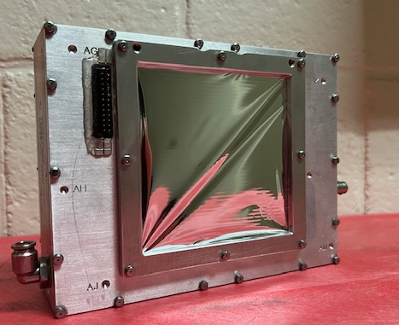
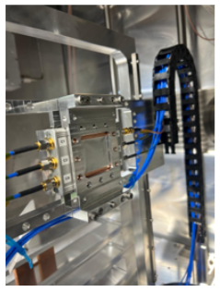
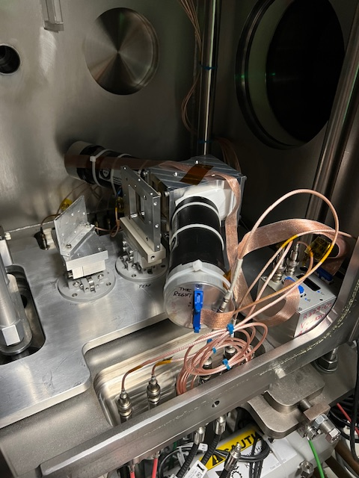
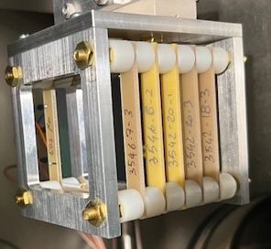
State-of-the-art Diagnostics to support ARIS operation
Delay-Line PPAC (DL-PPAC)
Various sizes
Delay-line readout
Custom-made two-stage pre-amplifiers
Anti-Discharge Unit implemented
Performance:
  Position → 0.5 mm (σ)
  Time → <150 ps (σ)
  Rate → up to 300 kHz
Time of Flight (ToF):
Plastic Scintillator:
EJ232 (0.15 mm – 1 mm)
PMMA Light guide
Hamamatsu H6533-20
Performance:
  Time → <100 ps (σ)
  Rate → up to 1 MHz
Diamond
Area up to 30x30 cm²
Thickness = 100/200 μm
Performance:
  Time → <50 ps (σ)
  Rate → above 1 MHz
Si-PIN (Micron Semiconductor model MSX25)
ΔE/E measurement
Performance:
  Energy → < 5% (σ)
  Rate → up to a few kHz
TKE Si-PINs
(Micron Semiconductor. MSX25)
Thickness → 0.3–1.5 mm
CSP → Mesytec MSI-8 (up to 5 GeV)
Performance:
  Energy → <5% (σ), 5.9 MeV α
  Rate → up to a few kHz
Total Kinetic Energy (TKE)
EJ232 (20x20 cm² single block)
Two PMTs (Hamamatsu H6533-20)
Dedicated QDC-based DAQ
Performance:
  Rate → up to 1 MHz

Slide 8
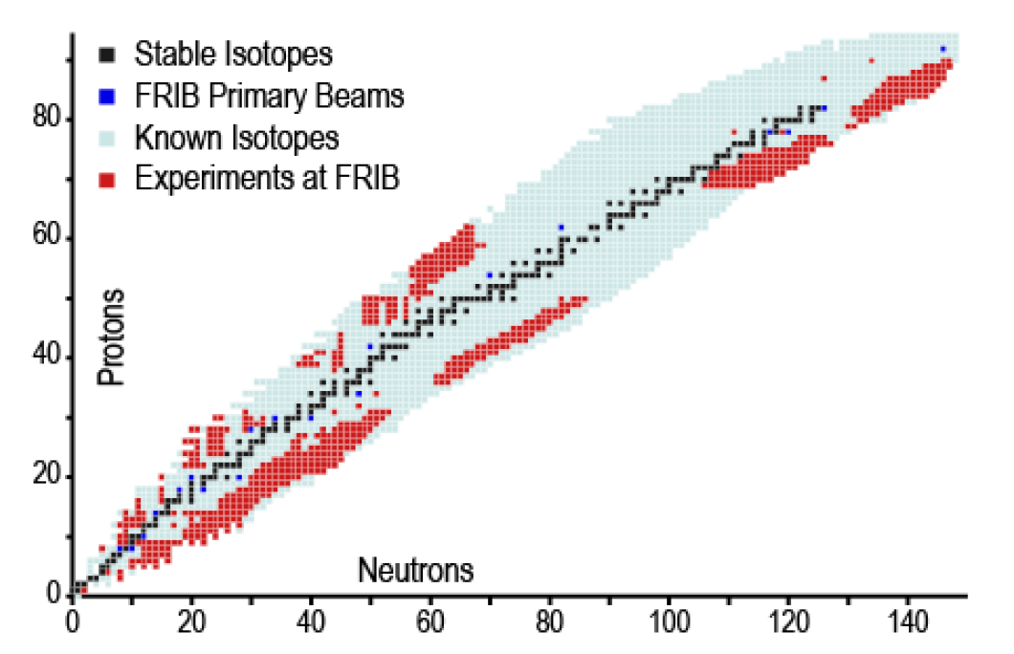
Operating with 20 kW Beam since March 2025
Total 4190 Scheduled Operating Beam Hours at 92.8% Availability in FY2026
Experiments since October 2025:
E21023 (238U): ²²⁴Th, ²¹³Fr
E21048 (238U): ⁸⁵Se
E23035 (64Zn): ⁶⁰Ga, ⁵⁹Zn, ⁵⁸Cu
E25506: (64Zn): ⁶²Zn, ^{60,61}Cu
E25058 (28Si): ²⁰Na, ^{20,21}Mg, ²²Al
E21004 (124Xe): ^{106,108}Sn
E21021 (124Xe): ⁹⁹⁻¹⁰¹Sn, ⁹⁸⁻¹⁰⁰In, ^{97,98}Cd, ^{96,97}Ag, ^{95,96}Pd
E21066 (70Zn): ⁵⁴Sc, ^{52,53}Ca, ⁵⁵Ti
E21039 (92Mo): ⁷⁷⁻⁸⁰Y, ^{79,80}Zr, ^{82,83}Nb
E23005 (40Ar): ²¹O
E21080 (208Pb): ¹⁸³Tm, ¹⁸⁶⁻¹⁸⁷Yb, ¹⁸⁹⁻¹⁹⁰Lu, ¹⁸⁸⁻¹⁹²Hf, ¹⁸⁹⁻¹⁹⁴Ta, ¹⁹¹⁻¹⁹⁶W, ¹⁹⁵⁻¹⁹⁹Re,¹⁹⁷⁻²⁰³Os,¹⁹⁹⁻²⁰³Ir
E23071 (144Sm): ¹²⁸⁻¹²⁹Sm, ¹²⁵⁻¹²⁸Pm, ¹²³⁻¹²⁷Nd, ¹²¹⁻¹²⁸Pr, ¹¹⁹⁻¹²⁵Ce, ¹¹⁶⁻¹²⁴La,¹¹⁴⁻¹²²Ba, ¹¹²⁻¹¹⁹Cs, ¹¹¹⁻¹¹⁶Xe, ¹¹⁰⁻¹¹⁴I, ¹⁰⁹⁻¹¹²Te, ¹⁰⁸⁻¹¹¹Sb
E25022 (40Ca): ³⁵Ca, ³³Ar, ³²Cl, ³¹S
More than 650 Rare Isotope Beams Have Been
Delivered to FRIB Experiments
Primary Beams
¹⁸O
²²Ne
²⁸Si
^{36,40}Ar
^{40,48}Ca
⁵⁸Ni
^{64,70}Zn
⁸²Se
⁹²Mo
¹²⁴Xe
¹⁴⁴Sm
¹⁹⁸Pt
²⁰⁸Pb
²³⁸U

Slide 9
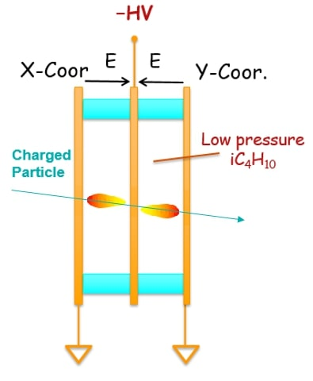
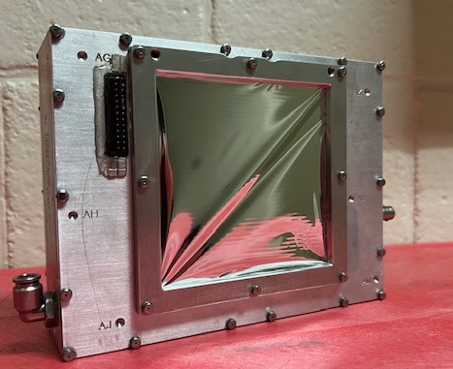
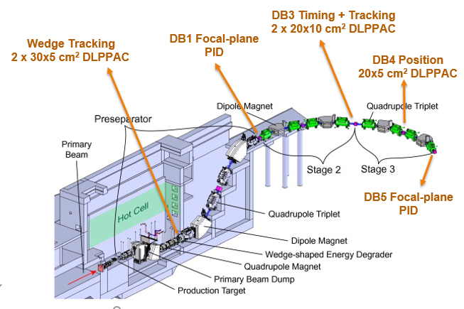
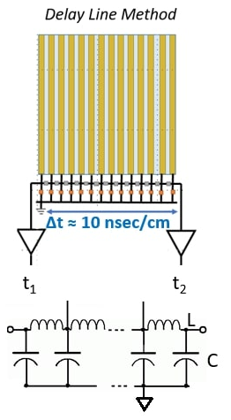
Delay-Line Parallel Plate Avalanche Counter (DL-PPAC): Design Overview
Various sizes (10x10cm², 20x5cm², 20x10cm²,30x5cm²)
Delay line (33 nH, 3.3 pF → 1 ns/mm )
Custom-made two-stage preamplifier (20dB + 10dB).
Dedicated GHS and DAQ (CFD+TDC)
Operation at <15 Torr iC₄H₁₀ or C₃F₈
Provides: Event-by-event momentum vector determination and ToF signals
Used at several locations in ARIS
X-coordinate
Y-coordinate
Cathode
(+)
(+)
(-)
Electrodes: 150 nm thick metal (Au, Ag, Cr) layer on a 0.75 μm polypropylene foils
Cathode: uniform foils or wires (MWPC)

Slide 10
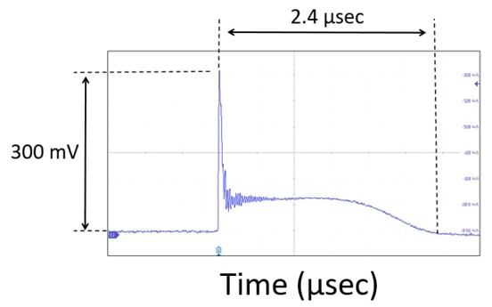
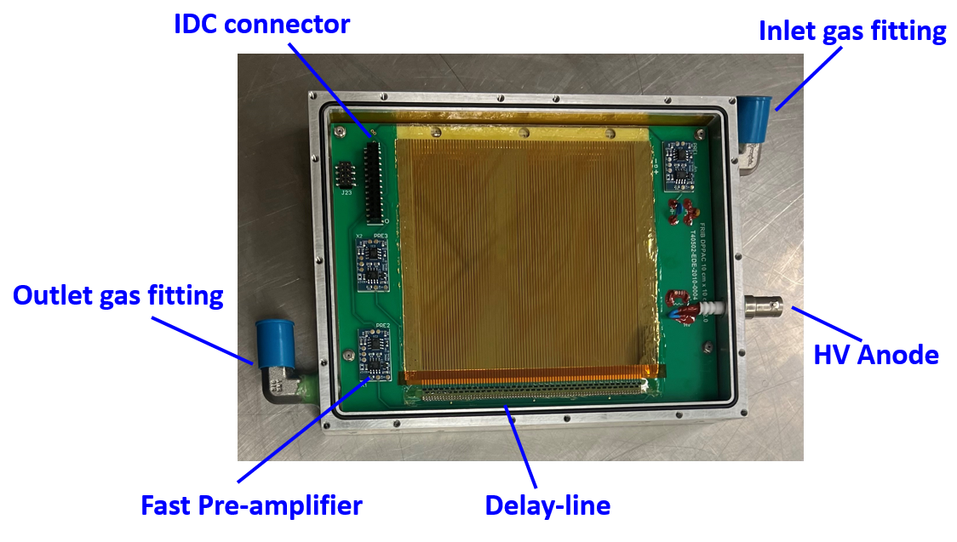
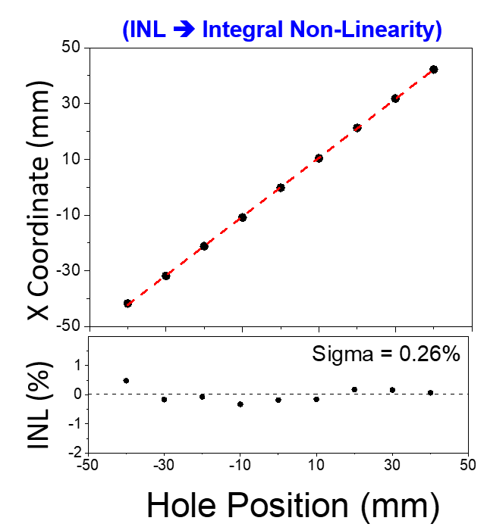
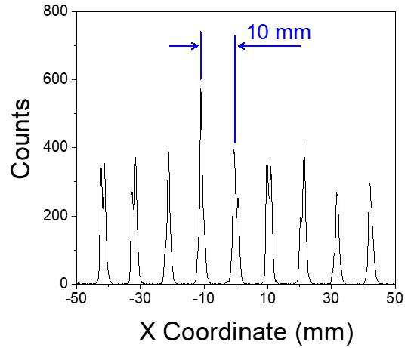
DL-PPAC: Summary of Performance
10x10 cm² DL-PPAC
Summary Performance:
Uniform gain (>10³) across the effective area
Time resolution (ToF) < 150 ps (σ)
Position Resolution ≈ 0.5 mm (σ)
Rate capability up to ≈300 kHz
Electrons
Ions

Slide 11
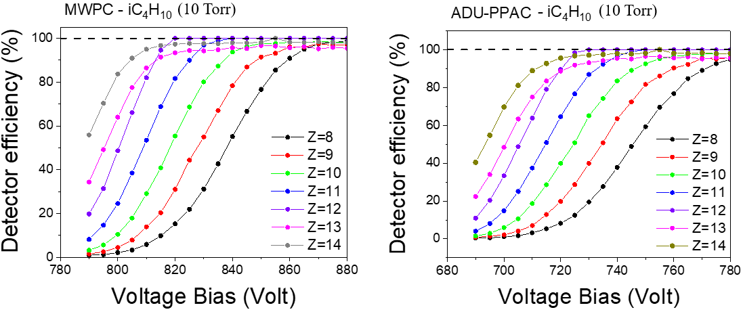
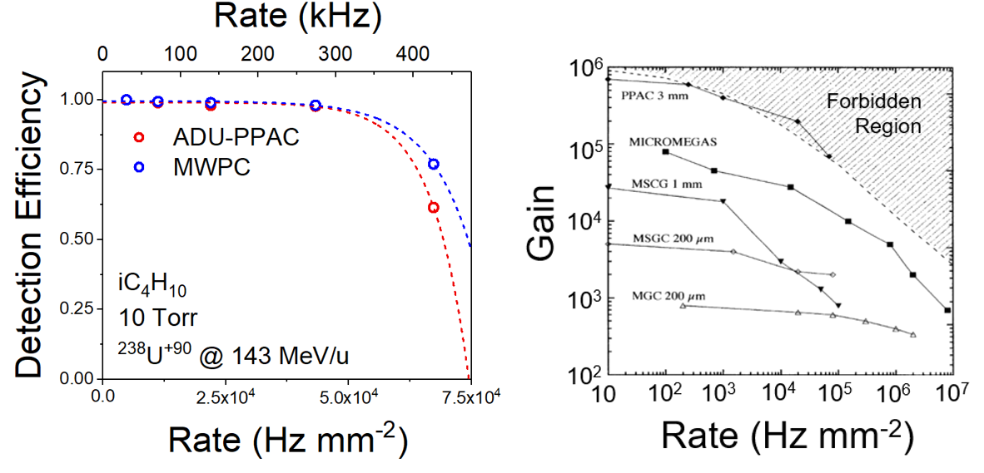
Beam Tests of DL-PPAC and MWPC
Demonstrating High Efficiency at Low Z and High Rate
Low Z detector efficiency test
with a beam (Z<30) @ 180 MeV/u
  100% efficiency for all fragments
  achieved under optimal operational
  conditions
    iC₄H₁₀ at 10 Torr
    PPAC bias > 780 V
    MWPC bias > 865 V
High-rate detector efficiency test with
U-238 (Z=92) beam @ 194 MeV/u
  Full detection efficiency for rates up to ≈300 kHz
  Improved by a factor of ~60 compared to the old
  NSCL PPAC readout technology based on
  resistive chain
S. Di Carlo, M. Cortesi et al., “High-rate heavy-ion tracking using MWPCs and PPACs with an Anti-Discharge Unit”, JINST, vol. 21, P03022, 2026

Slide 12
ARIS Particle Identification Capability with PPACs
Delay-line PPACs provide:
  Good time resolution
  Reduced thickness vs scintillators
  Lower charge-state production
  No wedge effect in dispersive plane
Trajectory reconstruction provides Bρ
PID from ΔE–TKE, ToF, and Bρ
  ΔE–TKE: PIN telescope
  ToF: DB3-PPAC1 & DB5-PPAC1
  Bρ: PPACs at DB3, DB4, DB5
Trajectory-reconstructed PID for 228 MeV/u ¹²⁴Xe fragments on 3.5 mm thick Carbon target.
Z
50
A/q
40
Z
30
Z
Resolution (DB3-DB4-DB5 reconstruction)
σ(Z) = 0.167 (as average of first 3 PINs)
σ(q) = 0.093
σ(A-2q) = 0.105 (mass resolution)
σ(A/q) = 0.0024
q
20
10
A/q
E. Kwan et al., in Proc. HIAT2025, pp. 311-314.
0
5
10
(A/q-2) Z

Slide 13
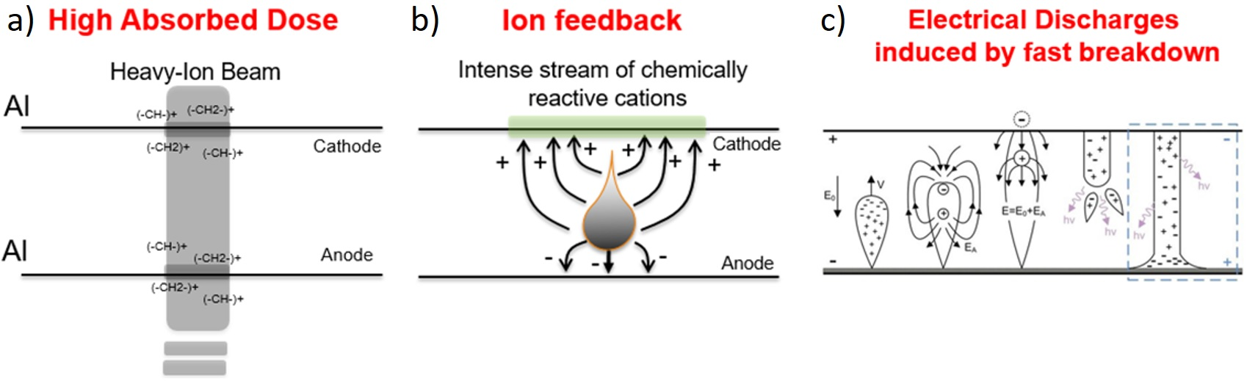
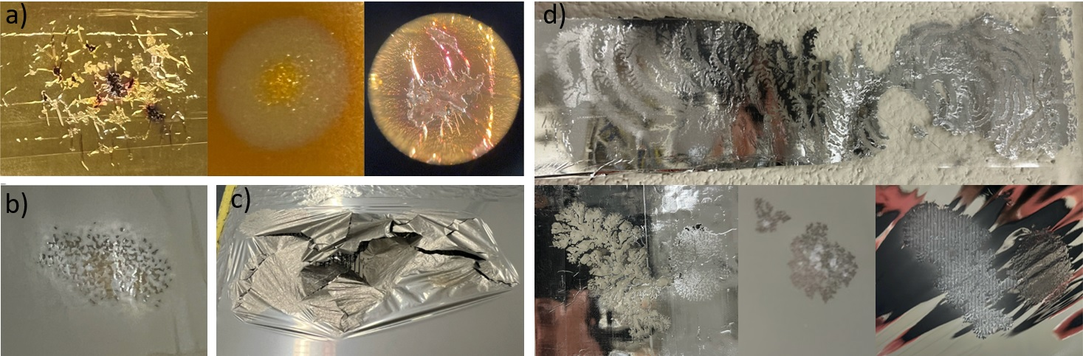
High-rate, Ion-Feedback, Spark-Mediated Effects
Significant foil aging caused by:
  Loss of polymer mechanical properties due to high absorbed dose
  Electrode demetallization due to ion back-streaming
  Violent streamer discharges
Observed foil damage:
  Localized circular gold etching
  Aluminum-surface corrosion
  Foil rupture from discharges
  Electrical tree-like discharge patterns
Lifetime-extension strategies:
  Radiation-hard materials
  Wire-based electrodes
  Anti-Discharge Unit (ADU)
AGING MECHANISMS
Di Carlo et al. NIM A 1071 (2025) 170076
TYPES OF FOIL DAMAGE

Slide 14
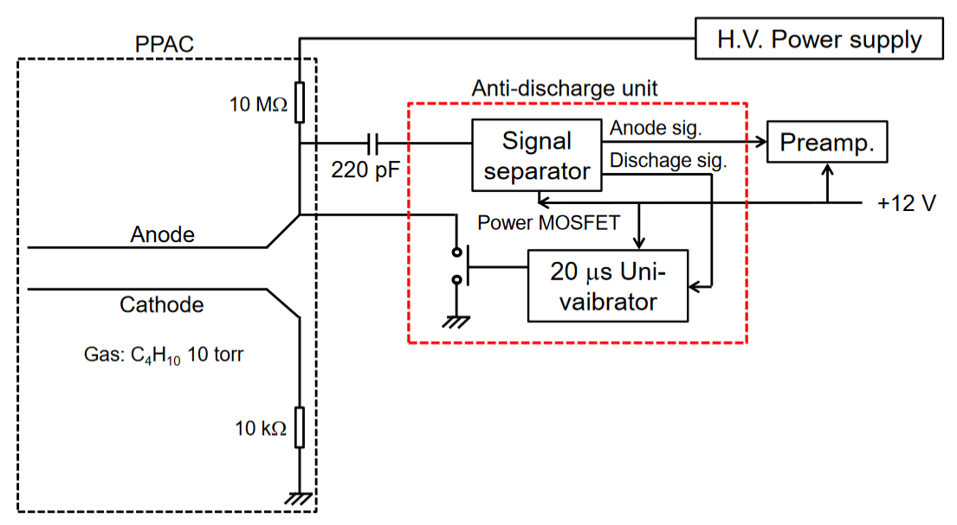
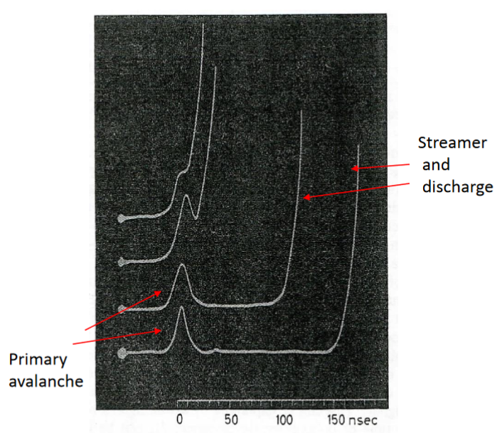
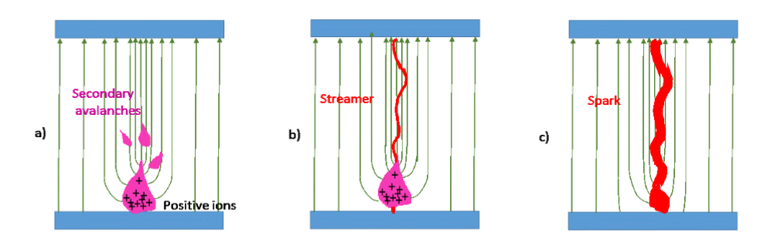
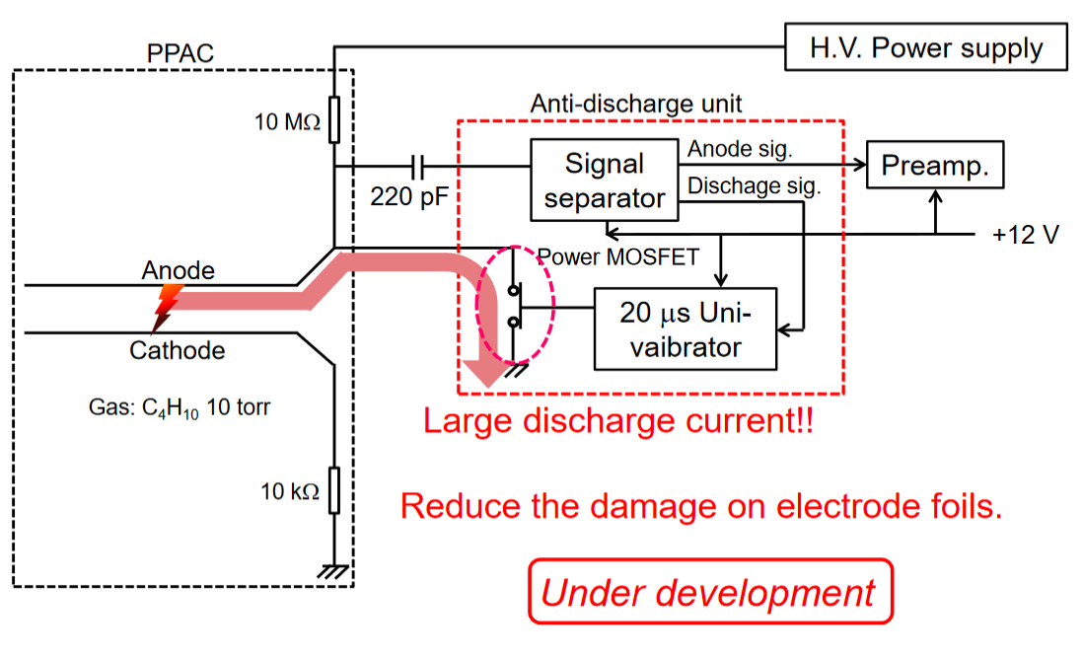
ADU: Operating Principle and Discharge Mitigation
Originally developed by Kumagai-san at RIKEN for PPAC applications
Operating principle: streamer current above threshold triggers a PMOS switch that grounds the anode within tens of ns; bias is restored within a few ms
Purpose: protect cathode foils from energetic discharges
Impact: minor reduction in effective rate capability
H. Sato, Expert Meeting @Grand Rapids 2016/8/31
Streamer
Potential mechanism: suppresses streamer-to-spark transition by sensing pulse-height and triggering on pulses above threshold
H. Raether, Electron Avalanches and Breakdown in Gases, 1964

Slide 15
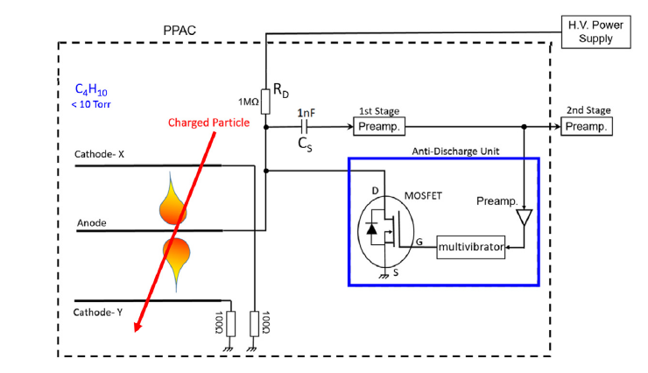
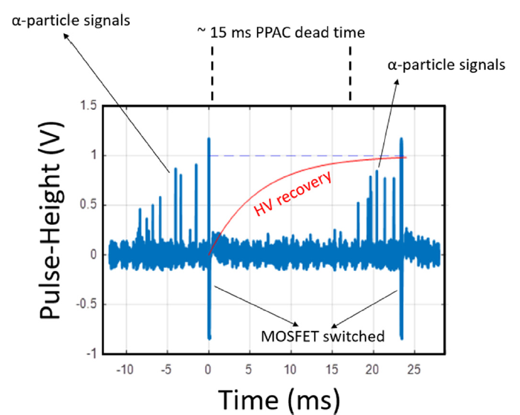
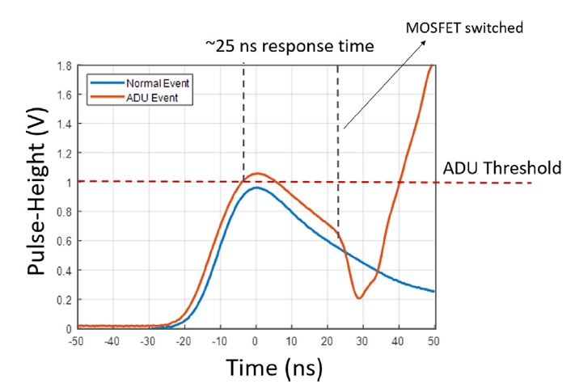
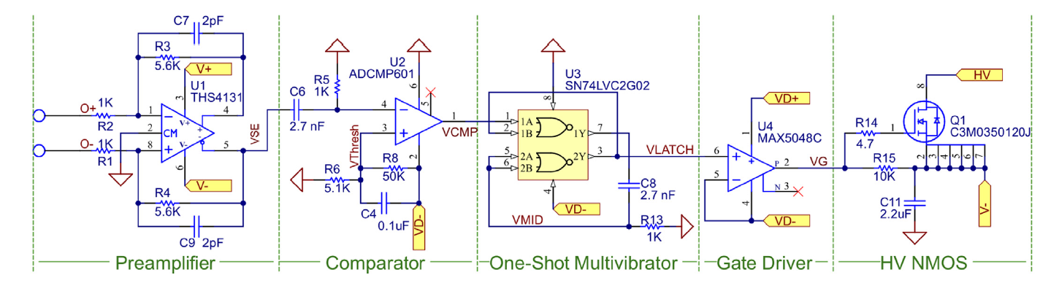
FRIB ADU Operation Principle
FRIB ADU device:
Installed inside the PPAC vessel
Selectable discharge threshold
Response time: ~25 ns
PPAC ADU dead time: ~15 ms
PMOS switching time < HV trip time (≥100 ms)
Suppresses streamer development
  Protects fragile foils
  Extends PPAC lifetime
Di Carlo et al. NIM A 1071 (2025) 170076
20 μs rest time from the monostable circuit
HV PMOS

Slide 16
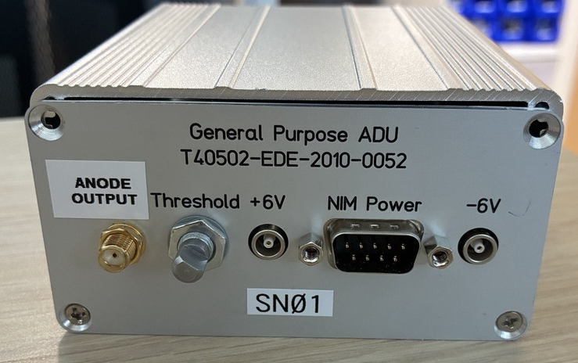
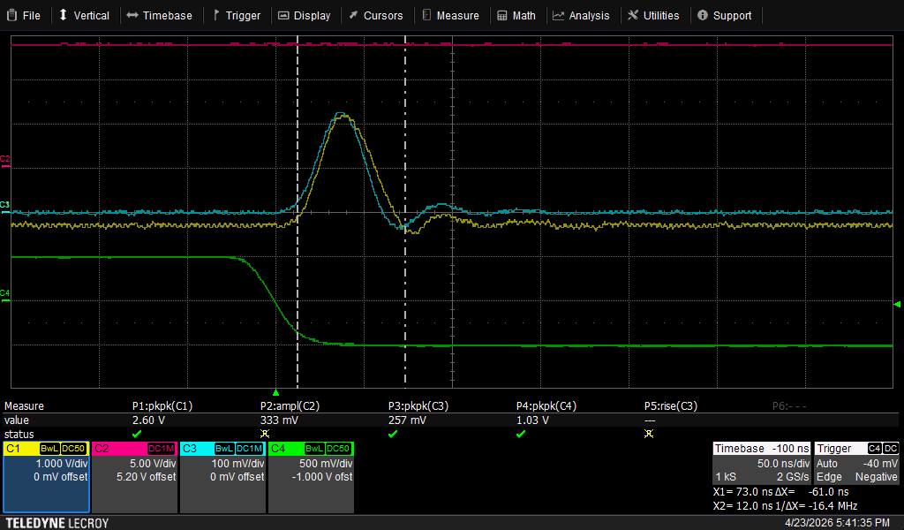
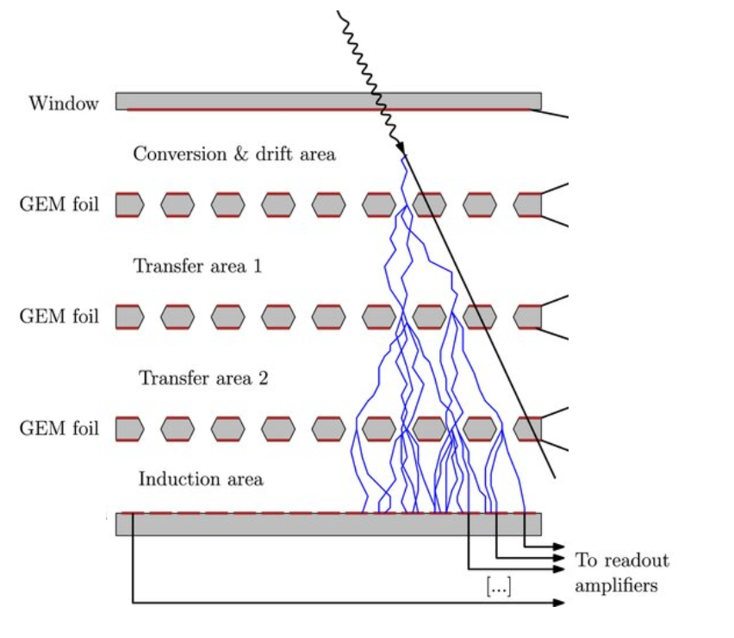
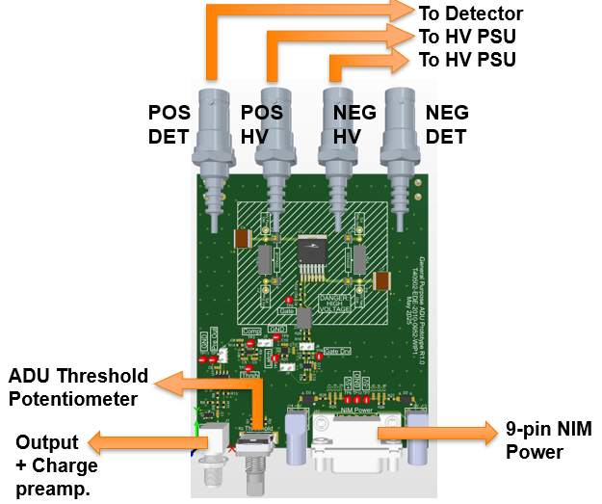
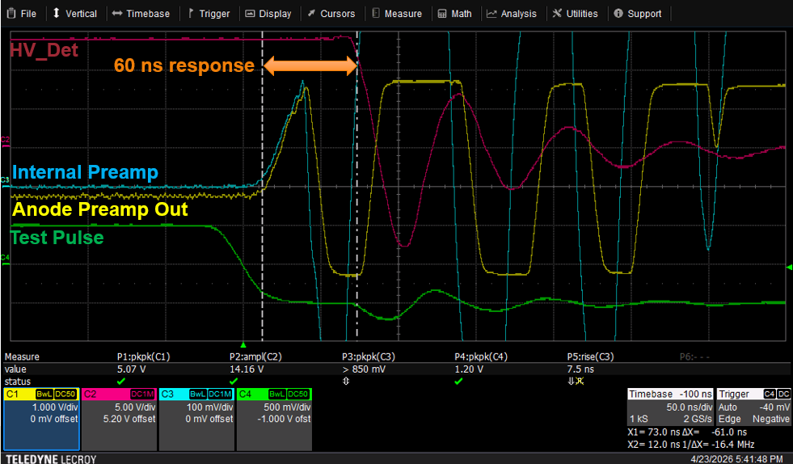
General Purpose ADU for Gaseous Detectors
GP-ADU features (NMOS/PMOS switching):
  Reconfigurable for positive or negative HV bias
  Can pull intermediate HV instead of GND
  Maximum operating voltage: 3.3 kV
  External potentiometer for threshold adjustment
  Response time: 50–60 ns
  GP-ADU recovery: ~5 ms + detector capacitance
  Powered through standard 9-pin NIM power
  Optional output signal with CR-112 charge preamplifier
  Prototype testing ongoing
Example of a pulse below threshold
MPGD-ADU: Operating Mode
V_{C}
Example of a pulse above threshold
ADU
V6
V_{R}6
V5
ADU
V4
V_{R}4
V3
ADU
V2
V_{R}2
V1
Each GEM protected by a dedicated ADU

Slide 17
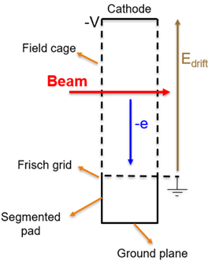
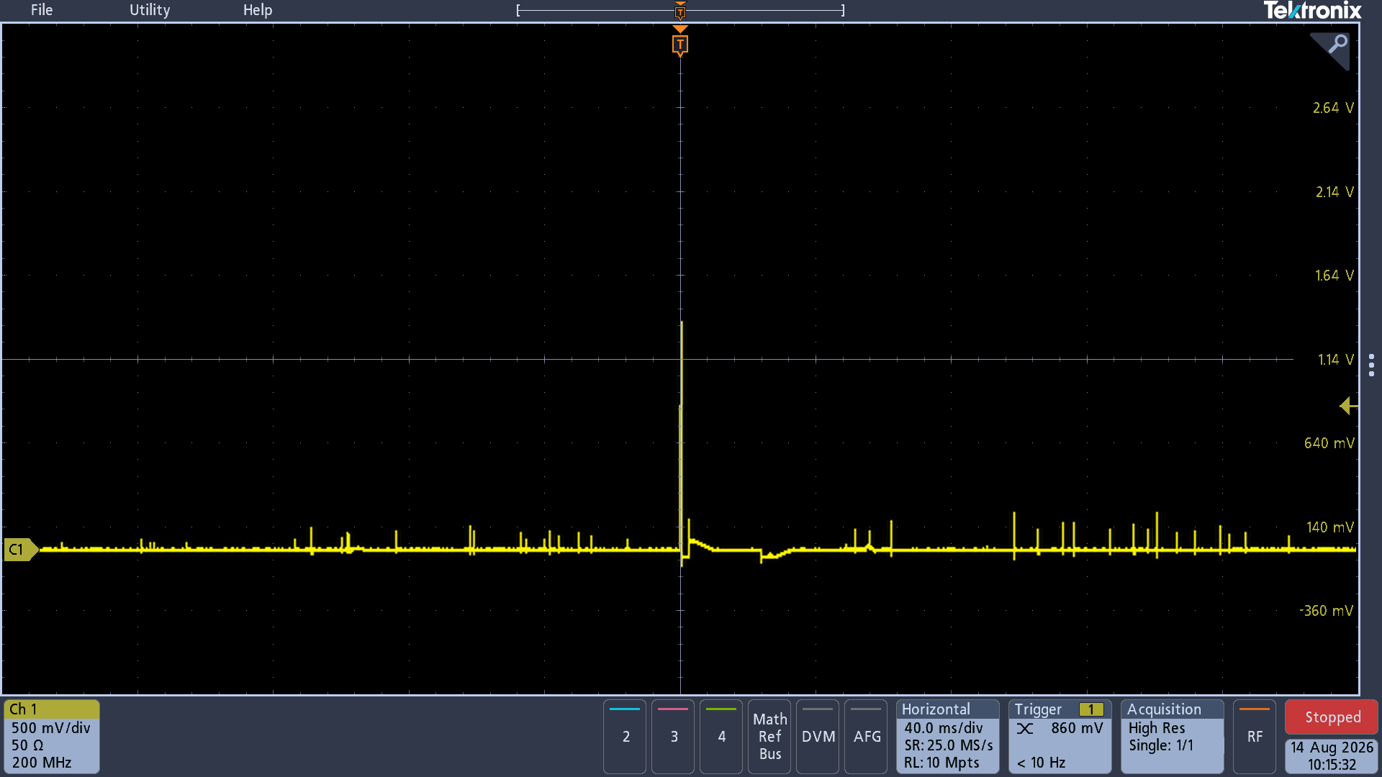
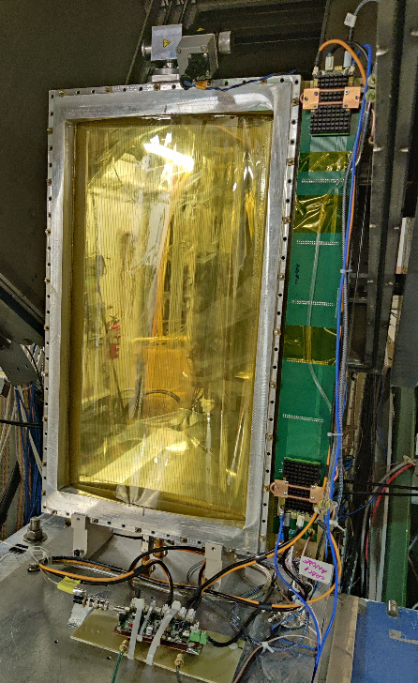
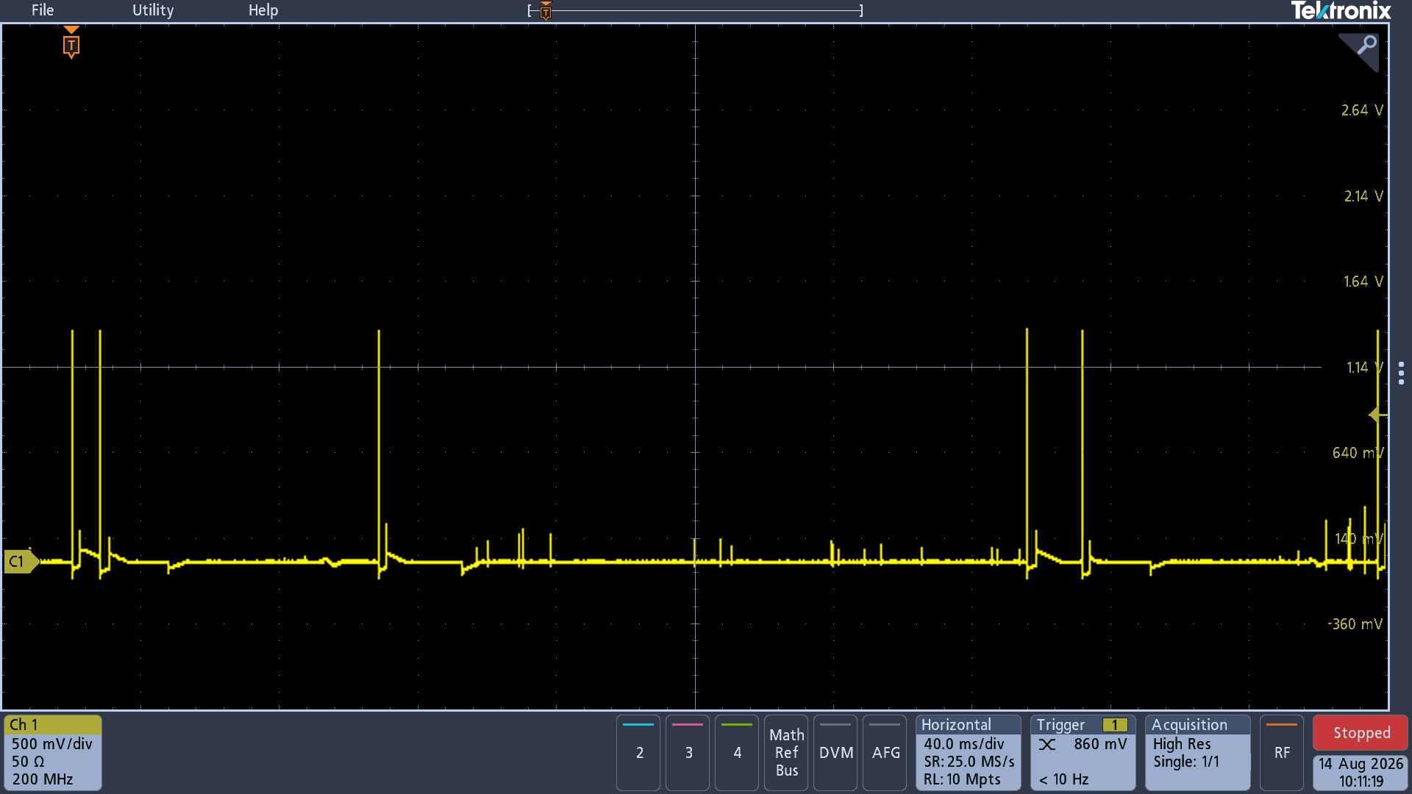
GP-ADU: Preliminary Results
S800 CRDC
ADU-on
Dead-Time ≈ 30 ms
Detector Pulses
Detector Pulses
GND
Threshold below spark limit
ADU
+HV
GND
Long-term CRDC test carried out with an SRS-based DAQ
Different thresholds were used to probe the dynamic range and capture discharge events
Effective protection also maintained with the ADU threshold set above the nominal discharge-onset region
48-h endurance test under repeated discharge conditions; no damage to detector components or VMM3a hybrids observed
Tests on GEM, THGEM-like, and Micromegas are ongoing; observed dead time is detector/test-condition dependent
Threshold reduced to a lower pulse-height

Slide 18
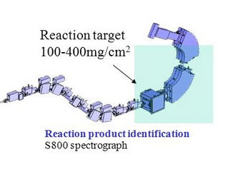
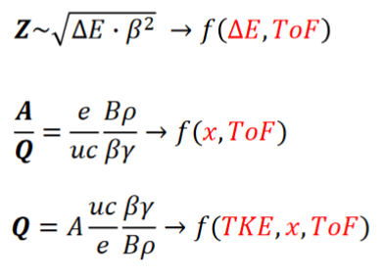
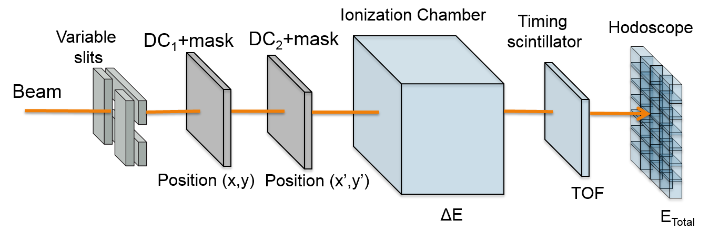
The S800: High-Resolution, High-Acceptance Spectrograph
S800 Spectrograph continues to be the main workhorse for nuclear structure and reactions studies with fast beams until High-Rigidity Spectrometer (HRS) is complete
Focal-Plane
Spectrometer Focal-Plane Detector functions:
Particle Identification (PID) based on Bρ-ΔE-ToF ➔ (Z, A/Q, Q)
Variable slits ➔ Beam shaping and background rejection
Event-by-event momentum vector determination ➔ Particle Track Position
Z-number Identification ➔ Energy-loss measurement
Timing/triggering ➔ ToF measurement + energy loss (with moderate resolution)
Charge-state separation & isomer tagging ➔ Total Kinetic Energy (TKE) and γ-ray detection
15 m
Standard Focal-Plane detector system for heavy-ion PID
Cortesi et al. EPJ Web of Conferences 290, 1006 (2023)

Slide 19
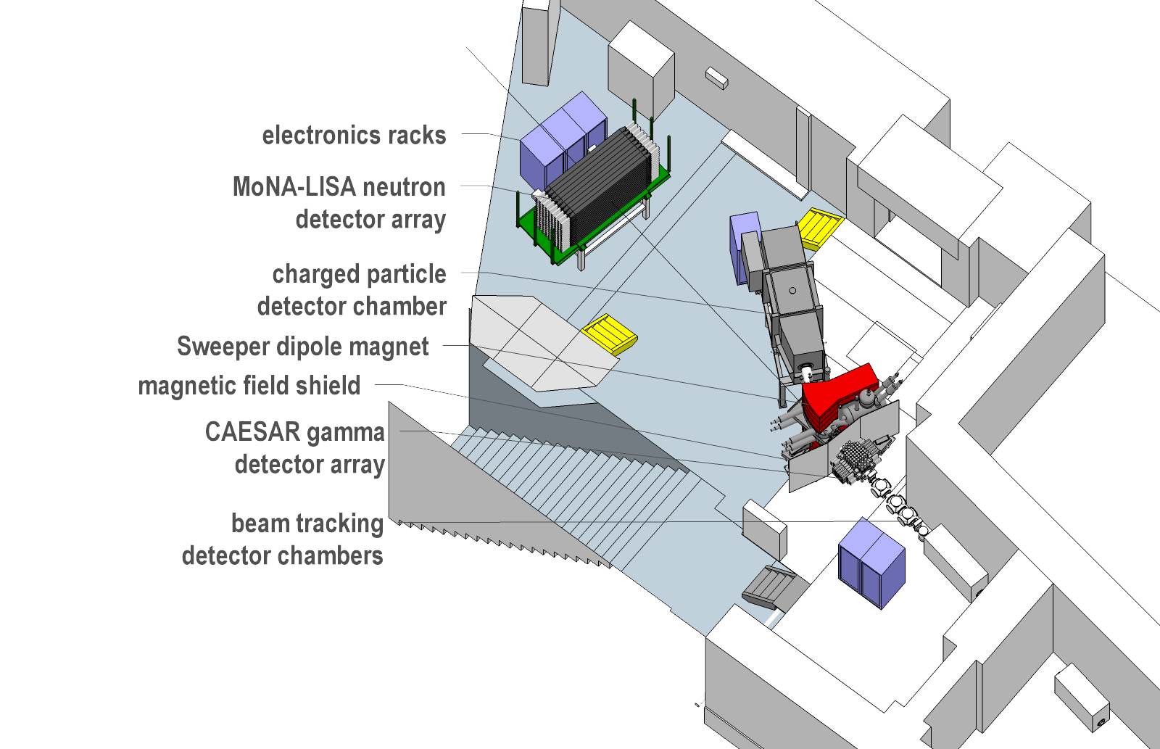
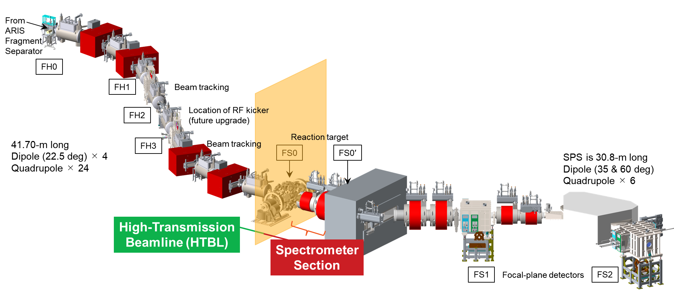
Sweeper Magnet and the Future High Rigidity Spectrometer
Same focal plane detector technology for tracking and PID developed for the S800 Spectrograph
Sweeper Magnet for invariant mass measurement
High Rigidity Spectrometer (HRS)

Slide 20
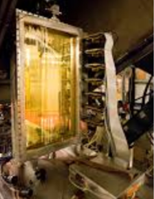
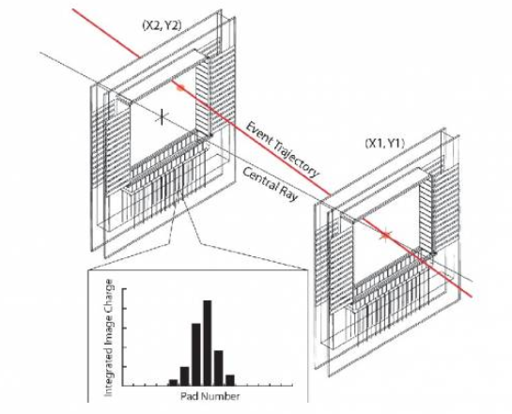
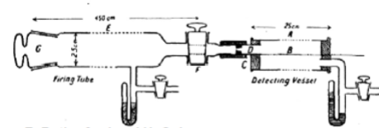
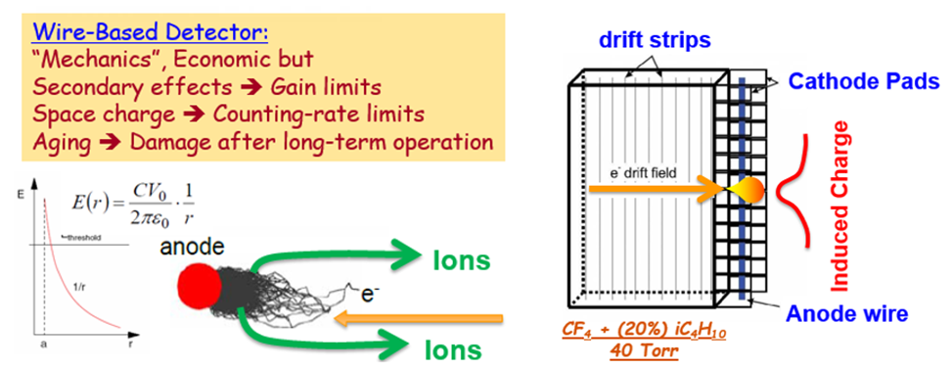
Tracking System: Drift Chambers
Provide event-by-event tracking (position and angle)
of each fragment that reaches the focal plane
Cathode Readout Drift Chamber (CRDC): 30 years of operation at NSCL/FRIB ➔ single-wire anode readout
Performance:
  Position resolution < 1 mm (FWHM)
  Rate < 5 kHz
  Fast aging
1908 Wire Counter (Single wire readout)
(Rutherford and Geiger)
Position (X,Y):
X ➔ segmented readout
Y ➔ electron drift time
Path Forward: Transition from single-wire readout to Micro-Pattern Gaseous Detector (MPGD) technology to achieve the increased rate handling and dynamic range performance required for high-Z beam operations!

Slide 21
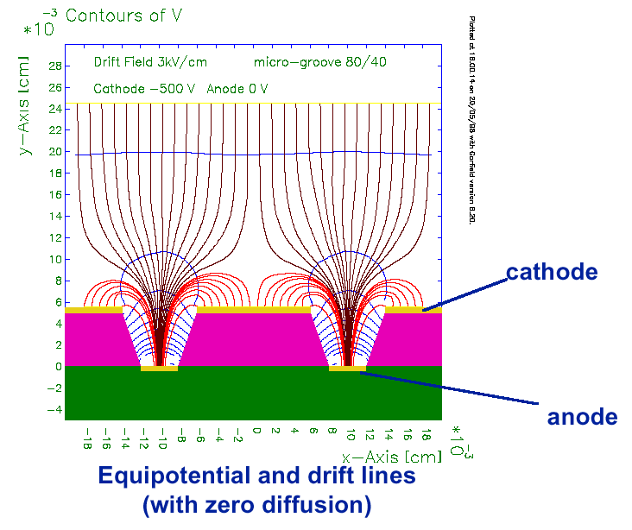
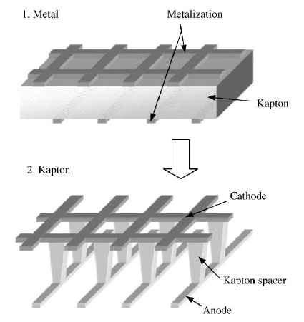
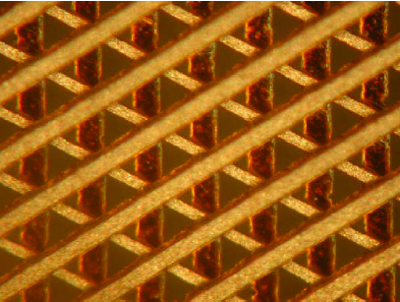




Micro-Pattern Gaseous Detectors (MPGDs)
MICRO-GROOVE CHAMBER
MICROWIRE CHAMBER
MICRO-PIXEL CHAMBER
MICROWIRE CHAMBER
FIELD GRADIENT LATTICE DETECTOR
Adeva et al.
NIMA 461 (2001) 33
Bellazini et al.
NIMA 424 (1999) 444
Dick et al.
NIMA 535 (2004) 347
Ochi et al.
NIMA 471 (2001) 264
GAS ELECTRON MULTIPLIER
MICRO-HOLE & STRIP PLATE
MICROMEGAS
MICRO-PIN ARRAY
Giomataris et al.
NIMA 376 (1996) 29
Sauli
NIMA 386 (1007) 531
Veloso et al.
TNS 49 (2002) 875
Rehak et al.
TNS 47 (2000) 1426
…. and many others

Slide 22

MPGDs at FRIB: new Science Opportunities
Applications: position-sensitive readout for low-pressure drift chambers and AT-TPC, fission fragment imaging, exotic decay studies ➔ heavy-ion tracking and TKE/ToF measurement for momentum vector reconstruction and PID
Operational requirements: wide range of operating pressures (0.1–1 atm) and simultaneous detection across a wide range of Z
Different MPGD structures to suit a diverse array of needs!

Slide 23





Multi-layer THGEM (M-THGEM)
Designed for stable operation in pure elemental gases and at low pressures
Cortesi et al., Rev. Sci. Instrum. 88, 013303 (2017)
Manufactured by multi-layer PCB technique out of FR4/G-10/ceramic substrate
No charge loss between stages ➔ high gain @ low voltage
Robust avalanche confinement ➔ lower secondary effects
Long avalanche region ➔ high gain @ low pressure
Field geometry stabilized by inner electrodes
2-Layer M-THGEM
3-Layer M-THGEM
Low pressure
AT-TPC & pure gases

Slide 24

M-THGEM vs. THGEM: Performance Comparison
M-THGEM exhibits:
  higher maximum achievable gain at all pressures
  Improved stability due to enhanced avalanche confinement
  Reduced photon-feedback effects
  Superior operation in He and light noble gases
Cortesi et al. Rev. Sci. Instrum. 88, 013303 (2017);
He
He

Slide 25





Hybrid MPGD-Based Readout → Micro-Pattern Drift Chamber
30 cm
M. Cortesi et al., 2020 JINST 15 P03025
-) Pulse Height
-) Peak location (time)
60 cm
DAQ Based on the SRS electronics
fully integrated into the FRIBDAQ
²³⁸U⁺⁹² beam
~90 MeV/u
Pulse height
Nov. 2024: first beam commissioning of the new MPDC in the S800
M. Cortesi, GSI, September 2026
, Slide 25

Slide 26



Sweeper MPDC: Tracking + PID Capability
Commissioned for experiments in February 2025; successfully supported two experiments:
Stable operation at gas gain ~10³–10⁴
Clear track separation: <1 mm FWHM resolution
Effective Z-identification with MPDC-ΔE
position-sensitive readout +
2-layer THGEM
Example tracking and PID from the first experimental campaign ➔ Cocktail Beam @ 130 MeV/u
J. Lois-Fuentes et al. 2026 JINST 21 P07007
Unreacted beam
Reaction products
PID after tracking correction
IC Z-identification
MPDC Z-identification
Al
Mg
y-Coordinate (mm)
IC-ΔE (a.u.)
Counts
Counts
Na
Mg
Al
Mg
Al
x-Coordinate (mm)
ToF (a.u.)
IC-ΔE (a.u.)
MPDC-ΔE (a.u.)

Slide 27




3-Layer M-THGEM: Consolidated AT-TPC Readout Technology
AT-TPC readout architecture
pAT-TPC
Active volume 25 liters
(L = 50 cm, Ø = 25 cm)
Cylindrical pad plane (~2000 pads)
Full scale AT-TPC
‣ Active volume 200 liters
(L = 100 cm, Ø = 50 cm)
‣ 10,240 triangular pads
‣ Inside 4 Tesla solenoid (SOLARIS)
Active Target Mode
Gas functions:
Target
Counting Gas
M-THGEM
Position-sensitive MM
Hybrid readout: Micromegas + (3 layers) M-THGEM ➔ GET electronics
Filling Gas/Target
H₂ as proton target
D₂ as deuteron target
³He as helion target
⁴He as alpha-particle target
Others: mixtures D₂ + C₄D₁₀, CF₄, CO₂, etc.

Slide 28


Low-Pressure Pure-Gas Operation (Active Target Mode): Challenges
Pure-gas (no quencher) operation (Active Target):
  Photon-mediated secondary effect → slow-breakdown mechanism (discharges)
Low Pressure (Heavy ion tracking):
  Long electron mean free path → Large avalanche volume (large spacing between electrodes)
➔ Avalanche readout performance: low gas gain (instability),
spatial/energy resolution, rate capability, …
Micromegas
Reduction of maximum achievable gain:
1) Diminished confinement of the electron avalanche inside the THGEM holes
➔ photo-mediated secondary avalanches initiated at the top electrode.
2) Abrupt shift from proportional mode to streamer (discharge)

Slide 29


M-THGEM: Asymmetric Mode of Operation
Asymmetric biasing:
  Enhances avalanche confinement in lower hole region:
  Potential reduction of e⁻ collection efficiency at the top of the M-THGEM electrodes
  Enhanced reduction of ion backflow into the drift region
3M-THGEM hole
THGEM hole
2M-THGEM hole
E-field strength computed along the hole axis

Slide 30




3-layer M-THGEM: Asymmetric Bias Mode
ɛ
Strategy ➔ Stop ions in asymmetric setup
Problems: energy resolution? Effective gain?
FEM Calculation of the electric field
Performance:
Same maximum achievable gain across different collection configurations
Lower ion backflow at different voltage bias configurations
No measurable loss of electron collection efficiency under tested configurations
Cortesi et al., Rev. Sci. Instrum. 88, 013303 (2017)

Slide 31











ReA applications: Example Sensitivity Cases
E20009 → pure D₂ (760 Torr)
¹⁰Be(d,p)¹¹Be
Spokesperson: Daniel Bazin
More Tracks
D. Bazin Courtesy
SOLARIS (up to 4 Tesla)
The cinnamon roll: 8 MeV p (5 m range)
E20020 → pure He (700 Torr)
4 α decay of ¹⁶O
Spokesperson: Clementine Santamaria
The big Kraken: 5 α-particle tracks

Slide 32






AT-TPC Particle Identification and Challenges
Acceptance effect of the AT-TPC
  Low energy cutoff at ~500 keV
  Polar angle acceptance effect for θ_{lab}<20º and θ_{lab}>160º
  Kinematic gap from transverse track reconstruction (θ_{lab}=90º)
PID based on magnetic rigidity and energy loss
¹⁰Be(d,p)¹¹Be (10 MeV/u)
Kinematic plot ¹⁰Be(d,p)
¹¹Be Excitation spectrum
Bρ/Sin(θ) (Tm)
(19⁰ <$θCM$<31⁰)
Counts
TKE (MeV)
$\sqrt{dE/dx}$ (a.u.)
$θlab$ (deg)
$$Excitation Energy (MeV)$$

Slide 33





Slide 34







Love in the time of … MPGDs
Marco Cortesi (FRIB)
Rui de Oliveira (CERN)
Hole-like
Multi-layer
Mechanical support
Multi-Mesh THGEM
Amplification in Meshes
R. De Oliveira and M. Cortesi, 2018 JINST 13 P06019

Slide 35




Multi-Mesh THGEM (MM-THGEM)
P. Bhattacharya et al., 2015 JINST 10 P09017
MM-THGEM
Solution
R. De Oliveira and M. Cortesi, 2018 JINST 13 P06019
Double Micromegas (DMM) → larger gain, lower IBF
Problem: mechanical stability of DMM over large area?
Features:
Geometry:
  Hole → diam = 0.3-0.7 mm, pitch = 1-1.2 mm, rim < 0.1 mm
  Thickness (single FR4), like in THGEM (0.2-1 mm)
Large-area double MM structure (40 x 30 cm² in this work)
Multiple amplification stages (uniform field geometry)
Expected excellent ion backflow suppression
Mechanically robust
Can be coupled to reflective photocathode (on top of the THGEM)

Slide 36



Science Case: Neutron-Rich Heavy-Ion Collisions - Reaction Dynamics
Goal: Assess how entrance-channel properties (N/Z asymmetry, projectile/target magicity) affect quasi-fission, fusion-fission, and evaporation-residue survival, improving our understanding of SHE-synthesis reaction mechanisms.
Experiment: Investigate FF/QF dynamics with rare isotopes (e.g., the ³⁴Si + ²³²Th reaction) using FRIB radioactive beams and fragment kinematic observables.
Courtesy K. Brown Group
Detector 1
Hinde et al. PRC 88, 054618 (2013)
Detector 2
Reaction identification based on:
-) ToF → FMT vs. Non-FMT
-) MAD → FF vs. QF
FMT = Full Momentum Transfer
MAD = Mass-Angle Distribution
Coincidence Fission Fragment Detector System (CFFD)
Mass ratio

Slide 37






Performance Evaluation of a 10x10 cm² Prototype
Detector: 10x10 cm² active area, equipped with a resistive anode (DLC, 10 MΩ/□) and a 2D delay-line readout
MM-THGEM: Hole diam. = 0.5 mm, Hole pitch 1 mm, rim = 0.05 mm,
FR4 layers: 0.4 mm, 0.2 mm, 0.2 mm.
Harca et al. 2024 JINST 19 P05023
Stable operation at about 10³ gas gain for FF and
position resolution
of about 0.5 mm (σ)

Slide 38





Low Pressure Prototype Detector for
Fission Fragments: ToF and Mass Reconstruction
Summary Performance:
Stable operation in < 10 Torr iC₄H₁₀
Uniform gain (>10³) across the effective area
Time resolution (ToF) ≈ 1 ns (σ)
Position resolution ≈ 0.5 mm (σ)
Rate capability up to ≈200 kHz
Good FF detection efficiency
Across MM-THGEM area
Time resolution ≈ 1 ns (σ)
²⁴⁹Cf α source
σ =1 ns
Counts
Harca et al. 2024 JINST 19 P05023
ToF [ns]
The extrapolated mass resolution computed by ToF is 2.3 amu (FWHM) (A≈100-140)
²⁵²Cf fission source
^{Normalized Yield}
PMT
^{Mass Number (A)}

Slide 39




Large-Area MM-THGEM Imaging Detector
Scale up the prototype (10x10 cm²) for Fission-Fragment Imaging Study (40x30 cm²)
Delay-line Readout
DLC Anode (10 MΩ/□)
MM-THGEM:
Hole diam. = 0.5 mm
Hole pitch = 1 mm
Hole rim = 0.05 mm
FR4 layers: 0.4 mm, 0.2 mm, 0.2 mm
Thin metallized cathode foil
Full Assembly

Slide 40





Performance Evaluation with α-Particle Source
Large MM-THGEM-based detectors demonstrate performance comparable to that of the small-scale prototype
Operating pressure = 10 Torr i-C₄H₁₀
MM-THGEM bottom mesh
Typical Bias Configuration:
gas gain ~ 10³
X1 DL signal
all DL signals
40 ns

Slide 41



Large-area MM-THGEM Detector: Position Resolution
< σ > ~ 0.65 mm
~ 7 h 30 min
< σ > ~ 0.62 mm
Y coordinate [mm]
Projection Y
Projection X
Y coordinate [mm]
Measured position resolution across the effective area ≈ 0.63 mm (σ)
➔ Expected coincidence angular resolution of the CFFD system ≈ 4.5 mrad (σ)

Slide 42






GIRAFFE: The new Gas-Ionizing Reactions Array for Fission-Fragment Experiments
Two large-area position-sensitive MM-THGEM detectors around the target provide complementary θ coverage for binary-fragment detection
Upstream start detector at 0⁰ provides t₀ signal for the ToF measurements
Kinematic coincidence reconstruction determines fragment mass ratio (M_{R}) and center-of-mass angle (θ) from position and timing.
Two SBS detectors provide beam monitoring and cross-section normalization
Target ladder enables target changes under vacuum
SBS = surface-barrier silicon detectors
➔ monitoring Rutherford Scattering events
Target Ladder
Detector#2
2×SBS
$$T_{1},x_{1,}y_{1}$$
Multi-Wire Proportional Chamber (MWPC)
as timing start detector
Detector 1
$${ToF}_{1}=T_{1}−T_{0}$$
$${ToF}_{2}=T_{2}−T_{0}$$
Start Timing
Detector
MWPC
beam
$$T_{0}$$
Performance:
  Position → 0.5 mm (σ)
  Time → <150 ps (σ)
  Rate → up to 300 kHz
Detector 2
$$T_{2},x_{2,}y_{2}$$
Detector#1
S. Di Carlo et al 2026 JINST 21 P03022

Slide 43



GIRAFFE First Science Case: ³⁴Si + ²³²Th (E=5.43 MeV/u)
Reaction identification: Coincident ToF enables identification of Full Momentum Transfer (FMT) reactions (FF/QF) relative to other reaction channels (elastic, quasi-elastic and deep-inelastic collisions)
Mass-angle distribution analysis further disentangles FF from QF
Preliminary data from ³⁴Si + ²³²Th → ²⁶⁶Rf* (E* ~68 MeV)
April 2026 run
ToF₁: Left MM-THGEM – MWPC
ToF₂: Right MM-THGEM – MWPC
Beam Spot on the MWPC
FMT
Y-Coordinate (mm)
ToF₂ (ns)
X-Coordinate (mm)
Non-FMT
Courtesy K. Brown, V. Zerbach (PhD student – Analysis in progress)
ToF₁ (ns)

Slide 44
Summary
FRIB is one of the premier facilities for rare isotope beam production, demanding state-of-the-art diagnostic and detector technologies
A strong R&D program has been established at FRIB to develop novel detectors supporting the nuclear physics user program
Examples of R&D presented in this talk:
  DL-PPAC/MWPC + ADU: high-rate, low-Z efficiency; discharge suppression; generalized to GP-ADU
  S800/Sweeper: mature Bρ-ΔE-ToF PID; MPDC commissioned; HRS underway
  M-THGEM: stable low-pressure, pure-gas operation for AT-TPC
  MM-THGEM/GIRAFFE: scaled to 40 × 30 cm² (≈0.63 mm resolution); first FMT/non-FMT separation demonstrated; FF/QF analysis in progress
This work reflects FRIB's continued investment in detector innovation, and its role within the broader national detector technology community, to meet the next generation of rare-isotope science

