Slide 1
PhD-Weekly News
Updates 5-Aug-2026

Slide 2
panda@cbm
Member of panda@cbm
Inclusion in CBM
Access to cbmroot, …

Slide 3
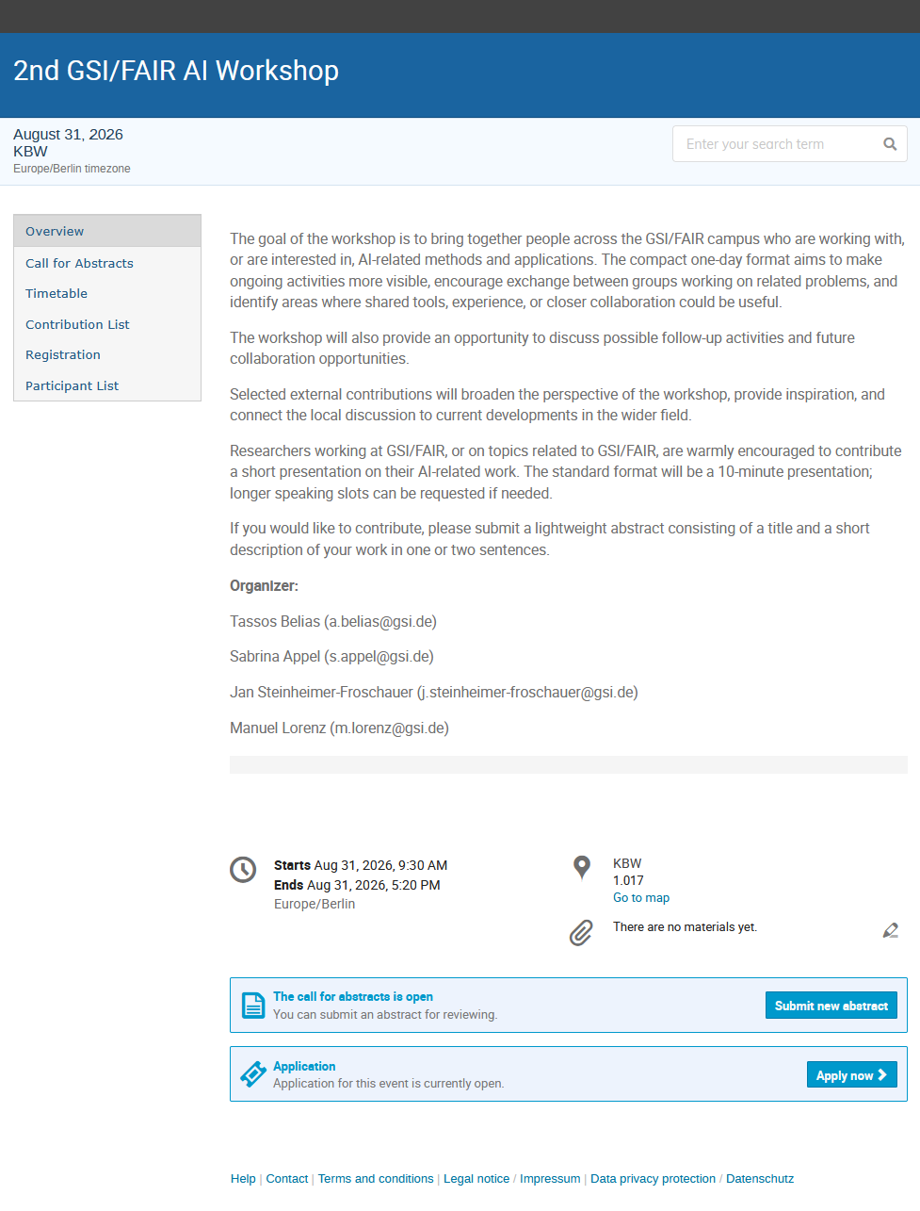
https://indico.gsi.de/event/25232/
Register and contribute with
BRAID project at GSI

