Slide 1
TOF-applications activity
Preliminary results
Anfimov Nikolay
PANDA JINR group meeting, 15/11/2013

Slide 2
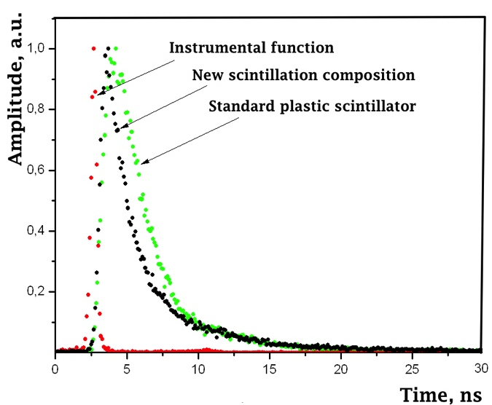
Fast plastic scintillator Main principle and results
We requested to ISMA (Kharkov, Ukraine) initiate activity in fast scintillation material developing.
It is known that scintillation kinetic is defined by time of secondary charge dissipation
The brilliant idea is to increase carriers mobility by changing the material electrical conductivity
New polymeric structure based on polystyrene and triphenylamine
Resluts:
New PS: Rise time = 0.49 ns
Standard PS: Rise time = 0.85 ns
The same light output!!!

Slide 3
MAPD timing study scheme of experimental setup
Picosecond laser: pulse FWHM=45ps, jitter<3ps
DRS4: sampling 5GS/s, 14 bit/V, intrinsic σT < 10 ps
INR amplifier: Gain K = 265, BW≈100 MHz

Slide 4
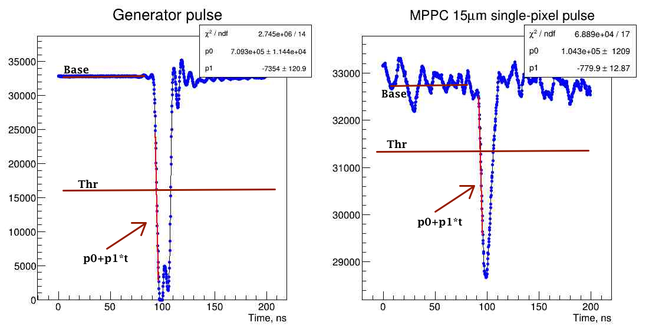
MAPD timing study Signal time stamp estimation

Slide 5
MAPD timing study Main idea of the method
MPPC has a good single photoelectron amplitude resolution
Making A-T cuts for each pixel peak (ex. Up to 10th)

Slide 6
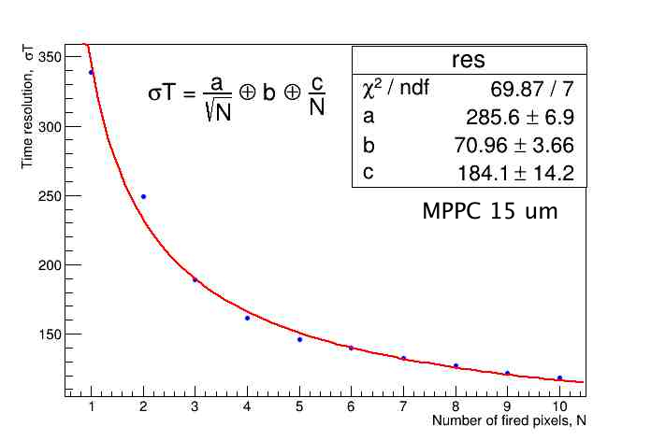
MAPD timing study Results
Preliminary results
“a” – term: seems it is a stochastic intrinsic SPTR σT (convoluted with σT of light pulse)
“c” – term: seems it is driven by signal to noise ratio
“b” – term ??? Probably, some differential non-linearities of mathematical procedure

Slide 7
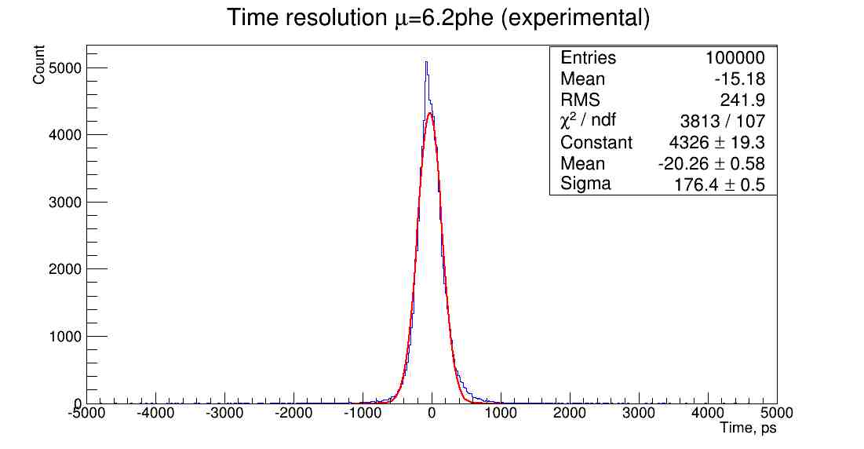
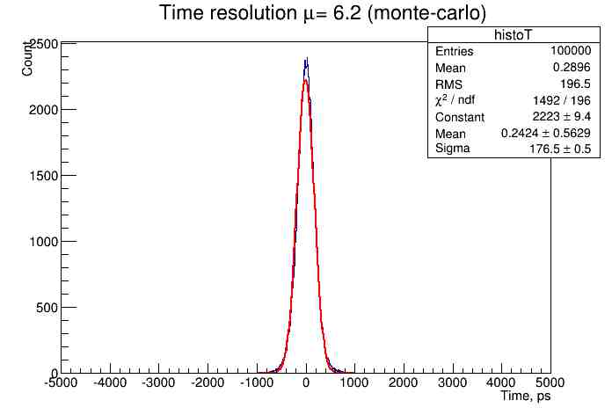
MAPD timing study Time resolution for Poisson photoelectron distribution
Computations based on simple random generators.
Known (from experiment) “a”, “b”, “c” – parameters are used
Computations allow to estimate time resolution for any light intensity

Slide 8
Plans Studying scintillator decay time
We ordered:
3 CFD 9237 – Fast CFD –Zero-crossing
(1GHz bandwidth)
2 MCP Hamamatsu R3809
Time-to-Analogue converter

Slide 9
Plans Studying MAPD timing method
We ordered:
Using ordered equipment
Try to use clipping of signal

