Slide 1
PANDA SOLENOID MAGNET
Brief Status Report
A.Vodopyanov
15 November 2013
PANDA JINR Meeting,
Dubna

Slide 2
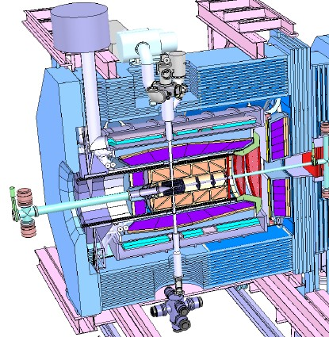
PANDA Target Spectrometer

Slide 3
The PANDA Target Spectrometer Magnet System:
a 2 T superconducting solenoid,
inner diameter 1.9 m and length 2.7m;
a winding cooled and operating at 4.5⁰ K;
a cryostat;
an iron yoke and moving system;
The magnet services comprise:
the vacuum system for the cryostat;
the helium liquefier and helium supply system;
the electrical circuit including a 5 kA power converter, switches, resistor-diode unit, busbars;
a magnet control and protection system;

Slide 4
MAGNET YOKE

Slide 5
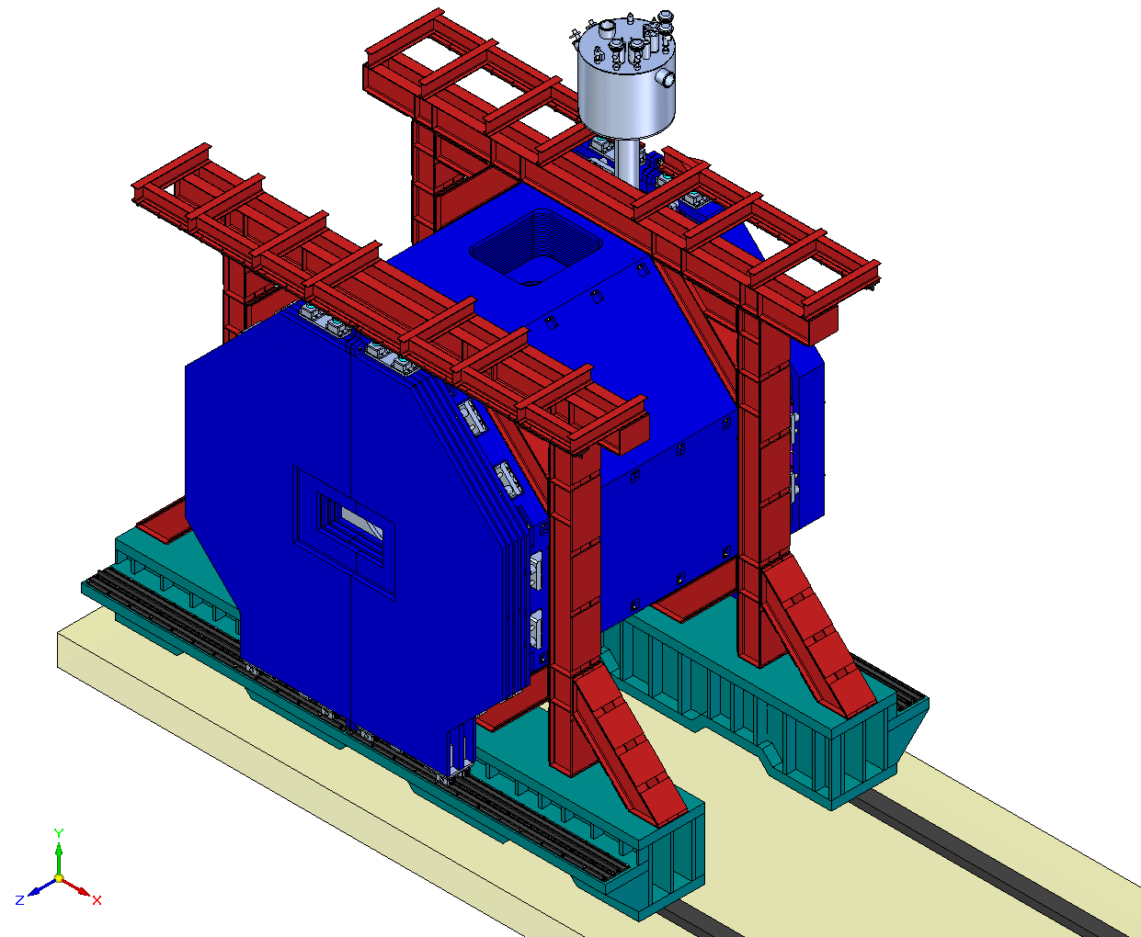
Magnet of the Target Spectrometer

Slide 6
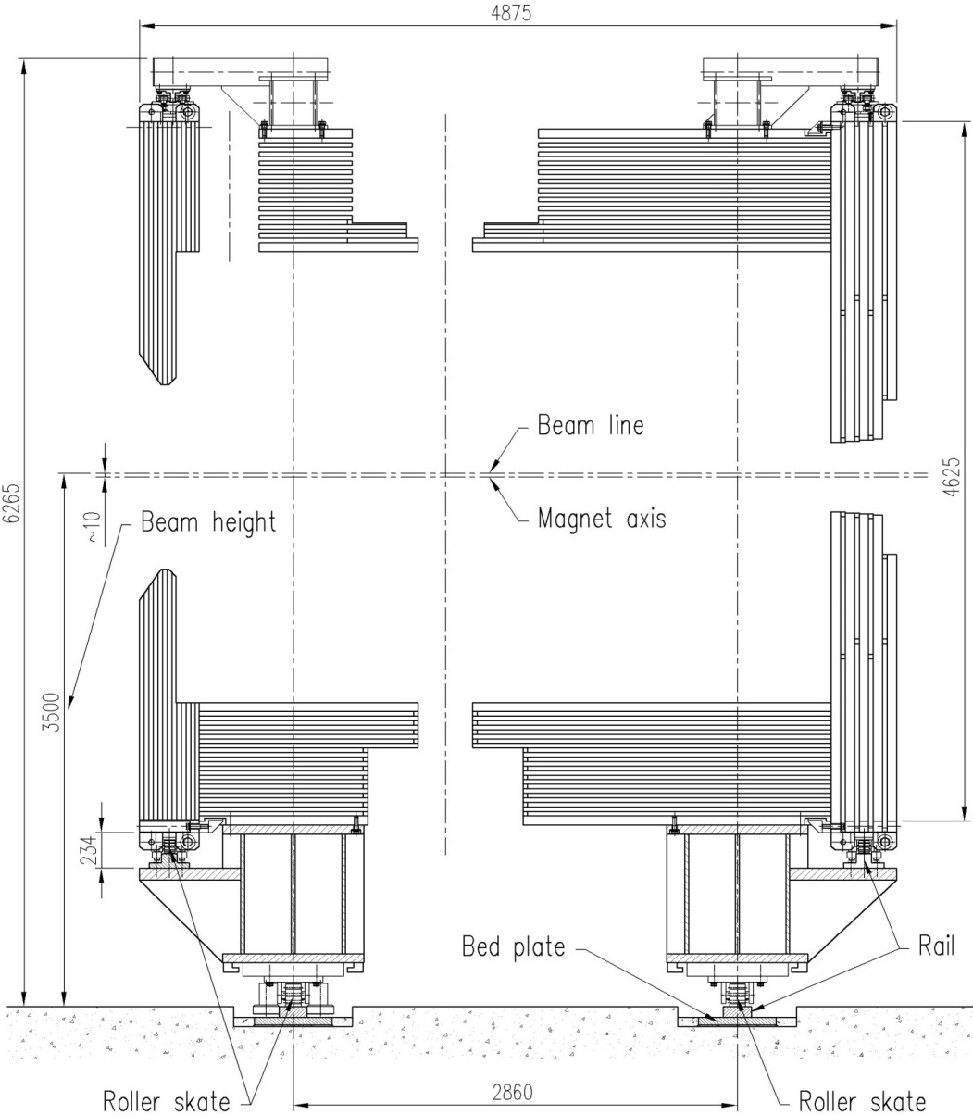
Roller skates for moving of the magnet and for opening doors
The PANDA magnet will be transported into the beam position after completion of the assembly on four track-guided roller skates. Typically once a year, a return move into the parking position for detector repair/upgrade should be foreseen.
The magnet is on the roller skates

Slide 7
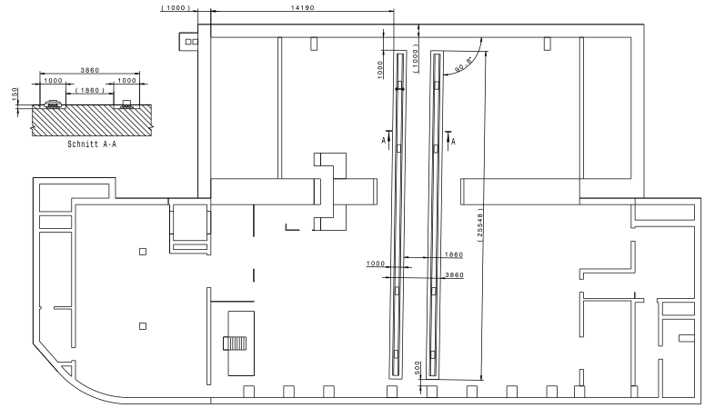
Experimental Hall Floor Plan with TS-Rail track
Deformations and stresses in the magnet and detector components during the movement should be minimized. It will be provided by keeping the magnet rails parallel

Slide 8
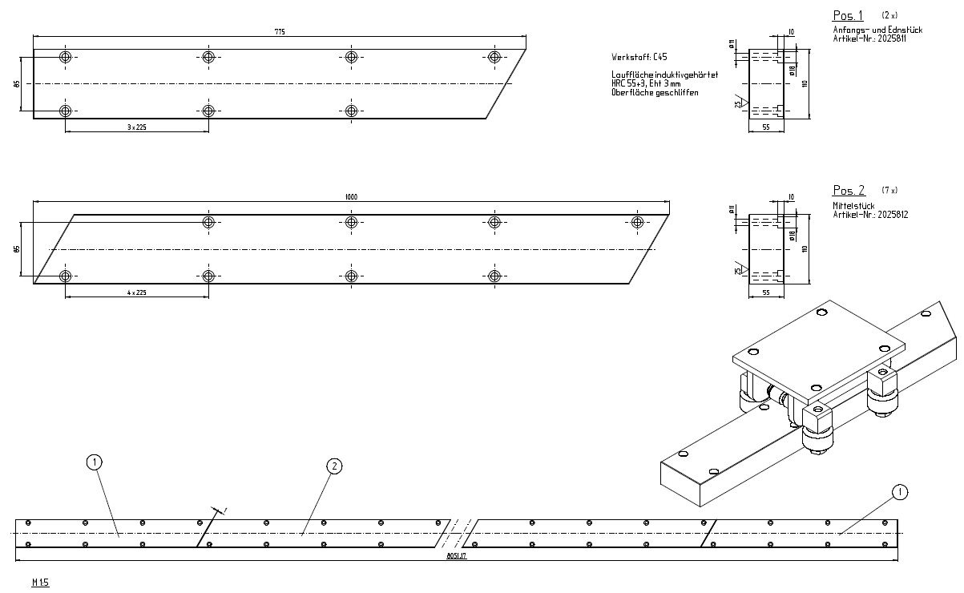
Rails for the door and for the magnet

Slide 9
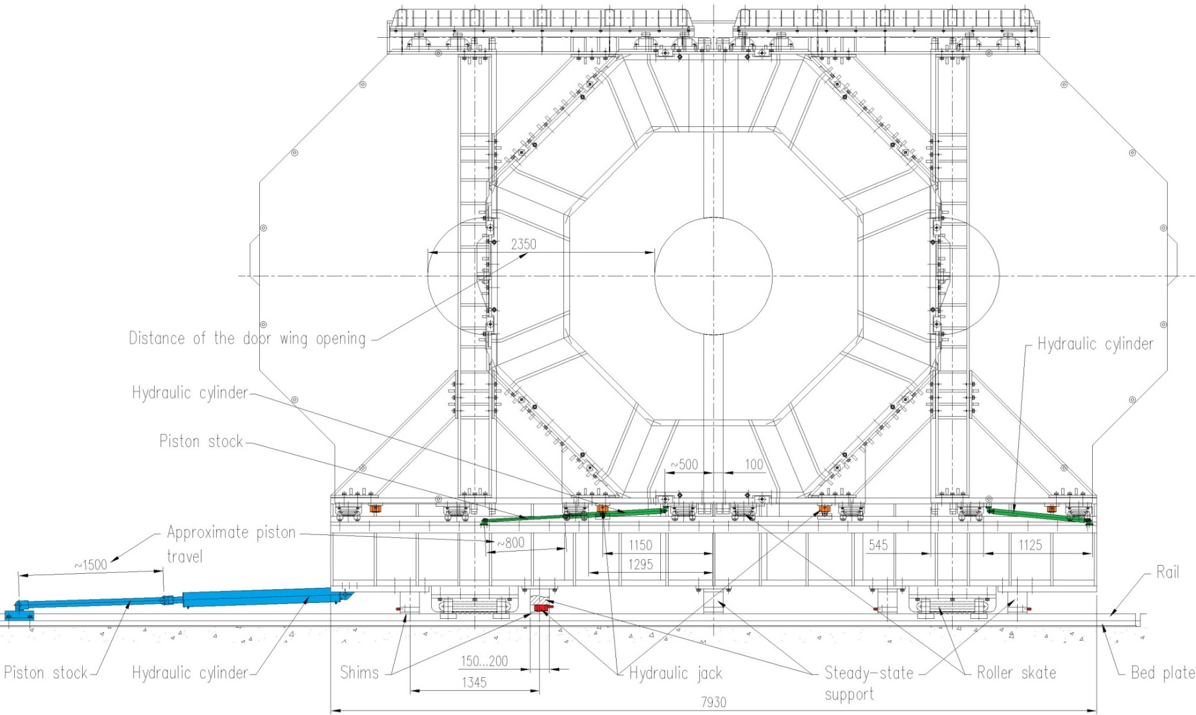
Hydraulic equipment of the magnet
The detector movement will be provided by two hydraulic actuators by means of displaceable fixation units. One step of movement will be 1.5 m at maximum. The total distance between parking and beam positions is ~12 m.

Slide 10
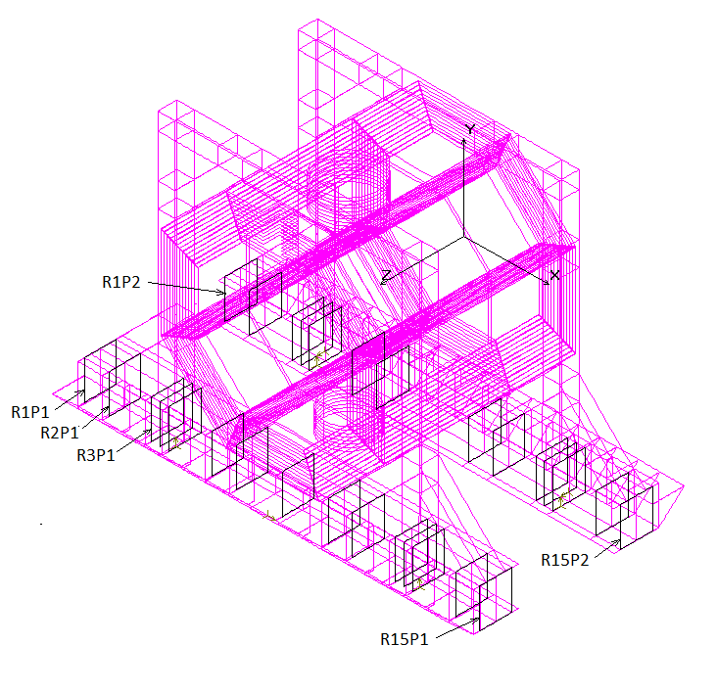
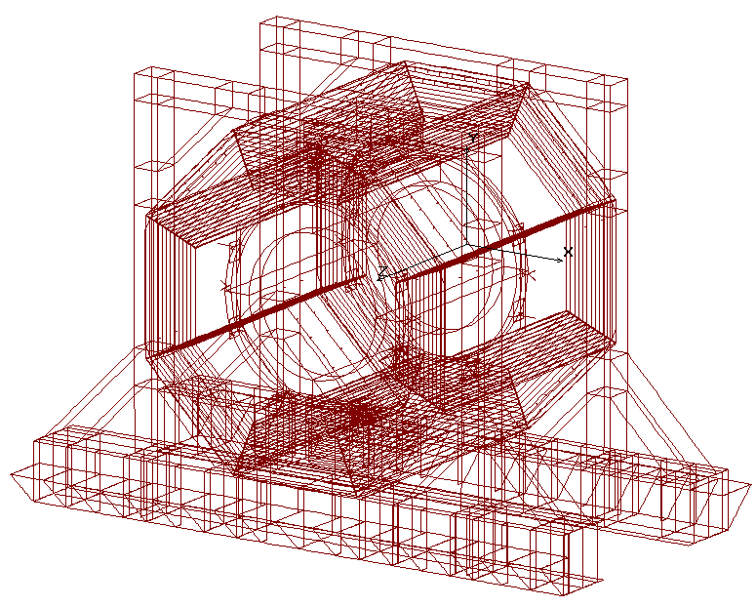
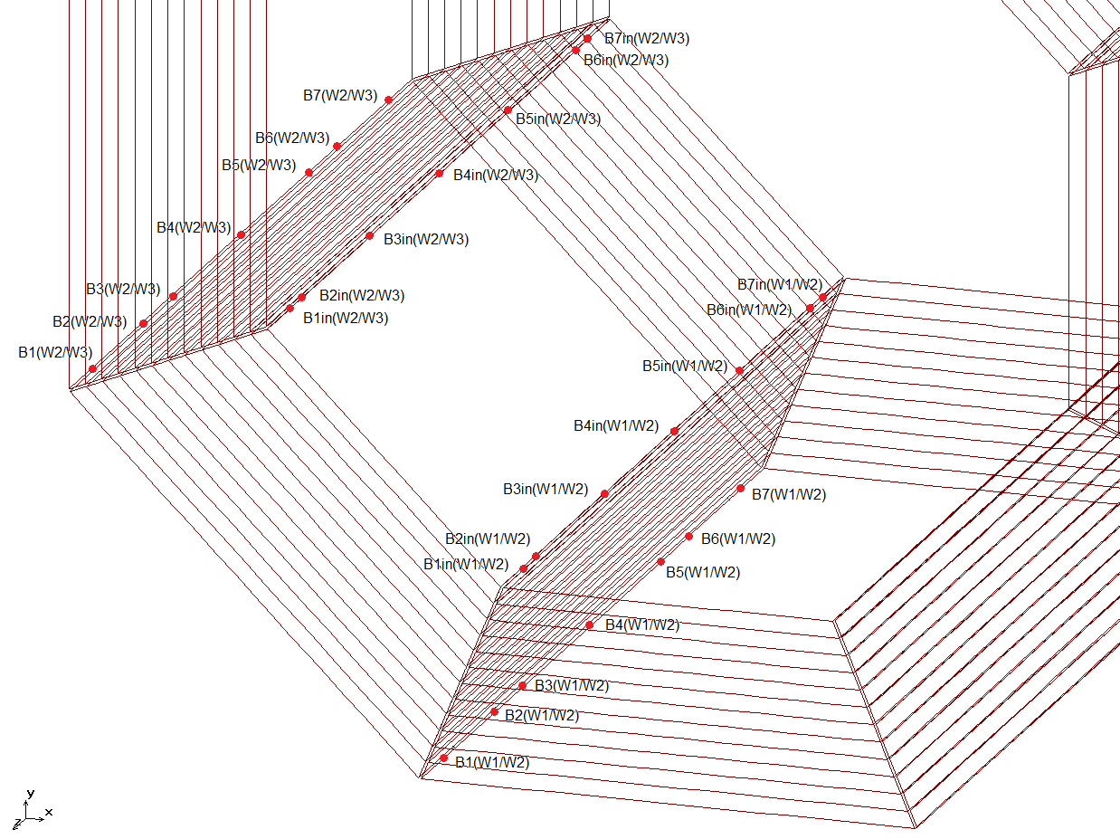
Magnet FE model

Slide 11
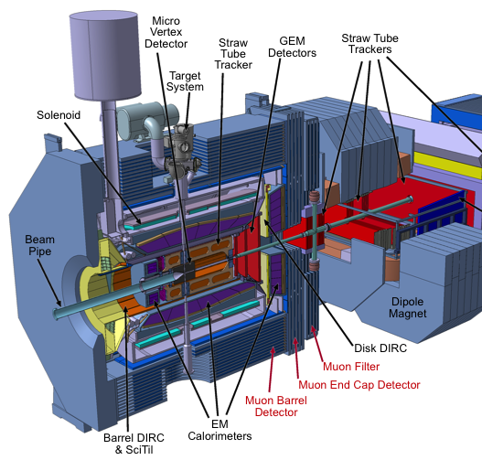
Interfaces that have not formalized jet
  Muon filter

Slide 12
MAGNET COIL

Slide 13
It is proposed to establish the collaboration with the CERN Group on the solenoid coil construction & testing:
ATLAS Magnet Group;
Leader: Prof. Dr. Herman Ten Kate
(an expertise in ATLAS, COMPASS, ITER etc.);
CERN – PANDA collaboration agreed from CERN side by:
Bloch P. – Physics Division Head;
Bertolucci S. – Research Director;
Heuer R. – Director General;

Slide 14
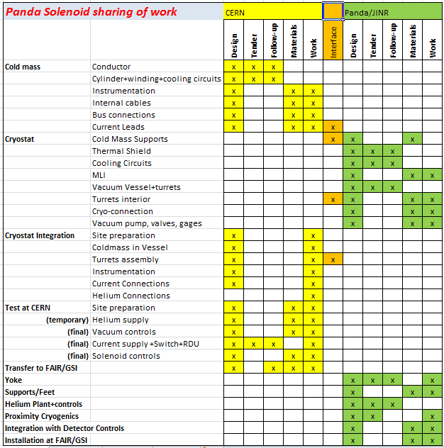

Slide 15
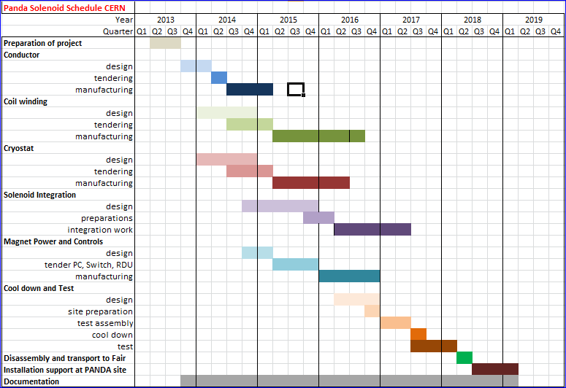

Slide 16
ADVANTAGES
OF THE COLLABORATION WITH CERN
High qualification and experience in design and production of superconducting magnets;
Good knowledge of the current status of the industry in this field;
Professional contacts w/ industry according to CERN rules on the base of tenders;
Possibility to use CERN stock of materials;
Final product will include the winding w/ complete electrical chain assembled and tested w/
cryostat.

