Slide 1
PhD Project Status Update
Weekly update report
Author: S. Sharma
Date: 23.July.2026

Slide 2
Current Progress:
I have generated the first set of histograms from the simulation output.
I have updated the analysis macro to read the simulation output and extract the required information.
I have generated histograms for primary and secondary particles, detector id, momentum, energy loss, particle distributions, and station/layer-wise distributions etc.
The output branches that were previously empty are now being read successfully, and the analysis macro is producing the required histograms.

Slide 3
Current Focus:
Now for the coming week I will generate some additional histograms for primary and secondary particles and their momentum distributions.
Extend the analysis to extract more physics information from the simulation output.
I will then study the generated histograms to obtain the physics results.

Slide 4
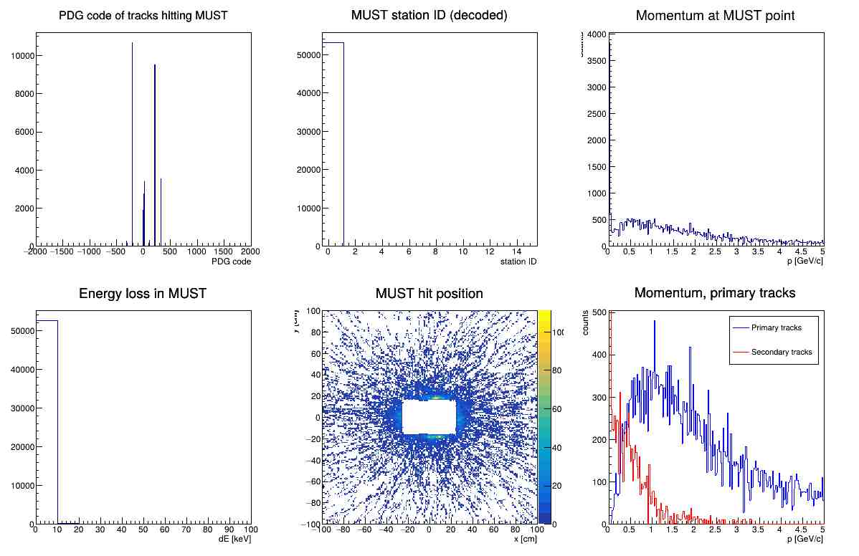
I have successfully generated these histograms which i am sharing below. I will learn the physics for this histos in this coming week and give a more detailed explanation about the histos in next update.

Slide 5
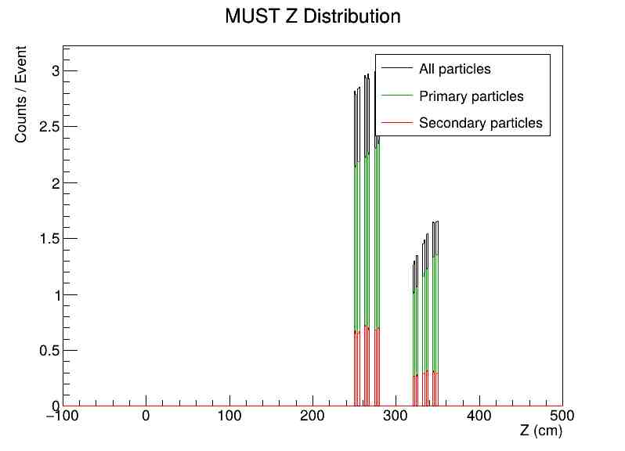

Slide 6
