Slide 1


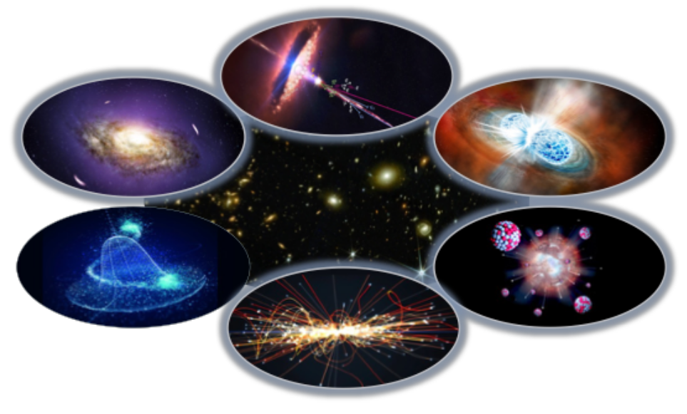
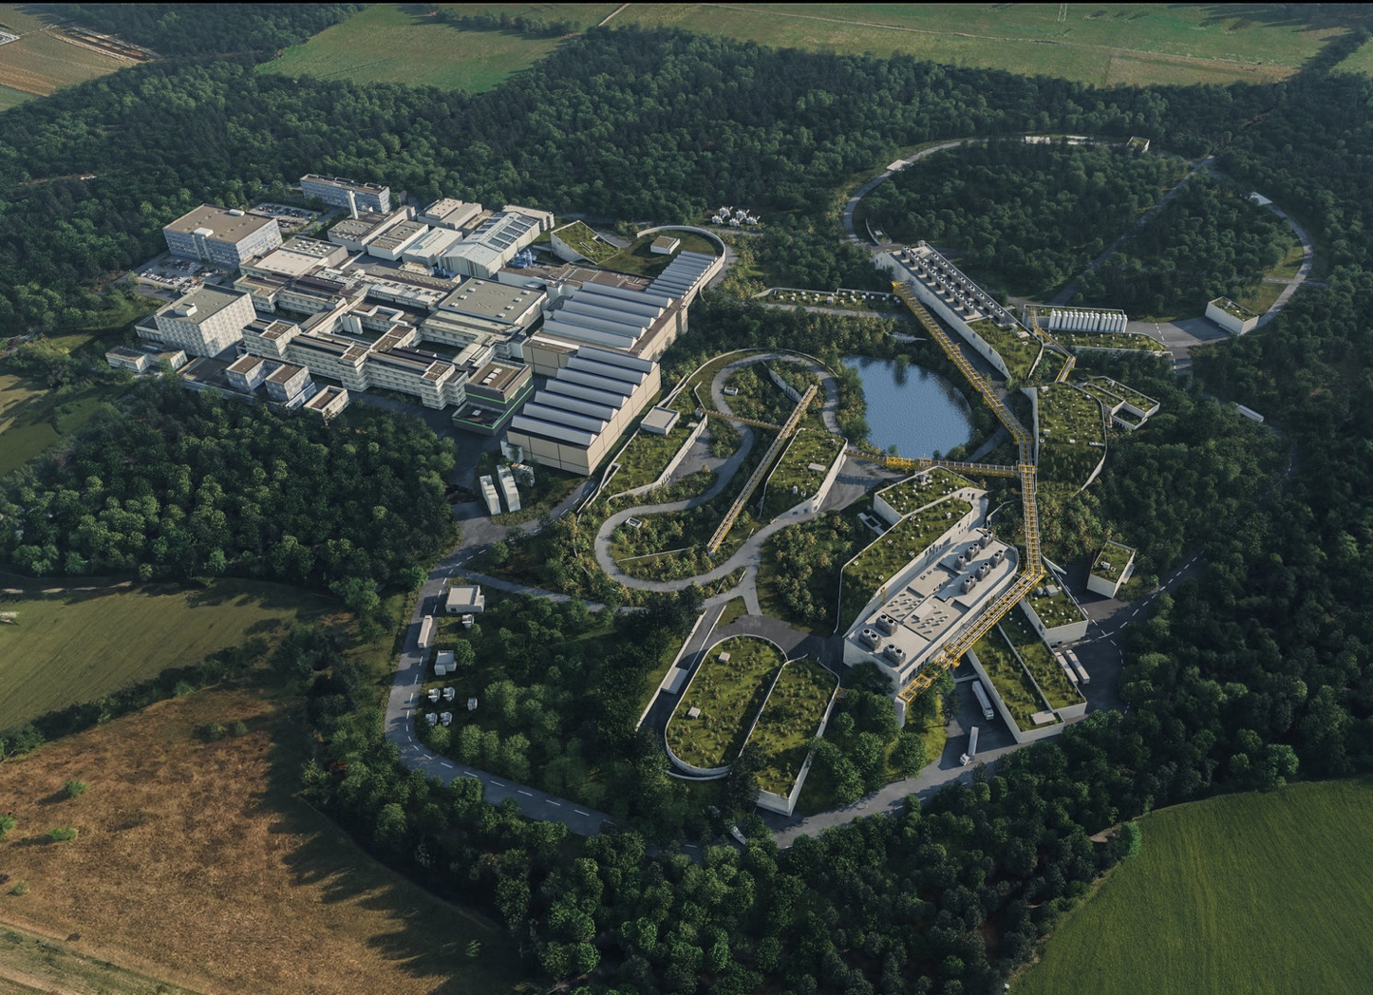
MU Days 2026 at GSI/FAIR
Closeout
Quarks Hadrons Nuclei
Gluons
Compact stellar objects
From microscopic to macroscopic scales

Slide 2
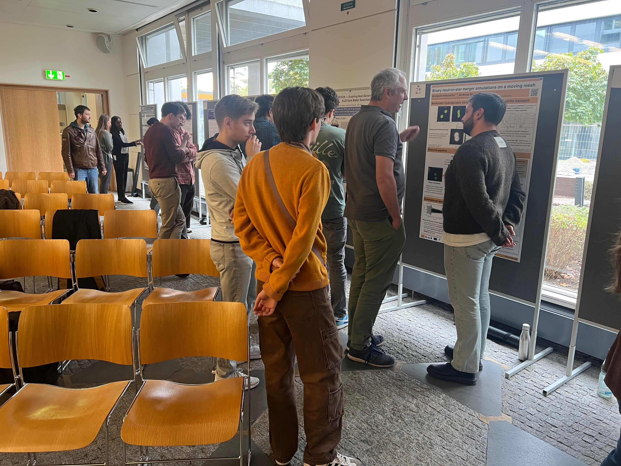
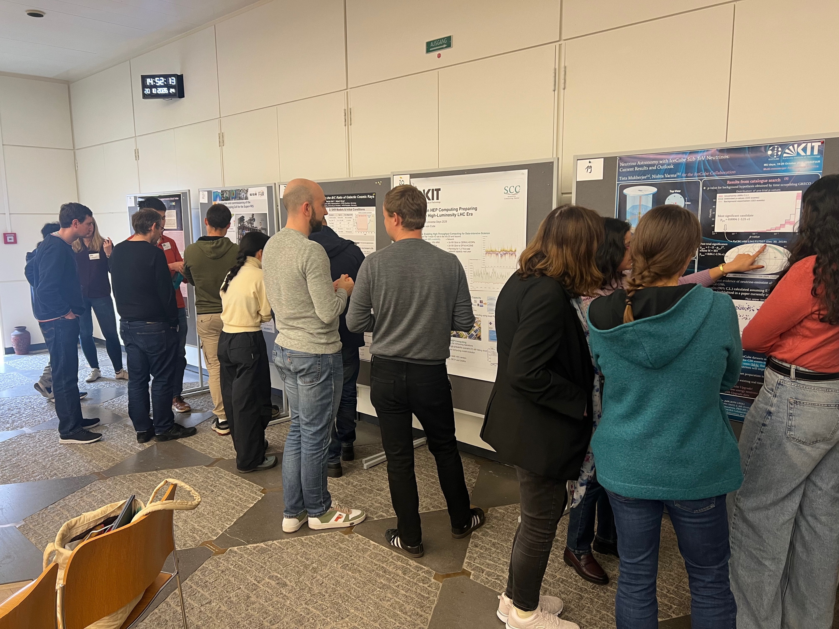
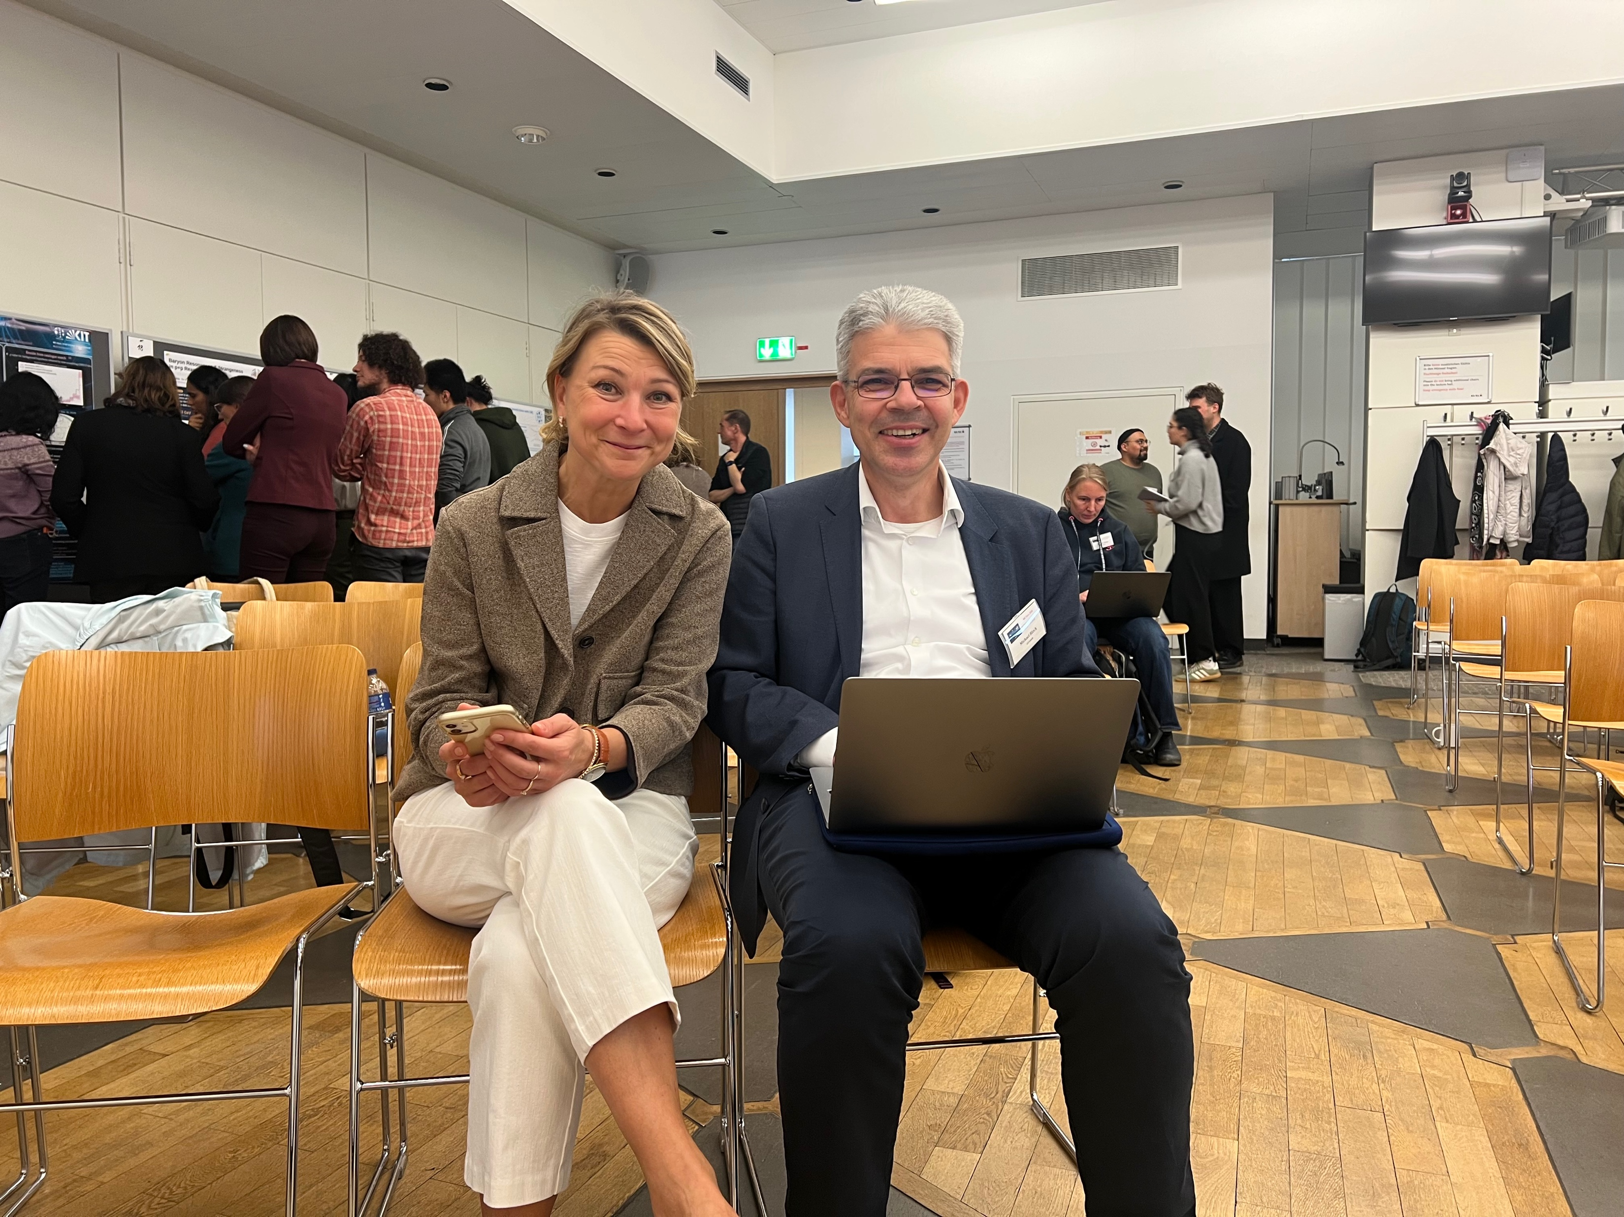
MU Days 2026 at GSI/FAIR
Impressions

Slide 3
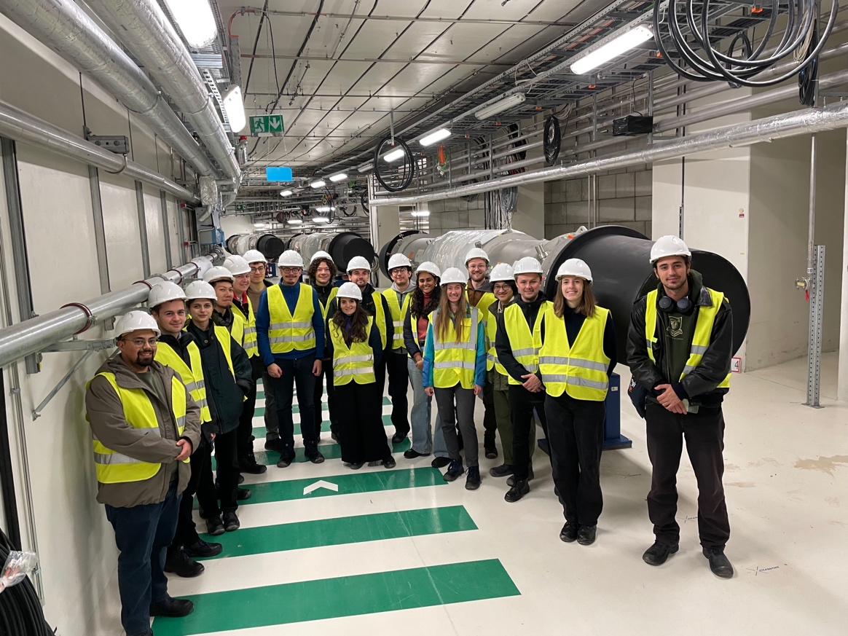
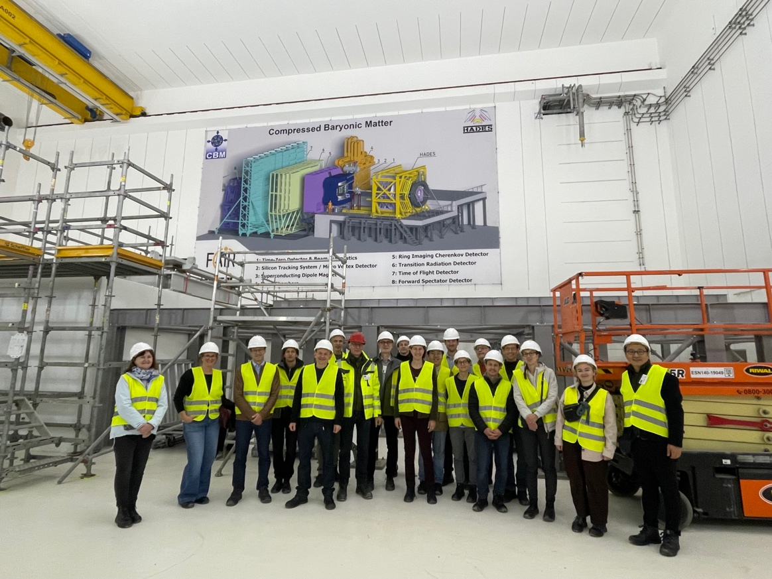
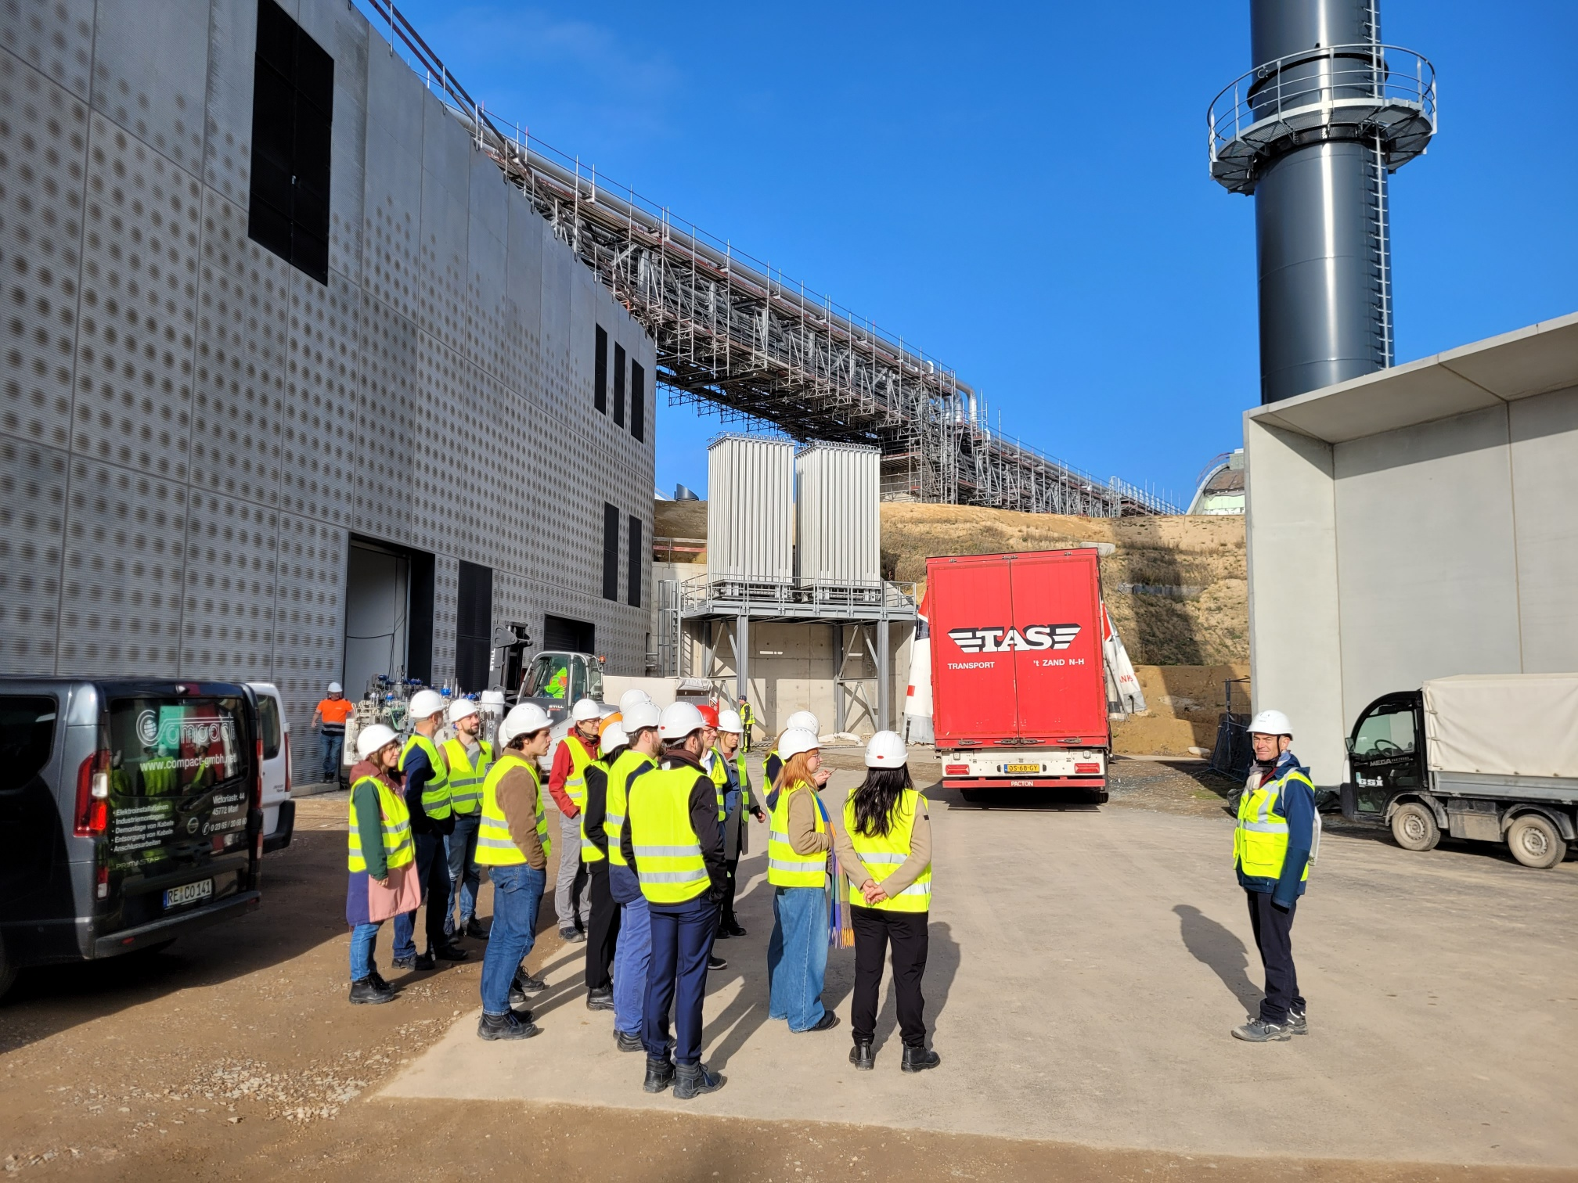
MU Days 2026 at GSI/FAIR
FAIR Tour 20 Oct 2026 – Impressions
Thanks to the tour guides: Alexander Herlert, Helena Albers, Patrick Dahms, David Emschermann, Juergen Eschke, Lars Schmitt

Slide 4
MU Days 2026 at GSI/FAIR
Poster Prize
The winner of Mondays’ poster session is:
Poster 2: Developing an atomic tritium source for KATRIN++
David Frese, KIT
The winner of Tuesday’s poster session is
Poster 30: Virtual photons from hot and dense matter at HADES
Carina Udrea, TU Darmstadt

Slide 5
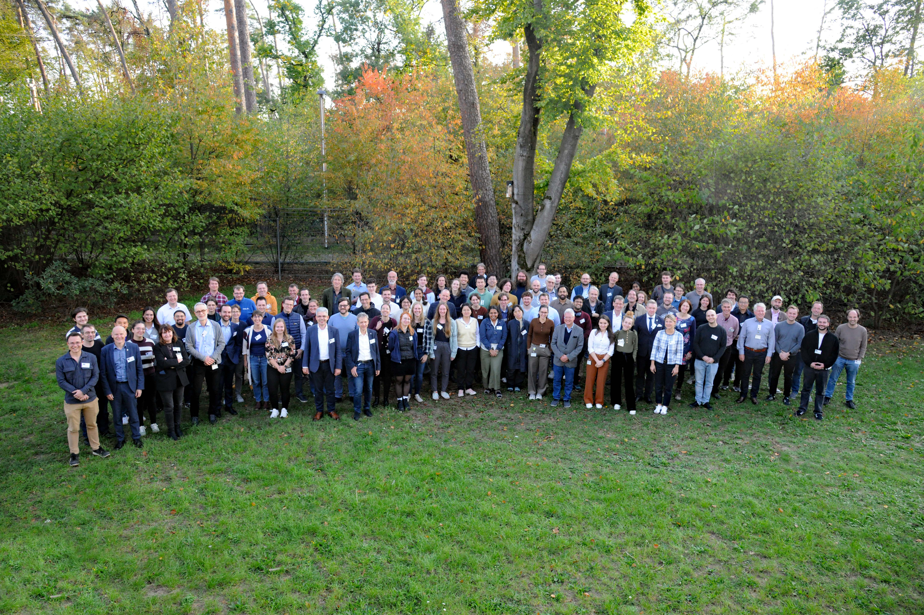
MU Days 2026 and 2027
Thank you for your contribution to
the MU Days 2026 at GSI/FAIR!
The MU Days 2027 will take place at
DESY Zeuthen on 29/30 Sep 2027

