Slide 1


Slide 2
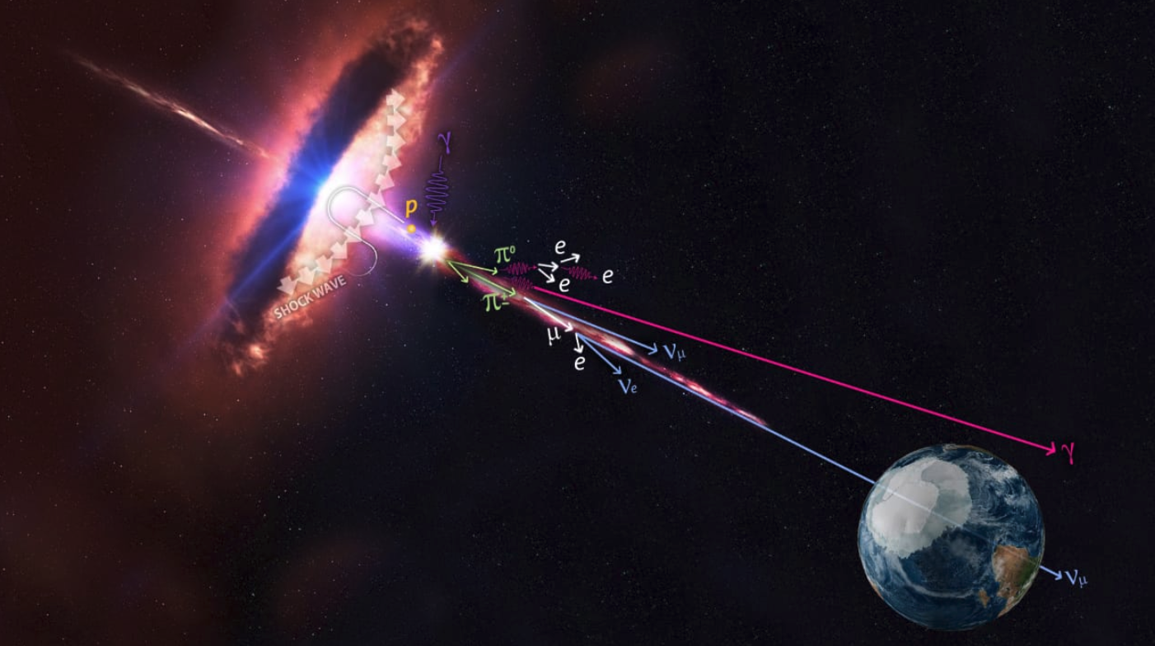
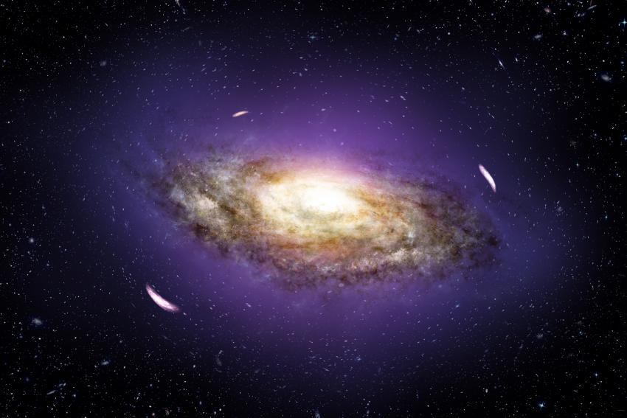
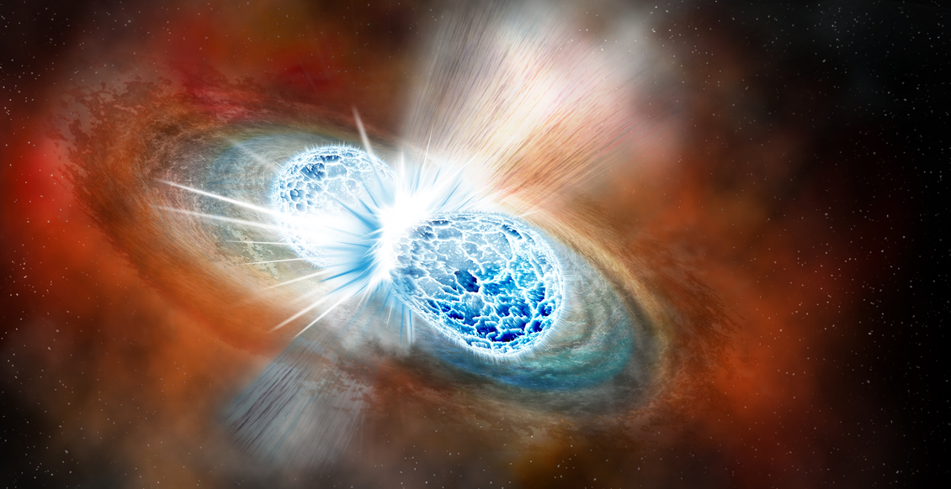
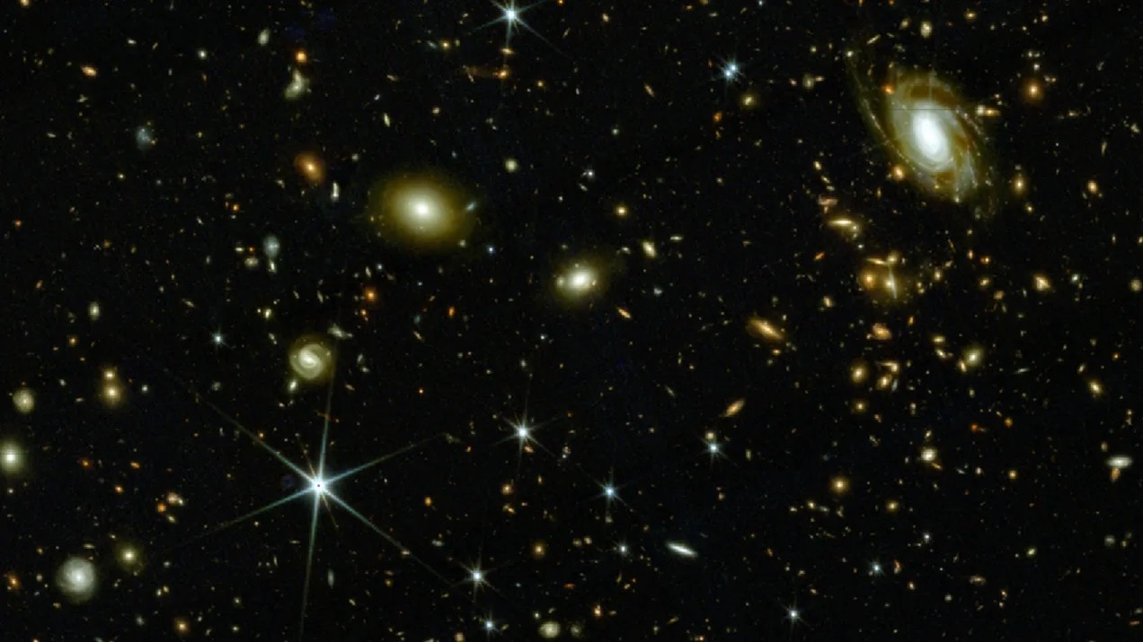

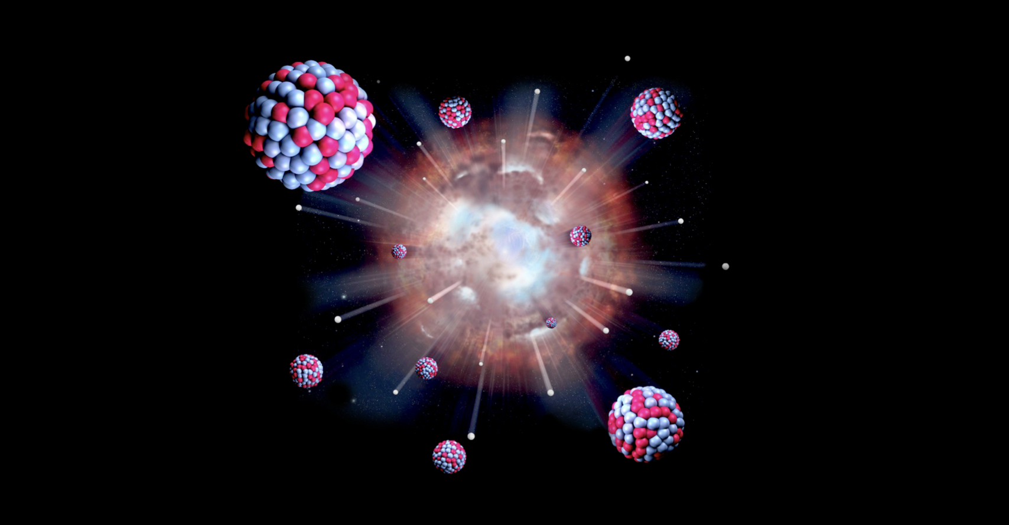
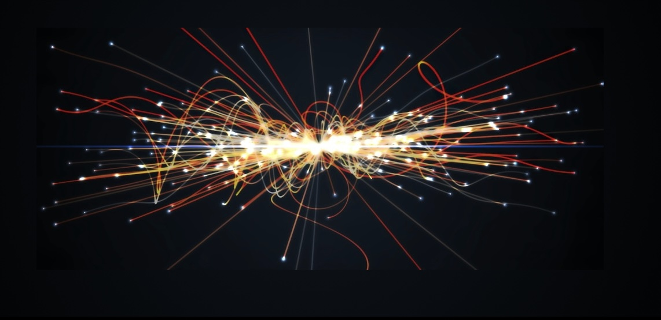
Mission
To understand the quantum universe
Central questions
What is dark matter?
What is the nature of the
Higgs mechanism?
How does it affect the vacuum structure?
Matter-antimatter asymmetry?
Connected to early universe!

Slide 3
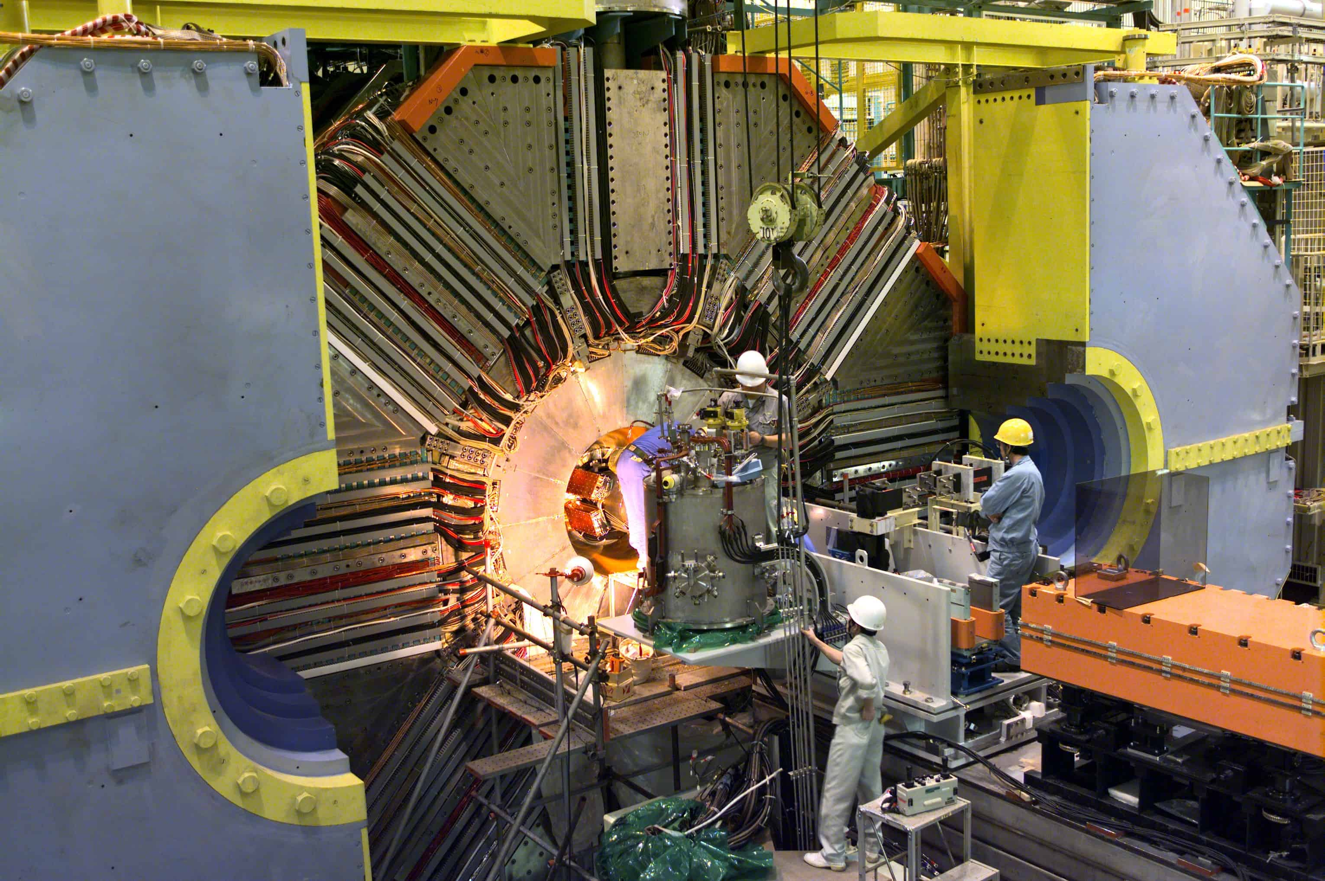
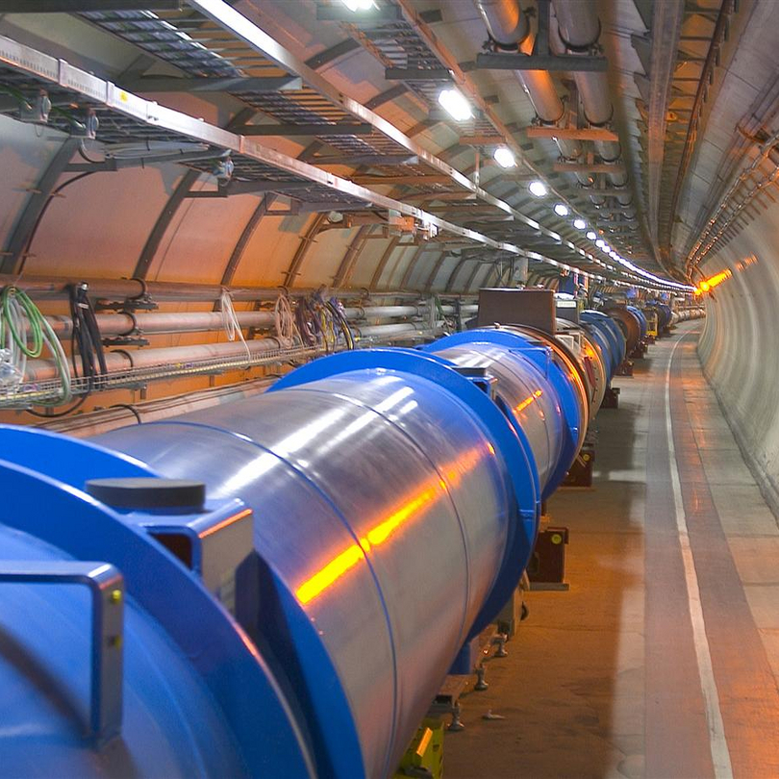
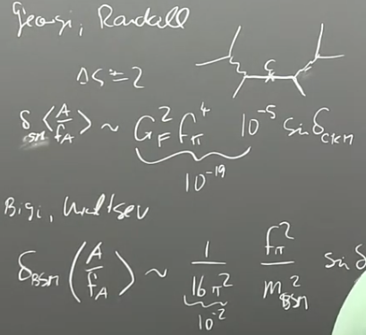
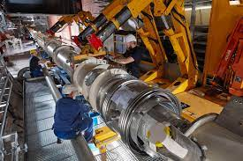
Mission
To understand the quantum universe
Central questions
What is dark matter?
What is the nature of the
Higgs mechanism?
How does it affect the vacuum
structure?
Matter-antimatter asymmetry?
Connected to early universe!
We generate the conditions shortly
after the big bang in the lab:
Large-scale instruments operated by international collaborations
New ideas and precision calculations from theory
Belle II
ATLAS
CMS
Theory
Local
dark matter
searches

Slide 4

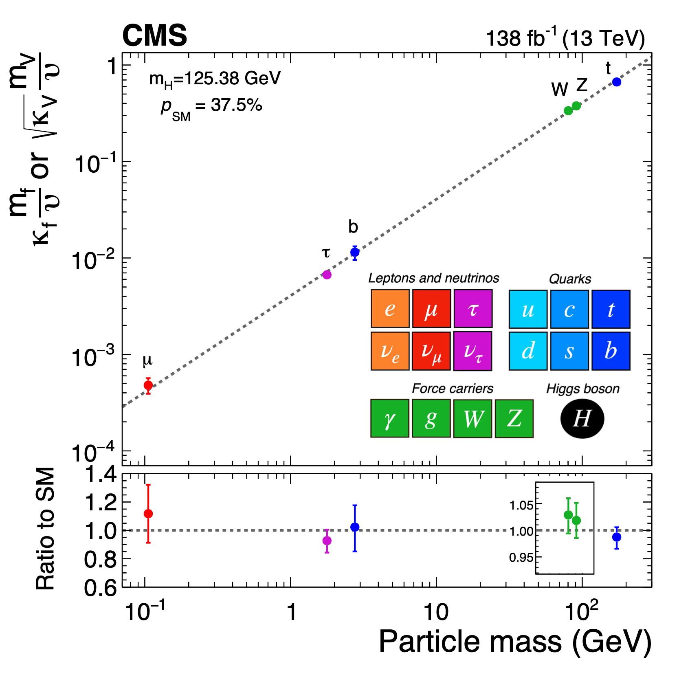
Precision measurements at the LHC
Higgs properties
PoF IV:
Precision measurements probe the Standard Model
The 2025 Breakthrough Prize in Fundamental Physics
Awarded to all four LHC experiments for “detailed measurements of Higgs boson properties confirming the symmetry-breaking mechanism of mass generation,...”
Higgs coupling vs. particle mass
Direct contribution
by FPF scientists
Nature 607 (2022) 52
Nature 607 (2022) 60

Slide 5
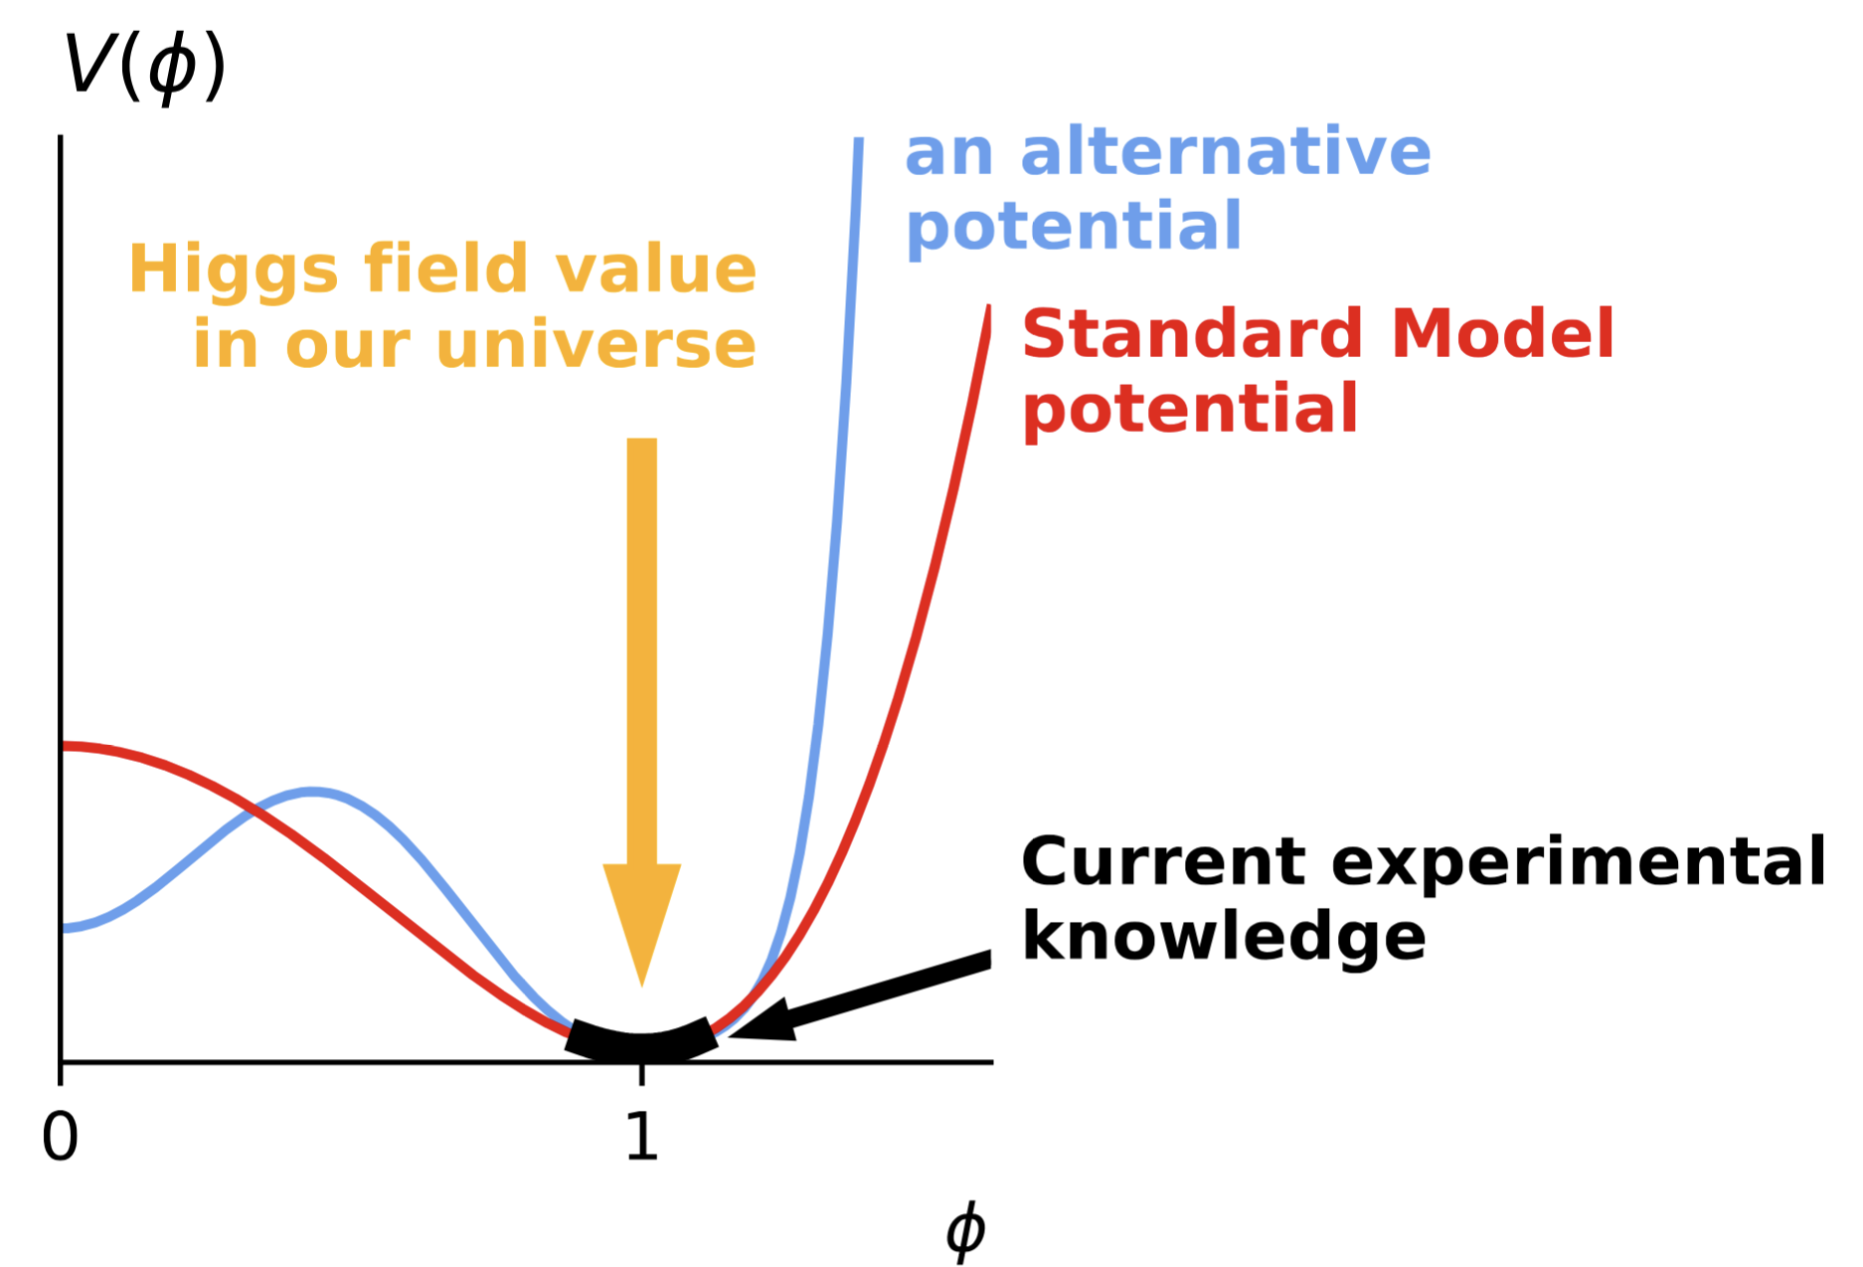


From LHC to High-Luminosity LHC
From Higgs properties to the Higgs potential
Higgs potential
PoF IV:
Precision measurements probe the Standard Model
PoF V:
First access to Higgs potential through di-Higgs production
Shape of the Higgs potential?
Structure of the vacuum?
1st order electroweak phase transition in the early universe?
- Gravitational waves
- Additional Higgs bosons
arXiv:2207.00478
Higgs coupling vs. particle mass
1st order electroweak phase transition
Nature 607 (2022) 52
Nature 607 (2022) 60

Slide 6
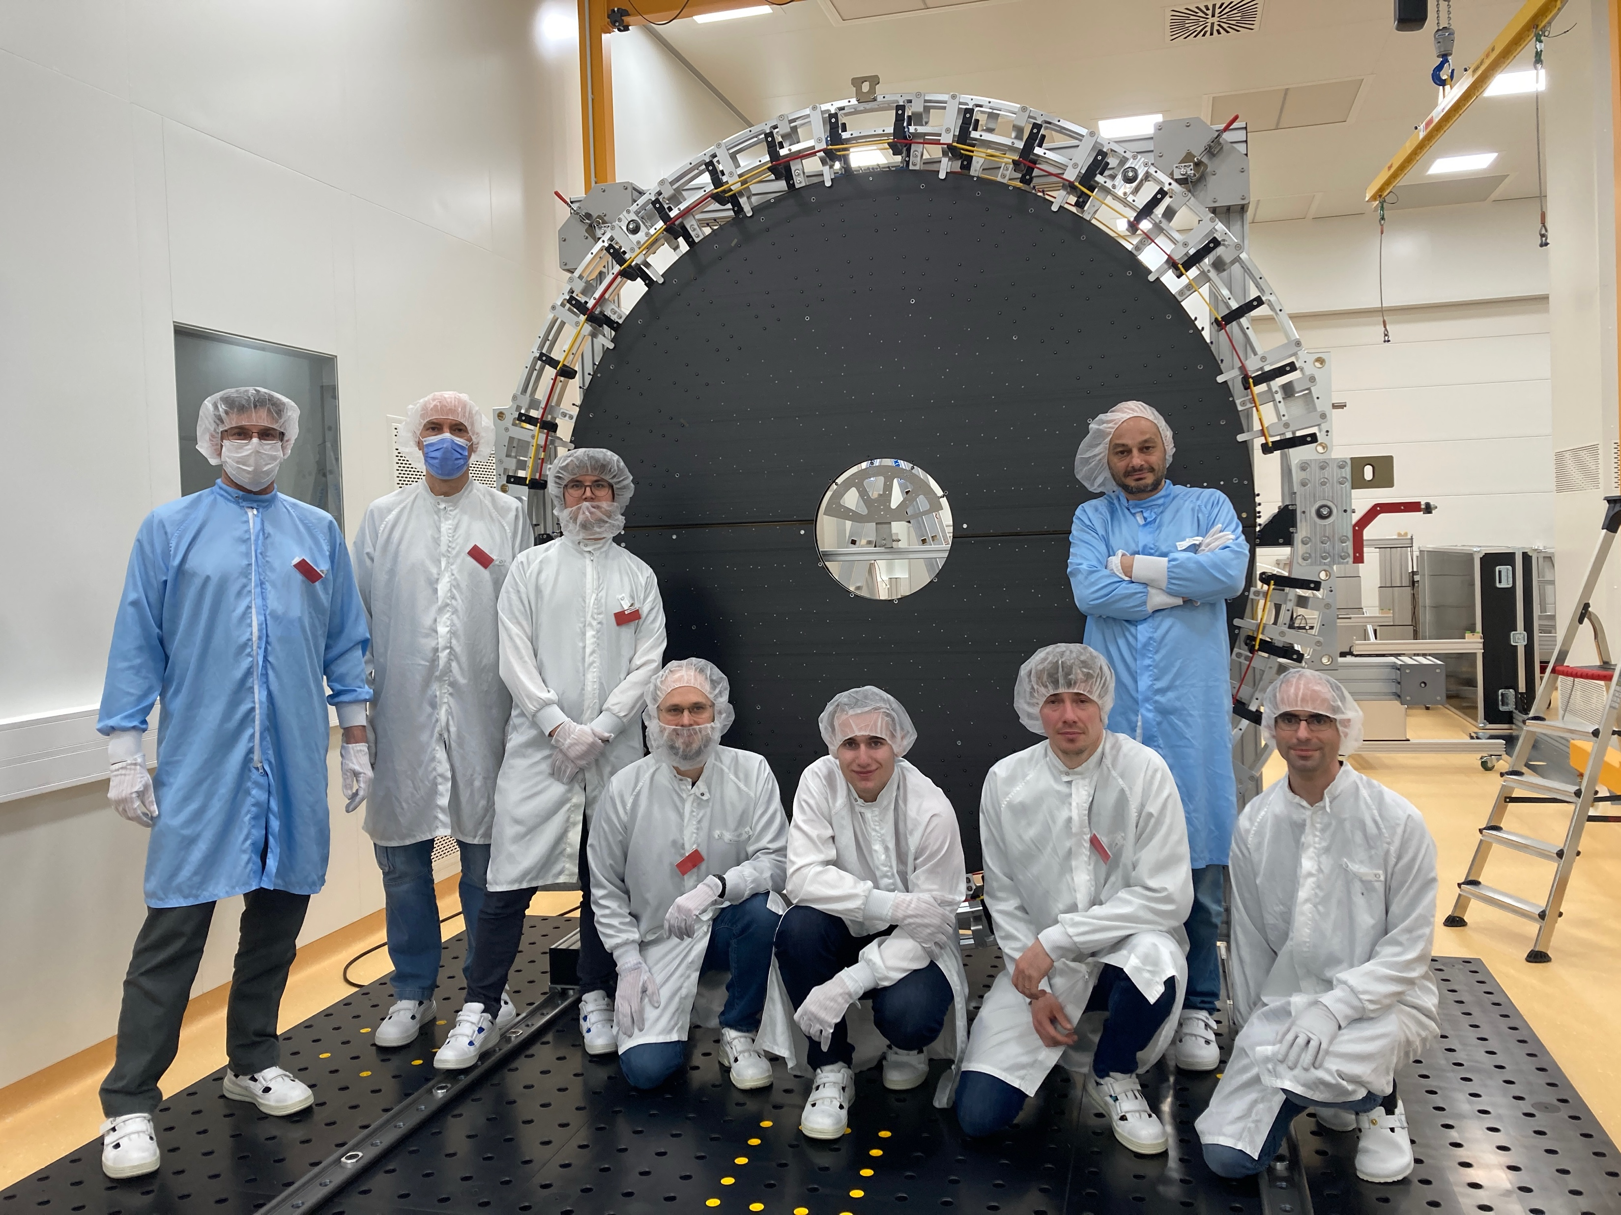
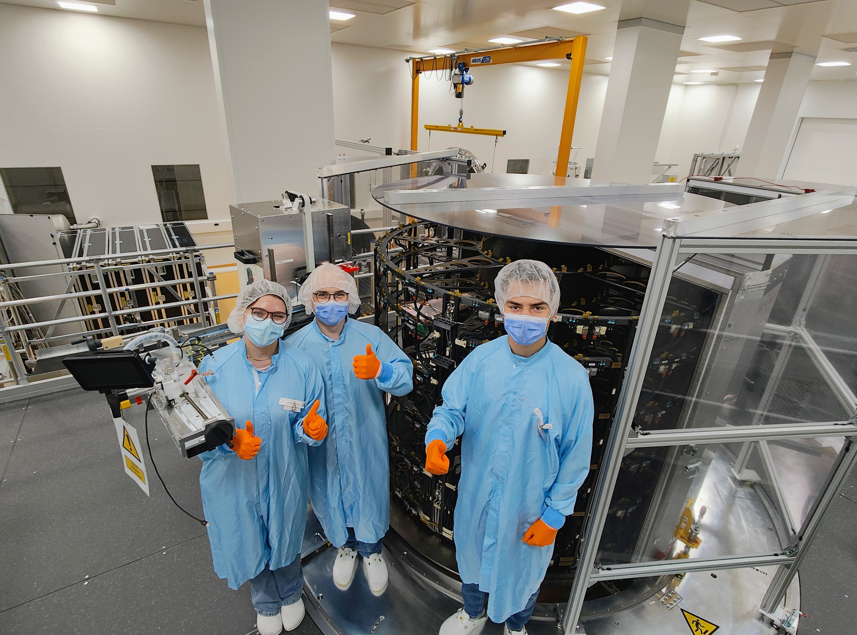
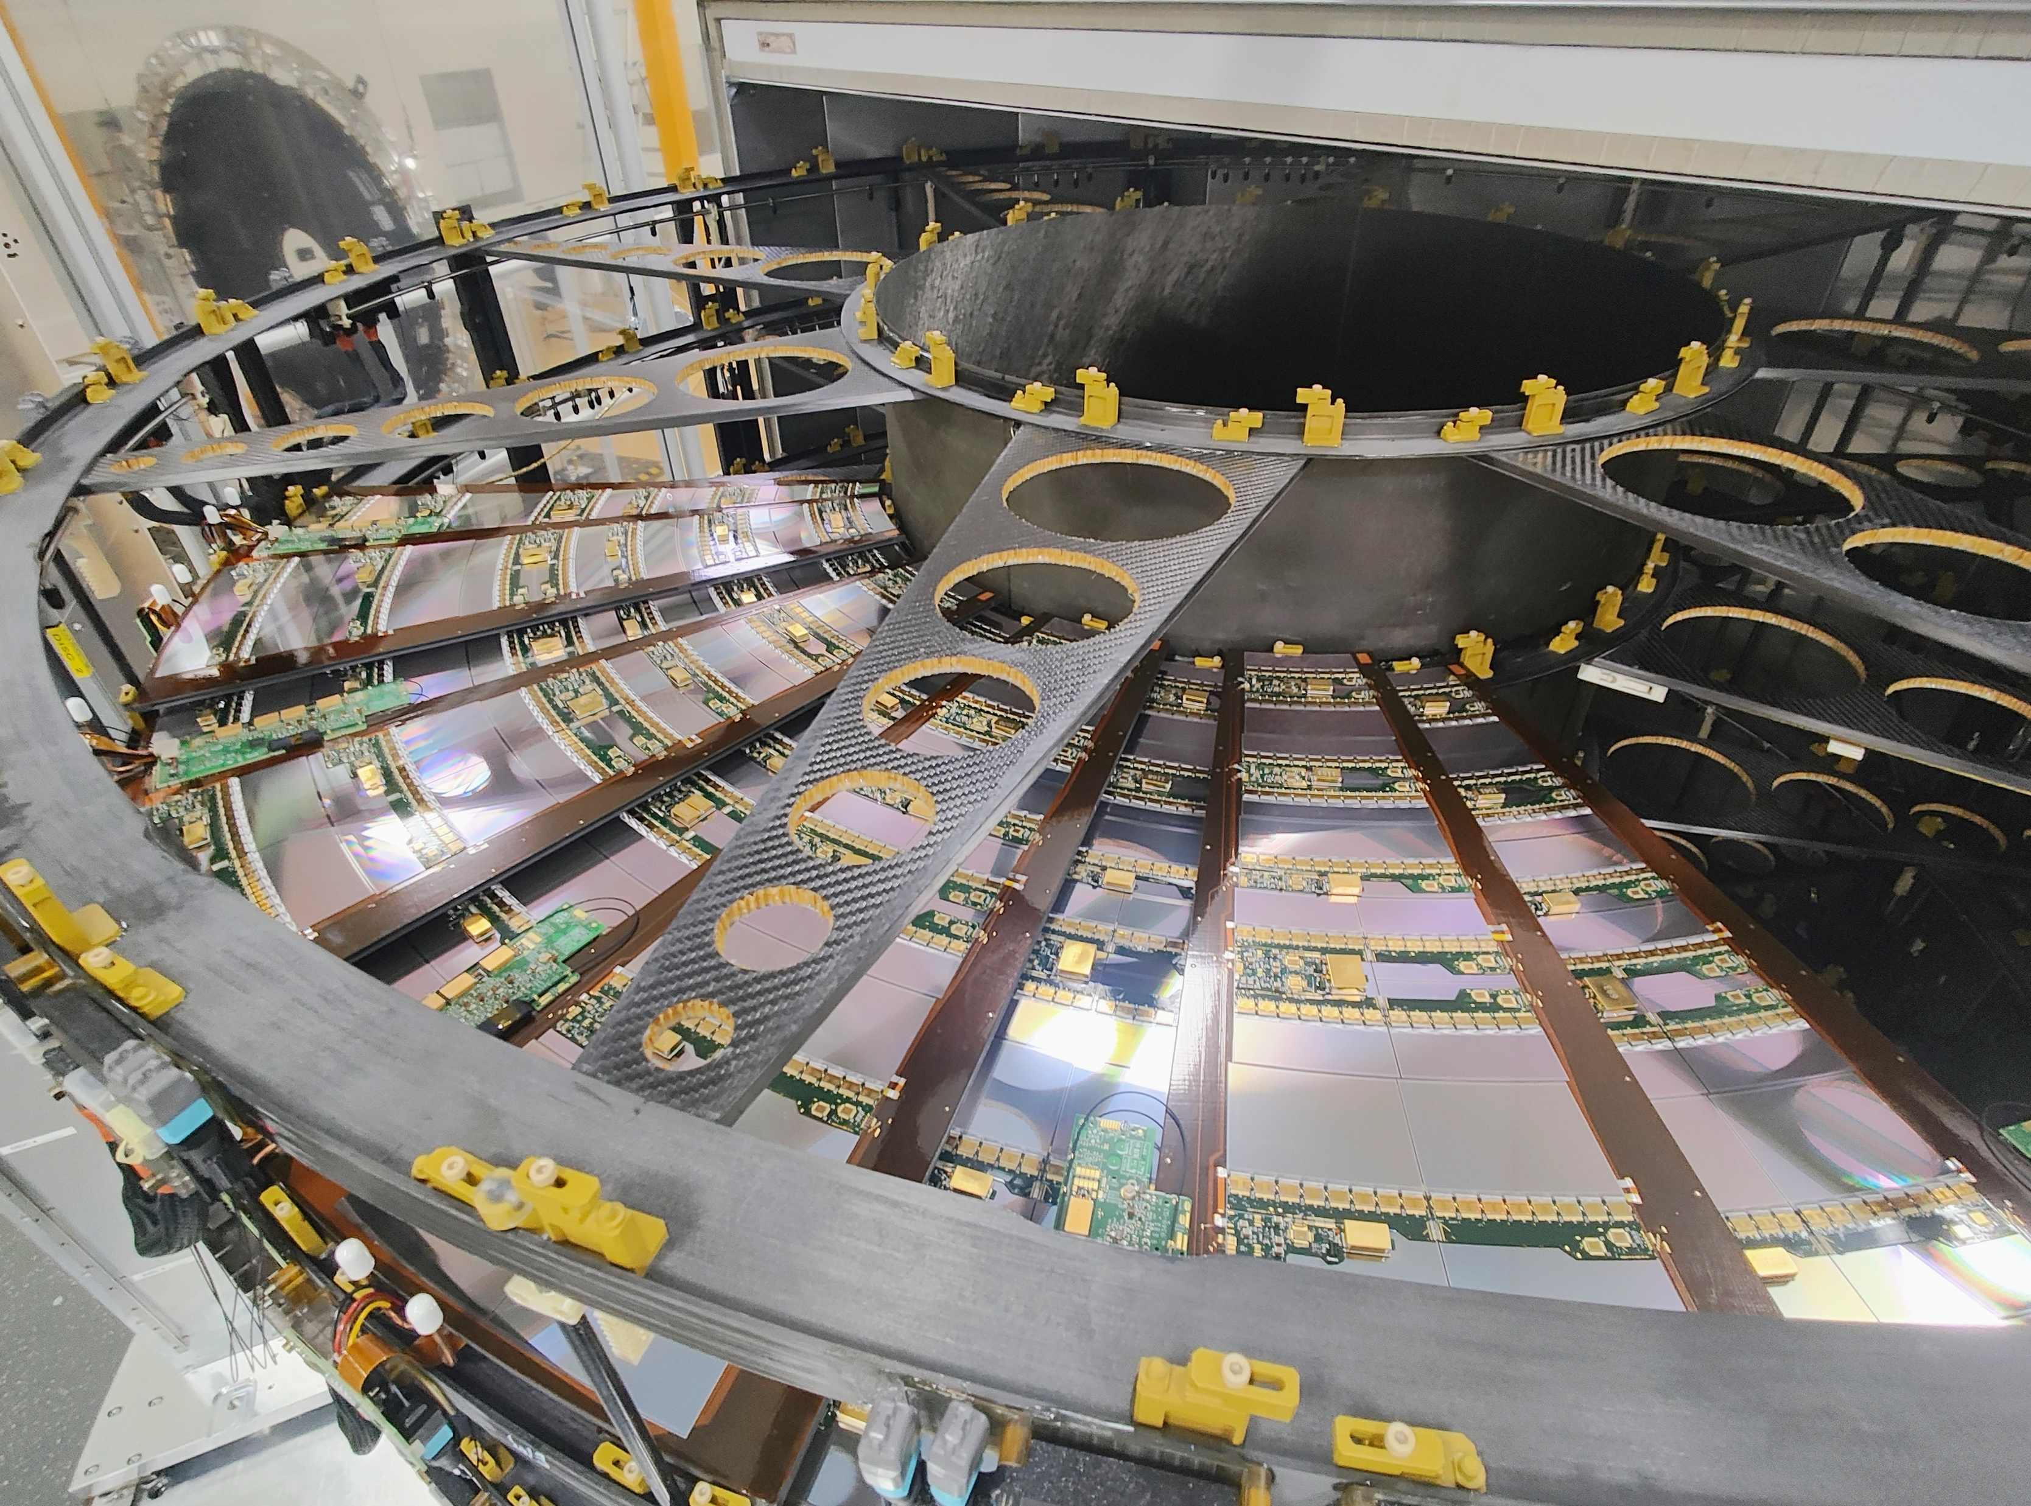

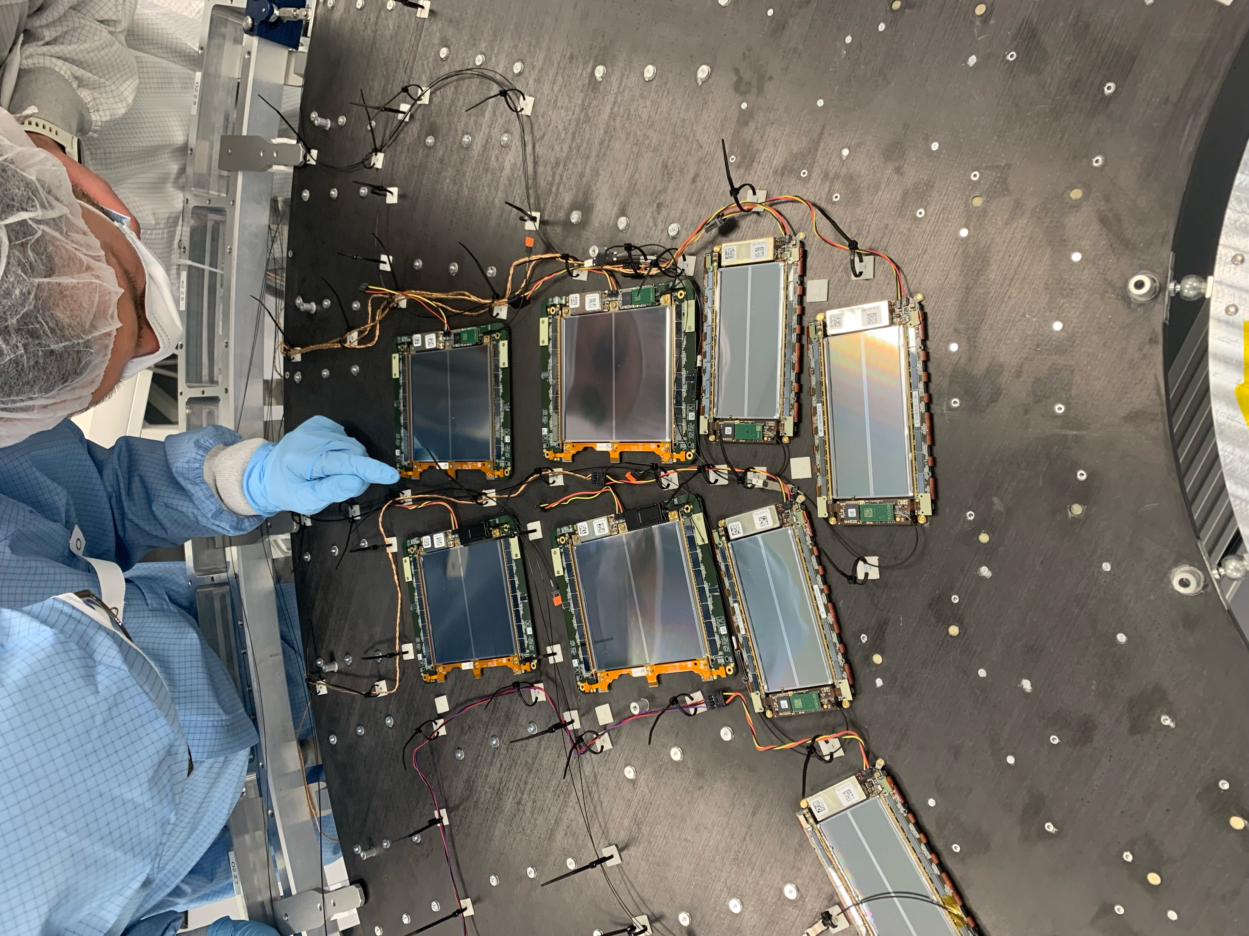
From LHC to High-Luminosity LHC
We are building novel detectors for HL-LHC
PoF V:
High-Luminosity LHC Run 2030-2041
Harsher environment
New technology:
radiation-hard silicon sensors
We build one silicon tracker endcap each for
ATLAS and CMS with 40-60 million channels each
5x higher instantaneous luminosity
Higher granularity needed
We build large parts of the first high-granularity
calorimeter endcap for CMS
One of five double discs of silicon strip endcap (CMS)
Inserted petals with full endcap structure (ATLAS)
Module integration (CMS)
New technology in production

Slide 7
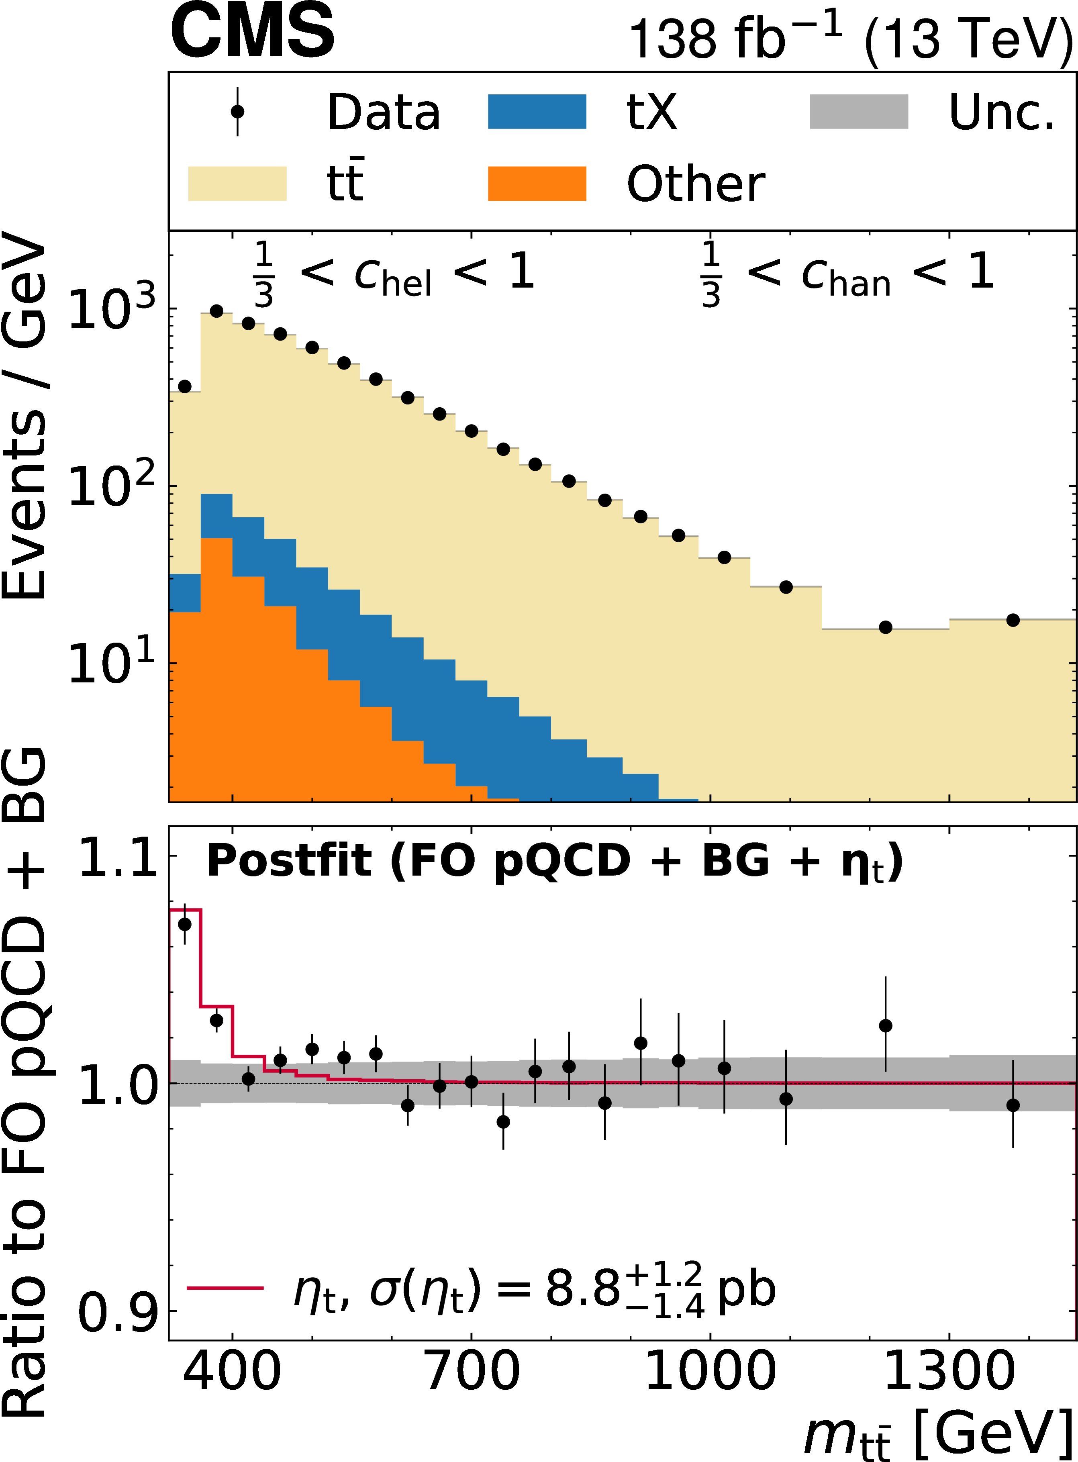
An (un-)expected discovery
Standard model or hints of new phenomena?
PoF IV:
Toponium at the LHC?
Bound state for 10⁻²⁵ s?
Challenging measurement
Difficult theory prediction
Invariant di-top mass
Rep. Prog. Phys. 88 (2025) 087801
Driven by FPF scientists:
Experimentalists from ATLAS and CMS at DESY
Theorists from DESY, Hamburg University and KIT
resonant production
in non-relativistic regime

Slide 8
More discoveries in PoF V?
Standard model or hints of new phenomena?
PoF IV:
Toponium at the LHC?
Bound state for 10⁻²⁵ s?
Challenging measurement
Difficult theory prediction
PoF V:
Profit from higher luminosity and upgraded detectors
Toponium only or also contribution by additional Higgs bosons?
Additional measurements and searches
Precision measurements and interpretations with effective field theories
Test for appearance of new particles in quantum effects, profiting from new detectors and high luminosity
Push sensitivity to new-physics scales to the order of
10-100 TeV
Invariant di-top mass
Rep. Prog. Phys. 88 (2025) 087801

Slide 9
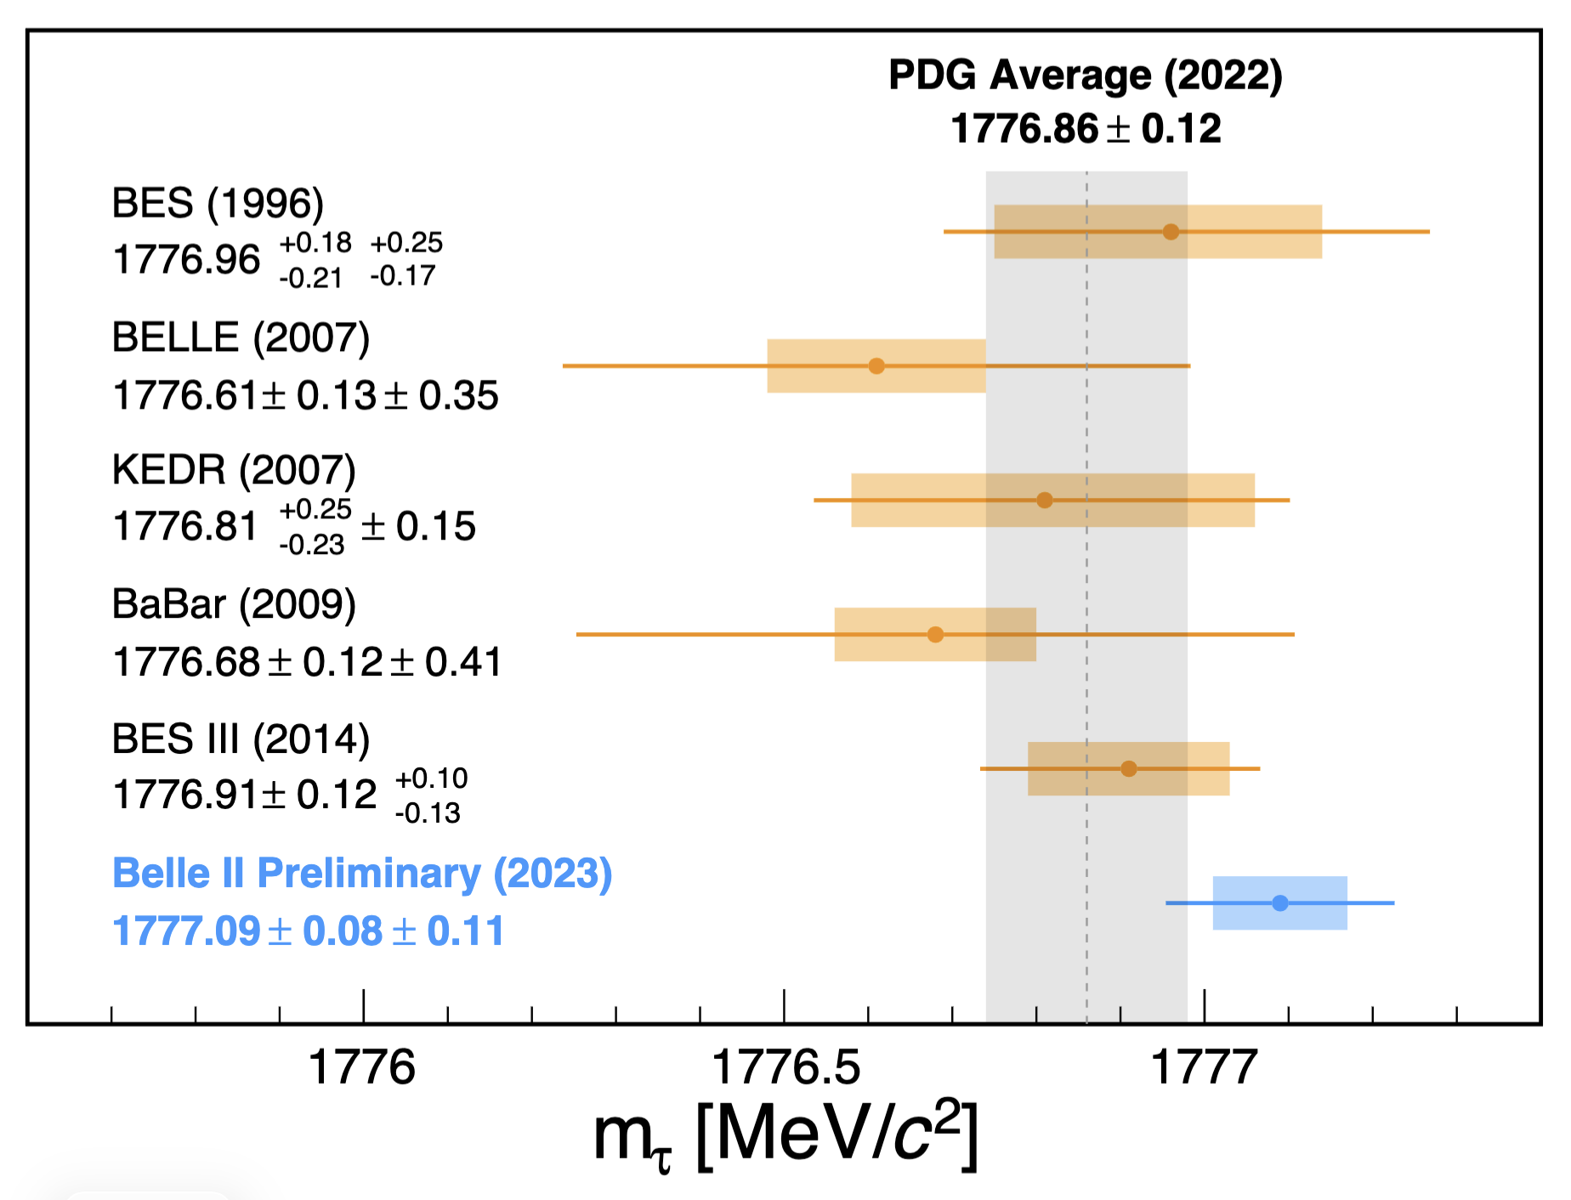
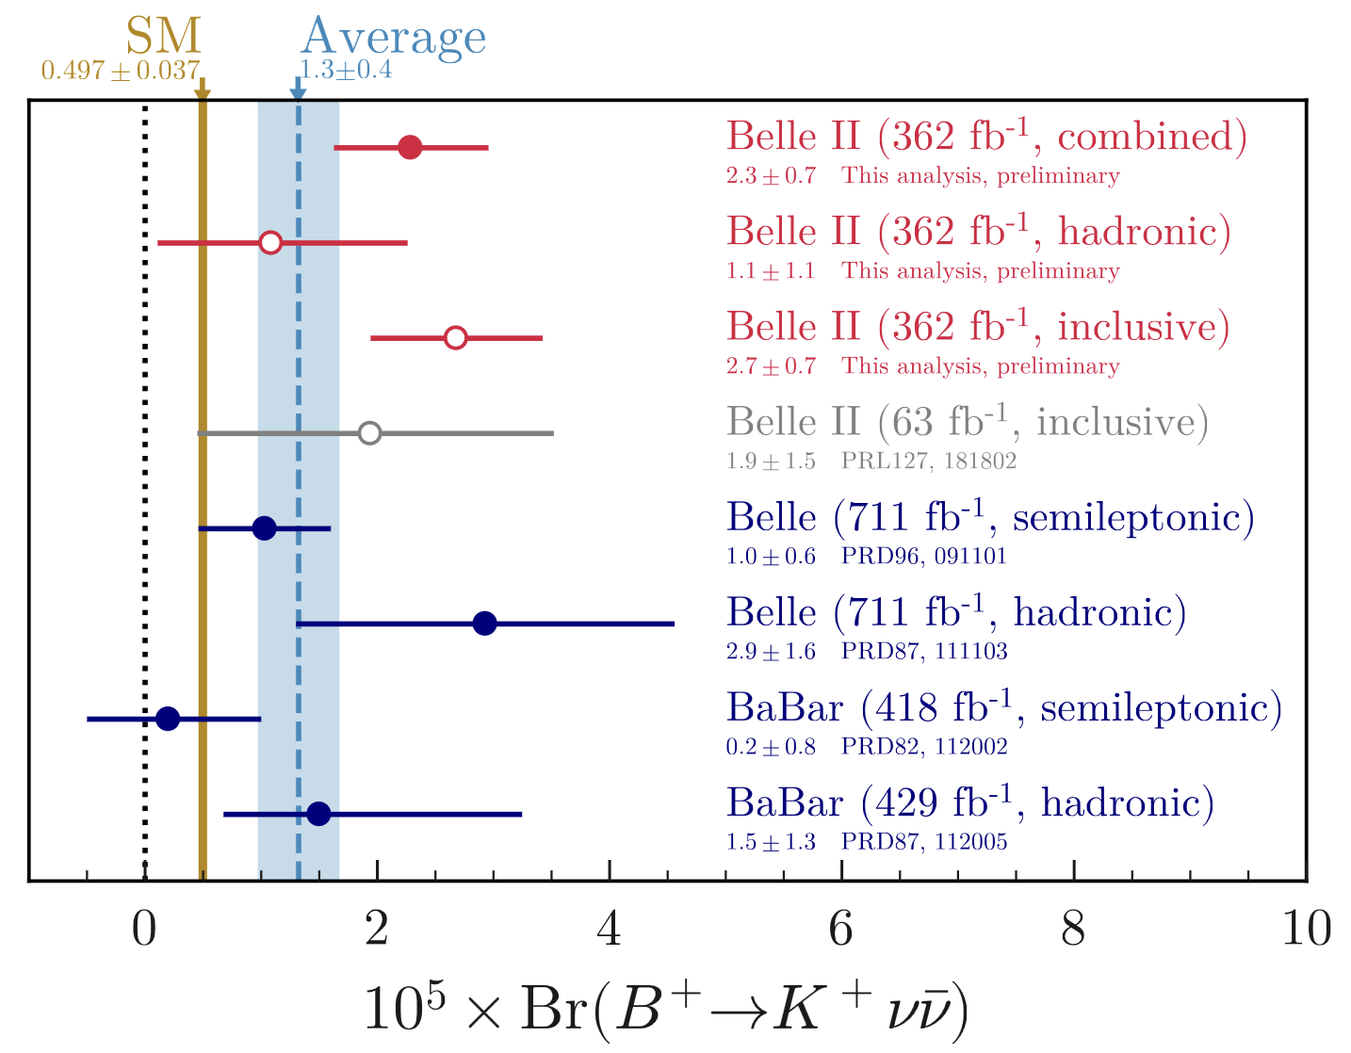


Belle II: Precision measurements
Hints of new phenomena?
PoF IV:
Most precise tau mass measurement
Excess of events in rare decay B± → K±$ν\overline{ν}$
2.7 σ above SM prediction – caused by new particles?
Tau mass measurements
Comparison of Standard Model prediction and measurements of Br(B± → K±$ν\overline{ν}$)
Strong contribution
by FPF scientists
PRD 108 (2023) 032006
PRD 109 (2024) 112006
Strong contribution
by FPF scientists

Slide 10
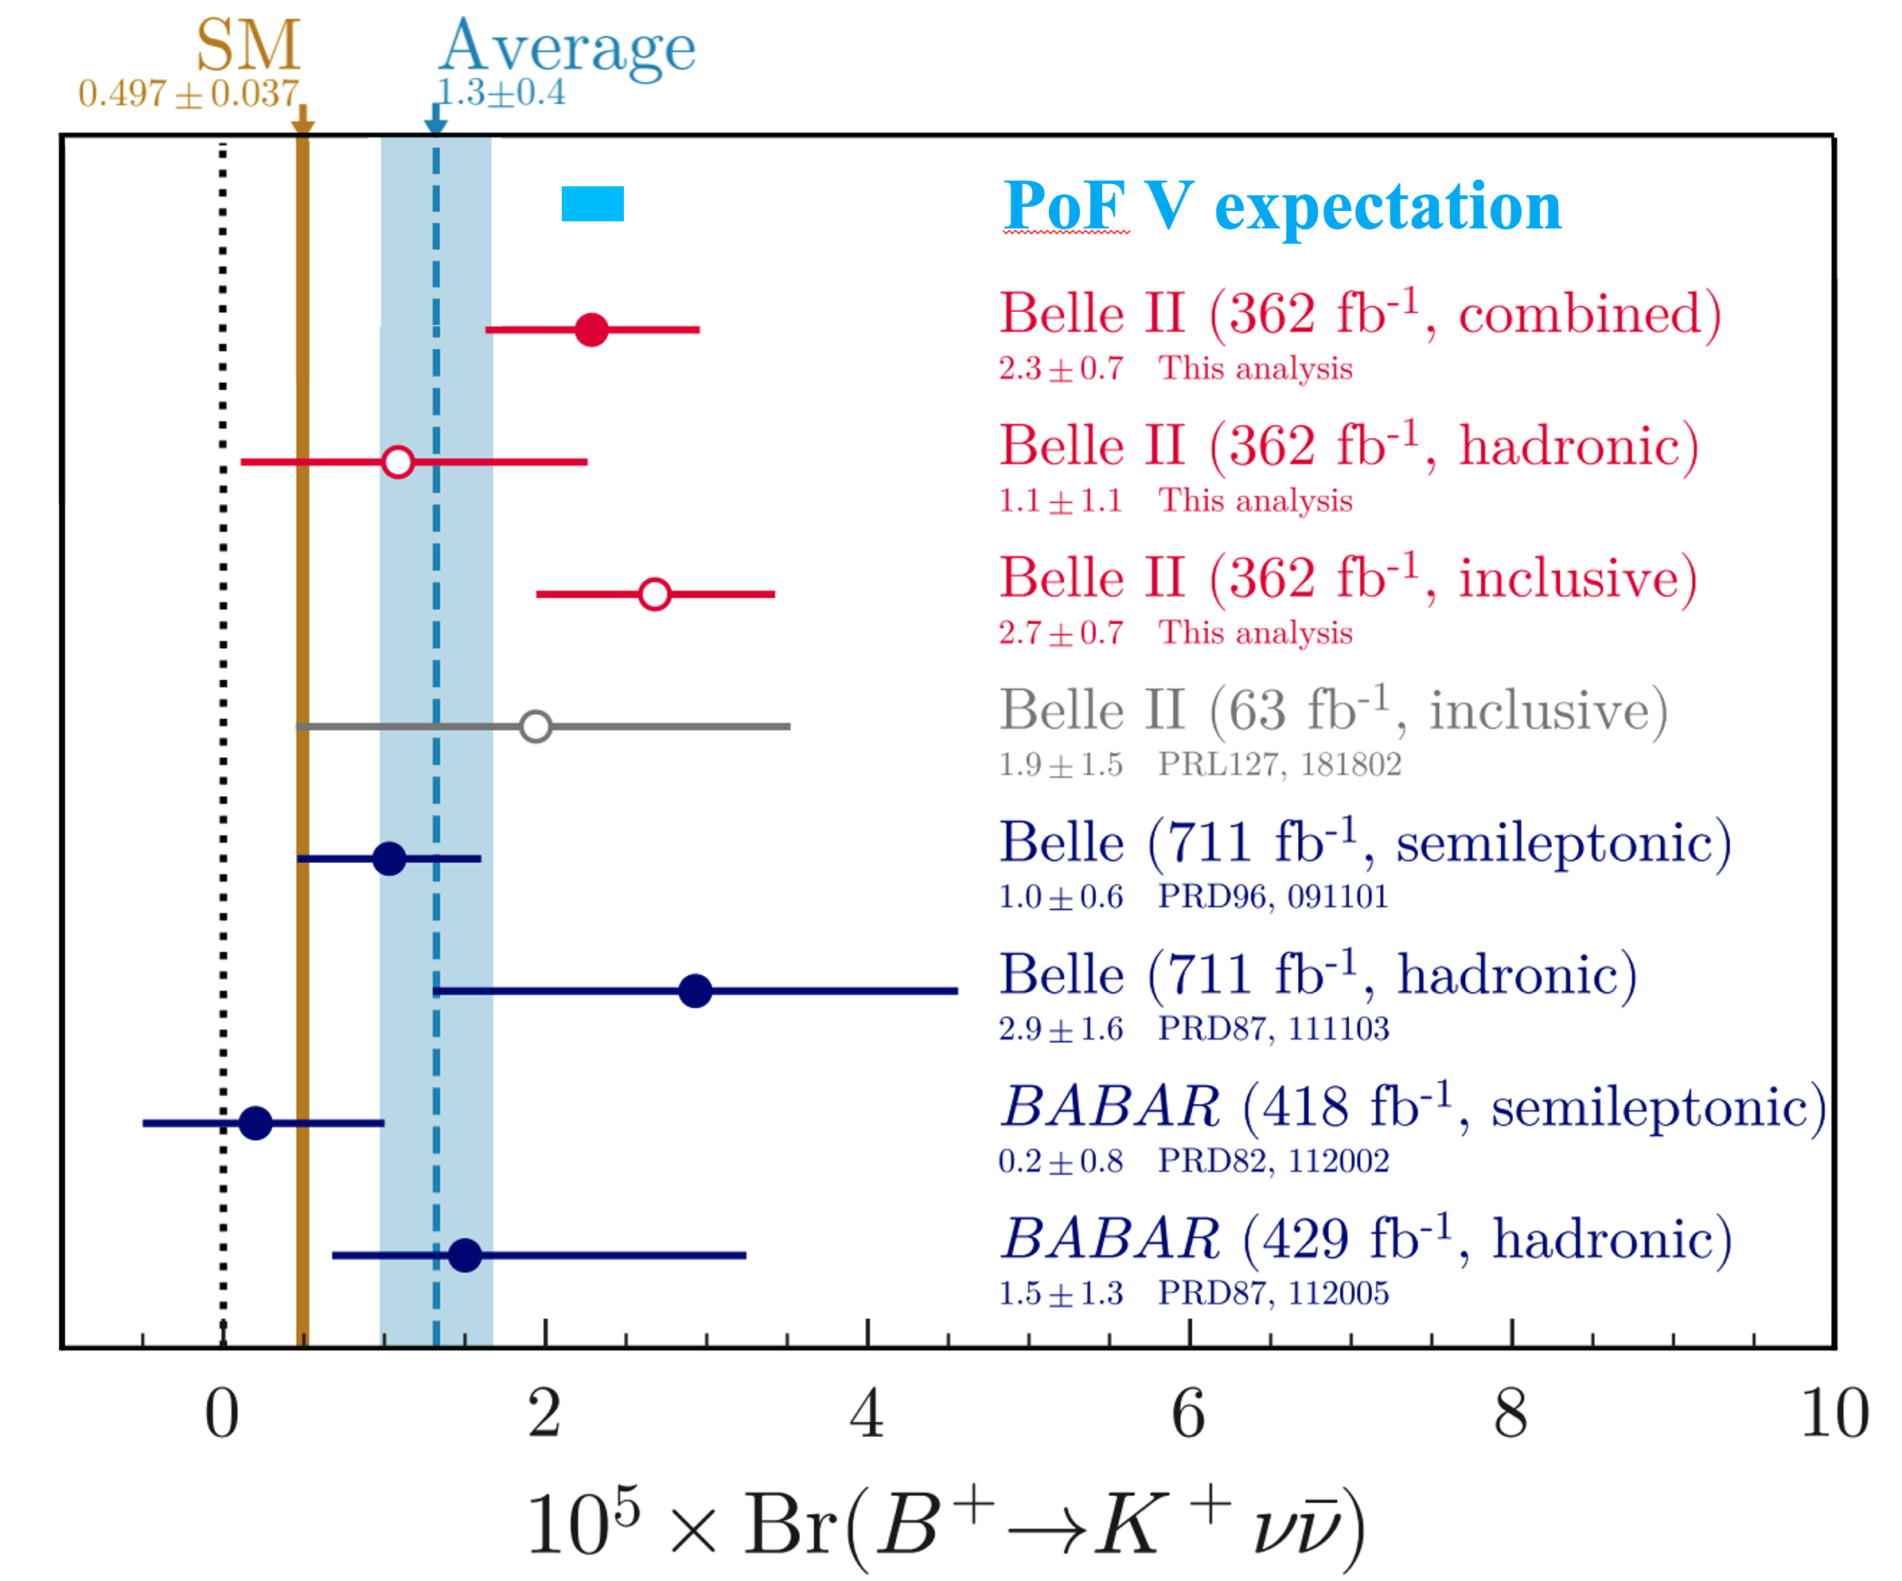
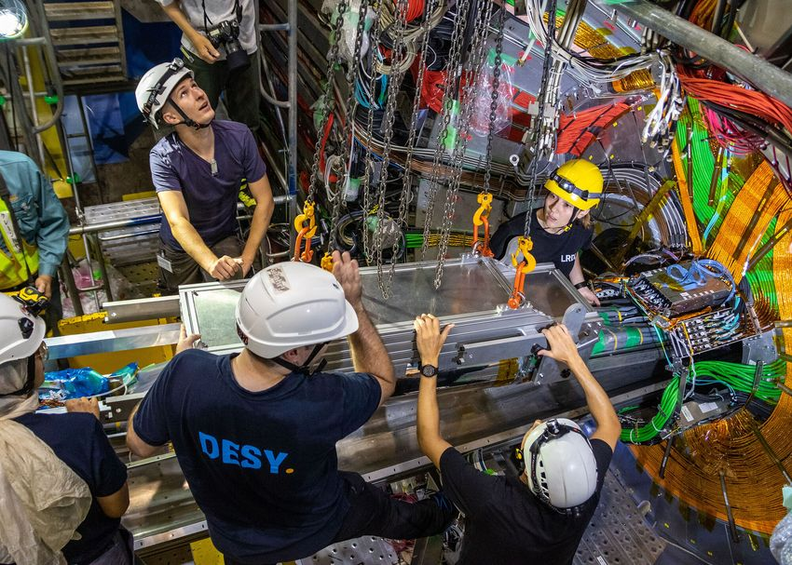

Belle II: Precision measurements
Hints of new phenomena?
PoF V:
Follow-up on measured excess and many other rare decays with significantly higher luminosity and new detectors
Sensitivity to CP violation
Projection of uncertainty on the measurement of Br(B± → K±$ν\overline{ν}$)
Projected uncertainty
in PoF V
Installation of the new Belle II pixel detector during PoF IV
Uncertainty
in PoF IV

Slide 11
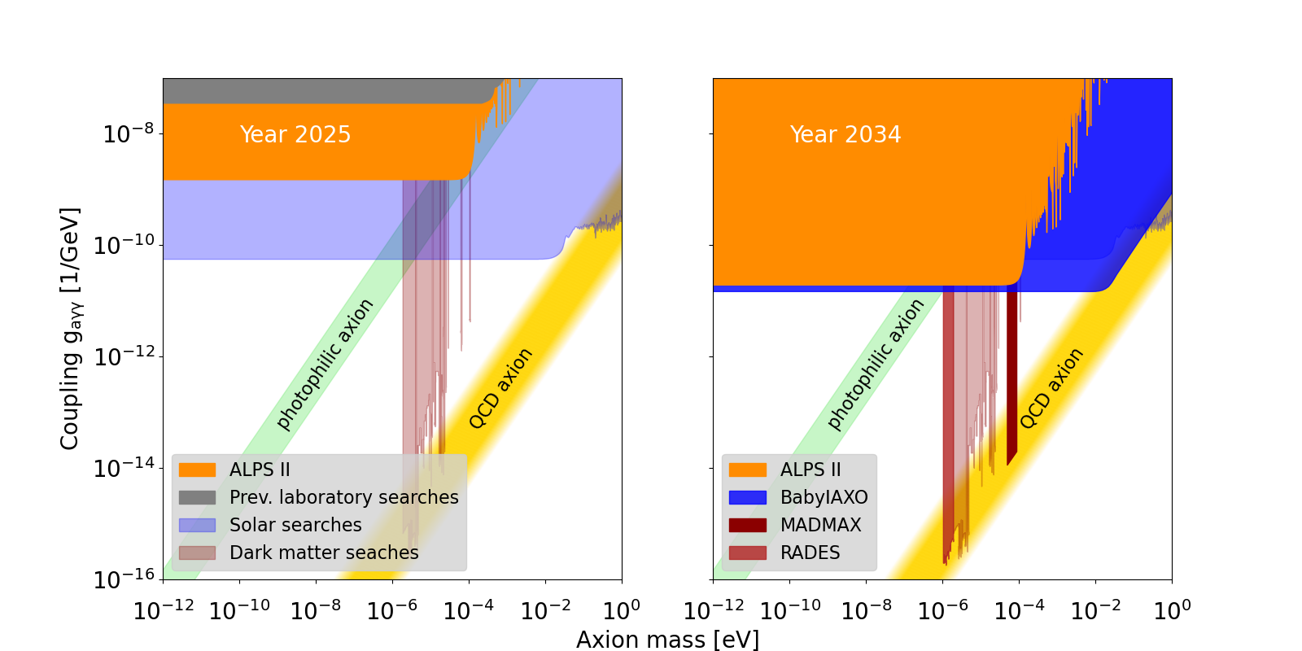
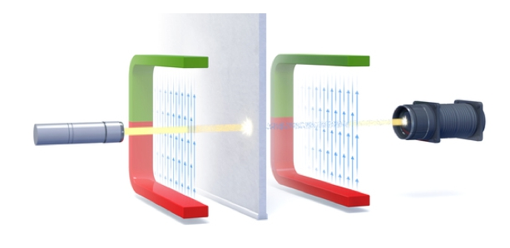
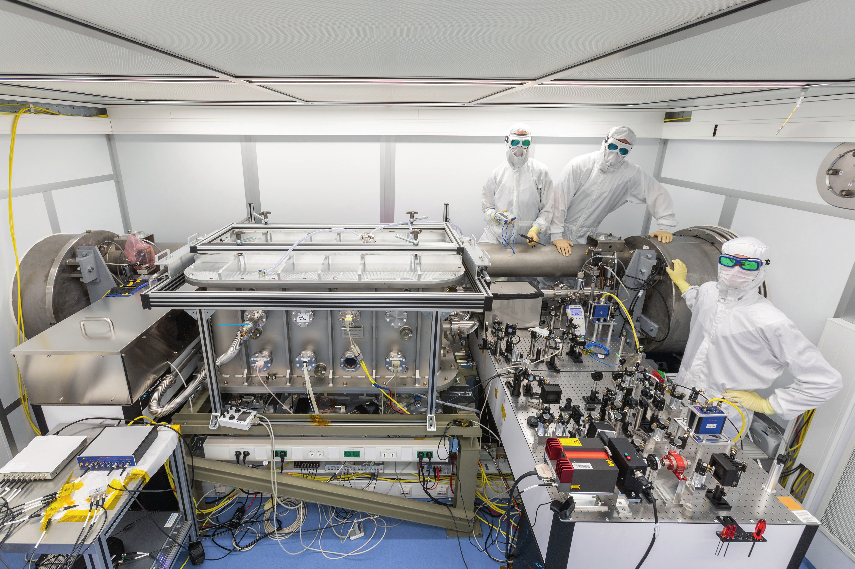
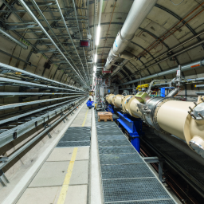
Probing light dark matter
We partly re-use existing local infrastructure
PoF IV:
First results from ALPS II
Probing axion production from laser light in strong magnetic field
Exceeding previous
sensitivity by factor ~10⁵
New nanomechanical membrane:
Application in industry, but also in searches for high-frequency gravitational waves (re-using ALPS II)
Sketch of a light-shining-through- wall experiment like ALPS II
Axion coupling vs. mass
ALPS II experiment views
Patent EP 4 446 714 B1:
Sensor for measuring two characteristics of a gas
Laser clean room
Magnets

Slide 12
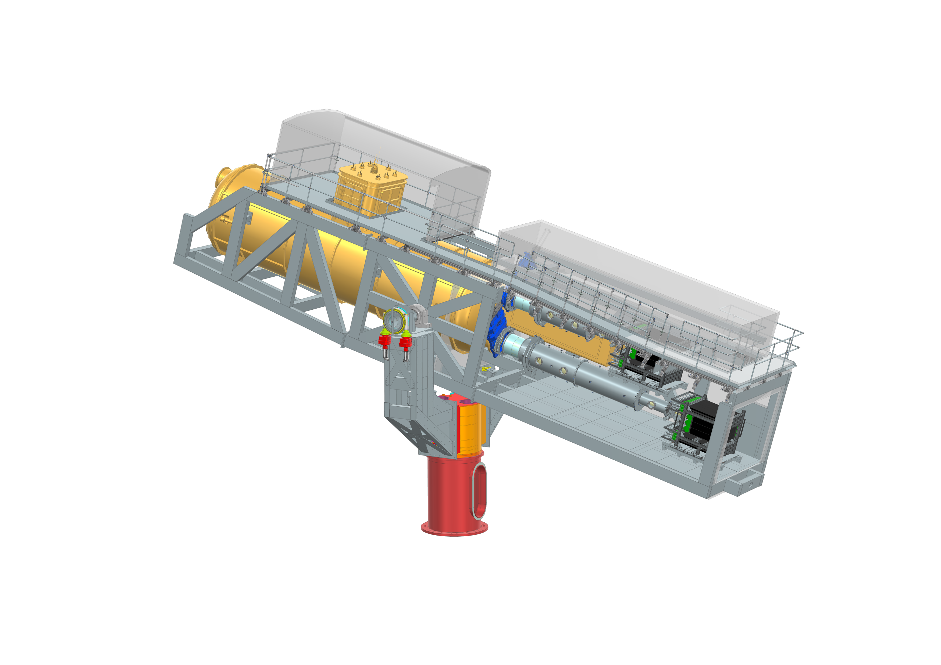
Probing light dark matter
Three flagship experiments: DESY to become a center for axion research
PoF V:
Final results from ALPS II
Two new experiments
BabyIAXO
Axions from the
sun and sensitivity
to halo dark matter
with RADES
MADMAX
Boosting the signal of possible axions from halo dark matter with dielectric haloscopes
Axion coupling vs. mass
Notes:
DESY is hostlab, but 80-90% invest come from external partners.

Slide 13
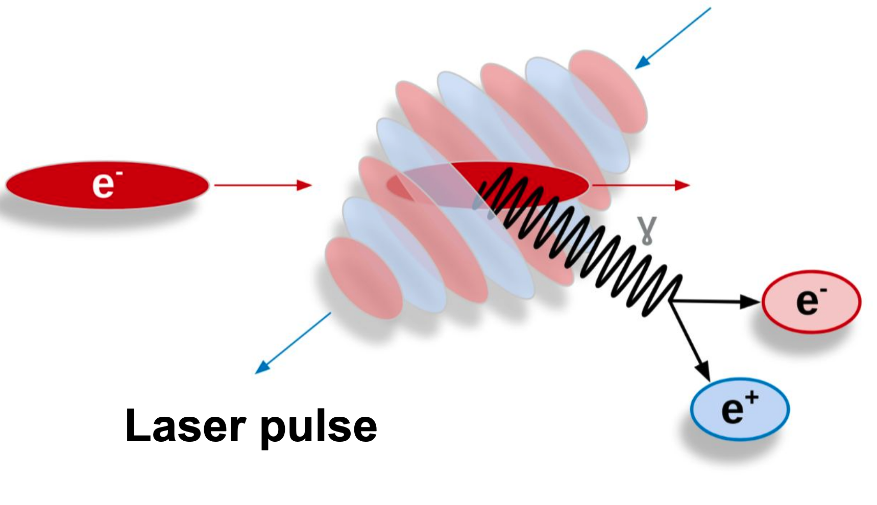



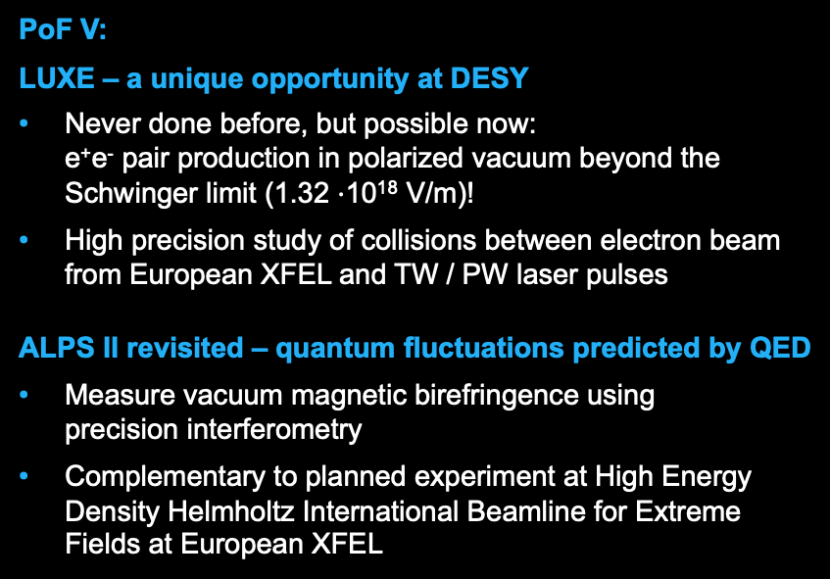
Testing QED at the extreme
We profit from existing large infrastructures
PoF V:
LUXE – a unique opportunity at DESY
Never done before, but possible now:
e⁺e⁻ pair production in polarized vacuum beyond the Schwinger limit (1.32 $⋅$10¹⁸ V/m)!
High precision study of collisions between electron beam from European XFEL and TW / PW laser pulses
ALPS II revisited – quantum fluctuations predicted by QED
Measure vacuum magnetic birefringence using
precision interferometry
Complementary to planned experiment at High Energy Density Helmholtz International Beamline for Extreme Fields at European XFEL
Sketch of the idea behind the LUXE experiment
ERC Synergy Grant: NP-QED
13

Slide 14


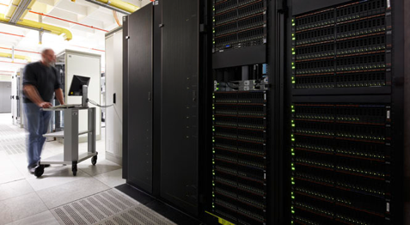
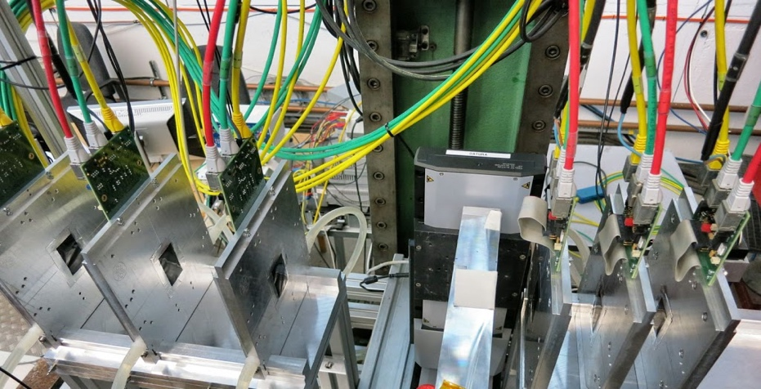

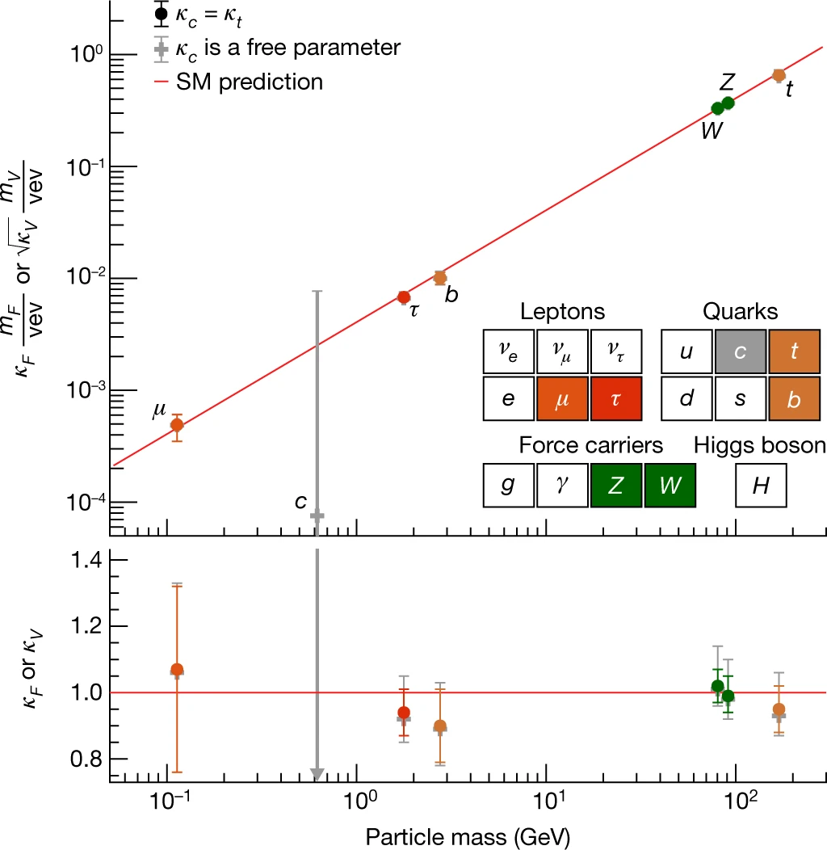
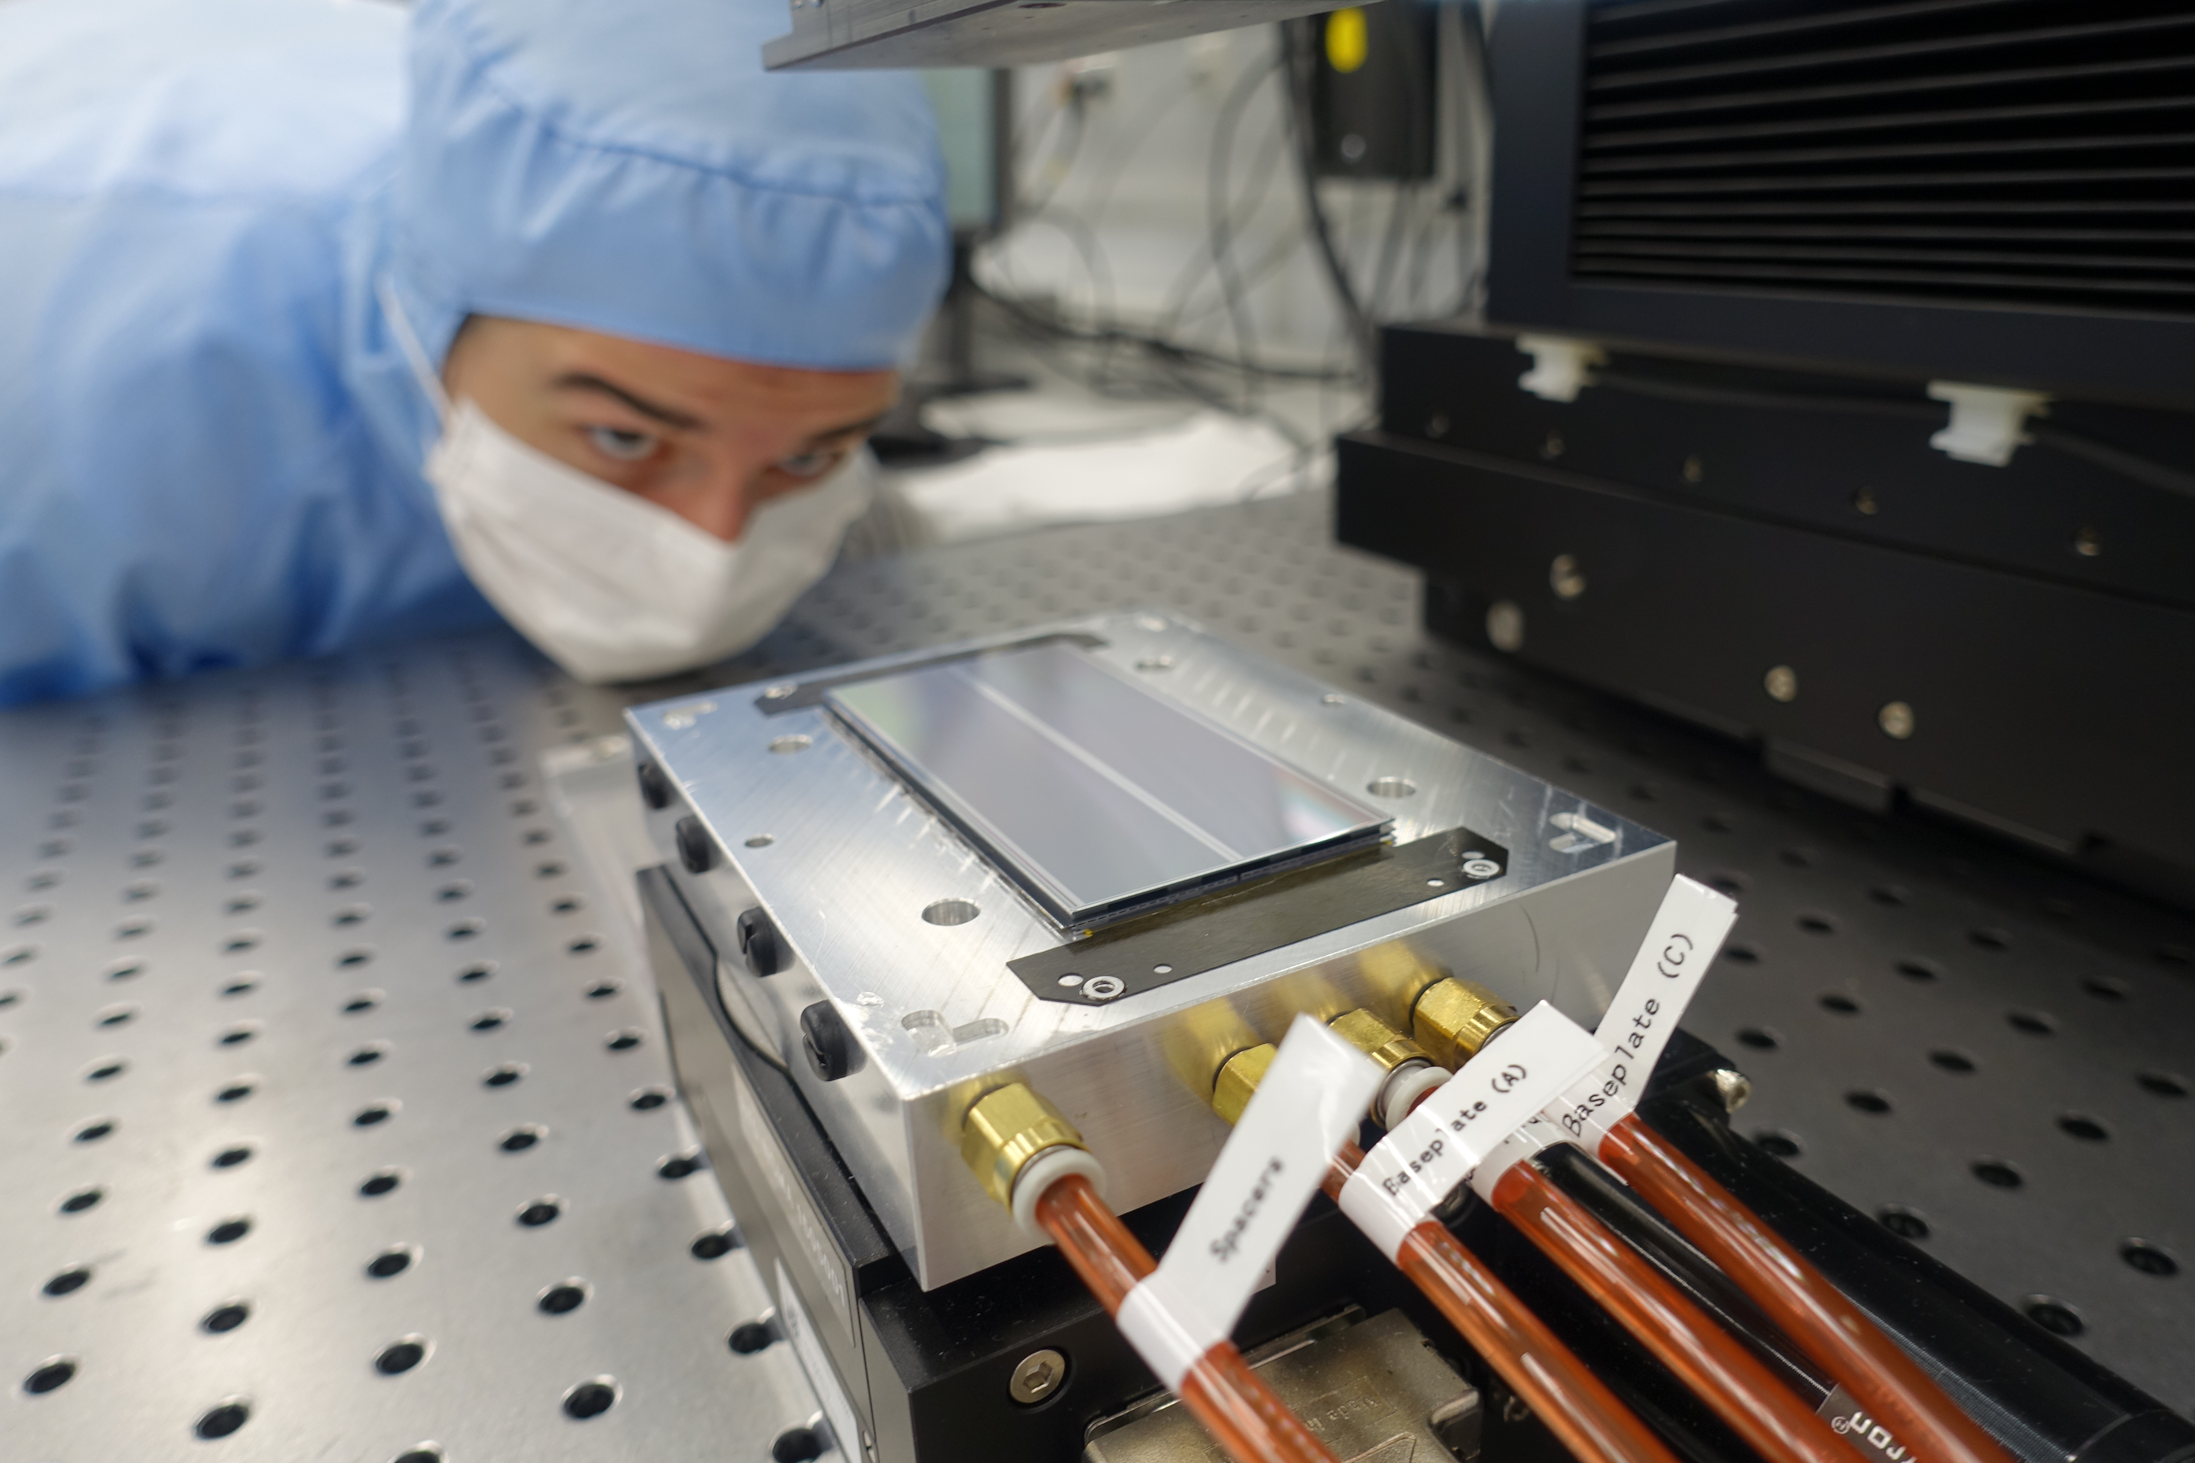


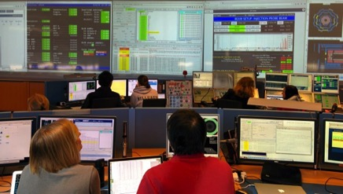
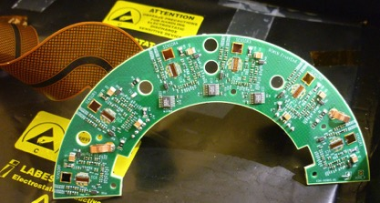



True Helmholtz spirit in FPF and beyond
We have full system and lifecycle competence for large projects
We are in an excellent position for the next flagship collider project at CERN
Strong involvement in relevant future projects, e.g. detector R&D collaborations at CERN
High-level positions in future project planning (European Strategy)
Large infrastructures and technical resources
Leadership in scientific computing
Theory as
idea factory
Detector
and accelerator R&D
Interpretation and data preservation
Data analysis
Construction
Operation
Commissioning
14

Slide 15
Project timelines
Experiments operated by international collaborations
2026 | 2027 | 2028 | 2029 | 2030 | 2031 | 2032 | 2033 | 2034 | 2035
ATLAS, CMS
Run 3
Shutdown: Upgrade
Run 4
Shutdown
Estimated FTE distribution in 2028
Belle II
Flagship colliders
Data taking
Shutdown:
Possible upgrades
Future collider at CERN*
Preparation
Implementation*
ALPS II
Upgrade
Data taking
Possibility to conduct new experiments using the ALPS II infrastructure*:
Vaccuum magnetic birefringence Search for ultra-high frequency gravitational waves
BabyIAXO*
Preparation
Construction
Data taking
w/o magnet
Upgrade with magnet
Data taking
Local experiments
MADMAX*
Preparation
Construction
Data taking
LUXE*
Preparation
Construction
Data taking
*project decision pending / not yet fully funded
15

Slide 16











Resources and environment
National and international collaborations
232 FTE, including 130 scientists and 61 doctoral students in 2028
38.7 M€ planned budget in 2028
Host of local experiments with many national and international
collaborators
Institutes from France, Israel, Italy, Poland, Romania, South Africa,
Spain, Switzerland, USA, Sweden, UK
FPF well represented in large international collaborations
Strong leadership, e.g. physics, performance, and computing
coordination; collaboration board chair
Joint professorships, collaborations with clusters of excellence,
Helmholtz Investigator Groups, Emmy-Noether groups, ERC grants

Slide 17
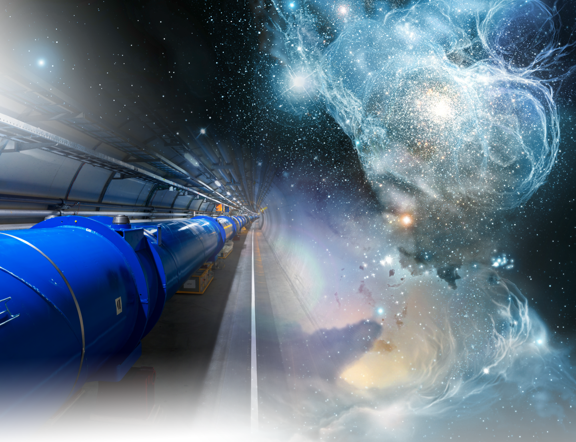
Coherence and synergies
Within Helmholtz Matter
Fundamental particles
and forces
Theory and local axion and dark matter searches
Gravitational
waves
QED
experiments
Theory and
data analysis at
international flagship colliders
Future
flagship collider
experiments
17

Slide 18
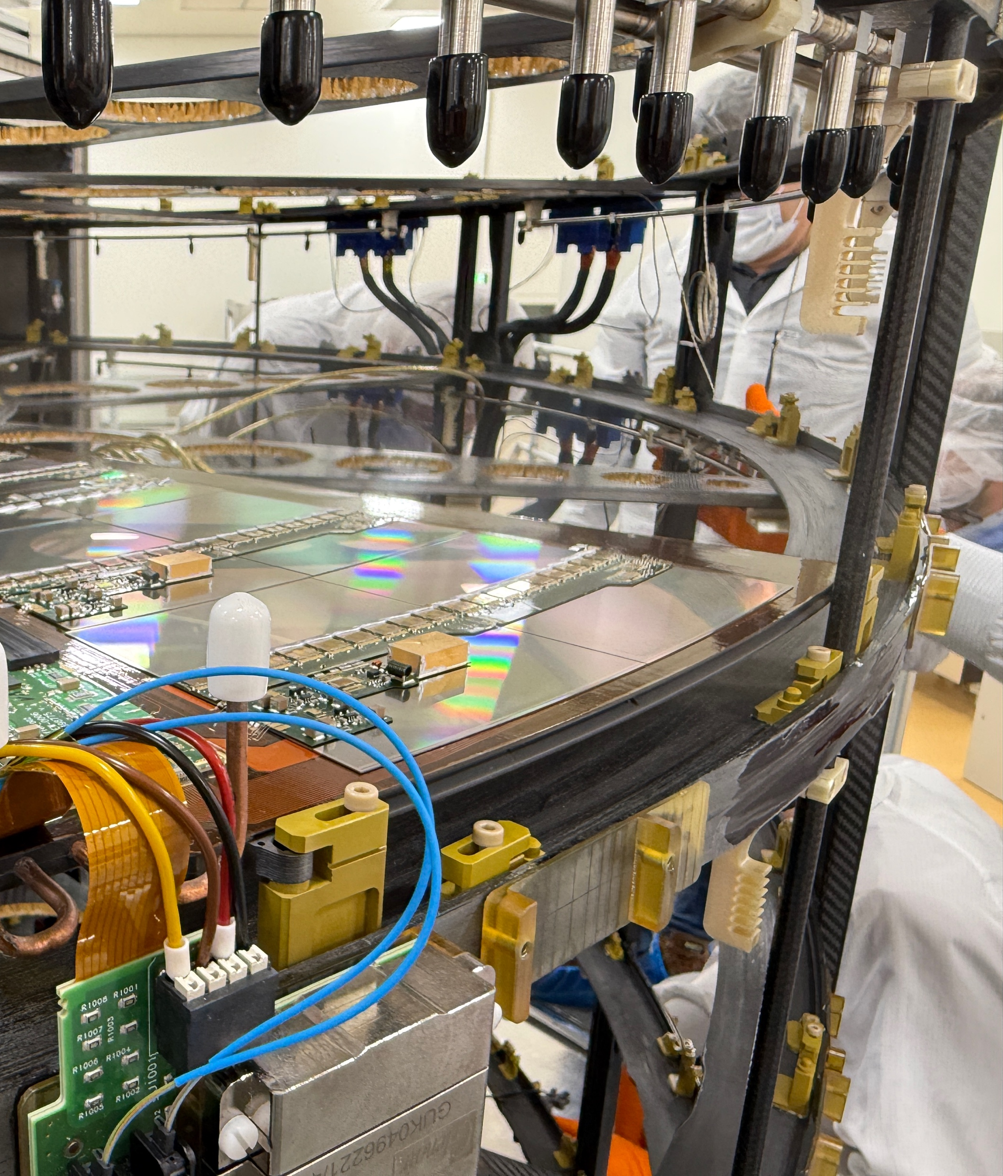
Conclusion and vision
We will expand our understanding of nature from the smallest scales
of elementary particles to the evolution of the cosmos
First results from HL-LHC on the Higgs potential, profiting from the newly built and installed detectors
New measurements from Belle II with record luminosity
New results from final ALPS II run, and new local experiments starting up
Theoretical innovation and precision calculations
Preparing for the next flagship collider project
18

