Slide 1
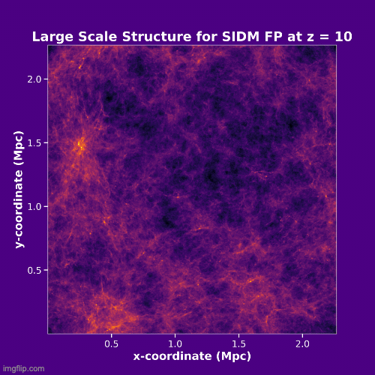
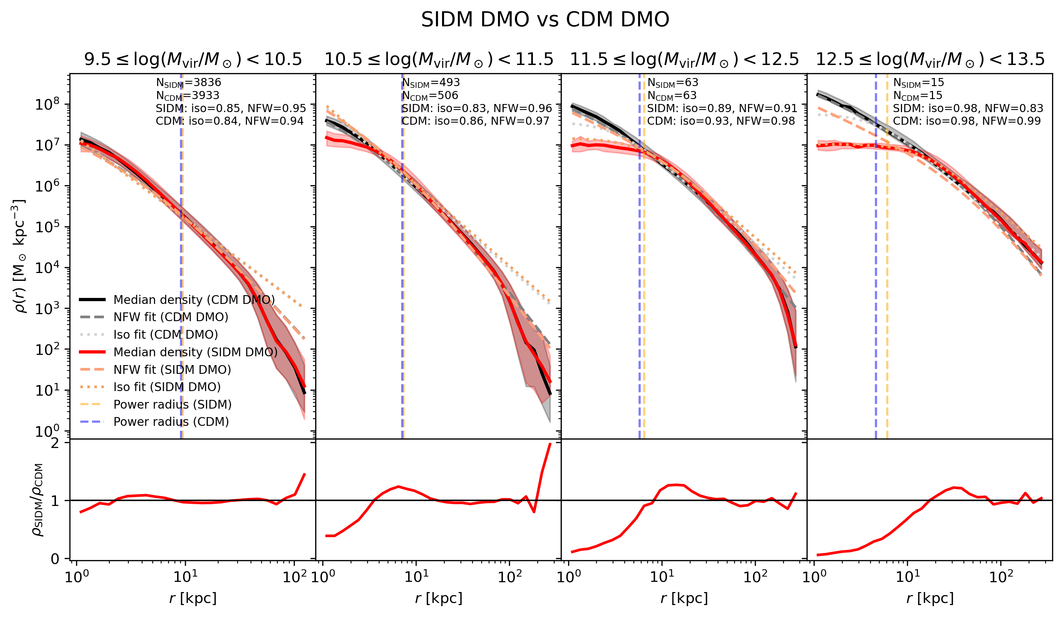



Investigating Dark Matter through Cosmological Simulations and Comparisons with Observations

