Slide 1
Baryon Resonances and Strangeness
In p+p Collisions Measured with HADES

Slide 2
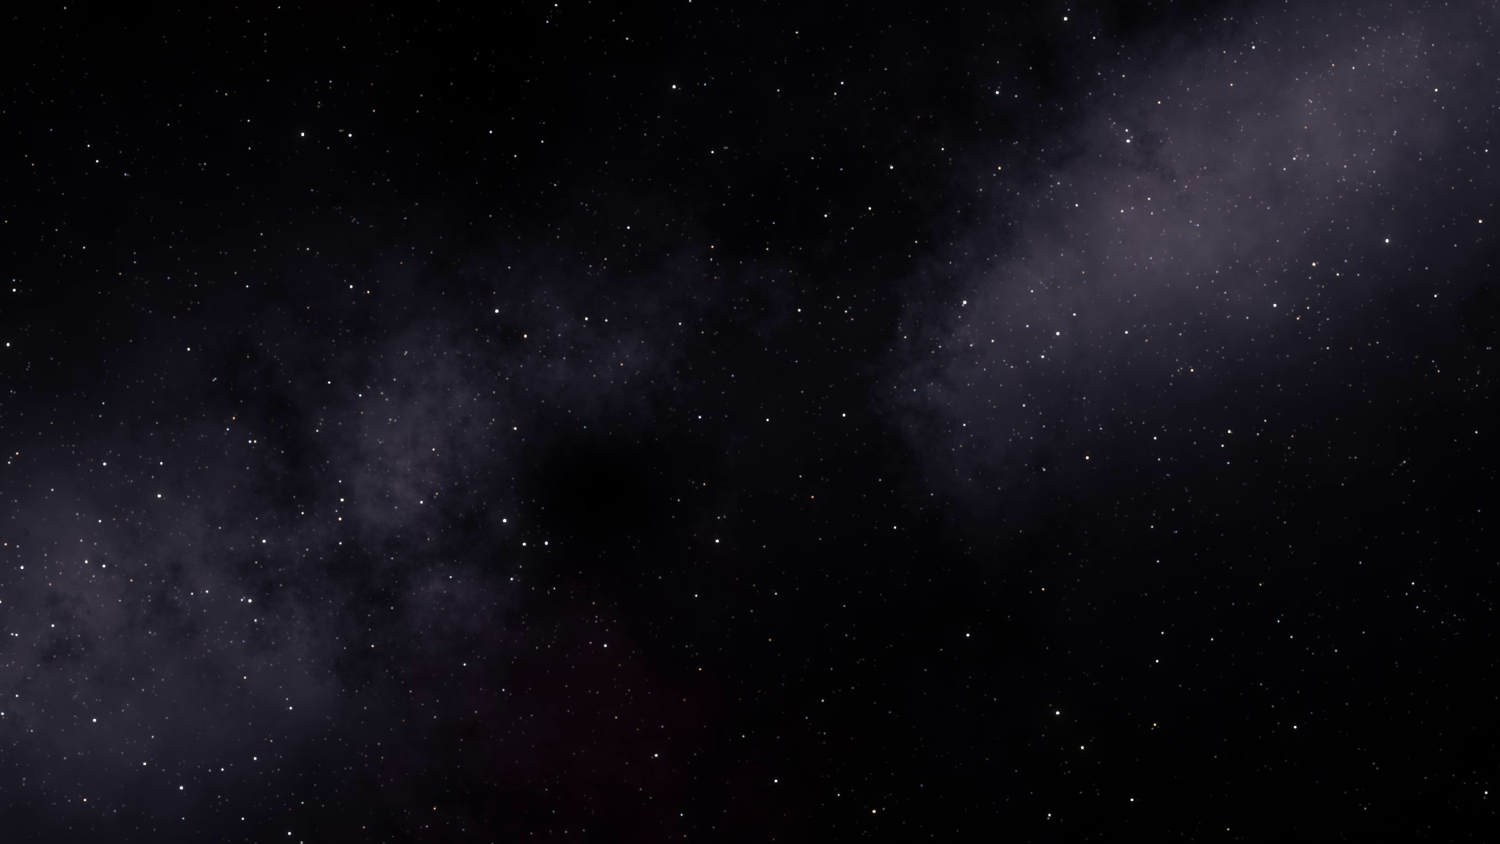

Slide 3
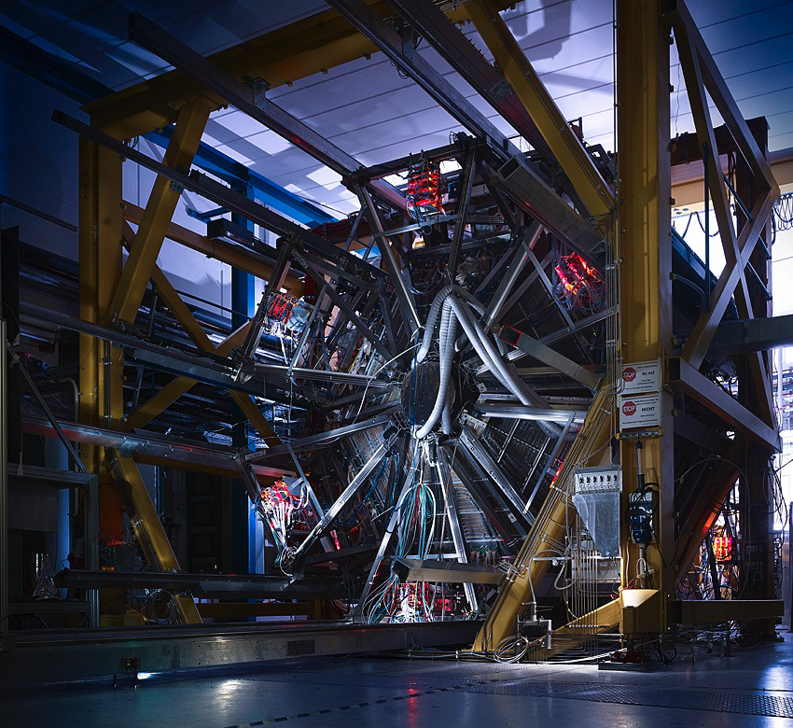

How do we learn about dense matter?
@ SIS 18

Slide 4

How do we learn about dense matter?
We study the constituents and their interactions

Slide 5
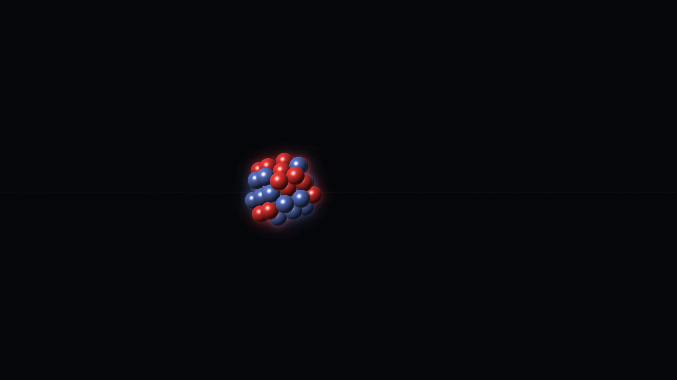
How do we learn about dense matter?
We investigate modifications of the constituent interactions in the medium

Slide 6
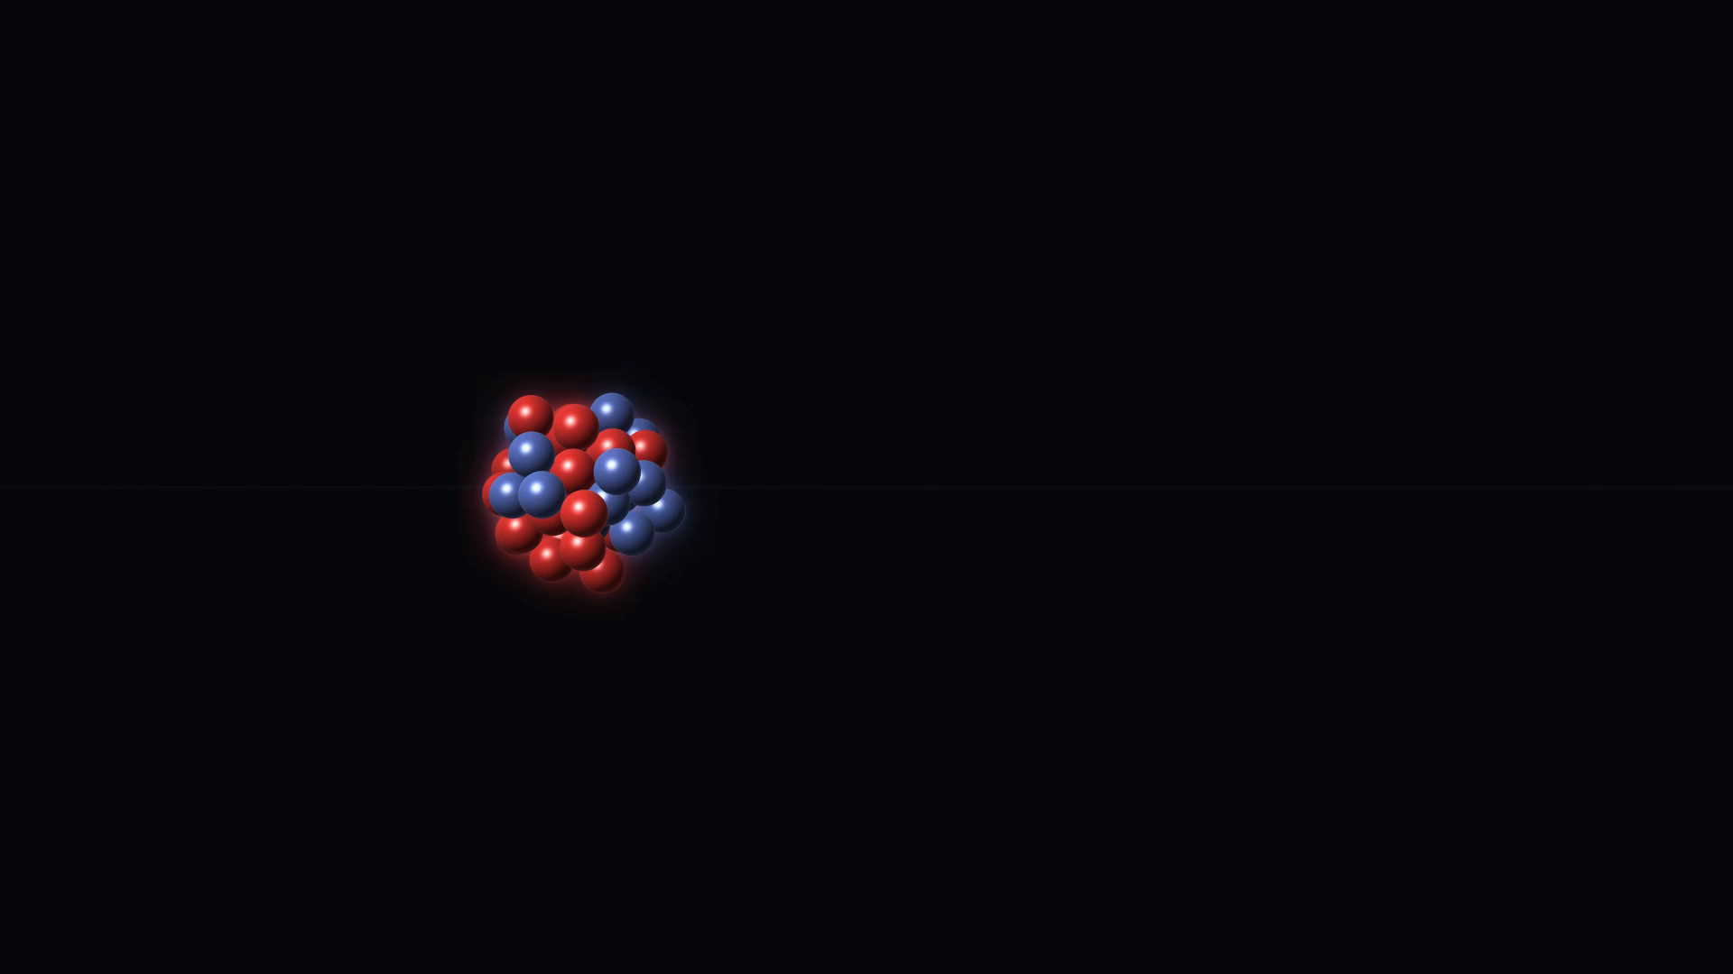
How do we learn about dense matter?
We make the medium dense

Slide 7
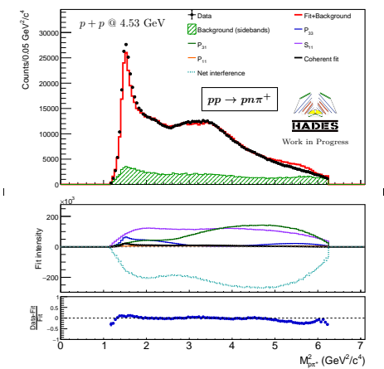
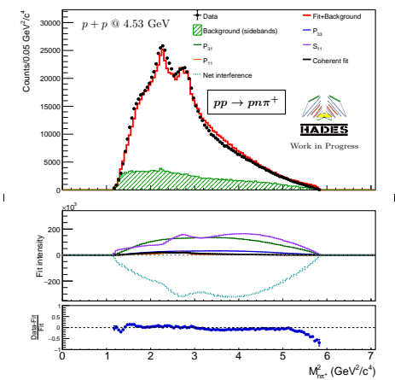
So what does our group do?
We study excited nucleons and their properties

Slide 8
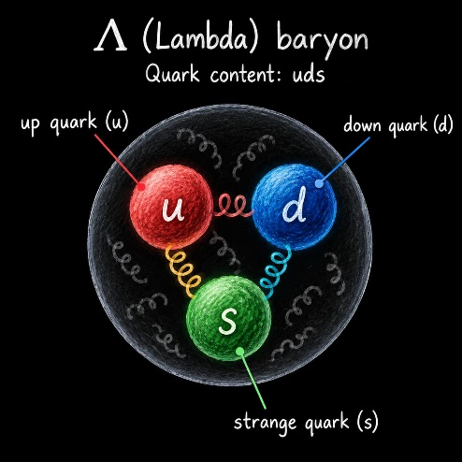
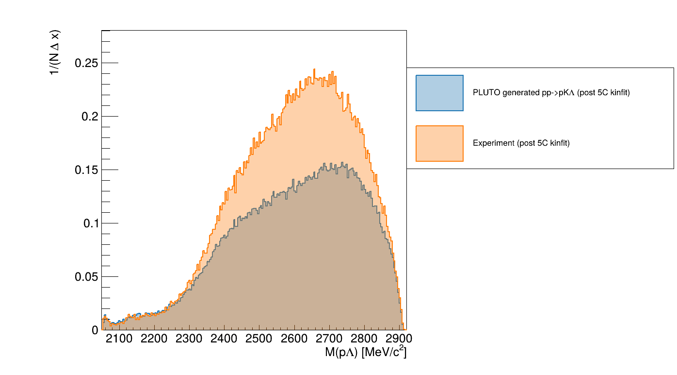
So what does our group do?
How the nucleons interact with hyperons

Slide 9
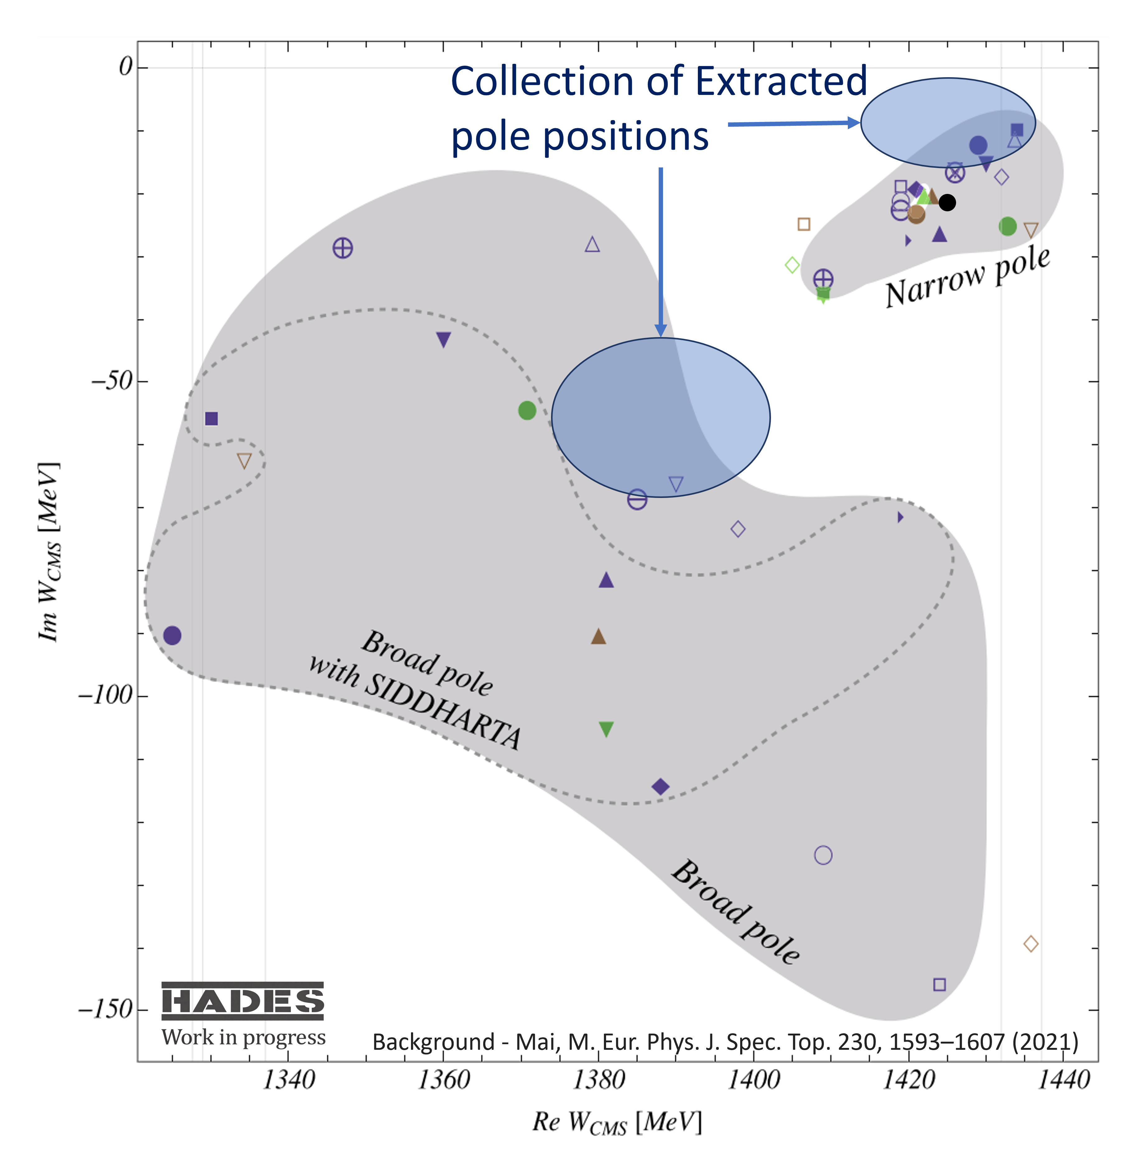
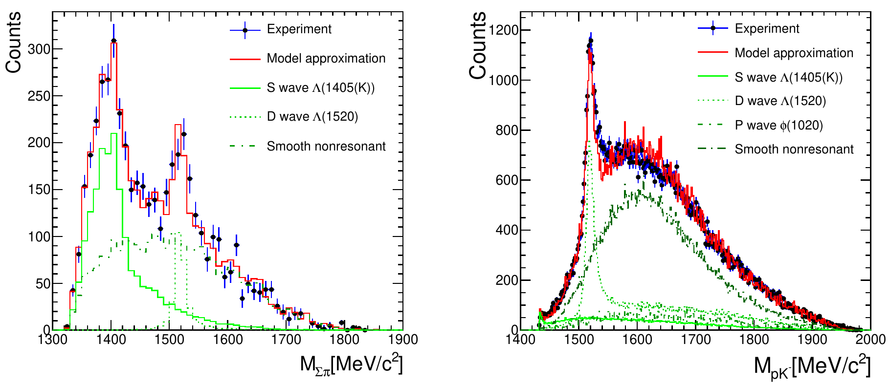
So what does our group do?
We study excited hyperons and their properties

Slide 10
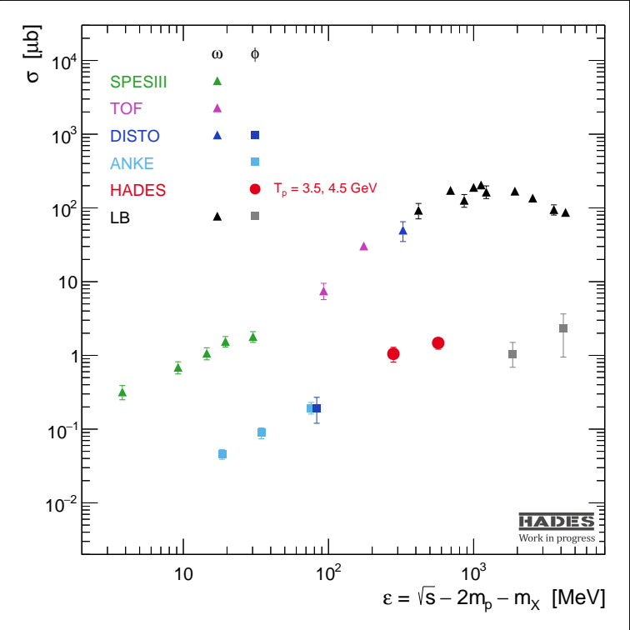
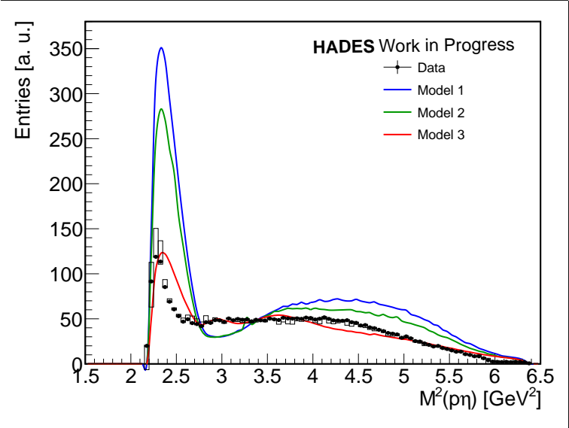
So what does our group do?
And the production of meson states with and without strangeness content

Slide 11
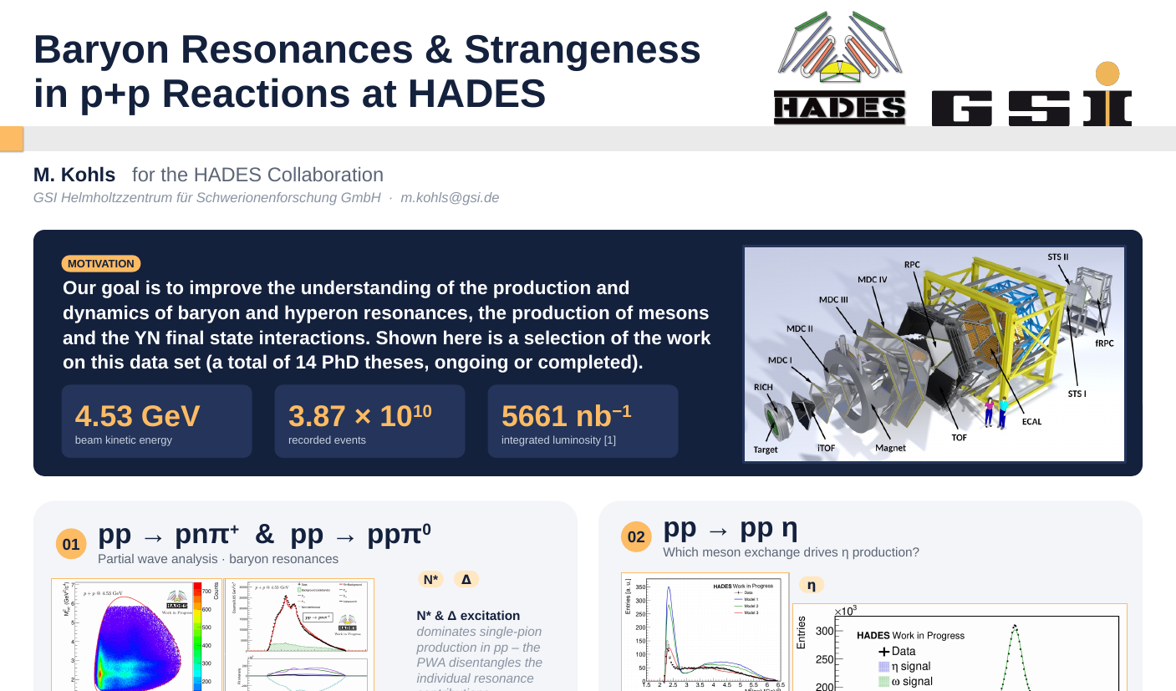
Come visit us!

