Slide 1
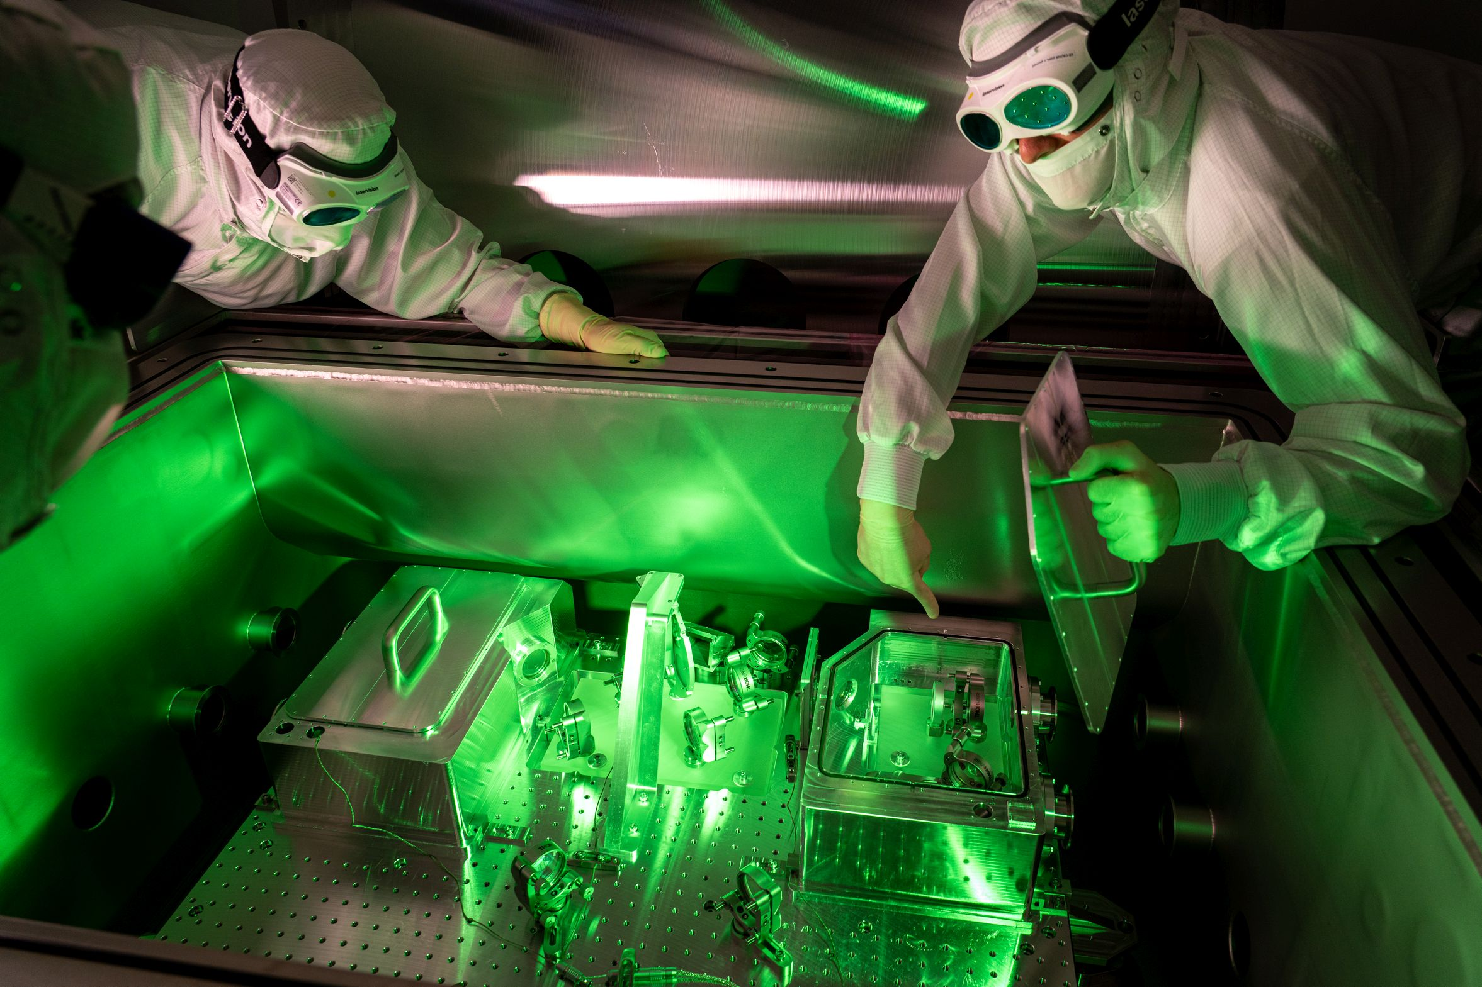


Dark matter searches with the ALPS II experiment
Bastien Smette, PhD student

Slide 2
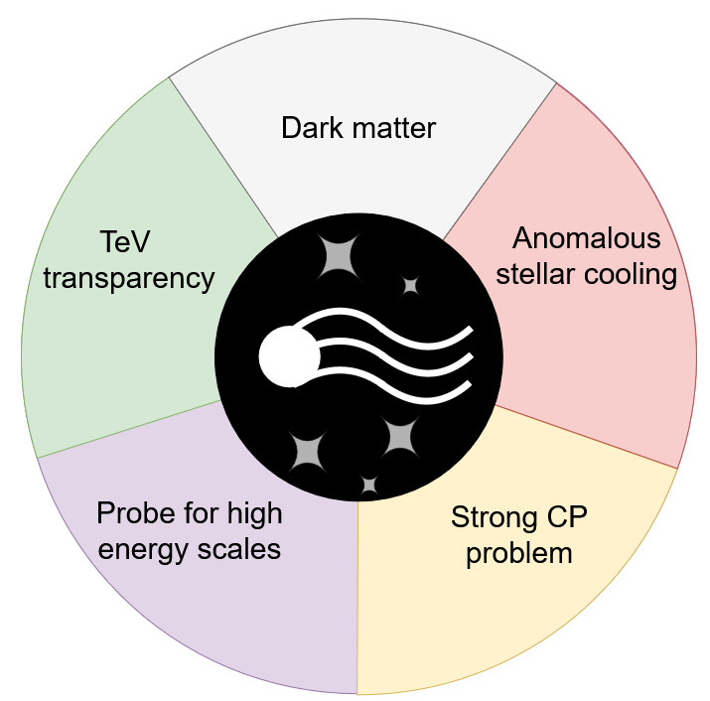
Axions and ALPs
Neutral scalars/pseudoscalars

Slide 3
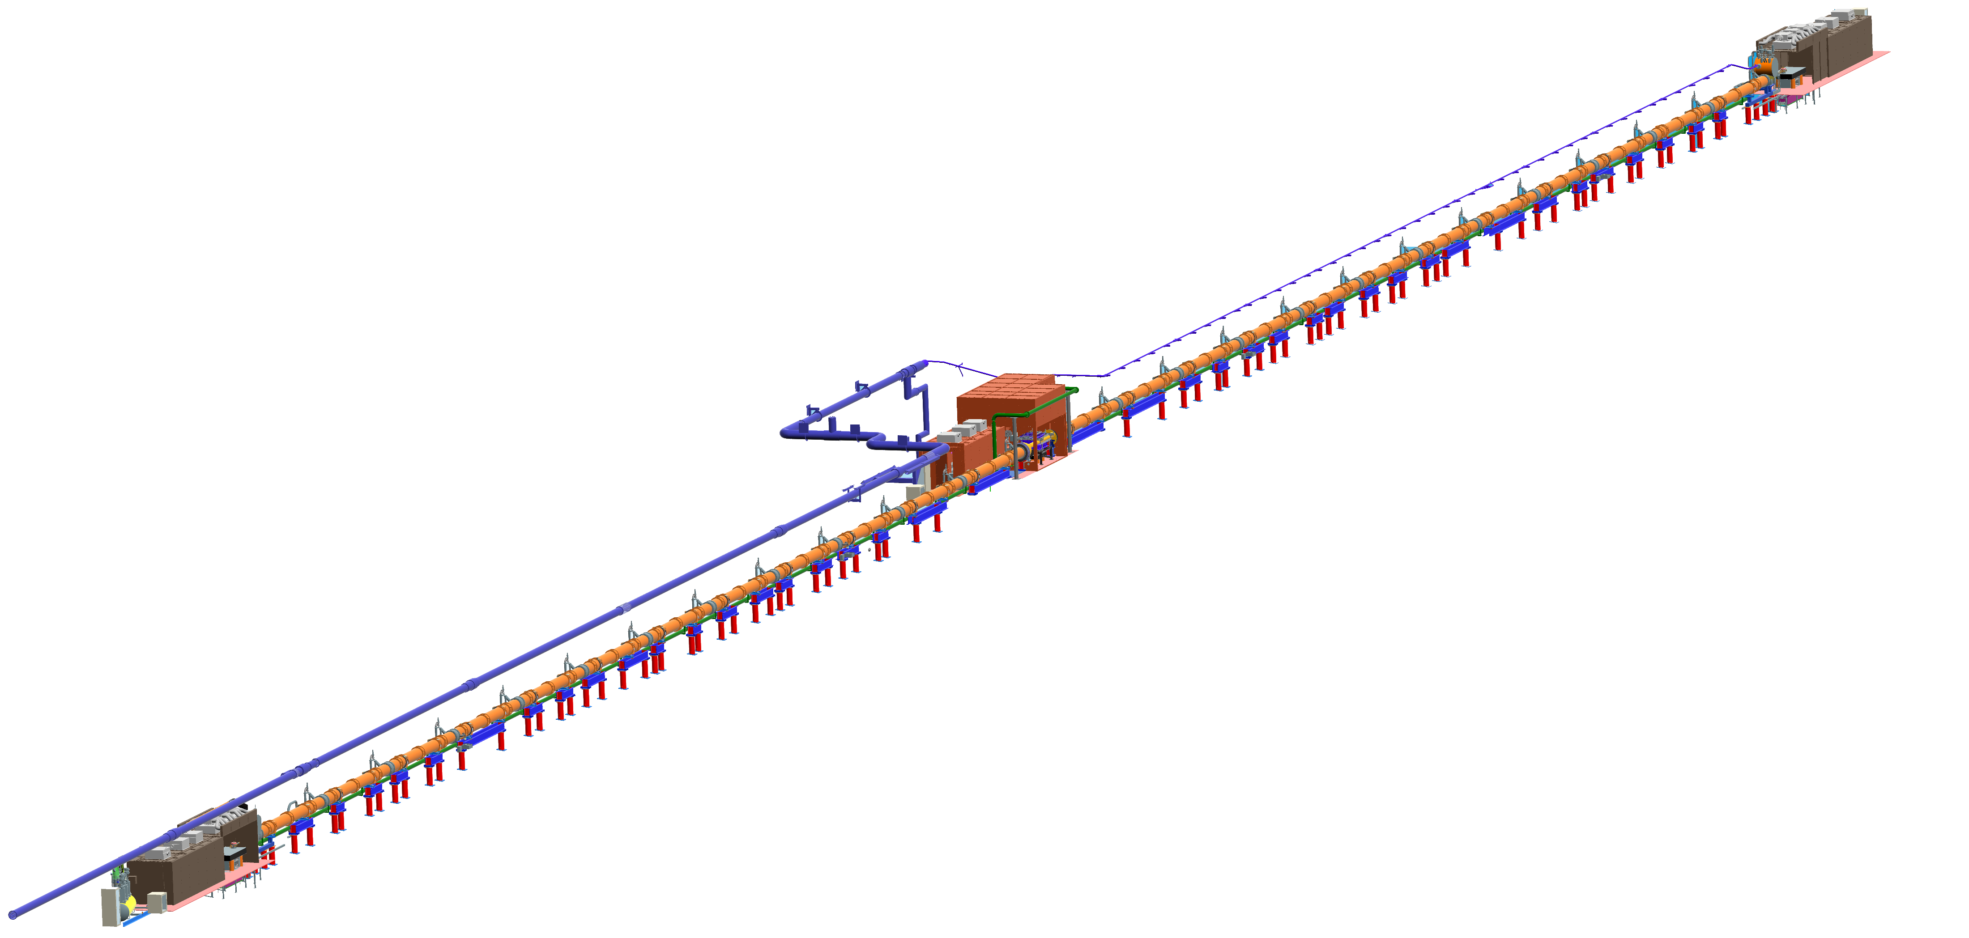
Axions and ALPs

Slide 4
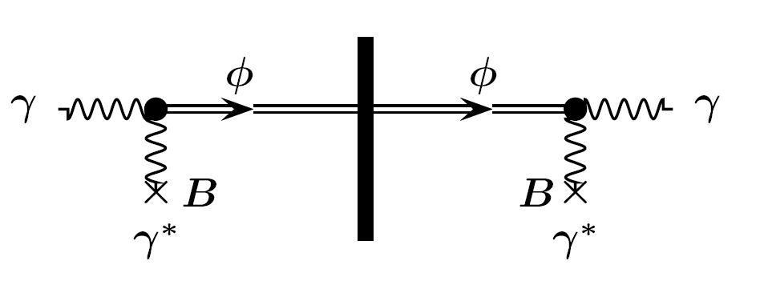
Light shining through the wall experiments
a
a
~1 photon every 100 000 years

Slide 5
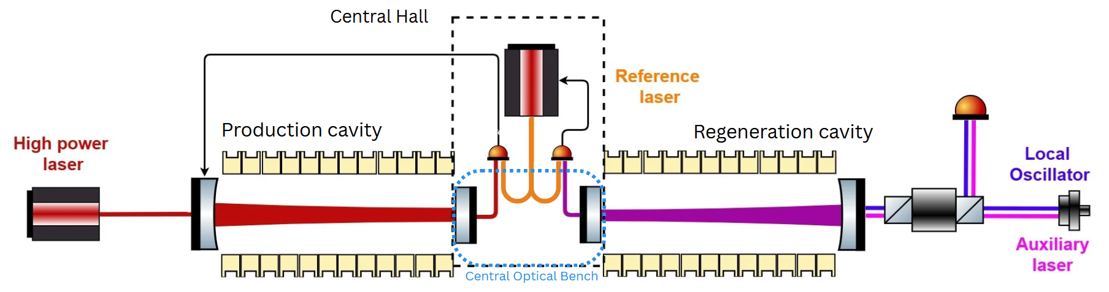
Light shining through the wall experiments
Heterodyne detection system
a
a
~1 photon every day

Slide 6
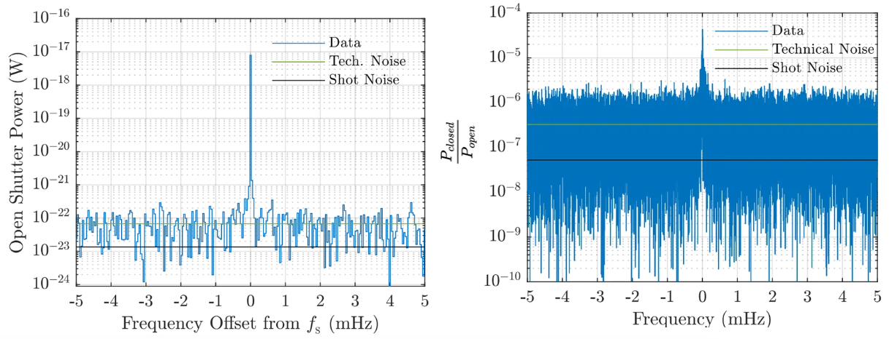
First science results

Slide 7
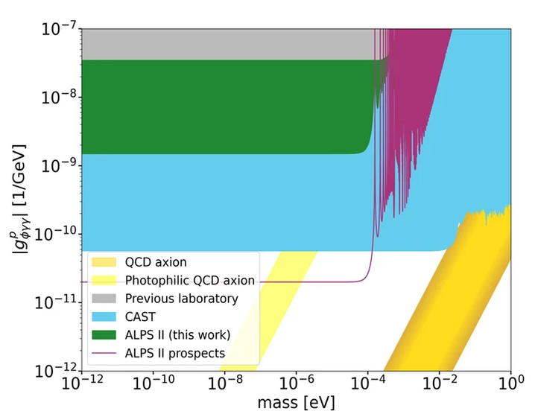
And what’s to come

Slide 8
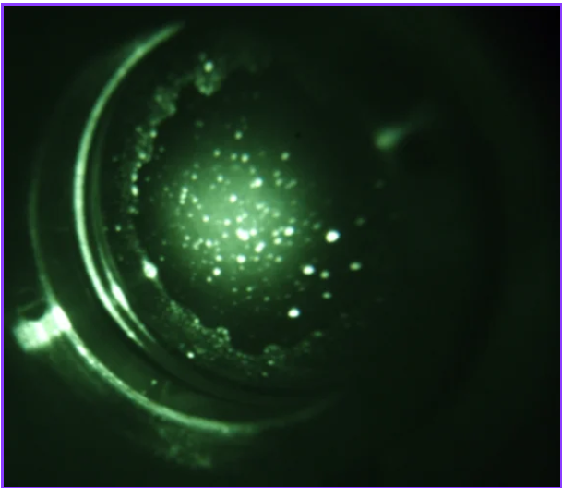
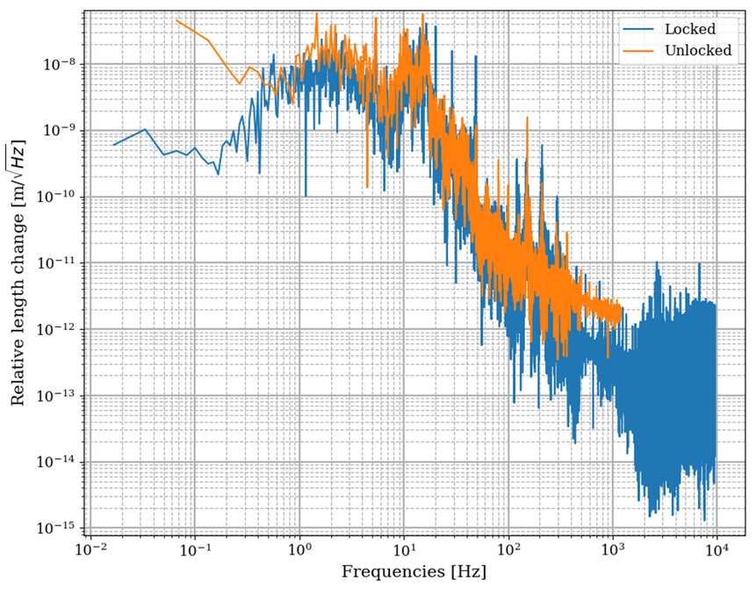
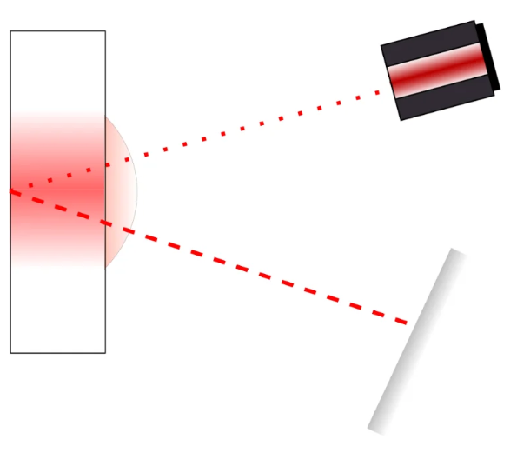
And what’s to come

