Slide 1
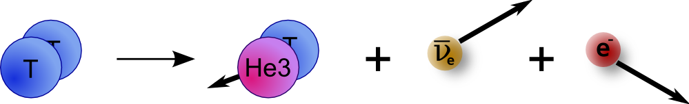
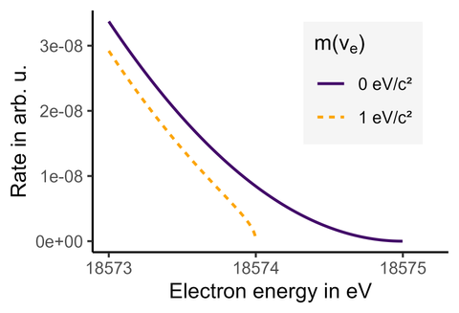
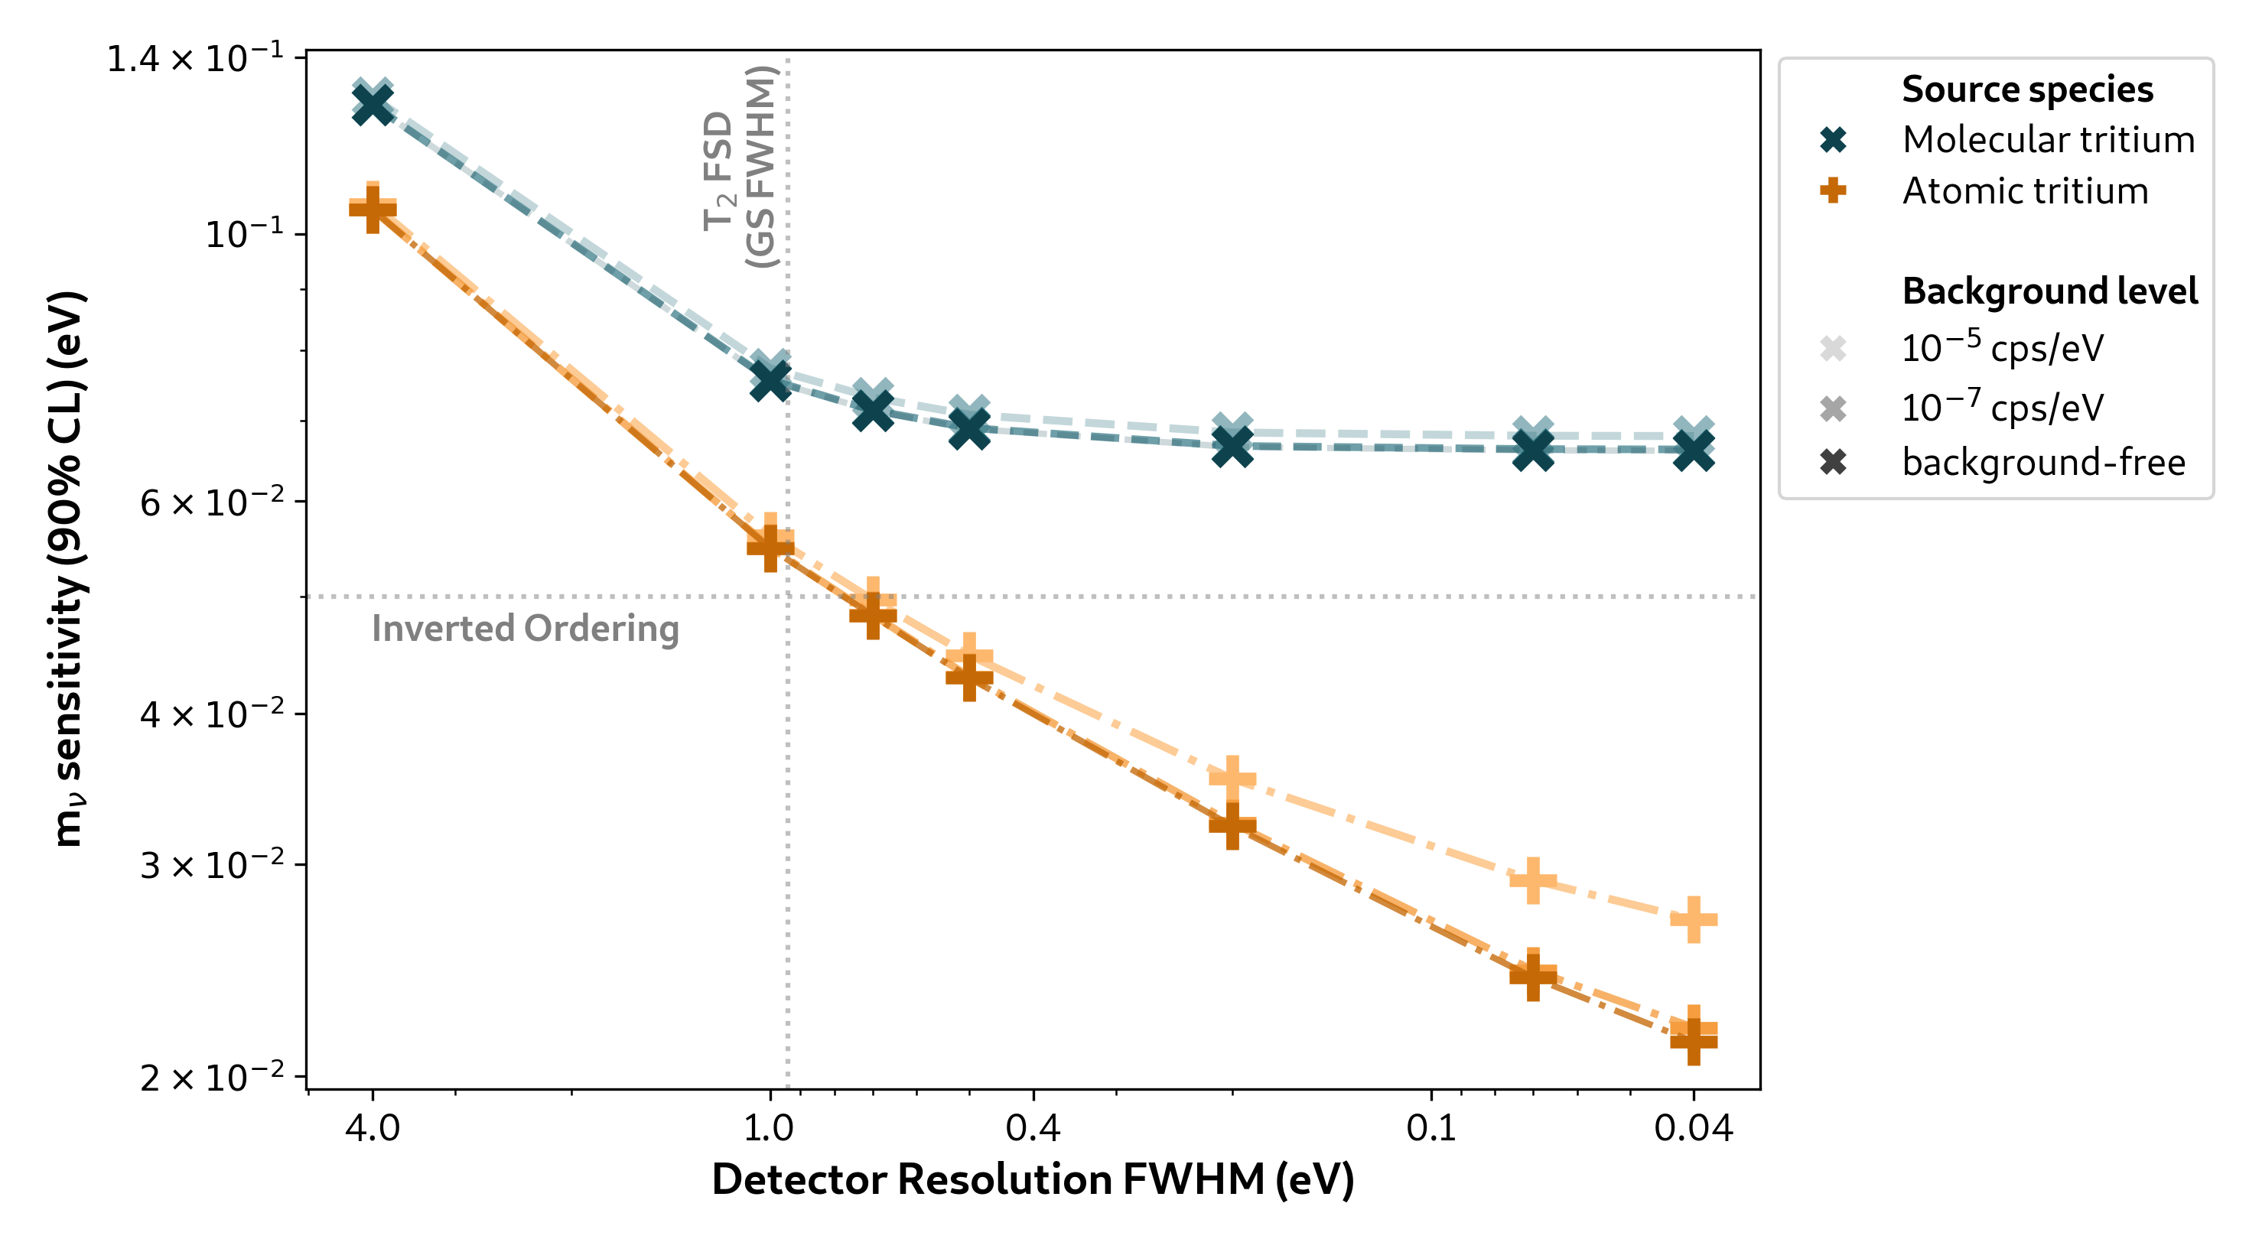
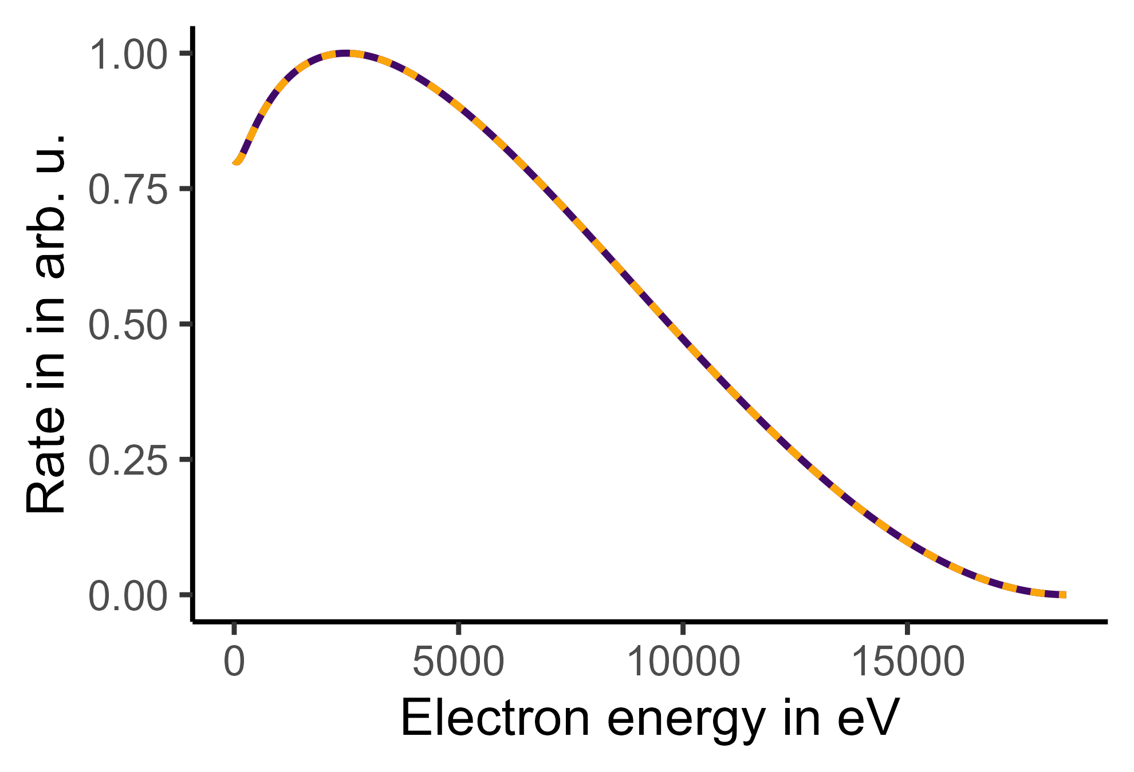
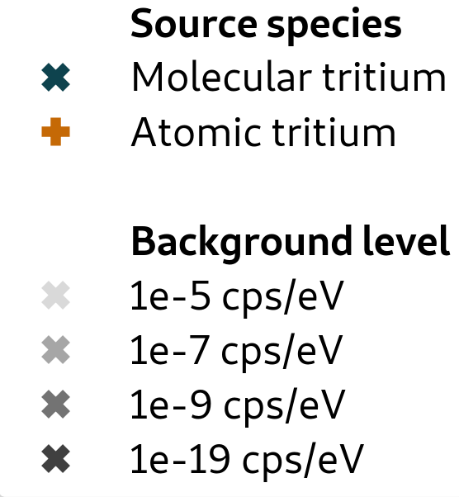

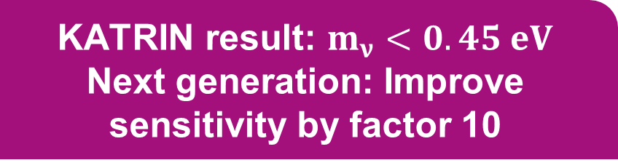
Atomic Tritium Source for KATRIN++
Katrin collaboration
Science 388, 6743, 180-185 (2025)
KATRIN result: $m_{ν}<0.45 eV$
Next generation: Improve sensitivity by factor 10
)))
(((
Atomic tritium is needed for future neutrino mass experiments
Sensitivity study: S. Heyns

Slide 2
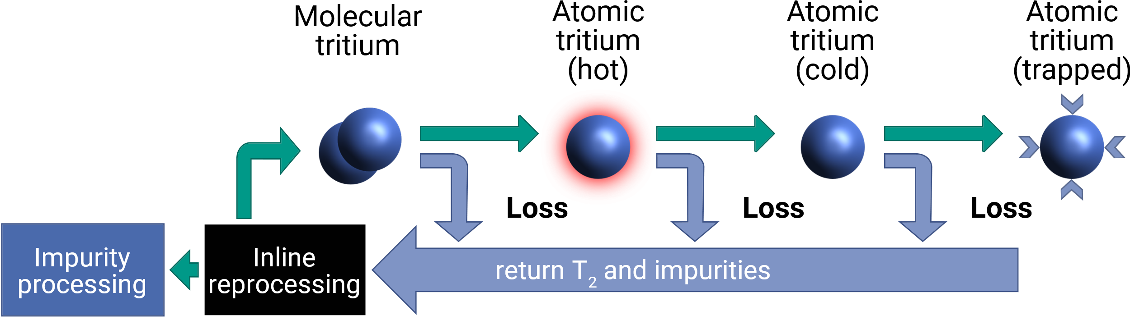
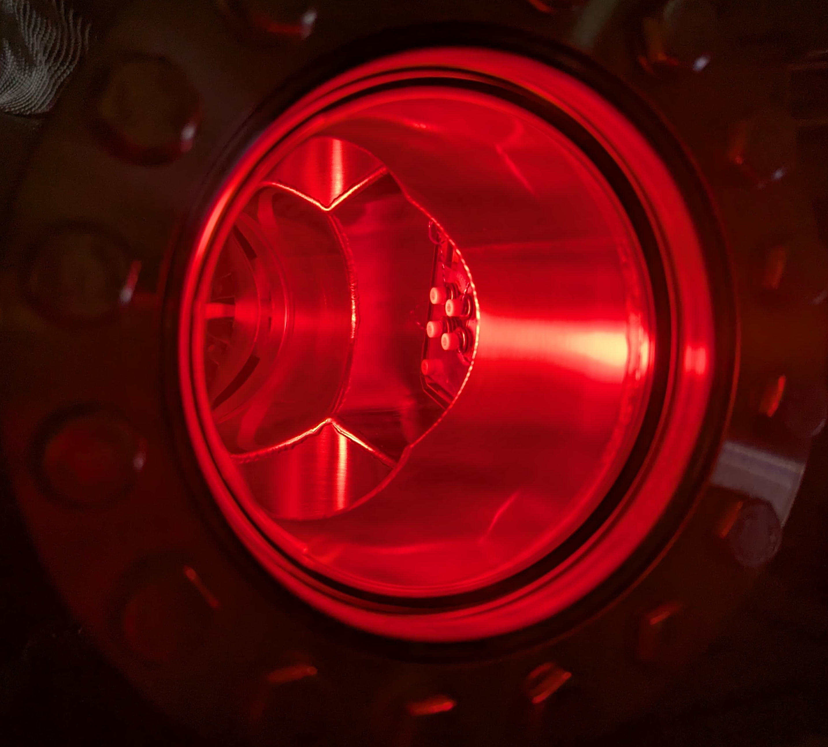
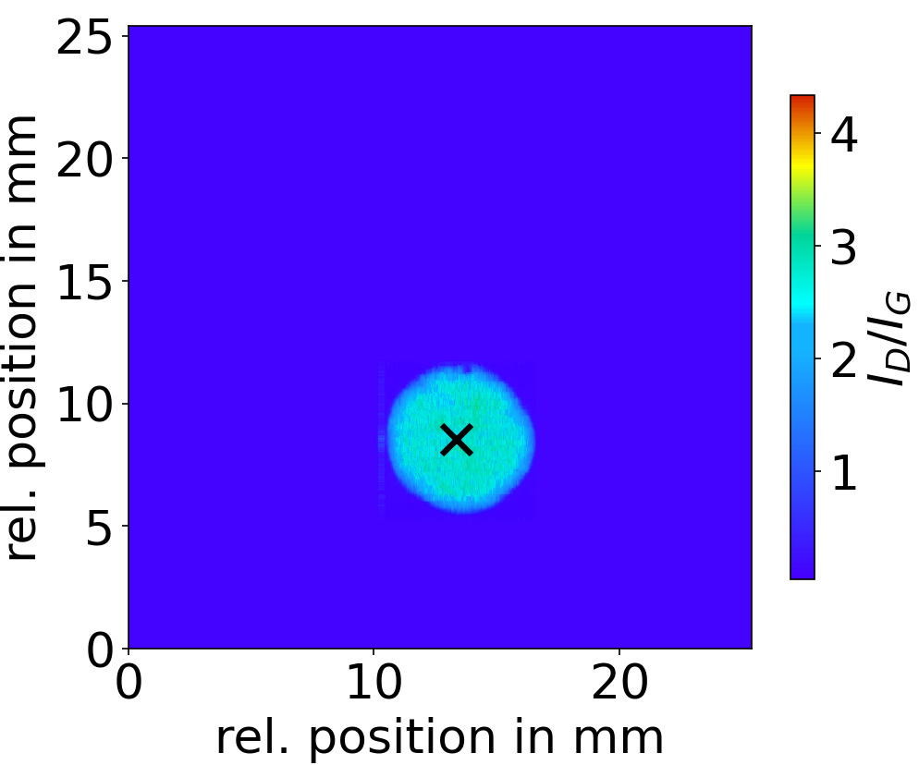
Atomic Tritium Source for KATRIN++
*Test with nonradioactive hydrogen
Produce atomic hydrogen via plasma
Detect atomic hydrogen beam profiles with graphene
Paper in preparation
Proposal: Atomic tritium source below 1K
Semakin et al. Physical Review Research, 8, 033096 (2026)

