Slide 1


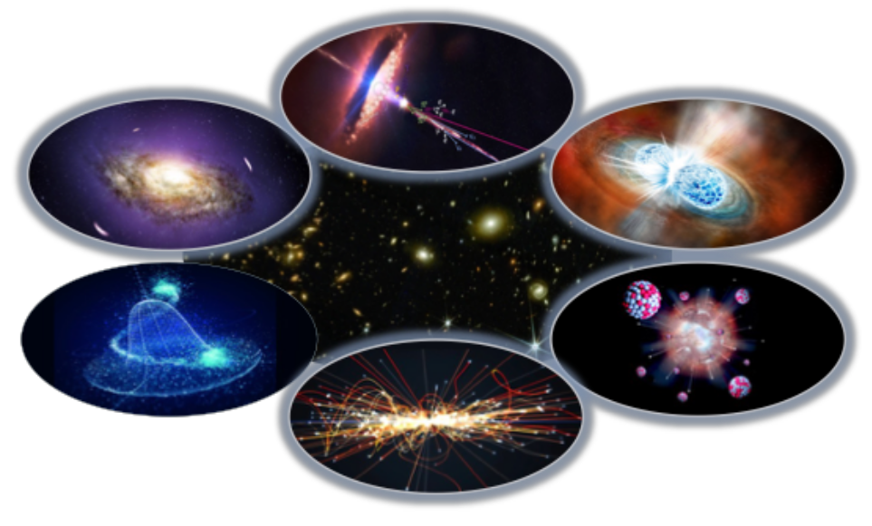
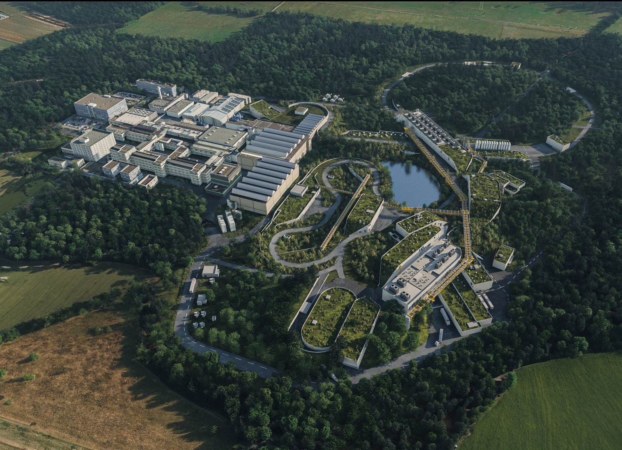
Welcome to the MU Days 2026 at GSI/FAIR on behalf of the entire CML Team
Quarks Hadrons Nuclei
Gluons
Compact stellar objects
From microscopic to macroscopic scales

Slide 2
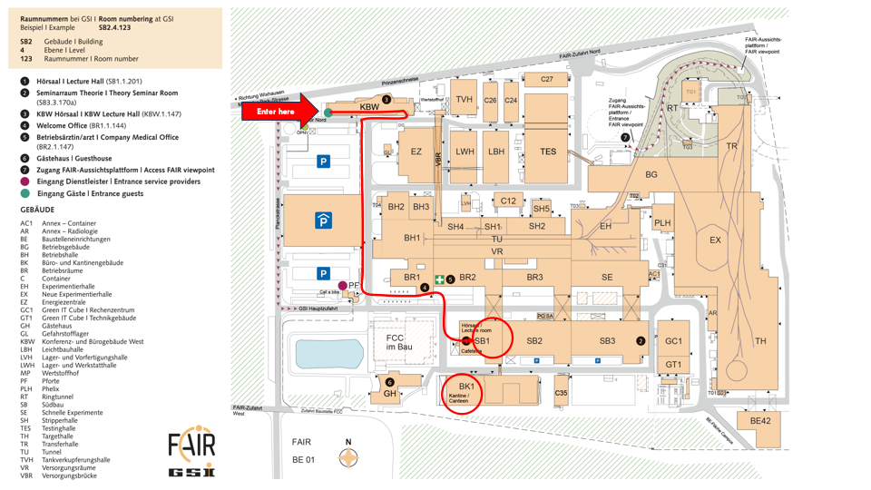
MU Days 2026 at GSI/FAIR
All session take place in
the lecture hall in SB
Put up posters in coffee break
and take them down at the end
of the session
meeting photo will be
taken after FlashTalks 1
Dinner will be served in
the canteen around 19:00
Please sign up if you need
a taxi after the dinner

Slide 3
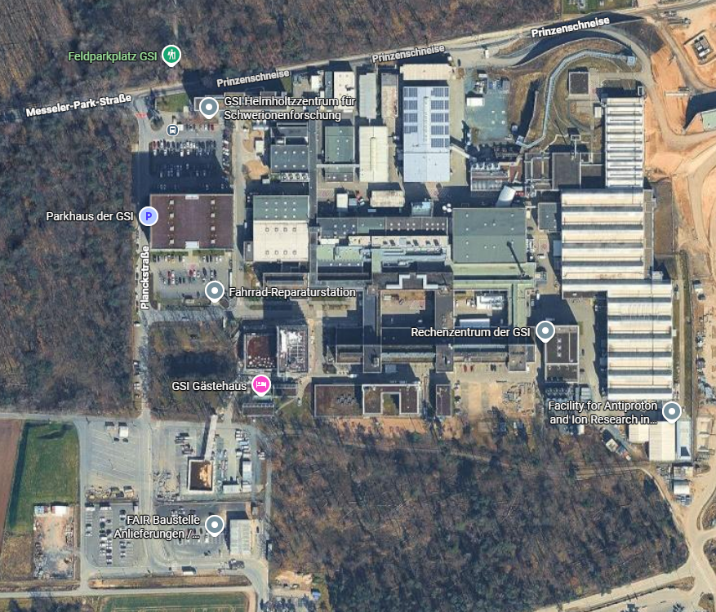
MU Days 2026 at GSI/FAIR
FAIR Tour 20 Oct 2026 – Practical information
Be at FAIR Gate West
at 8:30 - 9:00
Bring photo-ID
Safety training will be done on site prior to tour
Personal protective equipment will be provided
No lockers available
Gate/Tor West

