Slide 1
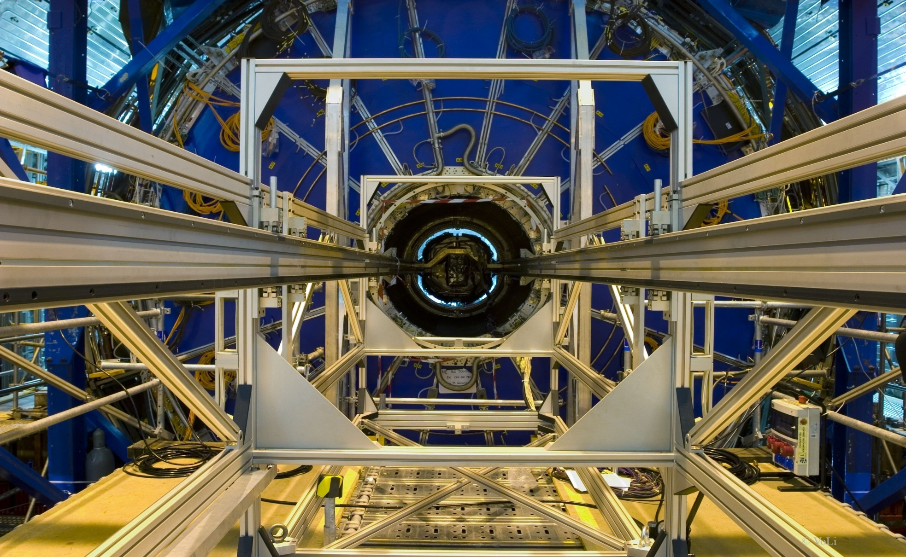
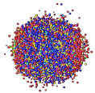
3.12.2013
Volker Lindenstruth
FIAS, IfI, LOEWE Professur Chair of HPC Architecture
University Frankfurt, Germany
Phone: +49 69 798 44101
Fax: +49 69 798 44109
Email: voli@compeng.de
WWW: www.compeng.de
GSI+FAIR Computing

Slide 2
Computing TDR
One TDR including sections for each FAIR pillar
Joint development
Develop common computing model
Develop common distributed computing model
Data management
Wo does what? Form working group
We need peer referees to follow the process
We need editor

Slide 3
Computing TDR ToC
Introduction
Experiment requirements
APPA
CBM
NUSTAR
PANDA
Over all architecture
Technology and Infrastructure
Common Appplication, Common Infrastructure
Prototypes, Evaluations
Resource requirements
Project organization, management

Slide 4
Experiment Requirement Subsection
Logical Dataflow, processing model
Event reconstruction
Event Simulation
Analysis requirements, plans
Resource requirements (on-line, off-line)
Start-up, staging

Slide 5
