Slide 1
LINAC4 RFQ
commissioning and measurements

Slide 2
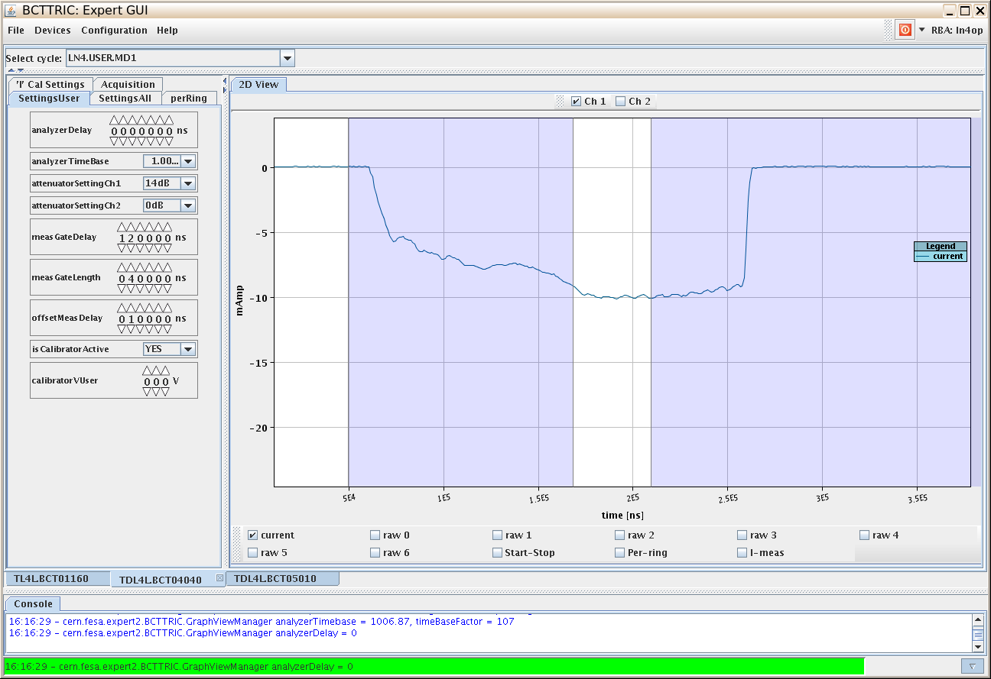
The time allocated for this talk is longer than the time it took to commission the RFQ …….
Talk outline
RFQ beam commissioning
Layout -1 min
Source measurements-2 min
Beam thru the RFQ-3min
Measurements -4 min
Conclusions and discussion -5 min
Set solenoids to nominal value- 1min
Open beam stopper and vacuum valve-30 sec
Empirically optimise steerers - 2 min
See beam at 3 MeV :

Slide 3
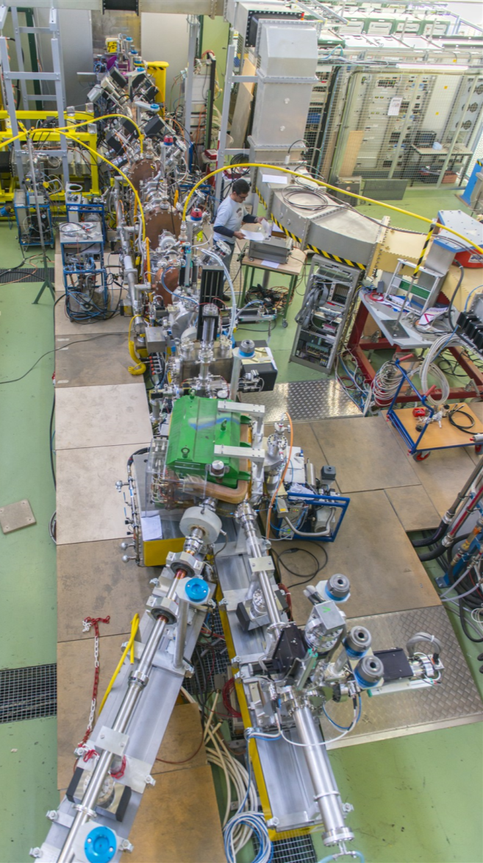
45 kev to 3 Mev
source : 45 keV
LEBT | 2 solenoids, 2 steerers | Beam current Beam profile Slit and grid emitt (temporary)
RFQ : 3 MeV
MEBT | 11 quads 3 bunchers 2 choppers | Beam current at 2 locations Wire scanners
ion source
RFQ
chopper line
Diagnostics line
spectrometer
beam dump

Slide 4
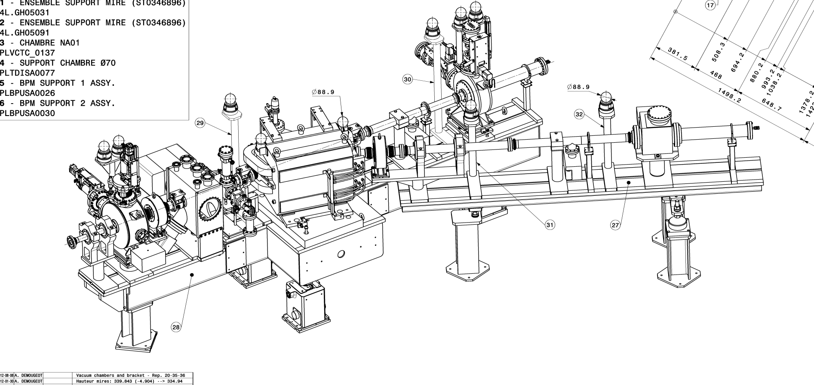
Movable Diagnostic bench
Low energy bench (up to 12 MeV)
Spectrometer (0.2 %) Slit and Grid Emittance ToF (calibration) Bunch Shape Monitor Halo Monitor (chopping eff.)

Slide 5
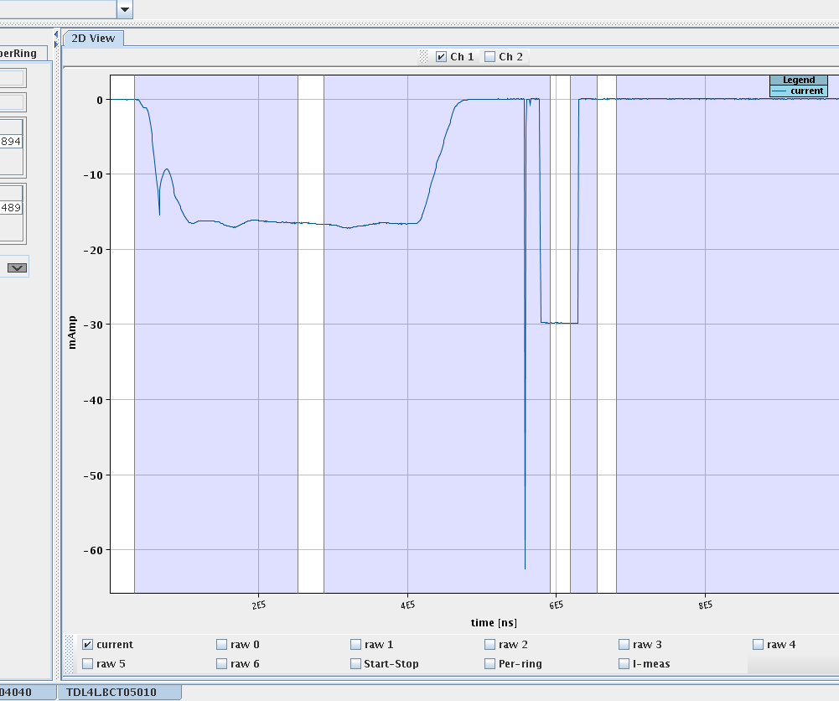
Beam at the source-45kev
Measured emittance, includes H0.
Measured current : 16mA for 200µsec.
Comparison of measured emittance (yellow) and RFQ acceptance (pink). The expected transmission (PARMTEQ + TOUTATIS) is 75%.

Slide 6
First beam thru the RFQ
Wednesday 13/03/13 at 16h10
10mA H- accelerated to 3 MeV

Slide 7
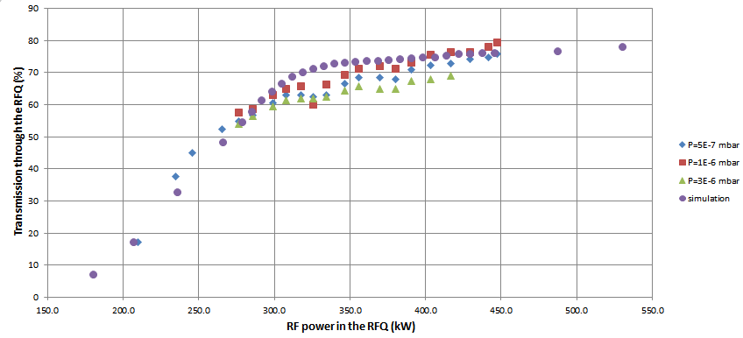
Transmission vs. RF power for different pressure in the LEBT (neutralisation)

Slide 8
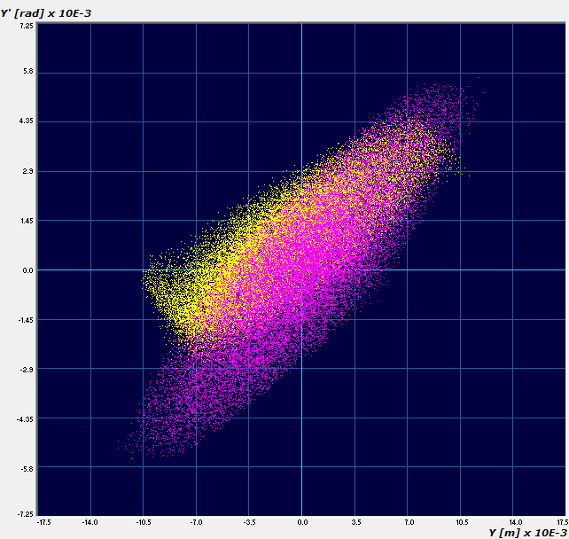
Transverse emittance-direct
Yellow = measured, pink = simulations

Slide 9
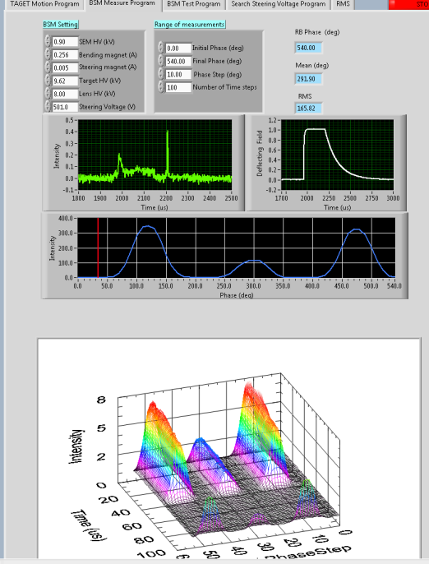
Long emittance -indirect
RFQ
BSM
BU.1 fixed
BU.2 varying
BU.3 OFF
Reconstruction
Measurement

Slide 10
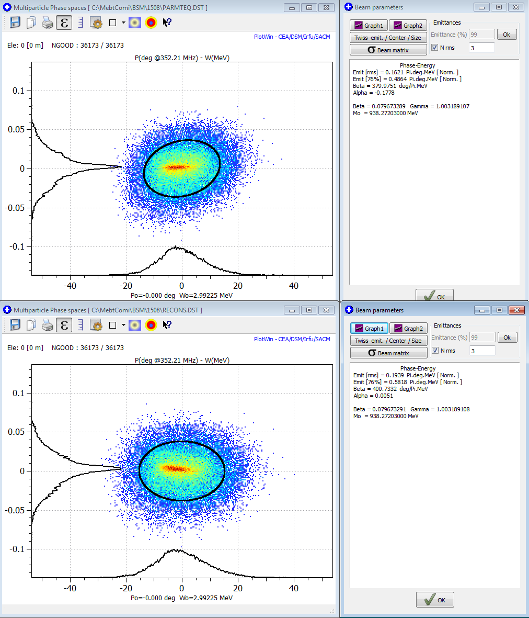
Long emittance -indirect
Expected : 21 keV
Reconstructed : 22 keV
Reconstruction technique and diagnostic performance were validated !

Slide 11
JUST LUCKY OR…?
The beam commissioning was very swift because of a strong collaboration between mechanics, RF and beam dynamics during the manufacturing phase AND a thorough work of simulations and measurements on the LEBT
We have developed a tool to generate a particle beam distribution FROM MEASURED data. We find that the simulations with a computer generated beam with the same rms emittance doesn’t represent the measurements as well.
Indirect measurements (transverse emittance via wire scanner; longitudinal via Bunch Shape Monitor) are sufficiently accurate, provided we use as input the measured beam at 45keV. SOMEWHERE A SLIT AND GRID EMITTANCE MEASUREMENT IS NEEDED!

