Slide 1
Proposal for a 325 MHz RFQ for the FAIR p-Linac and
Operation Experience with 4-Rod RFQs
FAIR p-Linac RFQ
Review Meeting
20.-21. November 2013
LINAC AG
B. Koubek, H. Podlech, A. Schempp

Slide 2
Outline
FAIR p-Linac
4-Rod RFQ
RFQ design
Operation issues

Slide 3
FAIR p-Linac
E=70 MeV
I=35 (70) mA
f=325.224 MHz
High current
Short pulses
Low duty factor

Slide 4
RFQ Requirements
Parameter |  | Parameter
f | 325.224 MHz | Voltage | 71 kV
Particles | Protons | E_{p} | <36 MV/m
Beam current | Up to 70 mA | RF power | ≈1 MW
E_{in} | 95/60 keV | Length | ≈3.3 m
E_{out} | 3 MeV | R_{p,min} | 15 kΩm
ε_{out,N,95%,trans} | <1.6 mm mrad | Coolant | H₂O, 11 bar
ε_{out,N,95%,long} | <2 MeV deg | Mass flow | 10 l/min
Pulse length | 200 μs | Dynamic tuner | tbd
Repetition rate | 4 Hz | RFQ structure | tbd

Slide 5
RFQ Structures
Ladder RFQ
4-Rod RFQ
4-Vane-RFQ
4-Vane with coupling windows
CH-RFQ
Spiral-RFQ
Split-Koaxial-RFQ
IH-RFQ

Slide 6
Design Issues for RFQ RF-Structure
Reliability
Availability
Tuning
Access
Efficiency
Capital costs
Technological risk

Slide 7
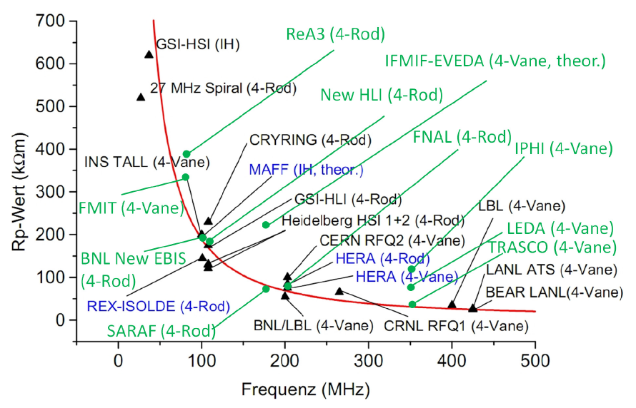
Shunt Impedance of RFQ-Structures
FAIR
Notes:
Struckturen durchgehen
Warum normalleitend / supraleitend
CH-Design
Solenoid-Design
Ein Kryomodul

Slide 8
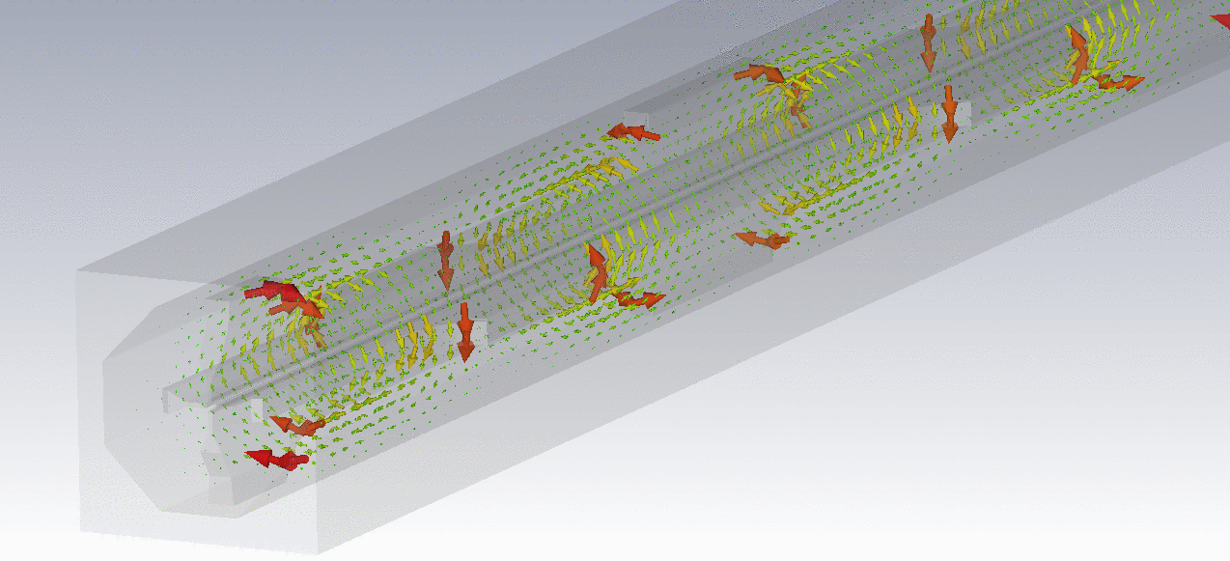
4 Vane RFQ with Coupling Windows
Adding windows in vanes
→ Decoupling of modes

Slide 9
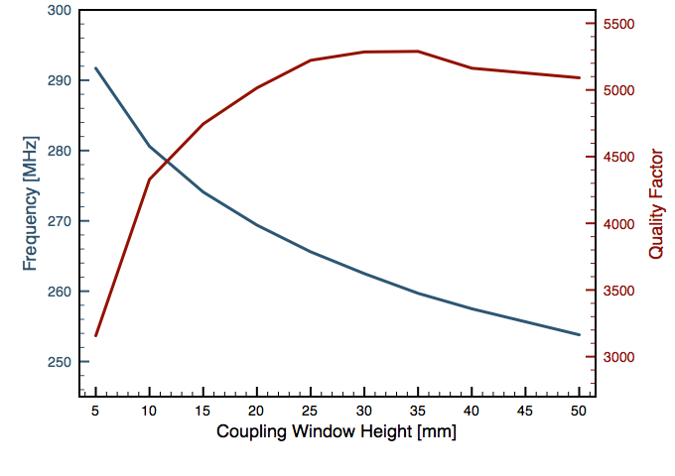
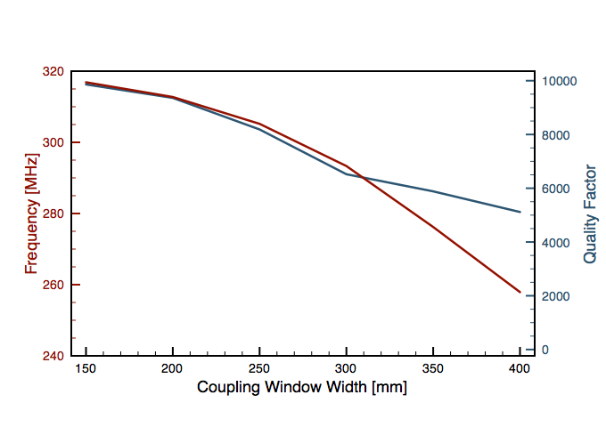
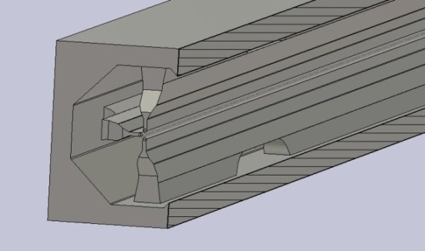
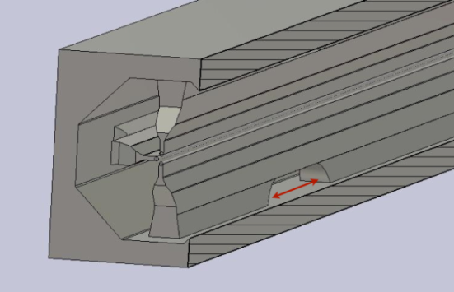
4 Vane RFQ with Coupling Windows: Tuning
𝝙f 25 kHz/mm
𝝙f 240 kHz/mm

Slide 10
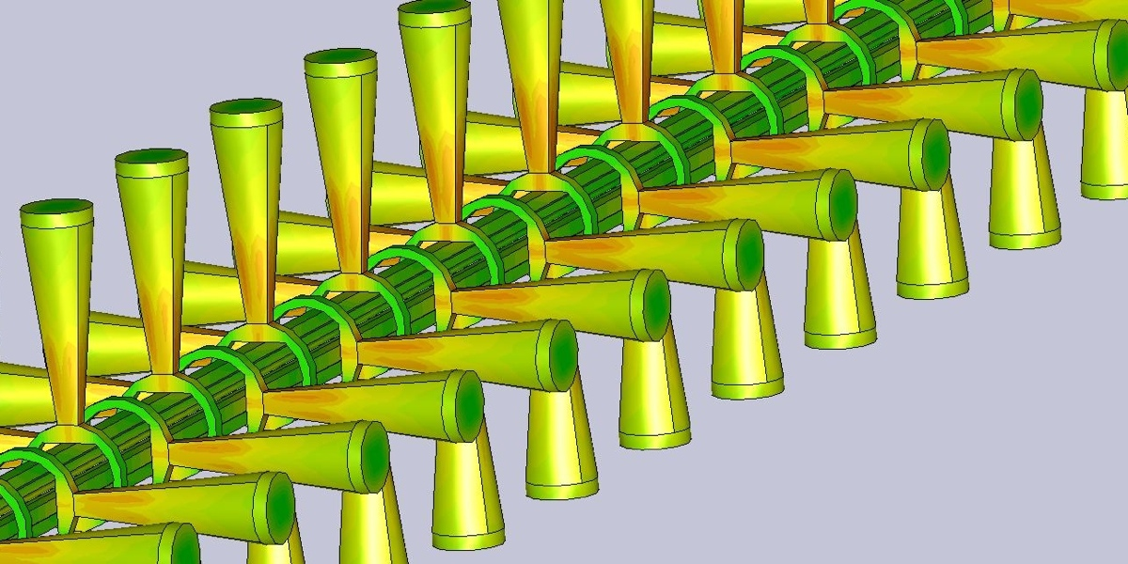
CH-RFQ
CH-RFQ is a „4-Vane“-structure with very large „coupling windows“

Slide 11
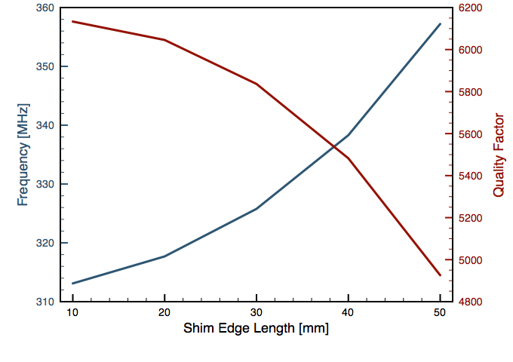
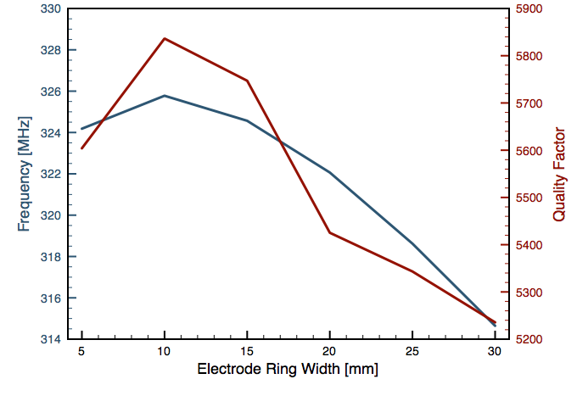
CH-RFQ Tuning
𝝙f 1,1 MHz/mm
𝝙f 380 kHz/mm

Slide 12
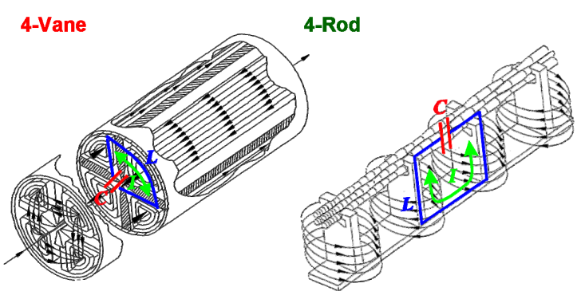
4-Rod RFQ
Well kown RFQ structure for heavy ions
Realized frequencies < 250 MHz
Dipole component increases with f
Excellent tuning and access possibilities
Field and frequency (almost) independent from tank dimensions

Slide 13
4-Rod RFQ
System of strongly coupled RF cells
By changing the tuning plate hight the frequency and voltage distribution can be changed over a wide range

Slide 14
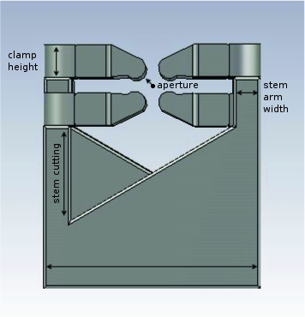
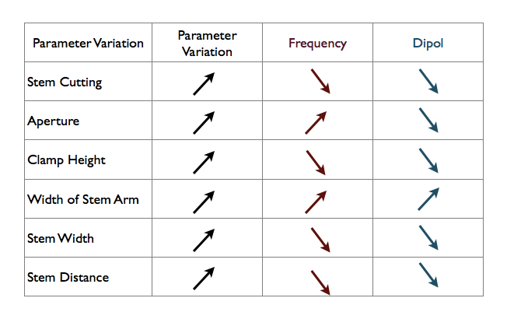
Optimization of 4-Rod RFQ

Slide 15
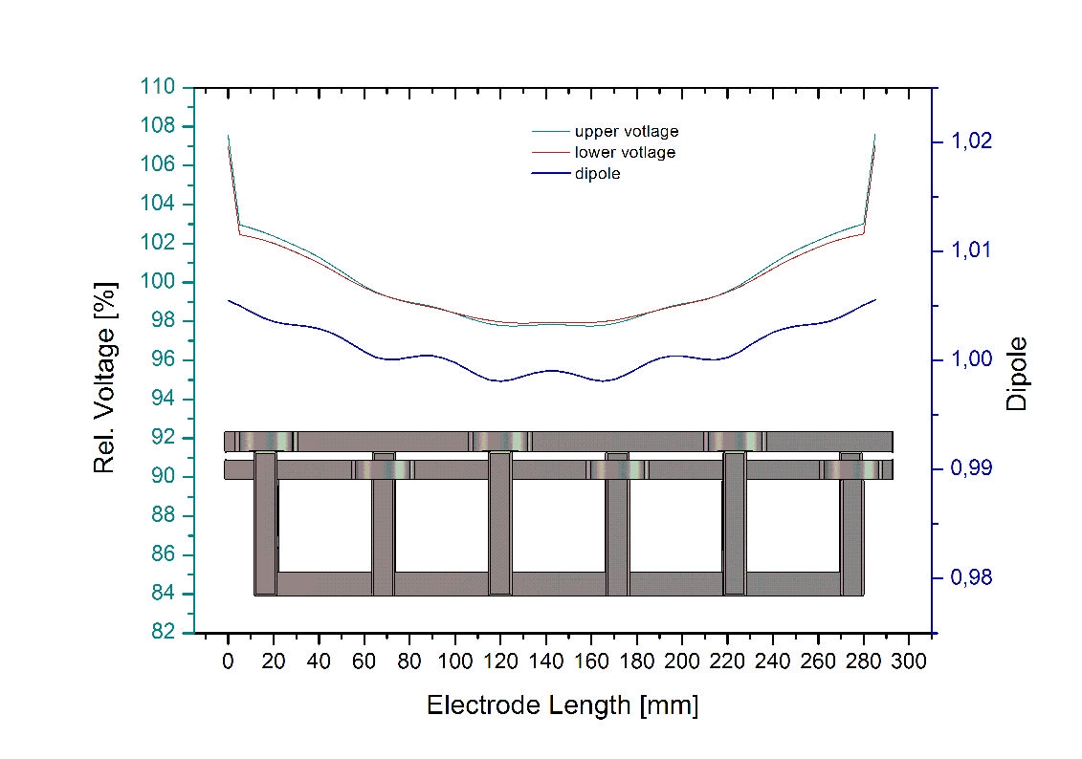
Dipole Component

Slide 16
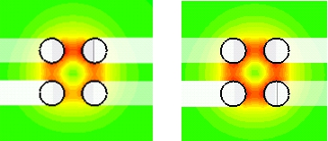
Optimization of 4-Rod RFQ
Dipole Minimization
before
after

Slide 17
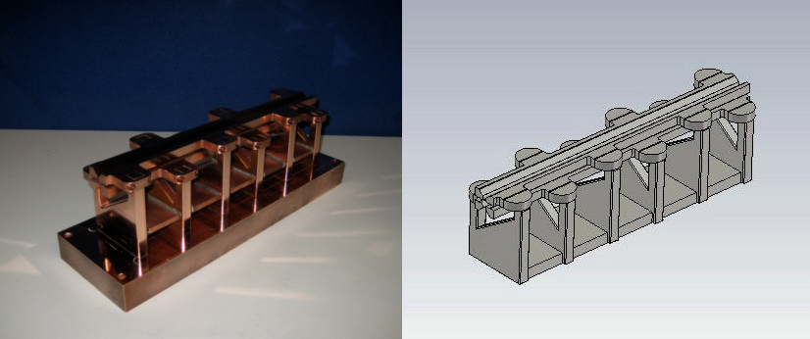
4-Rod RFQ
Short protoype has been designed and built (extremely low cost)

Slide 18
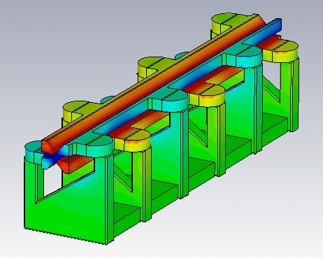
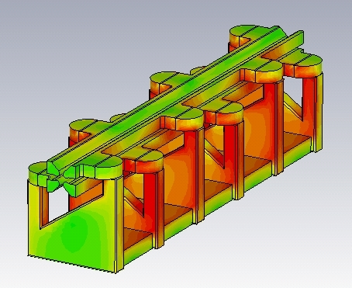
4-Rod RFQ
Electric and magnetic surface fields

Slide 19
4-Rod RFQ Prototype Parameter
Parameter
Beam Line Position [mm] |  | 65
Stem Width [mm] |  | 63
Stem Distance [mm] |  | 50
Mean Aperture [mm] |  | 2,9
Electrode Tip Radius [mm] |  | 2,5
Clamp Height [mm] |  | 8
Width of Stemarm [mm] |  | 10
Frequency Range [MHz] | 283,8 - | 335,3
Quality Factor |  | 2600
Shuntimpedance [kΩm] |  | 15
Dipole max |  | 1,03

Slide 20
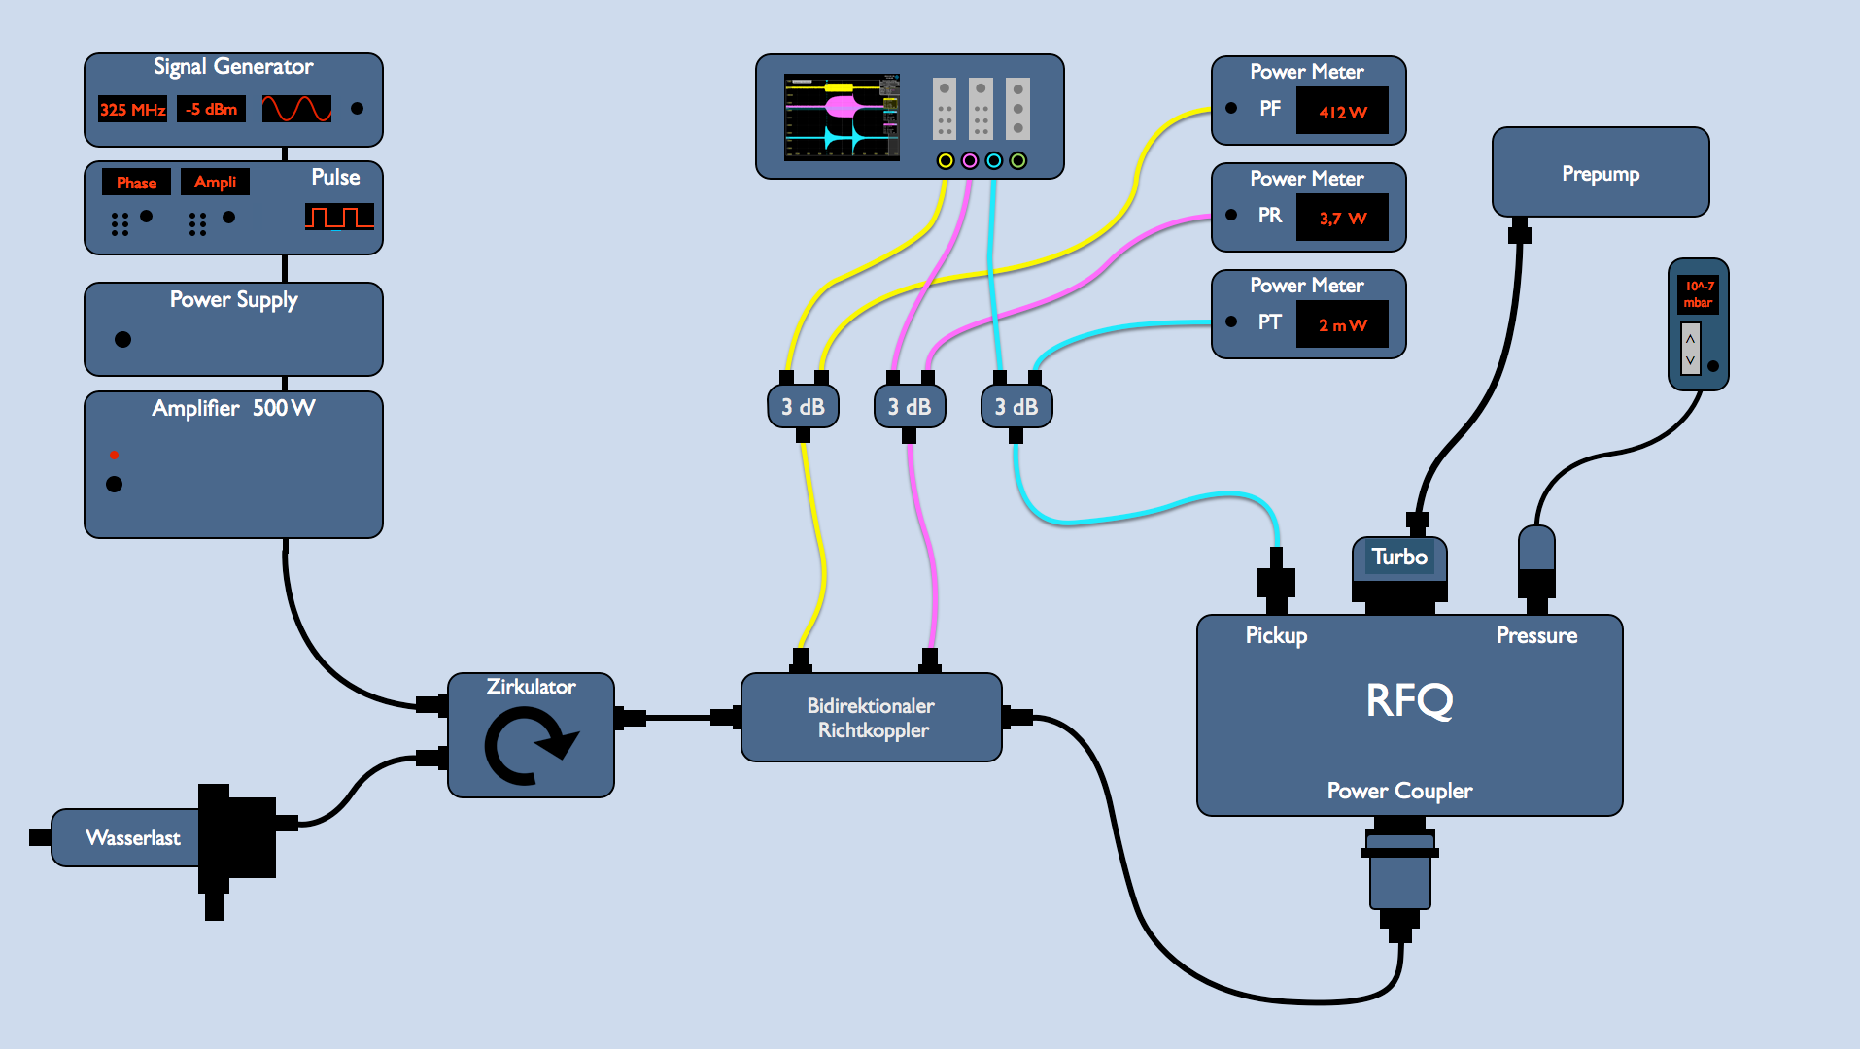
First Tests of Prototype
40 kW

Slide 21
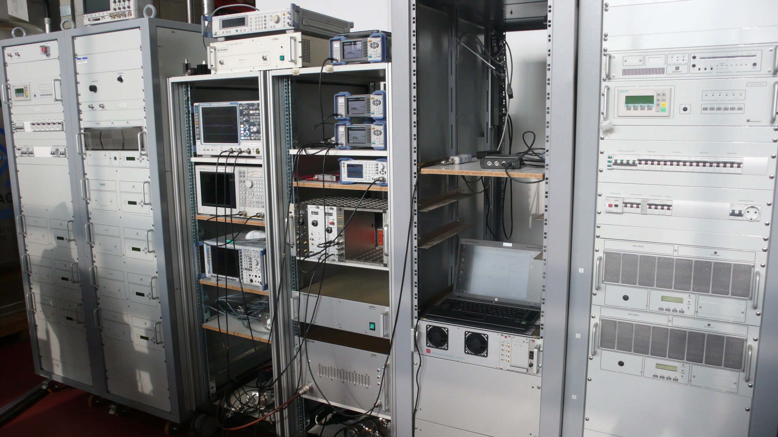
First Tests of Prototype

Slide 22
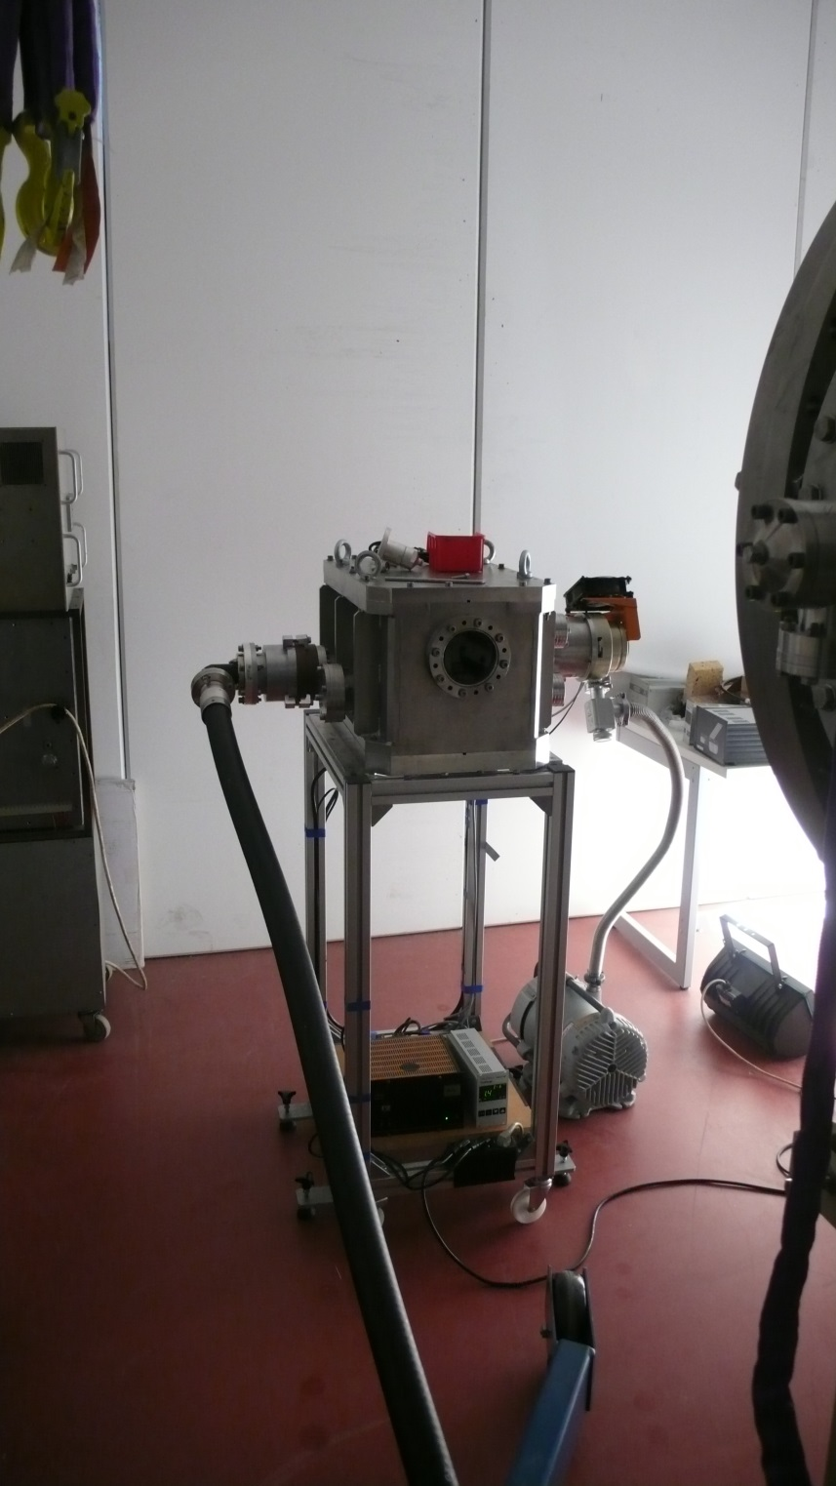
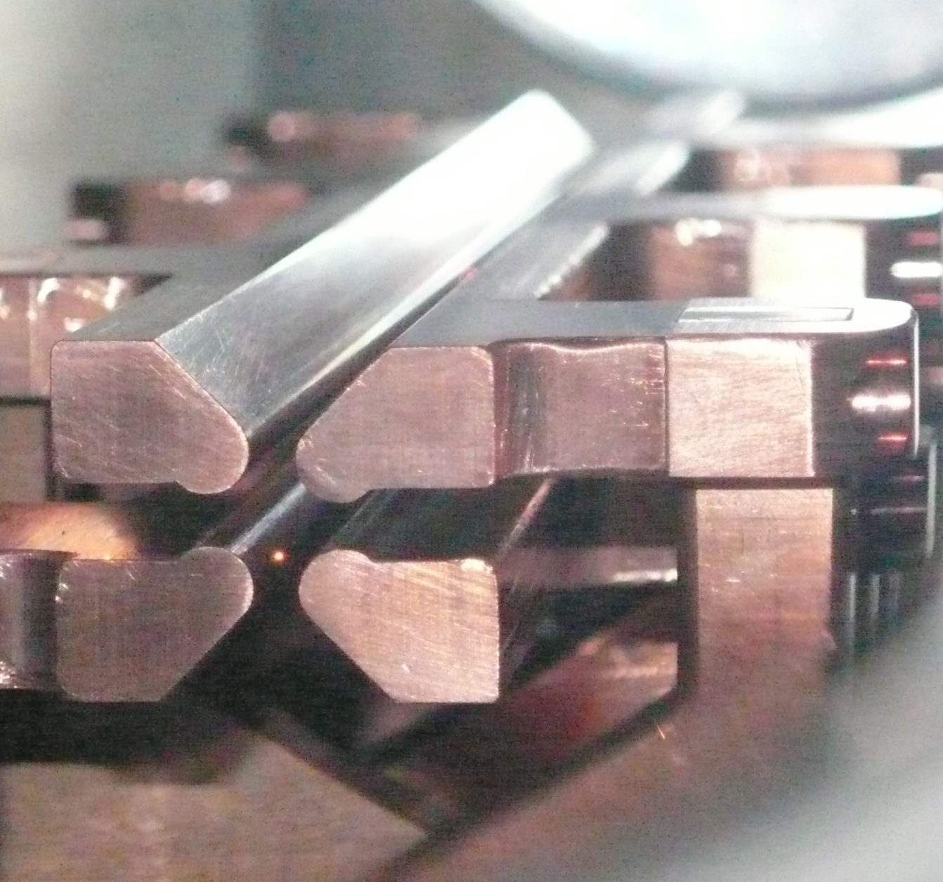
First Tests of Prototype
Up to 500 W cw

Slide 23
What is the most suitable RF Structure?
Thermal problems are not expected for all structures
Dipole component is no problem for all structures
With respect to RF performance all structures are possible
Main issues are:
Tuning and RF coupling
Access to cavity
Alignment tolerances
Capital costs
Repair and maintainance

Slide 24
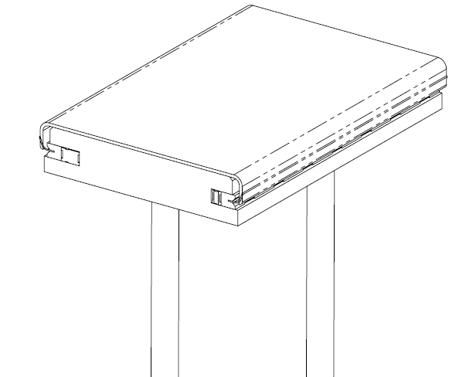
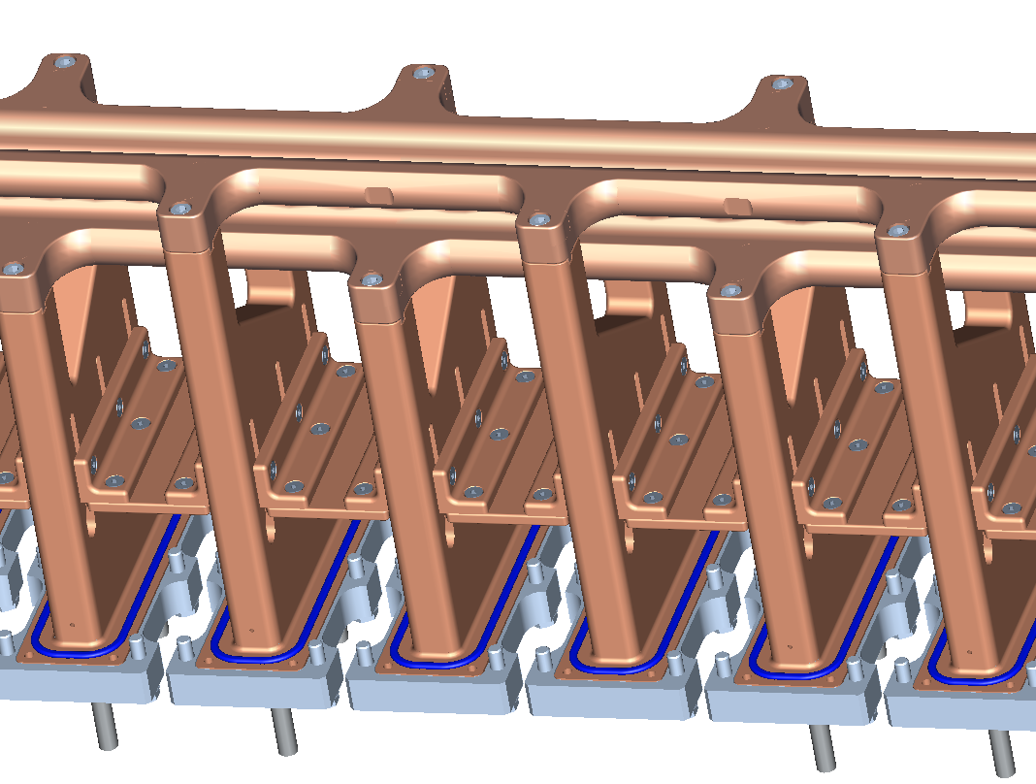
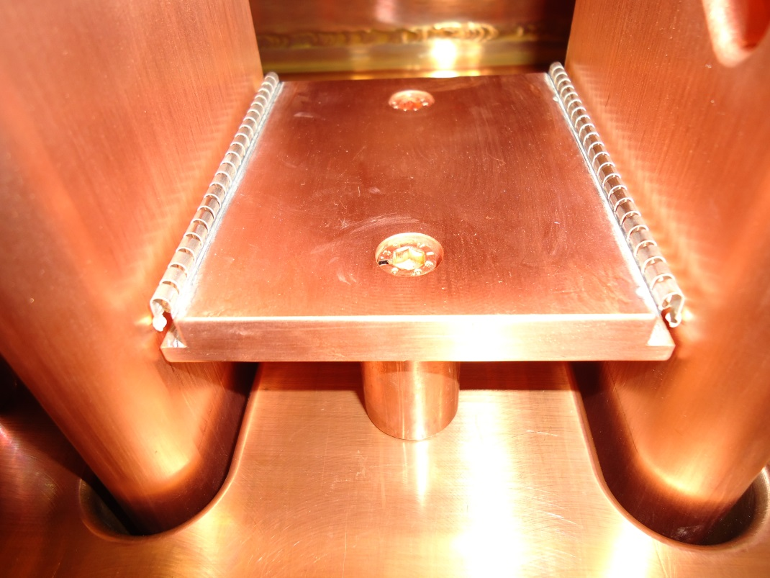
RF Contact of Tuning Plates
To be decided

Slide 25
Fabrication
It is planned to fabricate the ground plate and stems from massive copper blocks (3-6 single parts)
Better contact, no additional alignment error of stems
Already intense interaction with industry

Slide 26
Injection into an RFQ
There is a persistent rumor that 4-Rod RFQs have a lower transmission than other structures
There are some 4-Rod RFQ with (initial) poor tranmission
But in most cases the reason was inadequate injection
Much larger emittance delivered by Source
Not well designed LEBT
Examples: HIT RFQ, SARAF, …
RFQs are very sensitive to input parameters

Slide 27
Recent 4-Rod RFQs
Excel-File

Slide 28
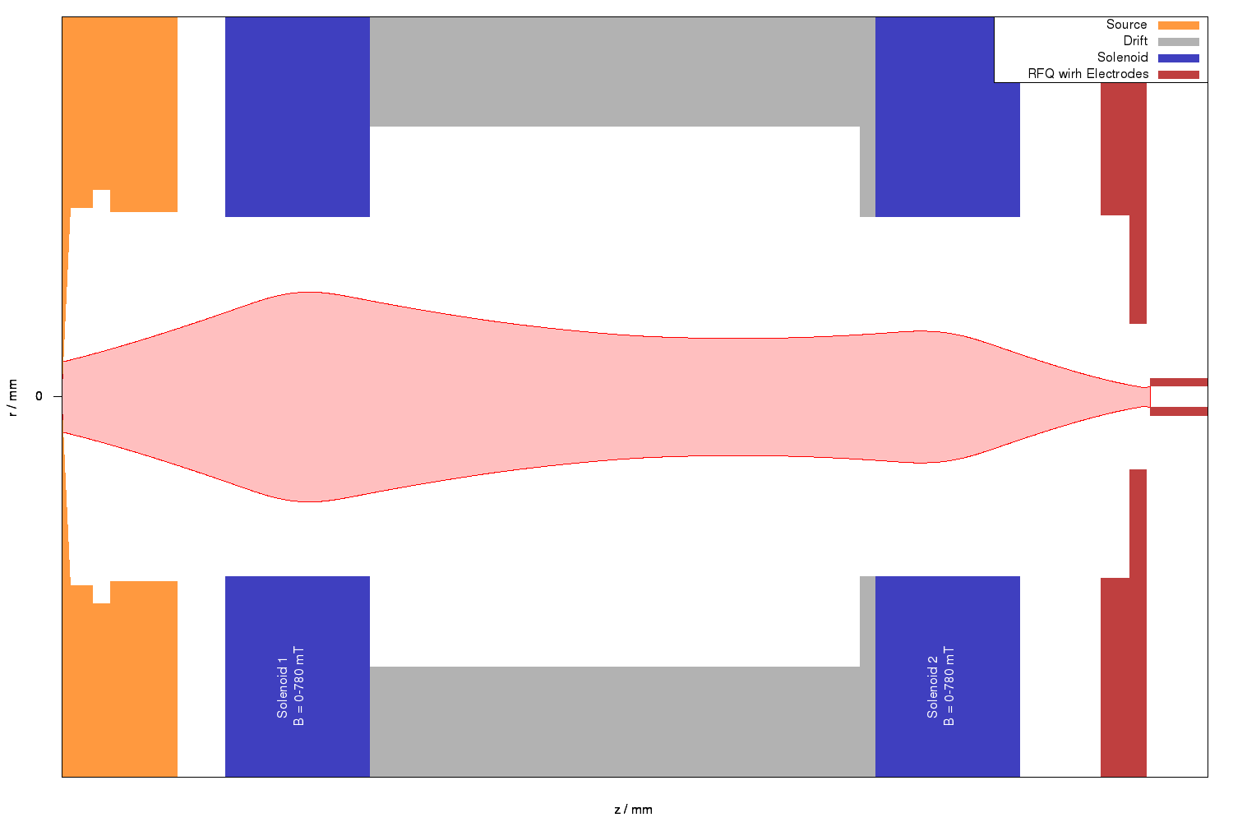
Injection into an RFQ

Slide 29
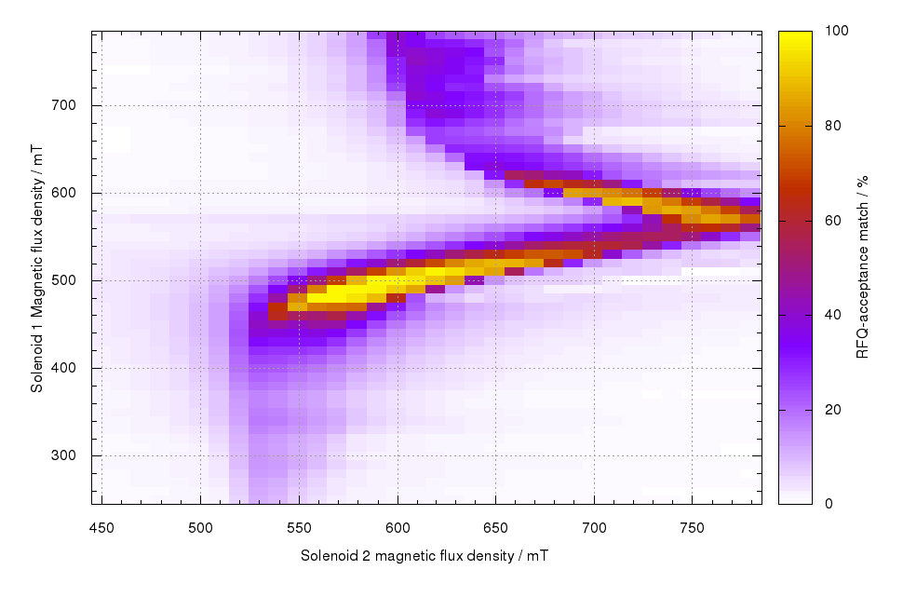
Acceptance Dependency

Slide 30
4-Rod RFQ
Impedance/ RF power o
Technological risk +
Tuning ++
Cavity Access ++
Maintainance ++
Tolerances +
Capital costs ++

Slide 31
Summary
Despite of the high frequency the 4-Rod RFQ is a suitable RF structure
for the FAIR p-Linac (as the other srtuctures)

