Slide 1
Beam Diagnostics for the FAIR Proton LINAC
RFQ Workshop at GSI
P. Forck for LOBI Department
November 20th, 2013
Outline
Diagnostics devices foreseen at pLINAC
Comments to special devices
Preliminary layout of test bench for commissioning
Interesting question for us
What are the lessons learned at LINAC4 RFQ commissioning?

Slide 2
Beam Diagnostics for FAIR p-LINAC
Beam parameter | Device | # | Non-dest. | Remark
Current | Transformer | 9 | Yes | Dynamic transmission control
 | Faraday Cups | 3 | No | Only used as beam dump
Profile | SEM-Grid | 4 | No | Standard
Transversal emittance & halo scraping | Slit-Grid | 3 | No | Standard
Position & mean energy | BPM | 14 | Yes | Position, relative current & time-of-flight or phase
Bunch shape | Non intersecting BSM or ‘Feschenko type’ | 1 | Yes or no | Novel, under development or know technology by INR
LEBT: charge states | Wien Filter | 1 | No | From CEA/Saclay
LEBT: emittance | Allison Scanner | 1 | No | From CEA/Saclay

Slide 3
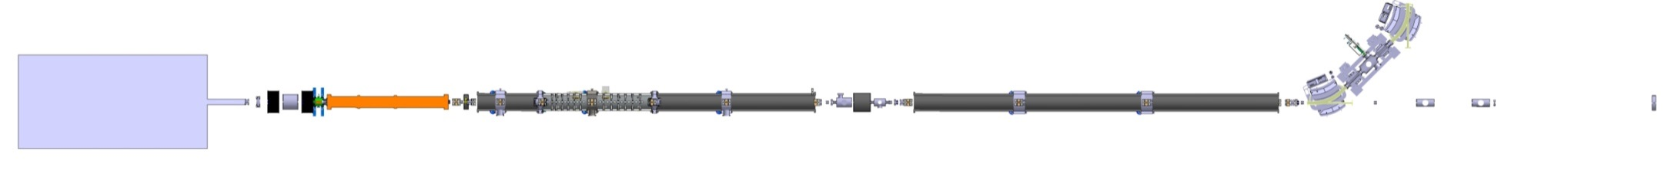
Diagnostics Elements (except BPM)
For the p-LINAC diagnostics:
3 Faraday-Cups: basically used as beam dumps → not critical
9 ACCTs: Detector either GSI design of commercial type i.e. improved Bergoz type
DAQ: VME ADC hardware, FESA software, Java GUI,
first version for CEA/Saclay ion source commissioning
4 SEM-Grids: GSI standard, DAQ via I-to-f converter CEA/Saclay ion source comm.
Will be used for emittance measurement in connection with slits
4 Slits: For halo scraping and emittance measurement
1 Bunch Shape Monitor: see below
BPMs (not shown): see below
to SIS18
Slit
ACCT
Faraday Cup
I
S
Slit & SEM-Grid
Bunch Shape M.
ion source
LEBT
beam dump & test bench
RFQ
3 x CCH
3 x CH

Slide 4
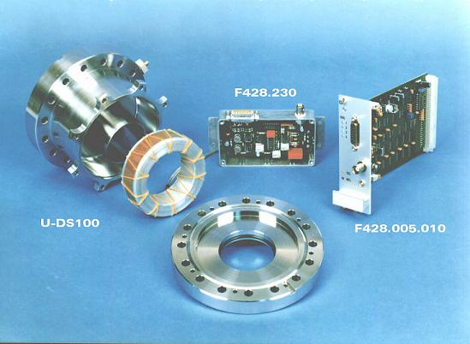
Current Measurements with ac-Transformers
GSI designed ACCT:
Transformers are widely used at GSI, improved version with 2-fold bandwidth required,
possible collaboration with company Bergoz
Beam loss control via pulse-by-pulse transmission meas. control of subsequent pulse
DAQ: VME based commercial ADCs, software FESA (as GSI standard)
Standard ACCT at GSI
Core radius | r_{i} =30 mm, r_{o}=45mm
Core thickness | 25 mm
Core material | (CoFe)70%(MoSiB)30% Vitrovac 6025
Number of windings | 2x10
Resolution | 0.2 μA for full BW
Bandwidth | 500 kHz
Droop | 0.5 % for 5 ms pulses
Max pulse length | 8 ms
H. Reeg (GSI) et al., Proc. EPAC’06

Slide 5
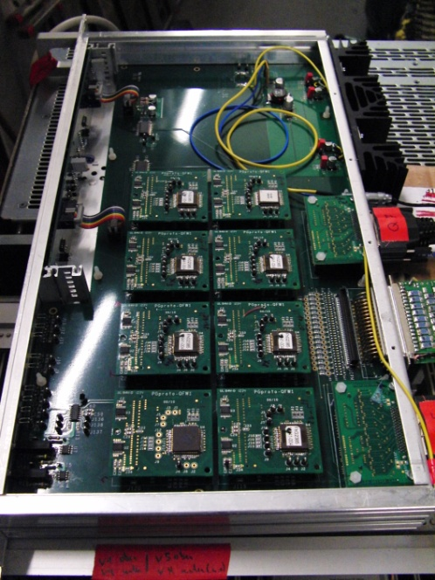
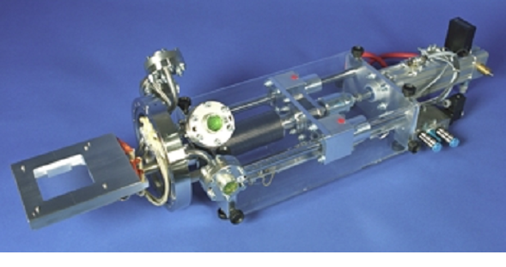
Profile Measurement by SEM-Grid
SEM-Grids:
Wire spacing 0.8 to 2 mm, #wires 15 to 63 per plane, Ø0.1 mm W-Re alloy
Different sizes at LEBT and LINAC area
Multi-channel current-to-frequency conversion as GSI development (lower costs as I-U)
First version used for ion source commissioning at CEA/Saclay
Emittance: Slit-Grid method, ⇒ mounted on stepping motor feedthrough.
I-to-f converter & digitizer ASIC
SEM-Grid feed-through on CF200:

Slide 6
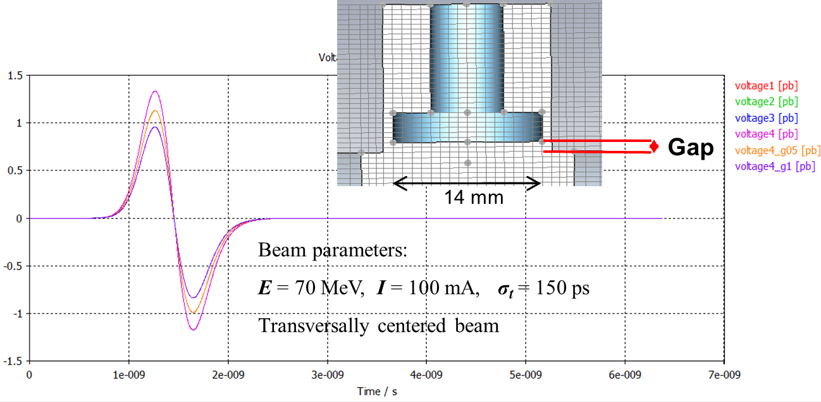
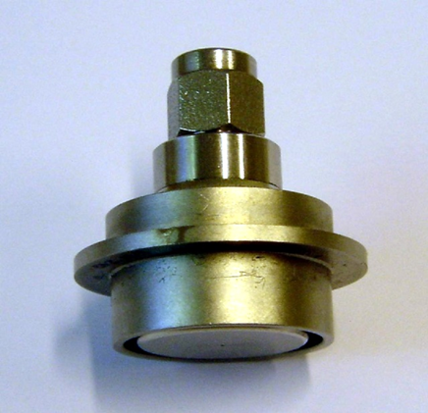
Investigations for BPMs
BPMs will be the main operation tool
for position, time-of-flight & rel. current:
Button type due to simpler mechanics
Detailed CST calculation performed
1
0
-1
voltage [V]
0 1 2 3 4 5 6 7
time [ns]

Slide 7
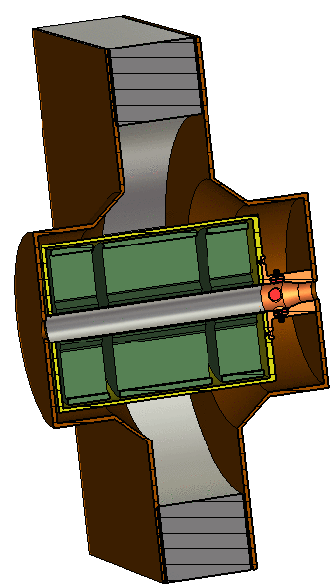
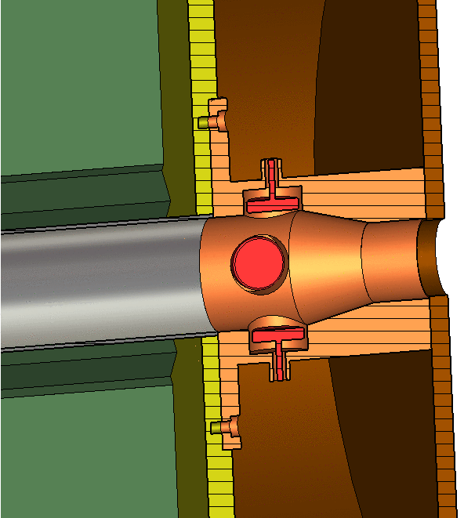
Investigations for BPMs
100 mm
BPMs will be the main operation tool
for position, time-of-flight & rel. current:
Button type due to simpler mechanics
Detailed CST calculation performed
4 BPMs in ‘intertank’ closed to cavity
→ rf pick-up from cavity
CST calculation → acceptable level
Mechanical design started
10 BPMs in regular beam pipe → mechanically less critical
→ non critical
CCH2
Cavity
BPM button of Ø14
CCH1
Cavity
CCH2
Cavity
600 mm
quadrupole
Ø30
Ø20
28 mm
48 mm

Slide 8
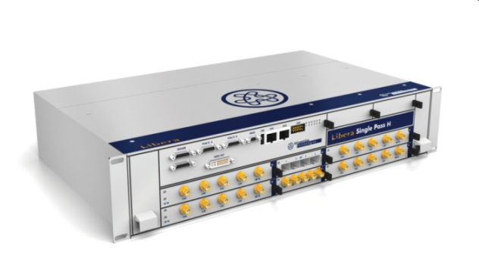
Digital BPM Electronics: Under-sampling using LIBERA
Expected Advantage:
Single electronics + digital processing → amplitude = position & phase = ToF
Input: 4 plate signals & master-oscillator via under-sampling f_{sample} = 4/11 ∙ f_{rf} = 118 MSa/s
Position and phase processor ‘Block diagram’
BPM signal
(left)
Filter
16 bit ADC
Additionally:
sum signal to
20 GSa/s scope
BPM signal
(right)
Filter
16 bit ADC
FPGA
Signal Processing
Filter
LAN
BPM signal
(top)
Filter
16 bit ADC
LAN adapter
Filter
BPM signal
(bottom)
Filter
16 bit ADC
reference input
Filter
16 bit ADC
LIBERA from I-Tech
as Slovenian
in-kind contribution
Filter
rf master
325.2 MHz
clock
PLL
118.3 MSa/s
x 4/11
Present status of LIBERA electronics:
General functionality shown, but some performance problems
Some problems and inconsistencies at UNILAC with f_{rf} = 108 MHz
Further test at UNILAC planned
⇒ Applicability of concept and hardware to be proven.

Slide 9
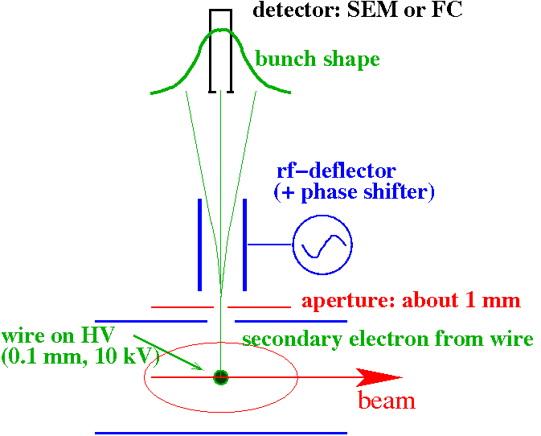
Bunch Structure using secondary Electrons: ‘Feschenko Type’
Secondary e⁻ liberated from a wire carrying the time information.
Working principle:
insertion of a 0.1 mm wire at ≈ 10 kV
emission of secondary e⁻ within less 1 ps
rf-deflector as ’time-to-space’ converter
detector with a thin slit
slow shift of the phase
resolution ≈1º < 10 ps
Status:
INR Moscow can produce such monitor
Status: Place of order nearly done
SEM: secondary electron multiplier

Slide 10
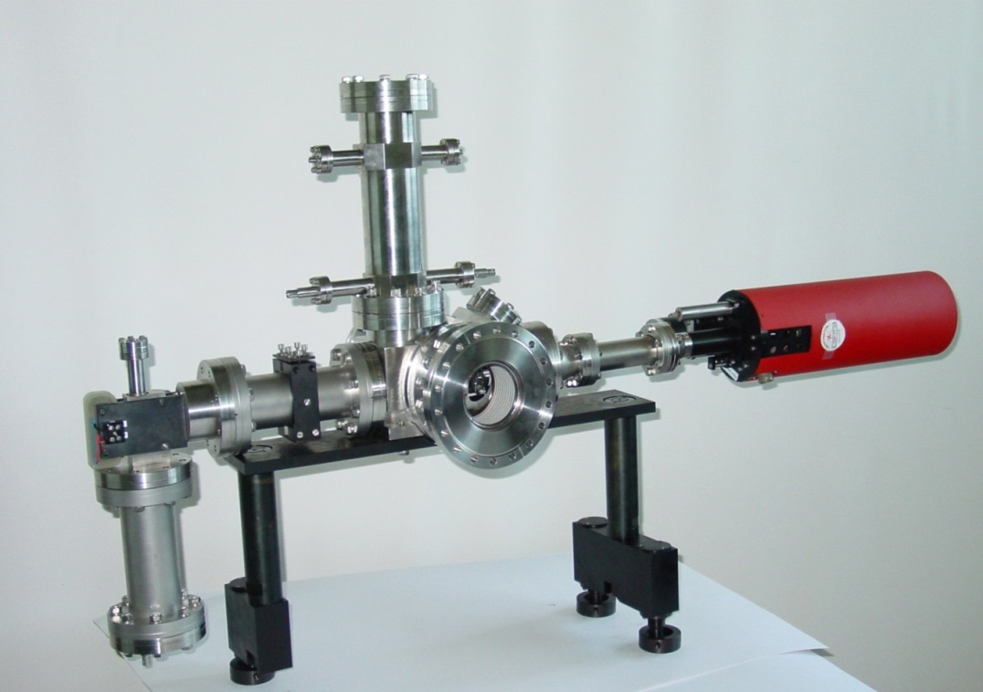
Bunch Structure using secondary Electrons: ‘Feschenko Type’
Secondary e⁻ liberated from a wire carrying the time information.
rf deflector
movable
HV wire support
electron detector
beam
Example: SNS type,
but comparable monitor for LINAC4
Alternative: Secondary electrons form residual gas
→ ongoing development at GSI for UNILAC
SEM: secondary electron multiplier

Slide 11
Test Bench for stepwise Commissioning
Test bench for characterization of all relevant beam parameters:
contains all monitors + magnetic spectrometer for energy measurement
+ quadrupoles and steerer
ACCT
SEM-
Grid
ACCT
Dipole
BPM
BSM
BPM
Slit
BPM
Slit
Cup
Status: Details not designed yet ! (Partly, due to ‘political’ reasons.)
Slit
SEM-
Grid
Cup

Slide 12
Summary
Summary:
Standard devices: ACCT, SEM-Grid, Slit, Cup partly designed
Partly new technologies used e.g. SEM-Grid digitalization
New developments for BPM readout (digital ampl. & phase determination)
‘Feschenko monitor’ never used at GSI
Test bench not designed yet
What is the lesson to learn from commissioning of LINAC4 RFQ?
Could the RFQ be sufficient characterized?
Thank you for your attention.

