Slide 1

THE LINAC4 RFQ – Experience with Design, Fabrication and Tuning
GSI Review – 20 November 2013
C. Rossi and the RFQ Project Team

Slide 2
PRESENTATION OUTLINE
The Linac4 RFQ Project
  Organization structure
  Initial milestones and achieved
Design of the Linac4 RFQ
  Beam dynamics
  RF
  Mechanics
Fabrication
Tuning and commissioning

Slide 3

The LINAC4 RFQ Project
ORGANIZATION STRUCTURE
Beam Dynamics
RF Design & Tuning
Mechanical Design
RFQ
3

Slide 4
The LINAC4 RFQ Project
PROJECT SCHEDULE
Engineering specification of the Linac4 RFQ was delivered in May 2007, with a very optimistic preliminary schedule (delivery in 2 years)
The collaboration with CEA was formalized in early 2008 and signed in early 2009
The RFQ detailed design work started at the end of 2007
3D forged OFE copper was bought at the end of 2007 and delivered in 2008
Machining of the first module started in January 2009
Fabrication of the Test Vane completed in October 2009
Final brazing of first module in November 2010
Last module delivered in April 2012
RFQ assembled at the Test Stand at beginning of September 2012
RFQ equipped with tuners and RF power coupler in January 2013
RFQ RF conditioning started on 28 February 2013
First beam accelerated by the Linac4 RFQ on 13 March 2013
4

Slide 5
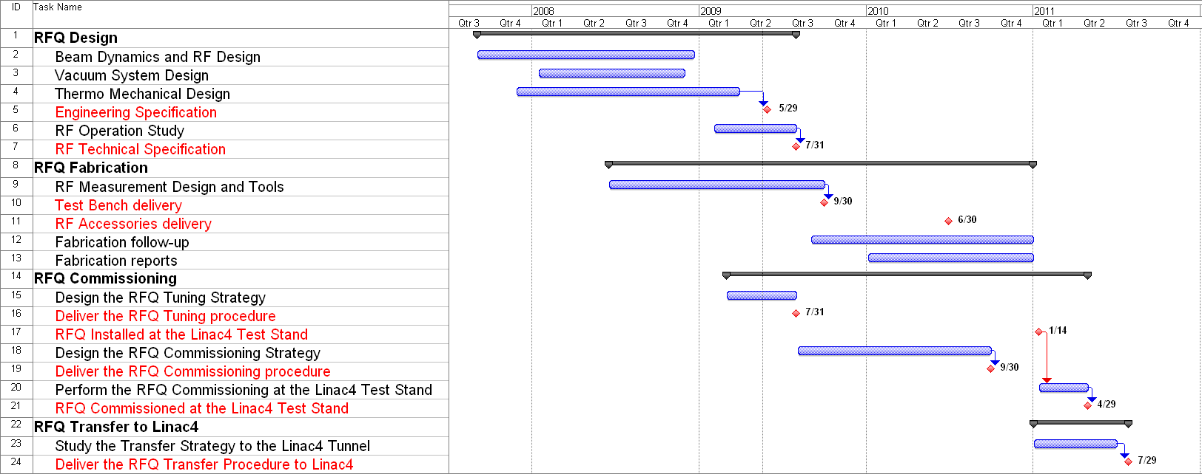
The LINAC4 RFQ Project
RFQ FABRICATION – The initial Schedule
From C. Rossi, A.M. Lombardi, A. France: the Engineering Specification for THE RADIOFREQUENCY QUADRUPOLE ACCELERATOR FOR THE LINAC4 – CERN EDMS 1020166.
5

Slide 6
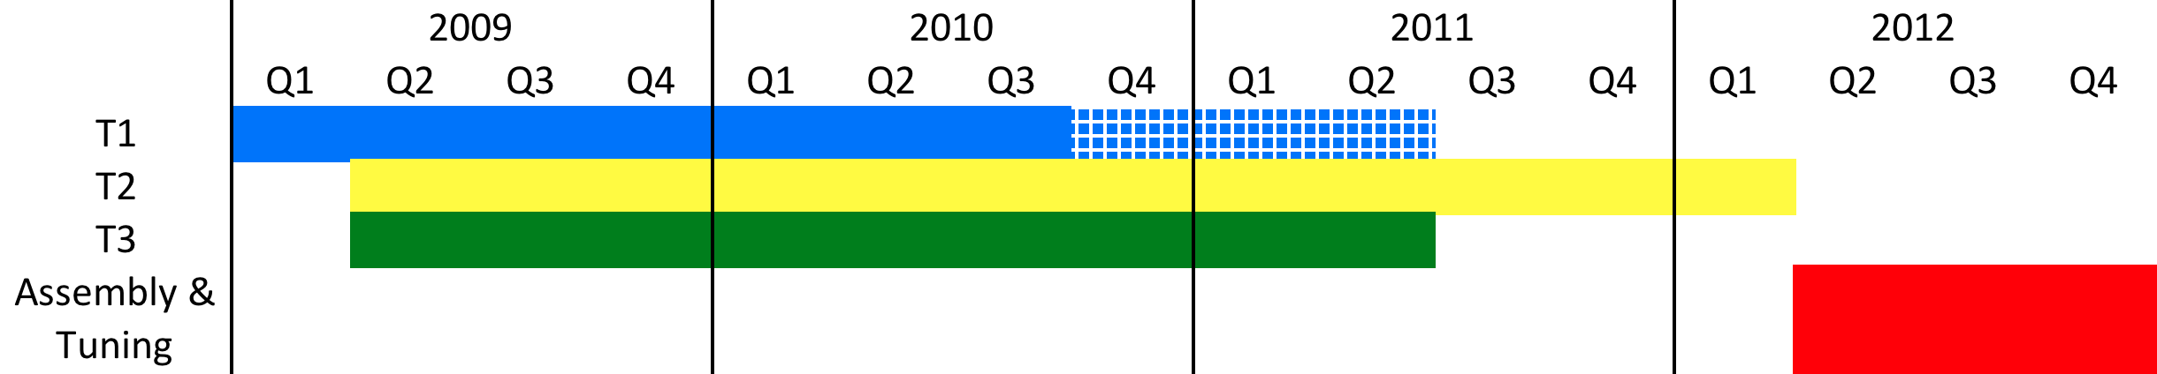
The LINAC4 RFQ Project
RFQ FABRICATION – Detailed Schedule
T1 rough machining completed in July 2009
  Semi-finishing February 2010
  Finishing + Assembly March 2010 (date of the RF measurement)
  Brazing 1 May 2010
  Brazing 2 November 2010
T3 rough machining completed in June 2010
  Semi-finishing October 2010
  Finishing + Assembly December 2010
  Brazing 1 February 2011
  Brazing 2 May 2011
T2 rough machining completed in October 2010
  Semi-finishing April 2011
  Finishing + Assembly June 2011
  Brazing 1 July 2011
  Brazing 2 April 2012
6

Slide 7
Design of the LINAC4 RFQ
ENGINEERING SPECIFICATION and preliminary constraints
An Engineering Specification was issued to provide a first estimate for the project and define the boundary conditions.
A.M. Lombardi, C. Rossi, M. Vretenar - Design of an RFQ Accelerator optimized for Linac4 and SPL, CERN-AB-Note-2007-027.
The initial Linac4/SPL design was foreseeing the use of the IPHI RFQ as low energy injector (CERN – CEA – CNRS agreement signed in 2001).
The RFQ design started with the following constraints:
Output beam characteristics equal or compatible with the IPHI parameter set (to avoid redesigning the chopper line and/or the following accelerators);
Mechanical and RF design compatible with the RFQ projects at the time under realization with the participation of CERN (IPHI and TRASCO), to avoid starting a completely new RF and mechanical design;
Elementary modules of 1 m;
Maximum RF Power required: 0.8 MW to allow the use of one single LEP klystron;
7.5% maximum RF duty cycle, to make it compatible with the SPL operation;
Maximum beam current: 70 mA;
Minimum extraction energy from the H-ion source: 45kV.
7

Slide 8
Design of the LINAC4 RFQ
PARAMETER TABLE
8

Slide 9
Design of the LINAC4 RFQ
BEAM DYNAMICS
Sacrifice beam transmission with acceleration gradient;
Keep surface electric field as low as possible;
Match to the existing MEBT;
Pole tip profile compatible with machining by milling wheel (constant radius);
ρ/R₀ = 0.85 (keep Kilpatrick under control).
9

Slide 10
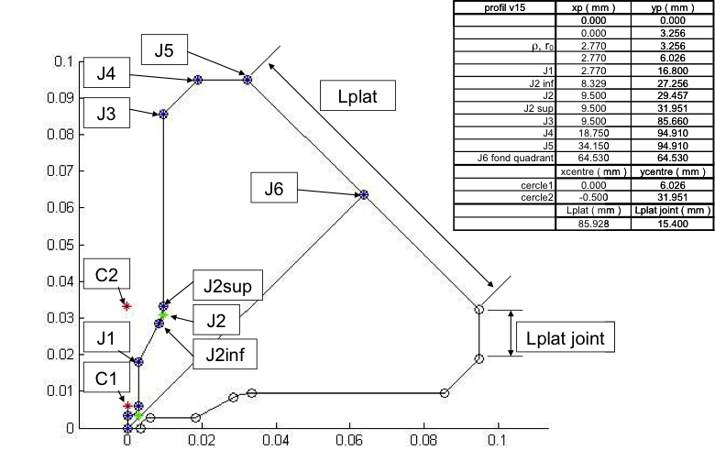
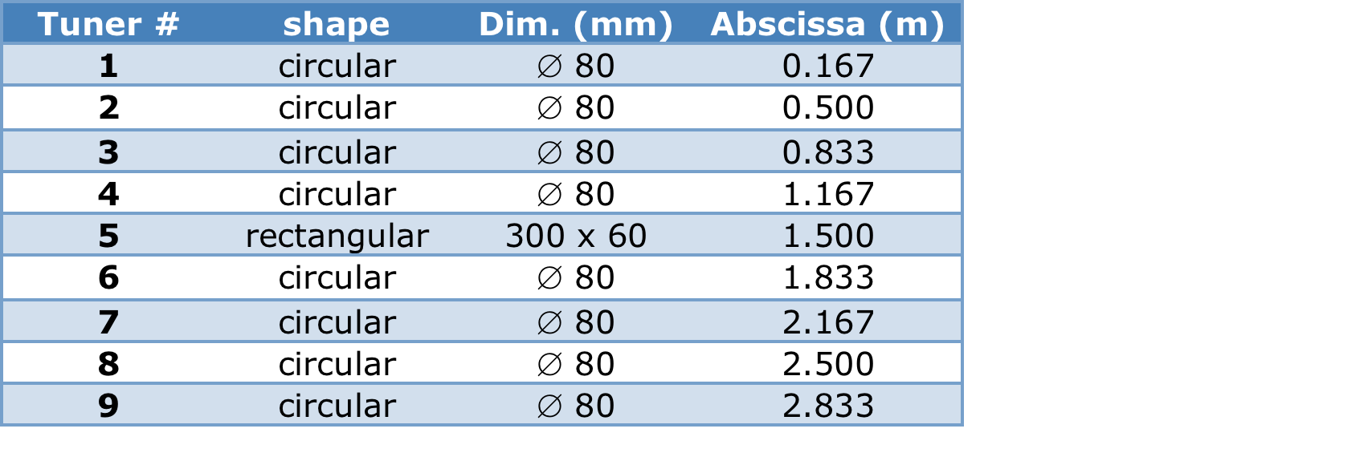
Design of the LINAC4 RFQ
RF DESIGN
Maintain a constant profile for the cavity transverse section;
0.1 mm gap between 1 m modules;
Provide at least 1 Mhz separation between Q₀ and D₂;
End-cell tuning performed by quadrupole rods.
3 Tuners/quadrant/module.
10

Slide 11
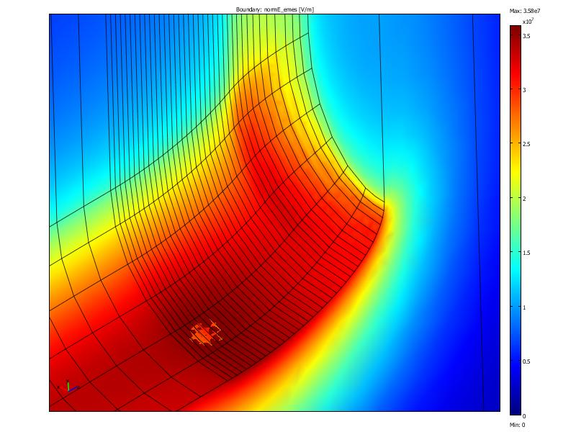
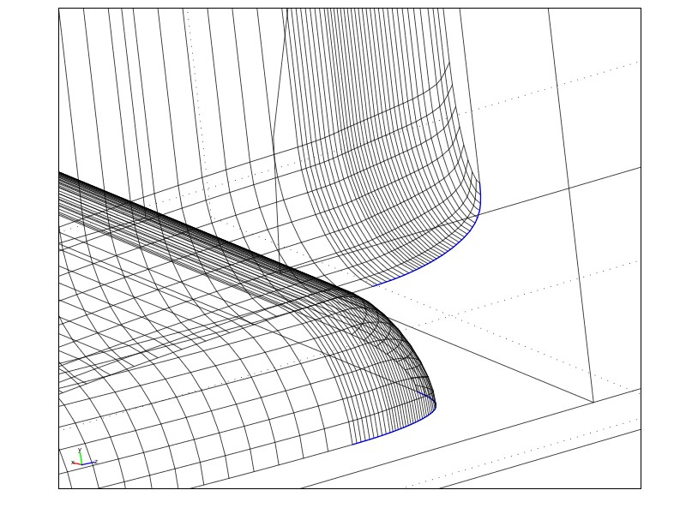
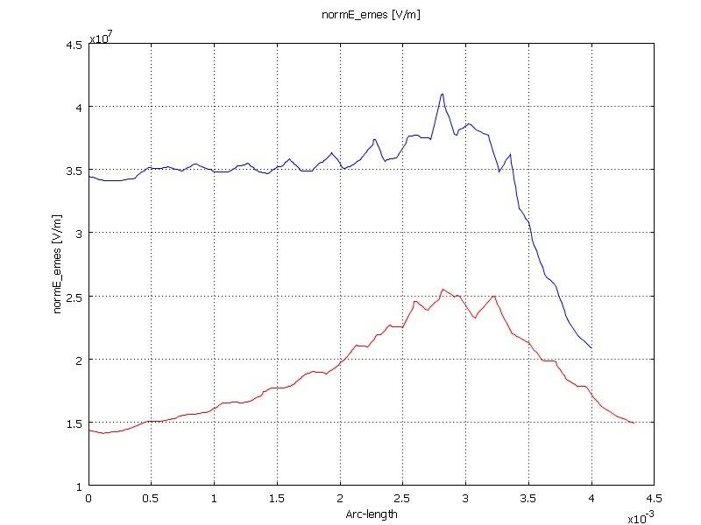
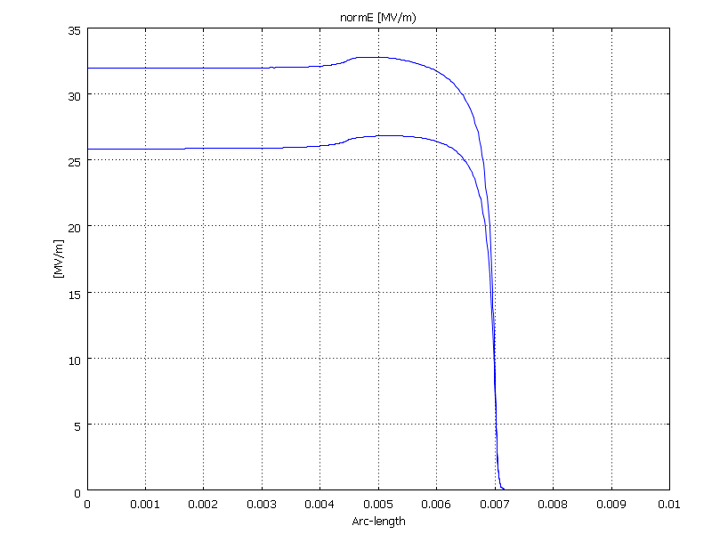
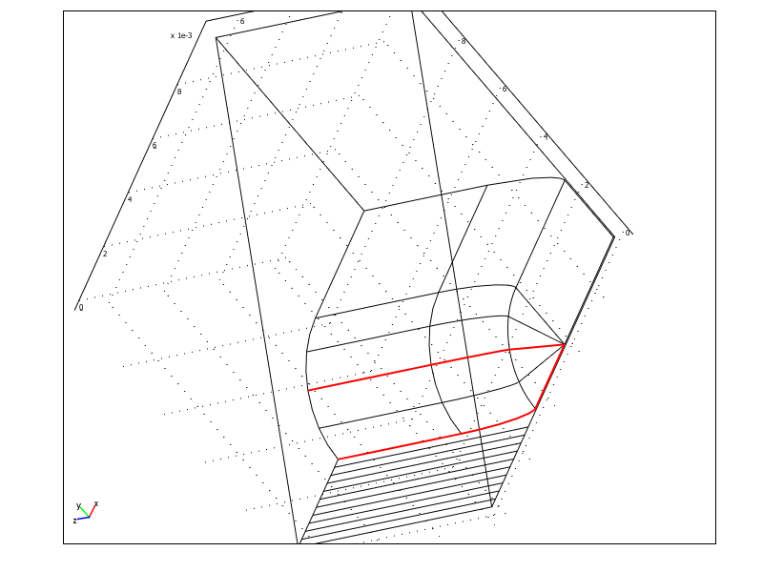
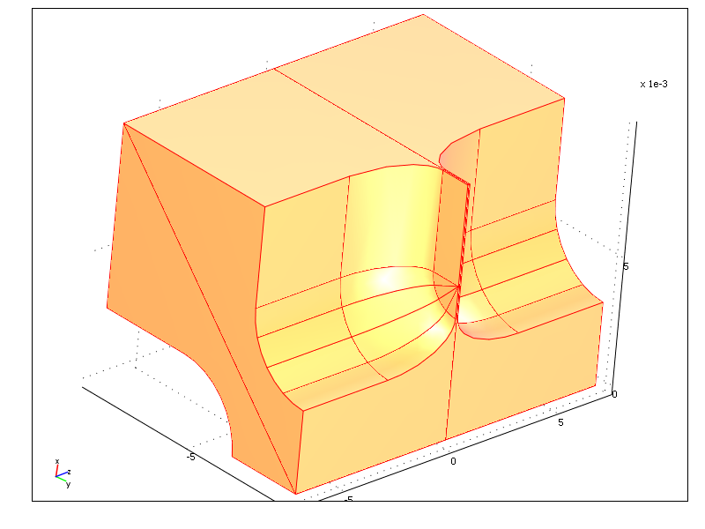
Design of the LINAC4 RFQ
RF DESIGN – Peak Field and RF Coupling
Limit peak surface field at vane ends and module transitions.
11

Slide 12
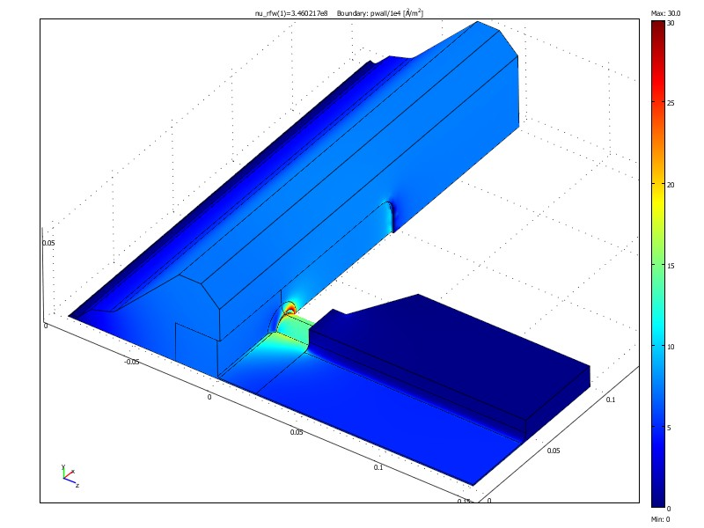
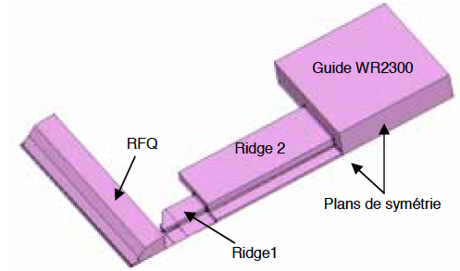
Design of the LINAC4 RFQ
RF DESIGN – Peak Field and RF Coupling
Power density in W/cm², for 640 kW coupled power.
With coupling hole diameter 12.42 mm critical coupling is obtained for I_{beam} = 70 mA
(S₁₁ = 0.02, β = 1.59)
12

Slide 13
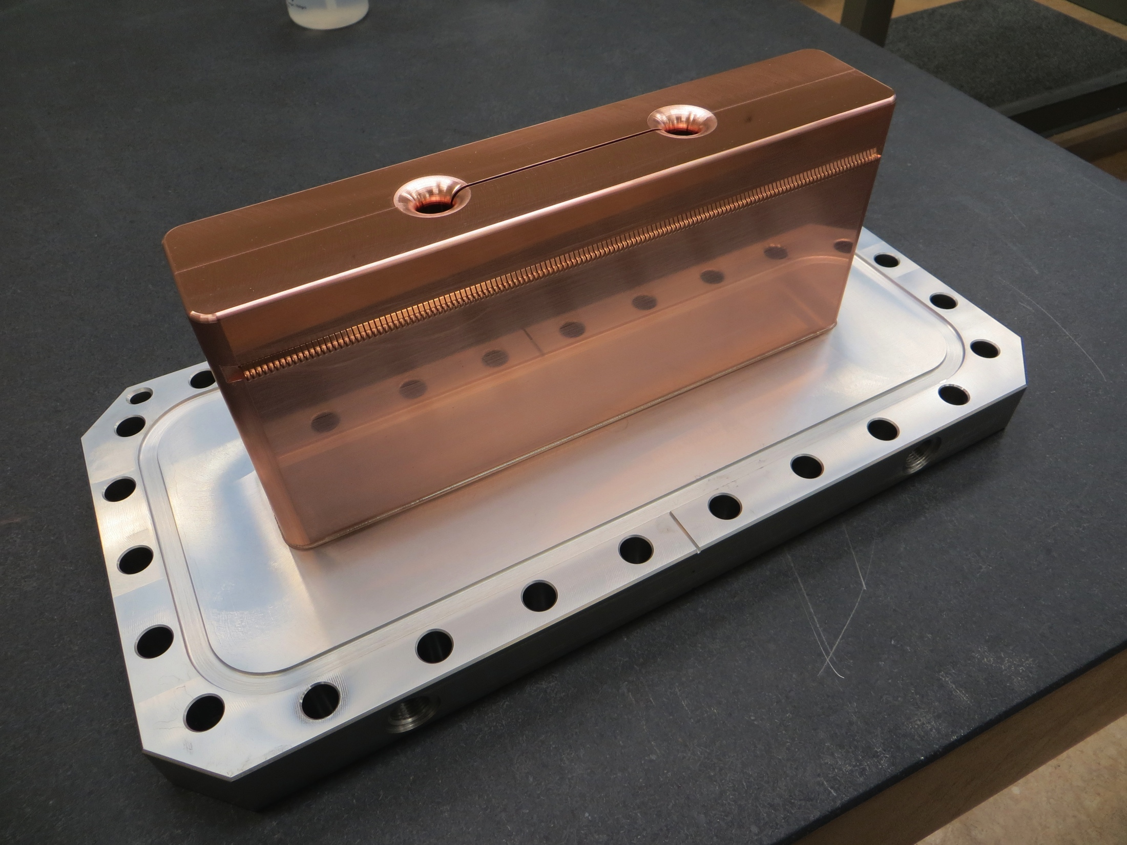
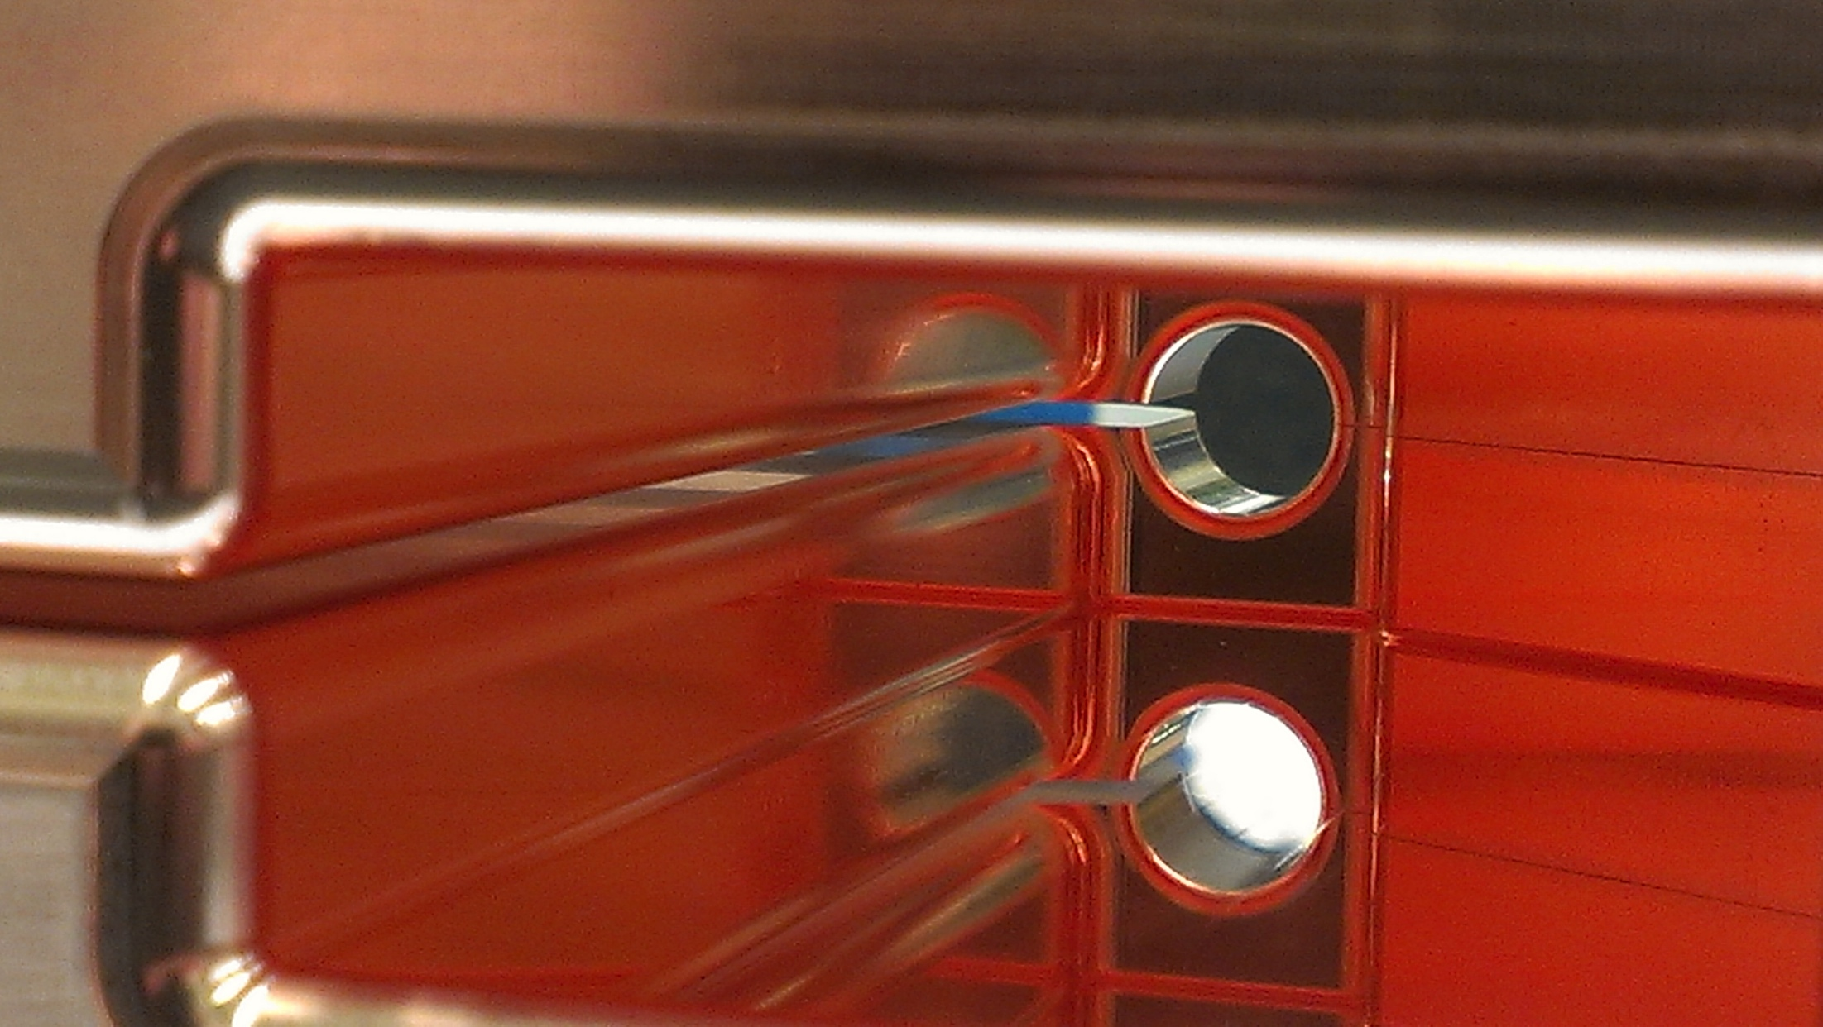
Design of the LINAC4 RFQ
RF DESIGN – Peak Field and RF Coupling
13

Slide 14
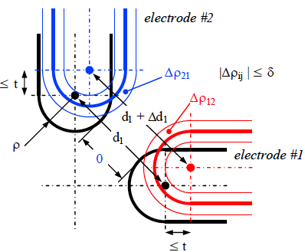
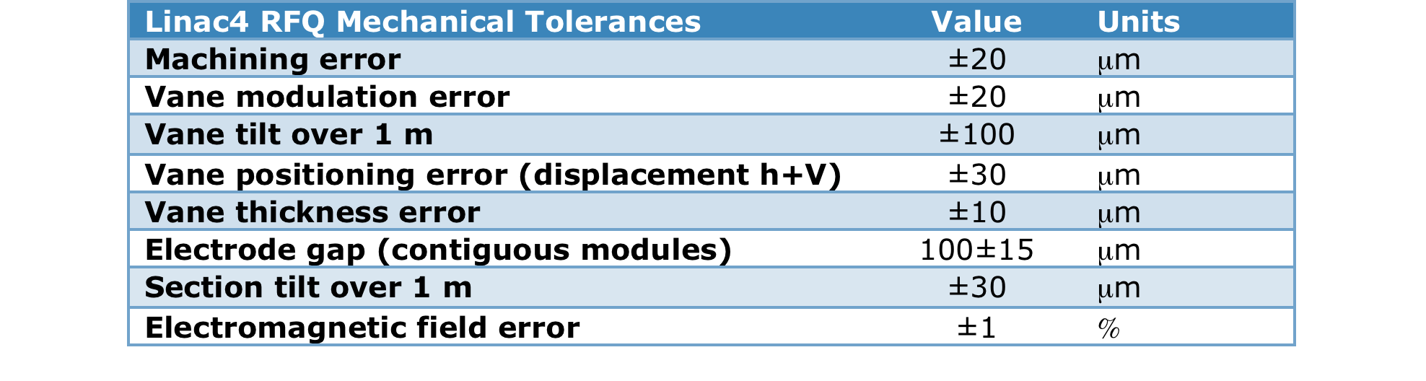
Design of the LINAC4 RFQ
MECHANICAL DESIGN – Machining and Assembly Tolerances
Inter-vane capacitance errors can be compensated by slug tuners up to ±2.3% and ±3.5% respectively for quadrupole and dipole modes.
Beam dynamics studies have provided the tolerances to be respected in order to avoid additional losses by 2% and emittance increase in all planes by 4%.
14

Slide 15
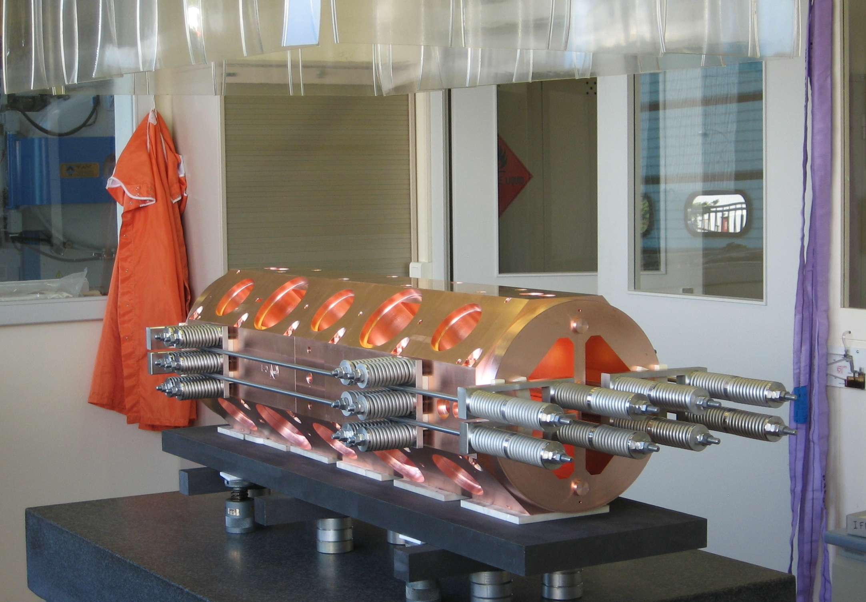
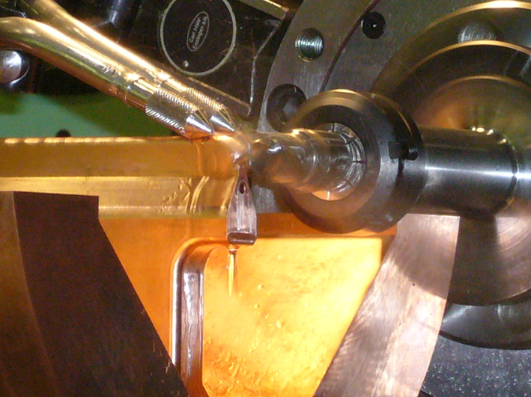
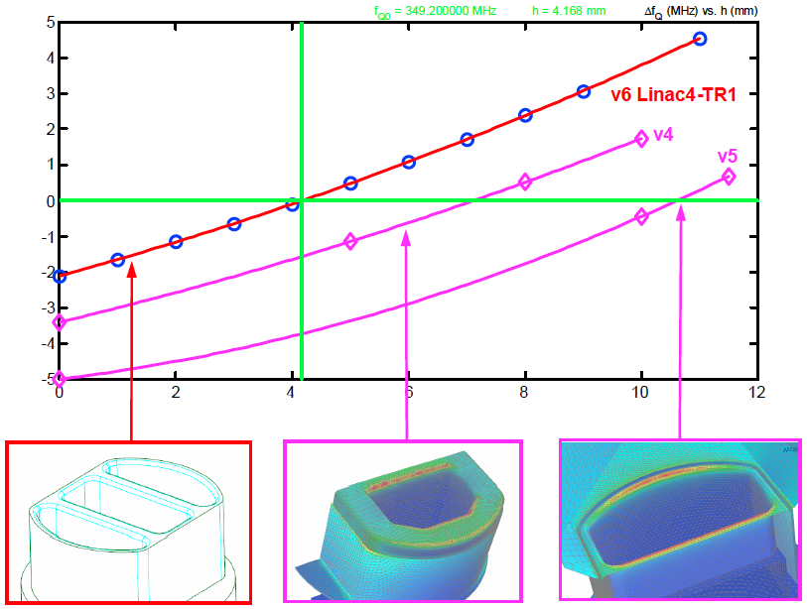
Design of the LINAC4 RFQ
MECHANICAL DESIGN
The mechanical design was based on the following assumptions:
Individual modules of 1 m length;
Pole tip machining with cutting wheel;
Assembly with two-step brazing.
Vacuum ports assembled at second brazing, allowing excellent compensation for field penetration.
15

Slide 16
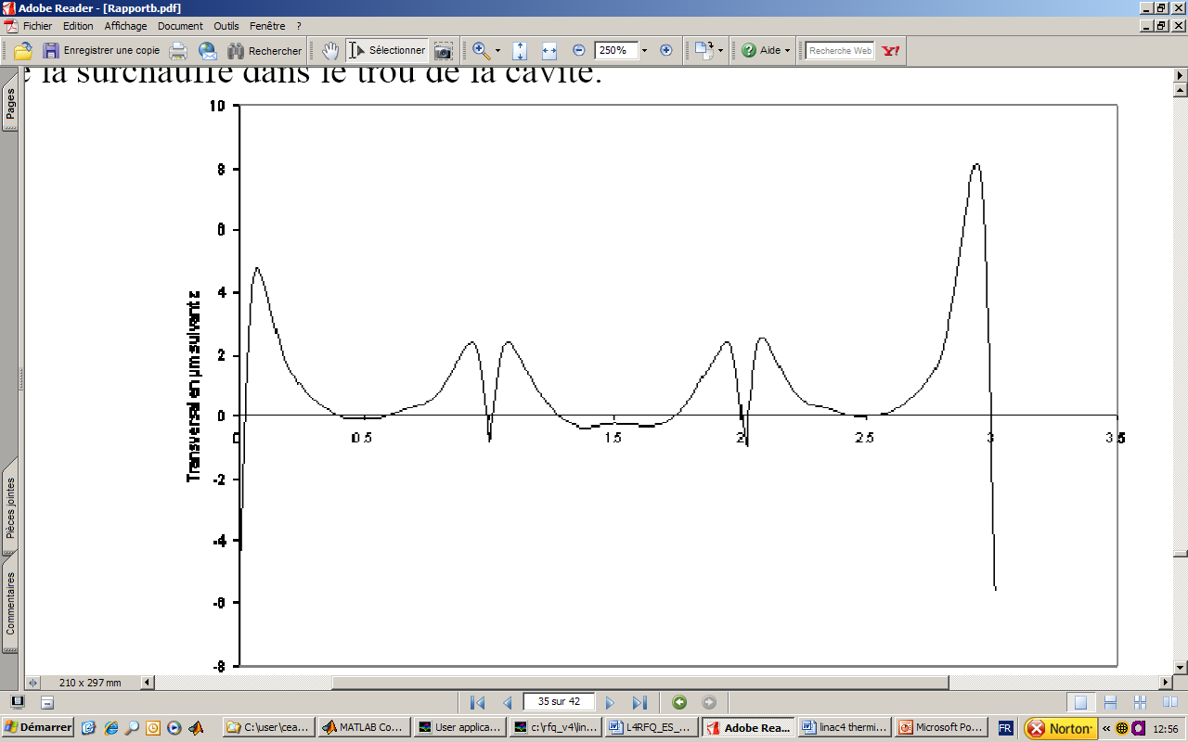
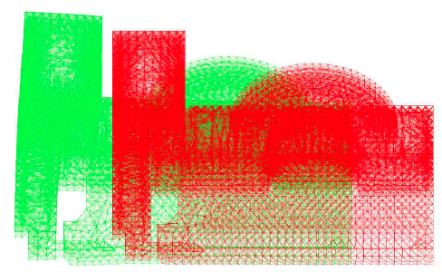
Design of the LINAC4 RFQ
MECHANICAL DESIGN – Thermal Stabilization
The Thermo-mechanical Study performed at CEA showed that:
A total of 8 water channels in the cavity are enough to stabilize the RFQ operation;
The water temperature can be effectively used to fine tune the RFQ frequency.
16

Slide 17
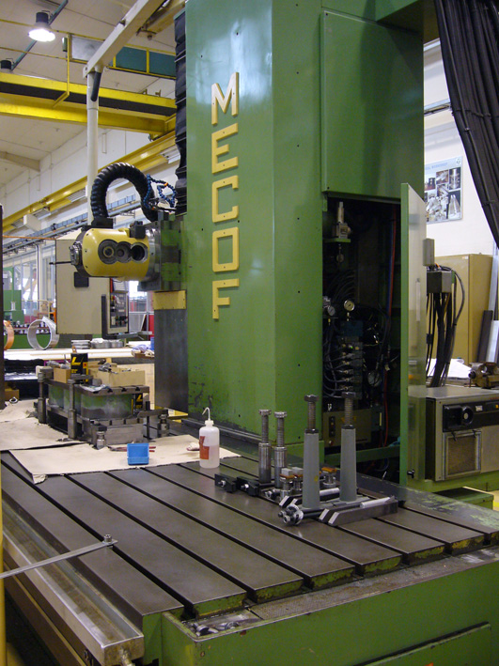
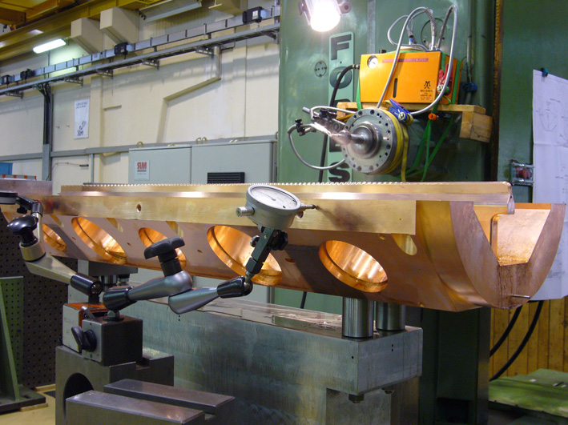
LINAC4 RFQ Fabrication
MECHANICAL FABRICATION
Manufacturing procedure
Rough Machining, Over thickness 3 mm
Deep drilling for the cooling channels and US control
Rough Machining, Over thickness 1 mm
Heat treatment at 600 ºC
Partial Finishing, Over Thickness 0.15 mm only for the vane tip and the brazing surfaces
Heat Treatment at 800 ºC
Finishing to nominal sizes
RF Bead-pull Measurement
First Brazing step: 4 vanes in horizontal position, vane over length 0.5 mm, brazing temperature 815 ºC
RF Bead-pull Measurement
Re-machining for the end and lateral flanges
Second brazing step: flanges on the module in vertical position, module over length 0.1 mm, brazing temperature 785 ºC
RF Bead-pull Measurement
Final machining: length and centering rings
17

Slide 18
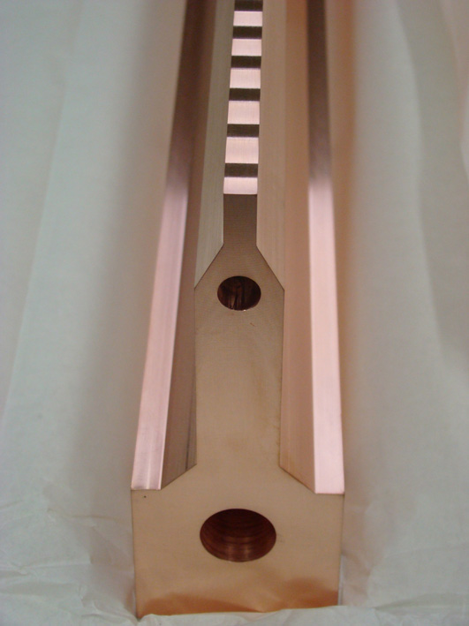
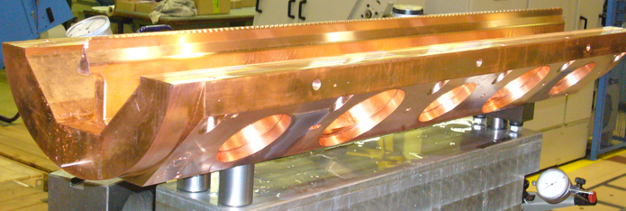
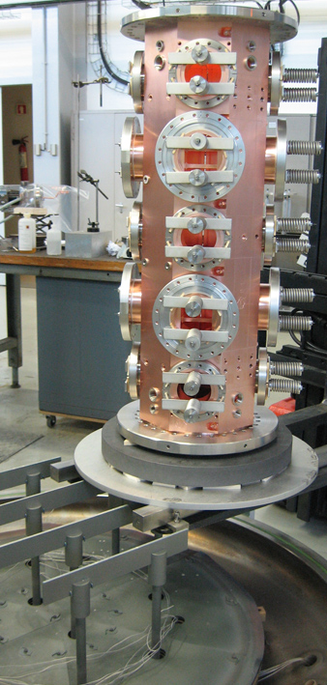
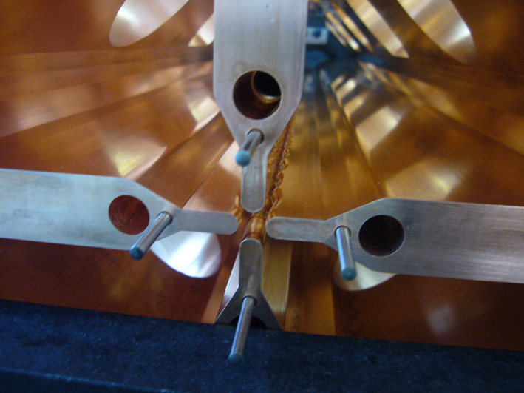
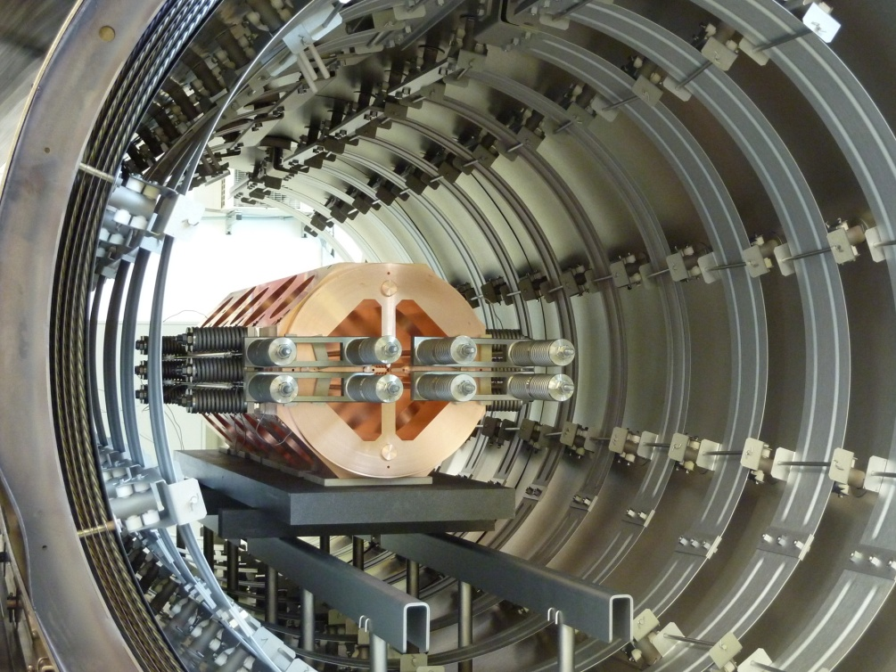
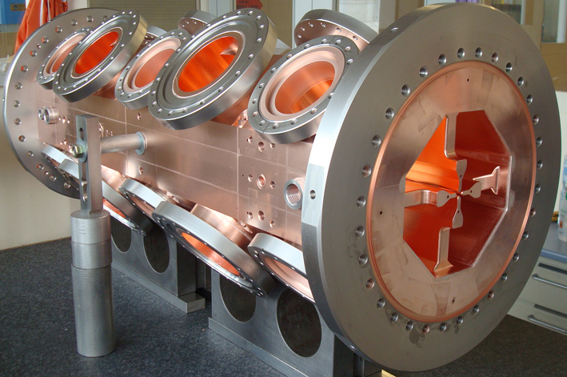
LINAC4 RFQ Fabrication
MECHANICAL FABRICATION
18

Slide 19
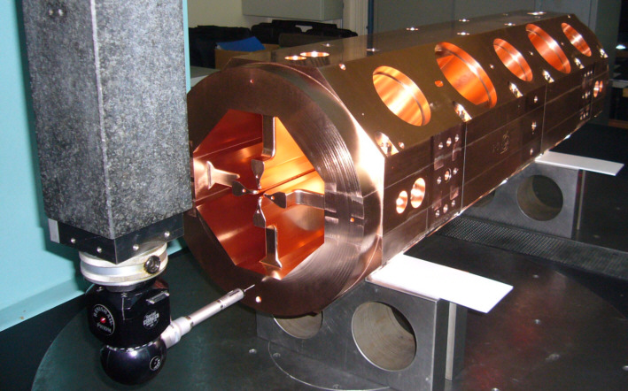
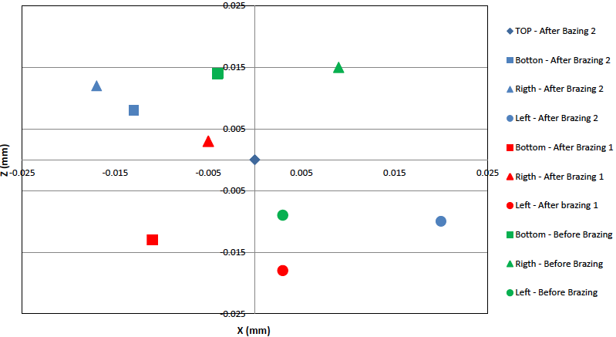
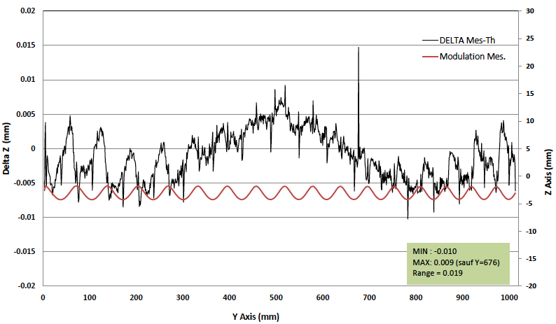
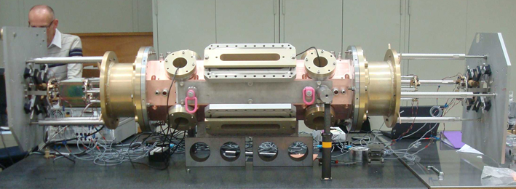
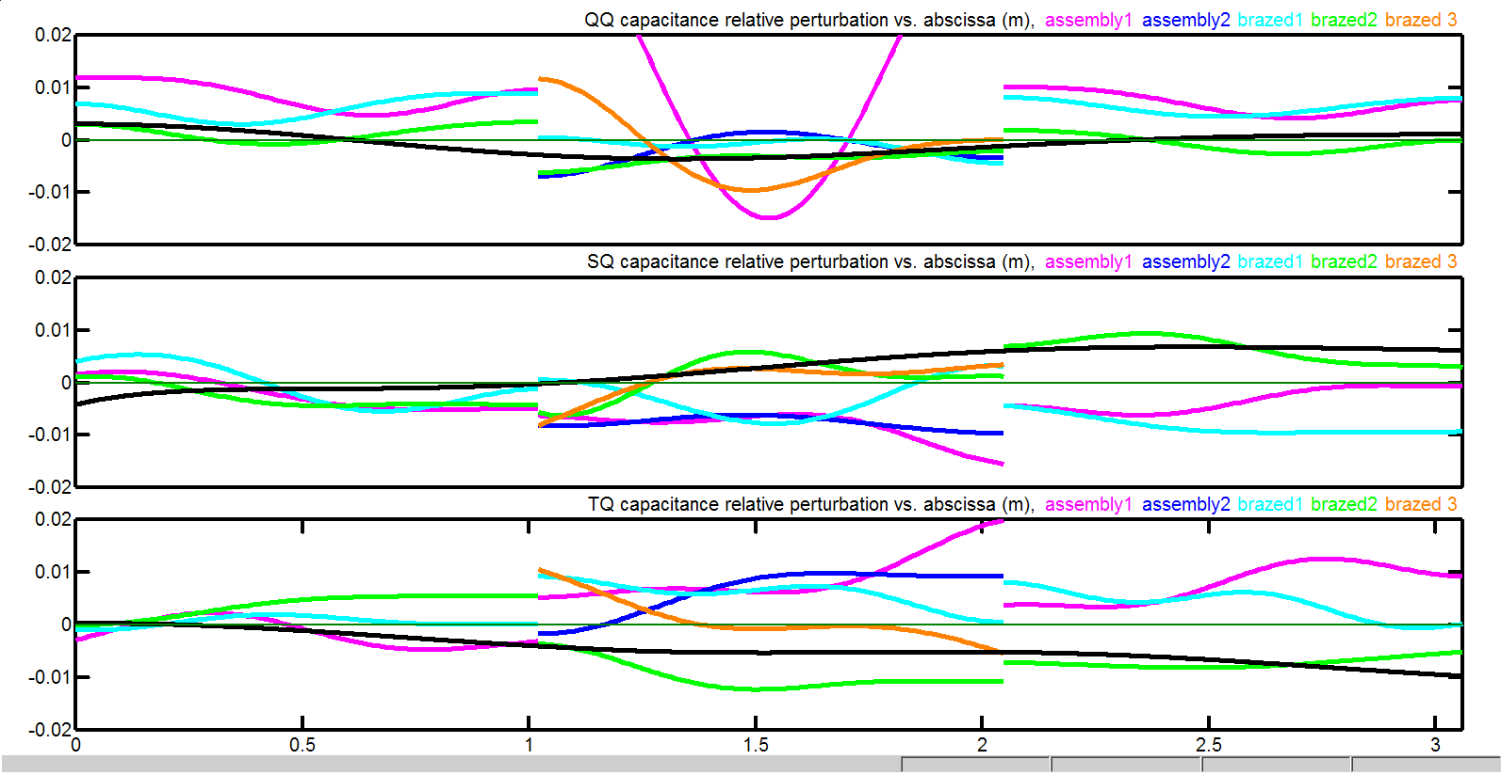
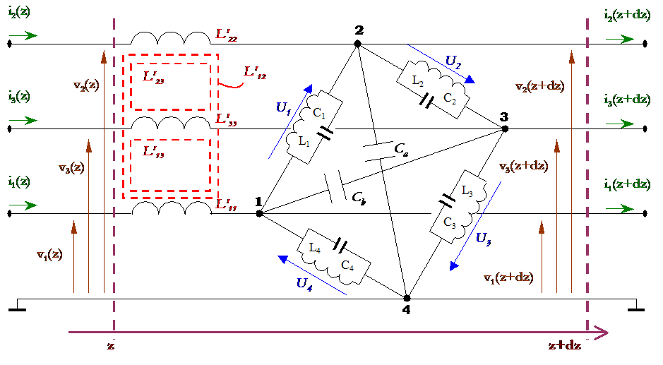
LINAC4 RFQ Fabrication
MECHANICAL FABRICATION – Fabrication Control by Metrology and Bead-pulls
RF Bead-pulls
19

Slide 20
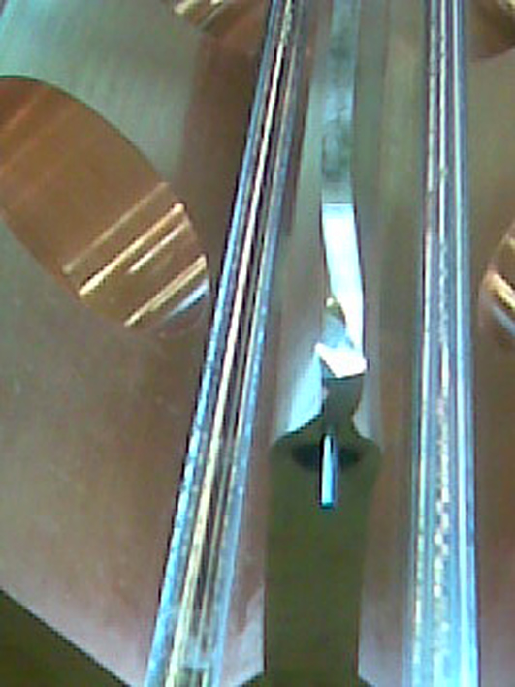
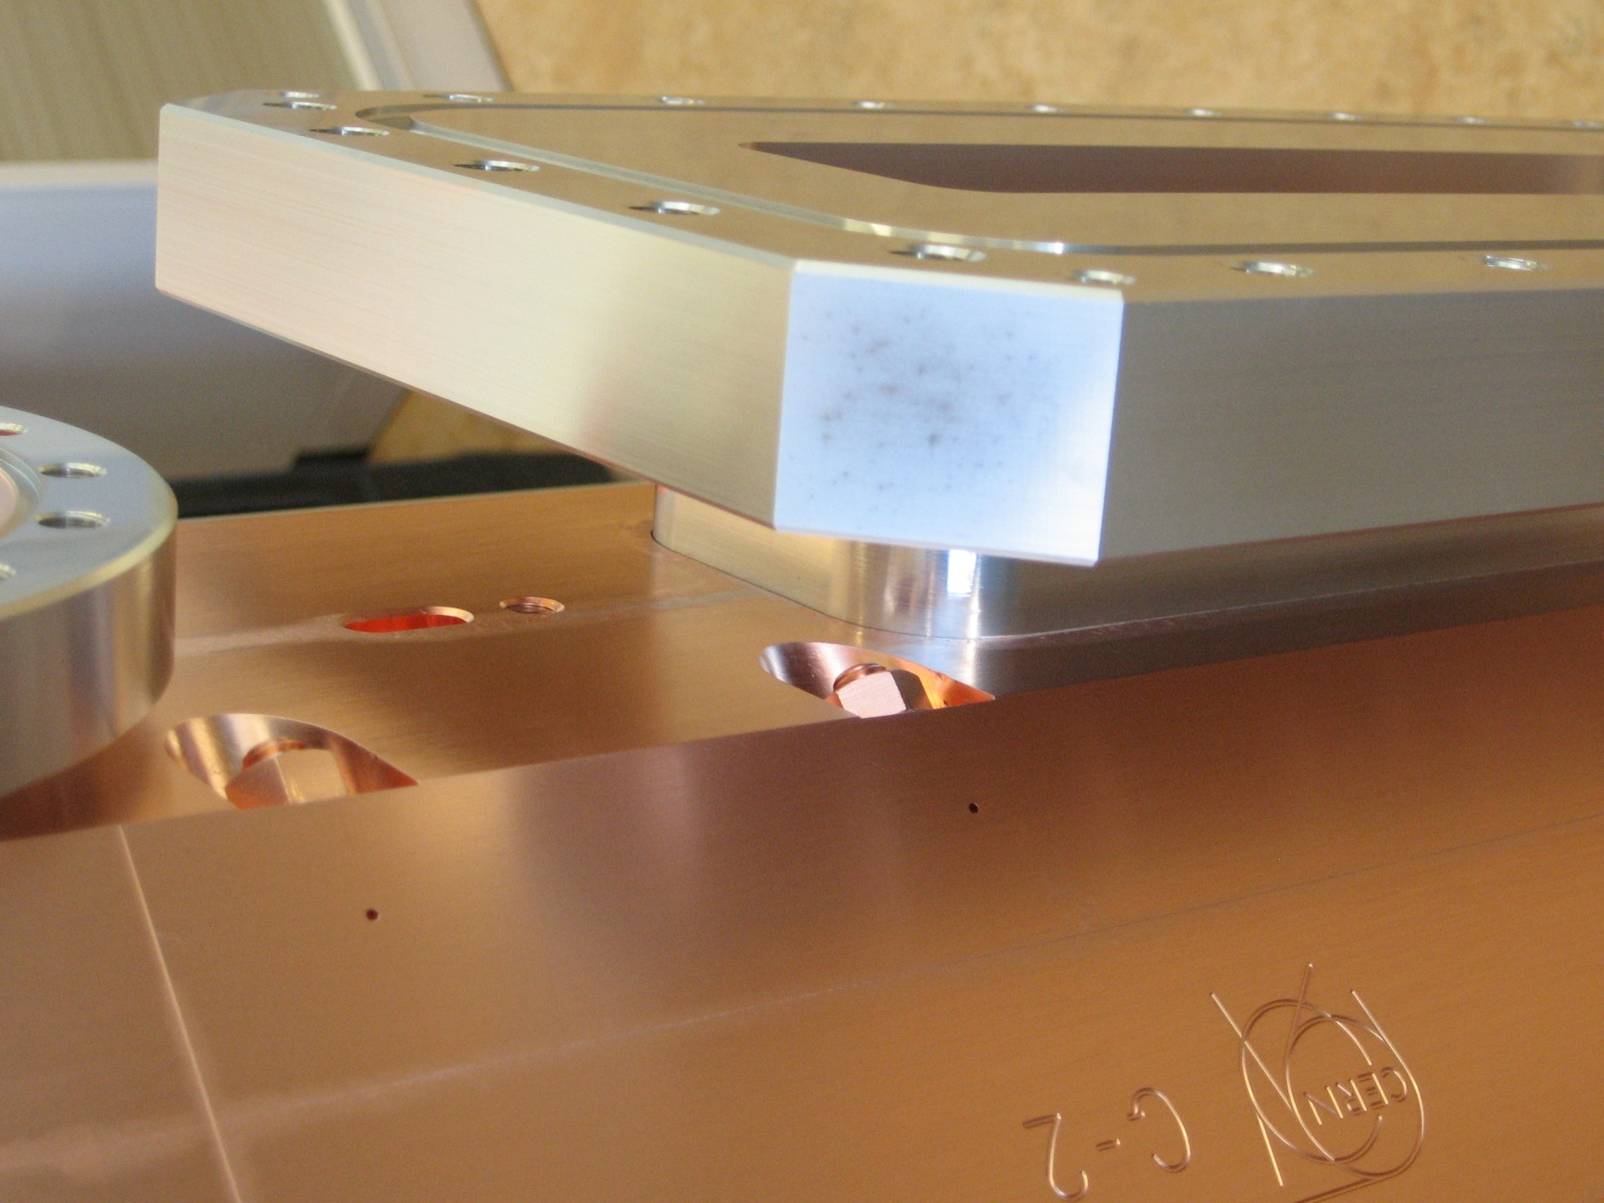
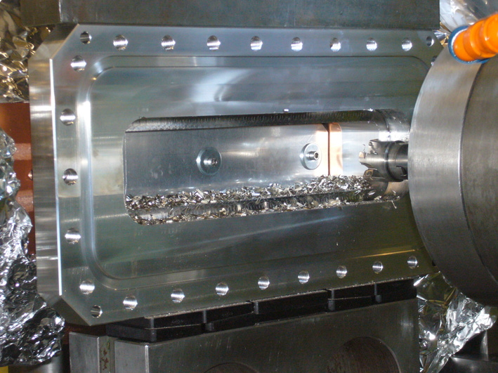
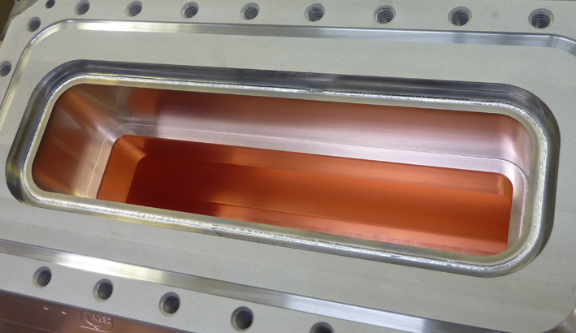
LINAC4 RFQ Fabrication
MECHANICAL FABRICATION – What went wrong …
Vacuum leaks on the collar
Required difficult machining …
… and new assembly technique
T3 Major Vane
RF Ports on T2
20

Slide 21
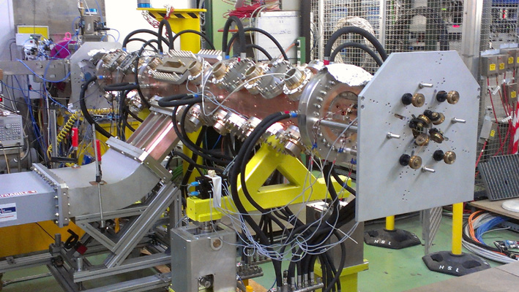
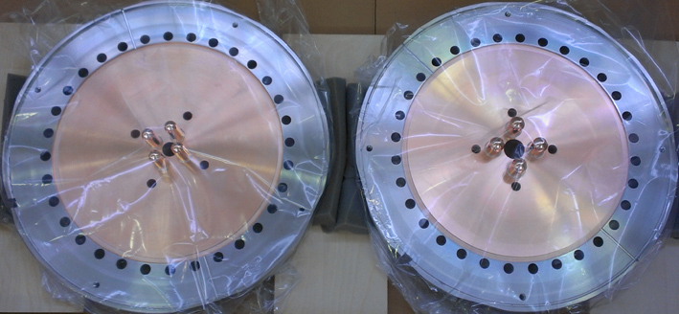
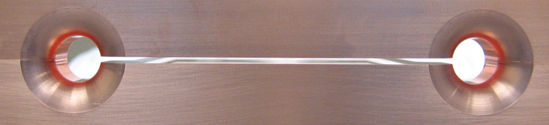
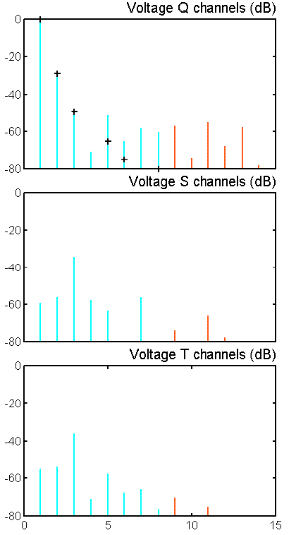
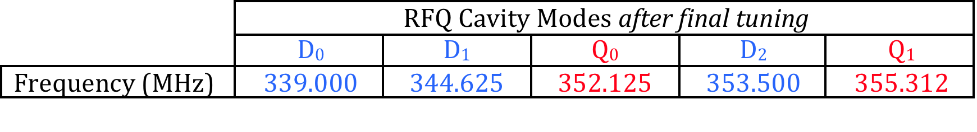
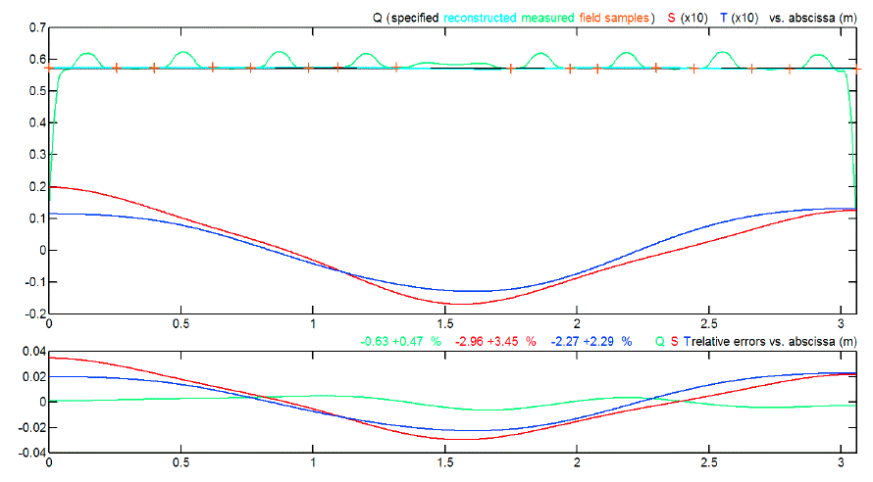
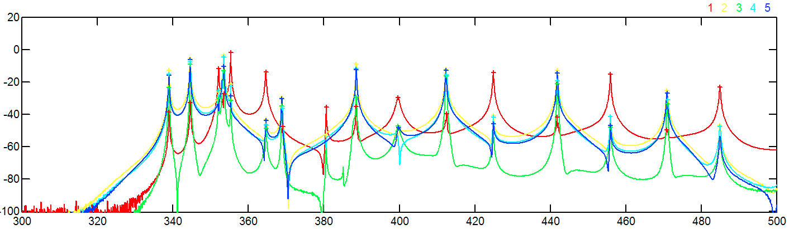
LINAC4 RFQ Tuning and Commissioning
ASSEMBLY AND TUNING
Final Tuning Sequence
End Plates
RF Power Coupler
Piston Tuners and Dummy RF Ports
Final Tuning result
Q₁
D₀
Q₀
D₁
D₂
21

Slide 22
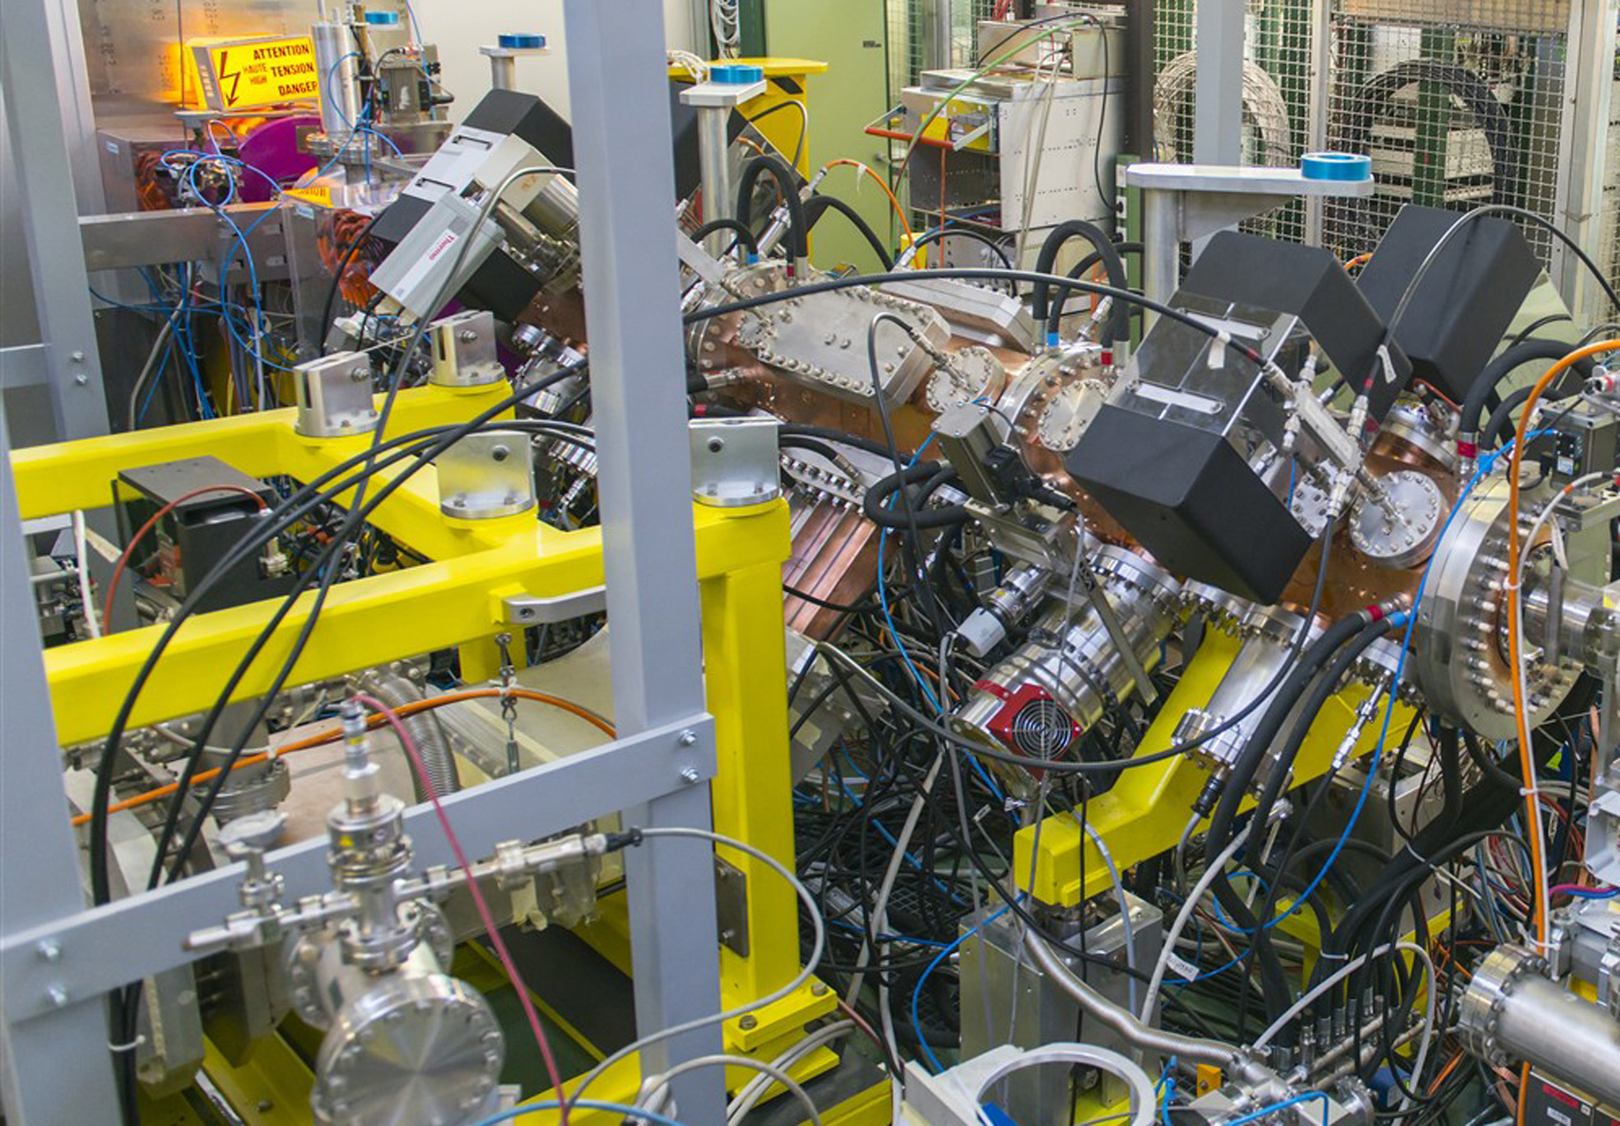
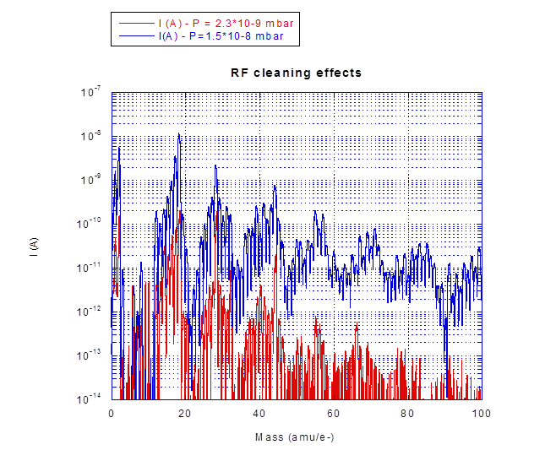
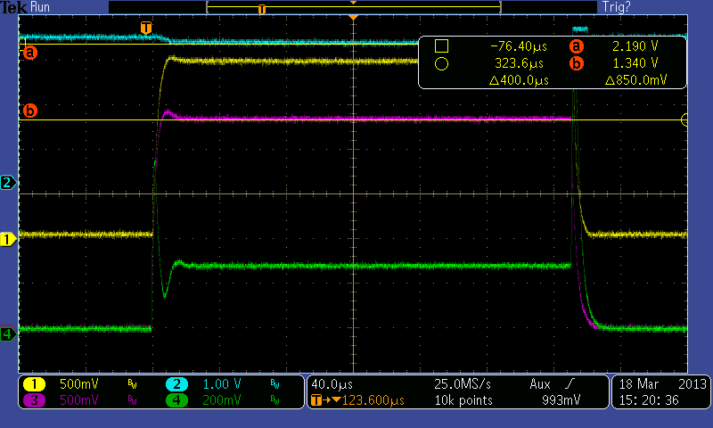
LINAC4 RFQ Tuning and Commissioning
RF COMMISSIONING
RF Commissioning
28 February 2013 RF Commissioning started
(few shots already the week before);
13 March first beam accelerated.
RF Commissioning target at the 3 MeV Test Stand:
480 kW, 250 μsec, 1Hz;
with 1E-6 gas load in the LEBT.
22

Slide 23
LINAC4 RFQ
CONCLUDING REMARKS
The importance of relying on benchmarked design and tuning tools translated into the possibility to avoid prototyping;
Simplifying the mechanical design allowed keeping the whole fabrication process in house;
The simple logistics made possible to have full control of the fabrication process;
It was very important to have a Quality Assurance Plan, with explicit procedures for validation of drawings and fabrication steps;
The Test Stand was ready much before needed;
The strong engagement of all Groups involved was essential for the final result;
Keeping the design group involved during the fabrication process has been very important for fast reacting to difficulties met in the process and for rapid decisions when needed.
23

