Slide 1
4 VANES RFQ EXPERTISE AT AVS
FAIR PROTON LINAC RFQ MEETING
AT GSI, DARMSTADT, GERMANY
Wednesday, 21st November 2013
By Alberto Garbayo :: Accelerator Physics Engineer
agarbayo@a-v-s.es

Slide 2
INDEX
OUR CLIENTS
WHAT WE DO... (1 slide)
MACHINE TOOL TO HIGH PRECISION (1 slide)
4 VANES RFQ EXPERTISE
  FETS – ISIS
    WELD TEST MODELS
    RFQ DESIGN
    COOLING POCKETS (CFD / FEA)
    3D DESIGN
    ALIGNMENT JIG & ALIGNMENT PROCEDURE
    MANUFACTURING
  ESS-BILBAO
    DESIGN
    COPPER TEST MODELS
      MACHINING
      METROLOGY
    COLD MODEL
      MACHINING
      METROLOGY
  LINCE – HUELVA
    RFQ, EM & RF DESIGN
    ENGINEERING & DESIGN
    FEM / FEA / CFD CALCULATIONS

Slide 3

























OUR CLIENTS
ASTROPHYSICS & SPACE
PARTICLE ACCELERATORS
INSTITUTIONS

Slide 4
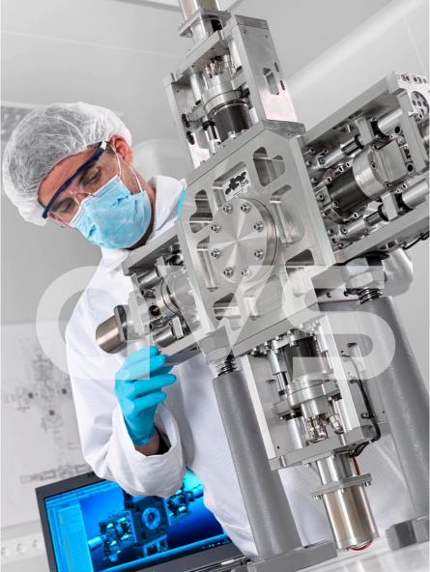
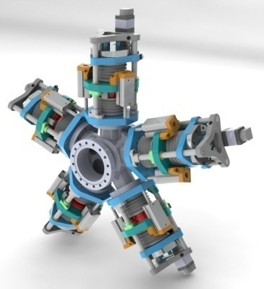
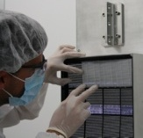
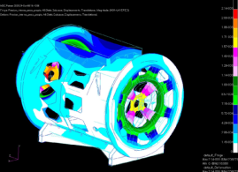
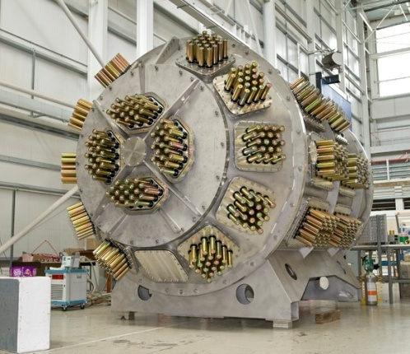
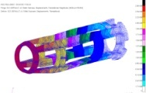
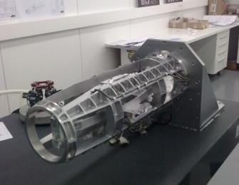
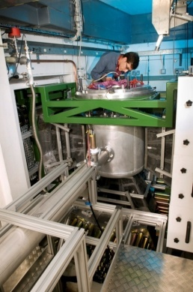
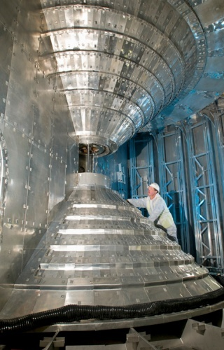
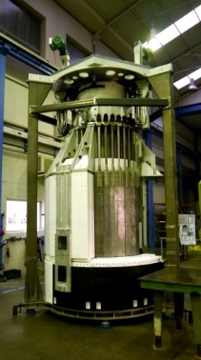
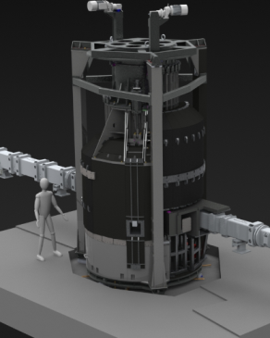
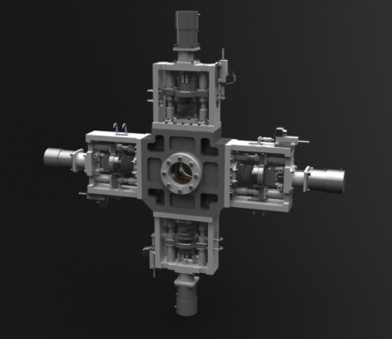
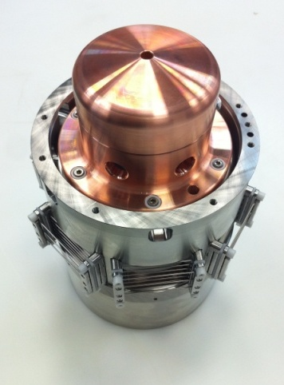
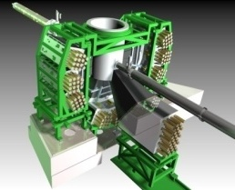
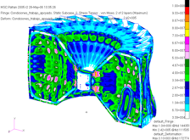
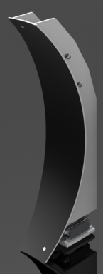
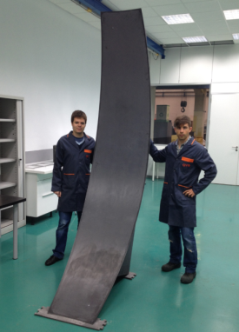
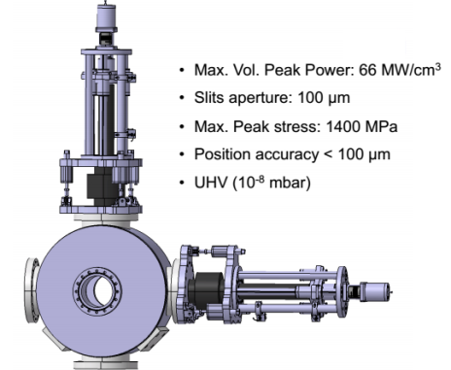
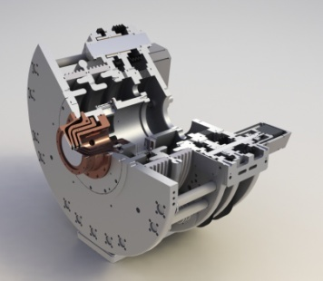
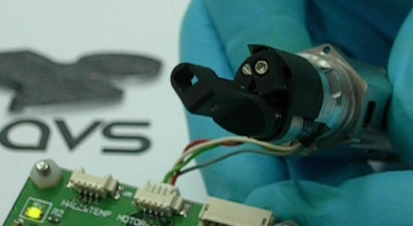
WHAT WE DO...
NEUTRONICS
ECR ION SOURCES
BEAM INSTRUMENTATION
SPACE & ASTROPHYSICS
COMPOSITE MATERIALS

Slide 5
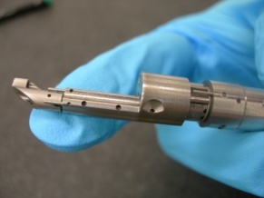
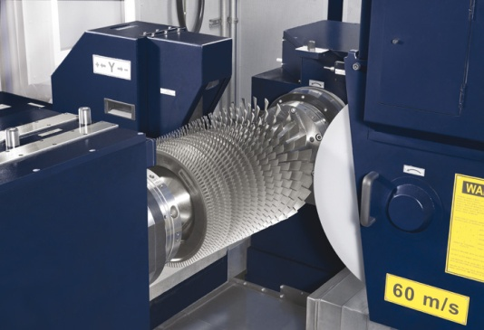
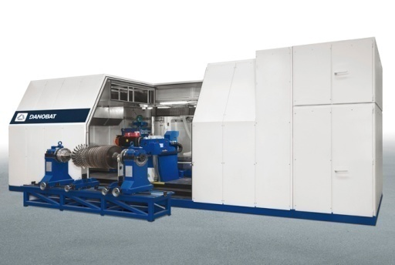
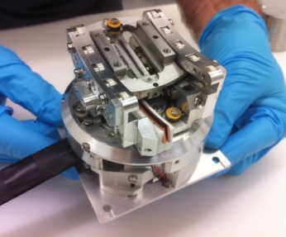
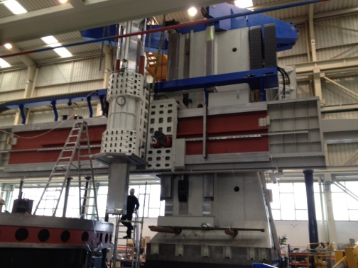
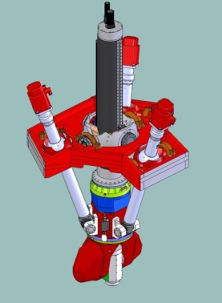
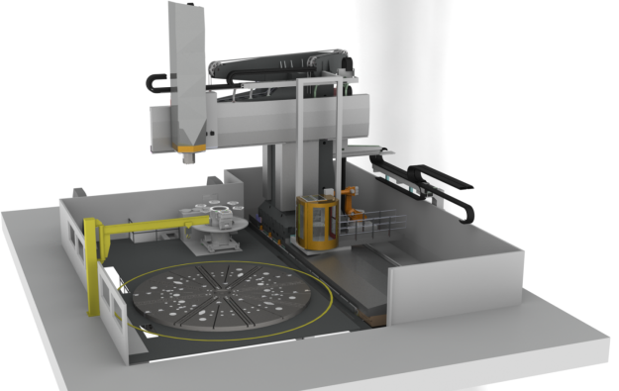
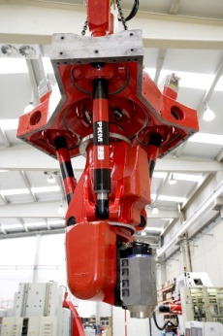

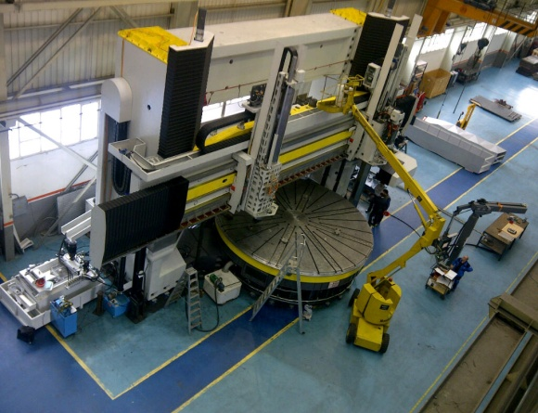
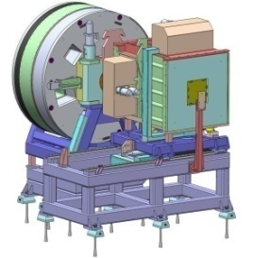
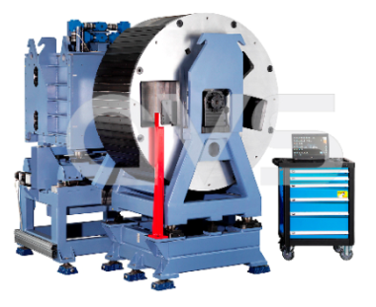
FROM MACHINE TOOL TO HIGH-PRECISION
92% of the turbines have been grinded with this machine world-wide

Slide 6
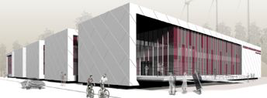

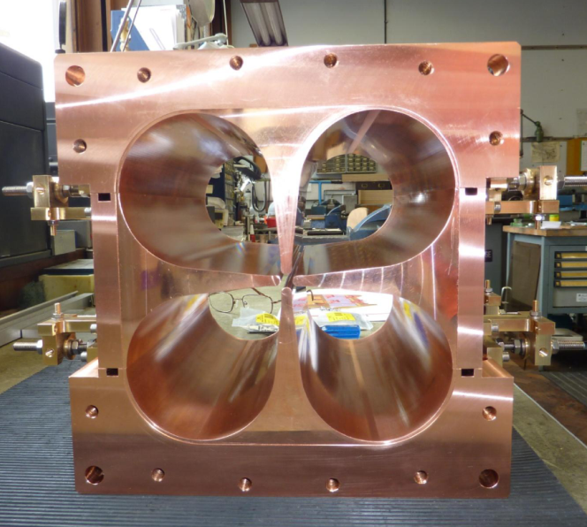
4 VANE RFQ EXPERTISE

Slide 7
FETS – ISIS RFQ :: 324 MHz
OVERVIEW OF THE FETS MODEL
    COLD MODELS
    BEAD PULL
    WELD TEST PROCEDURE & MODELS
    BRAZING vs BOLT-ON
      METROLOGY & TESTS
    DESIGN
      RFQ DESIGN
      RFQ BEAM DYNAMICS & EM CALCS.
      COOLING
      3D DESIGN
      ALIGNMENT PROCEDURE
    MANUFACTURING

Slide 8
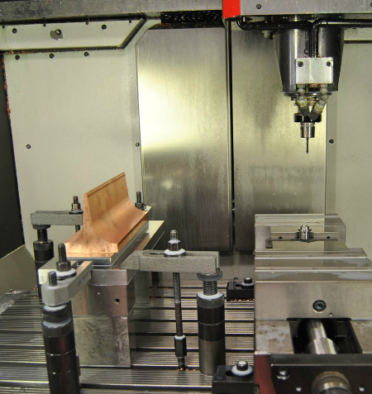
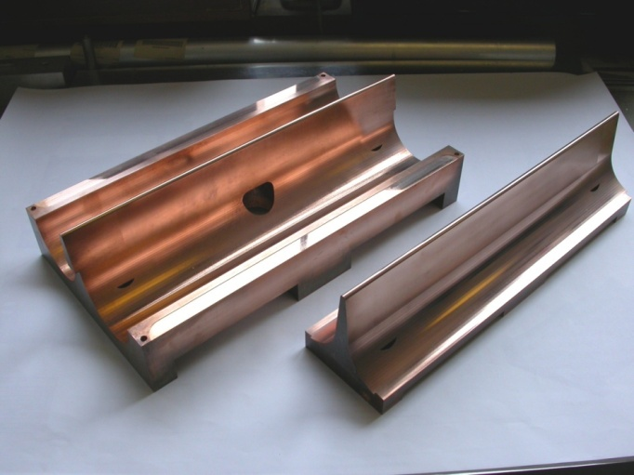
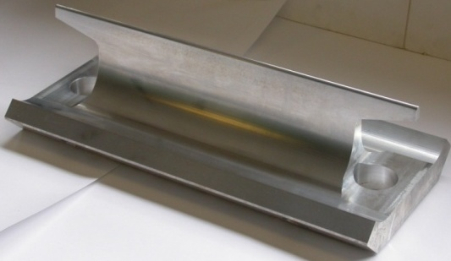
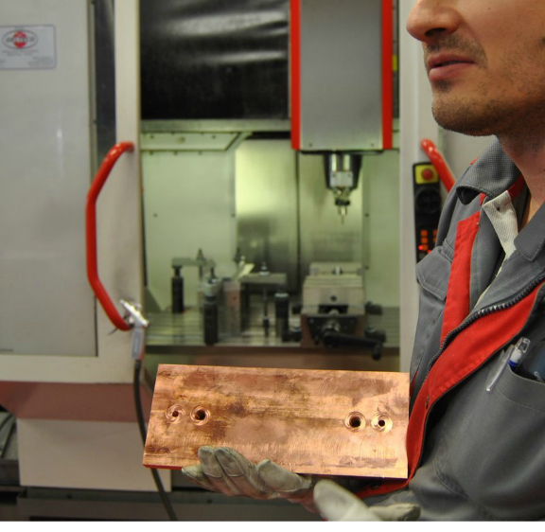
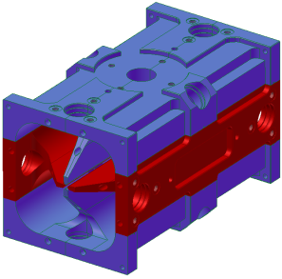
COLD MODELS
A 0.5 m, 324 MHz 4-vane RFQ cold model design has been carried out to learn about difficulties in the manufacturing process. The cold model contains all the significant features of the final 4 m long design.
1ST ALUMINIUM COLD MODEL
2ND COPPER COLD MODELS
(INCL. WELD TEST MODELS)
Aluminium machining model
C10100 Free oxygen copper Weld test models machining
Design of the 4 vane
Cold model

Slide 9
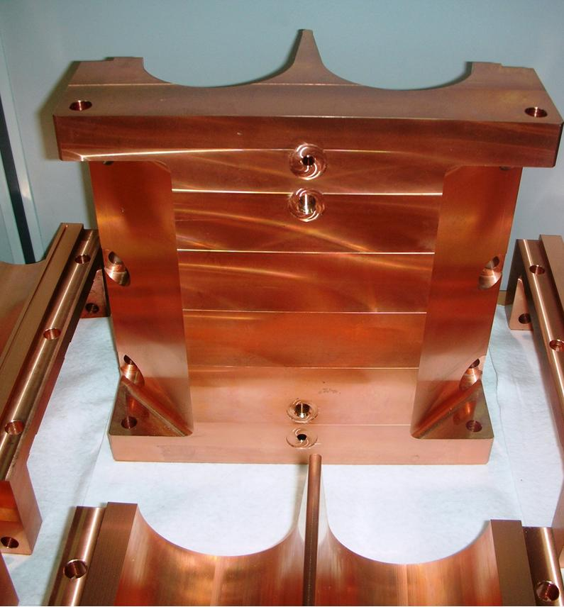
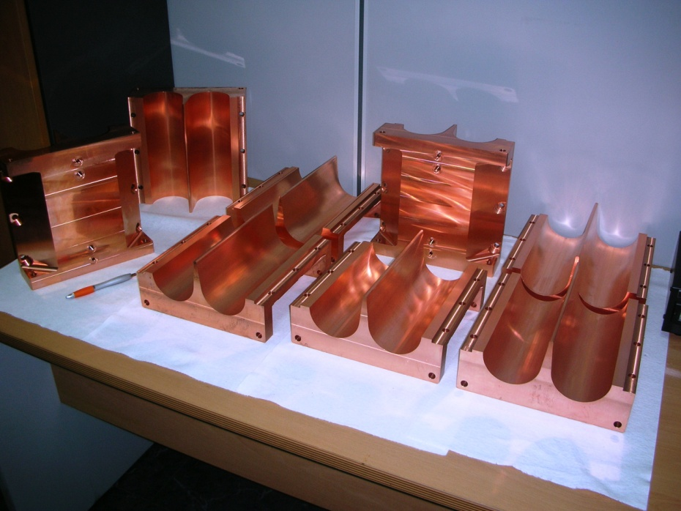
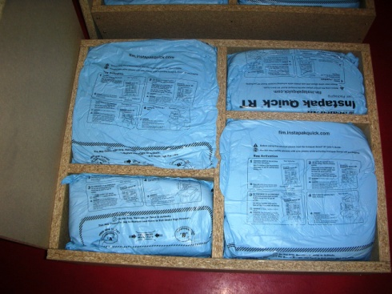
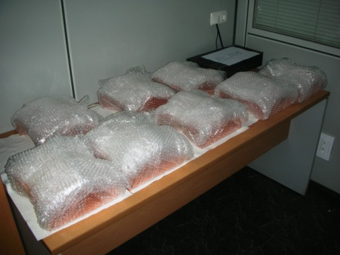
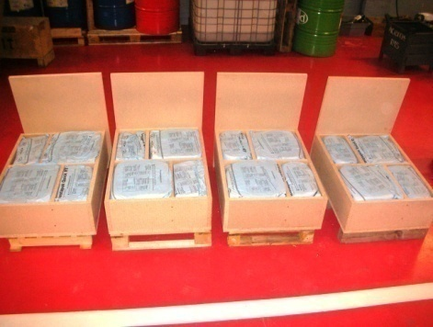
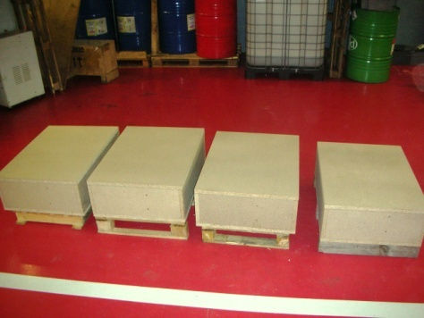
COLD MODELS

Slide 10
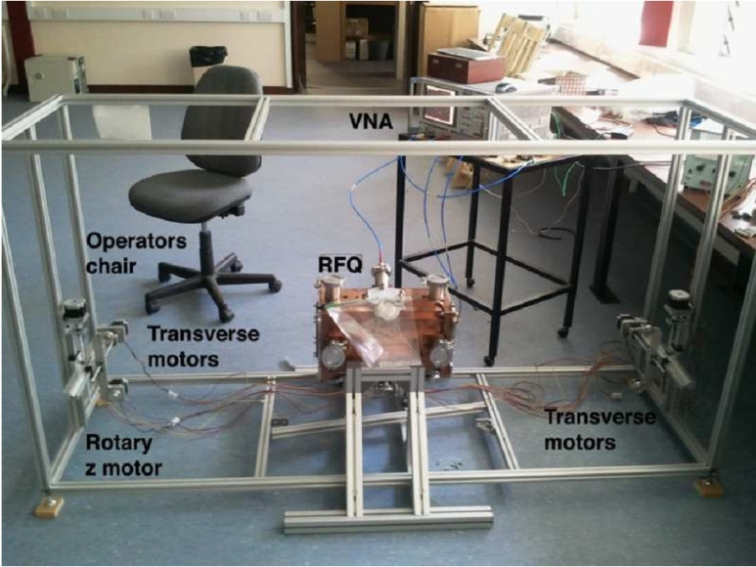
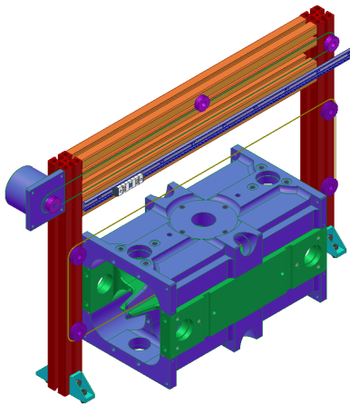
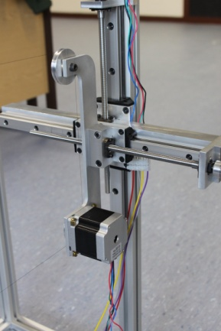
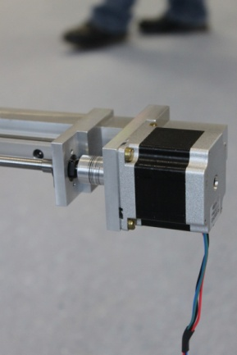
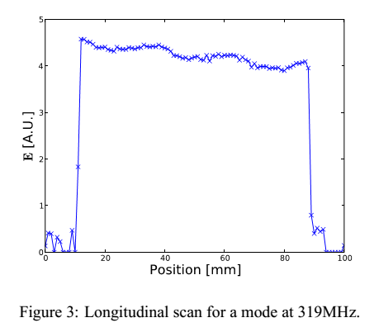
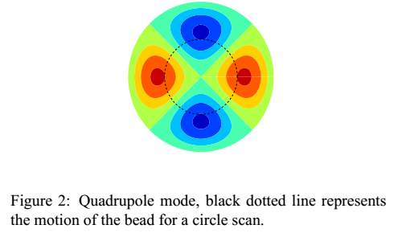


BEAD PULL MEASUREMENTS
Conceptual design of the bead pull measurement system.

Slide 11

WELD TEST MODELS
BOLT-ON DESIGN – 3D O-RING TESTS

Slide 12


WELD TEST MODELS
BOLT-ON DESIGN – 3D O-RING TESTS

Slide 13



WELD TEST MODELS
BOLT-ON DESIGN – 3D O-RING TESTS

Slide 14


WELD TEST MODELS
3D METROLOGY INSPECTION

Slide 15


WELD TEST MODELS
BRAZING TEST – 3D METROLOGY INSPECTION

Slide 16


WELD TEST MODELS
BRAZING TEST – 3D METROLOGY INSPECTION

Slide 17


BRAZING VS BOLT-ON
Default method is vacuum brazing. This technique offers a number of advantages including:
Results in one solid part.
Good vacuum seal.
Good RF seal.
High Q value.
Many joints made in one operation
Disavantages:
RFQ cannot be dismantled if required.
Distortion and annealing of the material due to high temperatures used.
Precise stress relieving cycles required during manufacture.
FETS team decided to pursue an RFQ design that allowed the assembled parts to be dismantled and some reasons are:
Realignment.
Cleaning.
Removing surface irregularities caused by sparking.
Re-machining to change operating frequency.
The price to pay for this flexibility of design includes:
Challenging vacuum seal.
Potentially lower Q value.

Slide 18

DESIGN

Slide 19

RFQ DESIGN
RFQ PARAMETERS (IPAC 10´) WITH RFQSIM (written by A. Letchford)

Slide 20





RFQ DESIGN
RFQSIM (written by A. Letchford for ISIS RFQ) generates r, a, m and L parameters (and accompanying field map) that describe RFQ vane modulation for every cell.
Integrated design takes these parameters and creates:
  Full CAD model of RFQ vane tips (Autodesk Inventor)
    The 3D design is parametrised in a Macro within CAD software.
  Electrostatic field map from CAD model (CST/Comsol).
Compare beam dynamics simulations using both types of field map.
GPT
CAD
RFQSIM
Matlab
Comsol

Slide 21


RFQSIM

Slide 22


CST

Slide 23


COMSOL

Slide 24




COOLING POCKETS
OTHER RFQs USE MANY CHANNELS
American SNS:
Four per quadrant
HINS (FNAL):
Three per quadrant
Indian SNS:
Six per quadrant
Chinese SNS:
Five per quadrant

Slide 25

COOLING POCKETS
REPLACE DISTRIBUTED WATER CHANNELS WITH ONE LARGE WATER BATH

Slide 26

COOLING POCKETS
REPLACE DISTRIBUTED WATER CHANNELS WITH ONE LARGE WATER BATH
Plate bolted on to cover the bath and allow water in/out
Bath milled into vane from air side
Baffle shaped to leave 2-3mm gap around edges of bath so the water flow is properly directed

Slide 27






COOLING POCKETS DESIGN

Slide 28



COOLING CALCS. CFD

Slide 29


COOLING CALCS. FEA

Slide 30

3D DESIGN
Datums used for the engineering Drawings will be used:
During manufacture of individual parts.
During assembly of each section
Section to section alignment

Slide 31


3D DESIGN

Slide 32

3D DESIGN

Slide 33

RFQ ALIGNMENT PLAN

Slide 34


ALIGNMENT JIG
DESIGN, DRAFTING, MANUFACTURING & METROLOGY

Slide 35






VANE TO VANE ALIGNMENT
1. ATTACH JIG & DOWEL PIN
2. ALIGN JIG TRANSVERSALLY WITH CMM
3. ALIGN JIG TRANSVERSALLY WITH DOWEL PINS
5. ATTACH JACKS & PULLERS
4. BRING MINOR VANE DOWN
6. ALIGN HORIZONTALLY AND DOWEL IT

Slide 36





VANE TO VANE ALIGNMENT
7. FIT DOWEL PINS
8. CHECK VANE TIPS POSITION
9. BOLT THEM ON TOGETHER TIGHTLY
11. REPEAT THE PROCESS WITH JIG
10. BRING TOP MAJOR VANE DOWN

Slide 37



SECTION TO SECTION ALIGNMENT

Slide 38

MANUFACTURING
ROUGH MACHINING & STRESS RELEIVING

Slide 39

MANUFACTURING

Slide 40

MANUFACTURING
FINAL MACHINING

Slide 41

RFQ 352.2 MHz ESS-BILBAO

Slide 42





DESIGN
RFQ CAVITY DESIGN

Slide 43



DESIGN

Slide 44






COPPER TEST MODELS
MODIFICATIONS TO ISIS MODEL:
  VANE TIP PROFILE
  INPUT RADIAL MATCHER
  ELLIPTICAL SHAPE GAP SECTION
MODULATION

Slide 45





COPPER TEST MODELS
MACHINING

Slide 46


COPPER TEST MODELS
METROLOGY
    METROLOGY STUDY HAS SHOWN VERY GOOD PERFORMANCE OF THE MACHINING PROCESS AND TOLERANCES

Slide 47


COLD MODEL
MACHINING
    2 DIFFERENT MACHINES HAVE BEEN USED:
      BORING DRILLING CNC MACHINE:
      for the main datums / references – base plane & side plane
      3D CNC MILLING MACHINE:
      for the CAVITY form & vane tip modulation
    PROCESS:
    Rough machining +5 mm.
    Annealing Heat treatment: stress relieving
    Pre-finish operation Final machining of datums & references
    Finish operation Final machining for the cavity form & vane tip modulation
    REQUIREMENTS
    Do not introduce linear nor torsional deformation with clamping forces
    Control feedrate during final machining

Slide 48





COLD MODEL
MACHINING

Slide 49





COLD MODEL
METROLOGY
REPORTS HAS BEEN PERFORMED AND HAVE SHOWN VERY GOOD RESULTS, SPECIALLY FOR THE DATUMS AND REFERENCE PLANES.
Face B
Face A

Slide 50

COLD MODEL
METROLOGY
(FEW DETAILS TO BE CONSIDERED AND STUDIED IN DETAIL THOUGH)
THAT SHOWS THAT CONTROLLING POSITION OF THE VANE TIPS IS COMPLICATED. IT SHOULD BE MEASURED AND CORRECTED BEFORE PROCEEDING WITH ASSEMBLY

Slide 51



COLD MODEL
METROLOGY
(FEW DETAILS TO BE CONSIDERED AND STUDIED IN DETAIL THOUGH)

Slide 52

LINCE – HUELVA :: HEAVY-ION RFQ 72.75 MHz

Slide 53









DESIGN 80 MHz
STARTED AS 80 MHz RFQ

Slide 54








DESIGN 80 MHz
DESIGN OPTIONS
FULL BRAZING MODEL
STEEL BRAZED JOINTS + 3D O-RING
STEEL BRAZED JOINTS + FULL BRAZING
BRAZED VANE TO BASE PLATE
BOLT-ON VANE TO BASE PLATE
ETC.

Slide 55

DESIGN 72.75 MHz
NEW DESIGN BASED ON ARGONNE NATIONAL LABS (ANL)
“WITH WINDOWS”
NEW FUNDAMENTAL FREQUENCY: 18.1875 MHz
NEW BUNCHING SET-UP: 1 MHB & 1 SHB (MULTI-ION)
A. Villari (now FRIB – MSU) – Technical director LINCE HUELVA
Peter Ostromouv (ANL) – visit and support letter to AVS
SOFTWARE:
DESRFQ & TRACK (RFQ PARAMETERS)
COMSOL (RF, EM, CFD, FEM)
SOLIDWORKS (3D CAD/CAE)
GPT (BEAM TRACKING)

Slide 56







DESIGN 72.75 MHz
ITERATIONS / OPTIMIZATION AVS-UHU

Slide 57







DESIGN 72.75 MHz
NEW DESIGN

Slide 58


DESIGN 72.75 MHz
TUNERS

Slide 59



DESIGN 72.75 MHz
INPUT MATCHER
V4

Slide 60





DESIGN 72.75 MHz
MESHING
LOCAL REFINEMENT FOR BETTER RESOLUTION
TO EXPORT DATA TO GPT

Slide 61


DESIGN 72.75 MHz
ELECTROSTATIC SOLUTION & POWER LOSS MAP

Slide 62



DESIGN 72.75 MHz
COOLING & CFD
1ST CALCS OF VANE´S COOLING

Slide 63






DESIGN 72.75 MHz
1ST SECTION PROTOTYPE
3D DETAILED DESIGN
DRAWINGS
BRAZING PROCEDURE
ETC.

Slide 64







DESIGN 72.75 MHz
FINAL DESIGN

Slide 65
THANKS!!!

