Slide 1
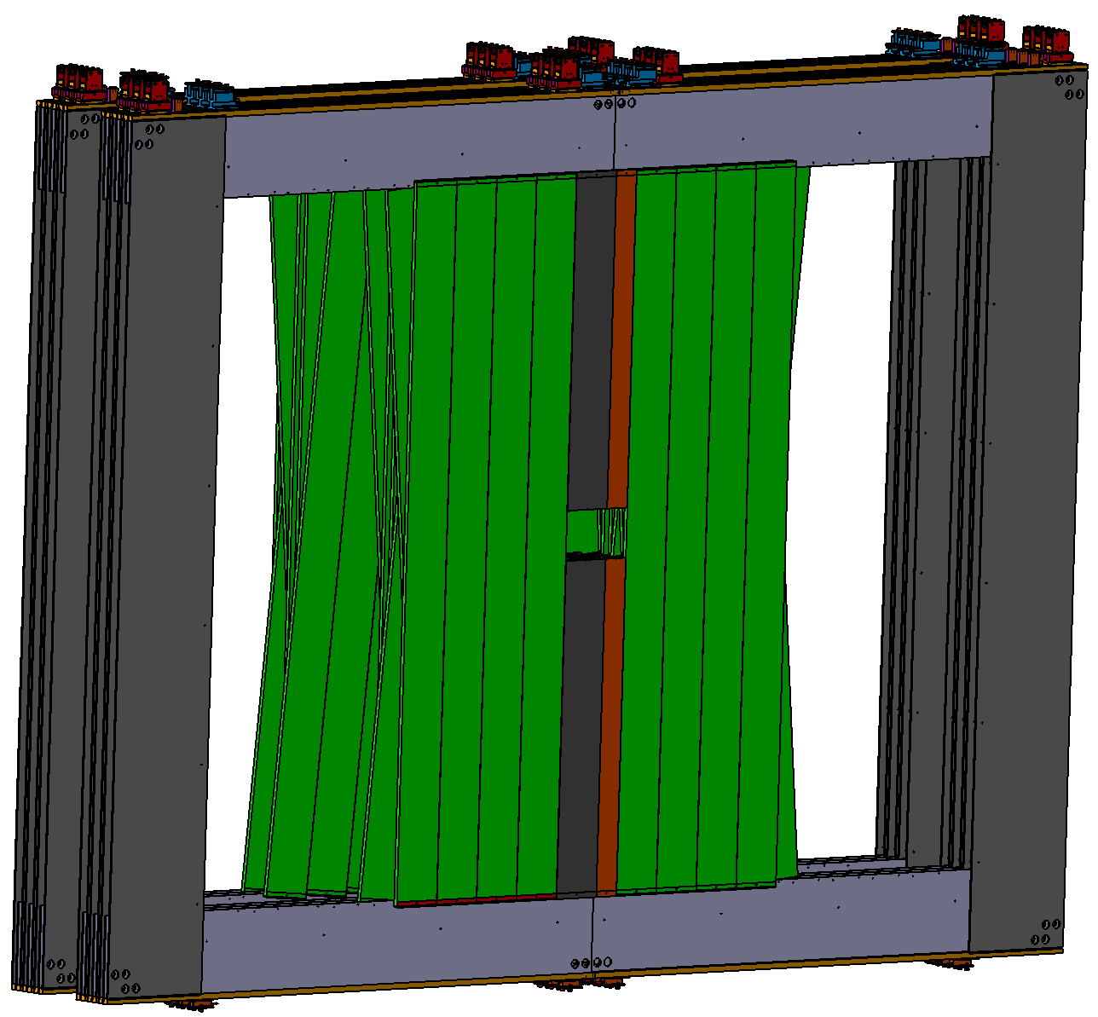
MUST Support Structure and transport to the CBM cave

Slide 2
Support frame for the MUST Detector
Contents:
General overview
First design of MUST support frame
MUST transport from GSI to FAIR
possible solutions:
Transport via LHCb transport frame
Transport of individual C-frames via trolleys
Transport by MUST support frame
…
Advanced design of MUST support frame including absorber 5
Open items and next steps

Slide 3
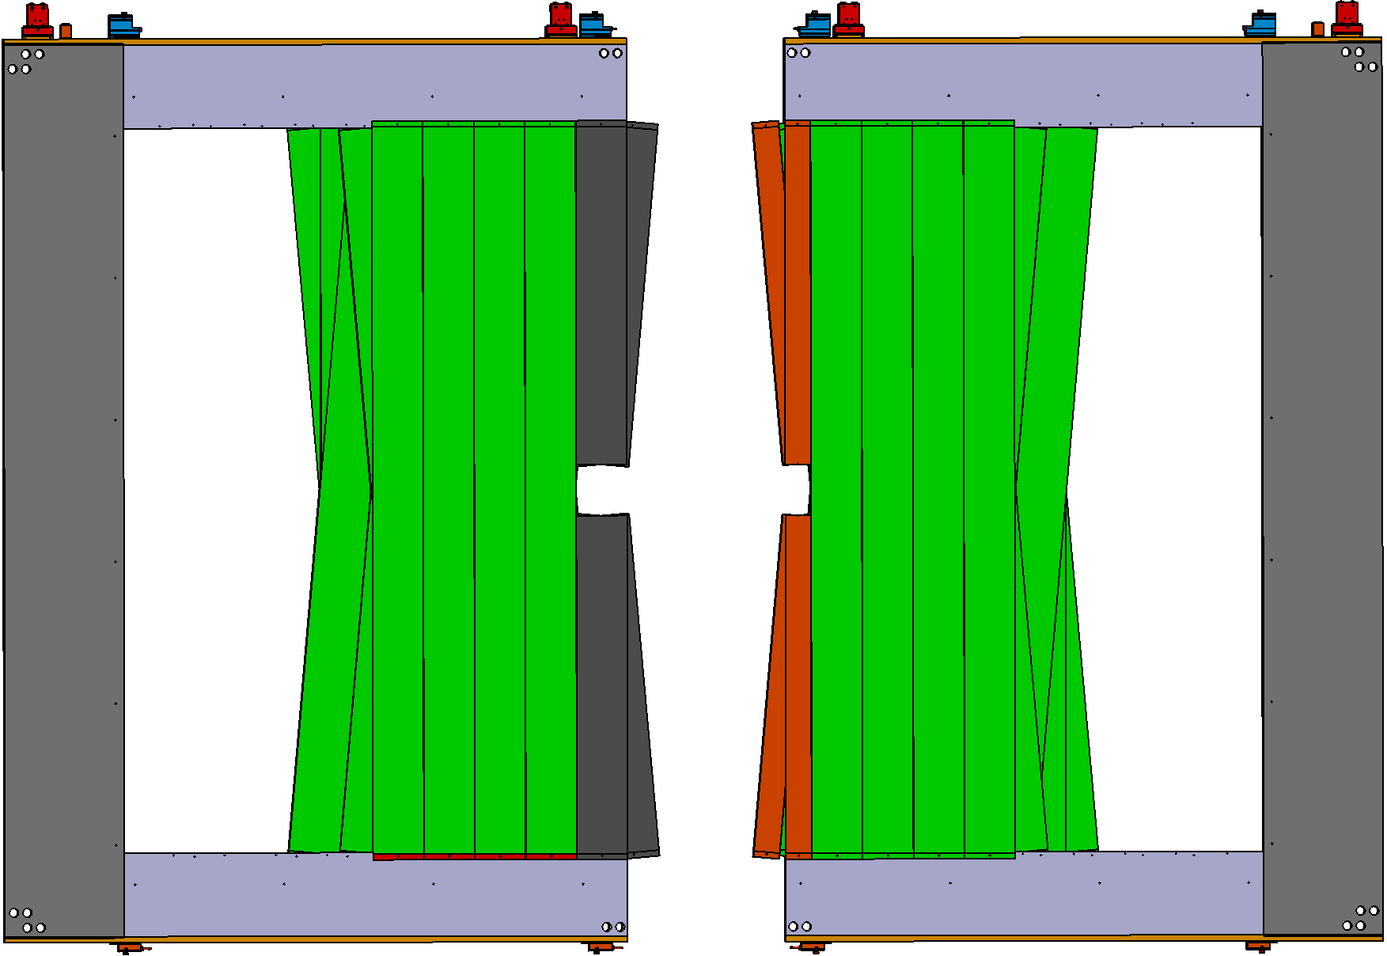
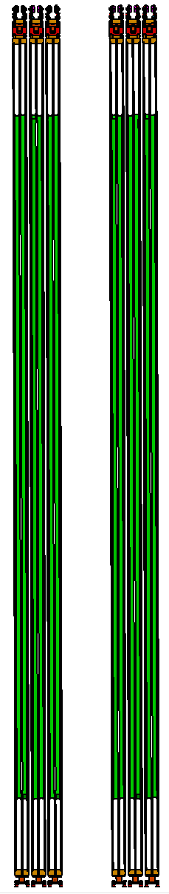
1. General overview
The MUST detector will consist of 12 C frames and will be divided in two stations.
4170 mm
4000 mm
Station 4
Station 3
C frame
C frame
6050 mm

Slide 4
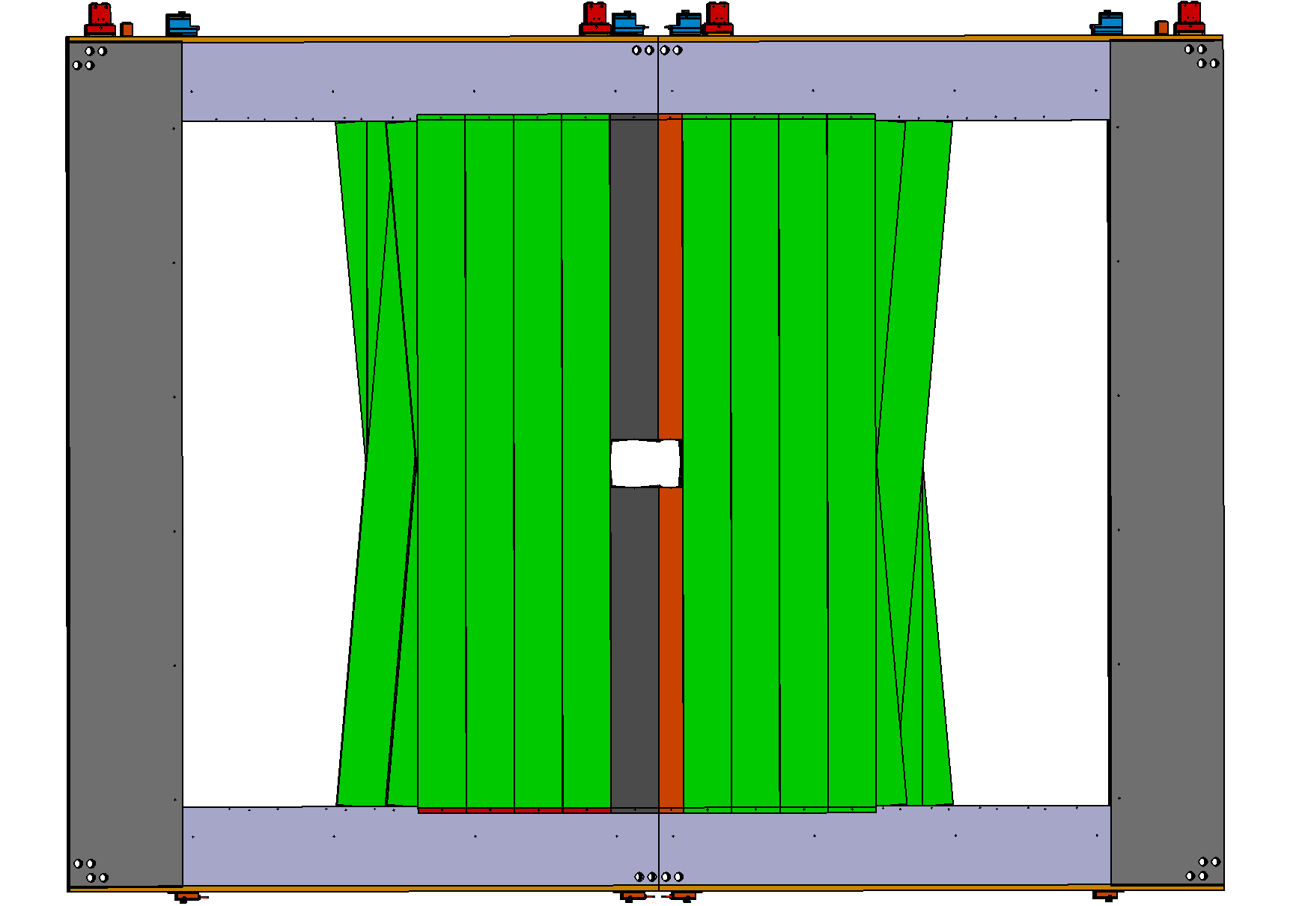
1. General overview
Each station consists of 6 C frames, 3 to the left and right of the beam axis. The position of modules are well defined via pin holes in the C frame.
8170 mm
Module type F
Module type S1
Module type S3

Slide 5
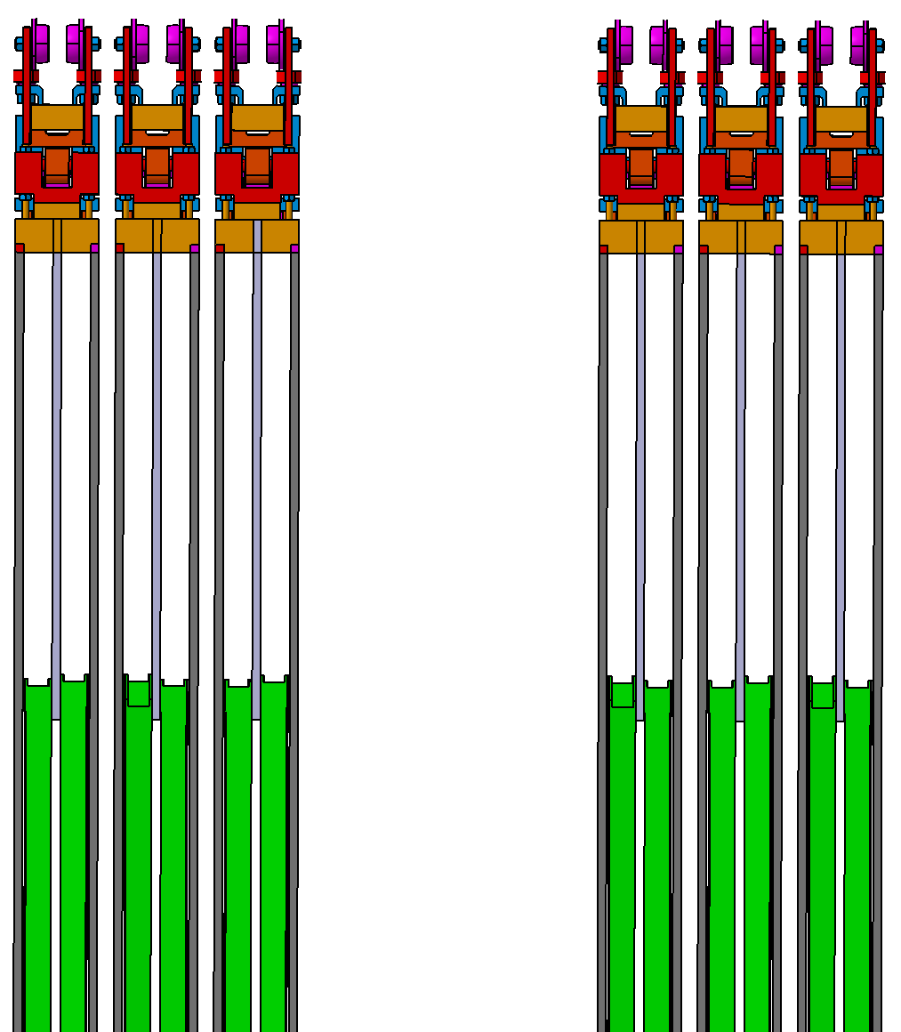
1. General overview
The gap between the C frames is 20 mm, the distance between C frames and absorber are 30 mm
3960 mm
End of the original MUCH detector
3785 mm
Station 4
Station 3
340 mm
360 mm
340 mm
2920 mm
100 mm
Mechanical
guides
IP
Station 4
Station 3
Apart from minor adjustments,
the layout corresponds to the original MUCH layout.
The layout is not yet final and is subject to change.
Simulations need to be done.

Slide 6
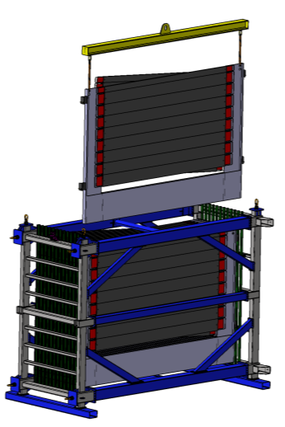
2. First design of MUST support frame
Requirements:
Supplementary:
The support frame must carry the C frames.
The design must prevent the absorbers from tipping over, even in the event of seismic activity.
The frame must be compatible with the existing C-frame guides.
Because the outer tracker transport frame is probably too large for the gate of the CBM hall, optionally, the holding structure could also serve as a transport device for the C-frames.
GSI
FAIR
Support frame
CBM hall

Slide 7
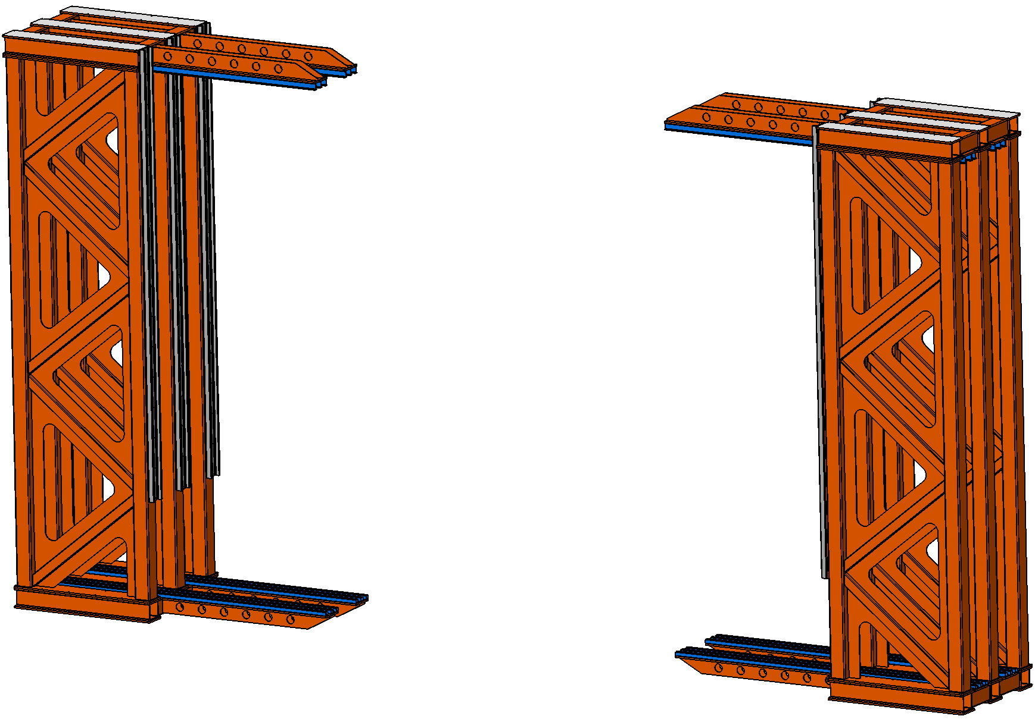
2. First design of MUST support frame
Proposal and first design:
The support frame is divided in two similar structures, left and right of the beam axis.
The left part carries the left frames of station 3 and 4, the other part the right frames of station 3 and 4.

Slide 8
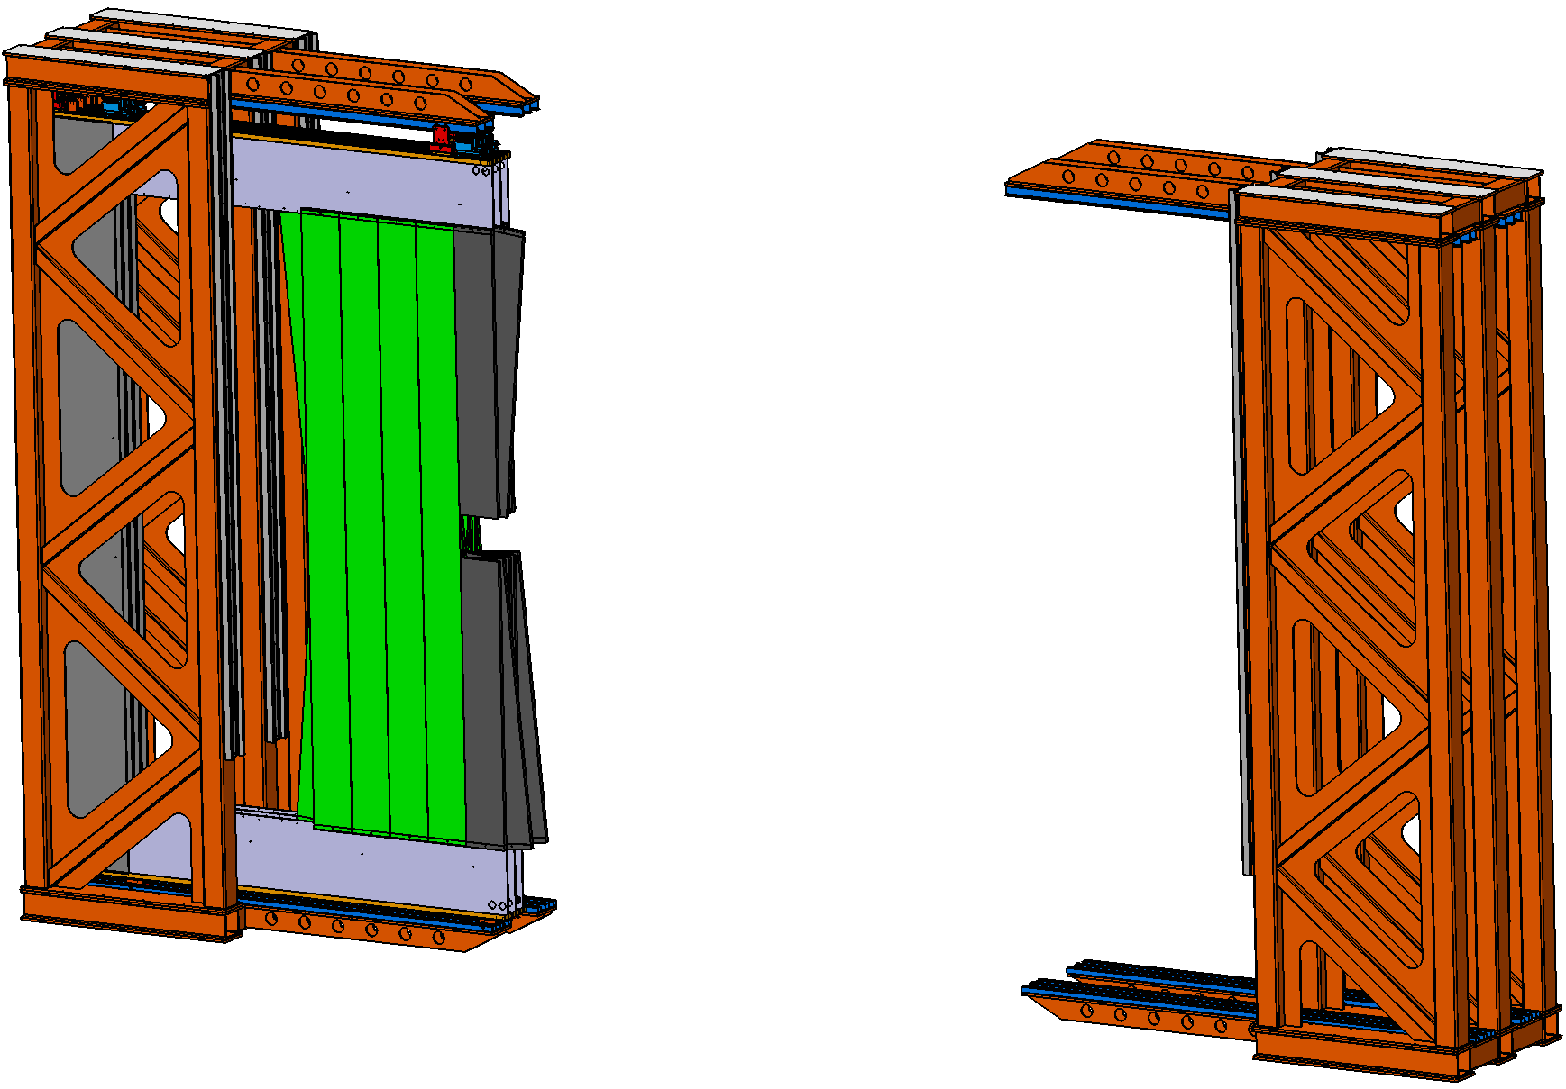
2. First design of MUST support frame
Proposal and first design:
The support frame is divided in two similar structures, left and right of the beam axis.
The left part carries the left frames of station 3 and 4, the other part the right frames of station 3 and 4.

Slide 9
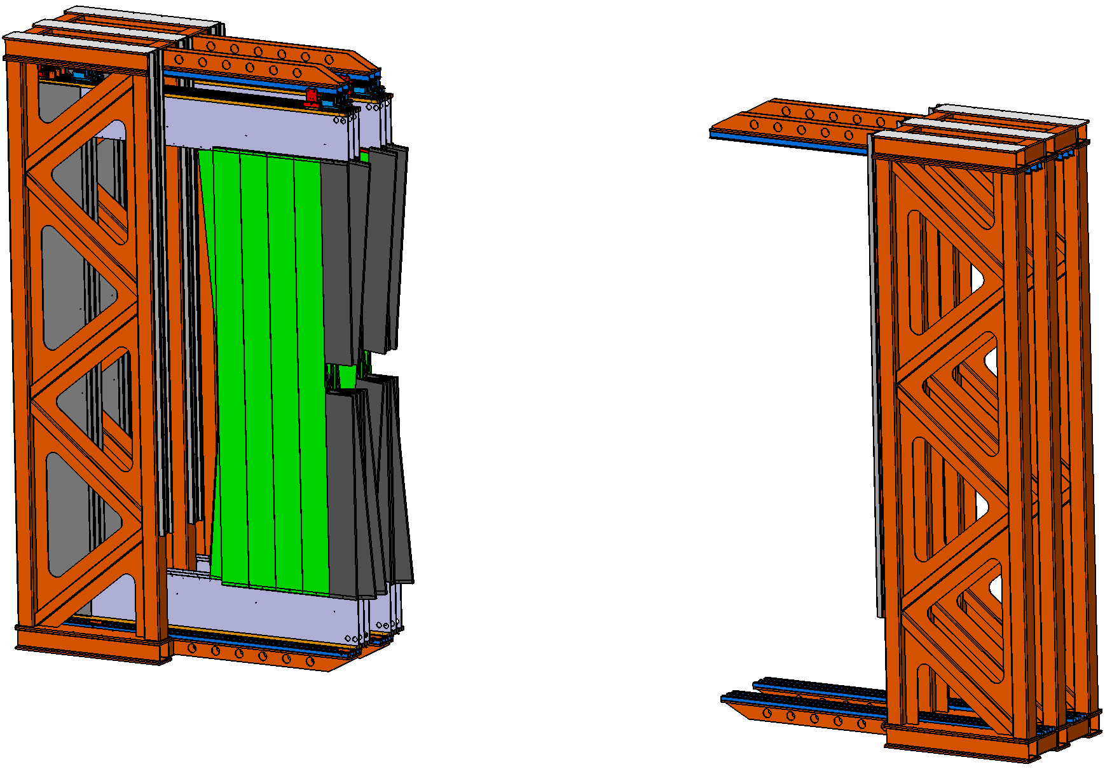
2. First design of MUST support frame
Proposal and first design:
The support frame is divided in two similar structures, left and right of the beam axis.
The left part carries the left frames of station 3 and 4, the other part the right frames of station 3 and 4.

Slide 10
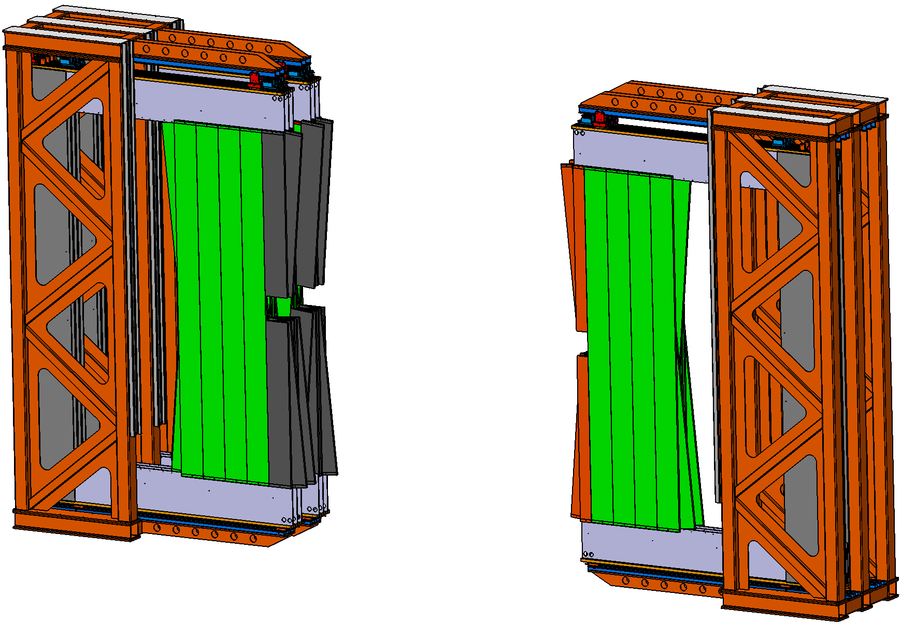
2. First design of MUST support frame
Proposal and first design:
The support frame is divided in two similar structures, left and right of the beam axis.
The left part carries the left frames of station 3 and 4, the other part the right frames of station 3 and 4.

Slide 11
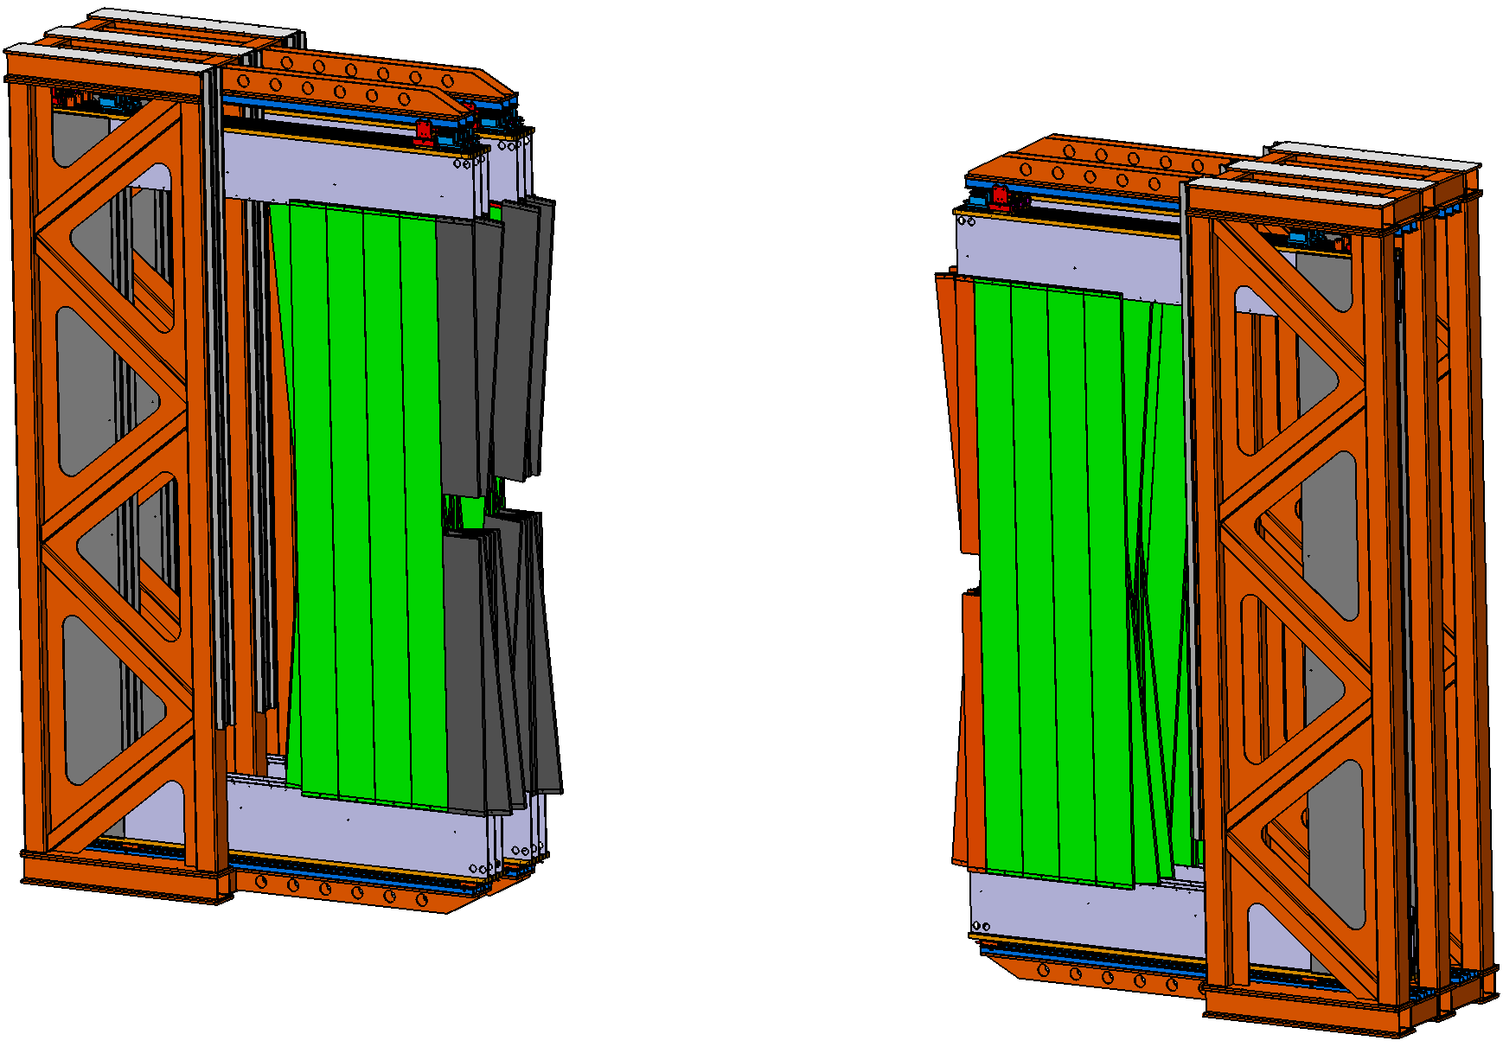
2. First design of MUST support frame
Proposal and first design:
The support frame is divided in two similar structures, left and right of the beam axis.
The left part carries the left frames of station 3 and 4, the other part the right frames of station 3 and 4.

Slide 12
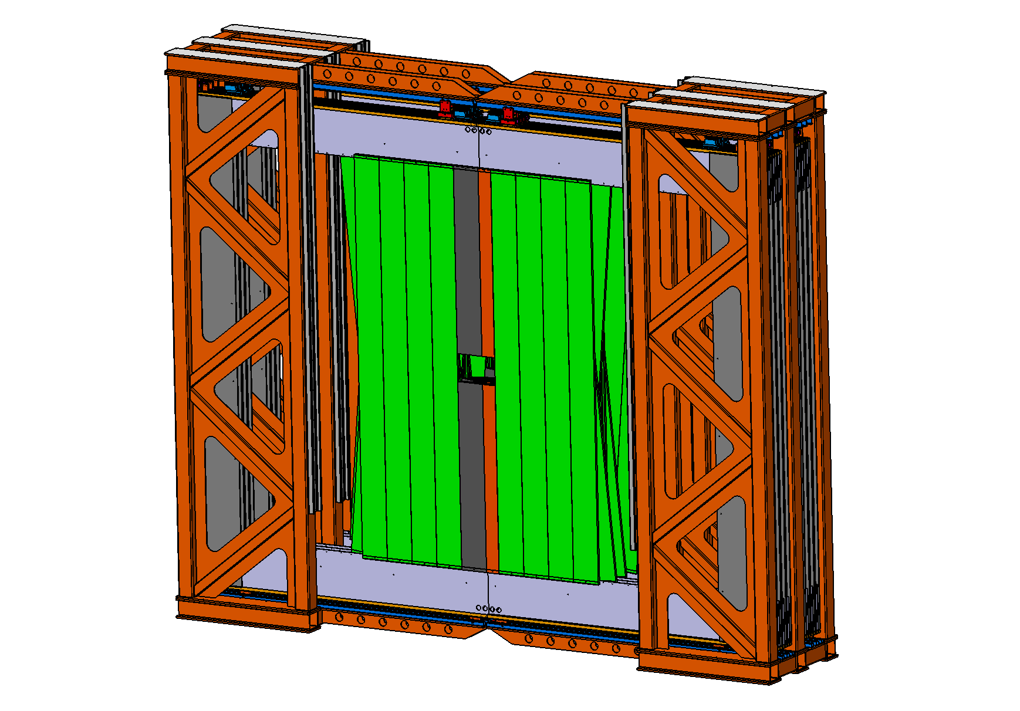
2. First design of MUST support frame
Proposal and first design:
The support frame is divided in two similar structures, left and right of the beam axis.
The left part carries the left frames of station 3 and 4, the other part the right frames of station 3 and 4.

Slide 13
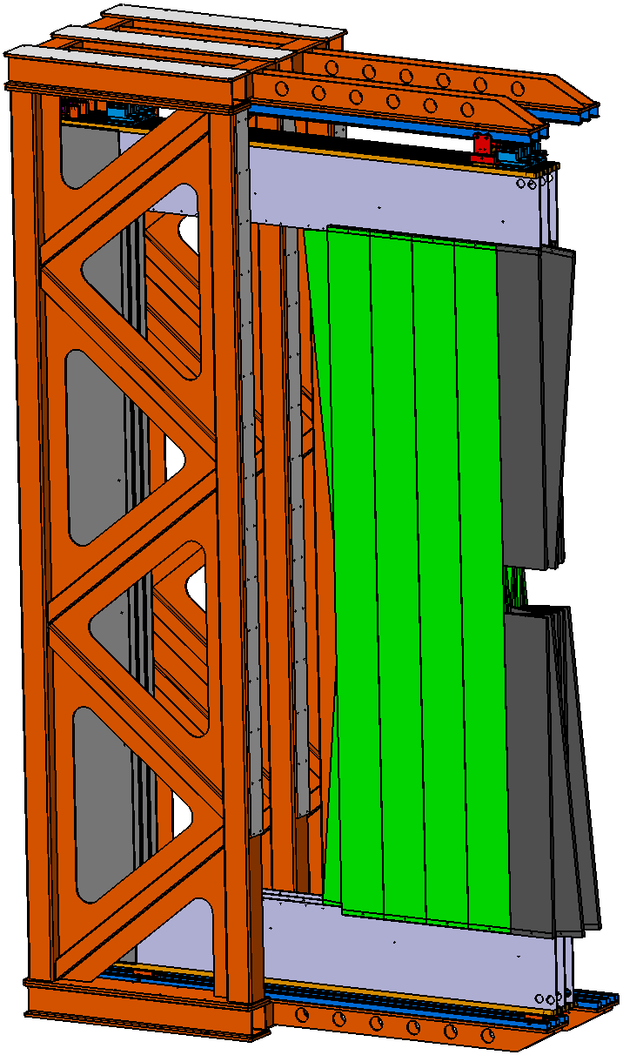
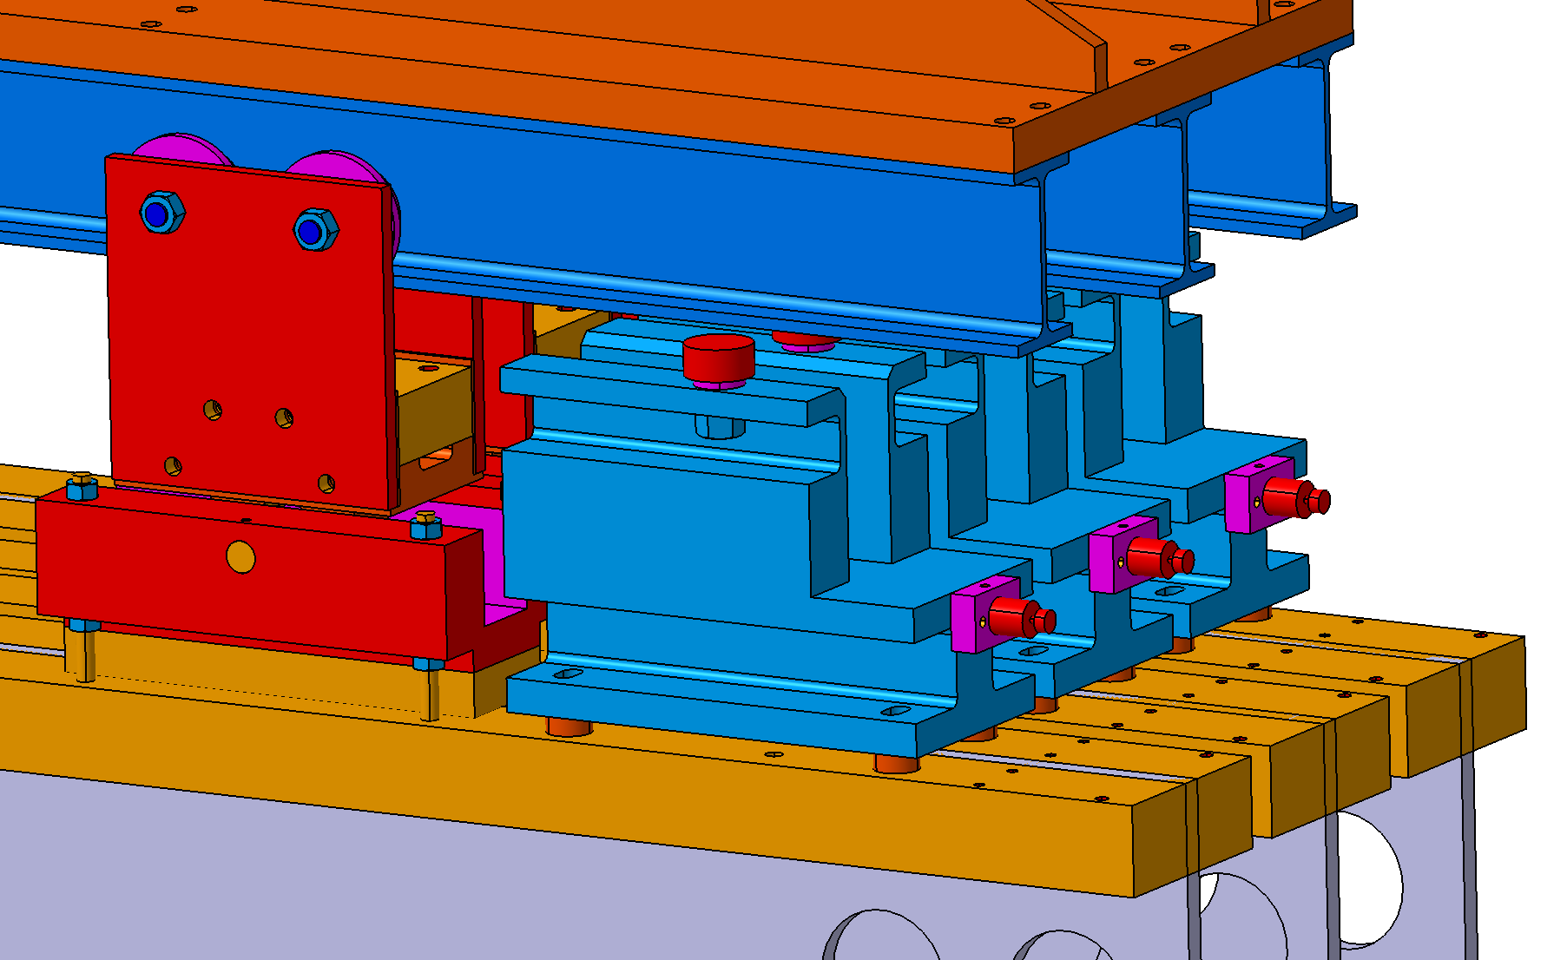
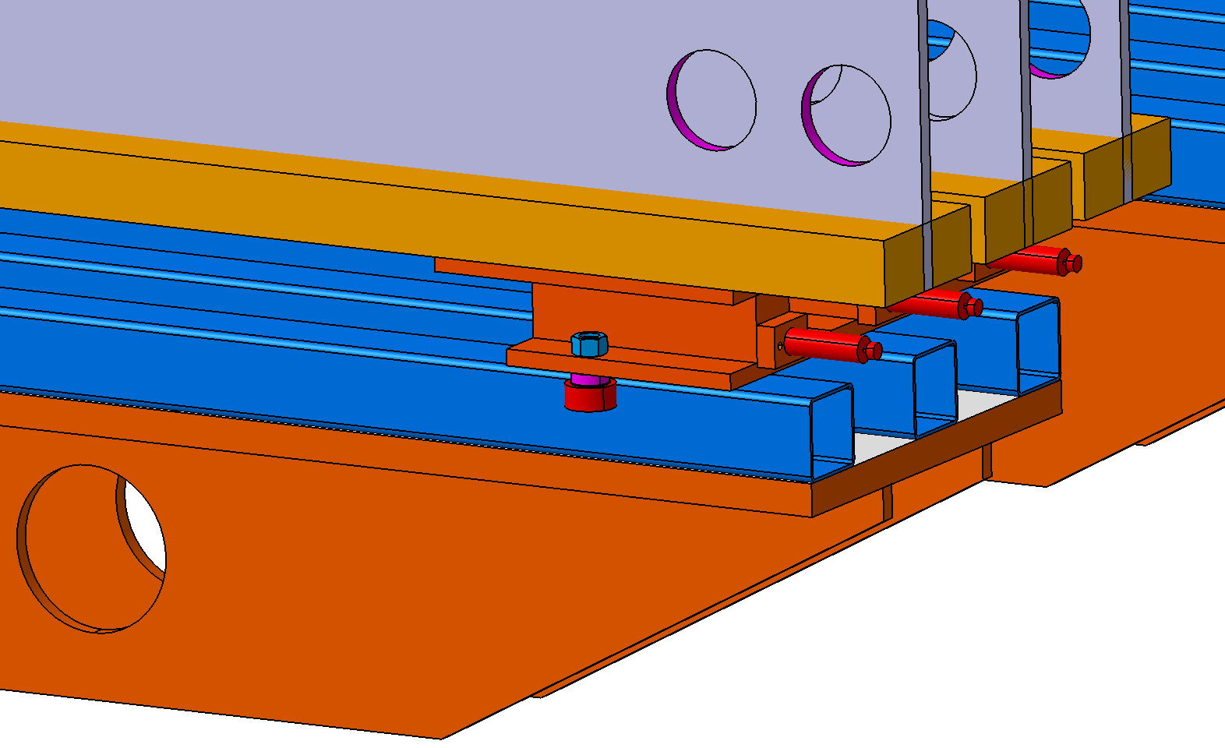
2. First design of MUST support frame
Proposal and first design:
For guiding the C frames we used the same profiles and roller as at LHCb.
The Roller are already attached to the C frames.
Standard IPE beam
LHCb Roller
C frame
C frame
Standard hollow profile
LHCb guiding Roller

Slide 14
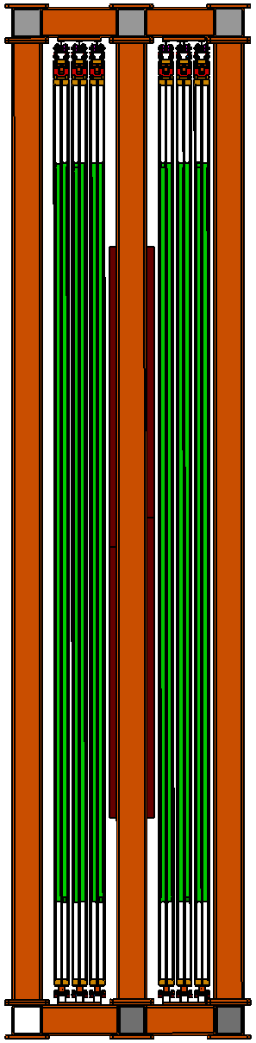
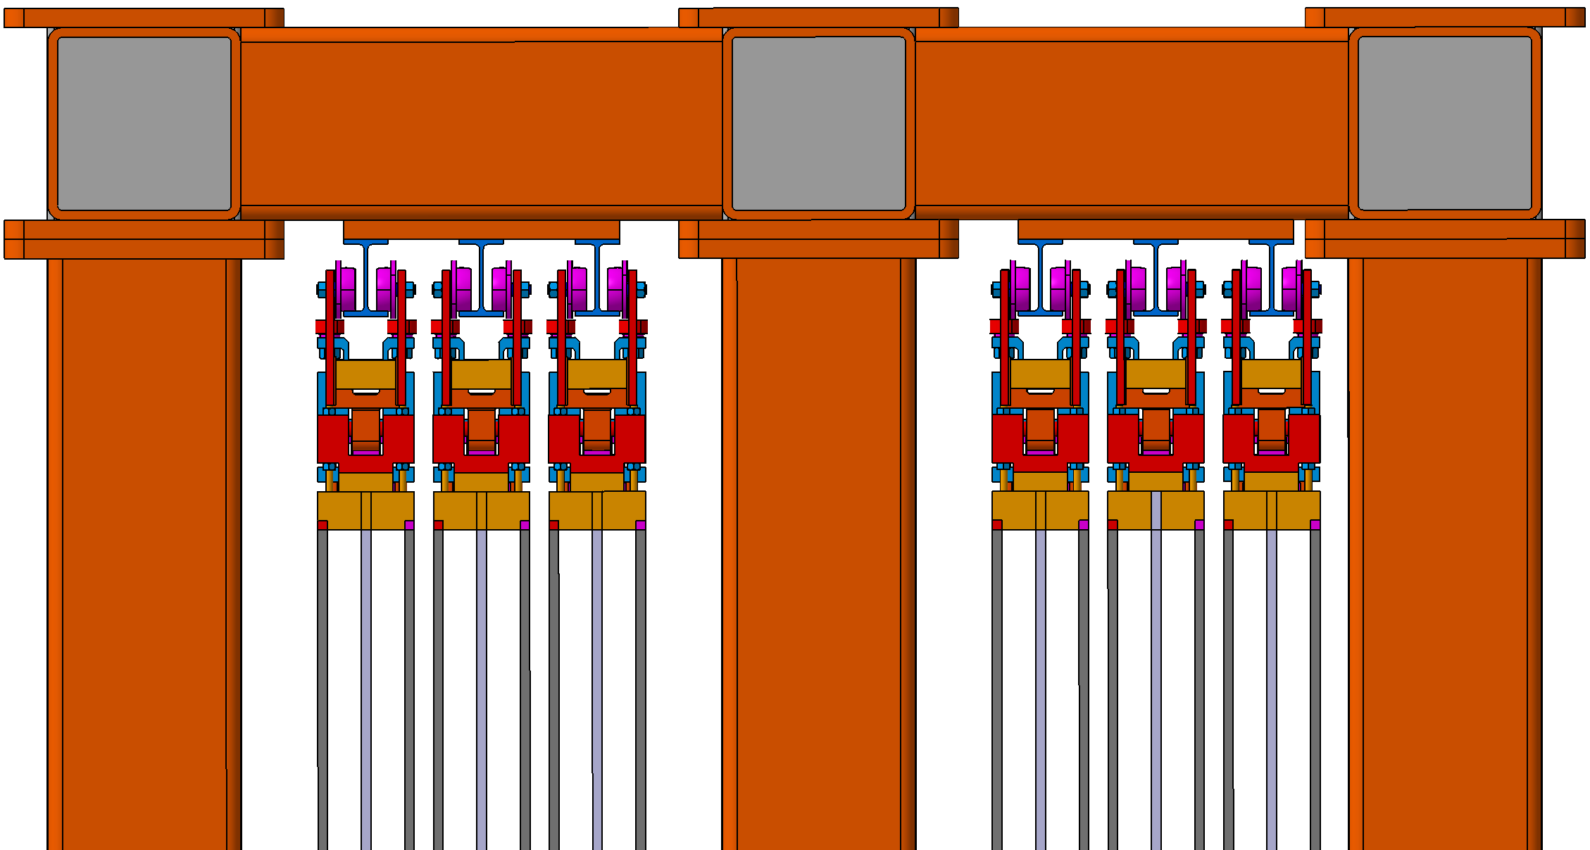
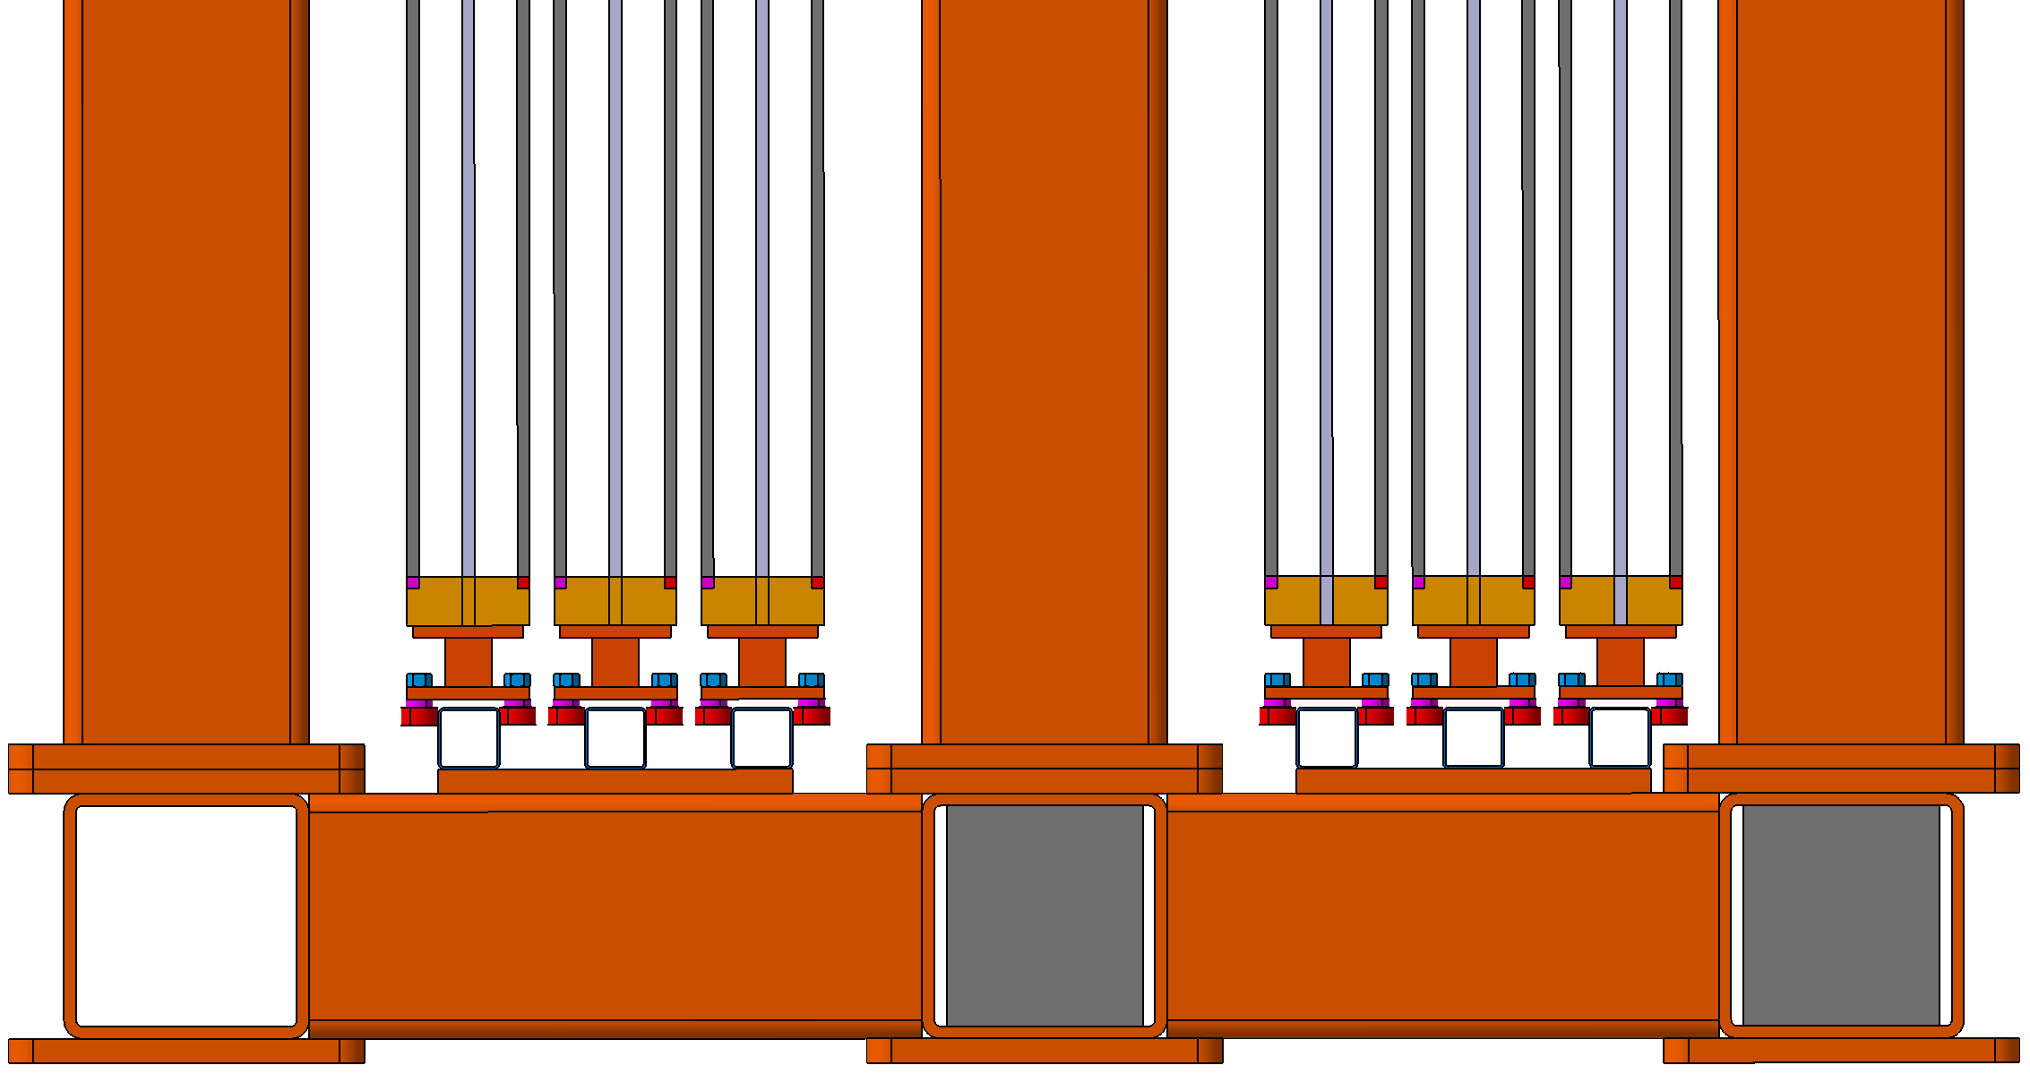
2. First design of MUST support frame
Proposal and first design:
The design is configured so that the C-frames can be removed laterally at any time.
Station 4
Station 3

Slide 15
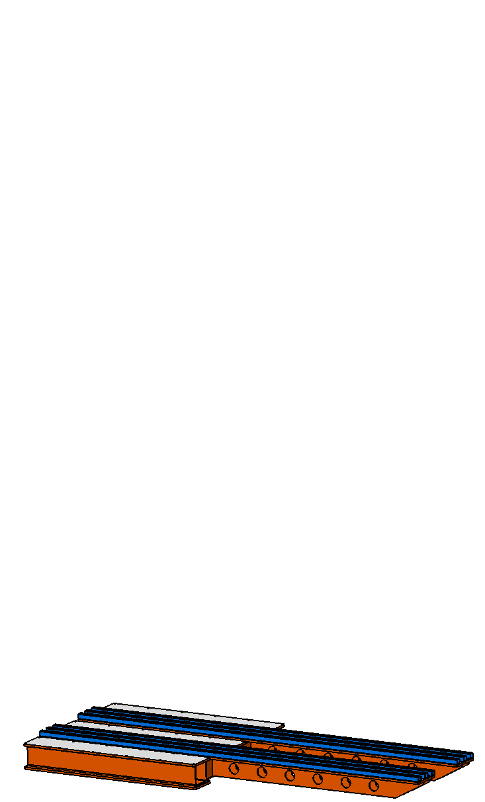
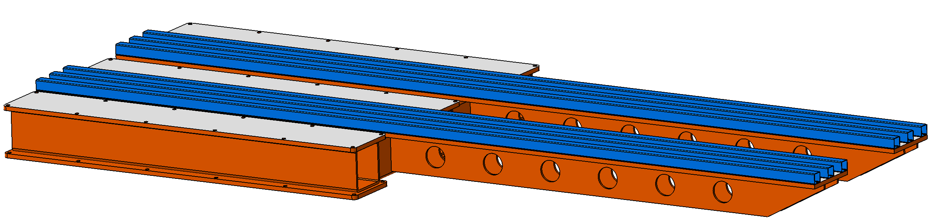
2. First design of MUST support frame
The two similar structures themselves consist of various welded assemblies.
1 x base platform bottom

Slide 16
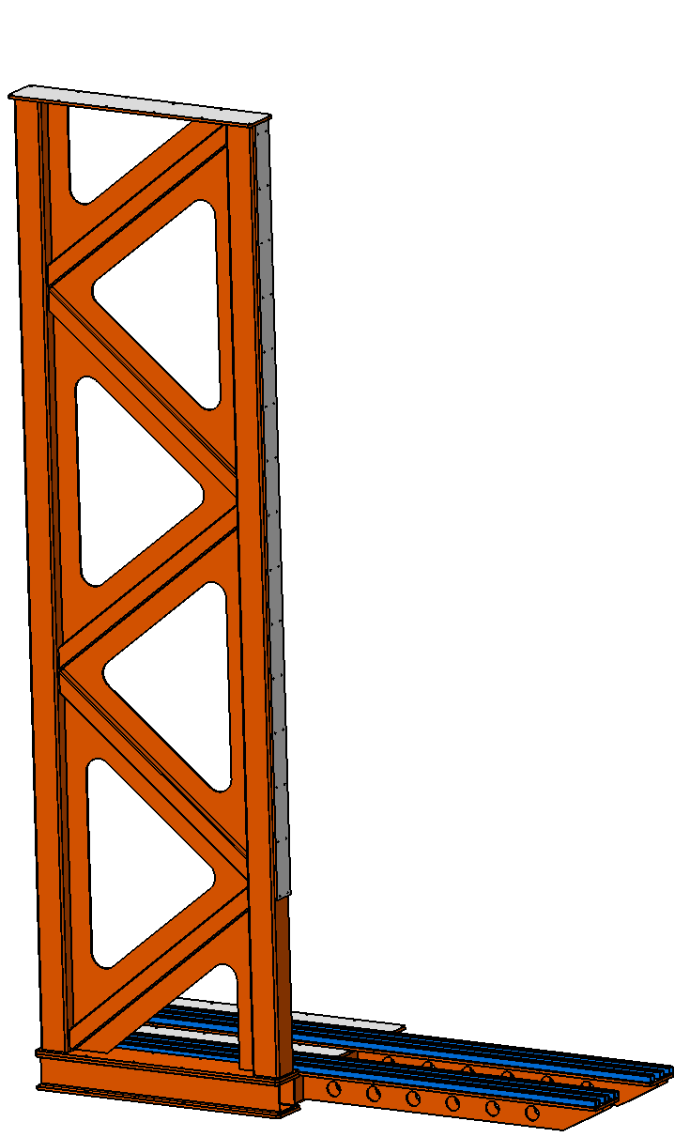
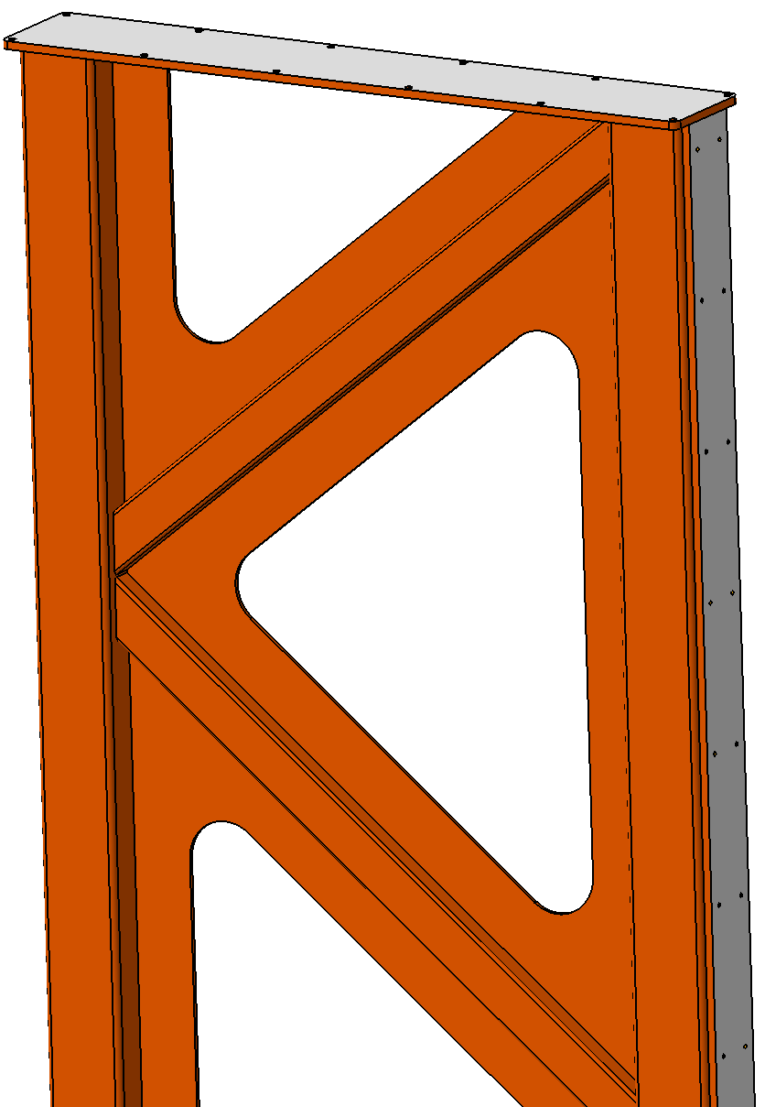
2. First design of MUST support frame
The two similar structures themselves consist of various welded assemblies.
3 x pillar frame

Slide 17
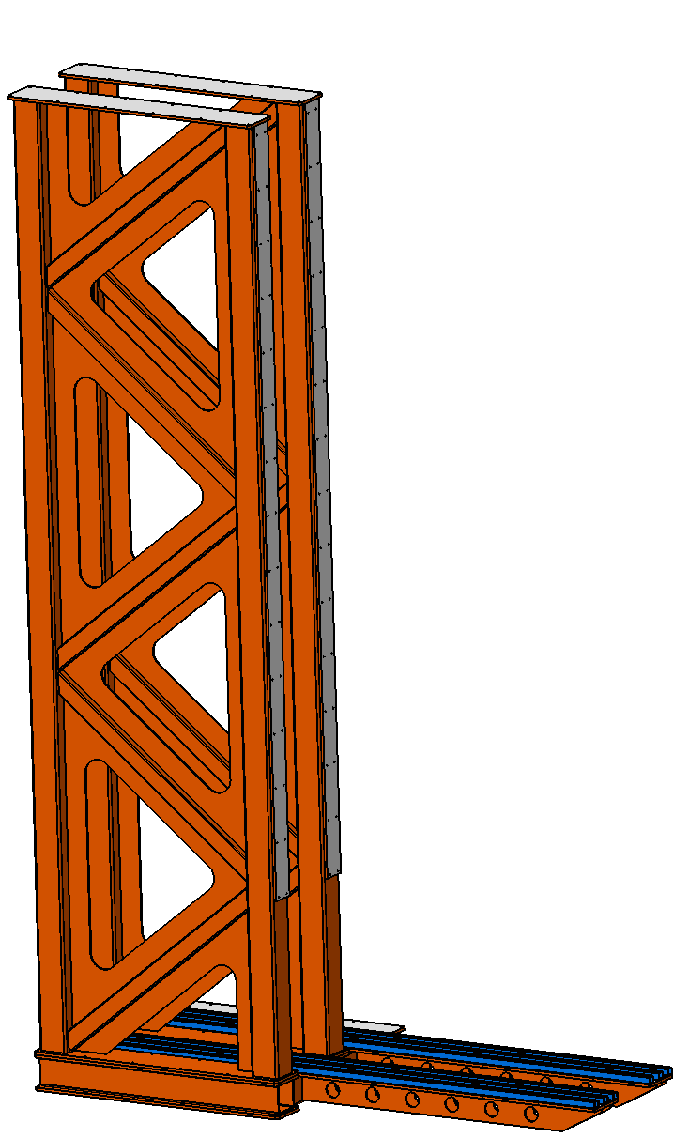
2. First design of MUST support frame
The two similar structures themselves consist of various welded assemblies.
3 x pillar frame

Slide 18
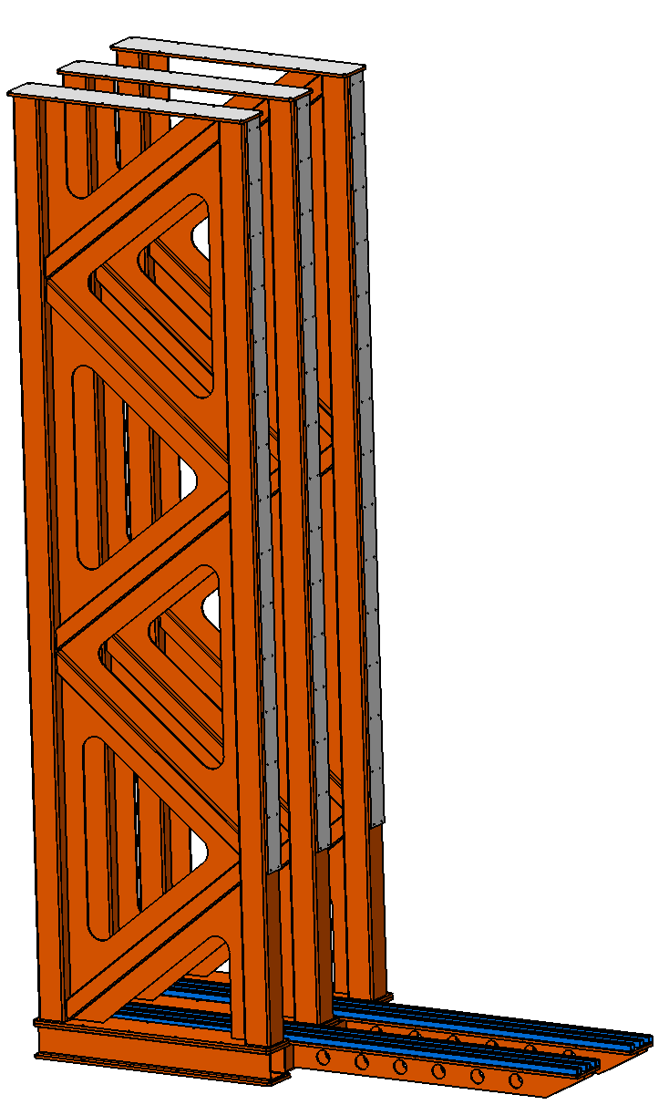
2. First design of MUST support frame
The two similar structures themselves consist of various welded assemblies.
3 x pillar frame

Slide 19
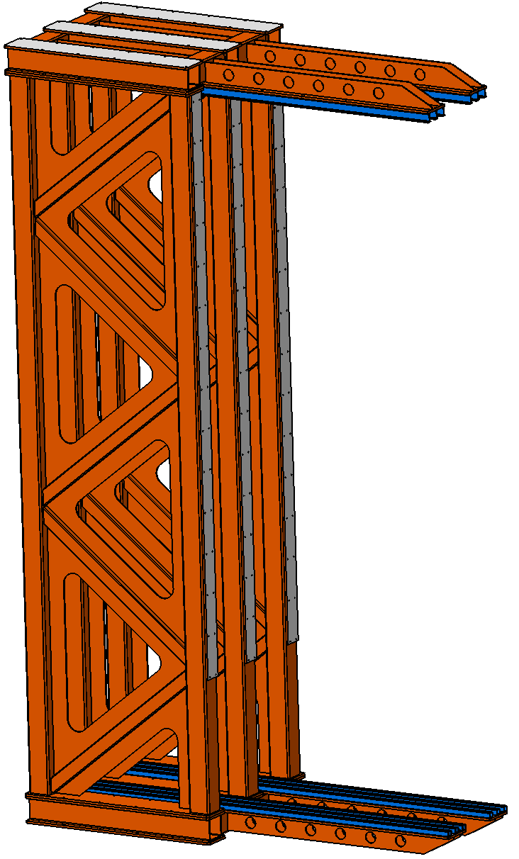
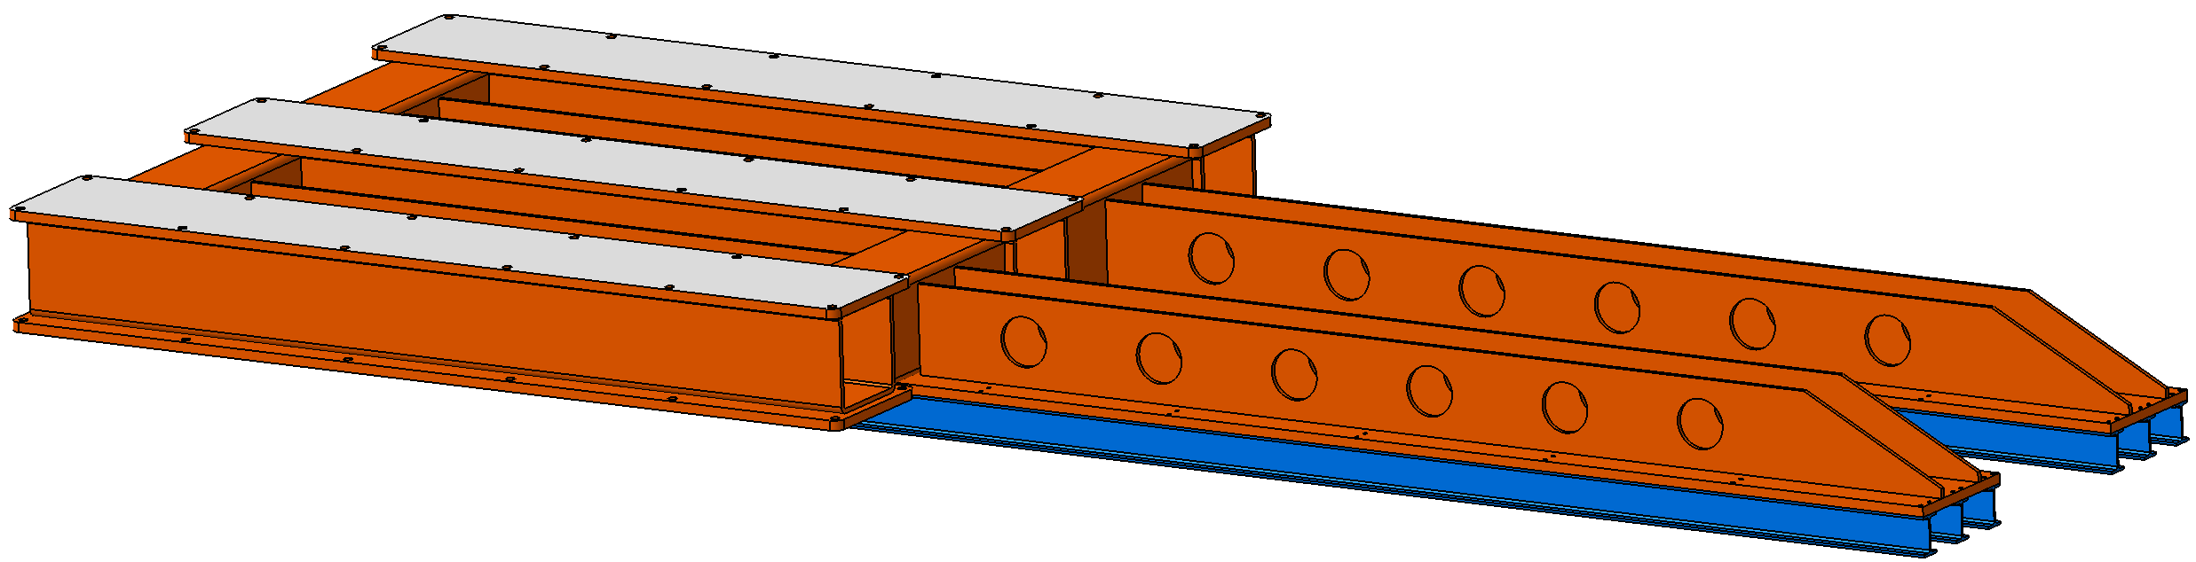
2. First design of MUST support frame
The two similar structures themselves consist of various welded assemblies.
1 x base platform top

Slide 20
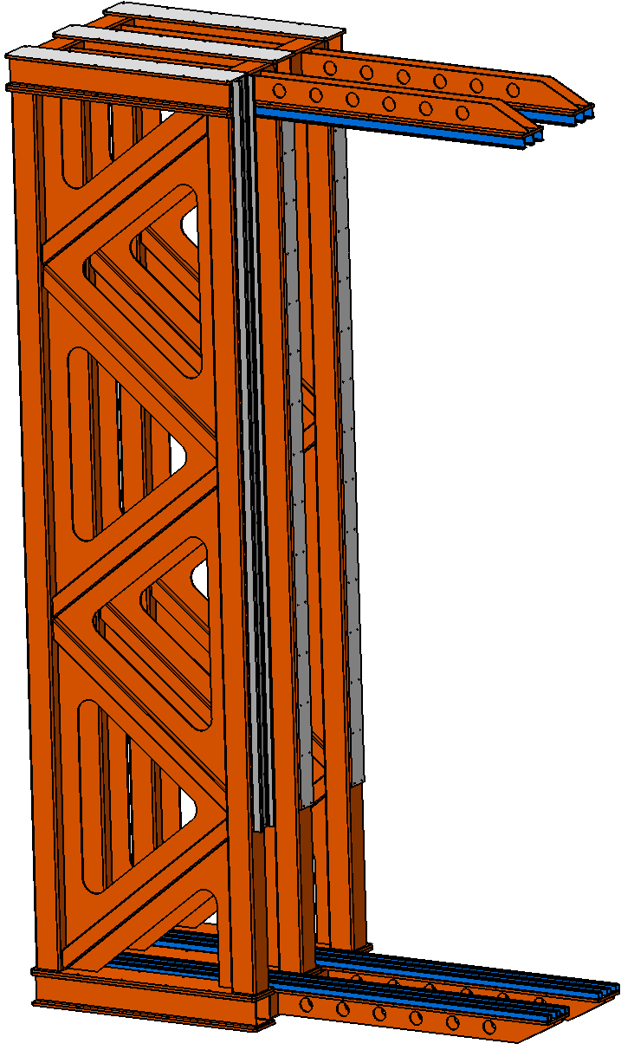
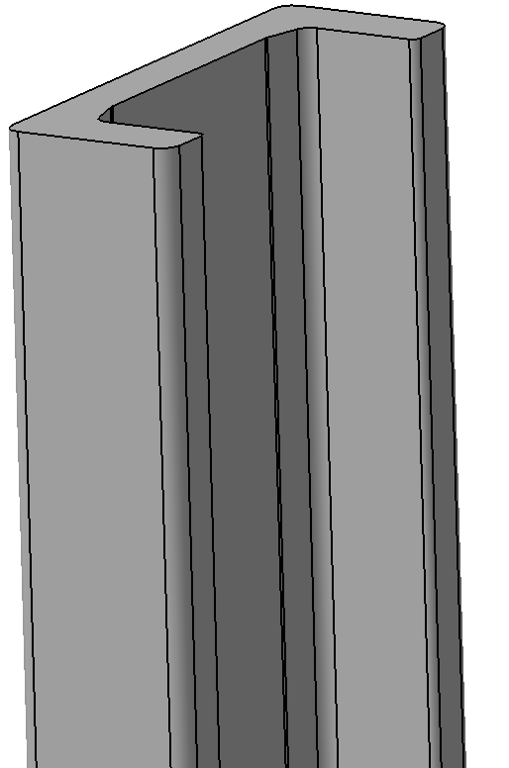
2. First design of MUST support frame
The two similar structures themselves consist of various welded assemblies.
3 x standard U profile

Slide 21

2. First design of MUST support frame
The two similar structures themselves consist of various welded assemblies.
3 x standard U profile

Slide 22
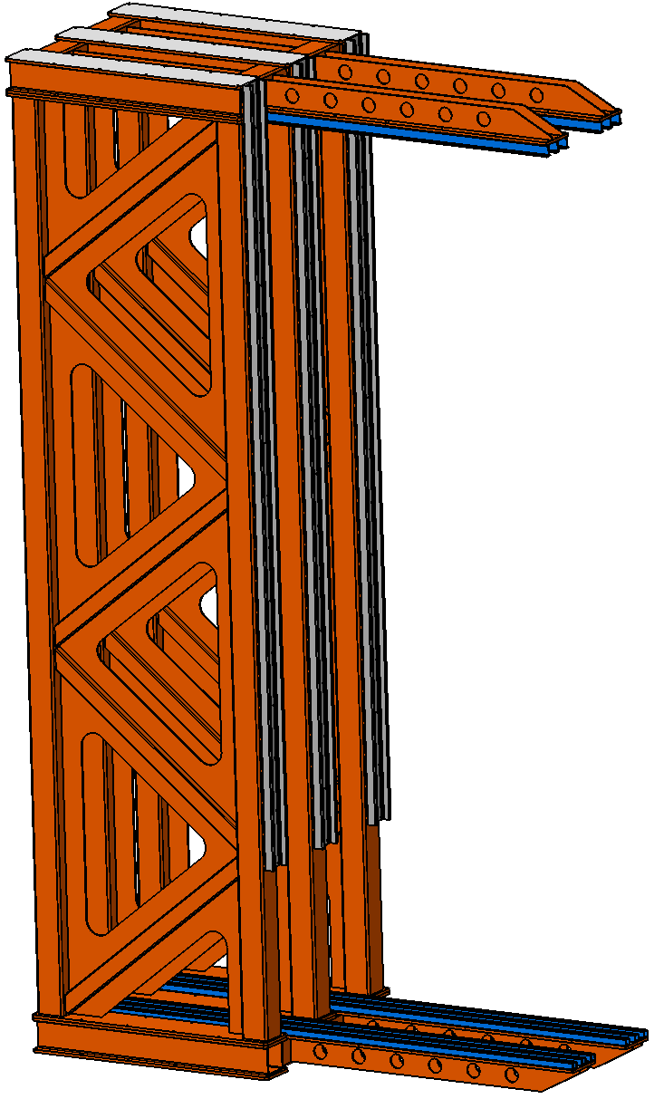
2. First design of MUST support frame
The two similar structures themselves consist of various welded assemblies.
3 x standard U profile

Slide 23
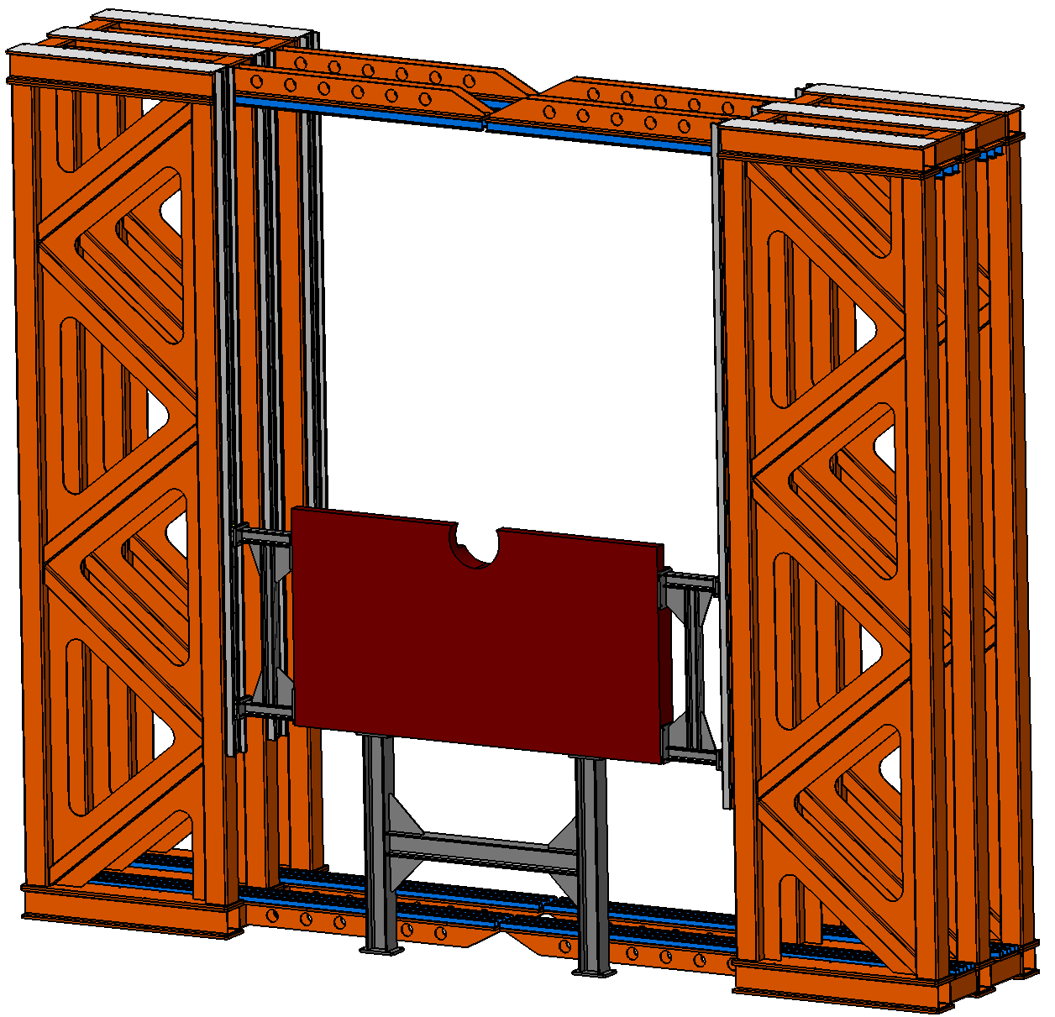
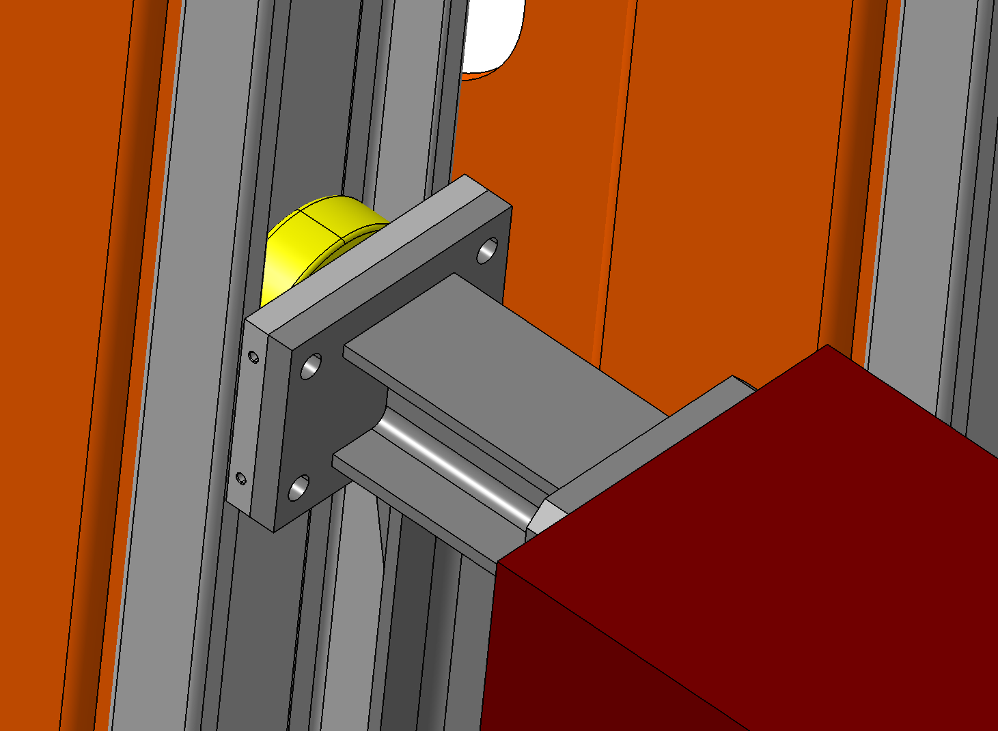
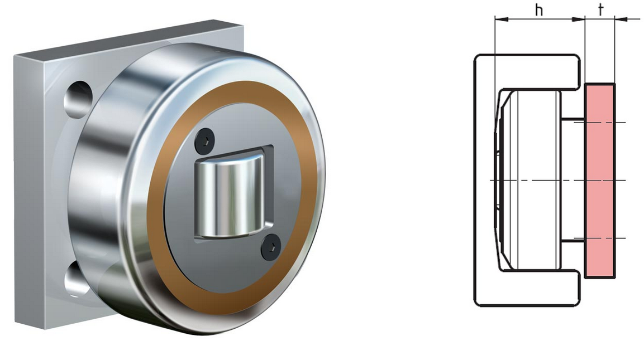
2. First design of MUST support frame
The standard U-profiles serve to guide and horizontally secure the absorbers via Roller.
This allows the absorbers to be installed and removed independently, without endangering the C-frames.
The geometry of the absorbers corresponds to the original MUCH layout.
Radial roller
U profile
Roller
Axial roller

Slide 24
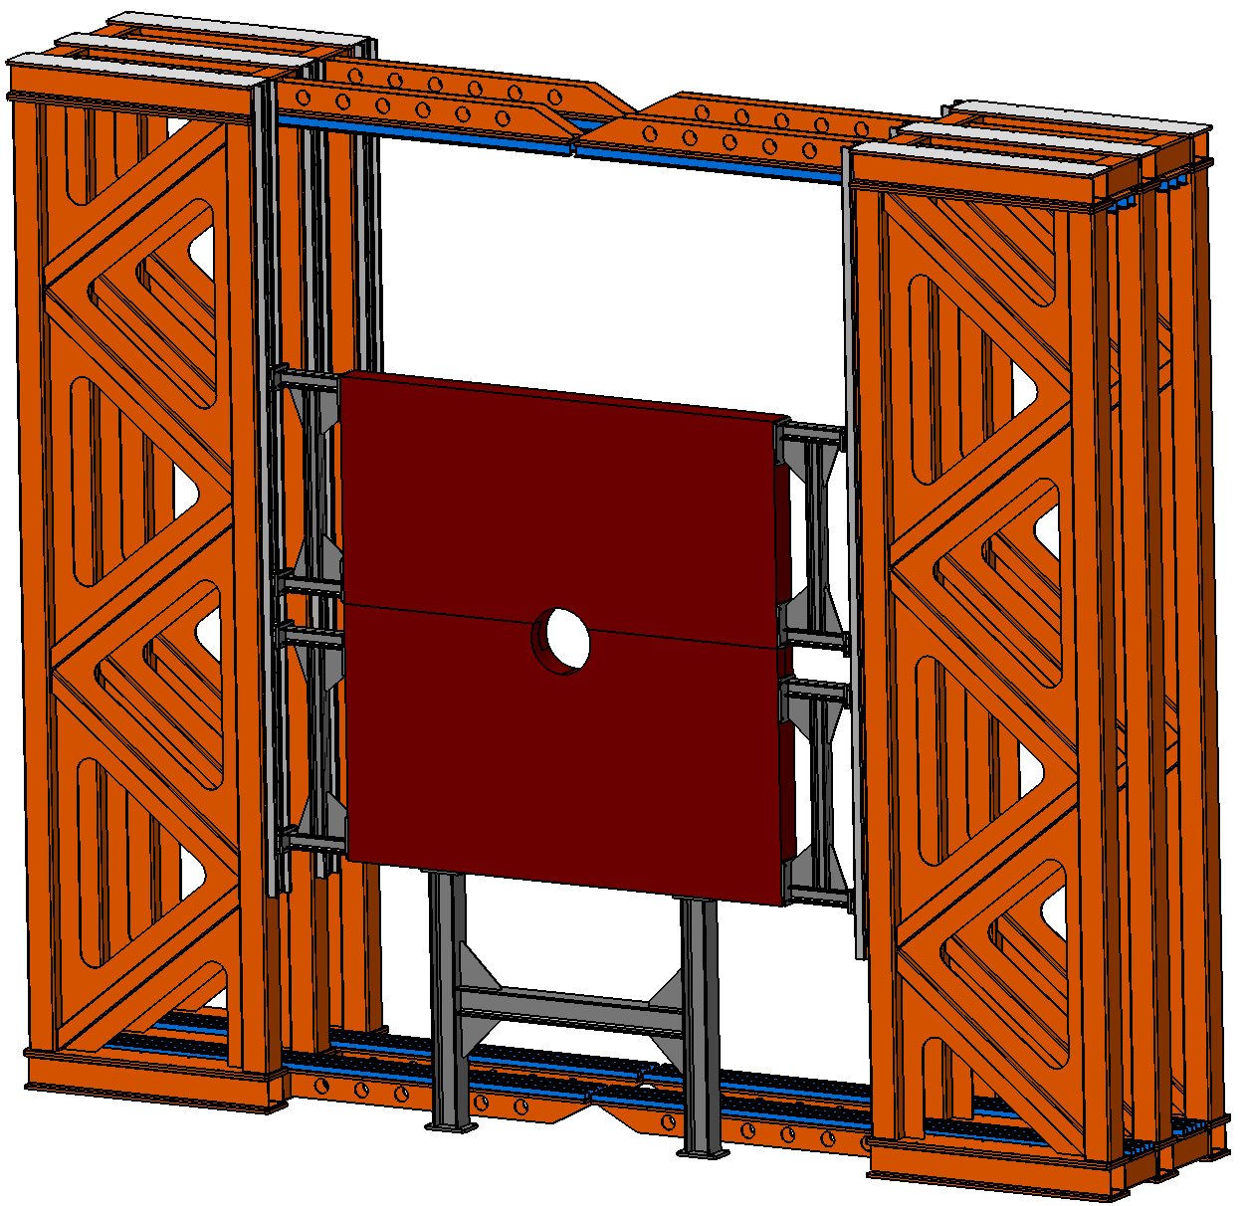
2. First design of MUST support frame
The standard U-profiles serve to guide and horizontally secure the absorbers via Roller.
This allows the absorbers to be installed and removed independently, without endangering the C-frames.
The geometry of the absorbers corresponds to the original MUCH design.
Radial roller
U profile
Roller
Axial roller

Slide 25
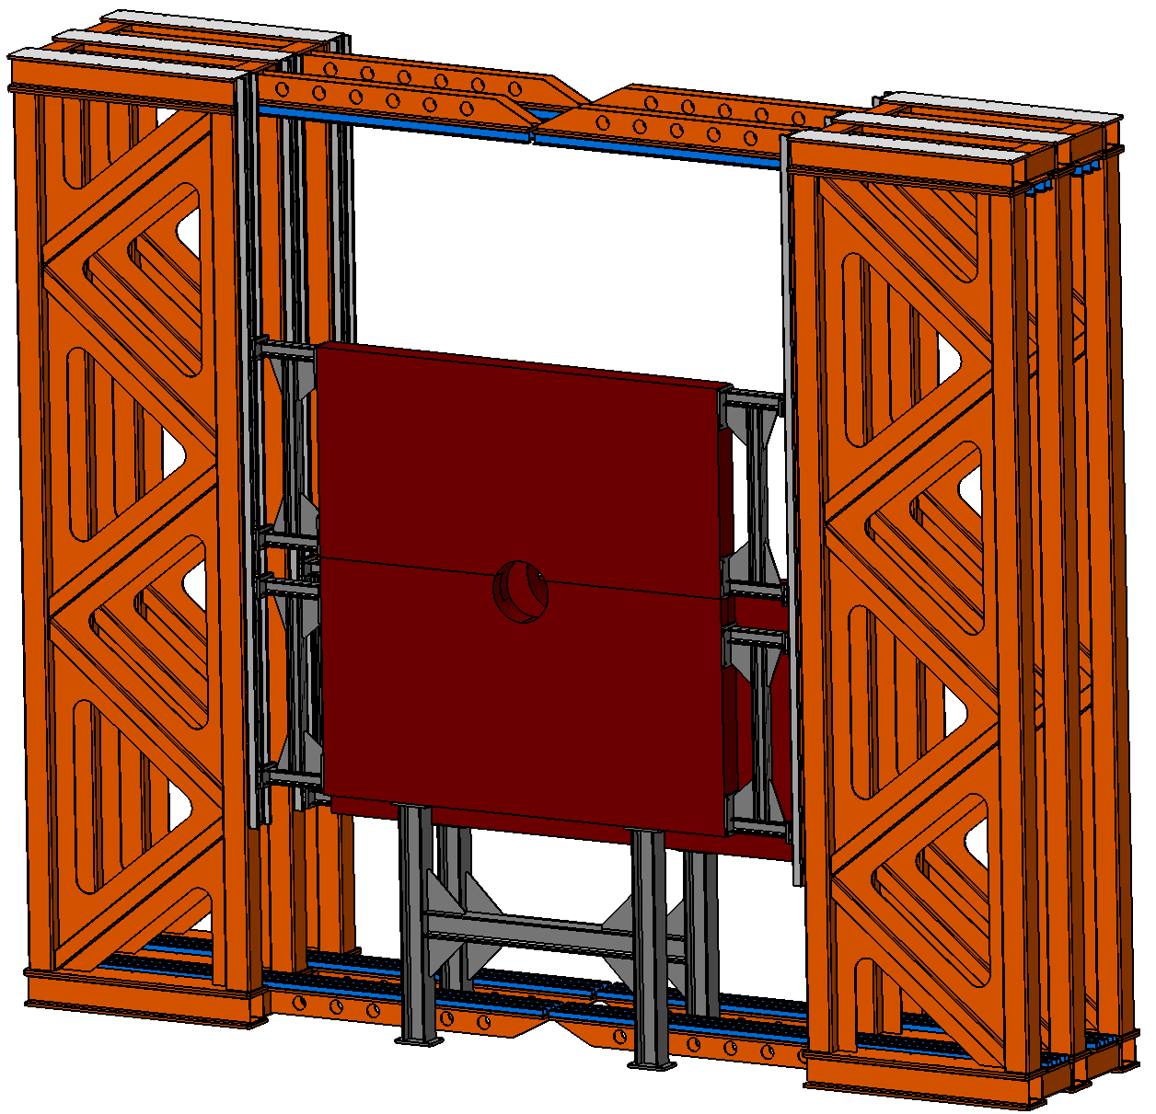
2. First design of MUST support frame
The standard U-profiles serve to guide and horizontally secure the absorbers via Roller.
This allows the absorbers to be installed and removed independently, without endangering the C-frames.
The geometry of the absorbers corresponds to the original MUCH design.
Radial roller
U profile
Roller
Axial roller

Slide 26
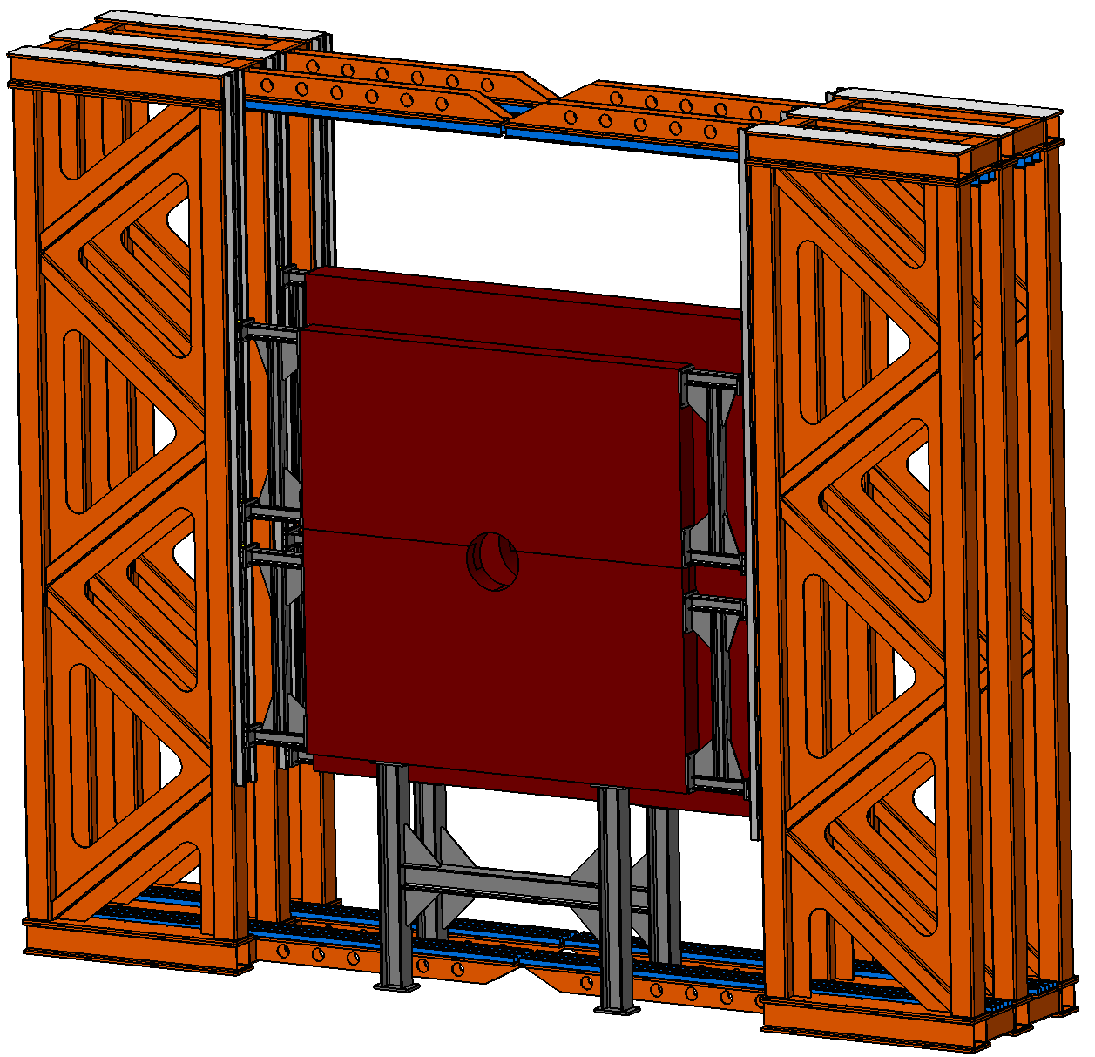
2. First design of MUST support frame
The standard U-profiles serve to guide and horizontally secure the absorbers via Roller.
This allows the absorbers to be installed and removed independently, without endangering the C-frames.
The geometry of the absorbers corresponds to the original MUCH design.
Radial roller
U profile
Roller
Axial roller

Slide 27
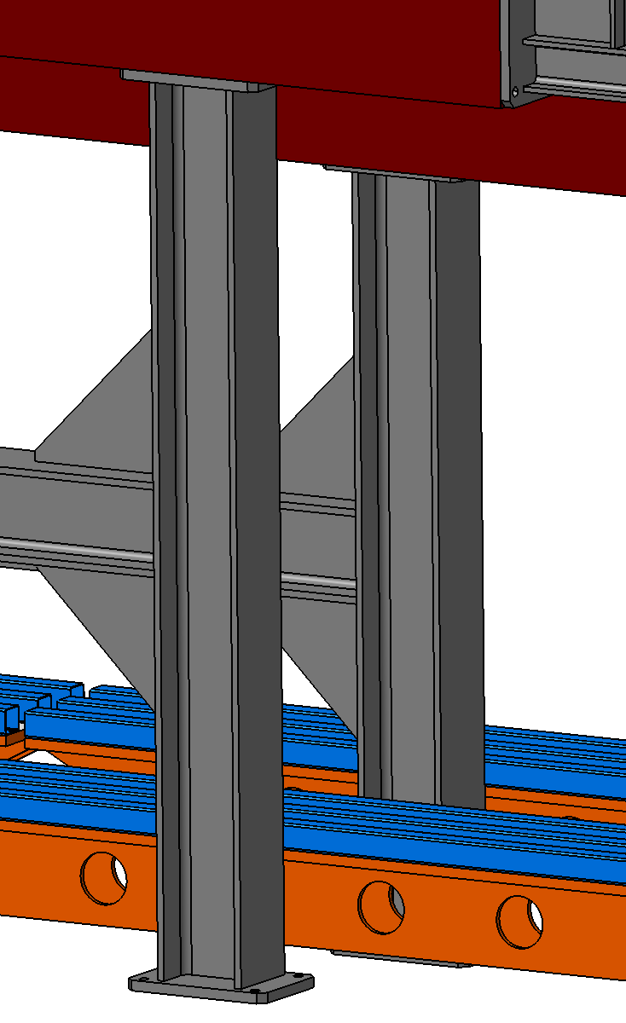
2. First design of MUST support frame
While the horizontal forces are absorbed by the support frame, the main load is transferred to the lower CBM infrastructure via supports on the lower absorber.
Absorber
Support
CBM Infrastructure

Slide 28
2. First design of MUST support frame
The following table shows a rough cost estimate.
Item | Costs | Comment
Support frame MUST (Weight approx. 20 tons)
Steel construction manufacturing | 70.000 EUR | Made of structural steel S235
Guide elements and heavy-duty rollers | 38.000 EUR
Static calculation | 4.000 EUR
Transport and assembly | 20.000 EUR | Screw connections, no welding
Total costs | 132.000 EUR

Slide 29
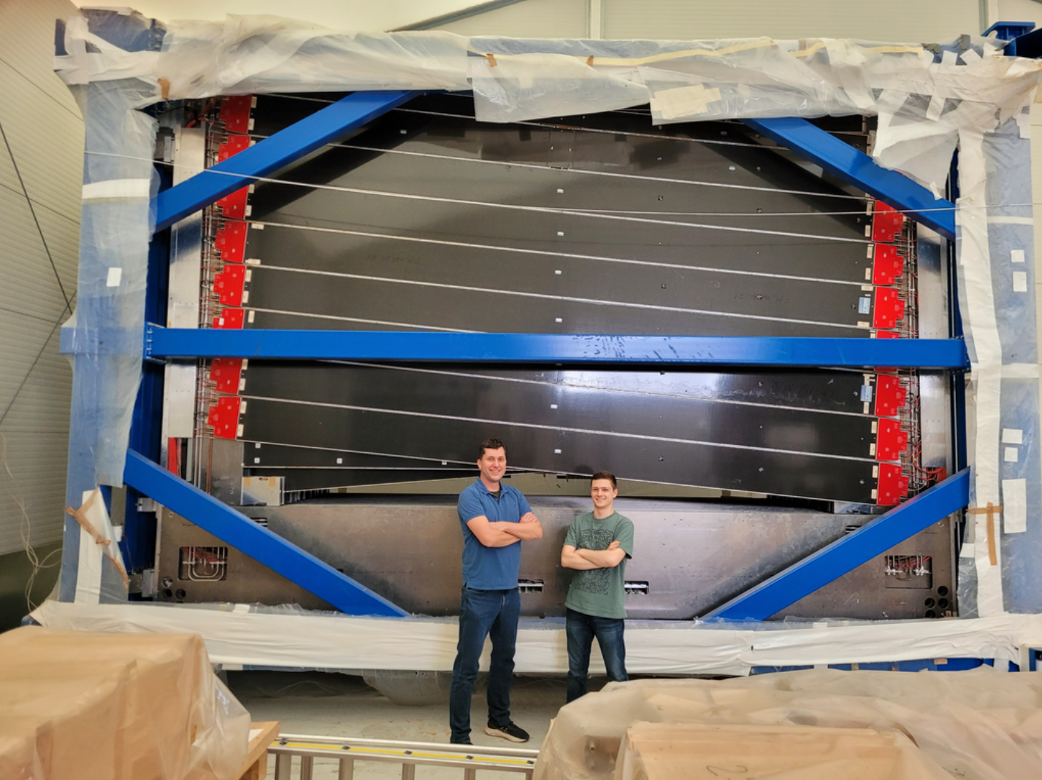
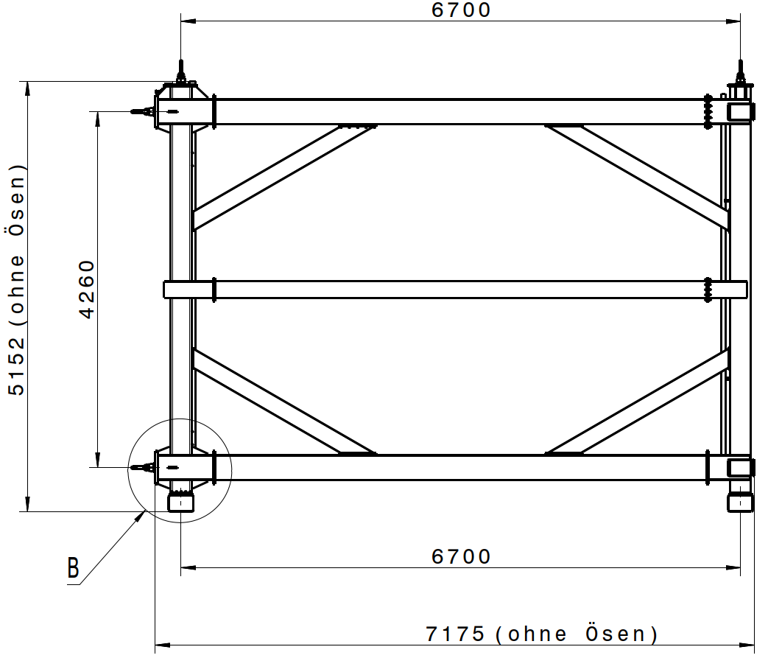
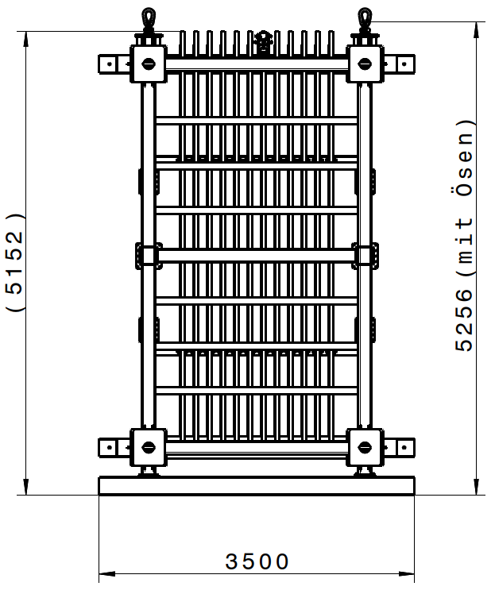
3. MUST transport from GSI to FAIR
Transport via LHCb OT transport frame
The C frames are currently located within the LHCb OT transport frame in the BE42 hall at GSI.
The easiest thing would be to transport the entire frame to the CBM Cave.
However, the transport frame is relatively tall at 5.152 m and likely won't fit through the truck entrance.
So the question is, can we somehow get the frame into the CBM cave?

Slide 30
3. MUST transport from GSI to FAIR
b) Transport of individual C-frames via trolleys
This short presentation shows two possible designs of trolleys for transporting and storing the C-frames of the LHCb Outer Tracker.
For the main frame of the car we choose aluminum profiles from ITEM.
These profiles allow a high degree of flexibility for later adjustments thanks to their groove system.
Since the ITEM profile is very common at GSI, they can be dismantled and storaged when they are no longer needed and reused later.
An assembly of welded profiles would be tailor-made for this purpose and would have to be disposed of afterwards.
For this reason, the use of ITEM profiles for this purpose, even if standard steel profiles. would be somewhat cheaper, has a financial and economic added value.

Slide 31
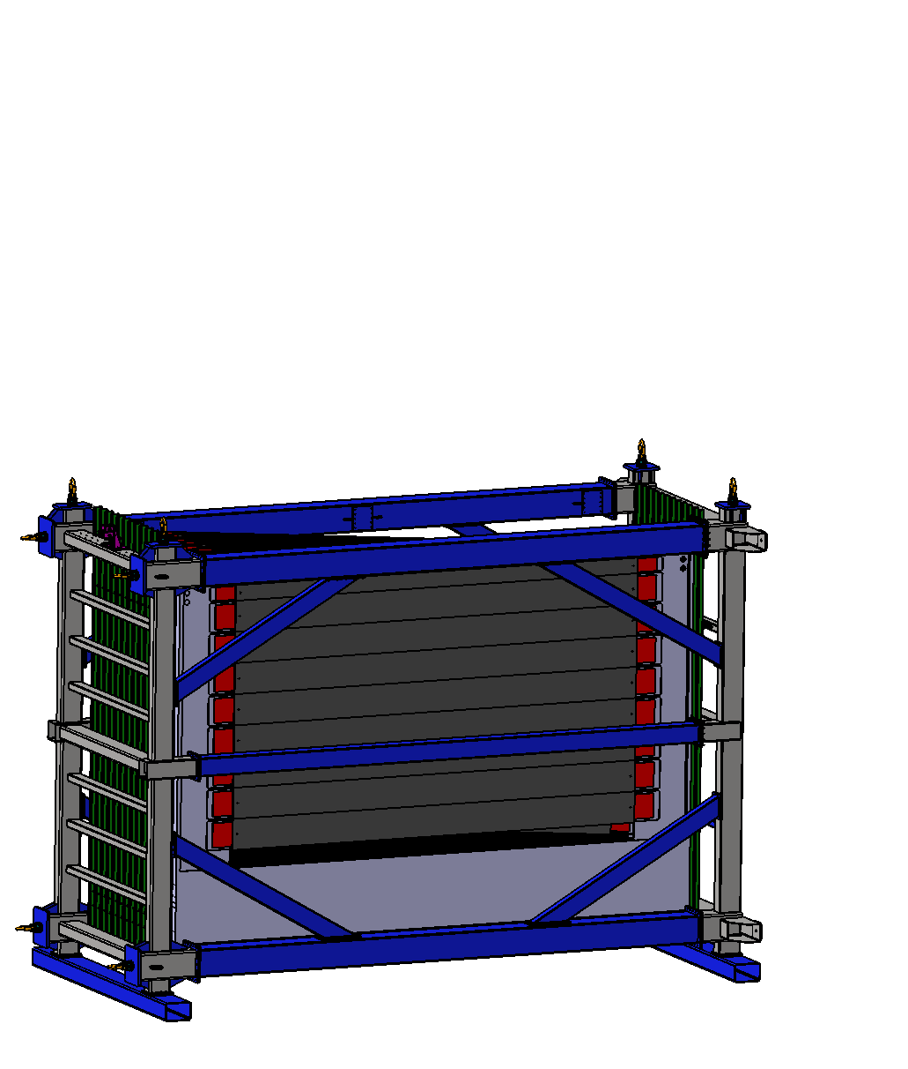
3. MUST transport from GSI to FAIR
1. The transport frame must be moved out of hall BE42.

Slide 32
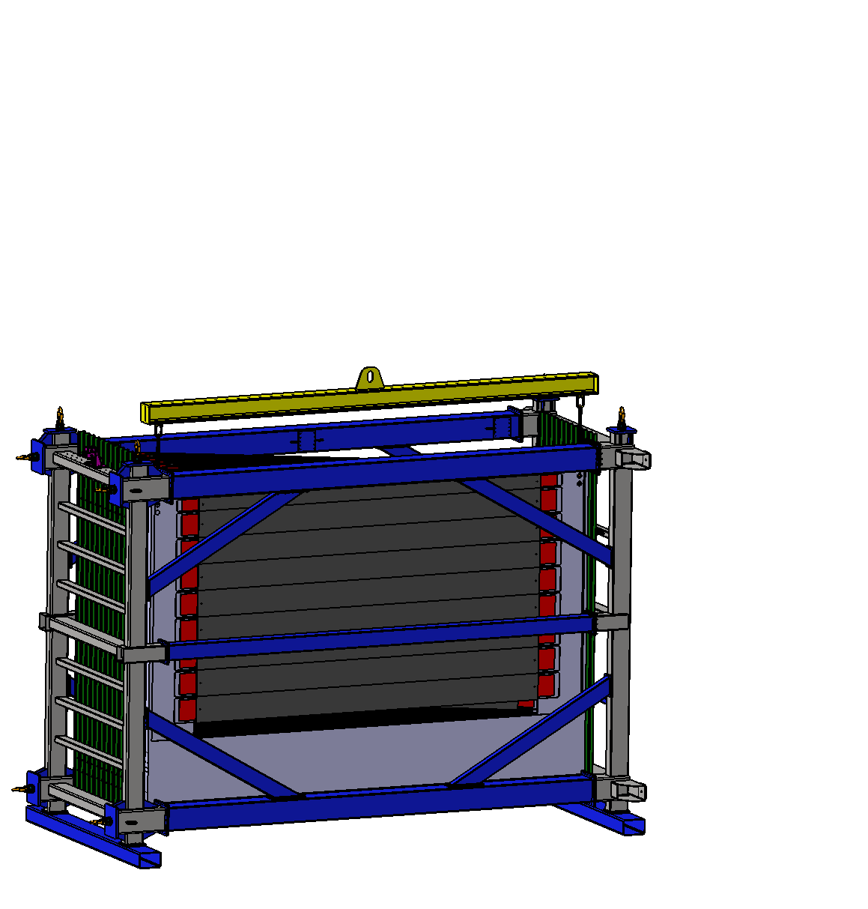
3. MUST transport from GSI to FAIR
2. A mobile crane and a suitable traverse are required.

Slide 33
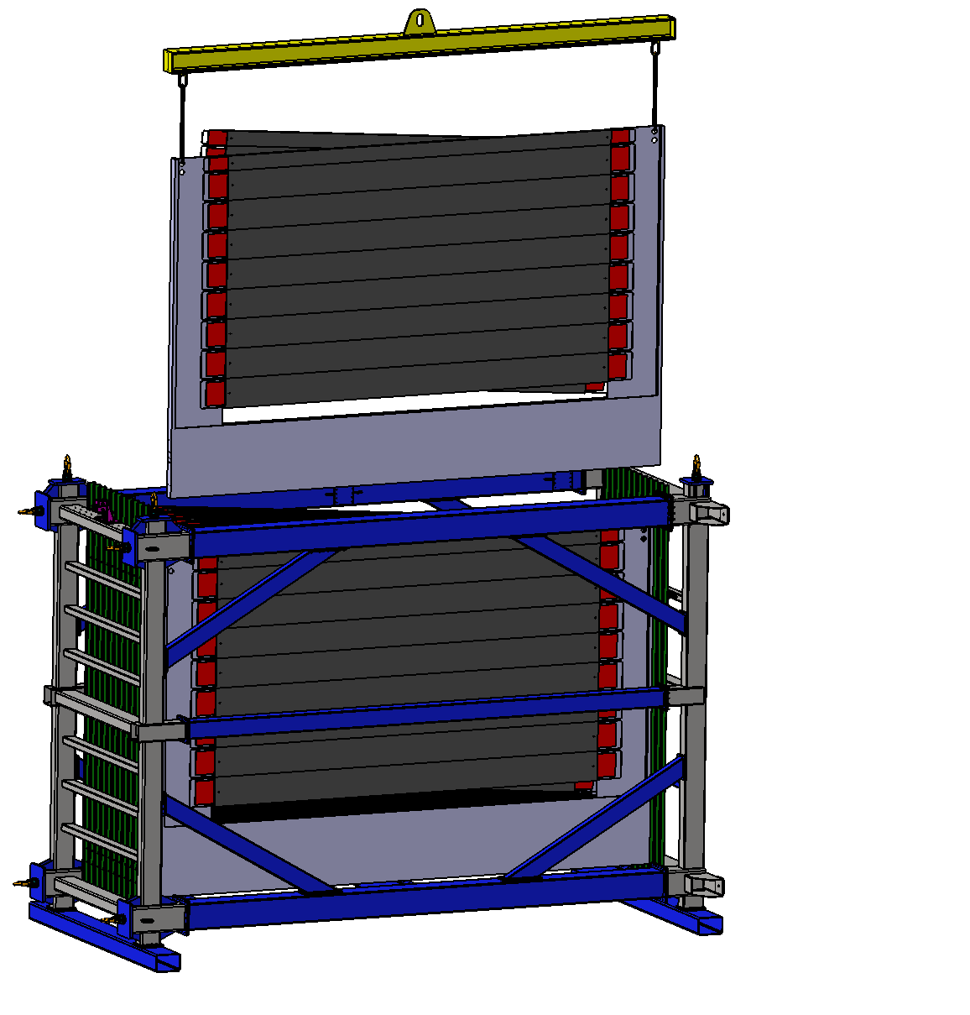
3. MUST transport from GSI to FAIR
3. The traverse is attached to existing holes in the C-frame and the C-frame is lifted out of the transport frame.

Slide 34
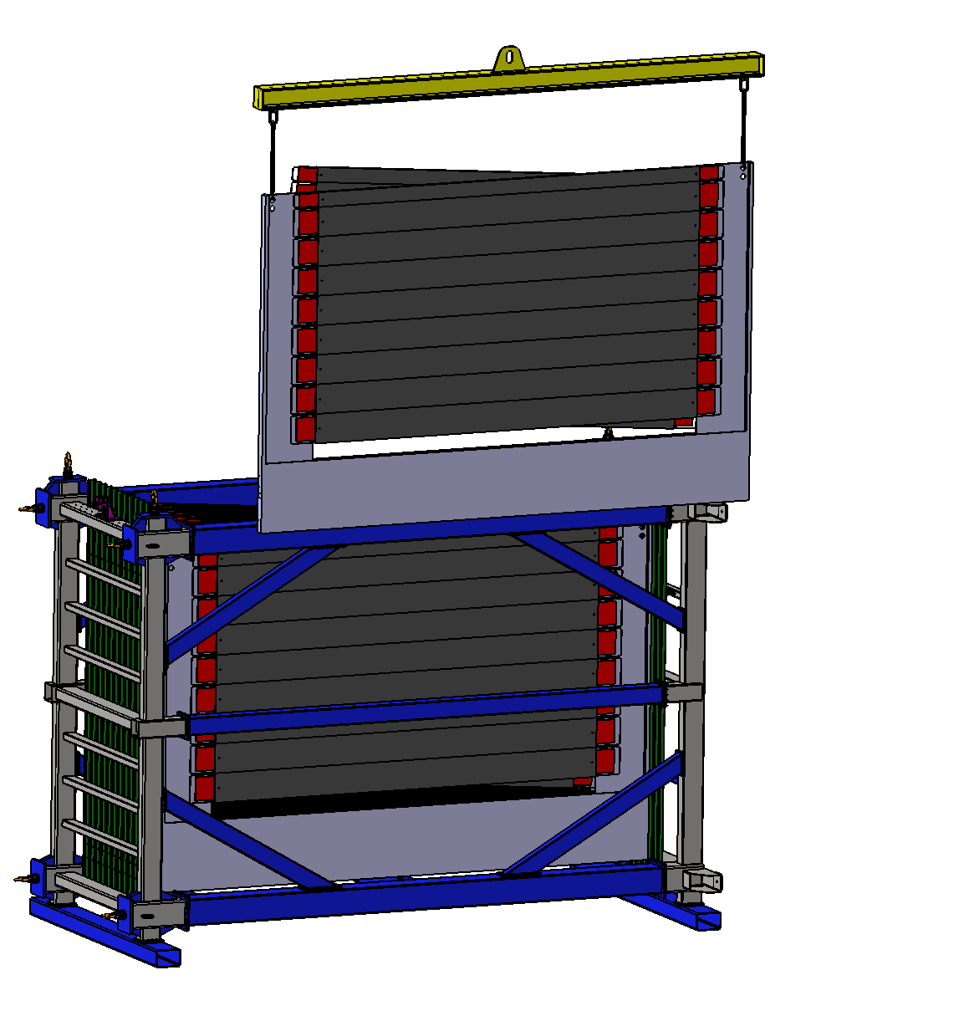
3. MUST transport from GSI to FAIR
4. The C-frame is lifted from the transport frame.

Slide 35
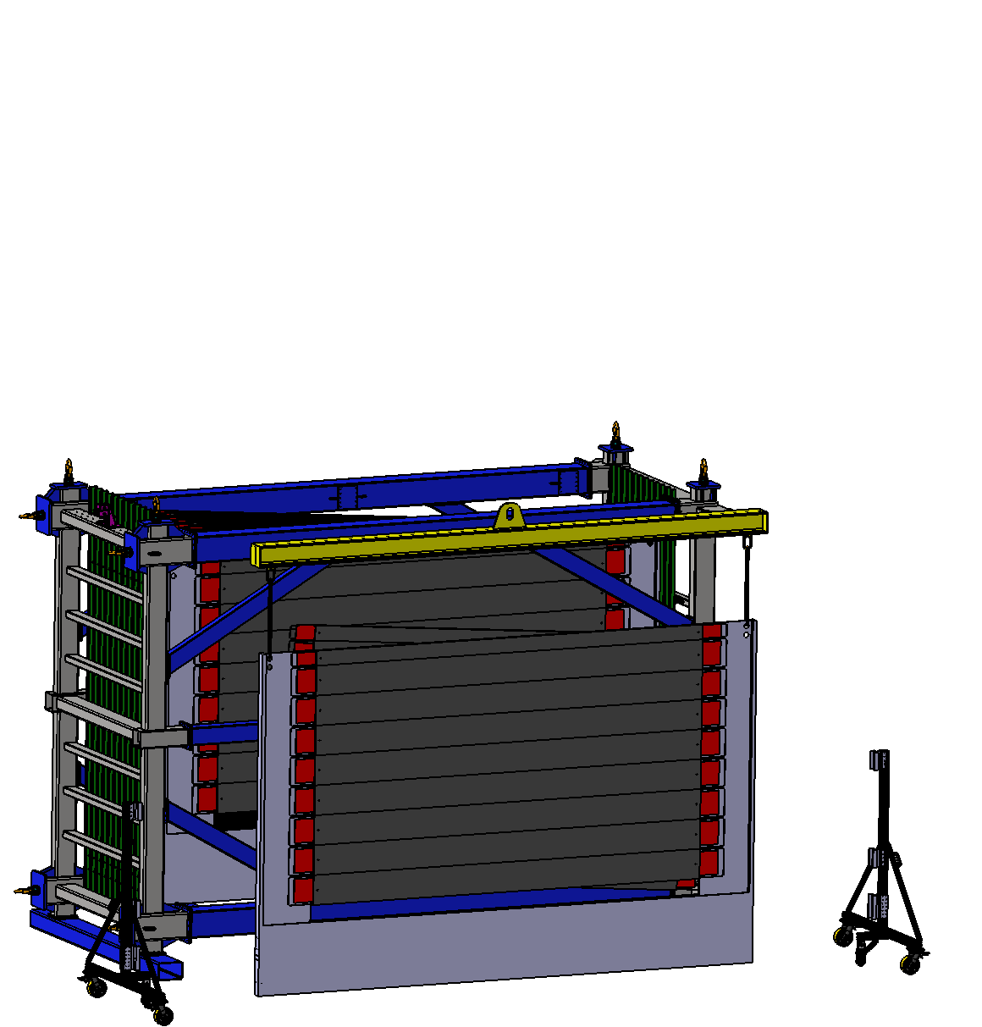
3. MUST transport from GSI to FAIR
5. The C-frame is lowered to just below the ground and special trolleys are brought into position.

Slide 36
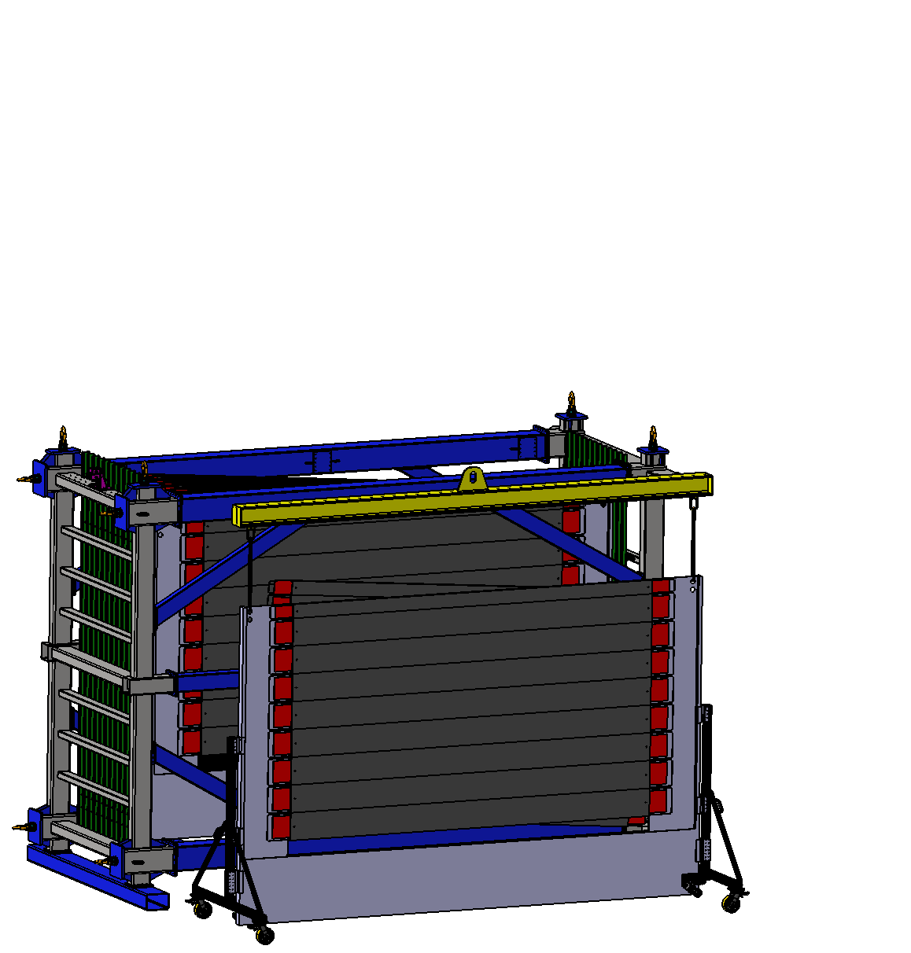
3. MUST transport from GSI to FAIR
6. The two trolleys are attached to the existing threaded holes of the C-frame.

Slide 37
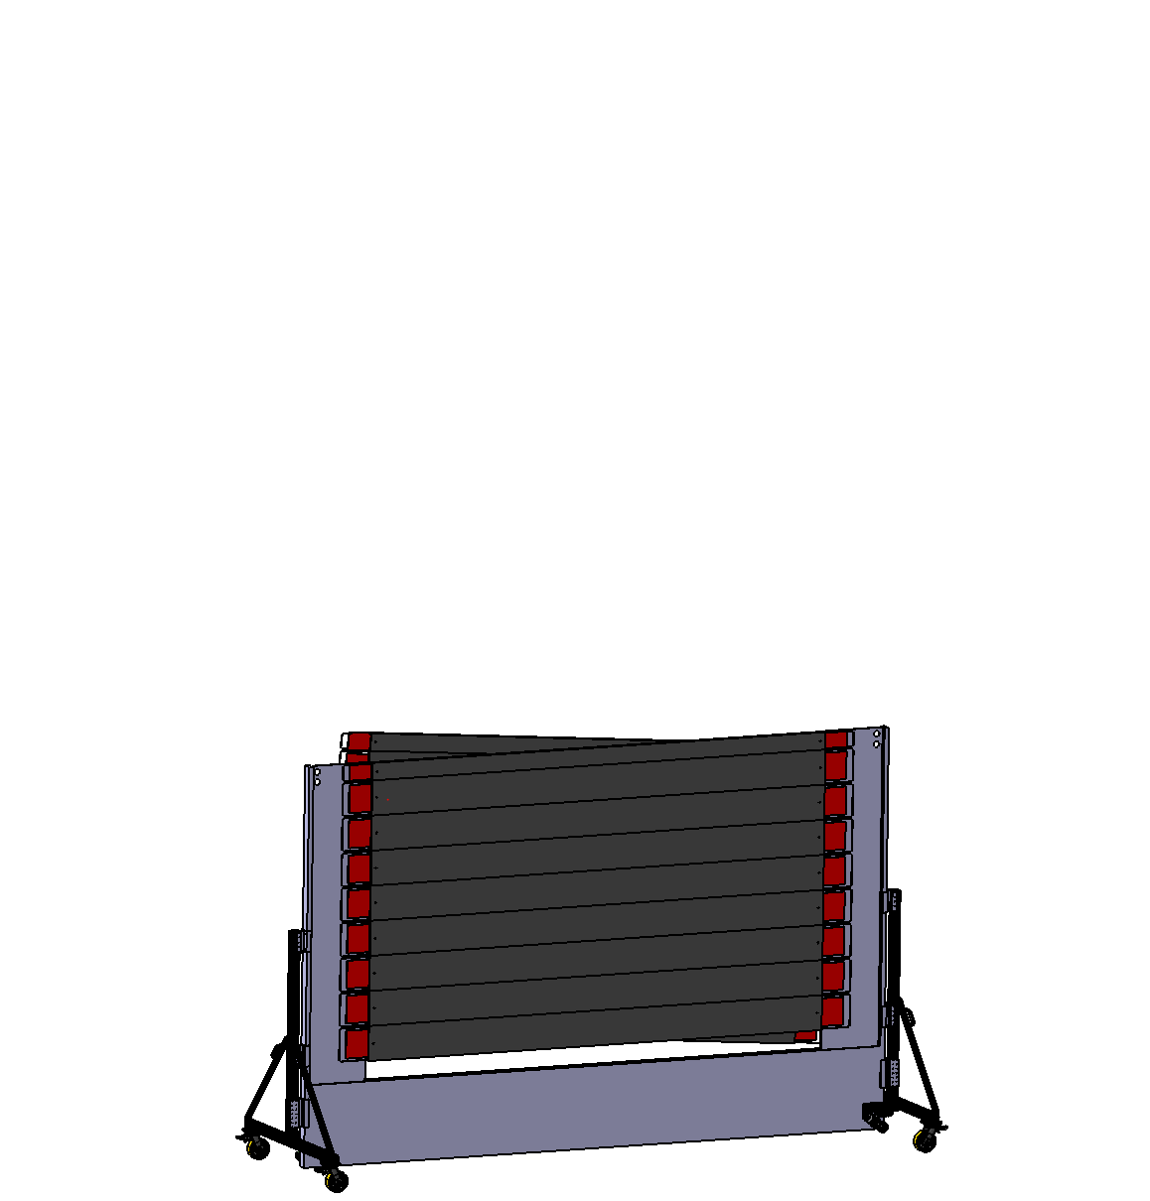
3. MUST transport from GSI to FAIR
7. When both trolleys are connected to the C-frame, the crane and transport frame can be removed.

Slide 38
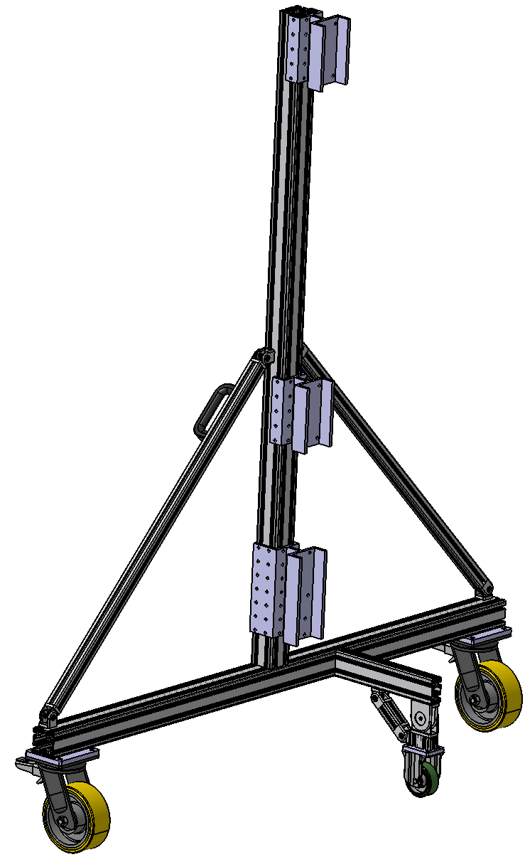
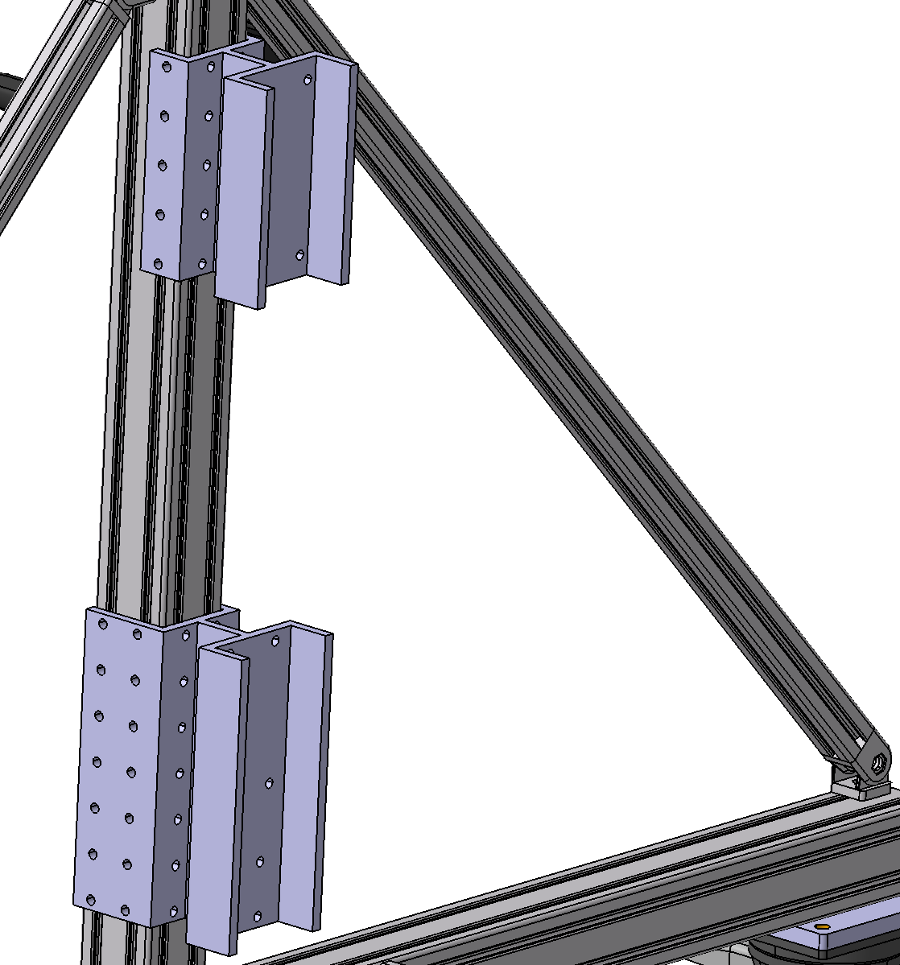
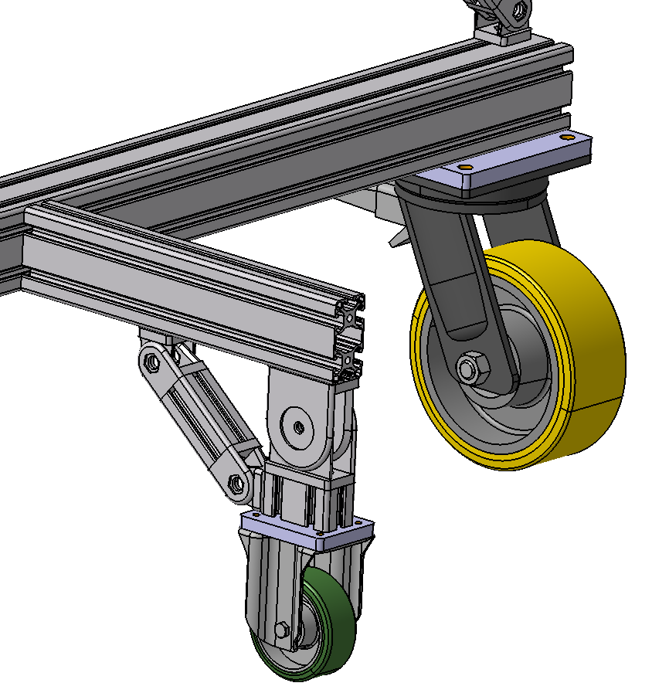
3. MUST transport from GSI to FAIR
The trolley V1 consists mainly of profiles from ITEM. Additionally, various adapters for attaching the C-frame and roller for transport are included.

Slide 39
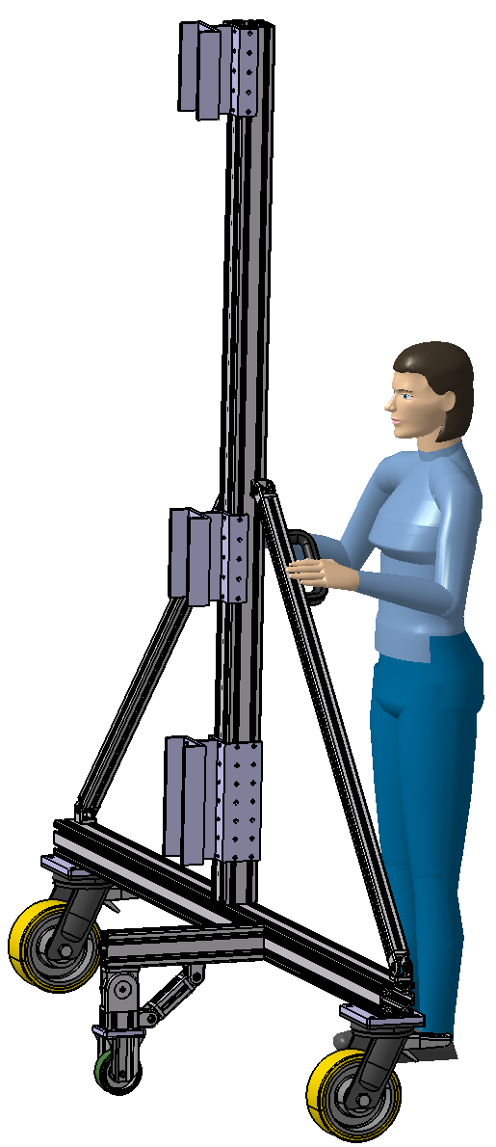

3. MUST transport from GSI to FAIR
The small roller are used exclusively for the safe movement of the individual trolleys and can be folded away after being attached to the C-frame.

Slide 40


3. MUST transport from GSI to FAIR
The position of the adapters, and thus the distance of the C-frame from the floor, can be adjusted as needed.
The maximum height adjustment is 500 mm. However, this requires the C-frame to be decoupled from the trolley, as the adapters can only be moved without force.

Slide 41

3. MUST transport from GSI to FAIR
The trolleys are identical on both sides of the C-frame.

Slide 42


3. MUST transport from GSI to FAIR
c) Transport by MUST support frame
The MUST mounting frame can be used as a transport frame in a horizontal position.

Slide 43


3. MUST transport from GSI to FAIR
To use the support frame as a transport device for the C frames, Roller and appropriate stopper can be attached.

Slide 44

Support frame for the MUST Detector
This would mean that no additional transport devices are needed.

Slide 45

Support frame for the MUST Detector
Since the height of 4,5 meters is still quite high, the question is can we get this into CBM cave?
4500 mm

Slide 46
3. MUST transport from GSI to FAIR
d) …
The transport options we have presented are not the final design.
Other ideas and proposals are welcome and can be discussed further.

Slide 47


4. Advanced design of MUST support frame including absorber 5
By extending the initial design of the MUST support frame, it can also secure the absorber 5.

Slide 48

4. Advanced design of MUST support frame including absorber 5
This could eliminate the need for an additional horizontal support structure for absorber 5.

Slide 49

4. Advanced design of MUST support frame including absorber 5
This could eliminate the need for an additional horizontal support structure for absorber 5.

Slide 50

4. Advanced design of MUST support frame including absorber 5
Finally, here is an image showing what the setup in CBM would look like. The first picture shows the RICH setup, and the other the setup with MUST.

Slide 51

4. Advanced design of MUST support frame including absorber 5
Finally, here is an image showing what the setup in CBM would look like. The first picture shows the RICH setup, and the other the setup with MUST.

Slide 52
5. Open items and next steps
Review of the concepts regarding potential conflicts with other CBM components.
Review the absorber layout for MUST.
First calculation and structural verification of the concept.
Integration of services and their components, such as electrical, gas, readout etc., into the concept.
Check how the detector can be transported to CBM.
Thank you for your attention!

