Slide 1

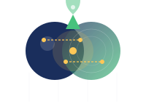

HADRON-2030
Access to Physics with Hadrons at the Frontier of Knowledge: Fundamental Research and Applications
Automating Accelerator Tuning at GSI/FAIR
Sabrina Appel (APH)
(Team: APH, Super-FRS, CERN, TUDa, PLUS Salzburg)
TwinRISE (Trusted AI-Generated Digital Twins for Research Infrastructures & Scientific Excellence)
iRIS (Intelligent, Resilient & Sustainable Research Infrastructures)

Slide 2
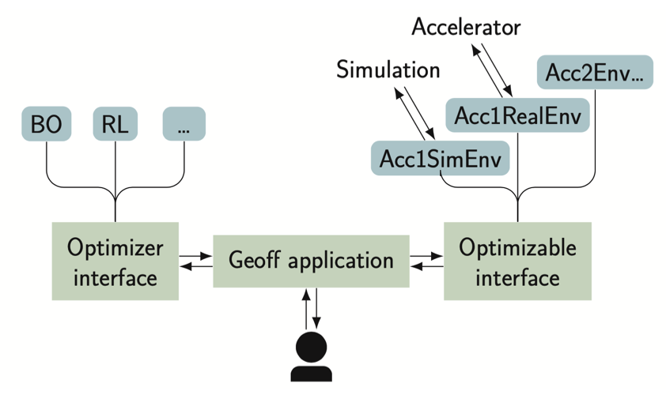
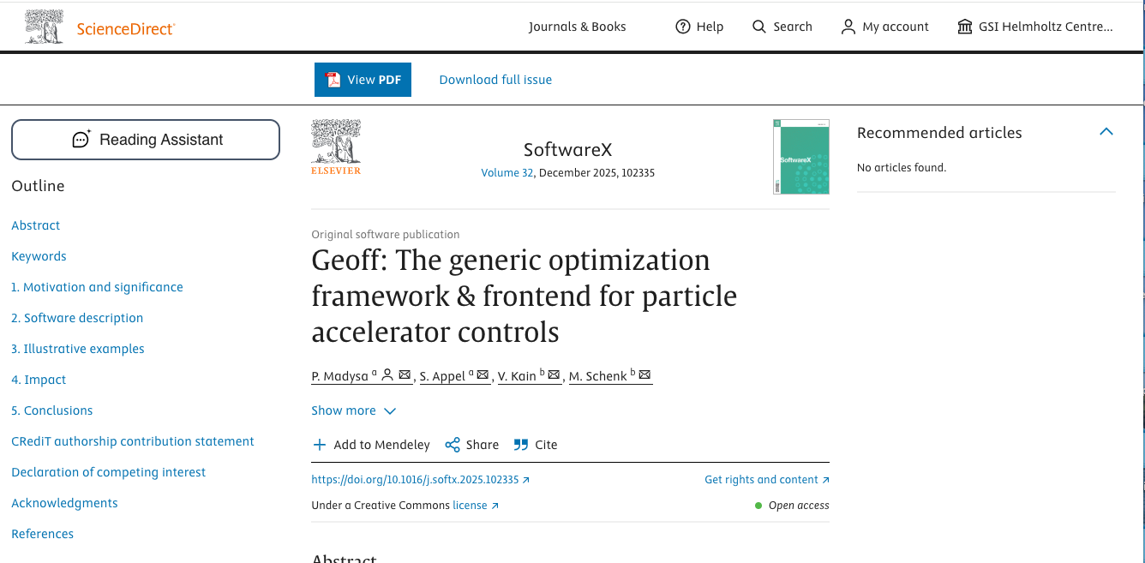
Generic Optimization Frontend & Framework (GeOFF)
Individual Python-based efforts led to duplicated work, incompatibilities, and poor usability.
Python-based framework (modern ML: TensorFlow, PyTorch)
lists, configures and runs optimization problems
standardized interfaces and adapters for various packages
via Common Optimization Interfaces
Optimization problems formulated as environment (classes)
(allow optimization of very complex problems)
Class contains logic for live plotting, data logging,
and communication with LSA, FESA + EPCIS
Quick adaptation of code and on-the-fly during shifts:
This is made easy due to flexibility of the framework.
Geoff GUI: Operators don’t need to juggle Python scripts
https://doi.org/10.1016/j.softx.2025.102335

Slide 3


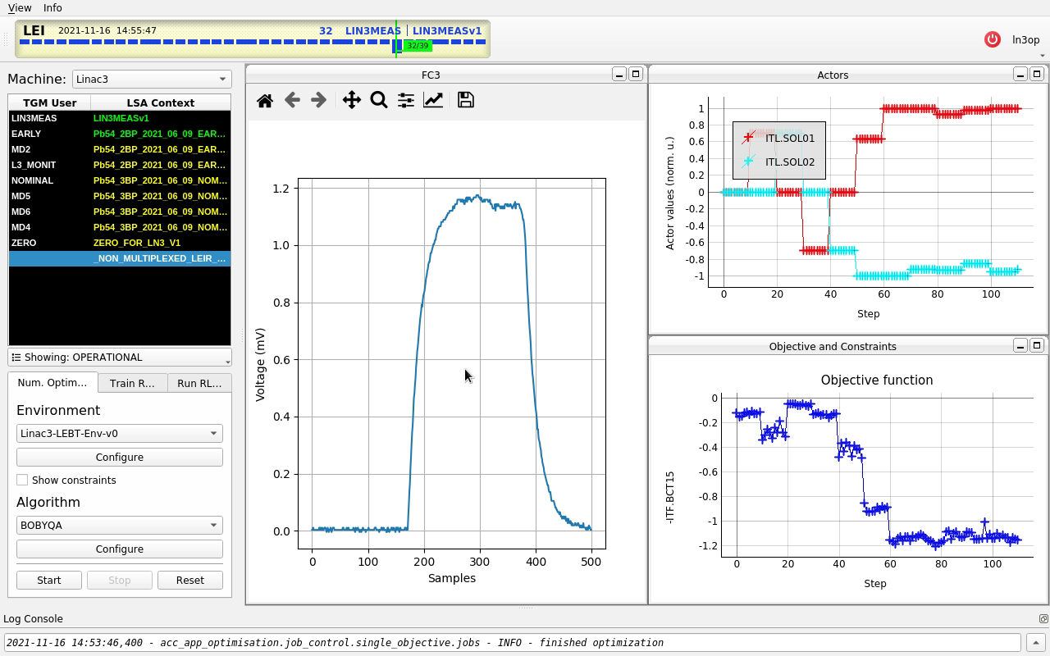
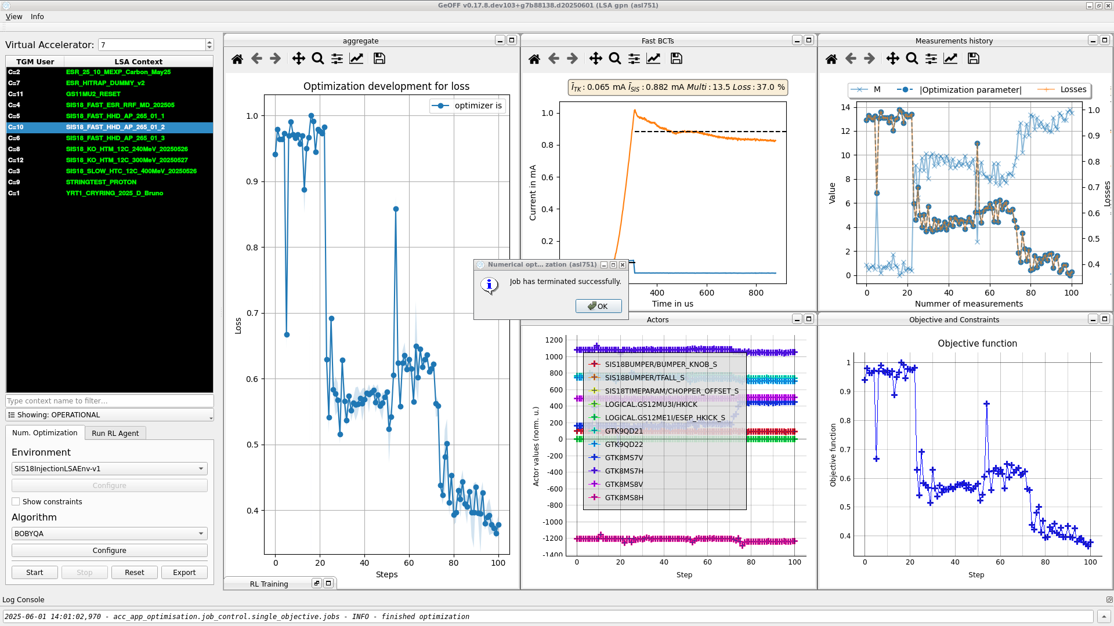
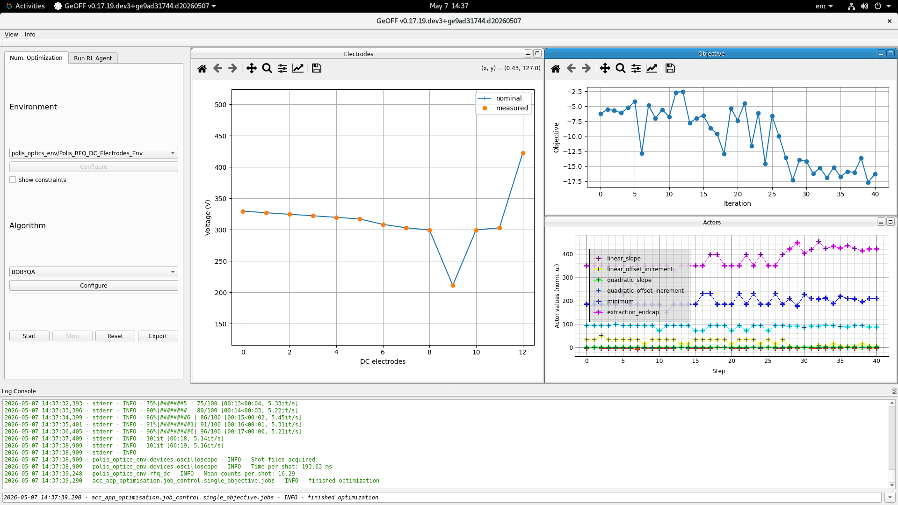

Accessibility & Professional Release
Core GUI
Idea: Each facility can add its own control-system-specific features (e.g., context selector).
Control systems: LSA (FESA), legacy GSI systems, EPCIS
Code hosting
Easy Installation
Documentation
https://gitlab.cern.ch/geoff
https://github.com/geoff-project
PyPI
https://geoff.docs.cern.ch/
pip install Geoff-app
Penny Madysa, Lisa Dingeldein, 2023-2026

Slide 4
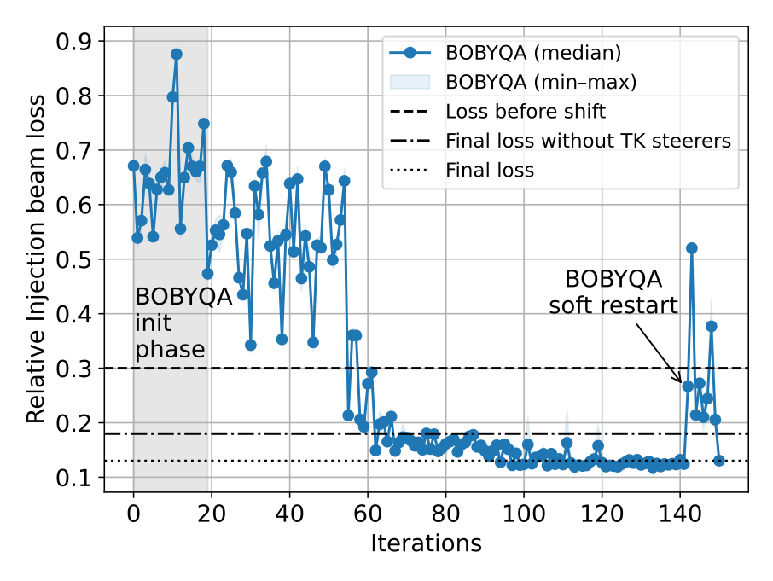
GeOFF: highlights from operations
Multi-Turn Injection Optimization in a Synchrotron
  Reproducible or improving beam quality and
  improving accelerator availability (less downtime)
May 2024
Traditionally tuned manually with inconsistent results
Significant improvement beam quality achieved using numerical optimization (BOBYQA)
Major reduction in setup time (~2 h → ~30 min)
Based on 150 optimization steps using 9 control parameters
S. Appel et al.: AUTOMATION OF GSI KEY BEAM MANIPULATIONS WITH AI METHODS , HB’25 - Proceedings Huizhou, China, (2025)
Sabrina Appel, Penny Madysa, 2023-2025

Slide 5
GeOFF: highlights from operations
New Phase Space Optimization for Super-FRS
S. Appel, M. Bajzek, J. Hetzel, D. Kallendorf, E. Kazantseva, P. Madysa, S. Pietri, H. Weick, 2023-2025
Simulation
Measurements
Effective quadrupole/sextupole optimization, even under severe detuning.
Intentionally detuning was restored
in 30 steps (less than 5 minutes)
Status:
Validated via simulations & beam operation
ready for integral Super-FRS deployment.
Reproducible or improving beam quality
USERS beamline: Toolkit with their observable
D. Kallendorf et al.: Non-linear phase space tuning for in-flight Fragment Separators, presented at IPAC'26, Deauville, France, May 2026, pp. 4028-4031, paper THP4068, doi:10.18429/JACoW-IPAC206-THP4068

Slide 6
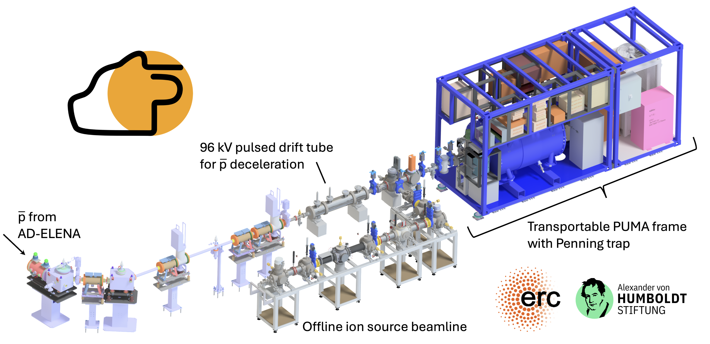
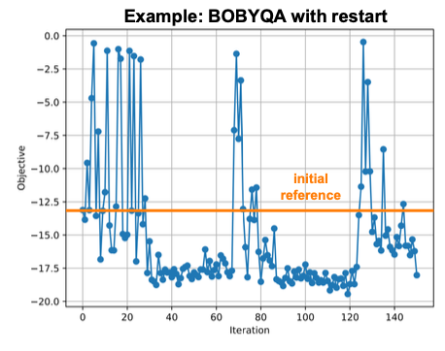
GeOFF: highlights from operations
unpublished
M. Schlaich et al., Nucl. Instrum. Methods Phys. Res. A (2025)
Geoff framework used to optimize the PUMA offline ion source beamline
Used knowledge of physics to reduce number of parameters
Efficiency improvement from ~20 % to ~50 % in RFQcb
(ion cooling and stacking)
Improved beam quality
USERS beamline: Toolkit with their observable
S. Appel, M. Kraeft, P. Madysa, A. Obertelli, M. Schlaich, F. Wienholtz, 2025-2026

Slide 7
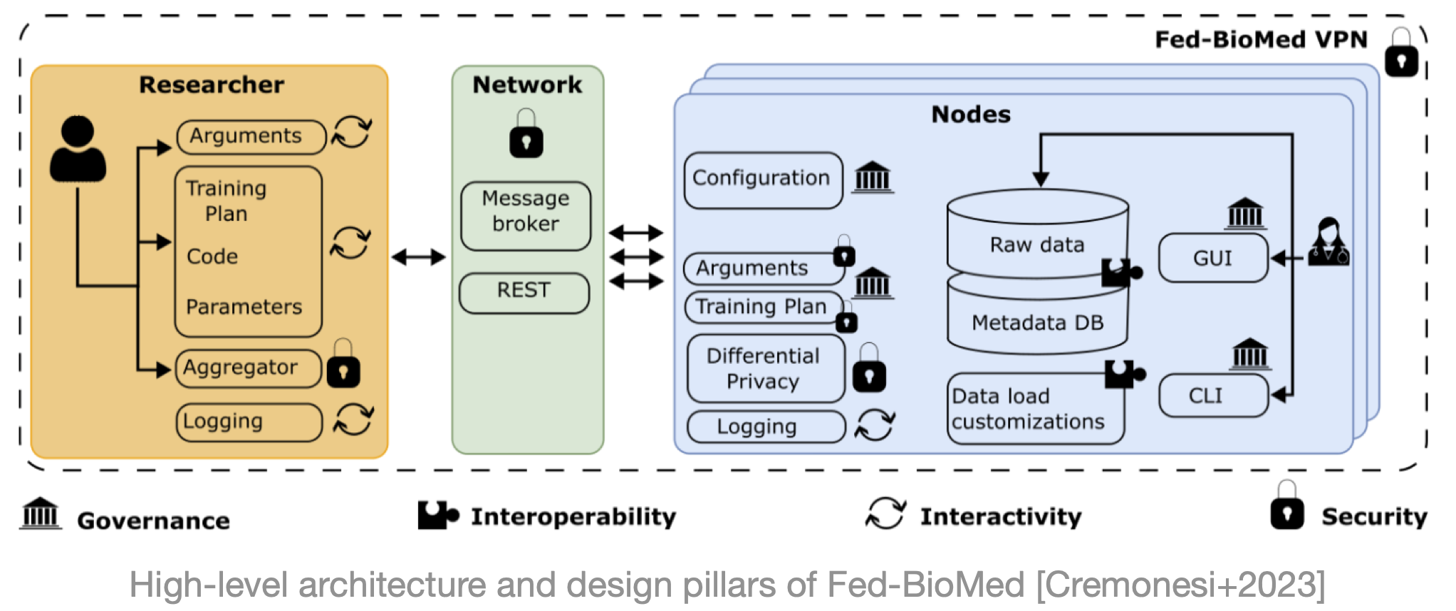
TwinRISE
7 pilots, 3 clusters
— Medical physics [lead : CFB]
  Dose from enhanced scintillation detectors
  MRI to CT neural translation
  Treatment optimization
— Beam operation [lead : KIT]
  Spectrometer Twin (SuperFRS - GSI):
  Ion-optic model and Maxwell-Consistent Magnetic Field Model
  Energy-ware accelerator twin (KIT)
  Beam availability & control resilience (esDONES)
— Transverse applications [lead : GANIL]
  AI enhanced dose cartography —>
  Radiation safety at GANIL/esDONES & clinical dose awareness at ULIV
FedBioMed federated learning framework
  Each facility trains on local data
  - never leaves the site
  Model updates (gradients) are
  aggregated centrally
  Global model improves from
  diverse facility data
  Fine-tuning adapts global model
  to local conditions

Slide 8
Summary and Outlook
HADRON-2030
Development and outlook
Separator tuning
Geoff enables rapid, automated tuning
Open-source framework for accelerator
Recent papers in SoftwareX + EPJ Res. Infrastruct
Geoff will participate in several new EU grant programs (TwinRise, iRIS, and HADRON-2030)
Collaboration with CERN, KIT + GANIL.
Super-FRS commissioning methods
New method ready for integral Super-FRS deployment
PUMA beamline tuning
Synchrotron tuning
Efficiency increased from
~20 % to ~50 % in RFQcb
(ion cooling and stacking)
SIS18 injection loss reduced
to ~12 %
More:
S. Appel et al.: Automating accelerator tuning at GSI/FAIR , EPJ Res. Infrastruct. 10, 23 (2026)

Slide 9
Thank you
Team:
Sabrina Appel, Hendrik Alsmeier, Martin Bajzek,
Oliver Boine-Frankenheim, Lisa Dingeldein, Rolf Findeisen, Benjamin Halilovic, J. Hetzel, Simon Hirlaender,
Sebastian Hirt, Daniel Kallendorf, Erika Kazantseva,
Olha Kazinova, Maximilian Kraeft, Eric Lenz,
Penny Madysa, Alexandre Obertelli, Maik Pfefferkorn, Stephane Pietri, Christoph Reinwald, Moritz Schlaich,
Stefan Sorge, Helmut Weick & Frank Wienholtz

