Slide 1

ELOG-RAG
Deep answers from measurement-heavy logbooks.
Finding a needle in the needle stack.
Alexander Warth · SC Magnets & Testing · GSI/FAIR AI Workshop, 31 August 2026
Supported by the GSI Innovation Fund · External industry pilot partner · Runs fully on-premise
Notes:
Take RAG as given – the previous talk covered it. This talk is about what happens when the questions are precise and the entries are dense.

Slide 2
01 THE DATA
Can a system understand this?
#8796 · 17.08.2026 · QDM-040 · cooldown run CD02 · "Bipolar Cold Run 2"
Dense by construction
Timestamped ramp sequences, currents, ramp rates, quench yes/no with time, operator remarks - several facts per line, in a house notation that never appears in any training corpus.
2,702 entries carry explicit measurements with units
79 authors over twelve years – notation drifts
97 % EN · 3 % DE bilingual, sometimes within one entry
The answer below is the system's, verbatim: it finds the entry, reads the quench, and reads the operator's #Mistake flag right after it.
Performed: %SH_Bipolar%, %SV_Bipolar%, %CS_Bipolar%
** CS ** Bipolar Stability (10 minutes)
1. [16:01:37], -250 A -> 0.000 s -> 250 A -> 0 A -> -250 A,
+1225.0 A/s, -1225.0 A/s --> CS Quench: [No];
** SH + SV ** Bipolar Stability Validation (10 minutes)
Green. [16:14:28], -100 A -> 250 A -> 0 A -> -100 A, +/- 857.5 A/s
--> SH Quench: [Yes @ 16:14:34], SV Quench: [No]; #Mistake
Green. [16:17:07], -100 A -> 250 A -> 0 A -> -100 A, +/- 857.5 A/s
--> SH Quench: [No], SV Quench: [No];
...
ASK-AI "Did SH quench above 800 A/s in cooldown 02 of QDM-040?"
Answer:
….Entry 8796 (Bipolar Stability, 17.08.26): SH + SV Bipolar Stability Validation at 857.5 A/s – one instance showed SH Quench: [Yes @ 16:14:34], but this was flagged as a "#Mistake" and subsequent runs at the same rate were stable….
ELOG-RAG · GSI/FAIR AI Workshop · 31.08.2026
2
Notes:
Real entry, operator names removed. Point: the information is there, it is just not in a form similarity search can use. Structure has to be extracted at ingest.

Slide 3
02 THE DATA
8,712 of those. Twelve years of them.
8,712
12
229
logbook entries
years
cooldown runs
Series Test Facility ELOG, July 2014 to today: 157 modules, every ramp and quench.
Reaches back well before the current campaigns. Vocabulary and authors change.
Ramp rates, quench currents, dwell times, module and feedbox IDs, cross-references to earlier entries – per run, per module.
Breadth vs. depth. A shift log spans a whole machine in narrative form. A test-facility log spans one magnet in numbers. The questions people ask it are entity-scoped, numeric and temporal - "which Corrector Magnet of QDM-030 quenched above 230A in any cooldown run?" - and similarity search alone does not answer them.
ELOG-RAG · GSI/FAIR AI Workshop · 31.08.2026
3
Notes:
Do not compete on volume. Position: different problem class – depth per entry instead of breadth of entries.

Slide 4
03 THE BASELINE
Where plain RAG breaks.
Baseline: vector retrieval, one LLM pass - naive RAG pipeline.
Similarity search finds look-alikes. It is fine for "what happened to module X" and fails outright on everything that needs structure or iteration:
exact counts, totals, most recent entries
procedures assembled from many entries
analyses across several runs or modules
scope limited to one test stand (FB1–FB4)
Fixed question set (99 questions in 13 groups now), re-run after every change.
Ground truth is not hand-labelled - each question carries a SQL recipe that re-derives it from the live database.
ELOG-RAG · GSI/FAIR AI Workshop · 31.08.2026
4
Notes:
The tactful answer to a single-branch RAG: nothing personal, just the measured failure modes. Everyone in the room asks these question types.

Slide 5
04 THE APPROACH
Classify, route, escalate.
Supervison
simple &
confident
Lane 1 · Single pass
1 LLM call · fast
Question
Classify
8 classes · confidence · entities
Resolve
names → canonical IDs
Route
complex or
unsure
Lane 2 · Iterative
≤ 6 tool steps
Answer
+ sources
"qdm050", "magnet 50", CID "02-000050-50-4" → QDM-050 · "last run", "CD03" → run ID · nothing unresolved reaches SQL
depth =
deep
Lane 3 · Deep
plan → gather ∥ → analyze
escalate: user button, or classifier unsure
Bounded effort at every level: one call, six tool steps, or a plan you can read before it runs. Every answer cites entry IDs; ambiguous names produce a caveat, not a guess.
ELOG-RAG · GSI/FAIR AI Workshop · 31.08.2026
5
Notes:
Concept level. Classes exist because each needs a different search strategy. Do not name internal components.

Slide 6
05 THE RESULTS
0.59 to 0.98 in ten iterations.
0.98
strict accuracy at R62
What moved the curve
procedural 0.00 → 1.00
deep research 0.00 → 0.83
test-stand scoped 0.25 → 1.00
exact entry fetch 0.33 → 1.00
core retrieval 0.48 → 0.96
Temporal, multi-run and author questions were solid from the start and held. Shown: R53–R62 on the 99-question set;
ELOG-RAG · GSI/FAIR AI Workshop · 31.08.2026
6
Notes:
R56 dip = fixture change r45/r46, then recovery. The eval set is the thing that cannot be copied from a slide.

Slide 7
06 IN USE
It reads the logbook so nobody has to.
FB1
1 module
1 active
Autonomous dashboard
Per-feedbox module state, cold-run test coverage and a nightly activity digest with entry IDs - no question needed. Each summary links to its sources; the state on the left is the live one from this morning.
Ask-AI search
Plain-language questions, depth auto or deep, escalation offered on every answer. "Verify against the original" is built into the UI.
Live ingestion from the STF ELOG, containerised, GSI network.
QDM-040
● Cooldown 02 since 8/11/2026 — last entry 1d ago
RECENT ACTIVITIES
Digest 1d ago
Yesterday
Bipolar stability testing revealed an anomaly where an SV power converter crash led to an attempt to restart via DC -250 A, which triggered an SH quench at 250 A. (#8810)
Aug 21
AC loss characterization of the QD magnet was performed with high ramp rates (up to ±22,000 A/s) reaching 10.5 kA without triggering a quench. (#8806)
Aug 20
Fast and slow extraction cycles on correctors (SH, SV, CS) were successfully completed at ±1225 A/s with no quenches recorded. (#8804)
Aug 19
DC endurance test confirmed stability for SH, SV, and CS correctors held at 250 A for over two hours without incidents. (#8802)
Static heat load measurements required manual correction due to sensor QN10KK12_BT01 being out of calibration (reading 5.9 K vs expected ~5.4 K). (#8800)
COLD-RUN TESTS Cooldown 02 · 5/13 tests
○ Cooldown
✓ Magnet Training
✓ HV Test
○ Sensor Test
○ Heater Test
○ Quench Detection
✓ Heat Load
✓ AC Loss
✓ LCL Steerer
○ Warmup
ELOG-RAG · GSI/FAIR AI Workshop · 31.08.2026
7
Notes:
Rendered from the live dashboard on 27.08.2026 (FB1, QDM-040 CD02). If you can, show the real thing instead.

Slide 8
07 STATUS & NEXT
ELOG-RAG · GSI/FAIR AI Workshop · 31.08.2026
Production by year-end. Your logbook next.
Where we are
Bring your logbook
D1 RAG system with web UI – delivered
D2 GSI integration: live ELOG, on-prem inference, dashboard - delivered
D3 knowledge graph & evaluation - in evaluation, incl. user test against keyword-search baseline
D4 production operation & documentation - Q4. Needs: an on-prem VM, LDAP auth, an ELOG service account
Funded by the GSI Innovation Fund, Mar–Dec 2026
External industry pilot partner on board
Searching for further Partners – Industry and Research
The pipeline is a template. Any ELOG with structured entries - module, device, run, date - can be onboarded and evaluated with the same harness. Domain-specific parts: one fact schema, one set of relation rules.
What it costs you
read to your ELOG Instance (service account)
Meta Data Structure
What you get
AI Assisted Search - find your Information in the “Needlestack” quickly
>> Next: explicit ontology layer; same pattern on archived settings and observables.
a.warth@gsi.de · +49 6159 71-3044
8
Notes:
Collaboration hook for IT and other departments: shared inference infrastructure, no duplicated cost, portable pipeline.

Slide 9
Backup

Slide 10
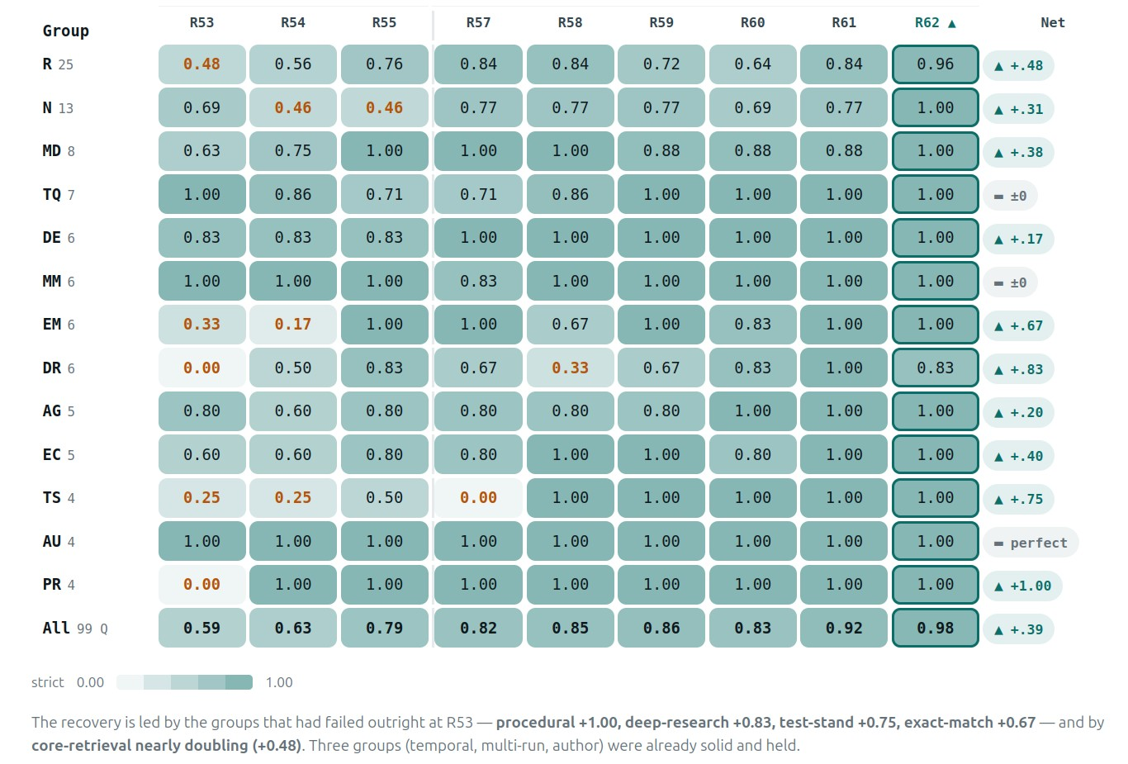
09 BACKUP
Recovery by question group (R53–R62).
13 groups, 99 questions
R core retrieval · N numeric/recency · MD module diversity · TQ temporal · DE German-language · MM multi-run · EM exact entry · DR deep research · AG aggregate · EC edge cases · TS test-stand · AU author · PR procedural
Strict = complete answer, every number and ID correct. A single wrong count fails the question. Each record carries expected route, class, entities, source entry IDs and an oracle SQL recipe; a judge rubric scores the rest.
The groups that failed outright at baseline are the ones that need structure and iteration – exactly where the graph and the agent lanes act.
ELOG-RAG · GSI/FAIR AI Workshop · 31.08.2026
10

Slide 11
10 BACKUP
Hybrid retrieval, one query.
QUERY "What is currently done on QDM-040?"
KNOWLEDGE GRAPH
VECTOR SEARCH
KEYWORD SEARCH
Structural traversal
Exact counts, relations,
current module state
Semantic similarity
Embed → cosine → top-k
BM25 full-text
"QDM-040", IDs, part numbers
Derived from entry metadata – no LLM
Finds cases described differently
Exact identifiers never get lost
FUSION & RERANKING deduplicate · merge · rerank · top-k → LLM synthesis with citations
ANSWER + SOURCES #8746 · #8747 · … – structured, semantic and lexical signals fused into one ranked answer.
ELOG-RAG · GSI/FAIR AI Workshop · 31.08.2026
11

Slide 12
13 BACKUP
Topology.
BACKEND
WEB UI
GSI LLMBot (on-premise)
Dashboard
Open-weight models
Embedding · inference
Feedbox & module state
Activity digest with entry IDs
ELOG-RAG
Ingest · hybrid retrieval
agent lanes · composer
PostgreSQL + pgvector
Ask-AI search
8,712 entries · 8,979 chunks
157 modules · 229 cooldown runs
Vectors · facts · graph relations
Beyond keywords · depth auto/deep
Structured answers, cited sources
STF ELOG
Live ingestion daemon
ELOG-RAG · GSI/FAIR AI Workshop · 31.08.2026
14

