Slide 1
Device Automator
Bringing “AI” to the Control Room Operation
W. Geithner

Slide 2
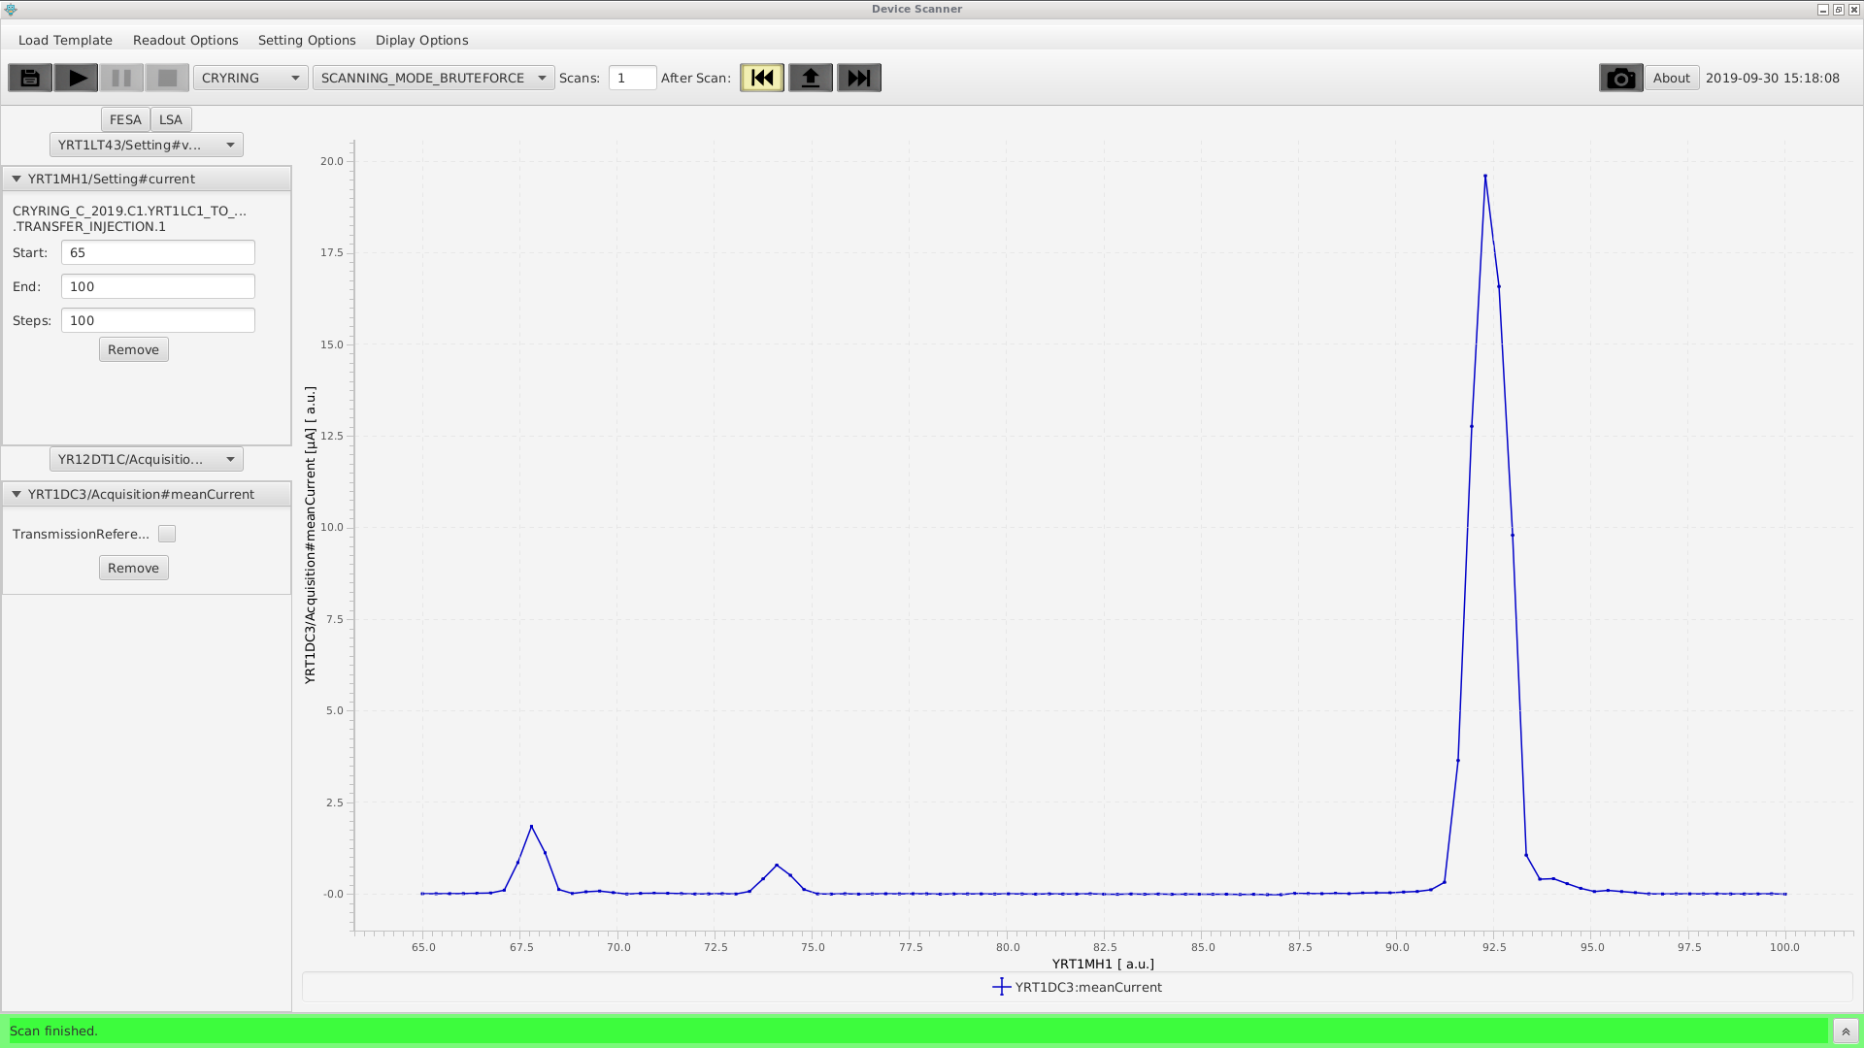
Device-Automator: the Beginning
Project-start: 2016, C. Hillbricht since 2017 W. Geithner
Initial scope: raster one FESA parameter step-wise
Coordinated diagnose-readout after step
Hard programmed parameter name
Visualization of readout vs. setting value
First use-case: current scan of CRYRING mass-separator magnet
Project-Git-homepage: https://git.acc.gsi.de/fcc-applications/device-automator-reactor
reported bugs to w.geithner@gsi.de

Slide 3
Progress since 2024 (last GSI AI Workshop)
Main goal and vision: high value application for operators + enable artificial intelligence for the control room
Replacement of configuration scripts with DEVAUTO-DB in Control System Oracle cluster
  Configuration: templates, parameter limits, miscellaneouos settings
  Scan-sesults: coordinated data sets with settings + readout, plus scan header data
  REST-interface isolating DEVAUTO-DB from direct access
  Web-UI for readout of stored data - https://lxyrpc01.gsi.de/scan-database
New optimizers
  JAVA Bayesian optimizer (master thesis M. Boschert, Hochschule DA)
  JAVA BOBYQA-optimizer (Py-BOBYQA port to Java)
Quite a number of HITRAP-beamline optimizations. Routine-tool for PhD students
UI- and Usability-improvements

Slide 4
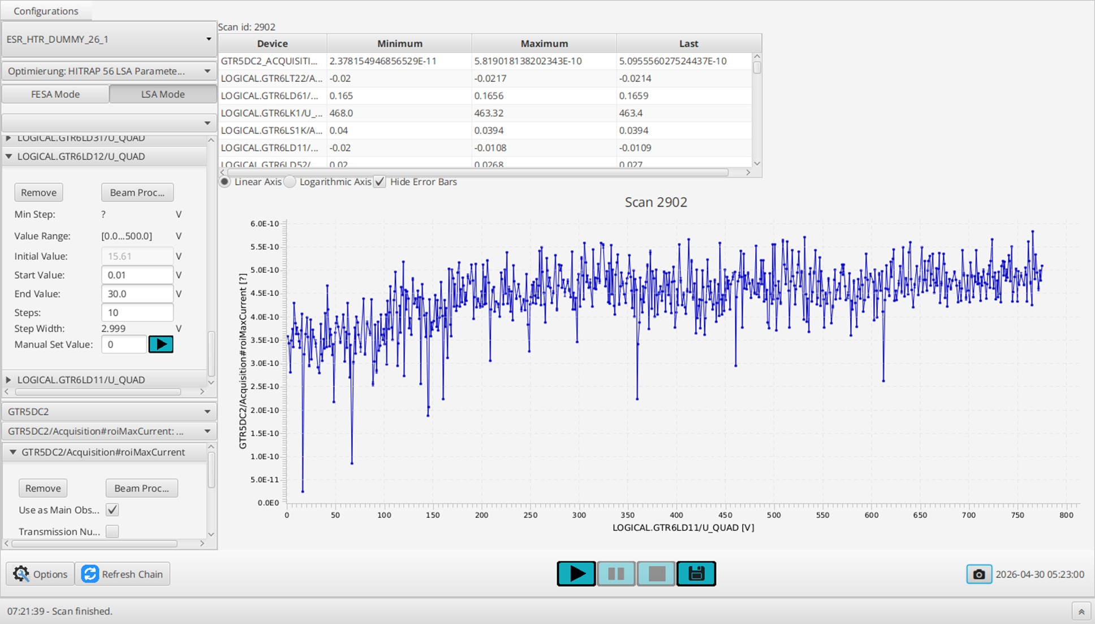


Software-Landscape – “what needs to run?”
LSA / FESA API
CS-Framework
FESA
Setting
setting values (LSA/FESA)
FESA
Readout
readout values
JAPC
API
Scan-Results,
data on parameters used
configuration,
templates,
scan-Results
FESA subscription
DEVAUTO-REST@ASL155
beam prosess-Info, etc.
Services
API
FESA-”Device”-information
FESA
REST
Service
Oracle-database ”DEVAUTO”
FESA-data

Slide 5
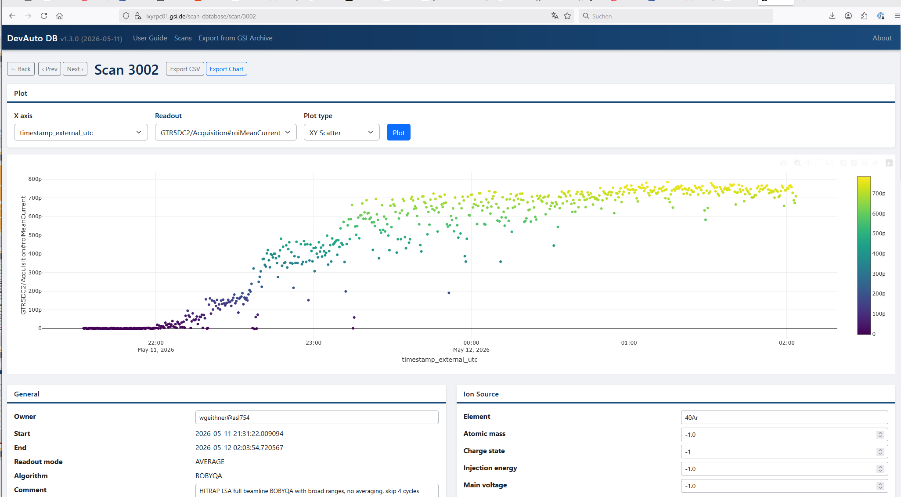
Scan Results Web Viewer - Details

Slide 6
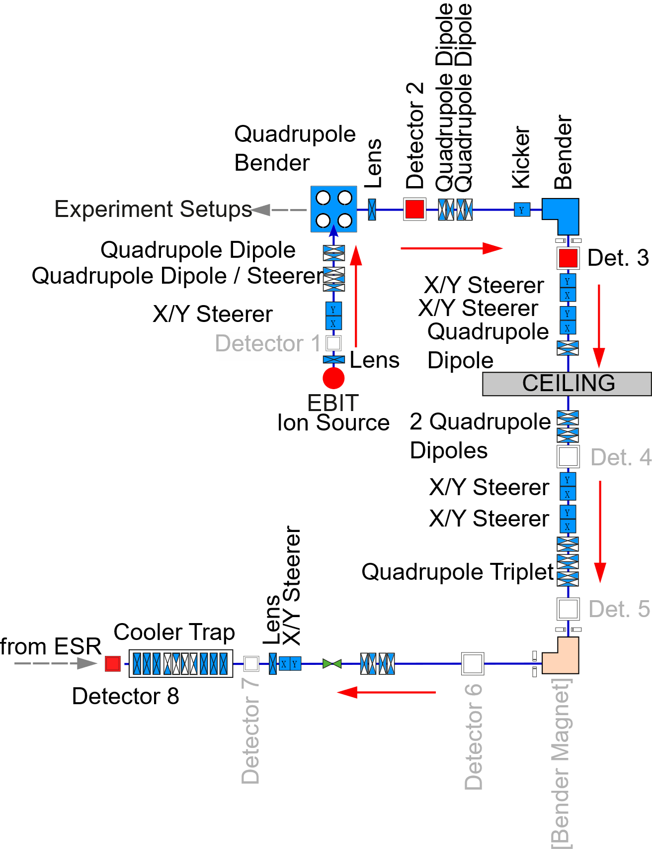
Device-Automator for HITRAP
HITRAP local operation
  EBIT ion source, Ar16+ beam, 5000 V static acceleration, microA-beam, pulsed operation ~ 0.5 Hz
  Only electrostatic elements in FAIR CS
  Only 1 detector integrated in FAIR CS (requires cable pulling)
  Hard integrated into ESR pattern. HITRAP cannot run standalone.
3 scenarios (LSA/FESA):
  EBIT -> detector 2 = 16 parameters
  EBIT -> detector 3 = 24 parameter
  EBIT -> detector 8 = 54(+) parameters

Slide 7
HITRAP Results – Bayesian Optimizer
Master thesis of M. Boschert at Hochschule DA:
„Bayes‘scher Optimierer in Java zur Optimierung von Ionenbeschleunigern“
Reference implementation: Py-BoTorch
Gauss-process surrogate engine
multiple acquisition functions: upper confidence bound, probability of improvement, expected improvement, Log expected improvement
internal hyperparameter optimizer L-BFGS-B for acquisition function
Based on SMILE-library for matrix math operations
Test experiments performed in 10/2025 using
  16 parameters / detector 2
  24 parameters / detector 3
Test result: optimizer performs as expected: very well
Further investigations: optimize hyperparameters and determine best acquisition function (candidates: EI, logEI), blocked by availability of HITRAP beam

Slide 8
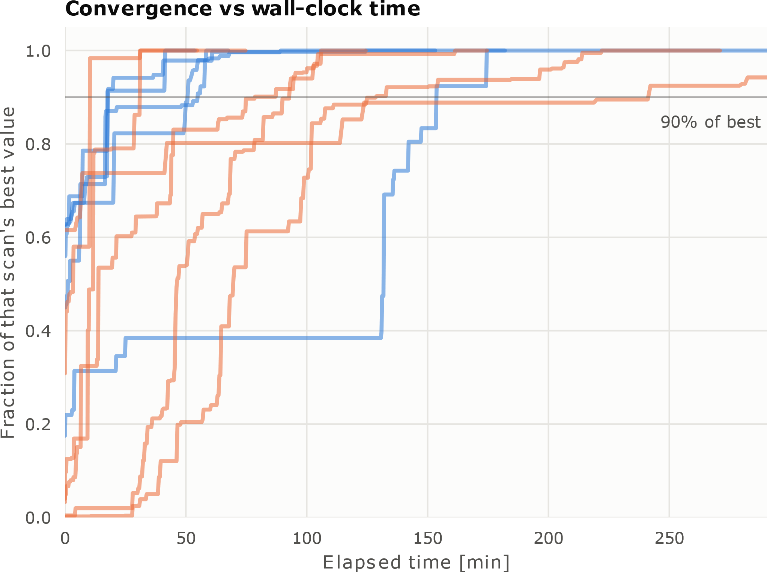
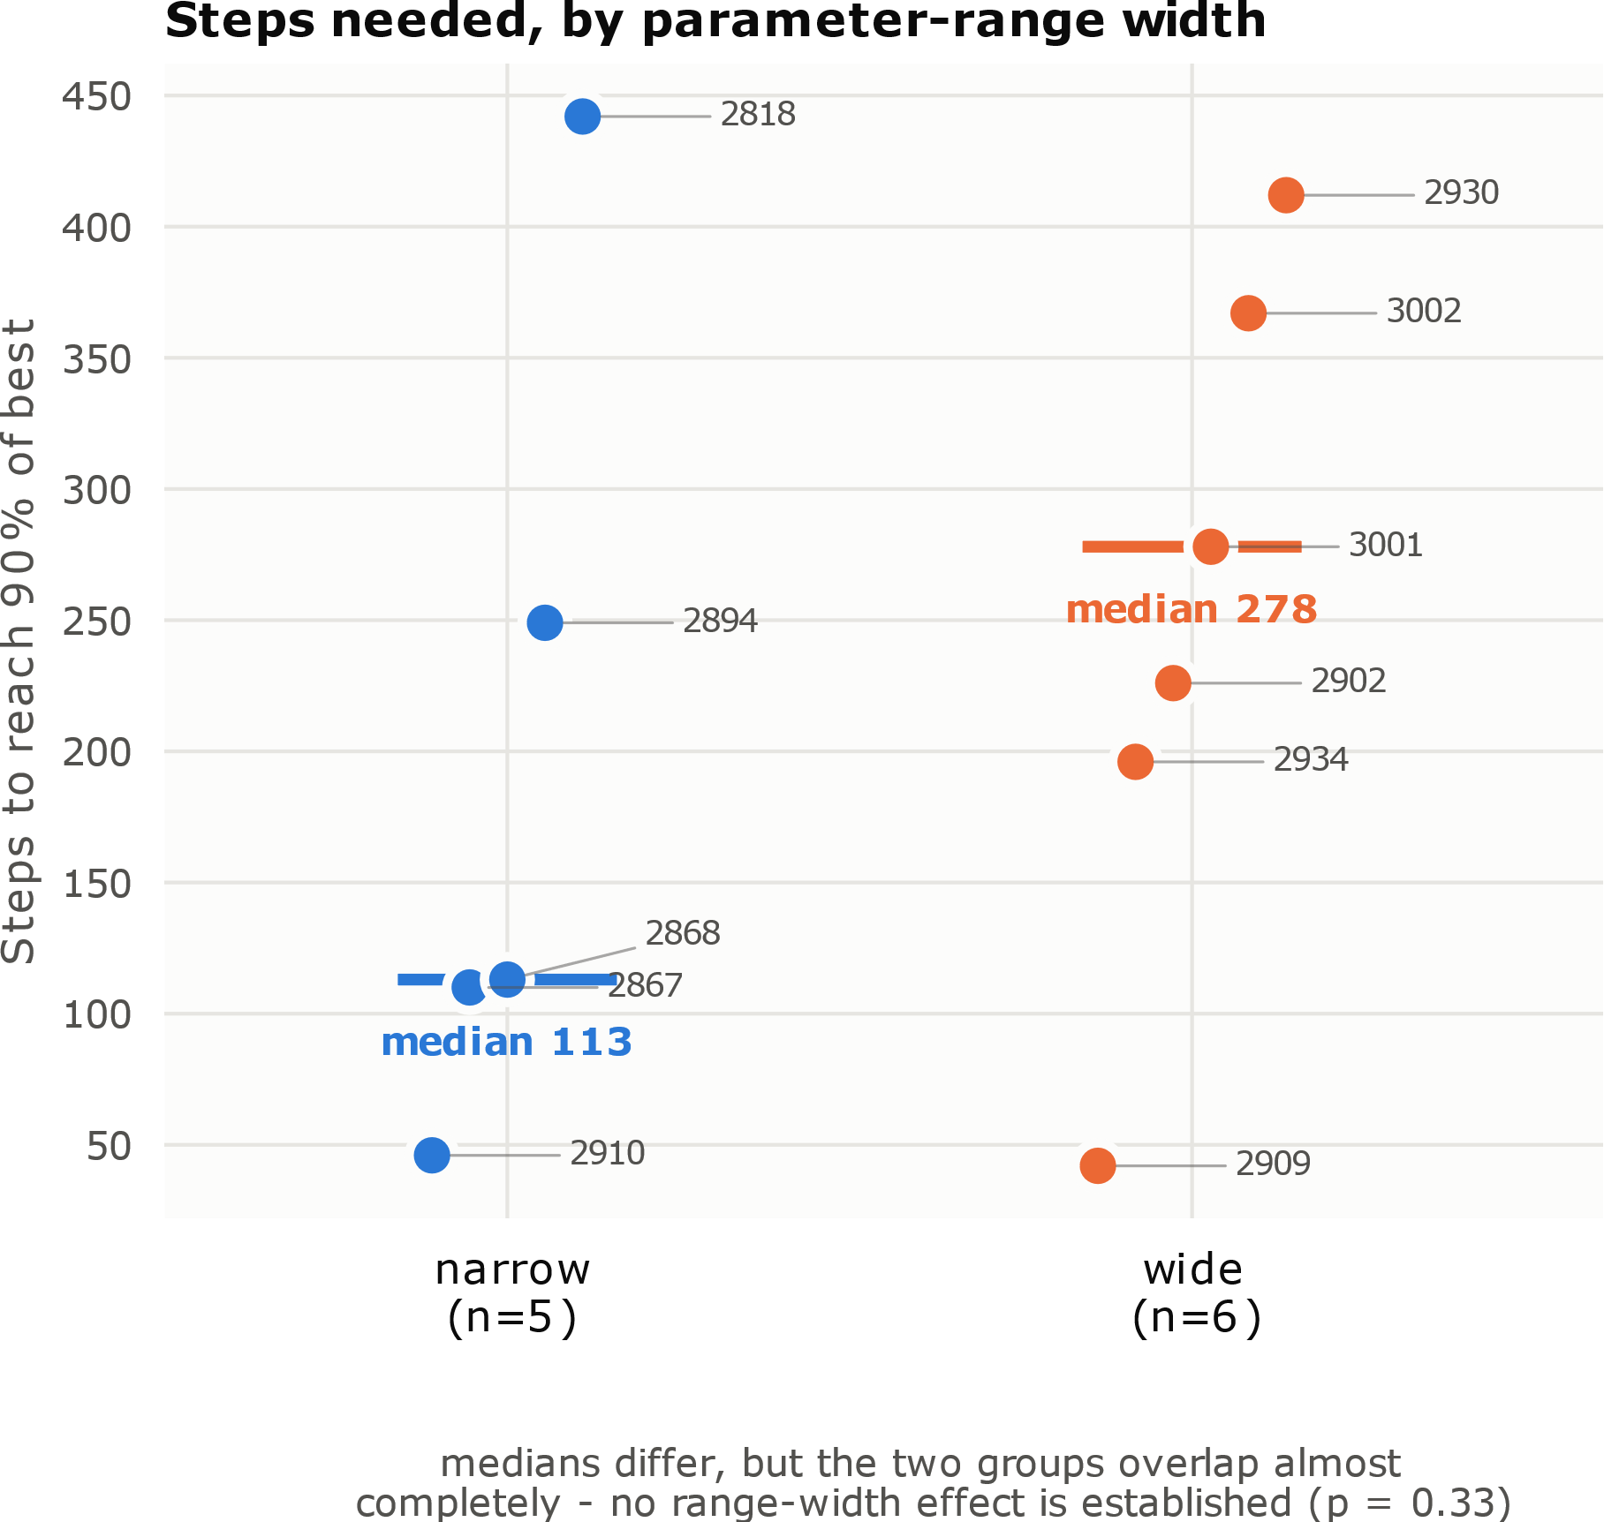
HITRAP Results – Java BOBYQA with Large Parameter Space
Series of 15 optimization runs at HITRAP beamline:
  54 LSA parameters
  9 x narrow setting ranges
  → Optimum after ∼220 steps
  1 – 2 h depending on timing
  6 x wide settings ranges
  → Optimum after ∼ 520 steps
  3 – 5 h depending on timing
  Note: applied as well successfully to CRYRING injector (03/2026)

Slide 9
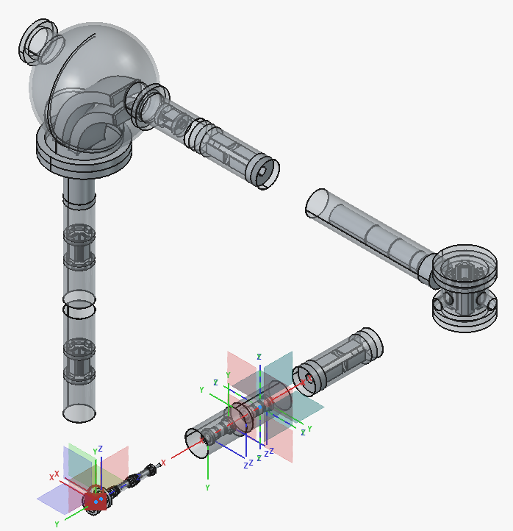
Latest Developments / Backog / Outlook
Remove SMILE from Bayesian optimizer, replace with own RUST: implemented, to be tested
Virtual environment, backend for testing DeviceAutomator
Workpackages
  beamline geometry exporter from STEP to simulation model (SIMION PA, own format): working
  BEM-based ion tracer replacing SIMION: good progress 80%
  Calibration of electrostatic bends as input for LADA (D. Varentsov): started
  Model beamlines 1. HITRAP, 2. CRYRING MAD-X/Xsuite: pending
  accelerator-gym environment to run JAVA optimizers against: working
Beamline CAD/PA/BEM modelling
  HITRAP beamline EBIT -> „detector 2“: working
  HITRAP beamline EBIT -> „detector 3“: working with issues
  HITRAP beamline EBIT -> „detector 8“: open
  CRYRING injector: open
Create systematic reference dataset of HITRAP beamline with response functions for each element: open

