Slide 1
MVD COOLING STATUS-PAST AND UPDATES
PIXEL COOLING PROJECT:
STUDIES and TEST on MATERIALS (Carbon Foam)
THERMAL FEM ANALYSES and TEST on DISKS and STAVES
STUDIES and TEST on GLUES,
CHOICE of COOLING FLUID,
DIMENSION of THE HYDRAULIC SYSTEM for STAVES AND DISKS
NEW PROJECTS
CHOICE and DEFINITION of CIRCUITS MODULARITY
PRESSURE DROP EXSTIMATION and TEST
DIMENSION of the EXTERNAL HYDRAULIC COOLING CIRCUIT
DEFINITION of the COOLING PLANT and the HYDRAULIC SYSTEM
REALIZATION of 2-lines HYDRAULIC SYSTEM in UNDER PRESSURE
TEST of 2 LINES of the HYDRAULIC SYSTEM
ADDITION of the NEW CIRCUITS FOR GBT AND DC-DC Converter BOARDS
INTEGRATION of the COOLING PLANT in PANDA AREA

Slide 2
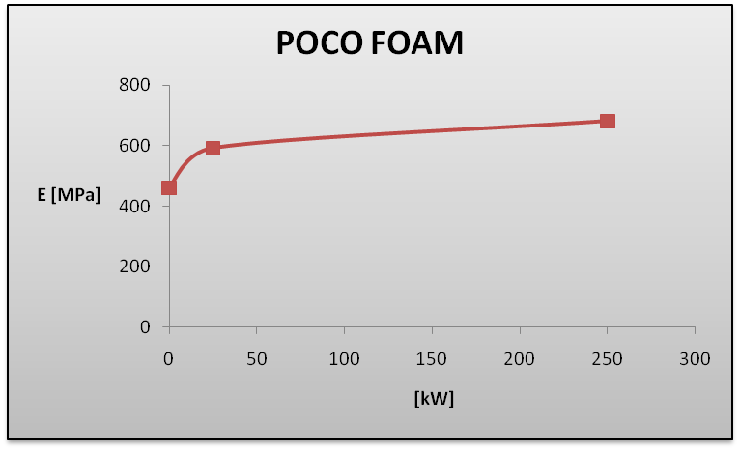
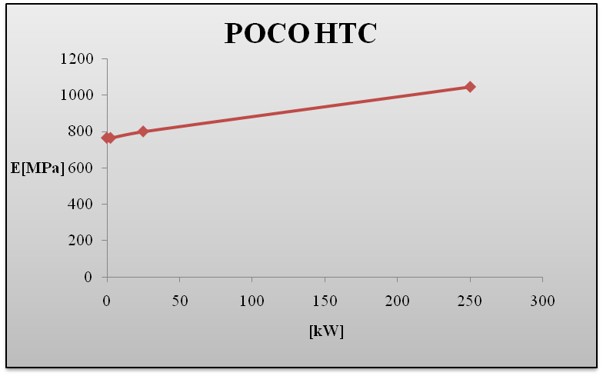
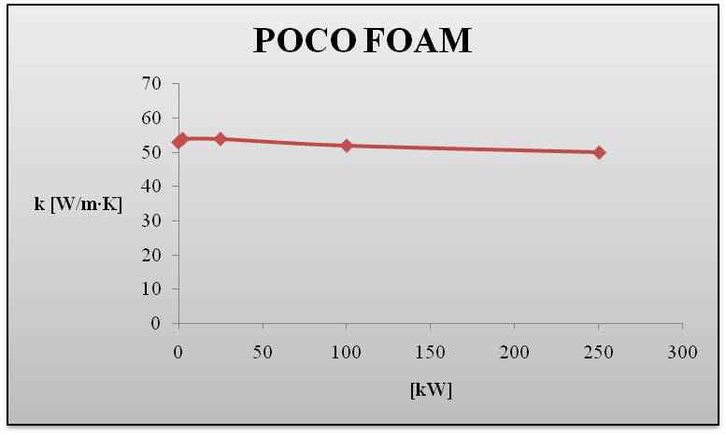
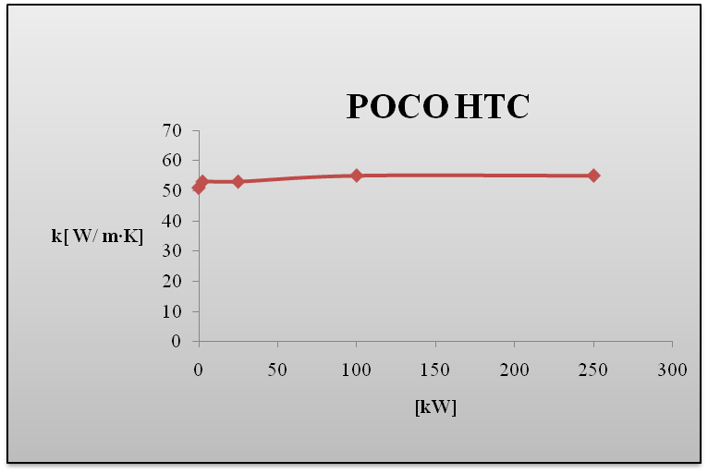
STUDIES ON CARBON FOAM in RADIATION FIELDS- REPORTED ON TDR
Test results: Young’s modulus [Mpa]
vs radiation levels [kW]
Test results: thermal conductivity [W/mK] vs radiation levels [kW

Slide 3
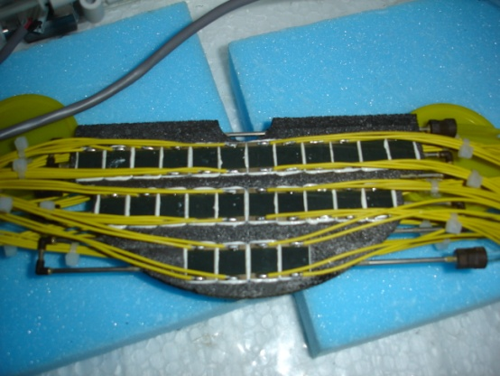
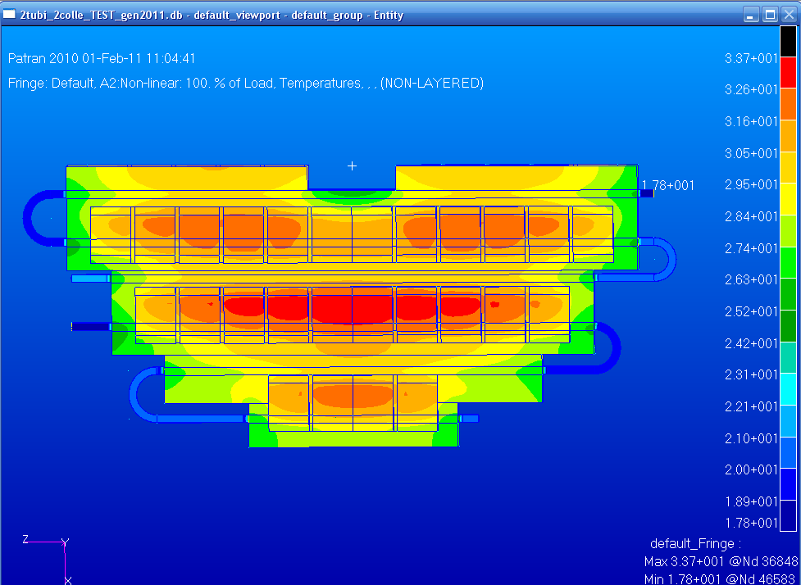
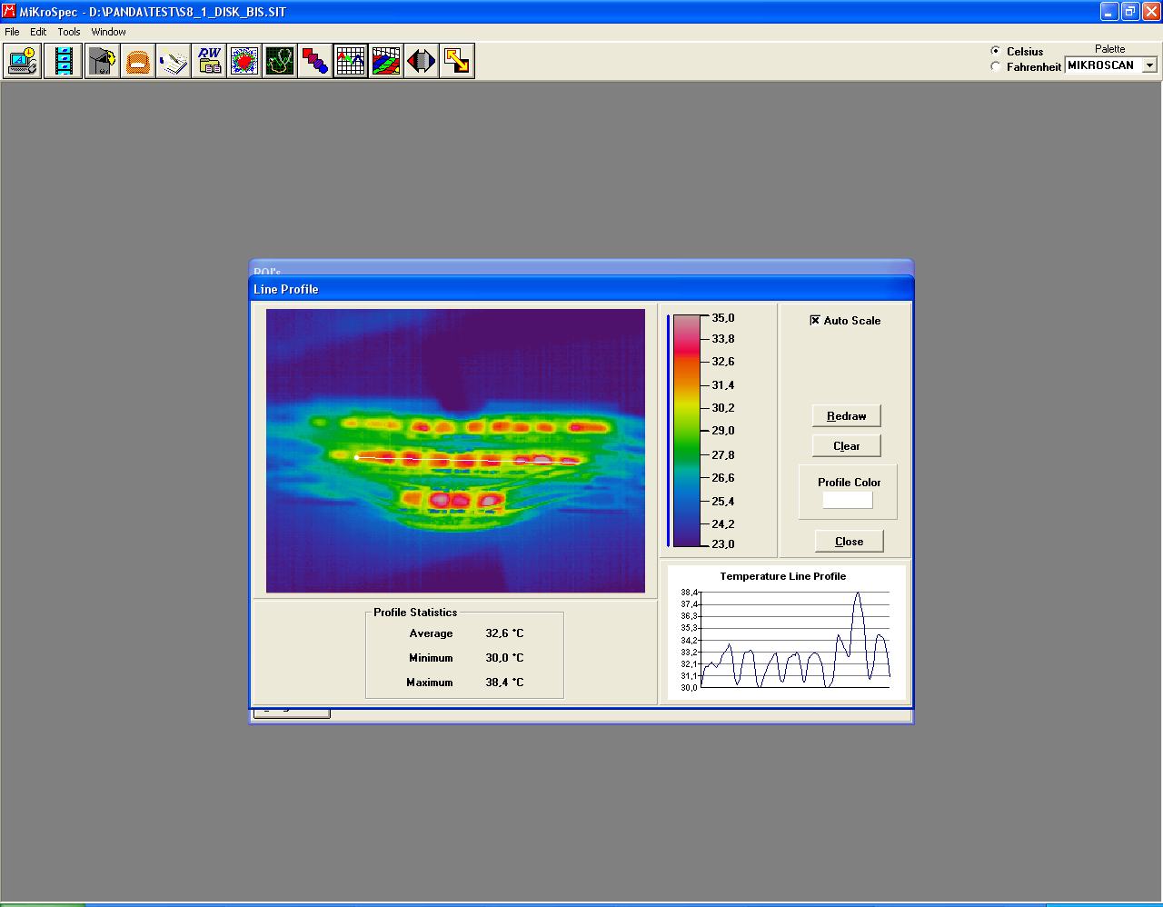
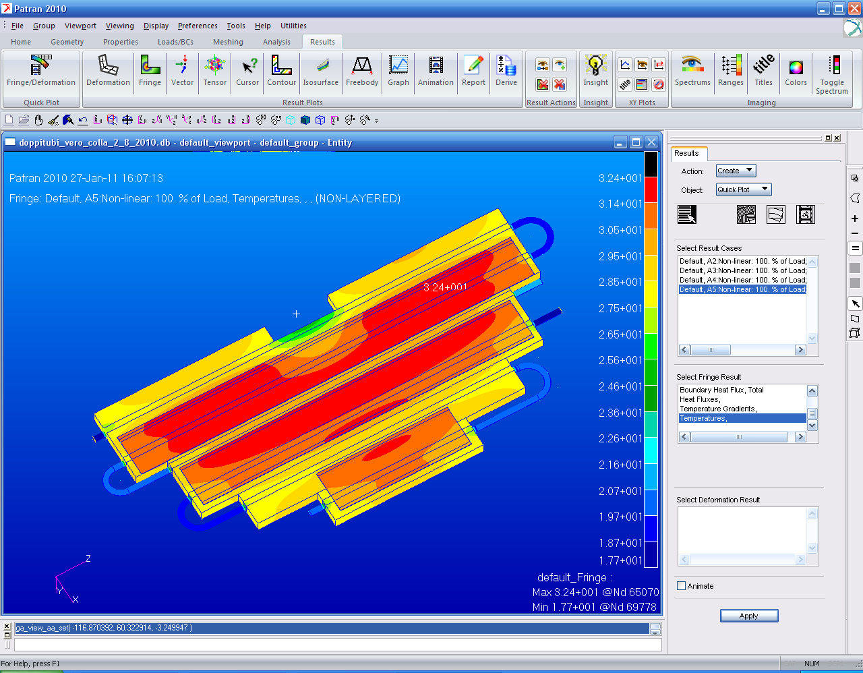
FEM ANALYSES AND TEST RESULTS- REPORTED ON TDR
Tmax=33,7°C
FEM ANALYSES with test configuration (TOTAL POWER 94W and 6 cooling pipes with 0,3 lit/min of water) at 18,5°C
TEST RESULTS (TOTAL POWER 94W and 6 cooling pipes with 0,3 lit/min of water) at 18,5°C
Tmax=32,4°C
FEM ANALYSES with real configuration (TOTAL POWER 94W and 6 cooling pipes with 0,3 lit/min of water) at 18,5°C

Slide 4
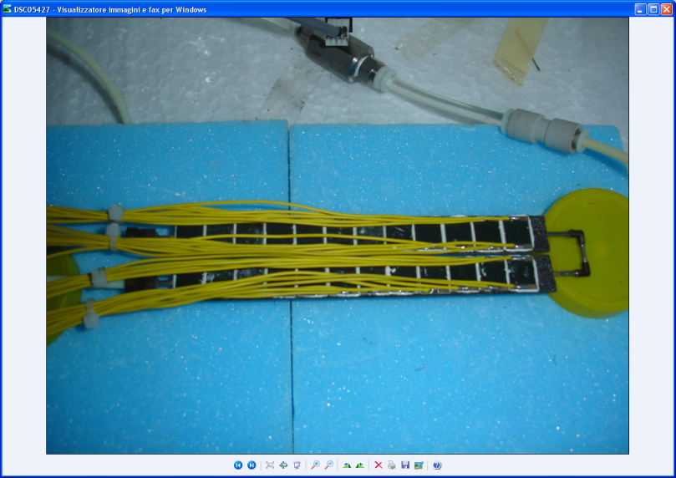
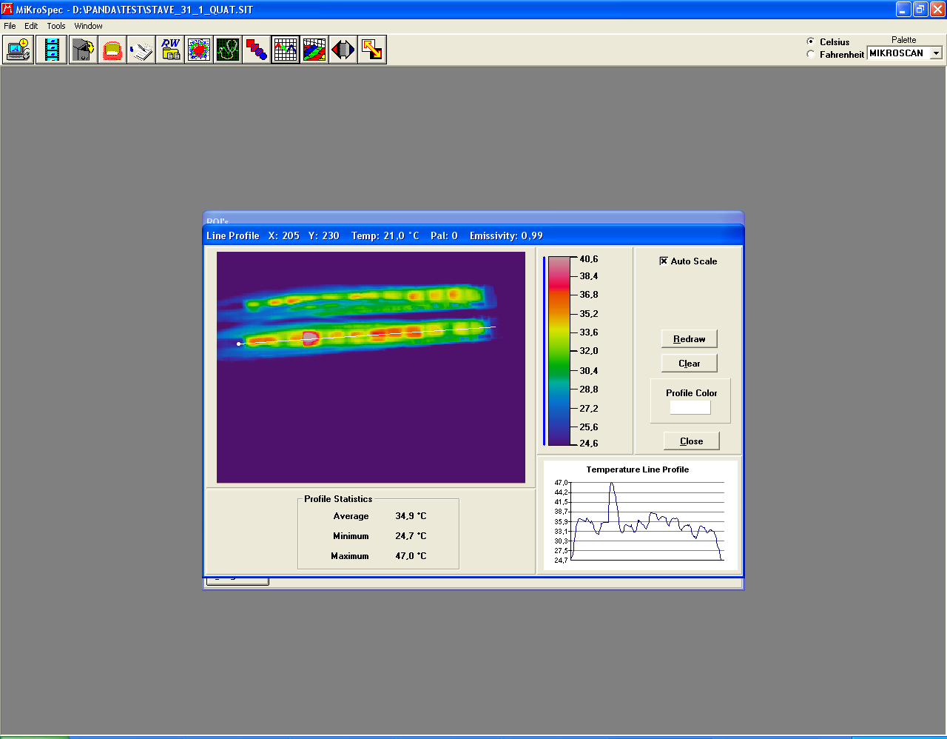
FEM ANALYSES AND TEST RESULTS- REPORTED ON TDR
TEST RESULTS (TOTAL POWER 42W and 2 cooling pipes with 0,3 lit/min of water) at 18,5°C

Slide 5
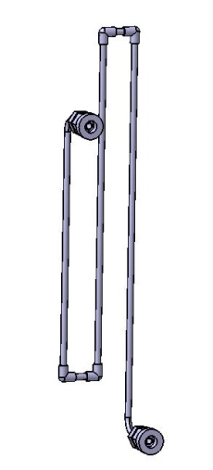
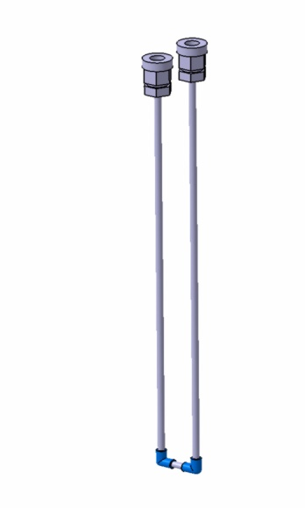
TESTED PRESSURE DROP- REPORTED IN TDR
S-TUBE
U-TUBE
TEST RESULTS
TEST RESULTS
O,3 lit/min
FLOW RATE [lit/min]
FLOW RATE [lit/min]

Slide 6
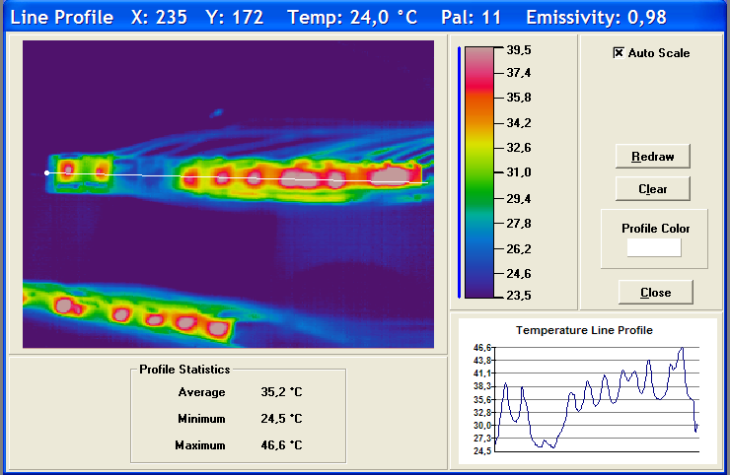
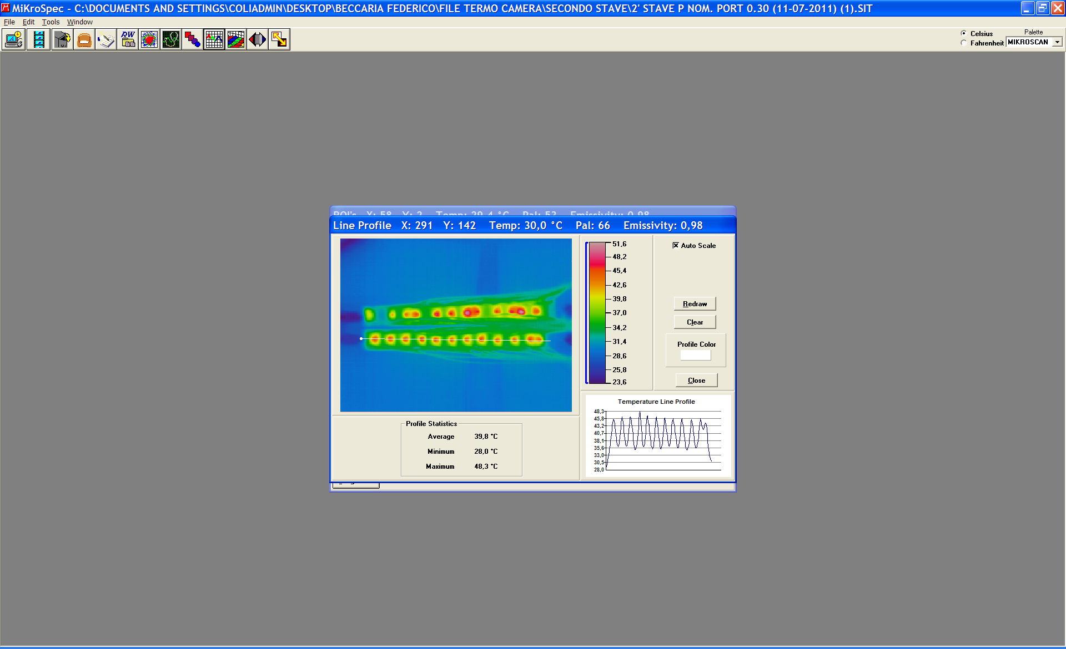
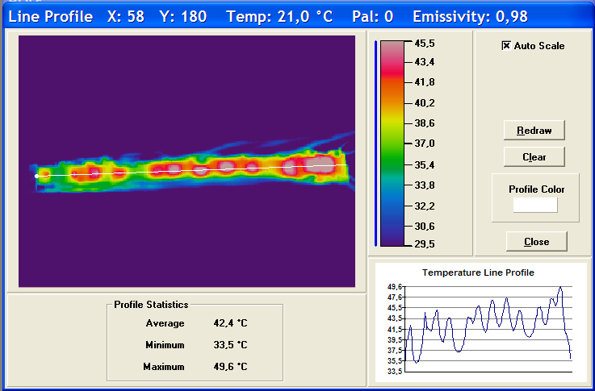
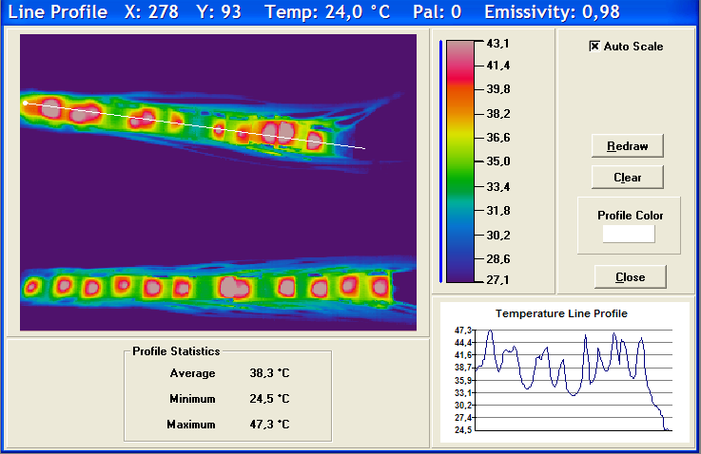
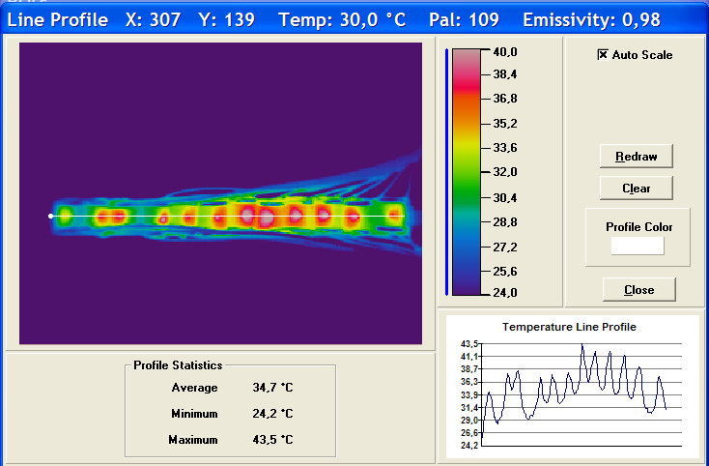
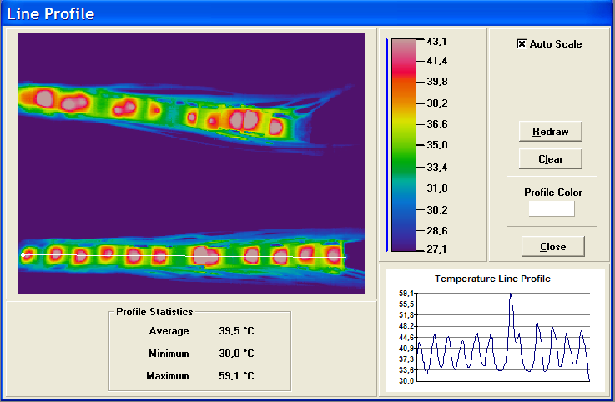
COOLING TEST ON PROTOTYPES WITH DIFFERENT GLUES- DEC 2011
21W ( 1,75 W each chip, 1W/cm²)
Flow rate: 0,3 lit/min
Inlet cooling temperature: 18°C
1ST prototype: T max around 39°C
H70 glue between tube, omega and foam
ARTIC ALUMINA glue (rapid) between chips and foam
17,5W ( 1,75 W each chip, 1W/cm²)
Flow rate: 0,3 lit/min
Inlet cooling temperature: 18°C
5TH prototype: T max around 43°C
H70 glue between tube, omega and foam
DURALCO128 glue between chips and foam
2 chips are broken!!
21W ( 1,75 W each chip, 1W/cm²)
Flow rate: 0,3 lit/min
Inlet cooling temperature: 18°C
2ND prototype: T max around 46°C
MASTER BOND glue between tube, omega and foam
MASTER BOND glue between chips and foam
21W ( 1,75 W each chip, 1W/cm²)
Flow rate: 0,3 lit/min
Inlet cooling temperature: 18°C
6TH prototype: T max around 48°C
H70 glue between tube, omega and foam
H70 glue between chips and foam
21W ( 1,75 W each chip, 1W/cm²)
Flow rate: 0,3 lit/min
Inlet cooling temperature: 18°C
3RD prototype: T max around 45°C
H70 glue between tube, omega and foam
ARTIC grease + H70 glue spot between chips and foam
21W ( 1,75 W each chip, 1W/cm²)
Flow rate: 0,3 lit/min
Inlet cooling temperature: 18°C
7TH prototype: T around 41°C
Duralco 128 glue between tube, omega and foam
Duralco 128 glue between chips and foam
PROTOTYPE:
2 glue layers/stave
Between tube, omega and foam
Between chip and carbon foam
CONCLUSION:
Best results with Arctic Alumina glue, BUT with rapid polymerization
Acceptable results with Duralco 128 glue (ceramic glue, polymerization in 24h at AT)
OPEN PROBLEM: not uniformity in gluing and presence of hot spots because of carbon foam structure
OPEN PROBLEM: how to control the effectiveness of gluing after detectors alignment.
21W ( 1,75 W each chip, 1W/cm²)
Flow rate: 0,3 lit/min
Inlet cooling temperature: 18°C
4TH prototype: T max around 45°C
H70 glue between tube, omega and foam
MASTER BOND glue between chips and foam

Slide 7
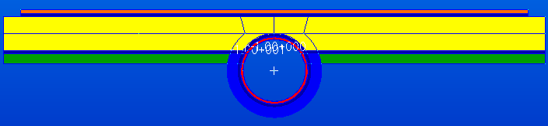
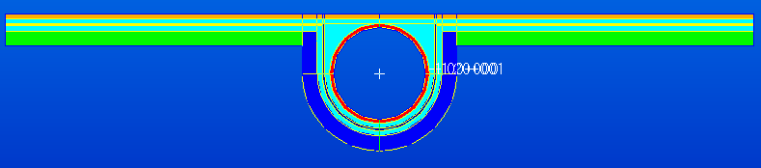
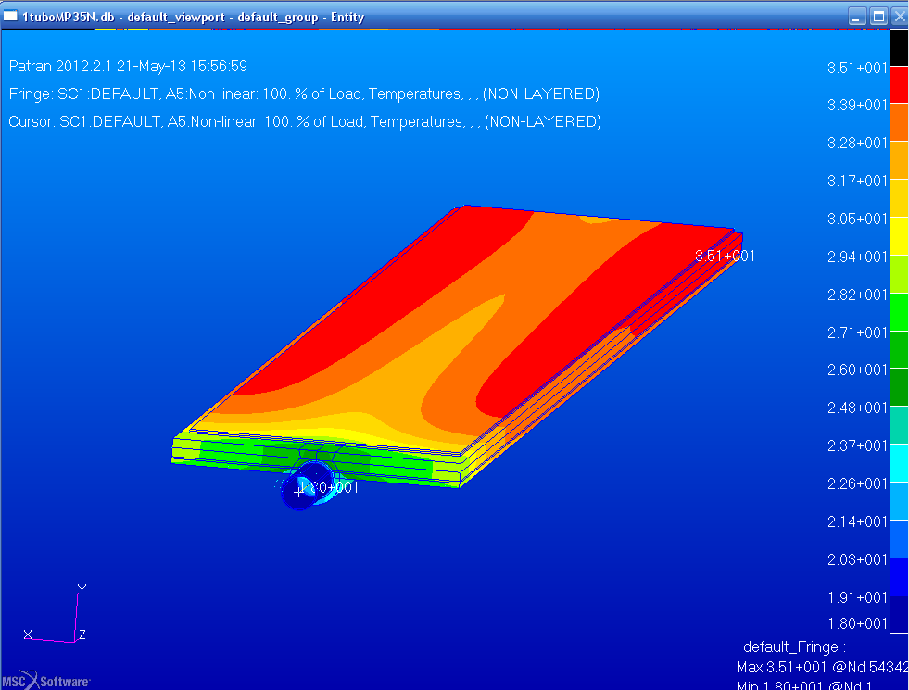
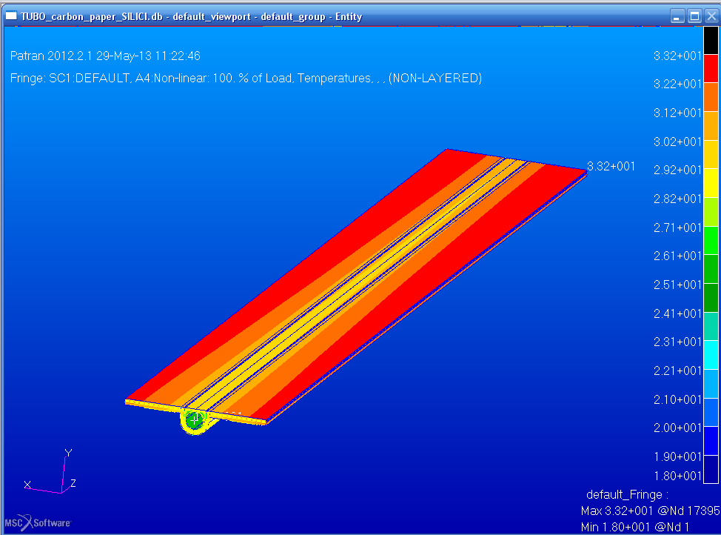
NEW PROJECT UNDER INVESTIGATION
CARBON FOAM PROJECT
CARBON PAPER PROJECT
Carbon Foam
Si=0,1mm
Glue=0,1mm
CF=1mm
Glue=0,1mm
Ω=0,3mm
Glue=0,1mm
MP35N=0,08mm
Si=0,1mm
Glue=0,1mm
MP35N=0,08mm
Glue=0,1mm
CP=0,05mm
Glue=0,1mm
Ω=0,3mm
Carbon Paper
TEST ARE NEEDED
Tmax 35,1°C
Tmax 33,2°C
ADVANTAGES: minor Temperature;
less material
DRAWBACK: plane precision
ADVANTAGES: CF plane workable
DRAWBACK: CF gluing uniformity

Slide 8
PIXEL MODULARITY AND COOLING CIRCUITS in PIXEL MVD
LAYER 1
Half layer has 6 staves 3 U tubes (φ_{e} 2mm) 1 circuit for 3 U tubes
Half layer has 8 staves 4 U tubes (φ_{e} 2mm) 2 circuits for 2 U tubes
LAYER 2
Half layer has 14 staves 7 U tubes (φ_{e} 2mm) 3 circuits, 1 for 3 U tubes and 2 for 2 U tubes
Half layer has 14 staves 7 U tubes (φ_{e} 2mm) 3 circuits, 1 for 3 U tubes and 2 for 2 U tubes
DISKS 1-2
Half disk has 4 tubes (2+2)*2 U tubes (φ_{e} 2mm) 4 circuits for 2 U tubes
DISKS 3-6
Half disk has 6 tubes (3+3)*4 U tubes (φ_{e} 2mm) 8 circuits for 3 U tubes
= =
21 Cooling circuits (11 for 3 U tubes + 10 for 2 U tubes)
=21 inlet tubes + 10 return tubes with φ_{i} = 6,5mm
+ 11 return tubes with φ_{i} = 8 mm
53 U tubes (φ_{e} 2mm)
COOLING CIRCUITS
OUTSIDE MAGNET INSIDE MAGNET INSIDE MVD
INSIDE MVD INSIDE MAGNET OUTSIDE MAGNET
φ_{i} 6,5mm
0,9 lit/min
φ_{i} 5mm
0,9 lit/min
φ_{i} 2,5mm
0,3 lit/min
φ_{i} 6,5mm
0,6 lit/min
φ_{i} 5mm
0,6 lit/min
φ_{i} 2,5mm
0,3 lit/min
U tubes
(φ_{e} 2mm.) in MP35N
N. 11 circuits for 3 U tubes
N. 10 circuits for 2 U tubes
φ_{i} 8 mm
0,9 lit/min
φ_{i} 5mm
0,9 lit/min
φ_{i} 2,5mm
0,3 lit/min
φ_{i} 6,5 mm
0,6 lit/min
φ_{i} 5mm
0,6 lit/min
φ_{i} 2,5mm
0,3 lit/min

Slide 9
PRESSURE DROP IN THE COOLING CIRCUITS for PIXEL STAVES AND DISKS- UPDATED
11 CIRCUITS FOR 3 U TUBES | G[g/s] | G[l/m] | L[m] | d[mm] | V[m/s] | Re | P_drop[bar]
INLET OUT OF THE MAGNET | 15 | 0,9 | 35 | 6,5 | 0,45 | 2939,7 | 0,25
INLET IN THE MAGNET | 15 | 0,9 | 2 | 5 | 0,76 | 3821,7 | 0,07
IN THE MVD | 5 | 0,3 | 0,3+2 | 1,84+2,5 | 1,88+1 | 3462 | 0,25+0,32
RETURN IN THE MAGNET | 15 | 0,9 | 2 | 5 | 0,76 | 3821,7 | 0,07
RETURN OUT OF THE MAGNET | 15 | 0,9 | 35 | 8 | 0,3 | 2388,5 | 0,09
 |  |  |  |  |  | TOTAL DP | 1,05
 |  |  |  |  |  | DP | 0,8
10 CIRCUITS FOR 2 U TUBES | G[g/s] | G[l/m] | L[m] | d[mm] | V[m/s] | Re | P_drop[bar]
INLET OUT OF THE MAGNET | 10 | 0,6 | 35 | 6,5 | 0,3 | 1959,8 | 0,08
INLET IN THE MAGNET | 10 | 0,6 | 2 | 5 | 0,51 | 2547,8 | 0,03
IN THE MVD | 5 | 0,3 | 0,3+2 | 1,84+2,5 | 1,88+1 | 3462 | 0,25+0,32
RETURN IN THE MAGNET | 10 | 0,6 | 2 | 5 | 0,51 | 2547,8 | 0,03
RETURN OUT OF THE MAGNET | 10 | 0,6 | 35 | 6,5 | 0,3 | 1959,8 | 0,08
 |  |  |  |  |  | TOTAL DP | 0,79
 |  |  |  |  |  | DP | 0,71
Δp = 0,71 bar
LIMIT=0,6 bar
Δp = 0,63 bar

Slide 10
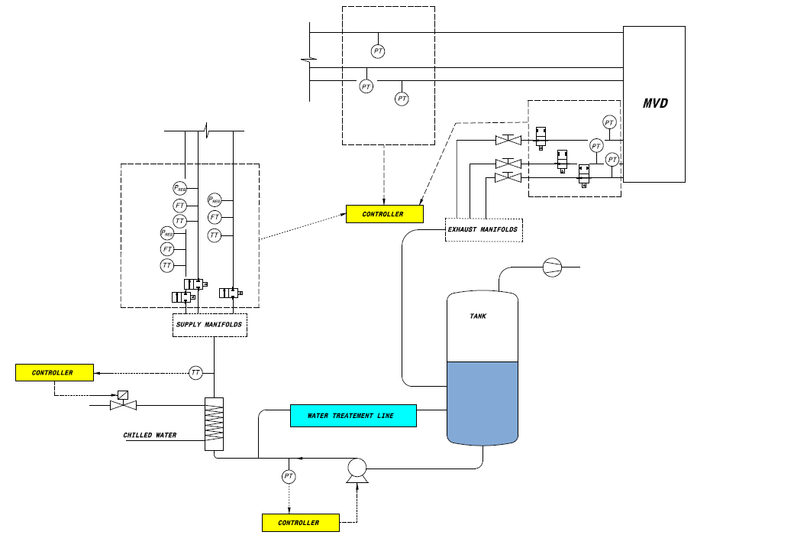
MVD HYDRAULIC CIRCUIT
PRESSURE SENSORS
PNEUMATIC VALVES FLOW METERS
PRESURE REGULATORS
HEATERS (?)
PNEUMATIC VALVES
COOLING PLANT
-PUMP
-VACUUM PUMP
-PLC
-CONTROLS
HEATER
HEAT EXCHANGER

Slide 11
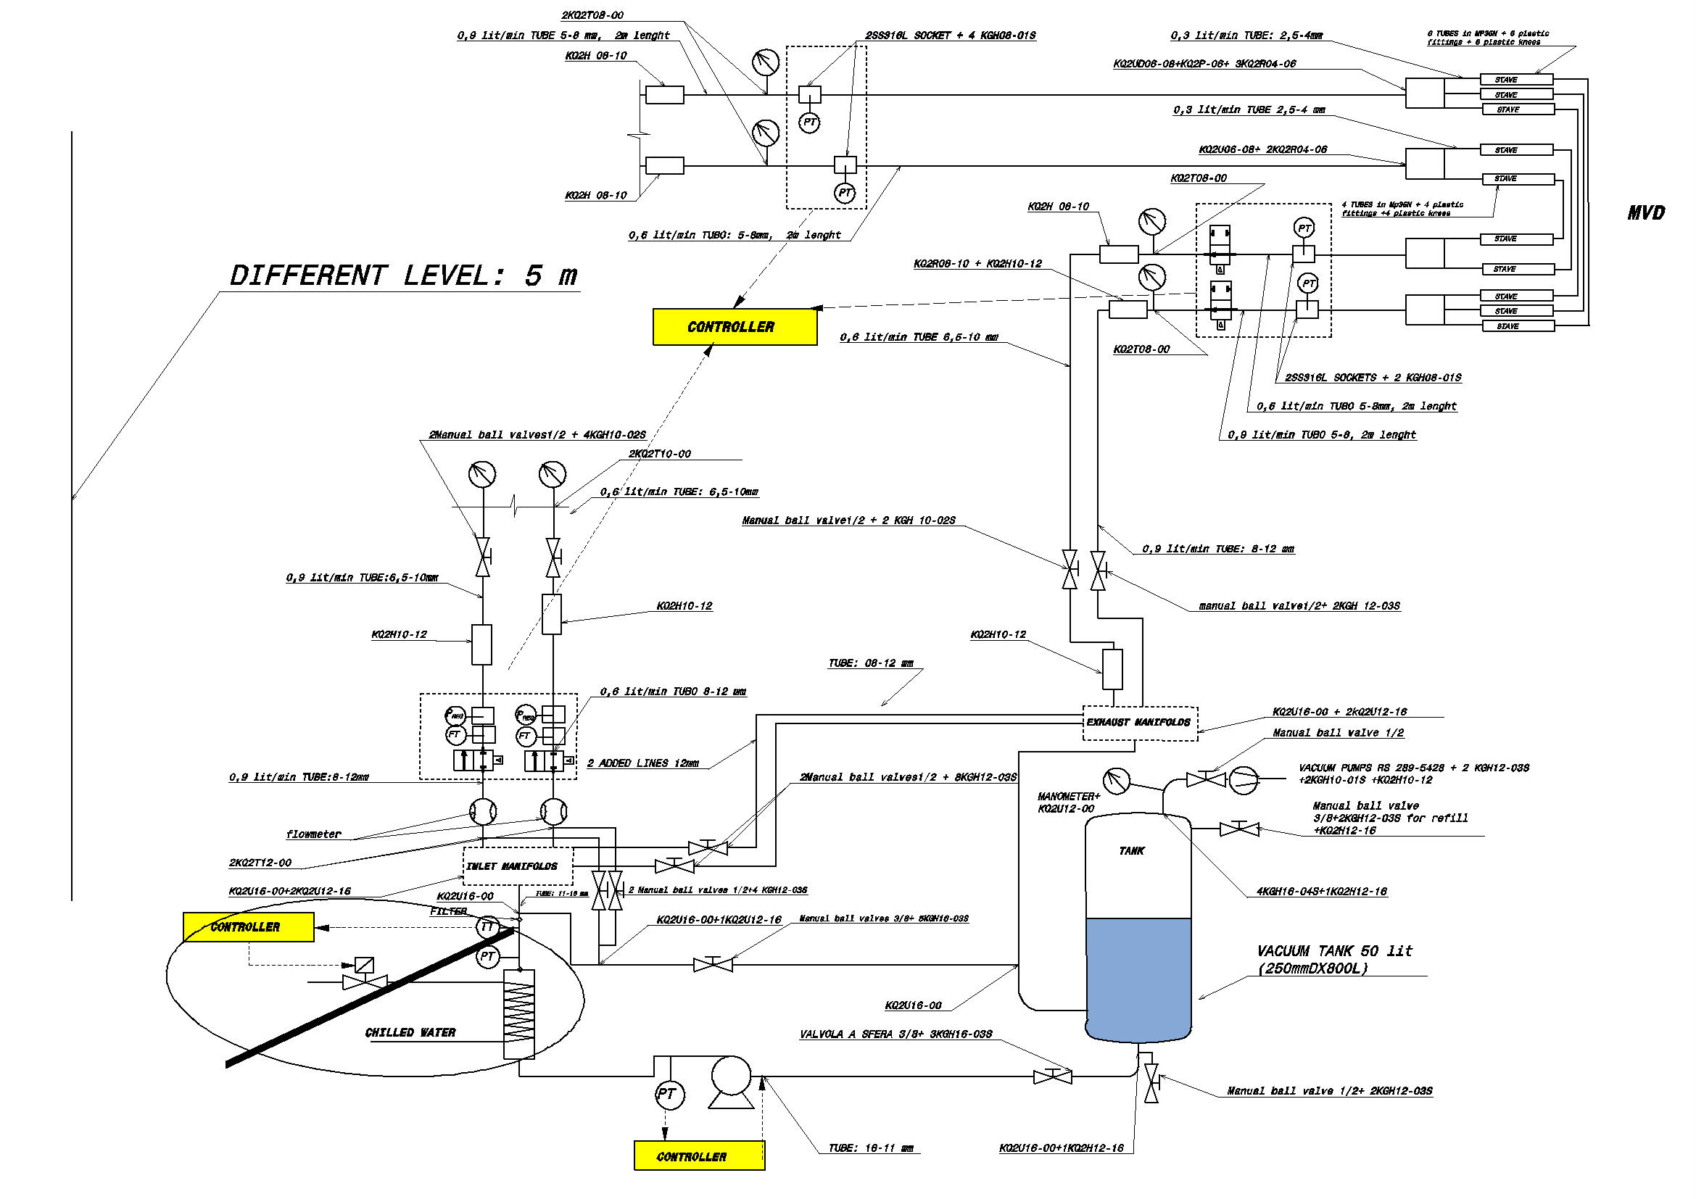
HYDRAULIC CIRCUIT for TEST- 2 LINES –
PRESSURE SENSORS
MVD
SAFETY VALVES+ PRESSURE REGULATORS+ FLOW METERS
TANK+VACUUM
PUMP+HEAT EXCHANGER

Slide 12
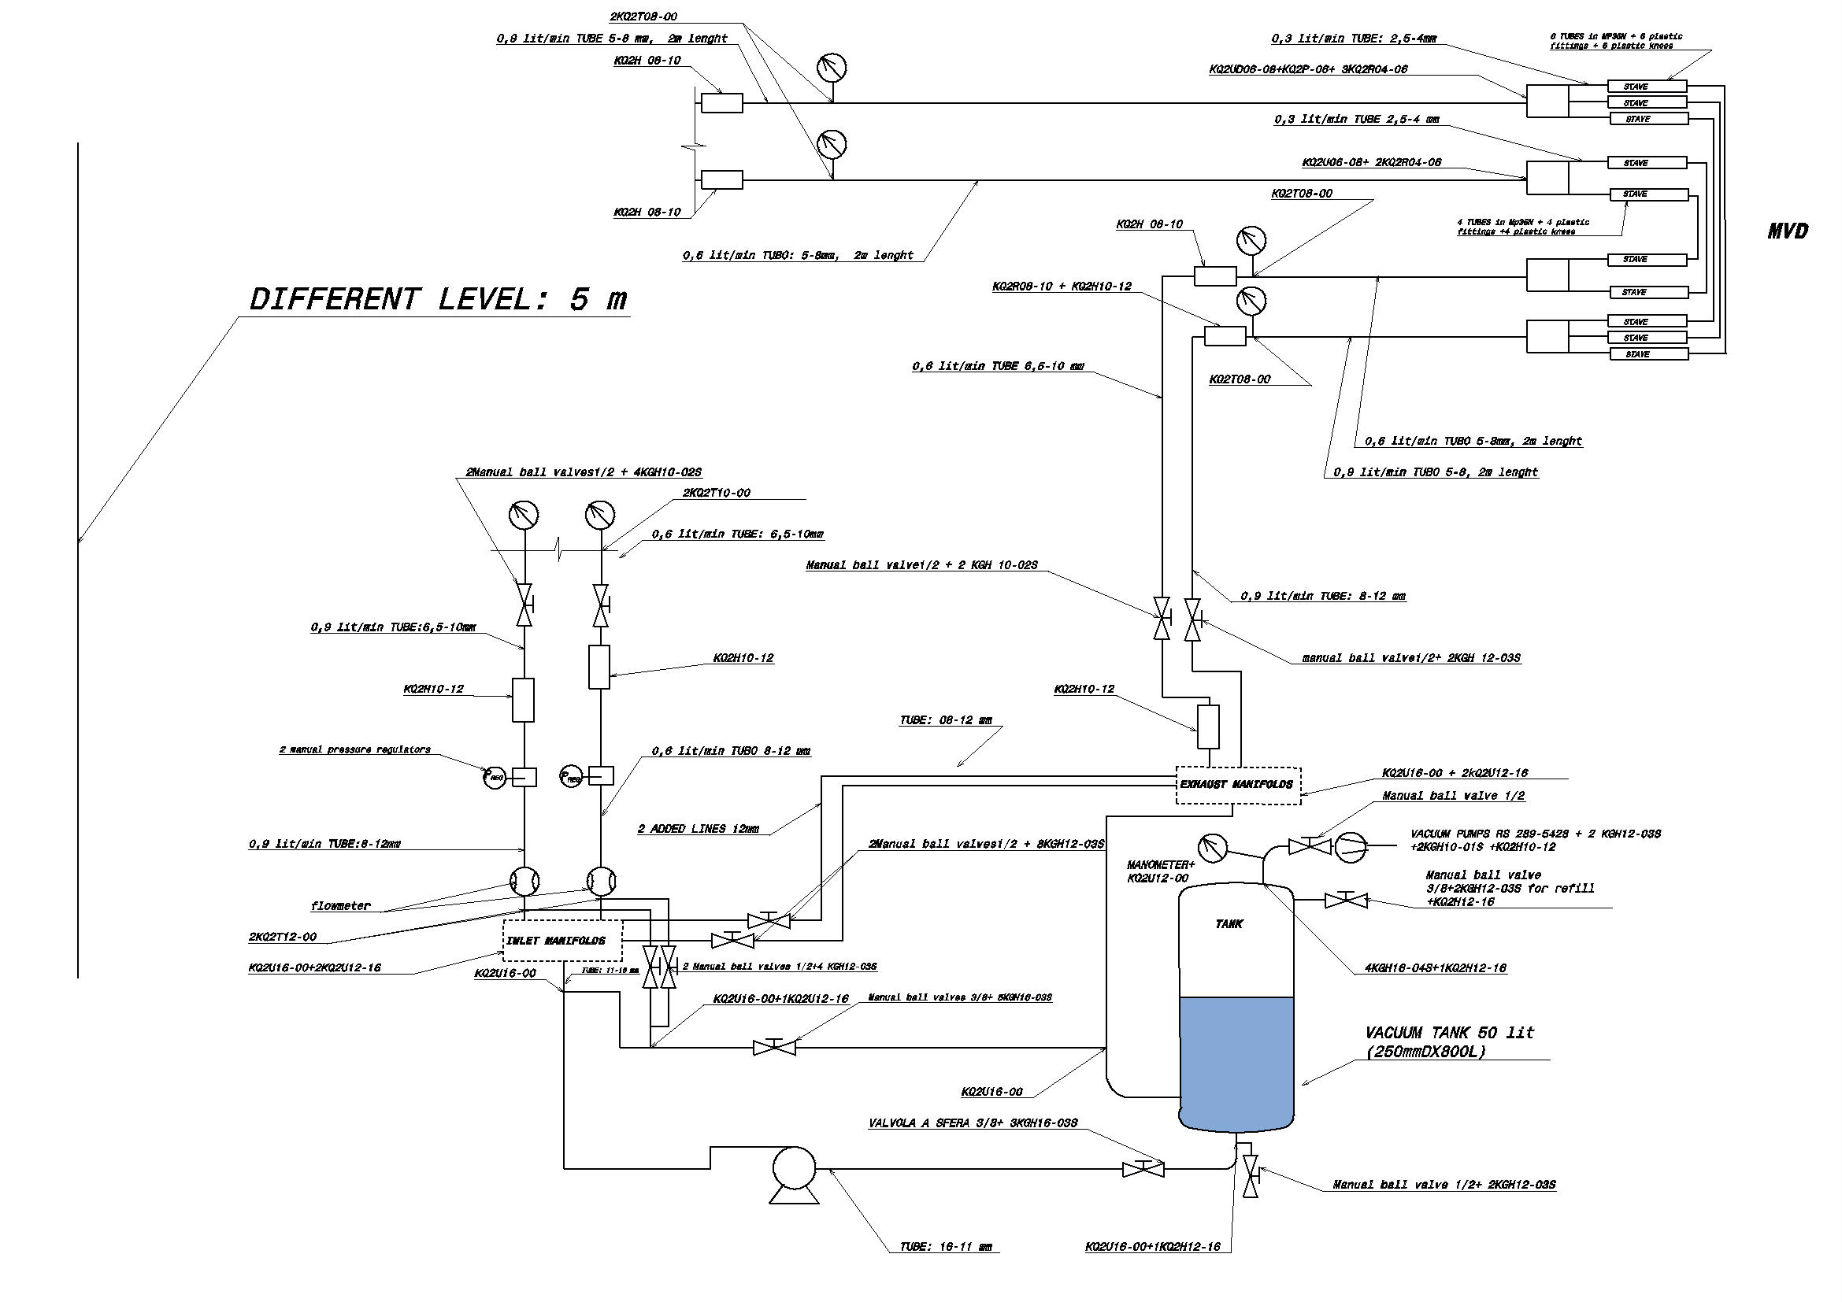
HYDRAULIC CIRCUIT - 2 LINES – TEST RESULTS
INLET IN THE MAGNET=2 mt Φ_{int}=5mm
MVD=1 mt Φ_{int}=2,5mm + Utube Φ_{int}=1,84mm
+1mt Φ_{int}=2,5mm
MANOMETERS
Circuit a) -170 mbar; -780 mbar
Circuit b) -220 mbar; -790 mbar
CIRCUIT a)
MVD
Circuit a) 3 U lines Circuit b) 2 U lines
Δp ~ 610 mbar
CIRCUIT b)
INLET =33 mt Φ_{int}=6,5mm
RETURN IN THE MAGNET=2 mt Φ_{int}=5mm
PRESSURE REGULATORS
Circuit a) 0,4 bar
Circuit b) 0,3 bar
FLOW METERS
Circuit a) 0,9 lit/min
Circuit b) 0,6 lit/min
RETURN =33 mt Φ_{int}=6,5mm and 8 mm
TANK+VACUUM
Tank Volume= 50 lit Vacuum pressure=-600 mbar
INLET PUMP
1,6 bar

Slide 13
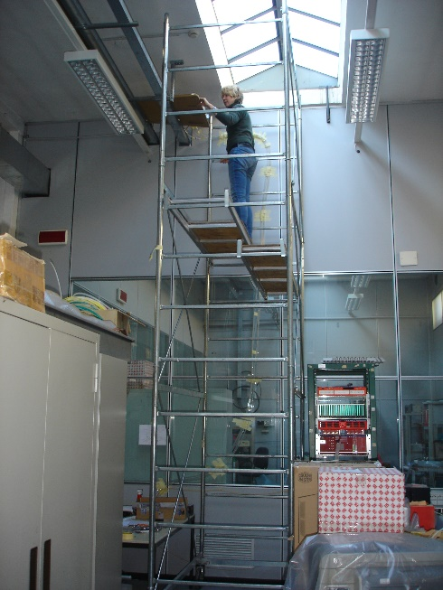
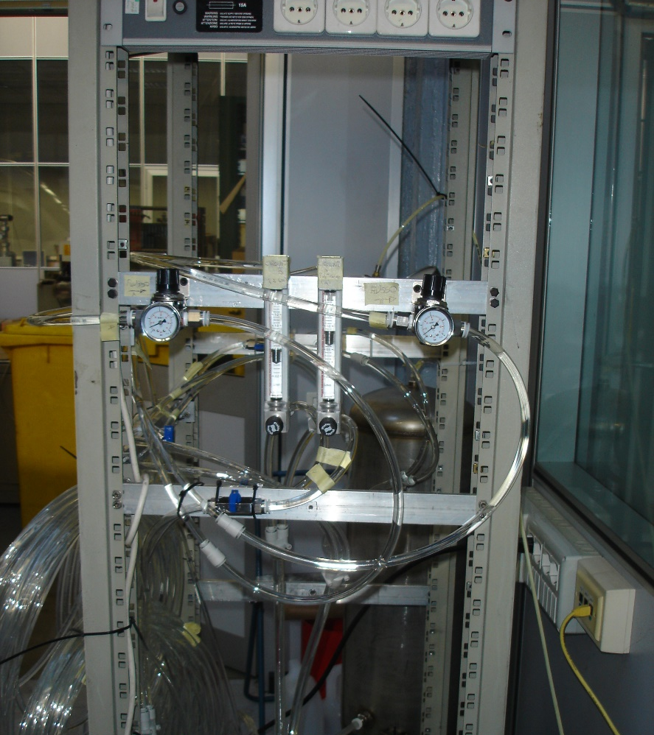
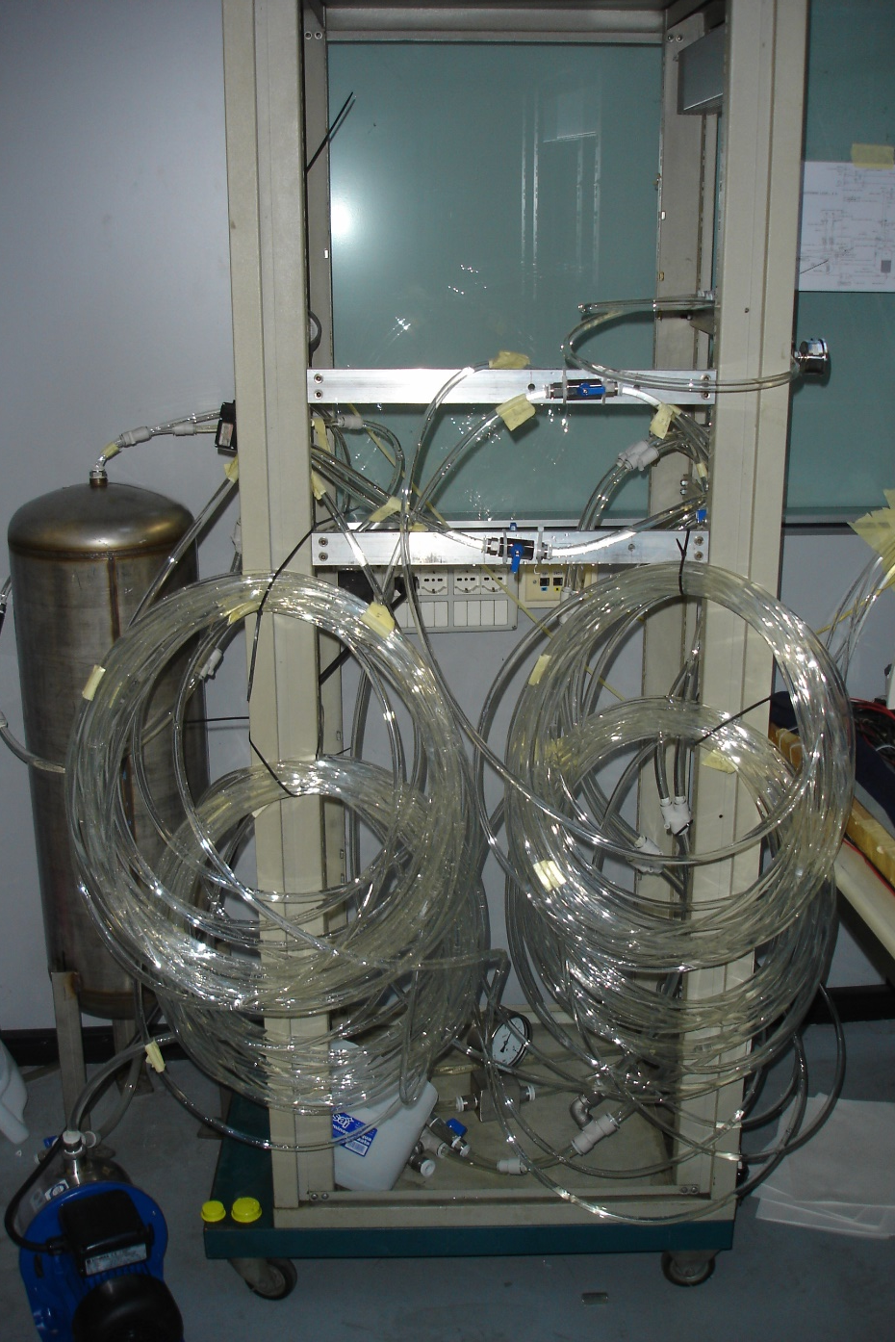
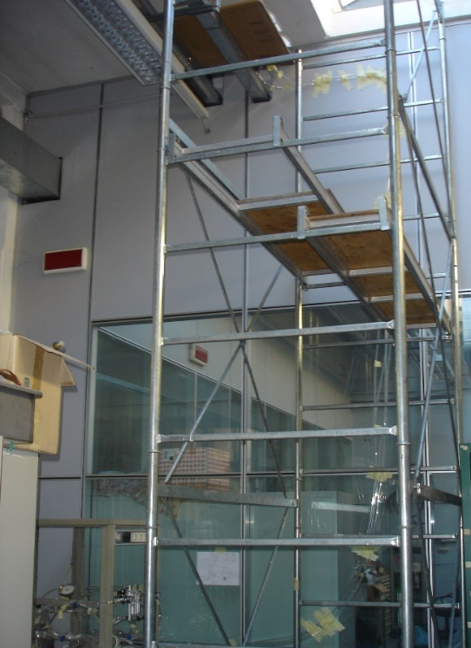
HYDRAULIC CIRCUIT - 2 LINES – TEST RESULTS
VACUUM TANK
INLET TUBES: 33 mt
RETURN TUBES: 33 mt
U lines
PRESSURE REGULATORS
FLOW METERS
GRADIENT U-lines-tank: 5 mt
INLET PUMP
COOLING PLANT

Slide 14
HYDRAULIC CIRCUIT - 2 LINES – TEST RESULTS- IMPROVEMENTS
TEST RESULTS:
INLET Pump=1600 mbar; VACUUM Pump= -600 mbar;
Circuit a): 3 U tubes; flow = 0,9 lit/min; pressure regulator= 400 mbar; Δp ~ 610 mbar; P inside magnet (-170 mbar, -780 mbar): in under pressure
Circuit b): 2 U tubes; flow = 0,6 lit/min; pressure regulator= 300 mbar; Δp ~ 570 mbar; P inside magnet (-220 mbar, -790 mbar): in under pressure
ACTIONS:
- DECREASE MASS FLOW:
0,3 lit/min in each U-tube : Δp ~ 610 mbar
0,275 lit/min in each U-tube : Δp ~ 540 mbar
- OTHER ACTIONS EVALUATED WITH TEST:
DECREASE ΔP IN THE MANIFOLDS (?) -TO BE MEASURED and IMPROVED
- TEST WITH BIGGER MANIFOLDS IN CIRCUIT b): NO DIFERENCES IN Δp
INCREASE TUBES DIAM. INSIDE MVD (?)- TO BE EVALUATED and TESTED
- BY THEORY GAIN COULD BE UP TO 200 mbar- EVALUATION of GEOMETRY and TEST WILL FOLLOW
INCREASE TUBES DIAM. INSIDE THE MAGNET (?) (from 5mm to 6,5 mm)
- TEST WITH BIGGER TUBES INSIDE MAGNET: Δp 550 mbar
REDUCE DISTANCE BETWEEN MVD AND PRESSURE SENSORS (?)- ACCESSIBILITY (?) -TO BE EVALUATED

Slide 15
PRELIMINARY ESTIMATION OF MVD COOLING PLANT POWER CONSUMPTION (~40KW (?)/ 400VAC tri+ N) – DEC 2011
HEATERS (ΔT 3°C, 1lit/min)=~ 0.3-0.4KW/circuit
[STRIP+PIXEL actual circuits= ~ 40= ~ 16 KW]
+ endstave elect. circuits [n.(?), flow (?), W(?)]
+ pressure regul. and flow meters [n. (?), W (?)]
IN ALICE THE HEATERS HAVE BEEN REMOVED
-PUMP
-VACUUM PUMP
-PLC
-CONTROLS
= ~ 8-9 KW
HEATER
CHILLERS(?) = ~ 6KW (?)

Slide 16
DIMENSION of the HYDRAULIC CIRCUIT for MVD SYSTEM (PIXEL + STRIP):
PIXEL:
TUBE LENGHTS:
35 m INLET outside the magnet
2 m INLET inside the magnet
2,3 m in the MVD (53 U tubes)
2 m RETURN inside the magnet
35 m RETURN outside the magnet
WATER VOLUME: about 60 liters
MASS FLOW RATE: about 15 lit/min
TUBE NUMBER: 21 INLET tubes + 21 RETURN tubes
TUBE MODULARITY: 11 circuits with 3 U tubes +
10 circuits with 2 U tubes (0,3 lit/min each U tube)
STRIP:
TUBE LENGHTS:
35 m INLET outside the magnet
2 m INLET inside the magnet
2,3 m in the MVD
2 m RETURN inside the magnet
35 m RETURN outside the magnet
WATER VOLUME: about 55 liters
MASS FLOW RATE: about 11 lit/min
TUBE NUMBER: 22 INLET tubes + 22 RETURN tubes
TUBE MODULARITY: 4 circuits with 3U tubes +
18 circuits with 2 U tubes (0,3 lit/min each)
SUMMARING
About 120 lit (PIXEL + STRIP)
About 30 lit/min (PIXEL + STRIP)
About 43 circuits
86 Tubes (PIXEL + STRIP, INLET + RETURN)
PIXEL and STRIP GBT BOARDS and DC-DC Converter=
14+8*3= 38 U Tubes (0,6lit/min)
AT THE STATUS OF THE WORK
CONFIRM?
PIXEL and STRIP GBT BOARDS and DC-DC Converter=
14+8*3= 38 U Tubes
About 120 lit
About 24 lit/min
About 38 circuits
About 76 Tubes

Slide 17
DIMENSION of the HYDRAULIC CIRCUIT for MVD SYSTEM (PIXEL + STRIP):
MVD COOLING :
TUBES FROM COOLING PLANT TO MAGNET:
21+22+38 INLET LINES= 81 INSULATED TUBES [Diam. 14mm+ insulation= 35 mm]
21+22+38 RETURN LINES = 81 TUBES [Diam. 16mm]
= 0,5 m* 0,5m total section for Tubes FROM COOLING PLANT TO the MAGNET (In Stainless steel and Polyurethane)
IN FRONT OF THE MAGNET DOOR
170 Pressure sensors (one on each tube) CLOSE TO MVD (immediately in front of the magnet)
170 Readout cables
170 Power supply cables
TUBES INSIDE THE MAGNET (around the beam pipe)
14 Polyurethane tubes - inlet lines (diam. 8-10mm) to GBT Boards.
14 Polyurethane tubes - return lines (diam. 8-10mm) from GBT Boards to magnet.
24 Polyurethane tubes - inlet lines (diam. 8-10mm) to DC-DC Boards
24 Polyurethane tubes - return lines (diam. 8-10mm) from DC-DC Boards to magnet.
43 Polyurethane tubes - inlet lines (diam. 8-10mm) to manifold patch panel
= 53+48= 101 Polyurethane tubes- inlet lines (diam. 4 mm) from manifold patch panel to MVD
= 53+48= 101 Polyurethane tubes - return lines (diam. 4 mm) from MVD to manifold patch panel.
43 Polyurethane tubes- return lines (diam. 8-10mm) from manifold patch panel to magnet
THE COOLING PLANT
PLC
Tank
Vacuum pump
Inlet pump + filter
Water cleaning unit
Manifolds and about 85 inlet tubes
Manifolds and about 85 return tubes
Heat exchanger
85 pressure regulator
85 flow meters
85 valves on return lines
85 water Temperature sensors
170 pneumatic valves
Other sensors (tank level indicator, pump pressure sensors, water temperature sensors…)
THE MVD:
53 + 48 U-Tubes for PIXEL and STRIPS in MP35N
14 + 24 U-Tubes for GBT and DC-DC Converter Boards in Stainless steel (?)

Slide 18
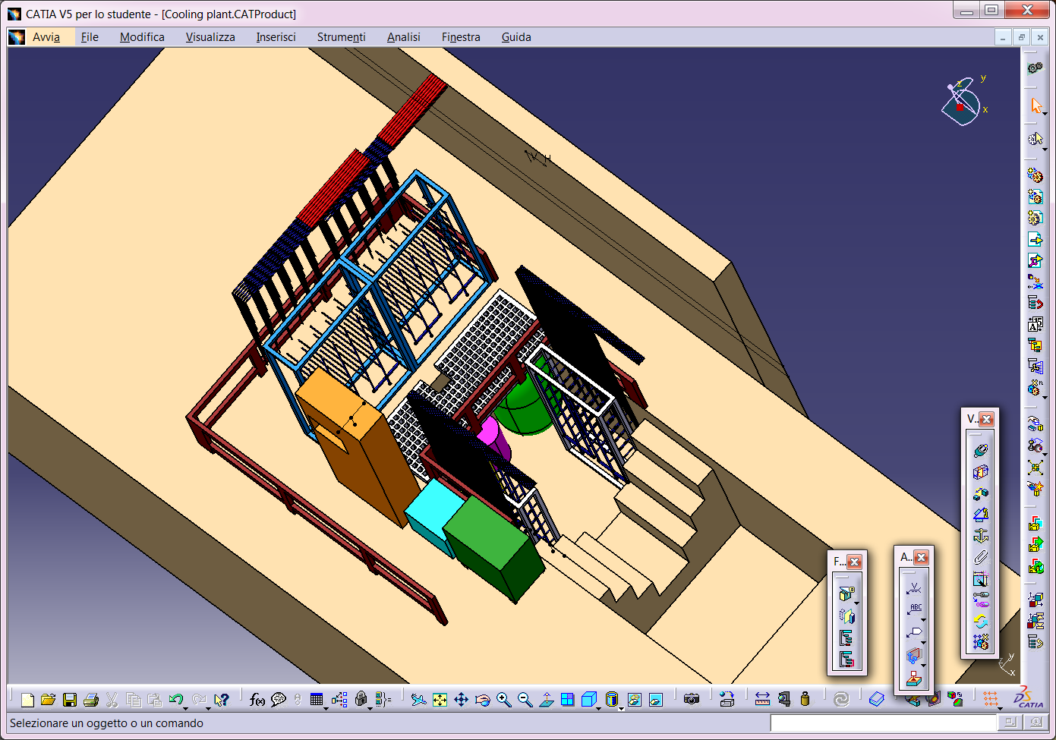
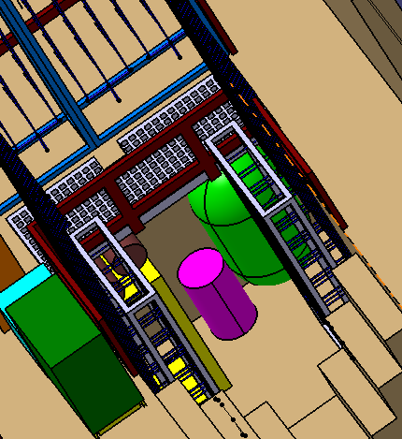
COOLING PLANT DRAFT- UPDATED
INLET TUBES for MVD and GBT+DC-DC Converter Boards
RETURN TUBES for MVD and GBT+ACDC Converter Boards
INSIDE THE PIT
TANK+ VACUUM PUMP
WORKING AREA
PLC
3,5 m
PUMP
3,8 m
WATER CLEANING UNIT

Slide 19
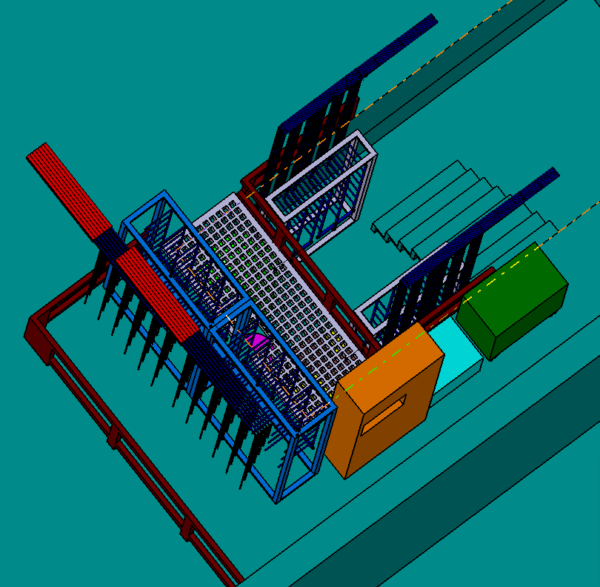
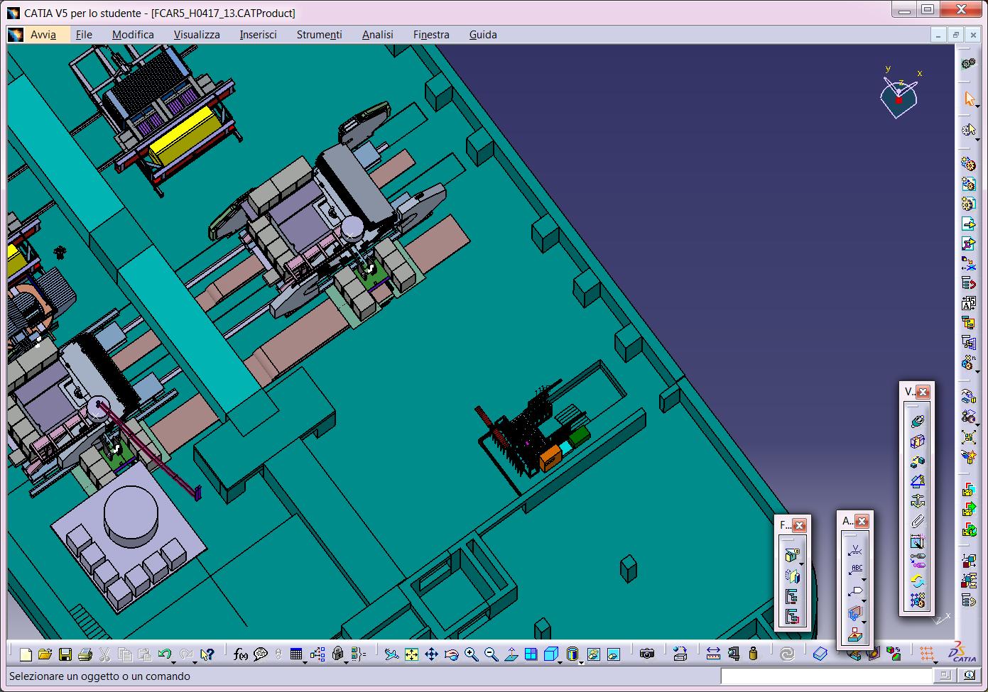
COOLING PLANT DRAFT
WARNING: RETURN TUBES CANNOT BE LOCATED HIGHER THAN MVD
MVD COOLING PLANT
PANDA AREA
170 PRESSURE SENSORS (?)
MVD TUBES (?)
3,8 m
3,5 m
MVD COOLING PLANT

