Slide 1
Disc DIRC project planning
M. Düren, K. Biguenko, E. Etzelmüller, K. Föhl, A. Hayrapetyan, B. Kröck, O. Merle, J. Rieke, K. Wolf
Panda Collaboration Meeting; PID session; 10.12.13

Slide 2
Open points:
TDR
ready in 6 month?
combined Disc/Barrel TRD?
Who does what when?
ASICS (based on ToFPET)
common solution for Disc/Barrel?
does Mainz join ASIC development?
Photon detectors
cooperation with Glasgow? Panda needs to talk in one voice with the companies about the Panda Dirc Photon detectors!
Test Beam Time in 2014?
Where, when, who, what?
DPG 2014:
group talks?

Slide 3
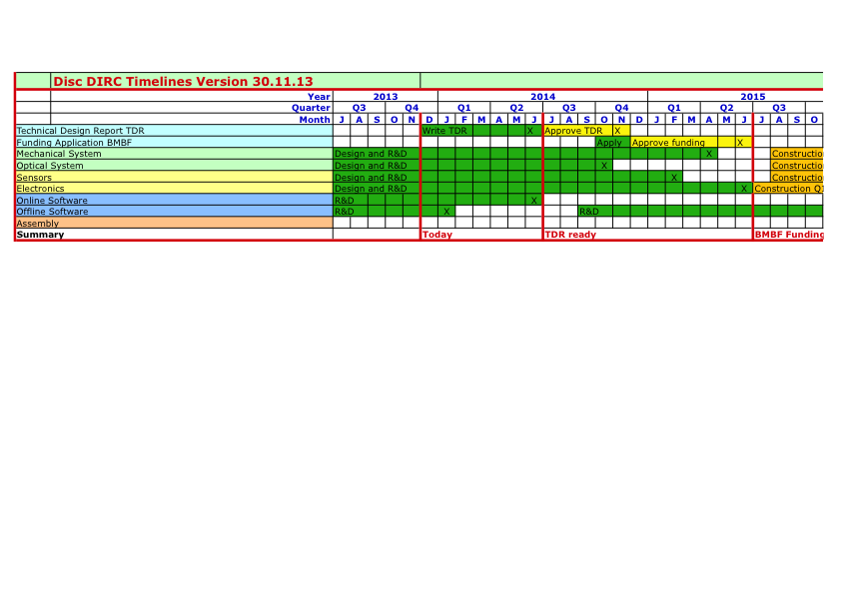
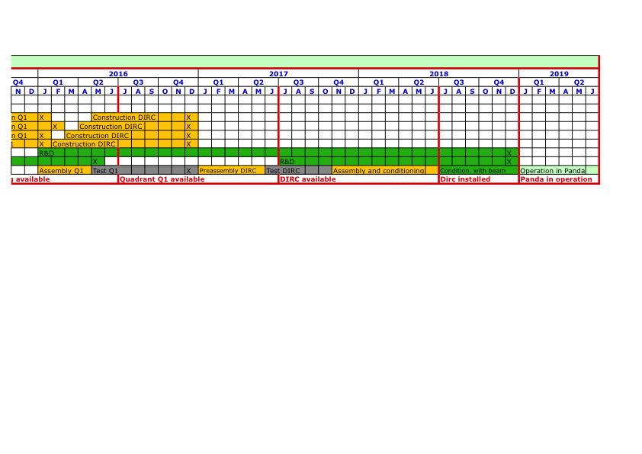

Slide 4
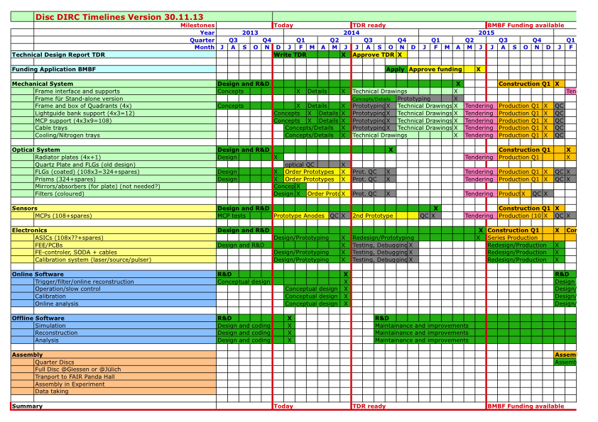

Slide 6
